Slide 1
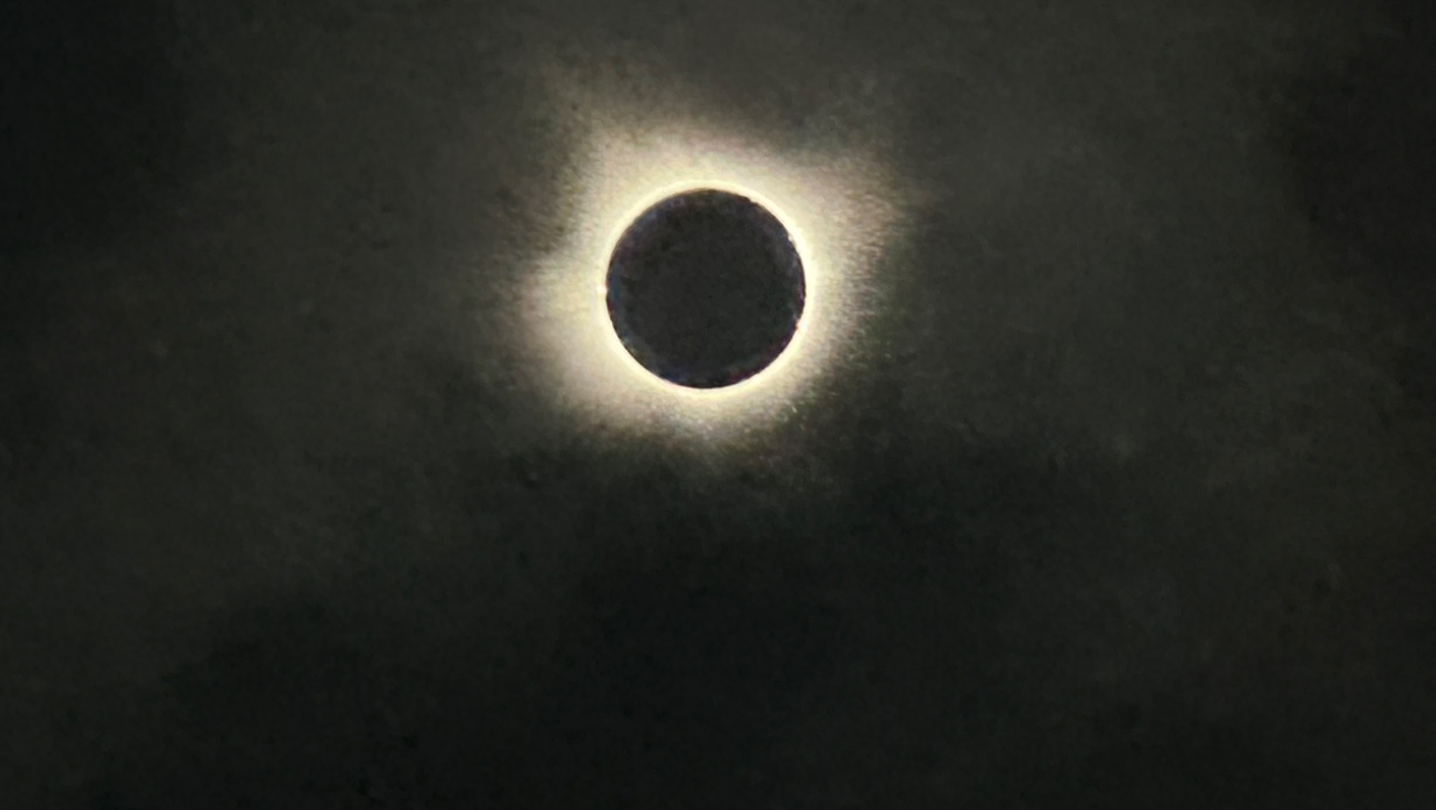

Determining the nanoflare heating frequency of an X-ray Bright Point observed by MaGIXS
TEAM:
Amy R. Winebarger (NASA MSFC)
P. S. Athiray (UAH/MSFC)
Sabrina L. Savage (NASA MSFC)
Ken Kobayashi (NASA MSFC)
Patrick R. Champey (NASA MSFC)
David E. McKenzie (NASA MSFC)
Genevieve D. Vigil (NASA MSFC)
MaGIXS team members
Biswajit Mondal
NASA Postdoctoral Program
Marshall Space Flight Center
Email: biswajit.mondal@nasa.gov
Space Science Seminar
NSSTC, Huntsville, 30 April 2024

Slide 2
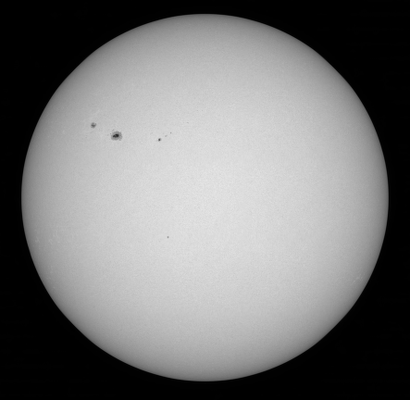
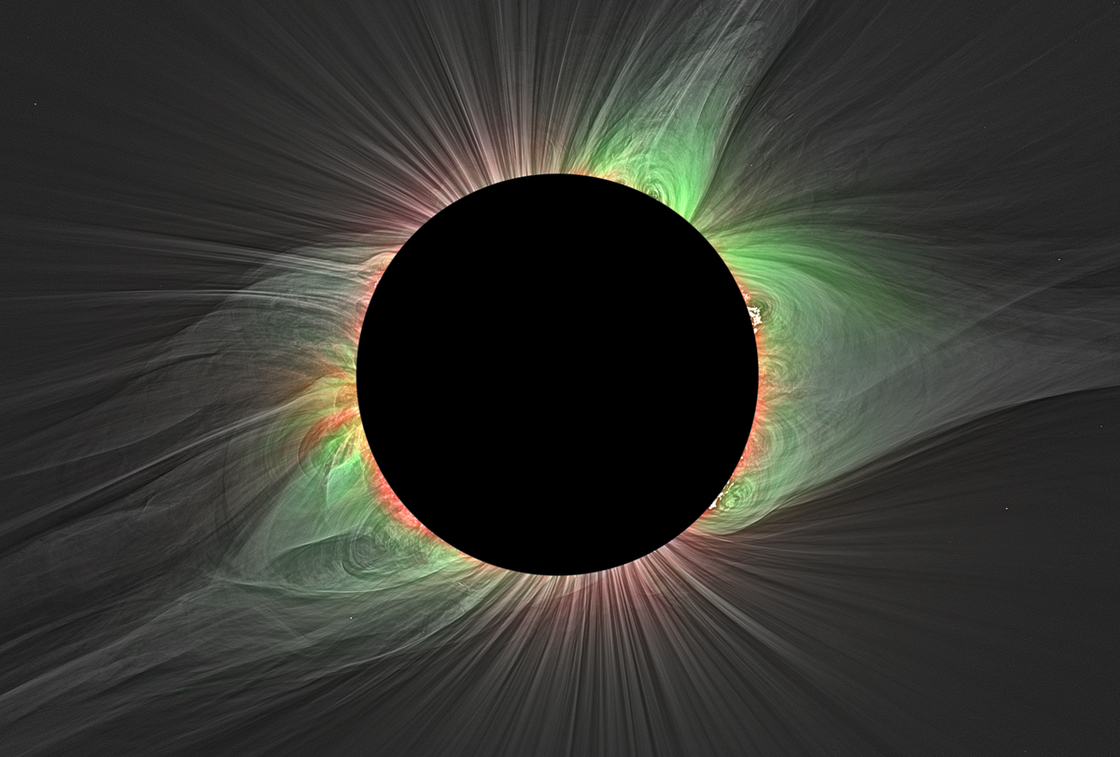
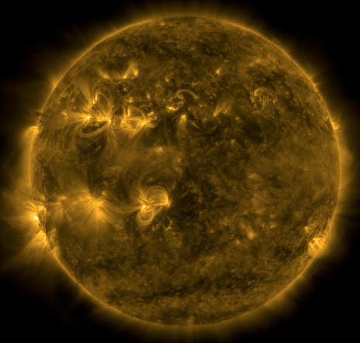
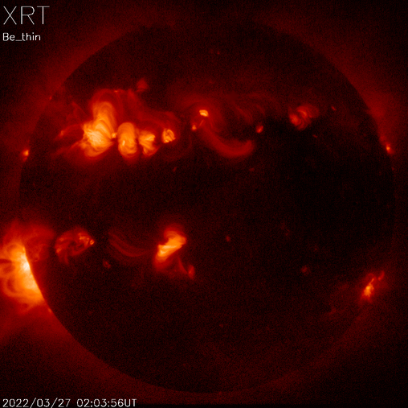
Sun in different wavelengths
Visible
Visible wavelength, during solar eclipse
Habbal et. al. ApJL(2021)
X-rays
EUV
Druckmüller et al., (2009)

Slide 3
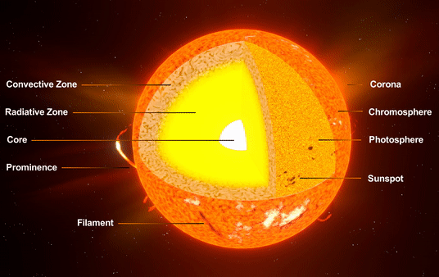
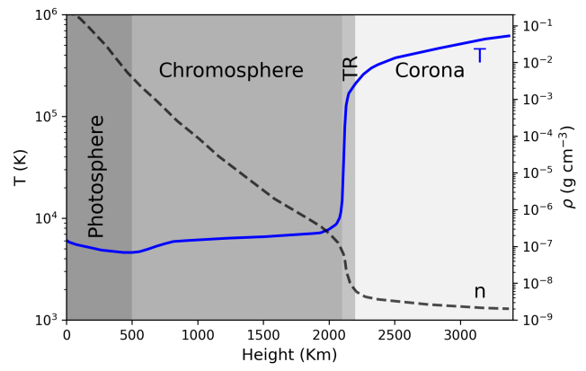
Coronal Heating Problem

Slide 4
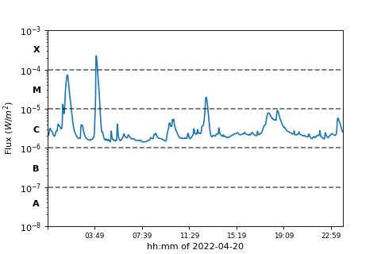
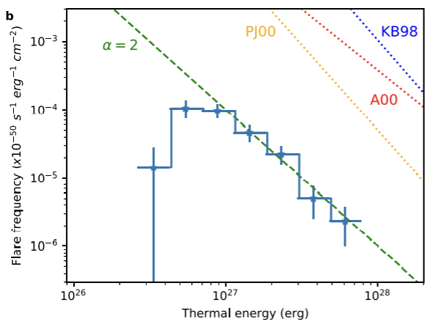
Nanoflare concepts from larger flares
The large solar flares, can not account for the overall coronal energy requirement (Sakurai 2017).
smaller flares occur more frequently.
Parker (1988) hypothesized the small-scale flares, termed as nanoflares having total energy around ∼10²⁴ erg, occurring all over the Sun.

Slide 5
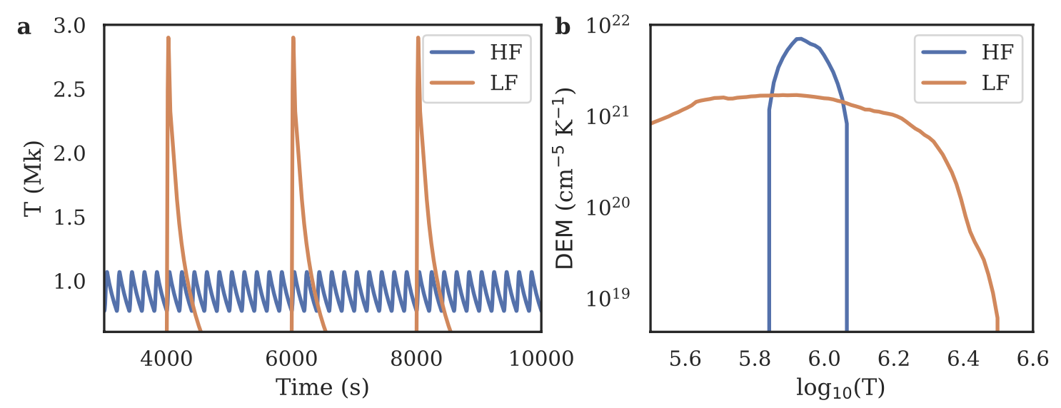
Observable properties
Direct detection of individual nanoflares are difficult.
Used indirect methods, e.g., Differential Emission Measure (DEM) or existence of hot plasma etc.
See Klimchuk et al 2006, 2015 for more details.

Slide 6
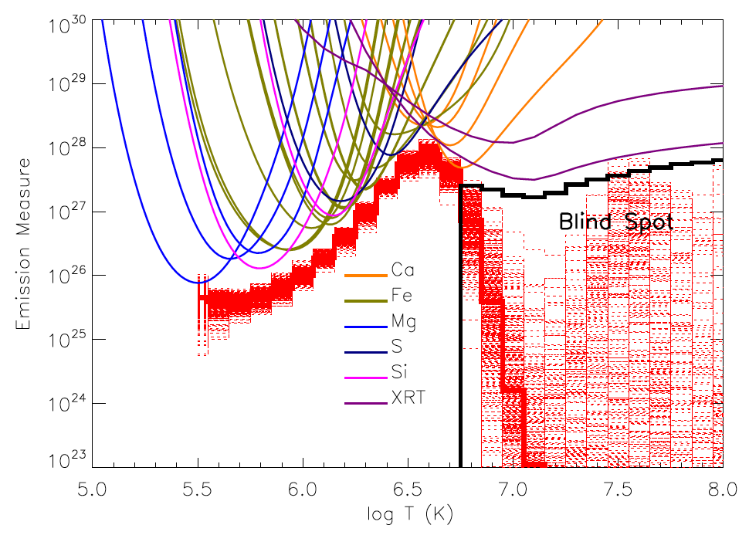
Challenges in determining DEM!
EIS + XRT
Winebarger et al. (ApJL 746:L17, 2012)

Slide 7
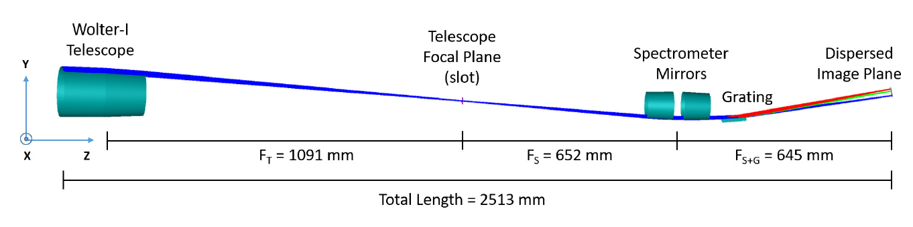
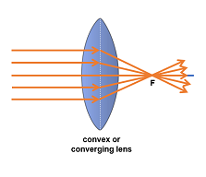
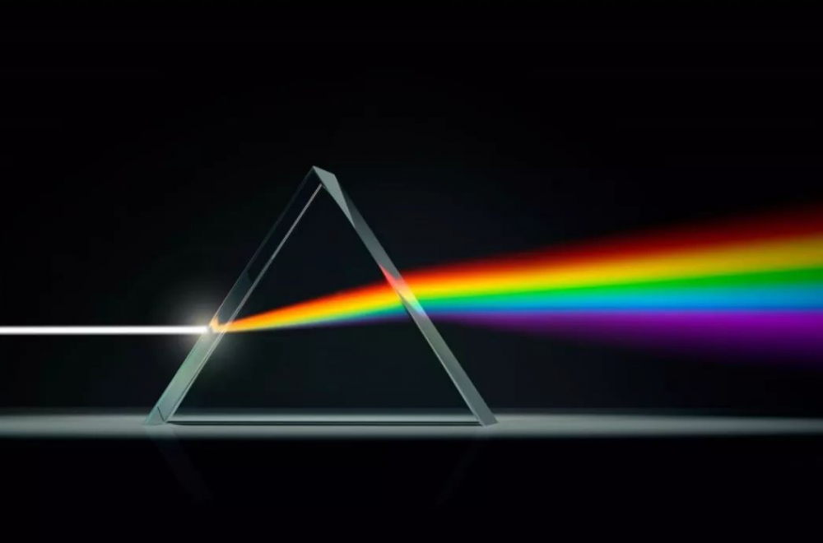
Marshall Grazing Incident X-ray Spectrometer (MaGIXS)
Champey et al. 2022

Slide 8
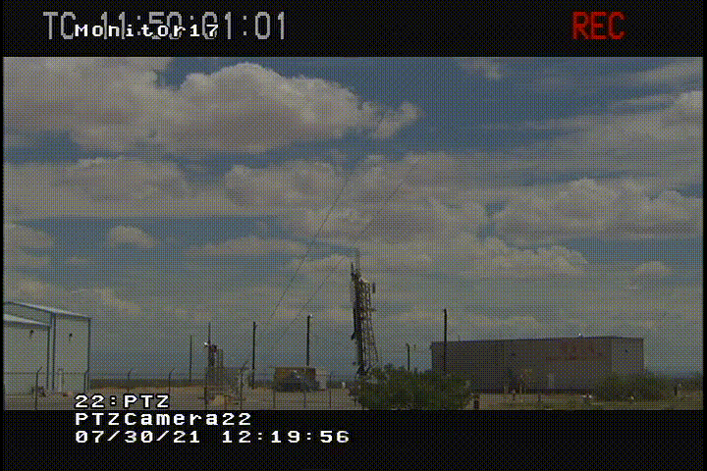
First flight of MaGIXS
Credit: MaGIXS team

Slide 9
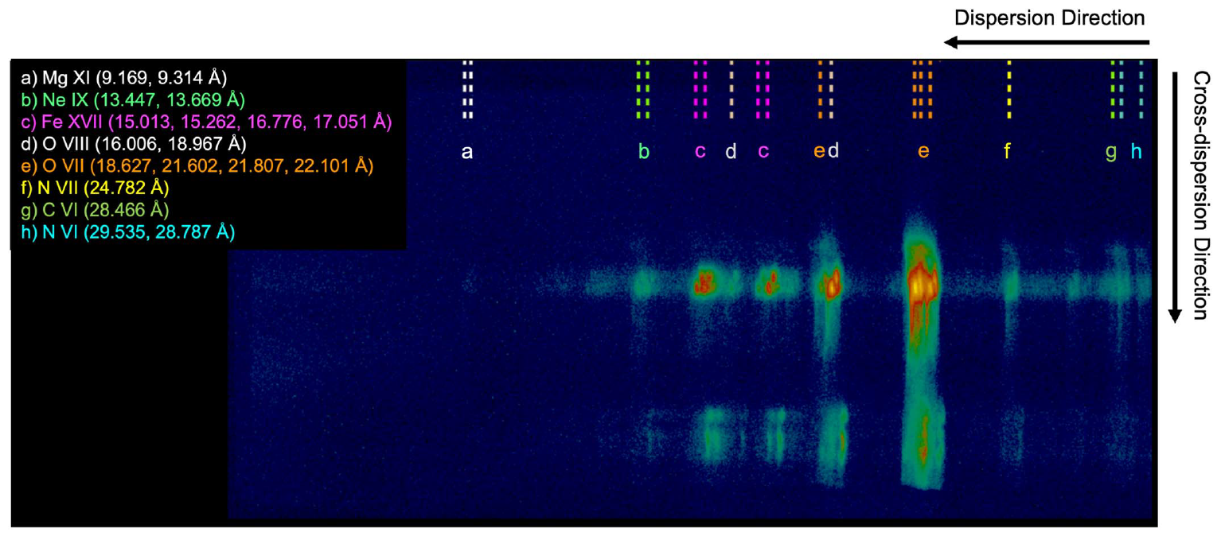
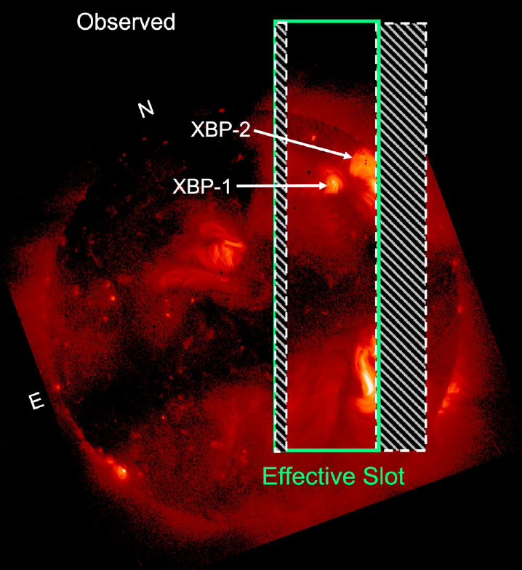
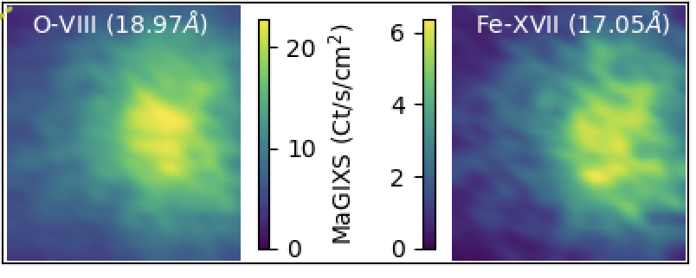
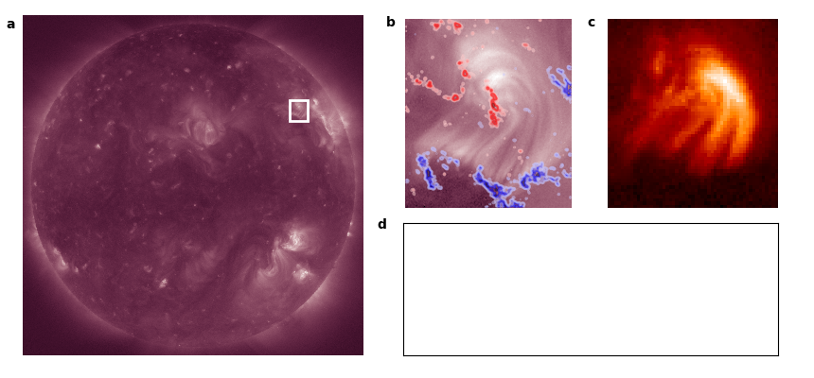
Overlapping spectral images observed by MaGIXS
AIA 193 + HMI
XRT
XBP-1
XBP-1
Savage et al (ApJ 945:105, 2023)

Slide 10
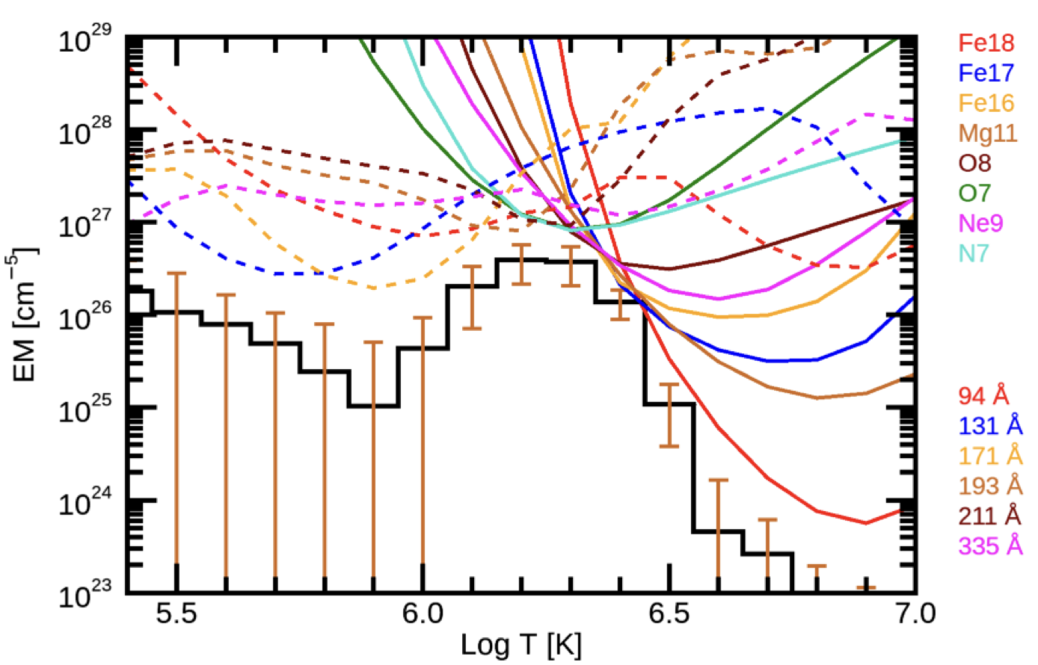
Better constraint of DEM at higher temperature
AIA + MaGIXS
Athiray & Winebarger (ApJ 961:181 2024)
What is the heating frequency?

Slide 11
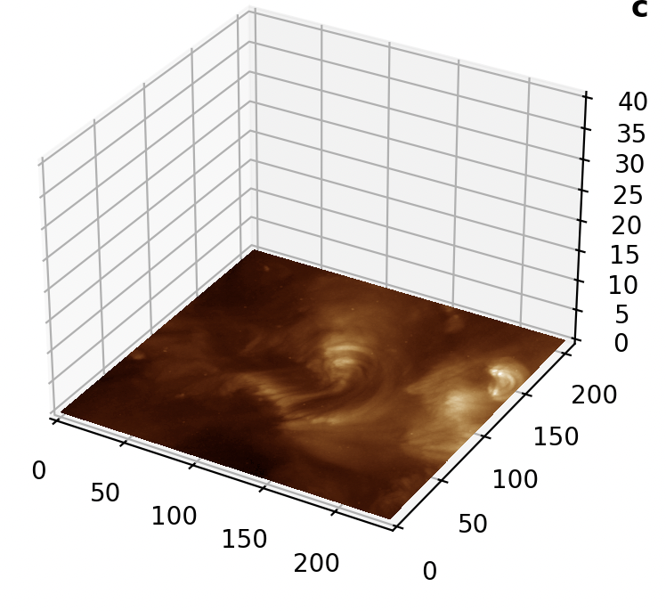
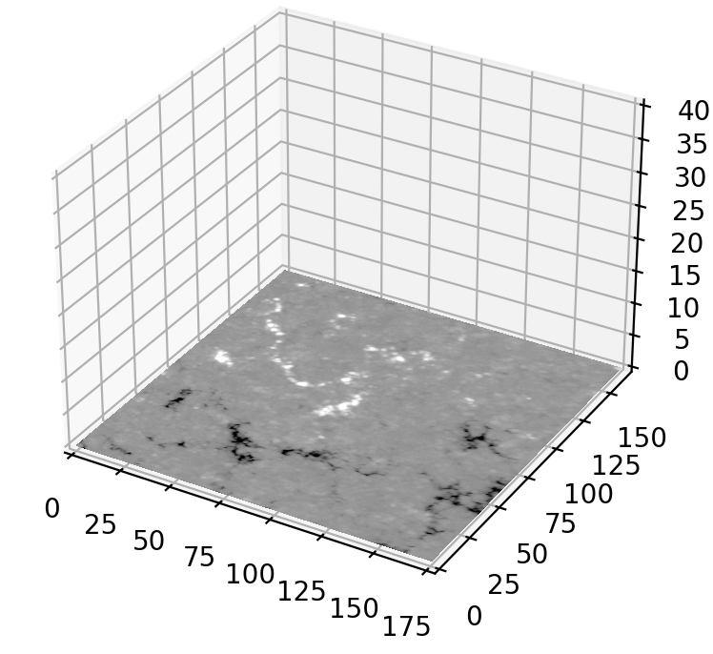
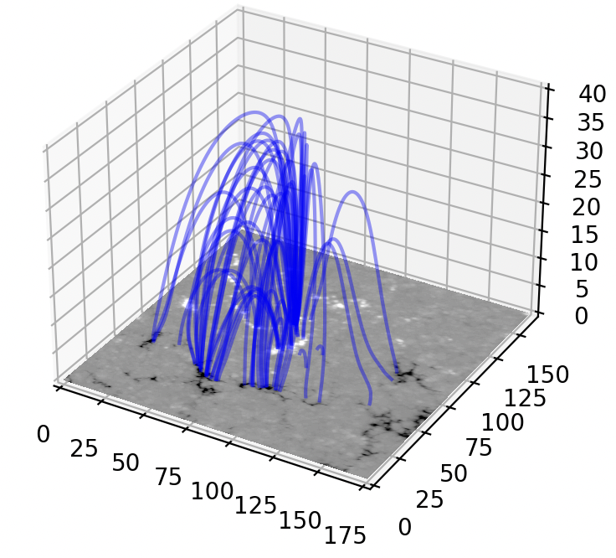
Combined observations with model
Our goal is to simulate XBP-1 emissions considering the nanoflare heating scenarios.

Slide 12
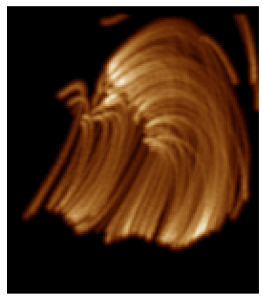
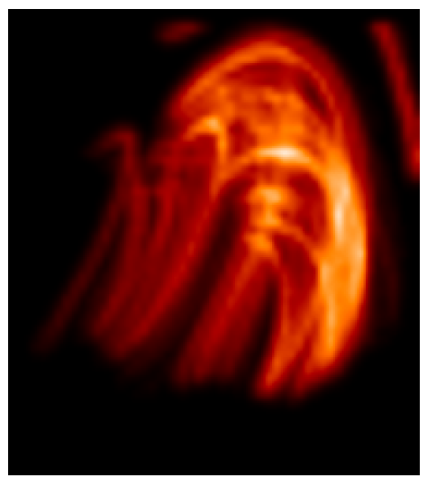
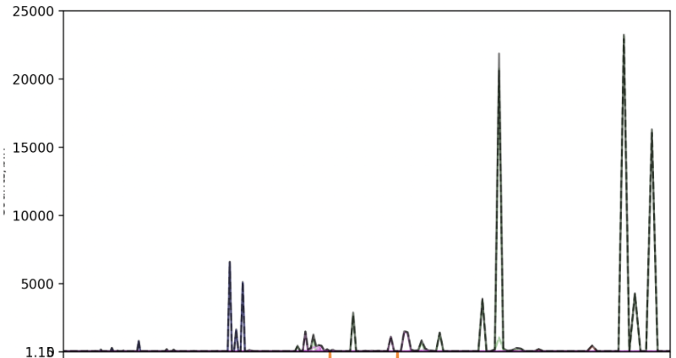
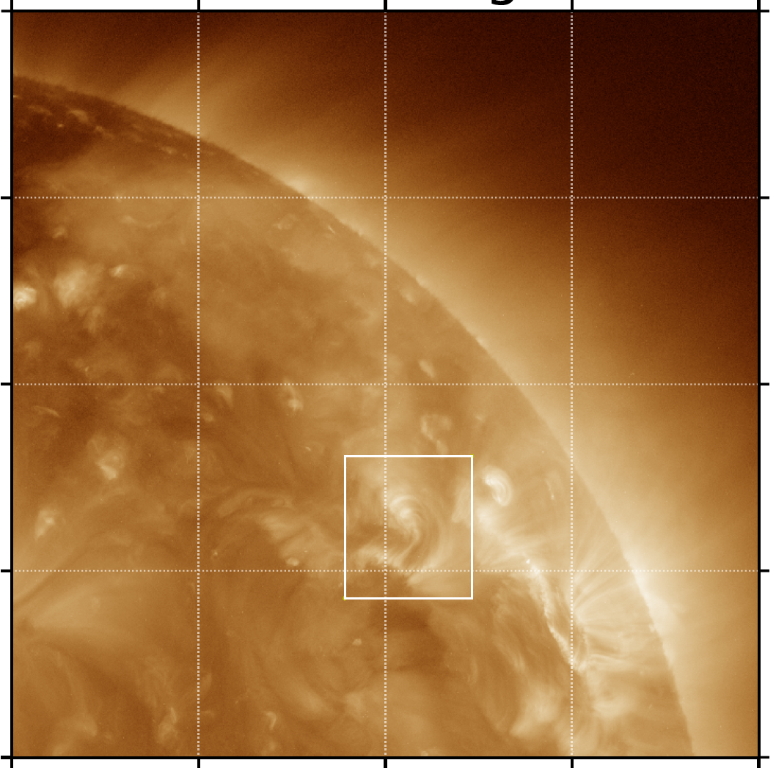
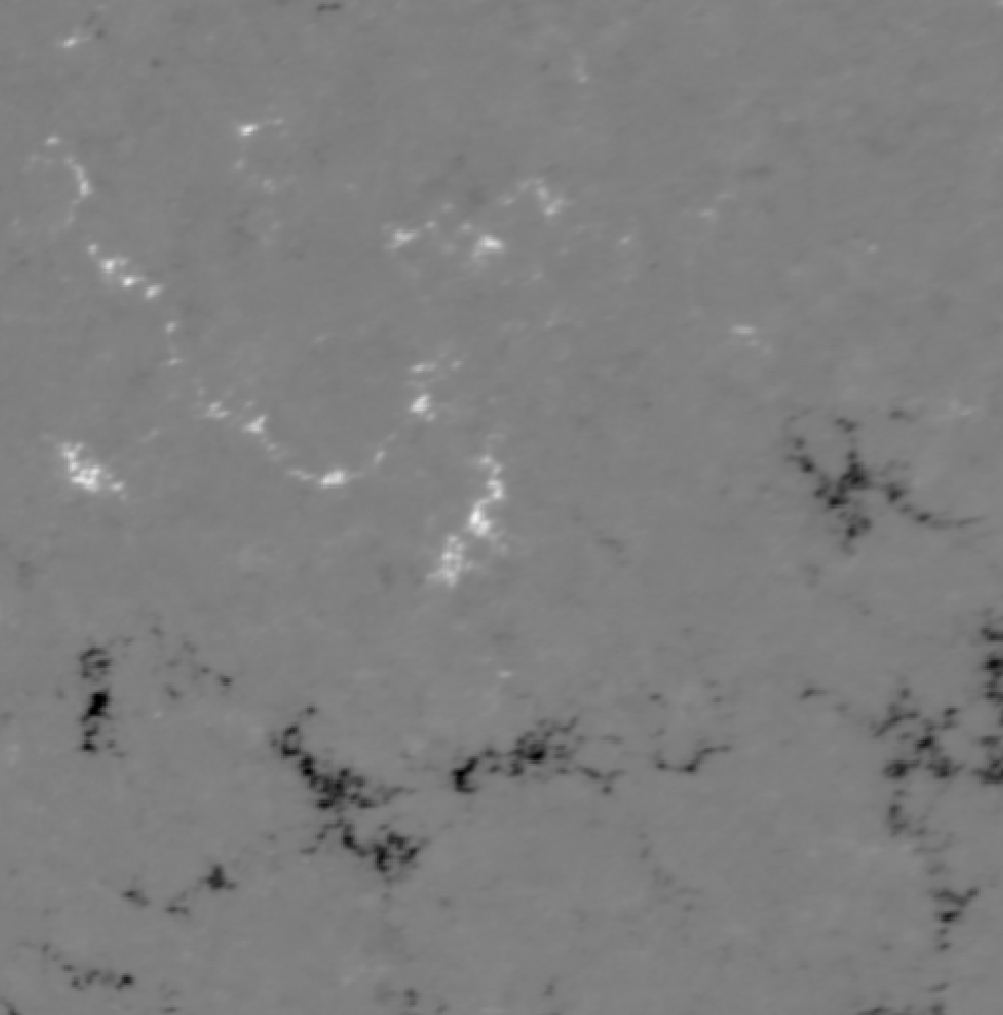
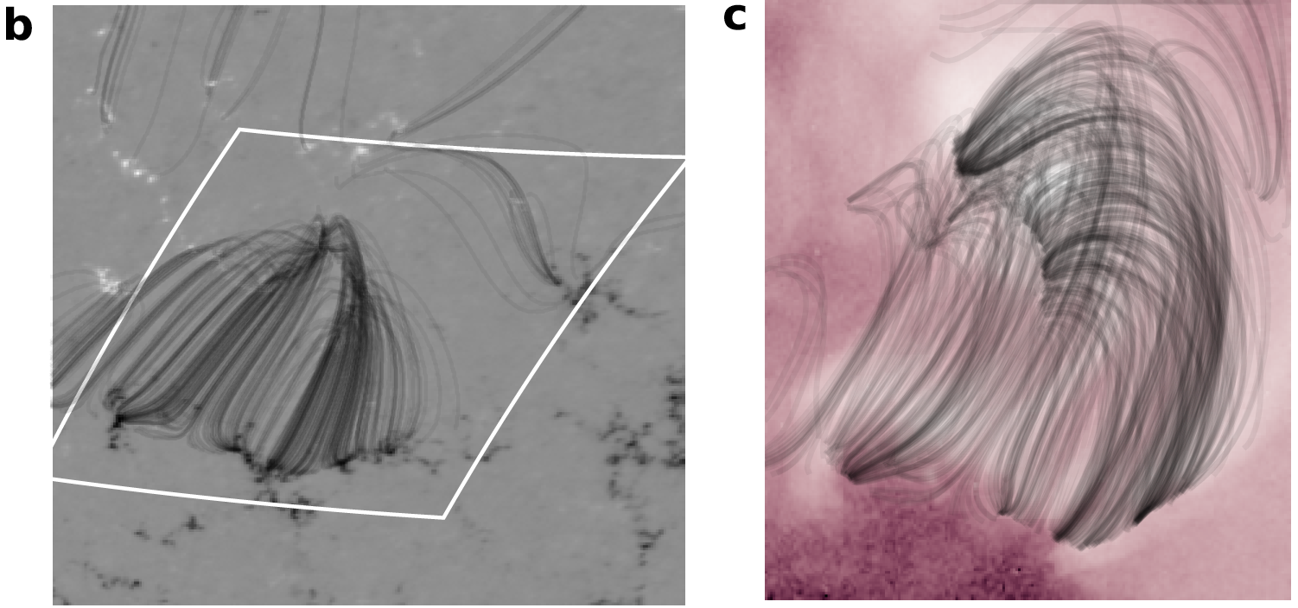
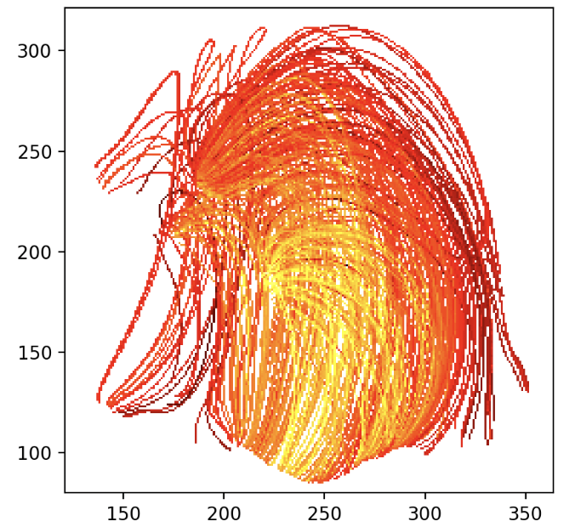
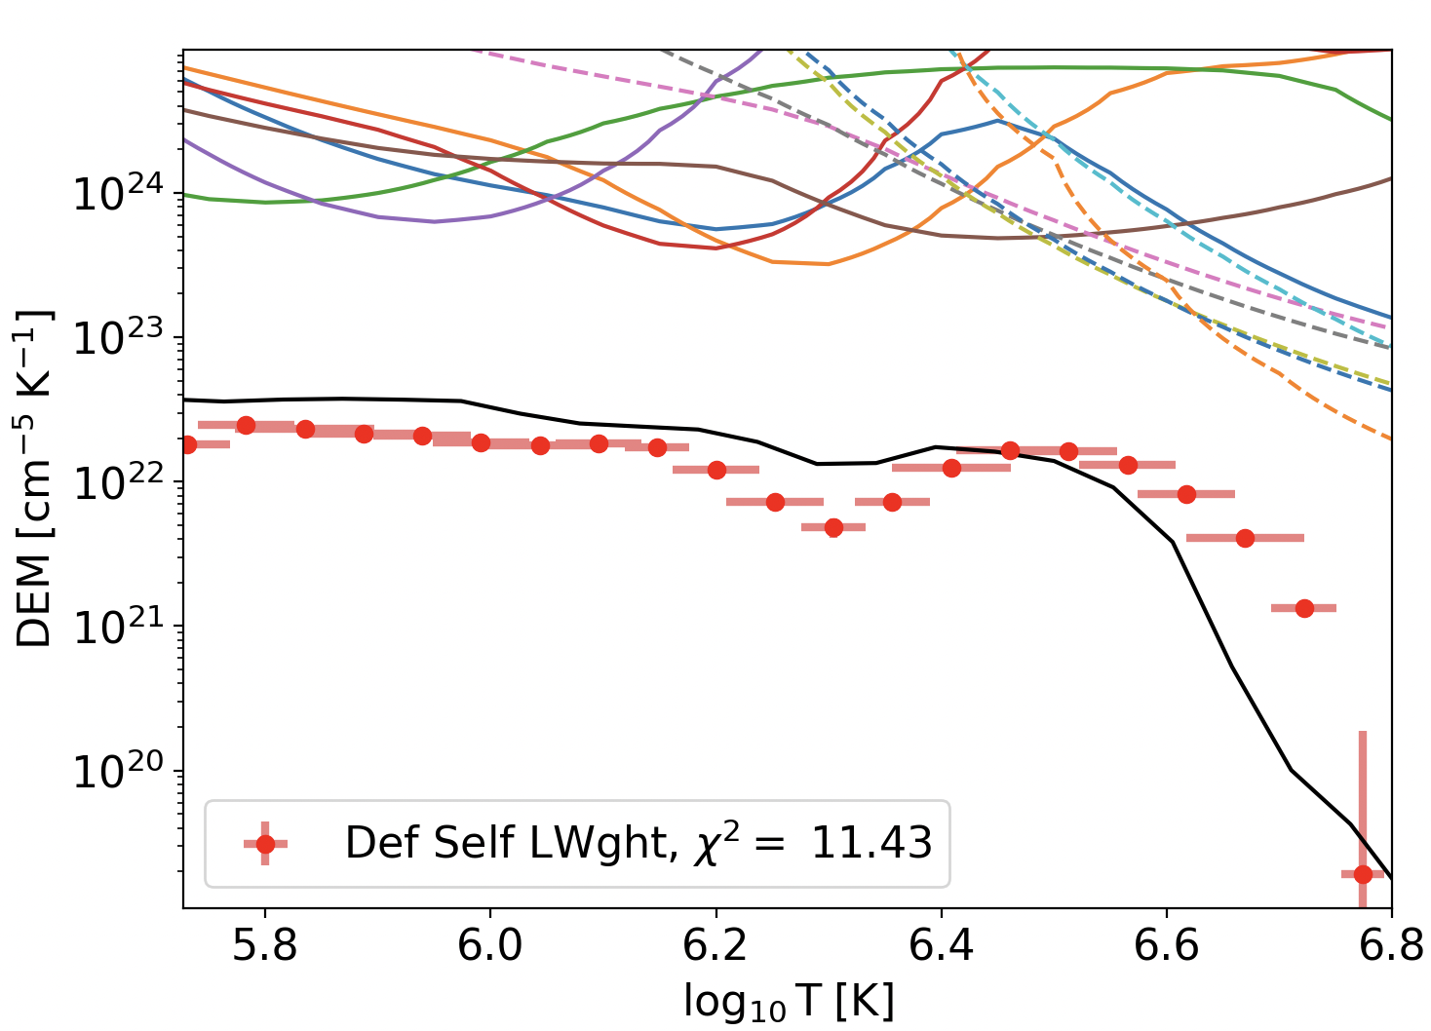
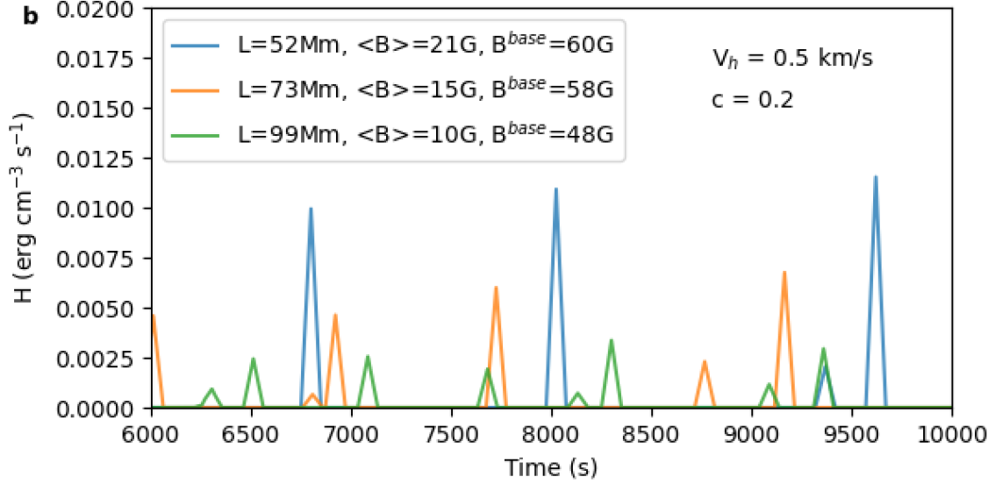
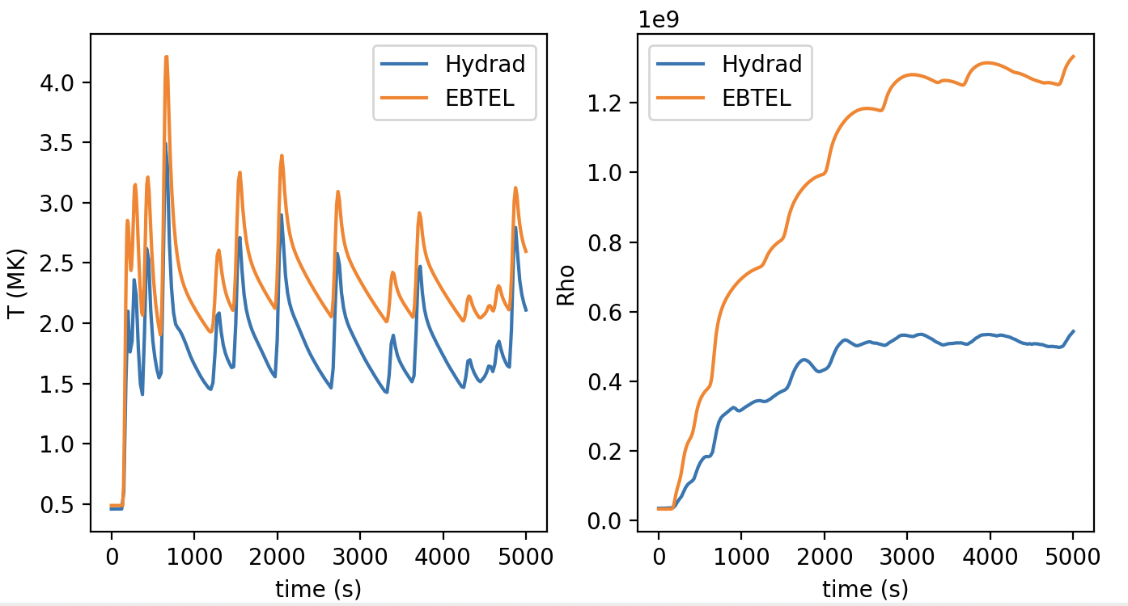
Python semi-automated pipeline
Given date & time
Images
&
spectra
Download and process HMI magnetogram + AIA
&
Select region interactively
CHIANTI + Instrumental parameters
Field extrapolation
&
Loop tracing
Create DEM map
Create nanoflare profile
Hydrodynamic simulations
(EBTEL++ or HYDRAD)

Slide 13
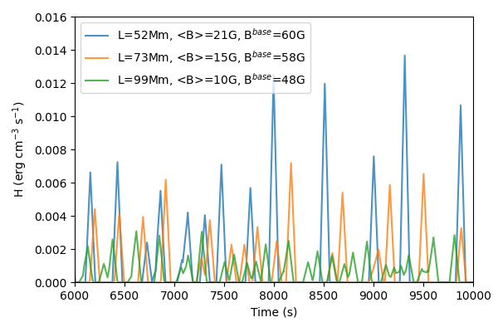
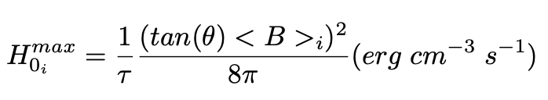
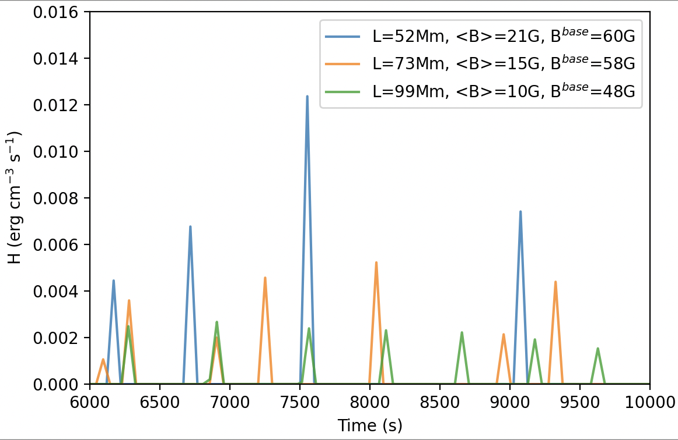
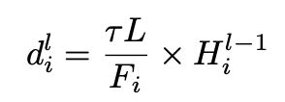
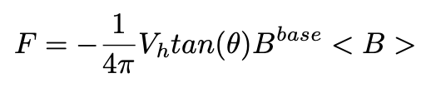
Create nanoflare profile
Consider triangular heating profiles having a duration, 𝜏 = 100 s.
The peak heating rate during an event is randomly chosen between minimum (H₀^{min} ) and maximum (H₀^{max}) values that are loop dependent.
tan(θ) = 0.2
V_{h} = 1.5 km/s
tan(θ)= 0.2
V_{h} = 0.5 km/s
Mondal, Klimchuk et al (2023 ApJ 945:37 2023)

Slide 14
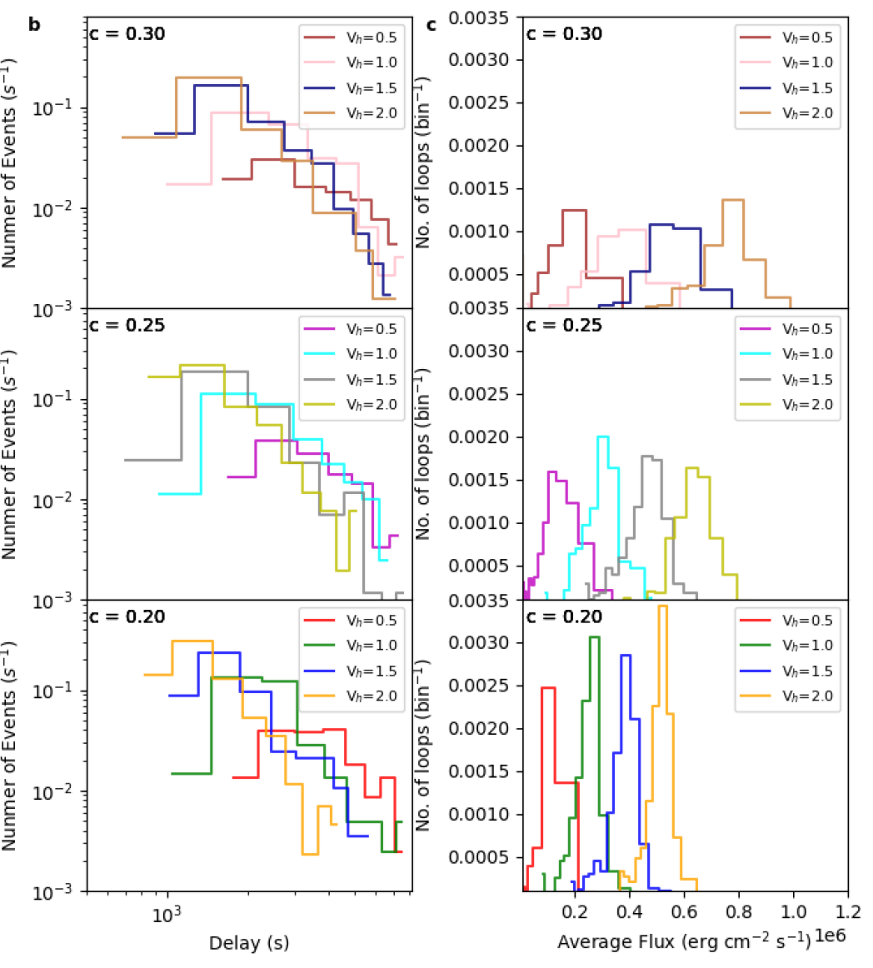
Distribution of nanoflare events for different heating parameters
Run the simulation setup for various combination of tan(θ) and V_{h}.
For each combination, we create the DEM map for the XBP.
Convolving instrument response with the DEM map provides the images.
c = tan(θ)

Slide 15
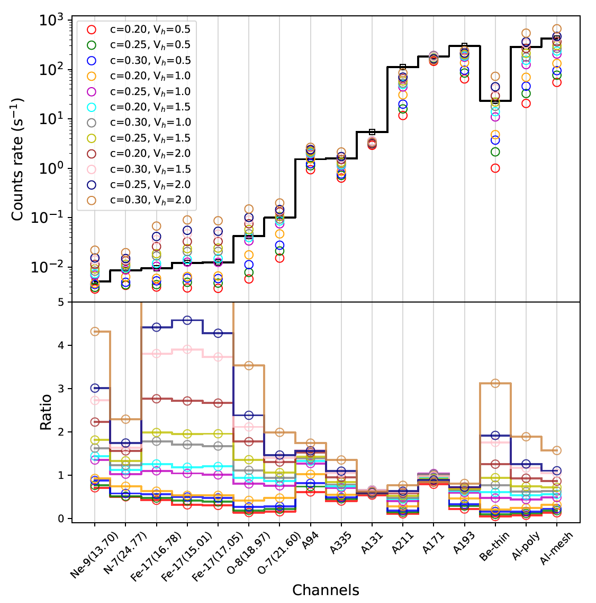
Comparison between simulations and observations
AIA
XRT
MaGIXS

Slide 16
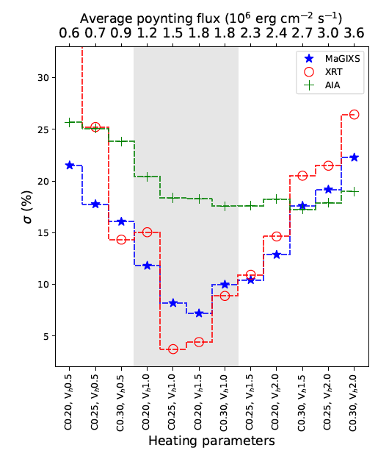
Results & Discussions
Avg. flux =
~3 ✕ 10⁵ erg cm⁻² s⁻¹.
Avg. delay = 1500-3000 s.

Slide 17
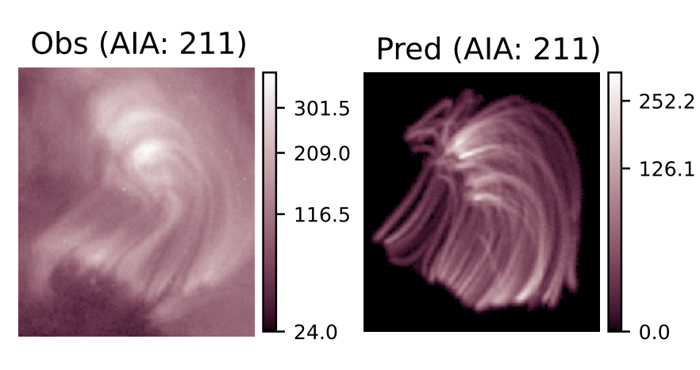
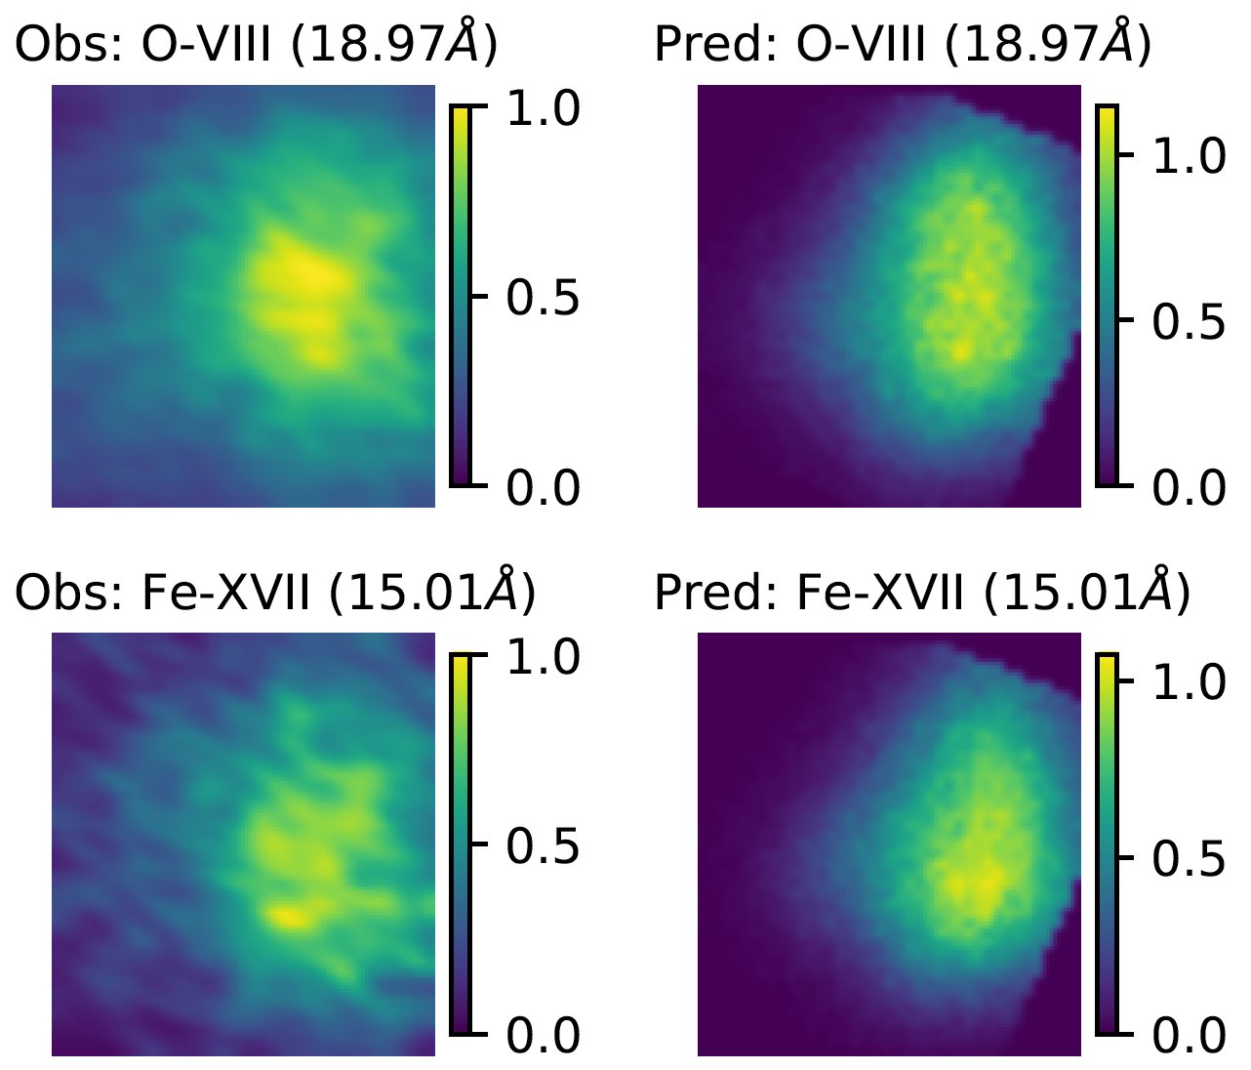
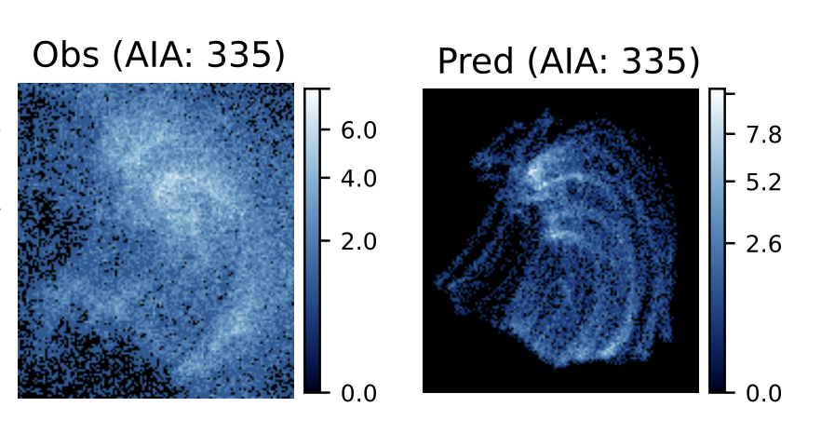
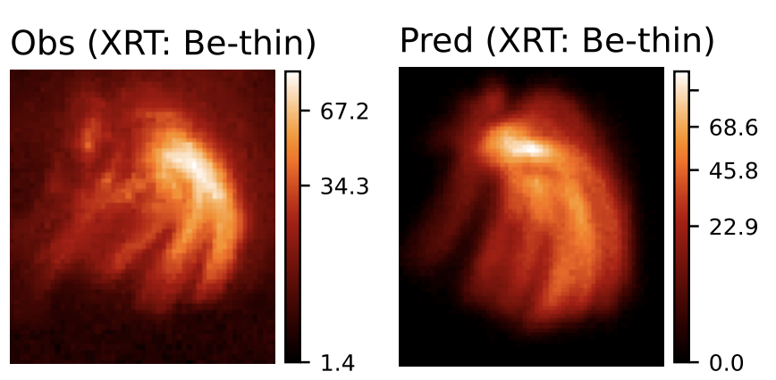
Observed and Predicted images of XBP-1
DN/s
DN/s
Derived from MaGIXS
Simulated
Observed by AIA & XRT
Simulated
Average delay = 1500 - 3000 s
MaGIXS and XRT are more sensitive.
Mondal et al, 2024 (accepted in ApJ)

Slide 18
Future perspectives
Can we use a similar approach to understand the heating during the evolution of an AR?

Slide 19
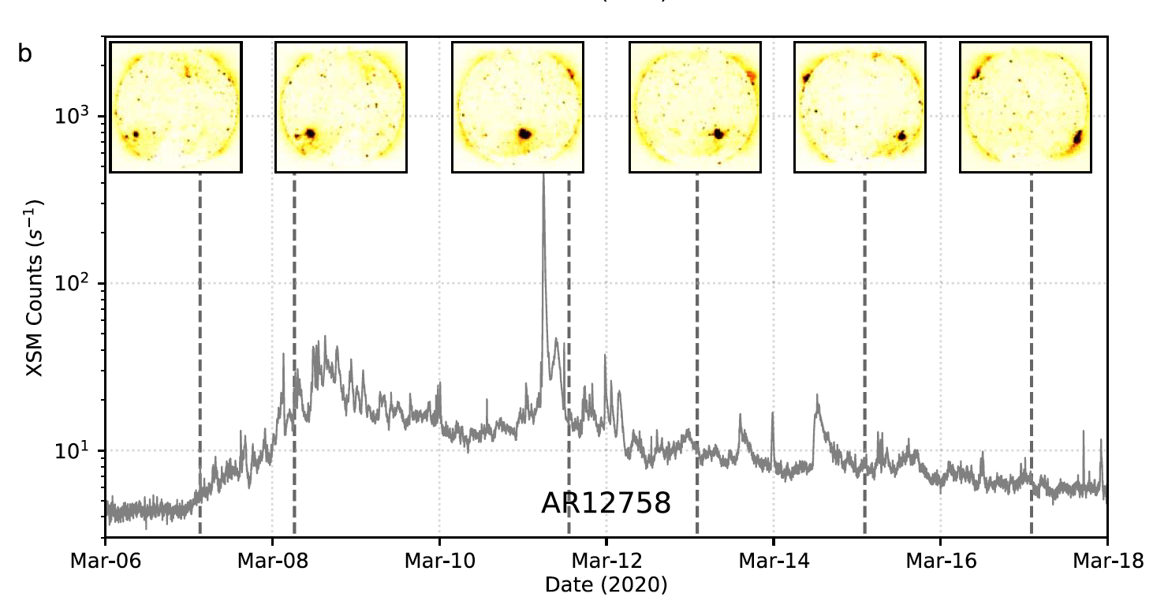
We choose AR 12758
Mondal et al (ApJ 955:146, 2023b)

Slide 20
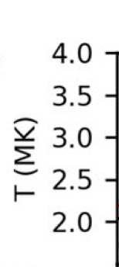
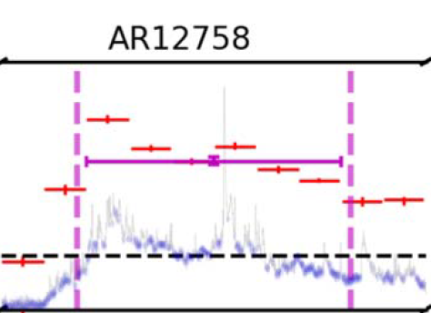

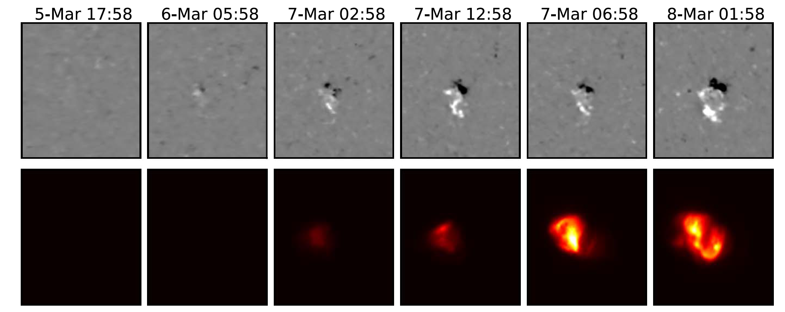
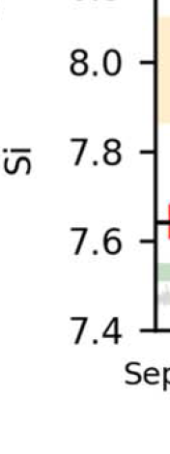


Formation of AR12758
Evolution of plasma parameters!
FIP bias
Evolution of this AR was studied from soft X-ray disk-integrated spectroscopy.
Step-1: Simulate the evolution of this AR and compared with disk-integrated quantities.
Mondal et al (ApJ 955:146, 2023b)

Slide 21

Variation of integrated X-ray flux

Slide 22

Variation of integrated temperature from X-ray spectra

Slide 23










Simulated
Observed
XRT Be-thin

Slide 24






Spatial variation of temperatures

Slide 25
Spatial variation of temperatures
EM weighted T varies (1 to 3 MK) with spatial location of the AR.
Indicating different heating frequency.
Needs imaging spectroscopy to understand heating parameters.

Slide 26

Evolution of heating frequency
Frequency
Number of events (s⁻¹)
Frequency
Delay time (s)
Mondal et al, 2024 (under preparation)

Slide 27
Summary
Investigated the nanoflare heating of an XBP observed by MaGIXS, AIA and XRT
Nanoflare heating can reproduce the observed intensity of the XBP with an average nanoflare delay time in the order of 1500-3000 s, which is likely to be high-frequency.
The average poynting flux is found to be in the range of ~3 ✕ 10⁵ erg cm⁻² s⁻¹, which agrees with the earlier report.
MaGIXS and XRT are more sensitive to diagnose the heating frequency, whereas only AIA channels are less sensitive.
Studied the evolution of heating frequency throughout the evolution of an AR.

Slide 28
MaGIXS-2 (This year)
Credit: MaGIXS team
Credit: MaGIXS team
Thank You for your attention!

