Slide 1
BSCW Computations Using KESTREL and AEROM
Walt Silva
Aeroelasticity Branch
NASA Langley Research Center, Hampton, VA

Slide 2
Outline
Benchmark SuperCritical Wing (BSCW), Aeroelastic Prediction Workshop (AePW)
Background
AEROM
Results
  Alpha=0, 1, 3, and 5 degs (skip alpha=1 deg; similar to alpha=0 deg)
  Amplitudes = 0.04, 0.01, 0.08, and 0.001 (modal)
  Comparison of full solution GAFs vs ROM GAFs (error quantification)
  Root locus
  Comparison of full solution transients vs ROM transients (at a specified Q)

Slide 3
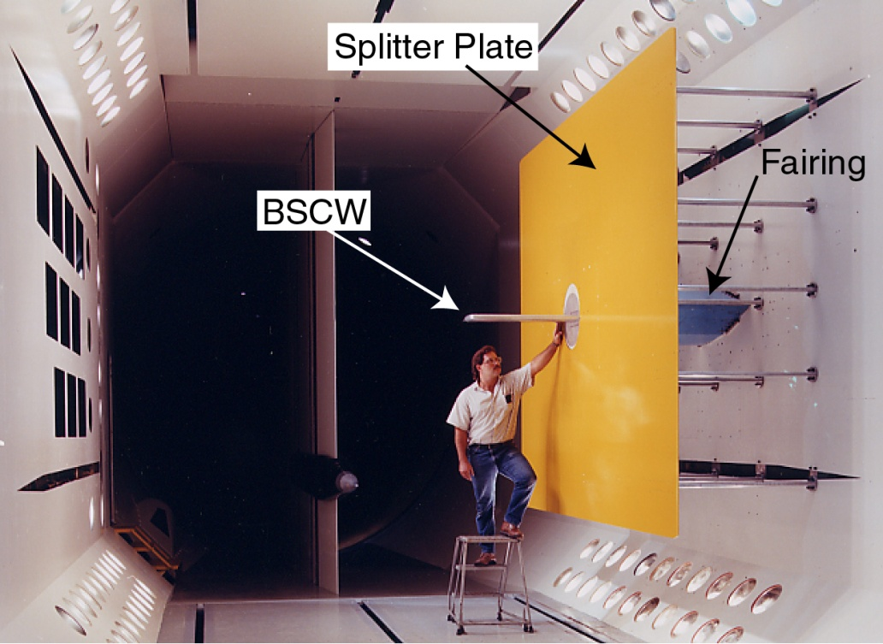
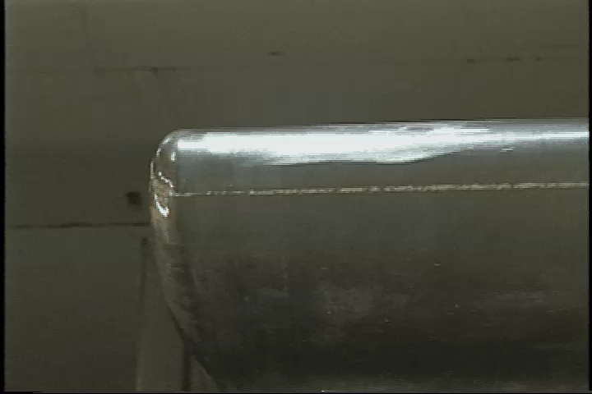
Benchmark Supercritical Wing (BSCW)
M=0.85, Re_{c}=4.49 million, test medium: R-134a, α = 5°, θ = 1°, freq 1 & 10 Hz
Challenging test case, simple geometry, complex physics
Strong shock with shock-induced separated flow
Computational methods had difficulty producing converged solutions due to flow field complexity
CFD solutions vary widely (static, aeroelastic solutions)

Slide 4
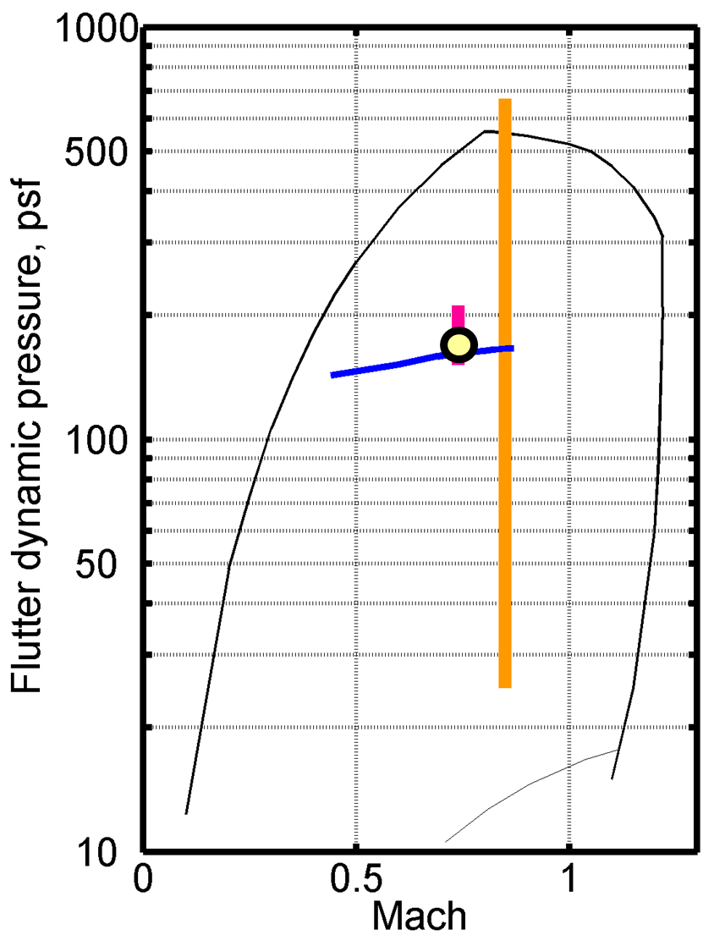
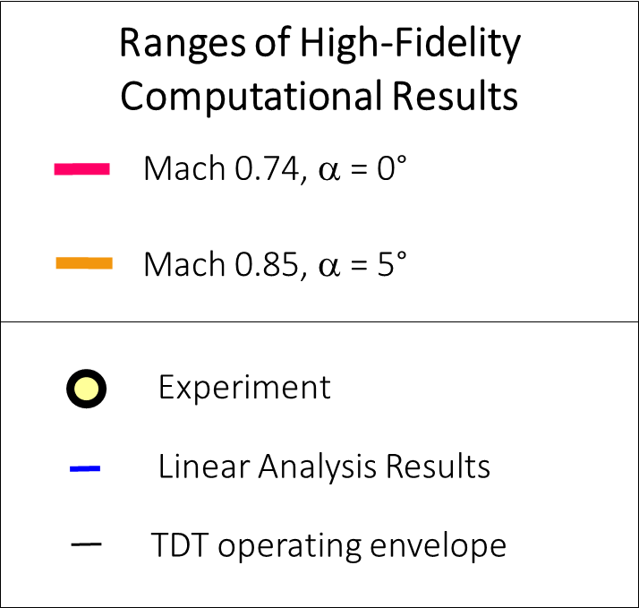
Aeroelastic Responses
At Mach 0.74, a = 0°
  Small variation in computational results
  Match the experimental results well
  Match the linear results well
At Mach 0.85, a = 5°
  Significant variation in predictions
  No experimental data for comparison

Slide 5
Background
Application of KESTREL and KESTREL/AEROM to BSCW wing
At M=0.74, alpha=0 deg, KESTREL, KESTREL/AEROM, FUN3D, and FUN3D/AEROM all compare nearly exactly with data
At M=0.85, alpha=5 deg, large flow separation/unsteadiness; very challenging problem
Large variance from one code to another at this condition; differences between KESTREL and FUN3D
Goal of this analysis: evaluate application of AEROM using KESTREL at M=0.80 and alpha=0, 1, 3, and 5 deg (similar unsteadiness to M=0.85) using multiple amplitude excitations (Walsh functions)
Follow-up with investigation of code-to-code comparisons
”Characterizing Aerodynamic Damping of a Supersonic Missile with CFD”, Shelton (AF), Martin (AF), Silva (NASA), SciTech 2018

Slide 6
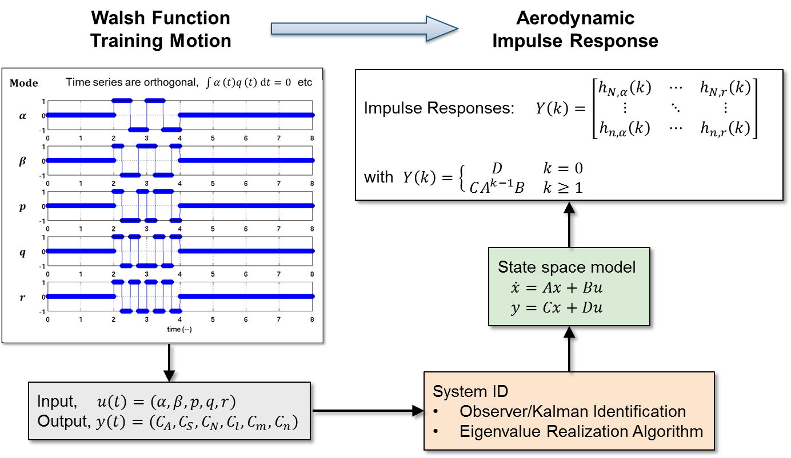
System ID for MIMO Systems
Computational Fluid Dynamics
(Kestrel or FUN3D)
System/Observer/Controller Identification Toolbox
(SOCIT)

Slide 7
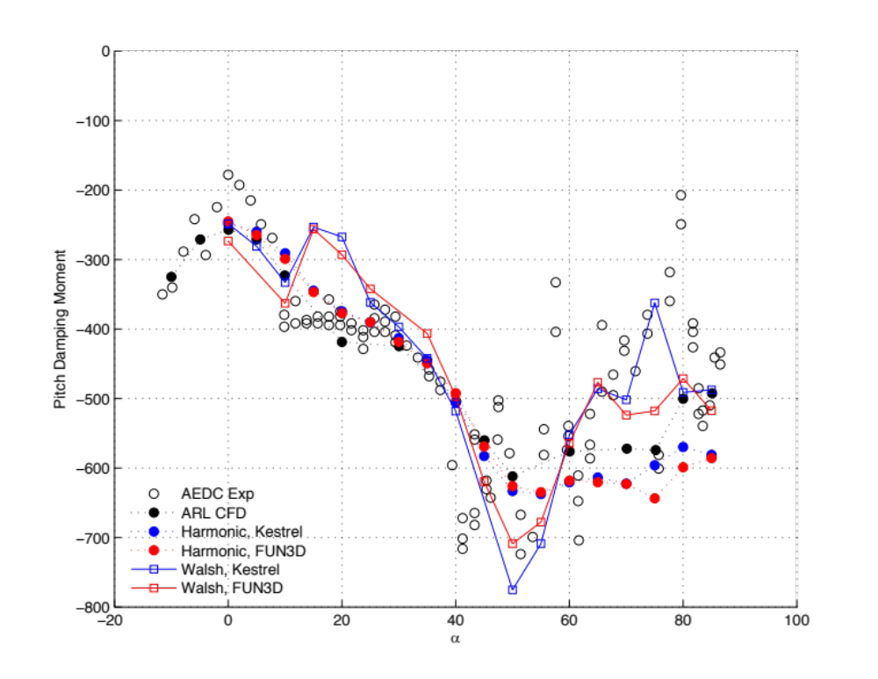
Pitch Moment Damping (Walsh vs Harmonic)

Slide 8
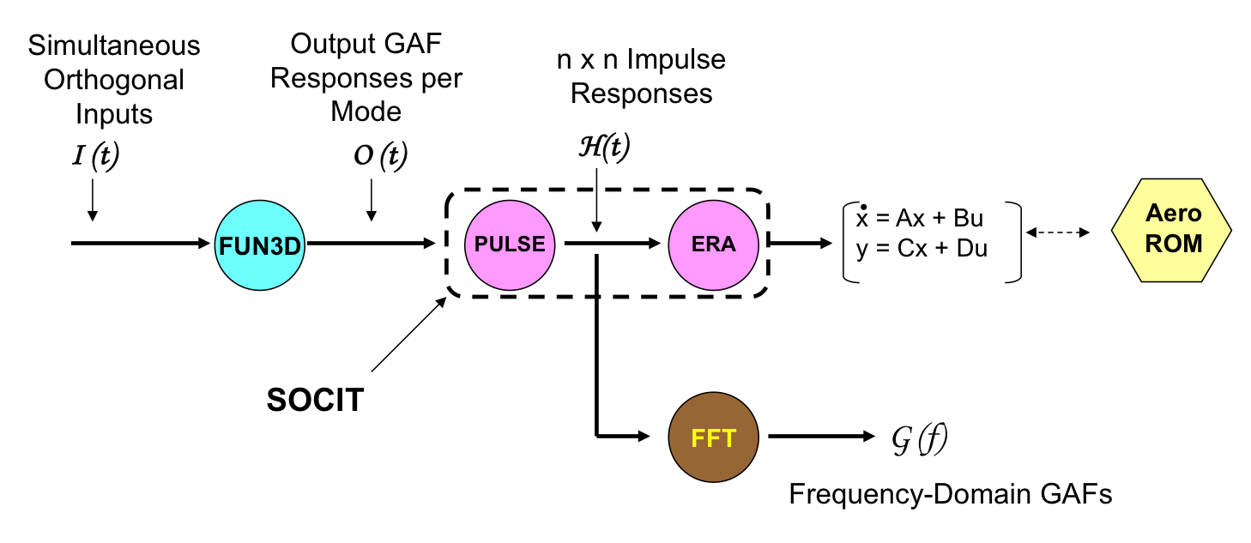
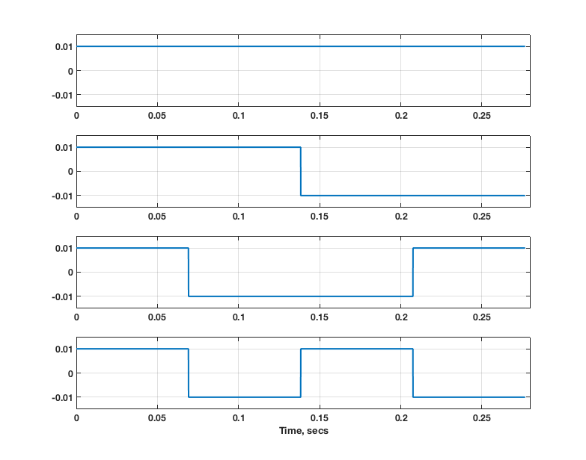
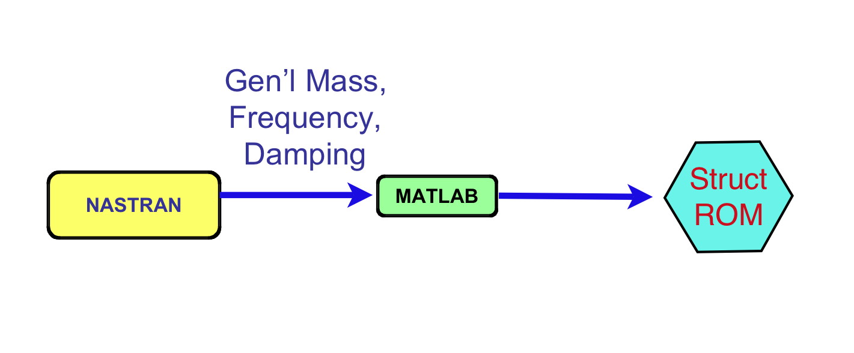
AEROM: Unsteady Aero State-Space ROM
Walsh Functions
(modal)
KESTREL
1
2
3
4
Structural state-space ROM

Slide 9
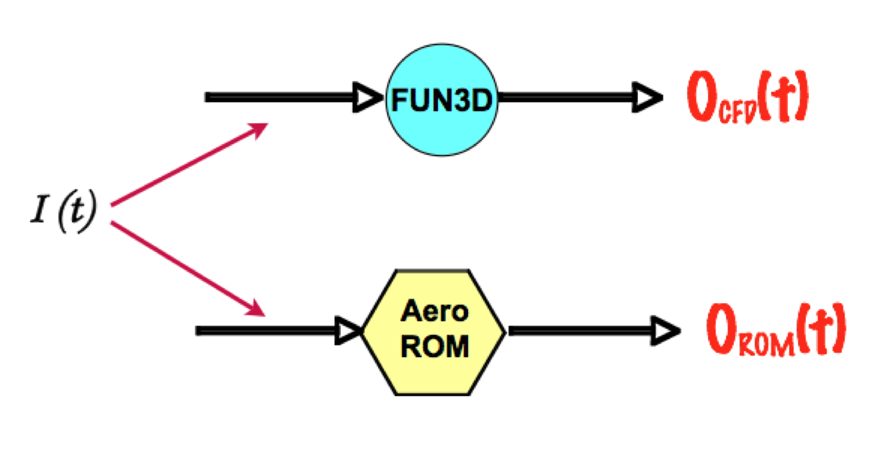
AEROM: Unsteady Aero State-Space ROM
Error Minimization (Unsteady Aero)
Low
Error ?
Yes
Continue
No
ERA
PULSE

Slide 10
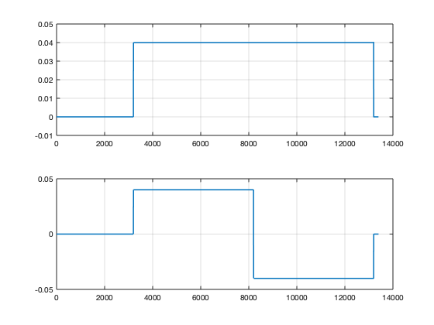
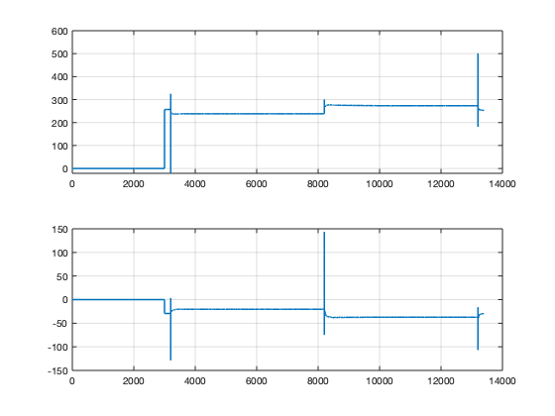
KESTREL/BSCW Application (Two Modes)
*.fmh file
*.modes file
KESTREL
BSCW
Two Walsh input functions
Two GAFs output functions

Slide 11
Walsh Functions Amplitudes, Alphas
Modal Amp/Alpha (deg) | 0 (K) | 1 | 3 (K) | 5 (K)
0.04 | M8A0a | M8A1a | M8A3a | M8A5a
0.01 | M8A0b | M8A1b | M8A3b | M8A5b
0.08 | M8A0c | M8A1c | M8A3c | M8A5c
0.001 | M8A0d | M8A1d | M8A3d | M8A5d
K = comparison with full KESTREL solution available or underway; using ‘Venkat’ limiter
KESTREL Solutions: Alpha = 0 deg, Q = 100 psf, Initial Modal Velocity = 5
Alpha = 3 deg, Q = 100 psf, Initial Modal Velocity = 5
Alpha = 5 deg, Q = 50 psf, 130 psf, Initial Modal Velocity = 5
CPU Cost (NAS)
ROM solution: 10K steps, 240 cores, 9hrs 45min (set up, high alpha case; shorter duration for benign cases)
Full Solution per Q: 15K steps, 240 cores, 53 hrs 04min (~5.5 cycles)

Slide 12
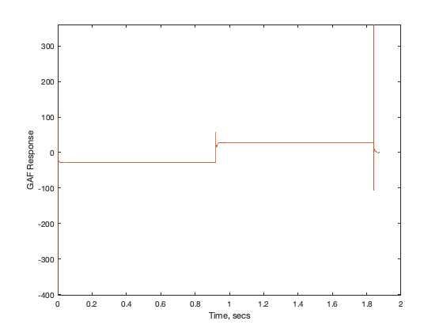
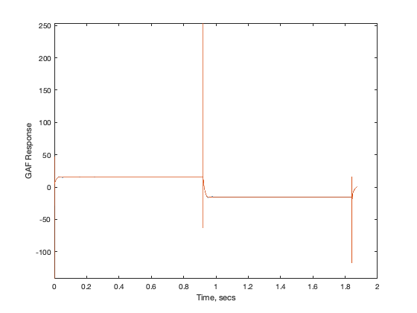
M8A0a – Comparison of ROM/KESTREL GAFs
a | .04
b | .01
c | .08
d | .001
GAF1 Output (ROM and KESTREL)
GAF2 Output (ROM and KESTREL)

Slide 13
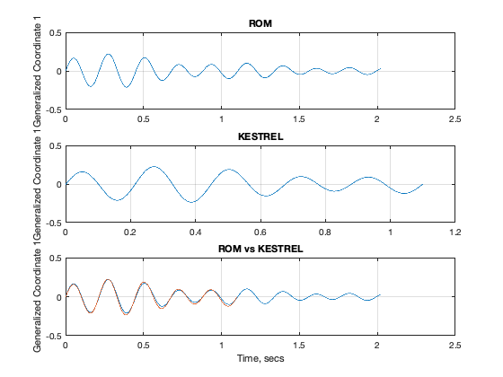
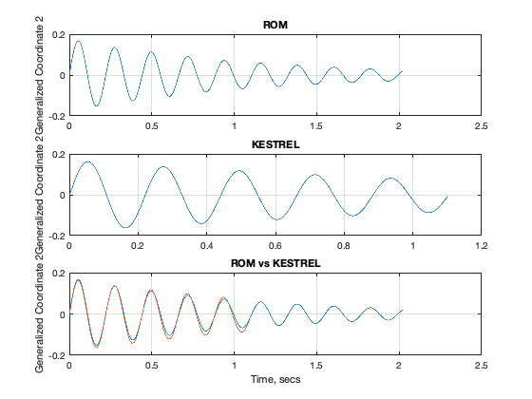
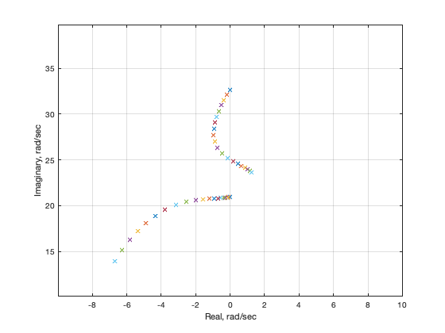
M8A0i – ROM/KESTREL Responses
Mode 1 (Q=100 psf)
Mode 2 (Q=100 psf)
Aeroelastic Root Locus
STABLE
UNSTABLE
Mode 2
FLUTTER
Mode 1
At M=0.8, for alpha=0 and 1 degs, all input amplitudes yielded identical responses at all dynamic pressures, with identical aeroelastic root locus behaviors
At M=0.8, for alpha=3 degs, started noticing some input amplitude dependence (larger amplitudes more accurate) with a slight change in aeroelastic root locus behaviors

Slide 14
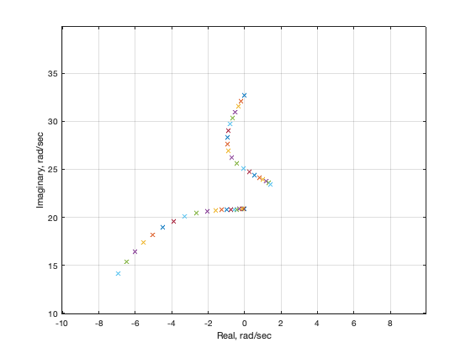
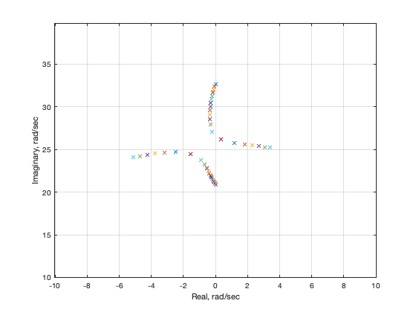
M8A0i,M8A5a,c – ROM/KESTREL Responses
Alpha=0 deg, All input amplitudes
Alpha=5 deg, Larger input amplitudes
At M=0.8, alpha=5 degs, obvious input amplitude dependence (larger amplitudes more accurate) with noticeable change in aeroelastic root locus behavior
Proximity of Alpha=5 deg root locus to imaginary axis could be cause of significant sensitivity across various CFD codes

