Slide 1

Nuclear Thermal Propulsion Engine Ground Testing with the High-Pressure Real-Time Exhaust Processing System
Lindsey Holmes
Vice-President, Advanced Projects
Analytical Mechanics Associates (AMA)
Additional Authors: Marc Neeley, Jim Rector, Ricky Sasmal

Slide 2
Acknowledgements
This work was supported by NASA’s Space Technology Mission Directorate (STMD) through the Space Nuclear Propulsion (SNP) Project
Contract No. 80LARC23DA003
Task No. 10.00305

Slide 3
Introduction
NTP Engine Ground Testing with High-pressure Real-Time (HPRT) Exhaust Processing
NTP ground test history
NTP exhaust processing concepts previously developed
Engine ground demonstration test concepts
High-pressure Real-Time (HPRT) Exhaust system overview
Design alternatives
Forward work

Slide 4
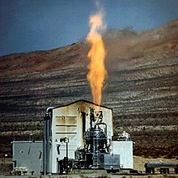
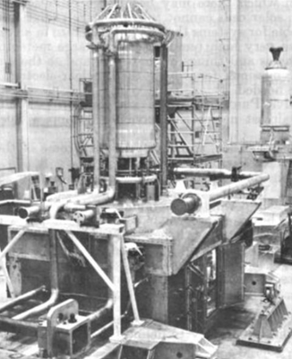
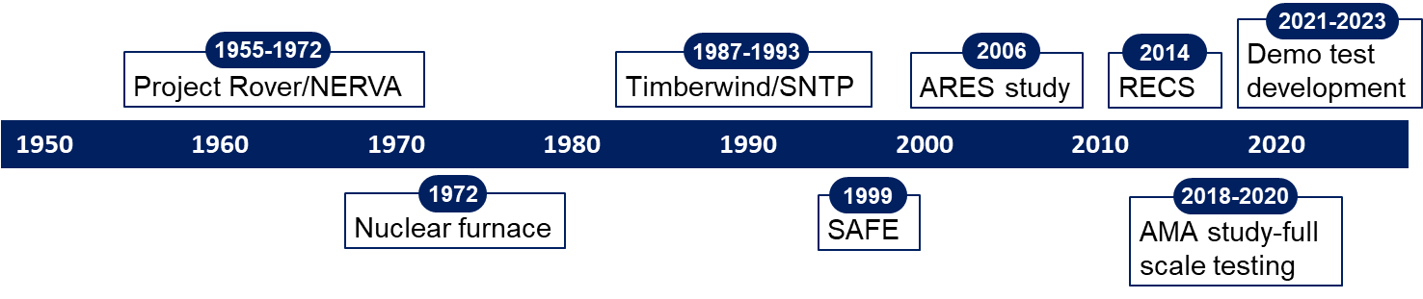
NTP Engine Ground Testing History
NTP engine ground testing has been studied for decades
1955-1972, Rover/NERVA: Tested 22 HEU reactors and engines in multiple open-air test stands
  Test Cell A and C: nozzle-up reactor tests
  Engine Test Stand 1 (ETS-1): only NTP engine test stand, tested XE’ nozzle-down with 28 restarts, 3 hrs 48 min total duration. Estimate to rebuild $FY24 ~$1.03B (no exhaust processing)
  Nuclear Furnace (NF-1): first demonstration of hydrogen exhaust scrubbing, albeit low power and low flow rates
1987-1993, Timberwind/SNTP: Planned for “real-time” exhaust scrubbing
  Environmental impact statement (EIS) for Nevada National Security Site (NNSS) approved; program cancelled prior to construction
  Particle Bed Reactor Integral Performance Tester (PIPET) system developed through PDR
1999-present: Multiple engine testing concepts proposed (see next slide) including demonstrating/testing in space.
  Recurring challenges: Cost, schedule and regulatory approval
Kiwi-A Test Fire
Nuclear Furnace (NF-1)
Engine Test Stand 1
(ETS-1)
Shielded Engine Test Compartment for ETS-1

Slide 5
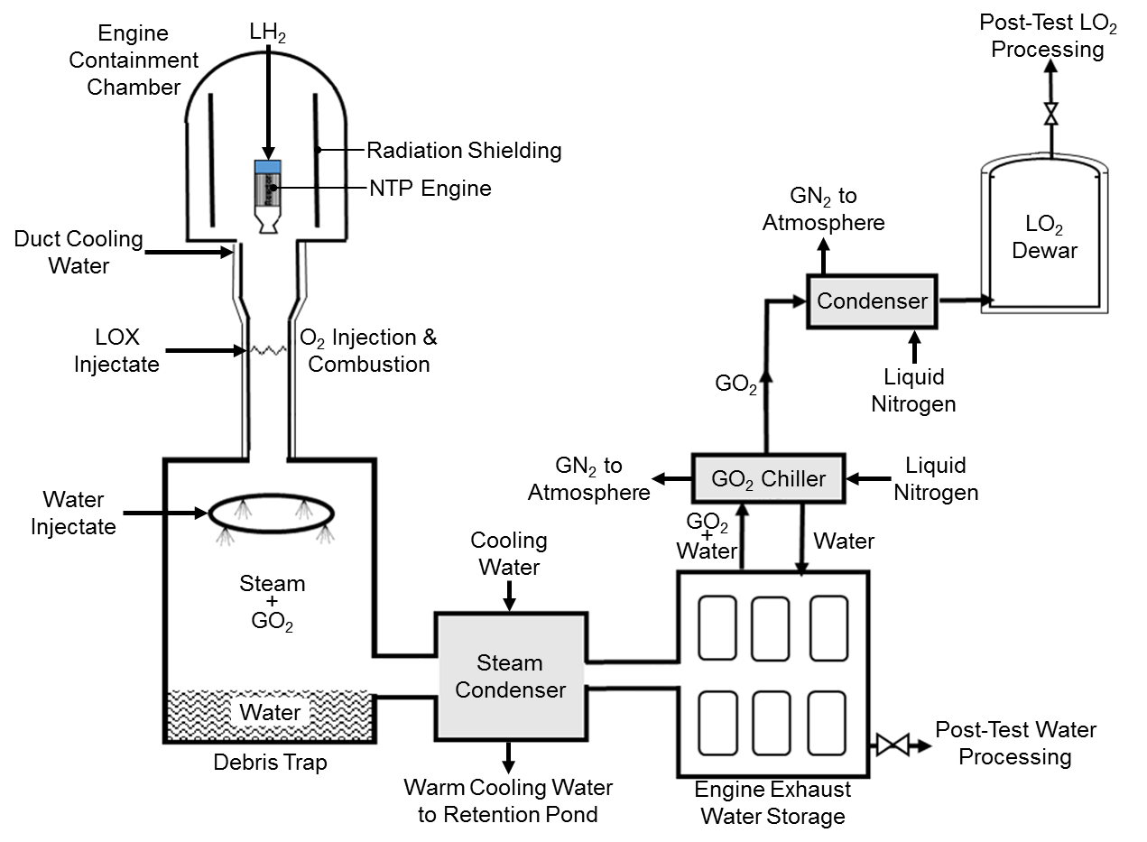
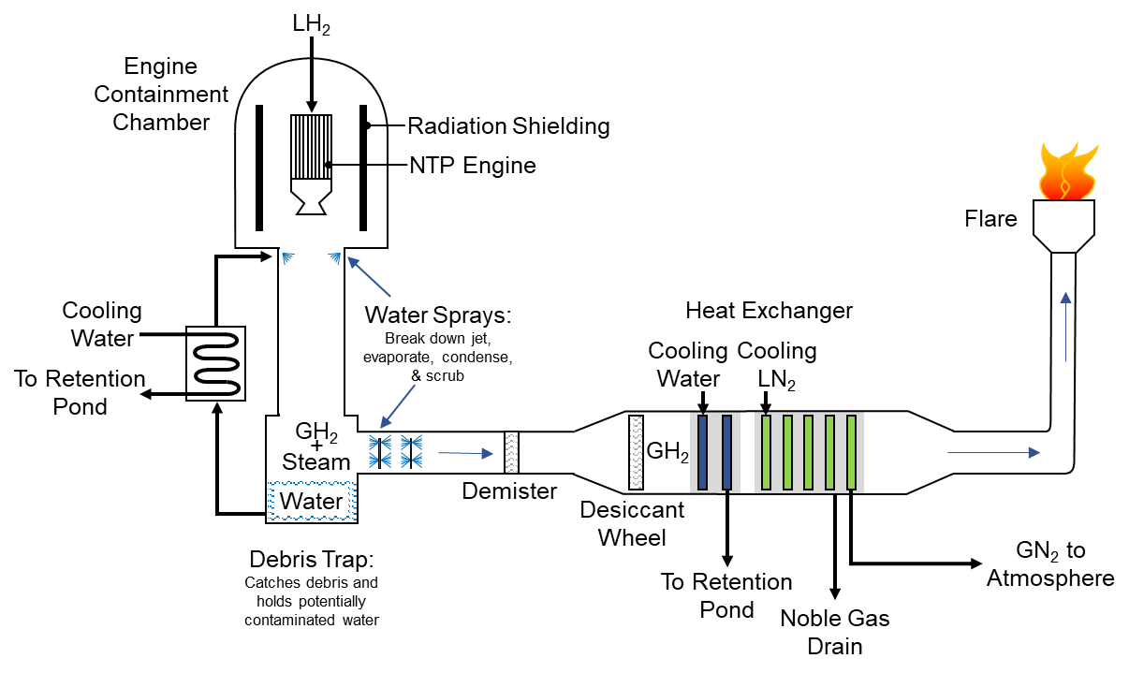
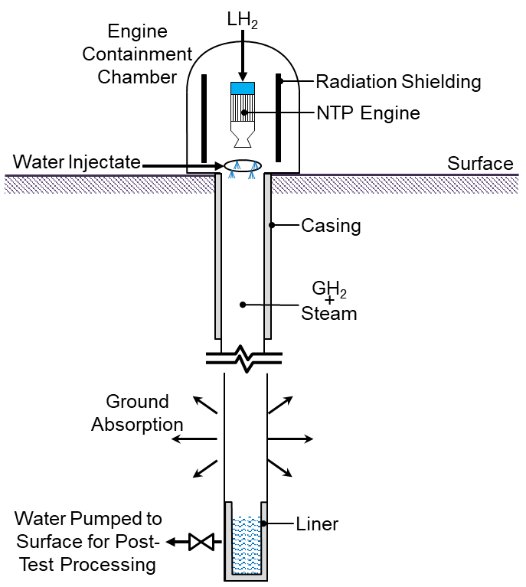
NTP Engine Exhaust Processing Concepts
Numerous concepts have been proposed to meet post-NERVA safety and regulatory requirements
Subsurface Active Filtration of Exhaust (SAFE) / Borehole
Rocket Exhaust Capture System (RECS)
Real-Time Processing
Numerous variations on concepts
MOAR SAFE: SAFE with exhaust flared until excessive fission product detected, then exhaust redirected to borehole
Various concepts utilizing tunnels for capture or containment

Slide 6
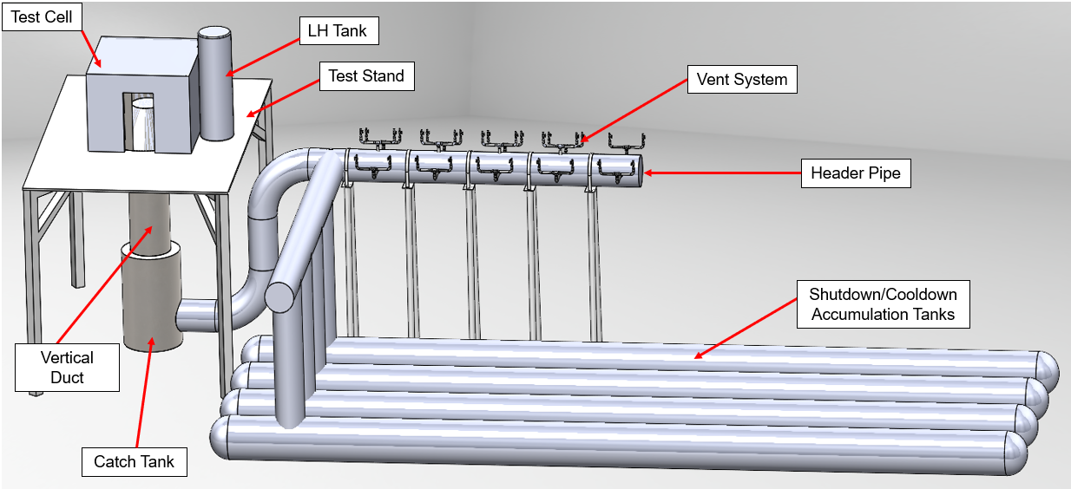
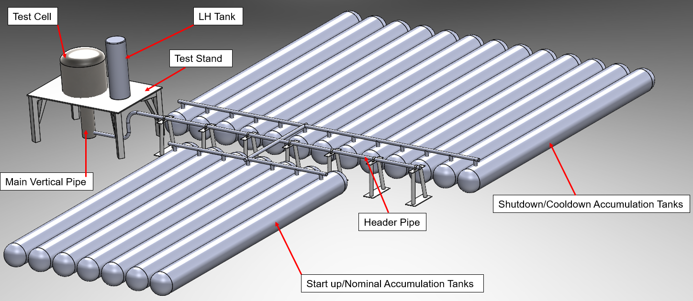
Ground Demonstration
Interest in cost reduction drove development of several ground demonstration concepts
A “Demonstration” would test a subscale engine at a significantly reduced duration and power/thrust level
Post-Run Capture System (PRCS) developed to capture exhaust at shut-down should levels of fission products be detected
  Provides cost reduction but has significant regulatory risk and limits testing
Test article assumptions were reconsidered resulting in the High-pressure Exhaust Capture System (HECS)
  Reduced cost with high likelihood of regulatory approval
  Test duration and power level/thrust limited by capture tank volume (still a demonstration)
Post-Run Capture System (PRCS)
 | RECS 25k | RT 25k | PRCS 12.5k | HECS 12.5k
Run duration | 1 hour | 1 hour | 5 minutes | 5 minutes
Backpressure | 20-psia | 20-psia | 20-psia | 300-psia
Nozzle area ratio | 8:1 | 8:1 | 8:1 | 2:1
Vertical duct length | 86-feet | 30-feet | 28-feet | 8-feet
Storage volume | 1.2M gal (water) 15k gal (LOX) | N/A | 600k-gallons | 1080k-gallons
High-pressure Exhaust Capture System (HECS)

Slide 7
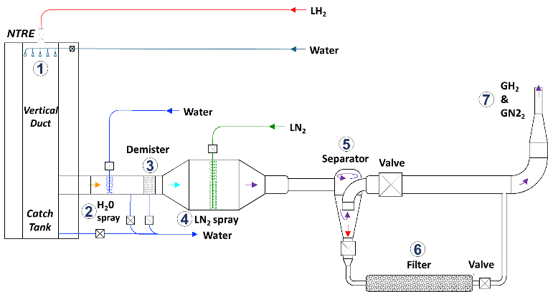
High-pressure Real-Time (HPRT) Exhaust Processing
High-pressure operations was extended to the Real-Time processing concept
Reconsideration of test article enabled conceptualization of a high-pressure (250 psi) “Real-Time” system
Conceptual/preliminary design work assessed several design changes from low-pressure (20 psi) real-time system
  Cryo heat exchangers replaced with cryo sprays (not feasible with low pressure system)
    Probable order of magnitude cost reduction
    Eliminates risk of coils icing
  Incorporate centrifugal separator (not feasible with low pressure system)
    Provides a more reliable separation of hydrogen gas and isotopes, and increases ease of collection
  Incorporate charcoal filter (enabled due to low flow rate coming out of separator)
    Provides defense-in-depth
    May be used without separator in low-flow operations
(Not to scale)
Low Pressure Real-Time Processing
High Pressure Real-Time Processing

Slide 8
System Overview
Exhaust is sprayed with water to cool.
Additional sprays further cool exhaust. Condensate and entrained particulate are drained and captured.
A demister is utilized collect, drain, and capture additional condensate and particulates.
Exhaust, fission products, and particulate are cooled with liquid nitrogen sprays.
A separators is used to extract solidified fission products and particulates which exit the bottom of the separator with small amount of exhaust. Most exhaust exits the top.
Fission products and particulates are adsorbed by a charcoal filter.
Exhaust from the top of the separator and filter recombines and vent to atmosphere.

Slide 9
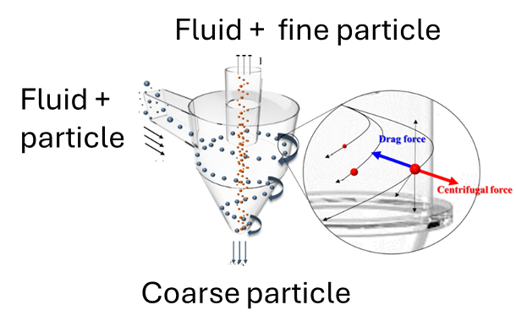
Component Description
HPRT can be implemented with existing technology and components available from multiple manufacturers
Centrifugal Separator
Separators are widely used in many industries
Swirls gas to cause heavier particles to separate and drop to the bottom for removal
  Isotopes collected in small cylinders
High efficiency
  >99% for particles >10 microns (0.0004 inches)
Wide range
  Typically, 10% to 115% of rated flow
Eliminates a 6-foot valve
Cannot be used in 20-psia, real-time system
Demister
Demisters are widely used in many industries
Reduces bulk water to reduce thermal load on sprays
Spray Nozzles
Spray Bar
Cooling gas with liquid sprays is a common practice
Eliminates concern for water ice to build up on HEX coils
More effective heat transfer than HEX
  Gains latent heat of vaporization (92 btu/lb for hydrogen!)
Order of magnitude cost reduction vs HEX
Increases total gas flow but still manageable
Tubing
Inlet

Slide 10
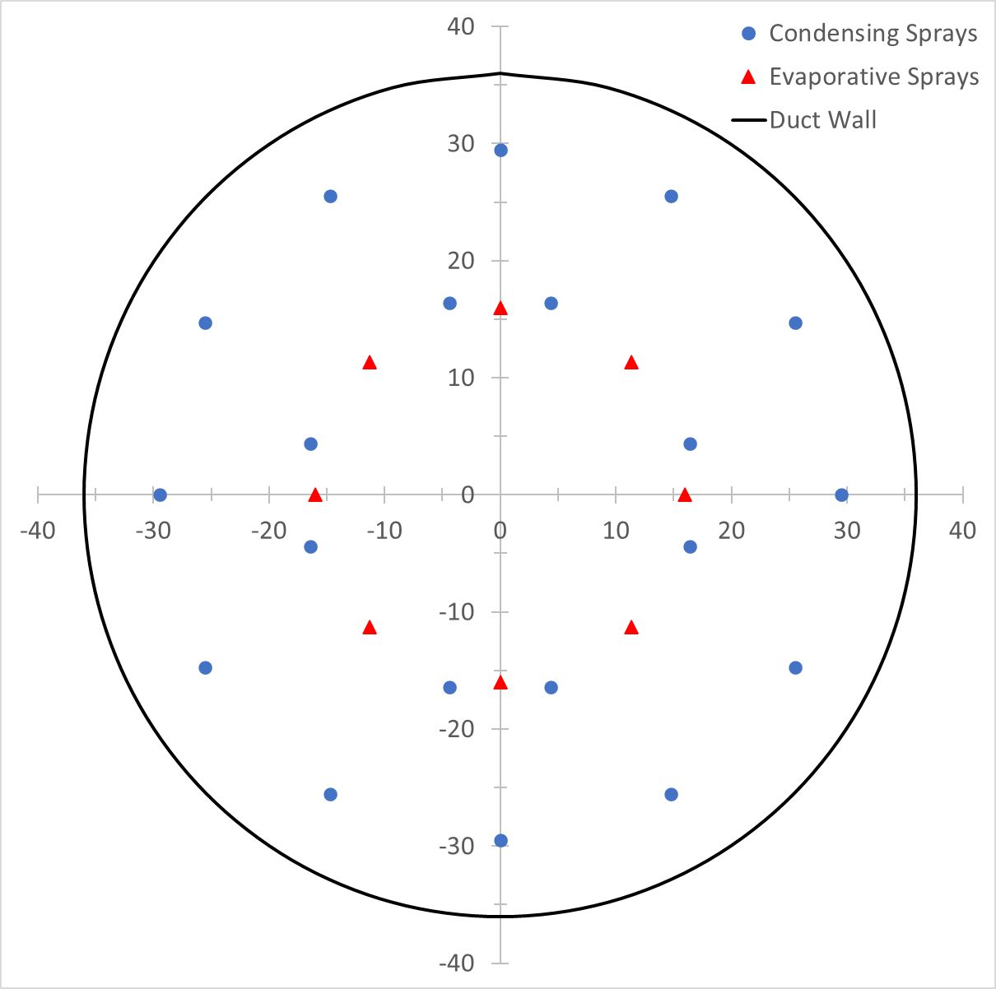
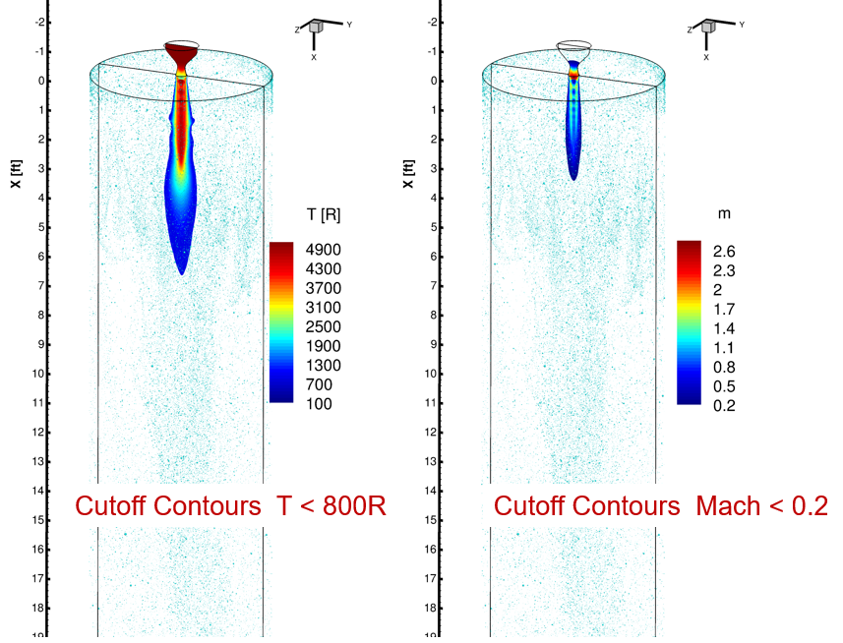

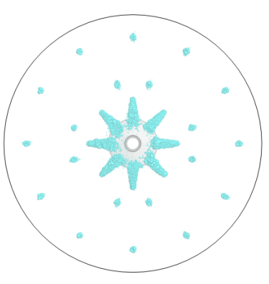
Computational Fluid Dynamics (CFD) Analysis
CFD analysis used to size ducting diameter and length, develop spray configurations
Spray configuration
12.5k lbf High-Pressure System Mach Number and Temperature CFD Assessment
CFD Visual of
Spray Patterns

Slide 11
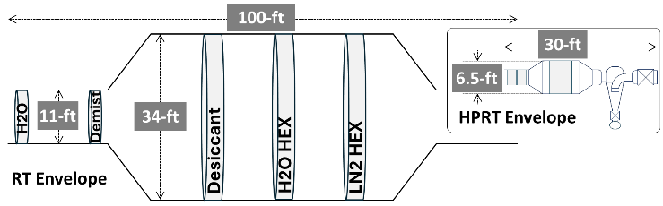
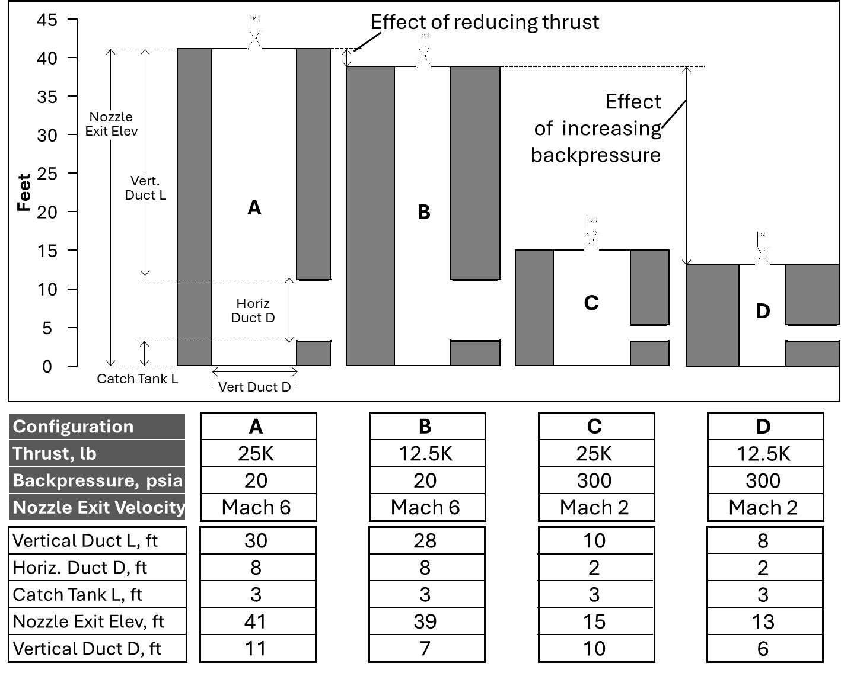
Concept Comparisons
CFD analysis indicates high-pressure significantly reduces test stand height and diameter (and therefore reduces cost)
  A smaller test stand also simplifies operations (installation/removal of engine, maintenance, etc.)
HPRT eliminates exhaust capture tanks required by RECS and HECS and reduces total water consumption
HPRT provides cost reduction and confidence in safety and regulatory approval
  Estimated to be ~25% or less than low-pressure real-time processing
Horizontal ducting sizing, low pressure vs
high-pressure Real-Time exhaust processing

Slide 12
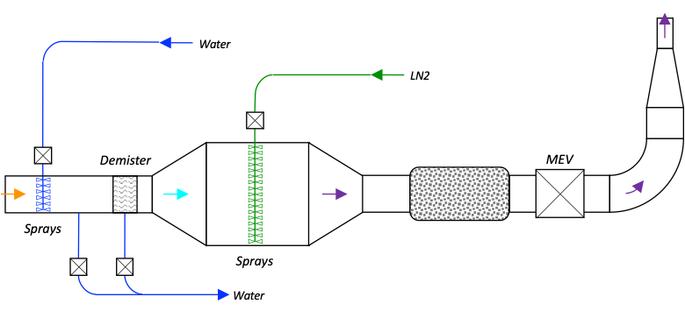
Design Alternatives
Lower flow rates used for “SMART” type testing may enable removal of separator
  Charcoal filters too large for engine testing
Final system configuration is being assessed
  Multiple, smaller exhaust system units could be used in place of a single, larger unit for redundancy (and defense-in-depth)
  Smaller units could be used to test fuel elements or lower thrust engines
Multi-system Configuration
Test Type | Exhaust Flowrate
Fuel Element | ~1-7 -lbm/s
12.5K-lbf Thrust Engine | ~14 -lbm/s
25K-lbf Thrust Engine | ~28 -lbm/s

Slide 13
Forward Work
Subscale demonstration
  Assess separators
  Efficiency of charcoal filters
Detailed design
  Build system power-balance model to define state-points and refine input and output rates
  Establish baseline configuration
  Mature CONOPS for transient operations
  Define test support systems
Cost and schedule estimate
Discussions with regulators

Slide 14
Summary
HPRT operates at a high-pressure and processes all exhaust in real-time
HPRT would support demonstration, development, and certification testing (may support SMART as well, further analysis required)
  Supports various thrust level (12.5k lbf and 25k lbf assessed)
  ~1 hour+ run duration
High-pressure eliminates RT desiccants and heat exchangers and enables use of sprays and separators
No technology development is required and components are available from many existing manufacturers
HPRT reduces water required for testing
A HPRT test facility is expected to cost ~25% or less than a low-pressure real-time system
Regulatory acceptance is likely but hazard analysis and discussion with regulators still required

Slide 15
Questions?
Lindsey Holmes
Lindsey.m.holmes@ama-inc.com
928-273-0553

Slide 16
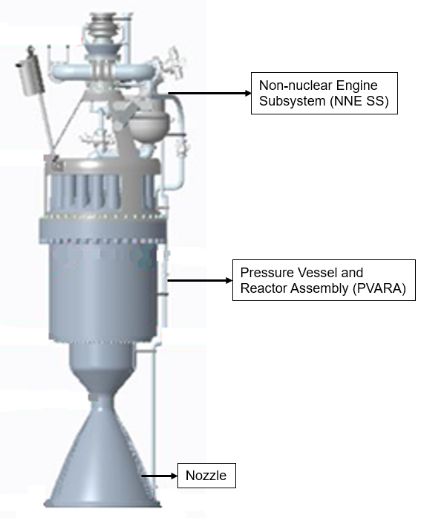
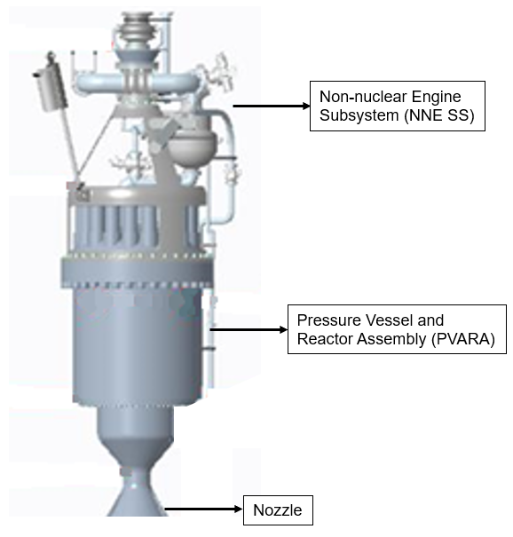
8:1 Nozzle are ratio for low-pressure exhaust systems
2:1 Nozzle are ratio for high-pressure ops

