Slide 1
OCI calibration: switching from GLAMR based to solar diffuser based
Gerhard Meister, 4/30/24

Slide 2
OCI calibration equation:
The OCI calibration equation converts Earth view dn to TOA radiance:
L_{t} = K1 · K2(t) · (1–K3·(T-T_{ref})) · K4(θ) · K5(dn) · Kp·dn
with
L_{t} = top-of-atmosphere radiance [W/(m² μm sr)]
K1 = absolute gain factor [W/(m² μm sr)/dn]
K2(t) = relative gain factor as a function of time t, normalized to first on-orbit data acquisition; unitless
K3 = temperature correction [(deg C) ⁻¹]
T = temperature at relevant locations [deg C]
T_{ref} = reference temperature [deg C]
θ = scan angle [deg]
K4 = response versus scan (RVS) ; unitless
K5 = nonlinearity factor ; unitless
Kp = polarization correction ; unitless
dn = dark-corrected instrument counts [dn]

Slide 3
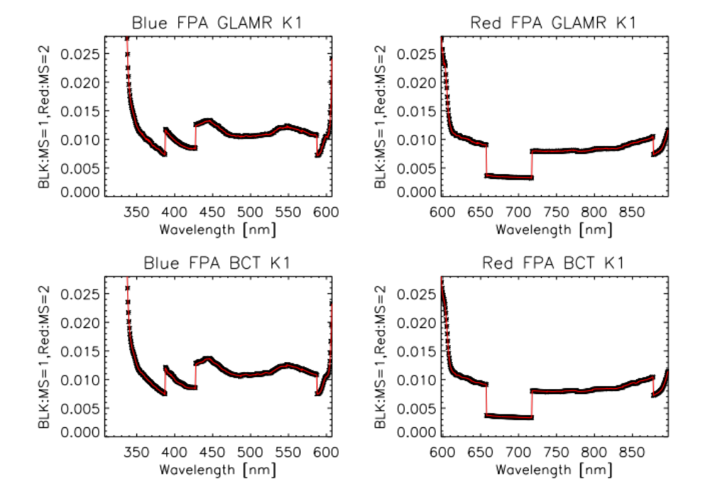

Slide 4
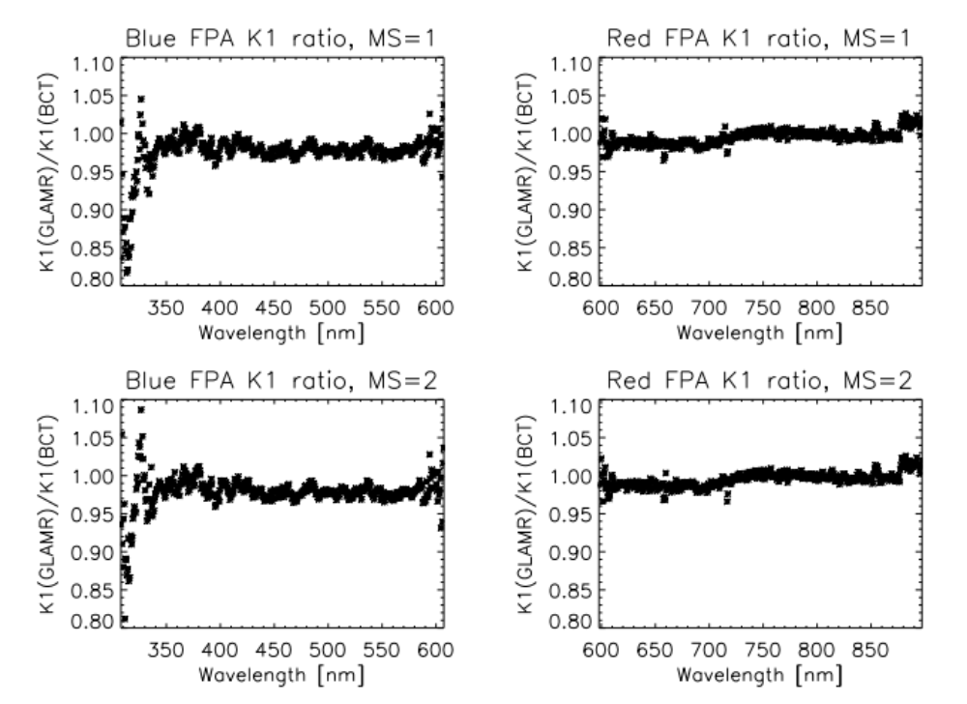

Slide 5
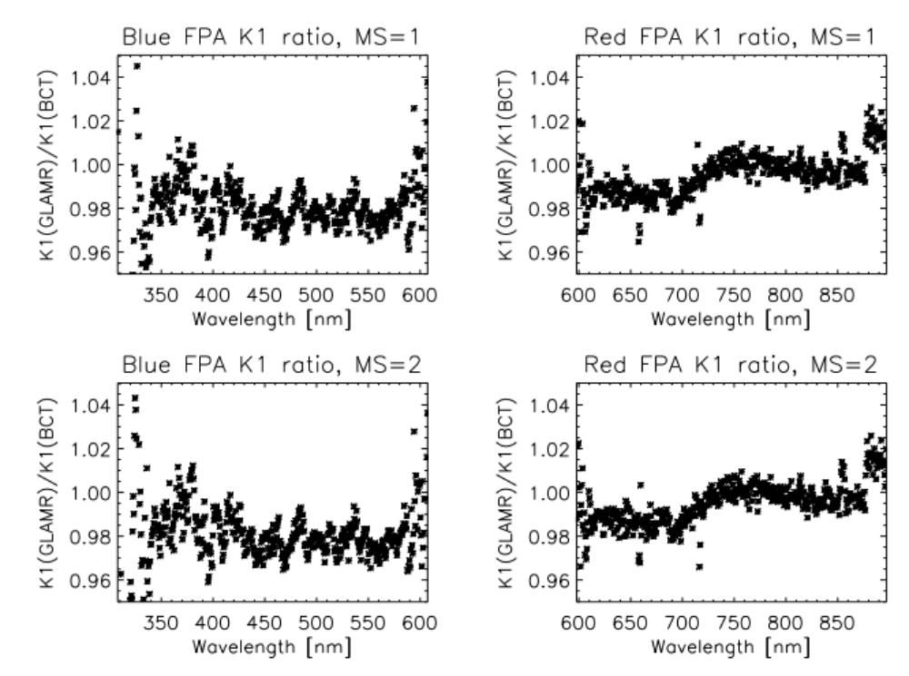

Slide 6
