Slide 1
Goddard Mission Services
Evolution Center “GMSEC”
Overview
May 7-9, 2024
James C. Hoffman
Contractor
NASA Goddard Space Flight Center
Software Engineering Division
James.c.hoffman@nasa.gov

Slide 2
GMSEC Background and Introduction
GMSEC was established in 2001 to coordinate ground and flight data systems development and services at GSFC. It has been operational since 2005.
  Goals
    Simplify development, integration and testing
    Facilitate technology infusion over time
    Support evolving development and operational concepts
    Allow for mix of heritage, COTS and new components while avoiding vendor lock-in
  Concepts
    Standardize interfaces – not components
    Provide a middleware infrastructure
    Allow users to choose – GMSEC does not decide which components are best or dictate which components a mission must use. It’s the mission/user’s choice!
  Some say it is like what Apple has done – created a simple interface standard and communications approach and let others develop compatible tools beyond anyone’s expectations.
Other NASA Centers and U.S. government space organizations are now recognizing the benefits of these simple concepts and are each working with NASA/GSFC’s GMSEC Team.

Slide 3
GMSEC Introduction
  The Goddard Mission Services Evolution Center (GMSEC) is a proven satellite mission operations center open architecture software framework for use at the mission, fleet, or enterprise level.
    The GMSEC team does not build ground systems. We build products that enable the mission ground
    system development teams to build their systems with the best possible mix of available mission
    support products and added GMSEC components in the areas of automation and situational
    awareness.
  We have had close collaboration with others to ensure its success and increase its value and broad use.
    • Command and Control system product vendors
    • Major integration contractors
    • Other NASA Centers
    • Other U.S. government space organizations
    • Space standards organizations

Slide 4
Observed GMSEC Benefits/Notes
Automation for cost and risk reduction is the #1 selling point
Most commercial command and control products are now GMSEC compatible – increasing choices for the missions
Significant reduction in integration time
Components added/upgraded without impacting existing system
Ideal for using multiple small distributed development teams/vendors
New concepts emerging for small independent components that integrate with the bus and provide immediate benefits
Standard message approach provides collaboration possibilities with other organizations
Enables new approach for maintenance of very long-term systems

Slide 5




GMSEC Architecture
GMSEC-Supported Middleware
GMSEC Support Suite
[not specific to mission ops centers]
Mission Ops Components
User/Mission Applications
Apache ActiveMQ
IBM WebSphere MQ
GMSEC Bolt
Apache Artemis
JMS Capable
Rabbit MQ (via AMQP)
ZeroMQ
Automation
Criteria Action Table
Extendable Message Utility
Notification – ANSR
Ground Equipment Monitoring
Event message reporting
Remote Access Tools
Message trap/dsp tool
Environmental Monitoring
Performance Monitoring Tools
GSFC AVAILABLE PRODUCTS
TLM/CMD
ASIST
ITOS
Archive and Data Access
DAT – Data Access Toolkit
ITPS
XTCE Support Suite
Countdown Clock
Make mission tools common where appropriate
GMSEC API and Middleware with security options
Comm Interface Components
MO Services Adapter
XTCE-based data generator
Simulators
Network front-ends
Event/Log Message Archive and Retrieval
GMSEC Heritage Tools
COTS Products
(dozens available – see
catalog)
OGA Products – see catalog
Config Files, Build/Dev Tools, Documentation
Msg Specification Doc,
Level 2 Addendums
  Operating Systems:
  Microsoft Windows 10,11 (64 bit),
  Red Hat 8 (64 bit); Ubuntu 20.04,
  Mac OSX (64-bit)
  Programming languages: C, C++, C#, Java, JavaScript,
  Ruby, Perl, Python (2.x and 3.x)

Slide 6
General GMSEC Discussion Topics
Why the GMSEC API and Software?
Today’s middleware messaging systems work great. In many cases, one can simply select a messaging product and have applications use it directly.
    But NASA teams have been burned by this approach before. We have missions that need to last 20+ years. We have had middleware messaging products be dead-ended due to corporate acquisitions, security failures, new business plans, cost changes, and new attempts at standardization.
    We also have needs that range from critical operations of billion-dollar spacecraft down to desktop product development. A high-end [costly] system may be best for one and a freeware capability may be best for the other.
    We need to be able to safely change middleware products over time.
But the GMSEC API can do a lot more
  Abstraction layer to allow different middleware products to run without changing the applications software.
  Translation to/from more efficient formats for transmission
  Security capabilities kept independent from the applications software
  Message validation at multiple levels
Organized into a single distributable, government-owned, contractor and vendor independent product, the GMSEC API software can be broadly and consistently applied throughout a large spacecraft control community.

Slide 7
GMSEC Framework
The GMSEC Framework consists of the GMSEC API, standardized messages, and an underlying middleware to interface with other components.
  Standard API available as NASA Open Source from: https://github.com/nasa/GMSEC_API
  “Secure API” is also available
    Note: API Open-Source does not contain modules to build CompatC2 wrappers.
  GMSEC Architecture Document and Message Specifications available upon request.
GMSEC supports a number of programming languages, COTS and GOTS middleware products, and operating systems.
  Programming languages: C, C++, C#, Java, NodeJs, Ruby, Perl, and Python (2.x & 3.x)
  Middleware Products: IBM WebSphere MQ, Apache ActiveMQ / Artemis, GMSEC Message Bus and Bolt, JMS Capability, RabbitMQ (via AMQP), ZeroMQ
  Operating Systems: Microsoft Windows 10 / 11 (64 bit), Red Hat 8 (64 bit); Mac OSX (64-bit)
Framework can be applied for an individual mission, for a constellation, for an enterprise, or for the communications between independent systems.

Slide 8
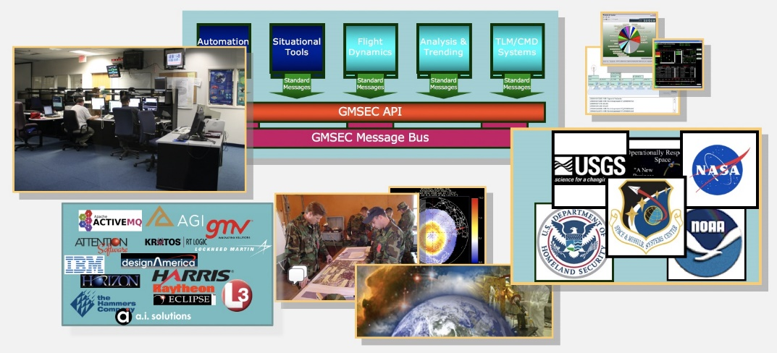
GMSEC Team’s Goals within NASA
To be NASA’s leader in open system approaches for satellite ground systems.
To promote the premise that each Center has their own capable experts and their own special heritage capabilities and operations approaches. Our goal is to enable the use of a mix of FOSS, GOTS, and COTS components from multiple sources to build the most appropriate system for each mission while enabling organizations and missions to utilize the best common capabilities.
To support GSFC’s goal to be the recognized developer for a select set of ground system components, including low-cost real-time telemetry, command, display, and analysis systems for mission operations.
To be a leader in working with the ground system industry and other government space organizations. By “working well with others”, GSFC can leverage the broad base of experience across these other groups and add to the advancement of the overall state-of-the-practice.

Slide 9
GMSEC as an OMG Standard
OMG Space Domain Task Force’s evolving model for mission operations data systems standardization that they call “architecture agnostic” or “platform independent”.
OMG-Hosted Architecture/Component Catalog – all entries are compliant with the message standards
Message Specification Standards [described in UML diagrams]
 | Reference Architecture A “GMSEC” | Reference Architecture B | Reference Architecture C
Infrastructure
Core S/W
Documentation
Government Products
Commercial Products
Open source products
OMG wants to maximize the use of CCSDS-based formats (i.e. NAV message content).
Reference Architectures and Components are not part of formal standards.
Derived XML
Derived JSON
Derived TBD
Reference Architecture examples could include NASA’s GMSEC or CCSDS’s MO-Services or some yet-to-be-created framework.

Slide 10
GMSEC Component overview
GMSEC provides a suite of general-purpose applications/components
GMSEC-Compliant
  Use the GMSEC API to connect to the middleware bus and publish/subscribe to messages
  Messages adhere to the C2MS specification
  Publish regular heartbeat messages to indicate health
  Log significant Events to the bus
Provide Various Functionalities
  Inspect messages
  Send email/text notifications
  React to events
  Monitor component health
  Validate message compliance
12+ Legacy components that are primarily in maintenance mode
  Bug Fixes
  Minor enhancements
New development
  GEMU – Allow users to create their own ‘applications’
  GSS OpenMCT – Access to messages from a web browser using OpenMCT framework
  GPTU – Provides Performance Assessment

Slide 11
GMSEC “GOTS” Components
Several years of operational use
  GREAT GMSEC Reusable Event Analysis Toolkit
  CAT GMSEC Automation. “Criteria Action Tool”
  ANSR GMSEC Paging Tool
  GEDAT GMSEC System Display
  SA GMSEC Node Interface. “System Agent”
  RAA GMSEC Room Alert Adapter
  GRASP GMSEC Remote Data Access Tool
  GSS GMSEC Services Suite (Web)
New Initiatives
  GEMU GMSEC Extendable Message Utility
  GSS 2.0 Utilizes NASA/Ames OpenMCT Framework
  XTCE telemetry and command database tools

Slide 12
Core GMSEC System Supports any Domain
Domain-Specific Components
Standard messages
Bridge
GMSEC Core
Message Bus (multiple choices) via API Software
Test
Tools
Monitoring
Tools
Situational
Tools
Automation
Tools
Compliance Tester
API automated test suite
Message recorder
Network Performance
Node Performance
Environment Sensing
Configuration Display
Integrated status and alarm displays
Paging System
Scripting Tools
Rule-based automation
Model-based automation
GMSEC’s common service tools bring immediate value to any system.

Slide 13



Example GMSEC System
TLM
Source
Automation
DB
Message archival / retrieval
Message Validation
Telemetry
And
Command
(e.g. ITOS)
GEMU
Message Util
EAGLE
CTS
GMSEC Message Bus
System Agent
GSS
CAT
ANSR
Domain
Specific
(User-developed
Components,
GMSEC
Adapters, etc.)
Node/network performance
Script execution
Application monitor
Web based telemetry viewer
Rule-based automation
Notifications

Slide 14


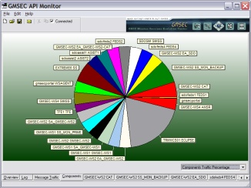


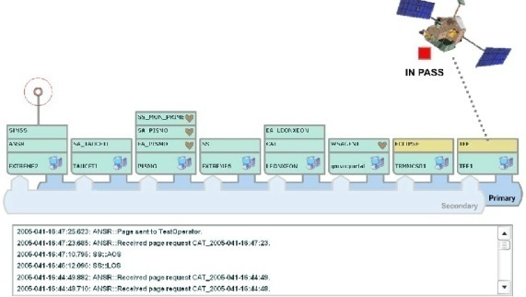
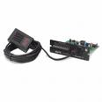




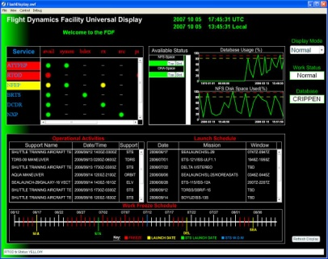


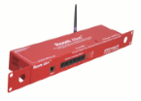
Examples of GMSEC’s Mission Benefits
The architecture enables new approaches for automation
  Can “listen” for status from all components → situational awareness
  Can direct actions of component → system-wide control
  Recognize status and respond → event-driven automation
GMSEC allows for monitoring of temperature, humidity, disk usage, etc. for GSFC control centers.
Tools show network performance, system configuration, and processing status.
GMSEC
EMC
Adapter
GMSEC Bus

Slide 15
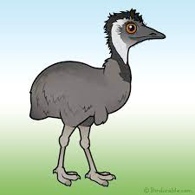
GEMU – Generic Extendable Messaging Utility
GEMU is a software component that is designed around the flow-based programming model
Computer programs are created with “flows” rather than lines of code
The flows are a network of black box functional nodes, which perform a specific task and have an input or an output or both
Connections are formed between nodes by connecting the output of one to the input of another
Different applications can be created by connecting different nodes in various orders to achieve different functionalities
Node A
Node B
Node C
Provides Functionality #1
Node D
Node B
Node E
Provides Functionality #2

Slide 16
GEMU – Domain-Specific Language (DSL)
Domain-Specific Language (DSL)
Custom syntax intended to make strands easy to write and easy to read
Tailored for handling GMSEC C2MS message objects
GEMU has a parser to ingest strand files, verify syntax, and produce run-time executable flows
DSL Example
source: bolt(subject: 'C2MS.*.*.*.*.*.MSG.LOG.>') |
filter: mixed(expression: ‘($error && $notgemu)',
error: 'severity >= 2’,
notgemu: 'component != "GEMU”’) |
filter: message(schema: ‘REQ.DIR’, DIRECTIVE-KEYWORD: ‘PAGE: Operators',
DIRECTIVE-STRING: ‘${message.message-text}',
RESPONSE: ‘false',
REQUEST-ID: ‘123) |
sink: bolt;

Slide 17
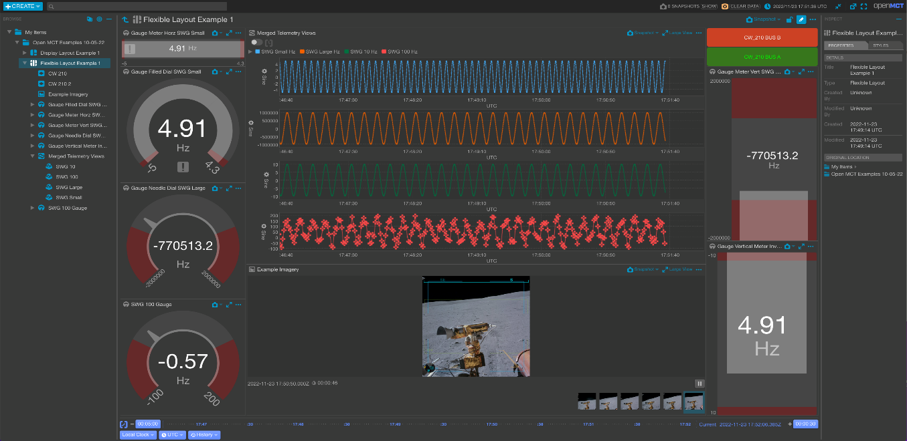
GSS OpenMCT Migration
The legacy GMSEC Services Suite (GSS) Web application is based on old AngularJS technology. When it came time to upgrade to a newer version, it was decided that rather than upgrading to a newer version of Angular, we would migrate to a whole new framework designed specifically for visualization of satellite telemetry.
Open MCT is a next-generation mission operations data visualization framework. It is based on the Vue 3 JavaScript framework and is open source. It is developed at NASA's Ames Research Center in collaboration with the Jet Propulsion Laboratory, and is being used by NASA for data analysis of spacecraft missions, as well as planning and operation of experimental rover systems

Slide 18
Additional GMSEC Information
Theresa Beech, Project Manager
NASA Goddard Space Flight Center
Code 583
Greenbelt, Maryland 20771
Theresa.w.beech@nasa.gov
Drew Parkinson, PDL
NASA Goddard Space Flight Center
Code 583
Greenbelt, Maryland 20771
Andrew.w.parkinson@nasa.gov
GMSEC tech support email: GMSEC-support@lists.nasa.gov
GMSEC Public Website: https://www.nasa.gov/goddard/gmsec/
  General, high level, copies of component fact sheets
GMSEC Developers Website: limited to NASA development team
  System documentation, developers toolkit, APIs, middleware, etc.
  Specific materials can be requested through e-mail requests.

Slide 19
Acronym List
API | Application Programming Interface |  | NASA | National Aeronautics and Space Administration
 |  |  | NOAA | National Oceanic and Atmospheric Administration
CCB | Configuration Control Board |  | XXX | Other government agency
CMMI | Capability Maturity Model Integrated |  | OGA | Other Government Agencies
COTS | Commercial Off The Shelf |  | OPS | Operations
CSTL | Communications, Standards, and Technology Laboratory |  | ORS | Operationally Responsive Space
Cx | Constellation |  | OS | Operating System
ESA | European Space Agency |  | OTF | Operations Technology Facility
ESTO | Earth Science Technology Office |  | PDL | Product Development Lead
FDF | Flight Dynamics Facility |  | RBSP | Radiation Belt Storm Probes
GLAST | Gamma-ray Large Area Space Telescope |  | RFP | Request for Proposal
GMSEC | Goddard Mission Services Evolution Center |  | SAMPEX | Solar Anomalous and Magnetospheric Particle Explorer
 |  |  | SDO | Solar Dynamics Observatory
GOTS | Government Off the Shelf |  | SMEX | Small Explorer
GPM | Global Precipitation Measurement |  | SOA | Service Oriented Architecture
GSFC | Goddard Space Flight Center |  | ST-5 | Space Technology 5
ISS | International Space Station |  | SWAS | Submillimeter Wave Astronomy Satellite
JSC | Johnson Space Center |  | TLM/CMD | Telemetry and Command
LRO | Lunar Reconnaissance Orbiter |  | TRACE | Transition Region and Coronal Explorer
MMOC | Multi-Mission Operations Center |  | TRL | Technology Readiness Level
MMS | Magnetospheric MultiScale |  | TRMM | Tropical Rainfall Mapping Mission
MOC | Mission Operation Center |  | USGS | United States Geological Survey
MSFC | Marshall Space Flight Center |  | XSD | XML Schema Definition

Slide 20
Mission Operations Automation with GMSEC:
A Presentation on Software Automation
May 7-9, 2024
NASA Goddard Space Flight Center
Software Engineering Division
GMSEC support email: GMSEC-support@lists.nasa.gov

Slide 21
GMSEC’s Mission Benefits
GMSEC General Information
GMSEC was established in 2001 to coordinate ground and flight data systems development and services at GSFC. It has been operational since 2005.
  Goals
  Simplify development, integration and testing
  Facilitate technology infusion over time
  Support evolving development and operational concepts
  Allow for mix of heritage, COTS and new components while avoiding vendor lock-in
  Concepts
  Standardize interfaces – not components
  Provide a middleware infrastructure
  Allow users to choose – GMSEC does not decide which components are best or dictate which components a mission must use. It’s the mission/user’s choice!
GMSEC Automation Benefits
The architecture enables new approaches for automation
  Can “listen” for status from all components → situational awareness
  Can direct actions of components in a standardized way → system-wide control
  Recognize status and respond → event-driven automation
GMSEC allows for monitoring of:
temperature, humidity, disk usage, etc. for GSFC control centers.
Spacecraft Telemetry
Visualization Tools show network performance, system configuration, processing status and spacecraft telemetry.
GMSEC
EMC
Adapter
GMSEC Bus

