Slide 1
2024 Space Situational Awareness
OPERATORS’ WORKSHOP
Earth Observing System (EOS)
Operational Collision Avoidance (OCA)
Experience
May 16, 2024
Bill Guit
NASA/GSFC
Aqua/Aura Mission Director
Ian Crum
EOS Collision Avoidance Engineer

Slide 2
Topics
Operational Collision Avoidance (OCA) Background
Overview of EOS Collision Avoidance Process
Aura versus CHEOPS High Interest Event (HIE)
Observations/Lessons Learned
Questions
Backup Slides
  Earth Observing System (EOS) – Terra, Aqua and Aura Background
  Earth Science Mission Operations (ESMO) Collision Risk Management System (CRMS) Operations Concept
  CHEOPS Background
  Aura/CHEOPS CRMS Event Details
  Timeline of Activities

Slide 3
Background
NASA’s Earth Science Mission Operations (ESMO) Project’s experience with Operational Collision Avoidance (OCA) began in 2002.
ESMO Collision Risk Management (CRM) process has been supported by two systems.
  NASA Conjunction Assessment and Risk Analysis (CARA) Team
  SpaceNav Collision Risk Management System (CRMS) in 2016
ESMO and CARA worked together to Devolve CARA Conjunction Analysis (CA) operations capabilities into the EOS Control Center. Mission Operations CA (MOCA).
  ESMO Pilot Program with CARA – Completed 9/25/2019
    CARA continues to provide shadow support if needed
ESMO MOCA CONOPS began in 2019.
  Ref: Earth Science Mission Operations (ESMO) Conjunction Assessment (MOCA) Concept of Operations (CONOPS)
  Transitioned to SpaceNav Webservices in 2023

Slide 4
Overview of
EOS Collision Avoidance Process
Automated process that has evolved and been significantly improved since it began in early 2005.
7-day predicted O/O ephemeris (with covariance) delivered 3-times per day for Conjunction Assessment by the 18th Space Defense Squadron.
  EOS missions no longer perform routine orbit maintenance maneuvers but will plan and execute collision avoidance maneuvers as necessary
Maneuver planning thresholds have evolved over time.
  HIE classification changed on 4/20/2023 to only consider events that are greater than 5e-5 Pc and 2 days to TCA
  NASA requirement to maneuver at 1.0e-04
All potential avoidance maneuvers receive conjunction assessment screening prior to execution.
  Command Authorization Meeting (CAM) prior to execution

Slide 5
Aura vs. CHEOPS

Slide 6
Aura vs. CHEOPS
Credit: SpaceNav
A High Interest Event (HIE) between EOS Aura and the maneuverable spacecraft CHEOPS (44874) was identified through the nominal operational process on 12/18/2023, TCA minus 4.5-days.
  TCA of interest on 12/23/2023 at 11:20:20 UTC
CHEOPS (CHaracterizing ExOPlanet Satellite) is a small, well-tracked European Space Agency (ESA) payload.
  8 different SSN stations were tracking CHEOPS
ESA Collision Risk Assessment Support team reached-out to NASA CARA Team on 12/19/2023 indicating that they also observe the HIE with TCA in about 4 days.
  ESA suggested they proceed with their orbit maintenance maneuver as planned (TCA 3.5 days post planned maneuver)
  Maneuver planned for: 12/20/2023 at 05:15:10 UTC
The ESMO team maintained constant coordination with ESA/ESOC Space Debris Office (OPS-SD).
  Emails and various data sets were exchanged and analyzed
  Detailed timeline in the backup slides
Notes:
3

Slide 7
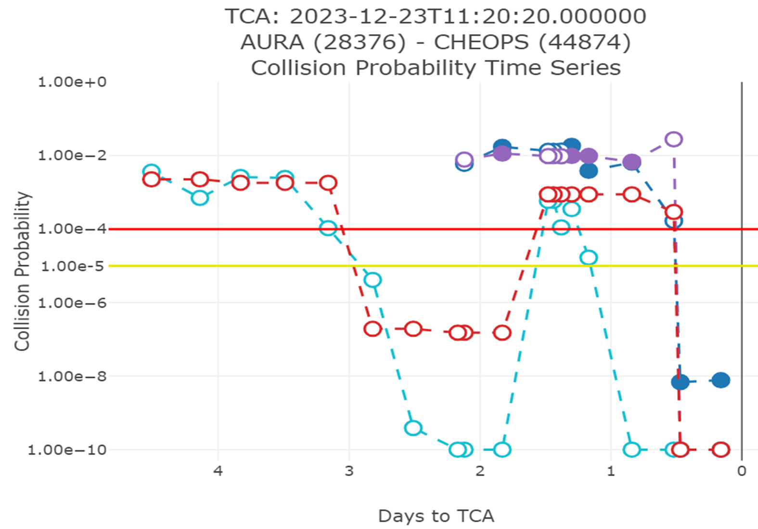
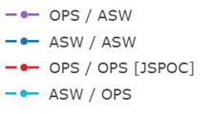
Initial notification
Credit: SpaceNav
7

Slide 8
CHEOPS maneuver execution
Initial notification
Credit: SpaceNav
8

Slide 9
New ASW data showed high risk
CHEOPS O/O data low risk
CHEOPS maneuver execution
Initial notification
Credit: SpaceNav
9

Slide 10
New ASW data showed high risk
CHEOPS O/O data low risk
CHEOPS maneuver execution
Initial notification
FOT decides for Aura to maneuver
Credit: SpaceNav
10

Slide 11
New ASW data showed high risk
CHEOPS O/O data low risk
CHEOPS maneuver execution
Aura maneuver execution
Initial notification
FOT decides for Aura to maneuver
FOT holds CAM and approves RMM
Credit: SpaceNav
11

Slide 12
Observations
Every High Interest Event (HIE) is unique.
HIEs with other operational missions are rare.
EOS experience with conjunctions with other operational missions since starting to using CRMS.
  12/05/2020: Terra/42901 (Venus)
  01/13/2023: Aqua/53757 (Centispace-1 S3)
  12/23/2023: Aura/44874 (CHEOPS)
  04/24/2024: Aura/39019 (Pleiades 1B)
  04/28/2024: Aqua/57958 (Yaogan-33 04)
Lot of experience with passing and crossing conjunctions with ESC/A-Train partner missions.
All previous HIE conjunctions with operational missions were successfully managed by the multiple teams involved – Thank You.

Slide 13
Lessons Learned
Identify stakeholders early and include all parties in the HIE maneuver planning communications.
Communicate early and often.
  Frequent communication is essential
  Consider operational cadence and time difference
Written communication preferred unless short turn-around necessitates verbal (meeting/telecon/phone) conversation.
Establish some common ground for delivery/exchange of ephemeris, miss distances information and maneuver plans.

Slide 14
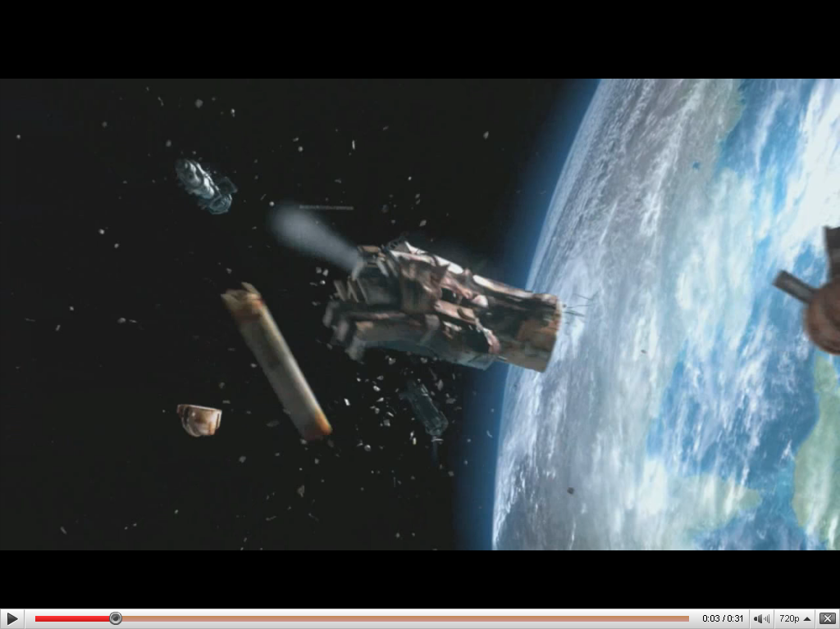
Thank you for your
time and attention
Questions
Source 2010 USAF Television Commercial

Slide 15
Abbreviations/Acronyms
List
  ASW – Astrodynamics Workstation
  CA – Close Approach
  CA – Collision Avoidance
  CA – Conjunction Assessment
  CAE – FOT Collision Avoidance Engineer
  CAM – Command Authorization Meeting
  CARA – Conjunction Assessment Risk Analysis
  CRMS – Collision Risk Management System
  DAM – Debris Avoidance Maneuver
  DMUM – Drag Make-up Maneuver
  EOS – Earth Observing System
  ESC – Earth Science Constellation
  ESMO – Earth Science Mission Operations
  FDS – Flight Dynamics System
  FOT – Flight Operations Team
  GMT – Greenwich Mean Time
  GSFC – Goddard Space Flight Center
  HIE – High Interest Event
  HQ – Headquarters
  km – kilometer
  m – meter
  m/s – Meters/second
  MLT – Mean Local Time
  MOCA – Mission Operations CA
  NASA – National Aeronautics & Space Administration
  Pc – Probability of Collision
  RIC – Radial, In-track, Cross-Track
  RMM – Risk Mitigation Maneuver
  s or sec – second
  TBD – To Be Determined
  TCA – Time of Closest Approach
  UTC – Coordinated Universal Time

Slide 16
Backup
Slides

Slide 17
EOS
Background

Slide 18
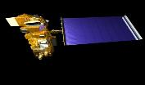
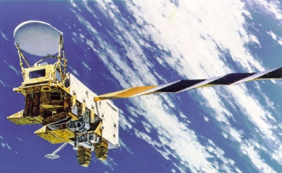
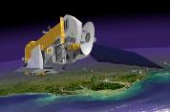
NASA’s Earth Observing System
(EOS)
AQUA
TERRA
AURA
As of 5/1/2024 | Terra | Aqua | Aura
Launch Date | 12/18/1999 | 5/4/2002 | 7/15/2004
Current Orbit # | 129,608 | 116,981 | 105,433
Duration | 24y 4m 13d | 21y 11m 27d | 19y 9m 16d
HIEs (5/1/2024) | 299 | 394 | 373
DAMs (5/1/2024) | 26 (2/20/2024) | 13 (11/10/2022) | 19 (2/11/2024)
Combined 66+ years of orbital debris collision-free safe operations

Slide 19
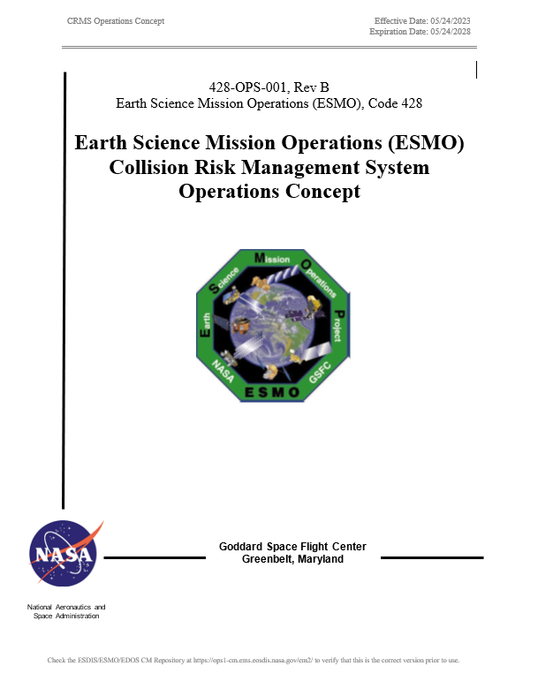
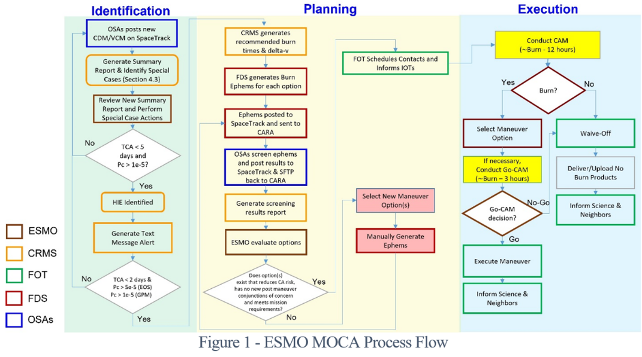
ESMO CRMS Operations Concept

Slide 20
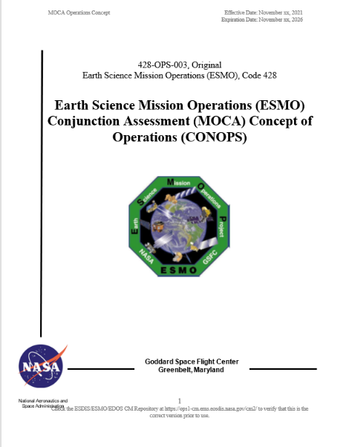
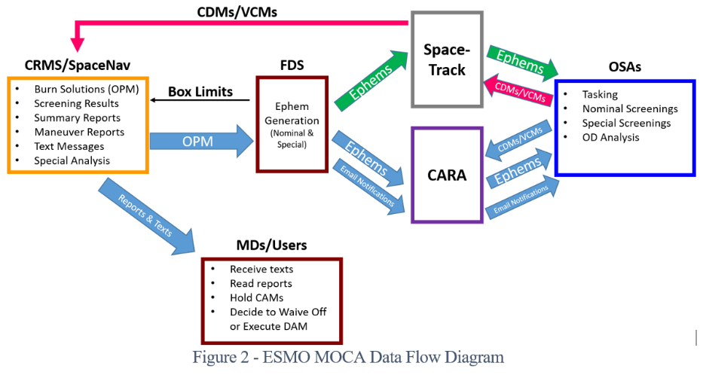
ESMO MOCA CONOPS

Slide 21
CHEOPS
Background

Slide 22
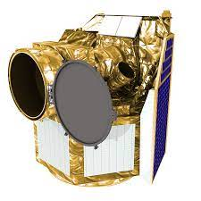
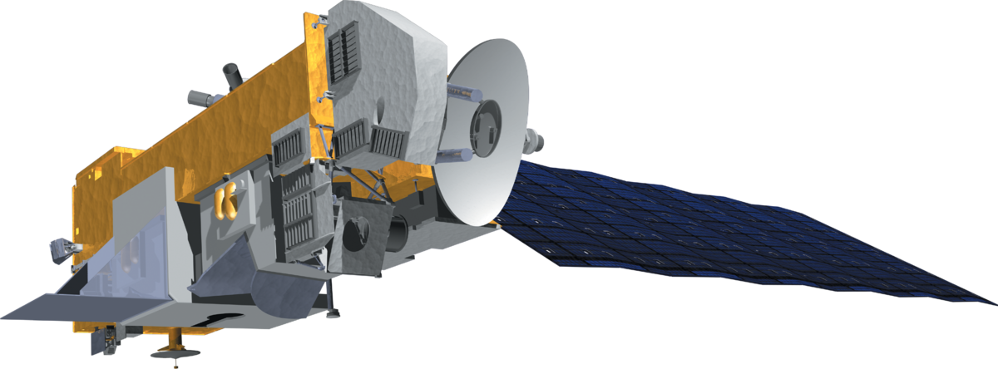
CHEOPS & EOS-Aura
https://cheops.unibe.ch/
https://www.wikidata.org/wiki/Q23649

Slide 23
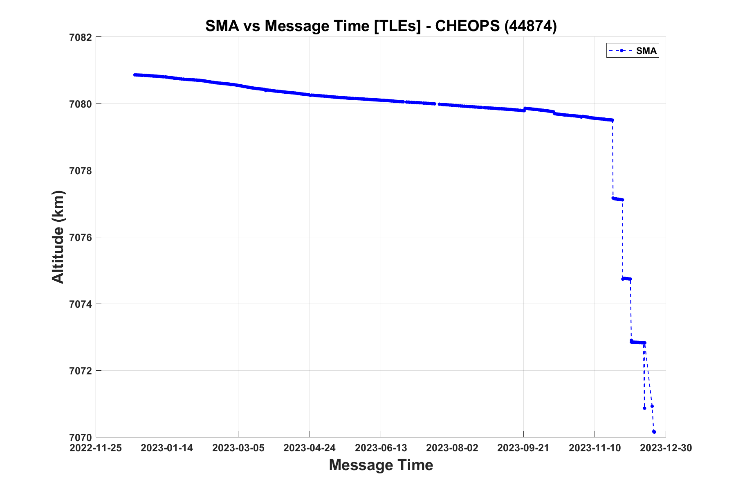
CHEOPS Maneuver History
Credit: SpaceNav

Slide 24
CRMS
Data Set

Slide 25
CRMS Data Set
Credit: SpaceNav
Days to TCA | Primary Object & RIC Uncertainties [m] | Secondary Object & RIC Uncertainties [m] | Primary Object Ephem Name | Screening Epoch | TCA [UTC] | Pc | Total Miss [m] | Radial Miss (UNC) [m] | In- Track Miss (UNC) [m] | Cross- Track Miss (UNC) [m] | R-vel Angle | Tracking Latency - Secondary Object
0.5 | AURA (28376) 15.6m [4 / 207 / 5] | CHEOPS (44874) (Maneuverable) 1.2m [6 / 79 / 11] | Aura SPECIAL MANEUVER ASW | 2023-12-22 22:13:13 | 2023-12-23 11:20:20 | Post-burn Screening Results 9.93e-13 1:1T | 735 | 15 (7.5) | 400 (209.8) | 616 (73.4) | 12557 114.0 | 9 hours 12-22 13:04 5A 12-22 22:33
0.5 | AURA (28376) 15.6m [5 / 70 / 3] | CHEOPS (44874) (Maneuverable) 1.2m [5 / 67 / 6] | ASW ASW | 2023-12-22 23:58:33 | 2023-12-23 11:20:20 | 6.86e-09 1:146M | 316 | 12 (7.1) | -175 (75.3) | -263 (61.1) | 12556 114.0 | 2 hours 12-22 21:29 5A 12-23 00:45
0.8 | AURA (28376) 15.6m [5 / 180 / 3] | CHEOPS (44874) (Maneuverable) 1.2m [6 / 111 / 11] | ASW ASW | 2023-12-22 15:11:24 | 2023-12-23 11:20:20 | 6.43e-03 1:156 | 266 | 14 (8.4) | -145 (185.8) | -222 (102.2) | 12557 114.0 | 2 hours 12-22 13:04 5A 12-22 16:30
1.1 | AURA (28376) 15.6m [6 / 255 / 3] | CHEOPS (44874) (Maneuverable) 1.2m [8 / 131 / 13] | ASW ASW | 2023-12-22 07:09:34 | 2023-12-23 11:20:20 | 3.86e-03 1:259 | 370 | 17 (10.3) | -202 (260.3) | -309 (120.1) | 12557 114.0 | 4 hours 12-22 03:26 5A 12-22 08:15
1.4 | AURA (28376) 15.6m [6 / 363 / 3] | CHEOPS (44874) (Maneuverable) 1.2m [8 / 180 / 12] | ASW ASW | 2023-12-21 23:50:27 | 2023-12-23 11:20:20 | 1.34e-02 1:75 | 337 | 13 (9.7) | -182 (370.1) | -284 (164.9) | 12557 114.0 | 3 hours 12-21 20:51 5A 12-22 01:44
1.8 | AURA (28376) 15.6m [6 / 553 / 3] | CHEOPS (44874) (Maneuverable) 1.2m [9 / 250 / 13] | ASW ASW | 2023-12-21 15:22:08 | 2023-12-23 11:20:20 | 1.73e-02 1:58 | 322 | 11 (10.5) | -177 (562.4) | -269 (229.2) | 12557 114.0 | 3 hours 12-21 12:23 5A 12-21 17:20
2.1 | AURA (28376) 15.6m [7 / 752 / 3] | CHEOPS (44874) (Maneuverable) 1.2m [18 / 998 / 16] | ASW ASW | 2023-12-21 08:31:05 | 2023-12-23 11:20:20 | 5.96e-03 1:168 | 521 | 11 (19.1) | -282 (853.6) | -438 (913.1) | 12557 114.0 | 17 hours 12-20 15:06 5A 12-21 08:59

Slide 26
Timeline of Activities
CHEOPS timeline | 12/23/2023 11:20
(local ET) | (UTC) | Days to TCA | Comment
12/19/2023 11:31 | 12/19/2023 16:31 | 3.78 | notification of event from CARA
12/19/2023 12:32 | 12/19/2023 17:32 | 3.74 | notification from CRASS team with ephems
12/19/2023 17:51 | 12/19/2023 22:51 | 3.52 | response from NASA with our operational maneuver exec. Threshold, request for their HBR and covariance in ephem
12/20/2023 00:15 | 12/20/2023 05:15 | 3.25 | CHEOPS performs maneuver
12/20/2023 10:04 | 12/20/2023 15:04 | 2.84 | response from CRASS, gave HBR of 1.16m, and will look into covariance, their burn threshold is 2e-5
12/20/2023 20:00 | 12/21/2023 01:00 | 2.43 | SN updated CHEOPS HBR in CRMS to 1.2m
12/21/2023 03:48 | 12/21/2023 08:48 | 2.11 | nominal report data comes in with CHEOPS still high-risk E-3 post-maneuver.
12/21/2023 16:16 | 12/21/2023 21:16 | 1.59 | NASA email to CRASS indicating the presence of high risk in E-4/E-3
12/21/2023 17:22 | 12/21/2023 22:22 | 1.54 | CRASS response that they do not evaluate a high-risk event, instead see E-12 risk level
12/21/2023 20:53 | 12/22/2023 01:53 | 1.39 | CA engineer recommend planning for maneuver due to high risk (E-2) and CRASS team not planning maneuver since they don't see high risk
12/21/2023 21:45 | 12/22/2023 02:45 | 1.36 | NASA email to CRASS, recommend that Aura perform a maneuver to eliminate our risk, we request that they do not maneuver and stand down
12/22/2023 08:29 | 12/22/2023 13:29 | 0.91 | CA Engineer created manual maneuver plan, with 1.4cm/s burn option shortly before TCA
12/22/2023 10:39 | 12/22/2023 15:39 | 0.82 | CA Engineer re-created manual maneuver plan with 1.75cm/s burn at 10:07pm (local) to better suit FOT operations
12/22/2023 14:33 | 12/22/2023 19:33 | 0.66 | NASA response to CRASS, including our burn ephems for 1.75 and 2.0 cm/s burn options
12/22/2023 16:00 | 12/22/2023 21:00 | 0.60 | FOT held CAM and approved maneuver with 2.0cm/s burn option at 12/23/2023 03:07z
12/22/2023 18:30 | 12/22/2023 23:30 | 0.49 | Nominal evening report, still showed high risk E-2
12/22/2023 20:47 | 12/23/2023 01:47 | 0.40 | received new update with nominal report that showed risk dropped off to E-9. FOT was already on console and had setup for maneuver execution. MD decided to continue with burn as planned
12/22/2023 22:07 | 12/23/2023 03:07 | 0.34 | Aura maneuver successfully executed

