Slide 1
Lensless Particle Image Velocimetry
Dr. Jenna Eppink and Dr. Chung-sheng Yao
Flow Physics and Control Branch, NASA Langley Research Center
Experiments in Fluids Seminar Series, May 7, 2024

Slide 2
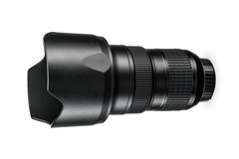
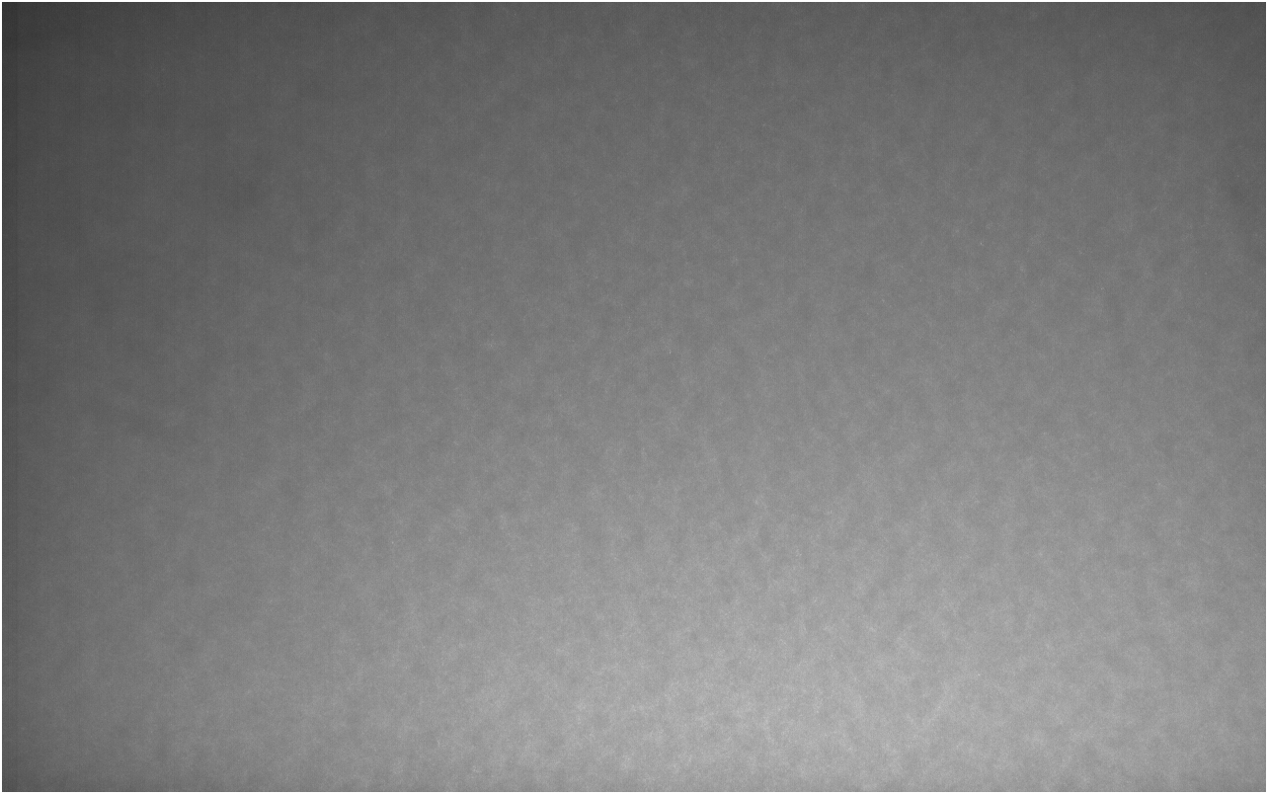
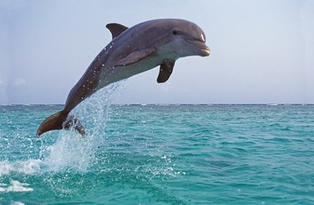
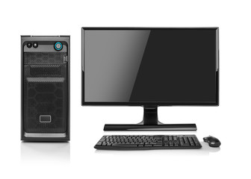

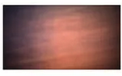
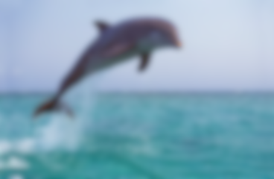
Lensless Imaging
Instead of a lens, some type of optical modulator (coded amplitude mask, diffuser) is placed in between the scene and the sensor, usually very close to the sensor.
Current applications: microscopy, wearables, implantables, photography, and in vivo imaging
Lens
Sensor
Image
Conventional
Lensless
Mask
Sensor
Raw Image
Computer Algorithm
Reconstruction

Slide 3
Towards Lensless PIV
Why Lensless PIV?
  Small size of image sensors allows for potential to embed sensors in wind tunnel models for measurements very close to the surface.
    Not meant to replace standard PIV setup for larger working distances.
  The masks can be made from very inexpensive materials, and are very versatile.
  3D measurements are possible with a single camera.
Existing Lensless/Single-sensor 3D PIV Concepts
  Astigmatism PIV¹ – a controlled astigmatism is introduced into the optical system to deform the particle image based on its depth position.
  Structured/colored light PTV – Uses structured or colored light to distinguish particle depth²⁻³.
  Holographic PIV⁴ – records 3D information of tracer particles in fluid volume by capturing phase information of light waves scattered off the particles.
¹Cierpka, C., and Christian J. Kähler. "Particle imaging techniques for volumetric three-component (3D3C) velocity measurements in microfluidics." Journal of visualization 15 (2012): 1-31.
²Aguirre-Pablo, et al. "Single-camera 3D PTV using particle intensities and structured light." Experiments in Fluids 60 (2019): 1-13.
³ Xiong, Jinhui, et al. "Rainbow particle imaging velocimetry for dense 3D fluid velocity imaging." ACM Transactions on Graphics (TOG) 36, no. 4 (2017): 1-14.
⁴Hinsch, Klaus D. "Holographic particle image velocimetry." Measurement Science and Technology 13, no. 7 (2002): R61.

Slide 4
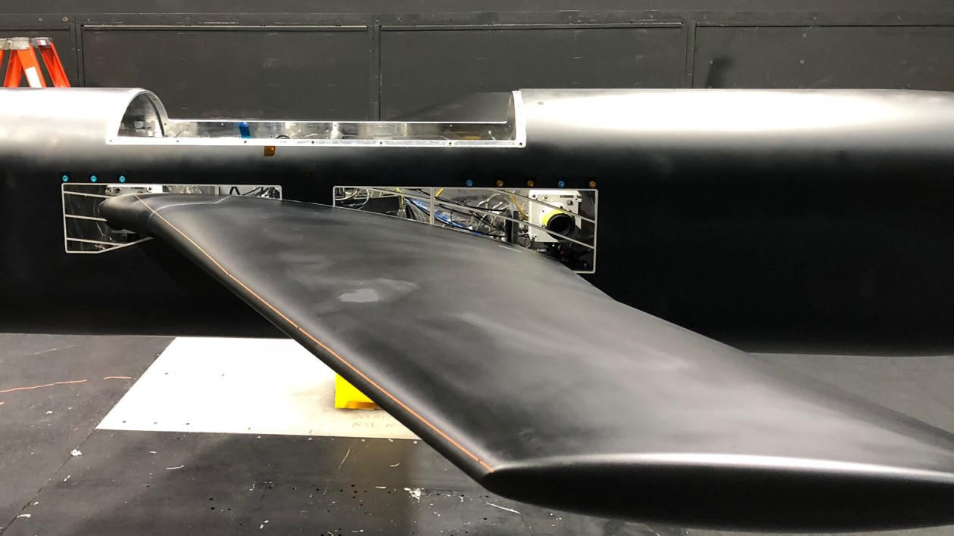
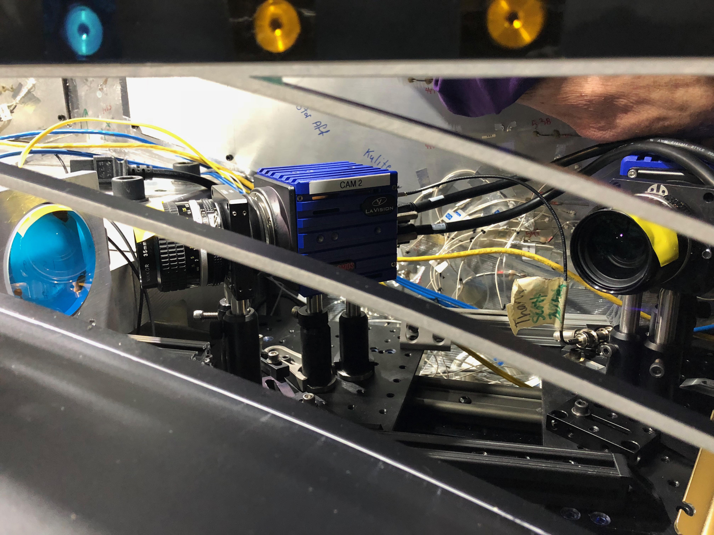
Example Application– Juncture Flow Test in the NASA Langley 14’x22’ Subsonic Tunnel
Successful test to study wing-body juncture flow separation.
Long working distances make external near-body measurements difficult.
Internal optics require significant amounts of space and introduce limitations on system.
What if….we could embed sensors in the wing surface (or fuselage)?
Juncture Flow Model
Flow Direction
Stereo Camera Setup
Source: NASA
Source: NASA

Slide 5
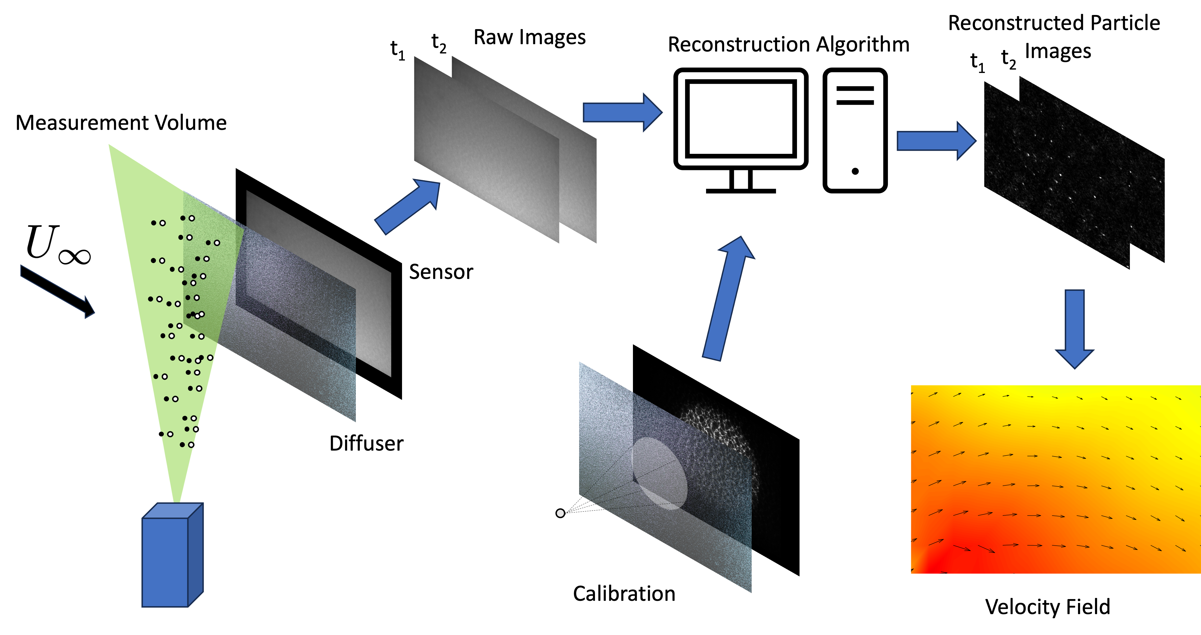
Lensless PIV

Slide 6
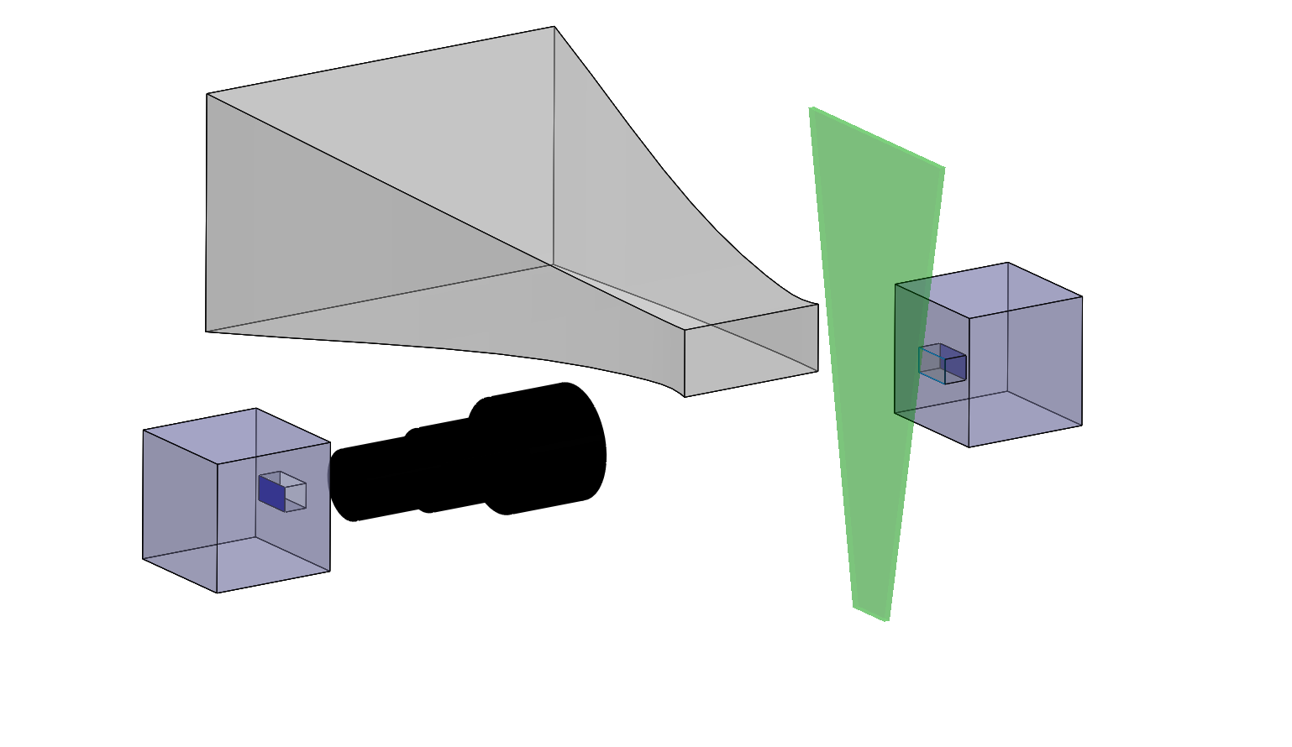
Schematic of Experimental LLPIV Setup
LLPIV
1:2 magnification
TRPIV Camera
Sensor
19 mm
U∞
Mask
y
x
z
9.5 mm
Laser Beam
(a) Schematic of Lensless PIV and traditional PIV experimental setup
(b) Sketch of Lensless Camera setup

Slide 7
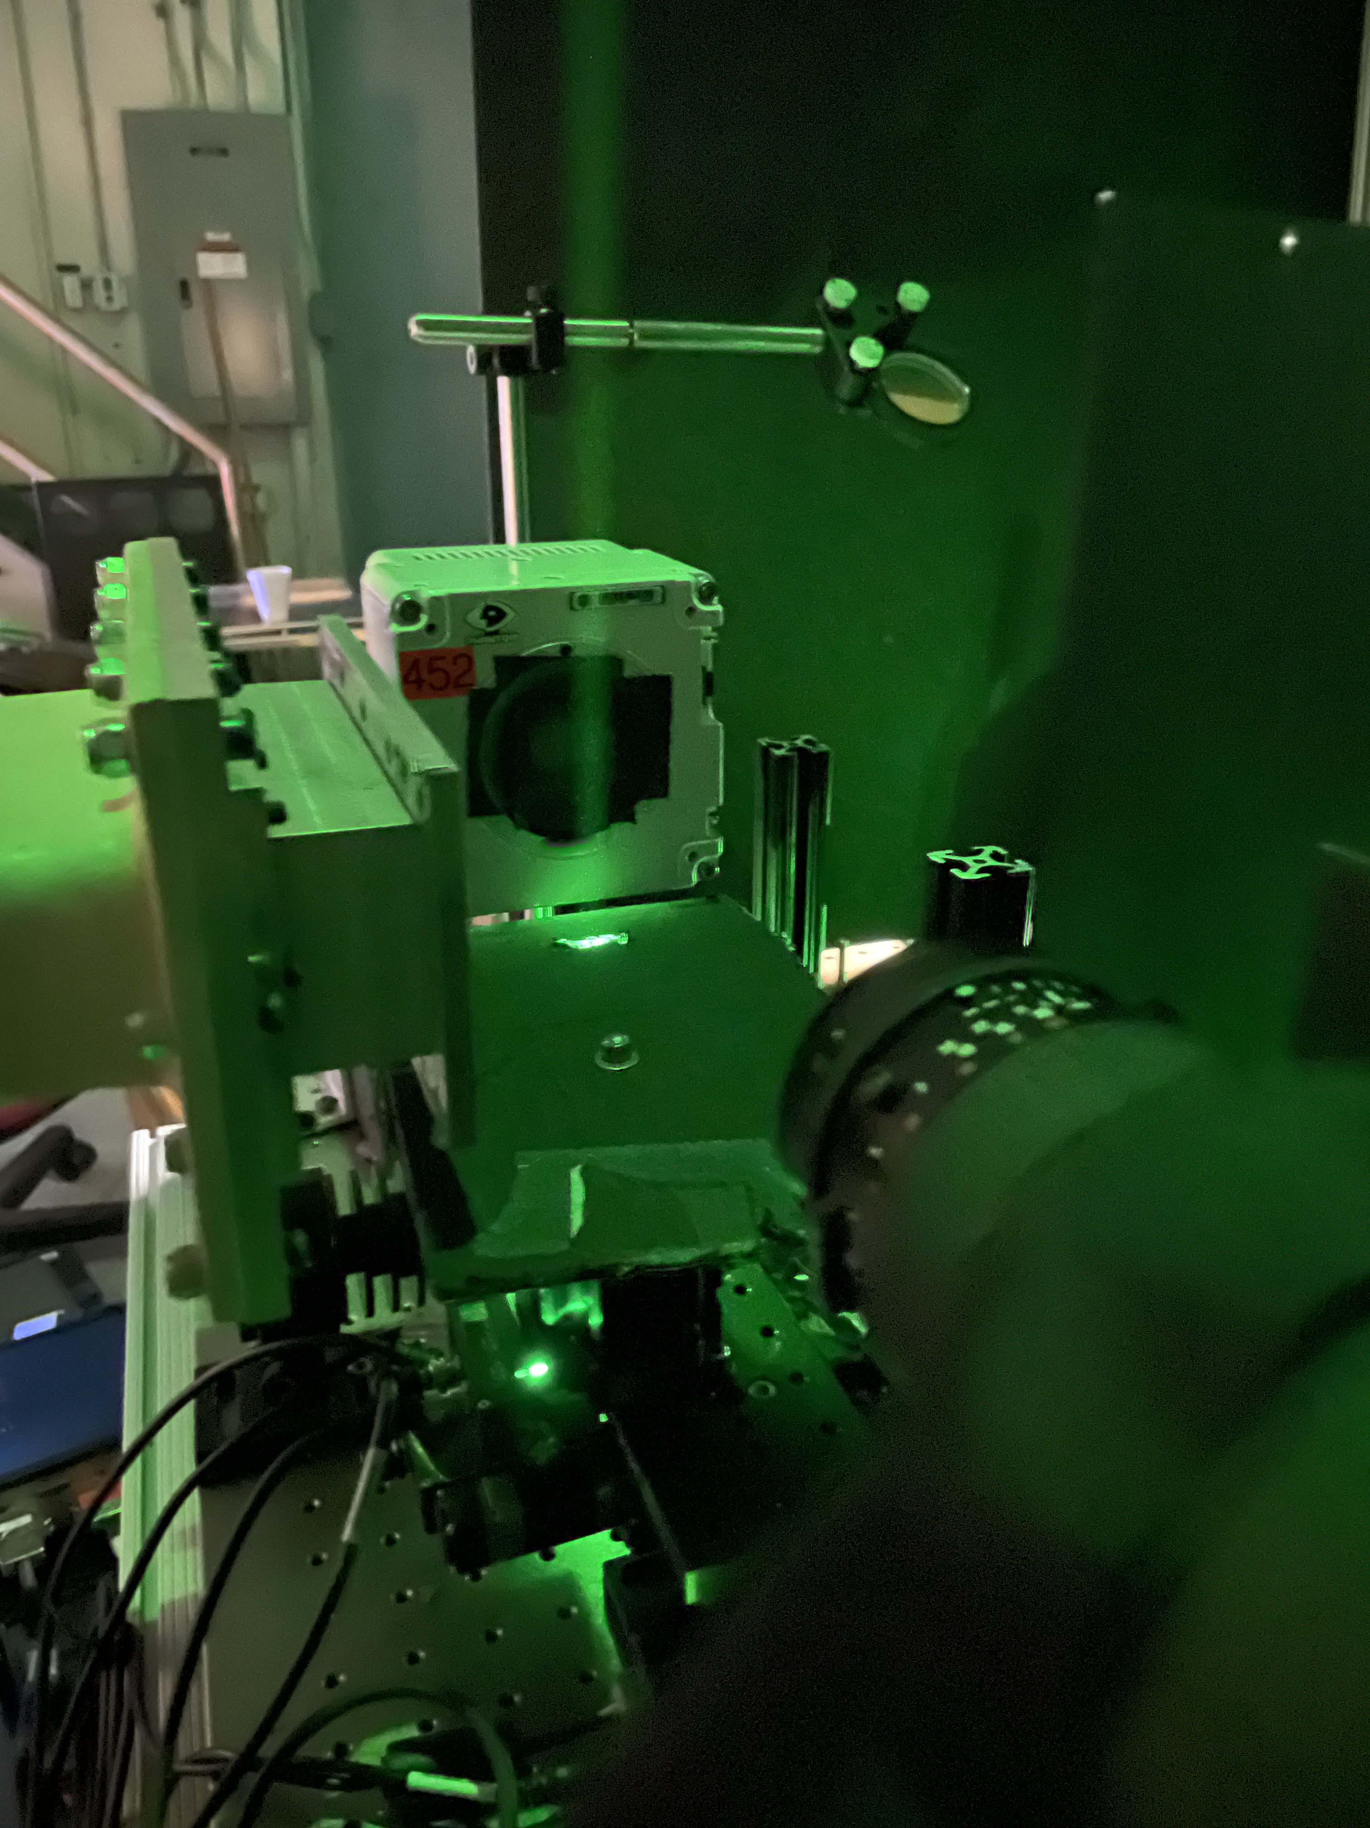
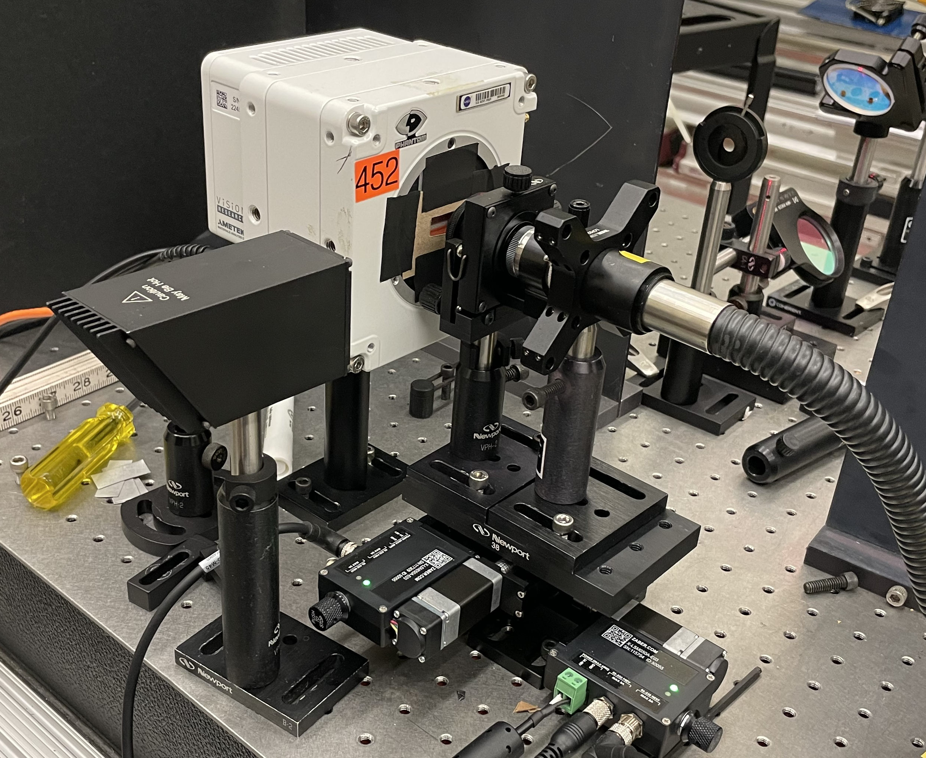
Lensless PIV Setup
Particle Imaging Setup
PSF Calibration Setup
PIV camera
15 μm pinhole
PIV camera
Mask
Light source
Wind tunnel
Laser sheet
Flow
Direction
Lens
Source: NASA
Source: NASA

Slide 8
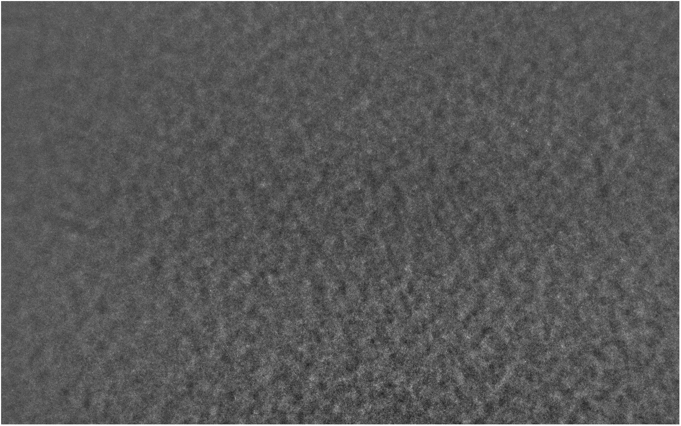
Example Images
Sample Point Spread Function (PSF)
Zoomed in PSF
(c) Sample particle image
(d) Zoomed in particle image

Slide 9
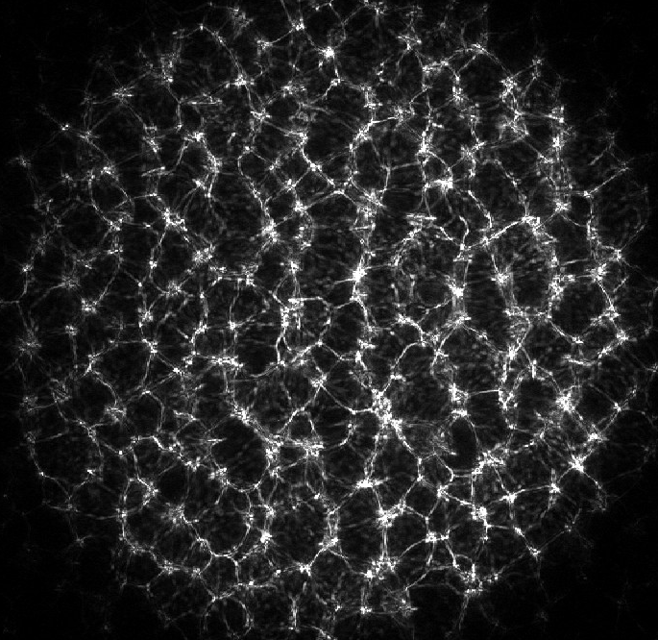
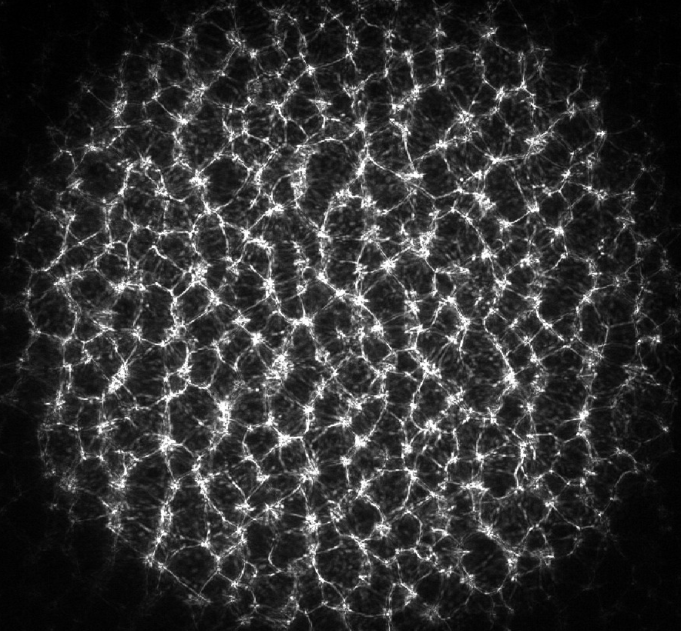
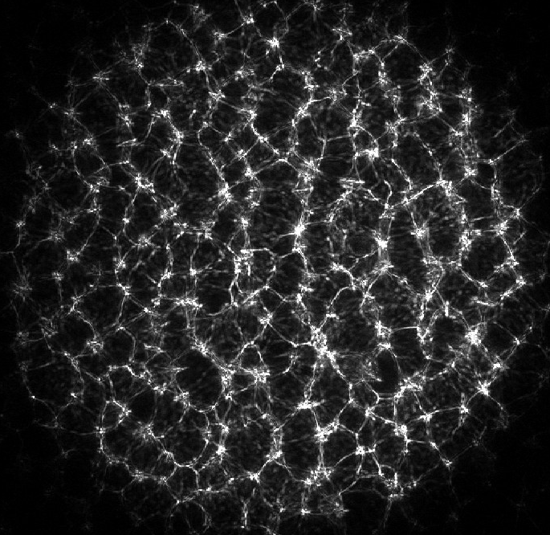
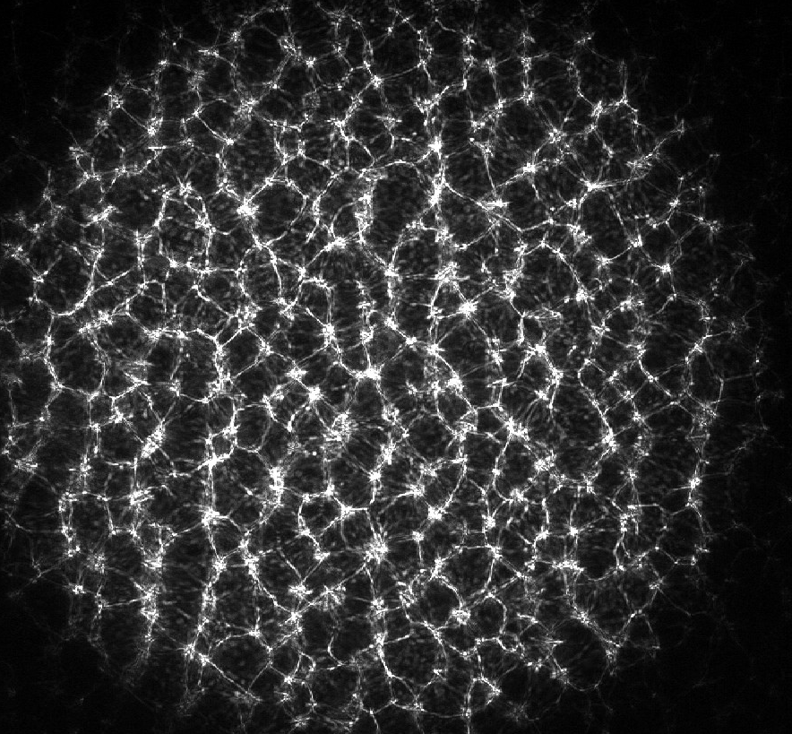
Point Spread Function Examples
In-plane Movement
Out-of-plane Movement

Slide 10
2D Particle Image Reconstruction
  Composite particle image is compiled from reconstructed subimages
  Multiple PSFs are acquired across the whole field of view (separated by 0.5 mm).
  A subimage (300x300 pixels) is reconstructed at the center of each PSF.
  The reconstructed subimages are compiled into a single image, and overlap is accounted for by averaging.
  One downside: out-of-plane particles will appear “out of focus”.
Particle image
PSF 1
PSF 2
PSF N

Slide 11
Example Reconstructed Particle Image
Black – reconstructed from lensless image
Red – particle image from traditional PIV system
*Images are shifted slightly to allow for easier comparison

Slide 12
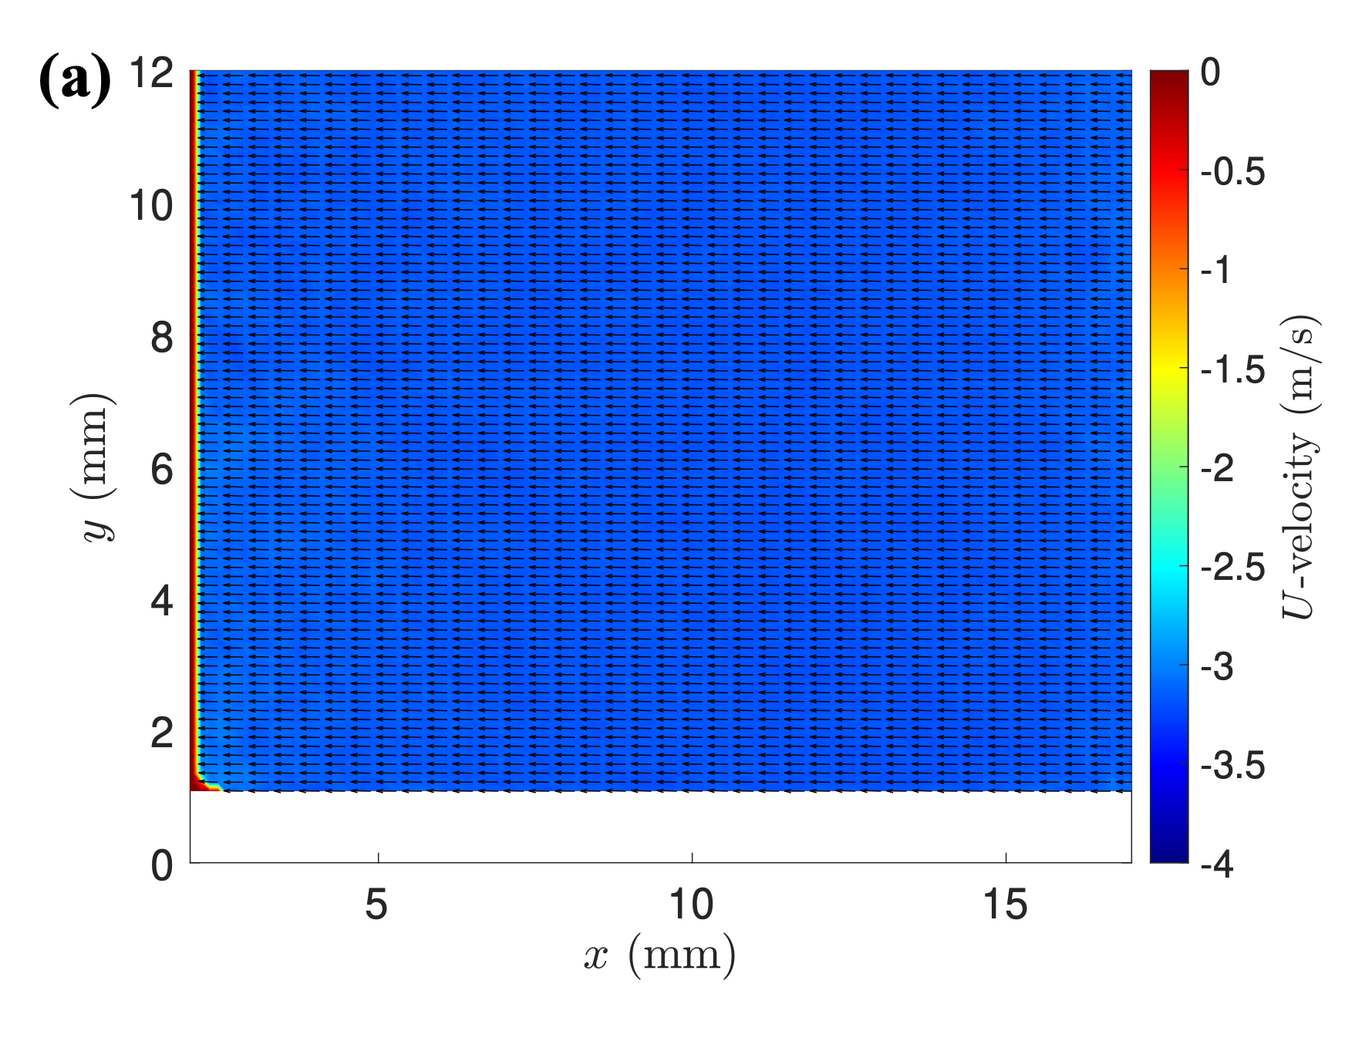
PIV Results: Lensless PIV Uniform Flow

Slide 13
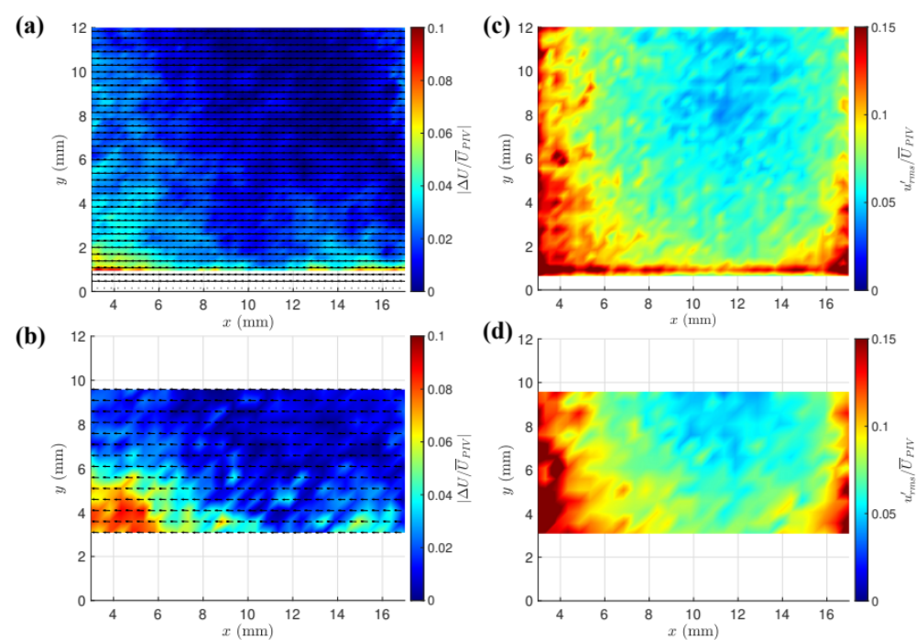
PIV Results: Uniform Flow
Comparison with Lensed PIV System
Mean U Difference
(Systematic Error)
u’_{rms} Velocity Difference
(Random Error)

Slide 14
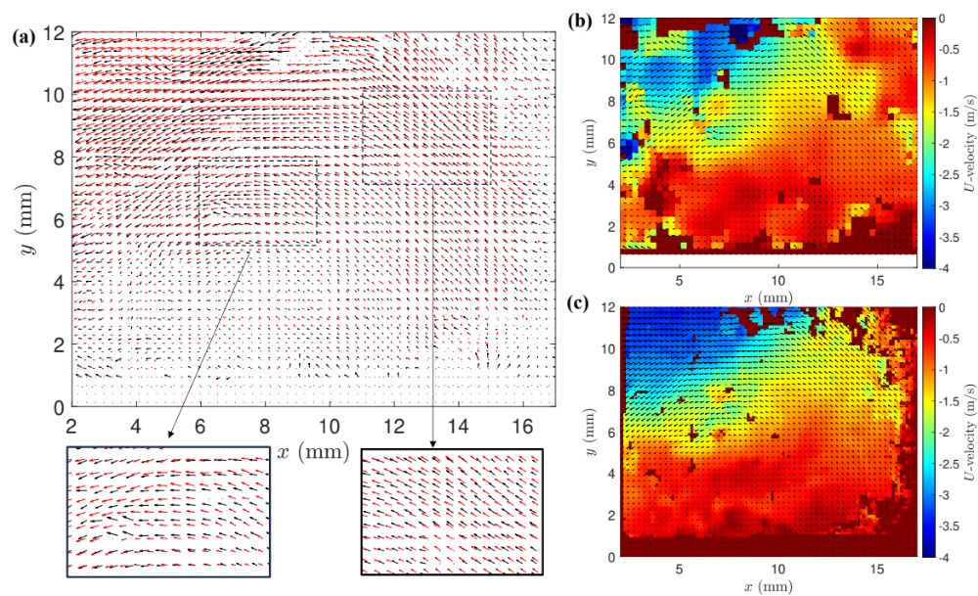
PIV Results: Non-uniform Flow
Comparison of flow vectors: black – Lensless PIV,
red = traditional PIV
U-velocity contours from lensless PIV (overlapping technique)
U-velocity contours from traditional PIV

Slide 15
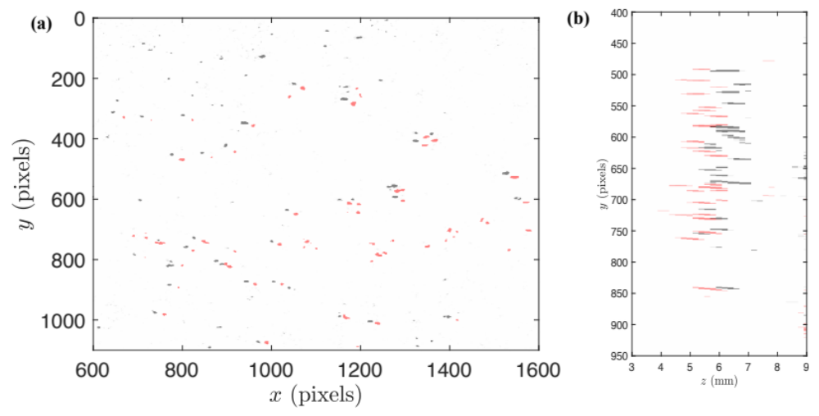
3D Reconstruction
Z-plane of laser shifted 0.5 mm from red to black
Red – 3D reconstruction, Black – 2D reconstruction
¹³Antipa, Nick, Grace Kuo, Reinhard Heckel, Ben Mildenhall, Emrah Bostan, Ren Ng, and Laura Waller. "DiffuserCam: lensless single-exposure 3D imaging." Optica 5, no. 1 (2018): 1-9.

Slide 16
Summary
The Lensless PIV concept was demonstrated and verified with a traditional 2D PIV system.
  With a simple, quick, inexpensive setup, we were able to recover many of the same particles and similar particle displacements.
This approach provides numerous potential benefits:
  Small form factor, allowing for embedding in models and near-wall measurements
  3D measurements
  Inexpensive and versatile masks
Many potential areas exist for further research/improvement:
  Mask design/optimization/simulation
  System design/optimization (2D vs 3D resolution, etc.)
  Processing methods
  Background noise removal
  Seeding (optimal size, PSF characterization)

Slide 17
Background Noise Removal
There is a lot of background noise from reflections.
Potential approaches:
  Subtract time-average
  Subtract background
  POD noise removal (works best for us so far)
POD Noise Removal:
  Perform POD on set of images
  Rebuild each image from subset of POD modes, removing the first several modes (in our case ~15-20).
¹²Mendez, Manuel Alejandro, Marco Raiola, Alessandro Masullo, Stefano Discetti, Andrea Ianiro, Raf Theunissen, and J-M. Buchlin. "POD-based background removal for particle image velocimetry." Experimental Thermal and Fluid Science 80 (2017): 181-192.

Slide 18
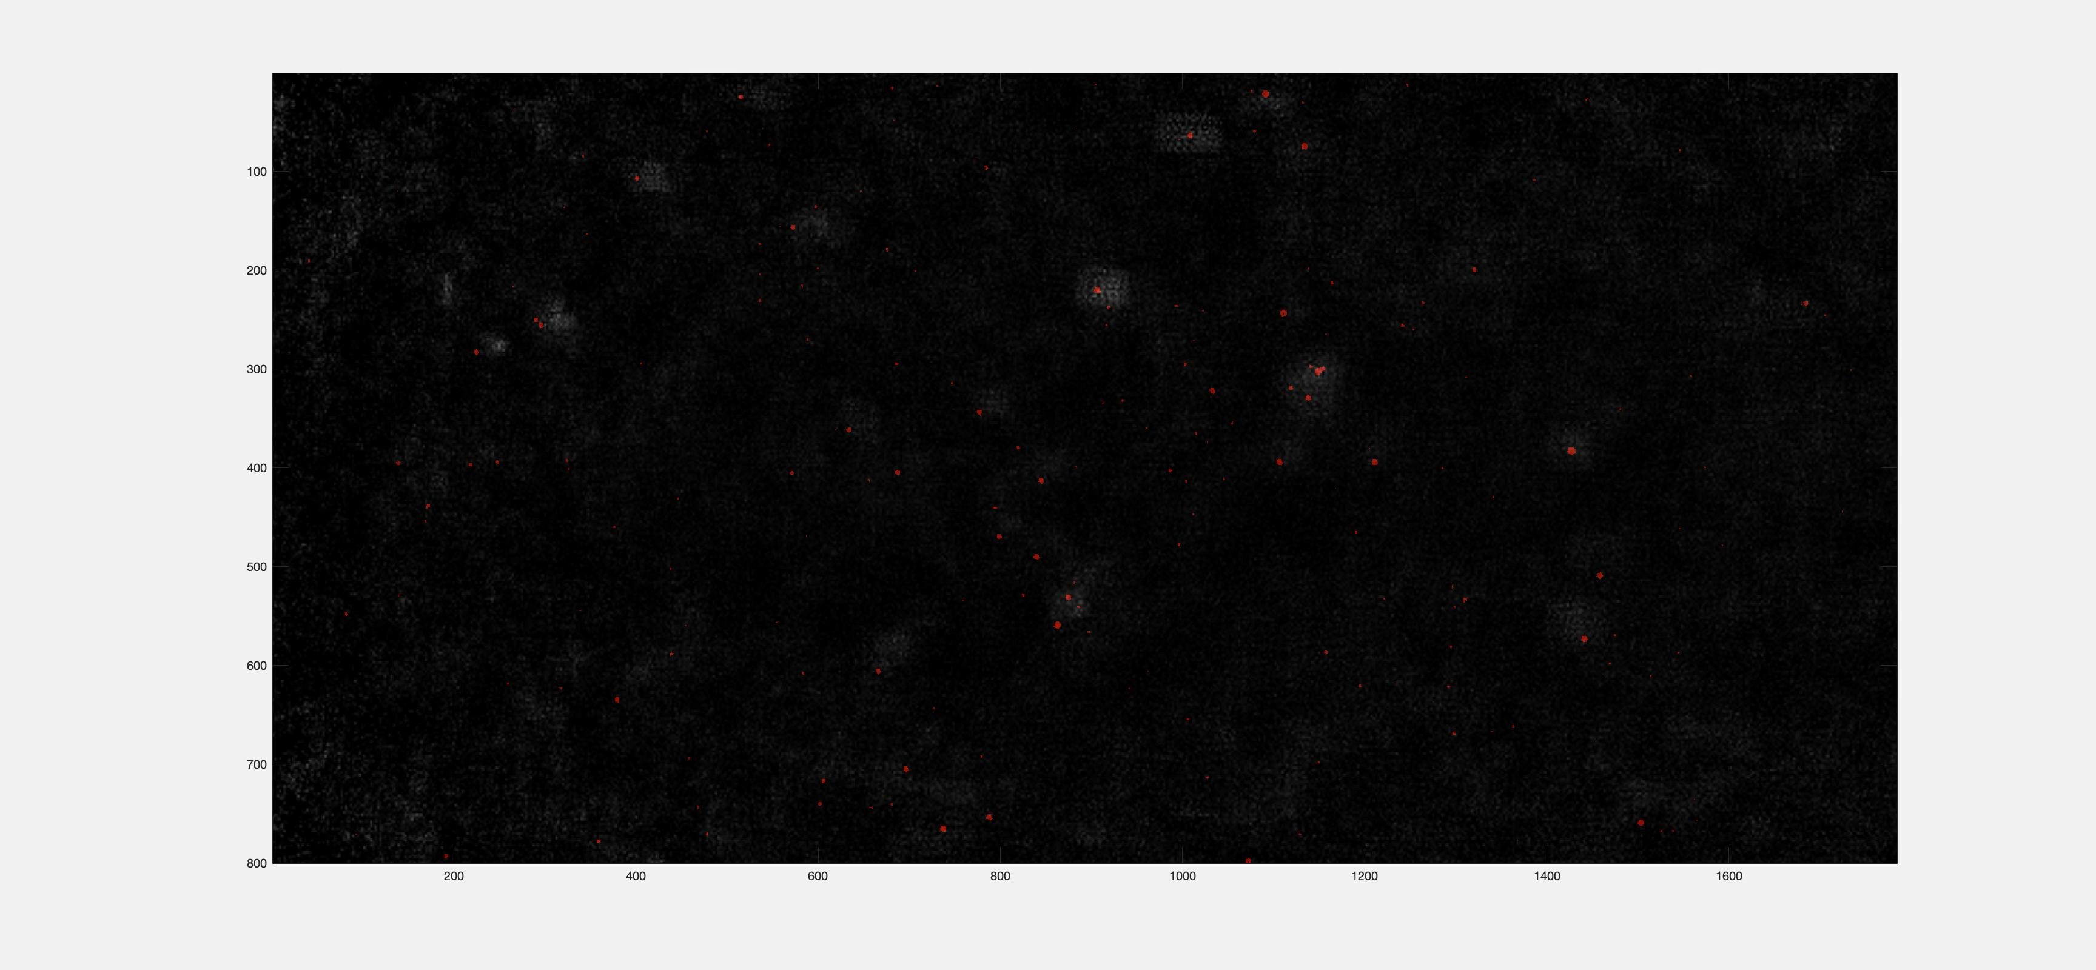
Varying Shifts for Overlapping Reconstruction

Slide 19
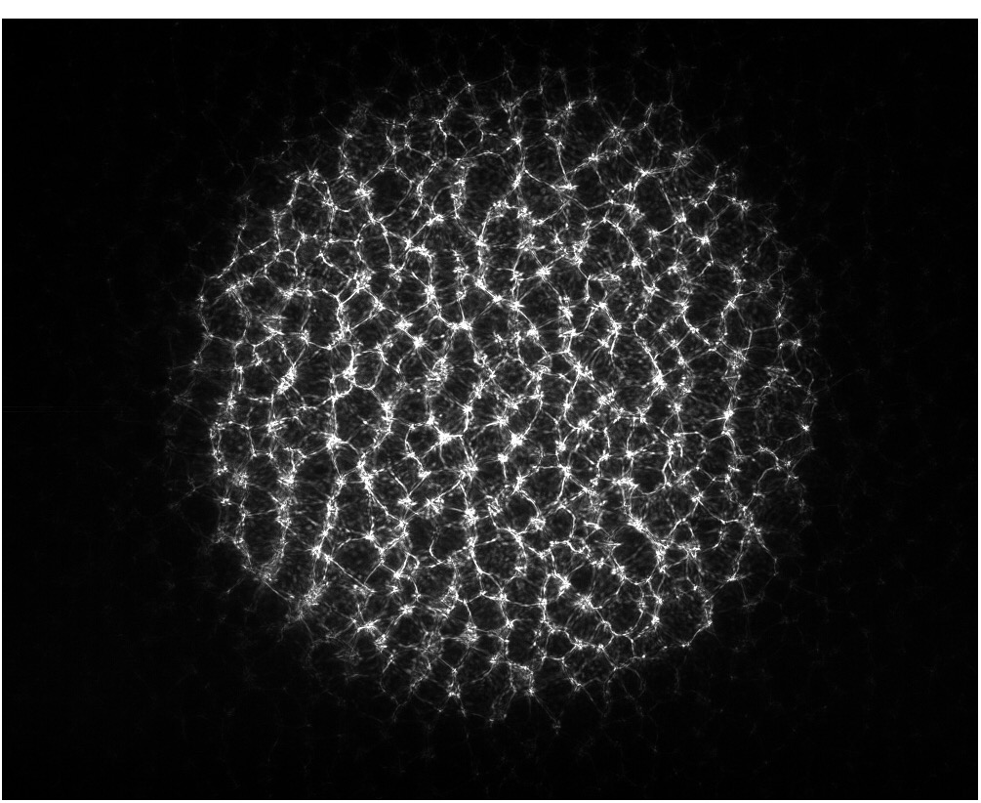
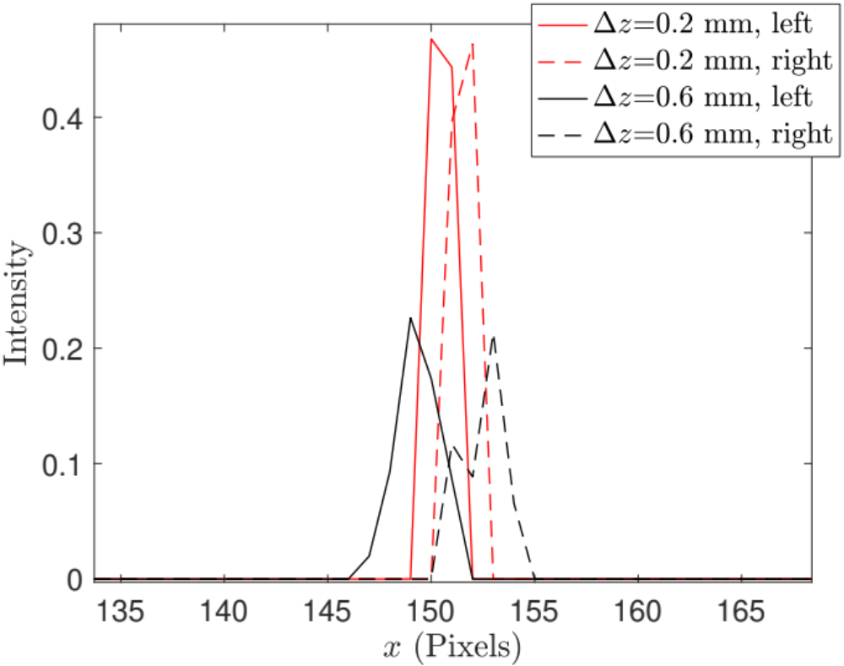
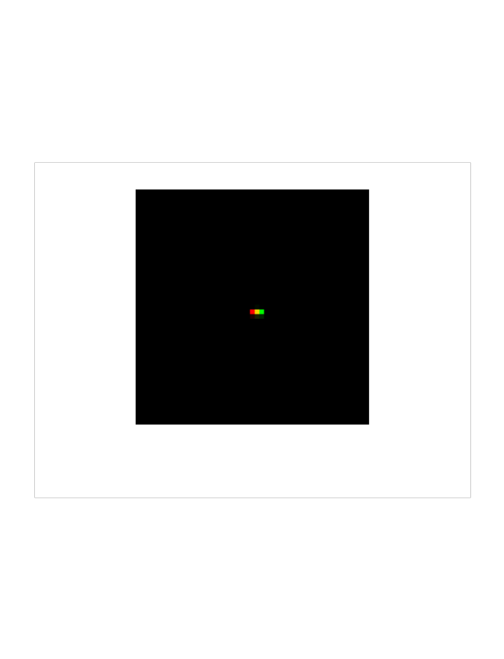
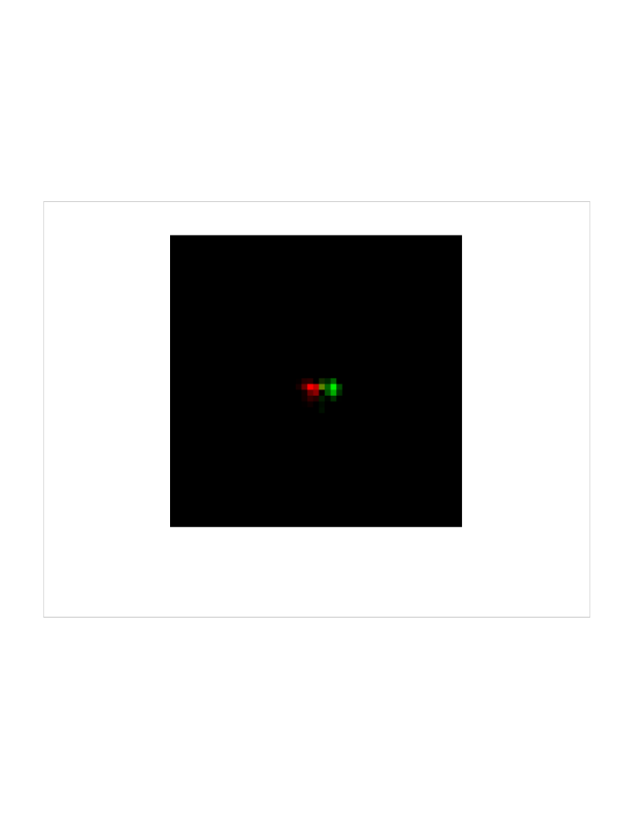
3D Potential: Stereo Processing
(a)
(b)
400 pixels
Δz = 0.2 mm
Δz = 0.6 mm
L
R

