Slide 1
Planetary Protection
Amy Baker¹, J. Nick Benardini², Erin Lalime², Elaine Seasly² and J. Andy Spry¹
¹SETI Institute; ²NASA Headquarters
April 25, 2024
MEPAG Hybrid Meeting #41
Washington DC

Slide 2

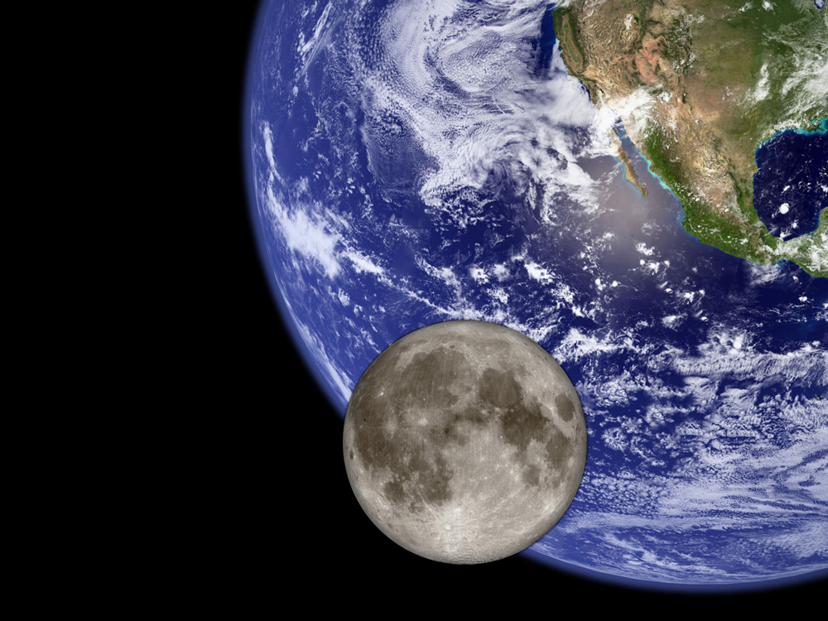
Planetary Protection Objective
Protect current and future scientific investigations by limiting biological and relevant molecular contamination of other solar system bodies through exploration activities and protecting the Earth’s biosphere by avoiding harmful biological contamination carried on returning spacecraft, as described in the Outer Space Treaty.
Forward PP - Understand and control harmful contamination of other worlds by terrestrial organisms, organic materials, and volatiles from spacecraft
Backward PP - prevent harmful biological contamination of the Earth-Moon system by potential extraterrestrial life and bioactive molecules in returned samples

Slide 3
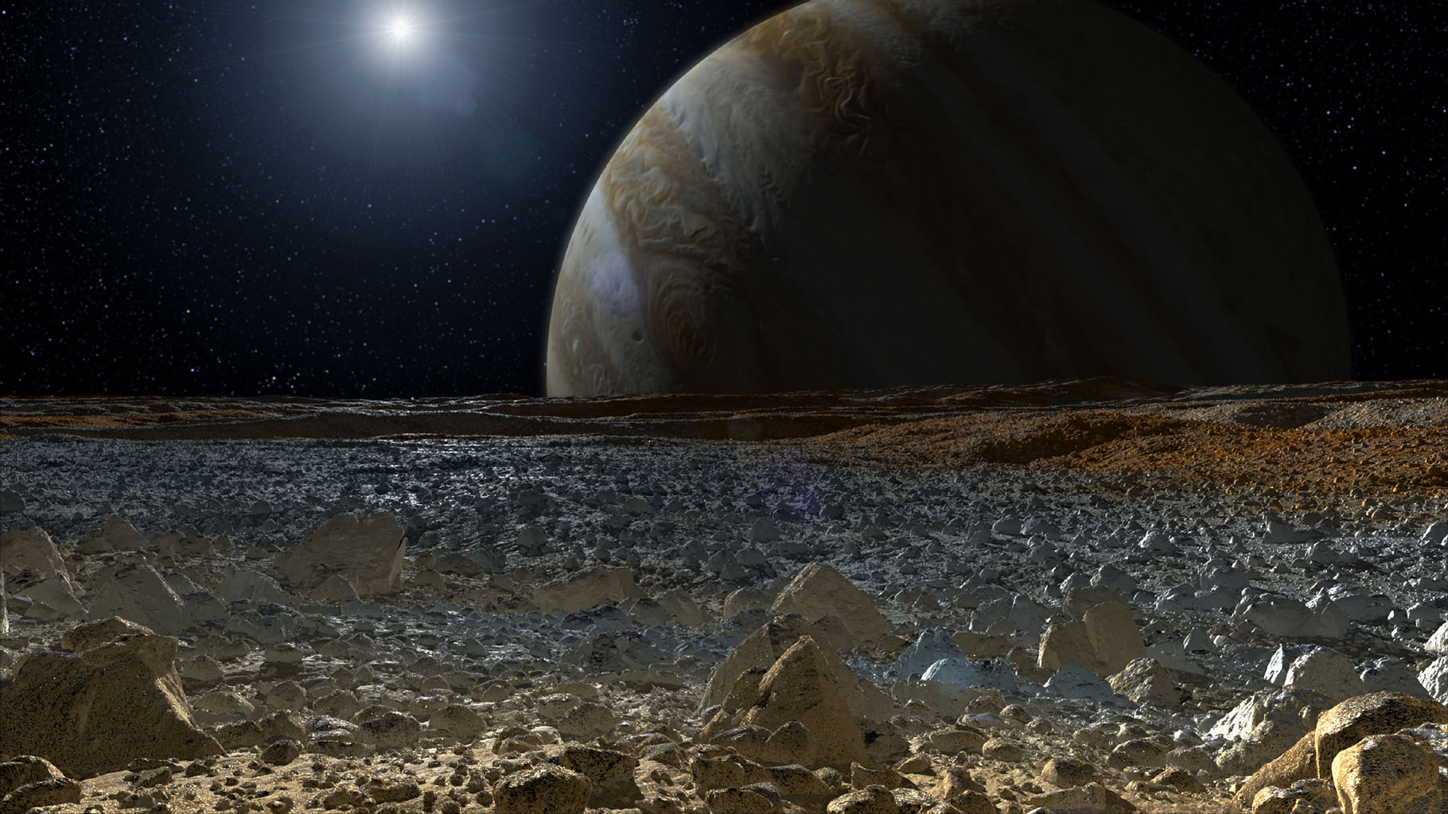
International Planetary Protection Process
The Outer Space Treaty of 1967
International Responsibility
Planetary Protection
Article VI:
States Parties to the Treaty shall bear international responsibility for national activities in outer space, including the moon and other celestial bodies, whether such activities are carried on by governmental agencies or by non-governmental entities, and for assuring that national activities are carried out in conformity with the provisions set forth in the present Treaty
Article IX:
States Parties to the Treaty shall pursue studies of outer space, including the Moon and other celestial bodies, and conduct exploration of them so as to avoid their harmful contamination and also adverse changes in the environment of the Earth resulting from the introduction of extraterrestrial matter and, where necessary, shall adopt appropriate measures for this purpose
Committee on Space Research (COSPAR)
Panel on Planetary Protection forms international consensus guidelines
Defines PP Categories I – V based on target body and mission type
Support the science-based international consensus process
Develop new guidelines and provide significant input to COSPAR
NASA
Supports the science-based international consensus process
Develops new guidelines and provides significant input to COSPAR
3

Slide 4

NASA’s Planetary Protection Policy & Guidance
NPD 8700.1F
Replaced NPD 8020.7G
NASA Policy for Safety and Mission Success
Effective Date July 28, 2022
Expiration Date: July 28, 2028
NASA Policy Directives (NPDs)
Documents Agency policy statements
Describe what is required by NASA management to achieve NASA’s vision, mission, and external mandates
NID 8715.129 (“Mars NID”)
Biological Planetary Protection for Human Missions to Mars
Effective Date: July 9, 2020
Expiration Date: Sept 30, 2025
NPR 8715.24
Replaced NPR 8020.12D/NID 8020.109A
Planetary Protection Provisions for Robotic Extraterrestrial Missions
Effective Date September 24, 2021
Expiration Date: September 24, 2026
NASA Procedural Requirements (NPRs)
Provide detailed procedural requirements to implement policy
Guide how policy directives are implemented in the context of specific missions
NASA Interim Directives (NIDs)
Documents an immediate, short-term statement of the Agency’s policies, requirements, and identifies responsibilities for implementation
Temporarily modify policy directives or implementation requirements
Link to NASA Planetary Protection policy and guidance documents at www.sma.nasa.gov
NASA Standards
Provide technical requirements
Each NASA Technical Standard is assigned to a Technical Discipline
NASA-STD-8719.27
Implementing Planetary Protection Requirements for Space Flight
Effective Date August 30,2022
NASA-HDBK-6022
Handbook for the Microbial Examination of Space Hardware
Expiration Date: N/A
Status: Revision planned. Last draft revision released Aug 17, 2010
NASA Handbooks
Companion documents to NPRs and NASA Standards
Provide supporting material such as guidelines, lessons learned, procedures, and recommendations
All published documents found in NODIS: https://nodis3.gsfc.nasa.gov/ or
the OPP website: https://sma.nasa.gov/sma-disciplines/planetary-protection#PolicyGuidance
= Document being updated

Slide 5
NASA’s Planetary Protection Roles
Chief Scientist
Administrator’s Office
White House / OSTP
Inter-Agency
Mission Directorates
Office of Safety and
Mission Assurance
National Academies
implement
maintain NASA policy
Office of Planetary Protection
oversee implementation
(Technical Authority)
Review Panels
International Partners
Programs Projects
Program/Project-level
Technical Authority
NPD 1000.3 §4.13.2 “OVERALL RESPONSIBILITIES. The Chief, Safety and Mission Assurance reports to the NASA Associate Administrator and advises senior leadership, including the Administrator, on matters related to risk, safety, and mission success. Serves as the lead Technical Authority for safety and mission assurance, providing independent oversight of programs and projects in support of safety and mission success. Serves as the designated Agency-level "official voice" for institutional safety and the associated requirements established by NASA policy, law, and other external mandate aimed at protecting the public..”

Slide 6
NASA Policy Enabling Missions
Increased flexibility for gate products and reviews
  Enables missions to streamline PP reporting into the standard project life cycle reviews.
Risk-informed decision-making leveraged per NPR 8000.4.
  Enables missions in that they can propose a performance or prescriptive approach.
Adds the ability to leverage NASA, other government agency, and industry consensus standards.
  Enables missions by increasing the potential implementation trade space through adopting or adapting consensus standards of their choice.
Current scientific consensus used throughout the project life cycle
  Enables missions to propose alternative and analytical approaches that are both responsive to PP requirements and fit within a projects allocated resources.

Slide 7
Planetary Protection Categorization – Outbound + Inbound
Planetary Target Priority | Mission Type | Planetary Protection Category | Example Target Bodies
Not of direct interest for understanding the process of chemical evolution or where exploration will not be jeopardized by terrestrial contamination. | Any (Flyby, Orbiter, Lander) | I | Undifferentiated, metamorphosed asteroids, Io
Of significant interest relative to the process of chemical evolution but only a remote chance that contamination by spacecraft could compromise future investigations. | Any (Flyby, Orbiter, Lander) | II | Earth’s Moon (Cat. IIa & IIb), Venus, Comets, Asteroids, Jupiter; Jovian Satellites (excluding Io, Ganymede and Europa), Saturn; Saturnian Satellites (excluding Titan and Enceladus), Uranus, Uranian Satellites, Neptune, Neptunian Satellites (excluding Triton), Kuiper-Belt Objects <1/2 the size of Pluto
 |  | II* | Jovian Satellites: Ganymede, Saturnian Satellites: Titan, Neptunian Satellites: Triton, Pluto/Charon
Of significant interest relative to the process of chemical evolution and/or the origin of life and for which scientific opinion provides a significant chance that contamination by spacecraft could compromise future investigations | Flyby, Orbiter | III | Mars, Europa, Enceladus, Others to be determined
 | Lander, Probe | IV | Mars (Cat. IVa, IVb & IVc), Europa, Enceladus, Others to be determined
Any Solar System Mission | All Earth Return | V(r): Restricted Earth Return | Restricted Earth Return: Mars Europa Enceladus Others to be determined
 |  | V(u): Unrestricted Earth Return | Unrestricted Earth Return: Earth’s Moon Venus Most asteroids and comets (e.g., Bennu, Ryugu) Others to be determined

Slide 8
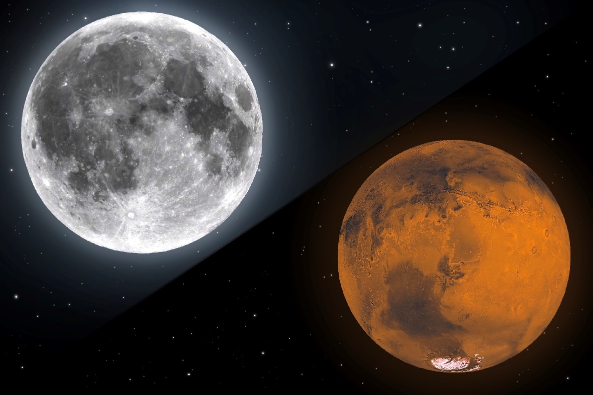
Exploration Planetary Protection Comparison: Moon vs Mars
EASY
Mars
COSPAR Assessment: “a target body of chemical evolution and/or origin of life interest and for which scientific opinion provides a significant chance of contamination which could compromise future investigations.”
Categorization (Outbound): III/IVa/IVb/IVc
Implication: Documentation Avoidance of Impact and/or Cleanliness Requirements
Categorization (Return): V(restricted)
Implication: Documentation Rigorous containment of unsterilized material to protect Earth’s biosphere Quarantine of crew
Moon
COSPAR Assessment: “of significant interest relative to the process of chemical evolution and the origin of life, but where there is only a remote chance that contamination carried by a spacecraft could compromise future investigations.”
Categorization (Outbound): II/IIa/IIb
Implication: Documentation
Categorization (Return): V(unrestricted)
Implication: No further constraints
NOT SO EASY
Notes:
Comparison of Moon and Mars from a planetary protection perspective

Slide 9
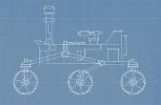
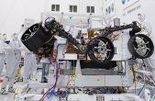
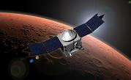
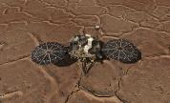

Control of Forward Contamination
Mission Design & Categorization
Spacecraft Assembly, Test, Transport, Launch, and Operations
Avoiding Contamination following Inadvertent Impact
Avoiding Contamination for Robotic Landed Missions
End of Mission Disposition
Information to be included in the PP Mission Categorization Proposal
Biological and organic contamination knowledge inventory materials
Controlled manufacturing environments and cleanrooms
Bioburden Control Approach
Analytical Approach
Documentation requirements and communication of data/analysis updates
Avoiding inadvertent impact of solar system bodies by spacecraft and launch elements during flyby, gravity assist, or orbital insertion
  Mars (Cat III-IV)
Secondary and auxiliary payloads
Prevent occurrence of a biological inoculation event into a potentially habitable environment during landing and surface operations
  Stationary and mobile activities
Mars IVa, IVb, IVc requirements
Bioburden Control Approach
Analytical Approach
Documentation of final disposition of hardware
Updates to organic, biological, and combustion product inventories
Information to be included in End of Mission PP Report

Slide 10

Mars Forward PP Implementation Trade Space
Orbiter - Spacecraft reliability and mission design to maintain orbiter inadvertent impact so bioburden considerations are not necessary.
Orbiter - Burnup and Breakup as a primary means to meet planetary protection compliance for bioburden managed spacecraft.
Orbiter / Lander – Evaluation of manufacturing provenance for bioburden credits from cleanroom manufacturing environments and non-metallic material cure and electronic break-in times and temps.
  Note: This is also can balanced with commercial off-the-shelf usage for lower risk class missions. Can you reduce PP implementation with MIL Spec parts?
Orbiter / Lander – Heat microbial reduction of strategic sub-systems to reduce bioburden below required limits. Typically, these are large surface areas such as cabling and thermal systems.
Orbiter / Lander – Bioburden management, microbial reduction, bioburden verification with wipe and swab sampling – required PP laboratory
Spacecraft Implementation
$
$$$
*Note that some combination of the above techniques may be required.

Slide 11
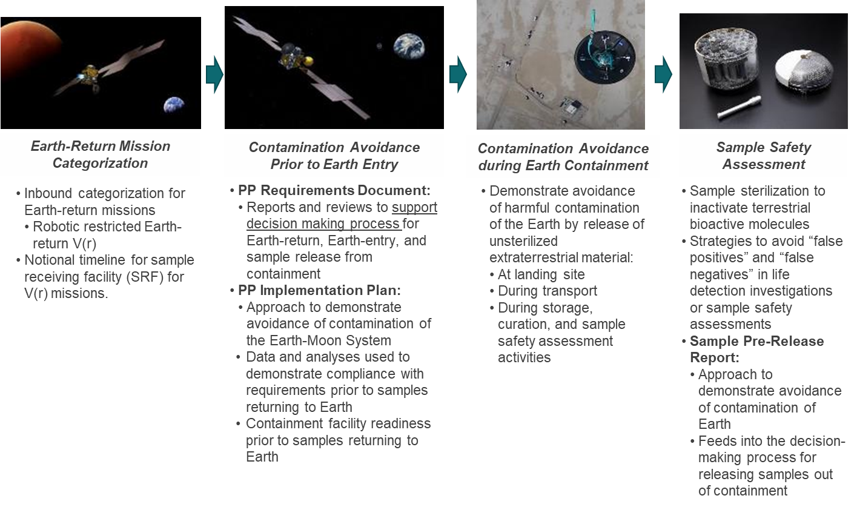
Backward Contamination – Restricted Earth Return
NASA/USG has obligations under the Outer Space Treaty to safeguard the Earth-Moon system.
  Article IX: States Parties to the Treaty shall pursue studies of outer space, including the Moon and other celestial bodies, and conduct exploration of them so as to avoid their harmful contamination and also adverse changes in the environment of the Earth resulting from the introduction of extraterrestrial matter.
Key Tenants
NASA Procedural Requirements 8715.24 §3.4
Implementation Example
NASA-Standard 8719.27 §5
Preventing harmful biological contamination of Earth’s biosphere is the highest priority.
Establish and implement a strategy and design concepts to break the chain of contact with the target body, isolate, and robustly contain restricted samples.
Approach to assure public safety and containment requires approval by relevant government entities.
Alternative approaches allowed with scientific and engineering consensus.

Slide 12
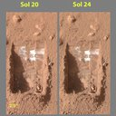
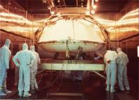
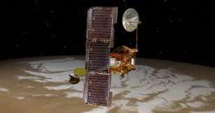
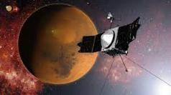

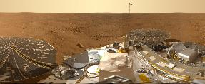

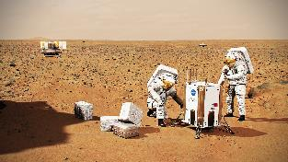

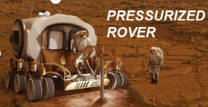

Notional Forward PP Mars Exploration Trade Space
REQUIREMENTS
Prescriptive
Credit: NASA
Robotic - Mars Lander
PP Category IVb – Life Detection
Viking Lander
Credit: NASA
Credit: NASA/JPL-Caltech
Credit: NASA
Credit: NASA
Robotic - Mars Orbiter
PP Category III – Orbital Lifetime
Mars Odyssey
Robotic - Mars Orbiter
PP Category III – Bioburden
MAVEN mission
Credit: NASA/JPL-Caltech/MSSS
Robotic - Mars Lander / Rover
PP Category IVa
Mars Science Laboratory – Curiosity
Robotic - Mars Lander / Rover
PP Category IVc – Mars Special Region
Phoenix Lander
NASA/JPL-Caltech
Knowledge Gaps
IMPLEMENTATION
Credit: CoSTAR / NASA / CalTech
Easier
Challenging
Credit: NASA
Credit: NASA
Credit: NASA
Crewed + Robotic - Special Region Exploration
Credit: NASA
Crewed – Habitat / Close EVA Study
Key
Robotic
Robotic + Crewed
Crewed
Credit: NASA
Crewed – Habitat / Far (kilometers?) EVA Study
Credit: ESA
Performance Based
Crewed Special Region/Sampling for life detection/In-situ life detection

Slide 13
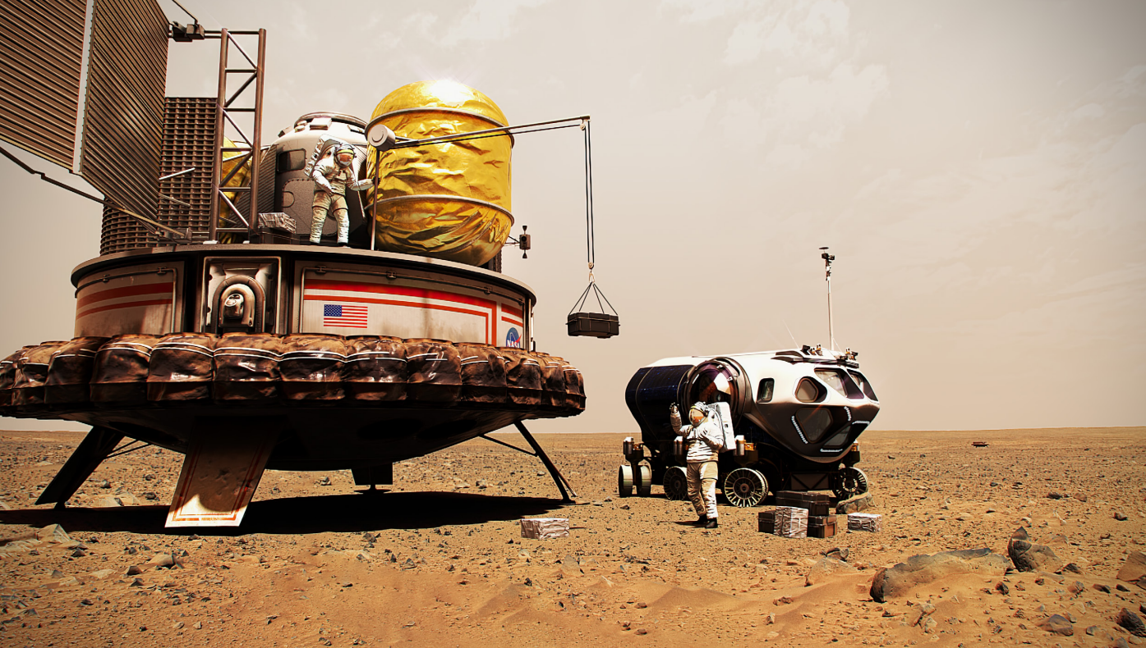
Knowledge-Based Robotic to Crewed Transition
Priority = safeguard the Earth from potential biologicals
Priority = crew safety
Driving question
How do we define contamination vs. harmful contamination?
Assumption
Microbial assessment + control of human associated contamination = key to preserve astrobiological exploration (PP enabling science)
Assumptions
Landed missions ≠ closed systems
Crew will be exposed to Mars
Crew is a constant source of bioburden unlike robotic spacecraft.
Guidelines
Maintain intent of PP to avoid harmful contamination
Mars Special Regions apply
Backward PP will require containment/quarantine
Baseline understanding of site
Knowledge gaps need to be established and mitigated
Notes:
To frame the discussions, and constrain the problem, this “evolved” set of assumptions provided boundaries so that we didn’t devolve into speculative conversations about terraforming, and the like.

Slide 14
Roadmap and Identification of Knowledge Gaps
Key knowledge gaps: microbial and human health monitoring, spacecraft technology and operations, and natural transport of contamination at Mars
2015
2016
2018
2018 & beyond
✓
COSPAR Working Meeting on Contamination Transport on Mars at LPI, May 2018
✓
✓
✓
✓
NASA Workshop at Ames
1st COSPAR Meeting at LPI
2nd COSPAR Meeting at LPI
COSPAR Working Meeting on Microbial Monitoring & Health at LPI, May 2019
✓
COSPAR Working Meetings on Spacecraft Systems (virtual) May 2020 and June 2022
Identification of Planetary Protection Knowledge Gaps for human missions to Mars
Refinement and prioritization of Planetary Protection Knowledge Gaps for human missions to Mars
Mission Opportunity identification for addressing Planetary Protection Knowledge Gaps for human missions to Mars
Measurements and Payload/Operation Concepts for addressing Planetary Protection Knowledge Gaps for human missions to Mars
What Knowledge Gaps…
…in what order…
…using what missions…
…to make what measurements…
…to establish the right quantitative and implementable planetary protection requirements for safe
and sustainable exploration and utilization of Mars.
  Spry, J. A., et al. (2024). Planetary Protection Knowledge Gap Closure Enabling Crewed Missions to Mars. Astrobiology, 24(3), 230–274.
Notes:
Just to emphasize how Workshop content, via COSPAR, feeds into Agency policy and implementation

Slide 15

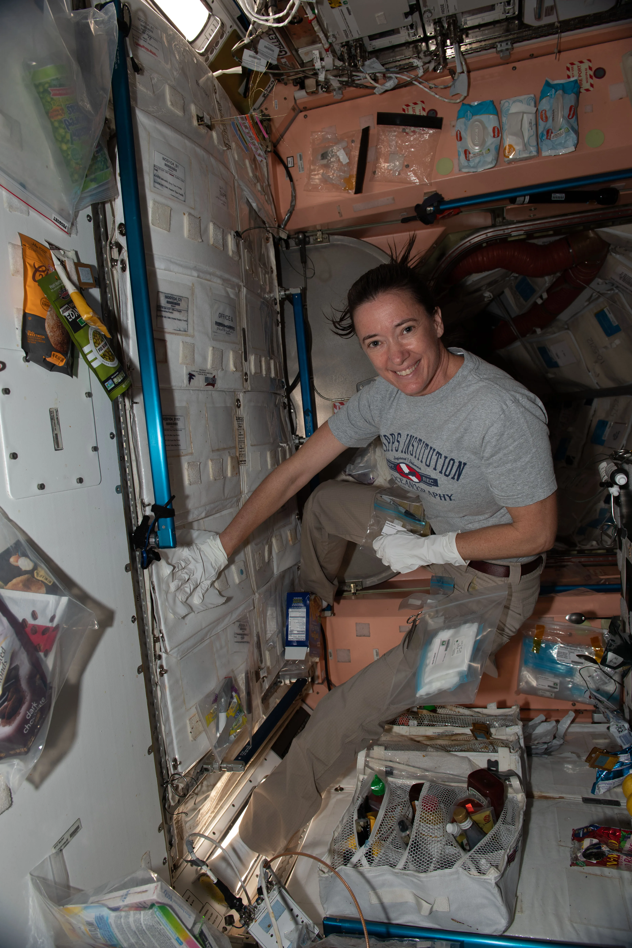
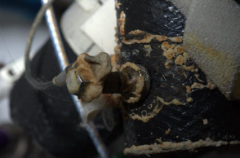
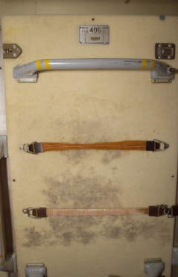
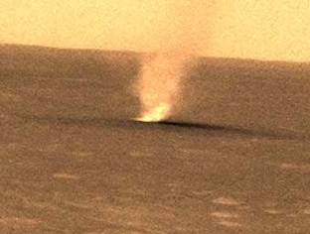
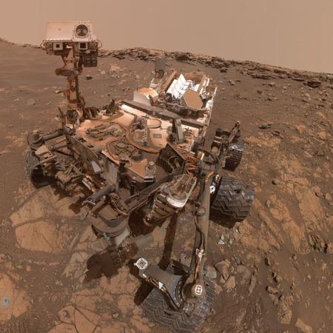
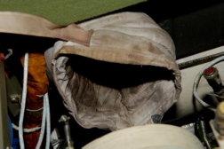
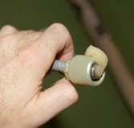
Planetary Protection Crewed Moon to Mars Knowledge Gaps
Key technology development areas for planetary protection include:
1) microbial and human health monitoring,
2) technology and operations needed for contamination control, and
3) natural transport of contamination Mars.
Microbial manifestations on the ISS:
Credit: ESA, DLR, FU BERLIN (CC BY-SA 3.0 IGO)
Credit: NASA
Credit: NASA
Credit: NASA/JPL-Caltech
Credit: JPL-CALTECH/NASA, MALIN SPACE SCIENCE SYSTEMS
  Spry, J. A., et al. (2024). Planetary Protection Knowledge Gap Closure Enabling Crewed Missions to Mars. Astrobiology, 24(3), 230–274.

Slide 16
Enabling and Evolving Crew PP Policy
Does planetary protection permit crewed exploration of Mars?
  Yes, if …Mars is explored so as to avoid harmful contamination there, and also adverse changes in the environment of the Earth resulting from the introduction of extraterrestrial (Martian) material.
How can this be achieved?
  Policy and implementation still being evolved, but are likely to include:
    Requirements to manage cleanliness of operations on the surface, based on best available scientific data.
    Requirements to quarantine (containment of) returning crew and contain Martian samples, respectively, until shown to be safe.
    Development of an assurance based, risk-informed decision-process
Objectives-Driven
Risk Informed
Case Assured
Objectives are substantiated, monitored, and independently evaluated throughout the lifecycle based on systematic argumentation, explicit assumptions, and objective evidence.
Risks are understood, documented, and consistent with the established risk posture.
Consider the potential benefits and strategic importance of the mission(s) and consequences of failure,
Comprehensive and logical claims made with sufficient argument(s) & objective evidence​.

Slide 17


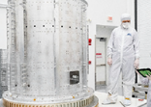
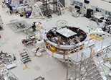

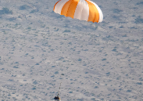




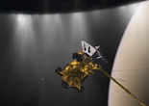
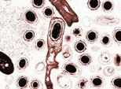
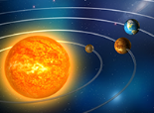
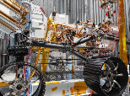
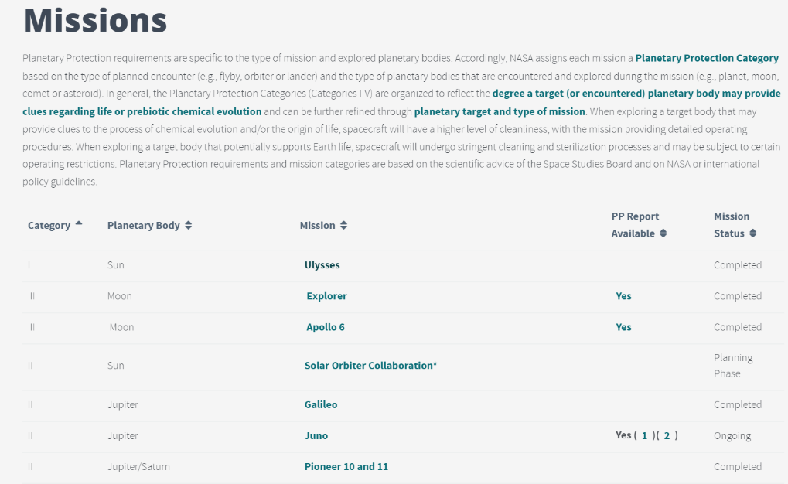
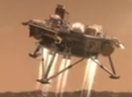
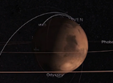
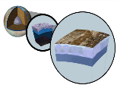
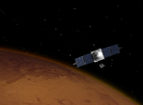
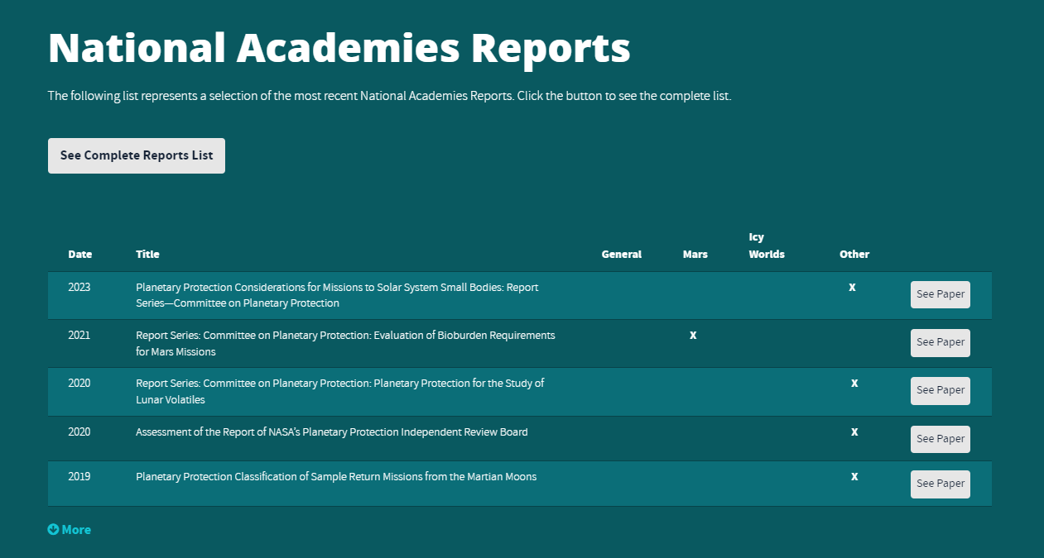
Resources Available Through The OPP Website
Articles
What Are Spores?
How to Build a Clean Spacecraft
Cleanroom Gowning or How to Dress in the Cleanroom
Ground Support Equipment
Protecting the Planet: Planetary Protection vs. Planetary Defense
OSIRIS REx Sample Return Doesn’t Pose a Risk to Earth’s Biosphere
Bioburden Accounting Tool Release
Organic Inventory Workshop
PP Crewed Knowledge Gaps
https://sma.nasa.gov/sma-disciplines/planetary-protection
Videos
Missions & Studies
Planetary Protection: An Introduction
Just How Small is a Spore?
Forward and Backward PP Overview
Behind the Spacecraft Perseverance
Mission Reports
Mission Design and PP Categorization
Probability of Impact
Ocean Worlds
End of Mission Disposition
NASEM Study Reports

Slide 18
Questions?
Feel free to reach out as well!
J. Nick Benardini – NASA Planetary Protection Officer – James.N.Benardini@nasa.gov
Erin Lalime – NASA Deputy Planetary Protection Officer (Acting) - Erin.Lalime@nasa.gov
https://sma.nasa.gov/sma-disciplines/planetary-protection

