Slide 1
Machine Learning Algorithms for Alignment Verification of the Roman Space Telescope
Joseph M. Howard (NASA)
Robert Campion (NASA/Aerodyne)
Samuel Nissim (NASA)
Tuong Phong (MIT)
Ariba Khan (MIT)
Brian Daley (Columbia Univ)
Sam Becker (Univ of Rochester)
Scott Rohrbach (NASA)
Margaret Dominguez (NASA)

Slide 2
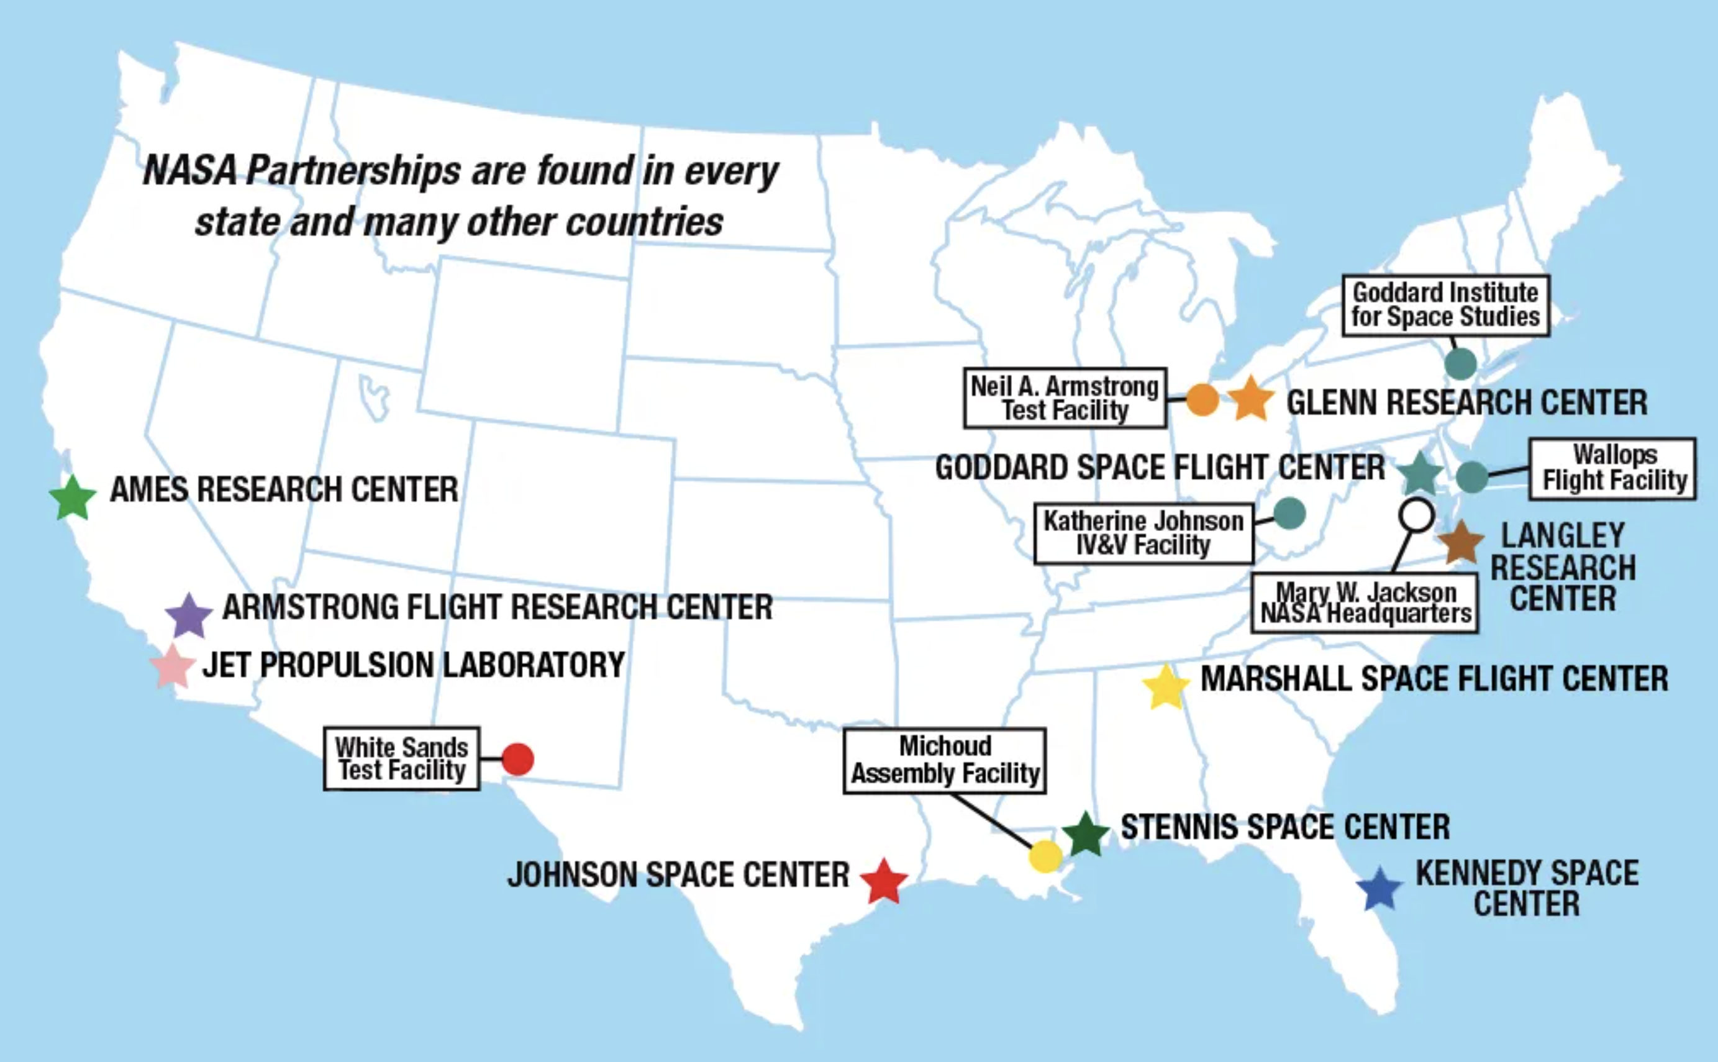
NASA has many locations in the USA…
We work at Goddard, near Washington DC

Slide 3
Agenda
Overview of the Roman Space Telescope
Roman Optical Alignment Test Measurement
Machine Learning approach
Simulation Results

Slide 4

Habitable Worlds Observatory

Slide 5
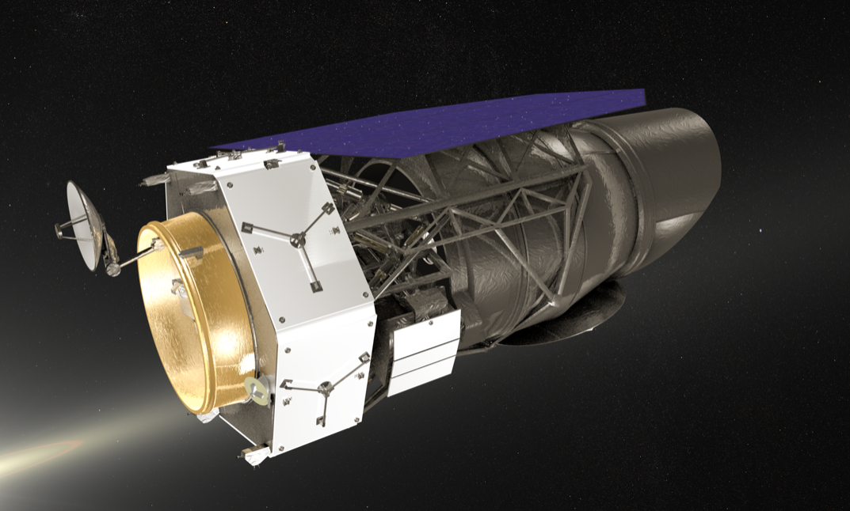
Nancy Grace Roman Space Telescope
EPD: 2.4 m
FOV: 50x25 arcmin
F/#: 8
λ: 0.5 – 2.0 μm
Design: TMA
Launch 2027
EPD = Entrance Pupil Diameter
FOV = Field of View
F/# = Focal Ratio, focal length/EPD
λ = Wavelength Range, bandpass
TMA = Three-Mirror Anastigmat

Slide 6
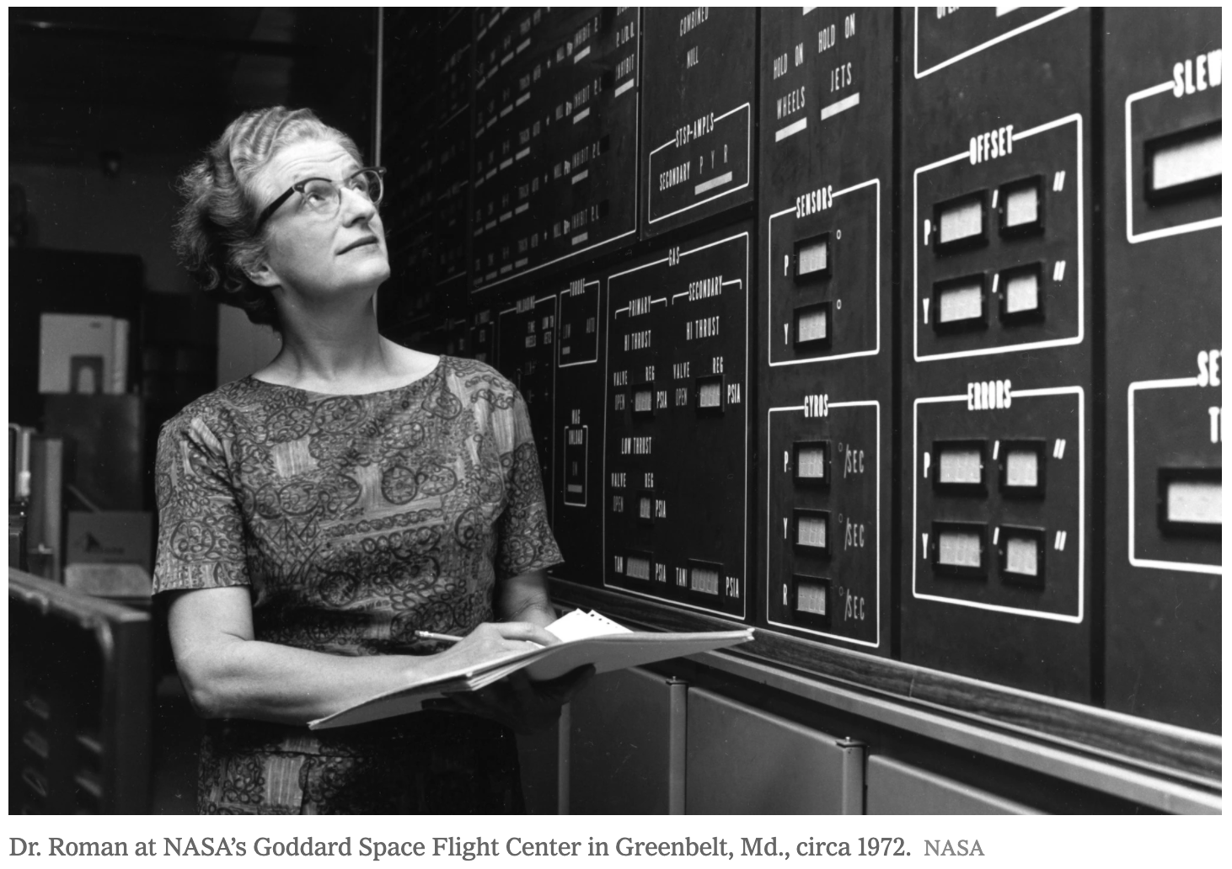
Who is Nancy Grace Roman?
This space-based observatory is named after Nancy Grace Roman (1925- 2018), NASA’s first chief astronomer who paved the way for space telescopes focused on the broader universe.
Considered the “mother” of NASA’s Hubble Space Telescope, Roman tirelessly advocated for new tools that would allow scientists to study the broader universe from space

Slide 7
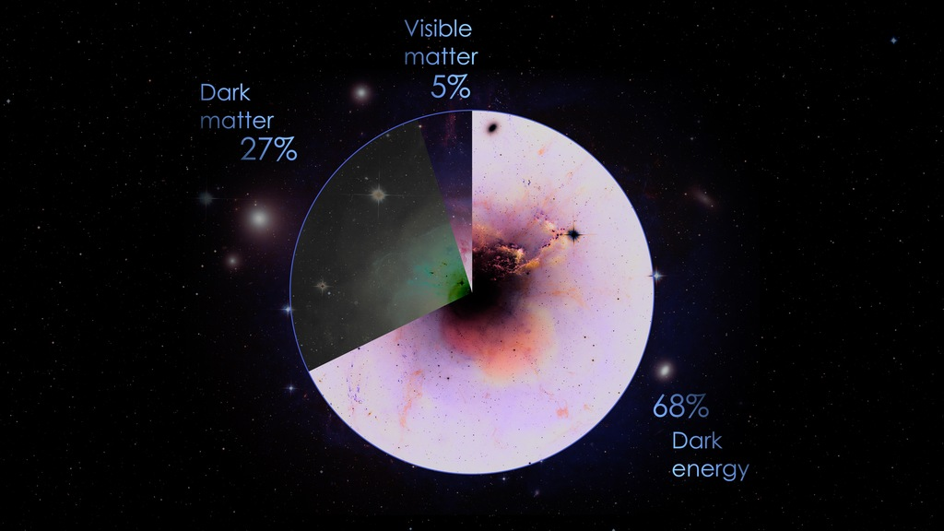
Roman will study the Physics of the Universe…
Dark Matter
Does not emit light or interact electromagnetically but has attractive gravitational force
Dark Energy
Drives the accelerated expansion of the Universe,
causing everything to move away from everything else

Slide 8
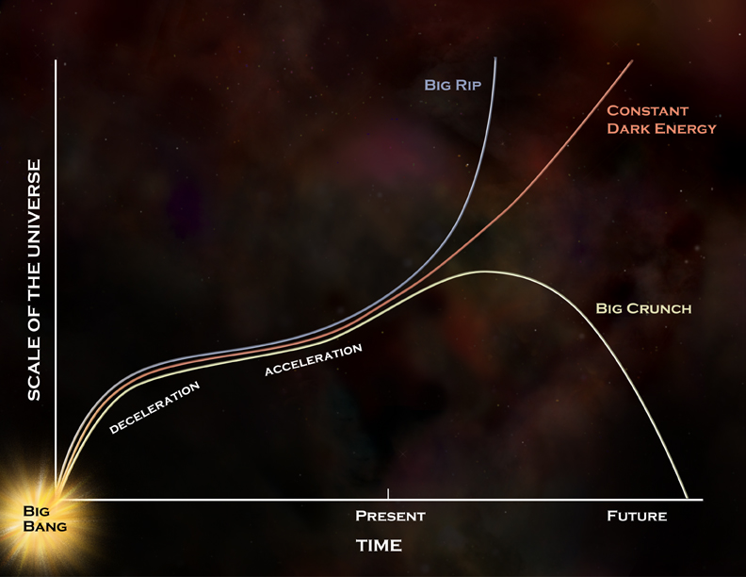
Roman will study the Fate of the Universe…

Slide 9
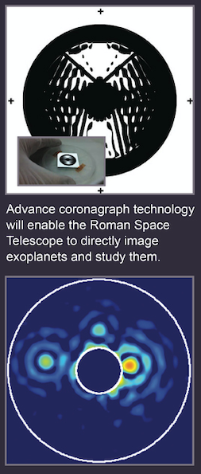
Roman will study Exoplanets…
Microlensing takes advantage of two stars crossing paths in our line of sight to determine whether the star closest to us has planets.
Coronagraph Instrument: A coronagraph blocks the light of a host star to directly image an exoplanet.
10 orders of magnitude contrast ratio!

Slide 11
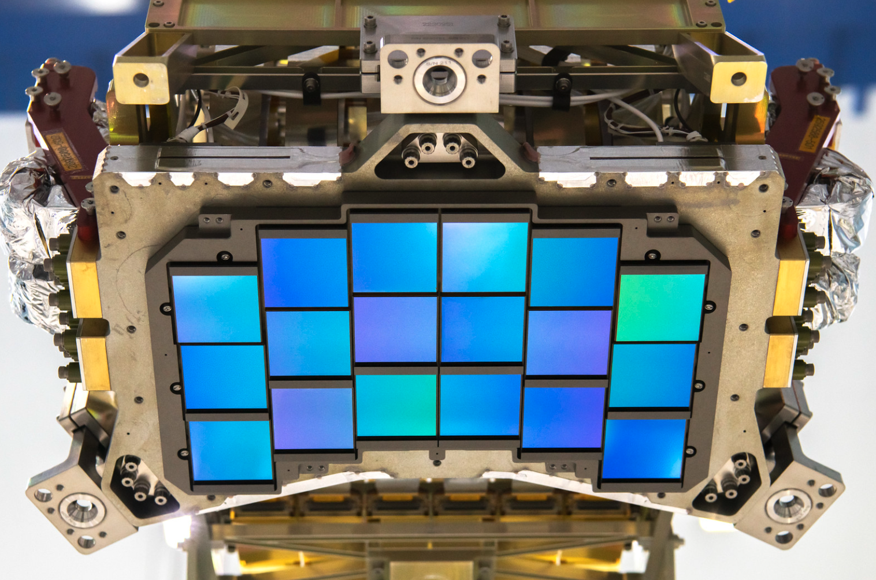
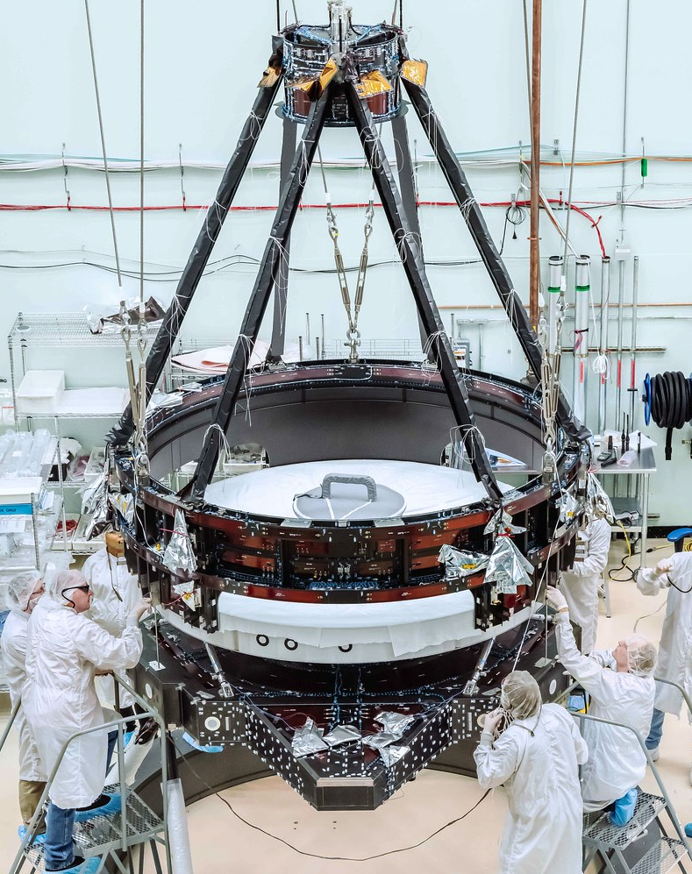

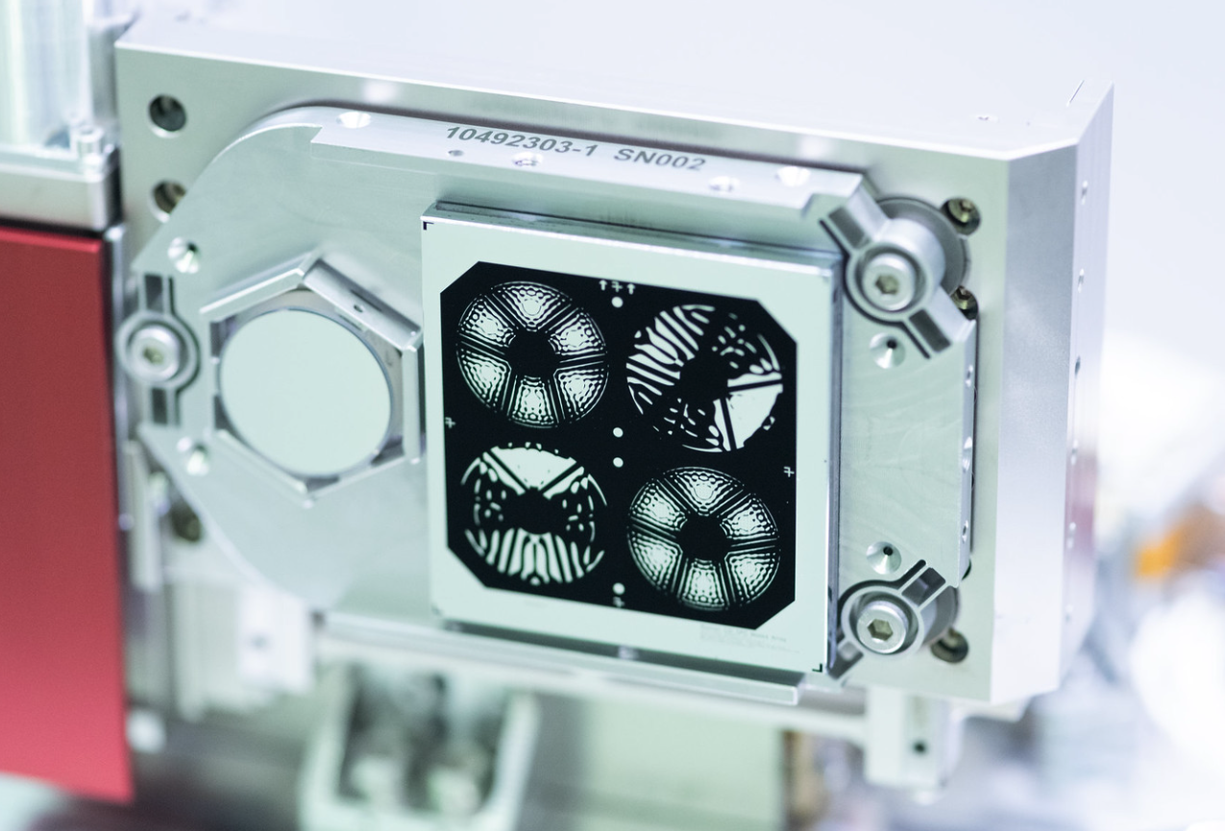
Roman Hardware Status:
Wide Field Instrument: Boulder, CO
Telescope: Rochester, NY
Coronagraph: Pasadena, CA

Slide 12
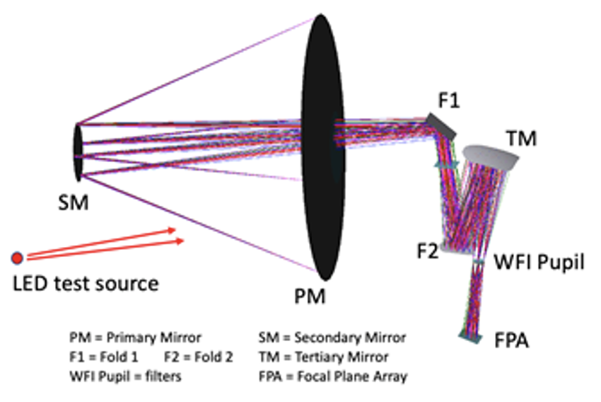
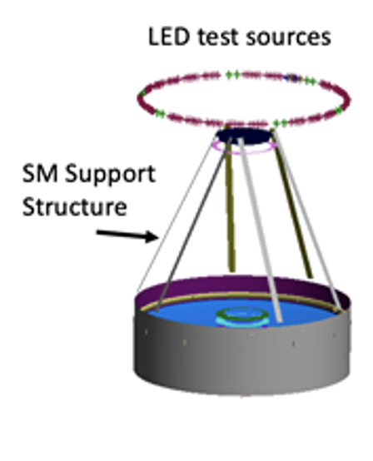
Roman Observatory Alignment Test Measurement
Purpose: to verify the “pupil alignment” interface between the telescope exit pupil and the entrance pupil of the Wide-Field Instrument (WFI).
Method: Multiple LED sources of light are illuminated one at a time towards the entrance pupil of the telescope (i.e. Primary mirror, PM), which projects shadows from the secondary mirror support structure and internal pupil masks located at the WFI entrance pupil.
These shadows are captured by the focal plane array (FPA), and are then analyzed for proper pupil alignment between the telescope and instrument (WFI).
The Machine Learning analysis approach described here is a crosscheck to the primary alignment verification analysis approach, which is described in this reference:
  SPIE O+P, 12677-21 Astronomical Optics: Design, Manufacture, and Test of Space and Ground Systems IV
Figure 1. Test source concept for creating shadows at the focal plane array of RST

Slide 13
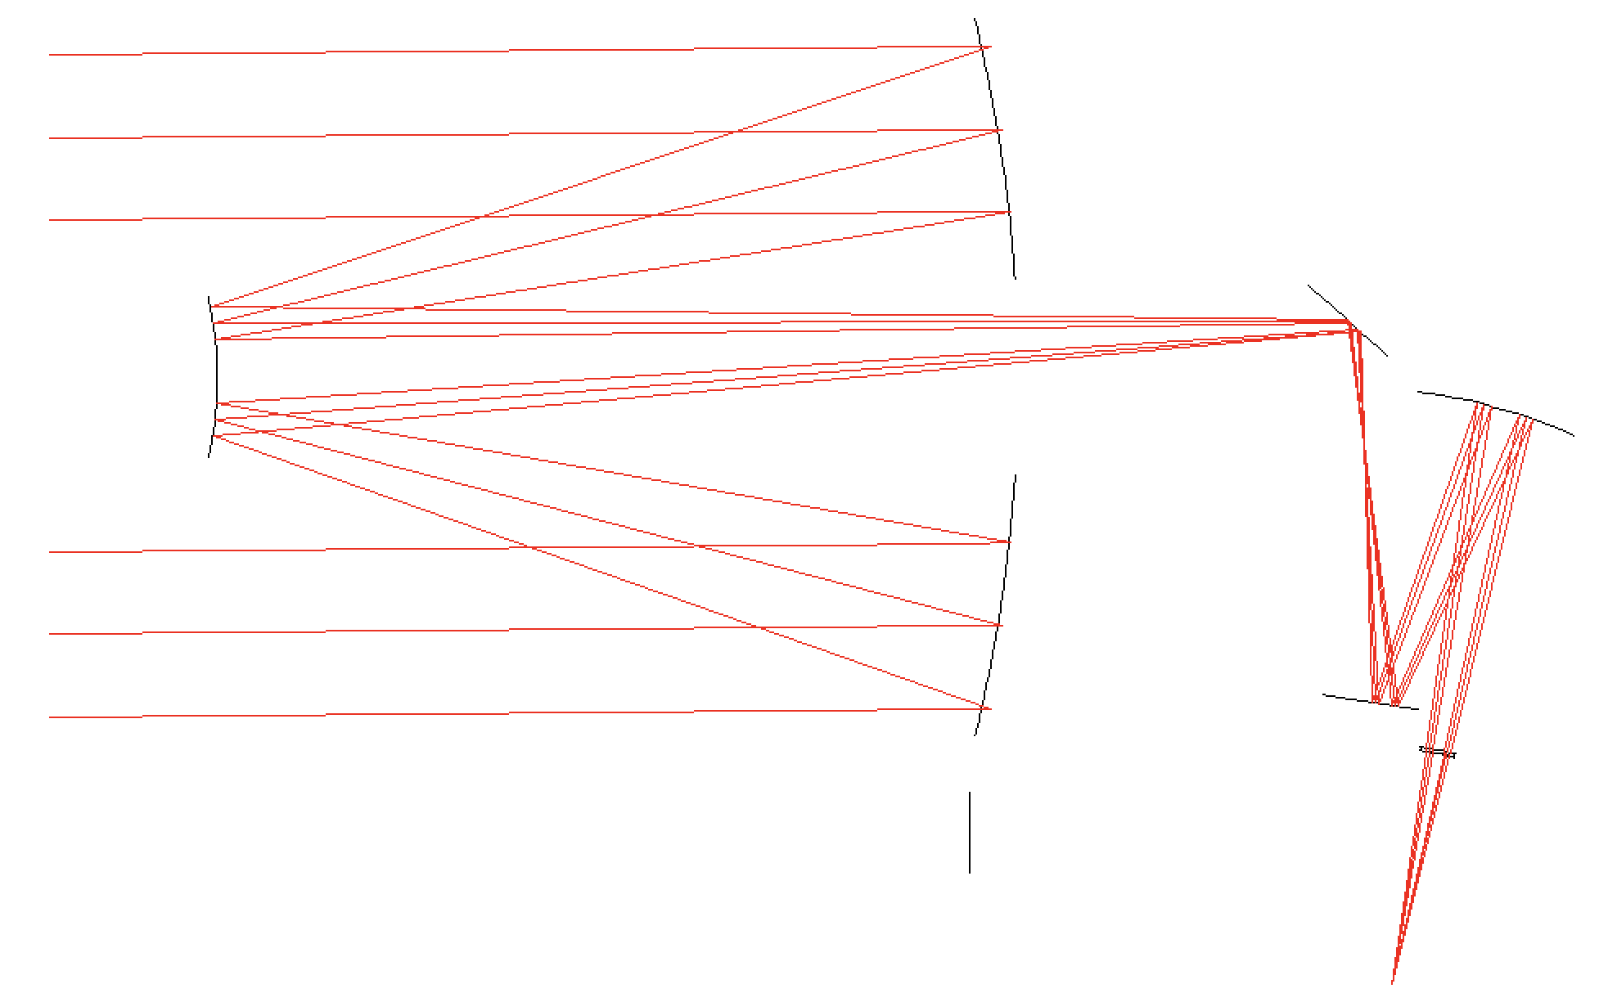
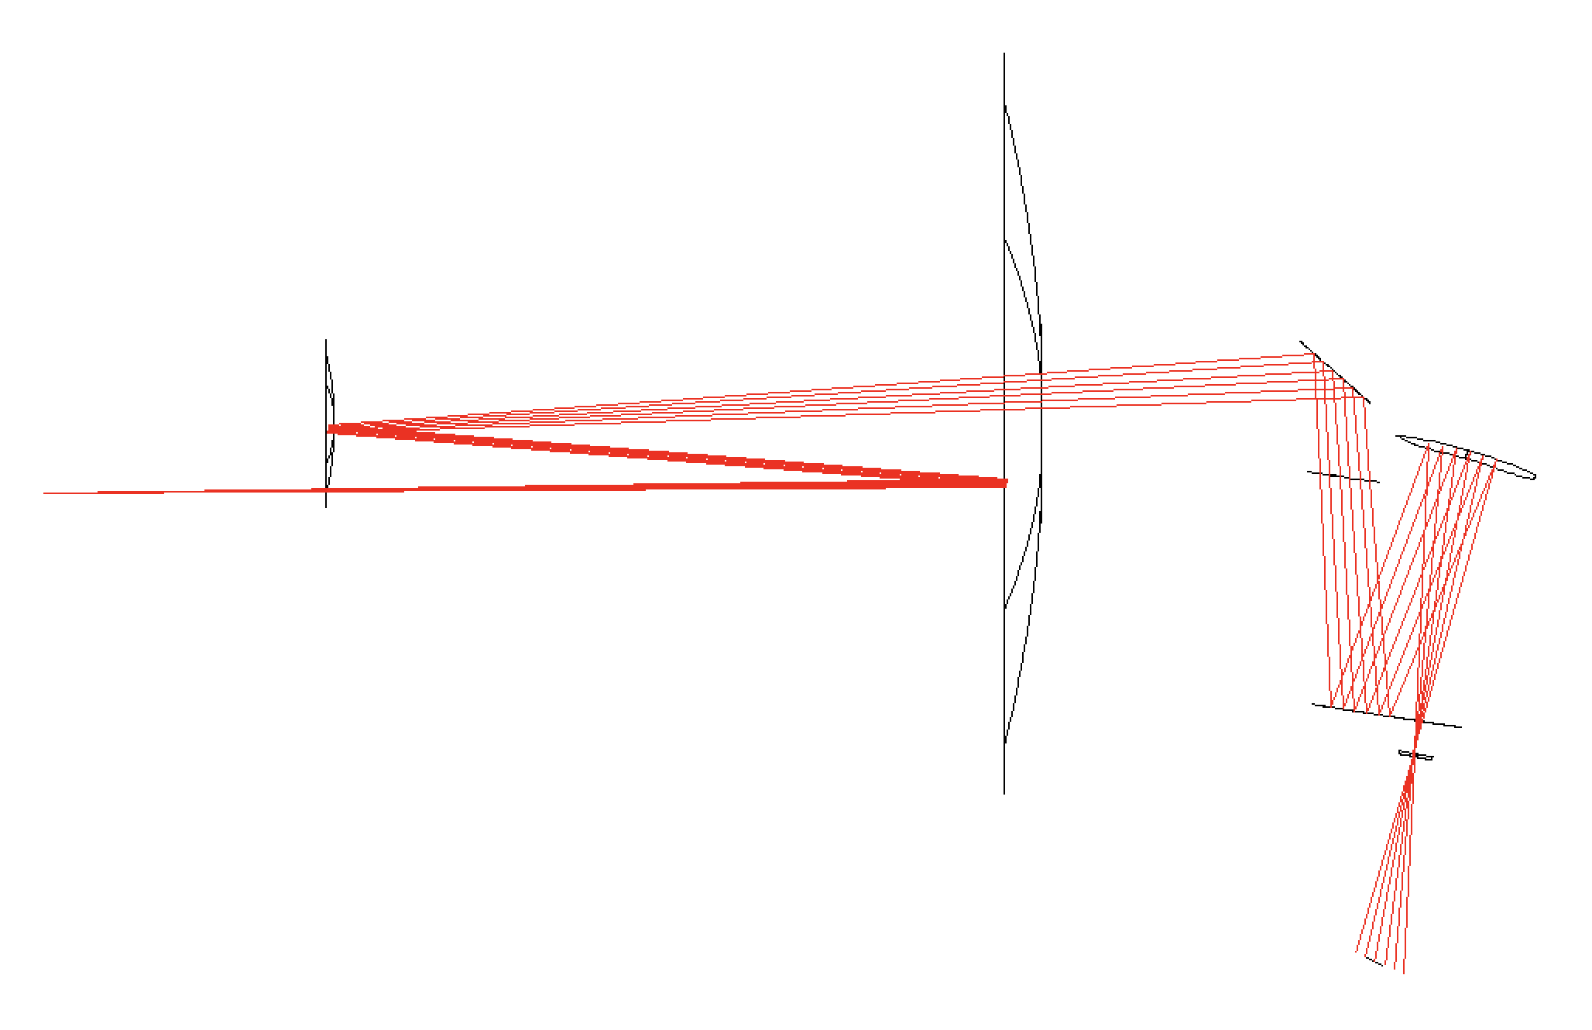
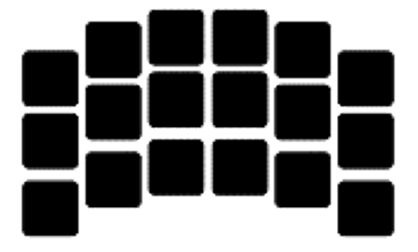

Star vs. LED as source for Roman
Star
LED
LED
Light is in focus.
Light is spread out at focal plane, with shadows.

Slide 14
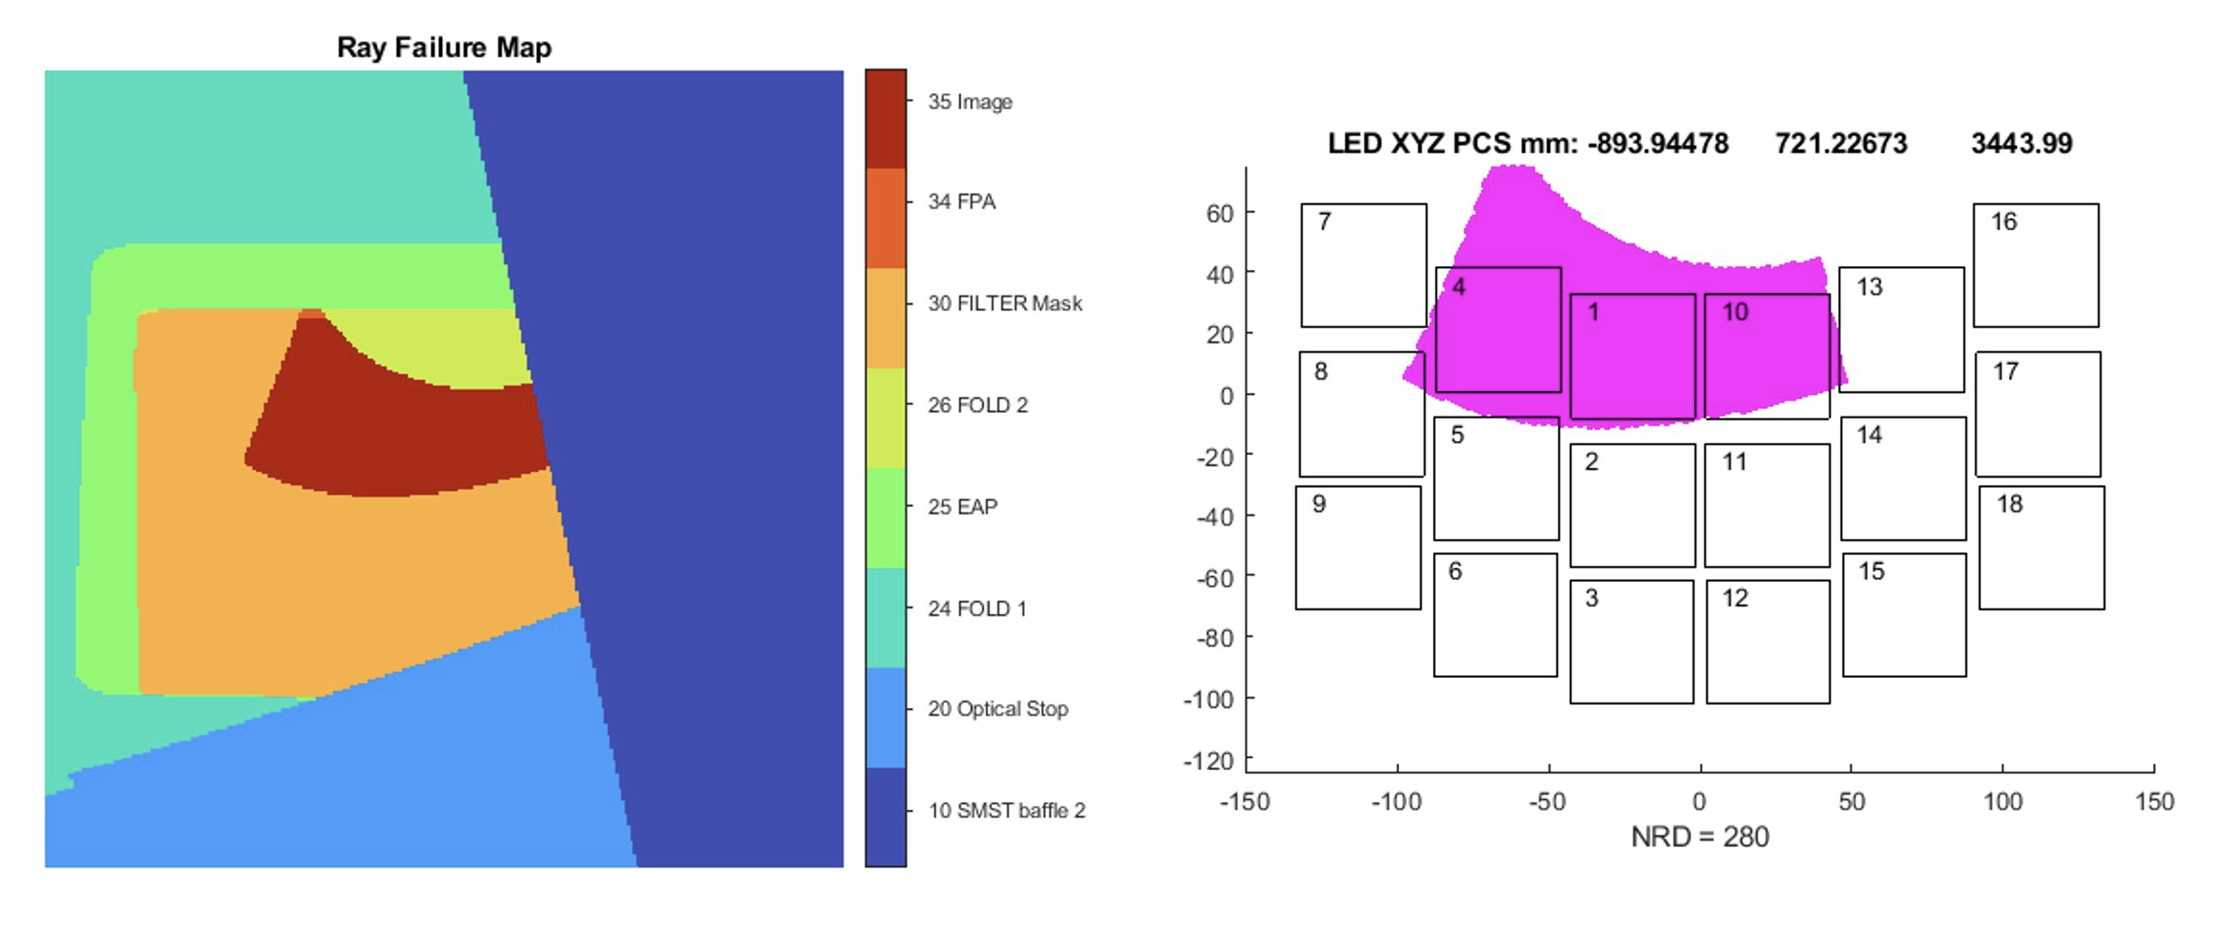
Ray Failure Maps
Ray failure maps help provide intuition of what surfaces are causing the edges of the shadows at the focal plane array.
In this example, a baffle on the strut holding the secondary mirror (i.e. telescope entrance pupil space) is adjacent to shadows from the filter mask (i.e. instrument entrance pupil).

Slide 15
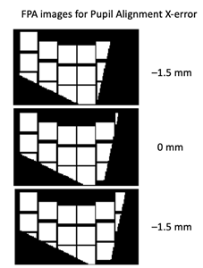
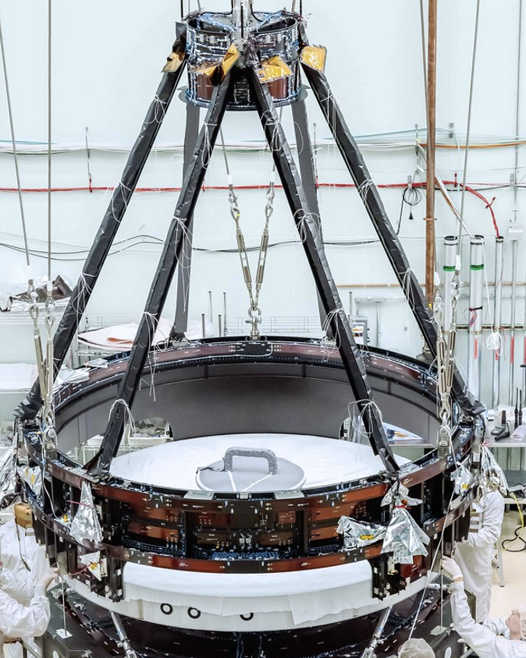
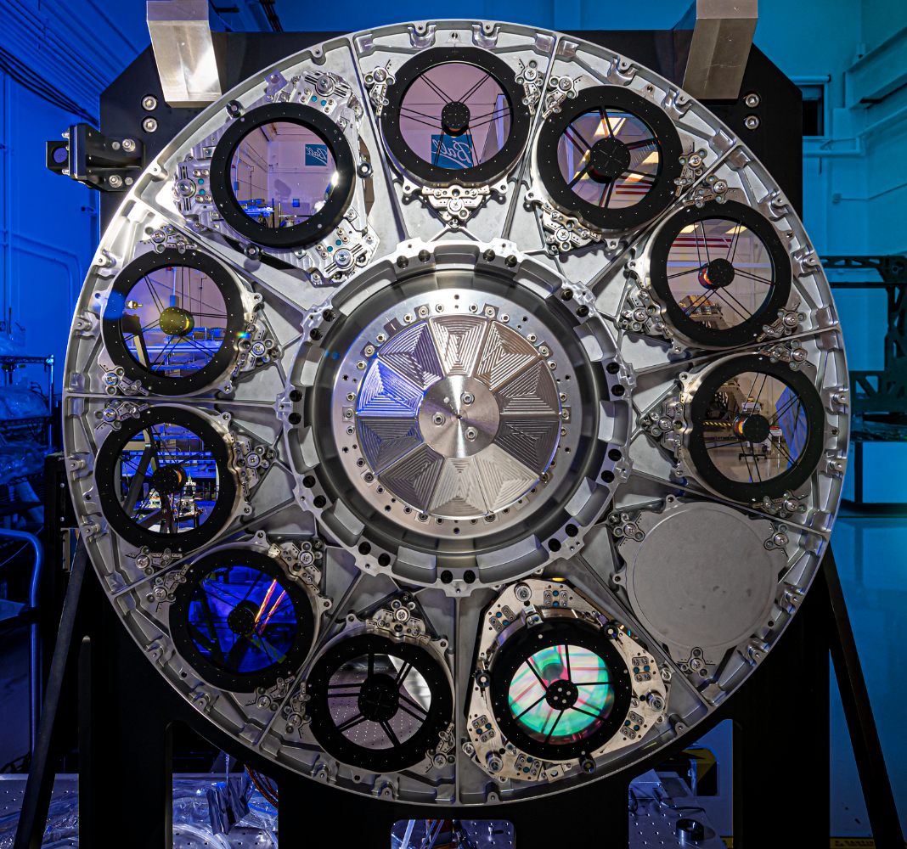
Example Images showing sensitivity due to X pupil shear
In the example shown on the left, the shadow edges move noticeably due to a pupil shear of +/– 1.5 mm.
To quantify this pupil alignment between the telescope and the Wide-Field Instrument (WFI), we can analyze LED image edges which are caused by the Secondary mirror struts at the telescope entrance pupil and a similar shaped mask at the WFI entrance pupil.
Two WFI pupil masks are used, one a “skinny mask” that is nominally hidden under the Telescope struts, and another “fat mask” where the struts are hidden by the WFI pupil mask.
Figure 2. Example with X pupil shear
Telescope Entrance Pupil
Instrument Entrance Pupil Masks

Slide 16
Machine Learning (ML) approach for Roman Optical Alignment
Generate a large dataset (e.g. 1500) of modeled LED images from a Monte-Carlo analysis
  Each sample represents a telescope to instrument mis-alignment case, and contains images from multiple LEDs.
  Tag each sample with the actual misalignments used in make the images (e.g. Pupil shear value, etc.)
  Split the data randomly into training (e.g. 960), validation (e.g. 240), testing (e.g. 300) sets
Pre-Process the images to make them readily accessible by the neural network
  Such as converting XY datasets to image files (e.g. .png or .jpeg)
Train a neural network on the training subset of the generated images (such as 80%)
  Choose a specific architecture of neural network (#, layers, etc.)
Validate the network on the validation subset of the training data (typically 20%)
  This subset of data monitors the training of the network, using the same sets of data to see how well the training is improving with each “epoch” of training.
Test the network (20%)
  This is the final performance check of the trained network.
  If the results “pass” the requirements, then the network is ready to be applied!

Slide 17




Interns for developing the Roman Alignment Test
NASA interns helped us get started on this crosscheck effort…
Three majoring in Computer Engineering/Science, and one in optics.
Tuong Phung
MIT
Jan 2022
Summer 2022
Ariba Khan
MIT
Jan 2023
Brian Daley
Columbia University
Summer 2023
Sam Becker
Univ of Rochester
Summer 2023

Slide 18
1. Generate Image Dataset
Image generation method
CODE V raytrace
Matlab reconstruction and raytrace
Image dataset properties
24 LEDs (12 clocking, 12 shear)
2 filter masks (F184 and F158)
1 mm pixel detectors (i.e. 40x40)
111 optical model Monte Carlo variables:
  Filter mask shear and clocking
  STOP location
  SMST Baffle locations
  FPA location
  LED location
3 variables to train/recover
Pupil x/y shear: Filter mask lateral
Pupil clocking: Filter mask clocking
Primary Difference between datasets is the LED source location uncertainty:
Low uncertainty (knowledge)
  LED ring: +/- 3.15 mm
  3300 Monte Carlo samples
High uncertainty (placement)
  LED ring: +/- 7 mm
  Individual LED: +/- 1 mm
  2500 Monte Carlo samples

Slide 19
3 Neural Network Architectures From 3 Interns
Input
384 × 512 × 1
Input
5472 × 1
Input
5472 × 1
× 48
Input
1,250,000 × 1
Dropout (25%)
1,250,000 × 1
3×3 Convolution
384 × 512 × 32
ReLu
384 × 512 × 32
2×2 Max Pool
192 × 256 × 32
FC
32 × 1
ReLu
32 × 1
FC
32 × 1
ReLu
32 × 1
Fully Connected
50 × 1
Normalization
50 × 1
ReLu
50 × 1
3×3 Convolution
192 × 256 × 64
ReLu
192 × 256 × 64
2×2 Max Pool
96 × 128 × 64
FC
16 × 1
ReLu
16 × 1
FC
16 × 1
ReLu
16 × 1
…
Fully Connected
20 × 1
Normalization
20 × 1
ReLu
20 × 1
3×3 Convolution
96 × 128 × 64
ReLu
96 × 128 × 64
2×2 Max Pool
48 × 64 × 64
Concatenate
768 × 1
Fully Connected
3 × 1
Flatten
196,608 × 1
Fully Connected
64 × 1
ReLu
64 × 1
Fully Connected
32 × 1
ReLu
32 × 1
Fully Connected
3 × 1
Fully Connected
3 × 1
Model A
41.9 million weights
Model B
11.7 million weights
Model C
8.4 million weights

Slide 20
Model A Details
Developed Summer ’22 by Tuong Phong
Simple architecture
  3× fully connected layers
  Dropout and normalization layers to reduce overfitting
  ~ 40 million weights
Preprocessing
  Discard pixels that don’t change
  Reduces data size
Neural network variables (hyperparameters):
  Dropout rate
  Fully connected layer size
  Number of fully connected layers
  Nonlinearity type
Input
1,250,000 × 1
Dropout (25%)
1,250,000 × 1
Fully Connected
50 × 1
Normalization
50 × 1
ReLu
50 × 1
Fully Connected
20 × 1
Normalization
20 × 1
ReLu
20 × 1
Fully Connected
3 × 1

Slide 21
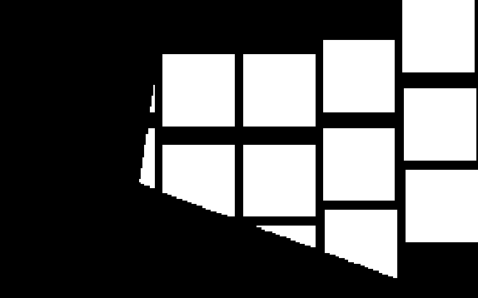

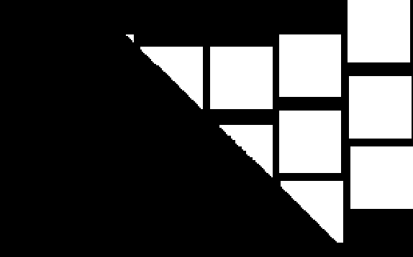
Model A Preprocessing
Step 1: flatten all images from a sample into a row vector
Motivation: fully connected layer requires the input to be a vector, not a 2D array

Slide 22
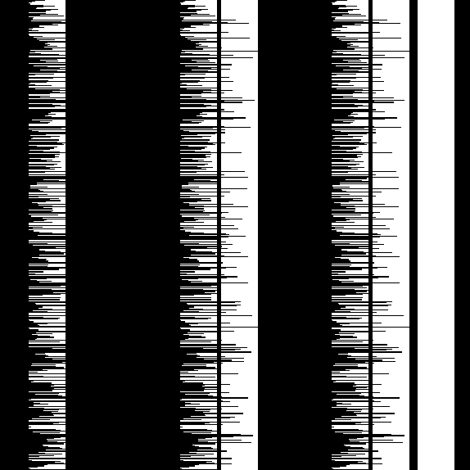
Model A Preprocessing
Step 1: flatten all images from a sample into a row vector
Step 2: combine the rows from each sample of the dataset into a table
Motivation: each column represents the variation of a single pixel across the dataset

Slide 23
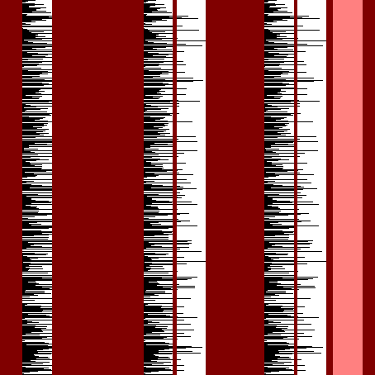

Model A Preprocessing
Step 1: flatten all images from a sample into a row vector
Step 2: combine the rows from each sample of the dataset into a table
Step 3: remove
constant columns/pixels
Motivation: removes unused data; decreases data/model size by 60%

Slide 24
Model B Details
Developed January ’23 by Ariba Khan
Deeper architecture (more layers than Model A)
  3× 2D convolution and max pooling layers; takes advantage of spatial structure of data
  2× fully connected layers
  11.7 million weights; pooling reduces layer size
Preprocessing to reduce size
  Resize images to 64x64;
  Tile images to adapt to 1 image input
Neural network variables (hyperparameters):
  Convolution kernel size
  Number of convolutional kernels
  Pooling size
  Number of convolution layers
  Fully connected layer size
  Number of fully connected layers
Input
384 × 512 × 1
3×3 Convolution
384 × 512 × 32
ReLu
384 × 512 × 32
2×2 Max Pool
192 × 256 × 32
3×3 Convolution
192 × 256 × 64
ReLu
192 × 256 × 64
2×2 Max Pool
96 × 128 × 64
3×3 Convolution
96 × 128 × 64
ReLu
96 × 128 × 64
2×2 Max Pool
48 × 64 × 64
Flatten
196,608 × 1
Fully Connected
64 × 1
ReLu
64 × 1
Fully Connected
3 × 1

Slide 25
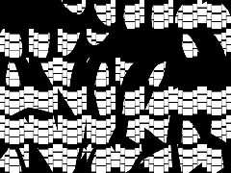


Model B Preprocessing
Step 1: Downscale each image
Step 2: Tile images into a single large image
165 × 265 × 48
64 × 64 × 48
384 × 512

Slide 26
Model C Details
Developed Summer ’23 by Brian Daley
Multi-input architecture
  48× inputs, one per image
  2× fully connected layers per image
  Concatenation layer
  2× additional fully connected layers
  8.4 million weights
Border preprocessing technique
  Shadow position information is contained in the intersection of the shadow edge and the detector border
  Remove redundant middle pixels to reduce input size
Neural network variables (hyperparameters)
  Number of fully connected layers
  Size of fully connected layers
Input
5472 × 1
Input
5472 × 1
× 48
FC
32 × 1
ReLu
32 × 1
FC
32 × 1
ReLu
32 × 1
FC
16 × 1
ReLu
16 × 1
FC
16 × 1
ReLu
16 × 1
…
Concatenate
768 × 1
Fully Connected
32 × 1
ReLu
32 × 1
Fully Connected
3 × 1

Slide 27











Model C Preprocessing
For each detector in an image:

Slide 28

Model C Preprocessing
For each detector in an image:
Step 1: select border pixels
Motivation: information is contained in the location of shadow edges; edge locations can be interpolated from their intersection with the detector borders

Slide 29
Model C Preprocessing
For each detector in an image:
Step 1: select border pixels
Step 2: unwrap/flatten border to a vector

Slide 30









Model C Preprocessing
For each detector in an image:
Step 1: select border pixels
Step 2: unwrap/flatten border to a vector
Step 3: concatenate vectors for all detectors

Slide 31
3. Neural Network Training
The preprocessed dataset is separated into training and validation sets
The training dataset is further divided into adjustable size batches
Model prediction error is quantified by a loss function, e.g. mean squared error
Layer weights are randomly initialized
At each iteration, layer weights are adjusted to reduce the prediction error on one batch
Amount of adjustment/step size is controlled by the learning rate hyperparameter
Dataset
Training set (80%)
Validation set (20%)
Batch
Batch
Batch
…

Slide 32
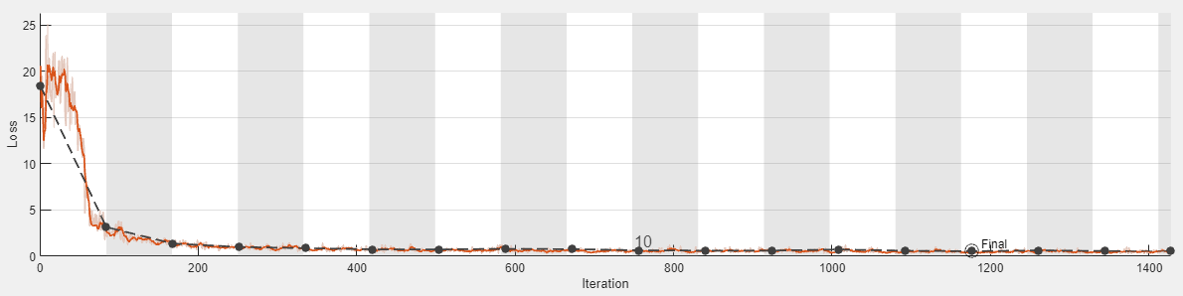
4. Neural Network Validation
An epoch consists of one run through the complete training set of batches
After each epoch, evaluate loss on the validation set
When validation loss stops decreasing, training is finished (early stopping)
Below is an example of a training progress plot (loss vs. iteration) generated by MATLAB Deep Learning Toolbox
  Striped regions are epochs
  Points show validation loss for each epoch

Slide 33
6. Model Test Performance

Slide 34
Takeaways
Importance of preprocessing
  Preprocessing strategy is affected by what types of layers are used: preprocessing that removes spatial information prevents convolutional layers
  Preprocessing can reduce data and network size by removing redundant information
Keeping network size (number of weights) down is important
  Models that are too large lead to memory issues, slow training
  Too many adjustable weights can cause overfitting: network performs well on training set but poorly on test set because it is ‘memorizing’ the answers instead of learning generalizable features
Tuning network variables (hyperparameters) manually is effective but time consuming
  Bayesian optimization can automate and speed up tuning
More training samples helps, up to a point
  With our current models, we started to see diminishing returns after about 3000–4000 samples

Slide 35
Concluding Remarks
Model B shows the greatest promise going forward as we fine tune the process
Future Work
  Add more tolerances/uncertainties expected to see during the test.
  Increase the number of Monte-Carlo samples per dataset
Test date: 2025/2026
Launch date: 2027

