Slide 1


Installing Optimus System for Wall Pressures at 14x22
Christopher Cramer and Samantha Zauber
14-by 22-Foot Subsonic Tunnel
NASA Langley Research Center
58th Annual SATA Conference – June 2024

Slide 2
Agenda
Overview
14x22 and WICS Description
Project Objectives
Development Timeline
Installation and Integration
Validation Testing & Results
Challenges
Future Enhancements

Slide 3
Overview
NASA recently invested in upgrading 14x22’s aging PSI 8400 electronically scanned pressure (ESP) measurement system with the TE Connectivity Optimus System
The focus for the project was two-fold
  Hardware replacement and installation
  Software integration with Test SLATE
This presentation provides a summary of the project objectives, development timeline, validation process and results, challenges, and future upgrade plans

Slide 4
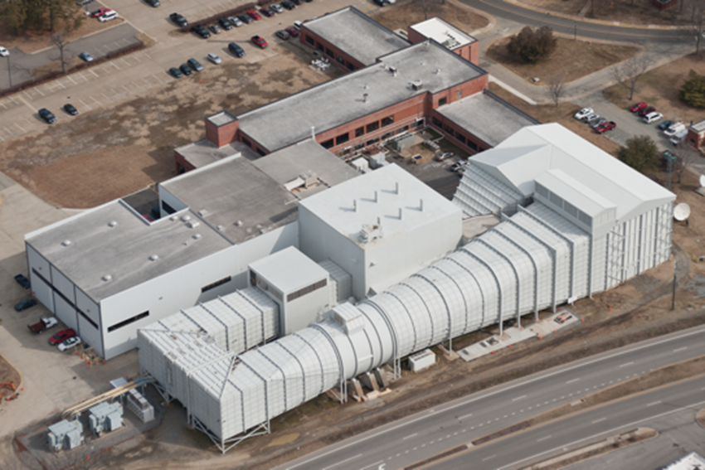
14x22 Description
Test Section Size
  14.5 ft x 21.75 ft x 50 ft
  4.4 m x 6.6 m x 15.2 m
Closed Jet
  Max Speed: 348 ft/sec
  (106 m/sec)
  Max unit Reynolds Number:
  2.2x10⁶/ft (7.2x10⁶/m)
Open Jet
  Max Speed: 275 ft/sec
  (84 m/sec)
  Max unit Reynolds Number:
  1.7x10⁶/ft (5.6x10⁶/m)
Usage
  Aircraft, Spacecraft, Rotorcraft
  Ground Effect, Acoustic

Slide 5
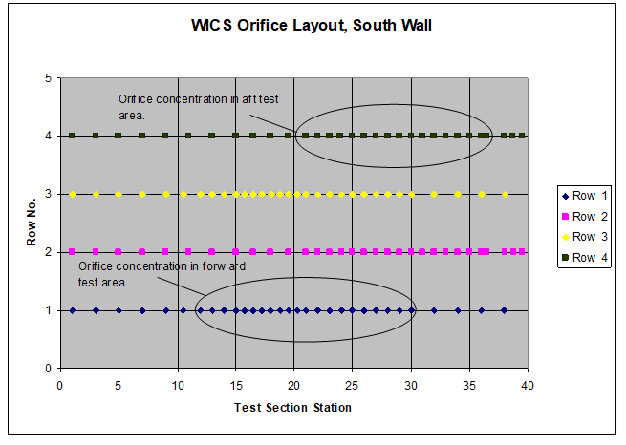
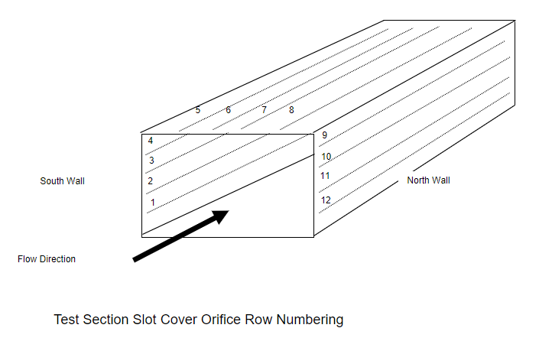
Wall Interference Correction System (WICS) at 14x22
WICS Concept
  The WICS system provides test-time wall pressure distributions for comparison to empty-tunnel data to define changes in the wall boundary condition resulting from the presence of the model
  Provides corrections to dynamic pressure and model angle of attack
  Utilizes large array of pressure orifices
  Accuracy requirements for pressure measurements are stringent
  Measurement stability is critical
Pressure Orifice Row Numbering
Pressure Orifice Spacing

Slide 6
Project Objectives
Replacement of aging PSI 8400 system with newest generation TE Connectivity Optimus
Integration of Optimus software into Test SLATE data acquisition system by Ground Data Systems (GDS)
Why Optimus?
  “Like for Like” system replacement
  Familiarity with ESP modules and troubleshooting methodologies
  Signal stability with Digital Temperature Compensation (DTC) and fiber optic data transfer
  Higher scan rates than the 8400
  Scalability
  Utilizes legacy components and infrastructure
Notes:
Scalability – reason we did not go with something like Scanivalve

Slide 7
Development Timeline
System Requirements Review
Oct 2022
Preliminary Design Review
Dec 2022
Critical Design Review
May 2023
Lab Development
May 2023 – Sep 2023
Lab Validation Testing
Sep 2023 – Jan 2024
Hardware Install
Feb 2024
Validation Testing
Feb 2024 – Mar 2024
Operational Readiness Review
Apr 2024

Slide 8
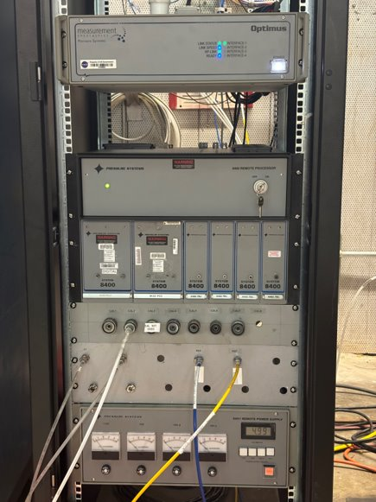
Installation and Integration
WICS Hardware:
  6 64-port DTC ESP modules with ±10” H₂O range
  1 Optimus System Processor
  1 remote Power Supply for mSDI
  1 remote Processor to house and control the PCUs and driven reference pressure
  Various cabling
Software integration
  Benchtop testing in lab environment offsite
  14x22 Test Engineers performed the lab acceptance testing of the system
  Able to resolve numerous software issues before tunnel installation
  Ongoing support from GDS
Notes:
Mentioning that GDS programmed custom Test SLATE drivers specifically for 14x22’s data system

Slide 9
Validation Testing Focus
Data Repeatability
  The test used the Common Research Model – High Lift (CRM-HL)
    A 10% scale model with significant blockage to fully test out the WICS system
    CRM-HL has been tested at 14x22 several times over many years so there is a database of historical data to compare to
    Model was already installed in the tunnel to prepare for upcoming test after maintenance downtime
Temperature Compensation
  Each DTC module was put in existing WICS module enclosures that used heaters for signal stability
  Heat was applied in each enclosure and then shut off and monitored over a period
Usability of the system
  Making sure test setup and calibration processes are clear and that personnel are trained and able to operate independently of the integration team

Slide 10
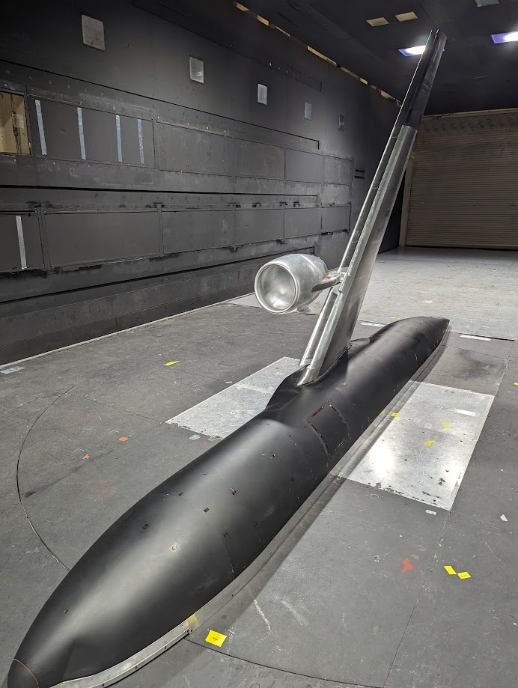
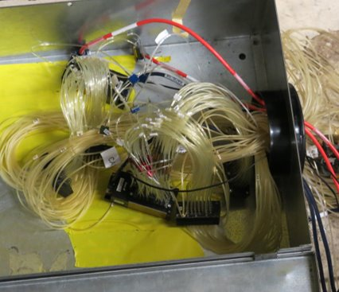
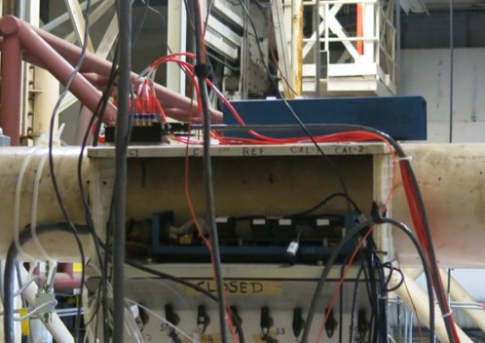
10% CRM-HL and WICS Hardware
Optimus mSDI
8400 IFC

Slide 11
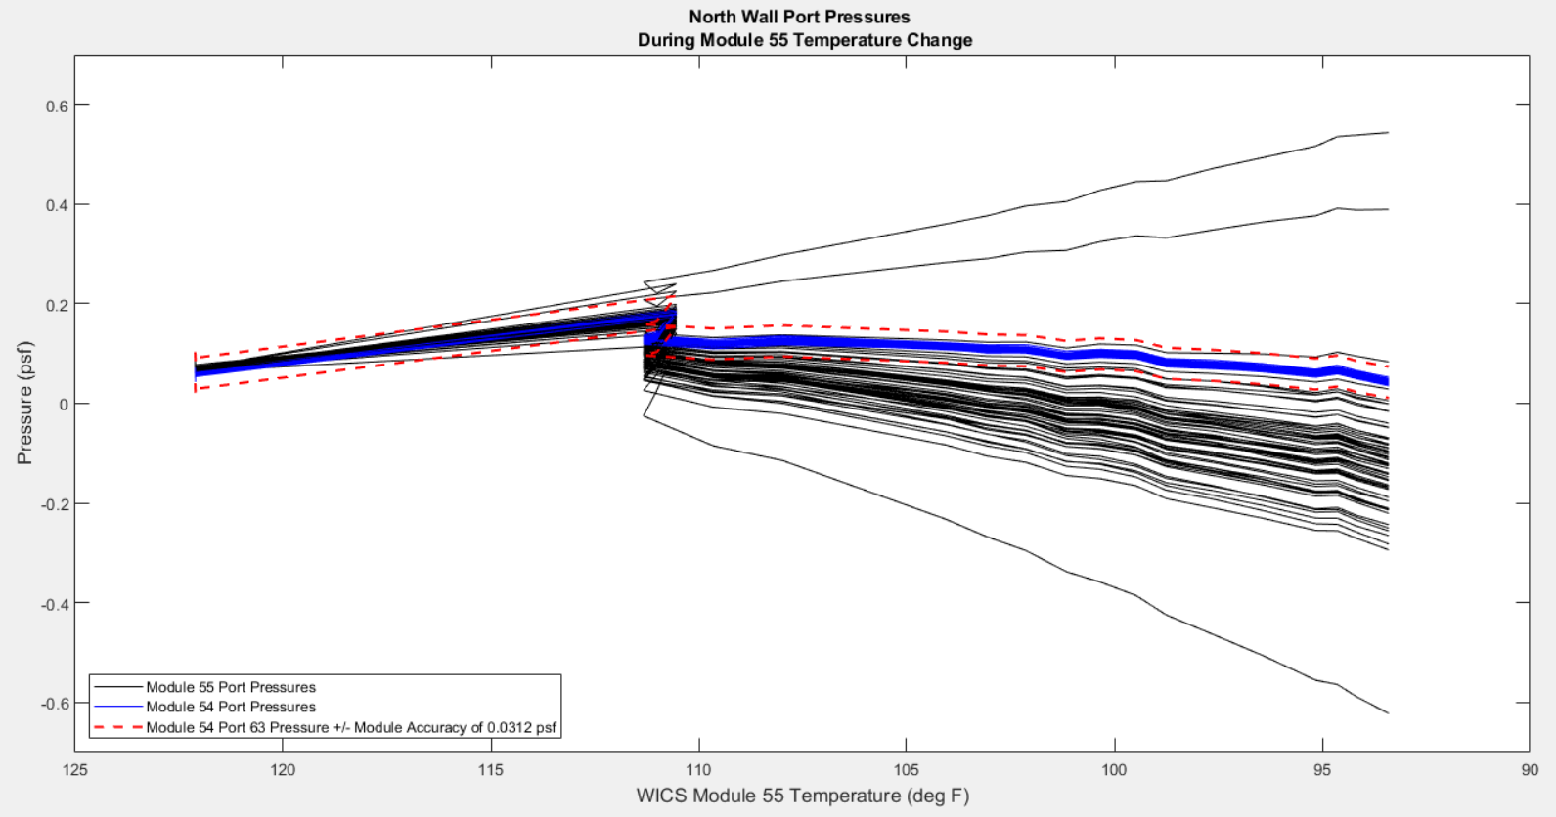
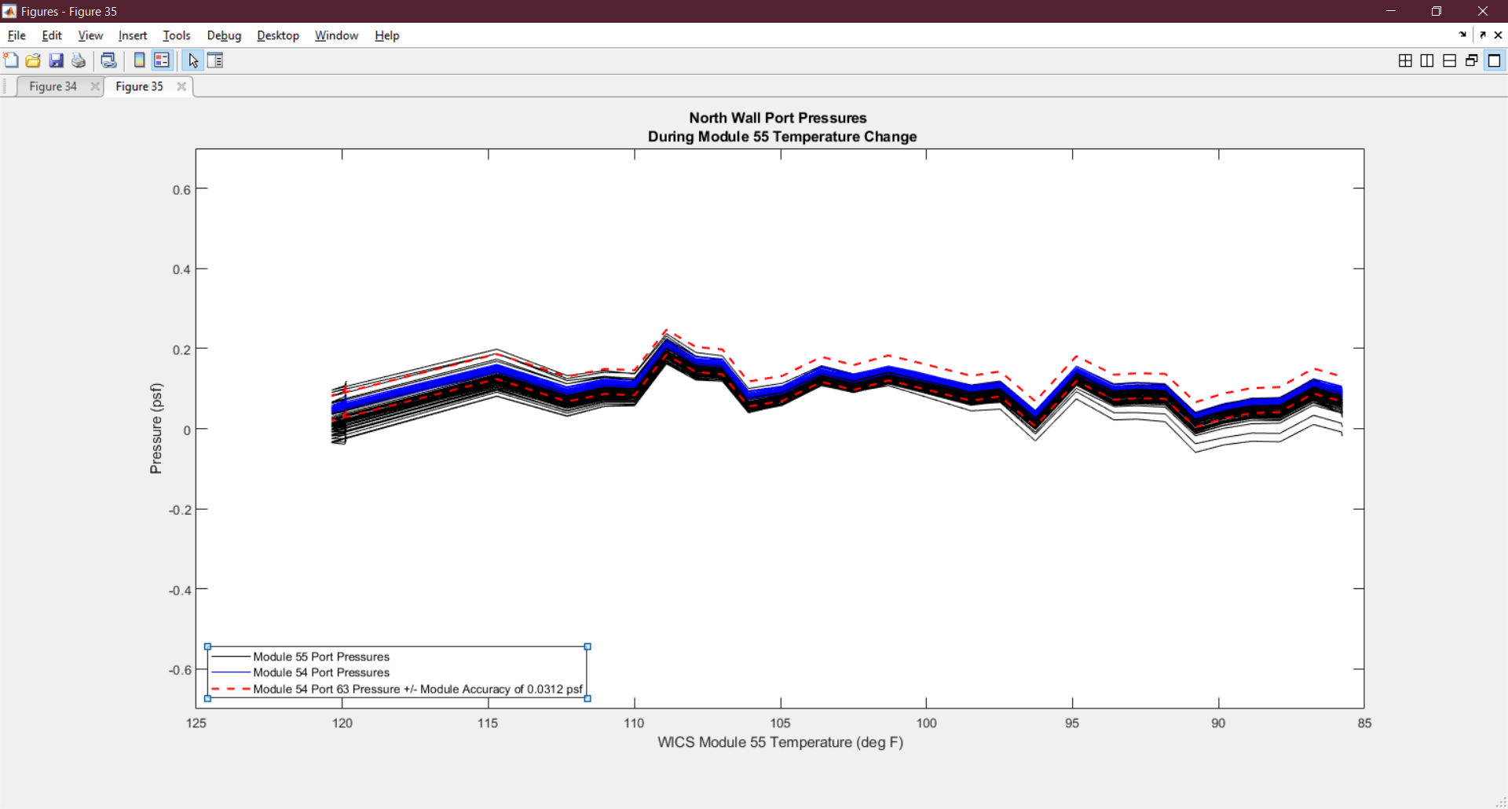
Temperature Compensation Assessment
  Initial test (left) revealed a dramatic shift in pressure data during a wind-off run with changing module enclosure temperatures
  Investigation revealed temperature compensation corrections were being applied when the Optimus system was initialized or restarted instead of at regular intervals during data acquisition
  After the temperature compensation frequency was changed to 1 Hz, the signals stabilized (right)

Slide 12
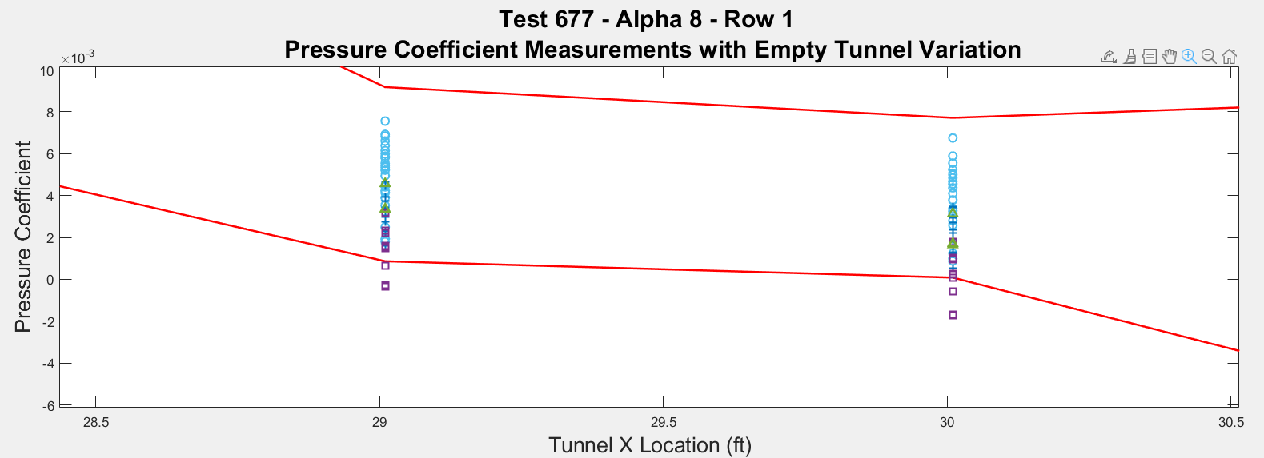
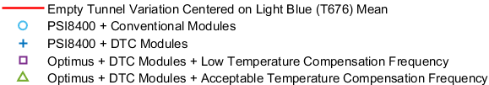
Repeatability Assessment
  Assessment was to ensure consistency across systems with potential for increased data quality
  Data was found to be repeatable across pressure system hardware configurations (8400 vs Optimus)
  Pressure coefficient variation is compared to database formed by multiple sets of empty tunnel data
  Purple outliers are with low temperature compensation frequency
PSI8400 and Optimus Data Overlap
Notes:
Potential for increased data quality via signal stability and temperature compensation, but not a major goal of the project – discuss that future enhancement include better understanding of the system’s capabilities.

Slide 13
Challenges
Long-term product support
  TE Connectivity has committed to providing support of purchased hardware through 2032
TE Connectivity communication issues
  Internal restructuring restricted previous points of contact
Fragile fiber optic cables
  Long cable runs
More hardware is needed to replace model 8400 system
  Back-to-back tests with models utilizing over 1000 pressures each
  Long lead time on modules – 1 year+
  Led to decision to only replace WICS hardware at this time

Slide 14
Future Enhancements
Facility Operations
  Define calibration frequency now that DTC corrections are inherent to each module
  Establish daily checkout best practices
  Determine system health status procedures and develop tools
  Replace remaining 8400 hardware (model system)
  Continued software support from GDS
Data Analysis
  Comparison with historical empty tunnel and characterization model data
    Check Standard Testing
  Measurement uncertainty characterization

Slide 15
Questions?

