Slide 1
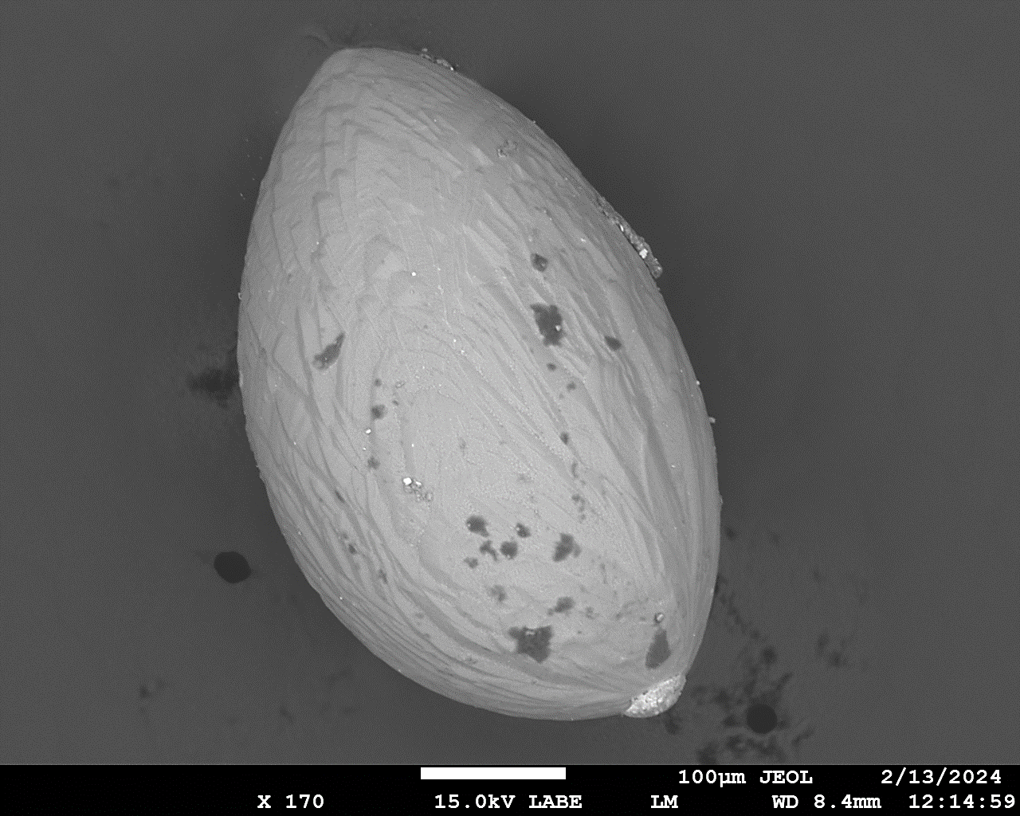
Cosmic Dust Collections Update
Dr. Marc Fries

Slide 2
Aircraft Collected Particles (ACP) IDP Collection
Small area collectors are on board WB-57 accumulating hours
Flight(s) for small area collectors on ER-2 are approved but still pending

Slide 3
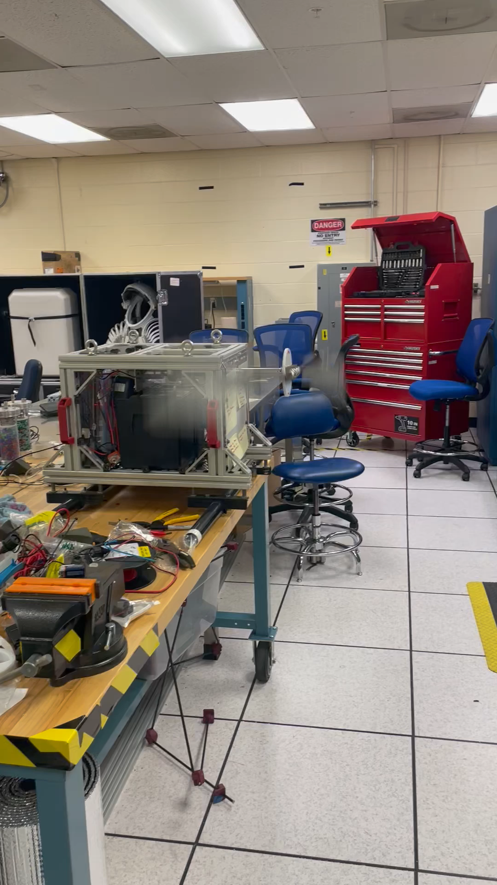
Balloon-Borne Cosmic Dust Collector (“Muninn”)
Intended to supplement aircraft collection
Balloons better suited to timed collection due to long flights
Product of two development cycles with Texas A&M undergraduates
First flight could occur this fall, delays are paperwork not hardware

Slide 4
Muninn Flight Status
~98% complete
Awaiting an engineering study required by NASA Balloon office
  Expensive, difficult to obtain engineering time
At this time, we cannot guarantee that Muninn will fly. This project was deferred by ARES in FY 2022 as we identify an appropriate venue for conducting the engineering study. As of this time, we have not identified a viable option

Slide 5
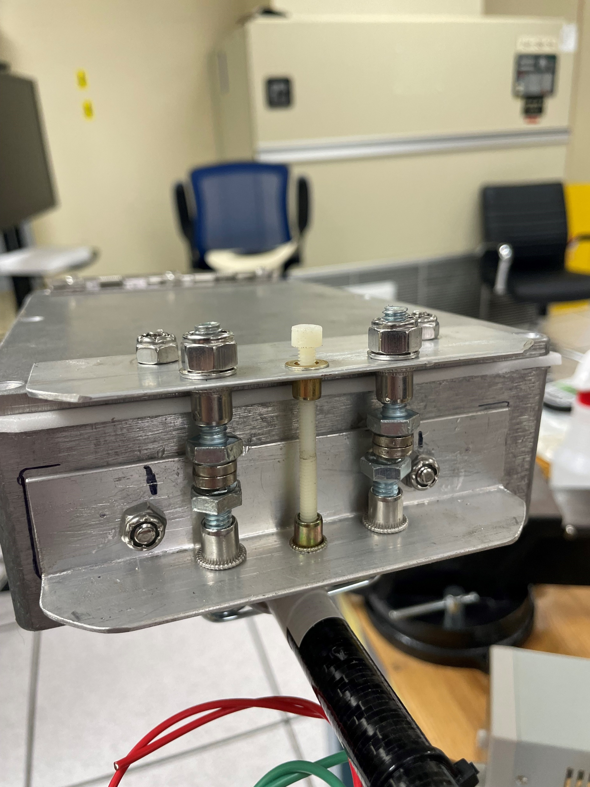
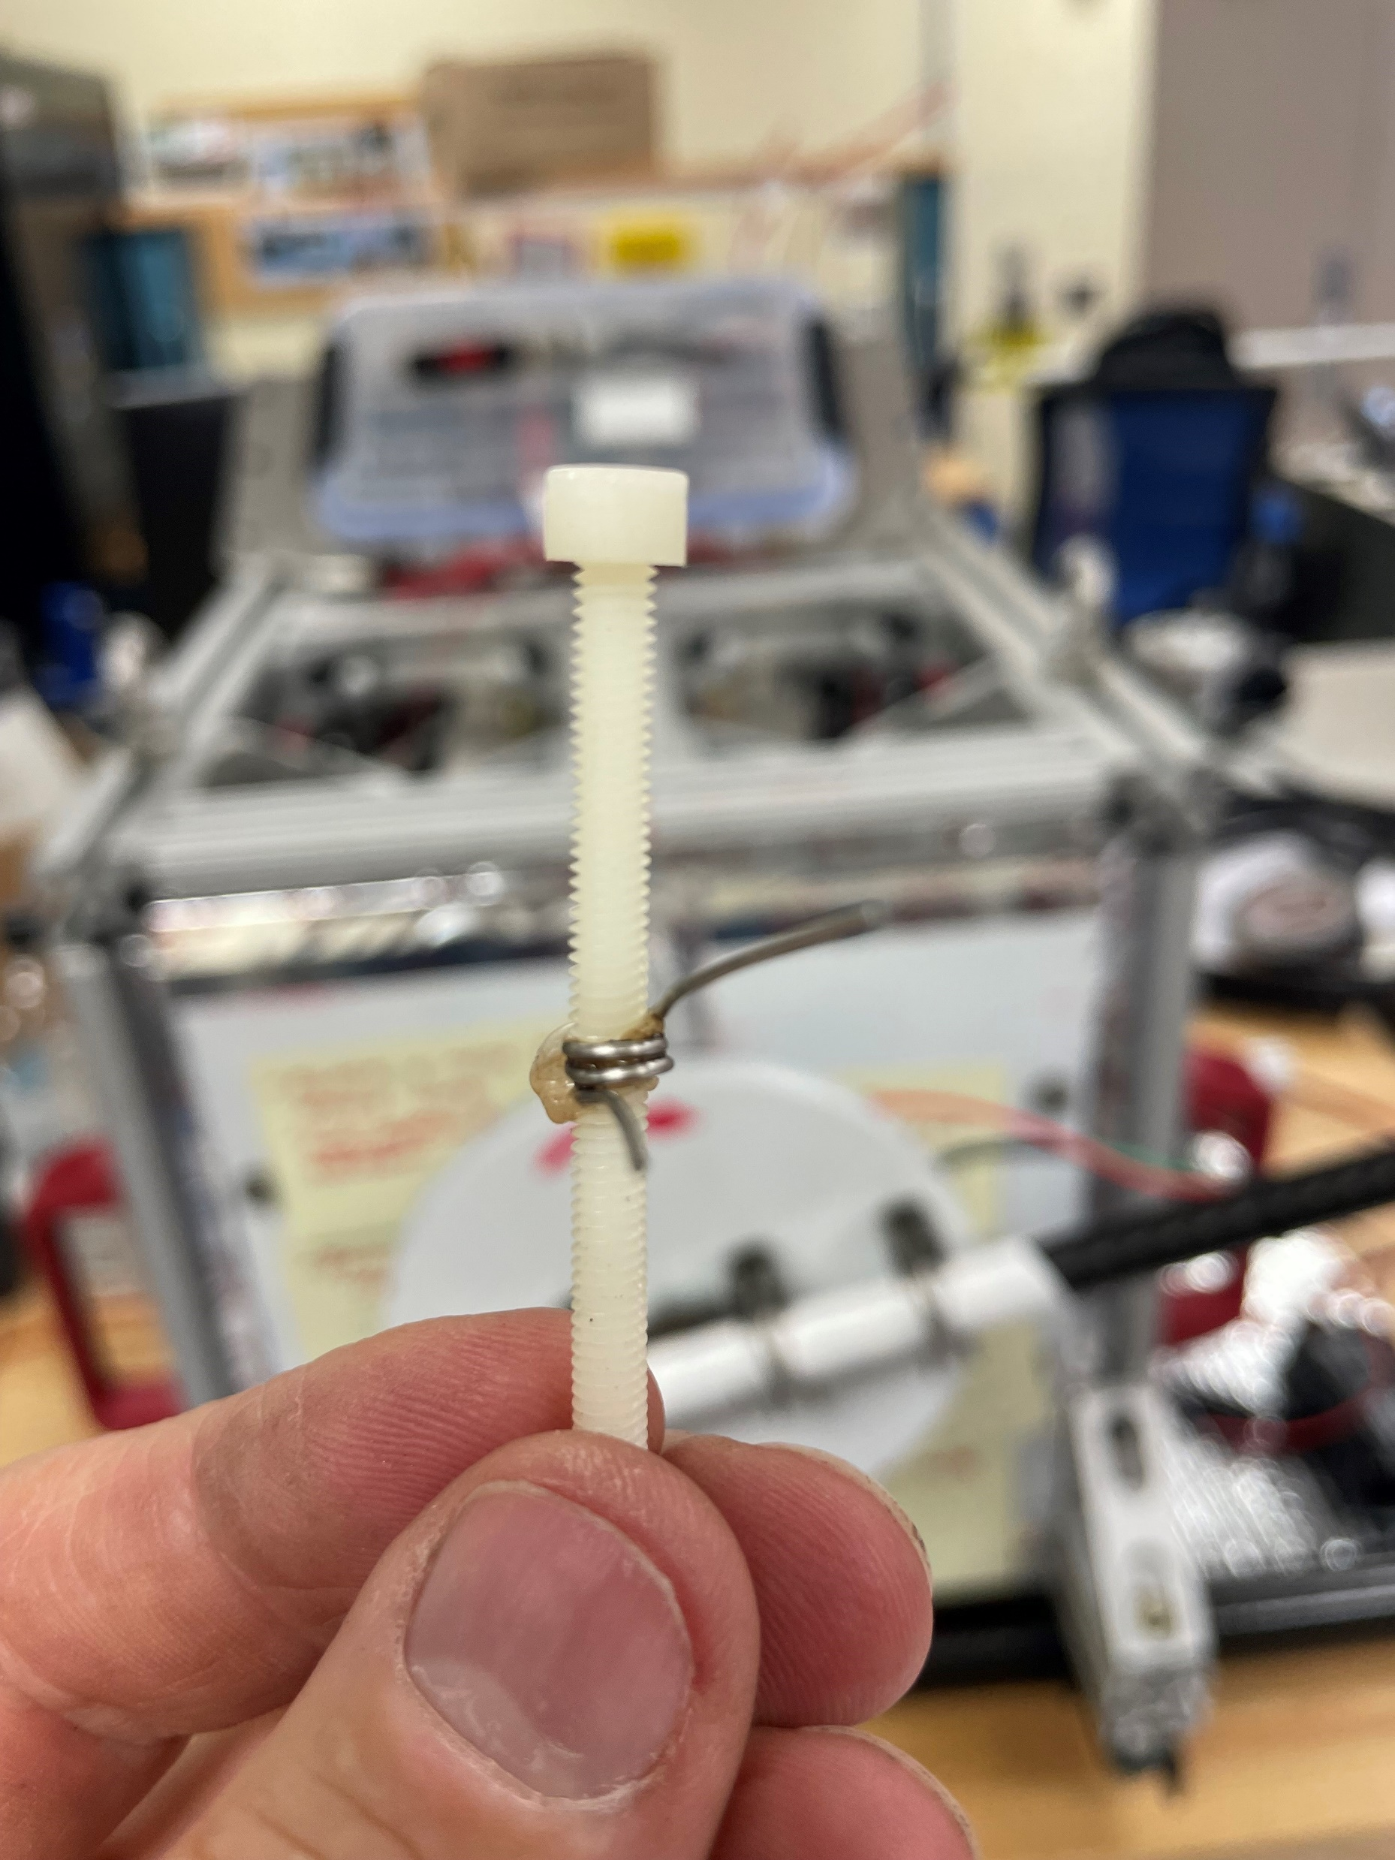
Muninn Collector Boxes
Boxes are held shut with adjustable magnets
Post-collection, melt a pair of nylon bolts together to lock the door

Slide 6
South Pole Water Well (SPWW) Micrometeorites
The micrometeorite collection is available for request and we have received our first sample request
First request is for relatively rare unmelted MMs, will require a significant percentage of those available in the collection
Lucky for us, South Pole MMs are a renewable supply
More South Pole MM recovery?

Slide 7
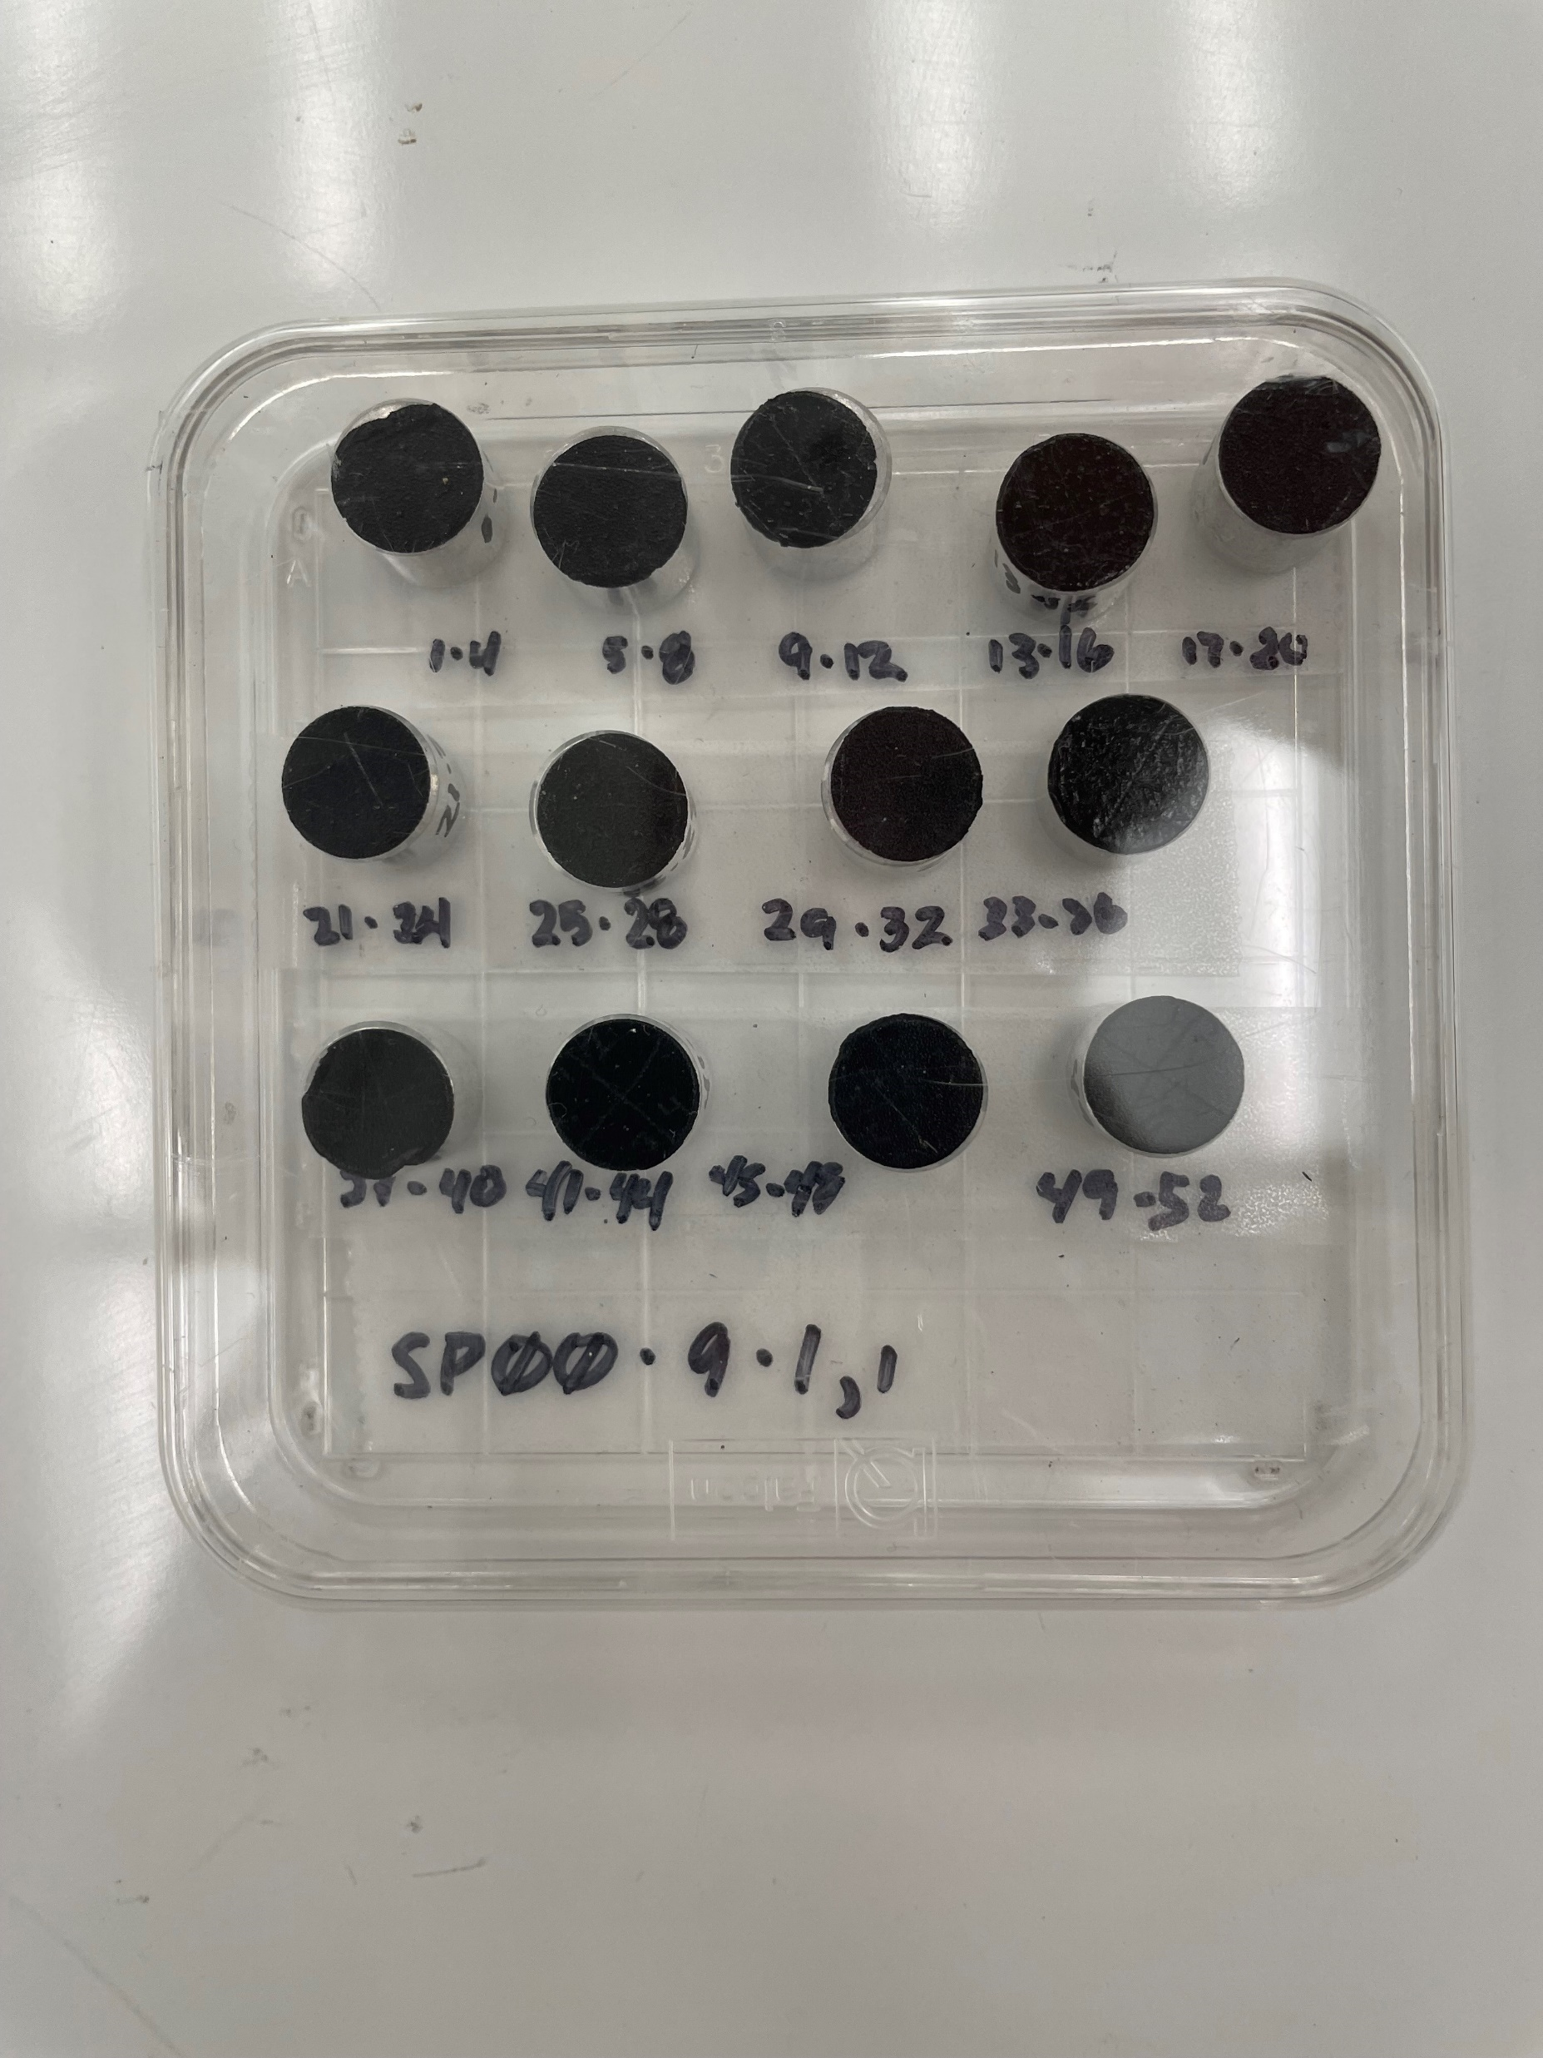
SEM Stub Mounting
Almost all of the SPWW MMs are in grain mounts, making allocation difficult
  Grain mounts have up to over 100 MMs in them, have to allocate the entire mount
We are mounting a representative sample of MMs on SEM stubs, taken from loose MM samples
Four per mount, adhered to carbon film and carbon coated

Slide 9
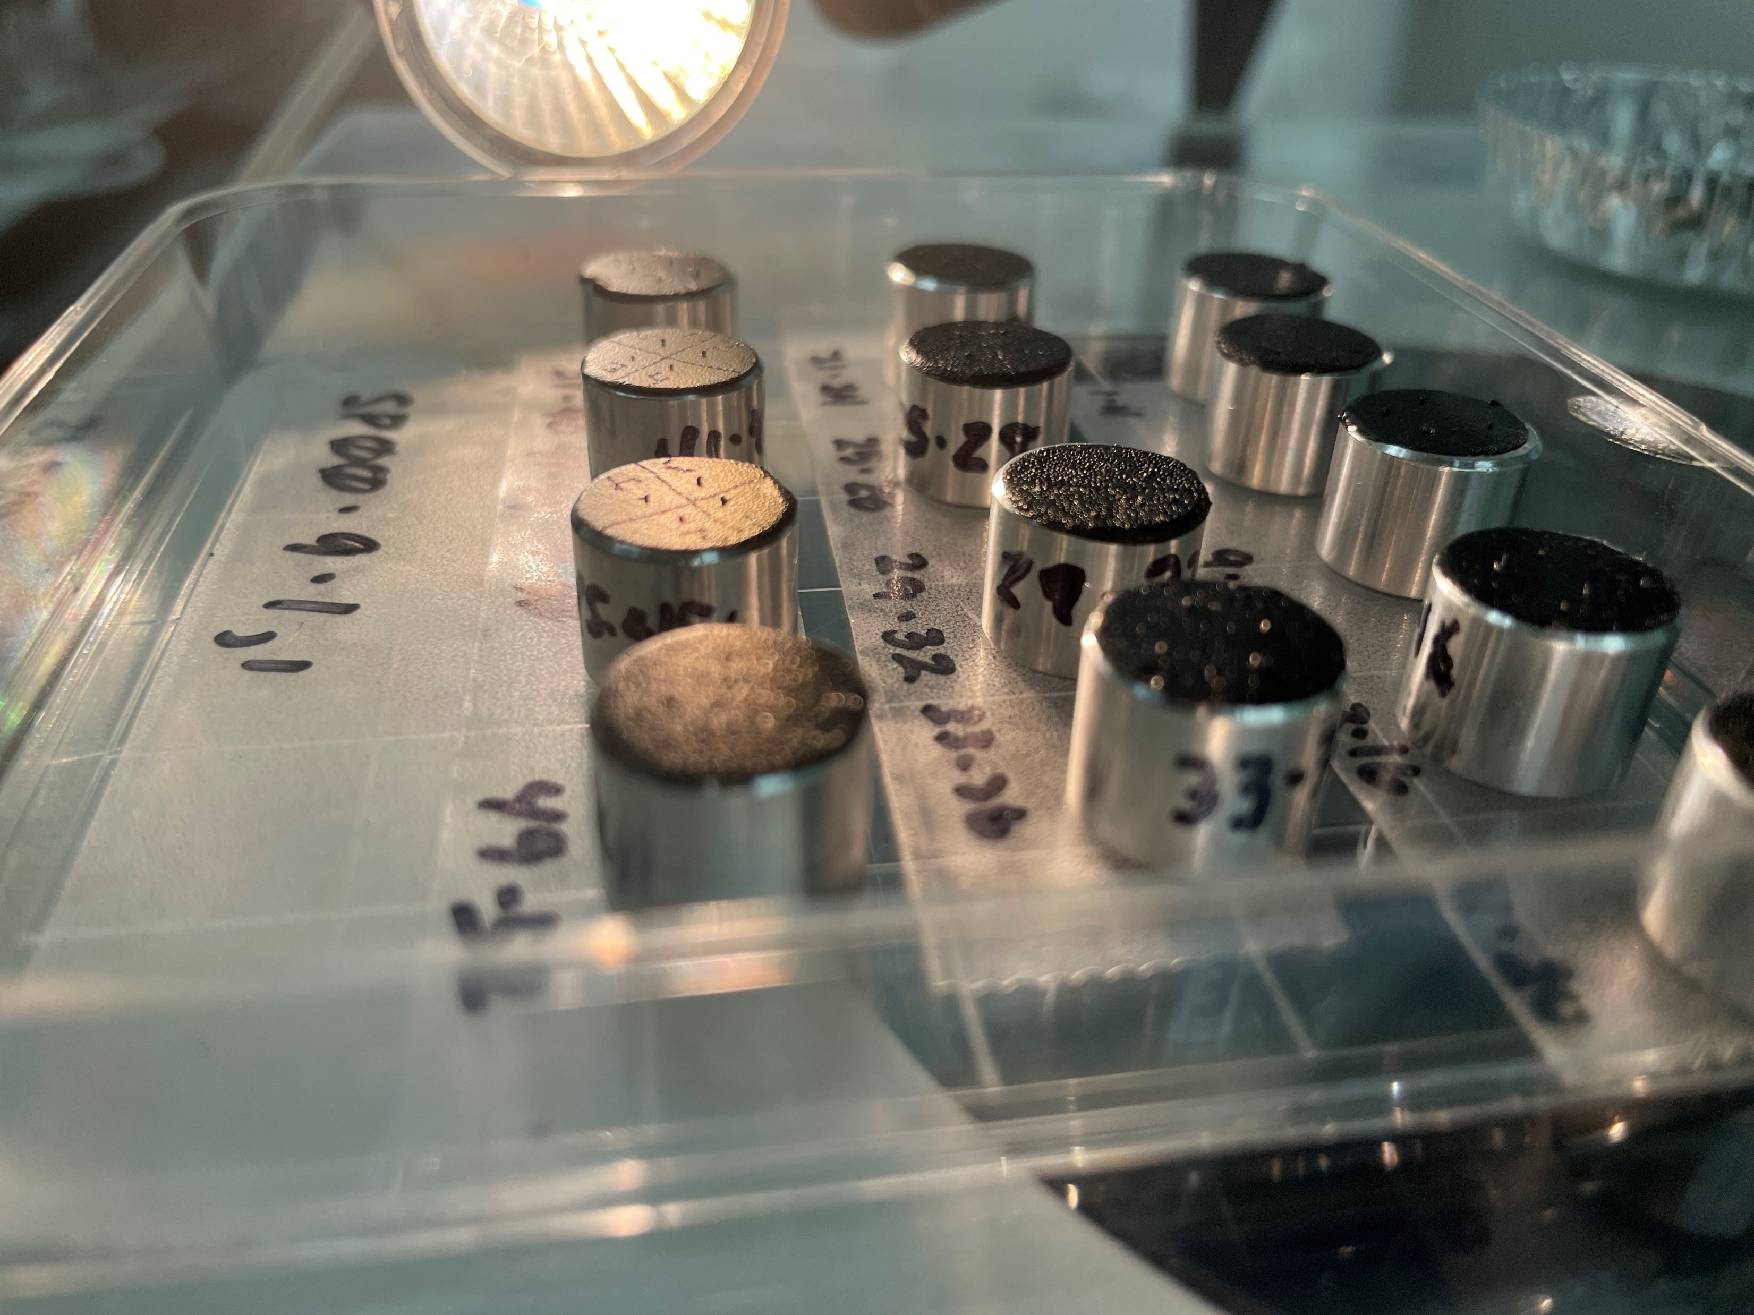

Slide 10
South Pole Air (SPA) Collection
Problem with the filters:
  they have adhered to the plastic bag they were originally packed in
  the filters have degraded, probably due to sulfuric acid droplets
Performed a trial with a small filter piece with no visible IDPs, attempting to separate the layers. The filter broke into small pieces and did not separate from the bag readily
All pores are filled with an amorphous solid, Raman indicates this is sulfate

Slide 11
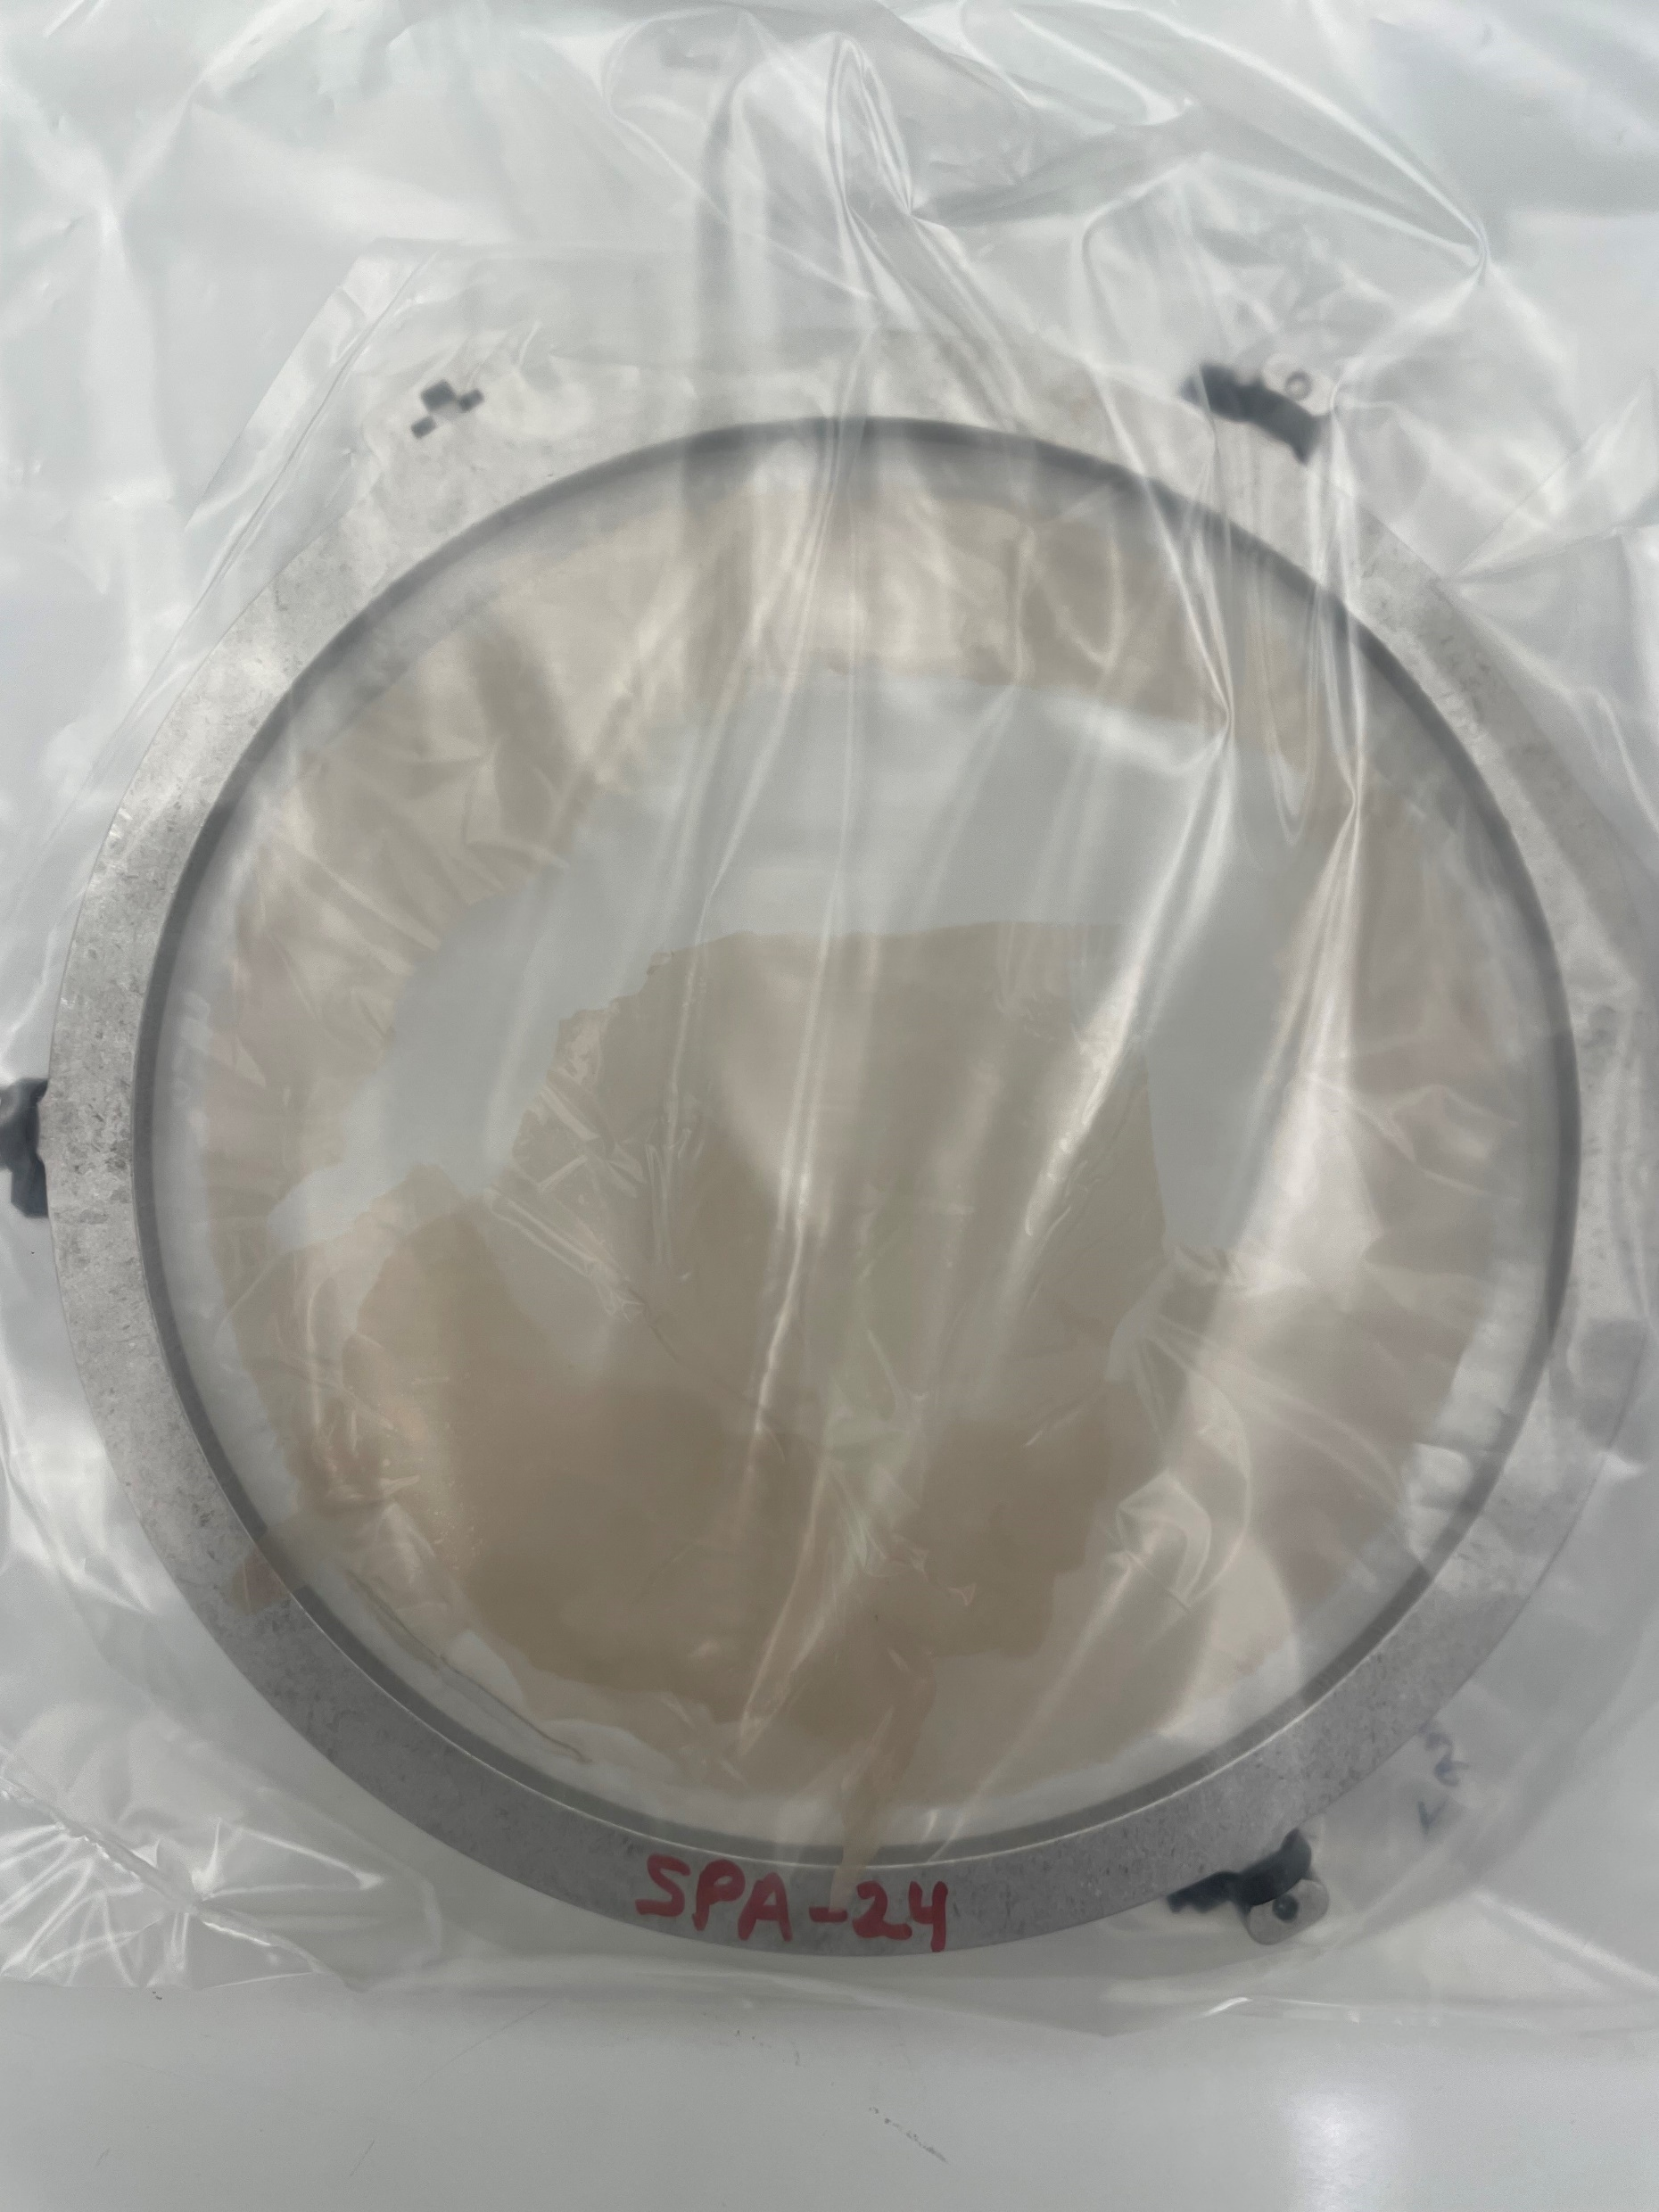
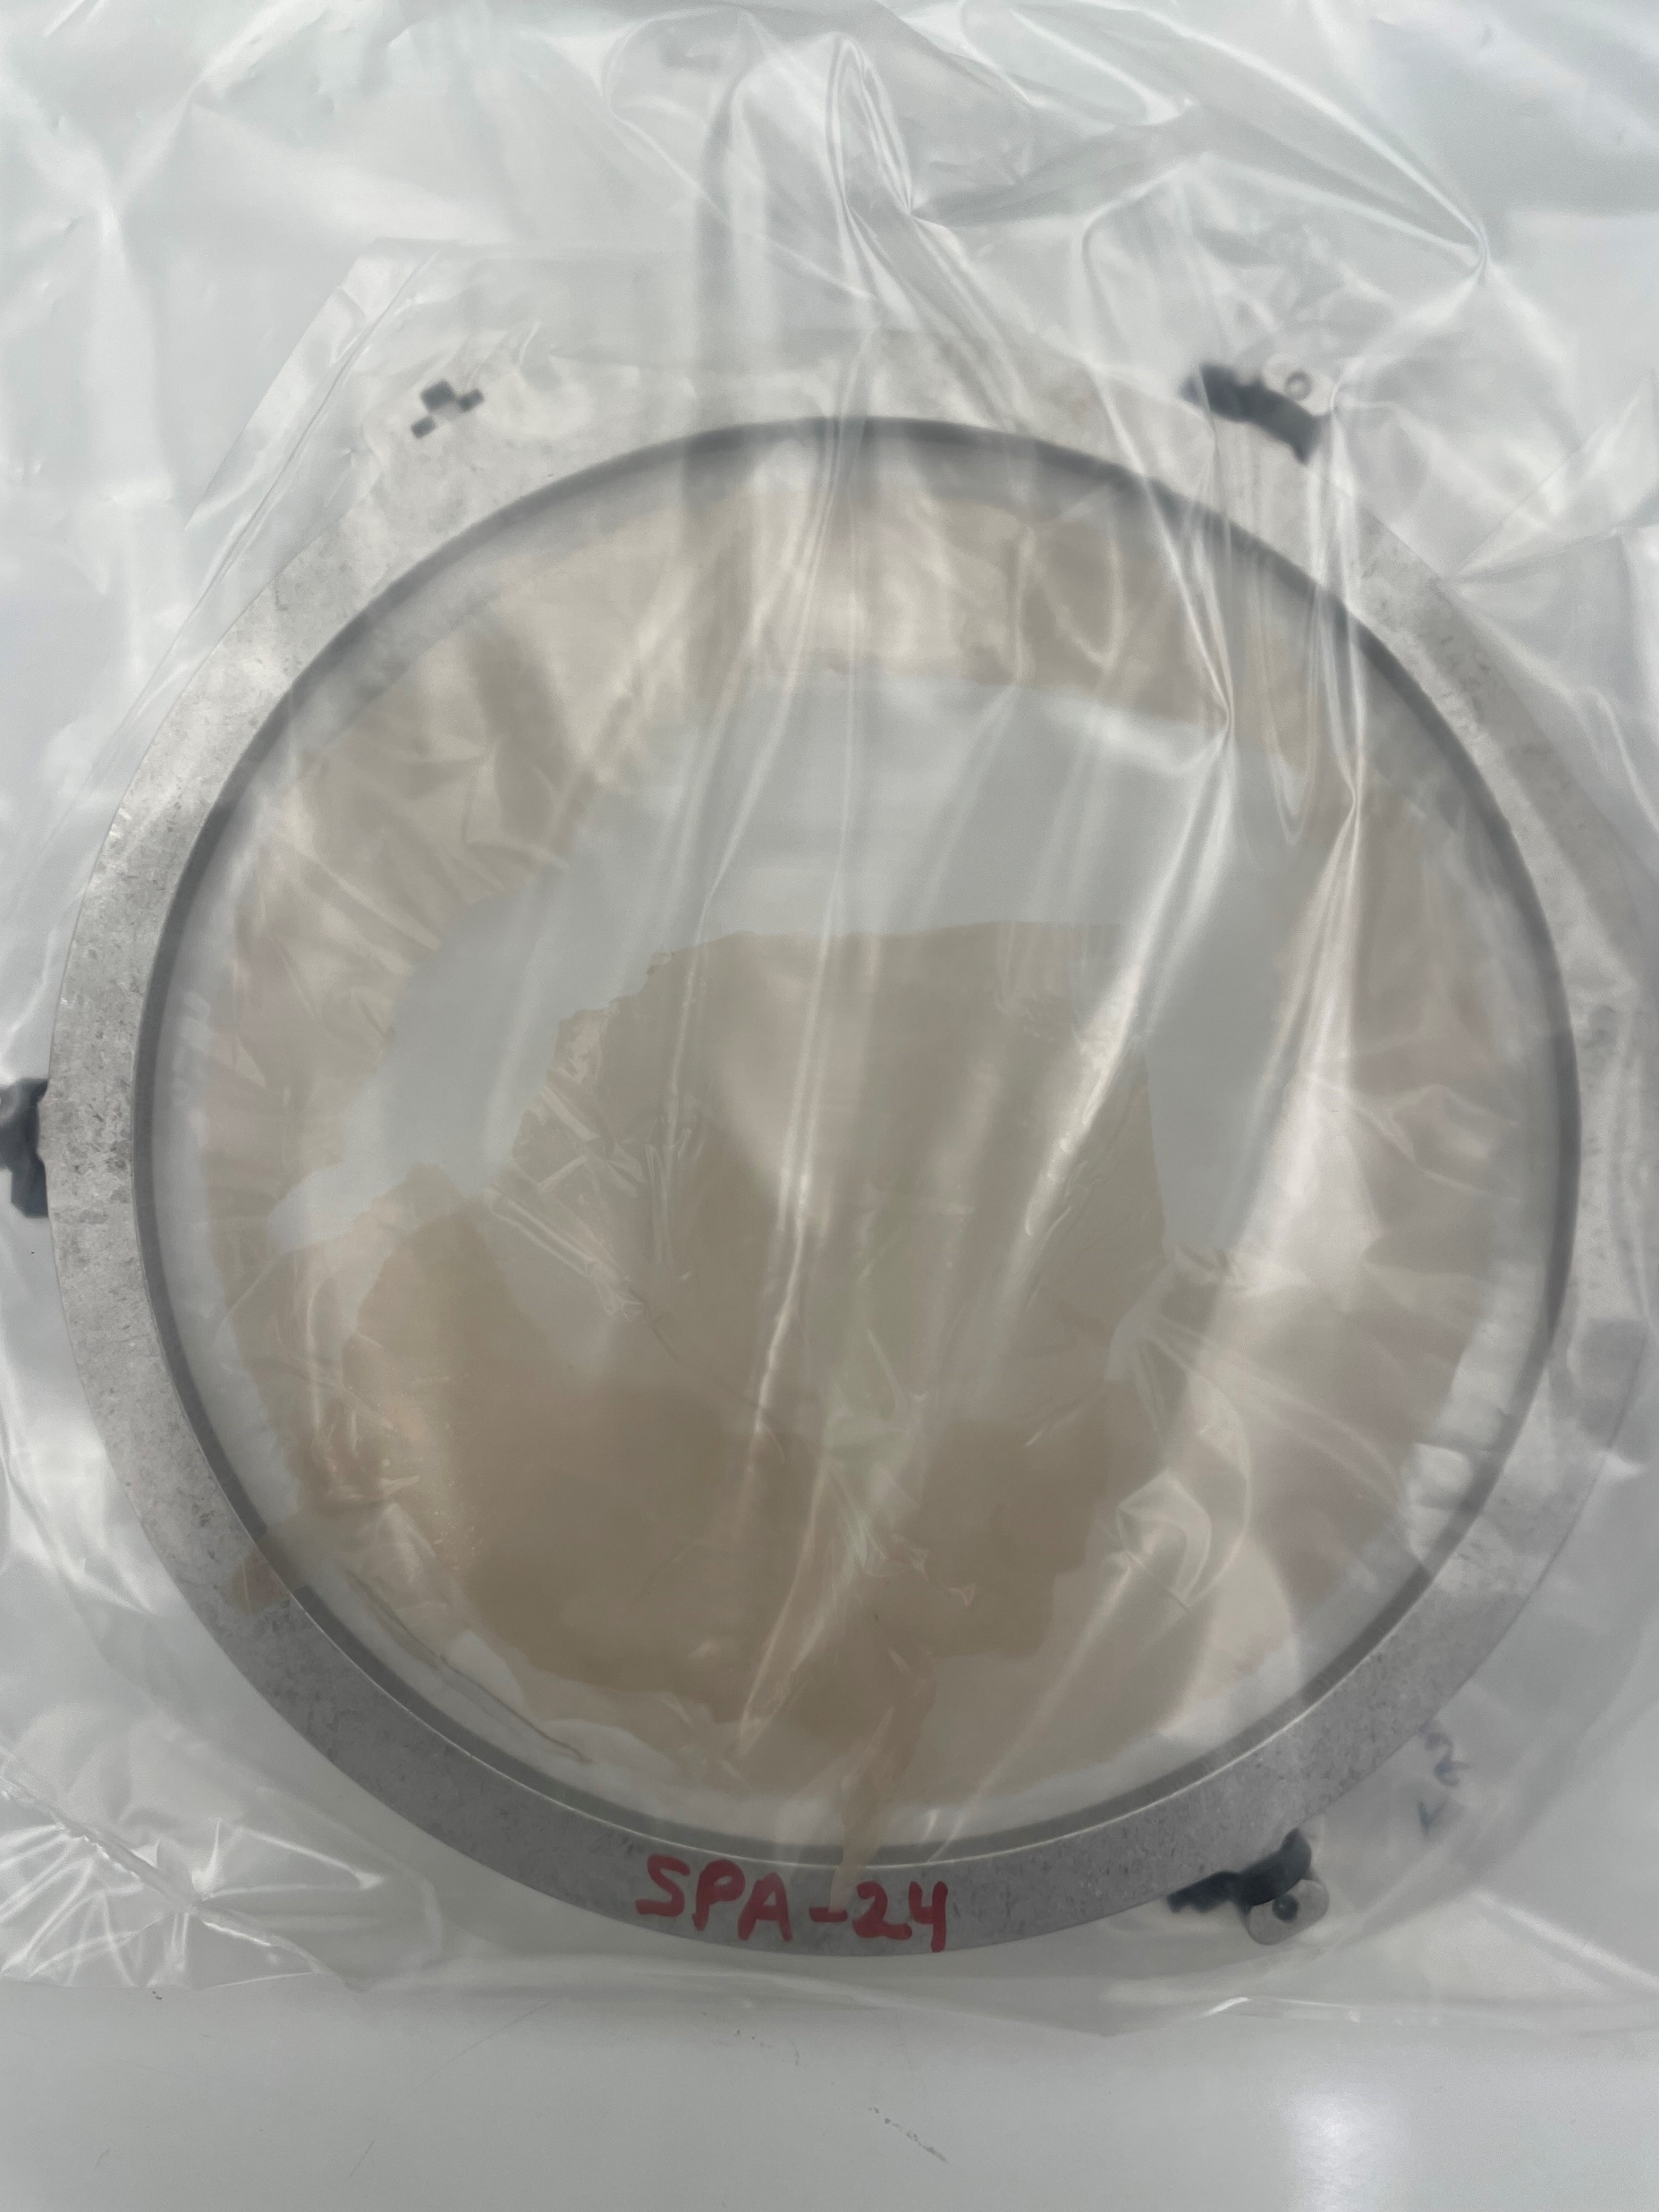

Slide 12
Advice from Community?
Need advice on a path forward:
We can try to peel the layers apart to expose IDPs
  Laborious, may expose CD lab to sulfate particulates
We can wash the filters to collect material
  Easier to implement
  Can neutralize the sulfuric acid by titrating with NaOH sol’n
  Loses particle context
  Exposure to water
Other ideas?
Advocate for change to Astromaterials Accessioning policy to include a Curation advisor to any grant involving material intended to reside in NASA’s Astromaterials Collections

Slide 13
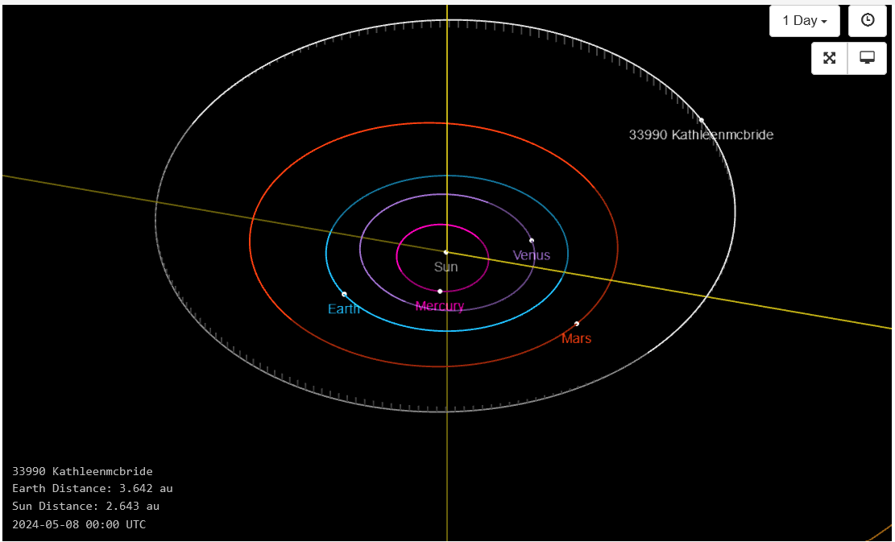
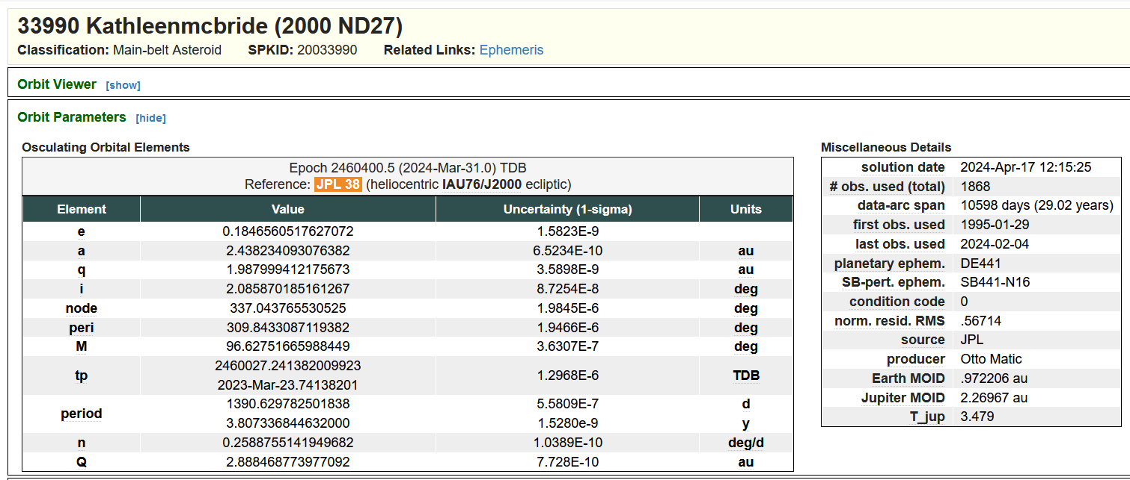
Kathleen McBride Retires!
Kathleen has retired after over 25 years of service to Curation
Worked in Meteorite and Cosmic Dust

Slide 14
Questions?

