Slide 1
Surge Pressure Testing of Flight-Like Components
PREP II Final Presentation
Wanyi Ng
NASA Goddard Space Flight Center
Propulsion Engineer
May 21, 2024

Slide 2
Outline
Background and Motivation
Test Setup
Methodology & Results
  Burst Disk Testing
  Pressure Transducer Testing
  Thruster Valve Testing
Conclusions
Notes:
Move to beginning

Slide 3
Outline
Background and Motivation
Test Setup
Methodology & Results
  Burst Disk Testing
  Pressure Transducer Testing
  Thruster Valve Testing
Conslusions
Notes:
Move to beginning

Slide 4
Background – What is Surge Pressure?
A transient, high pressure event
Occurs during priming of propellant lines
Usually the highest pressure event during the entire life of the mission
Difficult to model analytically in complex systems
Propellant Upstream He/Vacuum Downstream
Valve opens, flow starts
Liquid hits dead end, pressure spike
Scroggins and Fiebig (2014). “Surge Pressure Mitigation in the Global Precipitation Measurement Mission Core Propulsion System”. 50th AIAA/ASME/SAE/ASEE Joint Propulsion Conference
Bombadieri, Traudt, and Manfletti (2014). “Experimental and Numerical Analysis of Water Hammer During the Filling Process of Pipelines”
Notes:
https://www.ecosimpro.com/wp-content/uploads/2015/02/SP2014_2968541_Bombardieri.pdf
“top, middle, bottom”

Slide 5
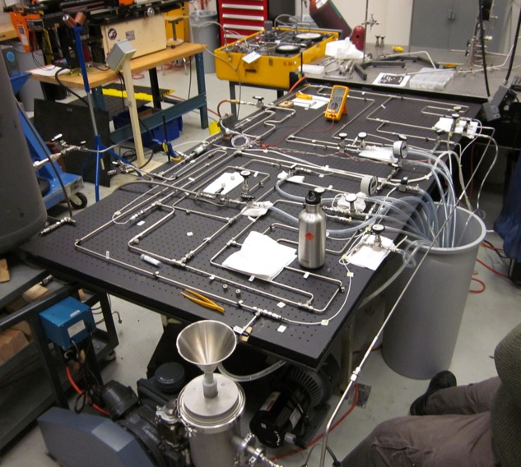
Motivation
Pressures can damage propulsion components
System design includes flow control orifices to reduce surge pressures
Flow orifices drive system performance
  High pressure drop during flow
  Reduced thruster performance
  Increases required tank pressure and/or volume
Extensive testing to optimize orifice size
Typically size orifices to keep surge pressure below component proof pressure
Is this over-conservative and limiting system performance?
  Evidence that pressure spikes do not affect components in the same manner as static pressures do
Example flight mission surge test setup
Notes:
Verbally indicate that last bullet is true

Slide 6
Objective
  Improve understanding of transient surge pressure events
  and their effects on flight components
  Are existing test requirements over-conservative?
  Compare the component failure point under transient surge pressures versus static pressures by:
  Impart transient surge pressure on flight-like component
  Determine pressure at which the component fails
  Compare that pressure to the rated proof pressure of the component

Slide 7
Outline
Background and Motivation
Test Setup
Methodology & Results
  Burst Disk Testing
  Pressure Transducer Testing
  Thruster Valve Testing
Conclusions
Summary
Notes:
Move to beginning

Slide 8


Simplified Diagram of Test Setup
Design a simple, repeatable test configuration for generating pressure surges
Control surge magnitude by changing water tank pressure and venturi throat diameter
Measure pressures during surge event
High Pressure Water Tank
Kistler Pressure Sensor
P1
P2
Latch Valve
Venturi
P3
(Test Article)
Initialize High Pressure Upstream
Initialize Vacuum Downstream
Open Latch Valve to Create Surge Event
Notes:
Putting different components here

Slide 9
Simplified Diagram of Test Setup
Design a simple, repeatable test configuration for generating pressure surges
Control surge magnitude by changing water tank pressure and venturi throat diameter
Measure pressures during surge event
High Pressure Water Tank
Kistler Pressure Sensor
P1
P2
Latch Valve
Venturi
P3
(Test Article)
Initialize High Pressure Upstream
Initialize Vacuum Downstream
Open Latch Valve to Create Surge Event
Notes:
Putting different components here

Slide 10
Simplified Workflow
High Pressure Water Tank
Kistler Pressure Sensor
P
Latch Valve
P
Test Article
Venturi
Flow water through system to fully wet upstream section
Close latch valve
Purge water out of downstream section using low pressure nitrogen
Vacuum downstream section using vacuum pump
Set upstream pressure
Enable data collection
Open latch valve to generate surge event
Close latch valve
Save data
Repeat steps 3 through 9

Slide 11
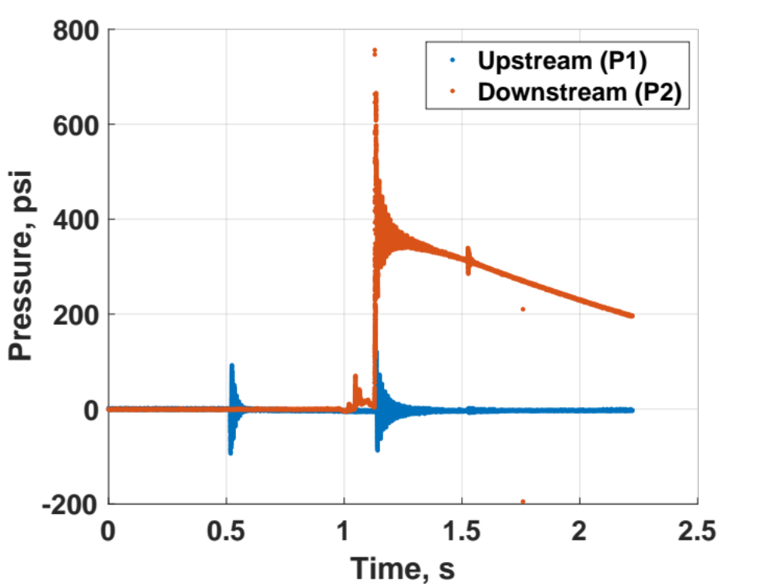
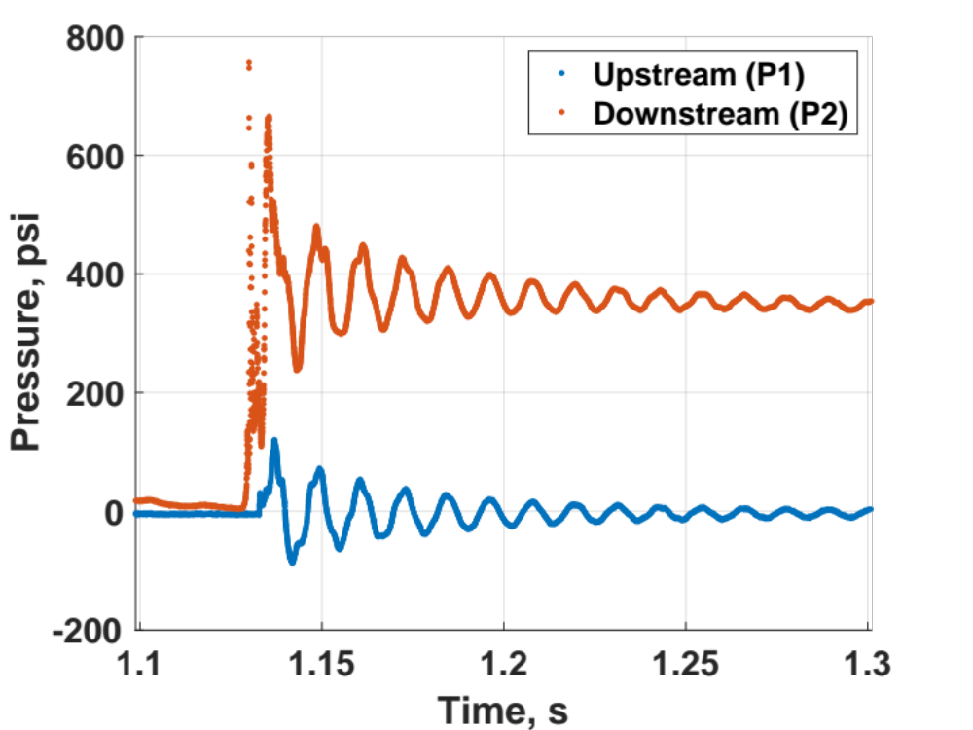
Sample Raw Data
Peak Surge Pressure
Close Up

Slide 12
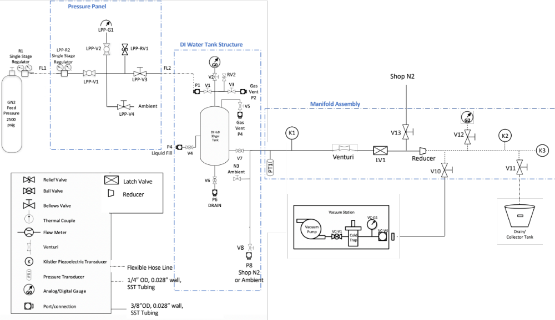
Full Schematic of Test Setup
Additional Electronics Not Shown

Slide 13
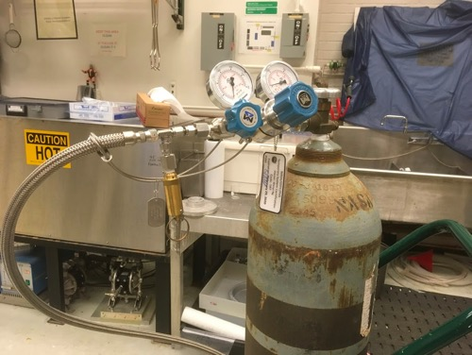
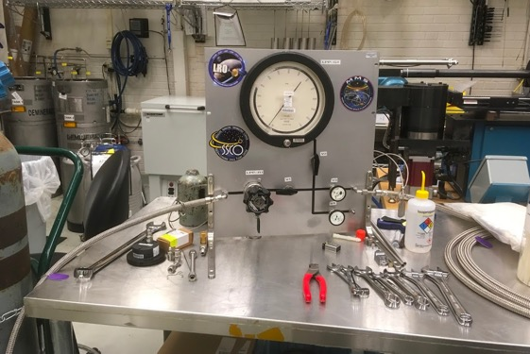
Photographs of Test Setup
Pressure Control System
Pressurized Nitrogen
Latch Valve
Data Acquisition Equipment
Test Article
Valve Actuation Equipment
Water Tank
(not shown)

Slide 14
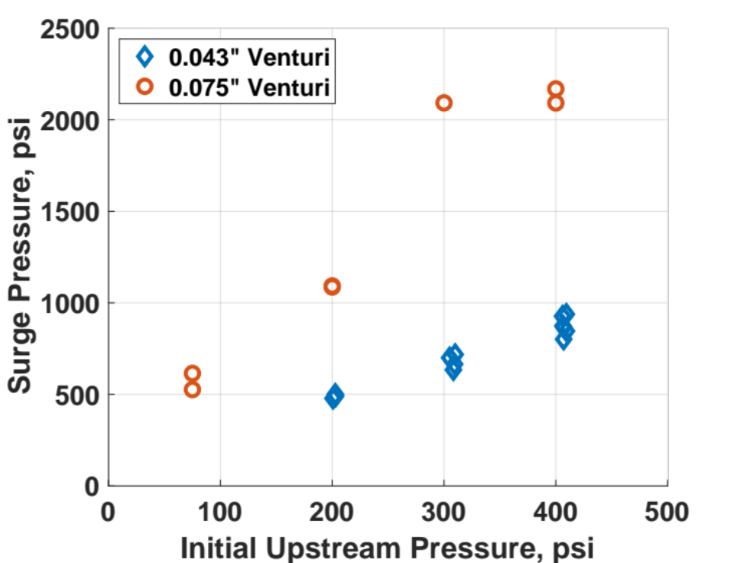
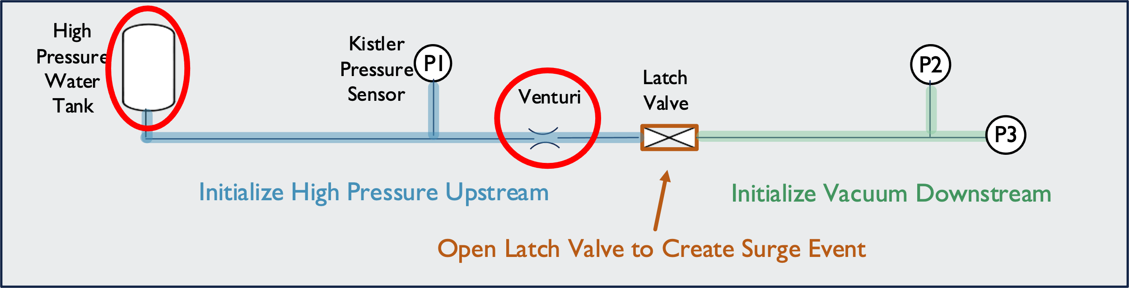
Setup Calibration
Determine initial conditions (upstream pressure and venturi size) to achieve any desired surge pressure
Notes:
Knobs you can turn are pressure at water tank and venturi throat diameter
Tested two different venturi sizes (one at a time) at different water tank pressures, measured surge pressures
For any target surge pressure (e.g. 1500, can initialize venturi and upstream pressure to achieve it)

Slide 15
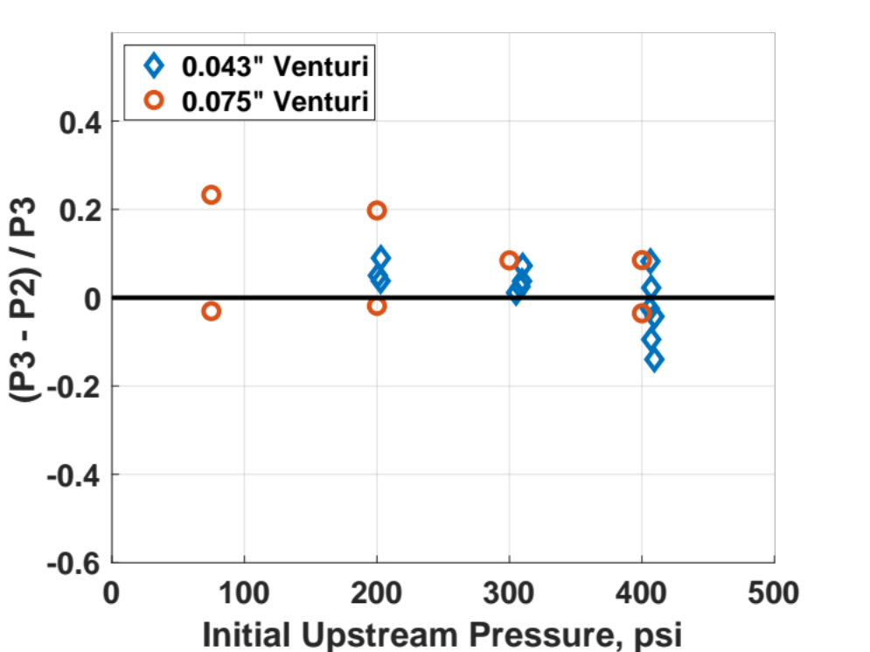
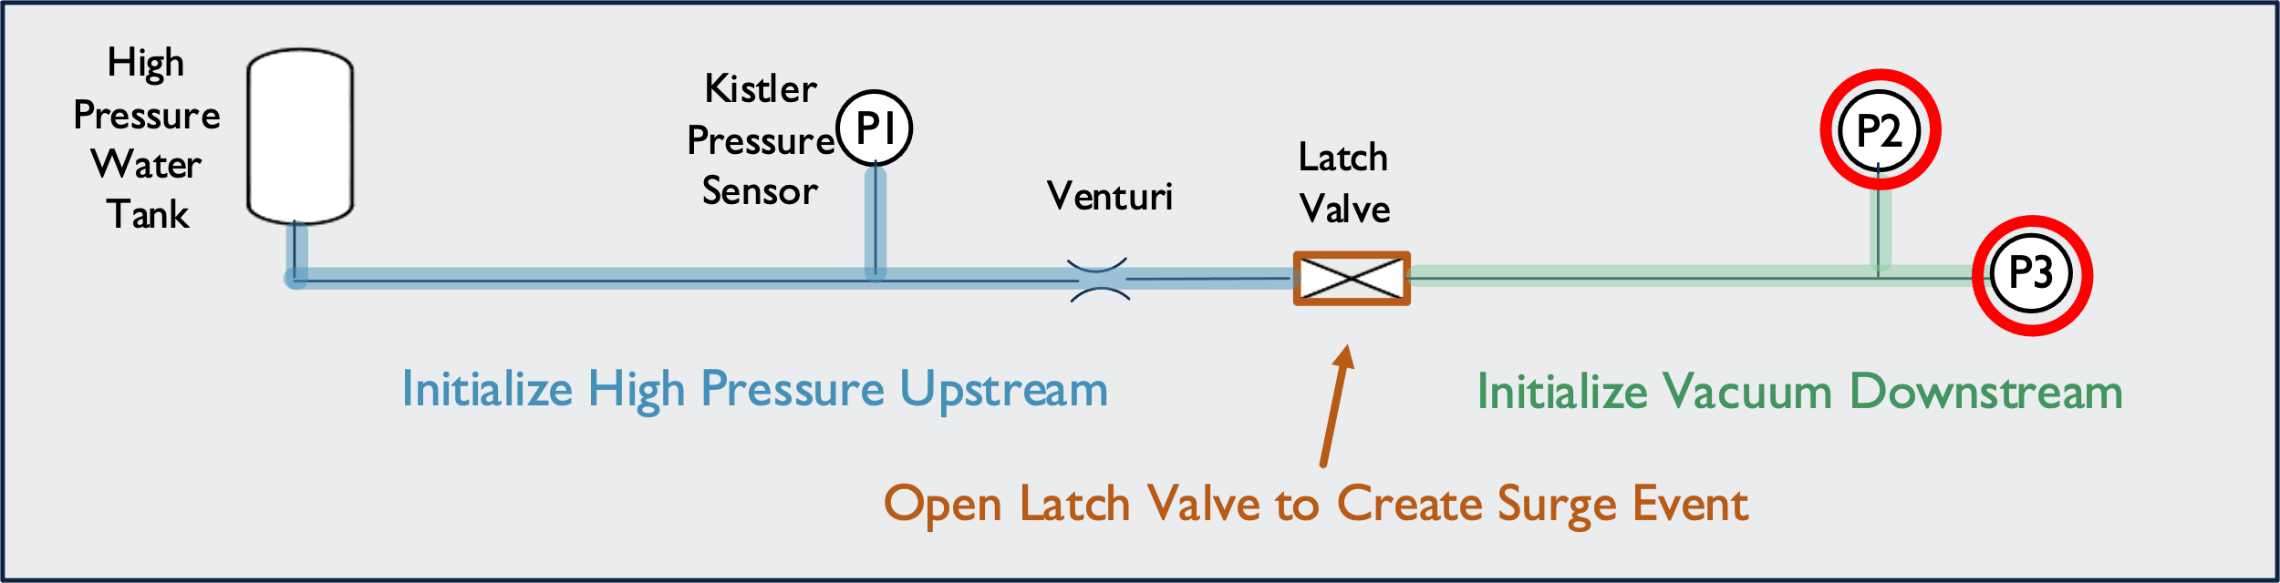
Setup Calibration
Verify that the location of P2 was appropriate the measure the pressures at the test article
(Test Article)
Notes:
Make sure P2 and P3 read the same value because eventually P3 is replaced by test article – plot shows within 20% difference across all initial pressures

Slide 16
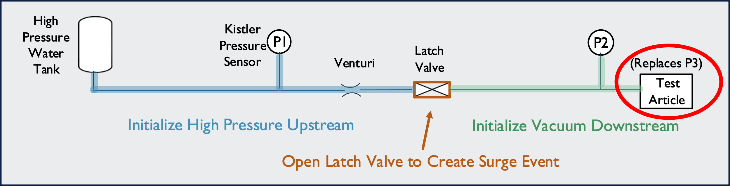
Simplified Diagram of Test Setup
Place different components on the downstream end and determine failure pressure
  Burst Disc
  Pressure Transducer
  Thruster Valve
Notes:
Putting different components here

Slide 17
Outline
Background and Motivation
Test Setup
Methodology & Results
  Burst Disc Testing
  Pressure Transducer Testing
  Thruster Valve Testing
Conclusions
Notes:
Move to beginning

Slide 18
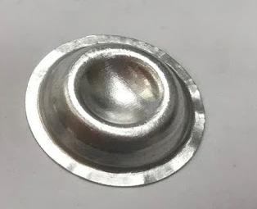
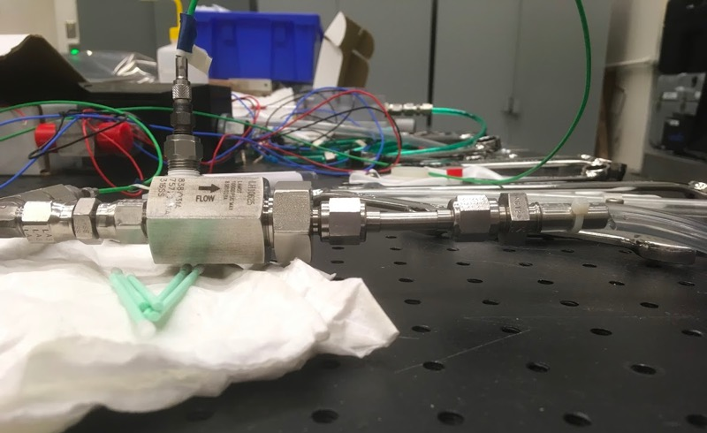
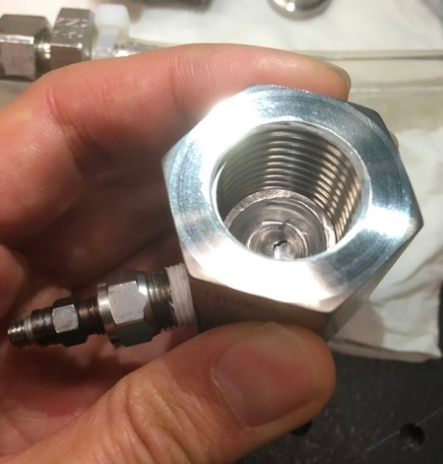
Burst Disc
Burst disc simulates flight-like component with similar geometry to pressure transducer
Readily available at achievable rupture pressures
Manufactured to a tight tolerance actuation pressure – good for comparing transient and static pressure failure
Inexpensive to test to failure compared to flight components
Burst disc
Disc and holder installed in-line
Disc holder with pressure tap

Slide 19
Burst Disc Setup
Holder Includes Pressure Tap
High Pressure Water Tank
Kistler Pressure Sensor
P1
P2
P3
Latch Valve
Venturi
Burst Disc in Holder
BD
Notes:
Same setup diagram as before, but with test article replaced with burst disc

Slide 20
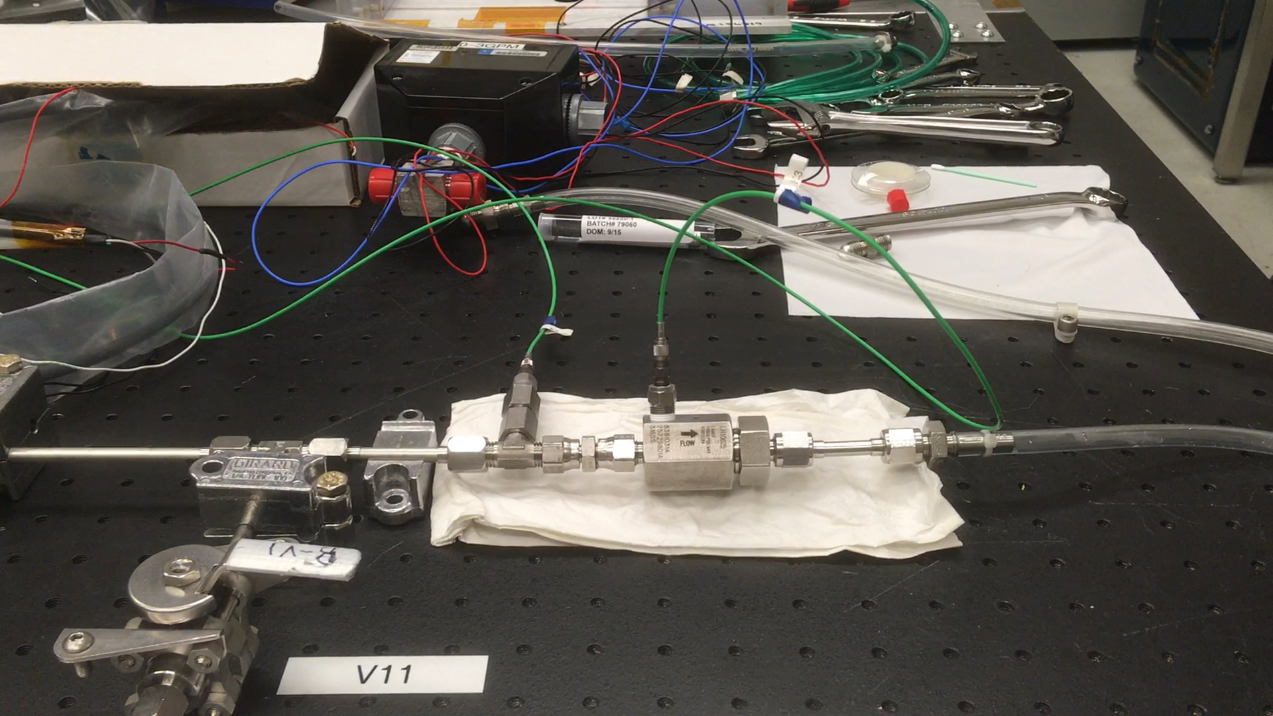
Test Video – No Disc Failure
Notes:
Will hear click for LV opening, immediately followed by thud as water flows and hits the dead end, LV closing

Slide 21
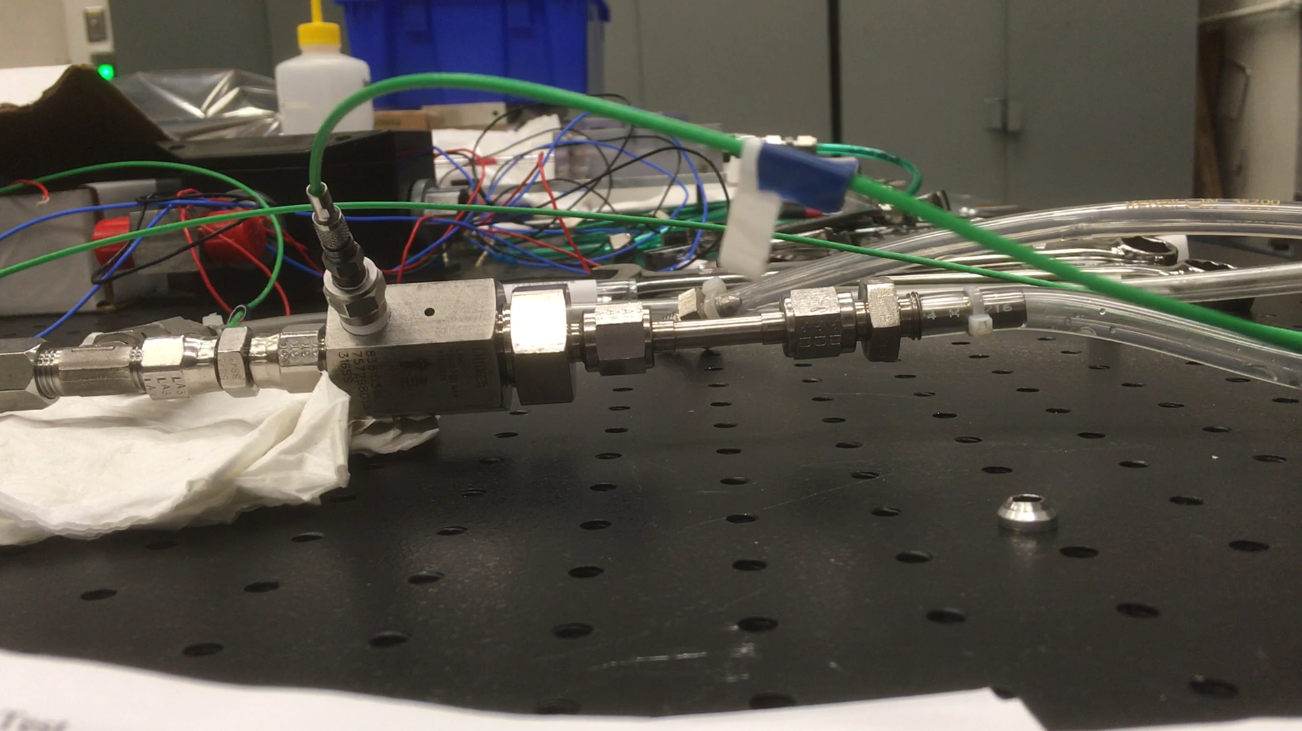
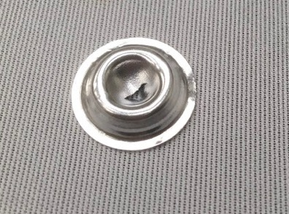
Test Video – Disc Failure
Two different broken burst discs
Notes:
Explain what ppl will see

Slide 22
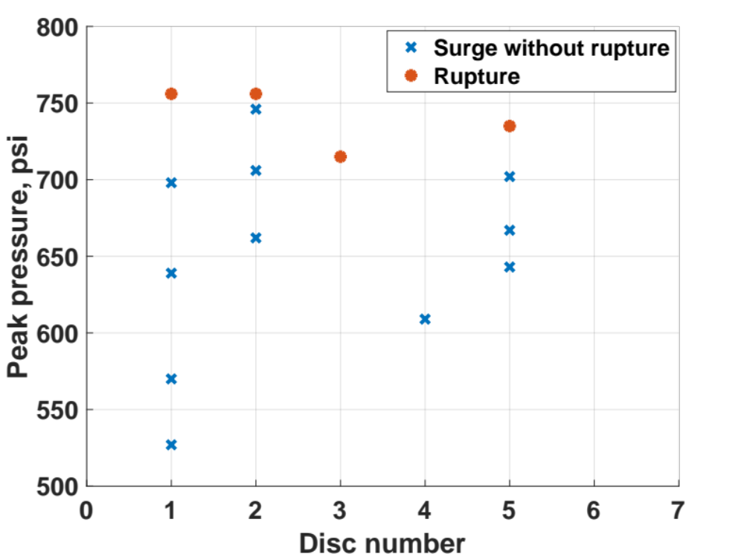
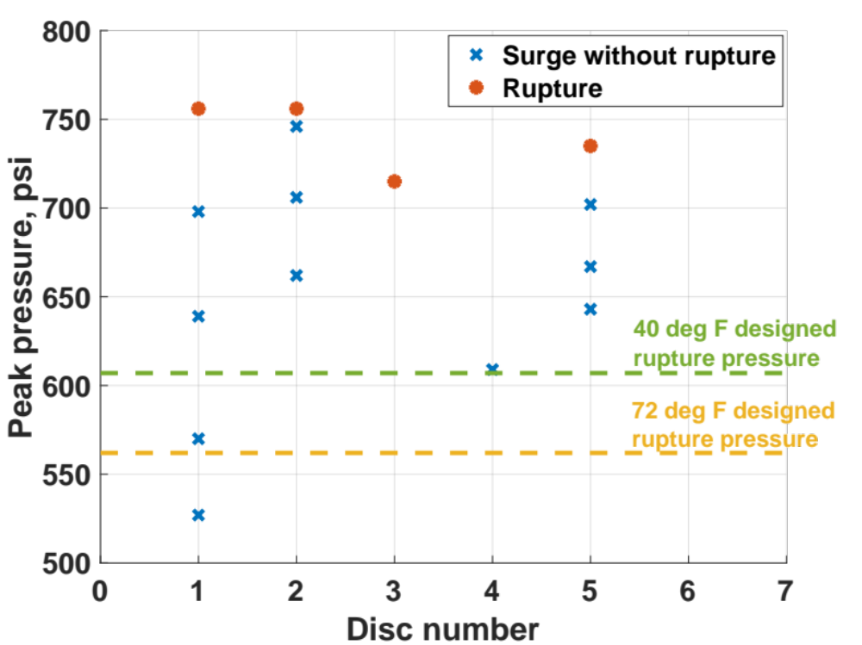
Burst Disc Results
Observed rupture pressure due to transient pressure spike was significantly above rated rupture pressure
Disc 4 not tested to failure to allow for 3D imaging
Notes:
Each column represents data for a separate disc that was tested

Slide 23
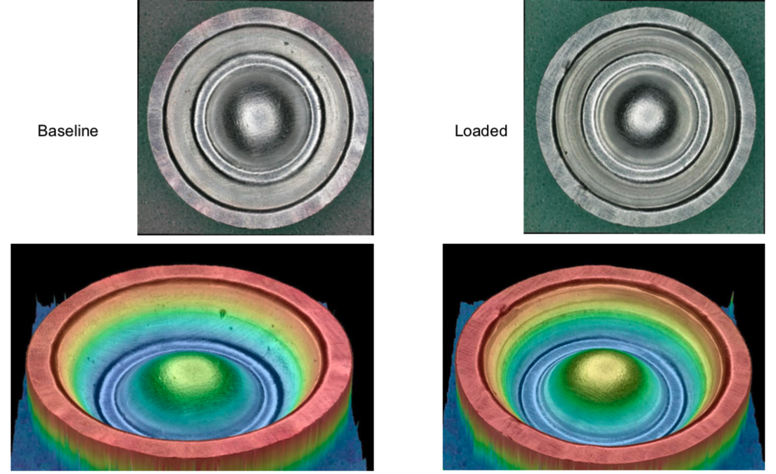
Deformation Before Burst
Digital microscope imaging shows dome deformation
May lead to strain hardening or thinning of disc material
Before Surge Event
After Surge Event
Credit: Justin Jones, Charles He, NASA GSFC

Slide 24
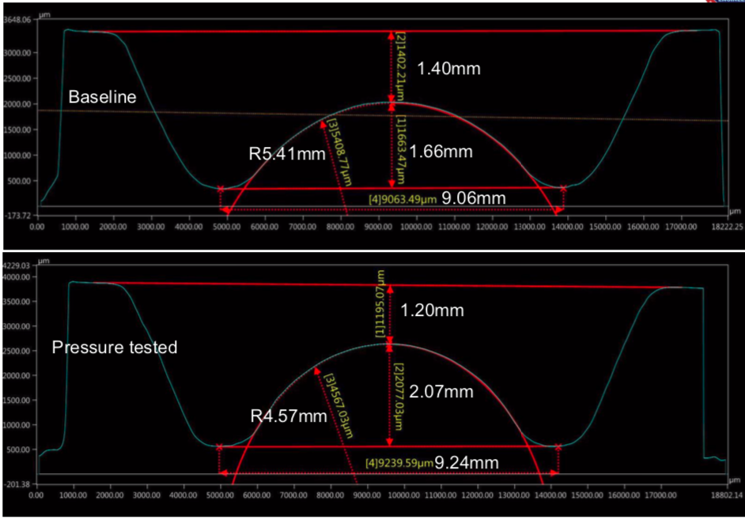
Deformation Before Burst
3D scan shows dome deformation
May lead to strain hardening or thinning of disc material
Before Surge Event
After Surge Event
Credit: Justin Jones, Charles He, NASA GSFC

Slide 25
Burst Disc Conclusions
Aluminum responds differently to transient pressure spikes than static pressures
The short duration of transient spikes can cause static deformation without full rupture
Transient failure pressure is higher than static failure pressure
Existing branch practices of treating transient and static pressures equally may be overly conservative
Notes:
Block out 7

Slide 26
Outline
Background and Motivation
Test Setup
Methodology & Results
  Burst Disk Testing
  Pressure Transducer Testing
  Thruster Valve Testing
Conclusions
Notes:
Move to beginning

Slide 27
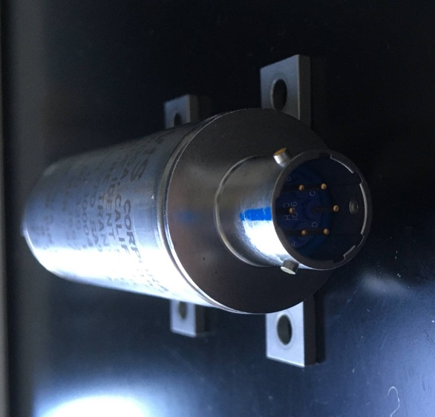
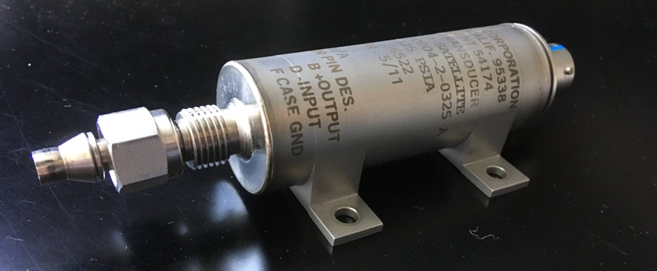
Pressure Transducer
Pressure transducers tested because they are commonly placed in locations that see high surge pressures
Flight spare selected for testing

Slide 28
Pressure Transducer Setup
High Pressure Water Tank
Pressure Transducer
Kistler Pressure Sensor
P2
P1
Latch Valve
Venturi
PT
Notes:
Take a little longer on this slide

Slide 29
Pressure Transducer Diagnostics
Performed before testing and after each surge event:
  Calibration
Performed before testing and after failure:
  CT Scan
Paper includes details about each diagnostic test

Slide 30
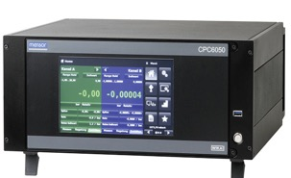
Pressure Transducer Calibration
Use pressure controller to apply pressure to pressure transducer
Measure transducer’s voltage output
Verify no change to calibration after each surge event
Pressure Controller
Pressure Panel
GN2 bottle
Pressure Transducer
Digital Multimeter
Power
Supply

Slide 31
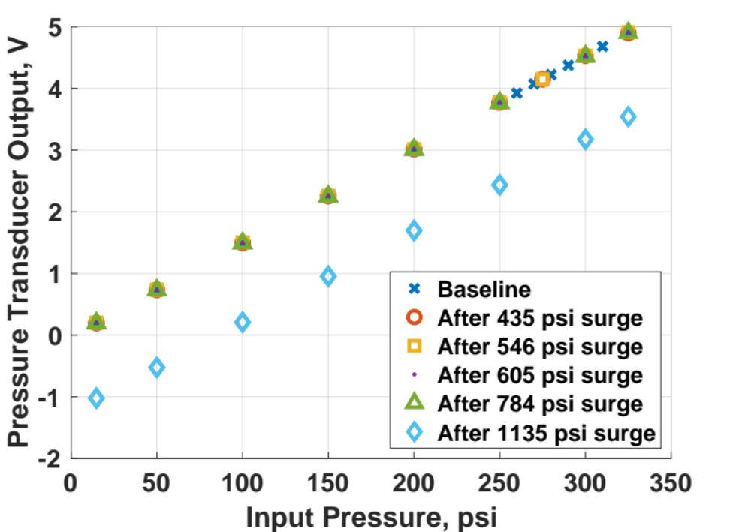
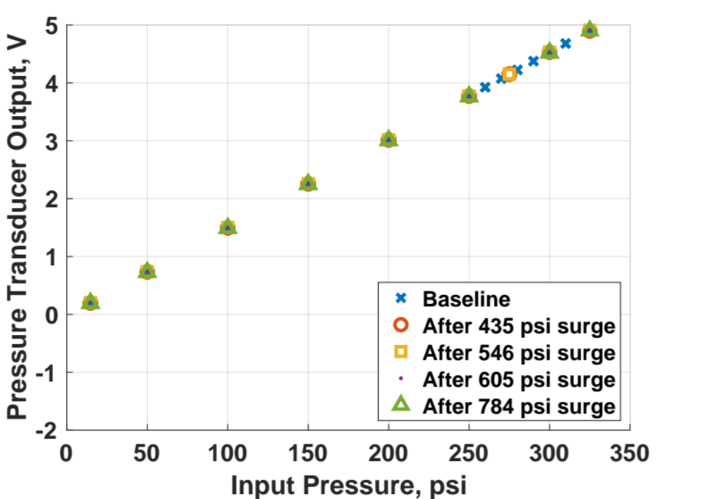
Pressure Transducer Calibration Results
Specified proof pressure: 488 psia
Specified burst pressure: 813 psia
Calibration showed no change up to 784 psi surge
Failure after 1135 psi surge
Would still be useable after re-calibration
3 identical units on a flight mission were unintentionally exposed to static pressure of 788 psi and similarly went out of calibration
Notes:
“Didn’t see out of cal after 784 psi, but did see it under static pressure of 788”

Slide 32
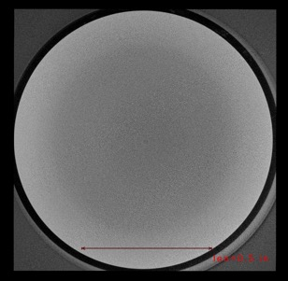
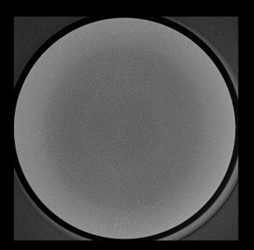
CT Scan
Before Testing
After Failure
Cross section view not shown (proprietary)
Diaphragm top surface
Diaphragm top surface
No visible change in cross section and diaphragm surface views
Diaphragm bottom surface
Diaphragm bottom surface
Credit: Bruno Munoz, NASA GSFC
Notes:
Mention that you can see differences, but that’s more due to image quality

Slide 33
Pressure Transducer Conclusions
Pressure transducer was fully functional and accurate after surge pressures well above specified proof pressure
Existing branch practices of requiring surge pressure to stay below proof pressure may be overly conservative
For this pressure transducer design, overpressure still results in a useable unit after recalibration

Slide 34
Outline
Background and Motivation
Test Setup
Methodology & Results
  Burst Disk Testing
  Pressure Transducer Testing
  Thruster Valve Testing
Conclusions
Notes:
Move to beginning

Slide 35
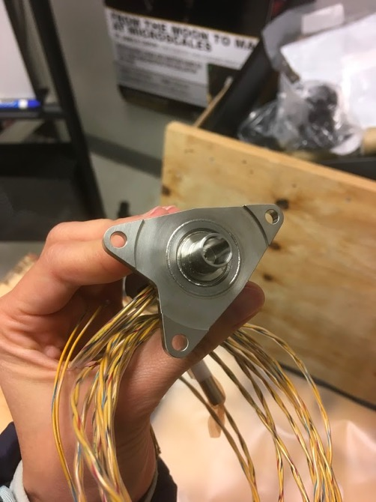
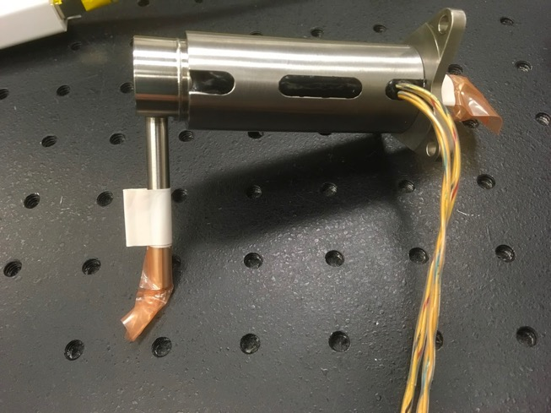
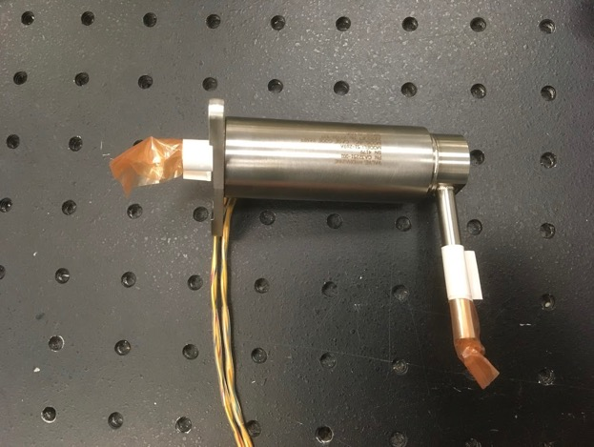
Thruster Valve
Thrusters tested because they are commonly placed in locations that see high surge pressures
Flight spare selected for testing

Slide 36
Thruster Valve Setup
High Pressure Water Tank
Kistler Pressure Sensor
P1
P2
Thruster Valve
Latch Valve
Venturi

Slide 37
Thruster Valve Diagnostics
Performed before testing and after each surge event:
  Internal Leak Test
  Pull-In / Drop-Out Voltage Test
  Response Time Test
  Flow Impedance Test
Performed before testing and after failure:
  Filter Inspection Using Borescope
Paper includes details about each diagnostic test

Slide 38
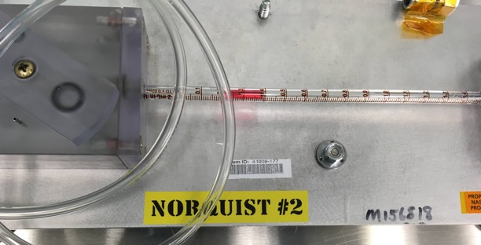
Internal Leak Test Procedure
Pressurize upstream of closed thruster valve
Open downstream valve seat
Use Norquist leak detector to measure internal leak rate
Verify no change to leak rate after each surge event
Norquist leak detector
High Pressure Water Tank
Norquist Leak Detector
Kistler Pressure Sensor
Thruster Valve
P
Latch Valve
P
Venturi

Slide 39
Pull-In / Drop-Out Voltage Test Procedure
Pressurize upstream of closed thruster valve
Apply low voltage through pulse box to thruster valve
Slowly increase the voltage to determine minimum voltage for valve opening
While water is flowing, reduce the voltage to determine threshold voltage for valve closing
Verify no change to threshold voltage after each surge event
High Pressure Water Tank
Power
Supply
Pulse Box
Kistler Pressure Sensor
P
Latch Valve
Venturi
P
Thruster Valve
Notes:
Current and voltage traces

Slide 40
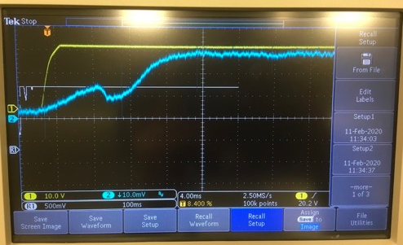
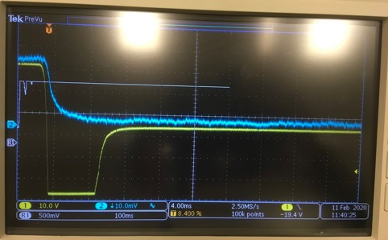
Response Time Test Procedure
Apply voltage through pulse box to actuate thruster valve
Use oscilloscope to measure current and voltage over time
Calculate response time
Verify no change to response time after each surge event
Current Trace
Voltage Trace
Valve Opening
Valve Closing
Oscilloscope Output
Current & Voltage Signal
Oscilloscope
High Pressure Water Tank
Power
Supply
Pulse Box
Kistler Pressure Sensor
P
Latch Valve
Venturi
P
Thruster Valve
Notes:
Current and voltage traces

Slide 41

Flow Impedance Test Procedure
Flow water through open thruster valve
Measure flow rate and pressure drop across valve
Verify no change to flow rate and pressure drop after each surge event
Differential Pressure Transducer
High Pressure Water Tank
Kistler Pressure Sensor
Metering Valve
P
P
Flow Meter
Latch Valve
dPT
Venturi
TV
FM
Thruster Valve

Slide 42
Thruster Valve Diagnostics Results
Specified proof pressure: 525 psi
Specified burst pressure: 875 psi
Specified water hammer pressure: 1200 psi
Vendor has proof pressure tested units up to 1510 psi
No damage to component up to 2200 psi
  Higher surge pressures not possible due to test setup limitations
 | Internal Leakage | Response Time |  | Pull-In / Drop-Out Voltage |  | Flow Impedance
 | Leak rate, GN2 400 psi (scch) | Opening time (ms) | Closing time (ms) | Pull-In (V) | Drop-Out (V) | Flowrate at 0 psid (GPM) | Flowrate at ~10 psid (GPM)
Baseline | 0 | 10.32 | 2.72 | 12.4 | 2.378 | 0 | 0.102
After 1100 psi surge | 0.24* | 10.4 | 2.16 | 12.52 | 2.031 | 0 | 0.107
After 1500 psi surge | 0.24* | 10.24 | 2.92 | 12.55 | 2.177 | 0 | 0.106
After 2200 psi surge | -0.06 | 10.12 | 2.32 | 12.17 | 2.32 | 0 | 0.102
 | No Change | No Change | No Change | No Change | No Change | No Change | No Change
* Verified no leakage using helium sniffer. Concluded that this measurement was due to thermal expansion. Specification is 1 scch at 350 psi

Slide 43
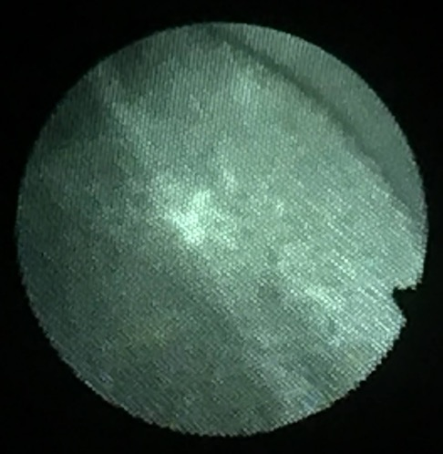
Thruster Valve Filter Borescope Inspection
Borescope used to image filter showed no damage
Borescope image of inlet filter

Slide 44
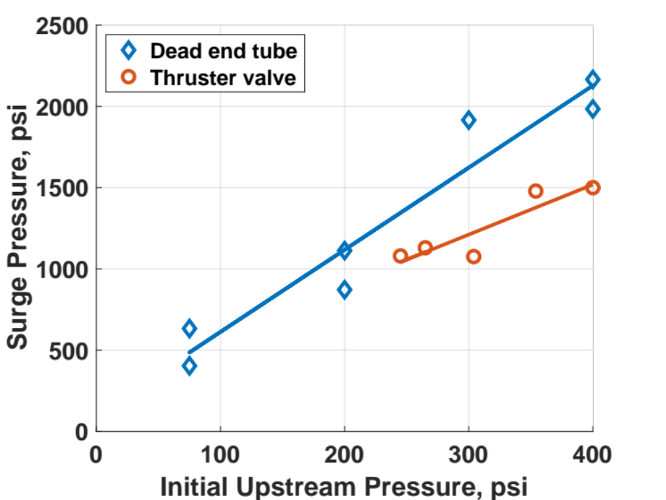
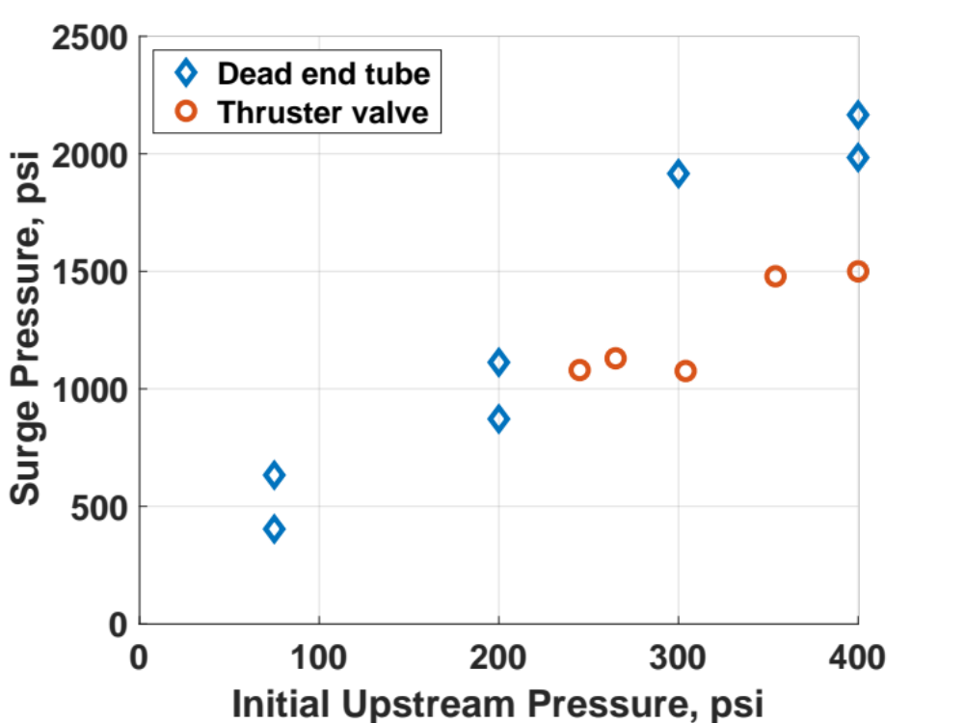
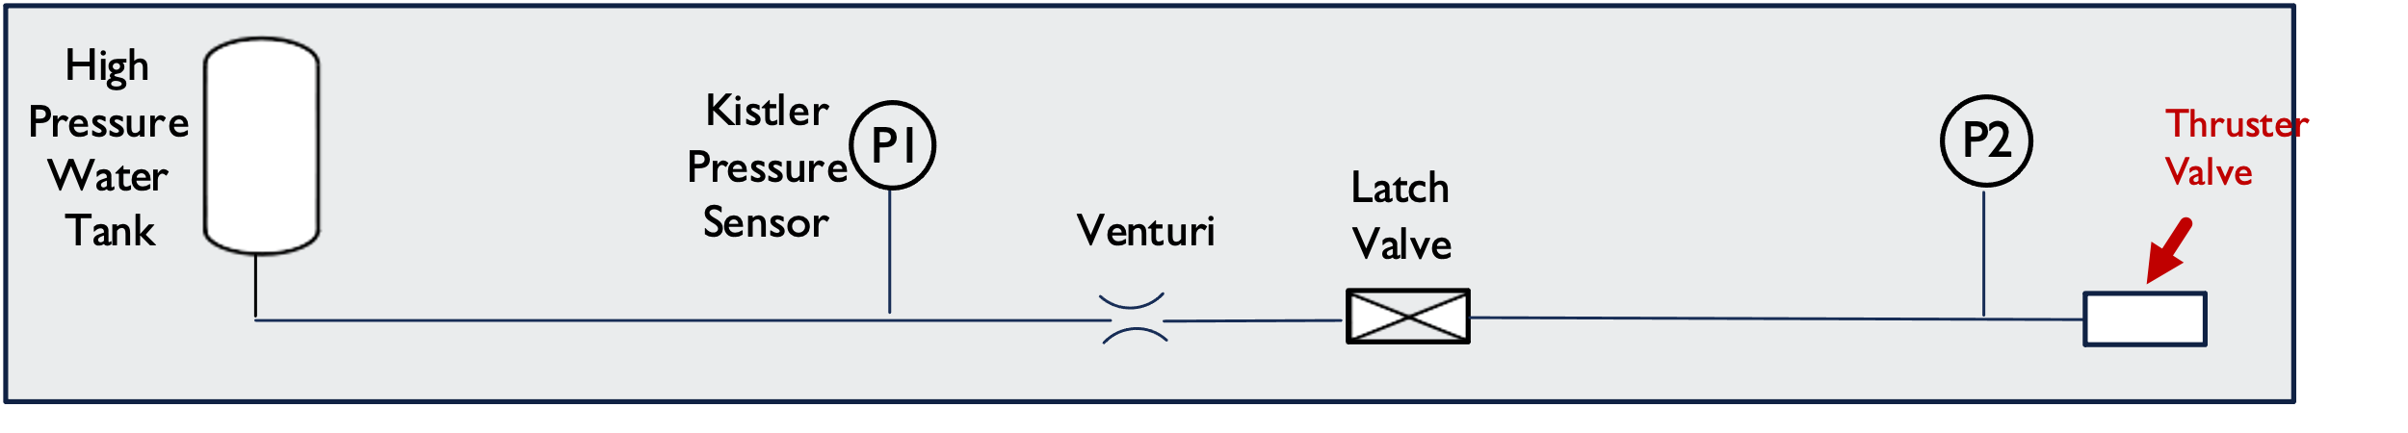
Presence of Thruster Valve Reduces Surge Pressure
Replacing dead end tube with thruster valve appears to reduce surge pressure, despite all other conditions remaining identical
  Systematically eliminated other possible causes
25% decrease in surge pressure
Possibly due to inlet filter acting as additional flow control

Slide 45
Thruster Valve Conclusions
Thruster valve was likely undamaged after surge pressures well above specified and tested proof pressure
  Existing branch practices of requiring surge pressure to stay below proof pressure may be overly conservative
This thruster valve design inherently reduces surge pressure compared to a Kistler used in branch surge testing
  Existing assumption that surge testing reflects flight conditions may be overly conservative

Slide 46
Outline
Background and Motivation
Test Setup
Methodology & Results
  Burst Disk Testing
  Pressure Transducer Testing
  Thruster Valve Testing
Conclusions
Notes:
Move to beginning

Slide 47
Conclusions
Tangential findings:
  A thruster valves reduces surge pressure – surge test setups used to size flight orifices do not have a thruster valve in line, therefore are over-conservative
  Short-duration pressure spikes can cause deformation different from static failure
Using specified proof pressure as the limit when designing flow orifices is over-conservative
  Burst Disc did not rupture under transient surge pressure until > 20% above its static rupture point
  Pressure transducer remained fully functional and accurate after surge pressures 60% above its specified proof pressure
  Thruster valve showed no indications of damage after surge pressures 4x its specified proof pressure, 45% above its highest vendor-tested proof pressure
Adding separate vendor specification for surge pressures is warranted and would improve system performance
  Improves system performance by allowing higher surge pressures
  Verification test would add cost

Slide 48
Acknowledgements
Thank you to:
Mentors (NASA GSFC)
  Alison Rao
  Eric Cardiff
Testing (NASA GSFC)
  Hal Baesch
  Justin Brumley
  Sean Fitzsimmons
  Jacob Stahl
Test Article Imaging (NASA GSFC)
  Bruno Munoz
  Charles He
  Justin Jones
Paper Review
  David Benson (NASA GSFC)
  Zac Regan (Continental Disc)
Continental Disc Corporation provided burst discs and custom holder at no cost and provided input on testing

Slide 49
Thank You

