Slide 1
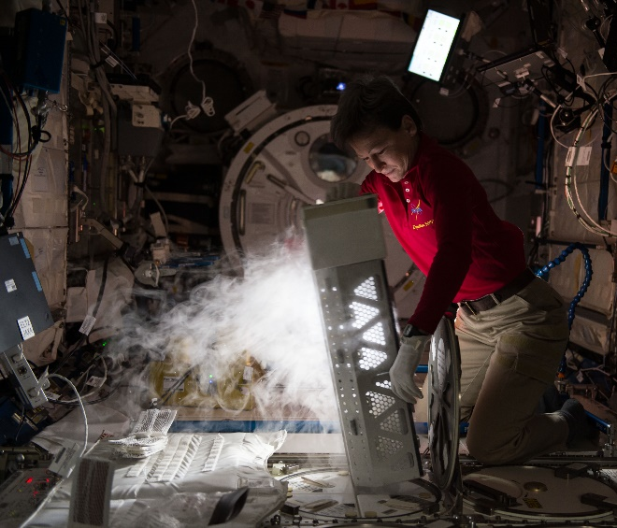
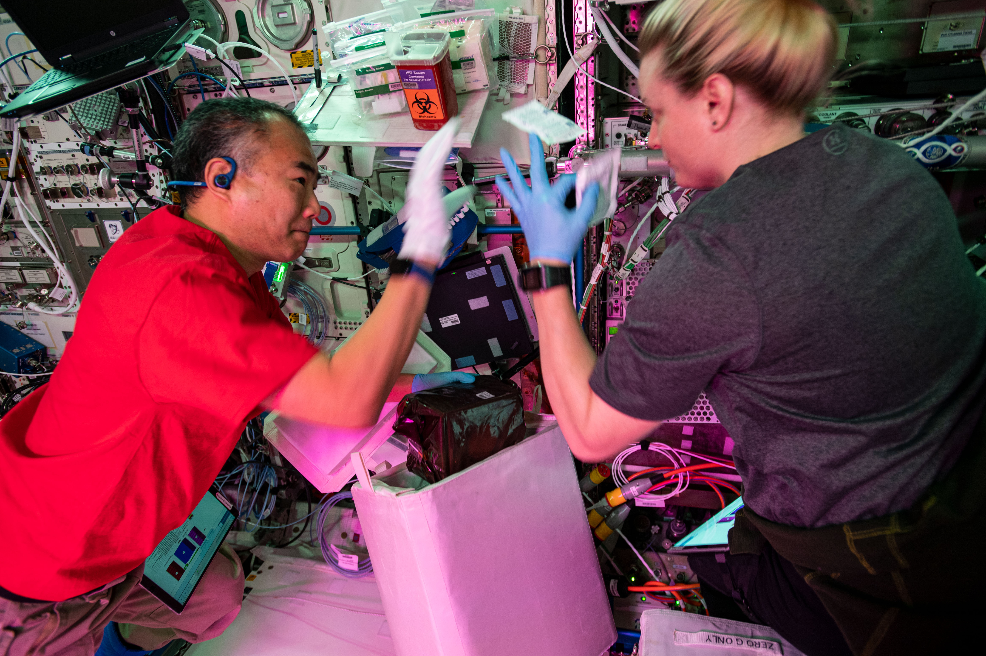
Cold Stowage kickoff

Slide 2
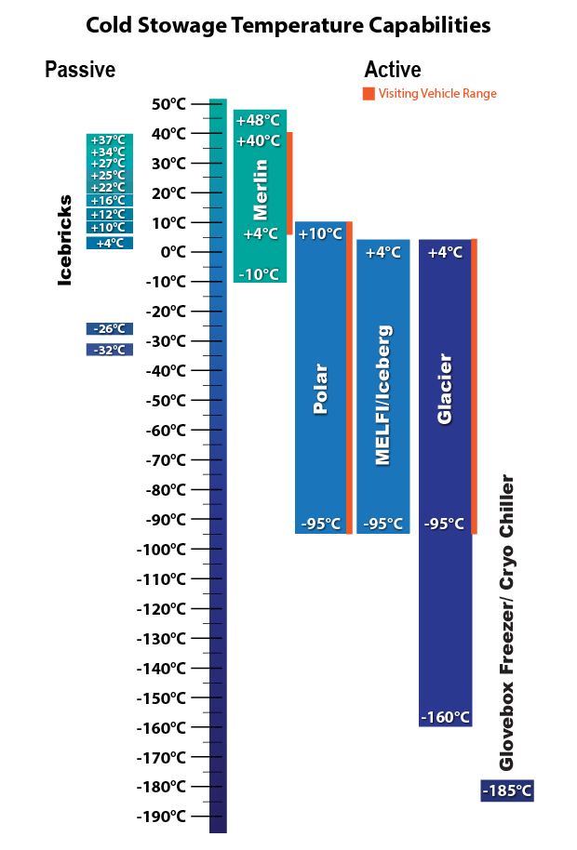
Cold Stowage Operations Overview
Cold Stowage consists of hardware, both active and passive, that transports science to/from and stows science on the International Space Station (ISS) in a temperature-controlled environment
      Active and passive systems provide more flexibility and redundancy
      Cold Stowage will assign experiments to assets based on mission requirements and best use of space.
      Temperature range for science support is -160°C to +48°C on ISS and -95°C to +40°C for launch and return
      All hardware is compatible with SpaceX and Northrop Grumman (NG) vehicles.
      Cold Stowage hardware is maintained by a joint effort between ESA, University of Alabama at Birmingham (UAB), and the JSC Cold Stowage Team which prepares the hardware for flight, including launch and landing support.
      The Cold Stowage team is based out of Johnson Space Center in Houston, TX.
      The Cold Stowage team also works in and maintains the Cold Stowage lab at KSC and Wallops.

Slide 3
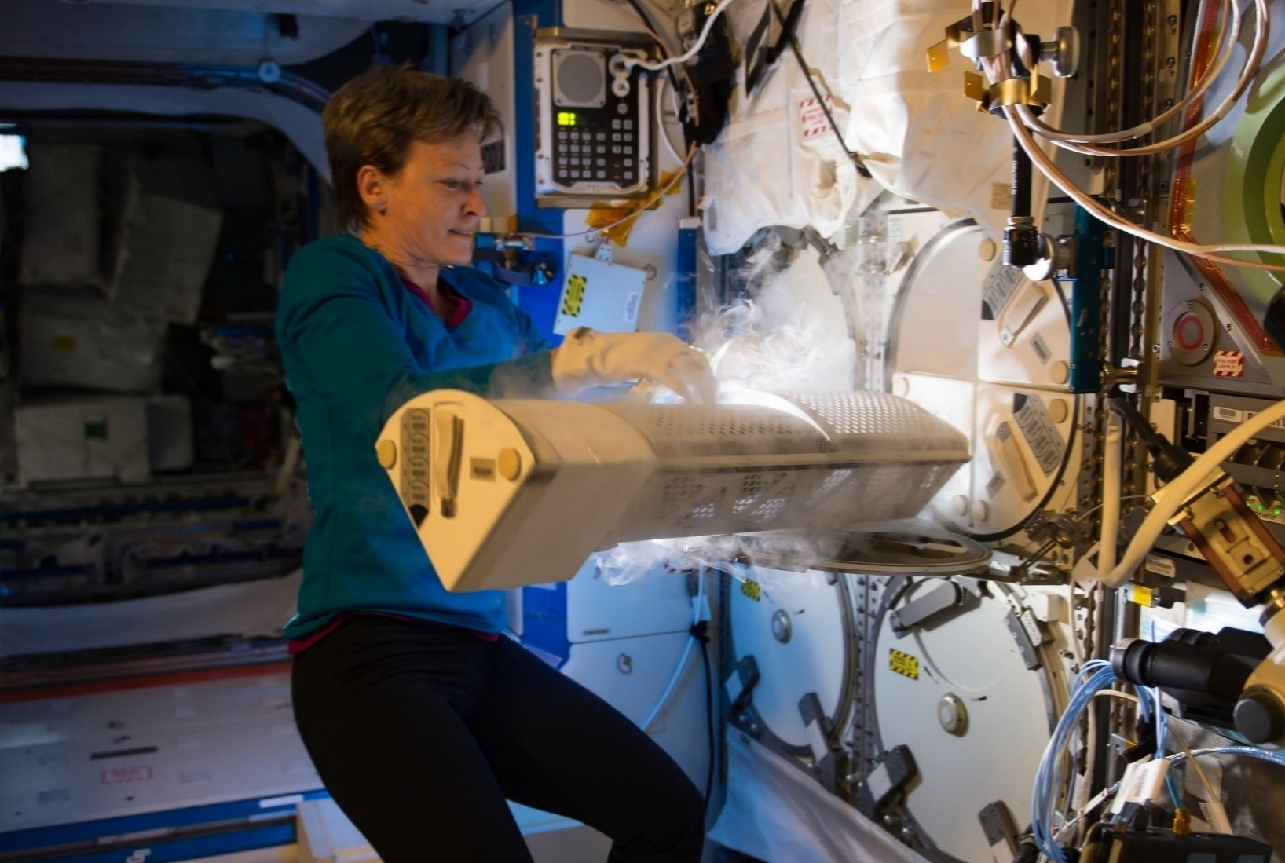
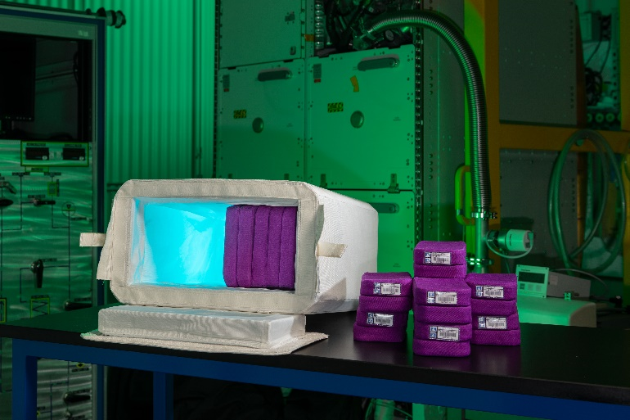
Cold Stowage Hardware Overview
Active Hardware
Passive Hardware
MELFI is a freezer/refrigerator located on ISS which has 4 insulated dewars that can be set to +2°C, -35°C, or -95°C.
Glacier is a freezer/refrigerator that can support samples from -95°C to +4°C for launch/return and -160°C to +4°C on ISS.
Polar is a freezer/refrigerator that can support samples from -95°C to +10°C for launch/return and on ISS.
Iceberg is a freezer/refrigerator that supports samples from -95°C to +4°C on ISS.
Merlin is an incubator/refrigerator/freezer that supports samples from +4°C to +40°C for launch/return and from -10°C to +48°C on ISS.
Rapid Freeze hardware consists of a Cryo Chiller and Glovebox Freezer. They provide a -185°C interface for samples requiring rapid freeze (close to LN2 rates).
Double Coldbags are insulated stowage bags used to transport samples to and from ISS on visiting vehicles
Mini Coldbag is a smaller version of a Double Coldbag commonly used to transfer samples between assets on-orbit
Ice Bricks provide cooling or incubation to samples stored inside Double Coldbags/Mini Coldbags
  Ice Brick temperatures include -32°C, -26°C, +4°C, +10°C, +12°C, +16°C, +22°C, +25°C, +27°C, +34°C and +37°C

Slide 4
Max PD Volume in CS assets
Hardware | MELFI | Glacier | Iceberg | MERLIN | Polar | Double Coldbag | Mini Coldbag
Size (LxWxH) | 22/7.5cm x 14.3/10.2cm x 27cm** | 25.2cm x 18.5cm x 18cm | 21.1cm x 20.7cm x 42.2 cm | 37.8cm x 21.9cm x 15cm | 33.1cm x 21.0cm x 15.8cm | 34.92cm x 17.14cm x 22.23cm | 17.15cm x 13.97cm x 15.24cm
 |  | (per each tray; 2 trays) | (per each tray; 2 trays) |  | (usable science volume) | (includes 12 Ice Bricks) | (does not include Ice Bricks)
ISS Operating Temps | +2°C, -35°C, -95°C | -160°C to +4°C | -95°C to +4°C | -10°C to +48.5°C | -95°C to +10°C | Dependent on Phase Change Material (PCM) used | Dependent on Phase Change Material (PCM) used
VV Operating Temps | N/A | -95°C to +4°C | N/A | +4°C to +48.5°C | -95°C to +10°C | Dependent on Phase Change Material (PCM) used | Dependent on Phase Change Material (PCM) used
** Max/min sizes correlate to pie shape of Box Module. See Box Module Drawing.

Slide 5
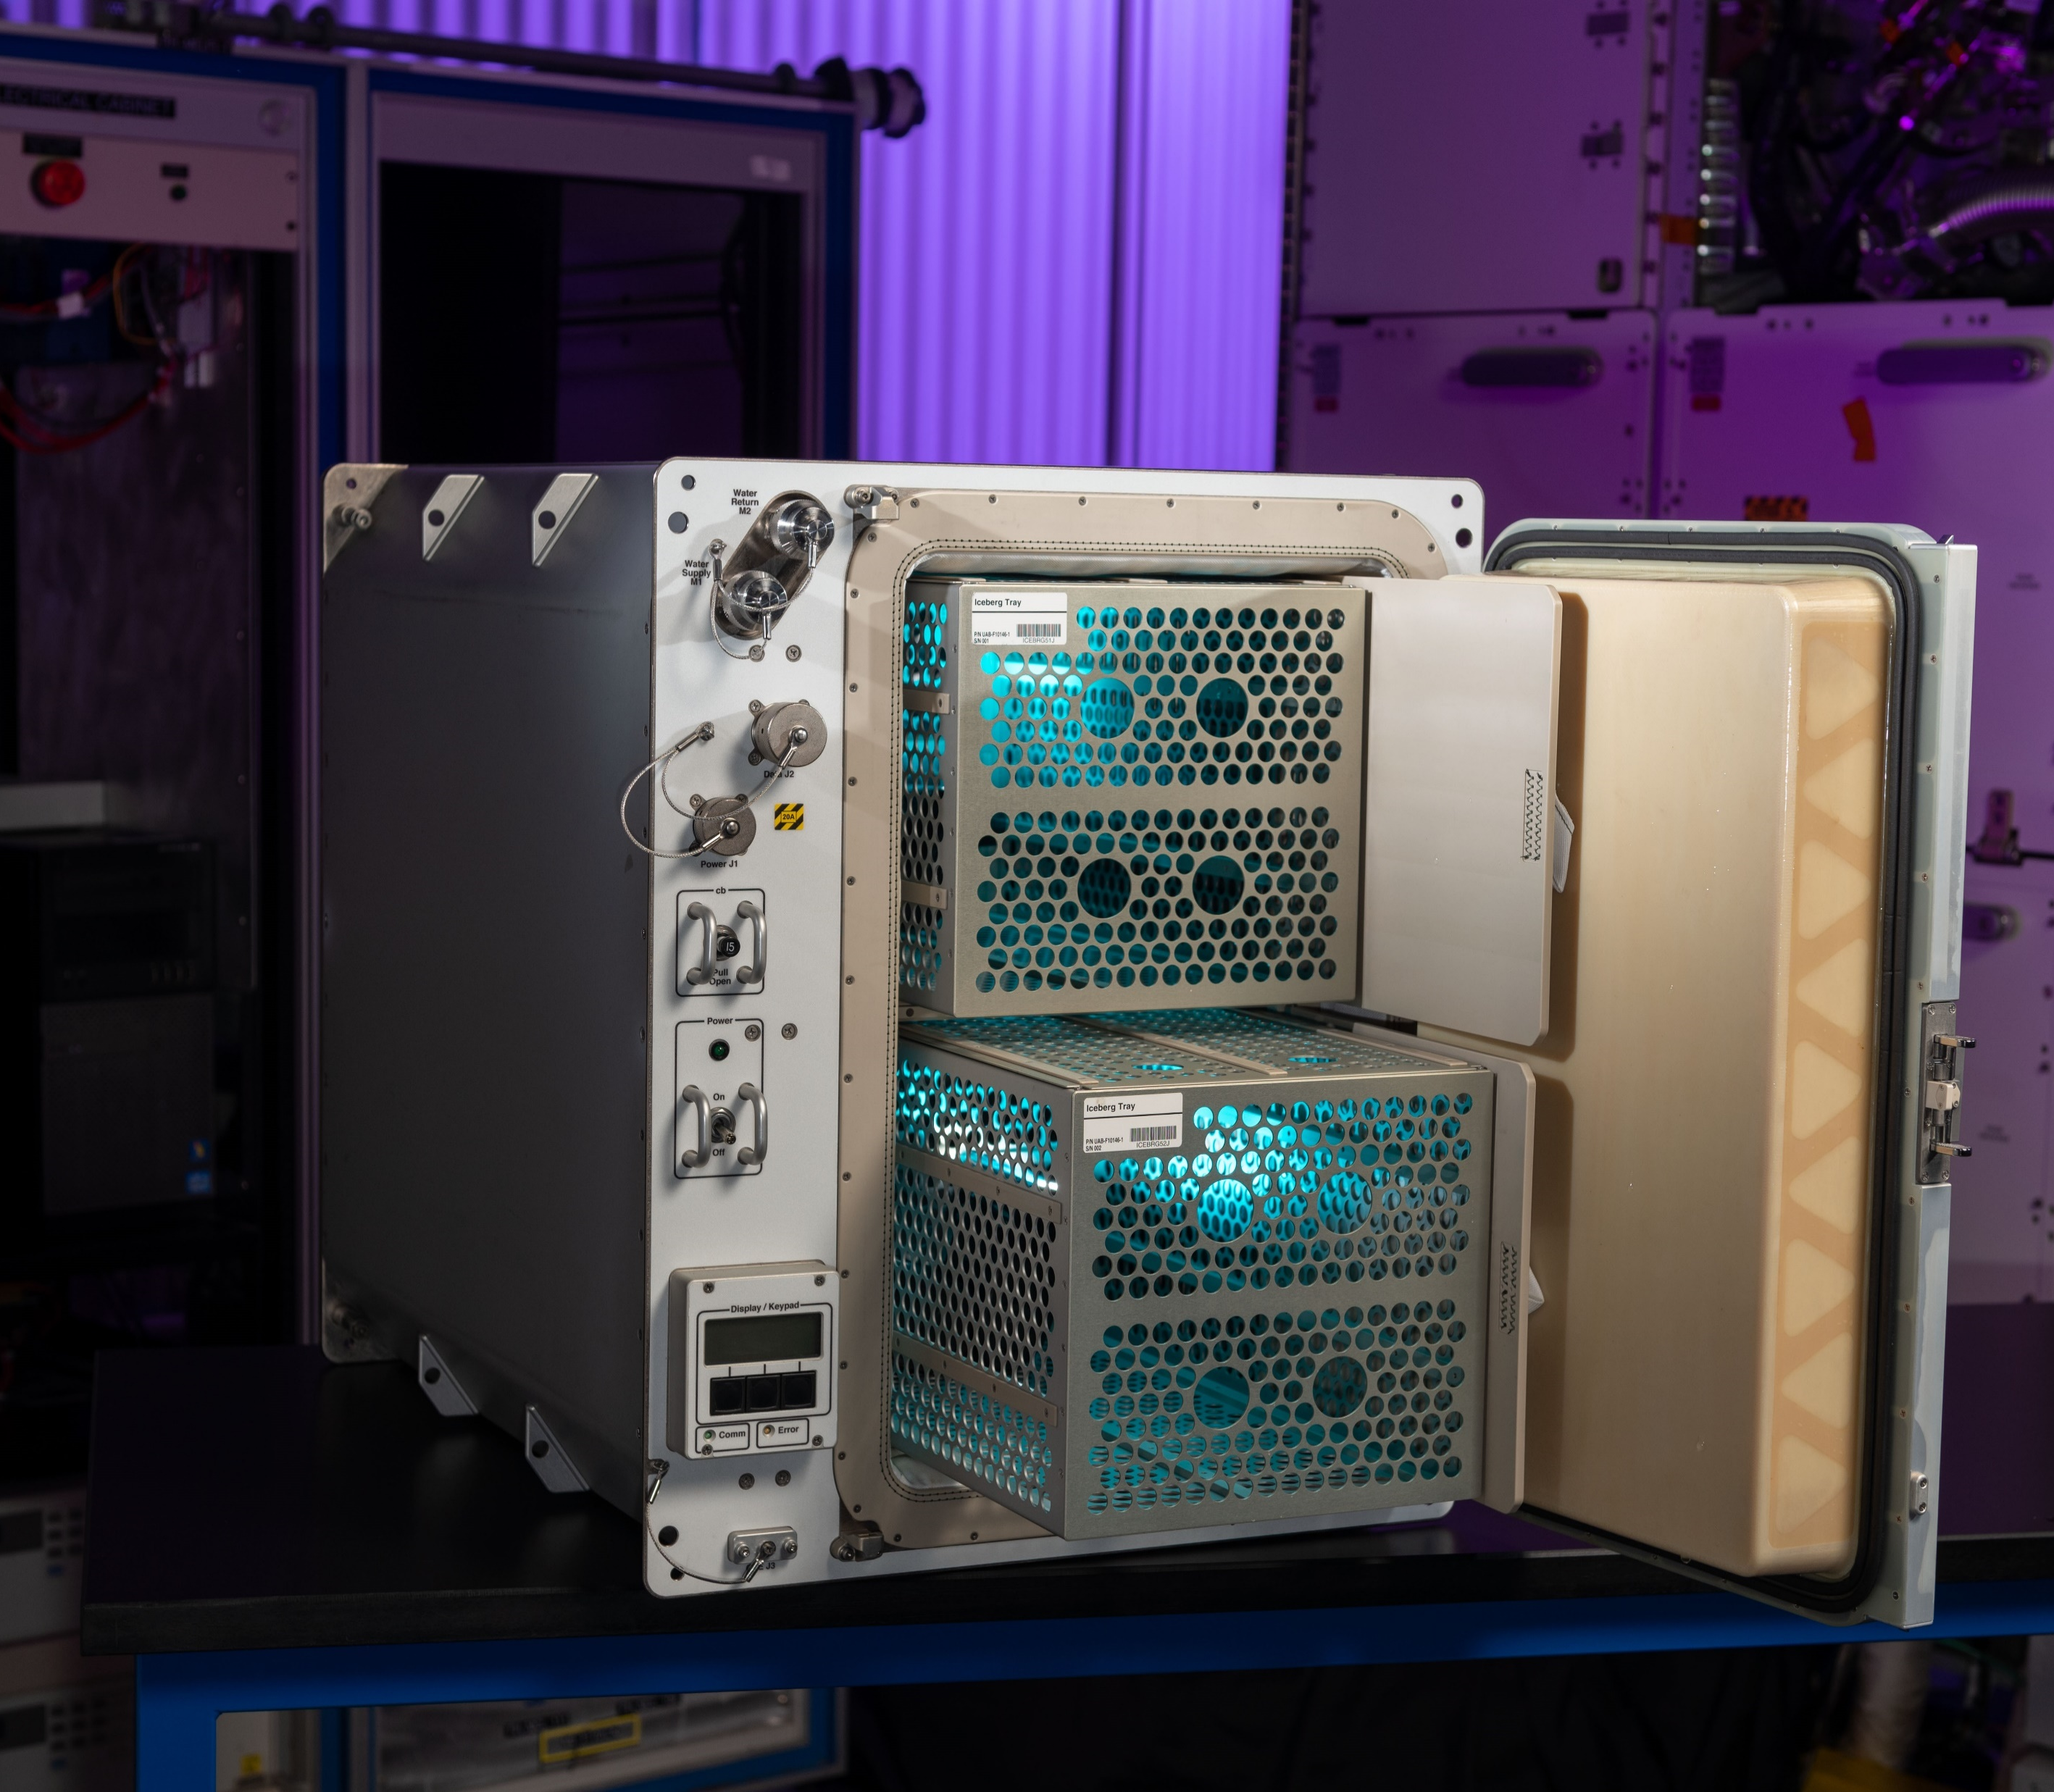
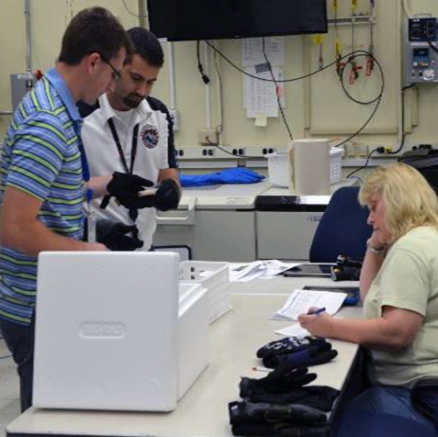
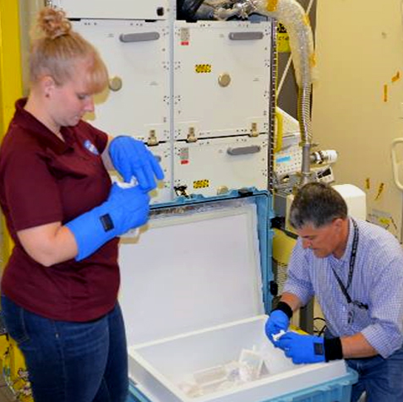
Cold Stowage Services
Rapid freeze ground control unit available for testing in PI’s labs.
Thermal testing of science experiments to 57000 App H requirements
Consultation regarding operation sequence, packaging, etc.

Slide 6
Cold Stowage Mission Flow
~ 24 hours post docking
72-48 hours
30-24 hours
On-orbit operations:
including sample transfers between Cold Stowage active freezers, sample insertions, & Glacier/Polar/MERLIN transfers
PI hands over to Cold Stowage
CS hands over to KSC/WFF for delivery to VV
Launch
Berthing/Docking
Hatch open and center stack removal
DCB removal and unpacking
A
Last sample insertion for conditioning must occur NLT 24 hours from DCB or Polar packing*
R+4 to 48 hours
**R+12.5-30.5
R+6 to 53 hours
R+67.5-86.5
R+3 to 5 days
R+45.5-64.5
~R-72 hours
~R-48 hours
R-12
R+0
**Orange R+ reflects West Coast estimated timelines
Polar/Merlin Packing
Transfer to VV
DCB Packing
VV Undock
Splashdown
Conditioned hardware turned over to CS
Sample return to PI at KSC
Sample return to PI at JSC
A
*Note: Durations will vary, final determination is done on a case-by-case basis and must take into account the entire ops flow for the mission and launch/return vehicle

Slide 7
Cold Stowage Do’s & Don’ts
DO
DON’T
Accurately document ascent, on orbit, and return requirements on the Cold Stowage form
  Accurately documenting sample dimensions and temperature requirements allows for the maximum amount of science to fly each mission
Request input from the Cold Stowage Team when developing packing solutions and complete fit checks with CS assets early in the development process
Keep Cold Stowage in the loop with payload specific real time ops planning
Remove unnecessary air pockets inside sealed bags/ziplocs, space is limited inside cold assets
Handover dimensionally incorrect hardware for late load into the vehicle
Change sample container size/dimensions or bundle samples together without informing Cold Stowage
Stick labels on outer bagging material, labels may fall off when frozen
Use large unnecessary bagging materials
For more information on Cold Stowage, including existing Cold Stowage Forms, a current Cold Stowage Plan, and to request Cold Stowage verification testing support, visit the following website: https://iss.sp.jsc.nasa.gov/Int/OB/CarrierPayload/coldstowage/SitePages/Home.aspx

