Slide 1
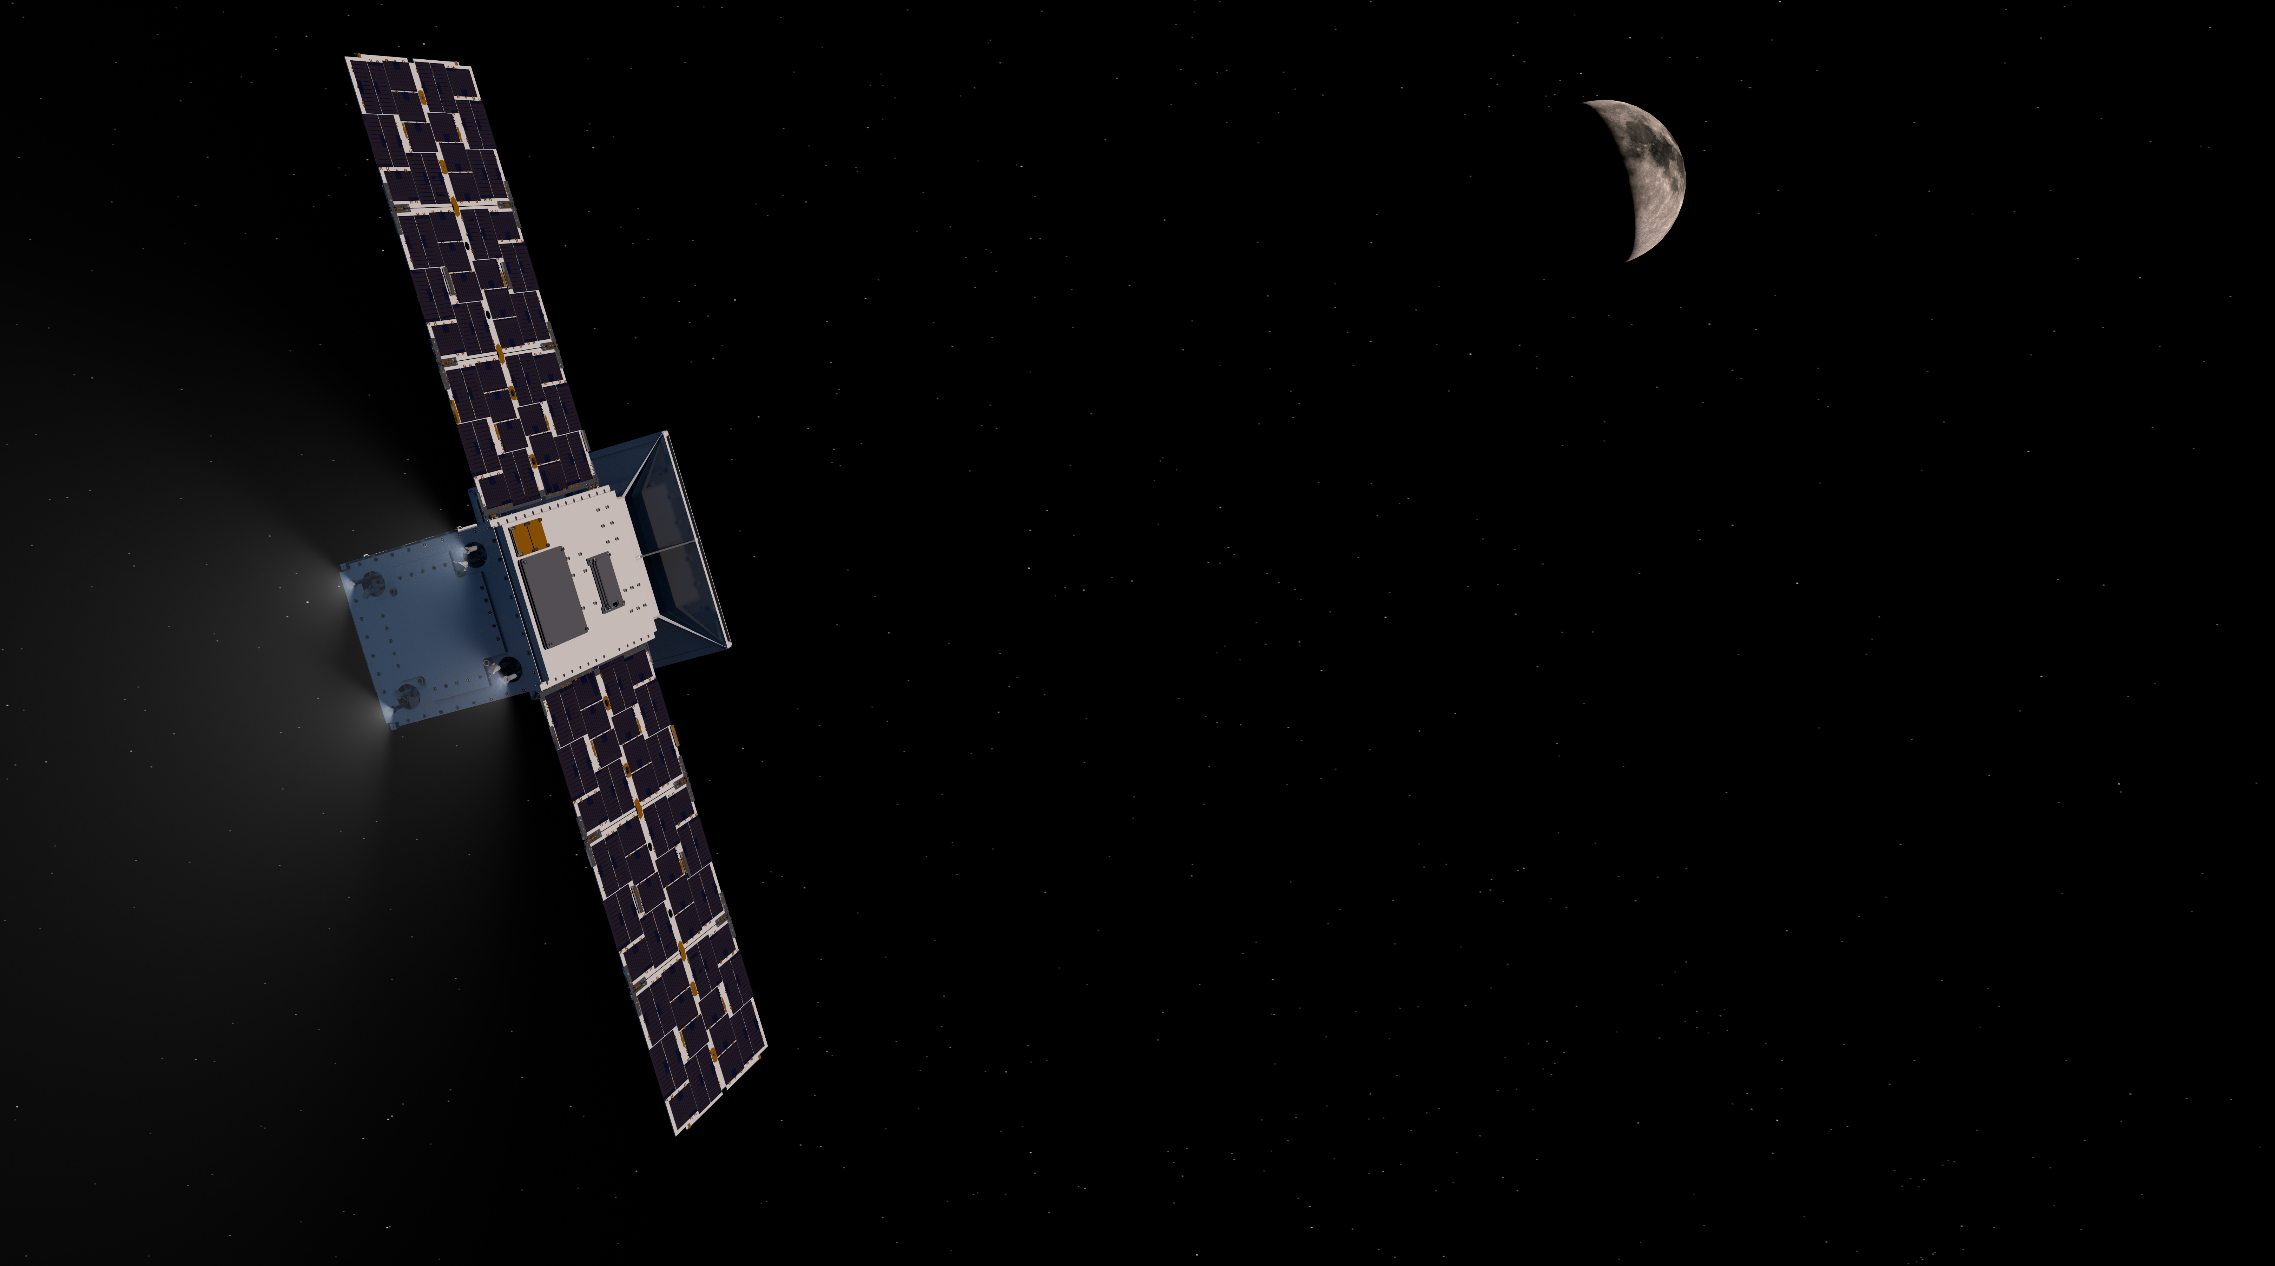


National Aeronautics and
Space Administration
Cislunar Autonomous Positioning System Technology Operations and Navigation Experiment (CAPSTONE)
Pathfinder for Artemis Gateway
Elwood F. Agasid
Deputy Program Manager
Small Spacecraft Technology Program
2024 4S Symposium
Palma de Mallorca, Spain 28 May 2024
www.nasa.gov

Slide 2
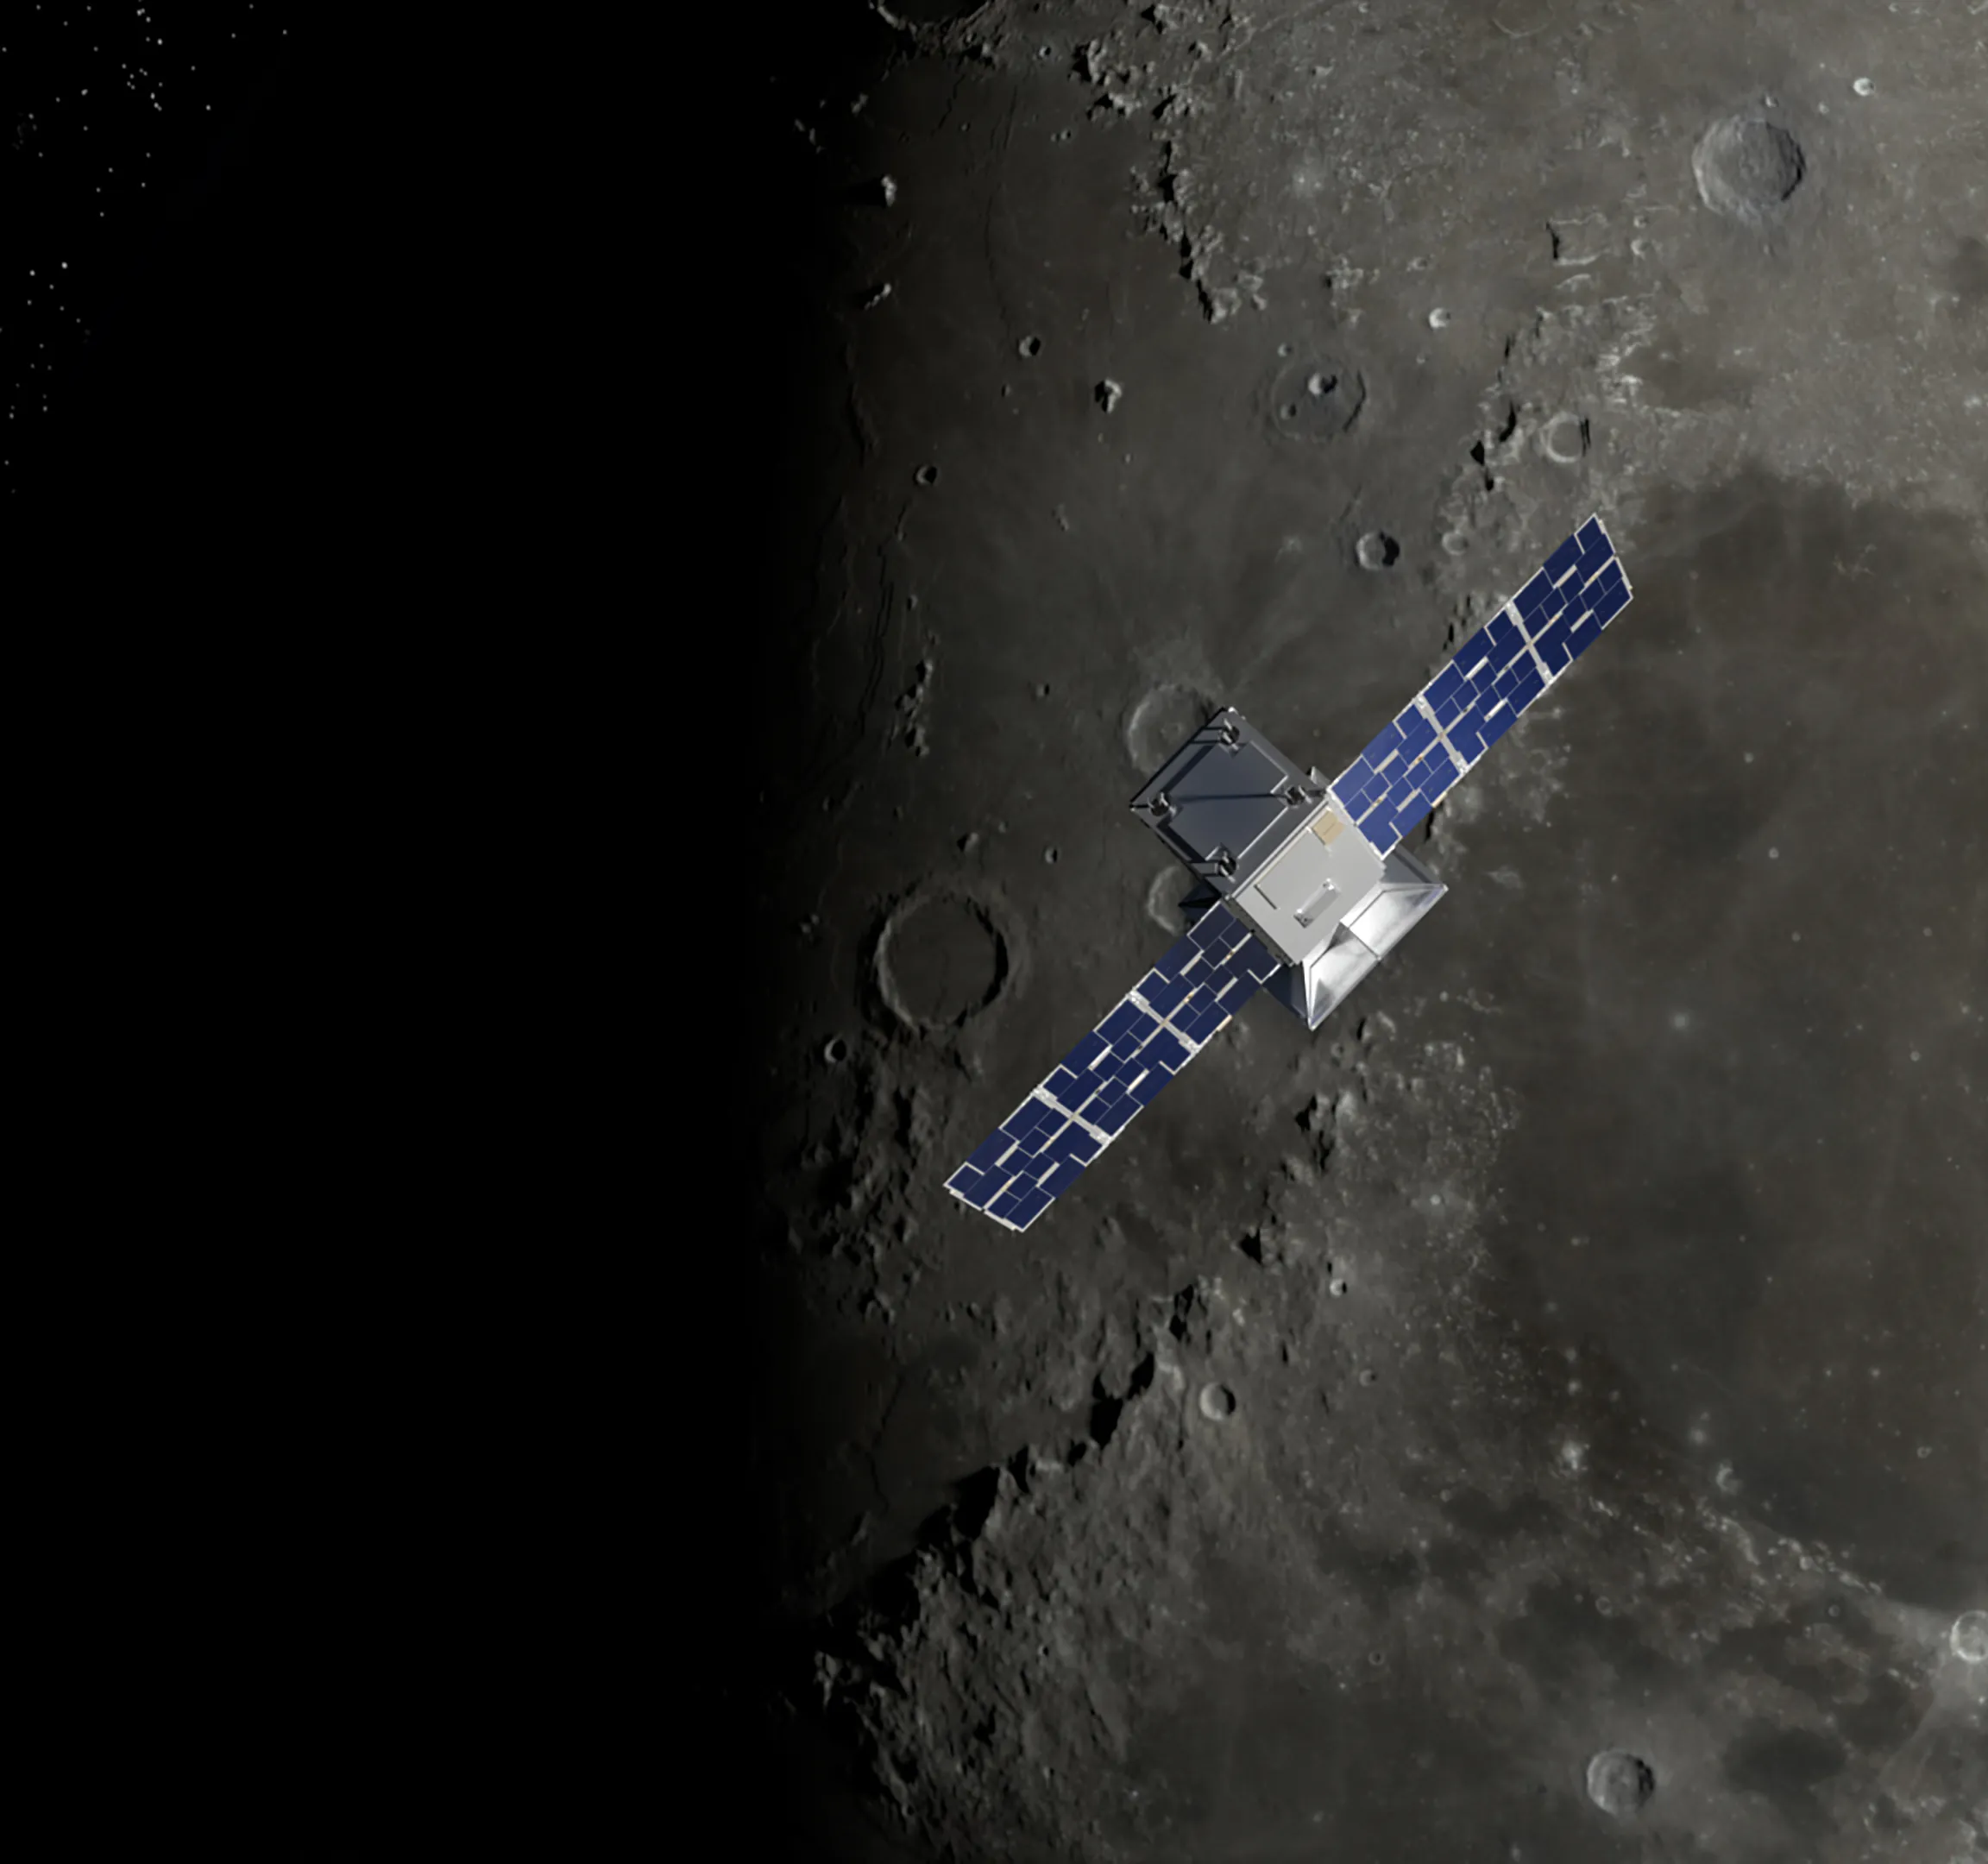
AGENDA
AGENDA
1 Mission Overview and Objectives
2 Spacecraft Systems
3 Launch Vehicle Systems
4 Ground Systems & Mission Operations
Development & Mission Timelines
6 Experiment Results & Status to Date
7 Decommissioning Plans
8 Lessons Learned

Slide 3
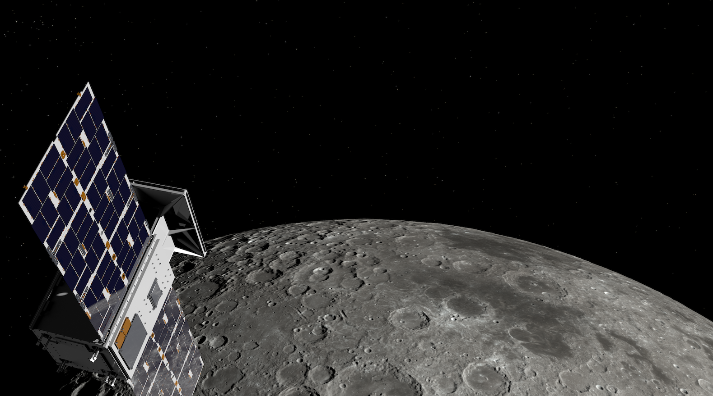
CAPSTONE is…
A12U CubeSat that serves as the first spacecraft to enter the near rectilinear halo orbit (NRHO) destined for Gateway, the Moon-orbiting outpost that is part of NASA’s Artemis program.
First CubeSat to fly in cislunar space.
Arrived at its target destination in the NRHO within 4 months via low-energy, deep space transfer using its own propulsion system.
Scheduled to remain in NRHO around the Moon for up to 18 months to understand the characteristics of the orbit and perform technology demonstrations.
Helping reduce risk for future spacecraft by validating innovative navigation technologies and verifying the dynamics of the NRHO.
Successfully launched on June 28, 2022 @5:55 AM EDT aboard a 3-stage Rocket Lab Electron rocket from Mahia, NZ.

Slide 4
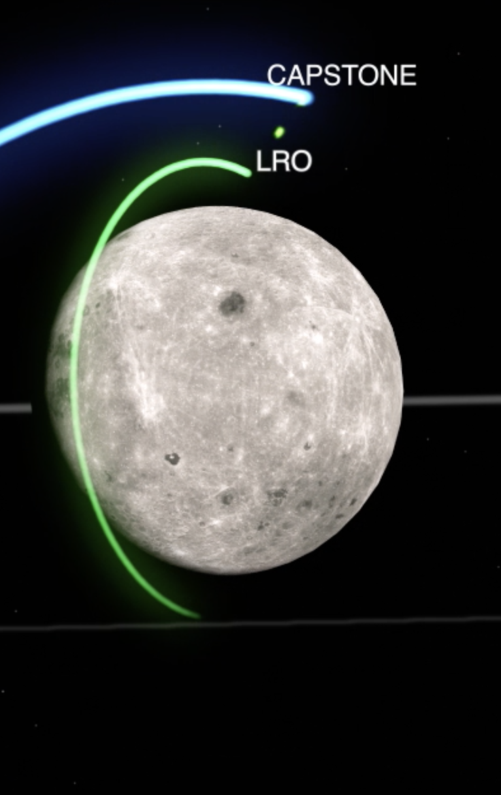
Mission objectives
      CAPSTONE is a pathfinder mission for NASA’s Gateway Operations team at NASA’s Johnson Space Center. The mission will inform the requirements and mission operations approach necessary to operate in the NRHO.
      Demonstrate inter-spacecraft ranging between the CAPSTONE spacecraft and NASA’s Lunar Reconnaissance Orbiter (LRO), orbiting the Moon since 2009.
      Validate the Cislunar Autonomous Positioning System (CAPS) navigation software system.
      Lay a foundation for commercial support of future lunar operations.
      Help gain experience with small dedicated launches of CubeSats beyond low-Earth orbit, to the Moon.

Slide 5
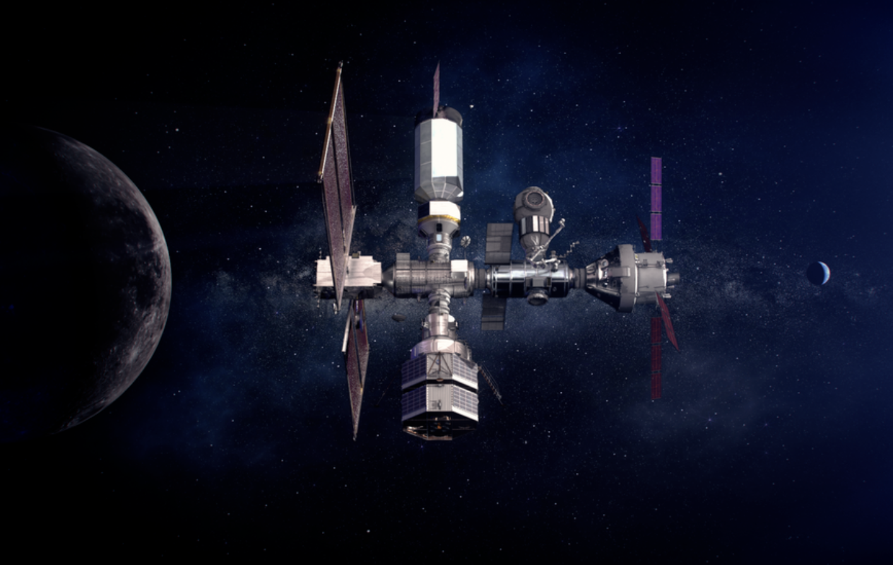
Pathfinder for Artemis Program & Operations in NRHO
The NRHO is desired for NASA’s Gateway
  This stable orbit minimizes the propellant required for orbit maintenance
  Offers a continuous view of Earth
  Provides coverage of both the lunar North and South Poles
CAPSTONE arrived at the NRHO about 4 months after launch
  CAPSTONE utilized a Low Energy (Ballistic) Lunar Transfer (BLT) to enter the NRHO. This transfer from the Earth to the Moon uses the gravity of the Earth, Moon, and the Sun to reduce the required dV to reach the Moon. This approach will also be used by the Artemis Program.
  Rocket Lab Electron took the Photon spacecraft containing CAPSTONE to low-Earth orbit (LEO) then performed a series of orbit-raising maneuvers prior to releasing the CAPSTONE spacecraft into its transfer path to the Moon.
Credit: Advanced Space, LLC

Slide 6
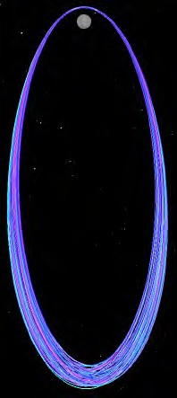
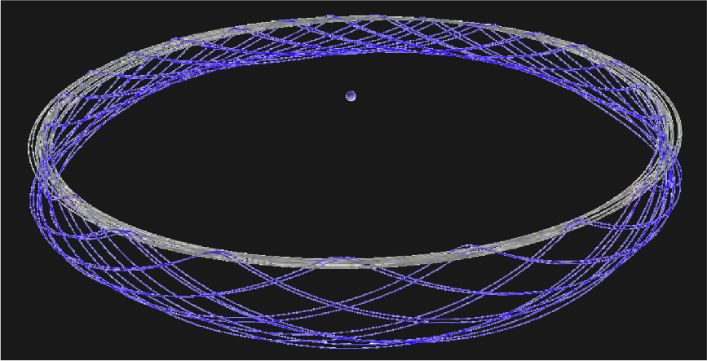
Near Rectilinear Halo Orbit (NRHO)
This quasi-stable orbit minimizes the propellant required for orbit maintenance.
Offers a continuous view of Earth
Avoids and/or minimizes eclipses
Provides coverage of both the lunar North and South Poles
Orbital period ~6.5 days
Perilune ~3,500 km
Apolune ~71,000 km
9:2 Moon-Sun resonant orbit
Earth-Moon pulsating, rotating frame
Earth
Moon’s orbit
Images this slide credited to:
Advanced Space, LLC
Inertial frame

Slide 7
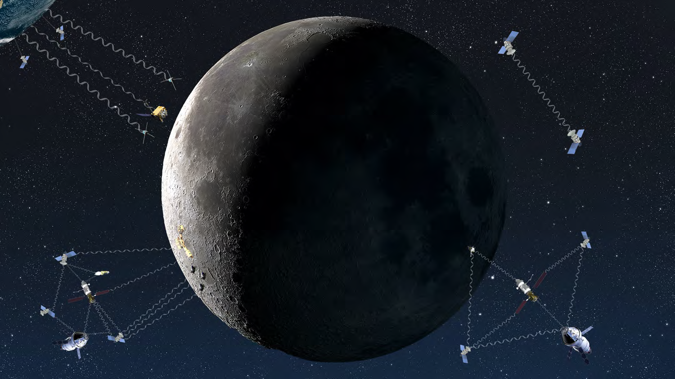
Cislunar Autonomous Position System (CAPS)
Paradigm Shift in Cislunar Navigation
Onboard computation of a spacecraft navigation estimate
Less reliance on over-scheduled ground networks
Up to several weeks of autonomous navigation
Principles of Operation
Ingest range (km) and range rate (km/s) measurements between two spacecraft, appropriately slewed prior to comm. link
Model both spacecrafts’ orbital motion or surface location adequately
Compute model deviations via a Kalman Filter and the measurements
Credit: Advanced Space, LLC

Slide 8
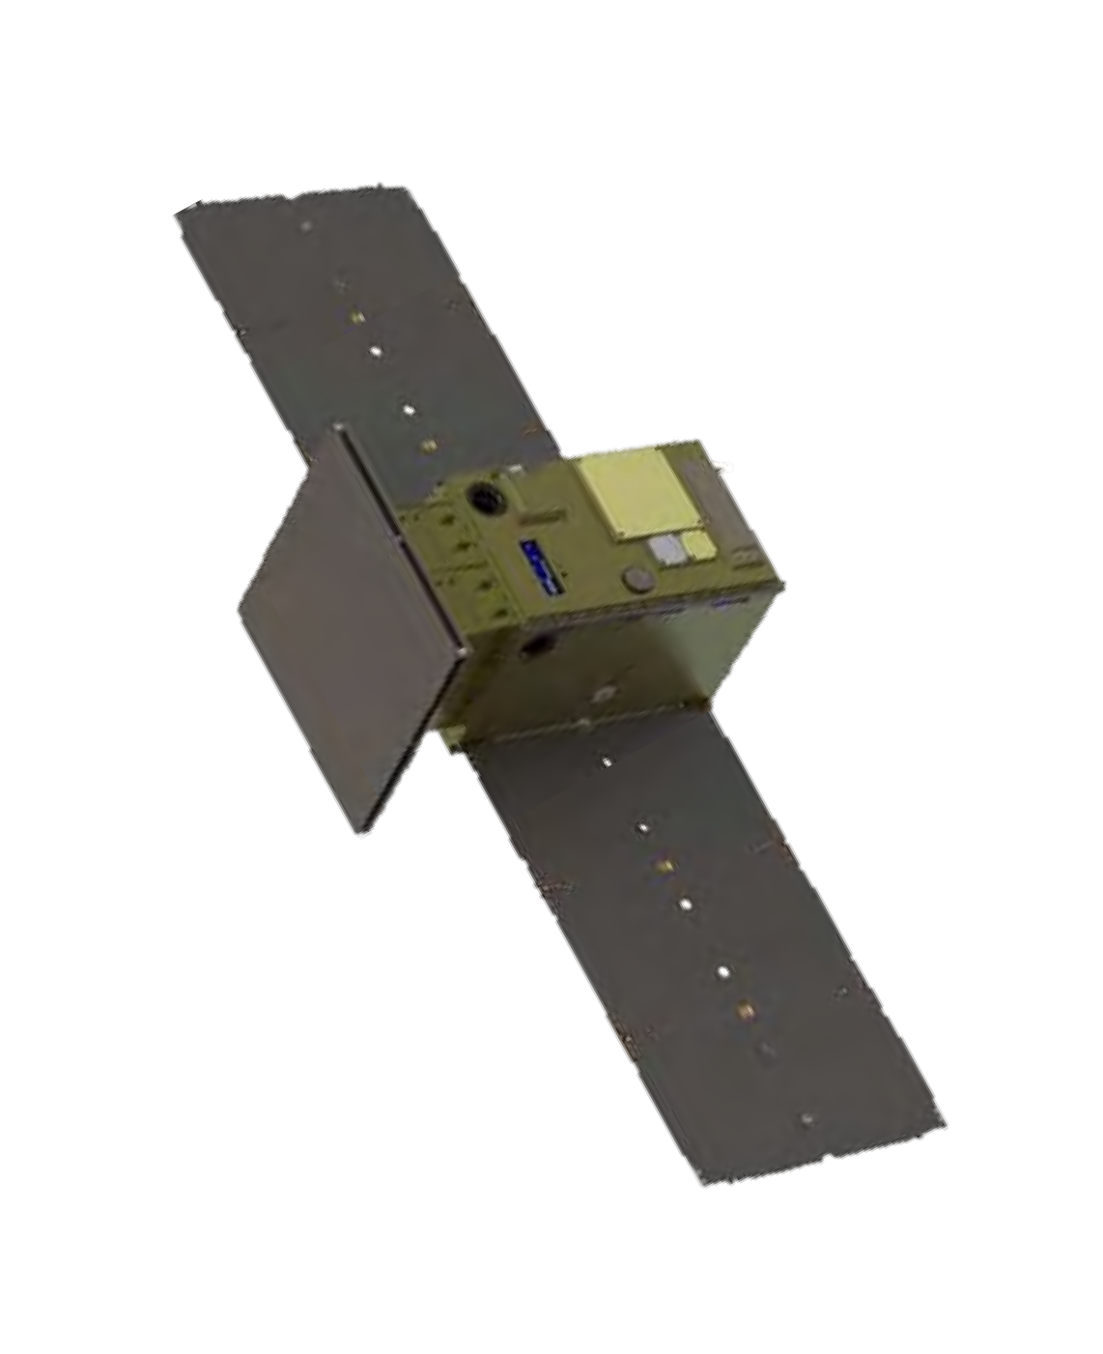
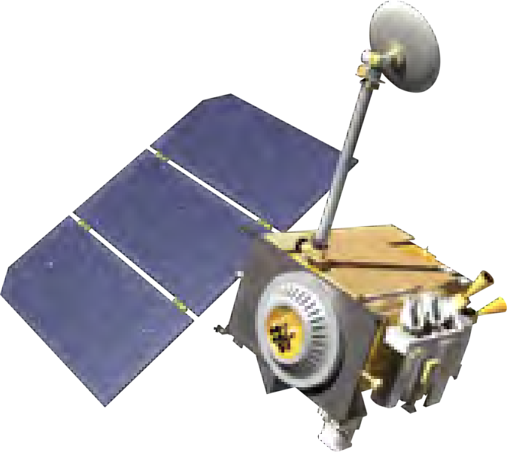
Autonomous Absolute Navigation experiment
CAPSTONE
TUI Swift radio for Cross-link
S-Band Crosslink with LRO:
CAPSTONE Tx/Rx: 2091/2271.2 MHz
LRO
The cross-link experiment between CAPSTONE and the LRO spacecraft will evaluate ranging capability.
The Cis-Lunar Autonomous Positioning System (CAPS) demonstrated automated navigation solutions to reduce ground segment burden and enhance future mission operations.
CAPS performed peer-to-peer measurements between CAPSTONE and the LRO spacecraft to generate absolute estimates of spacecraft position and velocity.

Slide 9
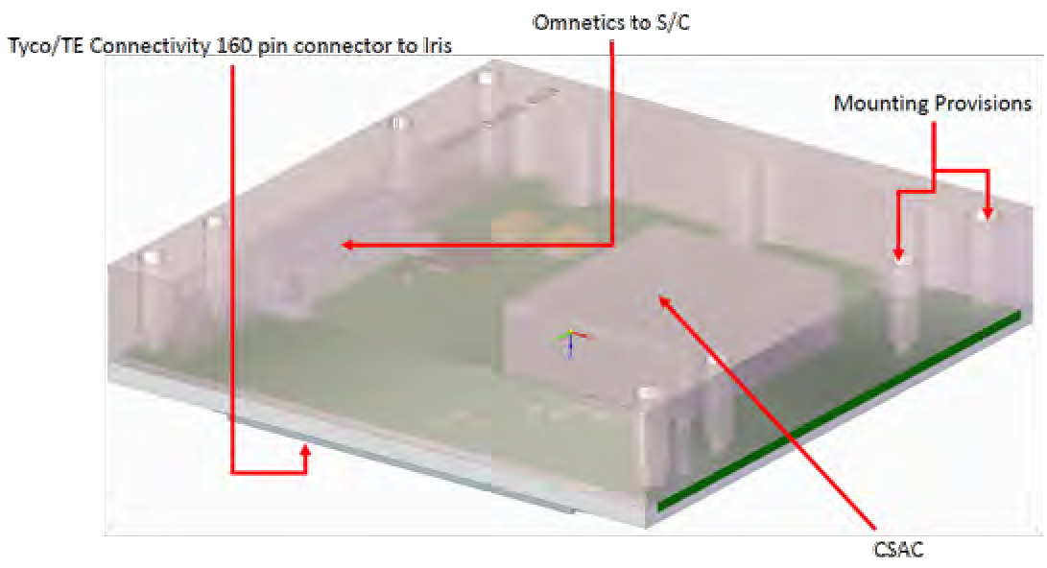
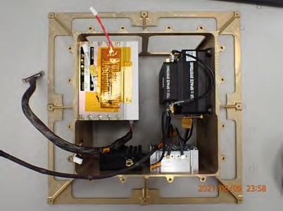
CSAC 1-Way Ranging Experiment
A Chip Scale Atomic Clock (CSAC) was added to the Iris X-Band radio in order to support a 1-Way ranging experiment during the CAPSTONE mission.
Collaboration with JPL to develop the Iris interface to the CSAC
JPL tested the ranging function and the firmware interface in their Iris testbed.
Tyvak completed the integration of the CSAC board package, the Iris transponder and the spacecraft SW interface in July 2021.
Advanced Space developed the 1-way ranging (uplink) navigation measurement processing software and delivered the flight software for test in October 2021
1-way ranging with the CSAC/Iris (DSN to spacecraft) during the CAPSTONE mission prior to end of primary mission.
CSAC Board Package
Images this slide credited to: NASA/JPL-Caltech

Slide 10
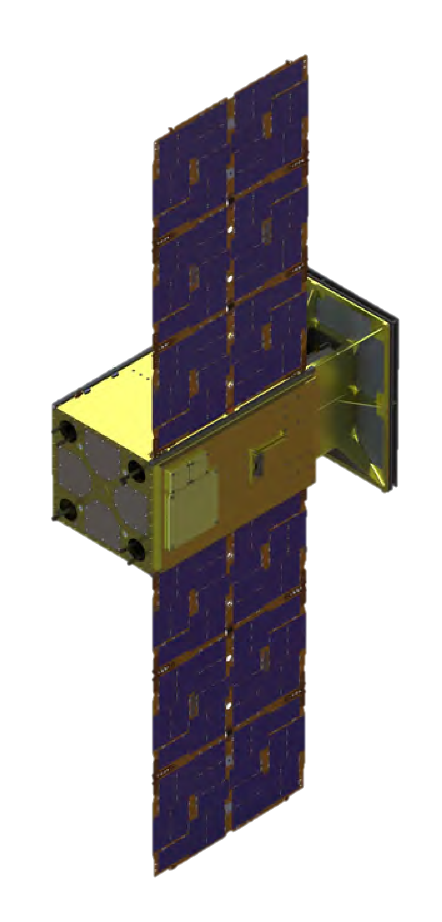
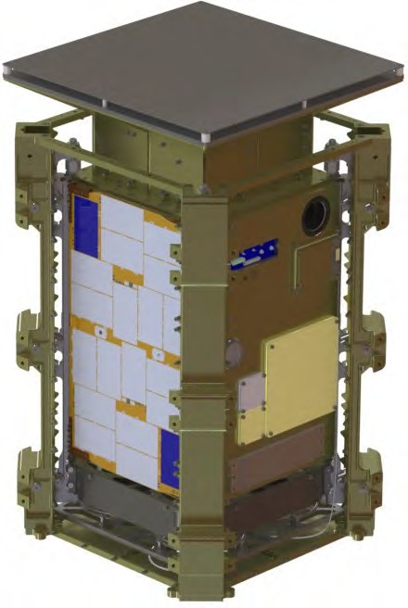
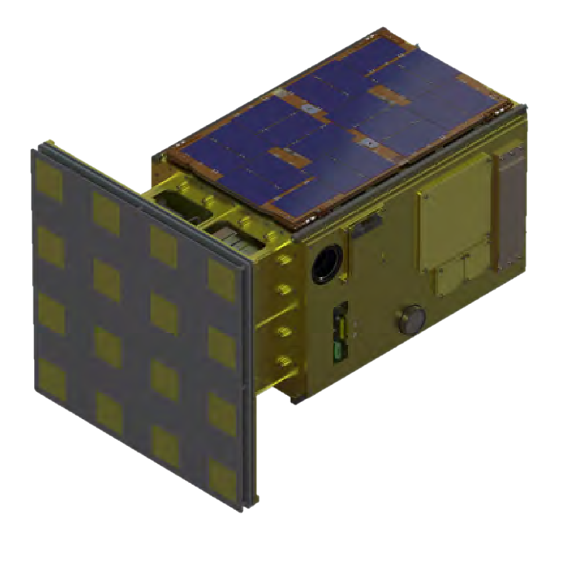
CAPSTONE Spacecraft
Spacecraft systems description
Antenna protrusion avoids the need for deployable antenna design
Coarse Sensor Module
Deployable Solar Array
Radio Tower (S and X-band)
Hydrazine Thrusters
Umbilical Access
X-band TX and RX Antennas (Low Gain)
Imager
X-Band TX Antenna (High
Gain)
Star Tracker
Ballast
Hydrazine Fill Port Access
Launch configuration in Tyvak 12U Deployer with built-in isolation system
S-Band Antenna
Credit: Terran Orbital Corporation

Slide 11
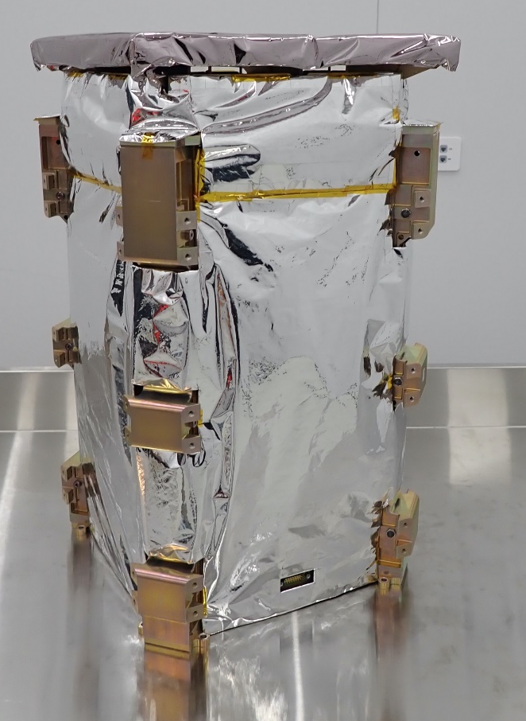
capstone spacecraft SPECIFICATIONS
Fully Assembled Spacecraft /Dispenser
Credit: Terran Orbital Corporation

Slide 12
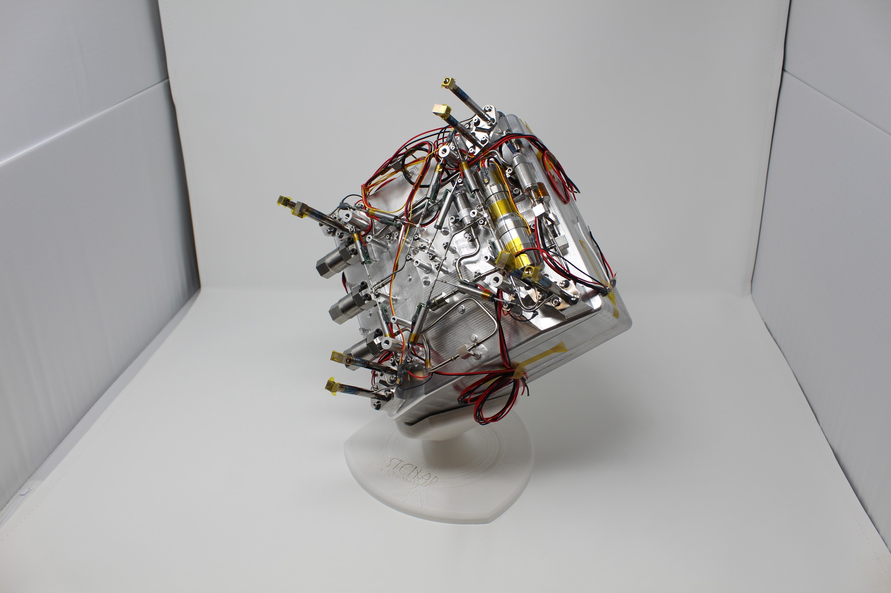
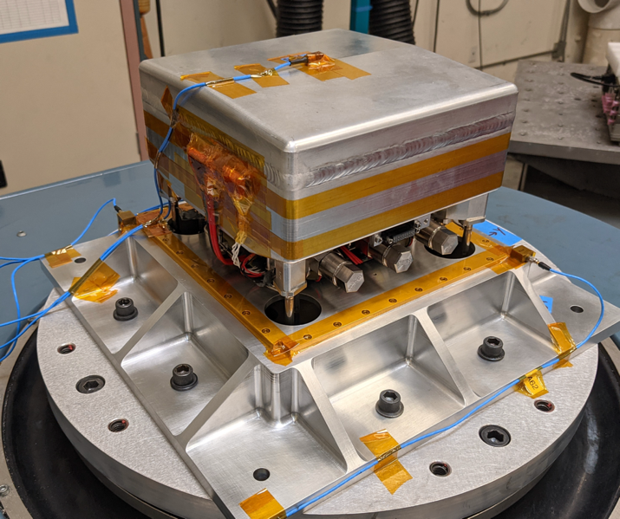
Stellar Exploration hydrazine propulsion system
Propulsion System Specifications
Subsystem/Spec | Value
Dimensions | 2U X 2U footprint for 12U spacecraft
Fuel Capacity | Variable height for fuel load ~ 3 – 6 kg
Delta V | 200 – 550 m/sec
Thrusters | 8 thrusters with 0.25 N thrust (200 sec Isp)
Attitude Control | Translational & 3-DOF rotational capability
Propellant | Hydrazine with catalyst decomposition
Pressurization | Electric gear pump
Launch Safety | 91-710 compliant, propellant tank not pressurized at launch, fully welded and sealed
Images this slide credited to: Stellar Exploration

Slide 13
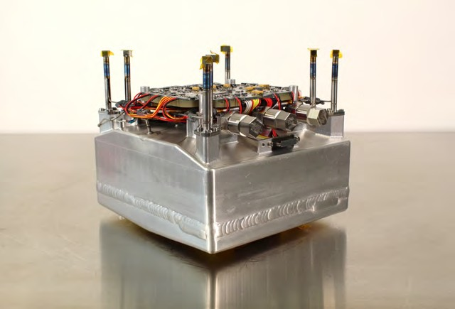
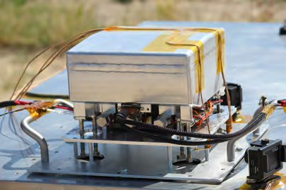


CAPSTONE Propulsion System
Subsystem/Spec | Value
Dimensions | 2U X 2U footprint for 12U spacecraft
Fuel Capacity | Variable height for fuel load ~3-6kg
ΔV | ~220 meters/sec
Thrusters | 8 thrusters with 0.25 N thrust (200 sec Isp)
Attitude Control | Translational & 3-DOF rotational capability
Propellant | Hydrazine with catalyst decomposition
Pressurization | Electric gear pump
Launch Safety | 91-710 compliant, propellant tank not pressurized at launch, fully welded and sealed
CAPSTONE Propulsion Flight Unit
Images this slide credited to: Stellar Exploration
CAPSTONE ETU System Testing

Slide 14
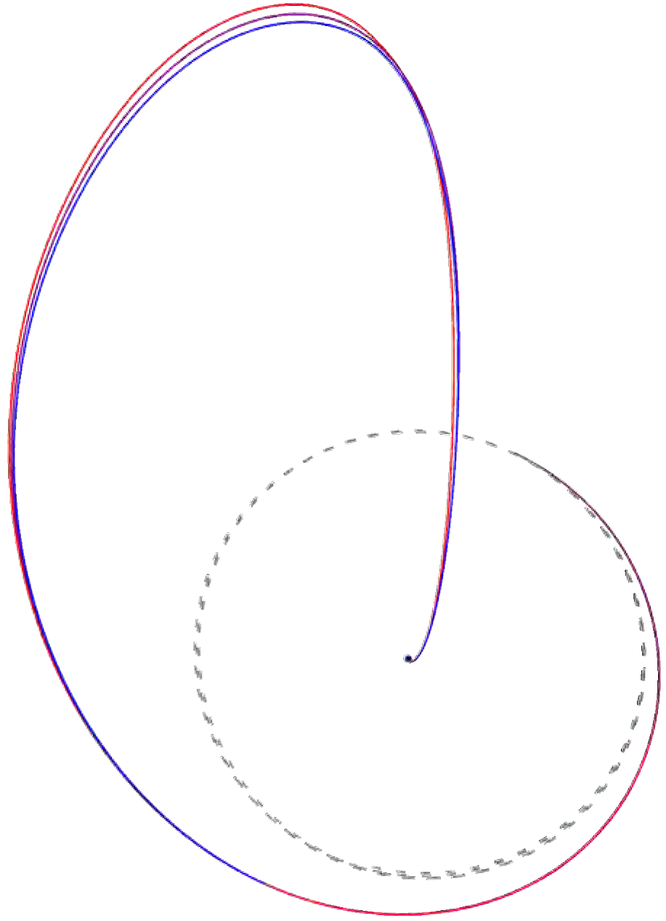
Low Energy, Ballistic Lunar Transfer (BLT)
CAPSTONE vehicle propellant requirements include:
  120 m/s of DV for insertion into NRHO once deployed from Photon
  40 m/s of DV is required to maintain orbit for 18 months
  5 m/s of DV is required for disposal.
8/10/22
1.437 M km from Earth
TCM-3
TCM- 2
TCM = Trajectory Correction Maneuver
NIM = NRHO Insertion Maneuver:11/13/22
Maneuver | Purpose | Timing
TCM-1 | Clean up launch errors | Executed on 7/6 and 7/11: 22 m/s
TCM-2 | Expand launch period | Executed on 7/25: 40 m/s
TCM-3 | Clean up sensitive TCM-2 | 9/8/22 – 60 days before NIM
TCM-4 | Target NRHO insertion | 40 days before NIM
TCM-5 | Target NRHO Insertion | 10 days before NIM
TCM-6 | Target NRHO Insertion | 5 days before NIM
NIM
TCM-4
TCM-6
TCM- 1
Moon’s Orbit
Earth
TCM-5
Earth-centered
Inertial Frame
Credit: Advanced Space, LLC

Slide 15
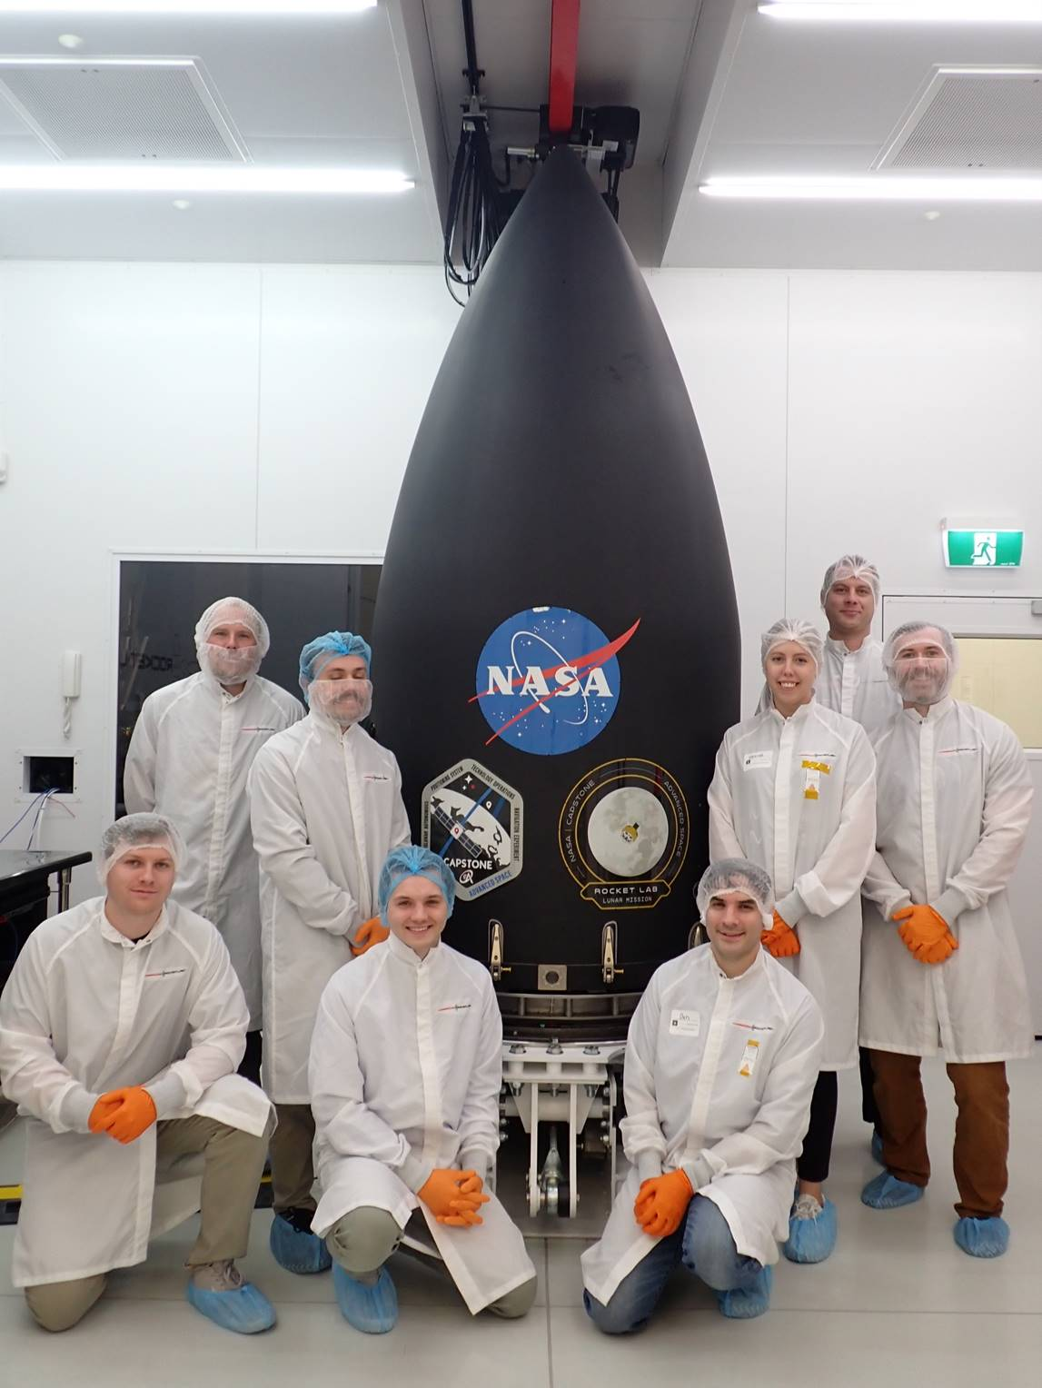
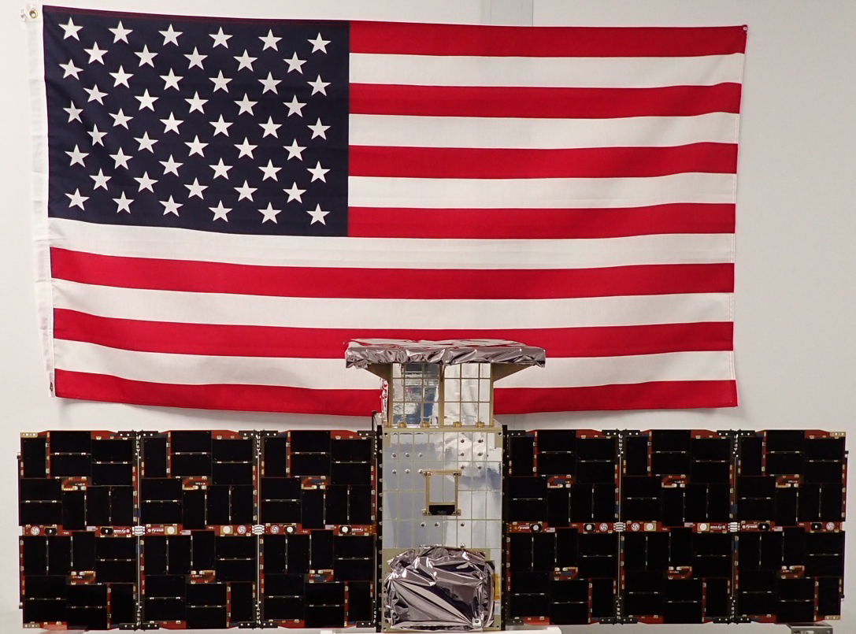
CAPSTONE Spacecraft Encapsulated
Credit: Rocket Lab USA, Inc.
Credit: Terran Orbital Corporation

Slide 16
ROCKET LAB LAUNCH VEHICLE SYSTEM
Rocket Lab Electron Rocket – 2 Stage +
Photon Spacecraft with Hyper-Curie Motor
Photon is the Trans Lunar Injection Stage
for the CAPSTONE Spacecraft
Images this slide credited to: Rocket Lab USA, Inc.

Slide 17
Credit: Rocket Lab USA, Inc.

Slide 18
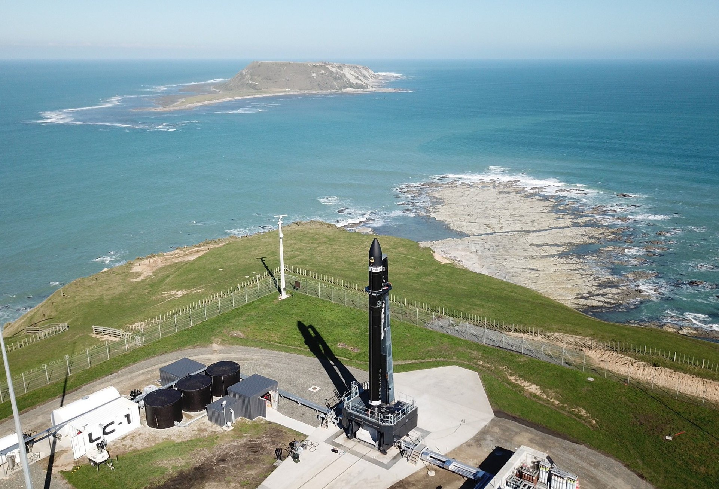
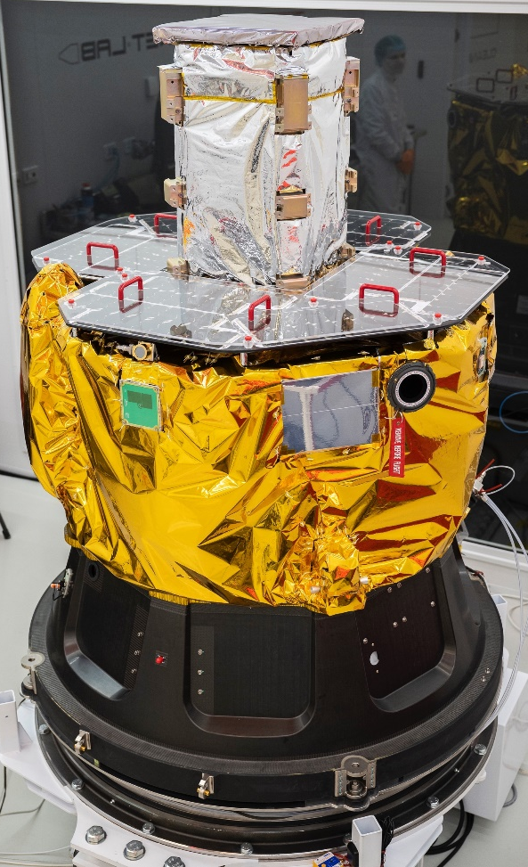
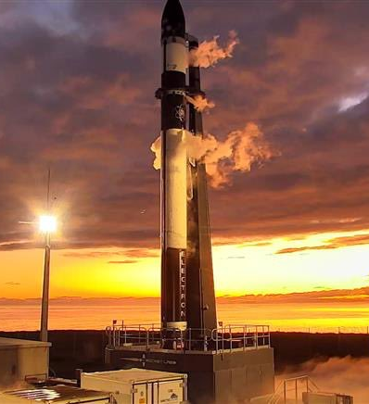

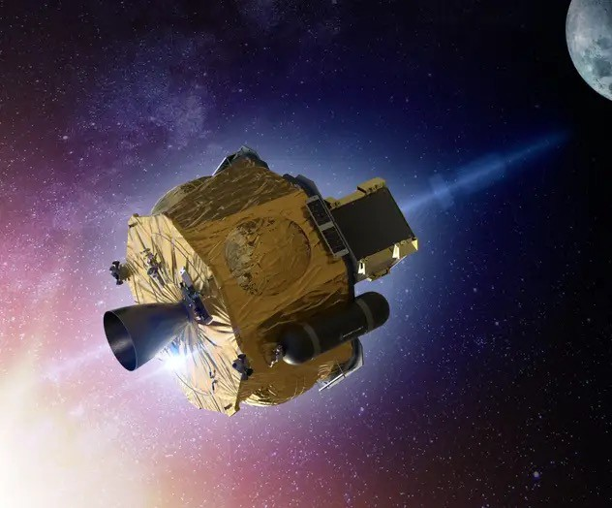
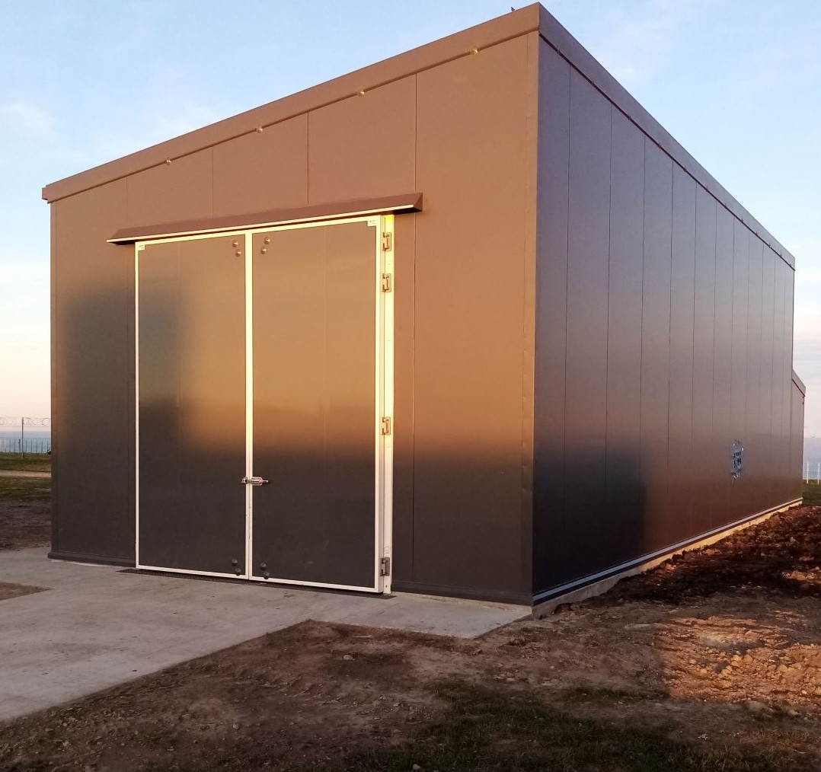
Rocket Lab Launch Support
Launch from LC-1, Mahia, NZ
Lunar Photon
CAPSTONE Integrated Stack
Pad
Fueling Facility
Images this slide credited to: Rocket Lab USA, Inc.

Slide 19
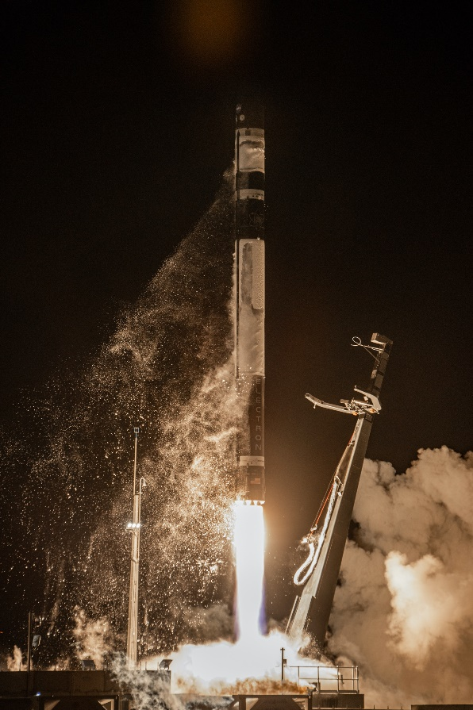
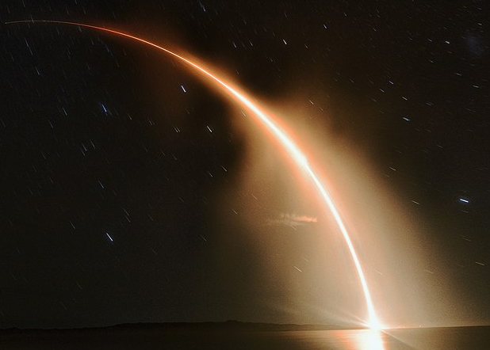
CAPSTONE Launch – Mahia, NZ
June 28, 2022, 5:55 AM EDT
Images this slide and video on slide 20 credited to: Rocket Lab USA, Inc.

Slide 20
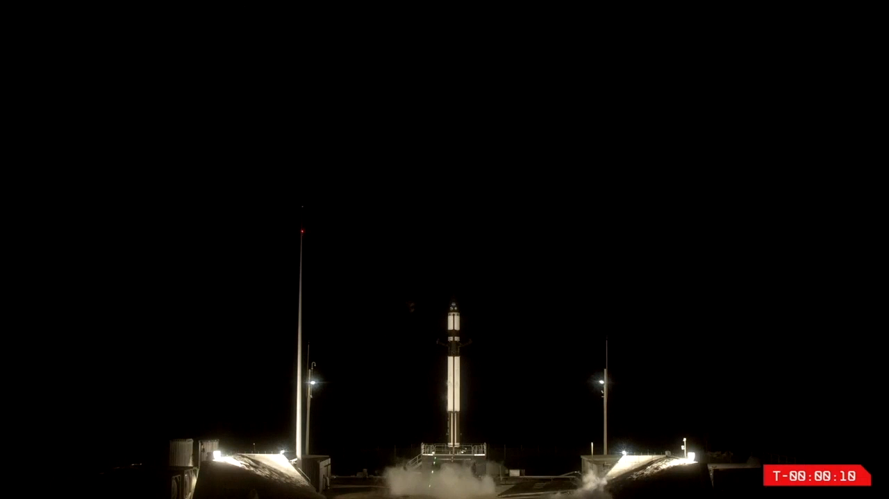

Slide 21
GROUND SYSTEMS & MISSION OPERATIONS
NASA Deep Space Network
LRO Operations, NASA GSFC
Tyvak Mission Ops, Irvine, CA
Advanced Space, Westminster, CO
  Flight Dynamics & Navigation
  CAPS Payload Operations
Launch Systems, New Zealand

Slide 22
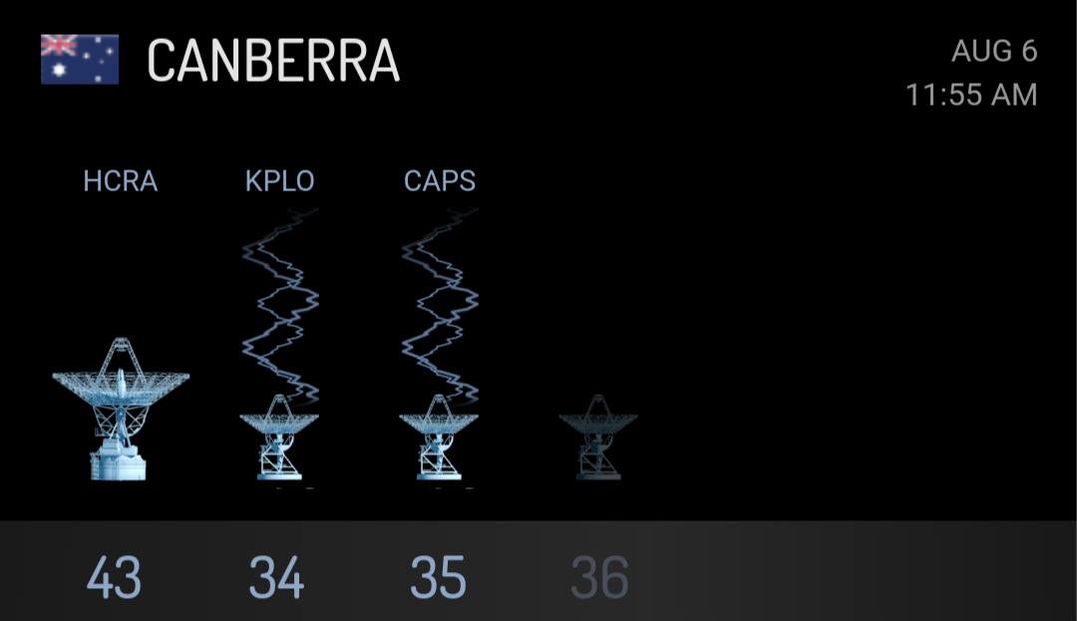
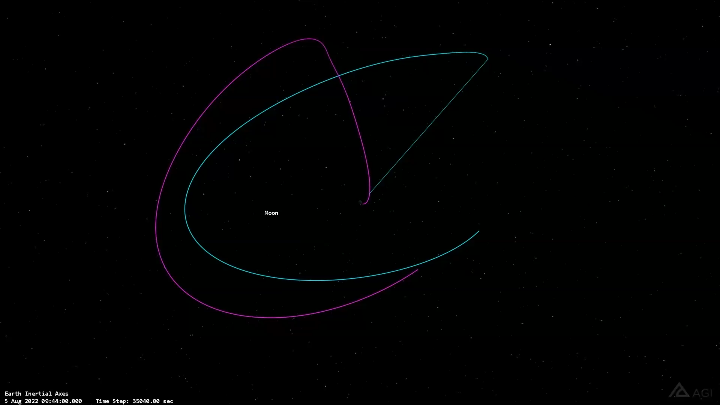


Slide 23
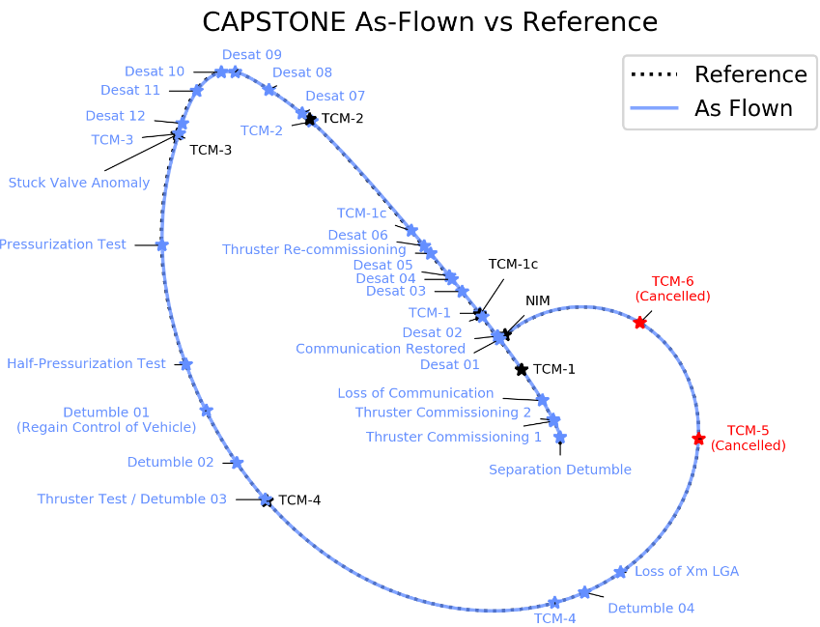
Credit: Advanced Space, LLC

Slide 24
CAPSTONE Entry into Near Rectilinear Halo Orbit
CAPSTONE was successfully launched by Rocket Lab on June 28, 2022 and was successfully deployed on its lunar transfer trajectory on July 4th.
The spacecraft completed the first two of six trajectory correction maneuvers and executed the largest of these on July 25th to target the lunar orbit insertion.
The spacecraft experienced a communications anomaly on July 4th ~10 hours after separation from the Lunar Photon. Communications were interrupted for ~43 hours but were automatically recovered by the spacecraft software system and communication was restored on July 6th.
Attitude Control anomaly occurred on September 8th. A stuck attitude control thruster valve caused the spacecraft the spacecraft to enter into a flat spin. Recovered prior to NIM.
NRHO insertion occurred on Nov 13th and began preparations for NRHO maintenance operations.
Loss of communications occurred January 26, 2023 due to suspected SEU. Spacecraft recovered and communication was restored February 6, 2023.

Slide 25
CAPSTONE Development Timeline
Project
KO
S/C Ship Readiness
9/18/19
ΔTRR-2
LDR
4/19/21
SRR/
MCR
ISR
ΔCDR
ATP
PDR
CDR
SIR
TRR
ΔTRR-1
STPR
MORR
5/19/22
Launch
8/30/19
10/16/19
12/4/19
2/28/20
5/7/20
7/30/20
11/13/20
2/5/21
8/13/21
11/19/21
6/28/22
48
97
2020
183
252
336
442
2021
526
716
813
2022
964
1036
Baseline schedule at ATP: 548 days (18 months)
Re-baseline 1 : 655 days (22 months) - Launch Vehicle Readiness, Spacecraft HW Development Issues
Re-baseline 2 : 782 days (26 months) - Launch Vehicle Readiness, Spacecraft HW Development Issues
Re-baseline 3 : 933 days (30 months) - Launch Vehicle Readiness, Spacecraft Testing
Re-baseline 4 : 974 days (32 months) - Launch Vehicle Readiness, Spacecraft Testing
Re-baseline 5: 1036 days (34 months) - Launch Vehicle Readiness, Spacecraft Testing Close-out
Fully 8 months of the ~16-month launch delay were due to complications due to COVID: Supply chain, personnel, launch vehicle upper stage testing and development. The remaining 8 months are due to risk realizations for the spacecraft and launch vehicle HW development and implementation.

Slide 26
CAPSTONE Mission Timeline Months from Launch
1 | 2 | 3 | 4 | 5 | 6 | 7 | 8 | 9 | 10 | 11 | 12 | 13 | 14 | 15 | 16 | 17 | 18 | 19 | 20 | 21 | 22 | 23 | 24
L + 3 |  |  | L + 4-5 months: Conduct primary demonstration operations for 6 months NRHO operations and flight dynamics assessment CAPSTONE to LRO cross-link experiment One-way ranging with the CSAC |  |  |  |  |  | L + 10-11 months: |  |  |  |  |  |  |  |  |  |  |  | Possible follow-on Ops with other NASA or commercial assets End of mission (EOM) - Spacecraft disposal
months: Launch to LEO Orbit raising |  |  |  |  |  |  |  |  | Conduct technology enhancement operations for 12 months Perform additional NRHO operations and
BLT & insertion into NRHO by spacecraft |  |  |  |  |  |  |  |  | autonomous system evaluation Continued CAPSTONE to LRO ranging experiments
 |  |  |  |  |  |  |  |  | Increase fidelity of CAPS system demonstration
 |  |  |  |  |  |  |  |  | Detailed demonstration of a one-way ranging experiment with the Chip Scale Atomic Clock (CSAC)

Slide 27
Cross Link Experiment Results

Slide 28
CAPS Crosslink (Ranging) with LRO Tests Summary
Date of Test | Cross-link Success | Result
18Jan2023 | Yes | LRO received signal, but no ranging data was observed.
9May2023 | Yes | CAPSTONE transmitted navigation signal to LRO. LRO returned signal. | CAPSTONE able to compute range and trajectory. A 17 minutes tracking pass with 78 usable measurements
21Oct2023 | Yes | CAPSTONE & LRO achieved lock. Measurements were generated for the entire duration of the pass. | A 56 minutes tracking pass with 259 usable measurements.
7Jan2024 | Yes | CAPSTONE & LRO achieved lock. A 66 minutes duration pass was longest pass. | All ranging data were extracted from cross link tests with 200 usable measurements.
3Feb2024 | Yes | CAPSTONE & LRO achieve lock. A 45 minutes tracking pass. This was first successful consecutive crosslink test. | 240 usable measurements. Used shorter ranging sequence.

Slide 29
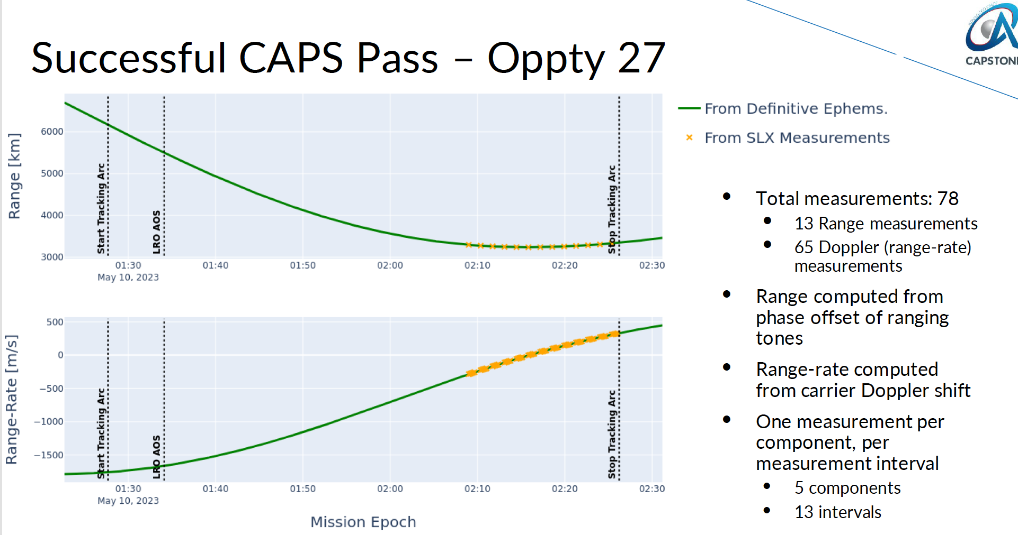
Crosslink Sample Data
Credit: Advanced Space, LLC

Slide 30
One Way Regenerative Ranging with
Deep Space Network (DSN)
Ranging is used for spacecraft and satellite navigation. Regenerative PN ranging improves ranging signal quality received at the ground station. It is more efficient in link power than non-regenerative techniques.
Between February 2023 – August 2023 CAPSTONE successfully completed 2 one way ranging tests with DSN.
By November 2023, CAPSTONE successfully gathered one way ranging data on 18 DSN passes.
Currently gathering one way ranging data on every ground pass with DSN.

Slide 31
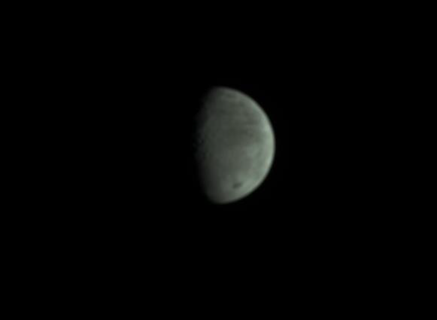
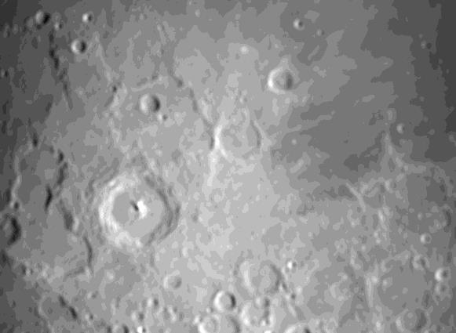

CAPSTONE On-board Camera Images
Sequence Images
Lunar Surface Image
Images this slide credited to: Advanced Space, LLC

Slide 32
Mission Summary To Date
CAPSTONE has been successfully operating for over 500 days since launch. The following activities have been tracked since the start of the mission.
Over 70 completed NRHO revolutions.
21 Orbital Maintenance Maneuvers have been completed.
4 Of 5 Operational Objectives have been met.
15 Crosslink attempts conducted with 4 successful crosslinks achieved.
All tracking passes now yield one-way ranging data with DSN.
Survived 16 eclipses, longest eclipse ~75 minutes.
152 images have been collected.

Slide 33
CAPSTONE DECOMMISSIONING
Credit: Advanced Space, LLC

Slide 34
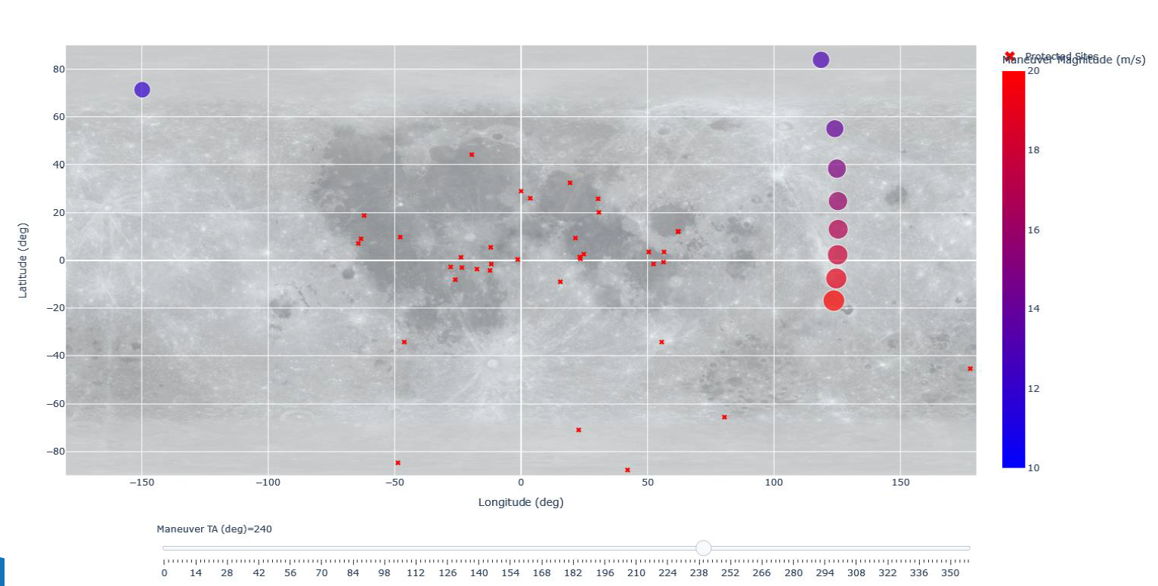
Selecting an EOM Maneuver
Credit: Advanced Space, LLC

Slide 35
CAPSTONE: Key Lessons Learned - 1 of 2
For a CubeSat/SmallSat-based mission with a clear set of mission goals, a better understanding of the overall system requirements is needed well before the PDR and certainly as part of the spacecraft acquisition process (i.e., RFP, contract requirements, deliverables, etc.)
  Low-cost, CubeSat missions often rely on COTS components and alleged “plug and play” designs that are often not as developed as advertised.
  A clear understanding of the unique requirements vs. capabilities for a unique mission needs to be better defined and detailed out BEFORE schedules and budgets are estimated and agreed to.
  Ground system requirements and operations are often not well understood until well after ATP and the complications related to those can drive schedule and costs that were not well considered. Plugging into existing ground architectures is not as simple as it is often advertised and the complexities of interface testing with those system is often underestimated.
Having a better understanding of vendor capabilities, heritage and past performance is important to understand prior to contract award and execution. Smaller, lower cost vendors often underestimate or underbid the costs and scope of the required work, and this leads to headaches and delays when inevitable problem arise.

Slide 36
CAPSTONE: Key Lessons Learned - 2 of 2
Regulatory approvals often require far more time and resources that expected
  Frequency approval for cislunar or deep space missions is often a labyrinth of requirements and approvals that require extensive attention to the detailed requirements and the time it takes to receive full approval.
  Multiple government agencies, who often don’t communicate with each other, are involved in getting final launch approval, i.e., New Zealand Space Agency (NZSA)
  Items like Planetary Protection, Orbital Debris, Range Safety requirements for launch, and transport requirements for an overseas launch (aka Rocket Lab in NZ) are not well understood by most space systems development teams and require significant oversight by project management.
Selling the project is great. Implementing the project is ALWAYS harder, takes longer and costs more that most everyone thinks.
  CAPSTONE was sold as a low cost, fast paced cislunar mission to deliver data and results to NASA in ~20-24 months. The reserves were considered adequate and that is often underestimated as well.
  COVID aside, several key challenges were not well understood by the team until well into the project and costly adjustments had to be made to mitigate these issues.
  Between the launch vehicle upper stage issues and the the unique spacecraft requirements impact on a COTS design, the mission launched ~16 months after it was initially planned.

Slide 37

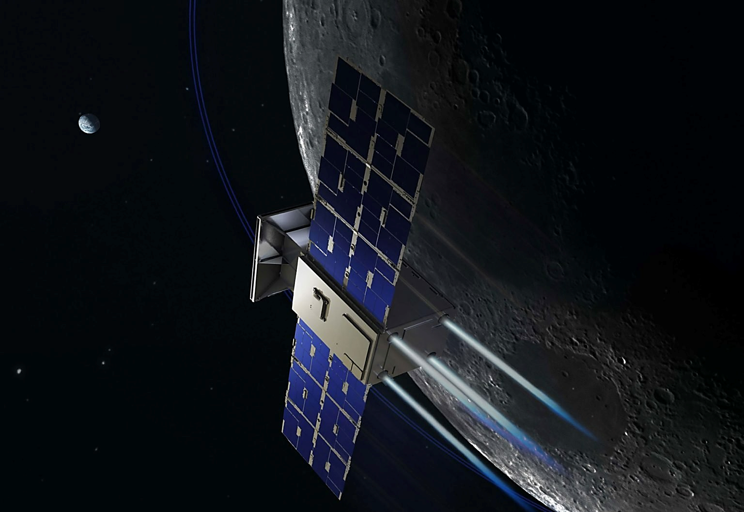





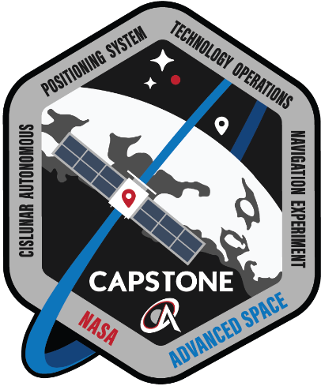
Thank you for your attention!
Cislunar Autonomous Positioning System Technology, Operations, and Navigation Experiment
(CAPSTONE)
Demonstrating an innovative spacecraft-to-spacecraft navigation solution at the Moon from a near rectilinear halo orbit slated for Artemis' Gateway.
NASA's Small Spacecraft Technology Program funds the technology demonstration. NASA's Advanced Exploration Systems funds the launch and supports mission operations.
The mission is developed and operated by Advanced Space, LLC.

