Slide 1
Space Weather 101
Dr. Dennis Gallagher
NASA Marshall Space Flight Center
Dennis.Gallagher@nasa.gov
Credit: NASA

Slide 2
Objective of the Presentation:
Enhance awareness of space weather and why you should care

Slide 3
Definition of Space Weather:
The conditions on the sun, in space, and in our upper atmosphere that can influence the performance and reliability of space-borne and ground-based technological systems and endanger human life or health.

Slide 4
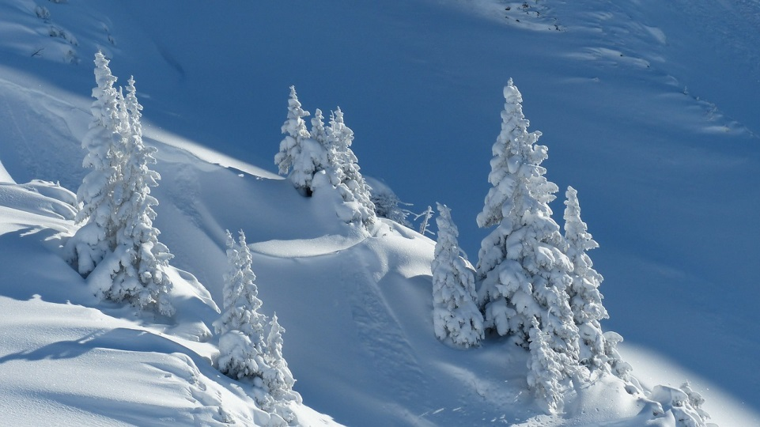
What does Weather mean to you?
Weather on Earth
Beauty
pixabay.com

Slide 5
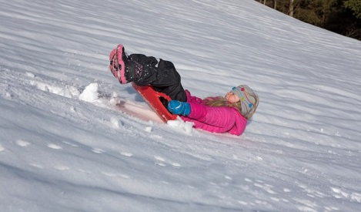
What’s does Weather mean to you?
Weather on Earth
Recreation
pixabay.com

Slide 6
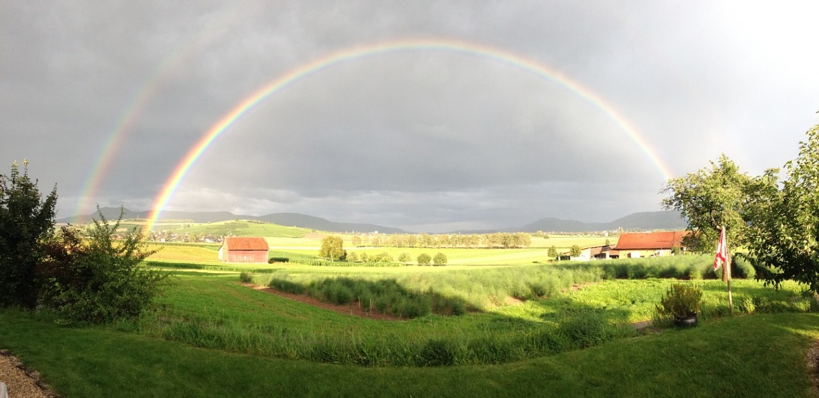
What’s does Weather mean to you?
Weather on Earth
Inspiration
pixabay.com

Slide 7
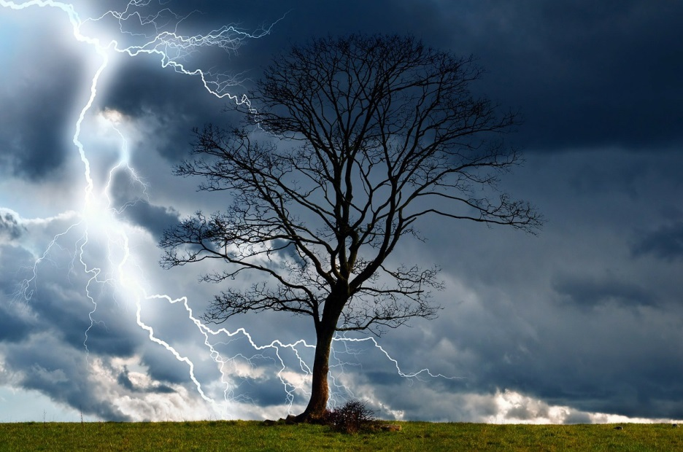
What’s does Weather mean to you?
Weather on Earth
Danger
pixabay.com

Slide 8
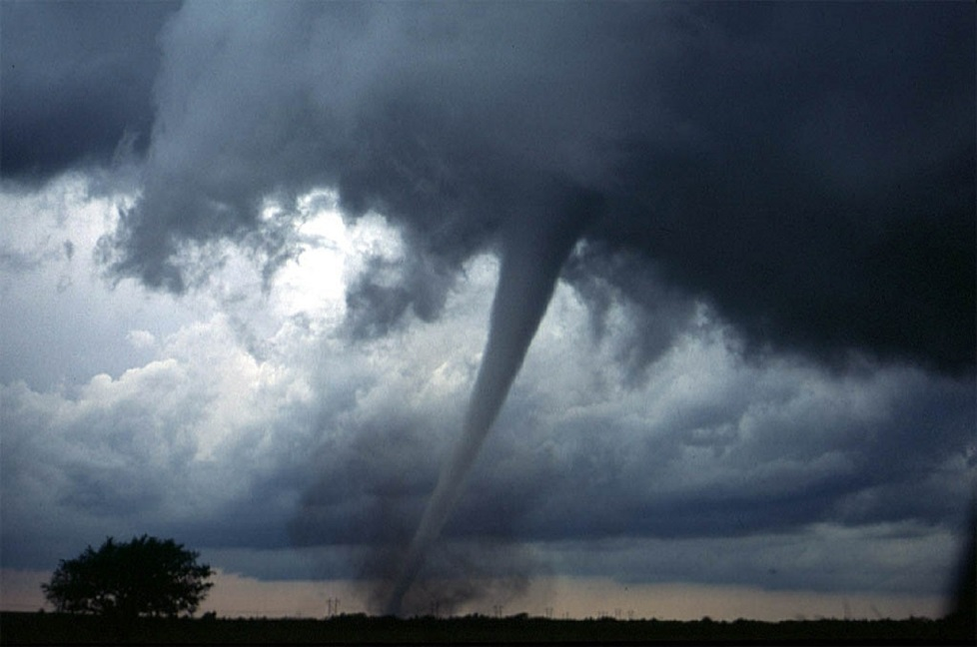
Weather on Earth
What’s does Weather mean to you?
Threat at Home
pixabay.com

Slide 9
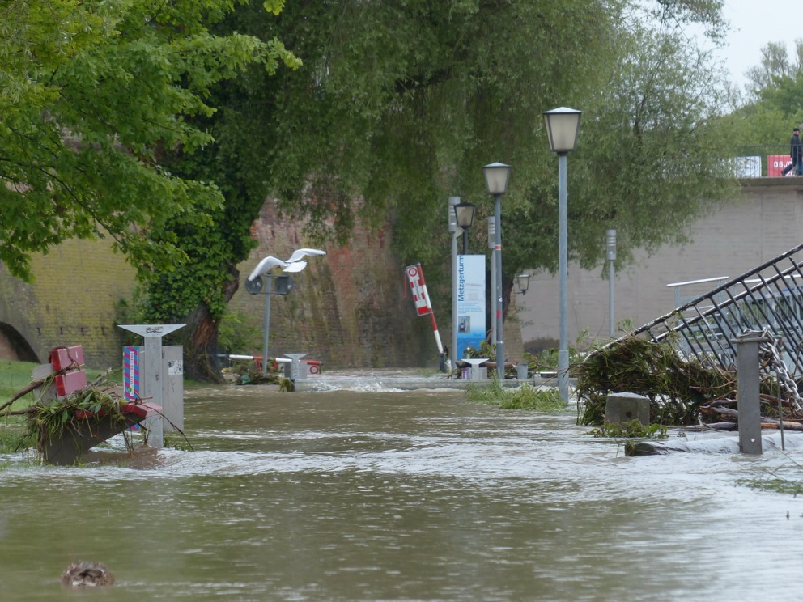
Weather on Earth
What’s does Weather mean to you?
Regional Threat
pixabay.com

Slide 10
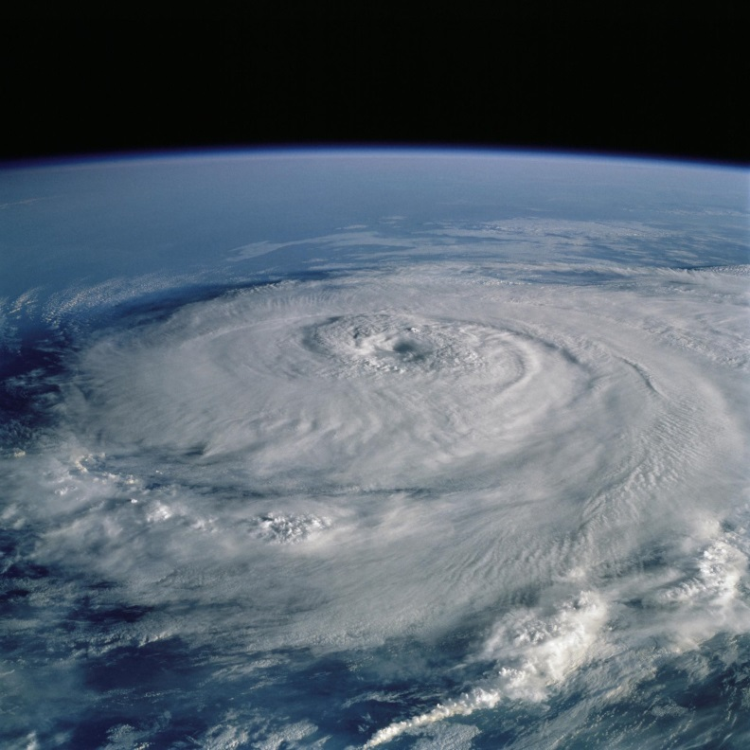
What’s does Weather mean to you?
Weather on Earth
Familiarity from Space
NASA
pixabay.com

Slide 11
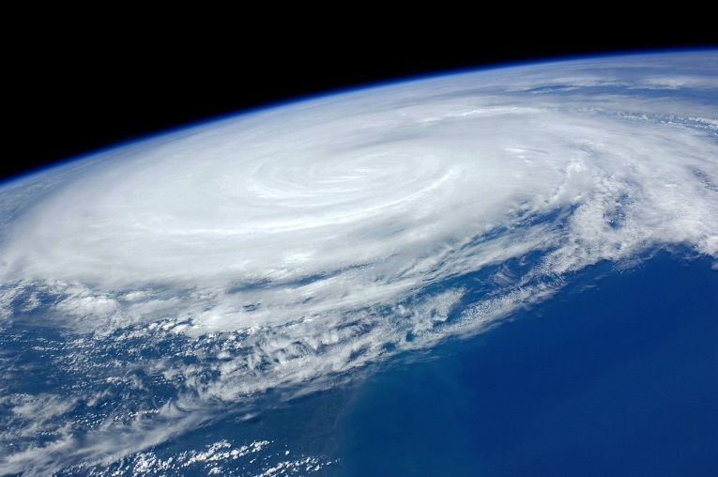
Weather on Earth
What’s does Weather mean to you?
Precipitation
Light Displays
Power of Nature
Societal Danger
pixabay.com

Slide 12
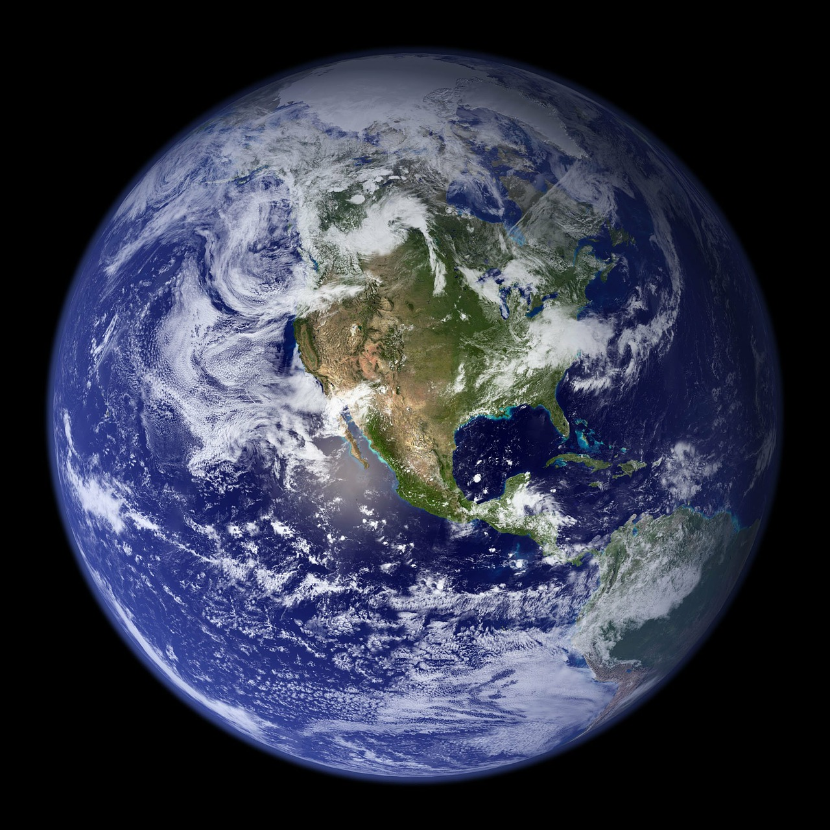
Weather in Space?
pixabay.com

Slide 13
Weather in Space?
Precipitation
pixabay.com

Slide 14
Weather in Space?
Precipitation
Light Displays
pixabay.com

Slide 15
Weather in Space?
Precipitation
Light Displays
Power of Nature
pixabay.com

Slide 16
Weather in Space?
Precipitation
Light Displays
Power of Nature
Societal Danger
pixabay.com

Slide 17
Weather in Space?
Precipitation
Light Displays
Power of Nature
Societal Danger
Where is the Shock and Awe?
pixabay.com

Slide 18
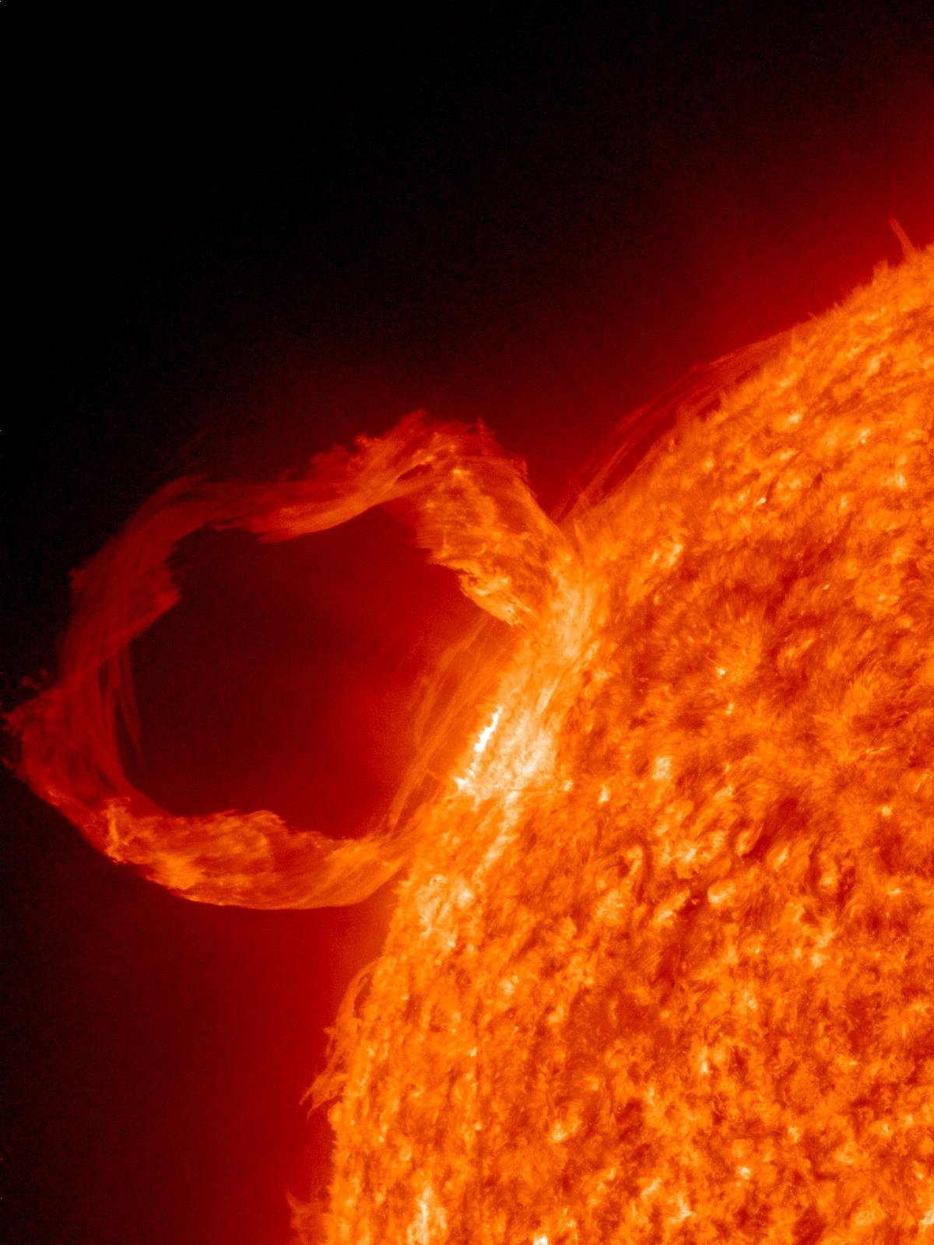

Start at the Sun
Flare: explosive brightening or
Coronal Mass Ejection:
Violent release of as much as a billion tons of matter (36 moderate sized mountains).
Can be equivalent of 40 billion Hiroshima-sized atomic bombs (enough to destroy everything on Earth’s surface more than 900 times).
Earth
pixabay.com

Slide 19
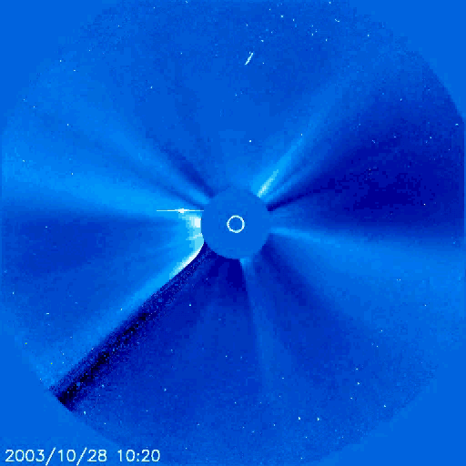
Weather at the Sun or Elsewhere Means There are Events
What do you see?
Near the Sun?
Far from the Sun?
Credit: NASA

Slide 20
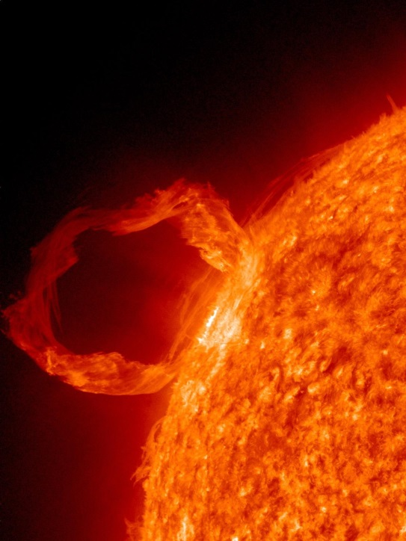
Time Scale for Solar Effects at Earth
~10 min
X-RAYS
8 Minutes
Warp 1: light speed
CME
Mins to hours
Radio Waves
10s Mins
Sub-light speed
Mins to a Day
High Energy Particles
pixabay.com
Few Days
Just a few M-mph
Days
Coronal Mass Ejection Blast

Slide 21
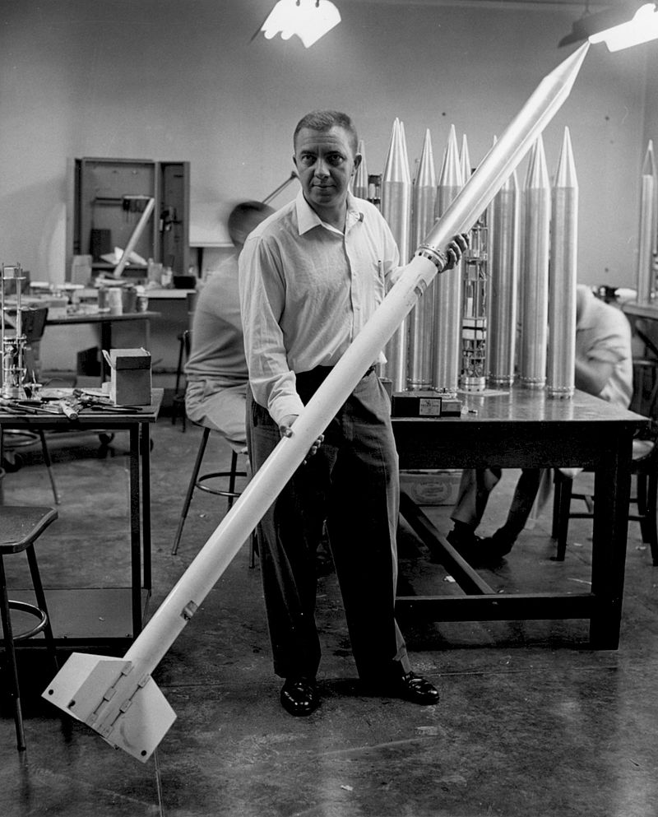
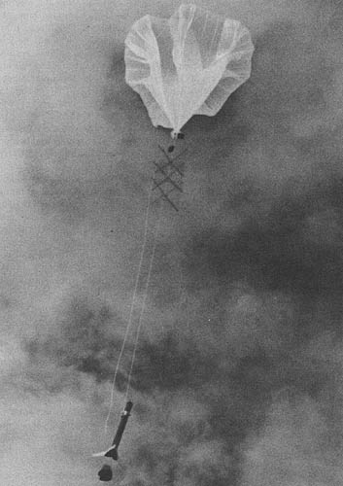
Cosmic Radiation
James Van Allen and Rockoons
Radiation: electromagnetic waves and particles
Ionizing radiation: more dangerous
Physical amount: radiation flux
Biological effect: much more complex
Loki Rocket
Credit JPL
By user:GDK - [1], Public Domain, https://commons.wikimedia.org/w/index.php?curid=1434580

Slide 22
Cosmic Radiation
James Van Allen and Rockoons
1 rem = 0.01 Sievert (current SI unit)
1 millirem = medical x-ray or background
1 rem → 0.05% chance of cancer
100 rem → over short time, acute radiation syndrome
Rad or Sieverts are better correlated to exposure symptoms
Loki Rocket
Credit JPL
By user:GDK - [1], Public Domain, https://commons.wikimedia.org/w/index.php?curid=1434580

Slide 23
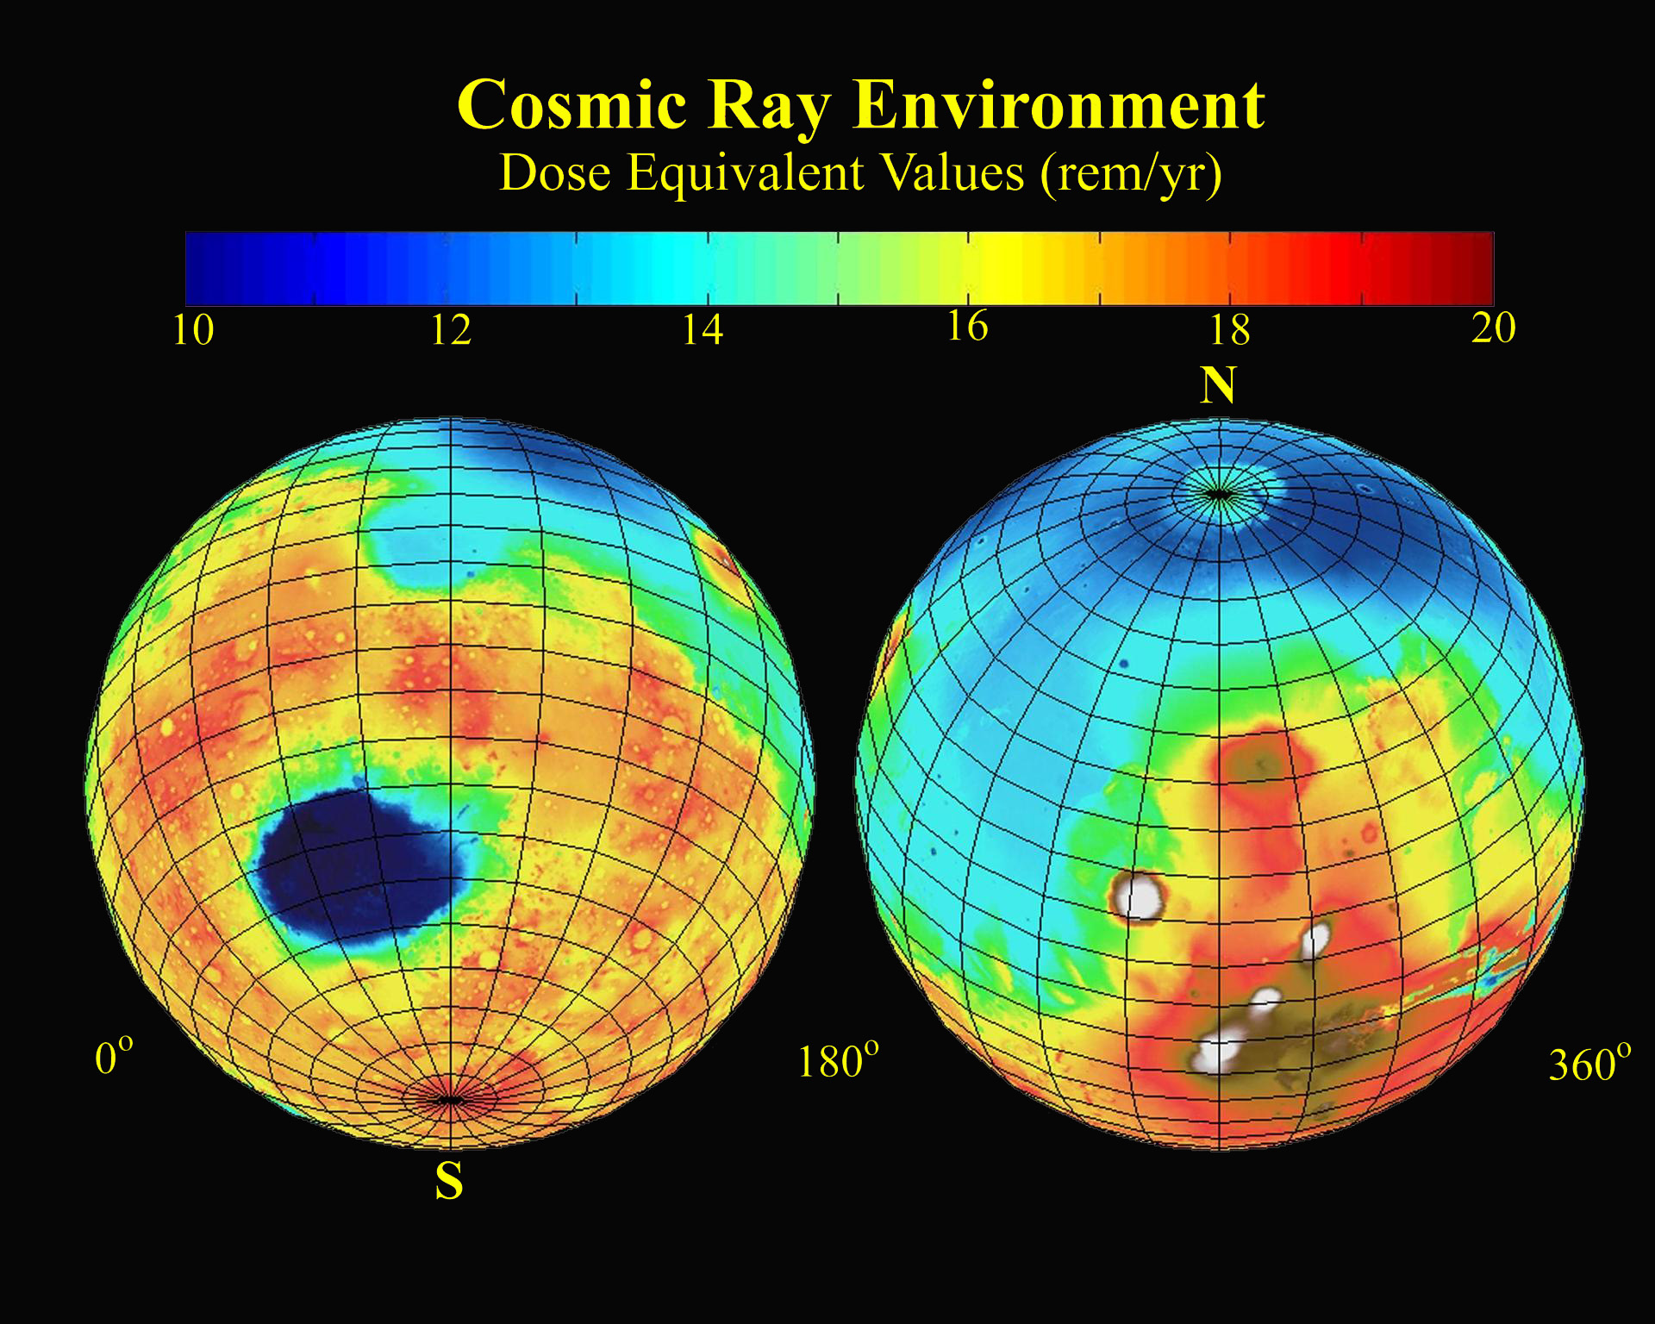
Mars
Surface of Mars!
10-20 rem/year
From EPA: Dose to lens of eyes from one brain CT 60 mGy (milligray)=6 rad
Worker limit 50 mSv (milli-Sievert)=5 rem/yr (emergency shelter if >1-5 rem/4 days)
Credit NASA

Slide 24
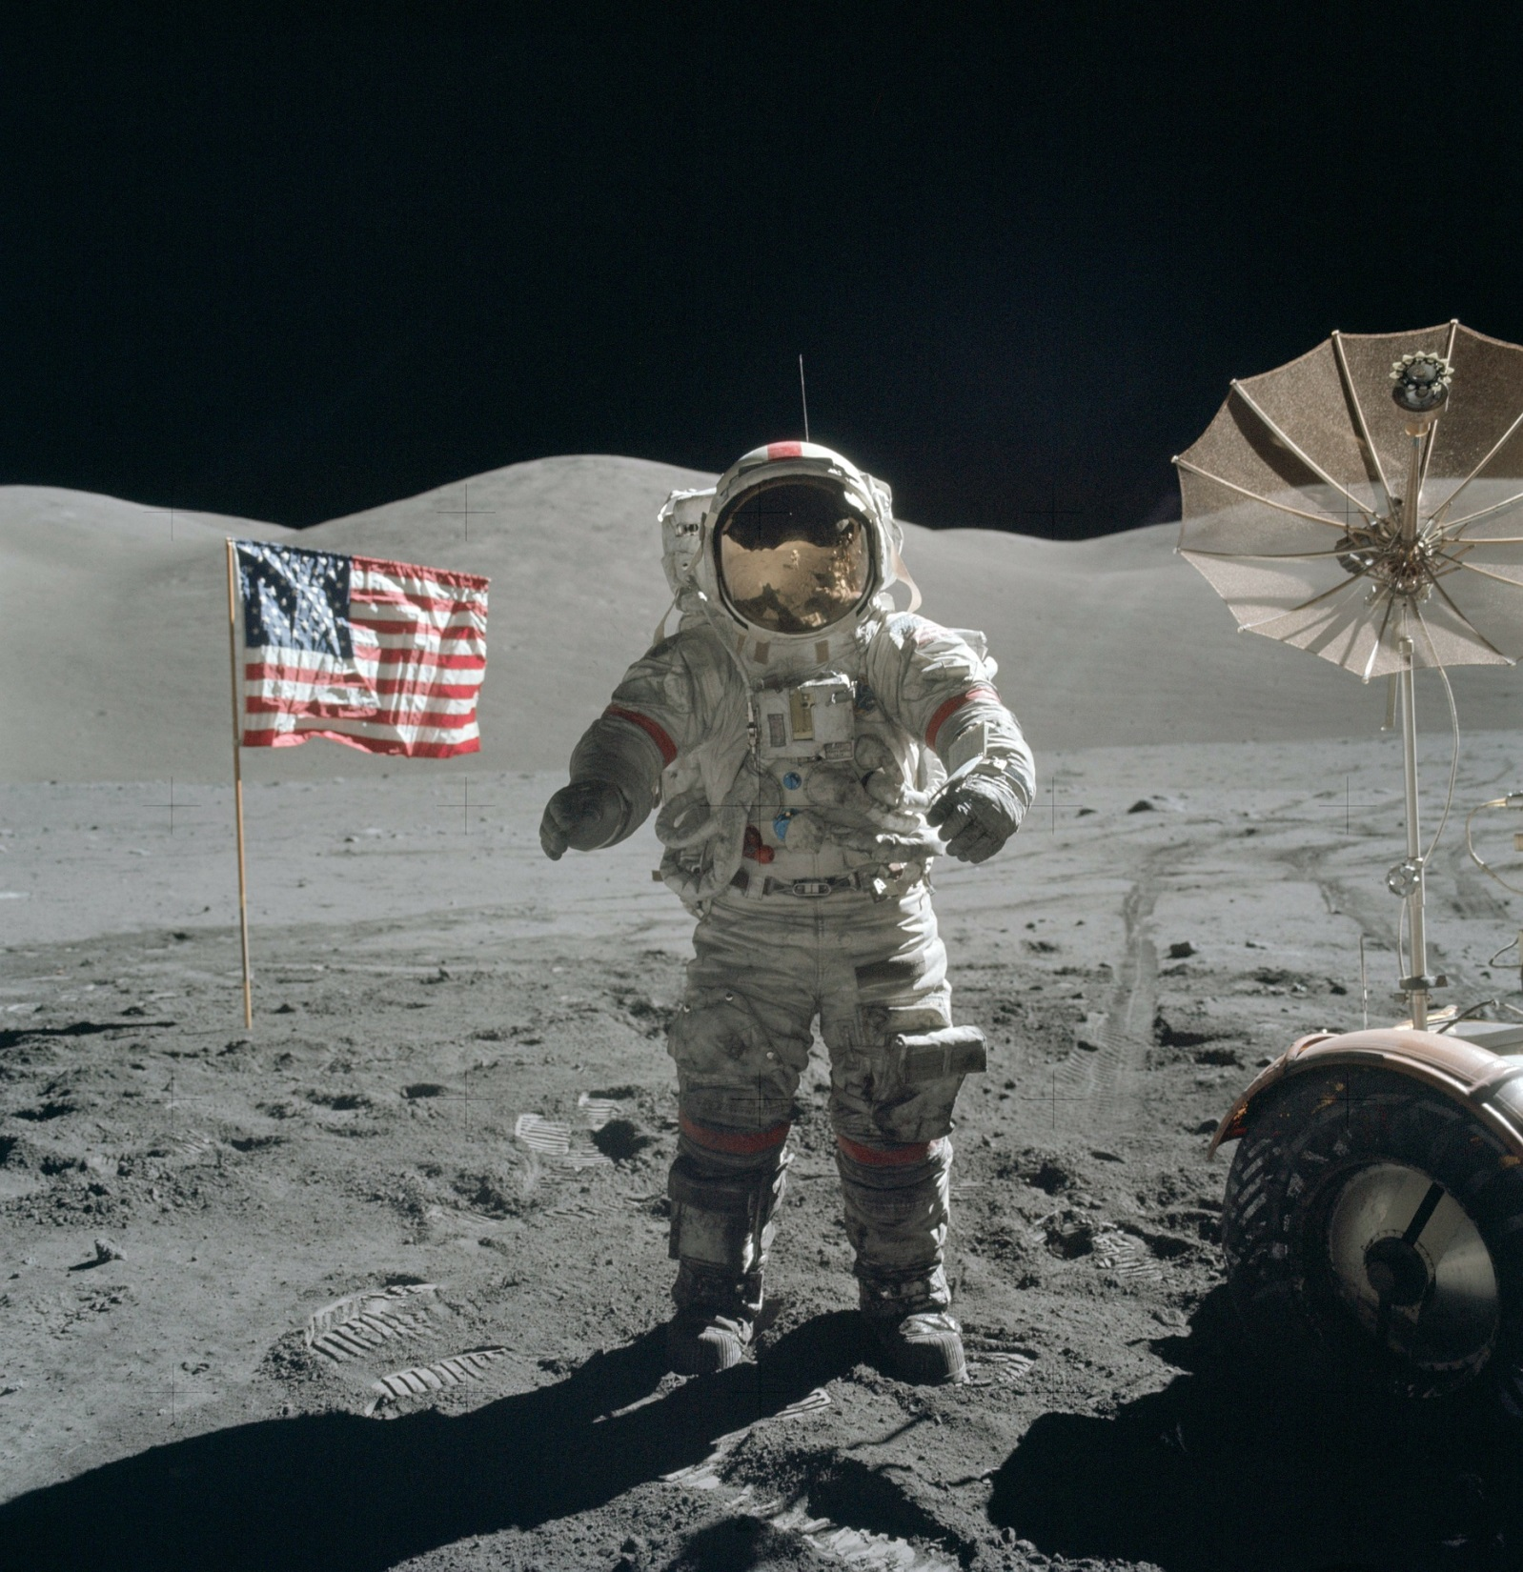
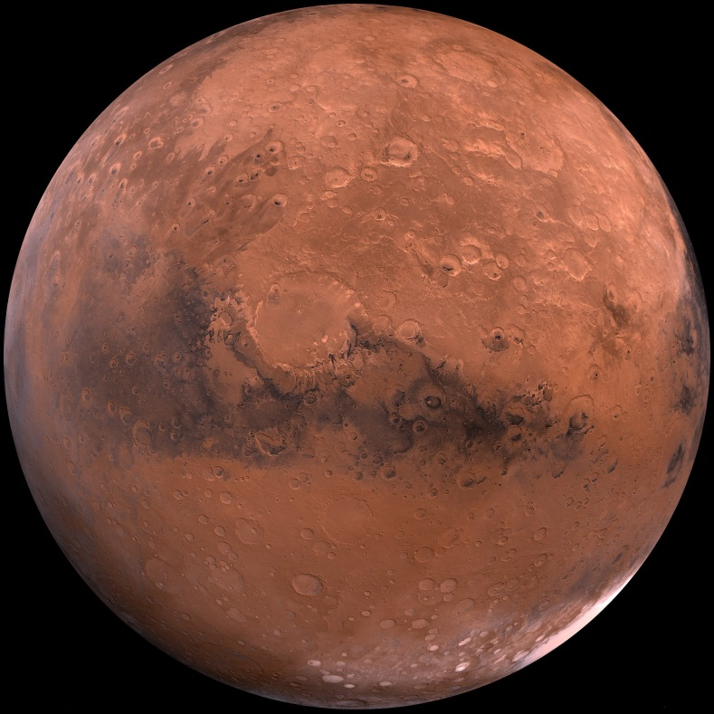
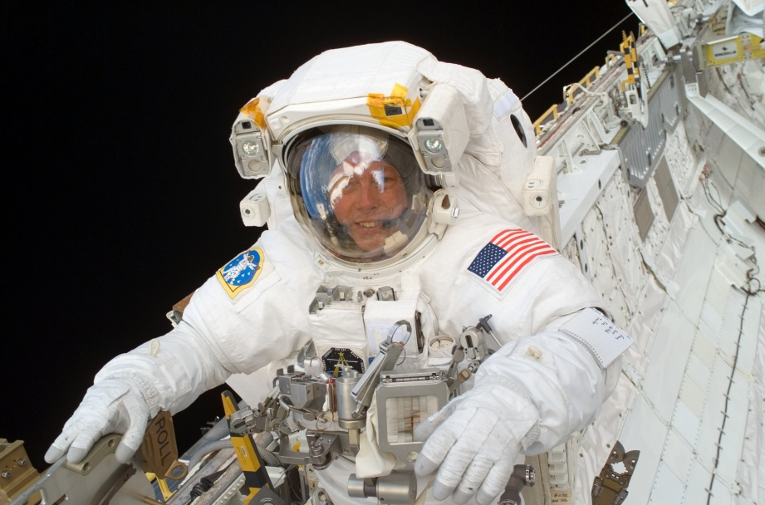
Hazards to Humans in Space
Credit: NASA

Slide 25
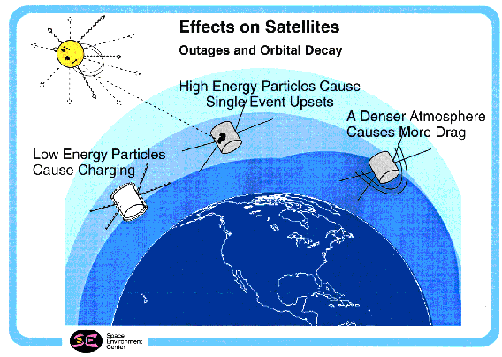
Satellite Hazards
NOAA

Slide 26
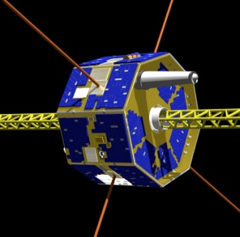
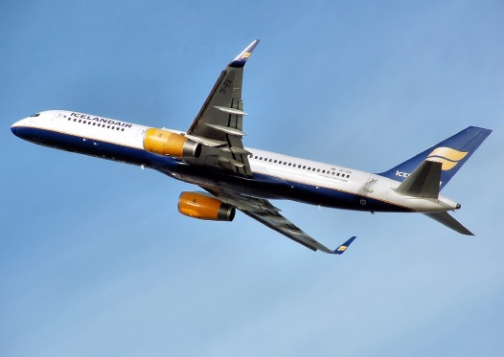
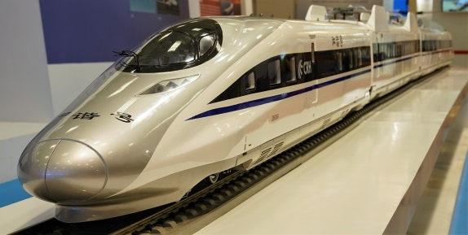
Risks for Electronics
In space single event upsets (SEUs) cause satellite control errors, risking damage or loss
In aircraft SEUs cause upsets of about 1 per 200 hours of operation measured on a Boeing 777 autopilot: (designed for 1:1 million); pacemakers have been used to measure SEUs in commercial aircraft
On the ground SEUs are thought to have caused power losses in German high-speed trains in the 1990’s from cosmic radiation
Credit: NASA
pixabay.com

Slide 27
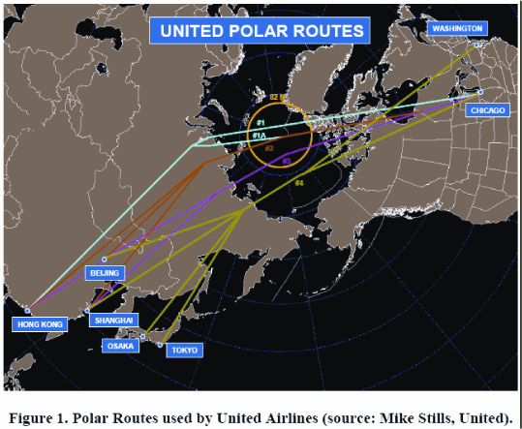
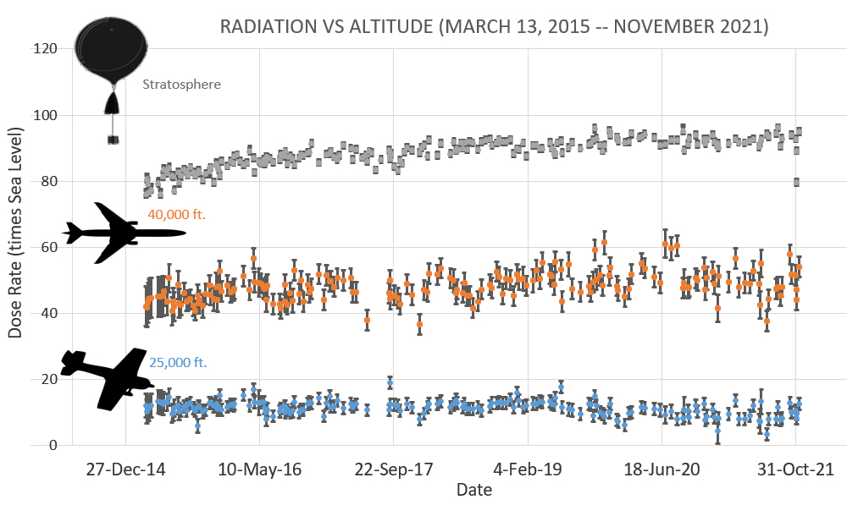
Transpolar Flights and cosmic radiation risks are increasing
Diversions: < 2-3/mo
Spaceweather.com
Credit: Mike Stills, United
Forbush decrease
From the American Meteorological Society & SolarMetrics Policy Workshop Report March 2007
Max permissible mean dose rate limit: 7.5 mSv/hour

Slide 28
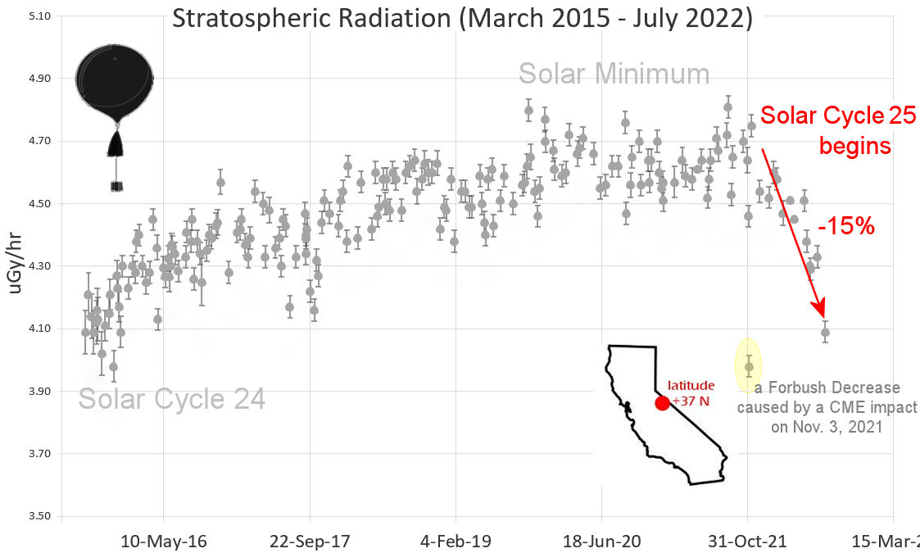
Students of Earth to Sky Calculus
@Spaceweather.com by Dr. Tony Phillips
From EPA: Dose to lens of eyes from one brain CT 60 mGy (milligray)=6 rad
Worker limit 50 mSv (milli-Sievert)=5 rem/yr (emergency shelter if >1-5 rem/4 days)
6-years of balloon results
Cosmic radiation comes from outside the solar system.
Falling solar cycle lets more reach Earth.
Stay tuned for continued reporting in future months…
Spaceweather.com
The radiation sensors onboard their helium balloons detect X-rays and gamma-rays in the energy range 10 keV to 20 MeV. These energies span the range of medical X-ray machines and airport security scanners.

Slide 29
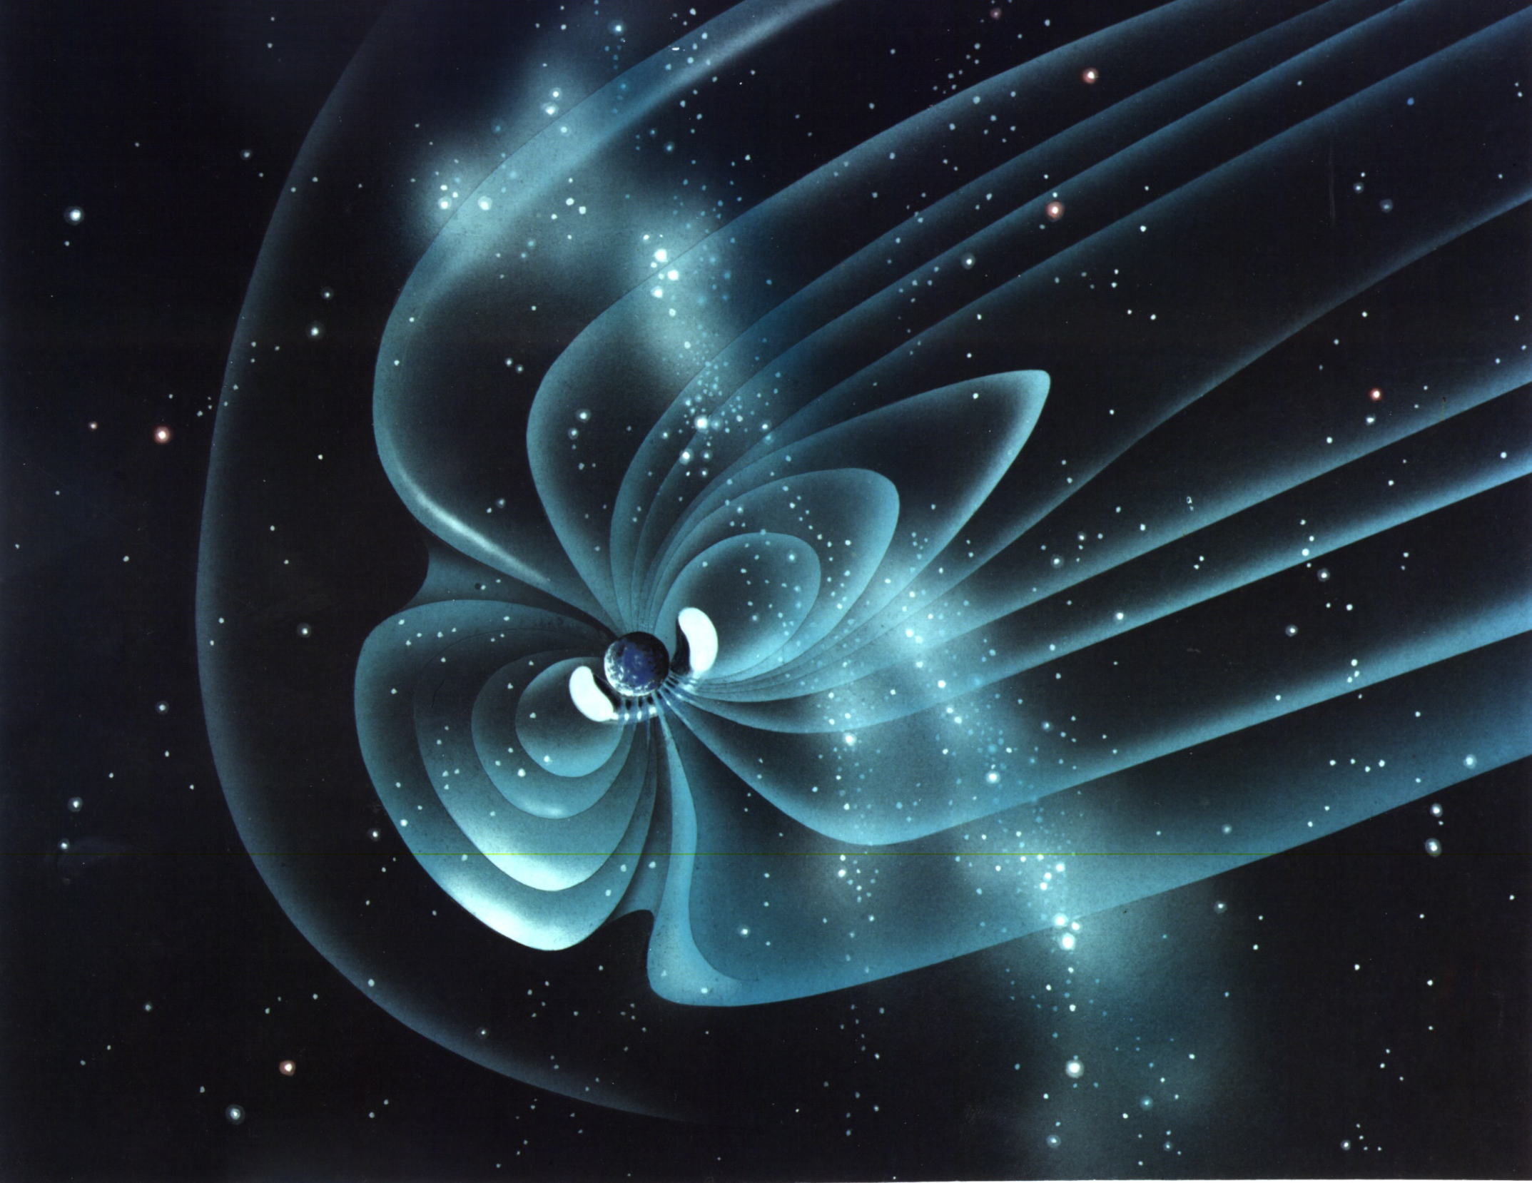
Earth’s Magnetic Environment
“The Magnetosphere”
Precipitation
Electric Currents
Ionospheric scintillation
10MW radio emission
Radiation
Cosmic Rays
Credit: NASA

Slide 30
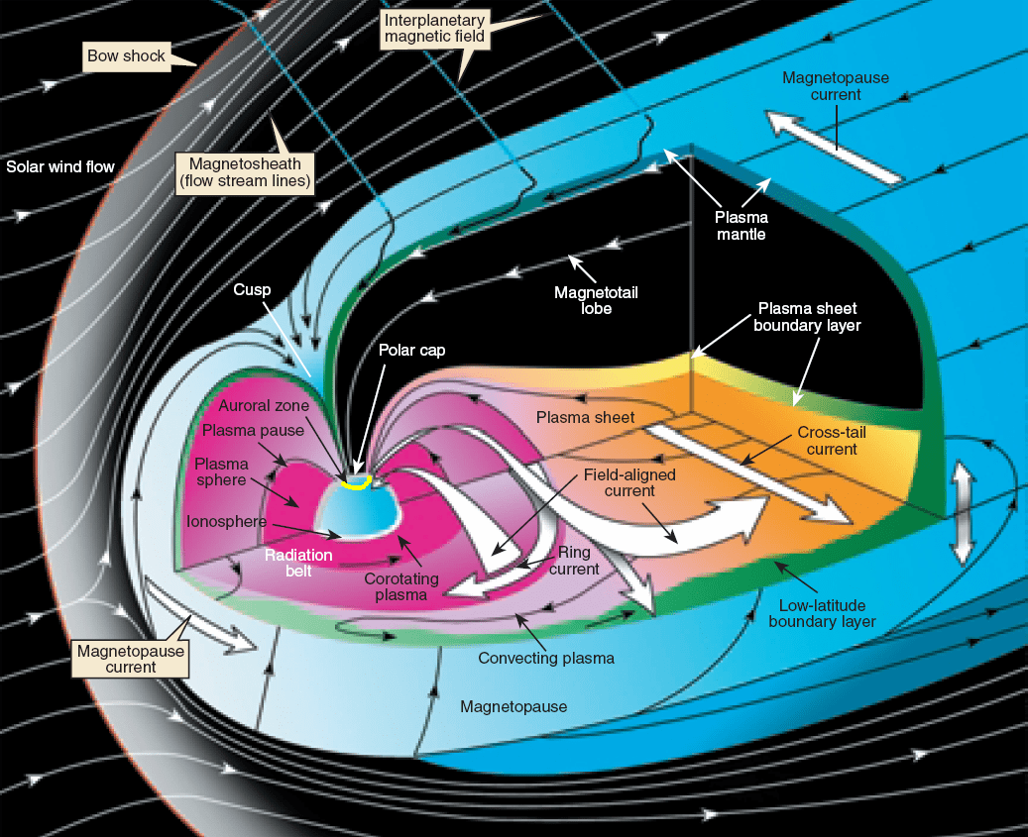
Credit: NASA

Slide 31
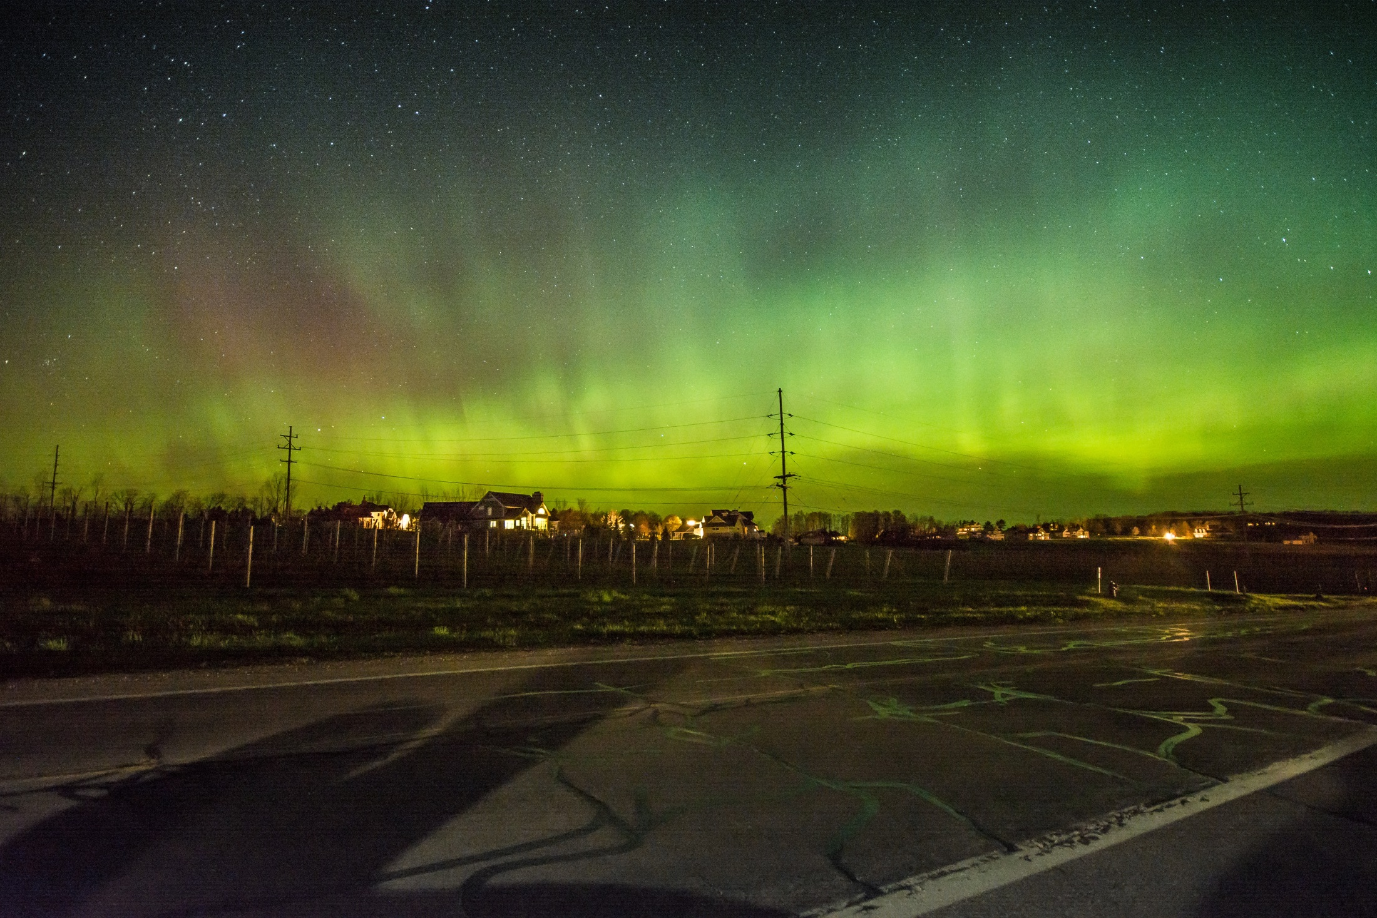
Aurorae: the greatest show on Earth…
Precipitating energetic particles
pixabay.com

Slide 32
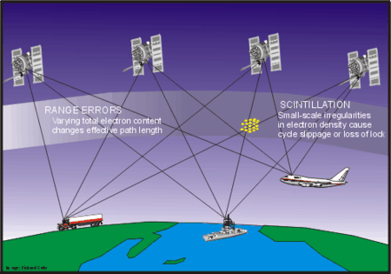

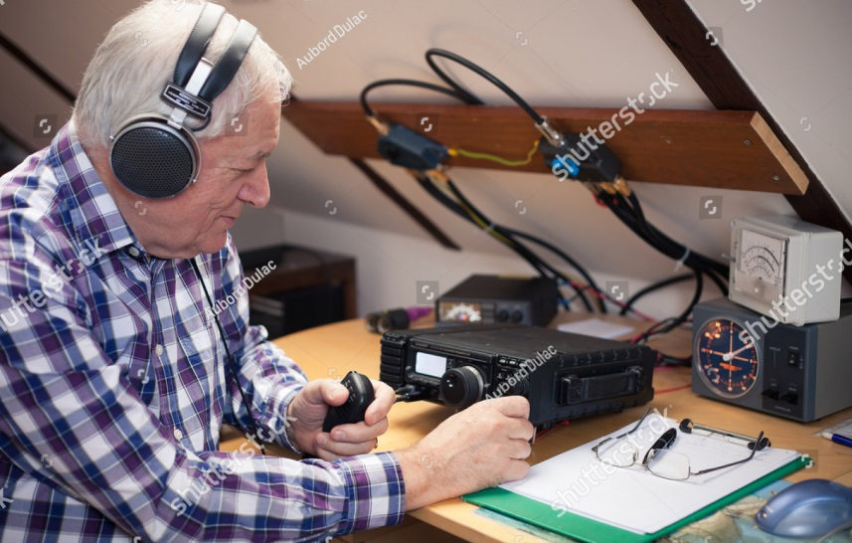
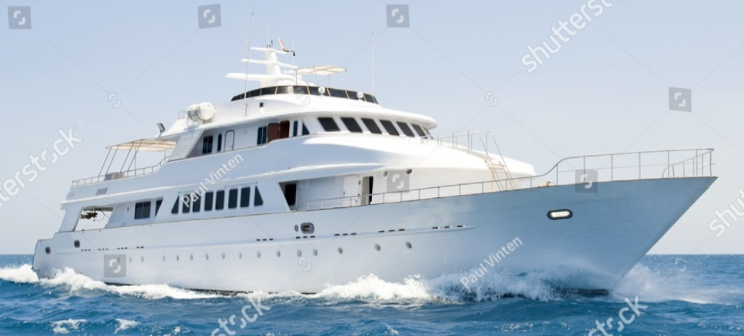
Navigation
Disruption of:
HF Communication
Citation: a product of the Canadian Government,
http://www.spaceweather.gc.ca/tech/se-gps-en.php
Pixabay.com
Pixabay.com

Slide 33
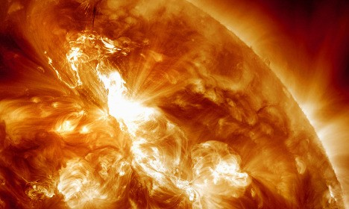
‘Solar storm’ grounds Swedish air traffic
Reported in the December 1, 2015 issue of “The Local Europe AB” an English version of Sweden’s news:
Planes were grounded at some of Sweden's busiest airports on Wednesday afternoon because of a "solar storm" interfering with air traffic control radar systems, authorities said.
Credit: NASA

Slide 34
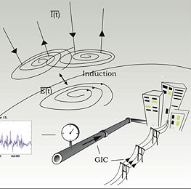
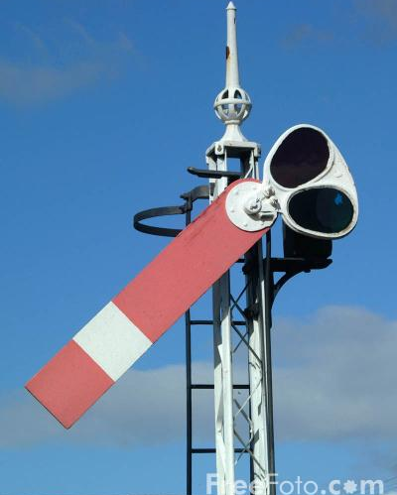
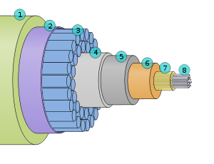
Ground Induced Currents (GIC)
Wikipedia.com
Railroads:
  Sweden in 1982, railway signals failed to switch correctly
  Norway in 2000, 19 lives were lost
Deep Sea Cables:
  Space Weather can generate hundreds to thousands of volts
Wikipedia.com

Slide 35
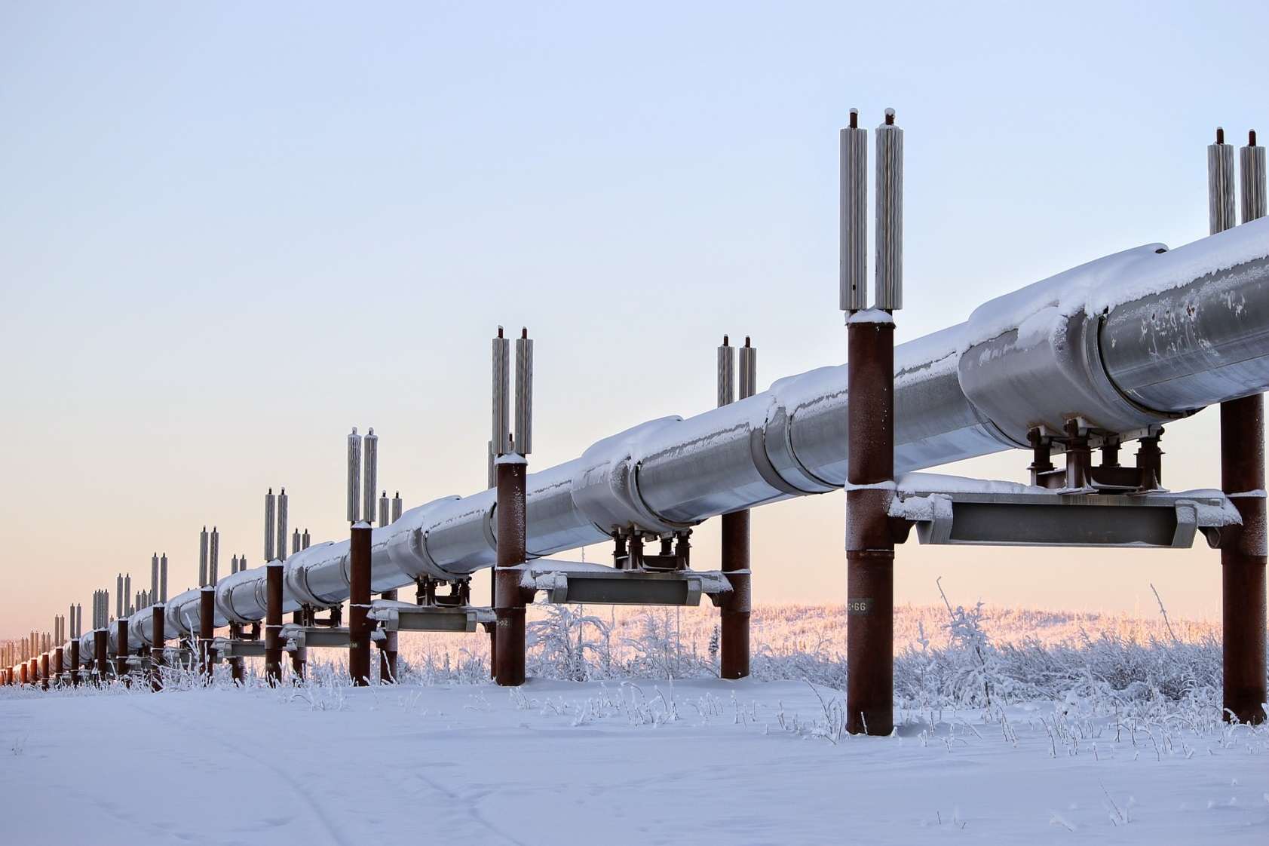
Pipeline Corrosion
_
Applied Voltage
To Fight Corrosion
+
pixabay.com

Slide 36

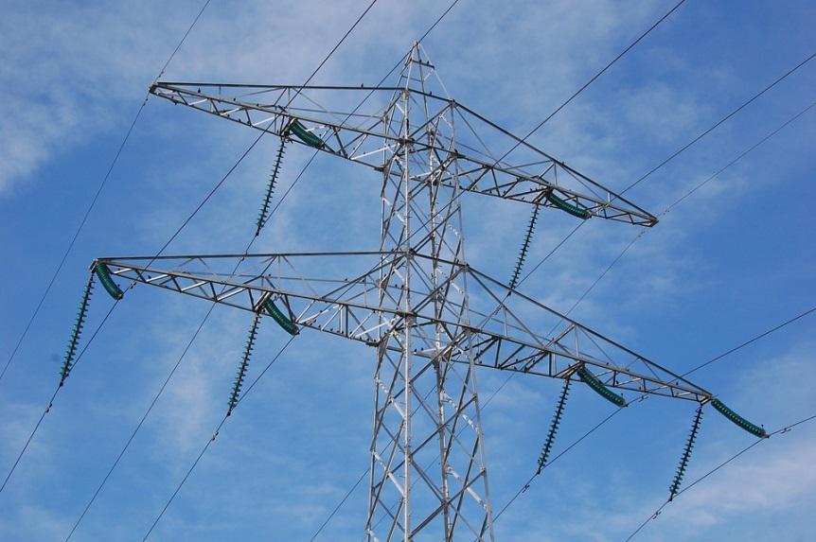
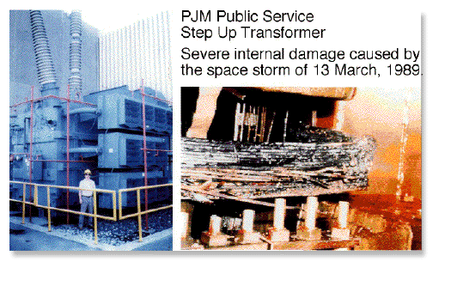
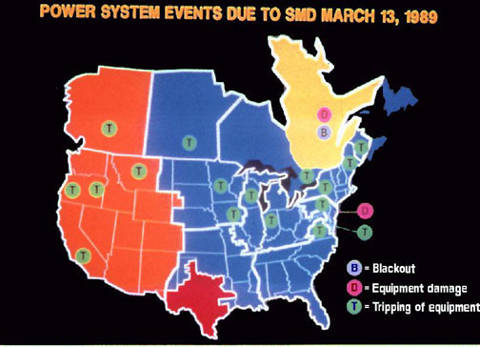
March 13, 1989
Electrical Power Disruption Due to Induced Electric Currents
pixabay.com
PJM Step Up Transformer-
Damage from space storm
6M w/o power
PJM Public Power
PJM Public Power

Slide 37
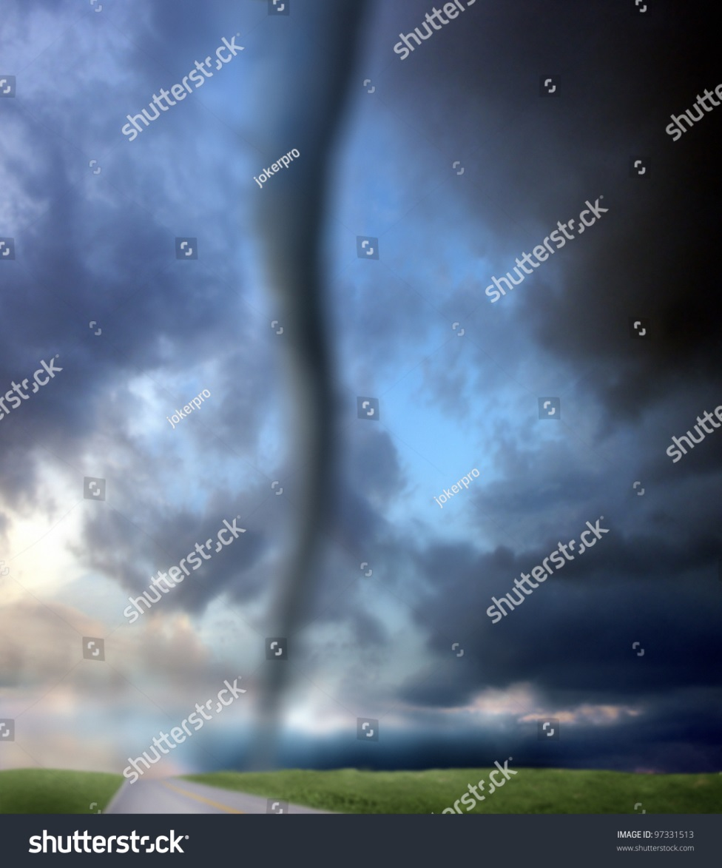
Atmospheric storms are measured. Space storms are too.
Space Storm | Minor Extreme
Solar Flares | B C M X
Solar Radiation | S1 S5
Radio Blackouts | R1 R5
Geomagnetic Storms | G1 G5
Credit: NOAA
pixabay.com

Slide 38
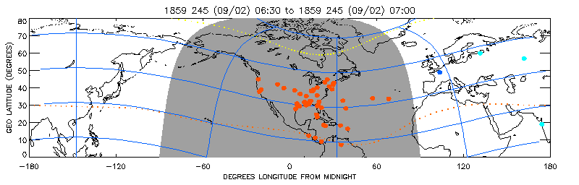
September 2, 1859 Event
3X recent storm strength / 1/3 strongest ever
Quiet Aurora
Reports
1859 Super Storm
Messenger (deck log: Lat. 49º) “we witnessed the most magnificent display of the aurora boreales (sic) imaginable … the whole firmament was a blaze of Crimson shooting up from all points of the compass but the most splendid from the South W. I have not the language to describe it”
Courtesy James L. Green, NASA/GSFC

Slide 39


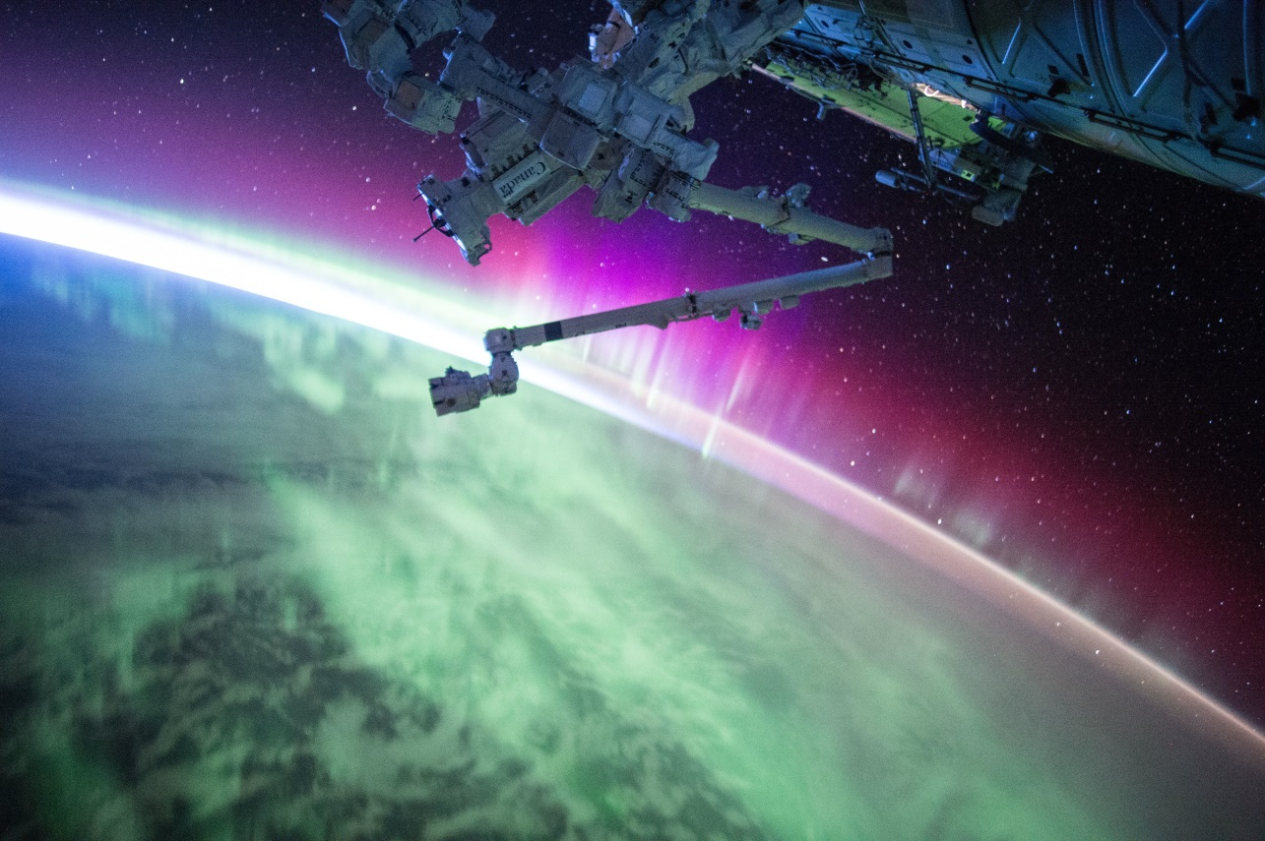
Weather in Space
PJM Public Power
Precipitation
Light Displays
Power of Nature
Societal Danger
Shock and Awe!

Slide 40

Audio from U. Iowa Professor Donald Gurnett: http://www-pw.physics.uiowa.edu/space-audio/
Lion Roars
Saucers
Bow Shock
Auroral Hiss
Upper Hybrid Resonance
Electron Plasma Oscillations
AKR
Chorus
Sounds of Space
Credit: NASA

