Slide 1
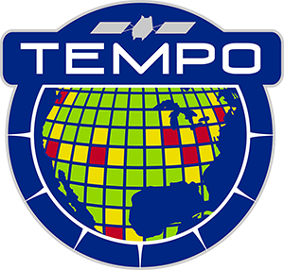



Tropospheric Emissions:
Monitoring of Pollution
A New Era of Air Quality Monitoring from Space over North America with TEMPO: Commissioning and Early Nominal Operation Results
Xiong Liu¹, Kelly Chance¹, Raid Suleiman¹, John Houck¹, John Davis¹,
Kevin Daugherty², David Flittner², David Rosenbaum², Crystal Fenn²,
Gonzalo Gonzalez Abad¹, Caroline Nowlan¹ , Huiqun Wang¹, Heesung Chong¹, Weizhen Hou¹, Junsung Park¹, Christopher Chan Miller¹, Juseon Bak¹, Jim Carr, James Szykman, Mike Newchurch, Aaron Naeger,Ronald Cohen,Zolal Ayazpour¹,
Christopher Brown², Zachary Fasnacht, Marcellin Feasson¹, Jean Fitzmaurice¹, Jeffrey Geddes, David Haffner, Jay Herman, Joanna Joiner, Laura Judd,
Emma Knowland, Xuming Lei, Nischal Mishra², Robert Neece², Ewan O'Sullivan¹,
Brad Pierce, Wenhan Qin, Eric Roback², Justin Strickland², Robert Spurr,
Luke Valin, Alexander Vasilkov, Eun-Su Yang, Barron Henderson,
Katherine Travis, Prajjwal Rawat, and the TEMPO Team
¹CfA | Harvard & Smithsonian
Int’l. Space Science Institute (ISSI) Workshop on
Geostationary Satellites & Atmospheric Chemistry
May 27, 2024

Slide 2
TEMPO Commissioning and
Early Nominal Operation
TEMPO commissioning: SAO + LaRC + Intelsat + Maxar + Ball + Carr Astronautics
  TEMPO power on 6/7, Dry out (6/9-7/9) and cool down (7/10-7/12)
  First light (7/31-8/2): working/reference diffuser solar & Earth imaging
  Instrument Characterization and Analysis (ICA) activities
  Coordinate with AGES+ campaigns in Aug. and Coastal Texas Air Quality Field Campaign in Sep. (no Earth imaging for only 6 days, special observations over LA and Texas)
Nominal operation: after the Post Launch Acceptance Review (PLAR) on 10/18-19/2023
  Weekly commanding, no special observations before L2/3 public release
  Optimize off-nominal twilight observations: city lights=>lighting types, Aurora, gas flaring, moonlight
  Overall very smooth operation except for some data dropouts
TEMPO
Power On
Launch
First Light
PLAR
L+0 (4/7/23)
L+61 days (6/7/23)
L+115 days (7/31-8/2/23)
L+194 days
(10/19/23)
Outgassing
S/C Activity
(TEMPO Off)
TEMPO Commissioning
Nominal Operations
Activation
Instrument Characterization and Analysis
Successful TEMPO commissioning and early nominal operation!

Slide 3
Baseline Line Mission &
Data Products Public Release Timeline
Baseline mission (Phase E, 20 months, 10/2023-6/2025), will be continued with NASA extension / senior review
Data products sent to ASDC for archival & distribution before nominal operation
Early access to TEMPO Science and Validation team members. Bi-weekly L2 Cal/Val meeting led by Jim Szykman & Brad Pierce
Mini release (Dec. 17-30, 8 days during Aug. commissioning) on Feb. 05, 2024
Beta Level 1 public release: Feb. 27,2024
Level 2/3 public release: May 20, 2024
Data Product | Description | Time beyond On-Orbit Checkout (OOC) to deliver initial data | Maximum data latency after first release for ≥ 80% of products
Level 0 | Reconstructed, Unprocessed Instrument Data | 2 months | Within 2 hours of receipt at SAO
Level 1b | Calibrated, Geolocated Radiances | 4 months | Within 3 hours of Level 0 and ancillary data receipt at SAO
Level 2 | Derived Geophysical Data Products | 6 months | Within 24 hours of production of Level 1 at SAO
Level 3 | Derived Gridded Geophysical Data Products | 6 months | 1 month after completion of data accumulation required for individual geophysical products
We are nearly on track to release the data products to the public!

Slide 4
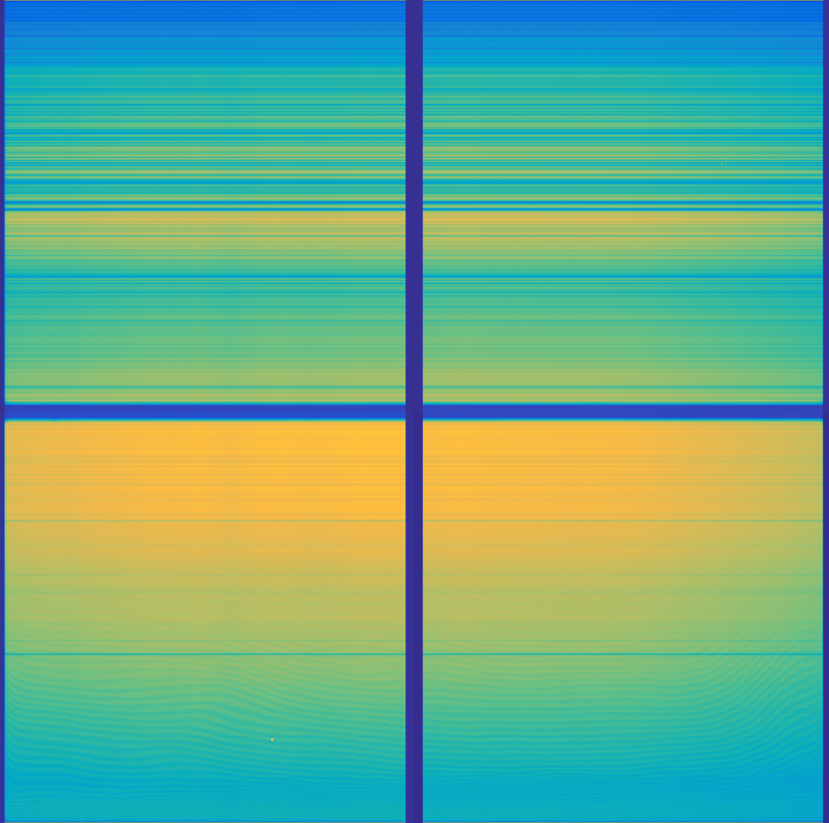
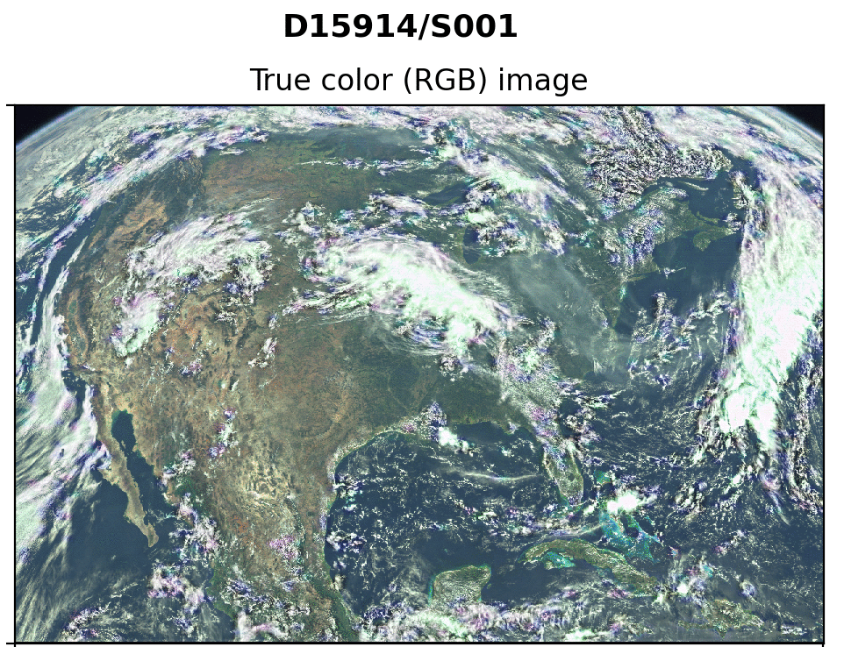

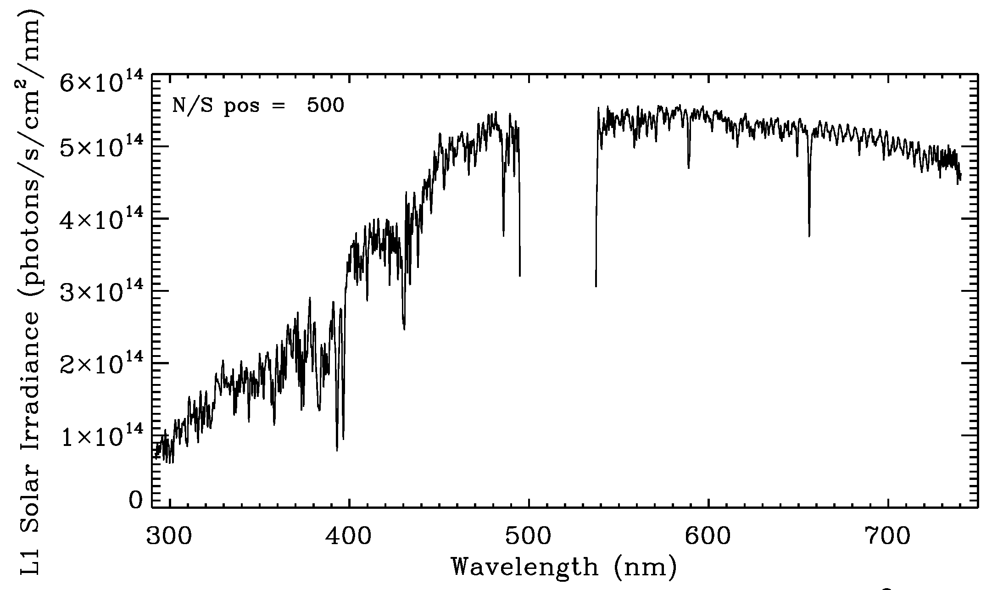
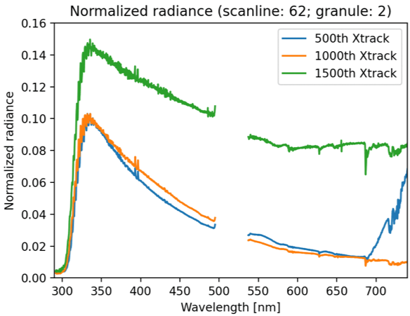
TEMPO Instrument & First Light (8/1-2/2023)
Imaging spectrometer measuring solar irradiance and solar backscattered Earth radiance
~293-494 nm
~538-741 nm
[Credit: John Davis]
First Light Earth 8/2/2023 @11:13-17:16 ET
RGB Images
First Light Solar
8/1/2023 @12:18 am ET
[Credit: Heesung Chong]
TEMPO First light and NRT checking showed that TEMPO is working very well!

Slide 5
Baseline and Threshold
Measurements Requirements
Species/Products | Required Precision | Temporal Revisit*
0-2 km O₃ (Selected Scenes) Baseline only | 10 ppbv | 2 hour
Tropospheric O₃ | 10 ppbv | 1 hour
Total O₃ | 3% | 1 hour
Tropospheric NO₂ | 1.0 × 10¹⁵ molecules cm⁻² | 1 hour
Tropospheric H₂CO | 1.0 × 10¹⁶ molecules cm⁻² | 3 hour
* # of hourly measurements to be averaged to achieve required precision
Mission duration: 20 months for baseline, 12 months for threshold
Spatial resolution: < 60 km² for baseline (4 native pixels coadded), < 300 km² for threshold
AOD, SO2, and CHOCHO removed at KDP-C.
Reduced list of baseline data products due to cost cap!

Slide 6
TEMPO Data Products
Baseline + SNWG TEMPO NRT
Level | Product | Algorithm | Major Outputs | A Priori (L2) | Res km^{2 *} | Freq/Size | Val. Status (5/20/2024)
L0 | Digital counts | Raw to L0 | Reconstructed/reformatted DN |  | 2.0 x 4.75 | Daily/hourly
L1 | Irradiance ^{NRT} | SAO L0-1 | Calibrated & quality flags |  |  | weekly | Beta
 | Radiance ^{NRT} | SAO L0-1 | Geolocated, calibrated, viewing, geolocation & quality flags |  | 2.0 x 4.75 | Hourly, granule | Beta
 | City lights | SAO L0-1 | Geolocated & calibrated |  | 2.0 x 4.75 | Variable, granule | Beta
L2 | Cloud ^{NRT} | OMI O₂-O₂ | Cloud fraction, cloud pressure | GEOS-CF | 2.0 x 4.75 | Hourly, granule | Beta
 | O₃ profile | SAO O₃ profile | O₃ profile, total/strat/trop/0-2 km O₃ column, errors, a priori, AKs | Climatology+GEOS-CF | >= 8.0 x 4.75** | Hourly, granule | Unvalidated
 | Total O₃ | TOMS V8.5 | Total O₃, AI, cloud fraction | Climatology | 2.0 x 4.75 | Hourly, granule | Beta
 | NO₂ ^{NRT} | SAO trace gas, BU strat./trop. sep. | SCD, strat./trop. VCD, error, shape factor, scattering weights | GEOS-CF | 2.0 x 4.75 | Hourly, granule | Beta
 | HCHO ^{NRT} | SAO trace gas | SCD, VCD, error, shape factor, scattering weights | GEOS-CF | 2.0 x 4.75 | Hourly, granule | Beta
L3 | Gridded L2 | SAO L2-3 | Same as L2 |  | 2 x 2 | Hourly, scan
* Spatial resolution at center of FOR. ** Might be at 8 x 9.5 km²
Research aerosols, SO₂, ocean color products
Satellite Needs Working Group (SNWG) funded TEMPO NRT products (L2 products < 3 hours from observation time): 3/26/2024-3/25/2026, NOAA GeoXO team to produce TEMPO/GOES-R NRT aerosol products

Slide 7
Algorithm/Data Products
Development Timeline
First Light NO₂ Images Release (8/24): updates to pre-launch (SDPC v4.0) (offline/development):
  Use initial wavelength grid for radiance from calibrated first light working solar irradiance
  No straylight correction and polarization correction
  Optimized Image Navigation and Registration (INR) for first light
  Optimization to clouds & NO₂ algorithms
First official SDPC update: SDPC v4.1 (V1 data products) approved on 10/16, operational on 10/17, L0-1b, cloud, NO₂, HCHO, total O₃ produced and sent to ASDC
  INR: working well meeting science requirements.
  L0-1b: gain/non-linearity, bad pixel map, improved saturation flagging, Octant phase (odd/even)
  Further optimization in cloud and NO₂
  Major changes to HCHO: radiance reference, and background/reference correction
  O₃ profile not ready due to absolute radiometric calibration
SDPC v4.2 (V1): approved on 11/17, operational on 11/18
  INR: remove UV/Visible biases, accurate at subpixel level, tested to work for special observation
  Data processing pipeline: more robust, automatically recover from INR crash, other minor updates
  Used to reprocess TEMPO commissioning observations

Slide 8
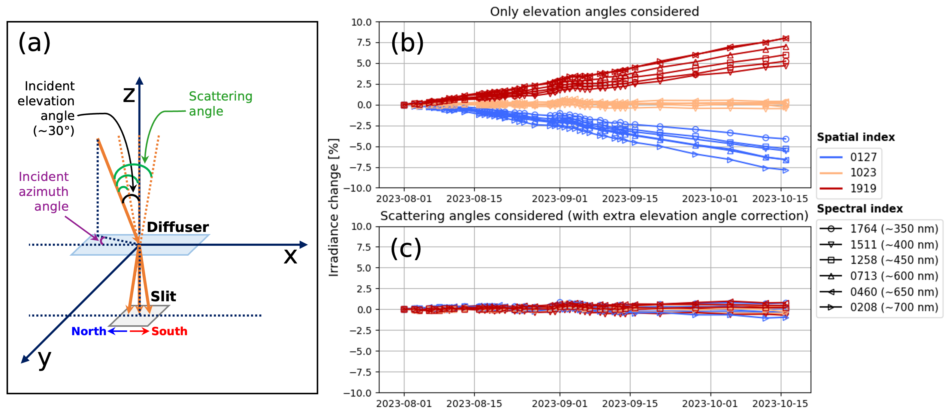
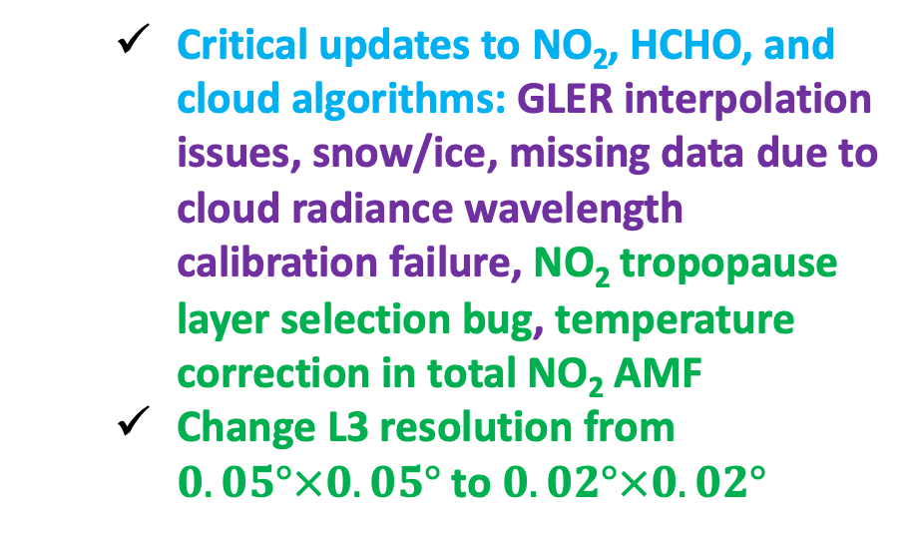
Algorithm/Data Products
Development Timeline
SDPC v4.3 (V2) & Level 1 release: approved on 2/23/2024, operational 2/26/2024
  Level 1 Beta Public Release:
    Scattering angle dependent BTDF correction, removing time- and across-track dependent biases
    Improved CCD image processing steps (electronic offset correction, smear correction, dark current correction after accounting for temperature dependence)
    Improved solar wavelength calibration, use latest solar irradiance wavelength for radiance
  Critical updates to NO₂, HCHO, and cloud algorithms: GLER interpolation issues, snow/ice, missing data due to cloud radiance wavelength calibration failure, NO₂ tropopause layer selection bug, temperature correction in total NO₂ AMF
  Change L3 resolution from $0.05°×0.05°$to $0.02°×0.02°$
[Credit: David E. Flittner]

Slide 9
Algorithm/Data Products
Development Timeline
SDPC v4.4 (V3) & Level 2-3 release: May 20, 2024
  Improved Level 1 & new Level 1 city lights
    Add nominal geolocations for city lights & Improve the robustness for INR
    Improve FPA temperature sampling and temperature-dependent dark current correction
    Add straylight correction (1-D PSF)
    Add radiance wavelength calibration
  Improved Level 2 & 3 and likely ozone profile (UV only) product for public release
    Update GLER (v6.0->v6.1, snow free + 100% snow, quality flag 2-> 5, fill in gaps via interpolation)
    Perform retrievals up to SZA 90
    Update main data quality flag (AMF > 6 as suspect), Revisit convergence flag & AMF diagnostic flag
    Add temperature profile to output (for AMF)
    Cloud: SCD fitting optimization, SCD T correction, ECF/OCP iteration, wavelength shifts to ECF
    Ozone profile: Update the use of GEOS-CF meteorology and ozone profile + Derive soft calibration
After the May 2024 L2/3 public release --- end of baseline mission:
  Reprocessing for all data products (except for ozone profile product)
  Updates to science algorithms & calibrations as needed based on validations and feedback
  Update O₃ profile retrieval with UV only
  Release UV/Visible to improve retrieval sensitivity to 0-2 km O₃
Power/cooling issues at our data center

Slide 10
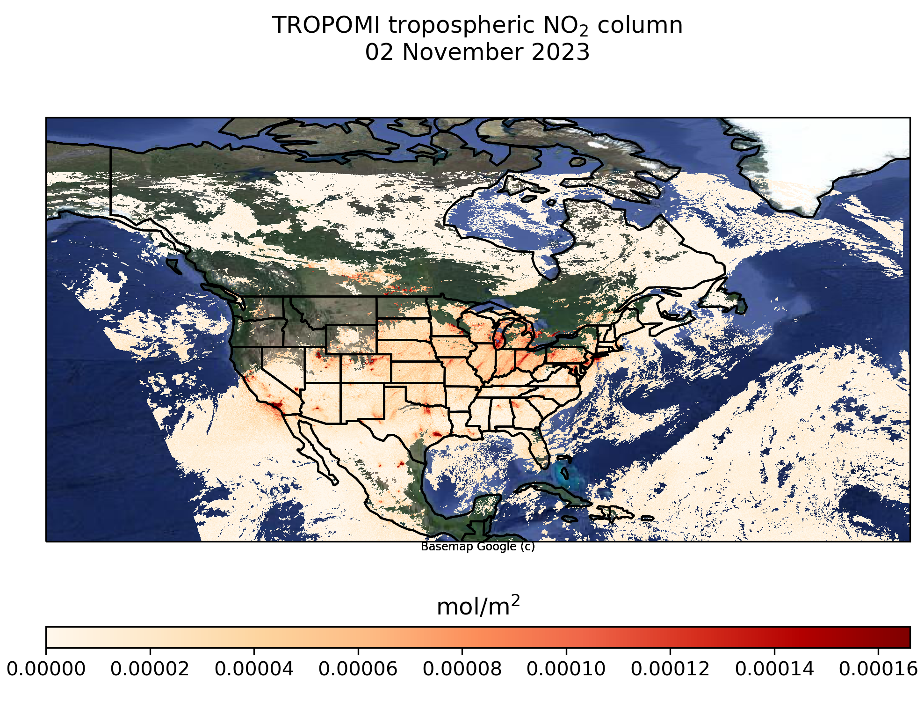
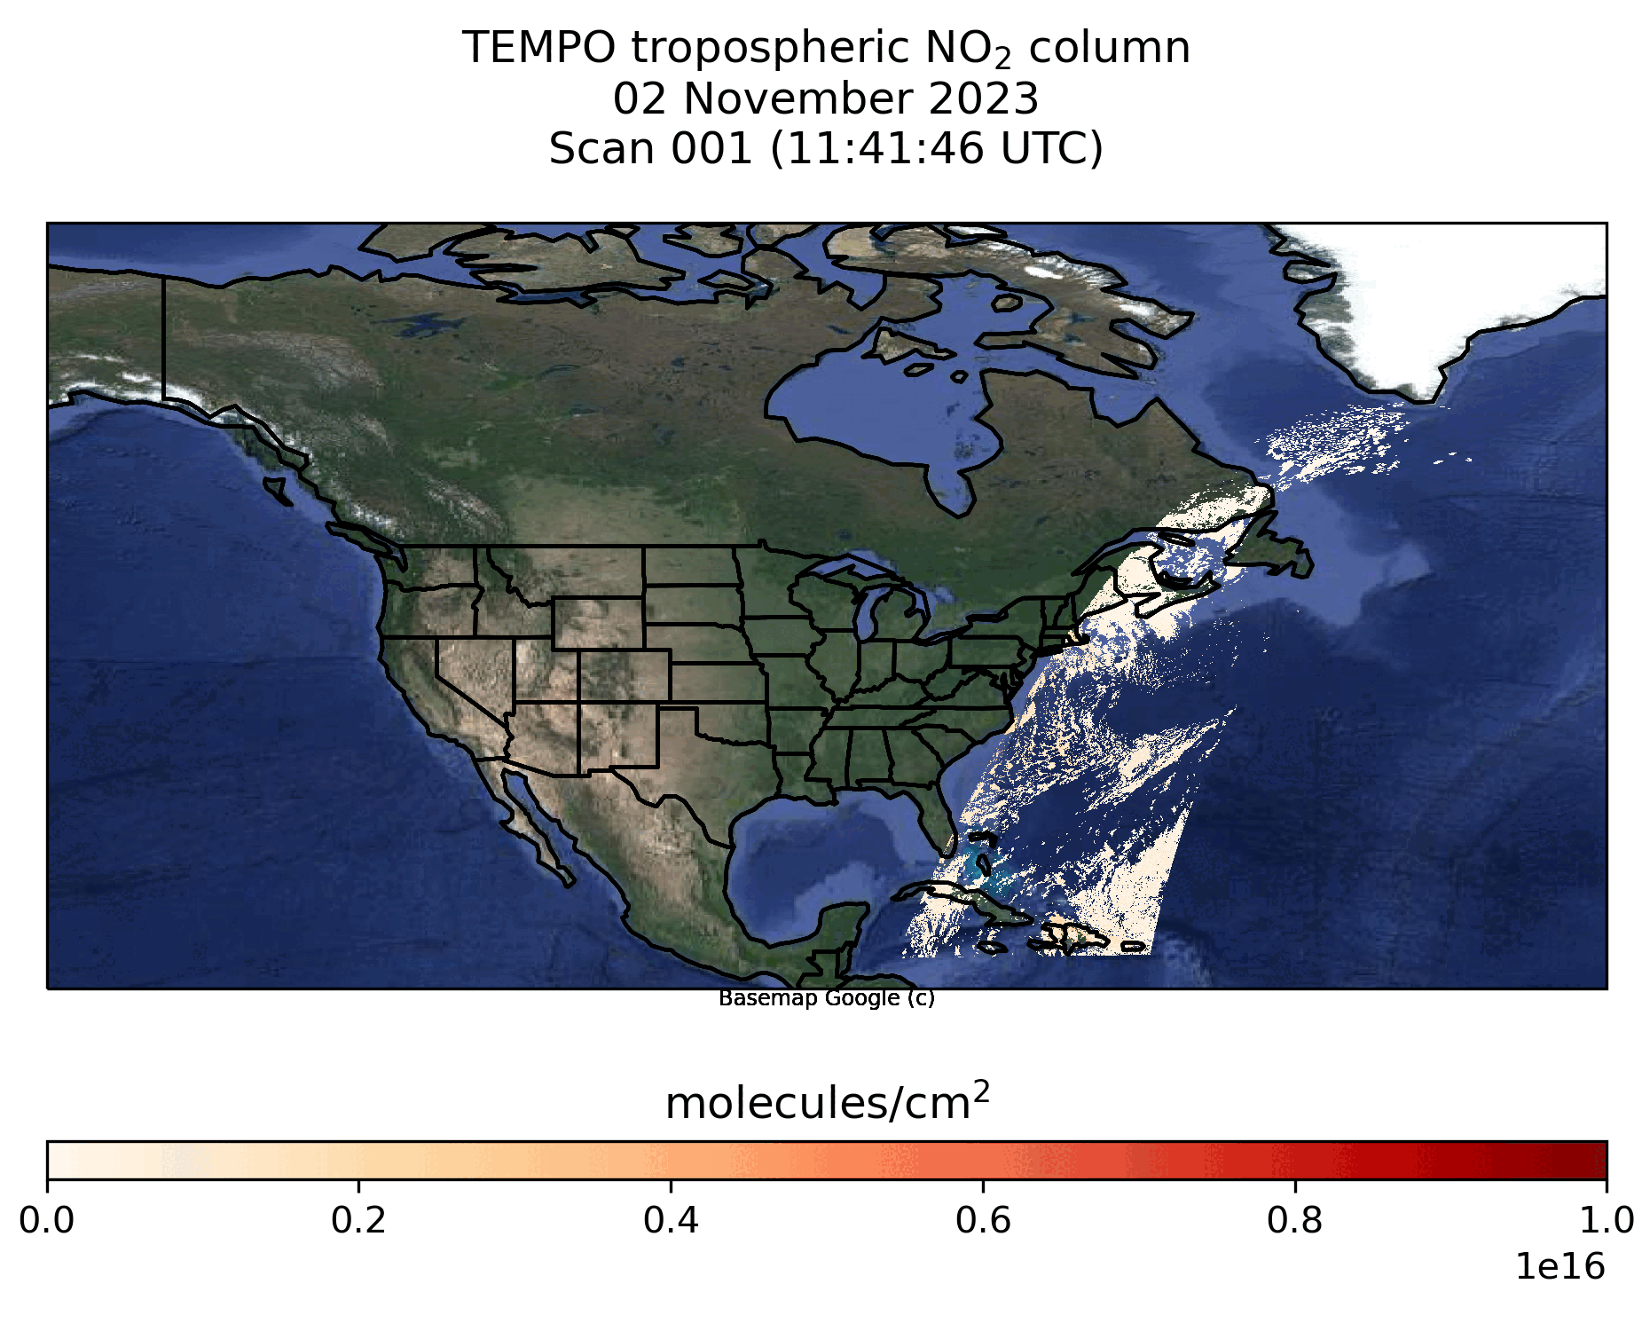
TROPOMI and TEMPO NO₂
[Credit: Caroline Nowlan]

Slide 11
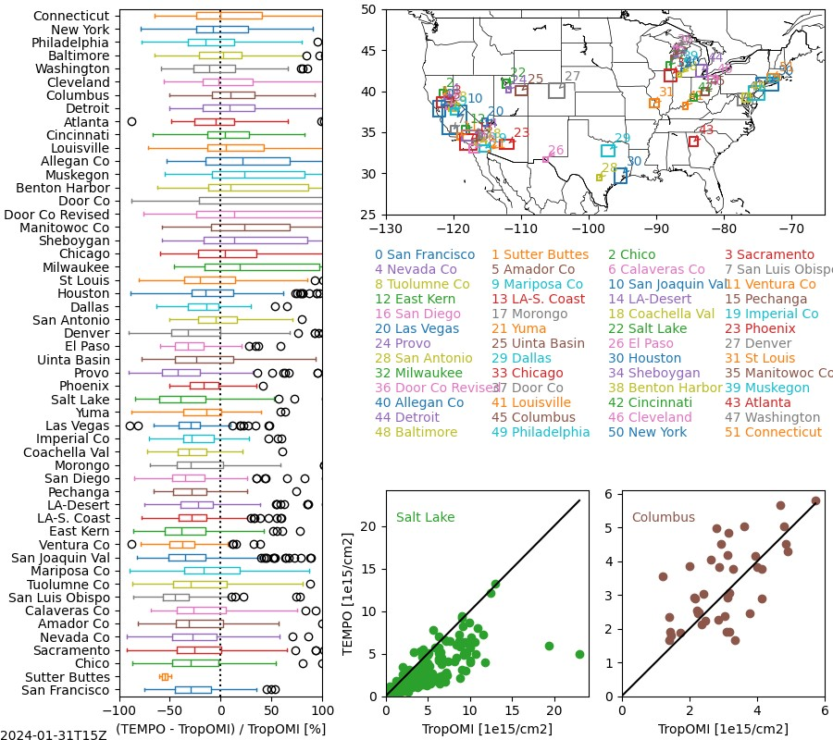
TROPOMI NO2 Comparisons
Courtesy of Barron Henderson, EPA
PRELIMINARY!!
Overall, TEMPO tropospheric NO₂ agrees well with TROPOMI
Biases between products can be due to differences in AMF inputs
Larger negative TEMPO bias in western U.S.?
11

Slide 12
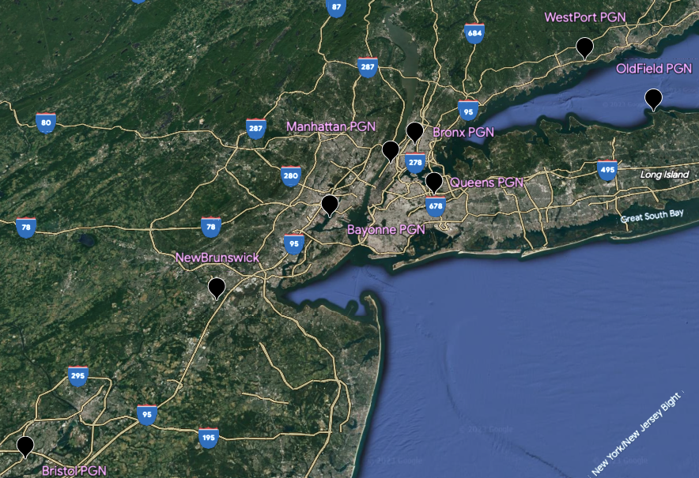
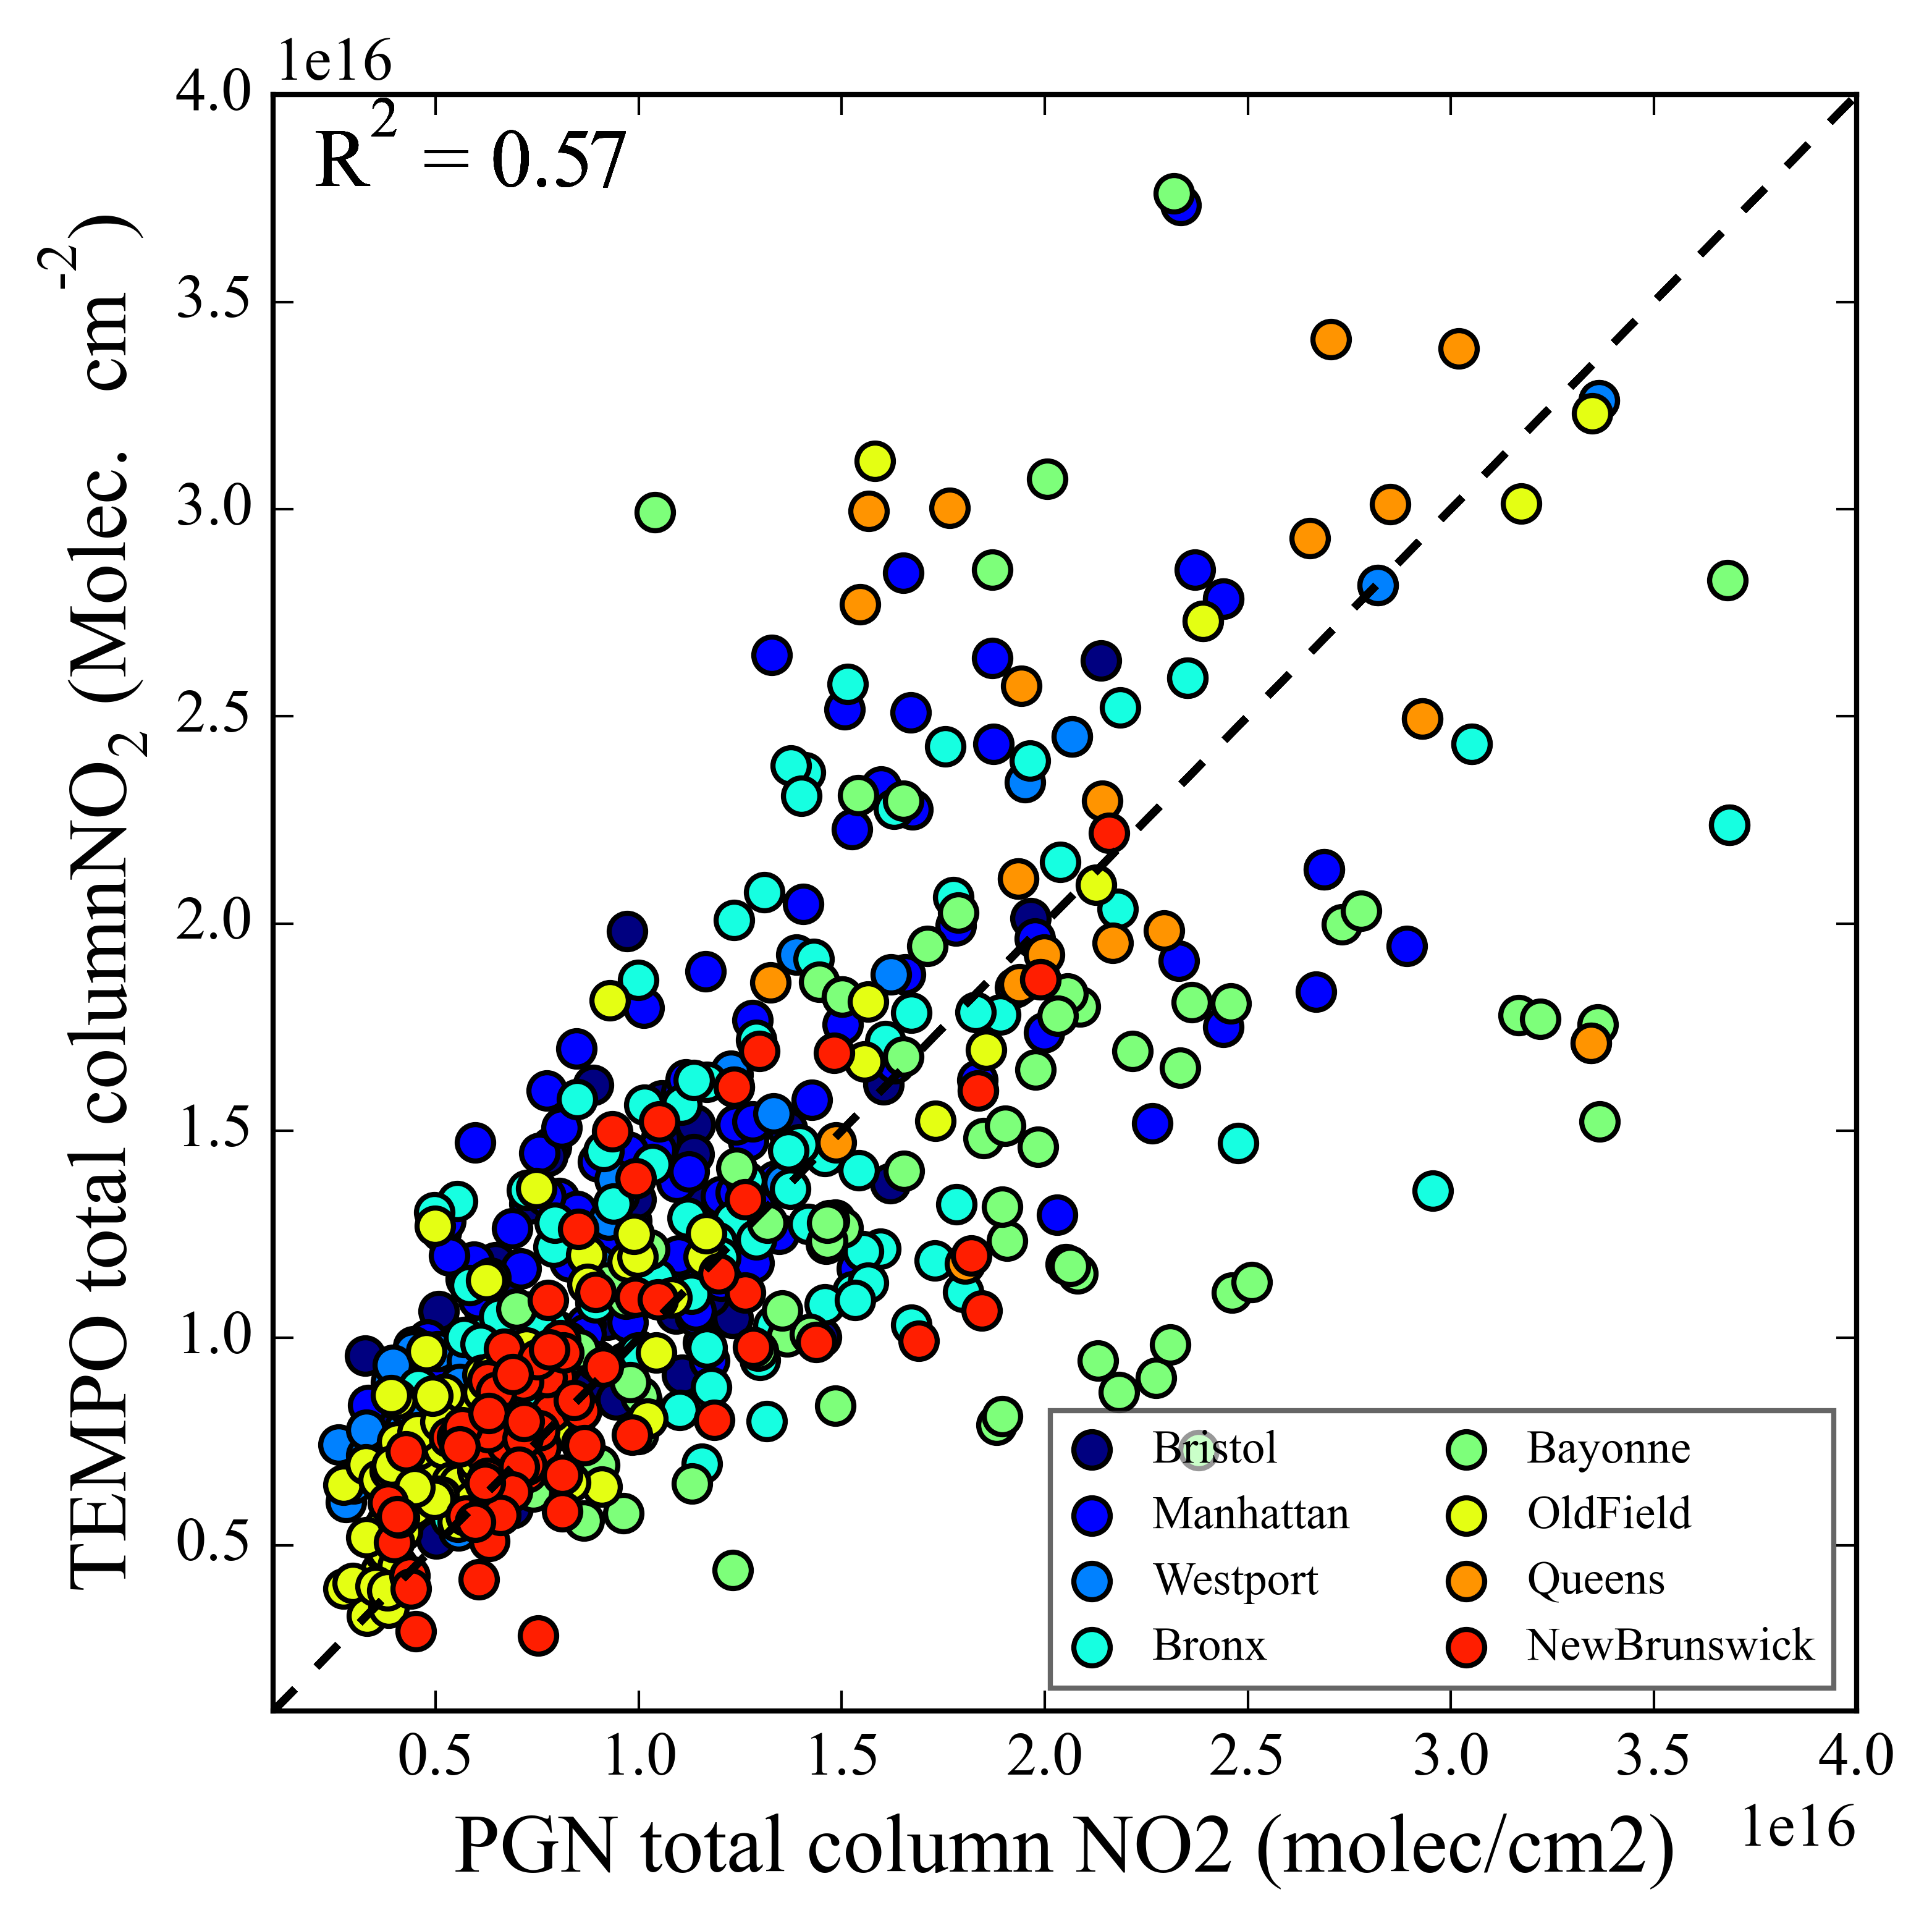
Pandora NO2 Comparisons
Courtesy of Prajjwal Rawat (NASA LaRC), Katherine Travis (NASA LaRC), James Szykman (EPA)
November 23-Jan 20
PRELIMINARY!!

Slide 13
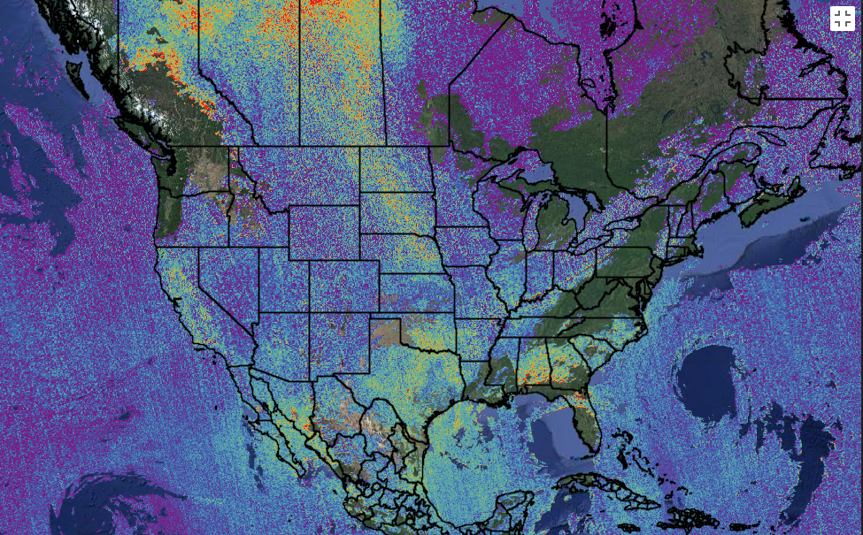
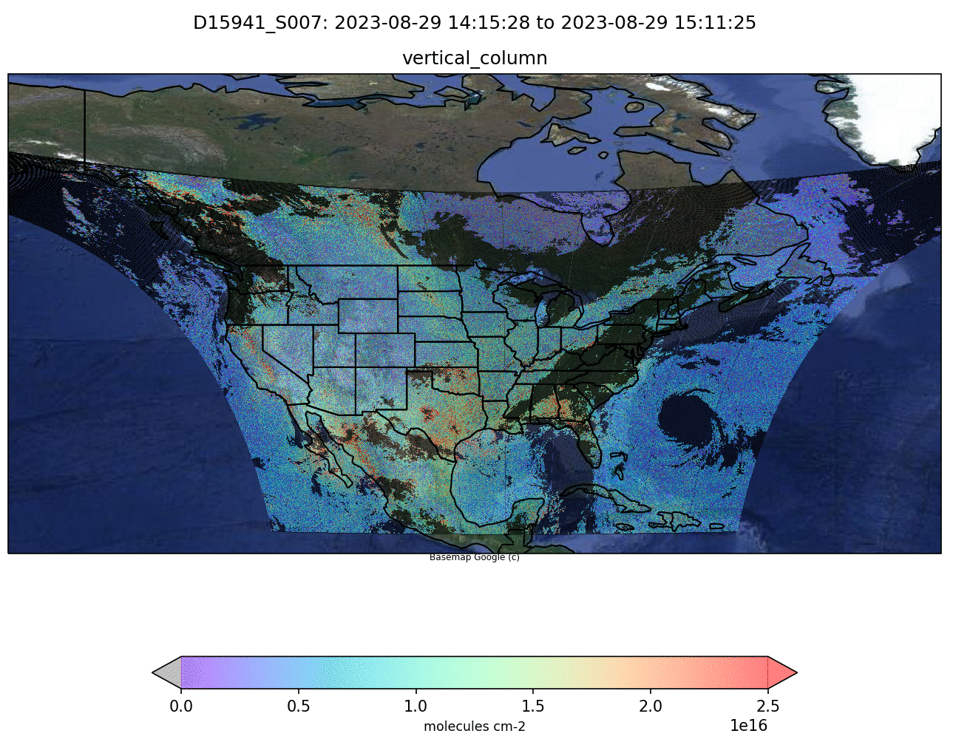
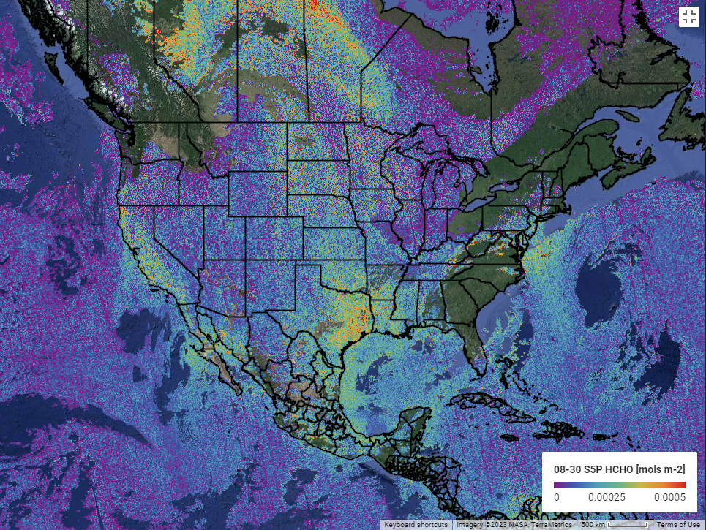
TEMPO and TROPOM HCHO
(29-30 August 2023)
Google Engine S5P HCHO 0829
Google Engine S5P HCHO 0830
TEMPO HCHO 0829-0830 (scans close to S5P overpass)
TEMPO vs TROPOMI shows spatial agreement in HCHO columns. TEMPO shows small noise and almost no striping. Systematic biases are expected associated with AMF, radiance reference and background corrections.
[Credit: Gonzalo Gonzalez Abad]

Slide 14
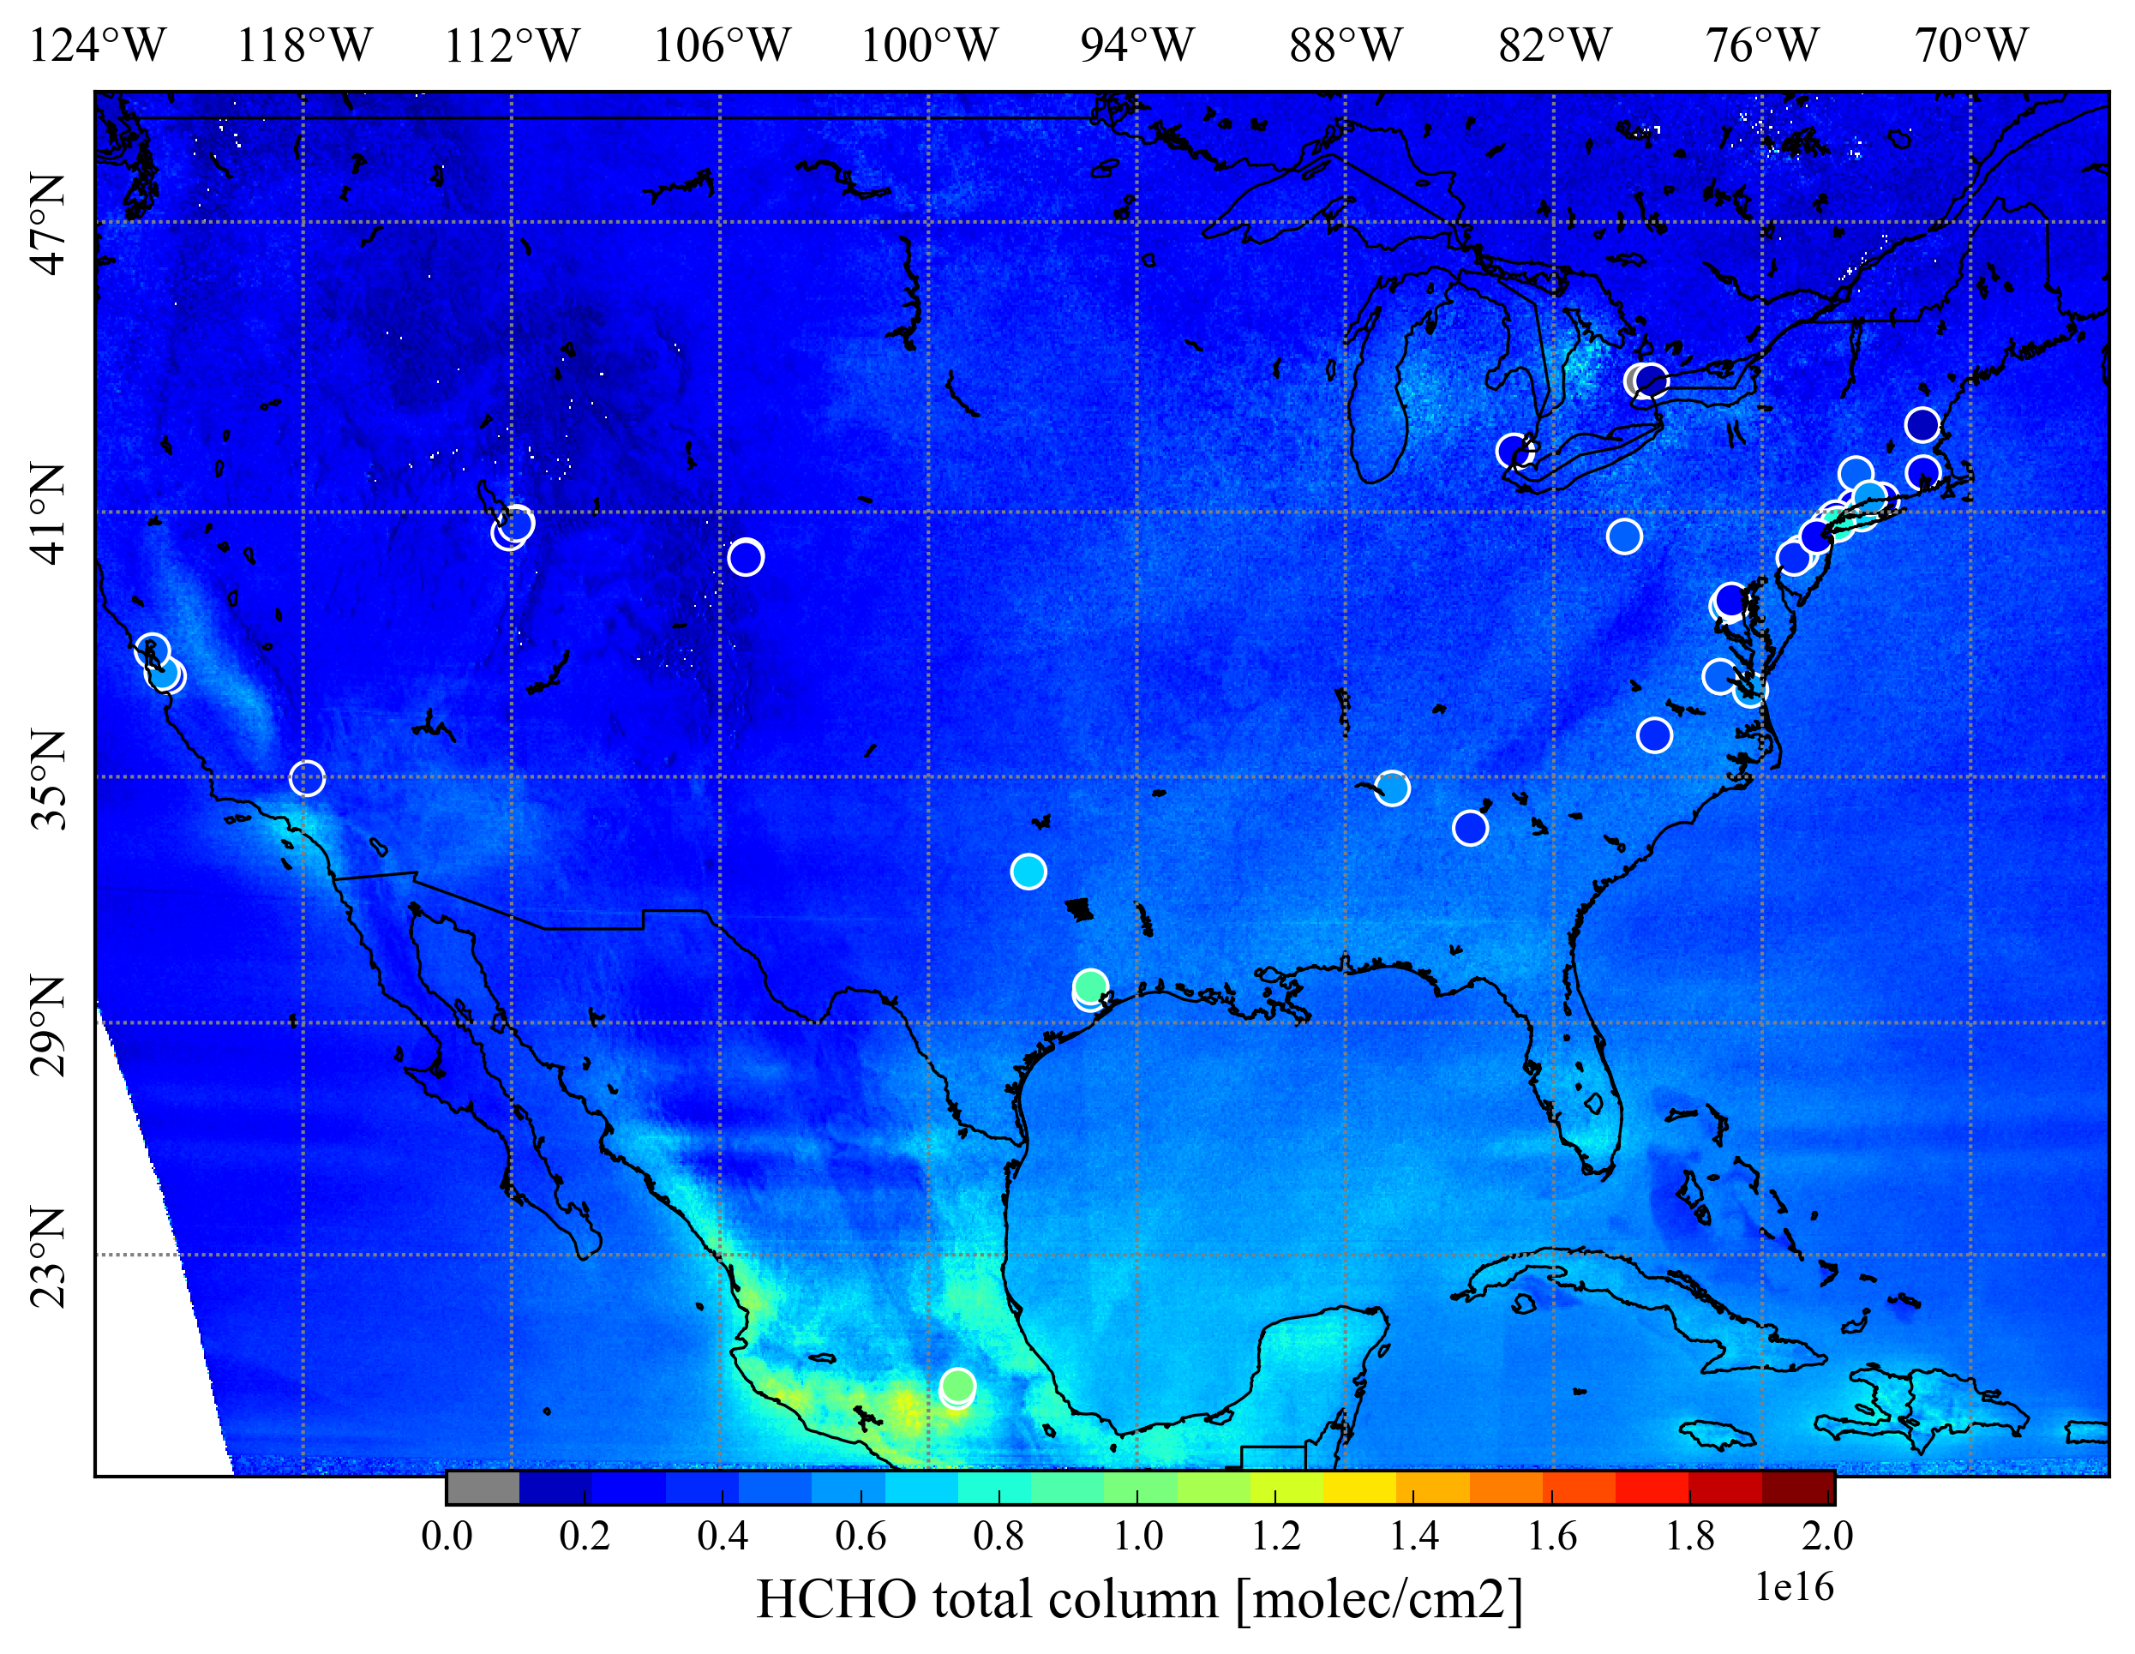
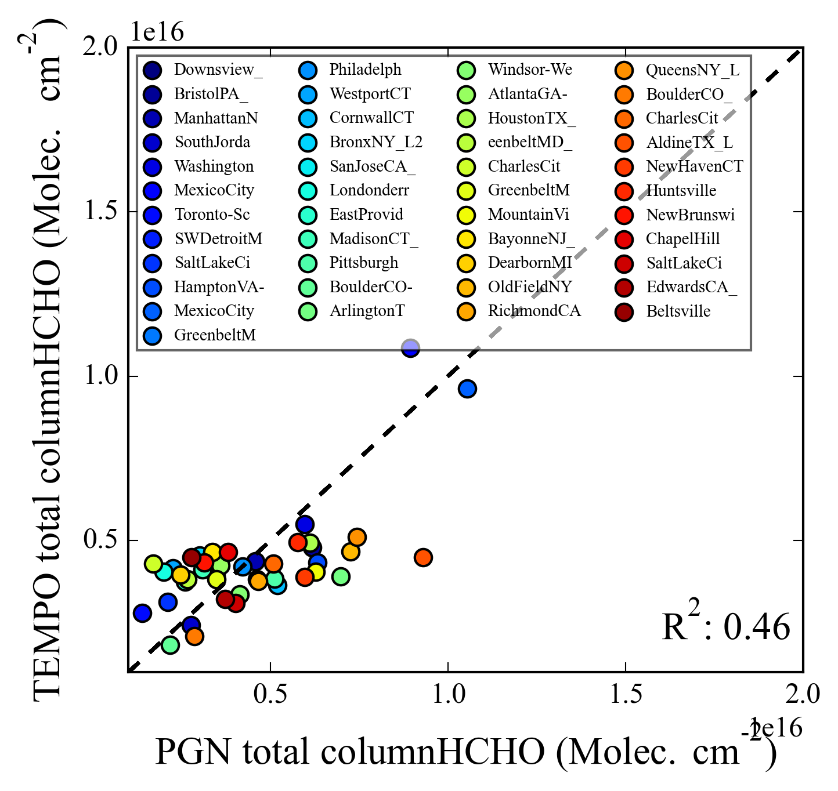
Pandora HCHO Comparisons
November 23-Jan 20
Courtesy of Prajjwal Rawat (NASA LaRC), Katherine Travis (NASA LaRC), James Szykman (EPA)
PRELIMINARY!!
HCHO hotspots are captured well by both the measurements, irrespective of Pandora locations.
A moderate spatial correlation is observed between Pandora direct Sun HCHO and TEMPO HCHO column with larger dynamical range in the Pandora observations.

Slide 15
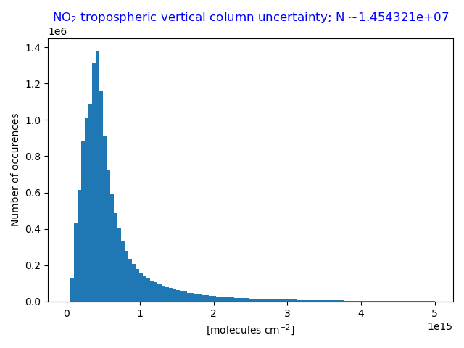
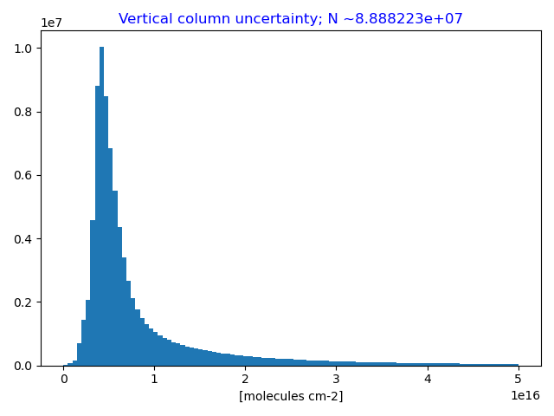
NO₂ Tropospheric Column &
HCHO Column Uncertainties
Single pixel performance
Single pixel performance
Aug. 29-Sep. 1
SZA < 70°
All cloud fractions
All scans
Aug. 29-30
SZA < 70°
All cloud fractions
All scans
Requirement
Coadd 4 pixels
Requirement
Coadd 12 pixels
NO₂ Median uncertainty = 0.46 × 10¹⁵ molecules/cm² (SZA < 70°, all clouds)
HCHO Median uncertainty = 5.5 x 10¹⁵ molecules/cm² (SZA < 70˚, all clouds)
TEMPO NO₂ & HCHO meets requirement for >90% of cloud-free scenes with no pixel coadding!

Slide 16
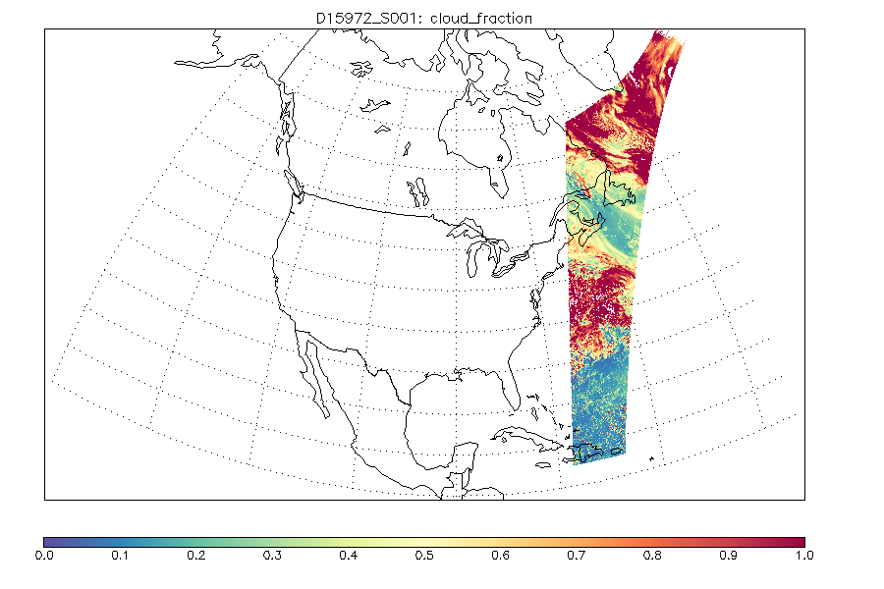
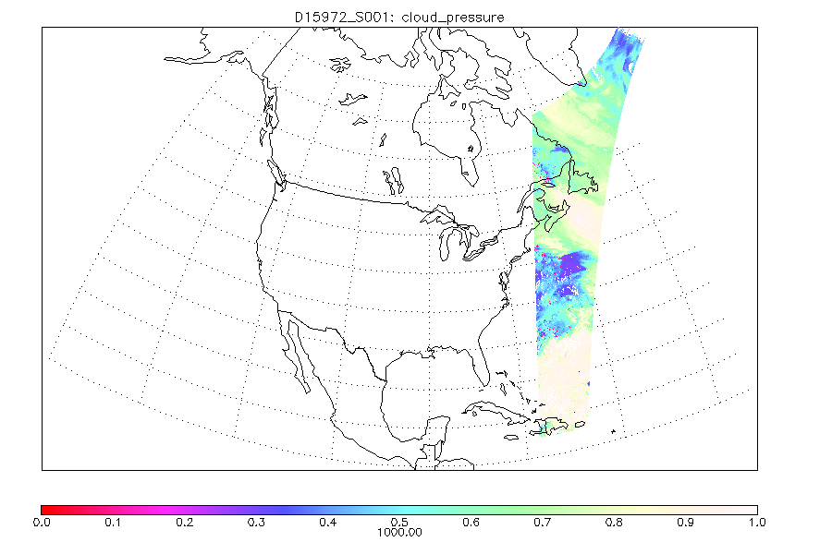
Cloud Products (29 September 2023)
Cloud fraction
Cloud pressure
Saturation causes no retrieval under very cloudy conditions.
[Credit: Huiqun Wang]

Slide 17
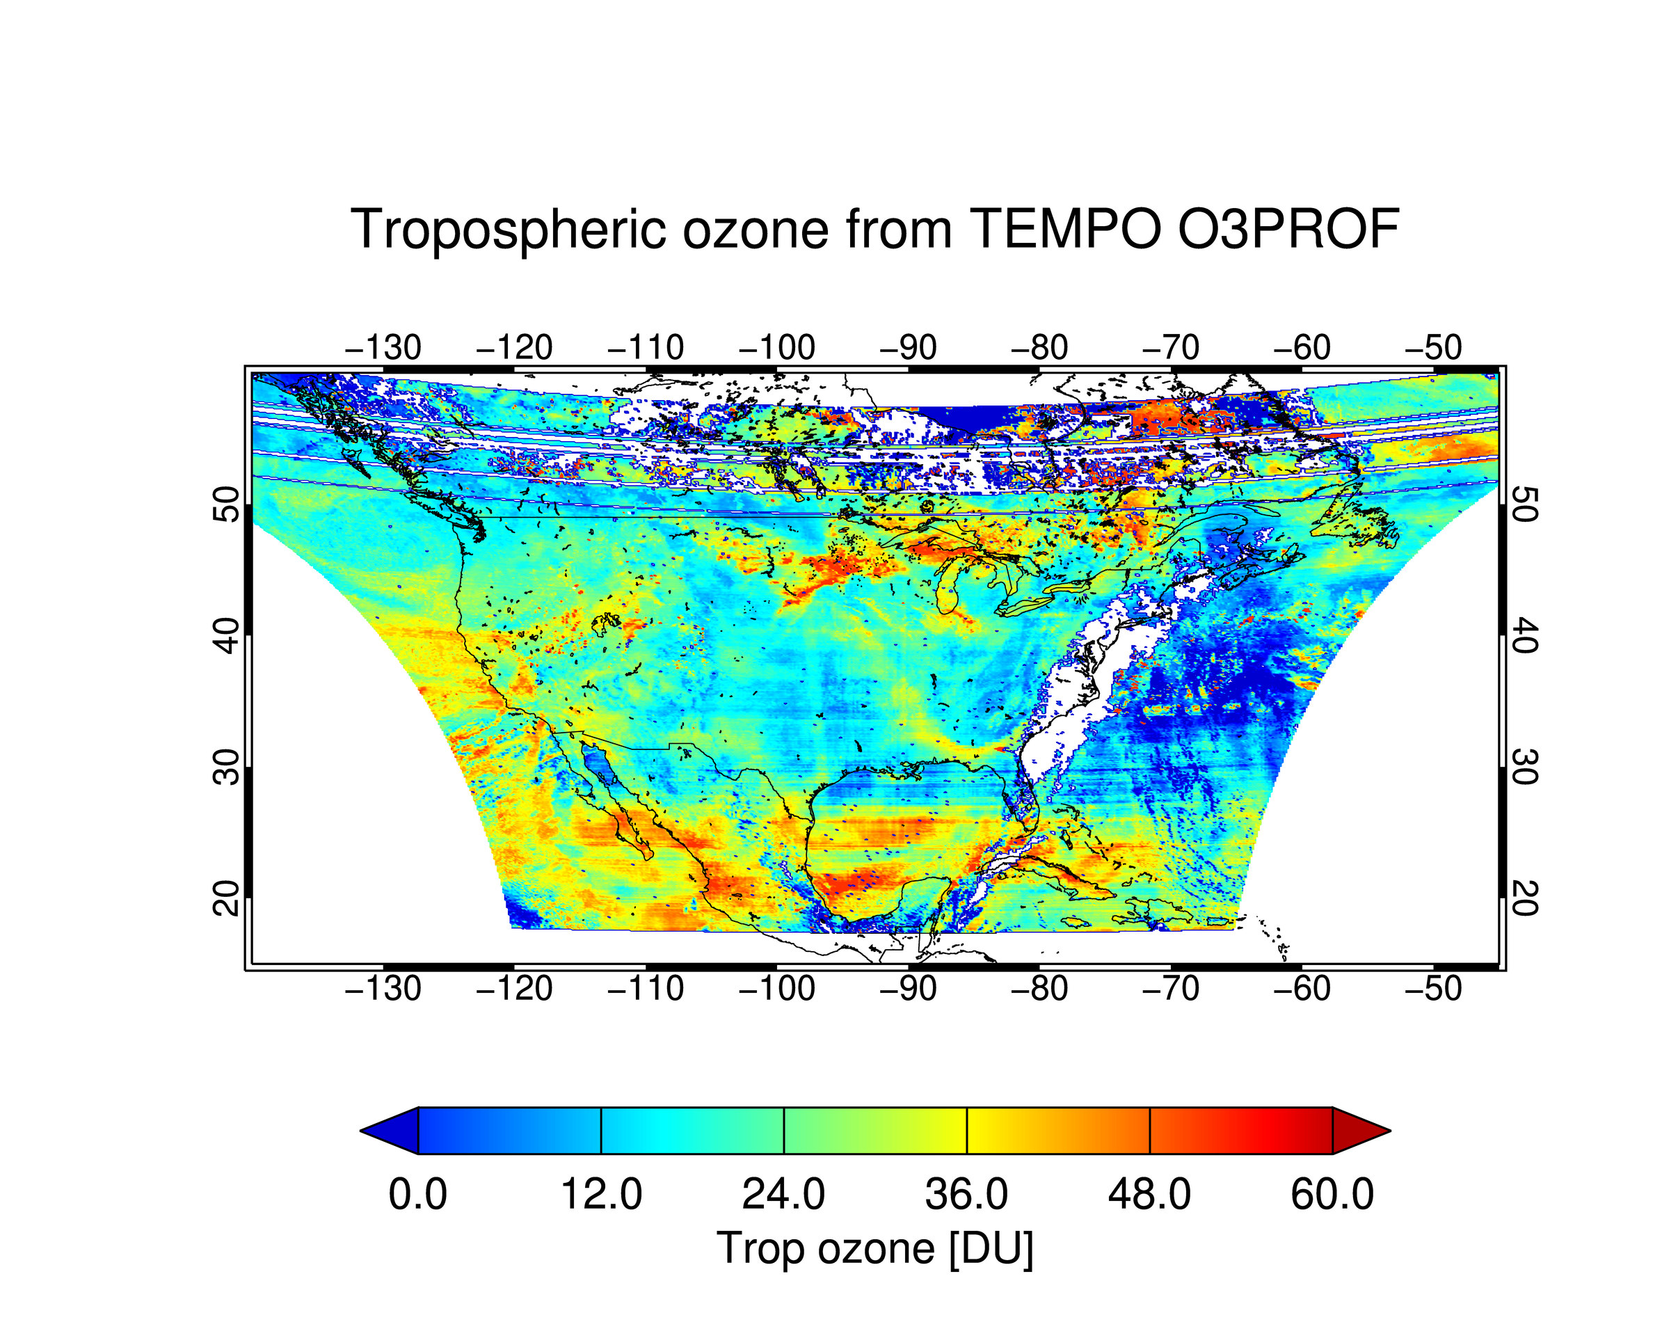
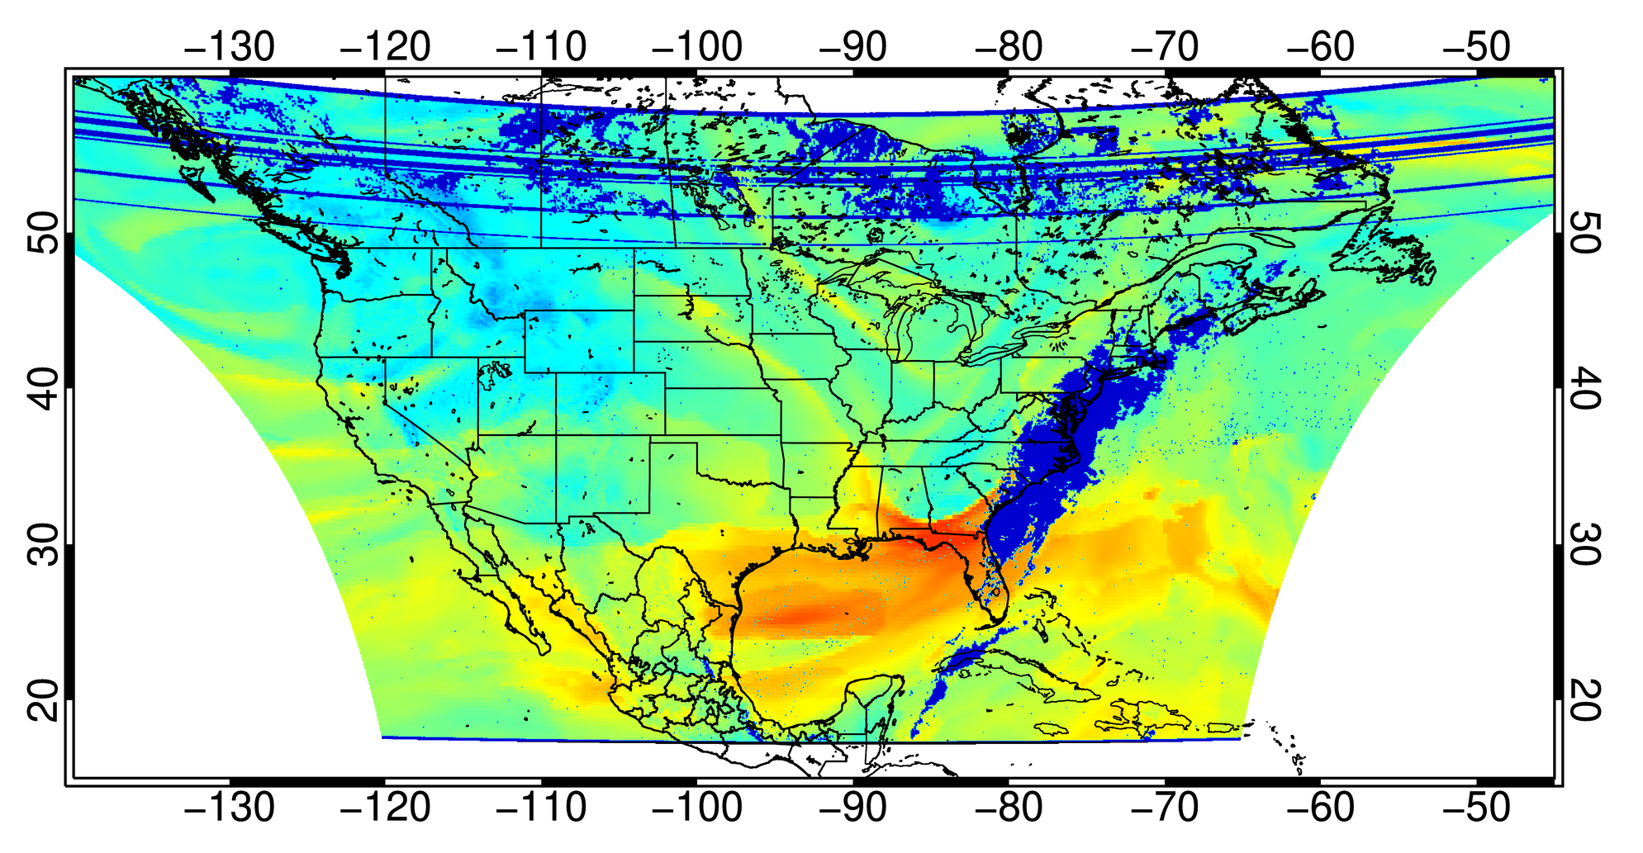
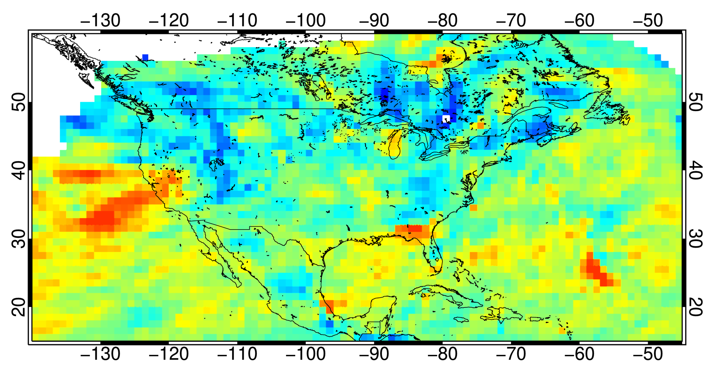
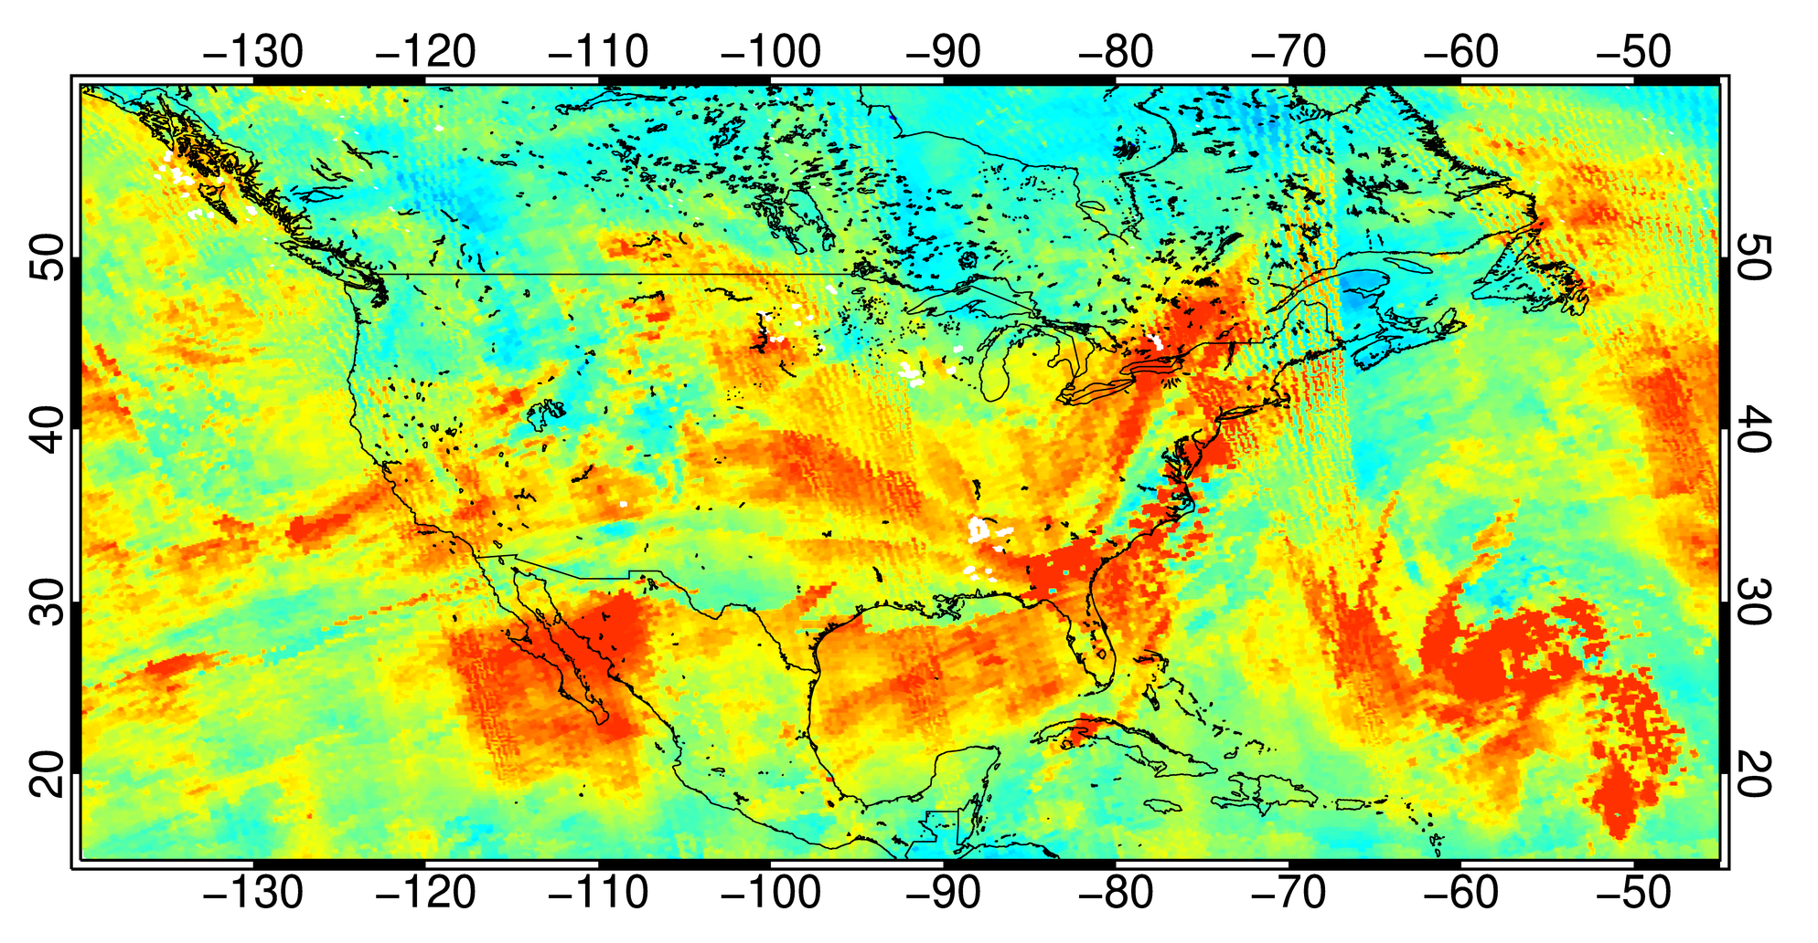
TEMPO O3PROF (3/28/2024 Scan 008)
Tropospheric O3 from TEMPO O3PROF
Tropospheric O3 from GEOS-CF
Earlier version
from 2 weeks ago!
PRELIMINARY!
Tropospheric O3 from EPIC
Tropospheric O3 from TROPOMI
[Credit: Jerry Ziemke]
Dobson Unit
Note different tropopause pressure from EPIC/TROPOMI!
[Credit: Junsung Park]

Slide 18
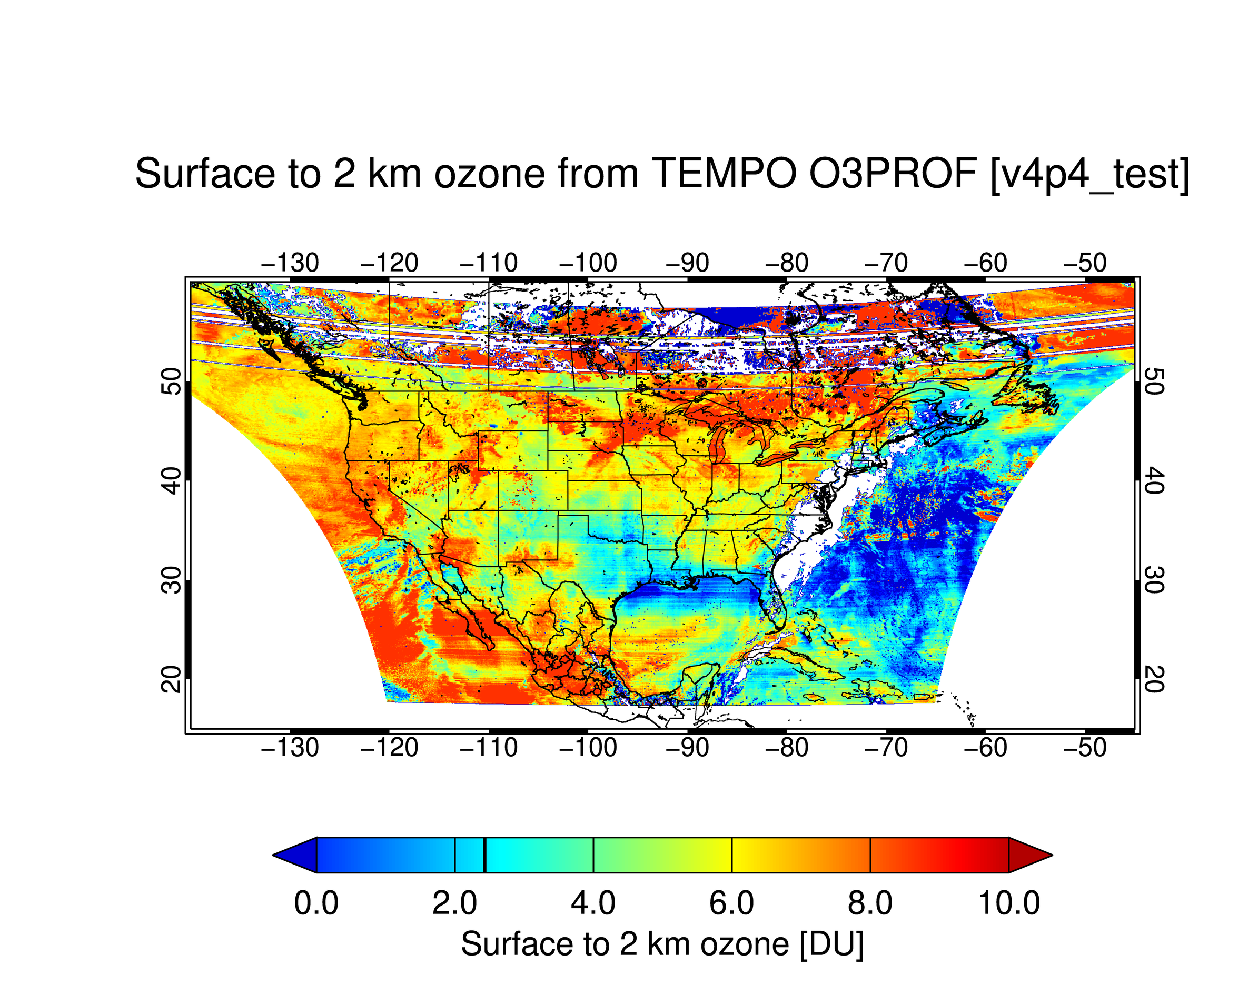
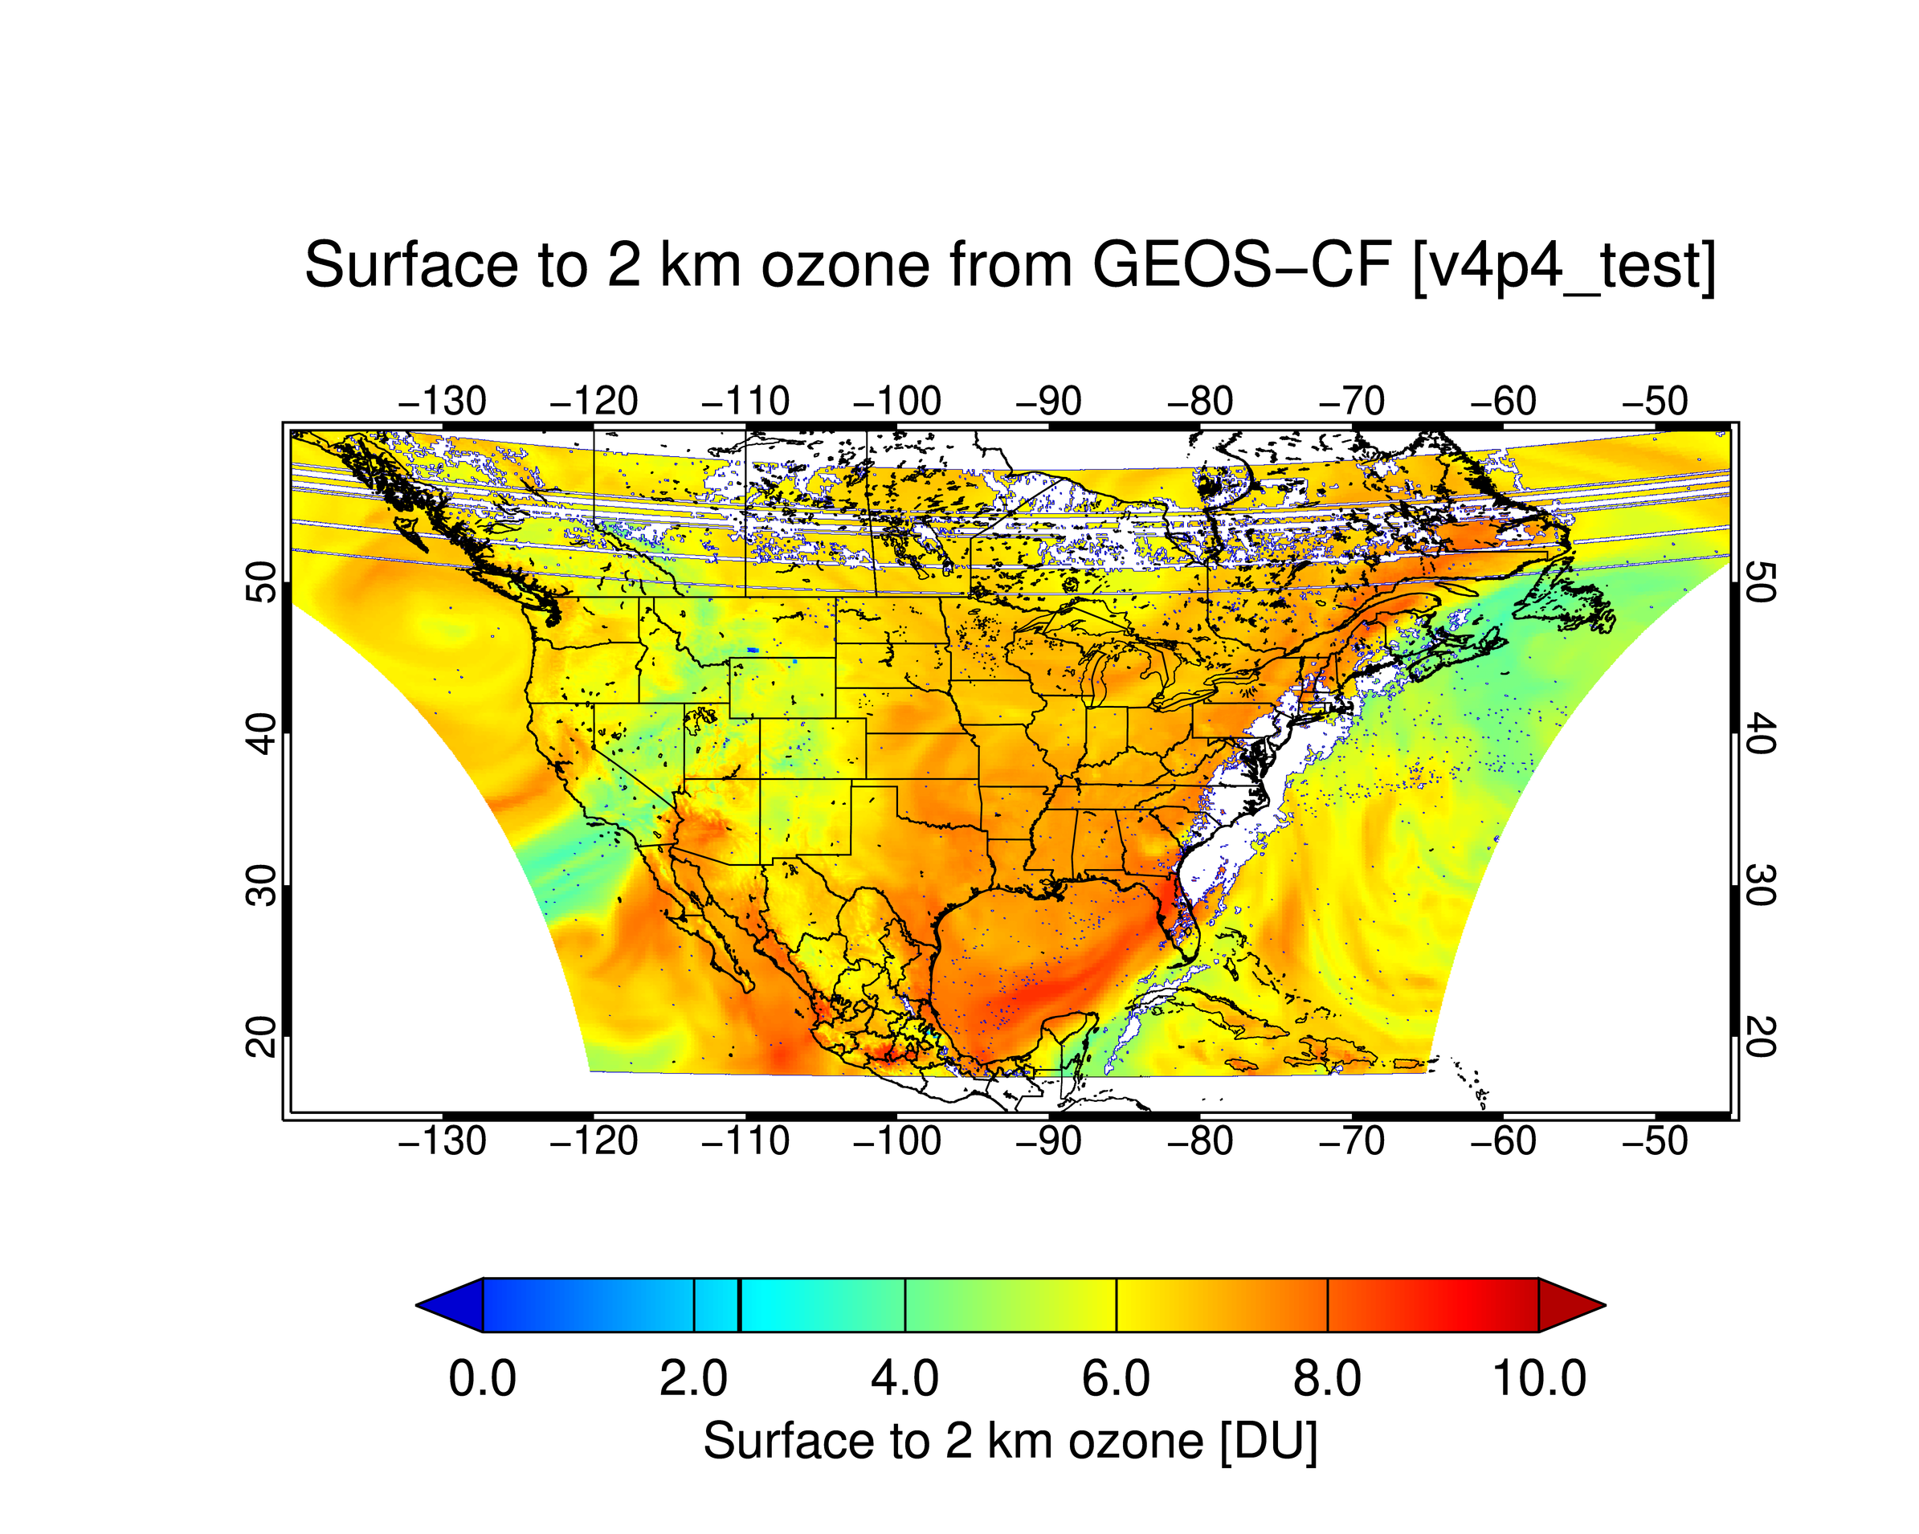
TEMPO O3PROF (3/28/2024 Scan 008)
Surface to 2 km O3 from TEMPO O3PROF
Surface to 2 km O3 from GEOS-CF
[Credit: Junsung Park]
Dobson Unit
PRELIMINARY!

Slide 19
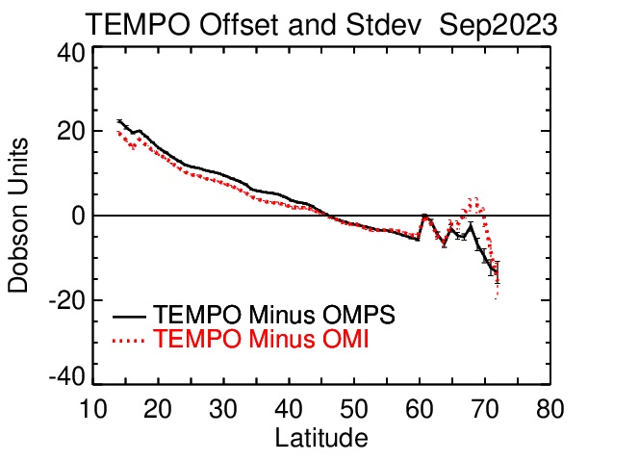
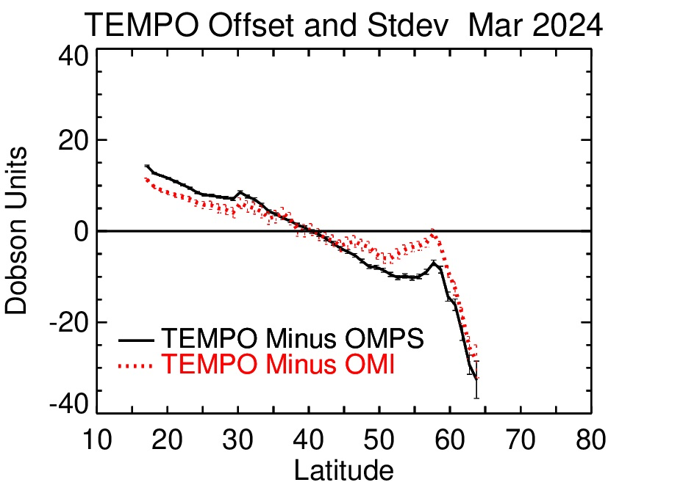
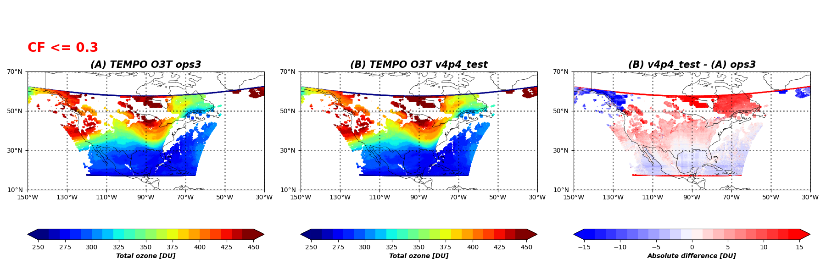
TEMPO Total Ozone (V2):
Comparison with OMPS and OMI
OMPS and OMI within ±3 hr overpass with TEMPO with all data binned to 1º × 1º daily averages
Credit: Jerry Ziemke & Stacey Frith, NASA GSFC
20240328, S008
CF < 0.3
V2
V3
V3 – V2

Slide 20
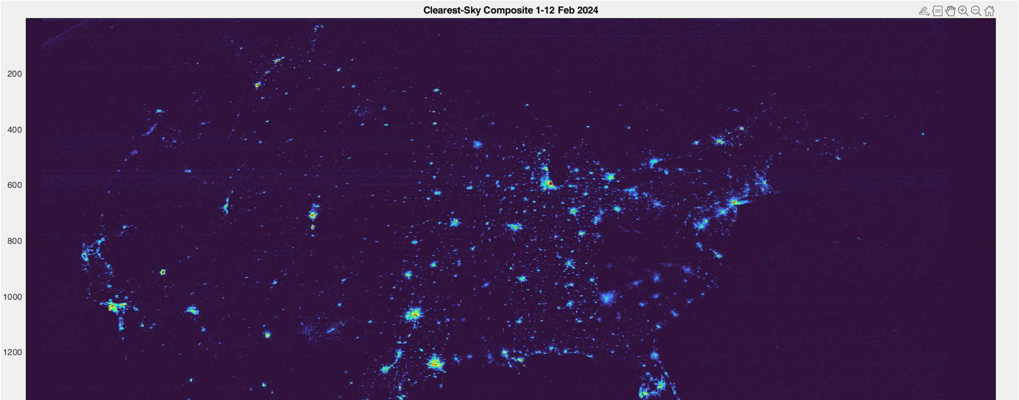
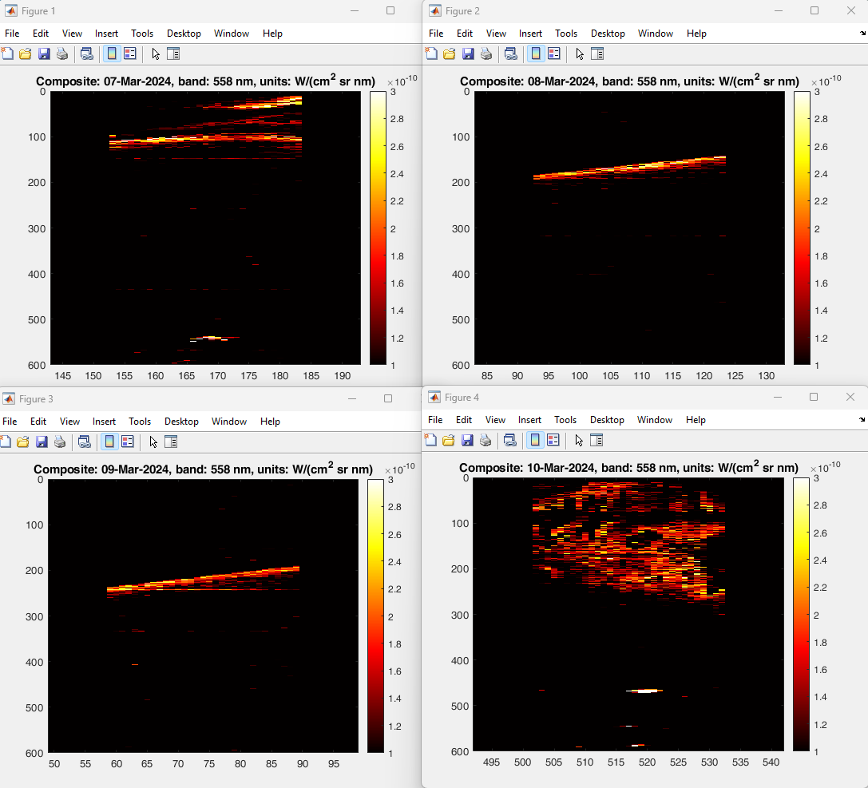
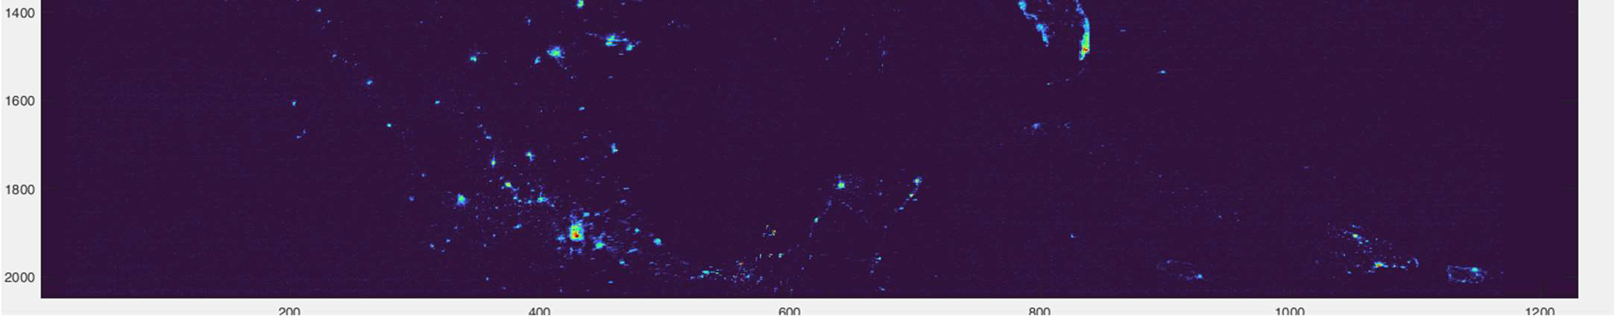
City Lights & Aurora
Clearest-Sky Composite 1–12 February 2024
Oxygen at 558 nm
Radiance derivation → Post-processing (de-speckling, de-streaking, etc.) → Composite
[Credit: Jim Carr]

Slide 21
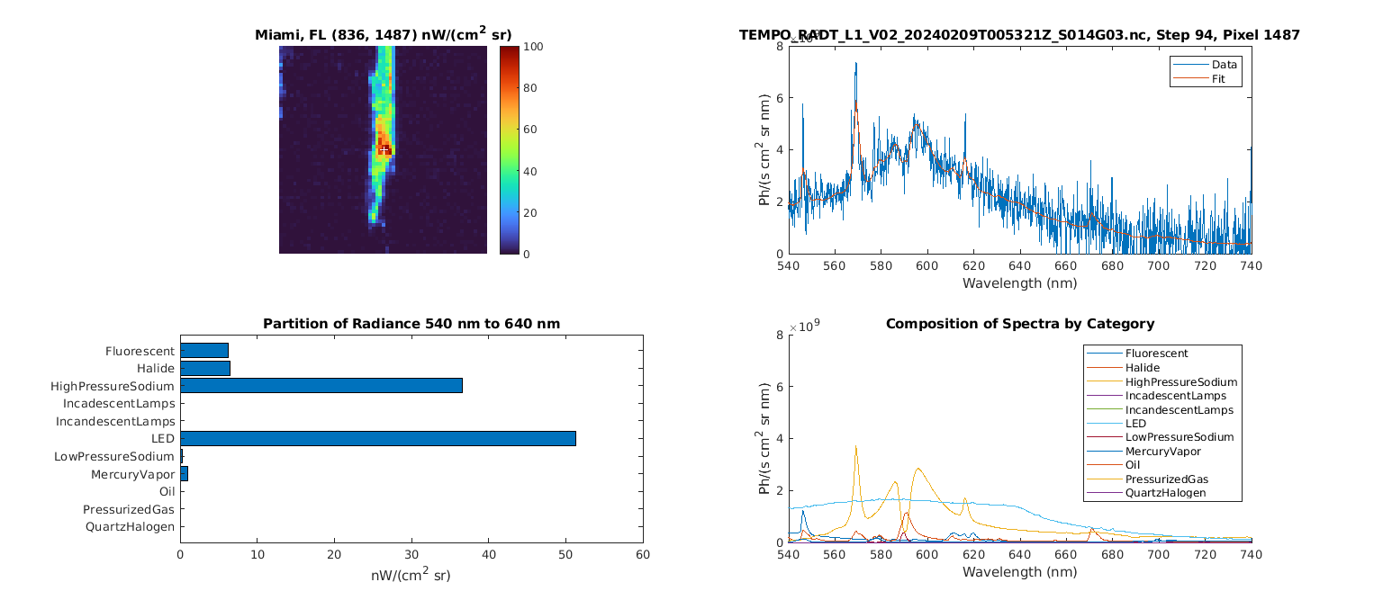
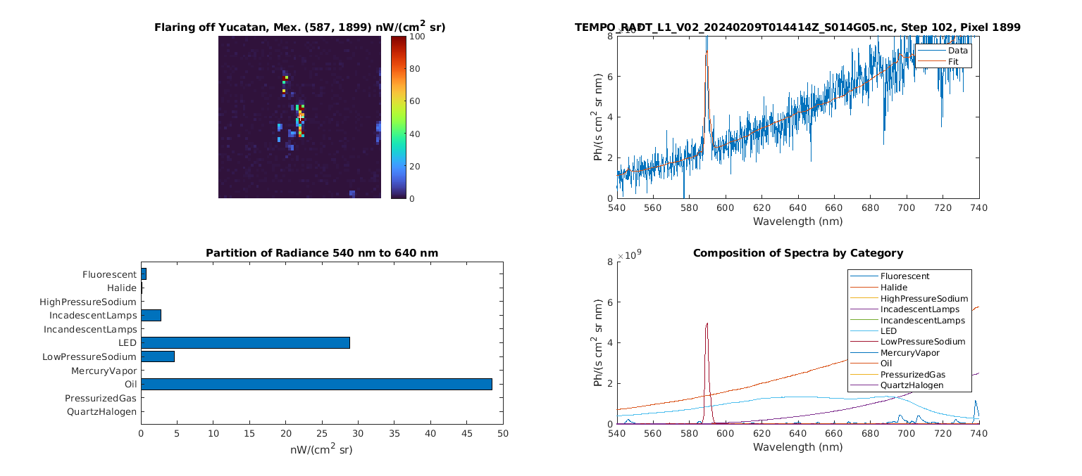
City Lights Spectral Classification
Miami, Fl
Offshore Flaring
~1200 K Blackbody
[Credit: Jim Carr]

Slide 22
Summary
TEMPO commissioning and nominal operation have gone on very well
TEMPO is providing revolutionary hourly daytime atmospheric pollution measurements at high spatial resolution over North America
Most data products (L1b, cloud, NO₂, HCHO, total O₃) are in good quality at this early stage, showing that the TEMPO instrument and science algorithms are working very well.
We are on track to release the L2/3 data products to the public (likely including the UV only ozone profile product)
On track to release TEMPO data products that are acceptable to enable meeting baseline science requirements!
Acknowledgements: Funding from
NASA (Contract No. NNL13AA09C )
Thank you!

Slide 23










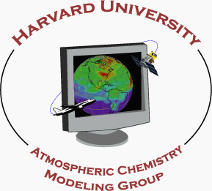













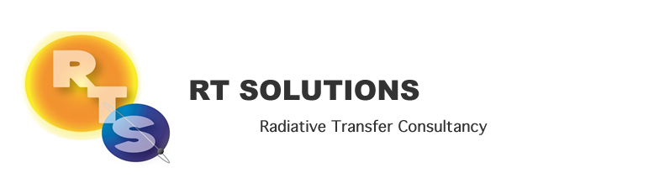






Slide 25
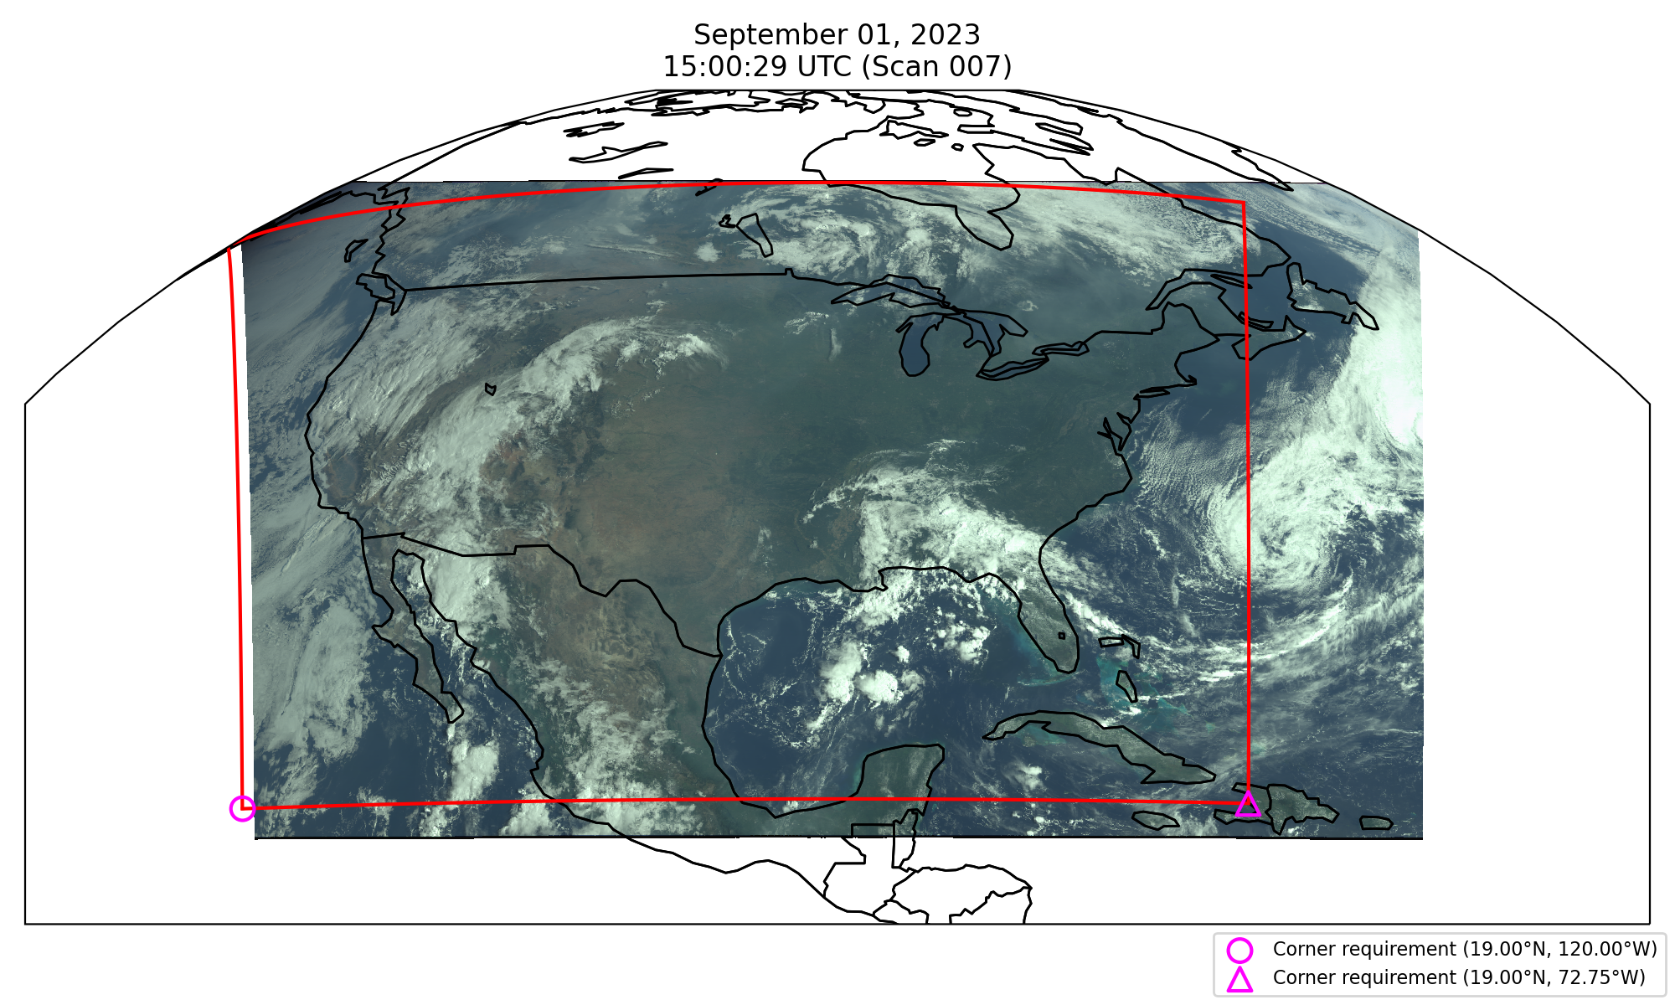
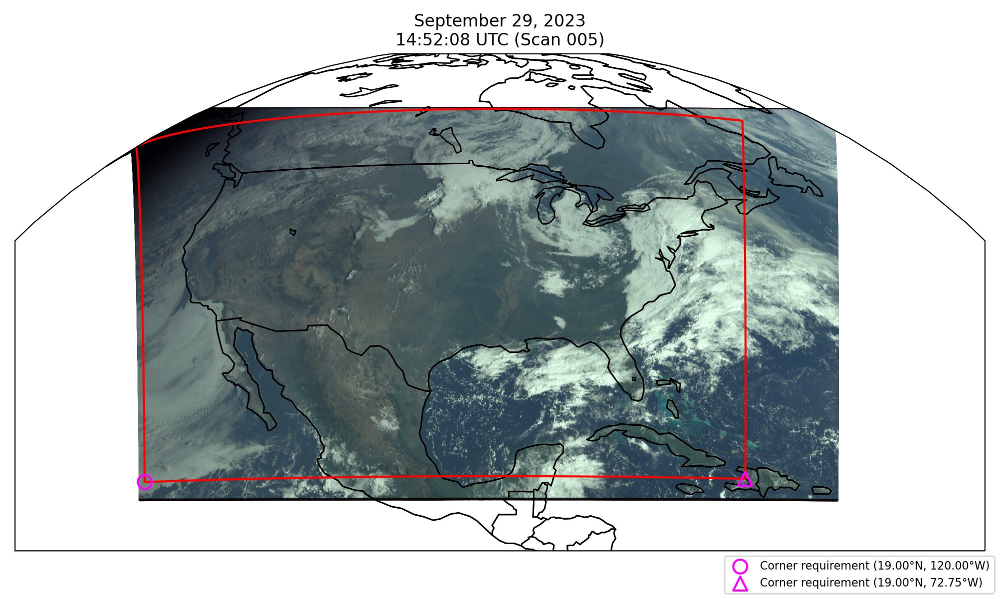
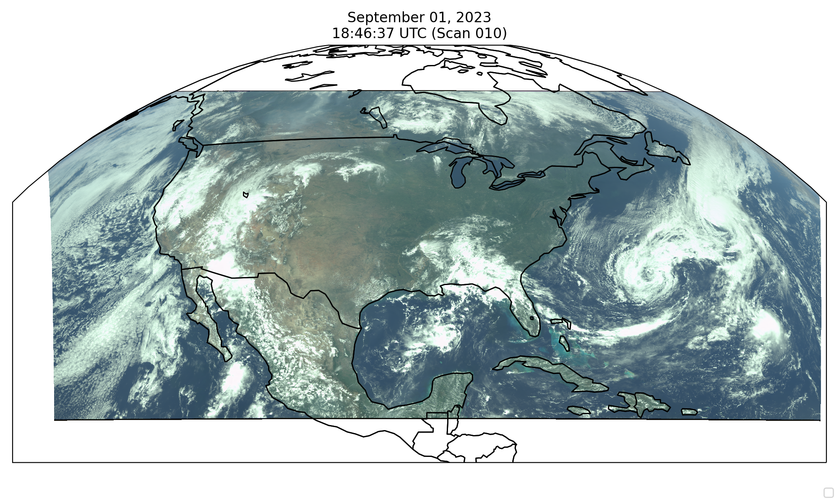
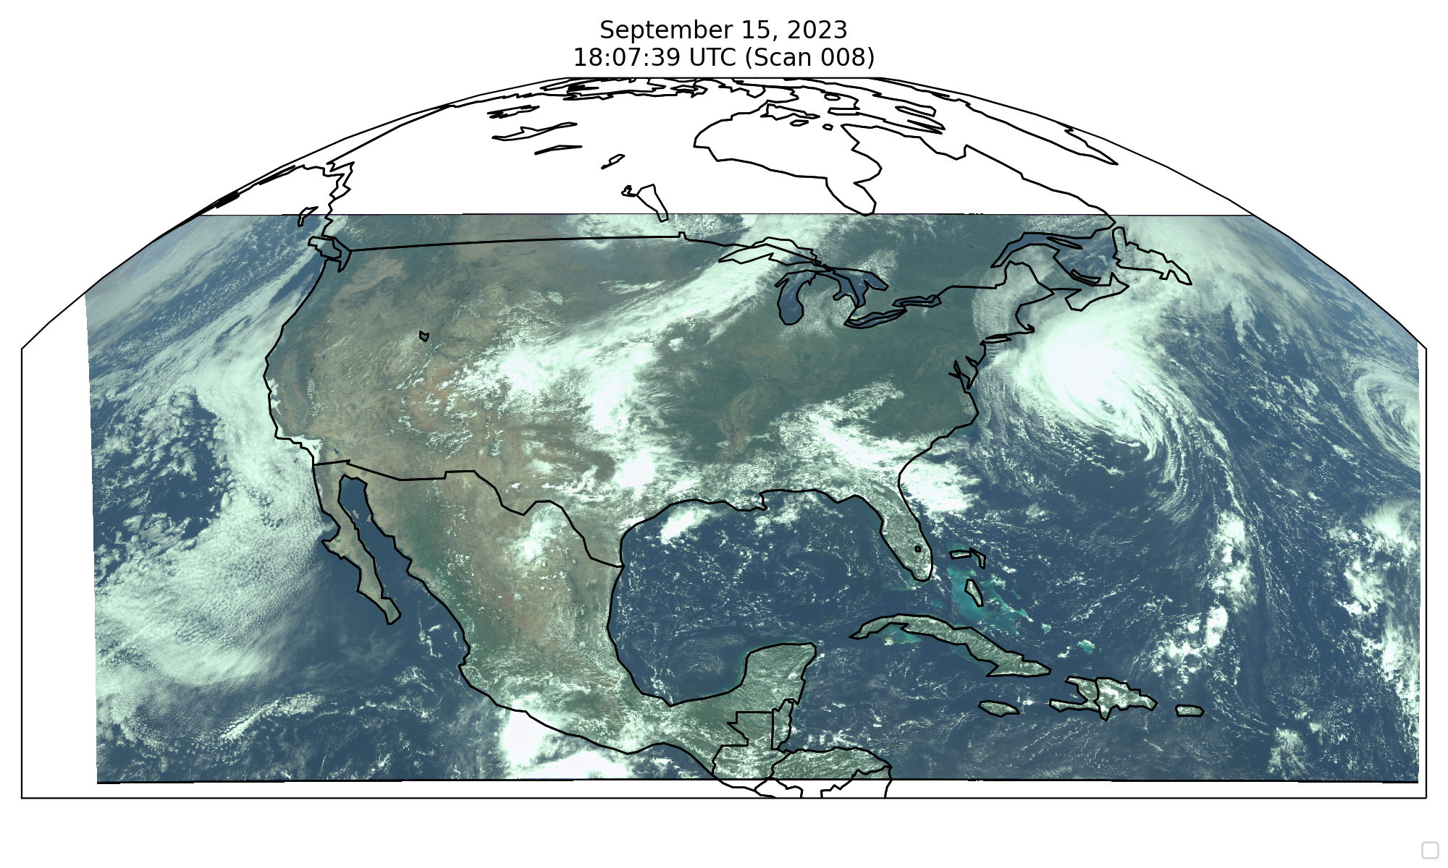
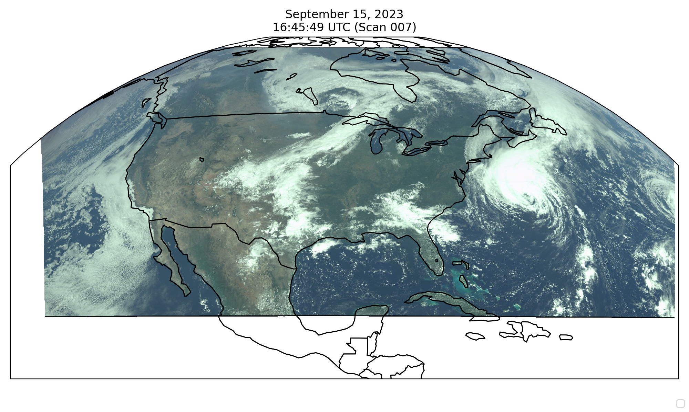
Field of Regard
Requirement
Performance
First light 8/2 field of Regard: 62.7 mins
(100 ms integration time, 26 coadds, 61.5 µrad)
Optimized field of Regard in late Sep.: 59.75 mins
(100 ms integration time, 26 coadds, 64 µrad)
Fields of regard characterization (FOR mapping) with different N-S SMA angles
[Credit: Heesung Chong]

Slide 26
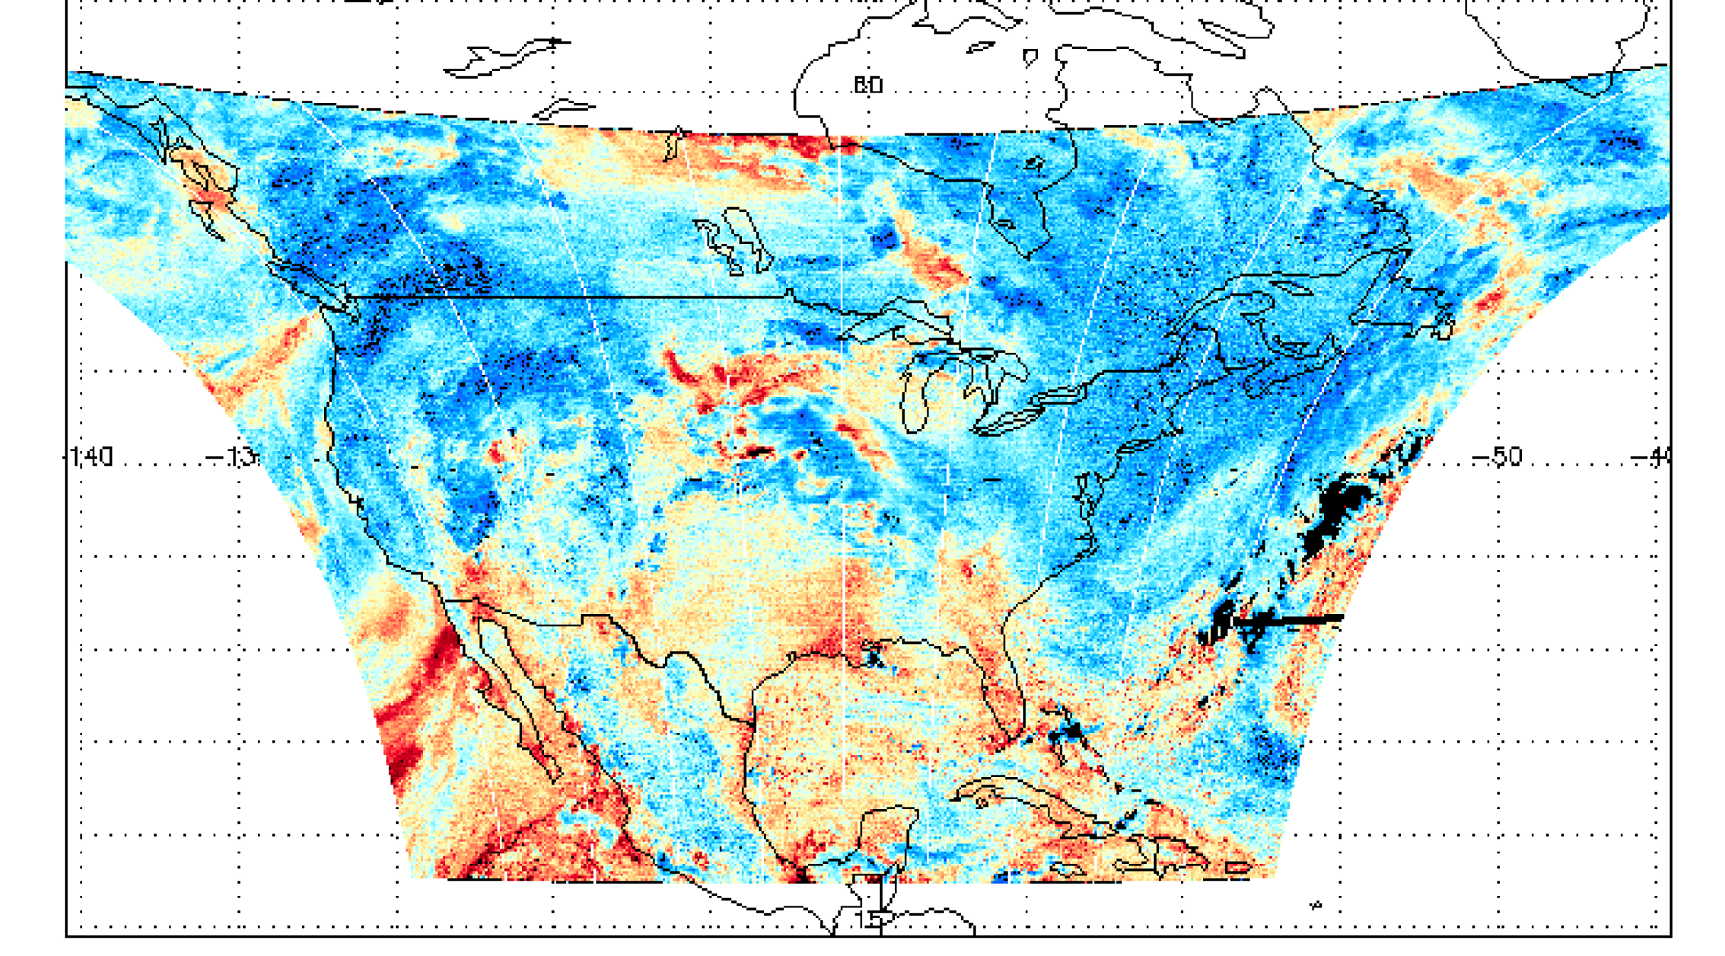
First Light H₂O SCD (2 August 2023)

Slide 27
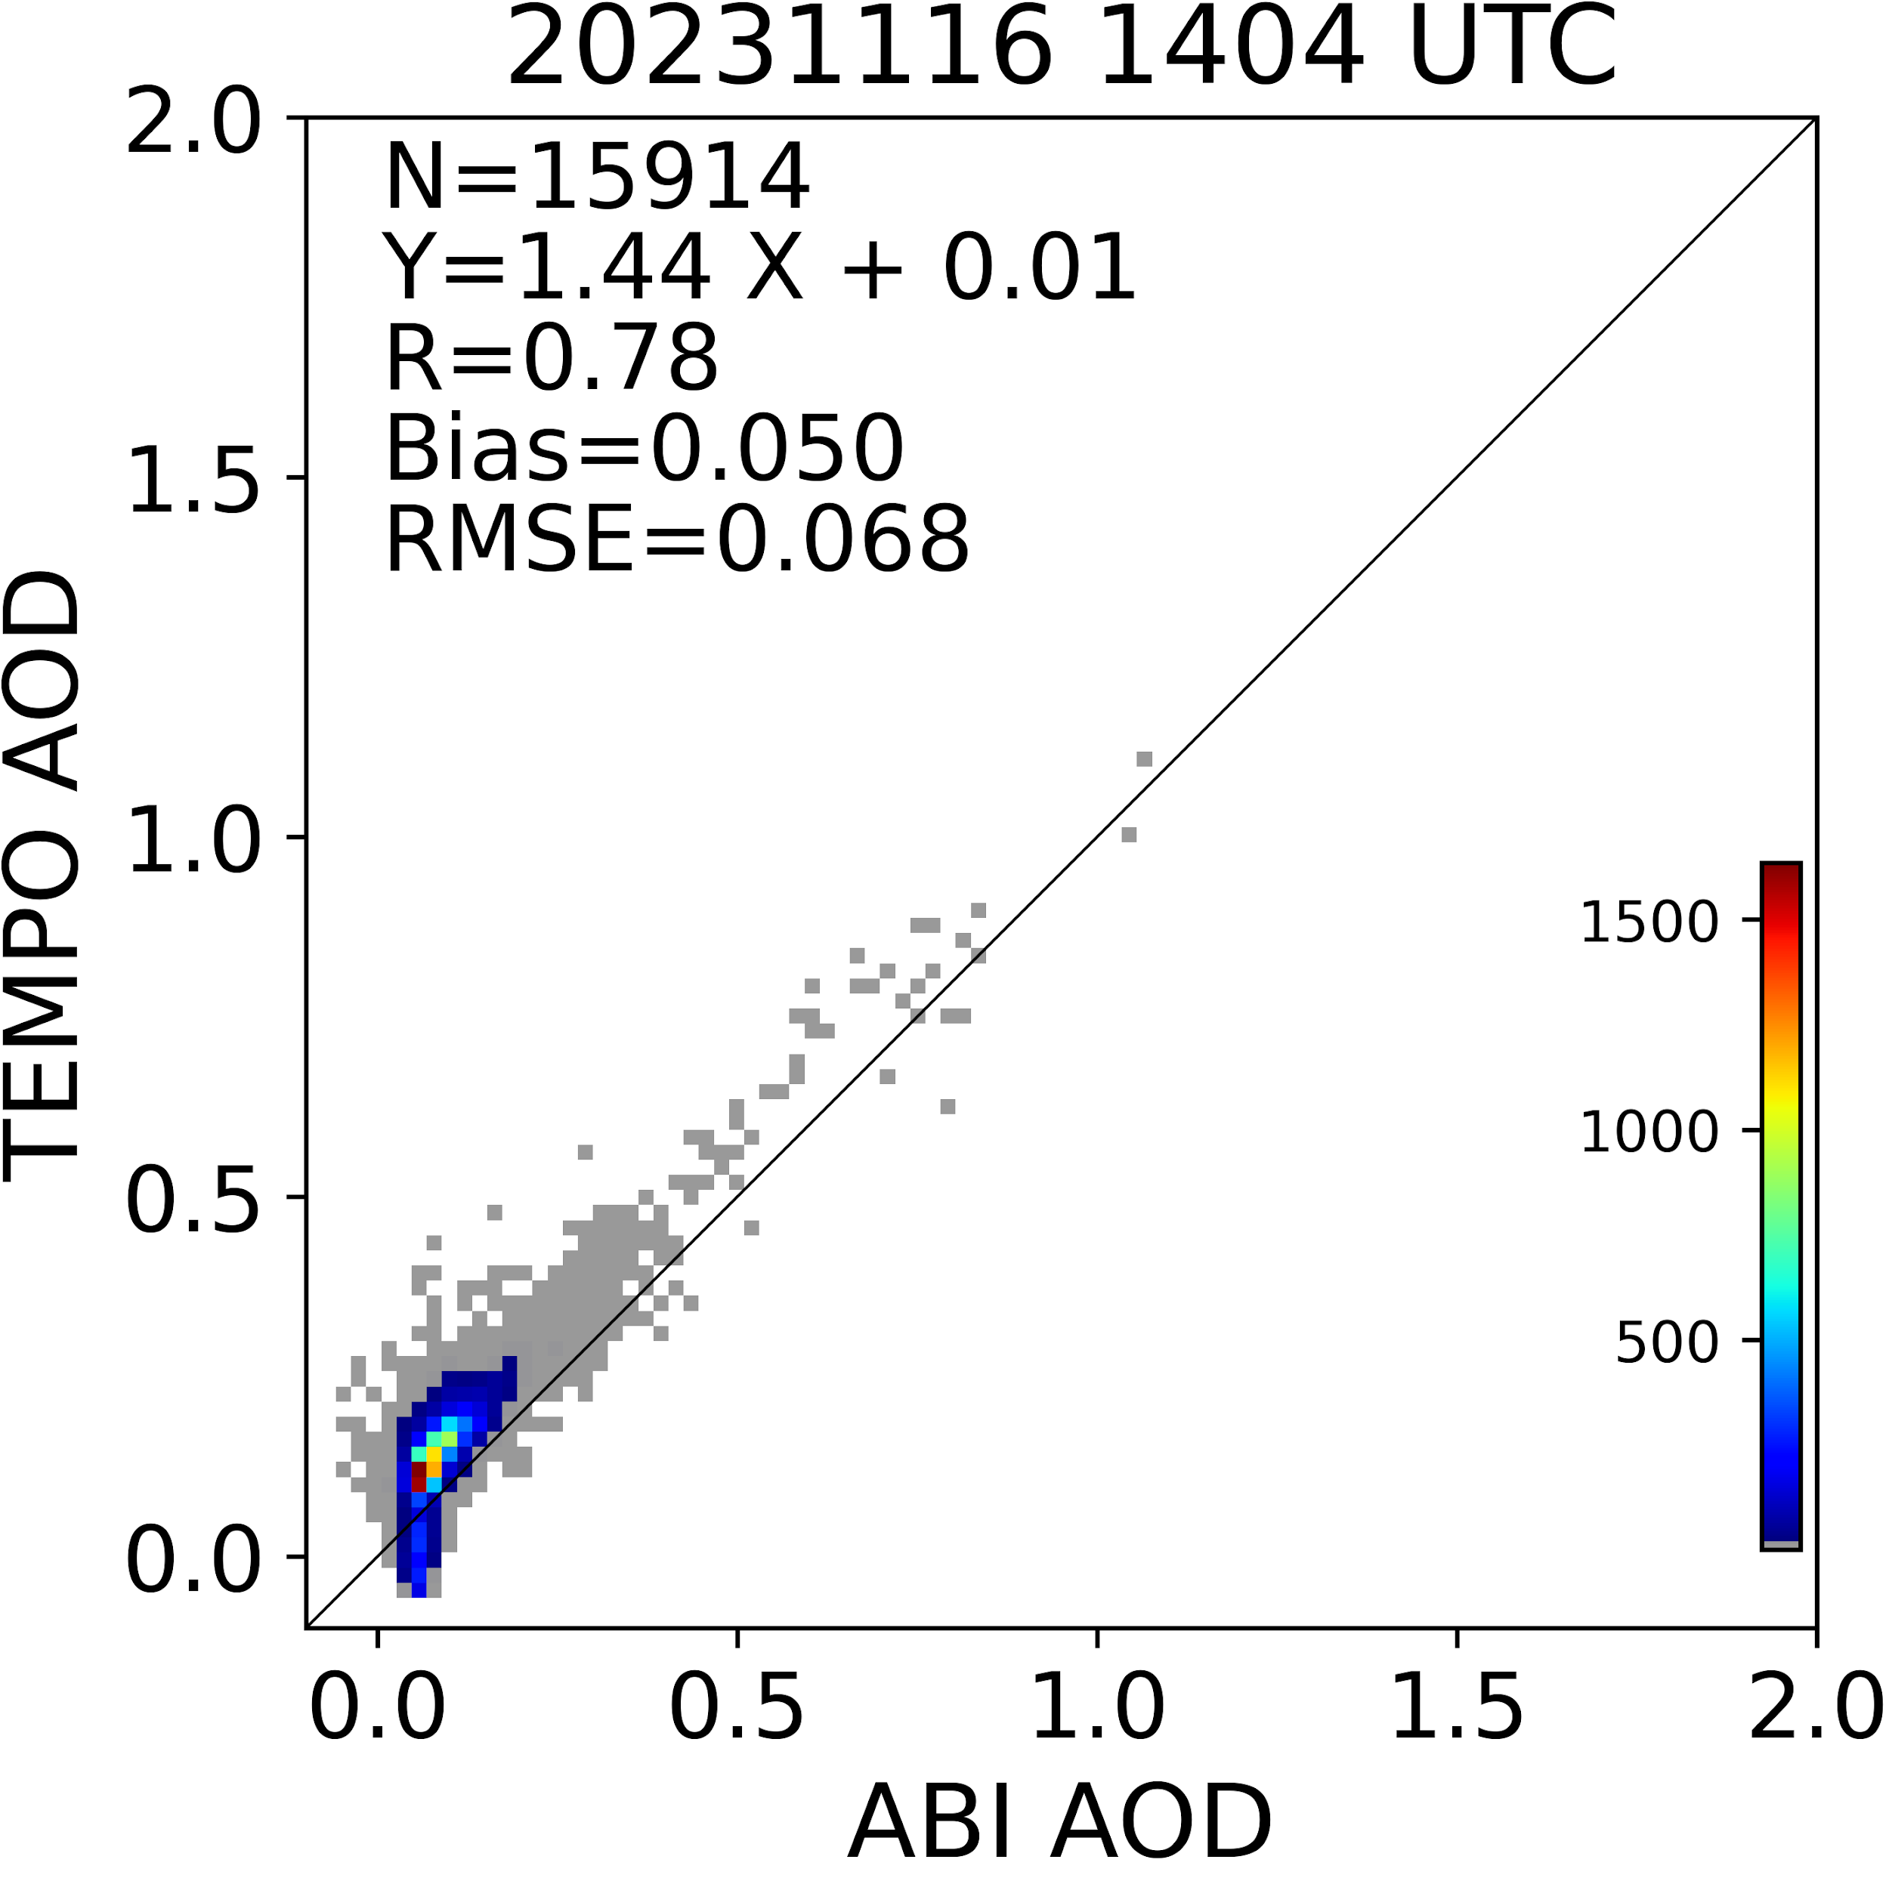
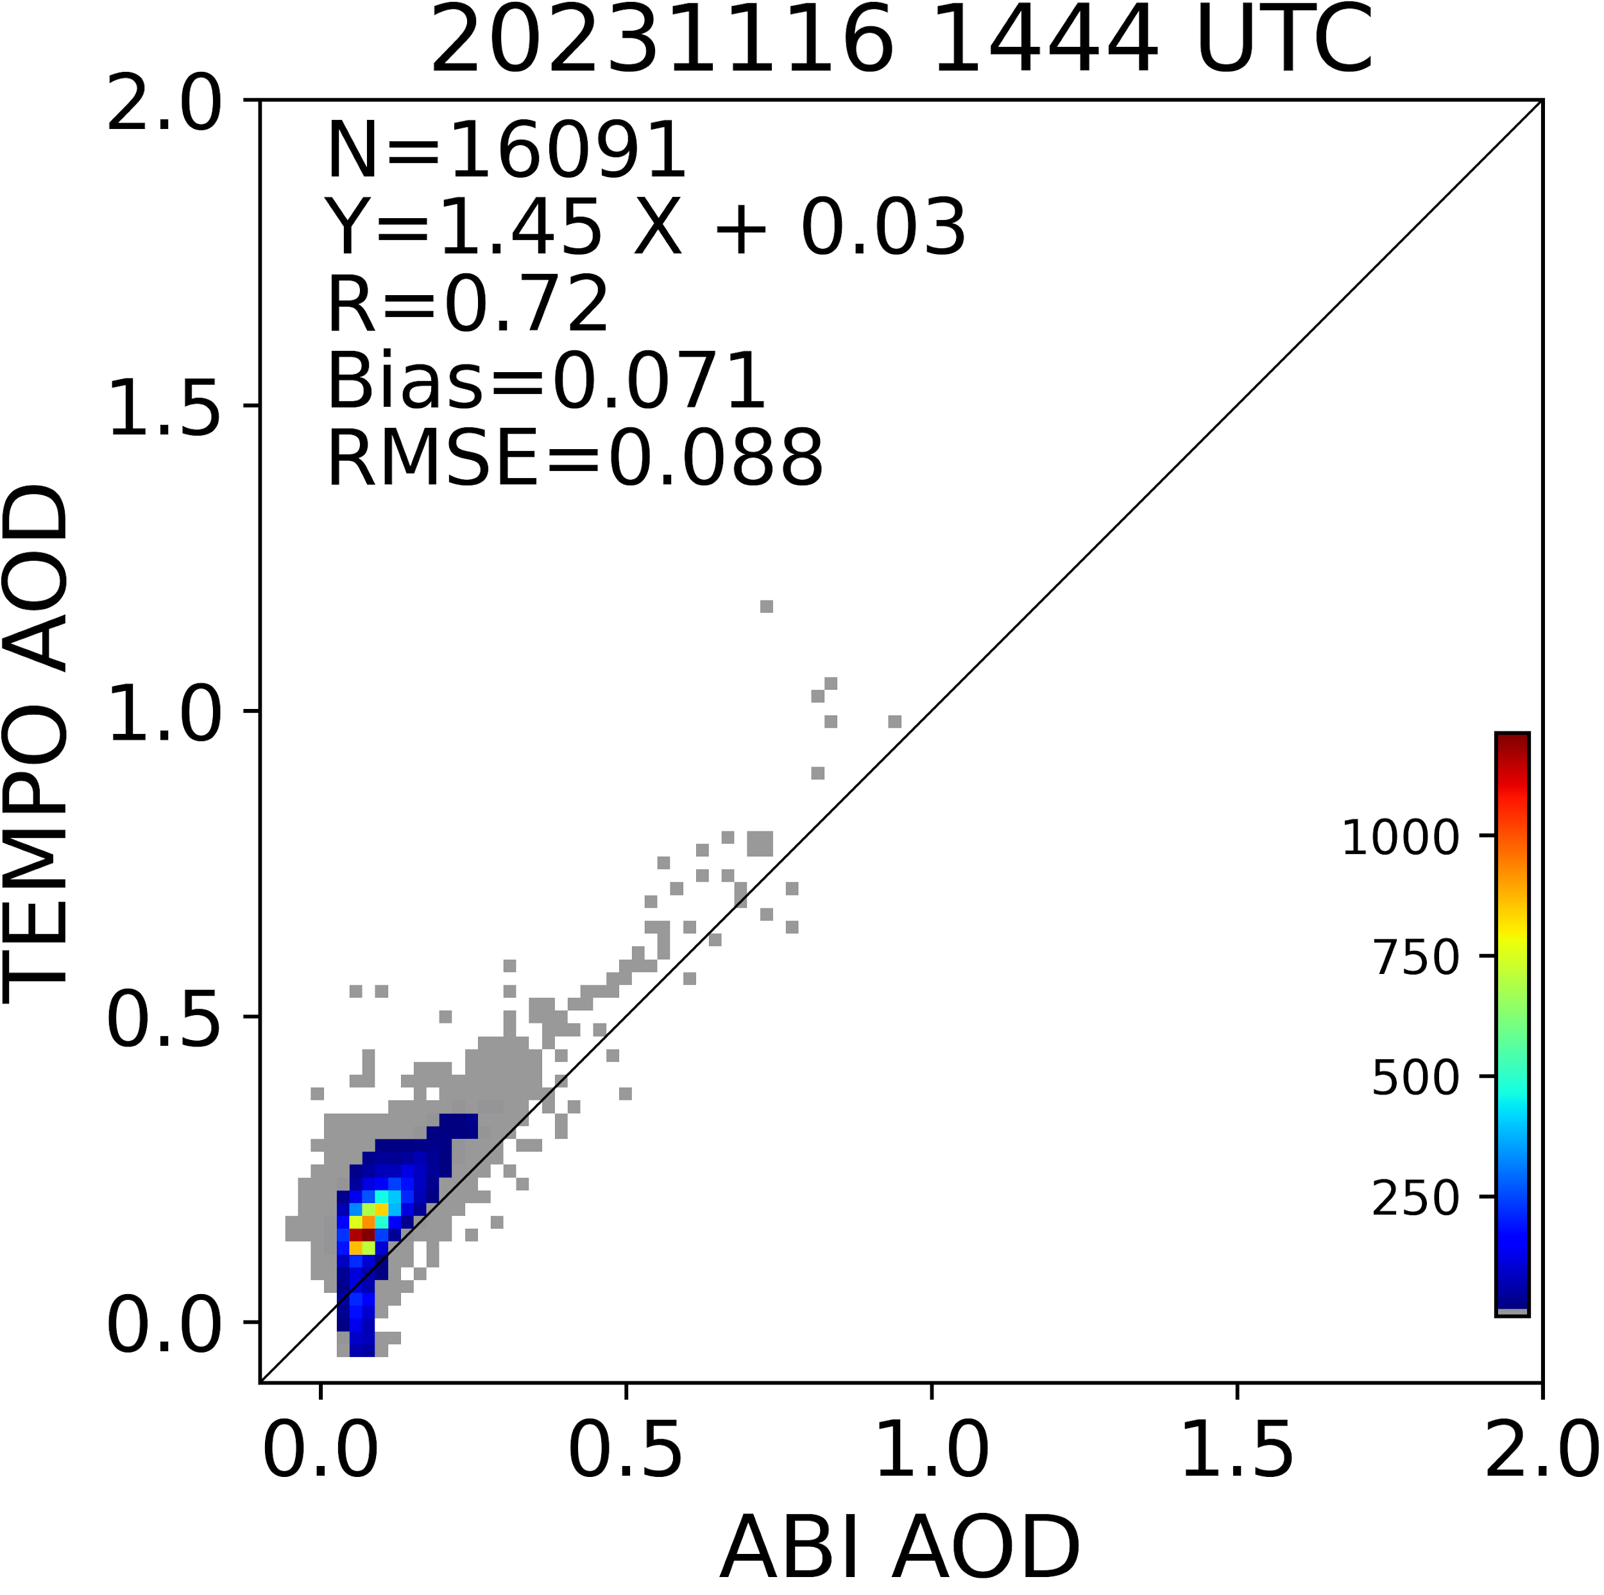
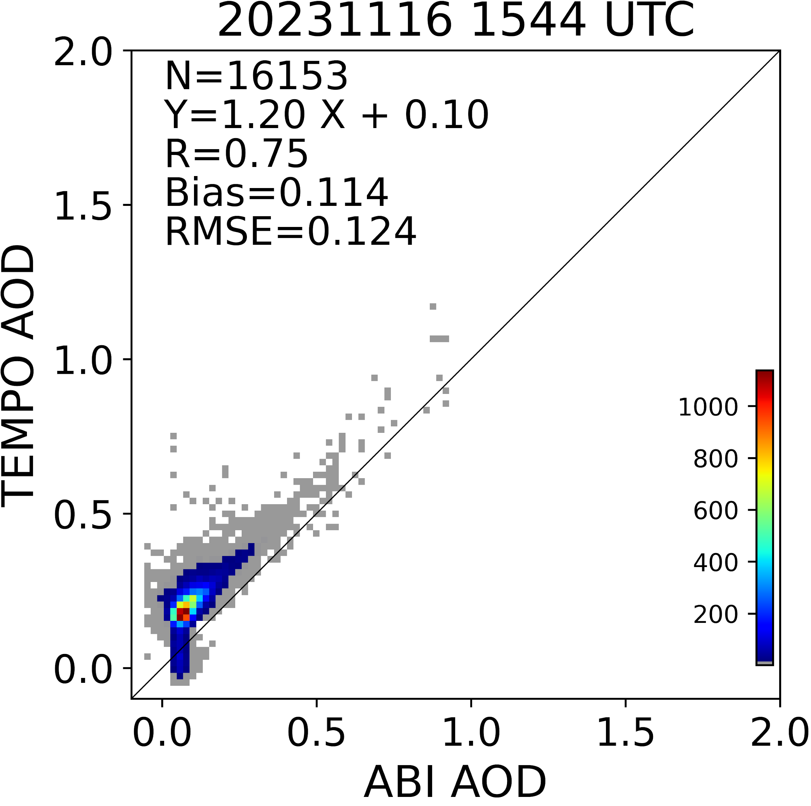
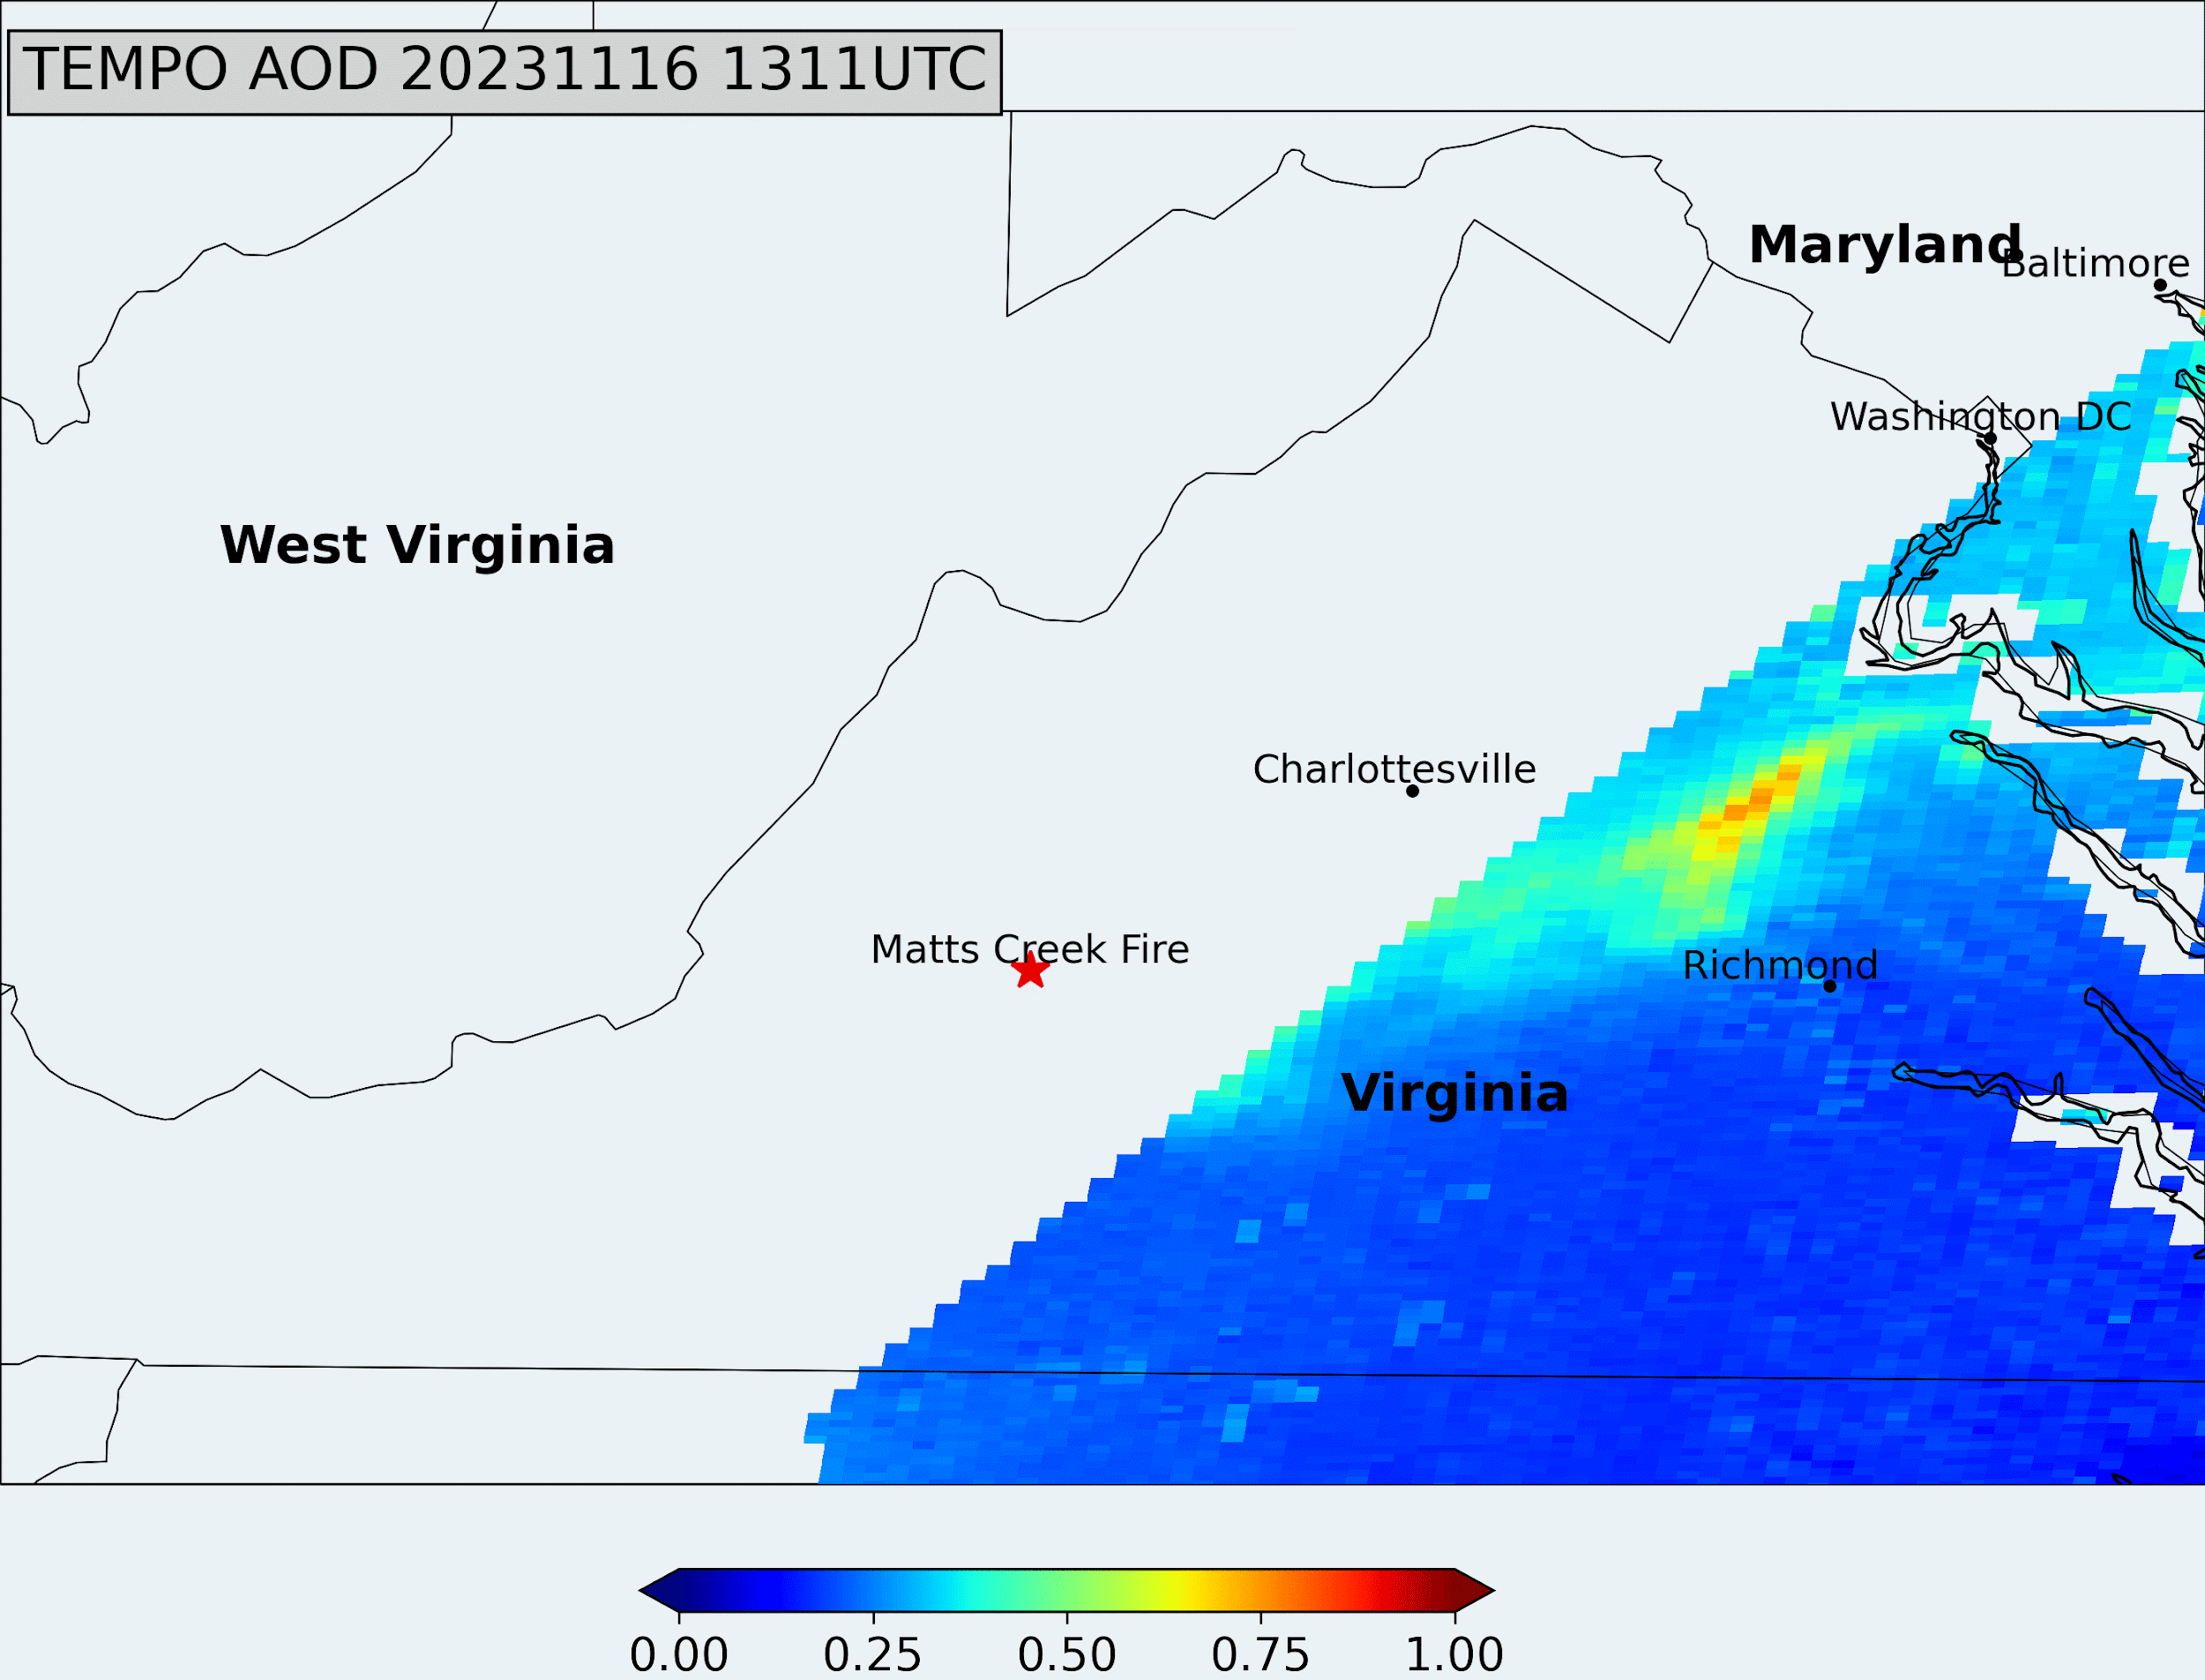
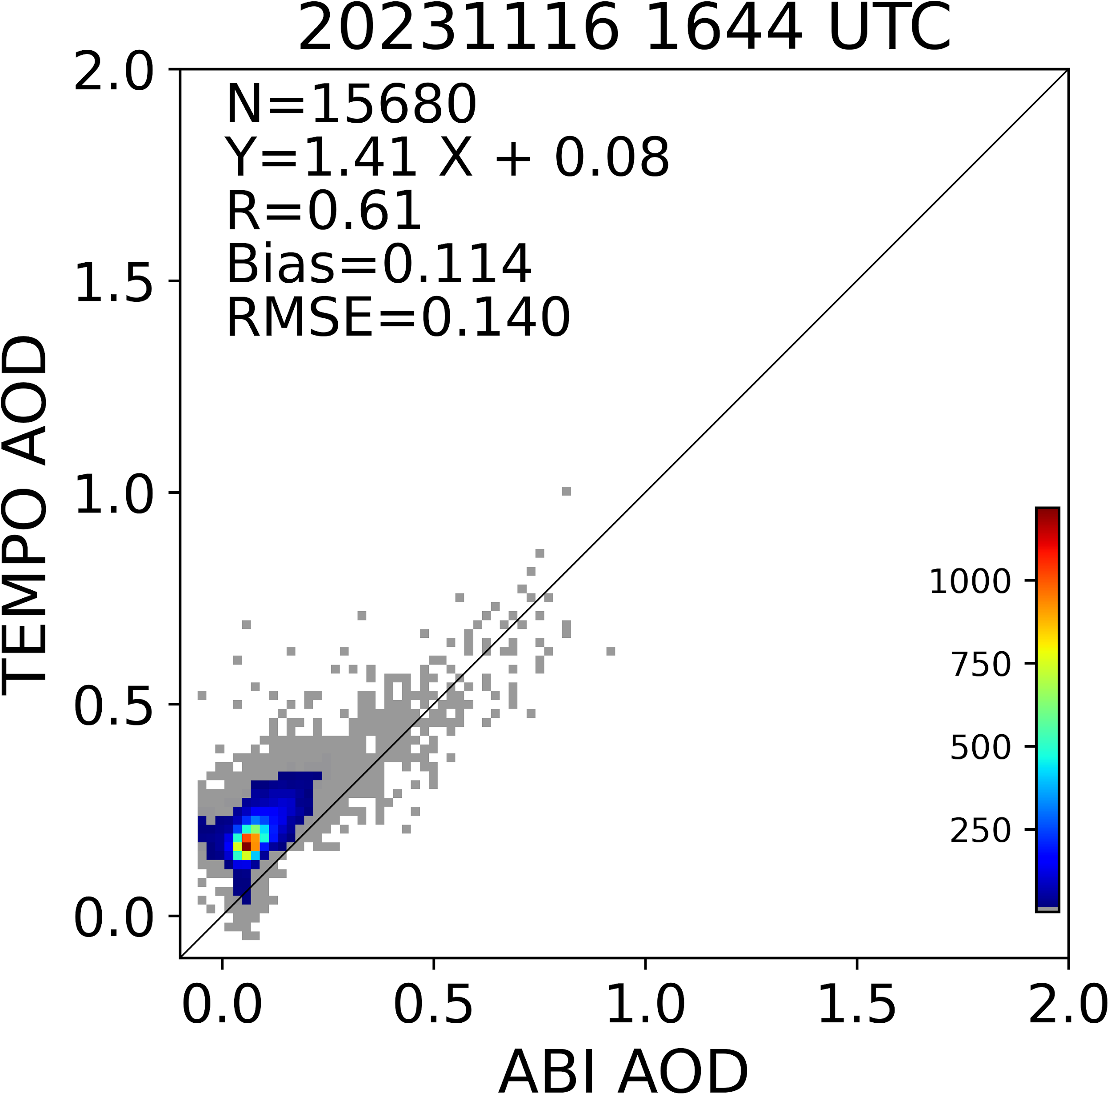
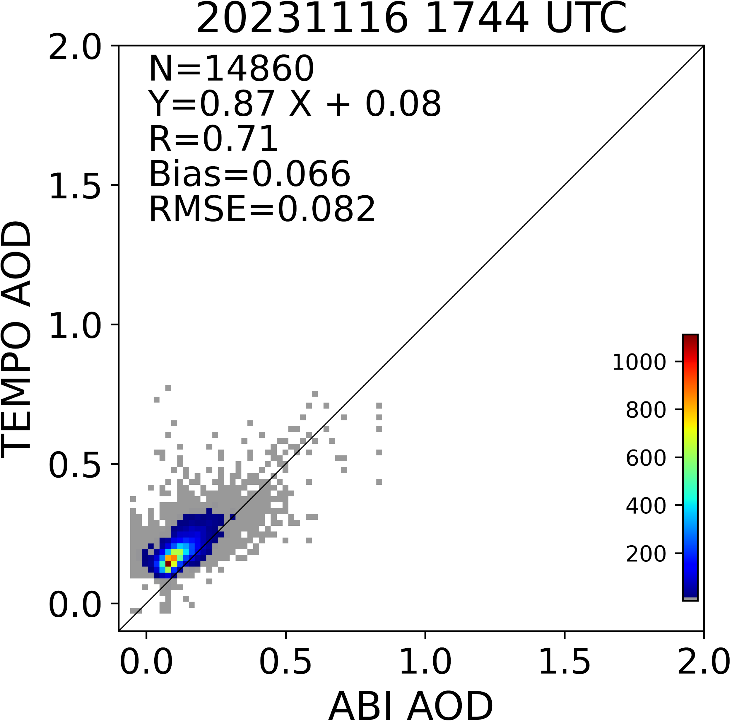
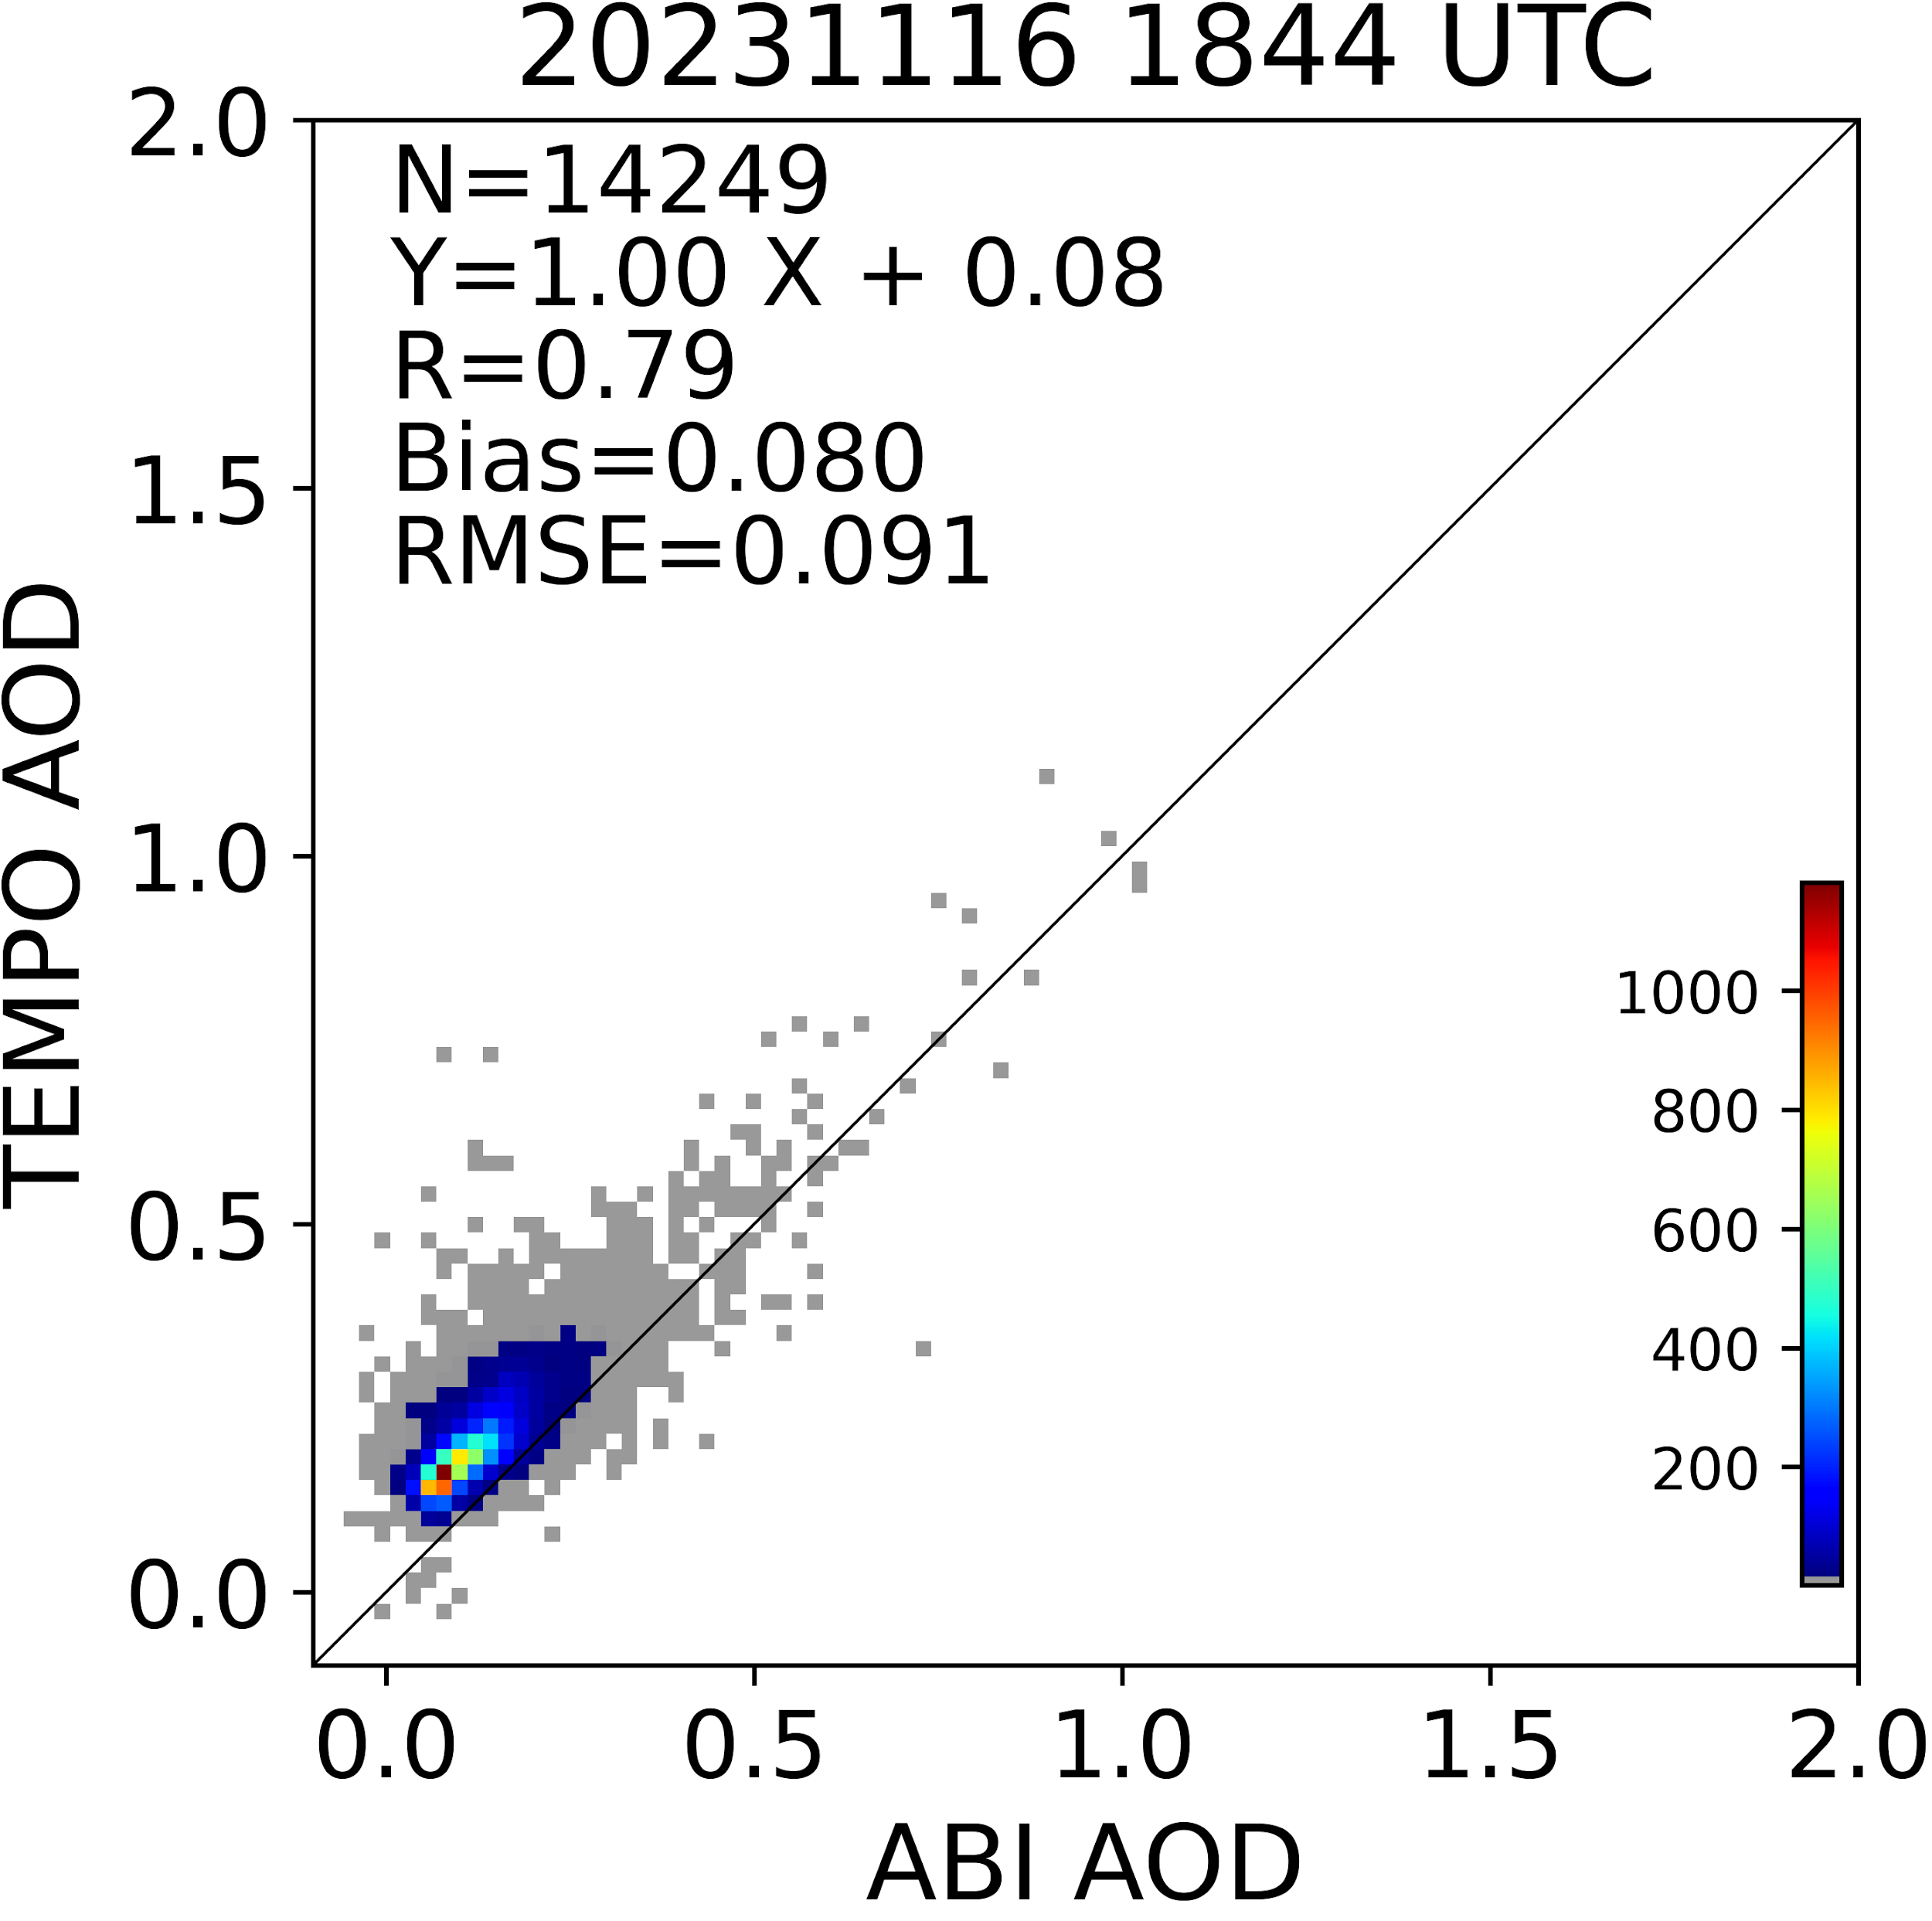

TEMPO AOD vs ABI AOD in the VA fire region
Credits: NOAA GeoXO Team, Pubu, Hai, Zigang and Shobha

Slide 28

Introduction to TEMPO
NASA’s first Earth Venture Instrument (EVI) selected in 2012
PI: Kelly Chance, Smithsonian Astrophysical Observatory (SAO): Science team, ground systems, science data processing center
Instrument Project Management: NASA LaRC → SAO (Phase E)
Instrument Development: Ball Aerospace
Other Institutions: NASA GSFC, NOAA, EPA, NCAR, Harvard, UC Berkeley, St. Louis U, UAH, U Iowa, Sitting Bull College, RT Solutions, Carr Astronautics
International collaboration: Mexico, Canada, Cuba, Korea, U.K., ESA, Spain
NASA’s first host payload
  Mission Project Management: NASA LaRC
  Host Satellite Provider: Maxar Technologies
  Satellite Host: Intelsat (IS-40e)
  Launch: SpaceX
TEMPO: It’s about Time!

Slide 29


TEMPO Operation
  Operate on geostationary communications satellite Intelsat 40e (IS-40e) at 91 ∘ W
Nominal: Scan Field of Regard (FOR) in 1 hour
  ~ 2K N/S pixels $×$ ~1200 steps/hr
  2 $×$ 4.75 km² @center of FOR
Optimized scan: in the early morning and late afternoon, daylight portion, higher temporal resolution (~40 mins)
Special Observations (up to 25%):
  High-time scan: selected portion at higher temporal res. (e.g., <= 10 mins)
  Oversample to effectively increase spatial resolution
  Change FOR
  No Special observations before April release
Field of regard is optimized to cover both Puerto Rico and Canadian tar sands.
S5p-TROPOMI NO₂ product oversampled by Kang Sun.
Request special observation
→https://weather.ndc.nasa.gov/tempo/green_paper.html

Slide 30
TEMPO Software/Algorithm Teams
Operational Algorithm | Personnel
Instrument Operation Center (IOC) including Raw-L0 | John Davis
L0-1b | Heesung Chong, John Houck, Weizhen Hou, Xiong Liu, Dave Flittner, Jim Carr
Ozone profile | Junsung Park, Xiong Liu
Total ozone | GSFC / Junsung Park + Xiong Liu
Nitrogen dioxide | Caroline Nowlan, Gonzalo González Abad
Formaldehyde | Gonzalo González Abad, Caroline Nowlan
Clouds | Huiqun (Helen) Wang, Eun-Su Yang, Alexander Vasilkov, Joanna Joiner
Science Data Processing Center Operational Implementation & Processing Pipeline | John Houck

Slide 31
Science Algorithms
Launch-ready Science Data Processing Center (SDPC) V4 software completed in Mar 2023
Algorithm mostly based on OMI heritage algorithms except for new L0-1b processor including Imaging Navigation and Registration (INR) using GOES-R by Carr Astronautics
SAO trace gas algorithm (HCHO, NO₂): spectral fitting to derive Slant Column Densities (SCDs), calculate air mass factor (AMFs) and derive Vertical Column Densities (VCDs)
  NO₂ requires stratospheric/tropospheric separation based on spatial filtering method (Geddes et al., 2018)
Cloud algorithm: SAO O₂-O₂ fitting + NASA GSFC’s O₂-O₂ cloud at ~477/466 nm
Total ozone algorithm: heritage TOMS V8.5, using ozone absorbing and non ozone absorbing pairs to derive total ozone column
Ozone profile algorithm: heritage SAO OMI O₃ profile, using 290-340, 540-650 nm, retrieve O₃ profile at 24 layers, including total, stratospheric, tropospheric, and 0-2 km O₃
Main L1-2 algorithms updates include:
  NASA GMAO’s GEOS-CF trace gas profiles and meteorology
  Hourly resolved monthly mean Geometry-dependent Lambertian Equivalent Reflectivity (GLER) climatology

Slide 32

First Light NO₂ (2 August 2023)
Credit: NASA Scientific Visualization Studio
Notes:
Caroline
- First mention these are from first-light. Got a lot of media attention.
I will talk about first light and describe the sources of NO2 as I go along on this slide: transportation, fires, lightning, soils
Mention how we can’t measure below clouds
Will point out these data are novel because we can measure every hour

Slide 33
Including Visible to Improve
Tropospheric Ozone Retrieval Sensitivity
This example is for solar zenith angle =25, viewing zenith angle 45, relative azimuthal angle 86, Signal to noise Ratio (SNR) with 4 pixels coadded
Add visible to improve retrieval sensitivity in the lower troposphere and help separate free tropospheric O₃ from boundary layer O₃
Under ideal conditions: 3-5 total Degree of Freedom for Signal (DFS) with up to ~1.5 in the troposphere, and up to ~0.5 DFS in 0-2 km
Adapted from OMI (Liu et al., 2010): Spectral fitting + VLIDORT + Optimal Estimation (OE) from Fitting windows: 293-345 nm, 540-650 nm
Retrieve partial O₃ columns at ~24 layers (bottom layer is 0-2 km above the surface) as well as total, stratospheric, and tropospheric O₃ columns, other trace gases, and auxiliary parameters.
A priori: a combination of tropopause-based climatology (Bak et al., 2013) with diurnally-resolved GEOS-CF data

Slide 34

TEMPO Observation of Solar Eclipse
[Credit: Heesung Chong]

