Slide 1
Machine Learning for Dynamic Test Sensor Placement
Kelsey Buckles EV31
Eric C. Stewart, Ph.D. EV31

Slide 2
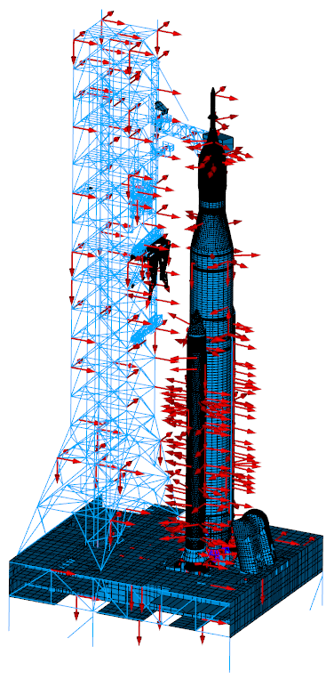
Introduction
Measurements typically at discrete points during structural tests
  Accelerometers and strain gages
  Limited by keep-out zones (KOZ) and Data Acquisition Unit (DAU)
  Other options include laser vibrometer or fiber optic strain sensor (FOSS)
Sensor locations are typically defined using an algorithm like effective independence, residual kinetic energy, or genetic algorithms
  For large structures, these algorithms can be computationally expensive to setup and implement
The goal of this work is to use machine learning to place sensors on a variety of structures as a proof of concept
This is an extension of work that was presented at SciTech 2024
  Kelmar, T. and Chierichetti, M. Machine Learning Based Sensor Selection for Modal Testing

Slide 3
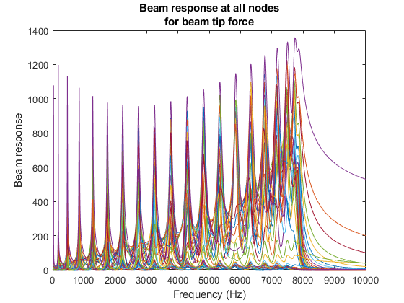
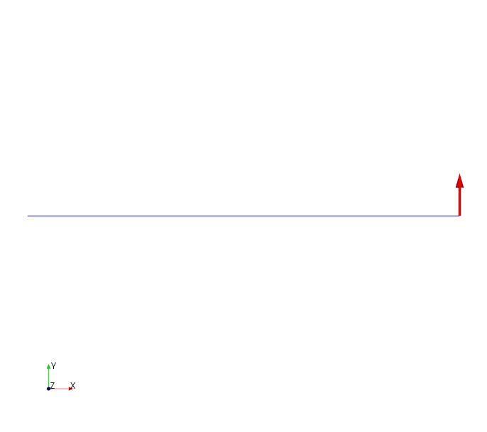
Training Data
To provide the machine learning tool with enough data to train the model, we are supplying it with FRFs
  At each frequency sampled in the FRF, we calculate the response metric: ODS’*ODS
  We train the ML codes to fit a regression that predicts one of our two metrics based on the values within the ODS. This is called the 'Global Parameter'
    We might extend the algorithm to predict both metrics in the future
  Couple of potential pitfalls:
    The high frequency modes are artificially weighted
    Generates a TON of data
    Does not necessary target small values on the off-diagonals
    Trains the model on modes and non-modes

Slide 4
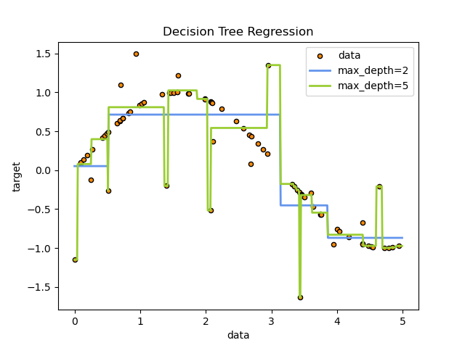
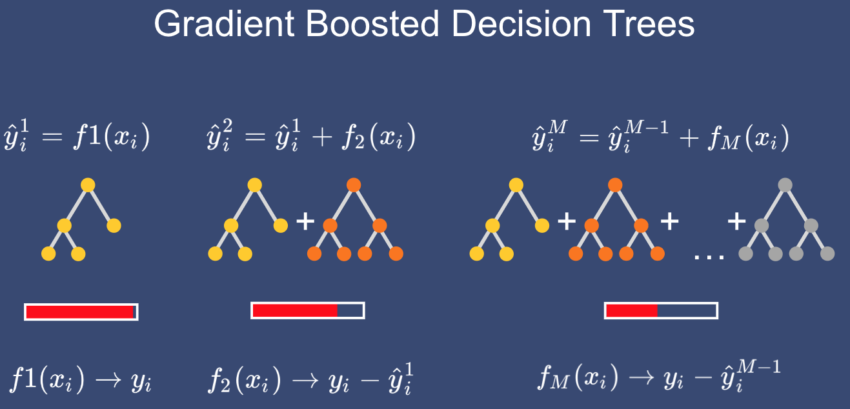
Model definitions
We use an AdaBoosted Decision Tree regressor to fit the relationship between the sensor readings and the global parameter
  Decision Tree Regressor: "Creates a model that predicts the value of a target variable by learning simple decision rules inferred from the data features."--Scikit-Learn Decision Tree documentation
  AdaBoost: Shorthand for Adaptive Boosting, AdaBoost is an ensemble method that incrementally builds a model by training each new data sample to emphasize the training data previously mis-modeled.-- Friedman, J. H. (1999). Stochastic gradient boosting. Stanford University.
From: https://scikit-learn.org/stable/auto_examples/tree/plot_tree_regression.html
From: https://talperetz.github.io/Tal-Peretz/mastering_the_new_generation_of_gradient_boosting/mastering_the_new_generation_of_gradient_boosting.html

Slide 5
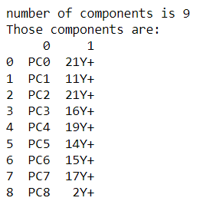
Machine Learning Algorithm
Choose number of sensors allowed
  In our test case we run the algorithm in a loop to predict on a range of allowable sensors
  For the sake of explanation, let's say we can have 9
Use Principal Component Analysis (PCA) to determine which 9 sensor locations have the most variance, ie are most relevant to calculating the global parameter
List the principal components for the user, and create a new matrix with only the 9 sensor locations the and global parameter

Slide 6
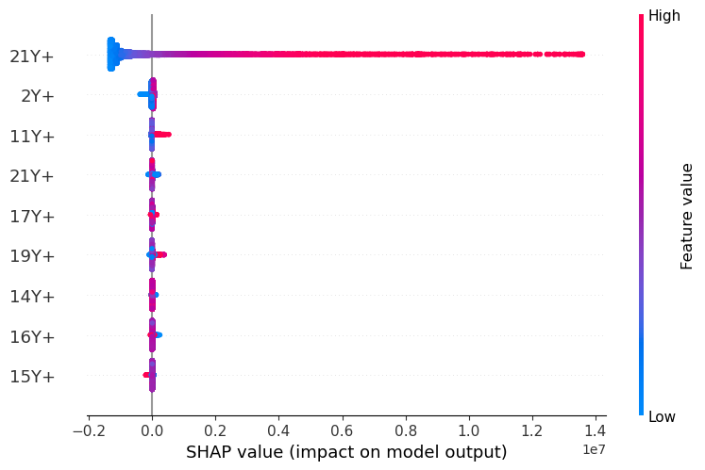

Machine Learning Algorithm
Randomly split the matrix into 80% training, 20% testing
Fit a model to predict the global parameter (using an Ada Boosted Decision Tree Regressor)
Use SHAP (SHapley Additive exPlanations) to explain each sensor's contribution to the estimation of the global parameter—lets us see under the hood of the ML model
Calculate accuracy using a D2 regression score, and R2 score

Slide 7
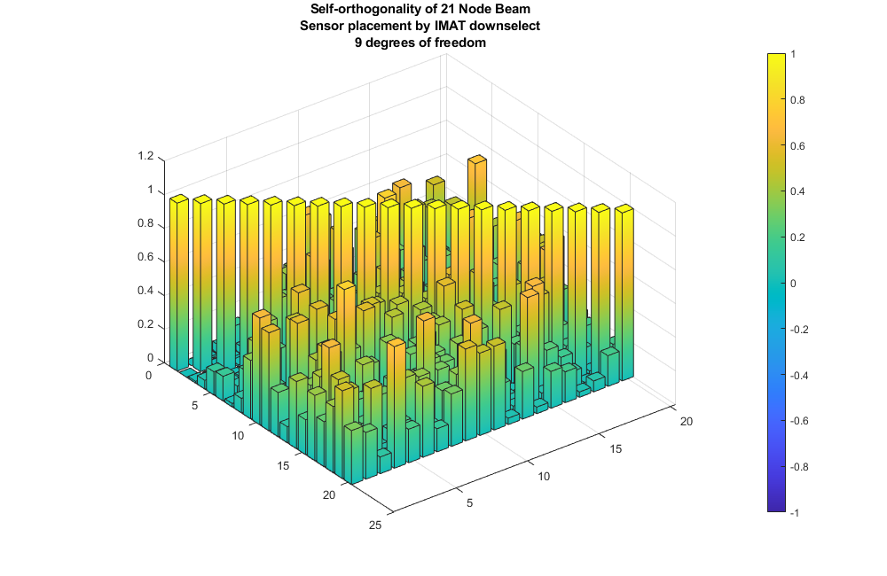
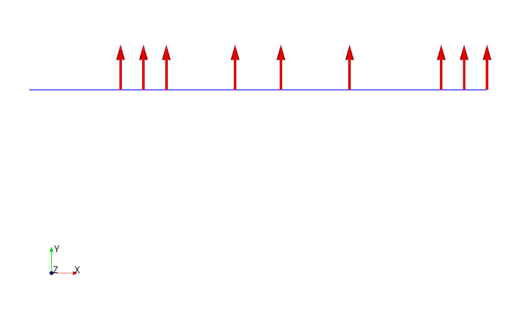
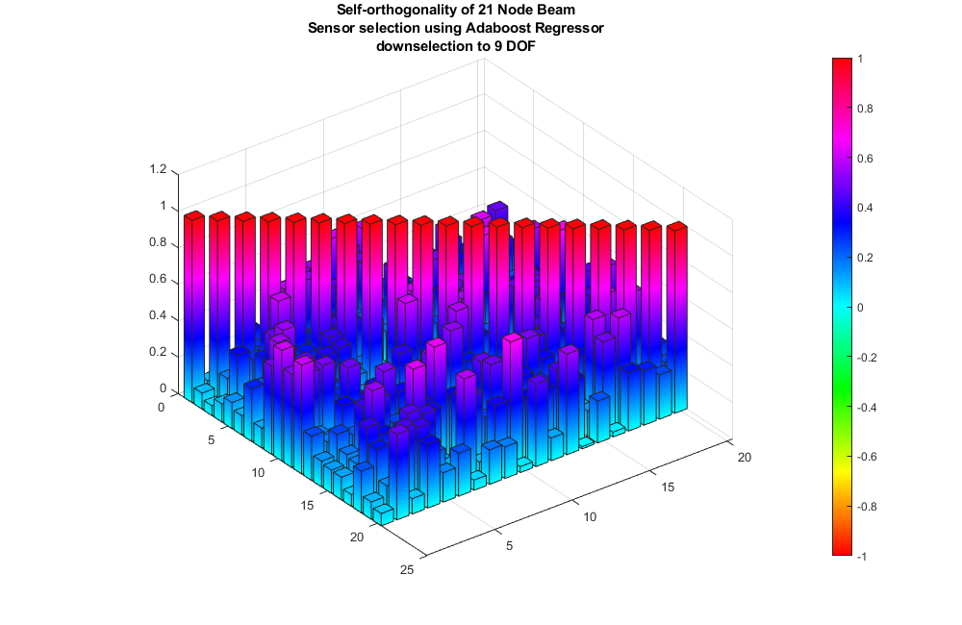
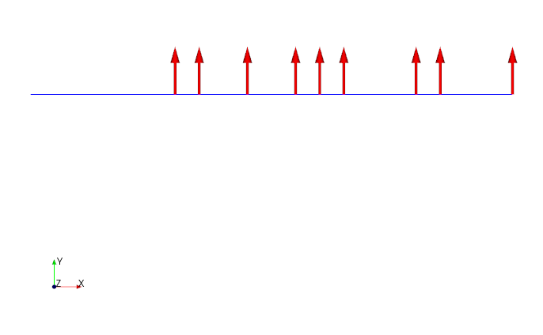
Example – Cantilever Beam
FRF calculated from tip-load of the cantilever beam
Downselect Algorithm
Machine Learning

Slide 8
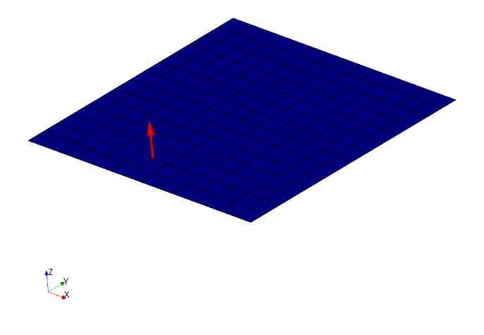
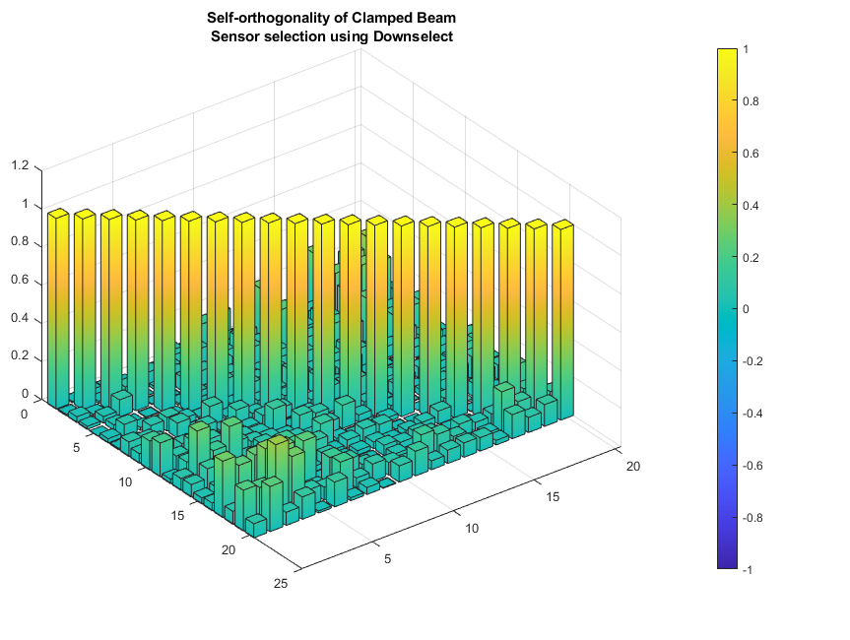
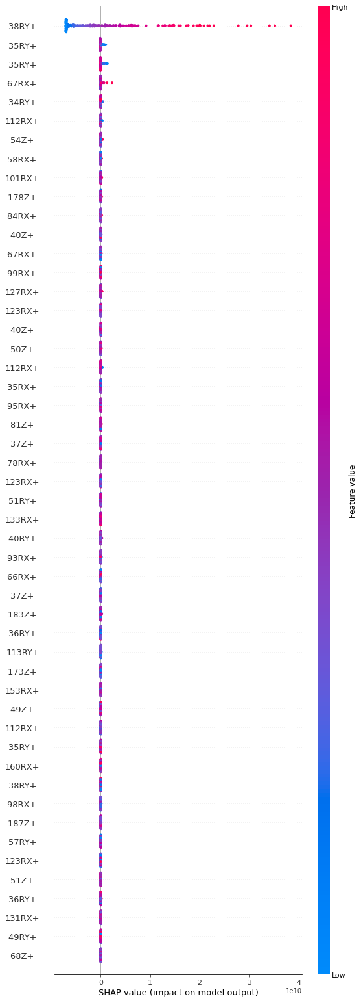
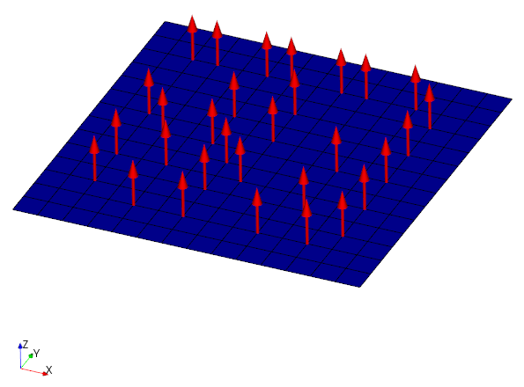
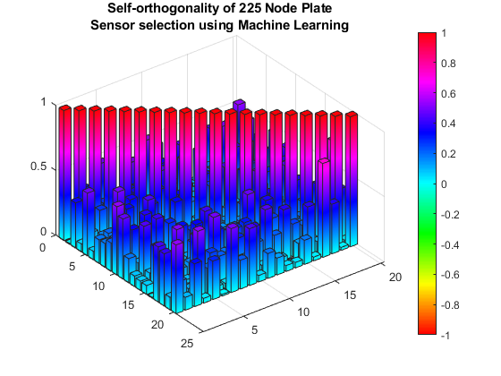
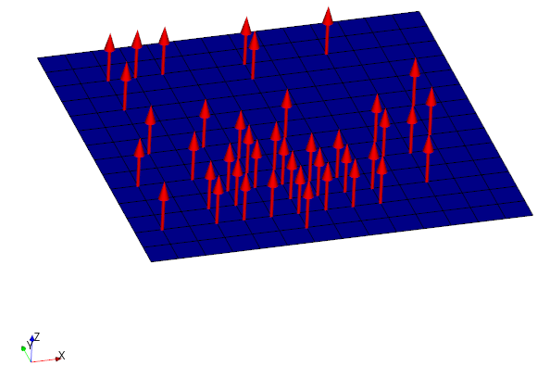
Example – Plate, 50 sensors
FRF calculated from a point loads applied near the edge of the plate, slightly off-center
The AdaBoosted Decision Tree Regressor selected nodal locations in a clump near the FRF point load
Downselect
ML
Notes:
Going to put SHAP plot with features listed as sensor locations here

Slide 9
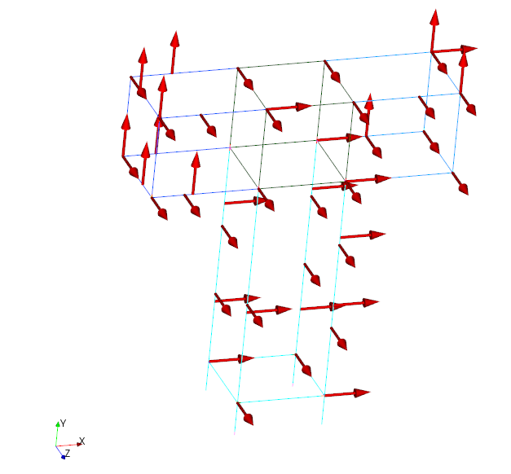
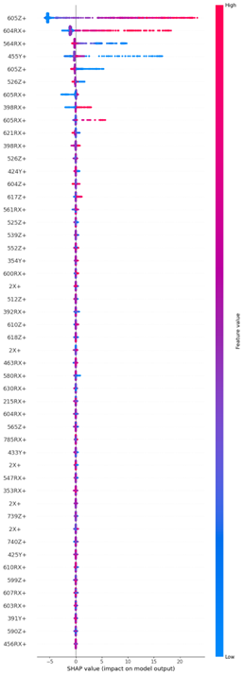
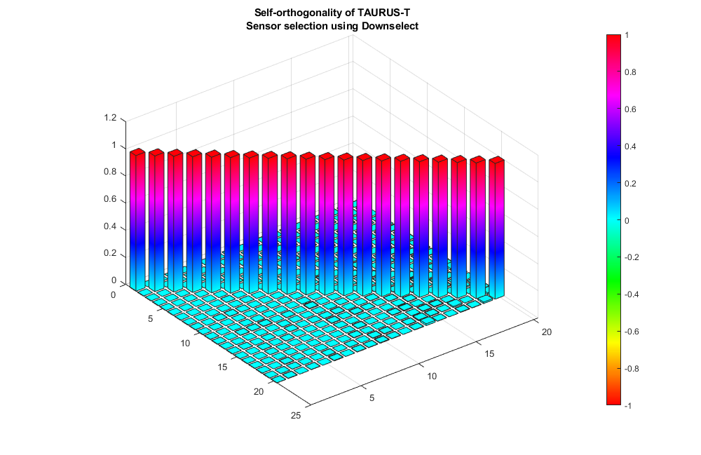
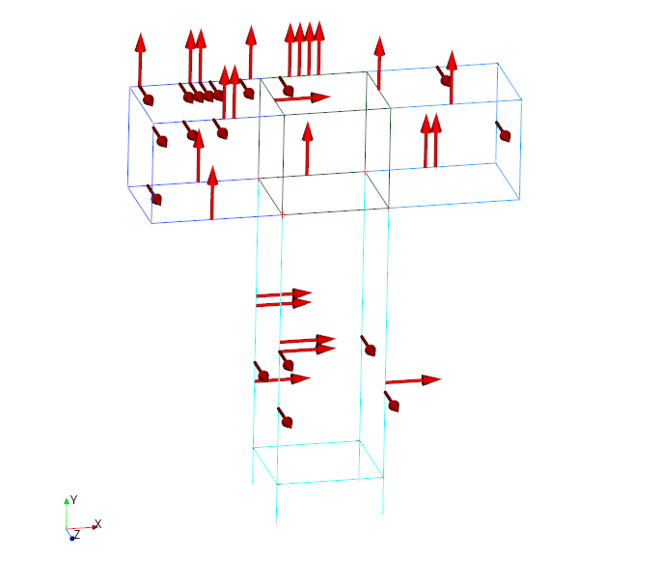
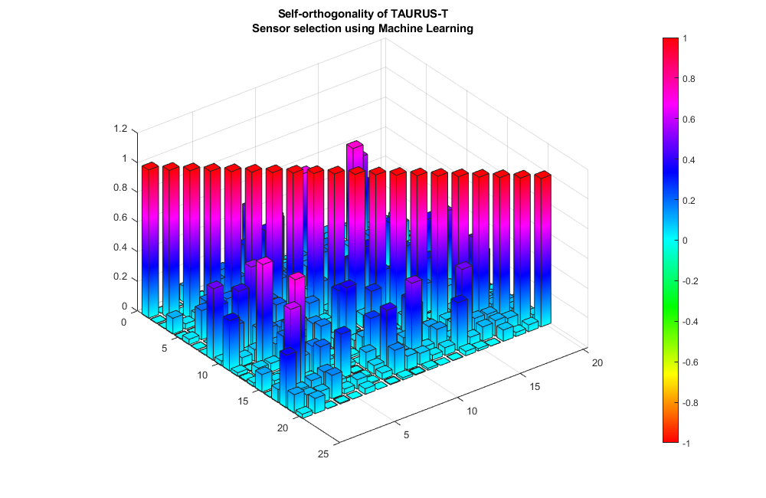
TAURUS structure
FRF calculated from a point load applied at the top of the T in all three translational DOFs
We see AdaBoost clumping of sensors near FRF point
Downselect
ML

Slide 10
Conclusions/Future work
Machine learning shows initial promise as a way of generating modal sensor set
ML method tends to have high off-diagonal values
ML method places sensors near the FRF input location
FRF data, by itself, is not sufficient to generate as a training data set
ML method accuracy does not seem to be affected by variations in geometry
Future work:
  Investigate PCA alternatives such as Singular Value Decomposition (SVD)
  Preprocess training data by splitting into subsets and generating a Decision Tree (DT) for each subset
  Dig deeper into SHAP results of this model
  Look into machine learning training data that de-emphasize the locations near the force input
  Investigate weighting the response at the modal frequencies
  Consider multi-input FRF data
  Test method on simple Space Launch System (SLS) model

