Slide 1
Inner Magnetospheric Physics
Dennis Gallagher, PhD
NASA Marshall Space Flight Center
dennis.gallagher@nasa.gov

Slide 2
Inner Magnetospheric Physics
Historical Background
Main regions and transport processes
  Ionosphere
  Plasmasphere
  Plasma sheet
  Ring current
  Radiation belt
Geomagnetic Activity
  Storms
  Substorm
Models
All audio files come from the University of Iowa (https://space-audio.org/) under a Creative Commons License (https://creativecommons.org/licenses/by/4.0/) where the narration has been removed from the AKR audio file.
Outline

Slide 3
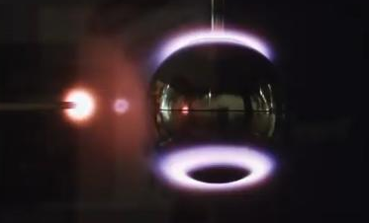
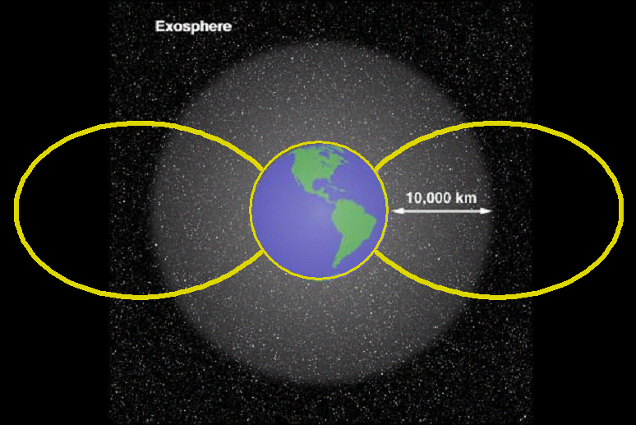
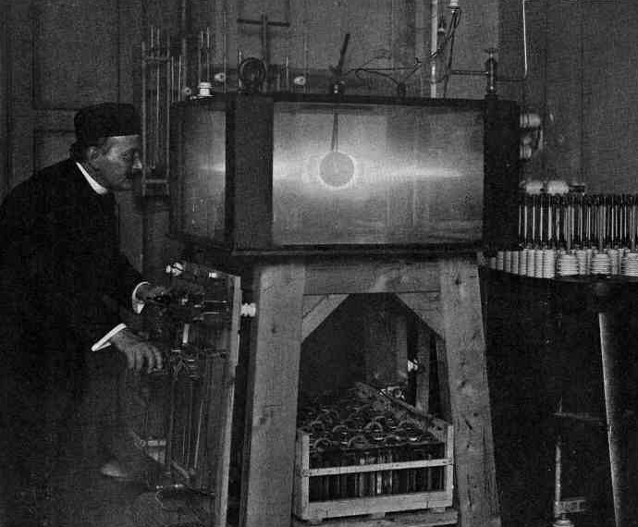
Historical Background: Space in 1950
Wikipedia
Heavyside layer
Kristian Birkeland 1895
Shell of Solar Electrons
Wikipedia
Historical Background

Slide 4
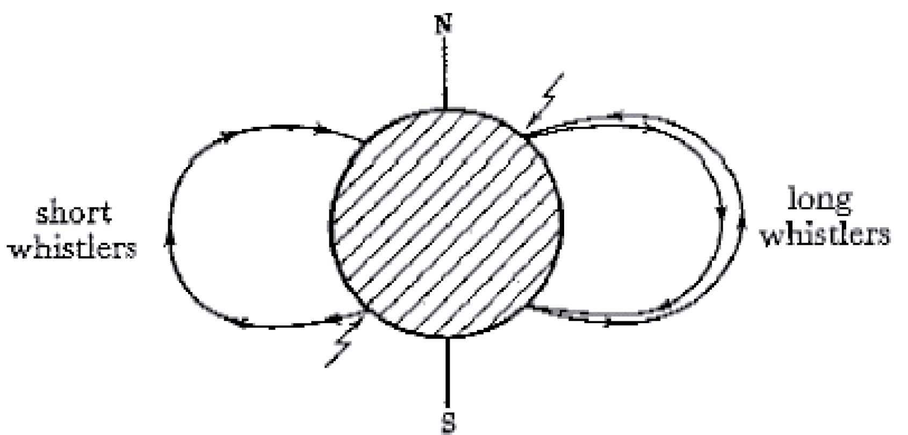

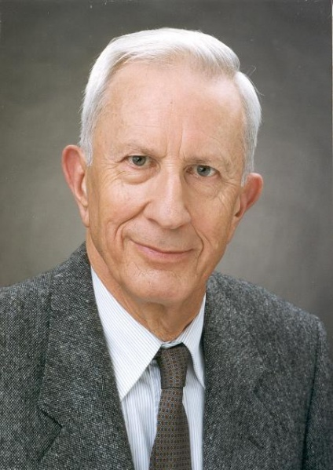
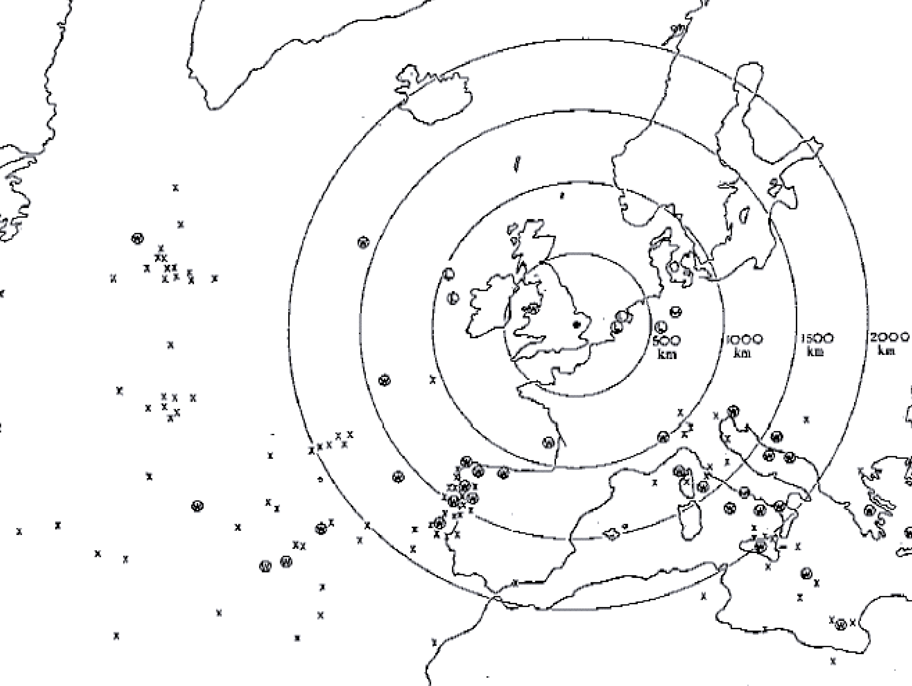
Historical Background
Whistlers revealed unexpected plasma
Whistlers
1952
L. R. Owen Storey
Cavendish Laboratory
University of Cambridge
Historical Background
L. R. O. Storey, Phil. Trans. R. Soc. Lond. A 1953 246 113-141; DOI: 10.1098/rsta.1953.0011. Published 9 July 1953

Slide 5
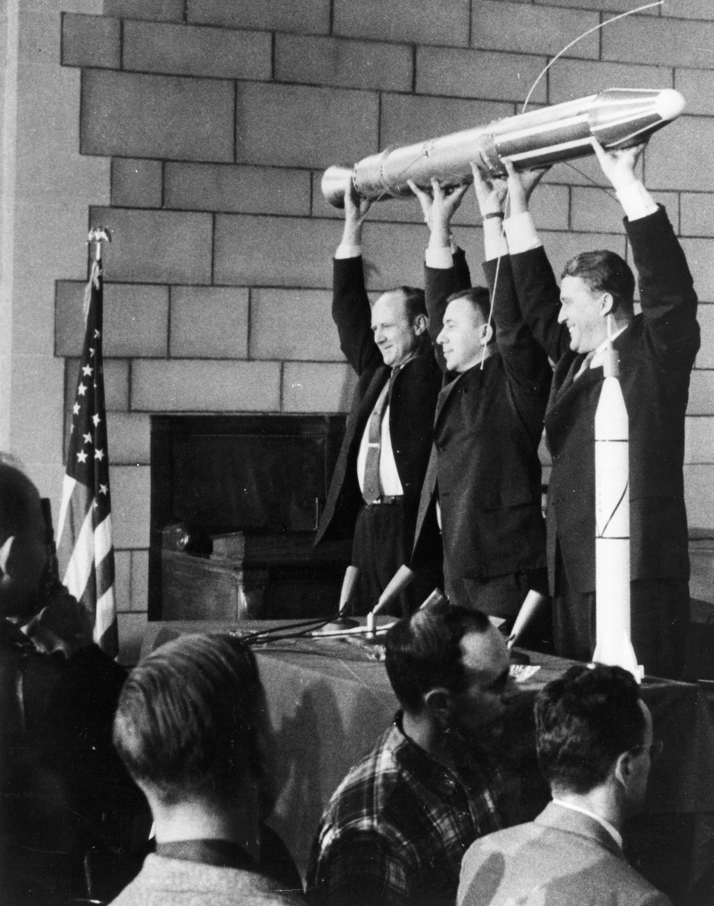
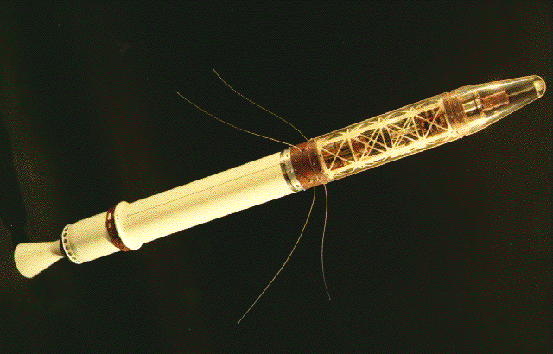
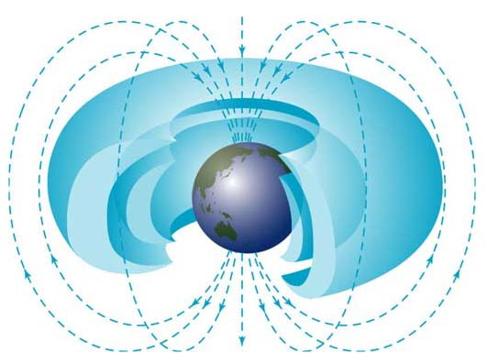
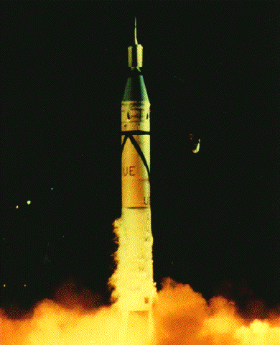
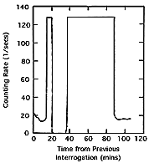
Historical Background
Explorer 1
January 31, 1958
William Pickering
James van Allen
Van Allen
von Braun
Wernher von Braun
Van Allen, James A., Observation of high intensity radiation by satellites 1958 alpha and 1
958 gamma, IOWA Univ. preprint SUI 60-13, reprinted in p. 58-75, Space Science Comes of
Age, P.A. Hanle and V.D. Chamberlain, editors, Smithsonian Inst. Press, Washington, DC 1981
Radiation Belts Discovered

Slide 6
Ionosphere
Reactions
Common Constituents
X+ɣ X⁺+e⁻
XY+ɣ X+Y
X⁺+e⁻ X
X-rays, EUV, O, N, O_{2,} N₂, NO, H, O₃
X⁻+Y XY+e⁻
X⁺+YZ YX⁺+Z
X⁺+e⁻ X+ɣ
XY+e⁻ Y+X
X+e⁻ X⁻
Ionosphere: ionized portion of upper atmosphere
  Extends from around 60 km to beyond 1000 km
  Completely encircles the Earth
  Main Source: photoionization of neutrals
    Other production processes dominate in different ionospheric regions
  Loss Mechanism: ionospheric outflow, recombination
Main regions and transport processes

Slide 7
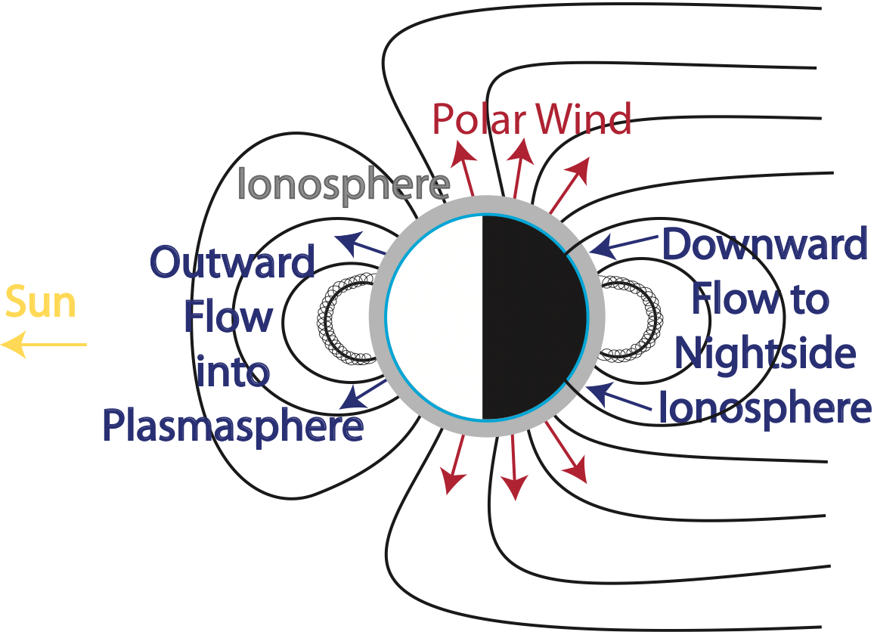
Ionosphere outflow
Main cause
  Ambipolar electric field
  pressure gradients
  Mirror force due to gyration of charged particles
Polar wind: Ionospheric loss at polar latitude
  Along essentially open geomagnetic field lines
At mid-latitudes the plasma may bounce to the conjugate ionosphere or become the plasmasphere
Sun
Main regions and transport processes

Slide 8
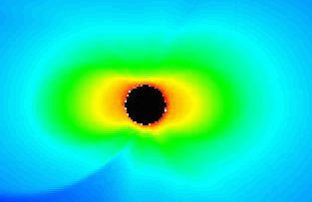

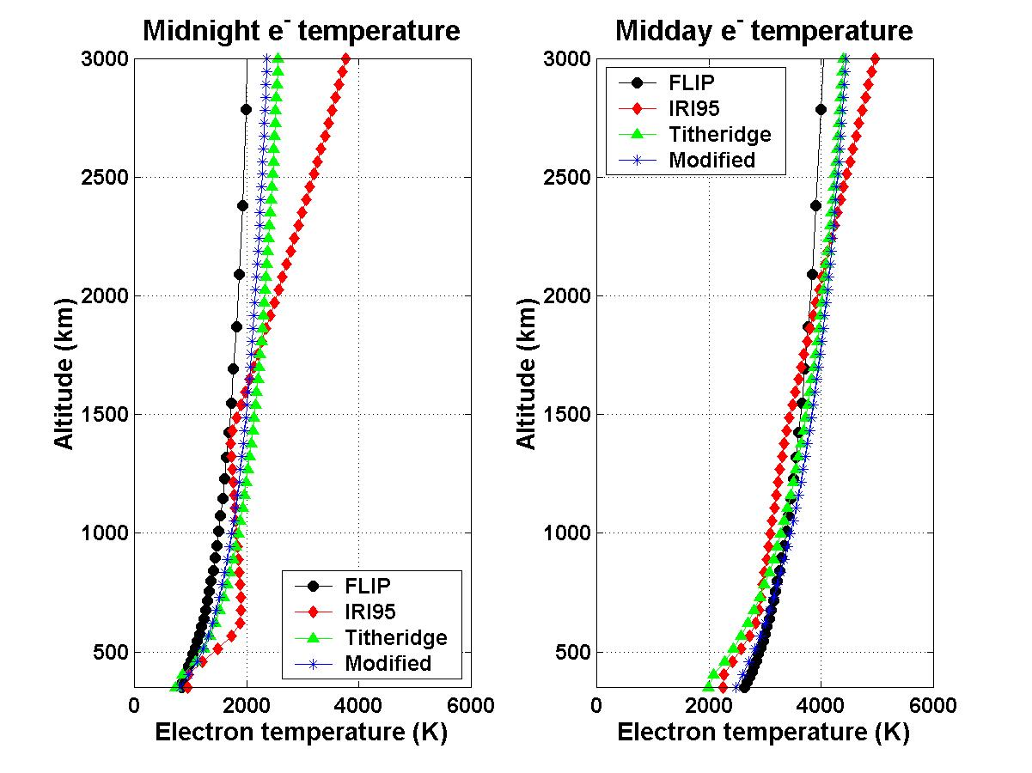
Plasmasphere Formation:
Diffusive Equilibrium
Global Core Plasma Model
H_{j} = scale height
k = Boltzmann constant
m_{j} = j’th ion mass
g = gravitational constant
m_{a} = mean ion mass
T_{e} = electron temperature
T_{t} = T_{i} + T_{e} total temperature
Titheridge, J.E., Planetary and Space Science, 20 (1972), pp. 353-369
Webb, P.A. and E.A. Essex, 2001, J. Atmos. Solar Terres. Phys., 63, 11, pgs 1249-1260, doi:10.1016/S1364-6826(00)00226-1
Main regions and transport processes

Slide 9
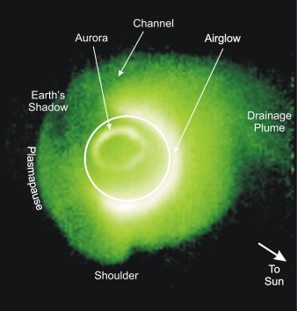
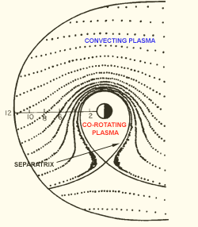
Plasmasphere
Cool (<10 eV)
High density (100s-1000s cm⁻³)
Co-rotating plasma
  Torus-shaped, extends to 4-8 R_{E}
  Plasmapause: essentially the boundary between co-rotating and convecting plasma
Main Source: the ionosphere
Loss Mechanism: plasmaspheric erosion and drainage plume
Main regions and transport processes

Slide 10
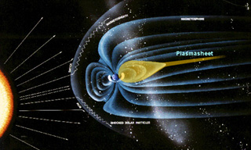
Plasma sheet
Plasma sheet: population of ionospheric and solar wind particles being accelerated Earthward
Neutral current sheet: large-scale current flow from dawn to dusk across the plasma sheet
  Separates the two regions of oppositely directed magnetic field in the magnetotail
  Accelerates particles towards Earth
Direct access to night side auroral oval
  Can fall into the atmosphere producing aurora
AKR
Main regions and transport processes

Slide 11
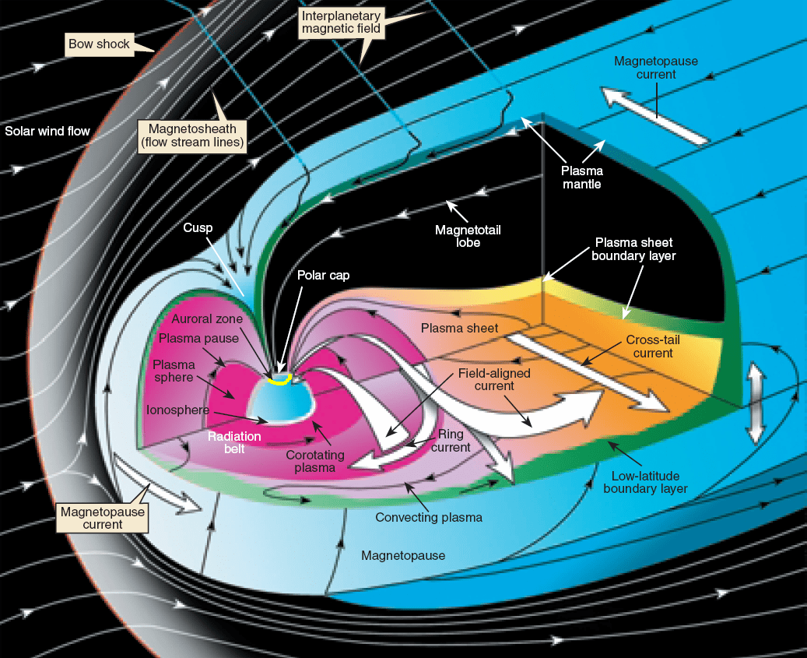
Credit: NASA

Slide 12











Solar wind dynamo
$$\vec{F_{Lorentz}}=q\vec{E}$$
$$\vec{E_{dyn}}=\vec{v_{sw}}⨯\vec{B_{z}}$$
Highly conducting plasma in the solar wind flows across polar geomagnetic field lines
  Induces an electric dynamo field
  Plasma and B-field lines are transported: Frozen-in flux concept
$$v_{sw}$$
$$v_{sw}$$
$$\vec{B}$$
$$\vec{B,}$$
Tail
Flank of Tail
$$\vec{j}$$
$$\vec{j_{B}}$$
$$\vec{j_{B}}$$
$$\vec{j}$$
Region 1
$$\vec{j_{P}}$$
Dusk
Dawn
Cross Tail Current
Main regions and transport processes

Slide 13
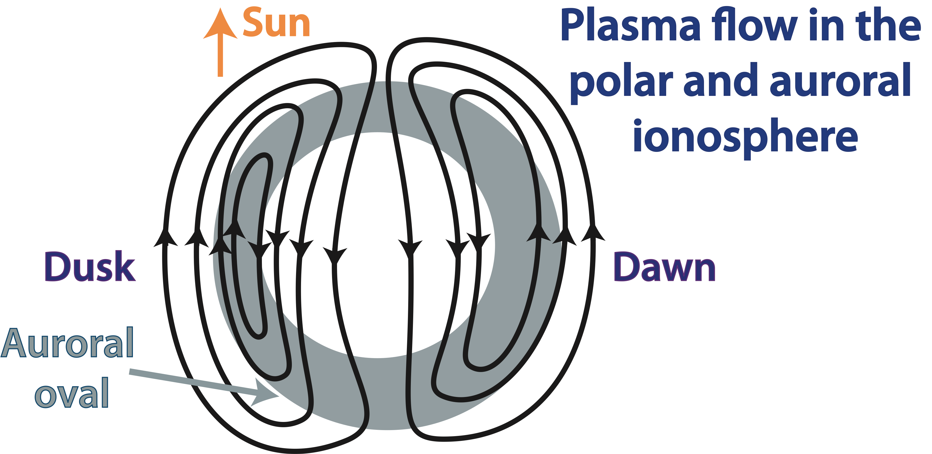
Global convection
In the Late 50s, ground-based measurements revealed the plasma flow pattern in the polar and auroral ionosphere
  Anti-sunward flow over the polar cap and
  Return flow equatorward of the auroral oval
In 1959 Gold introduced the term convection
  Resemblance to thermally driven flow cells
Main regions and transport processes

Slide 14
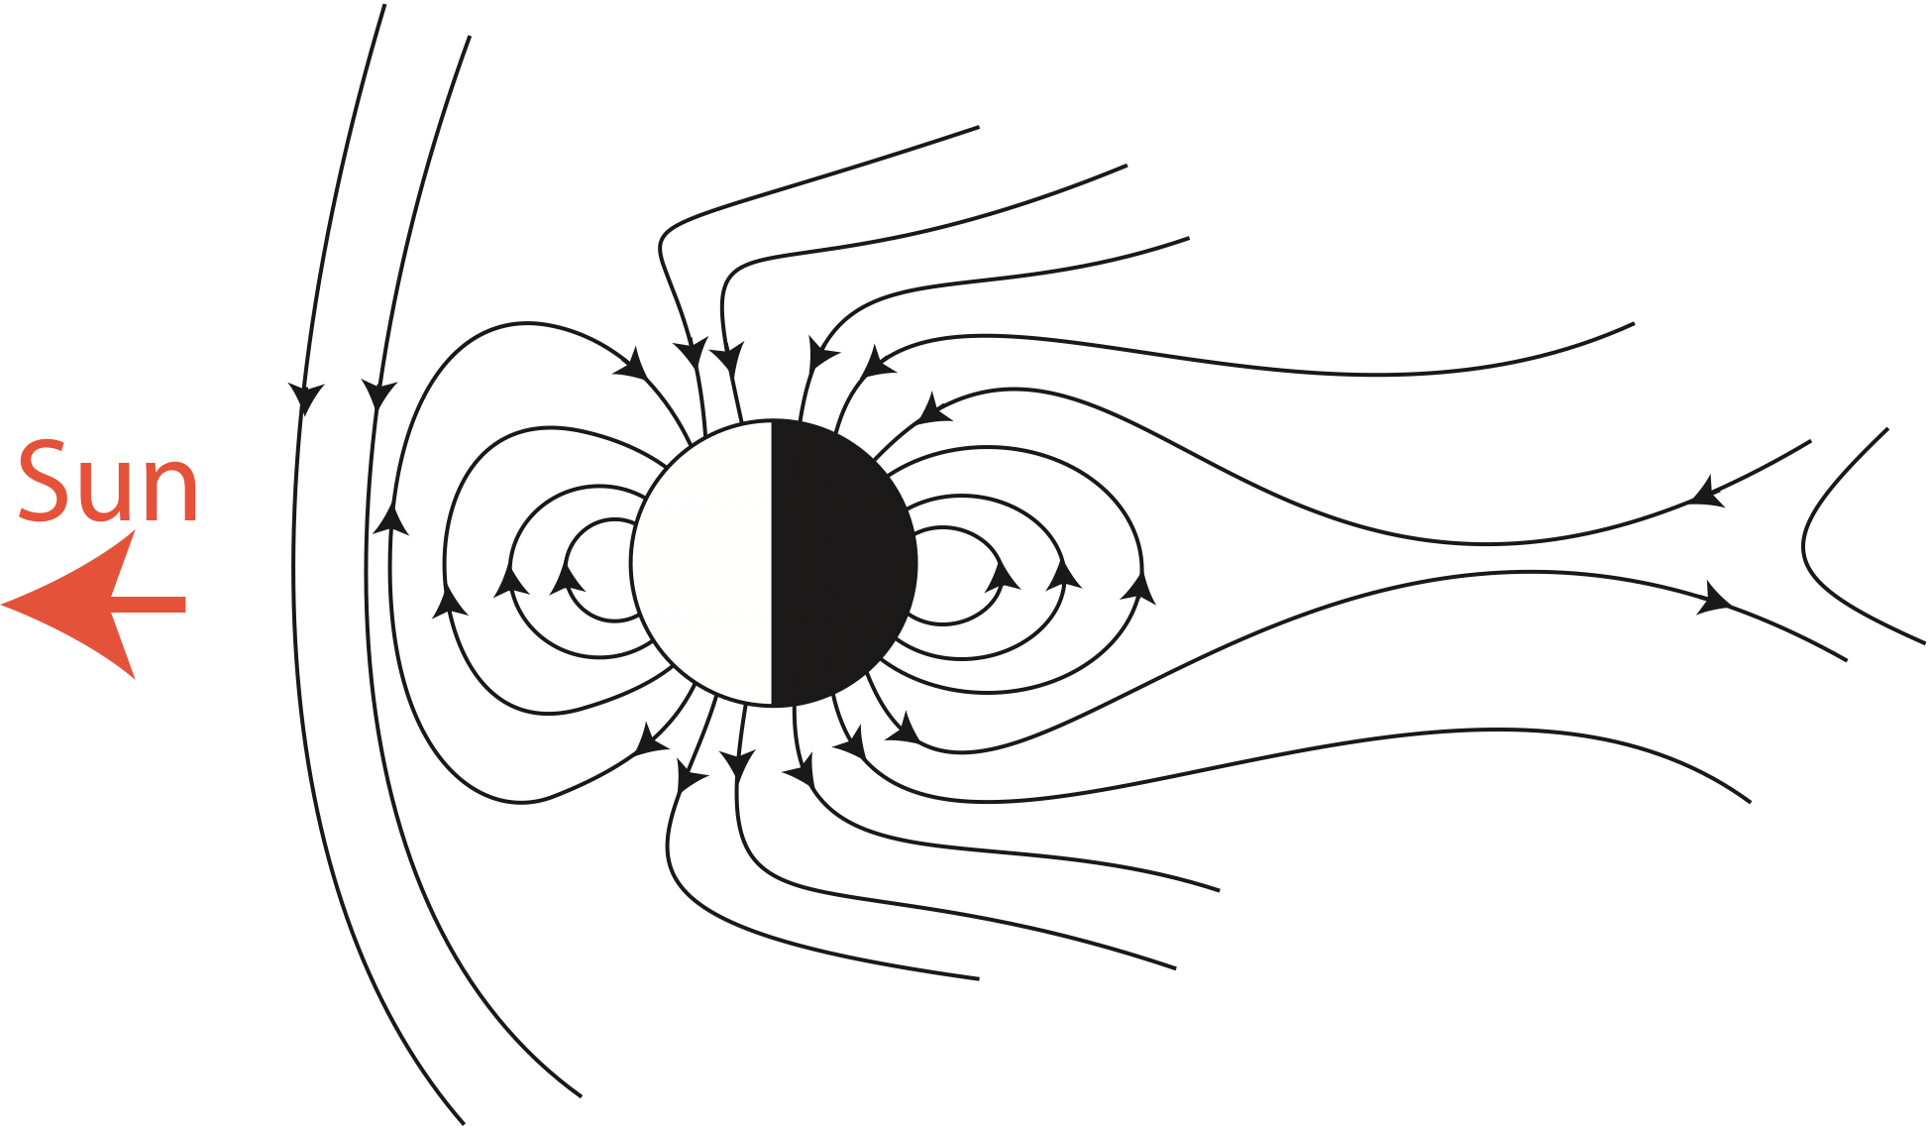
Reconnection
If the polar geomagnetic field lines are open
  The electric field produces an anti-sunward ExB drift of solar wind and magnetospheric plasma across the polar cap
  Reconnection occurs down tail
  Closed geomagnetic field lines flow back towards Earth at lower latitudes
Main regions and transport processes

Slide 15
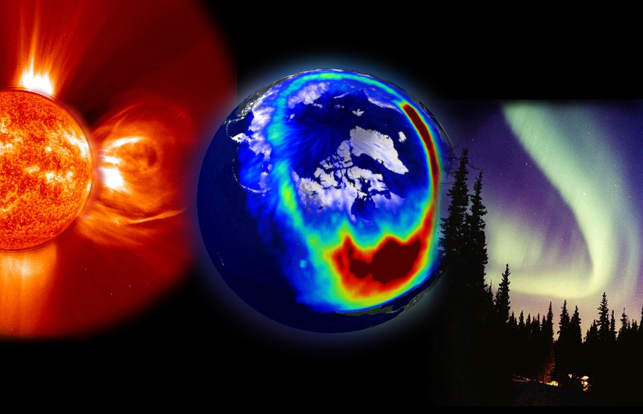
Substorms
Wikipedia
A relatively short (hours) period of increased energy input and dissipation into the inner magnetosphere
  Events may be isolated or occur during a storm
  Associated with a flip from northward to southward IMF Bz
Increased rate of reconnection
Increased flow in magnetospheric boundary layer
Release of energy accumulated in the near-Earth tail
Geomagnetic Activity

Slide 16
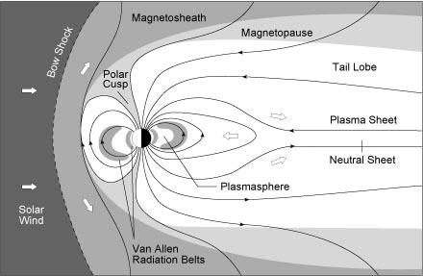
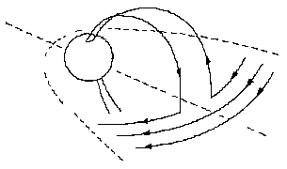
Substorms
Additional magnetic flux in the tail lobes causes the cross-tail current sheet thickness to decrease
  When the current sheet thickness reaches its threshold reconnection occurs
  The cross-tail current is disrupted
The substorm current wedge closes the cross-tail current through the ionosphere
Particle precipitation increases Auroral activity
Geomagnetic Activity

Slide 17
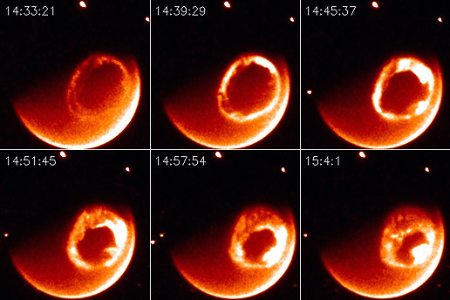
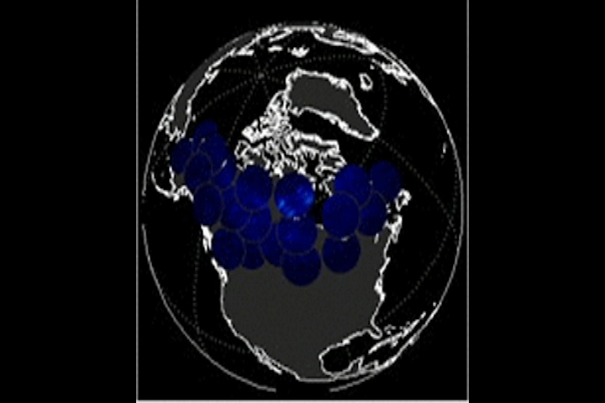
Substorms
Reconnection in the magnetotail initiates a depolarization event. Inward transport causes plasma to be energized and lost into the atmosphere. Drift fills the ring current. Wave-particle interactions scatter plasma into the atmosphere. The aurora fills the auroral oval.
ESA/NASA Cluster Mission
NASA IMAGE Mission
Geomagnetic Activity

Slide 18
Geomagnetic storms
Large (≥100s nT – reduced B-field on Earth’s surface due to ring current)
Prolonged (days)
Magnetospheric disturbances
  Caused by variations in the solar wind
  Related to extended periods of large southward interplanetary magnetic field (-IMF Bz)
    Increasing the rate of magnetic reconnection
    Enhancing global convection
Geomagnetic Activity

Slide 19
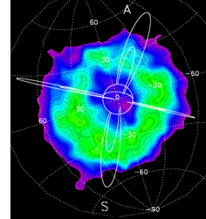
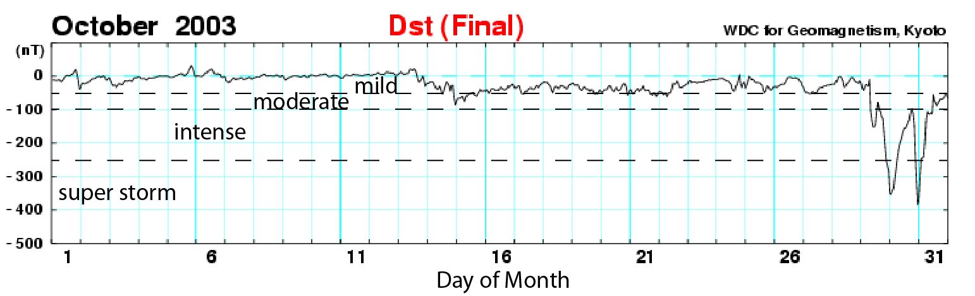
Geomagnetic storms
Halloween Storm of 2013
Enhanced convection
  Increased rate of injection into the ring current
    The ring current then expands earthward
    Induced current can reduce the horizontal component of the geomagnetic field (100s nT)
      Used to calculate Dst
Geomagnetic Activity

Slide 20
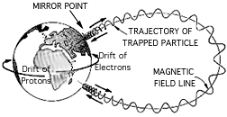
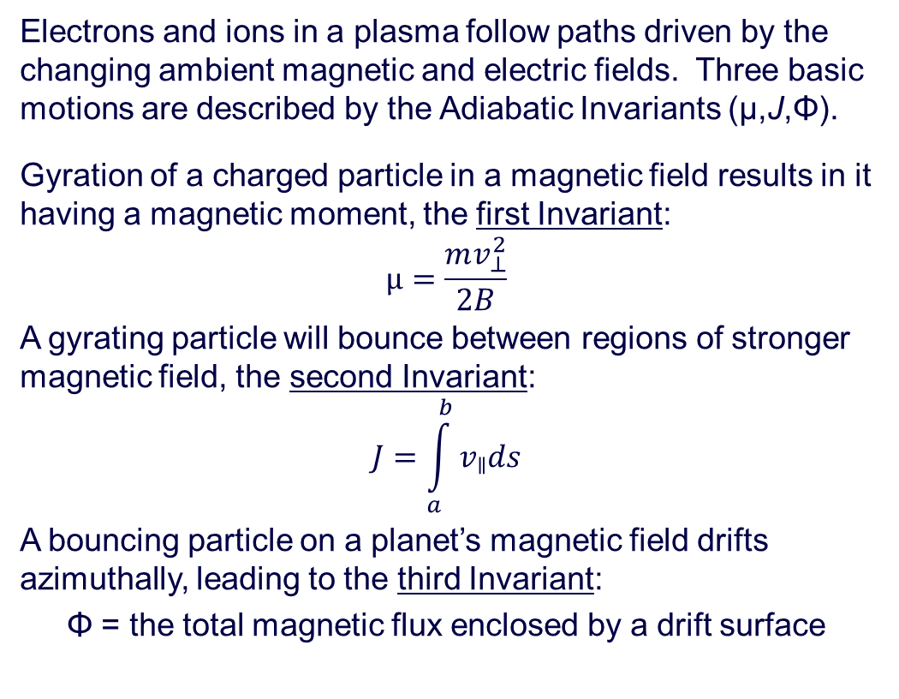
Adiabatic Invariants
Electrons and ions in a plasma follow paths driven by the changing ambient magnetic and electric fields. Three basic motions are described by the Adiabatic Invariants (μ,J,Φ).
Gyration of a charged particle in a magnetic field results in it having a magnetic moment, the first Invariant:
$$μ=\frac{mv_{⊥}^{2}}{2B}$$
A gyrating particle will bounce between regions of stronger magnetic field, the second Invariant:
$$J=\int_{a}^{b}{v_{ǁ}ds}$$
A bouncing particle on a planet’s magnetic field drifts azimuthally, leading to the third Invariant:
Φ = the total magnetic flux enclosed by a drift surface
Main regions and transport processes

Slide 21
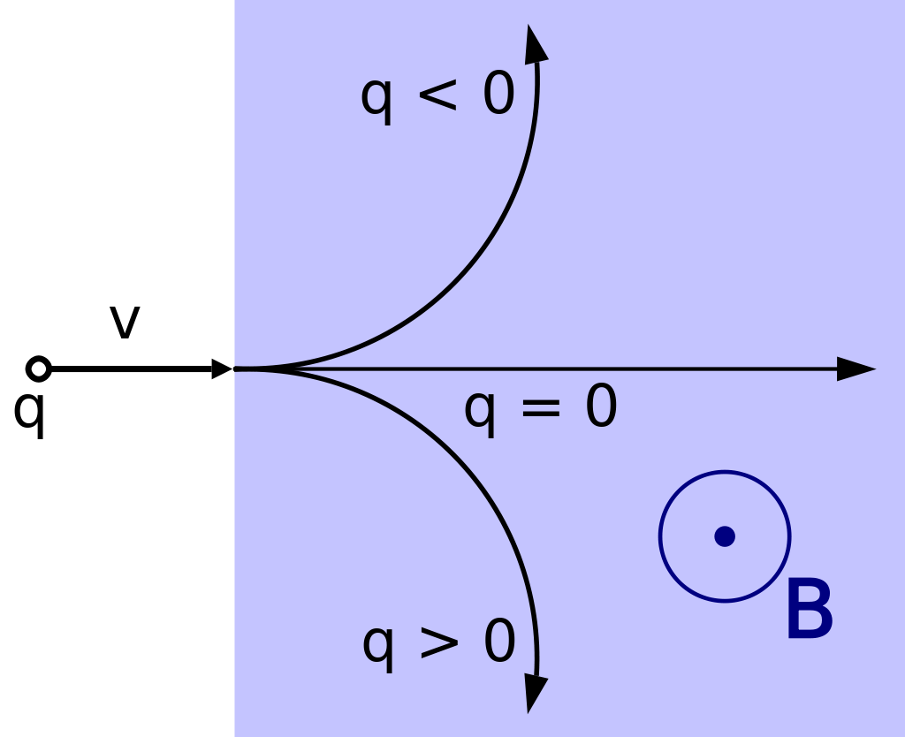
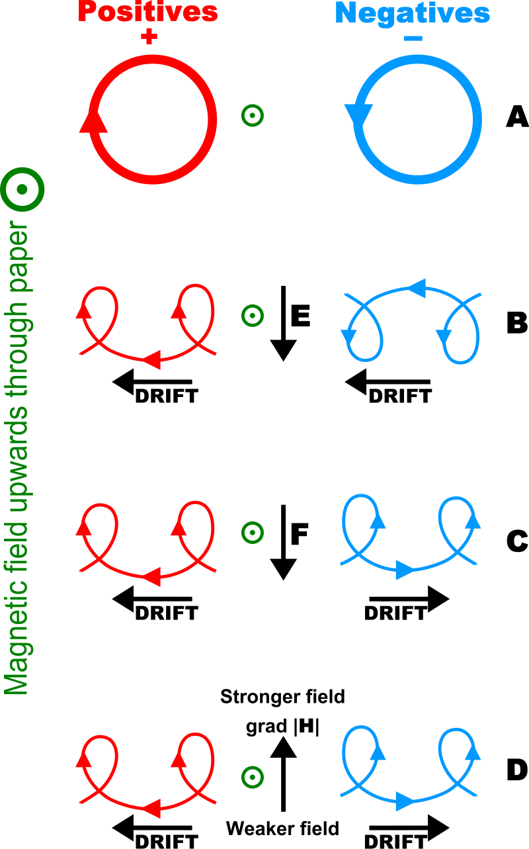

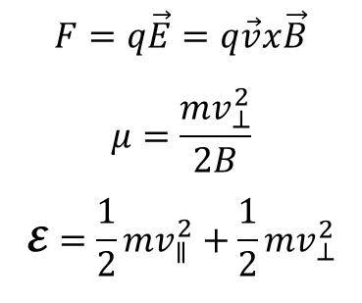
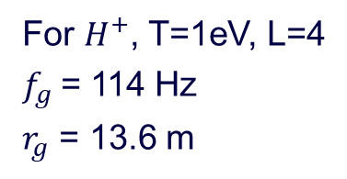

First Adiabatic Invariant
$$F=q\vec{E}=q\vec{v}x\vec{B}$$
$$μ=\frac{mv_{⊥}^{2}}{2B}$$
$$𝓔=\frac{1}{2}mv_{∥}^{2}+\frac{1}{2}mv_{⊥}^{2}$$
$$r_{g}=\frac{mv_{⊥}}{2B}$$
$$r_{g}$$
For $H^{+}$, T=1eV, L=4
$f_{g}$= 114 Hz
$r_{g}$ = 13.6 m
Main regions and transport processes

Slide 22
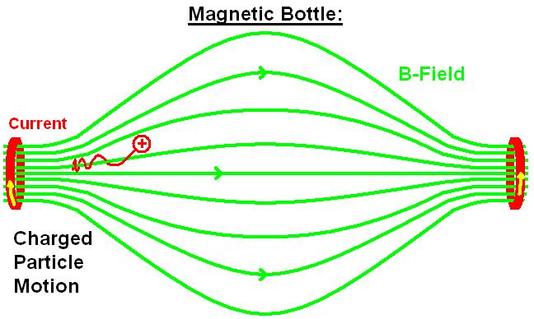
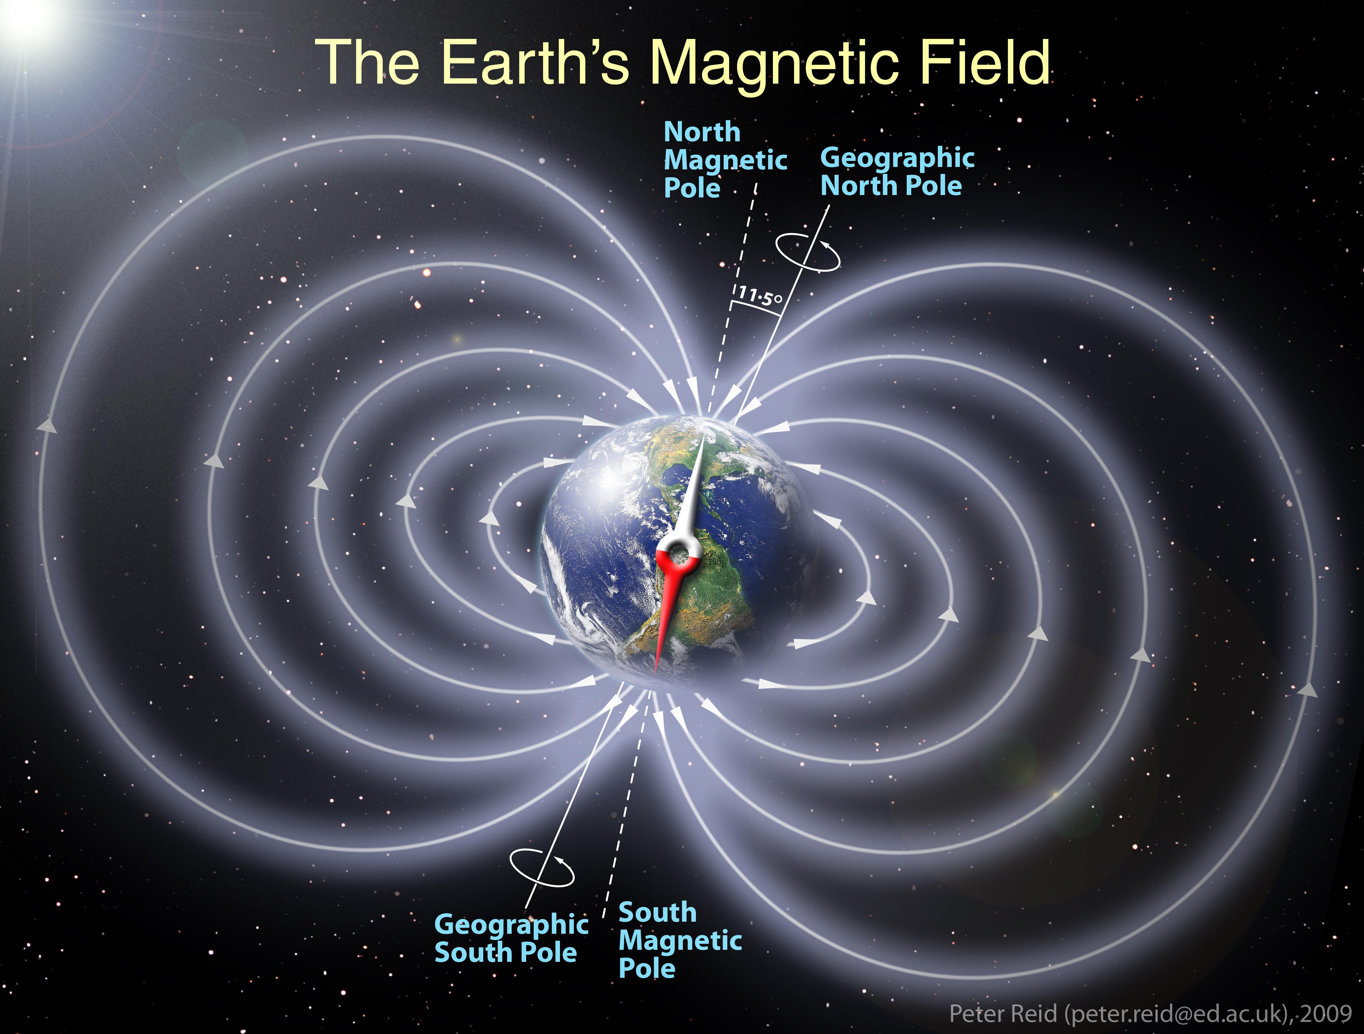
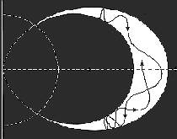
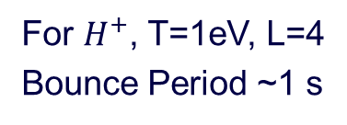
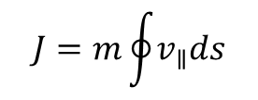
Second Adiabatic Invariant
$$J=m\oint{v_{∥}ds}$$
For $H^{+}$, T=1eV, L=4
Bounce Period ~1 s
Main regions and transport processes

Slide 23
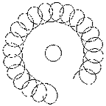
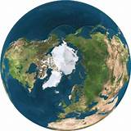
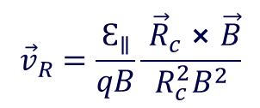
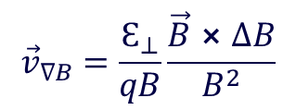




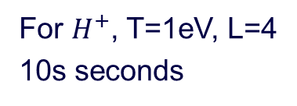

Third Adiabatic Invariant
Flux conservation inside the drift surface
$$Φ=πR^{2}B$$
Gradient-B Drift
$${\vec{v}}_{∇B}=\frac{Ԑ_{⊥}}{qB}\frac{\vec{B}⨯∆B}{B^{2}}$$
$$∆B$$
-
+
$$\vec{B}$$
For $H^{+}$, T=1eV, L=4
10s seconds
Curvature-B Drift
$${\vec{v}}_{R}=\frac{Ԑ_{∥}}{qB}\frac{ {\vec{R}}_{c}⨯\vec{B}}{{R_{c}^{2}B}^{2}}$$
$${\vec{R}}_{c}$$
-
+
$$\vec{B}$$
Main regions and transport processes

Slide 24
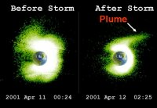
Plasmaspheric Plumes
Enhanced convection also causes the co-rotating plasmaspheric material to surge sunward
  Decreasing the night-side plasmapause radius
  Extending the dayside plasmapause radius
Creates a plume extending from ~12 to 18 MLT
For continued enhanced convection less material remains to feed the plume and it narrows in MLT
  Dusk edge remains almost stationary
  Western edge moves eastward
Geomagnetic Activity

Slide 25
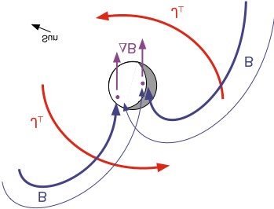
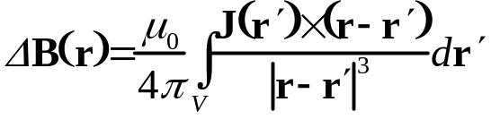

Ring Current
Hot (1-400 keV) tenuous (1-10s cm⁻³)
diamagnetic current produced by motion of plasma trapped in the inhomogeneous geomagnetic field
  Torus-shaped volume extending from ~3 to 8 R_{E}
  Main Source: plasma sheet particles
  Loss Mechanisms: charge exchange, coulomb collisions, atmospheric loss, pitch angle (PA) diffusion, and escape from magnetopause
Chorus
Main regions and transport processes

Slide 26
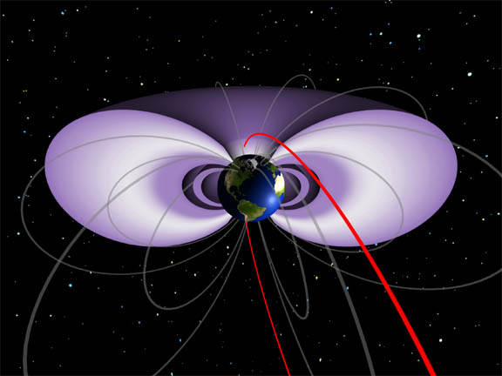
Radiation Belt
Very Hot (100s keV - MeV)
Extremely tenuous: <<1 cm⁻³
  Outer belt: very dynamic region
    Mostly elections located at 3-6 R_{E}
  Inner belt: fairly stable population
    Protons, electrons and ions at 1.5-2 R_{E}
Source: injection and energization events following geomagnetic storms
Loss Mechanisms: Coulomb collisions, magnetopause shadowing, and PA diffusion
Hiss
Main regions and transport processes

Slide 27
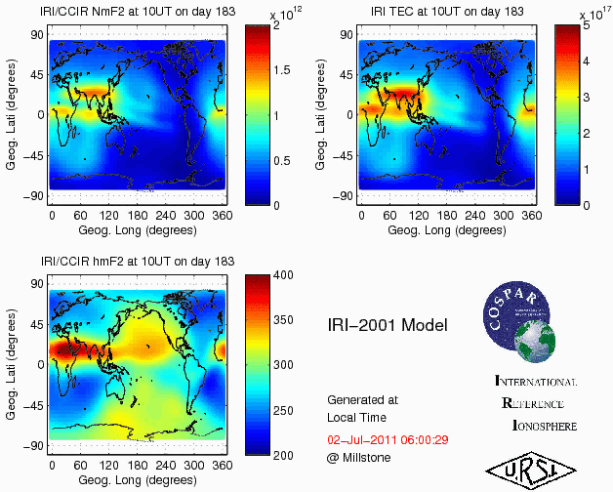
Models – Empirical: IRI

Slide 28

Models – Empirical: GCPM

Slide 29
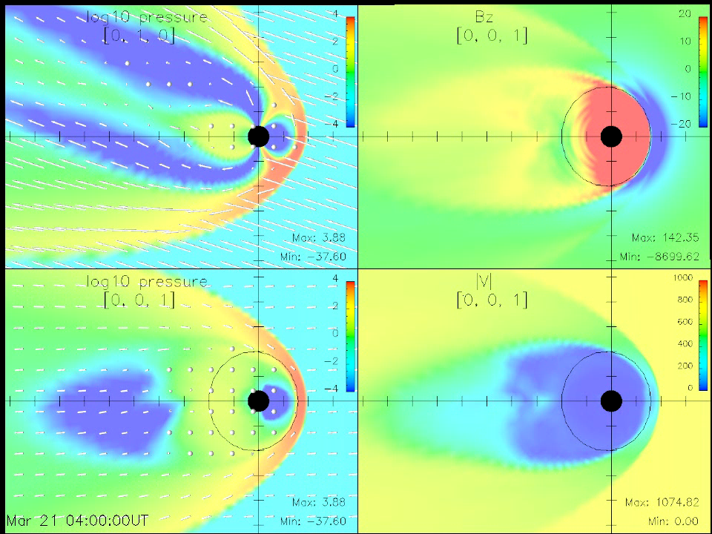
Models –LFM Model
(Multi-Fluid Lyon-Fedder-Mobarry MHD)
Lyon, Fedder, Mobarry, DOI: 10.1016/j.jastp.2004.03.020
Through the Coordinated Community Modeling Center, NASA/GSFC

Slide 30
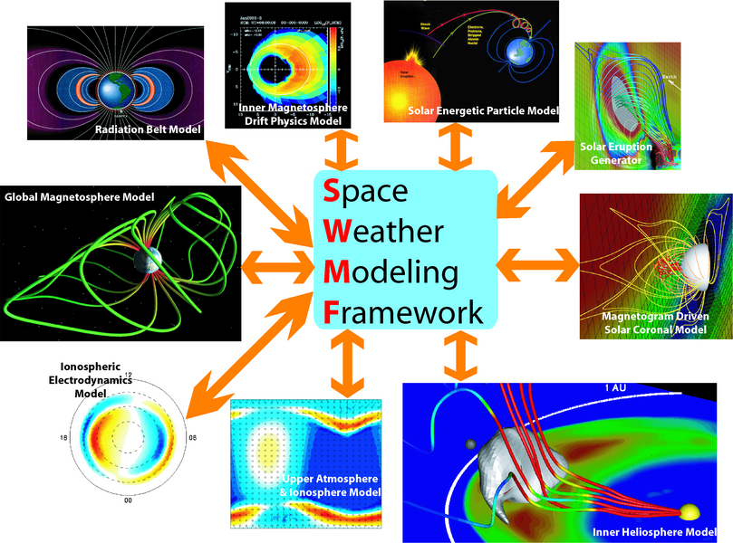
Coupling Models
Tóth, et al., The Space Weather Modeling Framework, Proceedings of ISSS-7, 26-31, March, 2005

