Slide 1

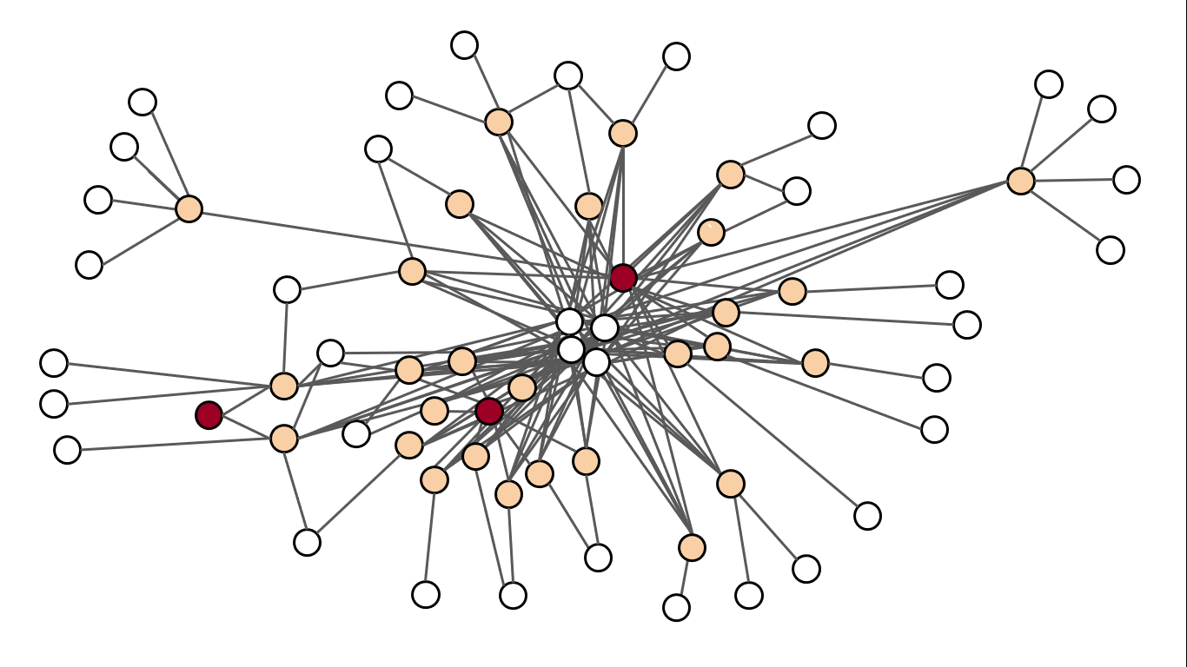
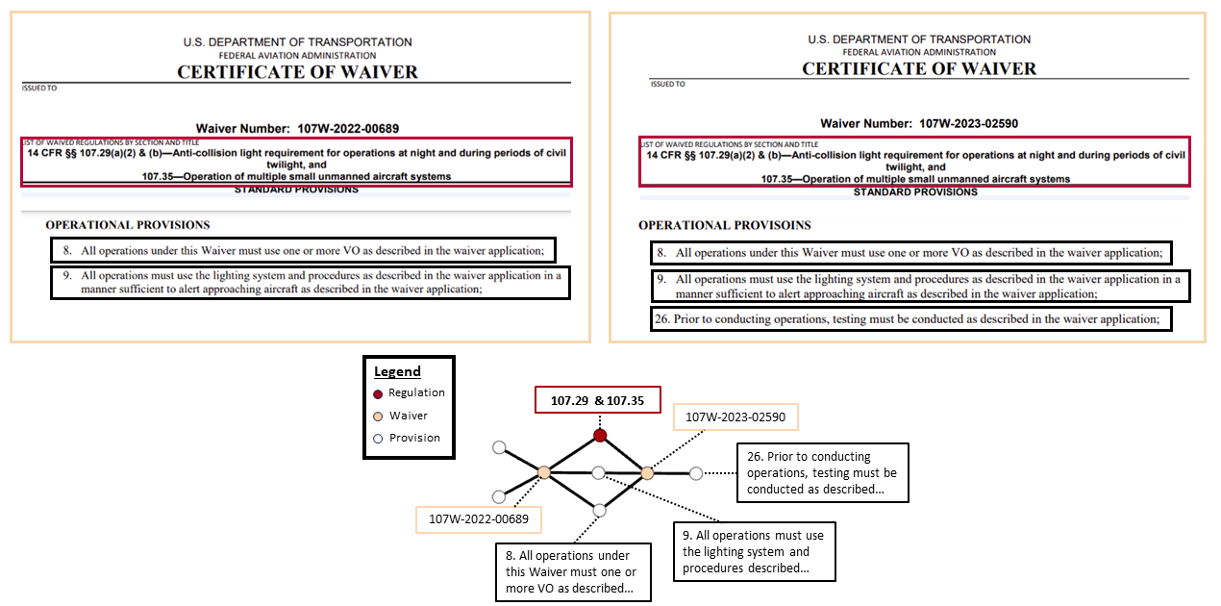


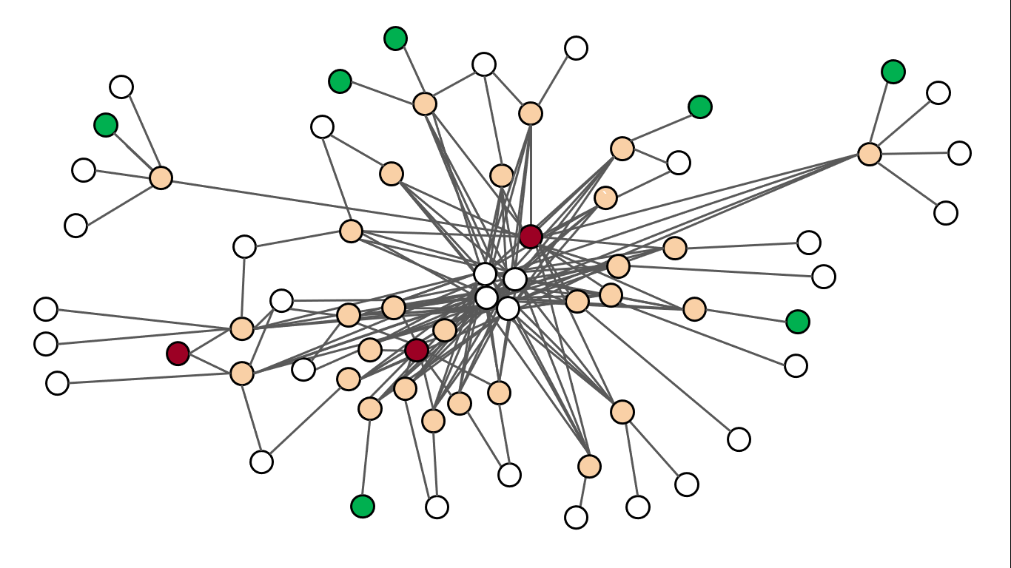
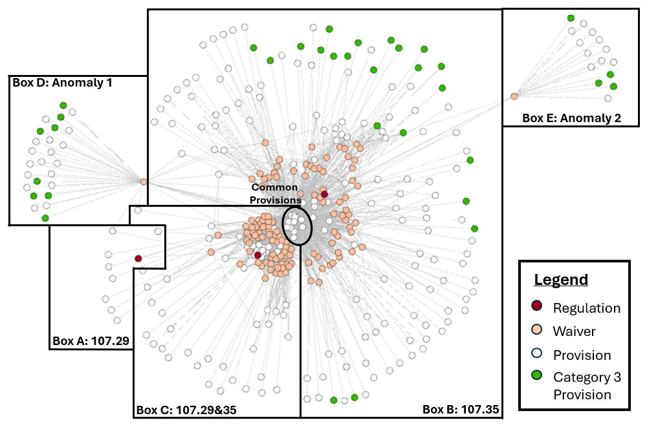
Textual and Network Analysis of Part 107 Waivers
Ethan Jordan
University of North Dakota
Carlos Paradis
KBR @ NASA Ames Research Center
Misty Davies
NASA Ames Research Center
Charles Werner
DRONERESPONDERS
Implementing Part 107 Provisions
Method
From Waivers to Networks
Part 107 reduced the need for sUA oversight.
Waived operations still require approval.
PID
Provision Text
1
2
3
Operations prior to Part 107
Requires Waivers
4
Waivable Regulations
FAA Issued Waivers
Data Schema
Provisions
29, 35, 29&35
Regulation | Description | Waivers
107.25 | Operation from a moving vehicle or aircraft | 9
107.29 | Anti-collision light required for operations at night and during periods of civil twilight | 63
107.31 | Visual line of sight aircraft operation | 273
107.33 | Visual observer | 149
107.35 | Operation of multiple small unmanned aircraft systems | 141
107.37 | Yielding the right of way | 0
107.39 | Operation over people | 38
107.41 | Operation in certain airspace | 0
107.51 | Operating limitations for small unmanned aircraft | 188
107.145 | Operations over moving vehicles | 33
PID
PMID
Summary
Cat
29
Waivers contain provisions that determine how operations are conducted safely.
We defined a graph representation of Part 107 waivers to better understand provision reuse across waivers.
107.205 lists ten regulations that can be waived.
1
1
2
1
29 Only
3
2
Cat
35
4
2
35 Only
Different
Provisions
29, 35
Vs
29&35
29 & 35
Cat 29&35
Mitigation Categories & Subcategories
Date of Issuance: 2/6/2020-10/4/2024
Limitations to Operational Area
Full Network Graph for Category C3
Categorization of Mitigation Concepts
C1. Area Limitation and Monitoring
Monitoring Operational Area
Restricted Access to Operational Area
Provisions were compared incrementally to derive higher abstraction groupings.
Category
C2. Communication
File NOTAM
Communication
Subcategory
C3. FAA Knowledge and Management
FAA Provided with Information
Provision Meaning
FAA Management of Operations
Notifying FAA Centers of Authority
C4. Failsafe Measures
Flight Termination
Waiver
Provision
Failure Causing Interference
Regulation
Part 107 Mitigations Concepts
Failure Notification
Other Failsafe Measures
Provision Meaning
C5. Hardware and Software
Limited Number of sUA
Waiver
Systems to Ensure Control
Physical sUA Limitations
Regulation
C6. Operation Knowledge
Other Hardware Requirements
Information Available During Operation
Subcategory
Participants Informed Prior to Operation
C7. Training and Planning
Training and Testing for Participants
Category
Operation Planning
Lighting
C8. Visibility
Maintaining VLOS
Participant Visual Identification
Waypoint Confirmation
Operation at Night/Twilight

