Slide 1
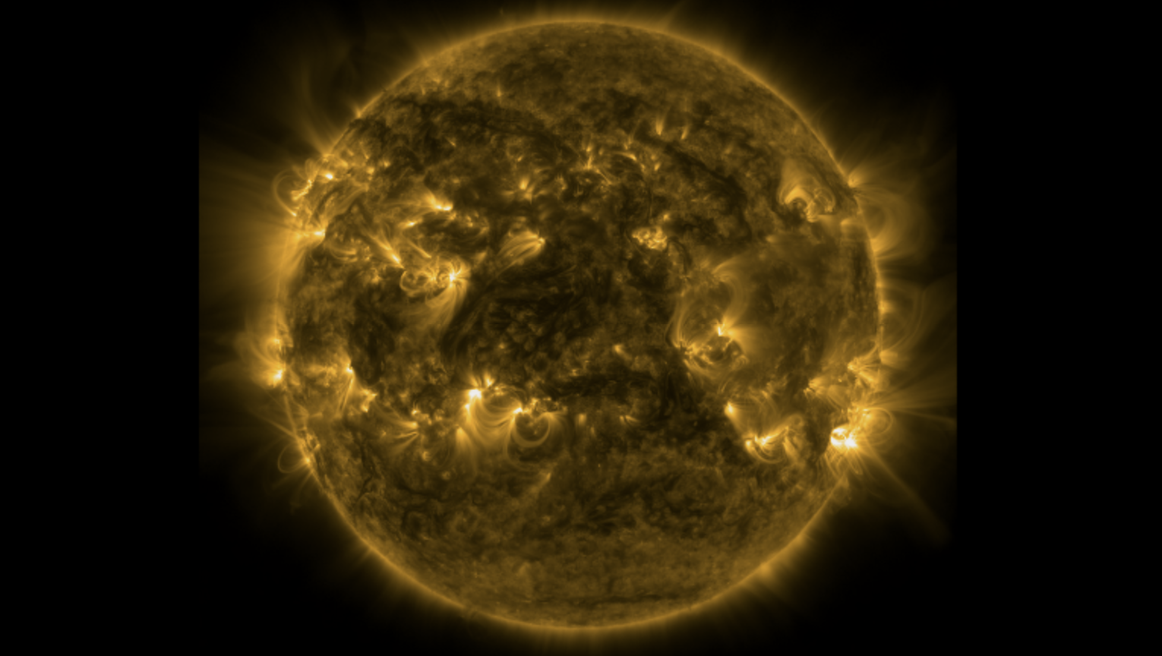

Heating of coronal X-ray Bright Points
Biswajit Mondal
NASA Postdoctoral Program
NASA Marshall Space Flight Centre
Huntsville, Alabama, USA
May-27-2024

Slide 2
Group and collaborators
MSFC heliophysics team:
Dr. Amy R. Wineberger,
Dr. P.S. Athiray,
Dr. Sabrina L. Savage
and MaGIXS team.
Collaborators:
Dr. Helen E. Mason (Univ. Cambridge)
Dr. Giulio Del Zanna (Univ. Cambridge)
Dr. J.A. Klimchuk (NASA GSFC)
Dr. Aveek Sarker (PRL)
Dr. Santosh Vadawale (PRL) and others!

Slide 3
What are the XBPs?

Slide 4
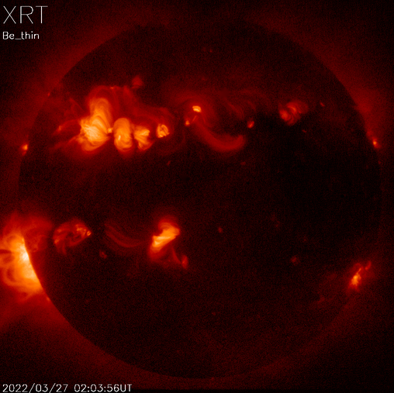
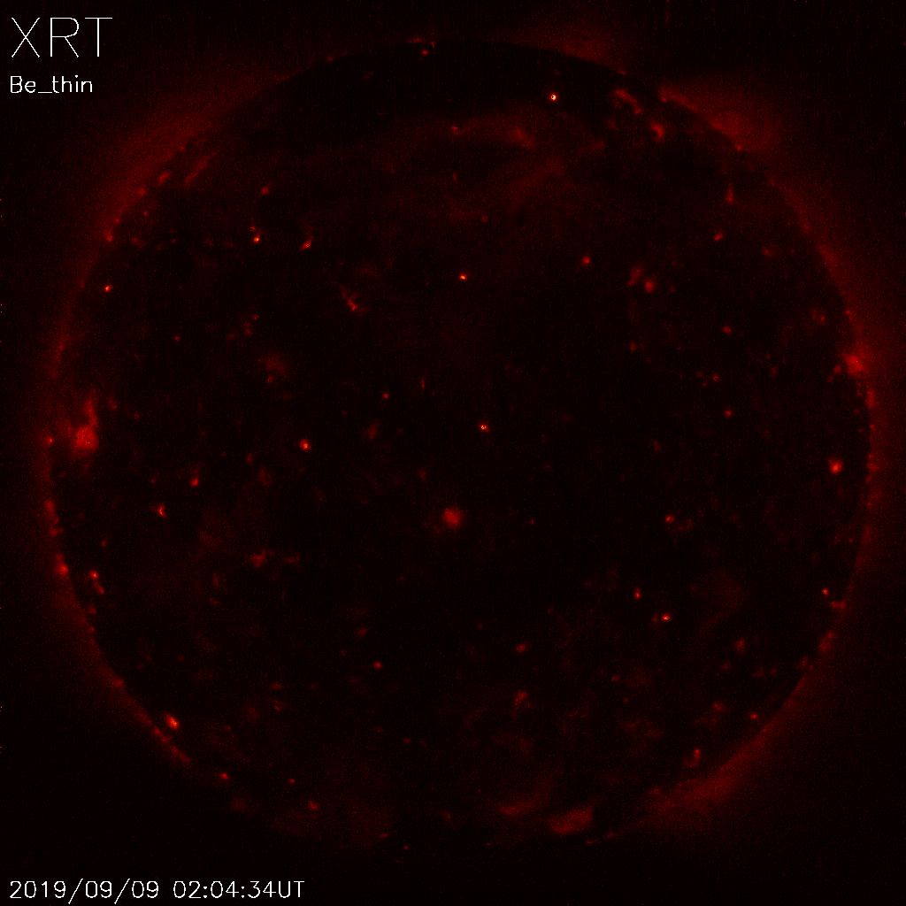
Solar cycle maximum
Solar cycle minimum
XBPs are located all over the solar disk. (Vaiana et al., 1973; Krieger et al., 1971; Golub et al., 1974)
In the solar maxima, their contribution is hidden behind the huge AR emission.
During the quiet phase XBPs are the primary on-disk X-ray contributors.

Slide 5
Questions
Fraction of the total quiet Sun X-rays contributed by the XBPs
Can nanoflares maintain the heating of the XBPs?
If yes, what is the nanoflare frequency?

Slide 6
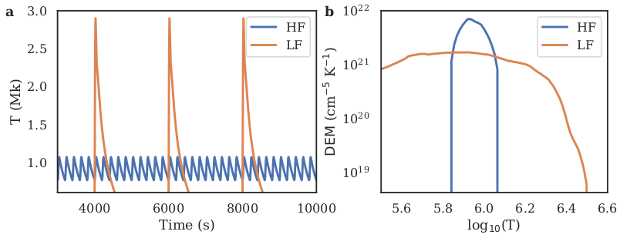
Differential Emission Measure (DEM) -> Diagnostics of Multi-thermal plasma

Slide 7

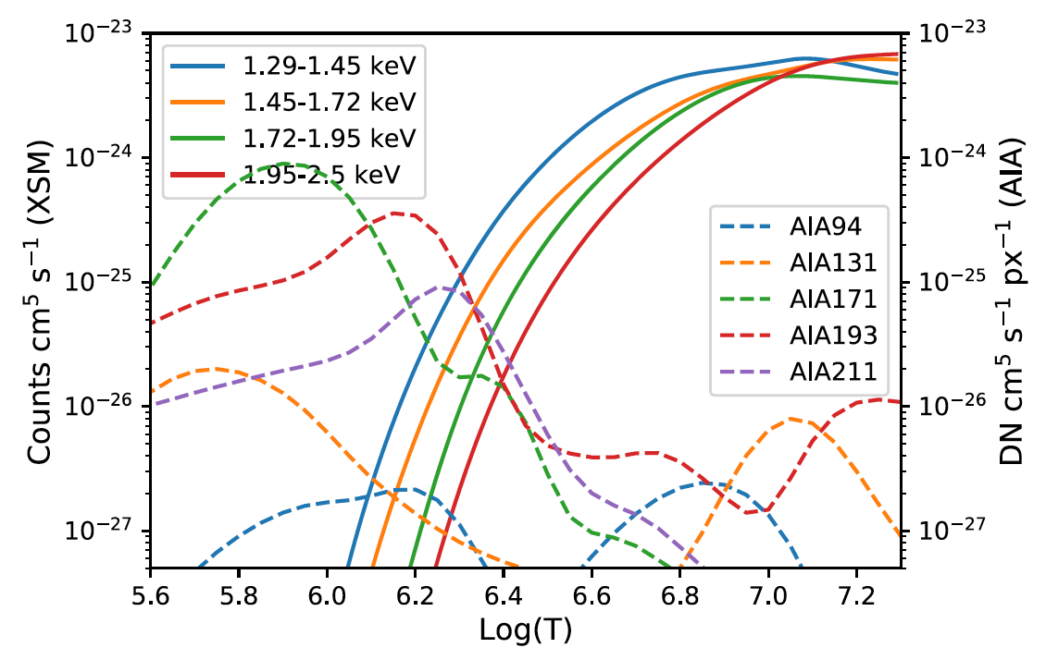
DEM reconstructions
Observed Intensity

Slide 8
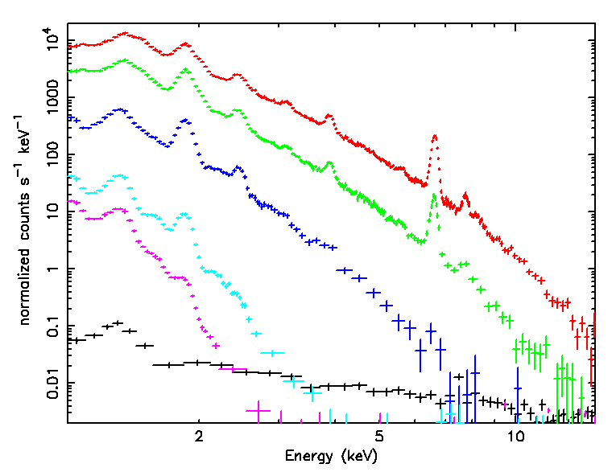
Chandrayaan-2 Solar X-ray Monitor (XSM)
M2 flare
C3 flare
B4 flare
AR
QS
BKG
Disk-integrated soft X-ray spectrometer of the Sun
Energy range: 1-15 keV(< M5 class) or 2-15 keV ( > M5).
Energy resolution: of 175 eV @ 5.9 keV.
Cadence: 1 second
Dynamic range: Sub-A to X-9 class flux level
Ca
Fe
Ar
Si
S
Ni
Mg/Al
Si
Mg
XSM website: https://www.prl.res.in/ch2xsm/

Slide 9
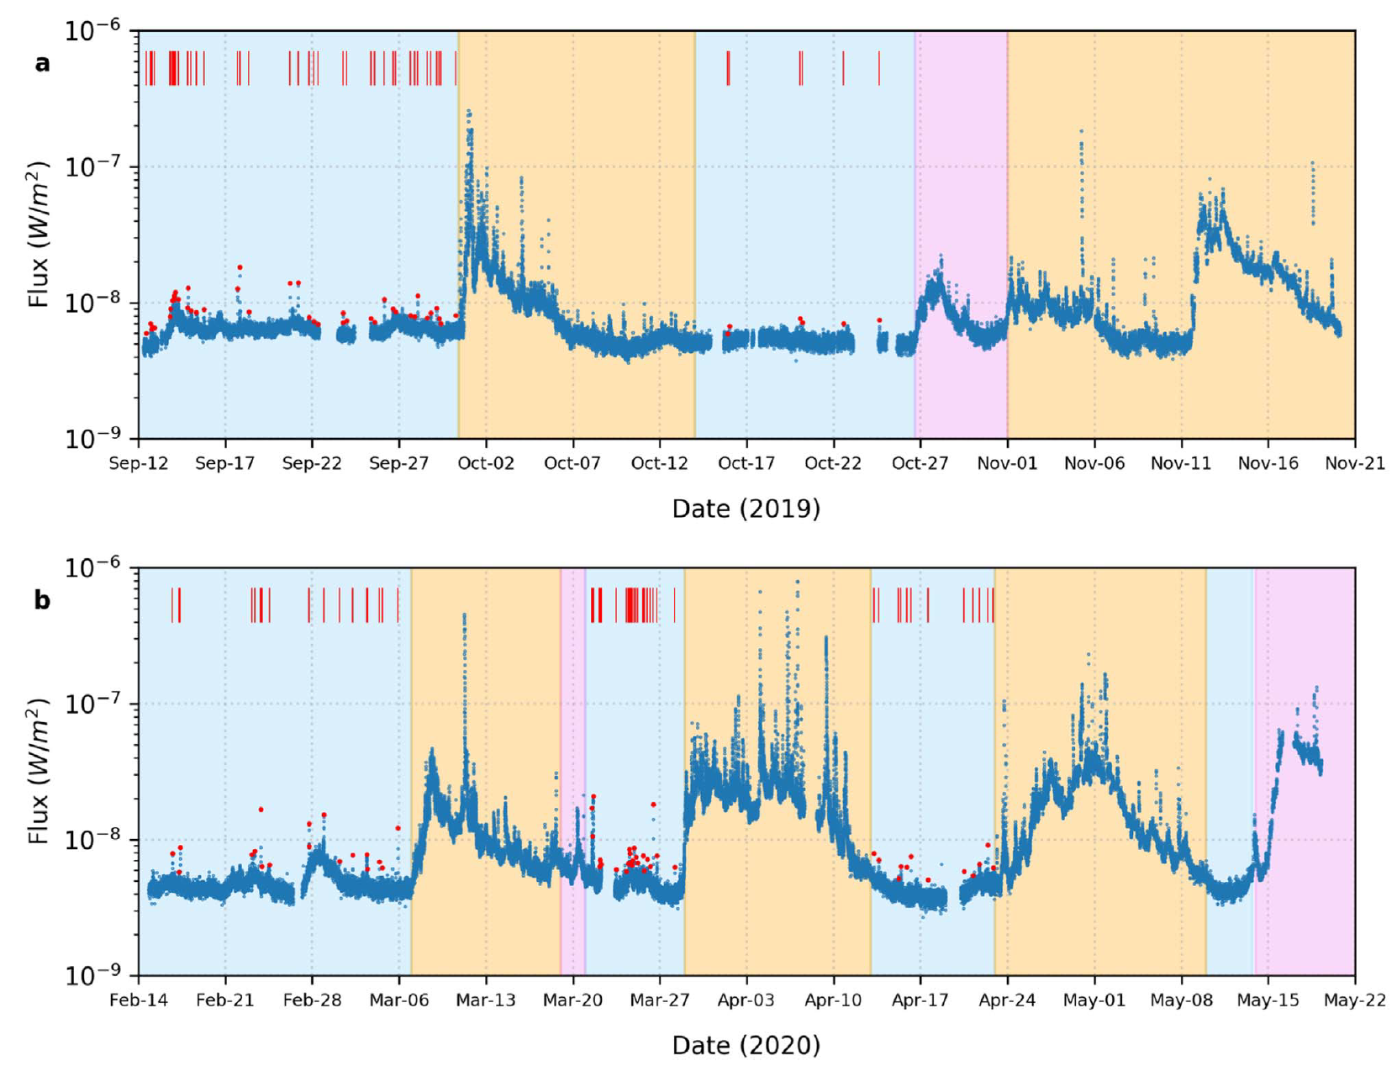
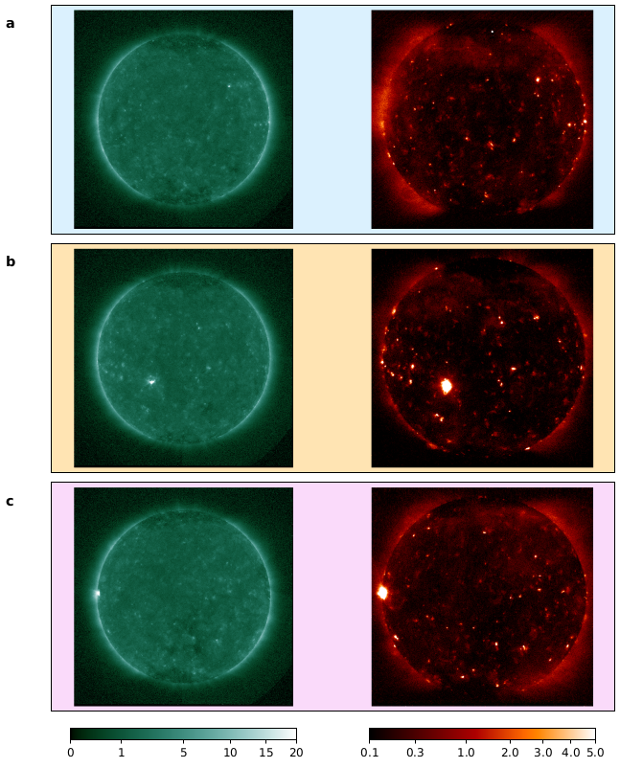
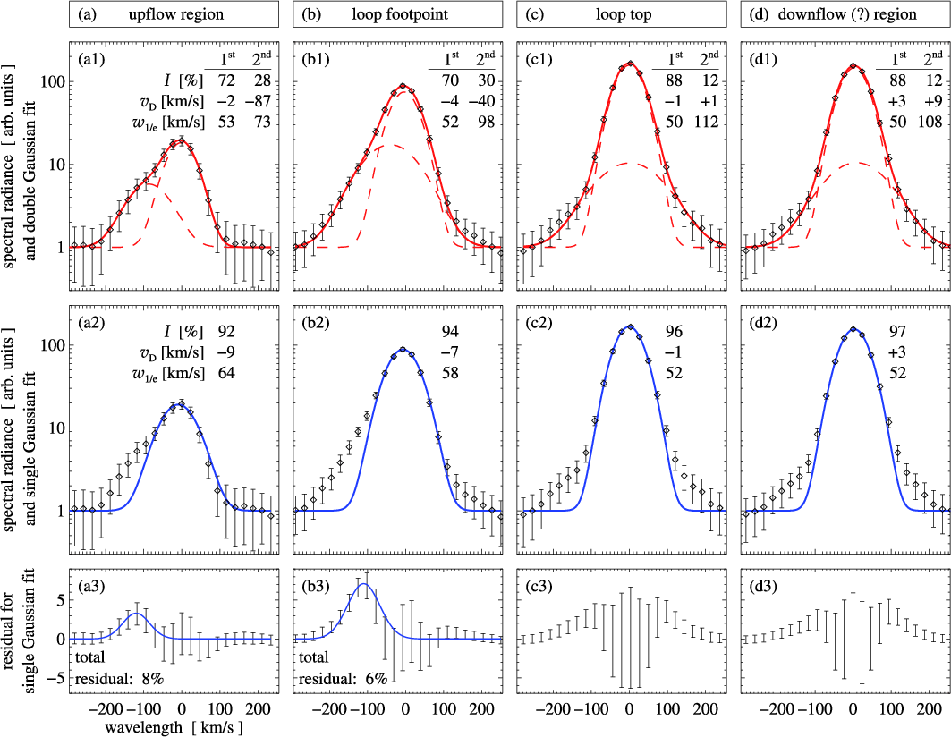
XSM Observations during the minimum of solar cycle 24
No AR
NOAA
AR
Undefined
AR
XSM spectra has the informations of temperature, EM as well as the abundances of Mg, Al, and Si.
Vadawale, et al, (ApJL 912:L13, 2021 & 912:L12)

Slide 10
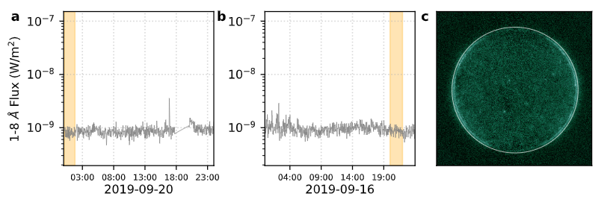
Observation used for combined DEM estimation

Slide 11
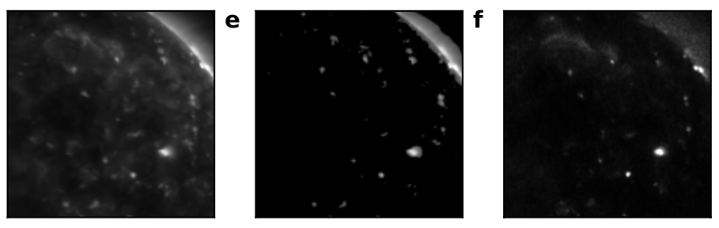
Extracting the XER emission from AIA
AIA 193 A
XER on AIA 193 A
XRT Be thin
Mondal et al, (ApJ, 945:37, 2023)

Slide 12
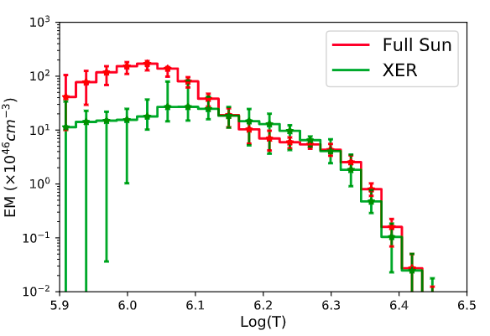
DEM of Full sun & XERs
Full Sun -> XER + diffuse corona
XER -> XBPs + limb
QS
XER
Mondal et al, (ApJ, 945:37, 2023)

Slide 13
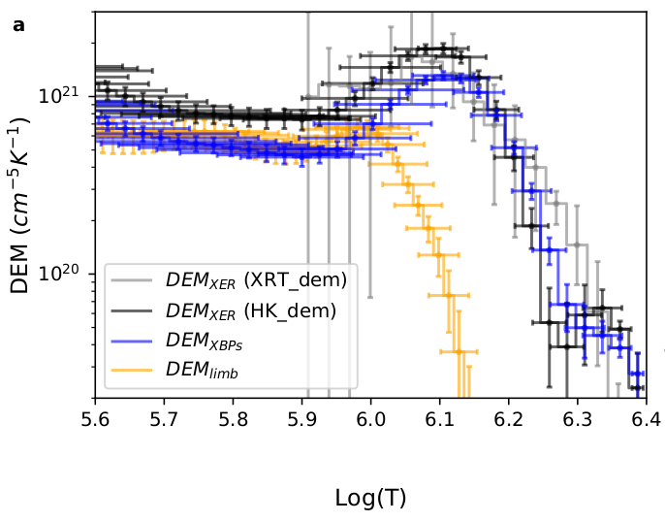

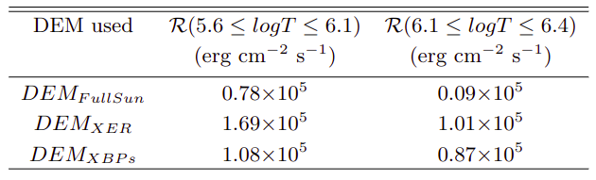
Separate the different QS component
XER
XBP
Limb
Lower temperature radiation loss from the diffuse corona is significant whereas at higher temperature it is negligible.
Lower temperature XBPs emission is more than 63%, while at higher temperature it is more than 85%
Mondal et al, (ApJ, 945:37, 2023)

Slide 14

Can nanoflares be responsible for heating the XBPs?
Modeled the XBPs assuming nanoflare heating scenario.
Estimate the simulated DEM, which is compared with the observed DEM.
We used EBTEL code (Klimchuk et al. 2008; Cargill et al. 2012; Barnes et al. 2016).

Slide 15
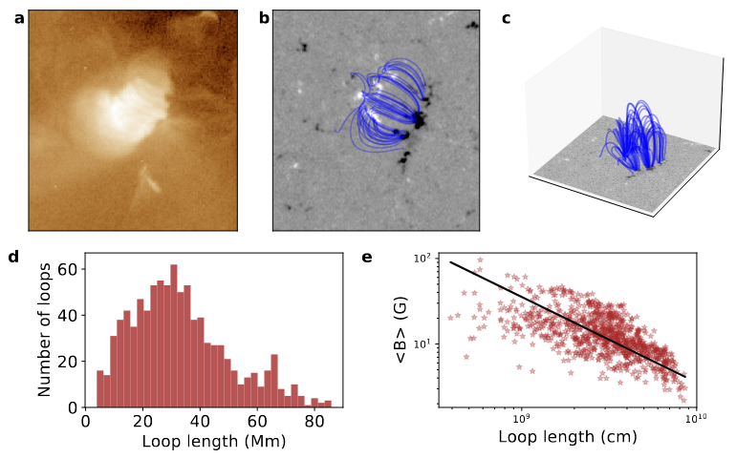
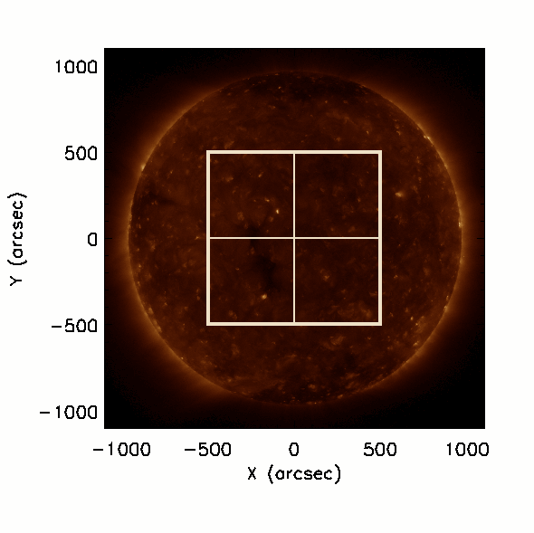


Magnetic skeleton of XBPs
assume, r = 1 Mm

Slide 16



Heating function
Here we consider that nanoflares occur with the release of stored magnetic energy (Parker, 1988)
Magnetic stored energy density :
tan(θ) = c –> 0.2 − 0.3, to satisfy observed coronal heating requirement (Parker 1988; Klimchuk 2015).
Consider triangular heating profiles having a duration (τ ) of 100 s.
The peak heating rate during an event is randomly chosen between minimum (H₀^{min} ) and maximum (H₀^{max}) values that are loop dependent.
H₀^{min} = 0.01 H₀^{max}
H₀ is randomly chosen between minimum (H_{0ij}^{min} ) and maximum (H_{0ij}^{max}) for a loop.
Model parameters → c and F
Mondal et al, (ApJ, 945:37, 2023)

Slide 17


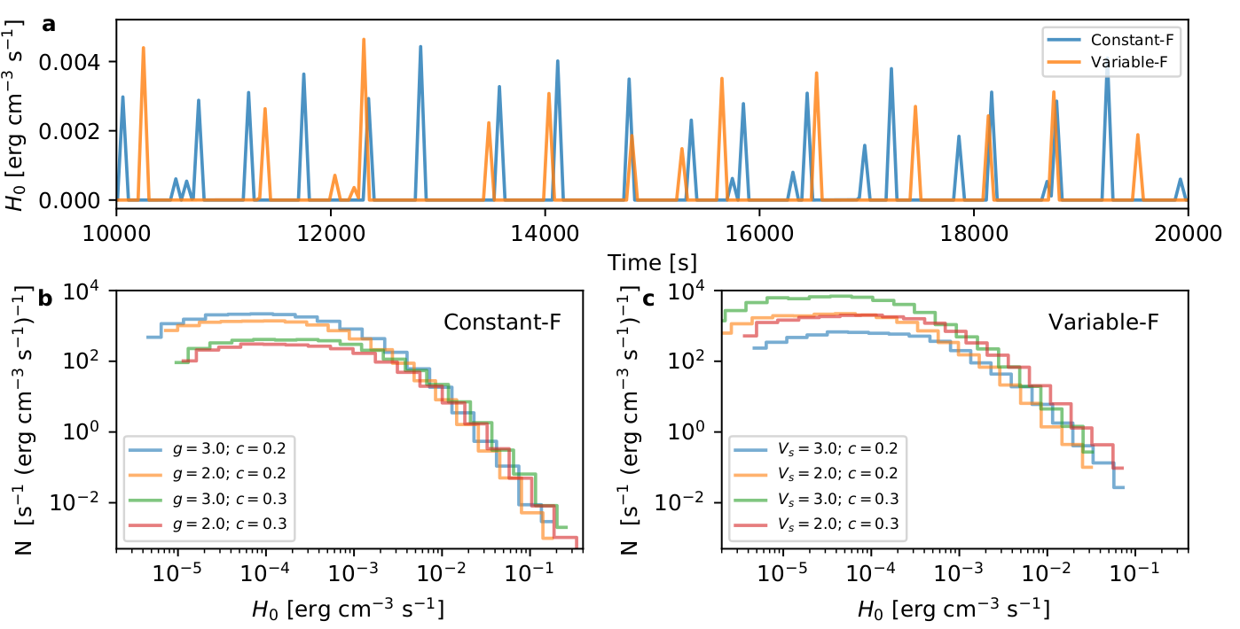
Heating function
Coronal radiation loss
Constant F:
Variable F:
; g —> 2 to 3 (Klimchuk et al. 2008)
; V_{h} —> 0.5 to 2 km/s
L =30 Mm
< B >=10 G
c = 0.25
g = 2.0
V_{h}=1 km/s
B_{base} = 15 G

Slide 18
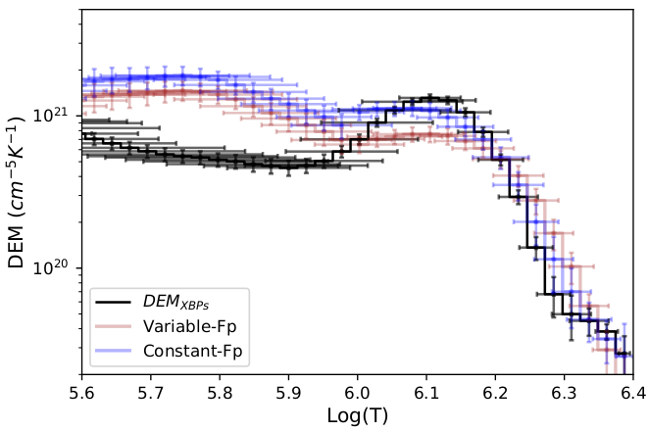
Simulated DEM convolved with instrument responses
Still, model DEM predicts 2-3 times higher emission at lower T.
Simulated TR predicts a larger emission than the observed one —> common (e.g., Warren et al. 2008) in loop simulations.
Possibility – absorption TR emission by frequent chromospheric jets, such as spicules (De Pontieu et al. 2009)
Simulated DEMs
Observed DEM
c = 0.21, g = 2.47, V = 1.5 km/s
Agreement for the coronal portion of the loops suggest nanoflare can maintain the heating of XBPs.
Mondal et al, (ApJ, 945:37, 2023)

Slide 19
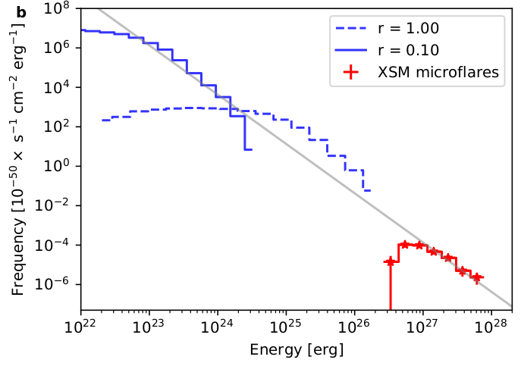
Frequency distribution with nanoflare’s energy
∝ E ^{-𝛼}
Power-law slope -2.5 : Nanoflare’s energy > larger flares or microflares.

Slide 20
Detailed study for a single XBP

Slide 21
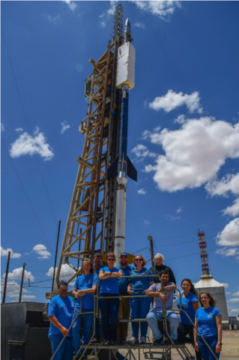
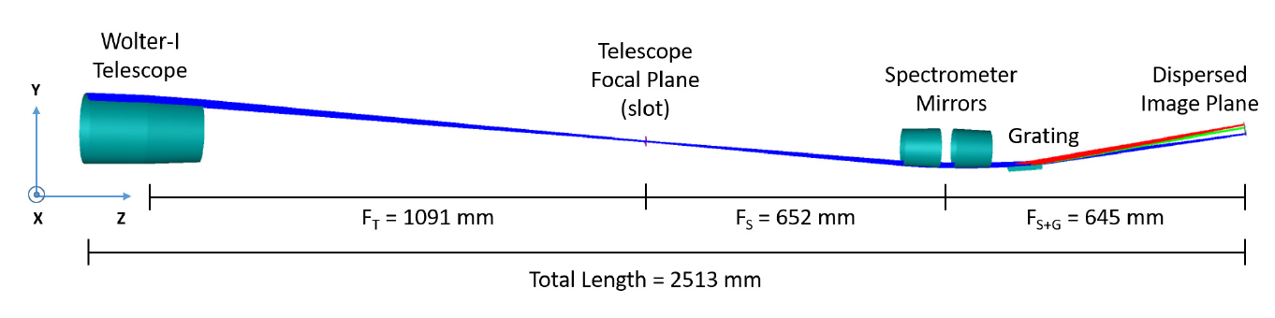
Marshall Grazing Incident X-ray Spectrometer (MaGIXS)
Champey et al. 2022
July-30-2021, 18:20 UT

Slide 22
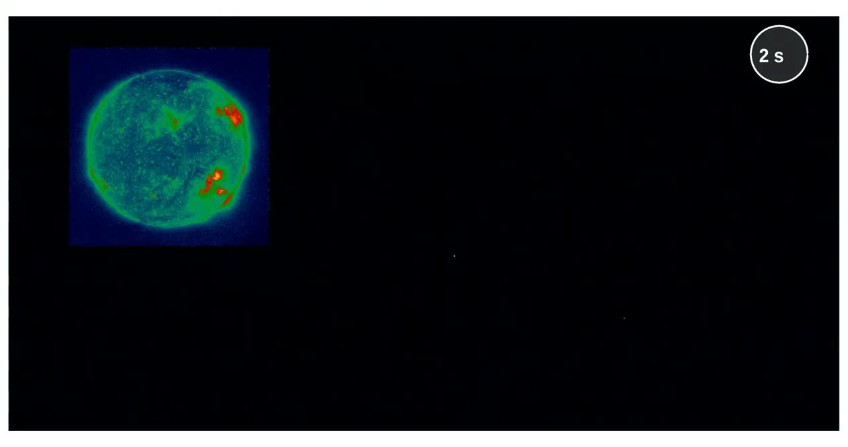
First flight of MaGIXS
Credit: Athiray, MaGIXS team

Slide 23
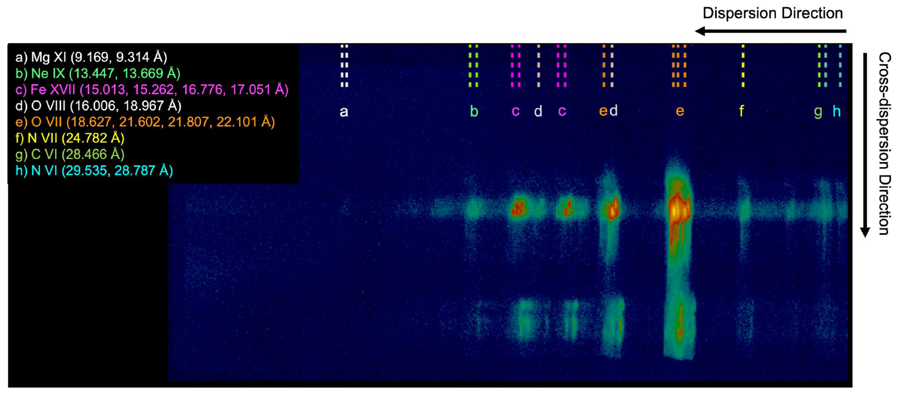
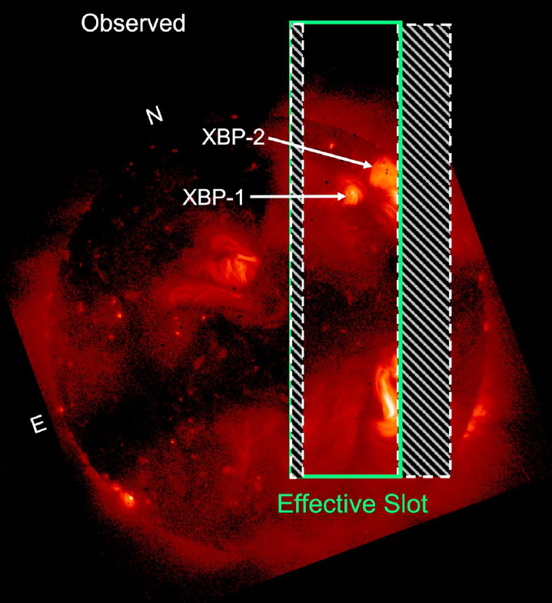
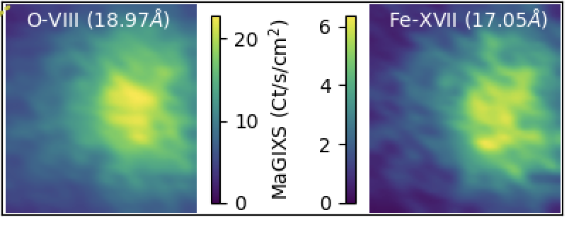
Overlapping spectral images observed by MaGIXS
XBP-1
XBP-1
Savage et al (ApJ 945:105, 2023)

Slide 24
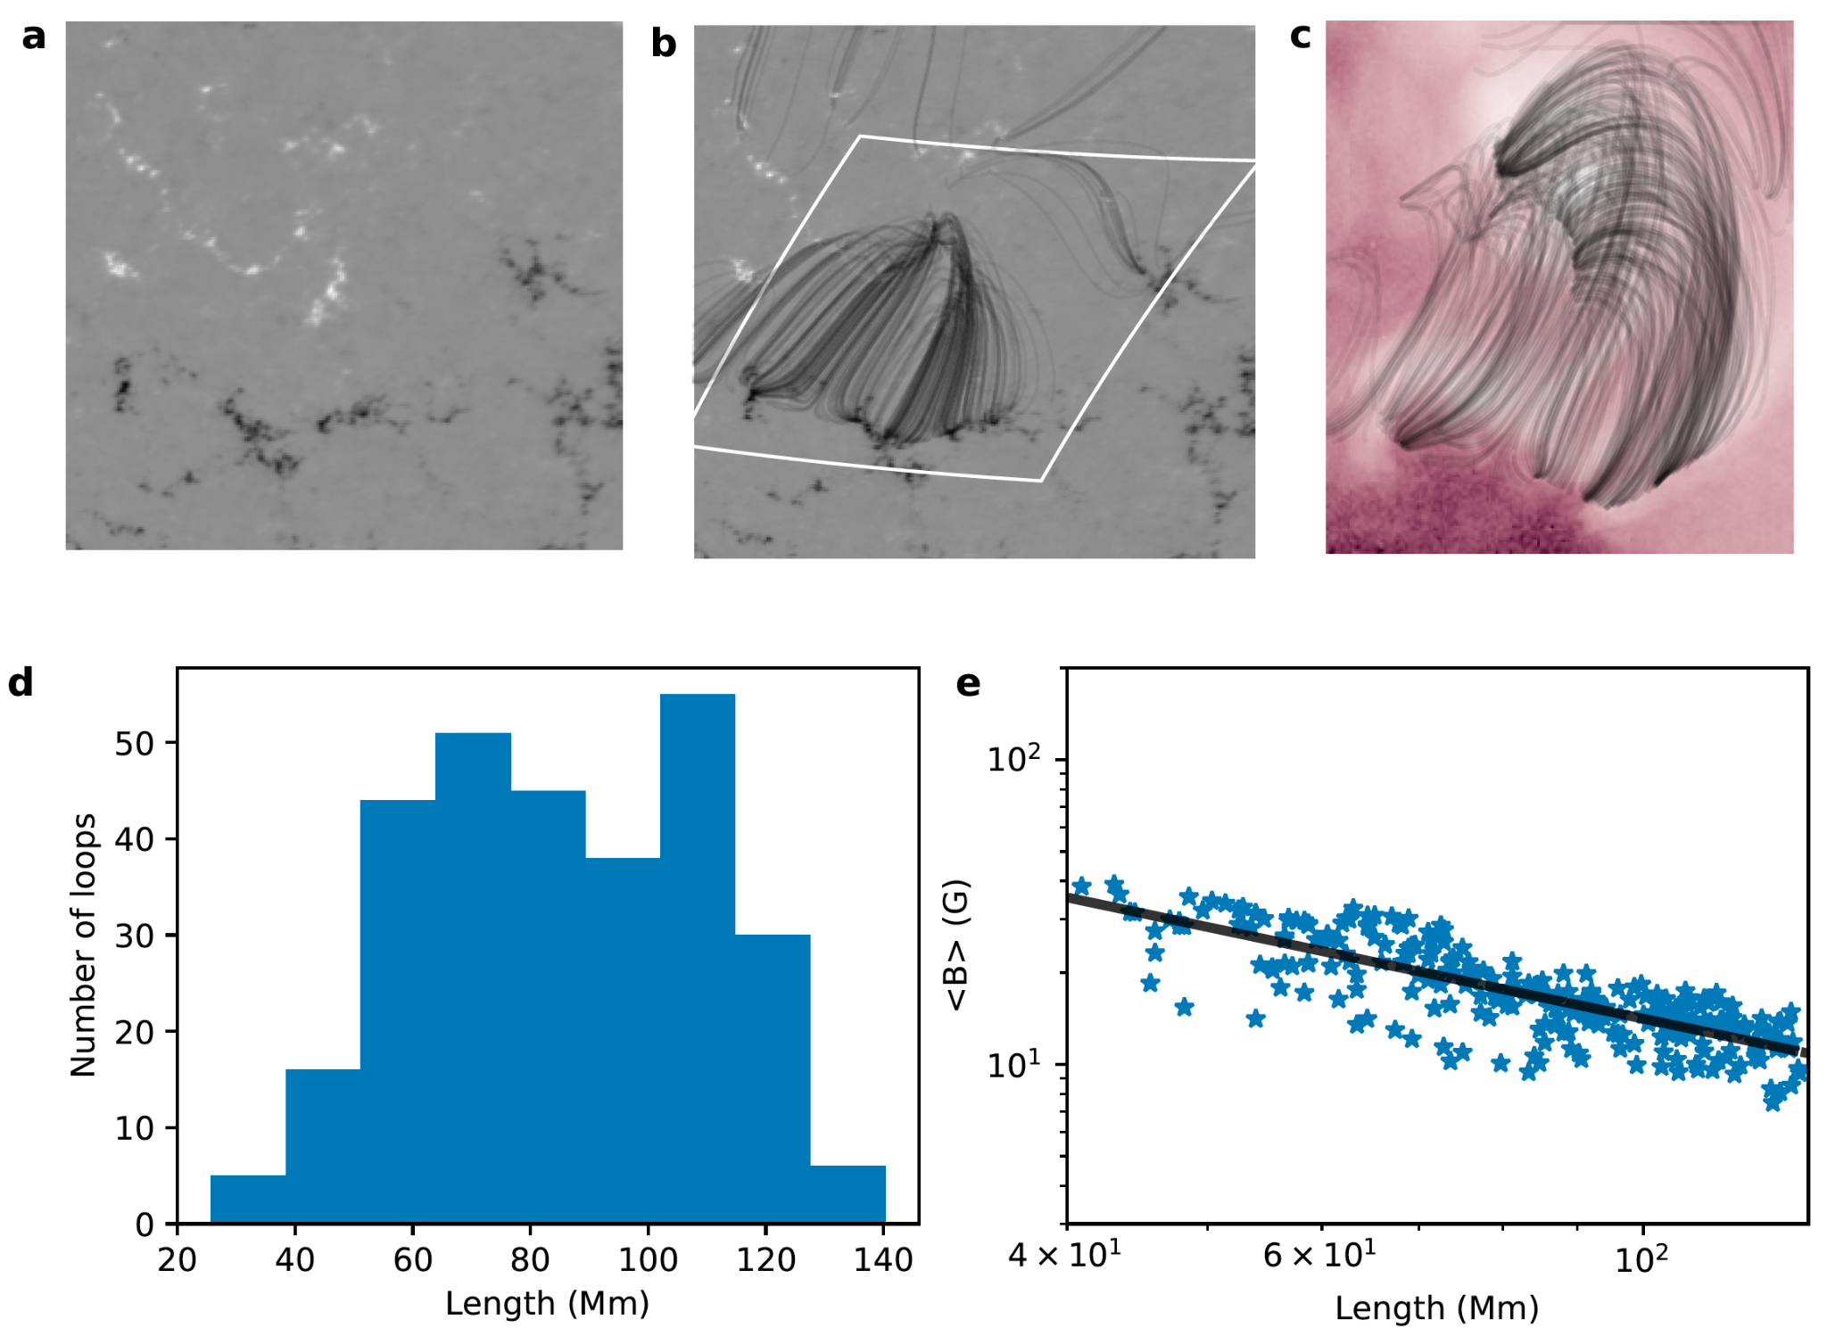
Hydrodynamic simulation of XBP-1
Used 1D hydrodynamic code, HYDRAD

Slide 25
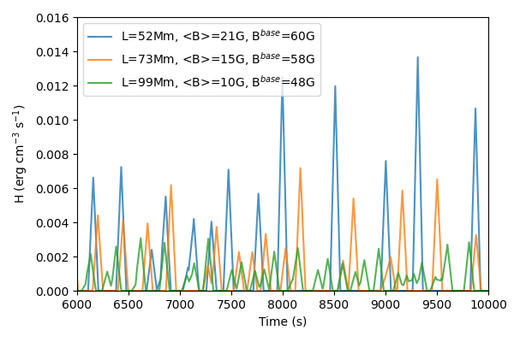
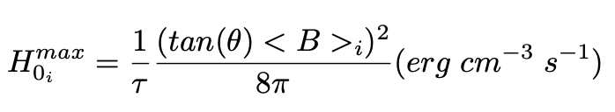
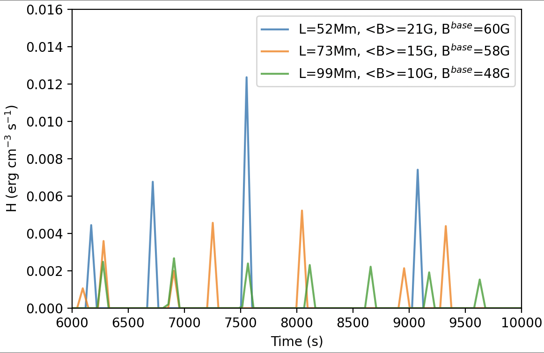
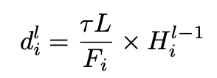
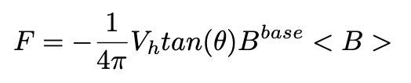
Nanoflare heating sequence
Consider triangular heating profiles having a duration, 𝜏 = 100 s.
The peak heating rate during an event is randomly chosen between minimum (H₀^{min} ) and maximum (H₀^{max}) values that are loop dependent.
tan(θ) = 0.2
V_{h} = 1.5 km/s
tan(θ)= 0.2
V_{h} = 0.5 km/s
Mondal, Klimchuk et al 2023

Slide 26
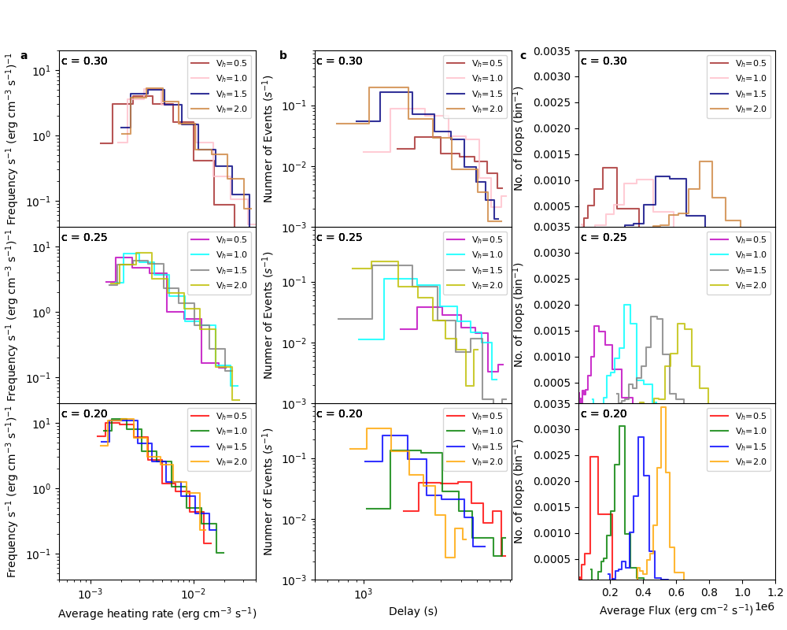
Distribution of nanoflare events for different heating parameters

Slide 27
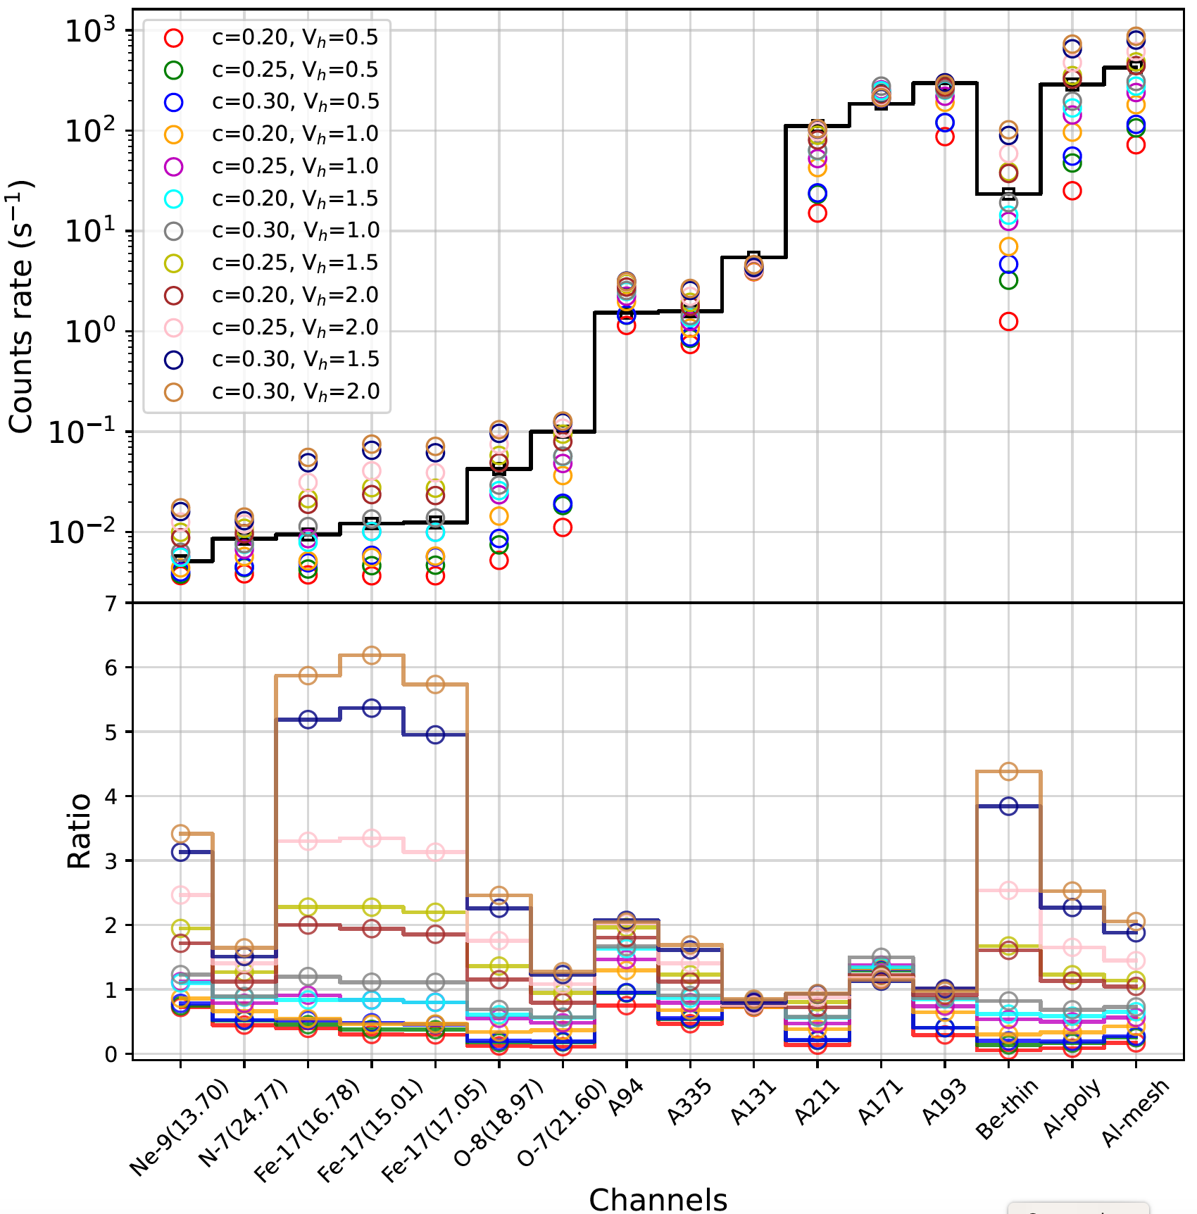
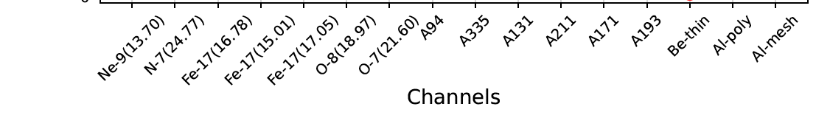
Comparison between simulations and observations
AIA
XRT
MaGIXS

Slide 28
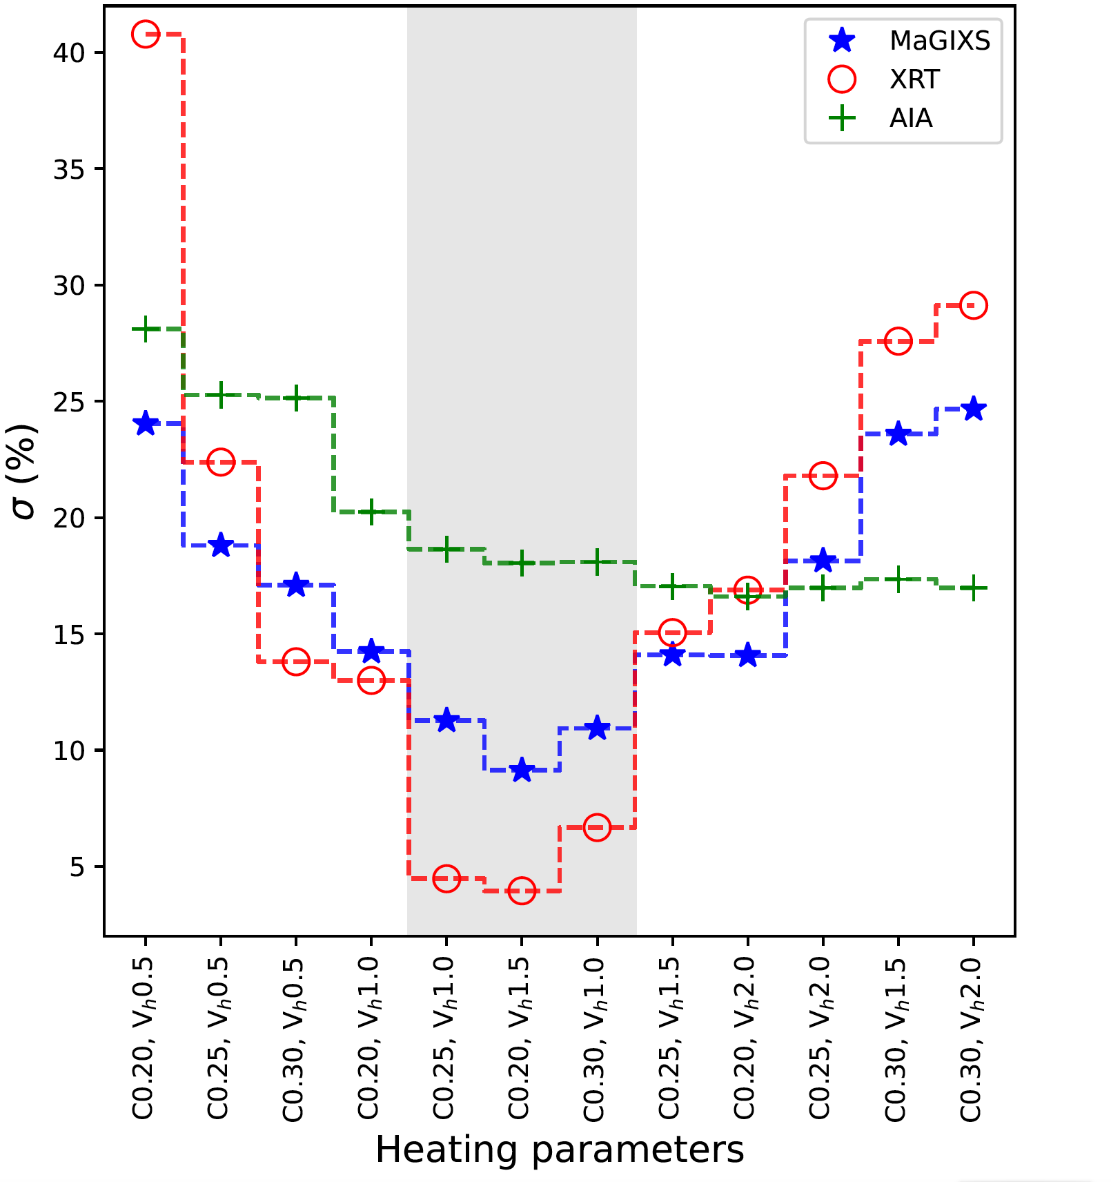
Results & Discussions
HF nanoflare -> average delay = 1500 - 3000 s (Which is smaller than the cooling time of the loops derived from the formula by Cargill et al 2014).
Average Poynting flux = ~5e5 erg/cm2/s
MaGIXS and XRT are more sensitive.
Mondal et al, (ApJ, 967, 23, 2024 )

Slide 29
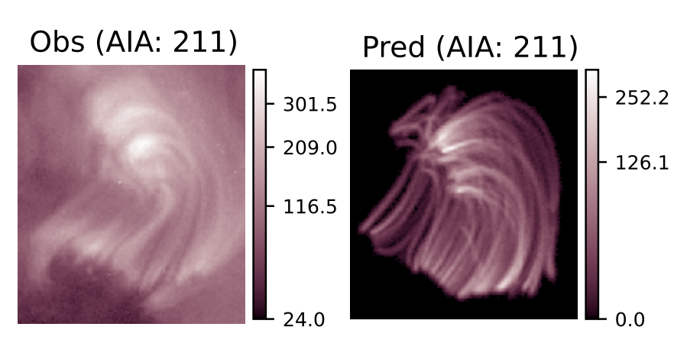
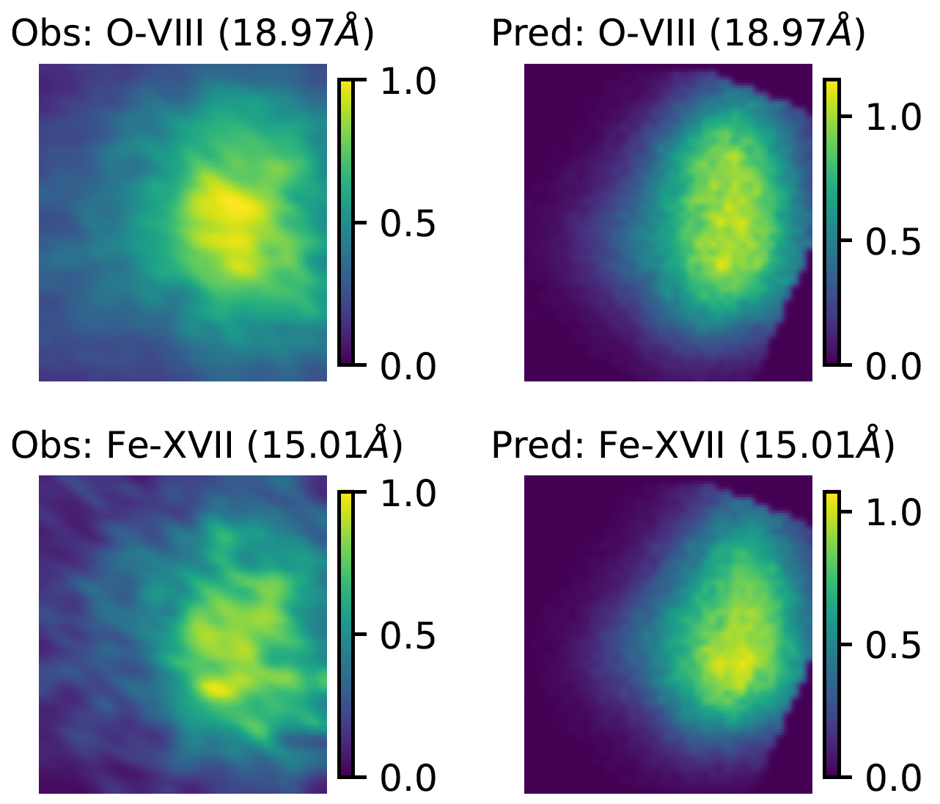
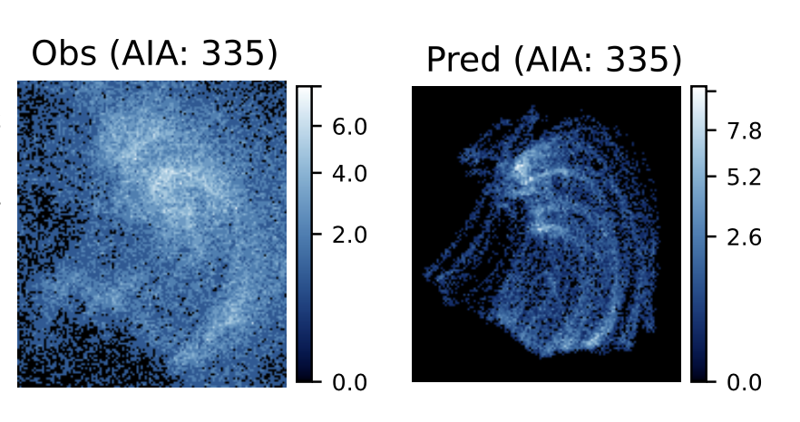
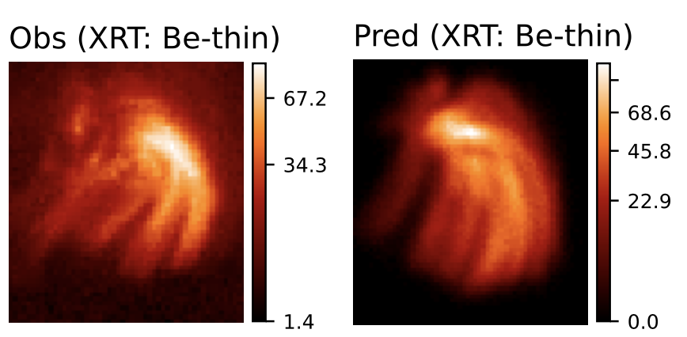
Observed and Predicted images of XBP-1
DN/s
DN/s
Observed by AIA & XRT
Derived from MaGIXS
Simulated
Simulated
Mondal et al, (ApJ, 967, 23, 2024 )

Slide 30
Summary
Most of the high temperature emission of the Sun in the absence of ARs comes from XBPs
Nanoflares can maintain the heating of XBPs (average temperature of 2MK).
Nanoflares delay time is in the range of 1500 s to 3000 s.
The average poynting flux of XBPs is found to be around 5 ✕ 10⁵ erg cm⁻² s⁻¹.
MaGIXS and XRT are more sensitive to diagnosing the heating frequency, whereas only AIA channels are less sensitive.

Slide 31
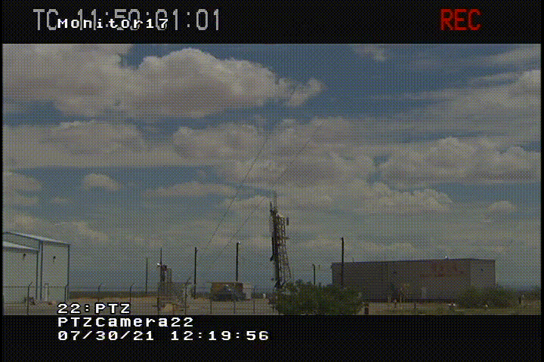
MaGIXS-2 (This year)
Credit: MaGIXS team
Credit: MaGIXS team
Thank You for your attention!

