Slide 1
Dragonfly Entry Aerosciences Measurements (DrEAM)
Do-No-Harm Testing
Ruth Miller
NASA Ames Research Center
Jose Santos¹, Hali Shaw¹, Kristina Skokova², Aaron Brandis¹, Chris Naughton¹, Helen Hwang¹, Thomas Thiele³, Niklas Wendel³, Frank Siebe³, Pascal Marquardt³, and Ali Gülhan³
¹NASA Ames, ²AMA Inc. at NASA Ames, ³German Aerospace Center (DLR)
International Planetary Probe Workshop (IPPW), June 10-14, 2024

Slide 2
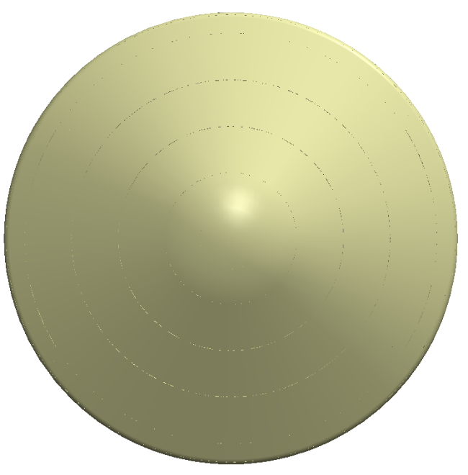
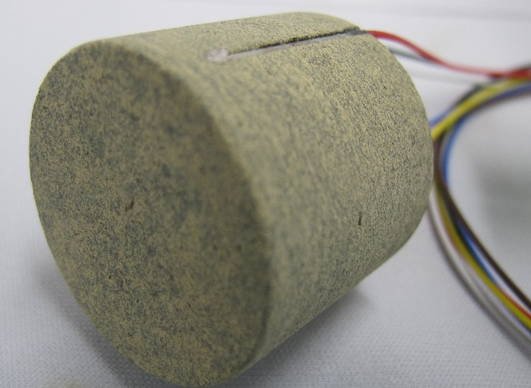
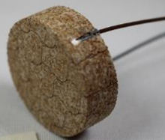
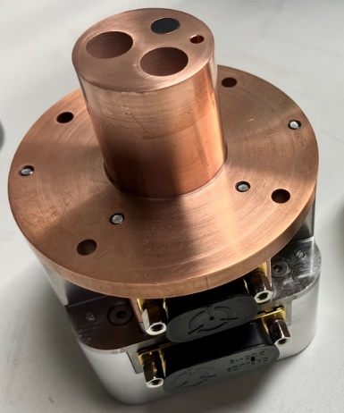
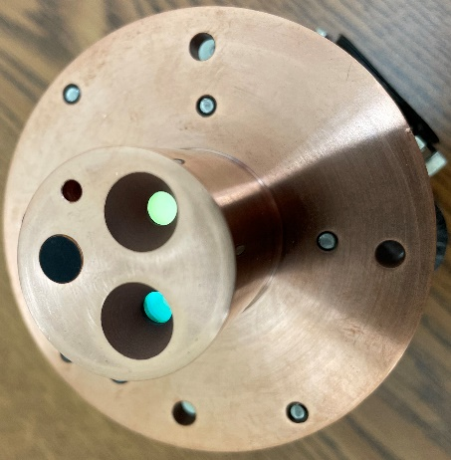
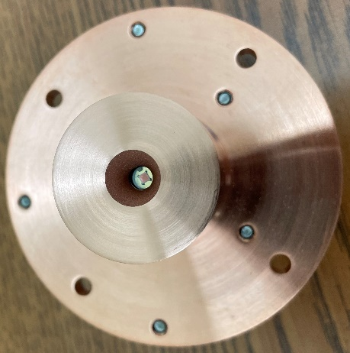
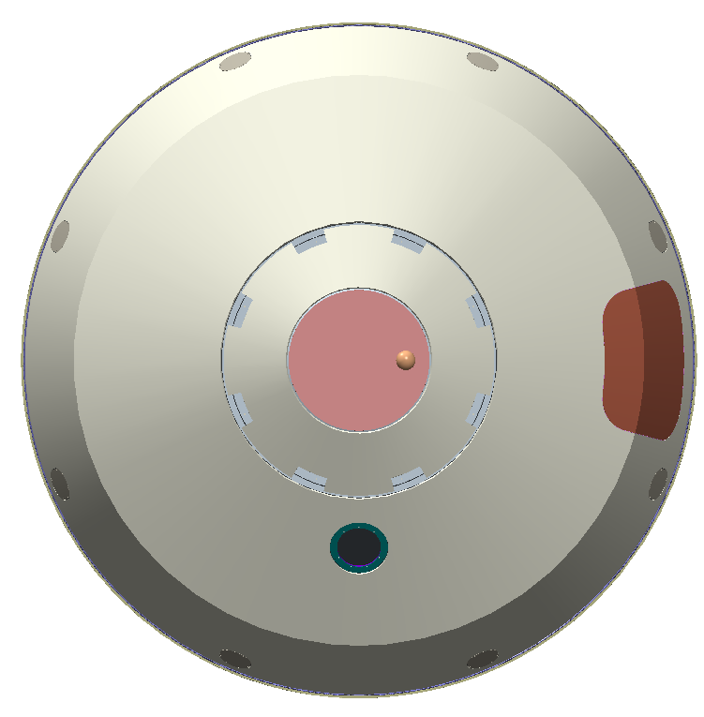
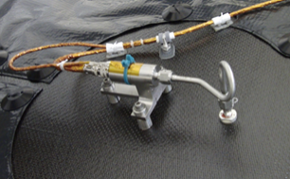
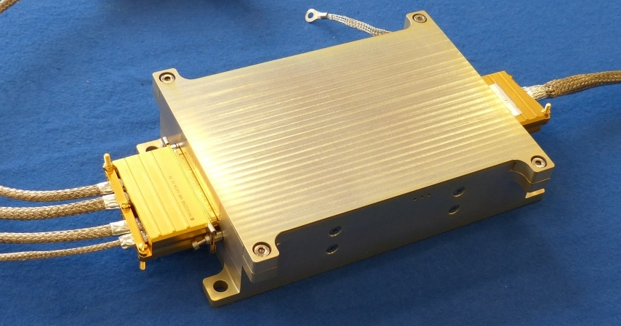
DrEAM Instrumentation Suite
Dragonfly Sensors for Thermal Reconstruction (DragSTR)
COmbined Sensor System for Titan Atmosphere (COSSTA)
  (NASA) In-depth thermocouples to infer the aerothermal environment and understand the Thermal Protection System (TPS) material response
Forebody
  (DLR) Radiometers, total heat flux sensors, and pressure transducers on the backshell to quantify radiative heating from CN and vehicle dynamics
T2
P2
T4
T5
T1
P1
P3
P4
T3
Backshell
T6
C3
R
Dragonfly Atmospheric Flight Transducers (DrAFT)
C2
Data Acquisition System (DAS)
  (NASA) Hypersonic pressure transducers on the forebody for atmospheric and aerodynamic reconstruction
C1
  (DLR) Two boxes (1) Digital Processing Unit and (2) Multiplexing Signal Conditioner which collect DrEAM instrumentation data for transmission back to Earth
DragSTR (T)
DrAFT (P)
COSSTA Aerothermal (C) & Broadband Radiometer (R)

Slide 3
Do-No-Harm Testing Overview
DrEAM is following a Do-No-Harm (DNH) philosophy, meaning DrEAM cannot negatively impact nor degrade the performance of Dragonfly and only minimally impact ConOps.
  DNH requirements (test types, levels, durations, tolerances, etc.) are flowed to DrEAM from Dragonfly.
  Primary objective is to demonstrate DNH; secondary objective is to obtain meaningful sensor measurements during testing.
Inheritance Review of NASA sensors was conducted in May 2022
  DragSTR subsystem meets all DNH requirements through heritage testing performed by MEDLI/MEDLI2
  DrAFT subsystem requires additional testing since MEDLI/MEDLI2 testing is not bounding of heat flux and temperatures
COSSTA sensors and DAS have traceability to ESA’s Schiaparelli mission. However, testing is necessary to demonstrate DNH to Dragonfly due to the more extreme entry environments and different TPS.
Subsystem. | DNH Testing Required | Status
DragSTR | No testing required | Completed as part of MEDLIs
DrAFT | Arc jet testing of pressure ports in PICA TVAC cycling of the pressure transducers EMI testing | Complete! Planned for Oct.-Nov. 2024 Planned for Oct.-Nov. 2024
COSSTA | Shock, random vibration, and TVAC cycling Arc jet testing | Complete! Complete!
DAS | Shock, random vibration, and TVAC cycling EMI testing | Planned for March-May 2025 Planned for March-May 2025
Covered in this presentation

Slide 4
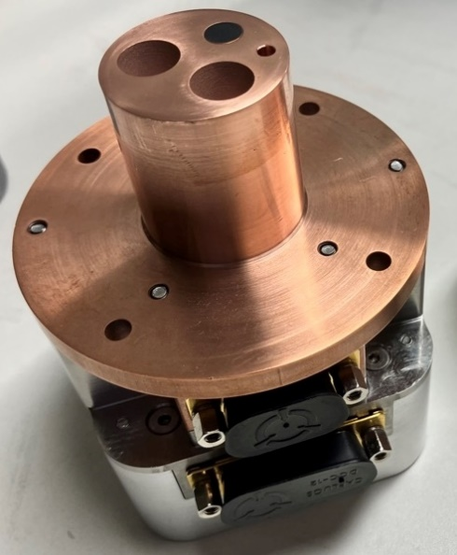
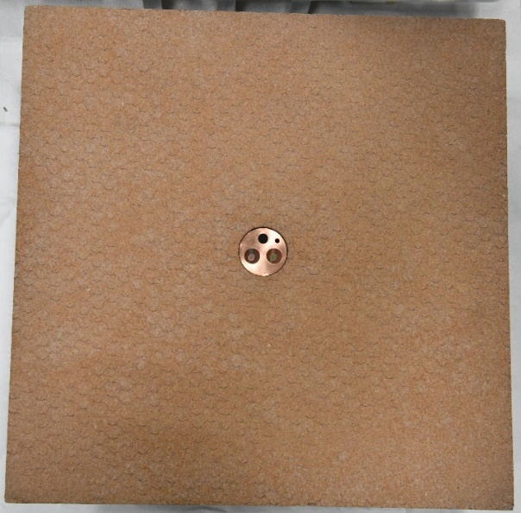
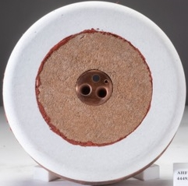
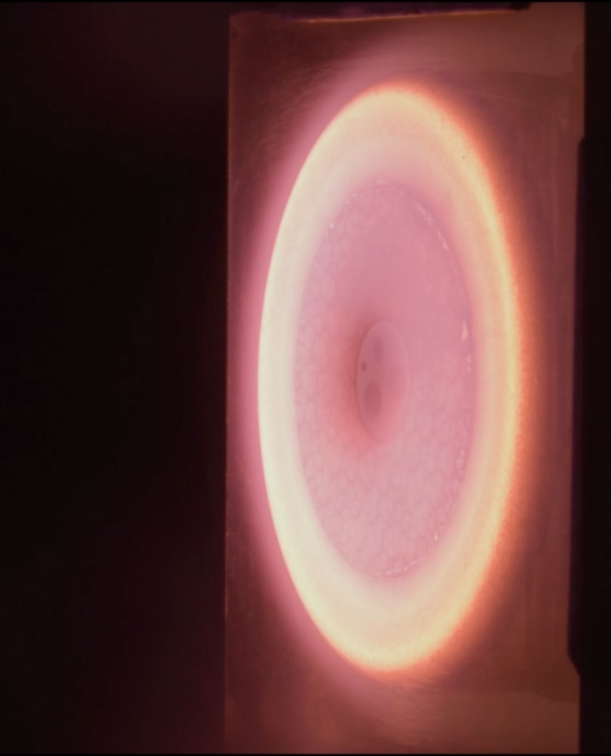
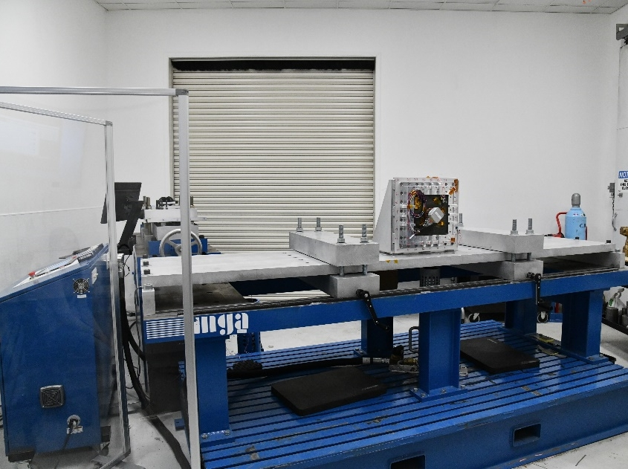
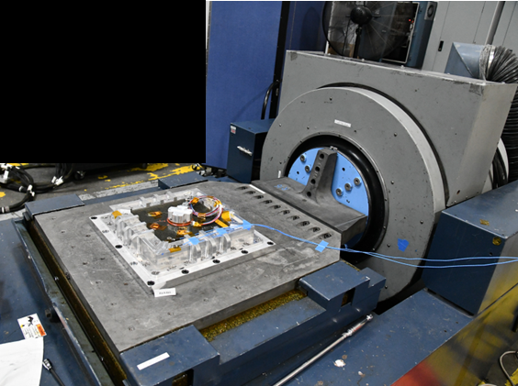
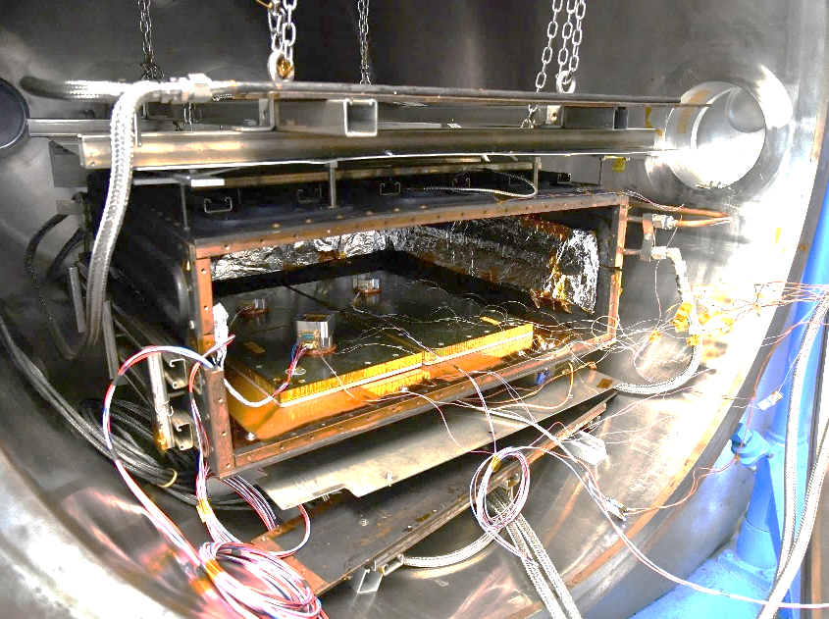
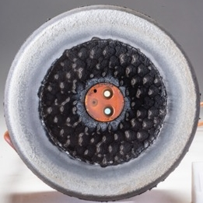
COSSTA Do-No-Harm Testing
Step 1. Receive 5 COSSTA sensors from DLR and perform functional checks
Step 4. Machine test panels and assemble 6” dia. flat face arc jet models
Pre-Test
Step 5. Perform arc jet testing
Step 2. Ship 5 COSSTA sensors to LM for installation in 12”x12” SLA test panels
Arc Jet Testing
Step 3. Receive 7 test panels (5 with COSSTA sensors, 2 blank) from LM and perform DNH environmental testing
Flow Direction
Shock Testing
Vibration Testing
TVAC Testing
Test Article
Slip Table
Test Article
Step 6. Perform post-test inspections and functional checks
Post-Test
Adapter Plate
Direction of Motion
Test Articles in TVAC Chamber
Pneumatic Cannon

Slide 5
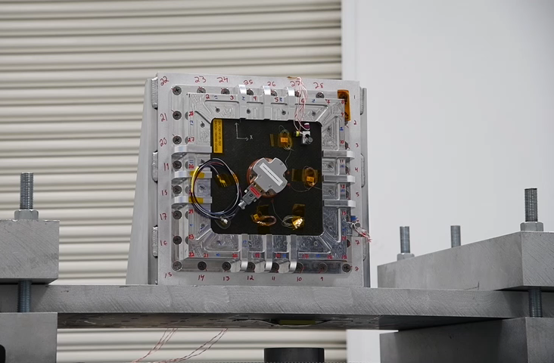
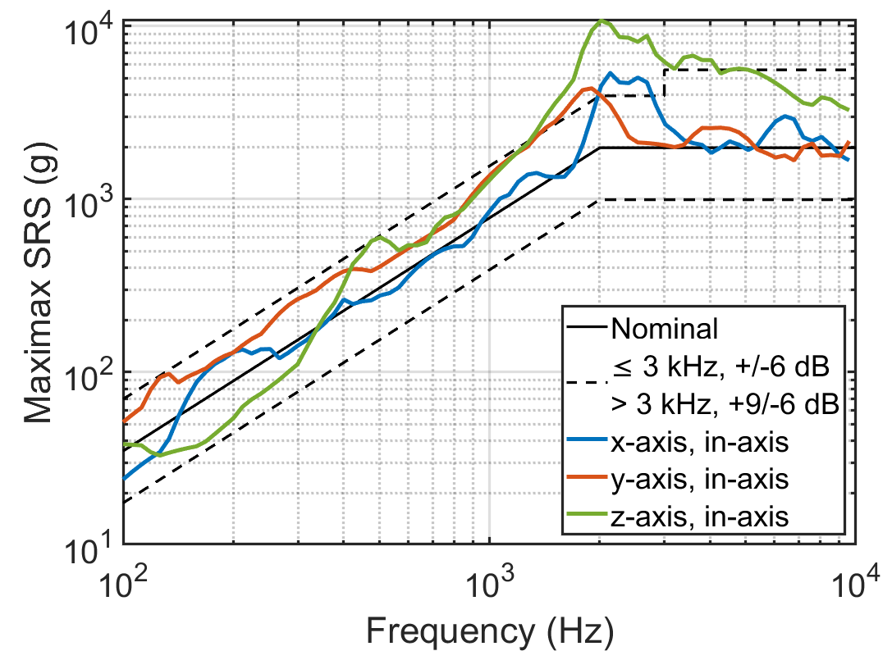
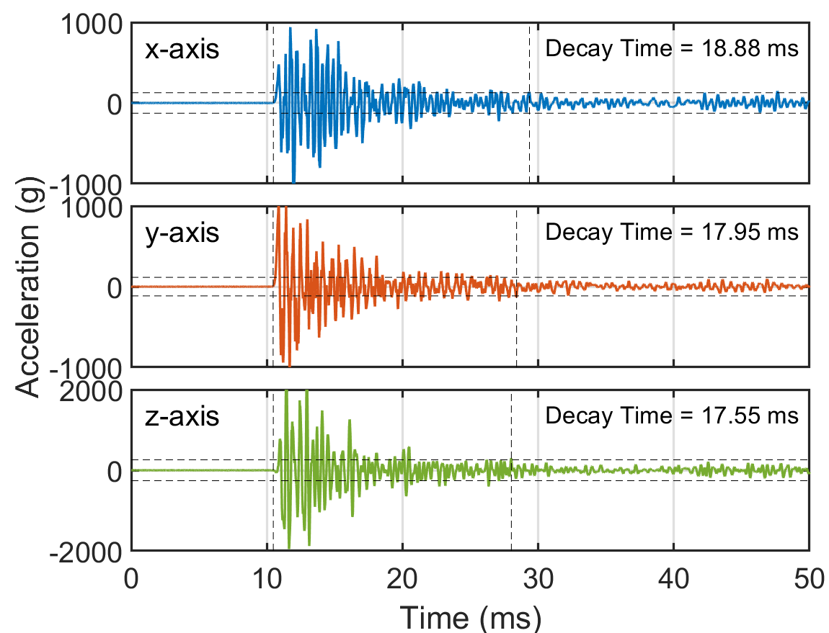
COSSTA Do-No-Harm Shock Testing
Test Facility: MGA Research Corporation (Hughson, CA)
Test Apparatus: Pneumatic cannon that impacts an aluminum beam
Shock Response Spectrum (SRS):
Test Article
Control Accelerometers
Frequency (Hz) | Peak Acceleration (g), Q = 10
100 | 35
2000 | 1980
10000 | 1980
Pneumatic Cannon
Results:
  Each DNH panel was subjected to one shock per axis
  Overtest at the knee of the SRS curve was accepted
  Time history was oscillatory with duration less than 30 ms
  Pre- and post-test visual and functional checks were passed
Aerothermal 1

Slide 6

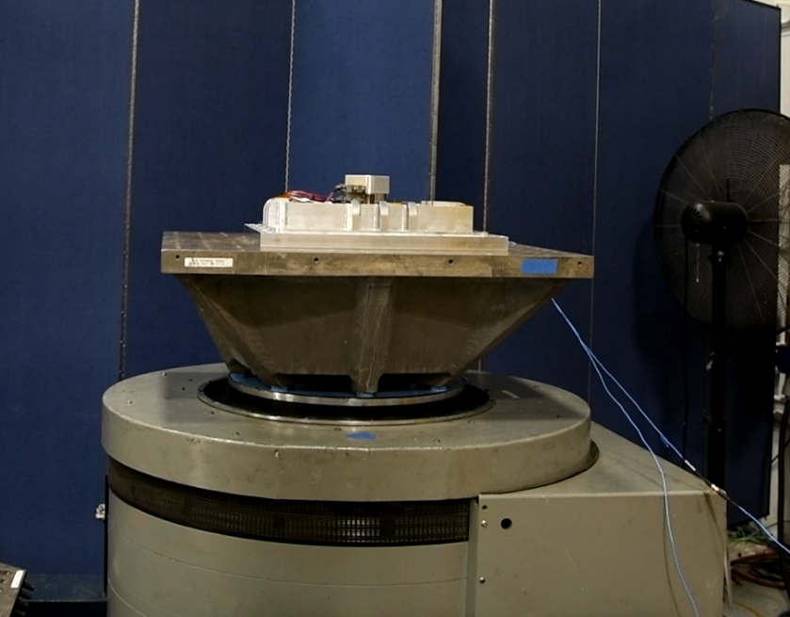
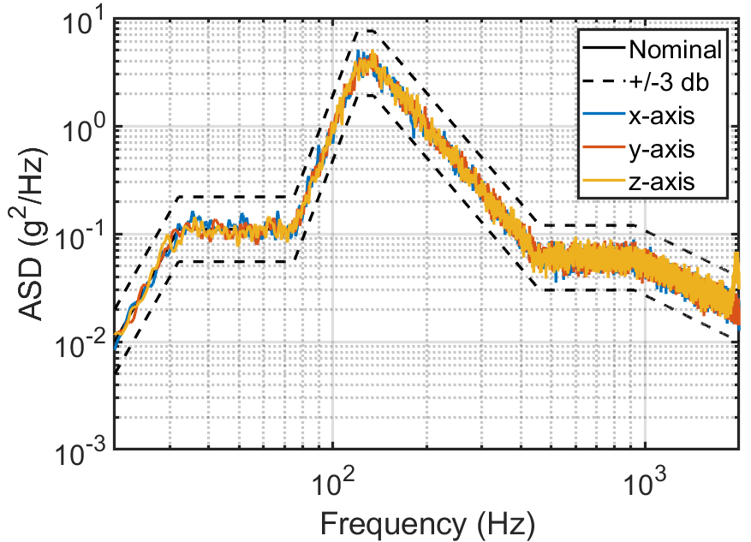
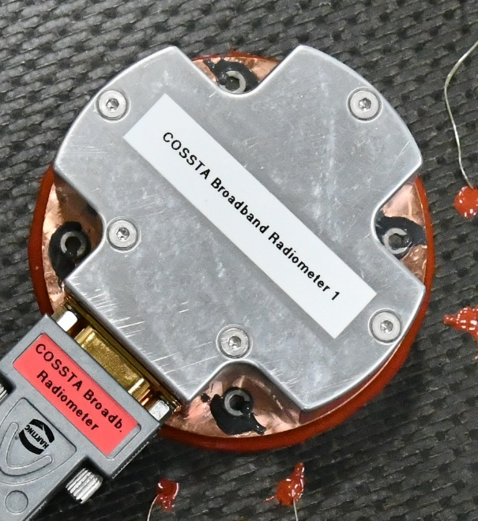
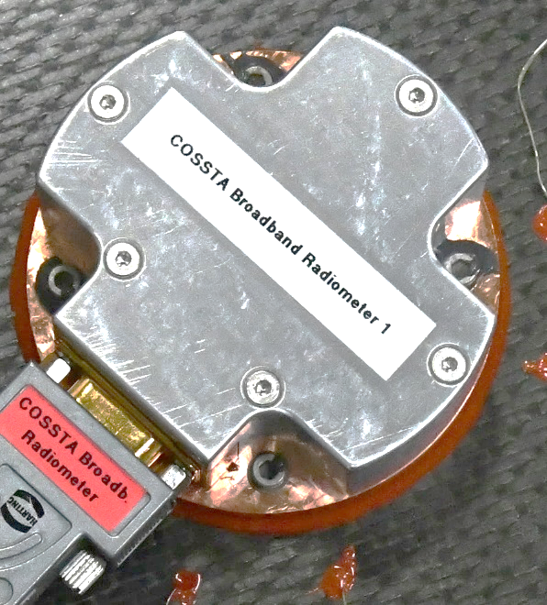
COSSTA Do-No-Harm Vibration Testing
Test Facility: NTS (now: Element US Space & Defense) (Fremont, CA)
Test Apparatus: Slip table and shaker head
Results:
  Required ASD achieved within tolerances
  Pre- and post-test visual and functional checks were passed
  Fastener staking issue considered a ground-test artifact, not a DNH failure
    This panel was used as a dummy mass for shock testing and experienced 69 shocks
Acceleration Spectral Density (ASD):
Test Setup for X and Y-Axes
Frequency (Hz) | Level (g²/Hz)
20 | 0.01
32 | 0.11
75 | 0.11
120 | 3.80
135 | 3.80
460 | 0.0599
925 | 0.0599
2000 | 0.02
G_{RMS} | 19.6
Duration | 1 min per axis
Slip Table
Test Article
Direction of Motion
Test Setup for Z-Axis
Pre-x-axis vibe
Post-x-axis vibe
Test Article
Direction of Motion
Aerothermal 1
Fastener staking
Shaker Head

Slide 7
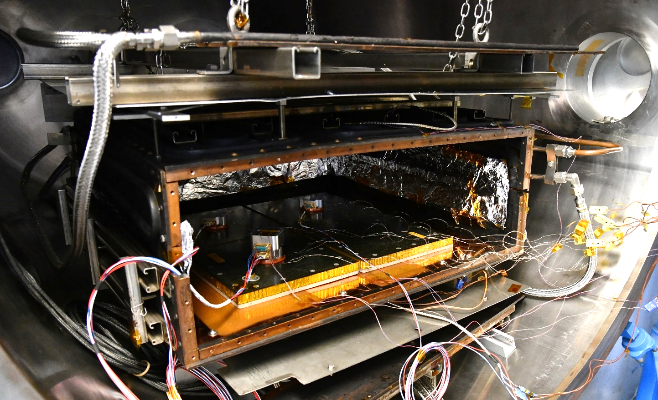
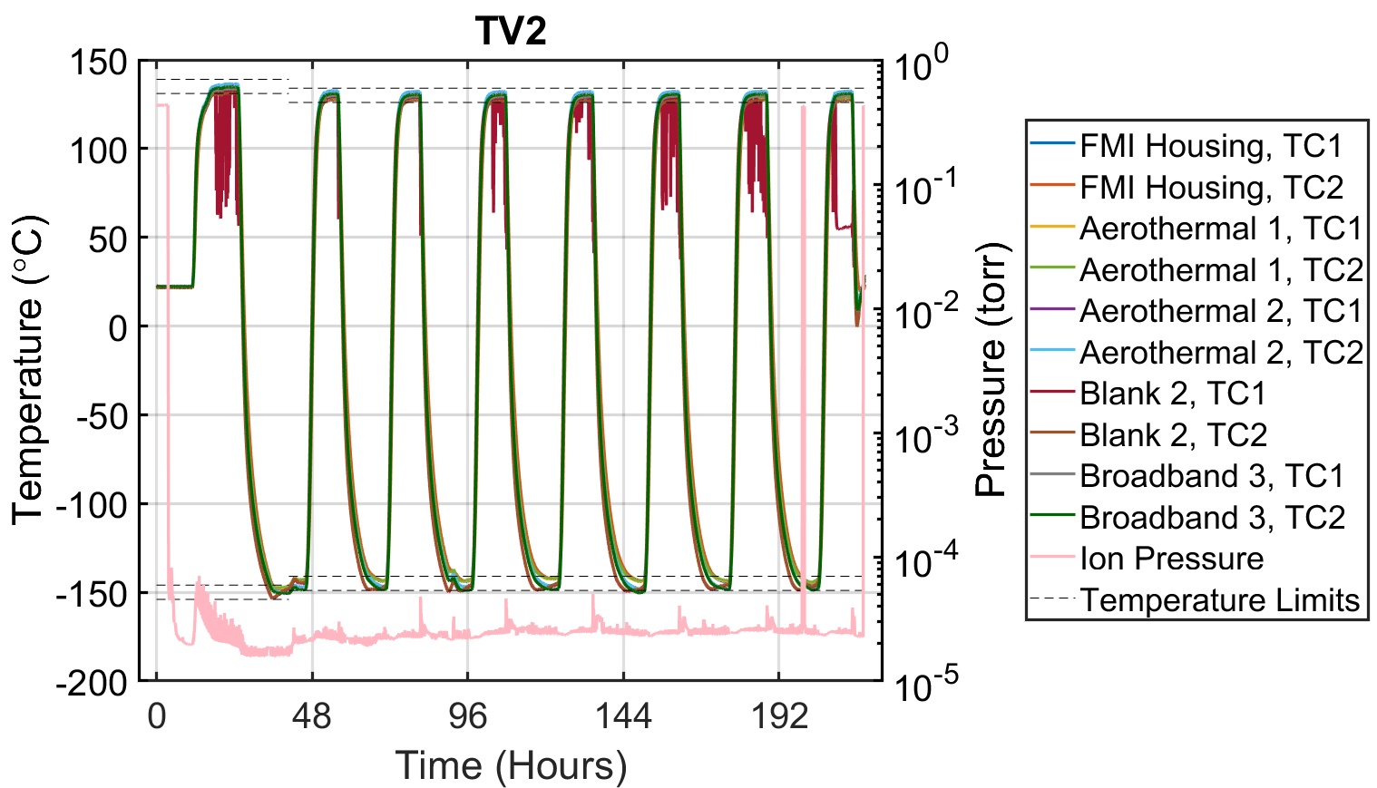
COSSTA Do-No-Harm TVAC Cycling
Test Facility: NTS (Los Angeles, CA)
Test Apparatus: 2x TVAC chambers
TVAC Test Temperatures and Requirements:
4 Test articles inside the “TV2” chamber
Description | Number Of Cycles | Target Temperature | Target Temperature (°C) | Temperature Tolerance | Pressure (torr) | Soak Time (hours)
 |  | Min | Max
Non-Operational | 1 | -150°C | 135°C | ±4°C | < 10⁻⁴ | 4
Operational | 7 | -145°C | 130°C | ±4°C | < 10⁻⁴ | 4
Results:
  Test temperatures and requirements were achieved
    TC1 in Blank SN2 displayed anomalous measurements
    Power outage at facility resulted in loss of vacuum for ~90 minutes
    Temperature tolerance exceedance (i.e., overtest) by ~1°C
  In situ measurements of COSSTA sensors performed as expected
  Pre- and post-test visual and functional checks were passed

Slide 8
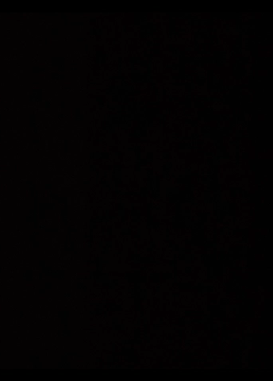
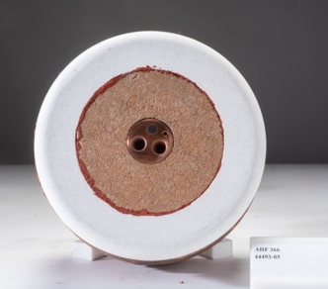
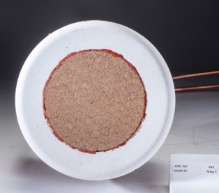
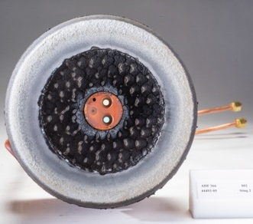
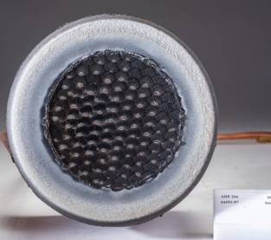
COSSTA Do-No-Harm Arc Jet Testing
Test Facility: Aerodynamic Heating Facility (AHF, NASA Ames)
Test Setup: AHF366, nitrogen test gas, 18” nozzle
  Prior to testing, models were cold soaked in liquid nitrogen to <-150°C
Calibrated Test Conditions:
  Target test conditions chosen based on margined predicted flight environments at the COSSTA sensor locations
Models tested at high condition
Condition | Cold-Wall Heat Flux on 6” Flat-Face (W/cm²) | Stagnation Pressure (kPa) | Exposure Duration (sec)
High | 69 | 1.7 | 37
Low | 49 (Facility Minimum) | 0.9 | 46
Aerothermal 1
Pre-Test
Blank
Pre-Test
Flow Direction
Results:
  No additional degradation of SLA for models with COSSTA sensors
  In situ measurements of COSSTA sensors successfully taken (data analysis is on-going)
    RTD (for COSSTA body temperature) output anomaly due to facility wiring issue
  Post-test COSSTA sensor functional checks were passed
Aerothermal 1
Post-Test
Blank
Post-Test

Slide 9
Conclusions
COSSTA DNH testing is complete!
DrEAM DNH results review with Dragonfly is planned for ~mid-2025… then on to flight hardware!
Lesson learned: Despite best efforts and planning, things will go wrong. Allow time in schedule to respond to issues.
  Stripped fastener heads
  Original vibe facility was not able to meet test levels
  Define plan of action for levels of overtesting
Broader take-away: Future flight instrumentation projects should consider leveraging heritage testing to meet DNH requirements and thus minimize environmental test campaigns. An inheritance review provides a forum to identify the bounding heritage tests and receive concurrence from stakeholders.
Check out these posters on Thursday!
  Mike Wilson, “DrEAM NASA Sensor Simulator to DLR Data Acquisition System Test”
  Alyssa Vellucci, “Dragonfly Entry Aerosciences Measurements (DrEAM) Suite Data Volume Estimates and Sensor Drift Characterization”
  Dropped torque wrench
  Tripped shock indicators during shipping of calibrated equipment
  Power outage

Slide 10
Thank you!
Questions?

