Slide 1
LOFTID Surface Heating Reconstruction June 12, 2024
Hannah Alpert¹, Steven Tobin²
¹NASA Ames Research Center
²NASA Langley Research Center
21st International Planetary Probe Workshop
Williamsburg, VA

Slide 2
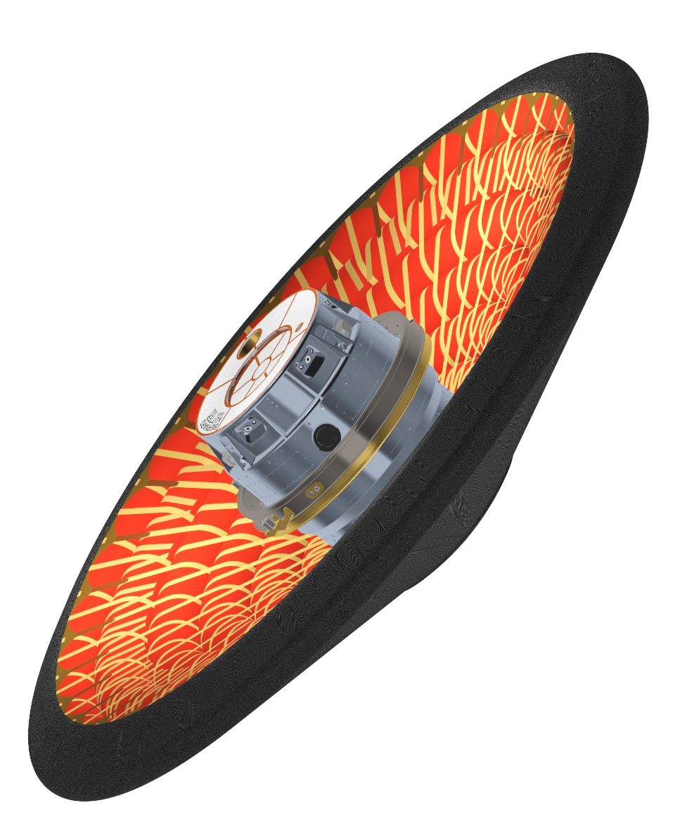
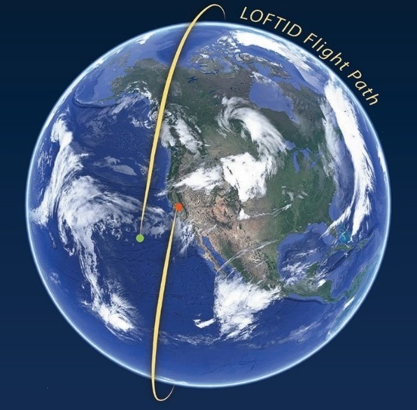
LOFTID Background
Hypersonic Inflatable Aerodynamic Decelerator (HIAD): softgoods aeroshell that can be packed and stowed for launch and cruise, then deployed prior to atmospheric entry to decelerate payloads
Low-Earth Orbit Flight Test of an Inflatable Decelerator (LOFTID): orbital entry of a Reentry Vehicle with an inflatable aeroshell, demonstrating HIAD technology at scale and entry conditions relevant for Earth and Mars
LOFTID launched on a United Launch Alliance (ULA) Atlas V rocket as a ride-share payload out of Vandenberg Space Force Base in November 2022
Extended Payload Fairing
JPSS-2
Primary Payload
Payload Adapter Canister
(LOFTID Stowed Within)
Centaur (Atlas V Second Stage)
Largest blunt-body aeroshell ever Entered at 8 km/s, and reached Mach 30

Slide 3
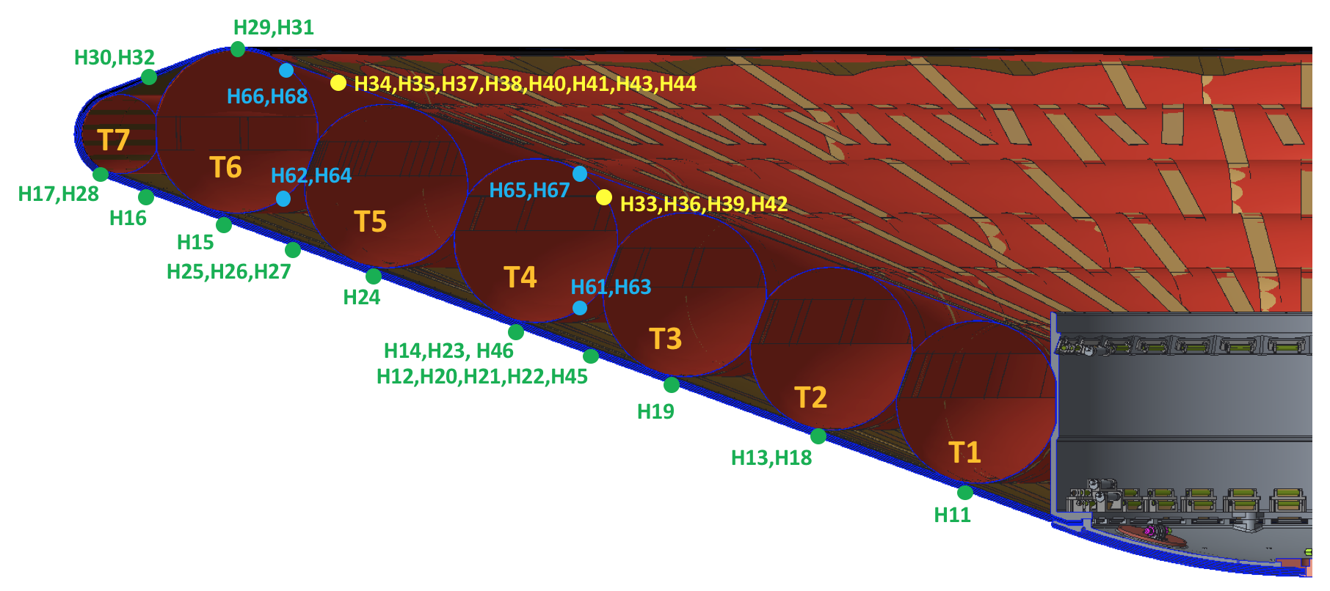
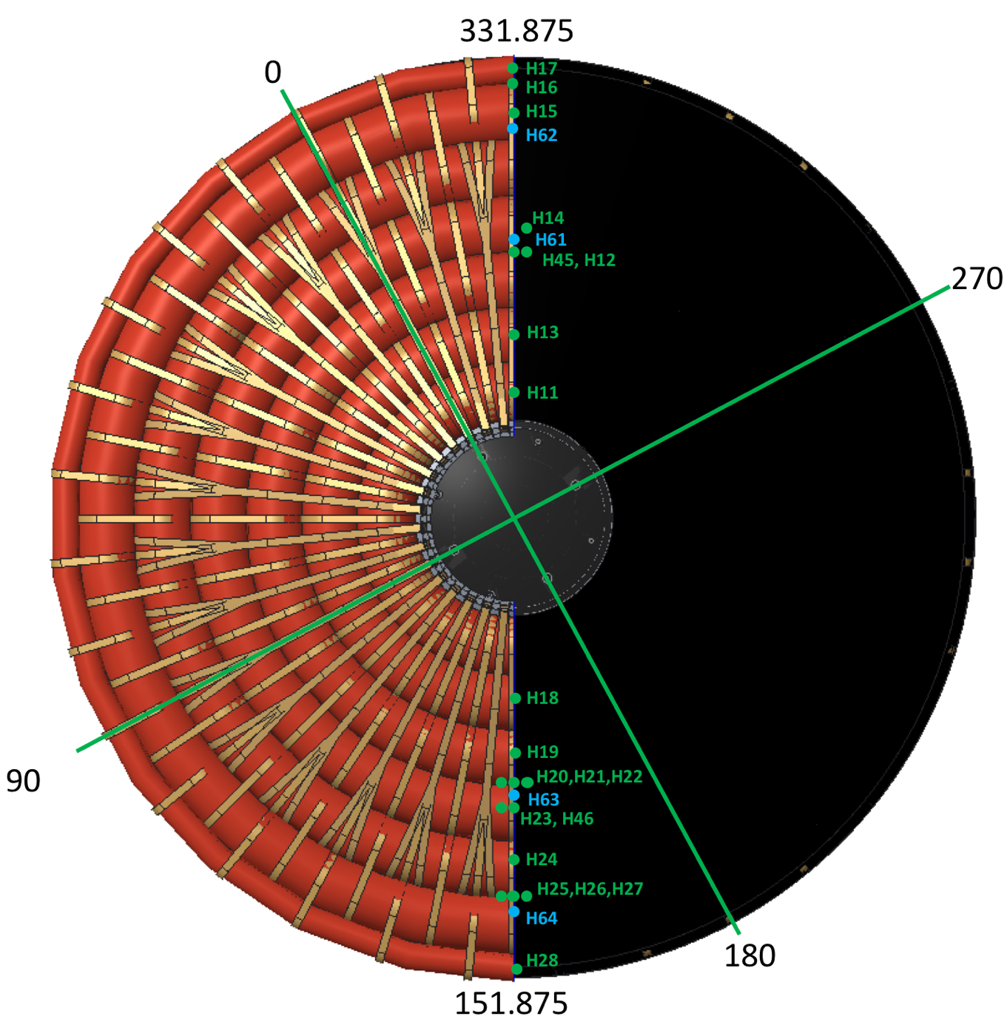
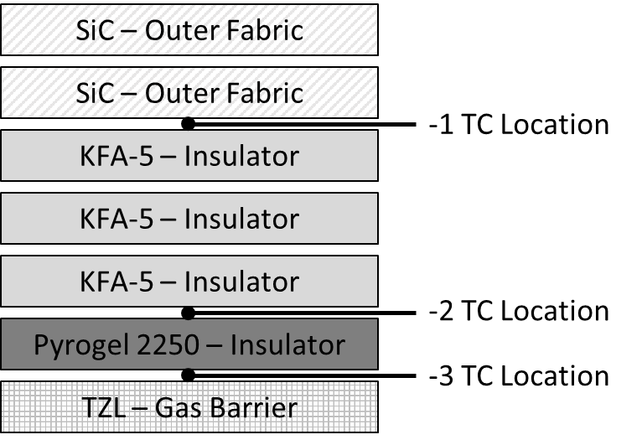
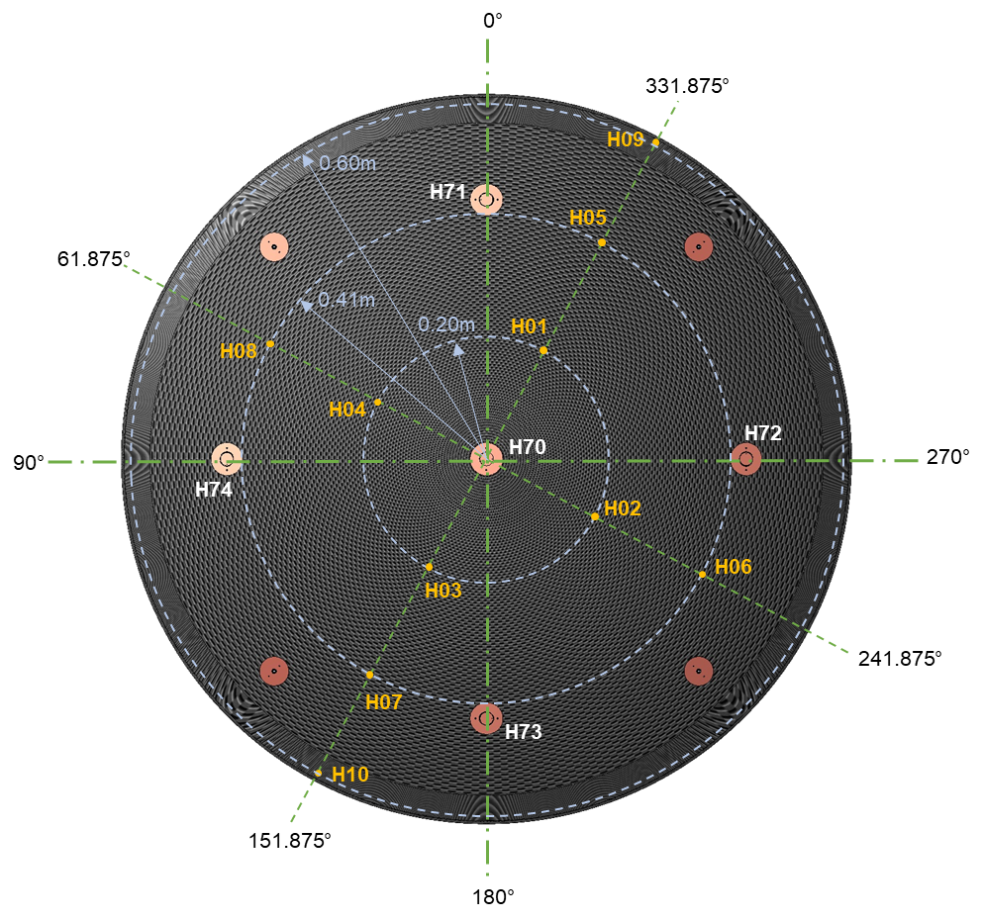
LOFTID Instrumentation: Heat Flux Gauges & Thermocouples
82 thermocouples at various depths distributed across the aeroshell
22 integrated into the FTPS on the rigid nose, 26 in the FTPS on the deployable structure, 24 on the inflatable structure
1 radiometer in the center of the nose surrounded by 4 total heat flux gauges
Flank FTPS In-Depth TC Locations
LTH71
Nose and Flank FTPS TC Types
Location | TC Type | TC Insulation
Nose, -1 | Type R | Flame Spray Alumina
Nose, -2 | Type N | Mica/Ceramic
Nose, -3 | Type K | Mica/Glass
Flank, -1 | Type N | Mica/Ceramic
Flank, -2 | Type K | Mica/Glass
Flank, -3 | Type K | Mica/Glass
LTH72
LTH74
LTH71 - THFS
LTH72 - THFS
LTH73 - THFS
LTH74 - THFS
LTH73
Notes:
Note, the Nose FTPS Layup is one less layer of ½KFA5.
It’s really ½KFA-5 layers, but this detail may not matter for this presentation

Slide 4
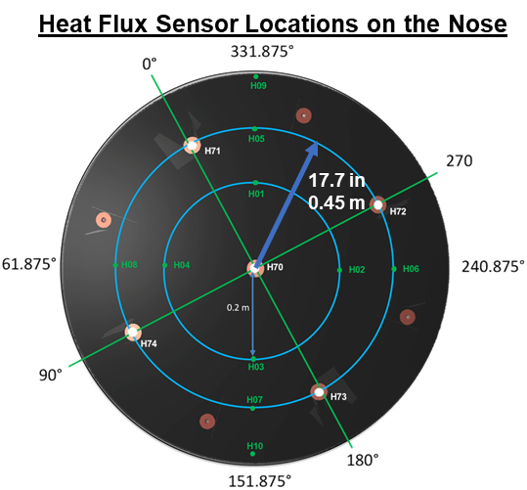
Inverse Surface Heating Background
Objective: Use flight TC data to estimate surface heat rate across the aeroshell during re-entry into Earth’s atmosphere
Evaluate fidelity of measurements from HFGs on the nose
Determine surface heat flux at aeroshell locations where heat flux gauges were not present
Estimate surface temperature across the aeroshell
Provide reliable heat flux boundary conditions to drive in-depth FTPS thermal model correlation to flight data
Method: Incorporate COMSOL’s Optimization Module into FTPS thermal model
A detailed COMSOL thermal model of the LOFTID FTPS was used to generate pre-flight heating predictions through the depth of the FTPS
Input near-surface TC data from flight as the target output temperature, type of function for the surface heat flux fit, and optimization solver parameters
Output estimate of calculated surface heat flux, temperature at TC depth, and surface temperature

Slide 5
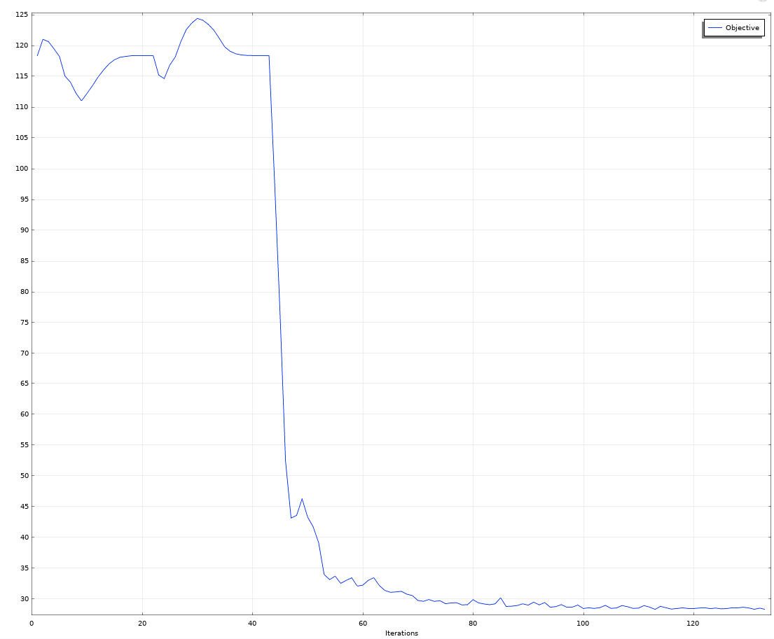
Optimization Parameters
Objective function: least squares difference between model temperature at TC depth and flight TC data
Control function: Bernstein polynomial (order n = 12 to 20)
Heat flux is optimized by multiplying the polynomial by the convective shock layer heat transfer coefficient C_{H}
Optimization Solver: Bound Optimization By Quadratic Approximation (BOBYQA)
Gradient-free method (explores region around current point by function evaluations only and uses that information to determine convergence)
Maximum number of model evaluations: 80-120
Number of iterations to convergence depends on order of polynomial but is ~60
Tried gradient-based solvers but did not get meaningful results
Convergence Plot

Slide 6
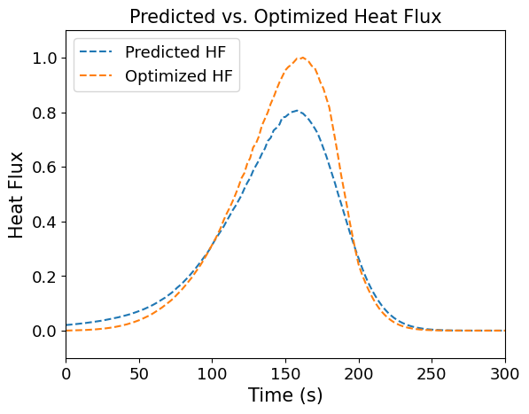
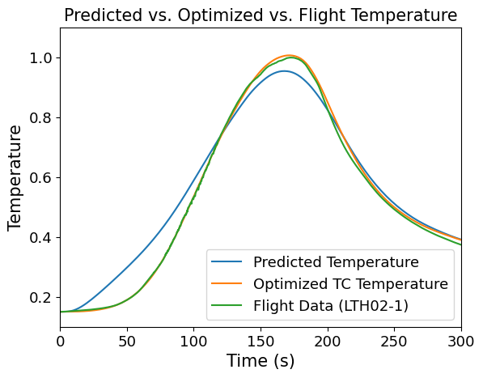
LTH02 Results (Highest Heating)
Reconstructed hot wall heat flux at LTH02 was greater than predicted stagnation point heating at the center of the nose
Vehicle was at an angle of attack (small effect)
Dimpled surface could have caused local heating augmentation
Normalized
Normalized
Notes:
Nice anticipation of questions regarding this result. In addition, the dimpled surface could have cause local heating augmentations that the TCs would pick up (to explain difference between heat flux at the same radials for an aeroshell rotating at 2RPM)

Slide 7
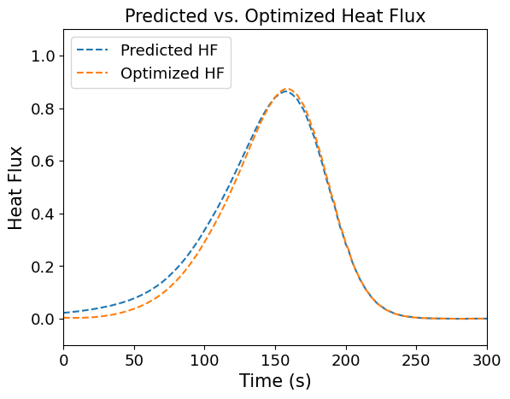
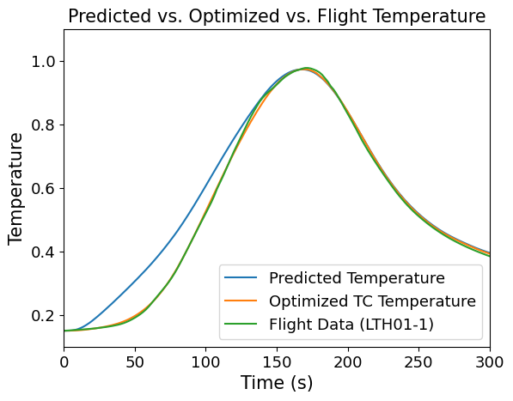
LTH01 Results
Reconstructed hot wall heat flux at LTH01 closely matches predicted stagnation point heating at the nose
Normalized
Normalized

Slide 8
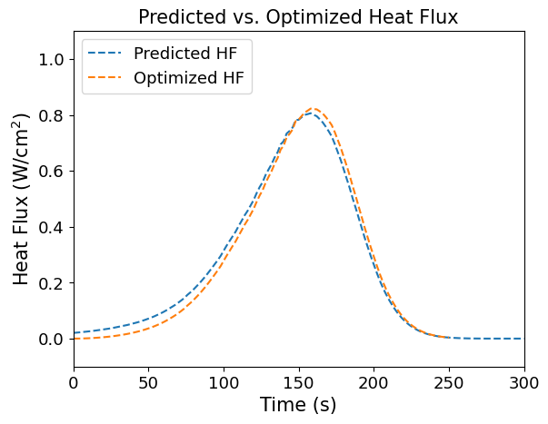
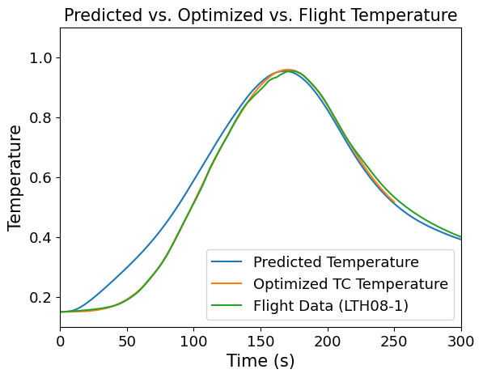
LTH08 Results (HFG Location)
Reconstructed hot wall heat flux at LTH08 slightly higher than that predicted at the LTH08 radial
Normalized
Normalized

Slide 9
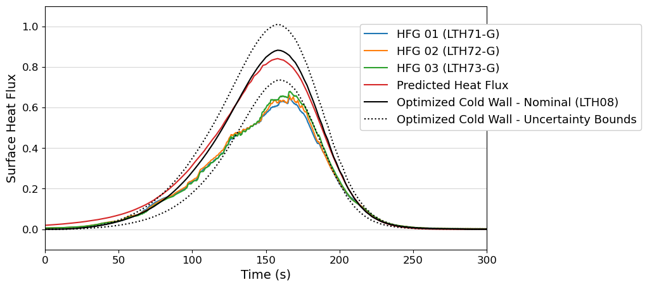
Comparison to Pre-Flight Predictions and HFG Data
Converted optimized heat fluxes from “hot wall” to “cold wall” to account for difference in surface temperature between hot FTPS and cooler HFG
Replaced wall enthalpy term in the heat flux calculation using the temperature from the HFG instead of the FTPS
Cold wall heat flux is ~6% higher than hot wall heat flux
HFG data is outside the uncertainty bounds in the reconstructed heat flux, suggesting that the measurement may not accurately represent the heat flux on the FTPS
Ring of RTV between the heat sink and the FTPS (burning off may have affected aerothermal environment)
Large copper sensor housing and heat sink are flat and sit slightly recessed compared to the FTPS
TC data does not show the “messy” behavior that the HFG exhibits, further suggesting it is not representative of heat flux on FTPS
Normalized
Notes:
Compare CW heat flux as calculated through inverse reconstruction to the HFG data

Slide 10
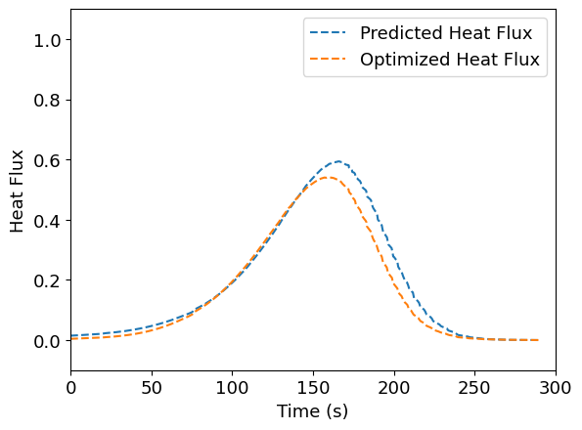
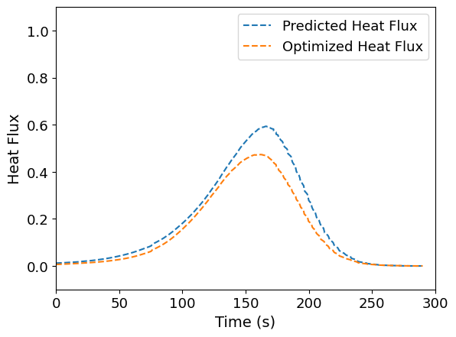
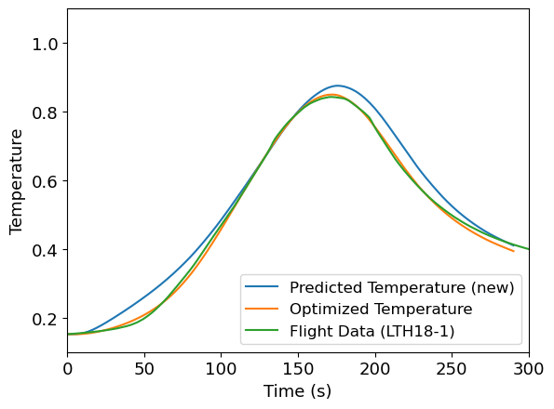
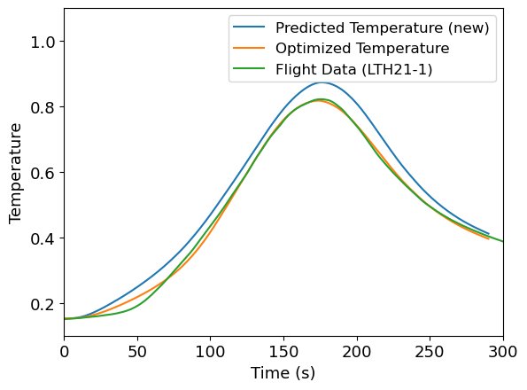
Preliminary Results: T2 and Valley
Reduction in heating from T2 to T3-T4 valley across ~0.5 meters is not exhibited in the predictions for fully turbulent flow
May indicate that the flow was more laminar (less turbulent) than assumed at mid-flank
LTH18
LTH21
Normalized
Normalized
LTH21
Normalized
Normalized

Slide 11
Results Summary
TC Name | Location | Peak Temperature | Peak Heat Flux
LTH01 | Nose | 0.978 | 0.874
LTH02 | Nose | 1.0 | 1.0
LTH08 | Nose (HFG Radial) | 0.955 | 0.822
LTH18 | T2 | 0.843 | 0.541
LTH21 | T3-T4 Valley | 0.822 | 0.474
LTH71
LTH72
LTH74
LTH73

Slide 12
Future Work
Conduct the same inverse heating reconstruction process for more flank and shoulder TC locations
Investigate causes of HFG behavior and mitigations for future missions
Results will contribute to FTPS/aeroshell thermal response model correlation
Improve pre-flight predictions for future missions such as VERA

Slide 13
Backup

Slide 14
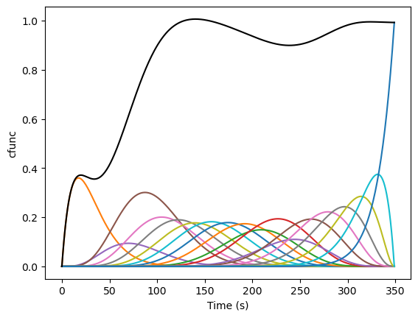
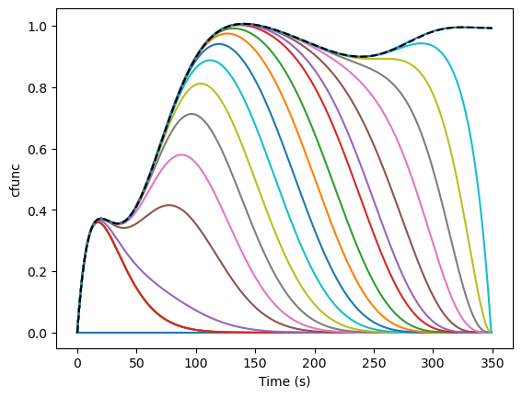
Bernstein Polynomials
The optimized function that is multiplied by the “initial guess” is called a Bernstein polynomial of order n=20
COMSOL provides the coefficients for each term in the polynomial summation
Adding up all the polynomials gives the final function

