Slide 1
Cryocooler Technology Opportunities within Space Exploration
B.T. Nugent¹
W.L. Johnson¹
R.J. Grotenrath¹
S.M. Kenny²
J.R. Stephens²
¹ NASA Glenn Research Center, Cleveland, OH 44135
² NASA Marshall Space Flight Center, Huntsville, AL 35808

Slide 2
Introduction
Several NASA missions for Lunar/Martian surface operations, as well as Lunar and Martian transport vehicles, requires long duration cryogenic fluid management to close.
The emerging need for cryogenic storage applications in the long duration space missions requires the optimization of existing technologies and development of innovative solutions.
This presentation will discuss:
  First order trades for optimization opportunities within cryogenic fluid management
    Compressor operation temperatures
    Optimization of intermediate shield temperatures
    Neon/Helium mixtures as a working fluid
  Gaps/Opportunities for industry development

Slide 3
Compressor Operational Temperature Trade
Various environments outside of the terrestrial sphere allow for adjusting the hot side temperature of a refrigeration system.
Trades balancing the mass of the power generation and heat rejection systems as a function of the temperature were conducted for four different environments: the Low Earth Orbit (LEO), the Lunar Surface, Near Rectilinear Halo Orbit (NRHO), and the Martian Surface.
Power systems considered were: Fission Surface Power (FSP), Photovoltaic Arrays with Li-ion batteries, and Regenerative Fuel Cells.
The use case was the hydrogen liquefaction system described by Johnson¹
  0.3 kg/hr of hydrogen
While the cryocooler mass itself was omitted, one would expect that at lower temperatures, the cryocooler mass would be lower due to less heat exchanger mass (either recuperator or regenerator).
Power Source | Specific Power (kg/Wpower) | Min mass compressor temperature (K)
Fission Surface Power (Lunar / Martian Surface) | 0.178 | ~200 K
NRHO – Photovoltaic + Li-ion battery | 0.052 | ~275 K
LEO – Photovoltaic + Li-ion battery | 0.058 | 250 – 275 K

Slide 4
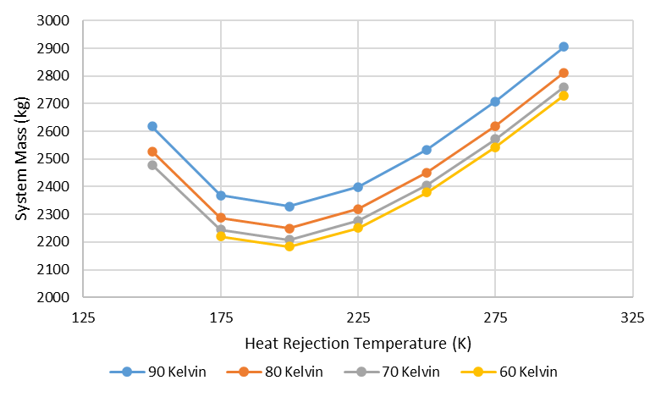
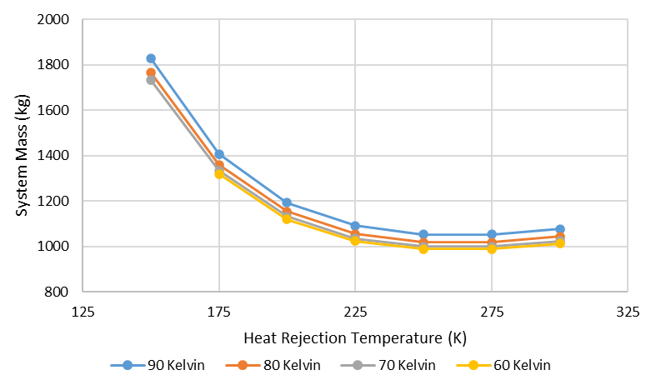
Compressor Temperature Trade Results
Lunar / Martian Surface - FSP
LEO – Photovoltaic + Li-ion

Slide 5
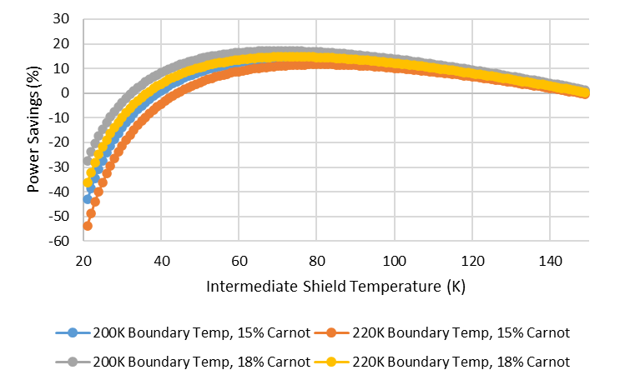
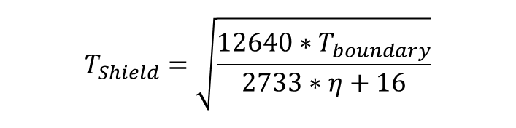
Intermediate Heat Rejection Temperature
Liquid hydrogen testing has demonstrated that utilizing a 2-Stage cryocooler system vs a 1-stage cryocooler system results in a cryocooler system mass reduction.
  Testing was done with a shield temperature at 90K.
A zero/first order analysis shows that shield temperature can be optimized to reduce power consumption as a function of the boundary temperature and Carnot efficiency.
  As Carnot decreases, the temperature for peak power savings increases.
$$T_{Shield}=\sqrt{\frac{12640∗T_{boundary}}{2733∗η+16}}$$
An example case, showing power savings for a system with a 10 Watt of passive heat load. A shield temperature of 70.5K, at a 200K boundary temperature and 18% Carnot efficiency results in 17.2% power savings.
Notes:
Negative power savings is interesting… What’s going on at the break-even/zero benefit point?

Slide 6
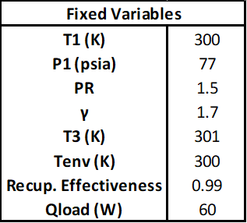
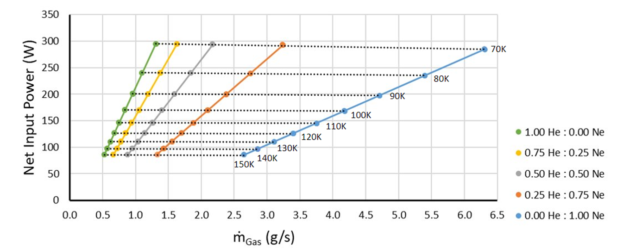
Mixed Gas Refrigerant Trade
Previous analysis suggests the potential for cryocooler design enhancements that provide an increase in cycle efficiency and a decrease in system mass when using mixtures of helium and neon as refrigerants.^{14,15}
A simplified first order RTB cryocooler model was considered to explore how refrigerant mixtures could impact the design of future RTB cryocoolers for space applications.
Pure helium, pure neon, and 3 helium to neon mixtures (3:1, 1:1, 1:3) were considered.
The RTB cryocooler model has 8 fixed assumptions.
The BAC exit temperature (recuperator low pressure, cold temperature) was varied, and the system mass flow was solved for each case to lift 60 W of heat imposed on the cycle.
Model Fixed Assumptions
Cryocooler Model Performance Results
Notes:
Need some bullets
Mixed units? (PSIA)
Why stop at 70K?

Slide 7
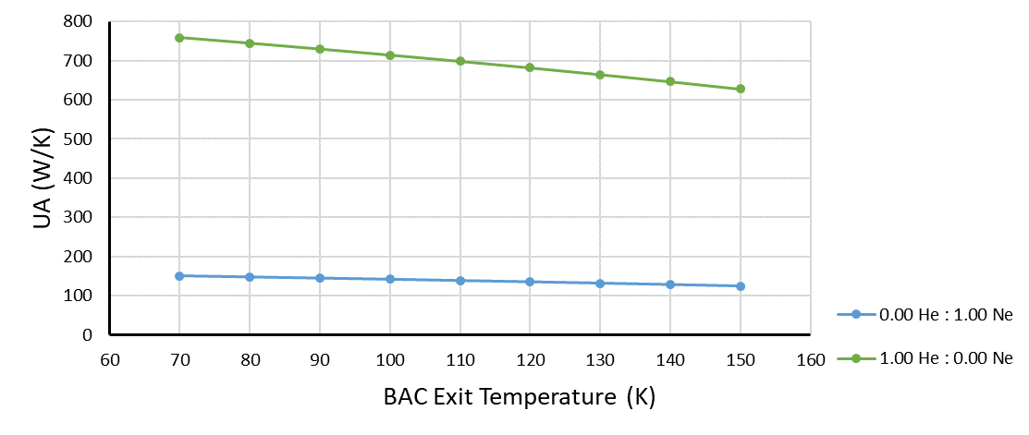
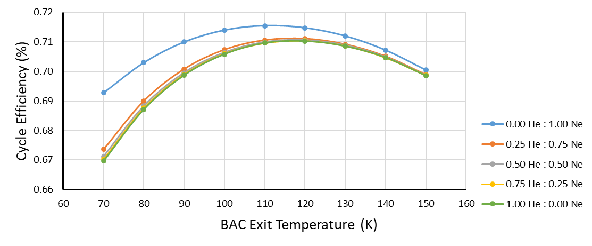
Mixed Gas Refrigerant Trade Takeaways
For a given heat exchange area in the model recuperator, helium would provide roughly 5 times the heat transfer rate than that of neon.
This is attributed to helium's high specific heat capacity.
Recuperator area and mass are the main trades of interest when considering pure or mixtures of helium and neon.
Recuperator Thermal Size (UA) Sensitivity
Pure neon and refrigerant mixtures with higher concentrations of neon than helium result in higher cycle efficiencies.
The increased cycle efficiency in the pure neon and neon mixtures is tied to compressor design.
Neon gas is easier to compress than helium gas due to their respective densities.
Pr
.
Cryocooler Model Cycle Efficiency Results
No one design choice will optimize a cryocooler's performance, but subsystem component trades should be considered to best address the cooling requirements.
Notes:
Need some bullets
Mixed units? (PSIA)
Why stop at 70K?

Slide 8
Gaps/Opportunities

Slide 9
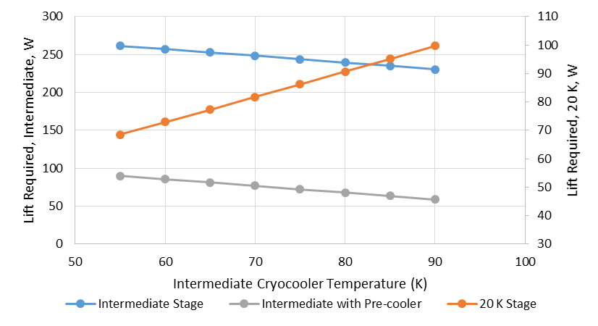
Gaps/Opportunities
Cold Compressor Design
  A compressor capable of operating between 175K – 225K
Reliability and Life Testing
  Long duration cryogenic missions to Mars > 5 years
  Reliability and life testing requires considerable time/budget
  Highly Accelerated life testing (HALT) with knowledge of life limiting features and operations
Modular Cryocooler Design
  Able to add/remove components, while maximizing system efficiency and quantifying integration and parasitic heat loss.
Hydrogen Liquefaction Cryocooler
  Capable of 70W - 100W of lift at 20K
  Capable of 250W of lift at 80K with a high turndown efficiency for an intermediate shield temperature.
Notes:
Modular in terms of switching during operation on a mission (in lieu of turndown?) or like legos that you can assemble to fit the mission in design phase? – BTN – I was thinking more like legos
Last sub-bullet: 80K doesn’t liquefy hydrogen? – BTN – Added that is for a shield temperature

Slide 10
Gaps/Opportunities
Broad Area Cooling Loop Design
  A BAC design for an advanced upper stage sized tank, maximizing lift capacity of the system while staying within cryocooler pressure drop capabilities.
Improved Turndown Efficiency
  The current SOA for a 20K cryocooler:
    91.6 W_{power}/W_{thermal} at 20 Watts of heat removal
    281.2 W_{power}/W_{thermal} at 3 Watts of heat removal
Non-RTB Cryocooler Designs for Space Applications
  Other thermodynamic cycles should be analyzed.
  Designs need to include cooling circulation capability and minimization of vibrations.

Slide 11
References
Nugent, B.T., Johnson, W.L., Stephens, J.R., and Guzik, M.C, “Space Exploration Applications for Development of High Capacity Cryocoolers”, Cryocoolers 21, R.G. Ross et. al. editors, pp 387, 2021.
Johnson, W.L., “Concepts for the Liquefaction of Hydrogen for In-Situ Operations on the Lunar or Martian Surface” presented at ASCEND 2023, AIAA 2023-4624, 2023.
Mason, L.S., “A Comparison of Fission Power System Options for Lunar and Mars Surface Applications”, NASA TM-2006-214120, 2006.
Mason, L.S. and Poston, D.I., “A Summary of NASA Architecture Studies Utilizing Fission Surface Power Technology”, NASA TM-2011-216819, 2011.
Mason, L.S., Gibson, M., and Poston, D., “Kilowatt-Class Fission Power Systems for Science and Human Precursor Missions”, NASA TM-2013-216541, 2013.
Personal communications with Lee Mason, EZ-Power.xlsx spreadsheet
Colozza, A.J., “Small Lunar Base Camp and In-Situ Resource Utilization Oxygen Production Facility Power System Comparison.”, NASA TM-20200001622, 2020.
NRHO description
Mars convection radiator
SMC-S-016
Plachta, D., Johnson, W., Feller, J., “Cryogenic Boil-Off Reduction System Testing,” 50th AIAA/ASME/SAE/ASEE Joint Propulsion Conference, (2014), AIAA 2014-3579.
Nugent, B.T., Grotenrath, R.J., Johnson, W.L. “20 Watt 20 Kelvin Reverse Turbo-Brayton Cycle Cryocooler Testing and Applications”, Cryocoolers 22, R.G. Ross et. al. editors, pp 327, 2022
Johnson, W. Tests at NASA Glenn Illustrate Thermodynamic Effects of Heat Intercept and Heat Reduction in Real Systems, Cold Facts, Vol 37, No 2, 2021, pp.20-21.
H. Quack, C. Haberstroh, I. Seemann, M. Klaus; “Nelium, a Refrigerant with High Potential for the Temperature Range between 27 and 70 K”, Phys Procedia, 67 (2015), pp. 176-182
A.K. Dhillon, P. Ghosh; “Study of reverse Brayton cryocooler with Helium-Neon mixture for HTS cable”, Materials Science and Engineering, Vol. 278 (2017)

