Slide 1
Electric Sail Design Sensitivities
John Inness, Aaron Houin, Daniel Tyler, Jaysal Shah

Slide 2
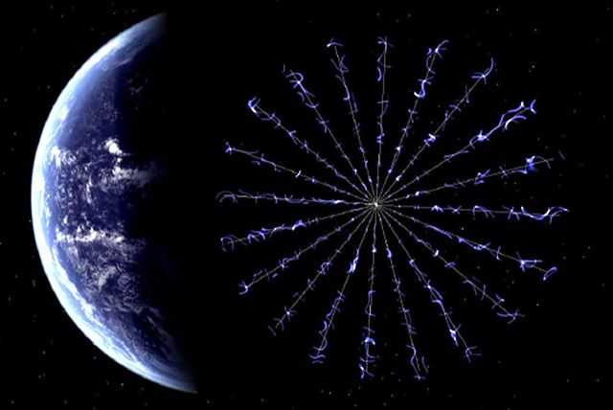
Electric Sails Overview
Electric sails are a propellentless form of propulsion that uses the momentum exchange from positively biased tethers and the solar wind
One of the driving design challenges is the GNC design of the sail system which is highly sensitive to design changes

Slide 3
Electric Sail Trade Space
Parameter Varied | Design Reference Value | Lowest Value | Highest Value
Length of Tethers | 8000 meters | 5000 meters | 11000 meters
Spin Rate | 0.005 rad/s | 0.0005 rad/s | 0.05 rad/s
Mass Ratio between Central Point and End Mass | Each End Mass is 12% of the Central Mass | Each End Mass is 4% of the Central Mass | Each End Mass is 34% of the Central Mass
Tether Voltage | 6000 Volts | 3000 Volts | 12000 Volts

Slide 4
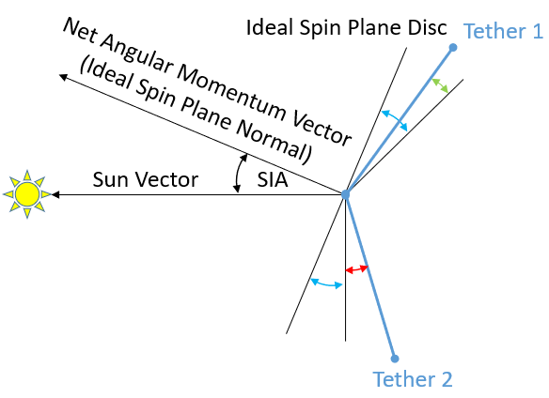
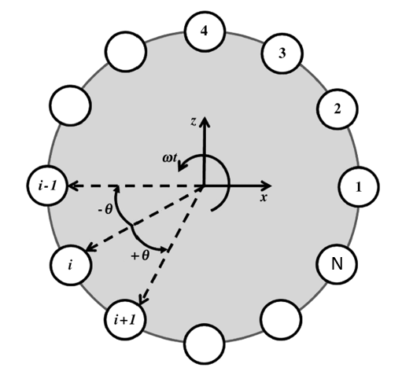
Key Performance Parameters
Key Performance Metric | Description | Ideal Performance
Characteristic Acceleration | Characteristic acceleration is the acceleration achieved by the sailcraft at 1 AU | Higher values are better than lower values
Cone Error | Deflections of the sail plane perpendicular to the direction of travel | Close to 0 degrees is ideal
Formation Error | Error between different end masses laterally | Close to 0 degrees is ideal
Slew Performance | Integrated sailcraft performance performing a slew | Smoothness of slew curve

Slide 5
Methodology
Parameters were varied on an electric sail GNC software and then the results were plotted
In initial design reference vehicle values were derived from the NIAC Phase 2 HERTS (Heliopause Electrostatic Rapid Transit System) was used focusing on a mission
GNC software then informed mission design for a sample Heliopause mission

Slide 6
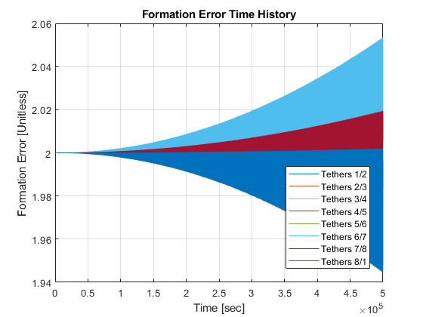


Results – Tether Length
Increasing tether length leads to an increased formation error which constrains the size. Graphs below featuring increasing tether length from left to right

Slide 7
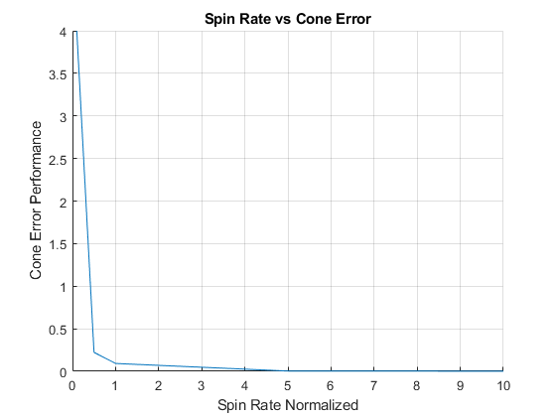
Results – Spin Rate
The driving error with spin rate is the cone error. Slower spin rates lead to a larger error while higher spin rates reduce this error but the relation between the two is inversely proportional with diminishing returns of increased spin rate

Slide 8
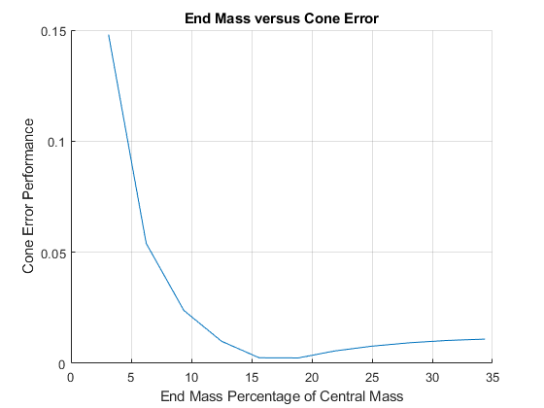
Results – Mass Ratio
Mass ratio between the individual end masses and central mass drives the cone error performance. Ideal range is between 15-20% of central mass with values outside of that range leading to worse performance

Slide 9
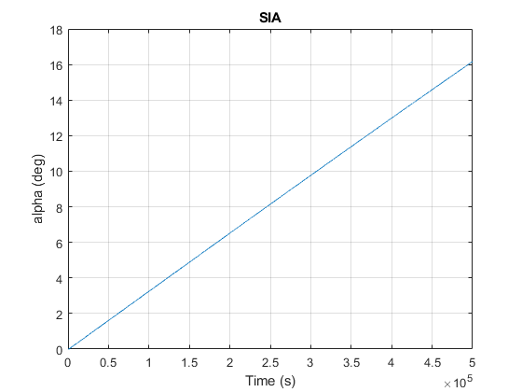
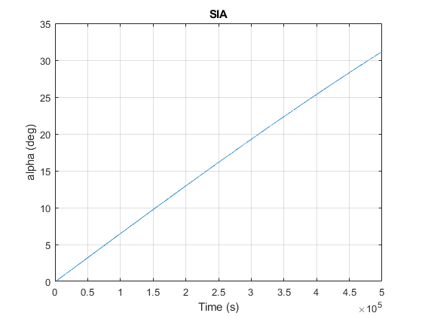
Results – Tether Voltage
Increased voltage leads to slightly worse cone and formation errors but leads to better slew performance. The plots to the left show slew performance with the bottom plot having a higher voltage than the top plot

Slide 10
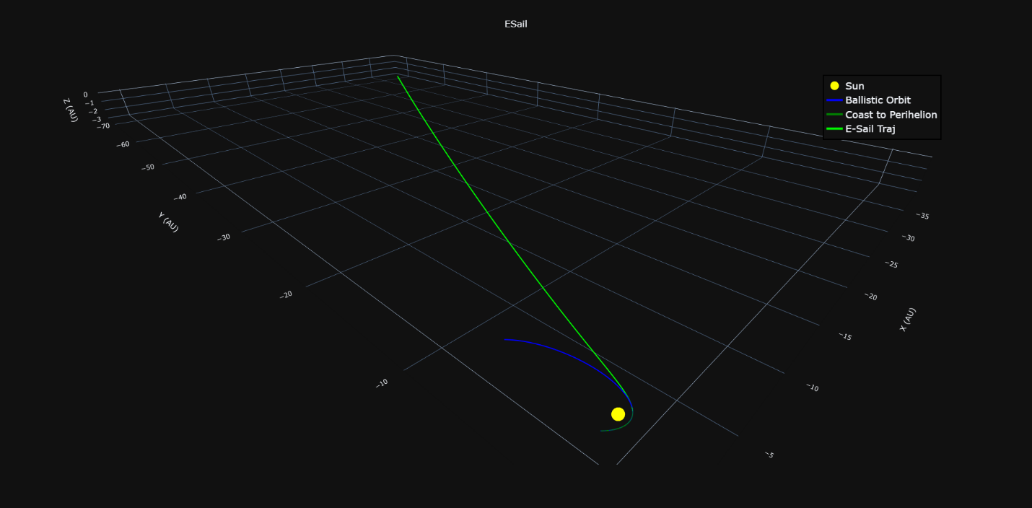
Results – Mission Design
Mission design was conducted in ASSET and characteristic accelerations were based on GNC results
Characteristic Acceleration (m/s²) | Time To Heliopause (years)
0.002 | 10.5999
0.004 | 8.4576
0.006 | 8.1539

Slide 11
Conclusions for E-Sail Designs
Parameter Varied | Old Design Reference Value | New Design Reference Value | Comparison
Length of Tethers | 8000 meters | 8000 meters | For this class of Electric Sails (150 kg), longer tethers increase control errors
Spin Rate | 0.005 rad/s | 0.005 rad/s | Different spin rates lead to larger formation and cone errors
Mass Ratio between Central Point and End Mass | Each End Mass is 12% of the Central Mass | Each End Mass is 16% of the Central Mass | Larger end masses lead to a more controlled formation
Tether Voltage | 6000 Volts | 9000 Volts | Higher voltage leads to better sail performance while not significantly impacting other control system errors

Slide 12
Next Steps
Utilize these design factors in updating a design reference vehicle
Further improvements and maturation of the ADCS software

Slide 13
Acknowledgements
MSFC Office of Chief Technologist for funding this short study
Previous E-Sail development efforts that led to the development of the control system software

Slide 14
Questions?

