Slide 1

An annoyance model for urban air mobility vehicle noise in the presence of a masker
Tyler Tracy, Matthew Boucher, Andrew Christian, Siddhartha Krishnamurthy, Durand Begault, Stephen Rizzi, Kevin Shepherd
NASA Langley Research Center, NASA Ames Research Center
June 12, 2024

Slide 2
Outline
Background: Urban Air Mobility
Masking Discount Hypothesis
Proposed Model
Psychoacoustic Test
Analysis
Results
Conclusions
2

Slide 3

Background: Urban Air Mobility (UAM) and Noise
Safe, efficient and accessible transportation for passengers and cargo ^{[1]}
Noise impact must be mitigated in communities where UAM operations take place ^{[2]}
Models of annoyance to UAM noise are needed ^{[3]}
[1] Thipphavong et al., “Urban Air Mobility Integration Concepts and Considerations,” 2018 Aviation Tech., Int., and Operations Conf., (2018)
[2] Hill et al., “UAM Vision Concept of Operations (ConOps) UAM Maturity Level (UML) 4’’, NASA (2020)
[3] Rizzi et al., “Urban Air Mobility Noise: Current Practice, Gaps, and Recommendations,” NASA/TP-2020-5007433 (2020).
3
Notes:
1st bullet:
Urban Air Mobility (UAM) operations offer an alternative to road and rail traffic for local and regional movement of people and goods.
The main goal of UAM is to provide…
2nd bullet:
Noise concerns will need to be overcome for large-scale UAM adoption.
For UAM operations to mature and be practical in a wide range of locations…
3rd bullet: A recent NASA white paper on UAM noise identified gaps and recommendations, such as…
Image on right:
New rotorcraft configurations -> new source of noise -> differences in sound quality
UAM noise will add to an existing soundscape. How will this background noise affect human response?
May induce a different human response than traditional vertical takeoff and landing vehicles.

Slide 4
Background: Focus of today’s talk
Annoyance model
Audibility
How does audibility affect annoyance?
Masking a UAM-like sound with background noise
How can we model the reduction (i.e., discount) on annoyance?
4
Notes:
Other facets of this annoyance model include Number of Events (Vaugh and Christian et al. NaN) and Sound Quality (Boucher et al. TUSQ)

Slide 5

Masking Discount Hypothesis
How does audibility (or masking) affect annoyance?
Hypothesis:
If a signal is partially masked → Annoyance is reduced (discounted)
Quantify detectability index (d’) like a perceptual signal-to-noise ratio
  Audibility Threshold when d’ = 1,
    Signal audible about 50% of the time
    Doubling d’ corresponds to a 3 dB gain in signal level
[4]
$$d′$$
Background
Noise
Signal +
Background Noise
[4] Green, “Auditory detection of a noise signal,” J Acoust Soc Am 32, 121 (1960)
5
Notes:
Detection, or d’, comes from signal detection theory. Human hearing context: if you have an internal representation of a sound in the presence of a background noise, then d’ is a measure of the distance between two distributions: one representing the noise alone and another representing the signal in the presence of the noise. D’ is this perceptual difference that signal detection theory tries to model.
It depends on bandwidth of auditory filters, duration, summation and observer efficiency. It is not a simple equation of signal-to-noise ratio.
Efficiency factor, bandwidth time correction, auditory filter bandwidth correction, high frequency adjustment.
Look for Andy’s aeroacoustics Appendix for more explanation of d’.

Slide 6
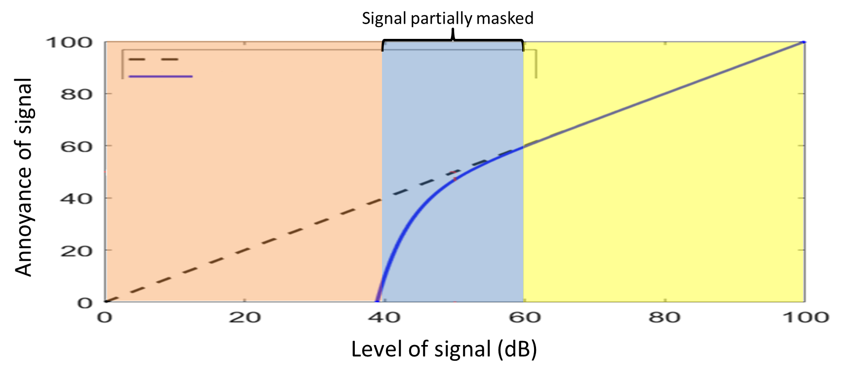

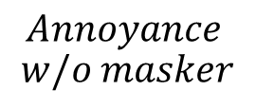

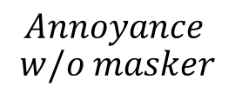
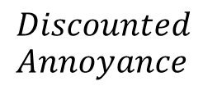
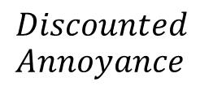
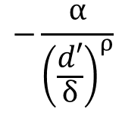



Proposed Model
$$Discounted$$
$$Annoyance$$
$$=$$
$$Annoyance$$
$$w/o masker$$
$$Discounted$$
$$Annoyance$$
$$=$$
$$Annoyance$$
$$w/o masker$$
$$−\frac{α}{{\left(\frac{d′}{δ}\right)}^{ρ}}$$
[5]
$$+$$
$$w_{D}(d^{′})$$
Annoyance w/o masker
Discounted Annoyance
Signal ~= Masker:
Annoyance of signal is discounted
Signal << Masker:
Signal >> Masker:
Annoyance of signal negligible
Annoyance of signal unaffected by masker
[5] Christian, “The effect of background noise on human response,” NATO/STO-TR-AVT-314.
6
Notes:
Testing approach is based upon a proposed empirical model. The form of the blue curve is restrained based on 3 regions: where the annoyance is unaffected by the masker, where the annoyance is discounted due to partial masking, and a region where annoyance of the signal is negligible because it is not audible due the masker.
Point out that this model is for the annoyance response to the signal only. It is possible that when the signal level is low, annoyance responses may contain a component due to perception of the masker. We are considering this as a potential complicating factor and our test design and analysis is able to see if this is important or not.

Slide 7
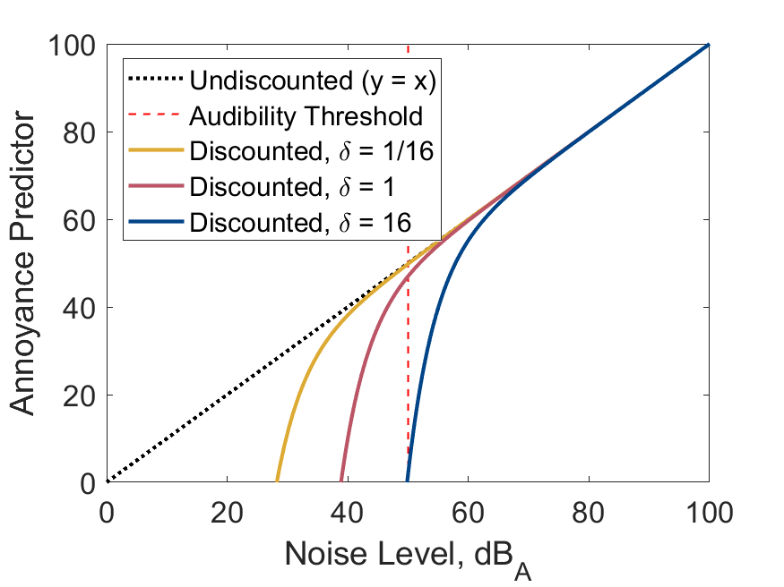
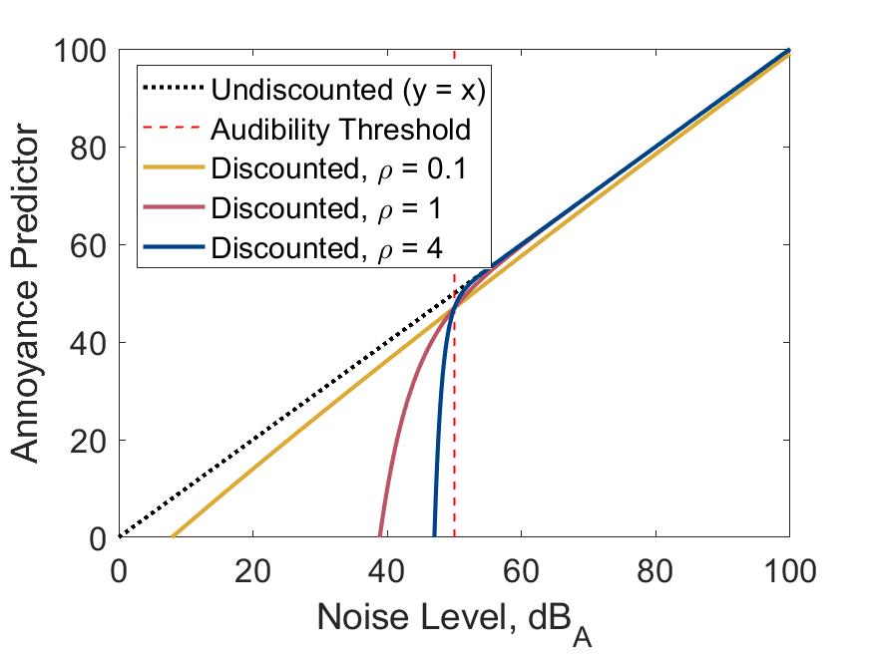
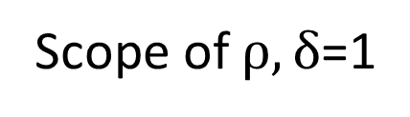
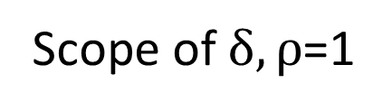
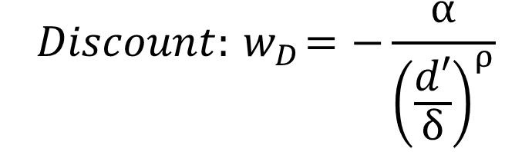
Discount Form
3
$$Discount:{ w}_{D}=−\frac{α}{{\left(\frac{d′}{δ}\right)}^{ρ}}$$
Scope of $δ, ρ$=1
Scope of $ρ,δ$=1
Signal
Signal
7
Notes:
- Fix alpha to 3 to reduce number of free parameters. Reason in paper
- Black dashed line is a linear relationship between target sound noise level and annoyance predictor (i.e. unmasked case). Red dashed line represents audibility threshold determined by d’ = 1.
- Delta determines the “roll-off point” of annoyance vs level relative to the audibility threshold d’. High values of delta indicate a stronger discount.
- Rho determines the steepness of the roll-off. Low values of Rho indicate not much discount. High values of rho indicate a steeper discount with a smaller partially-masked region.

Slide 8
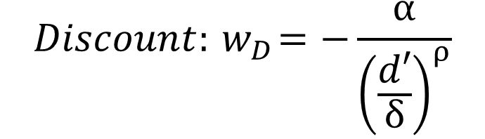
Psychoacoustic Test Goals
Measure d’,
Measure Equal Annoyance Points (EAPs),
Predict EAPs using measured d’,
Compare EAP predictions with measurements to determine values of discount parameters δ and ρ
$$Discount:{ w}_{D}=−\frac{α}{{\left(\frac{d′}{δ}\right)}^{ρ}}$$
8
Notes:
EAP = Relative difference in level when two sounds are equally annoying. More on this later.

Slide 9
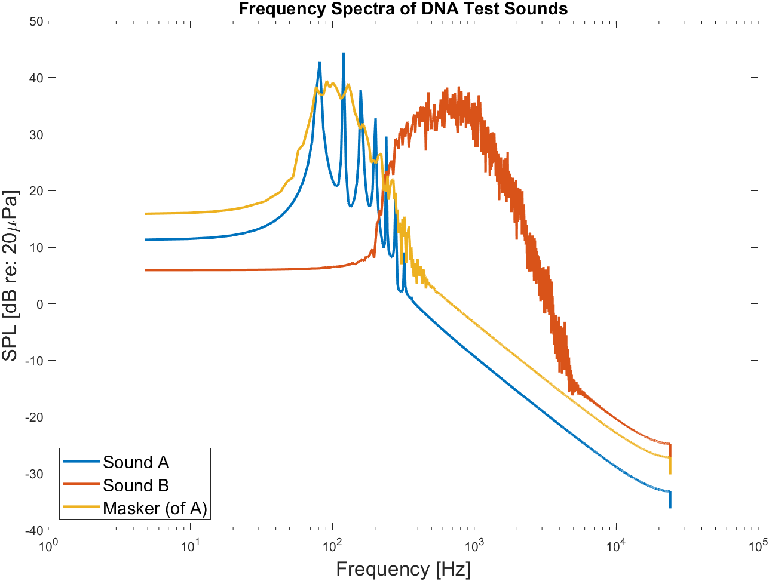
Psychoacoustic Test Content
5 Subjects
Sound A: Harmonic tone complex (80-320 Hz)
  Similar to rotorcraft loading and thickness noise
Sound B: Shaped broadband noise (300-2000 Hz)
  Similar to rotorcraft self noise
Masker: Designed to mask Sound A
  Equal amount of masking in 1/3 octave bands ^{[6]}
[6] Sneddon et al., “Laboratory study of the noticeability and annoyance of low signal-to-noise ratios sounds” NCEJ, 51 (5), 2003.
9

Slide 10
1. Measuring d’
Three Alternative Forced Choice (3AFC) adaptive staircase method to determine d’ [7]
  All three intervals contain masker, only one interval has a target sound
  “Which interval had the extra sound?”
  Find subject's Detection Threshold d’
  Extrapolate d' at other relative gains
[7] Boucher and Christian, ICHIN III TM , 2024.
10
Notes:
All 3 intervals have masker, only 1 interval has a target sound
3 down, 1 up from high end
2 down 1 up from low end
Detection Threshold of Masker at convergence level. Extrapolate d' to get at other gains
Annoyance comparisons: we need to know how well subject hears the sound so that we can measure effect of masking on annoyance.
Need to know d' at different levels of target sound relative to masker
Extra: d’ changes via relationship 2^(deltaG/3), where deltaG is the difference in gains of the target sound A and the masker

Slide 11
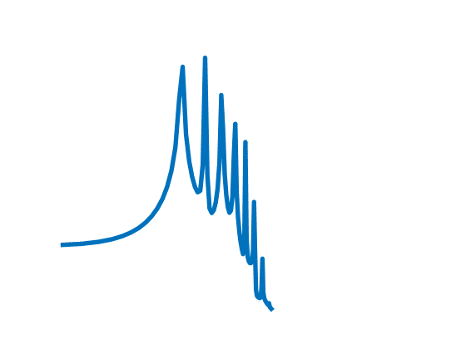
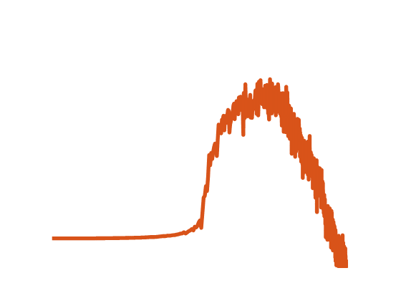
2. Measuring
Equal Annoyance Points (EAPs)
Paired Comparisons to determine how masking changes EAPs
  At what relative level is Sound A equally annoying to Sound B?
  No masker → Unmasked EAP
Sound A
Sound B
Sound Level
Sound Level
Frequency
Frequency
11
Notes:
- Every paired comparison had sound A in one interval and sound B in the other interval. Both intervals contained the same level of the masker. The responses were always comparing sound A to sound B.
- Unmasked EAP: Relative difference in level where Sounds A and B are equally annoying

Slide 12
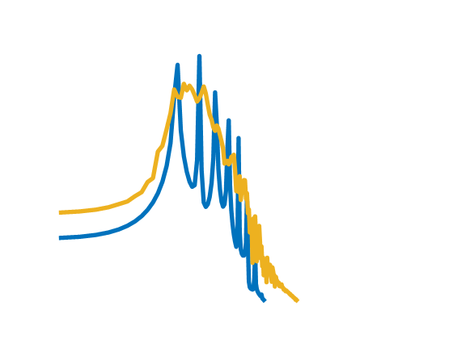
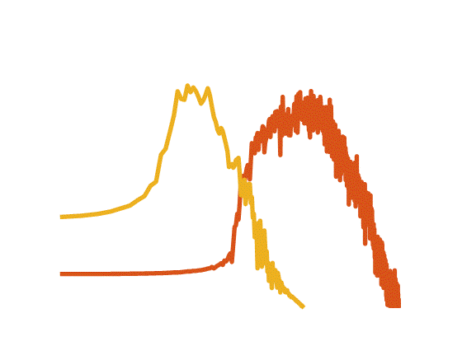
2. Measuring
Equal Annoyance Points (EAPs)
Paired Comparisons to determine how masking changes EAPs
  At what relative level is Sound A equally annoying to Sound B?
  With masker → Masked EAP
Vary signal levels and masker levels
  6 total EAPs measured
Sound A with Masker
Sound B with masker
Sound Level
Sound Level
Frequency
Frequency
12
Notes:
- Masked EAP: Relative difference in level where Sounds A and B are equally annoying, with the same masker played in each.
6 total EAPs measured. Unmasked, Loud and Soft signals at masker gains of 15dB and 25dB, Loud signals at masker gain of 35dB
Every paired comparison had sound A in one interval and sound B in the other interval. Both intervals contained the same level of the masker. The responses were always comparing sound A to sound B.

Slide 13
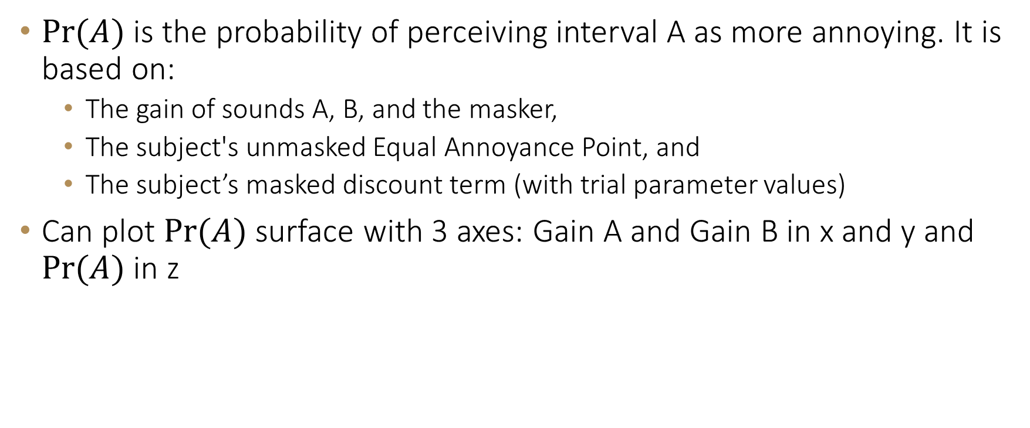
3. Predicting Equal Annoyance Points (EAPs)
$Pr⁡(A)$ is the probability of perceiving interval A as more annoying. It is based on:
  The gain of sounds A, B, and the masker,
  The subject's unmasked Equal Annoyance Point, and
  The subject’s masked discount term (with trial parameter values)
Can plot $Pr⁡(A)$ surface with 3 axes: Gain A and Gain B in x and y and $Pr⁡(A)$ in z
13
Notes:
Use sound levels, EAPs, and discount terms with trial parameter values to calculate Pr(A)
Pr(A) uses a normal cumulative distribution function with 0 mean and a standard dev. of 2dB
For C_M, the unmasked EAP is 0dB
C_B and C_M become negligible except when at low gains of sound B and the masker

Slide 14
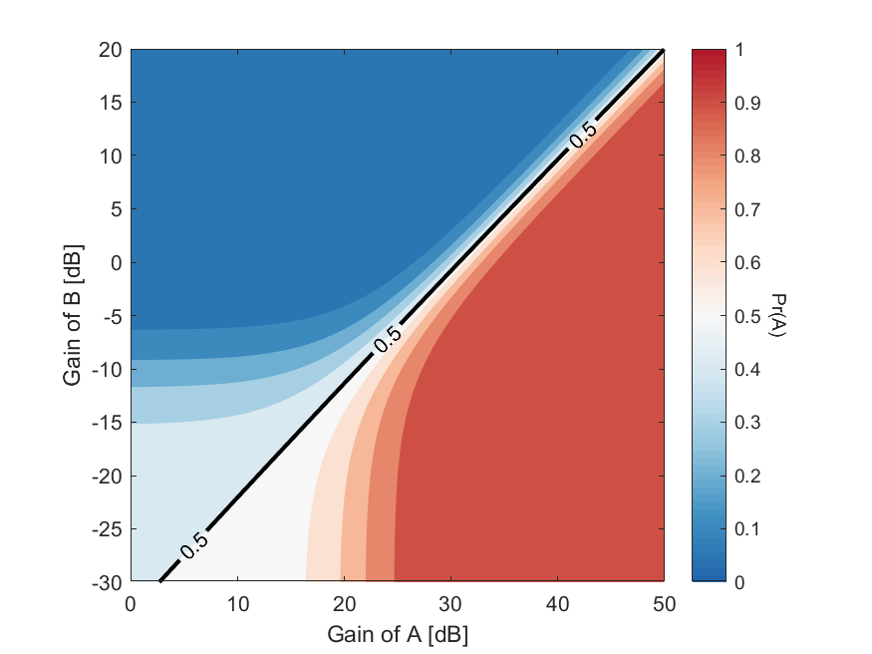
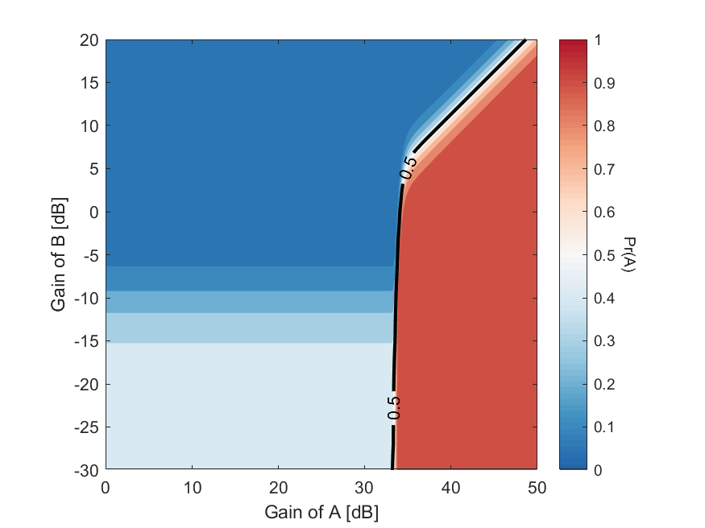

3. Predicting Equal Annoyance Points (EAPs)
Plot $Pr⁡(A)$ using trial values for δ and ρ.
  Predicted EAPs shown as $Pr⁡(A)$ = 0.5 black line
δ = 0.2 and ρ = 0.1 at a masker gain of 25 dB
δ = 20 and ρ = 10 at a masker gain of 25 dB
14
Notes:
Pr(A) is the color bar ranging from 0 (blue) to 1 (red).
Range of delta and rho values shown across these plots

Slide 15
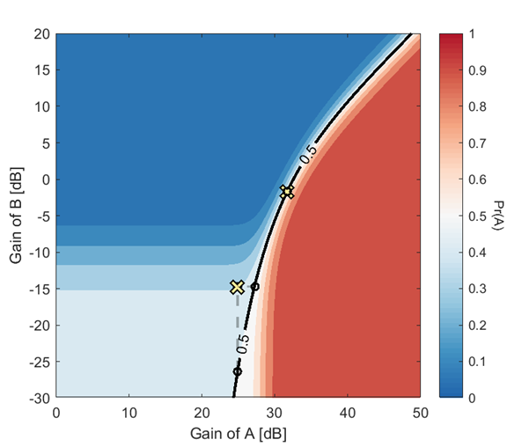
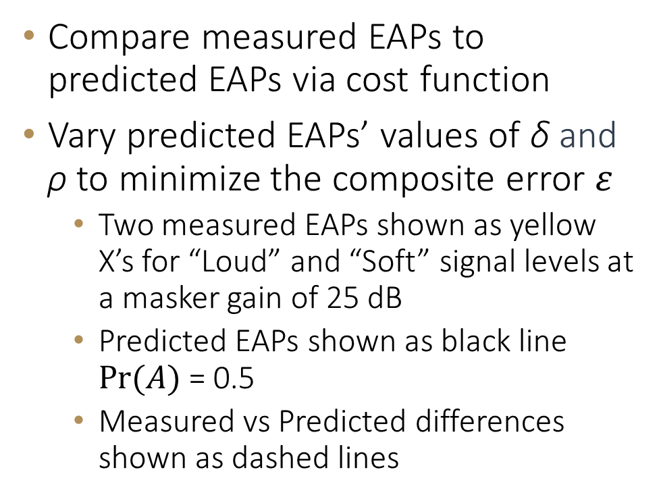
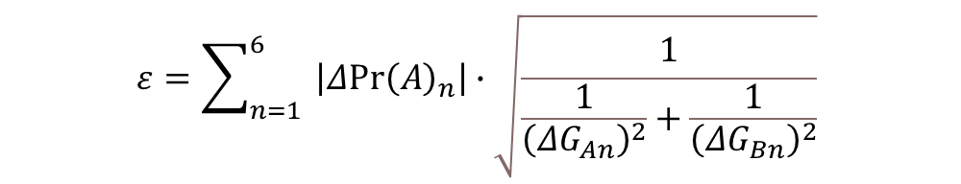
4. Compare: Parameter Optimization
$$ε=\sum_{n=1}^{6}{ \left|Δ{Pr\left(A\right)}_{n}\right|∙\sqrt{\frac{1}{\frac{1}{{\left(ΔG_{An}\right)}^{2}}+\frac{1}{{\left(ΔG_{Bn}\right)}^{2}}}} }$$
Compare measured EAPs to predicted EAPs via cost function
Vary predicted EAPs’ values of δ and ρ to minimize the composite error $ε$
  Two measured EAPs shown as yellow X’s for “Loud” and “Soft” signal levels at a masker gain of 25 dB
  Predicted EAPs shown as black line $Pr⁡(A)$ = 0.5
  Measured vs Predicted differences shown as dashed lines
15
Notes:
- For an individual subject, the error is summed across six measured EAPs
- Two EAPs shown are for Loud and Soft signal levels at masker gain of 25 dB
- This cost function was selected to account for cases where the values of $Δ{Pr(A)}_{n}$ and $ΔG_{An}$ are small compared to the value of $ΔG_{Bn}$, as may be the case with high trial values of ρ

Slide 16
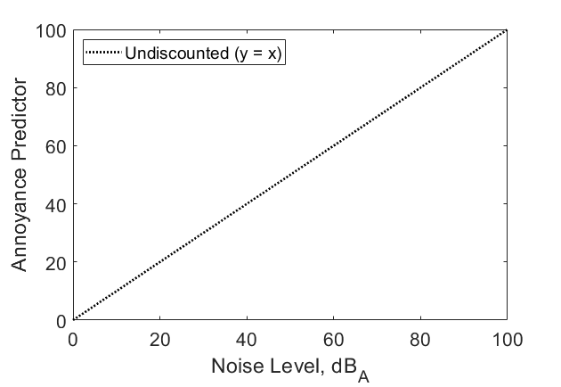
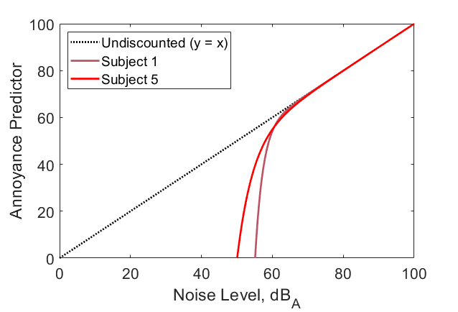
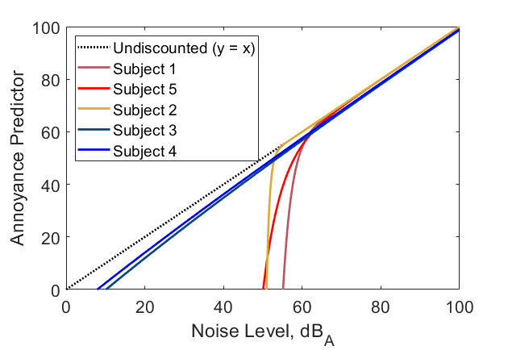
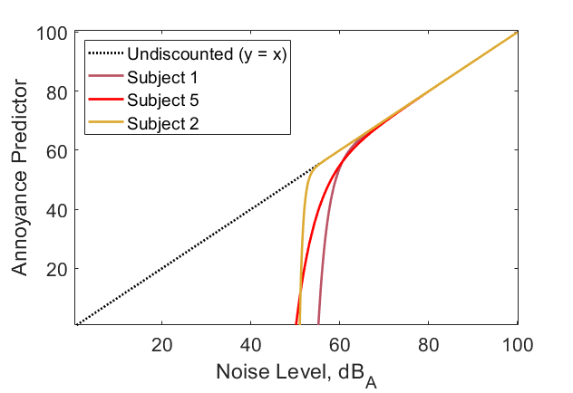
Results
Subjects fell into 3 categories:
  Strong Discount (masking discounts annoyance), Weak Discount (masking only discounts annoyance near detection threshold), and No Discount
Subject | δ | ρ
1 | 14 | 2
5 | 17 | 1
2 | 2 | 6
3 | 20 | 0.1
4 | 1 | 0.1
Strong Discount
Weak Discount
“No” Discount
Signal
16
Notes:
- High values of δ combined with values of ρ ≥ 1 indicate the subject’s annoyance responses are sensitive to a masking discount, as is the case with Subjects 1 and 5.
- Subject 2’s “weak discount” has δ close to 1 combined with a high value of ρ (much greater than 1), indicating the discount term applies close to the threshold of audibility for sound A. This means that if sound A is at all audible, there is not much reduction in Pr(A), the probability they will be more annoyed by a partially masked sound A compared to sound B. Conversely, subjects 1 and 5 with high values of δ may be less annoyed by a clearly audible, but partially masked, sound A compared to sound B.
- Generally, values of ρ much less than 1 indicate the subject does not have a strong masking discount, as is the case with Subjects 3 and 4. Expanding the range of δ and ρ in the optimization process is likely to produce the same result, as the low ρ value dominates the behavior of the discount curve.

Slide 17
Conclusions
Hypothesis:
If a signal is partially masked → Annoyance is reduced (discounted)
Experiment and analysis revealed three distinct types of subjects
  Hypothesis is true in subjects with Strong and Weak Discounts
  Annoyance reduction is much smaller in subjects with “No” Discount
Future work:
  More subjects, refine methods
  Population level evaluation
Notes:
Hypothesis true in some subjects, but nuanced. Weak discounts just have a small partially masked region.
Refine methods to determine if Strong, Weak, and “No” discount categories really exist.
Perhaps refine d’ determination.
Can we determine a generalized discount term at the population level?

Slide 18
Thank You
Questions?
tyler.d.tracy@nasa.gov
18

Slide 19


Extra: Pr(A) Calculation
$$C_{A}= L_{A}+Q_{A}−3{\left(\frac{d′\left({∆G}_{AM}\right)}{δ}\right)}^{−ρ}$$
$$AP\left(A\right)=10⋅log\left[{10}^{\left({C_{A}}/{10}\right)}+{10}^{\left({C_{M}}/{10}\right)}\right]$$
$$Pr\left(A\right)∝\frac{1}{2}⋅\operatorname{erf}\left(\frac{ΔAP}{2⋅\sqrt{2}}\right)$$
19

