Slide 1
Finding your TEMPO: An introduction to the mission, products, and data services for air quality observations over N. America
Caroline Nowlan, Center for Astrophysics
Gonzalo González Abad, Center for Astrophysics
Daniel Kaufman, ASDC
Hazem Mahmoud, ASDC
05/29/2024
Notes:
Good [morning/afternoon/evening] everyone wherever you are and welcome to today’s presentation that will include some demos.

Slide 2
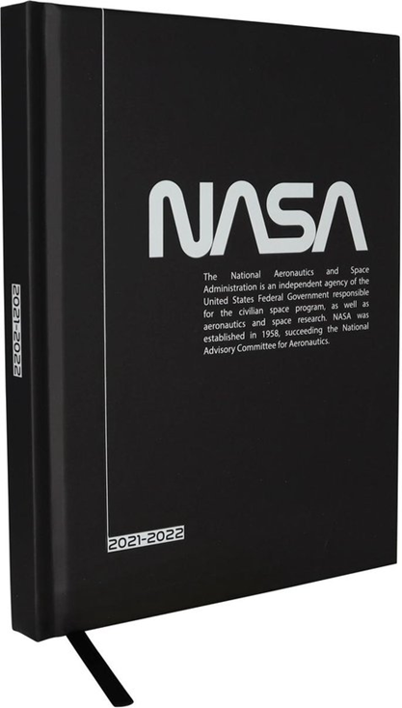
Agenda
Mission introduction
Data product details
Accessing TEMPO data on Earthdata Search
Finding documentation
Searching and filtering
Subsetting and concatenating
Additional TEMPO information resources
Asking questions on Earthdata Forum
How to learn more
Q&A

Slide 3
Mission Intro

Slide 4
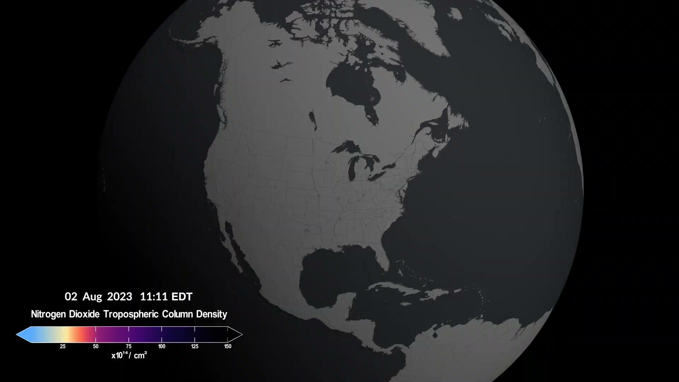
Tropospheric Emissions: Monitoring of Pollution
Hourly daytime air pollution measurements over North America
NASA’s first Earth Venture Instrument (EVI), selected in 2012
Geostationary orbit means TEMPO can scan the continent continuously
→ High temporal resolution
→ High spatial resolution
Baseline data products:
Ozone
Nitrogen dioxide
Formaldehyde
Credit: NASA’s Scientific Visualization Studio

Slide 5
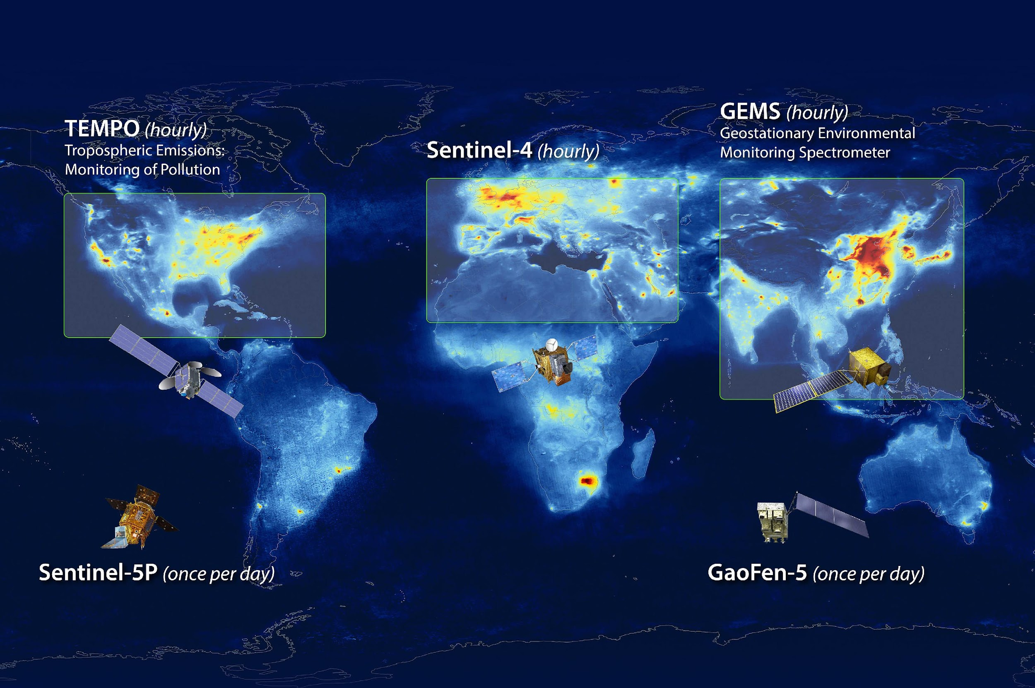
Atmospheric Composition Geostationary Constellation
Source: NASA LaRC

Slide 6
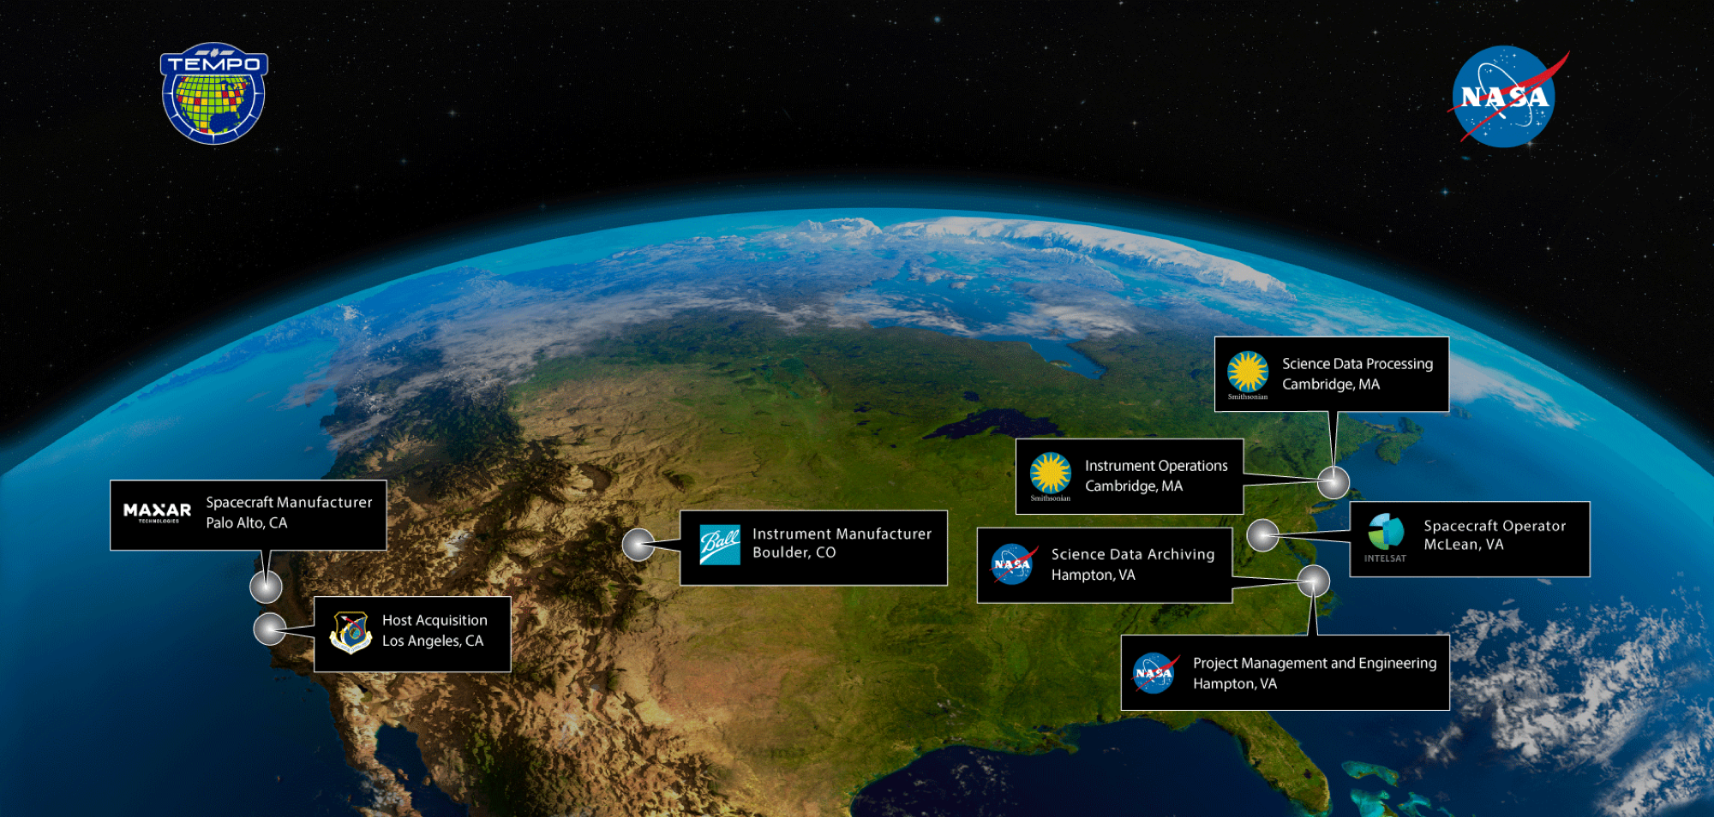
PI: Xiong Liu (Smithsonian Astrophysical Observatory)
Founding PI: Kelly Chance
Multiple partners, 600+ early adopters

Slide 7
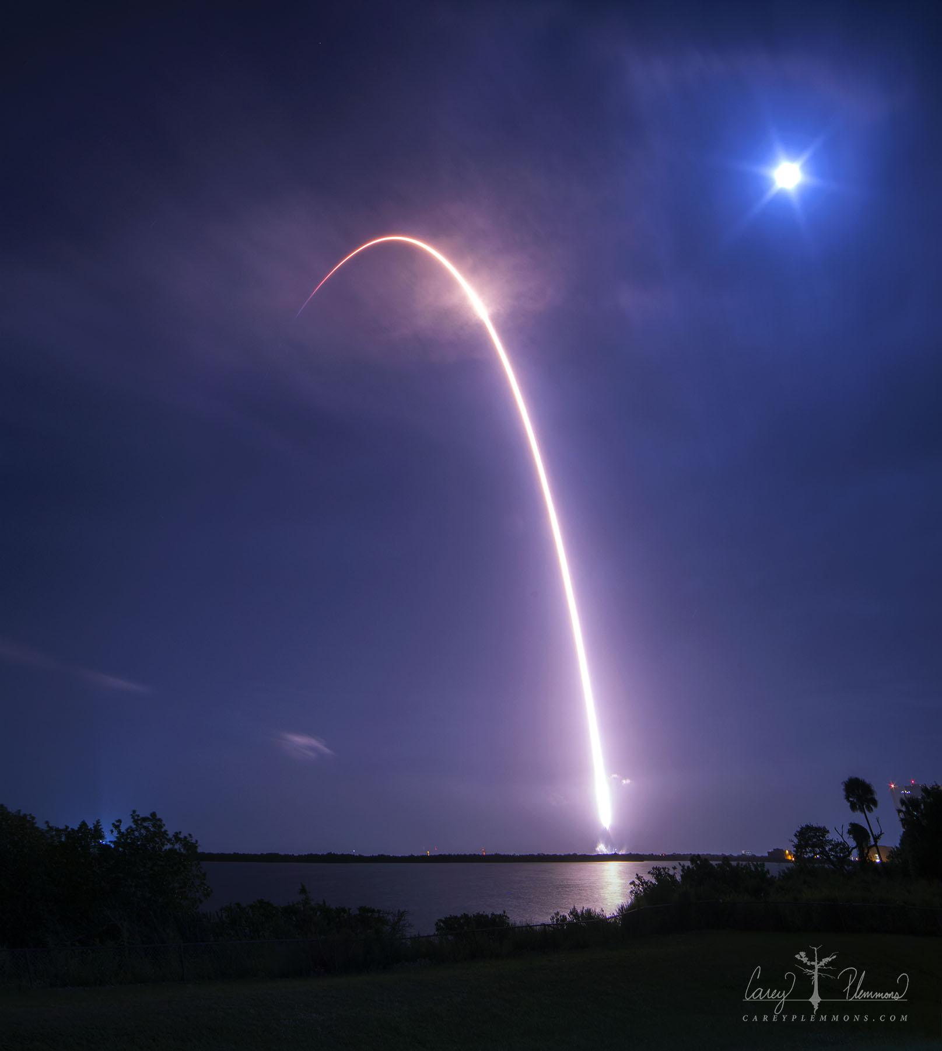
TEMPO Timeline
Kick-off | January 2013
Instrument delivered | November 2018
Integrated to Intelsat 40e | June 2022
Launch | 7 April 2023
First light | 2 August 2023
Nominal operations | October 2023
Radiances and 3 weeks of unvalidated trace gas files released to public | February 2024
Public data release | May 2024
Near real time products | Early 2025
* Baseline mission is 20 months, then up for extensions through NASA Senior Reviews
Notes:
Mention nominal lifetime is 20 months, then senior review

Slide 8
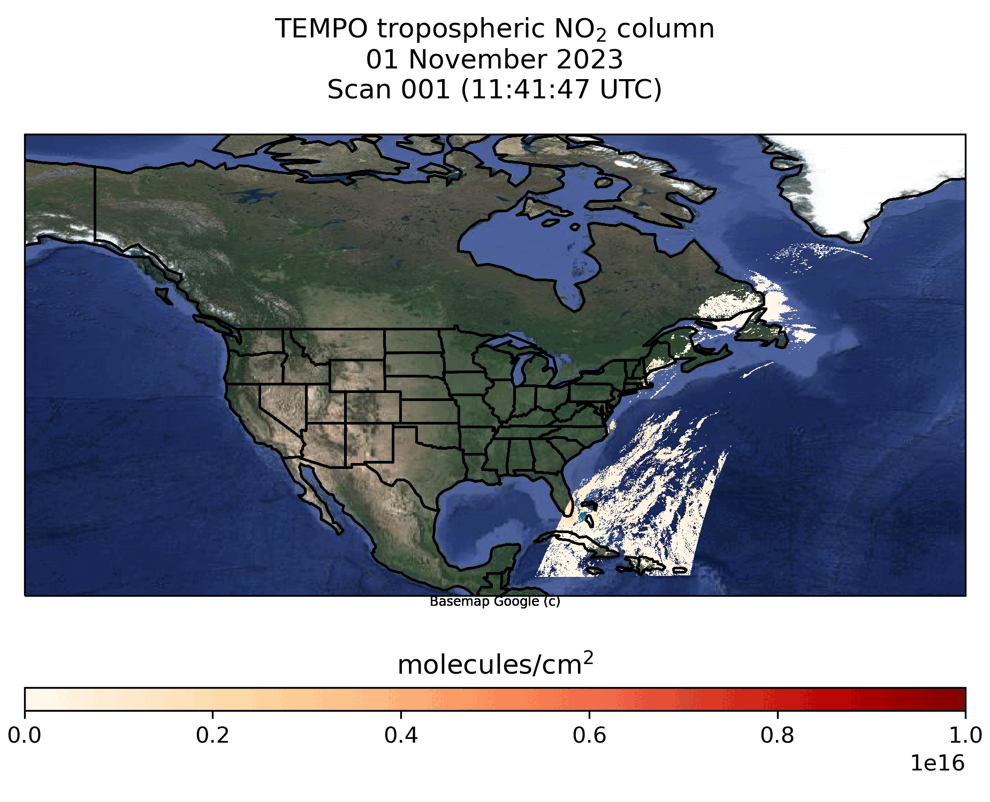
TEMPO Operations
Nominal scans
2048 North/South pixels
1181 East/West steps per hour
2 x 4.75 km² at center of field of regard
Optimized scans
Higher temporal resolution AM and PM scans over coasts (40 minutes)
Twilight scans (city lights)
Performed during darkness, before morning scans
High-time scans
Frequent scans (5 to 10 minutes) over selected longitudes
Rare → can be requested but require science team approval

Slide 9
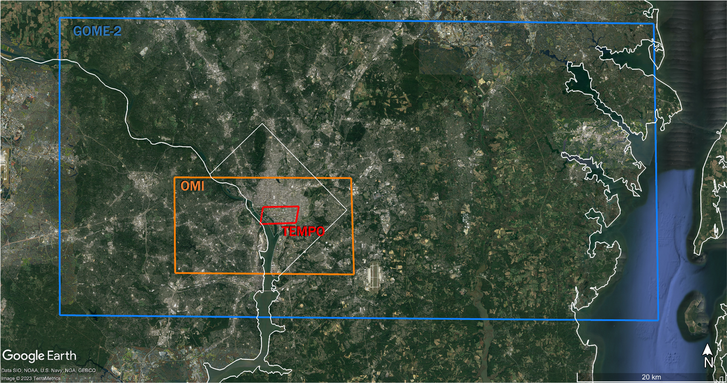
TROPOMI

Slide 10
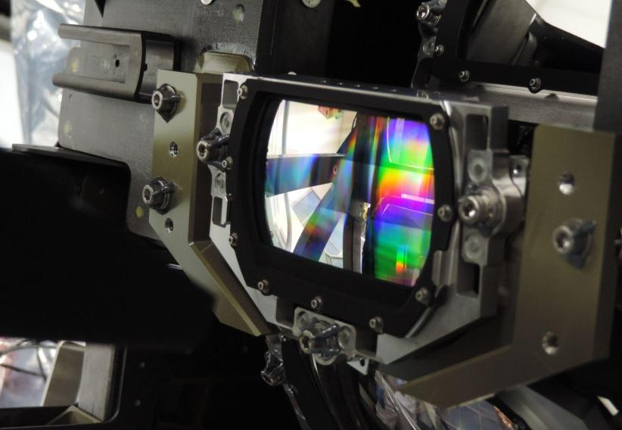
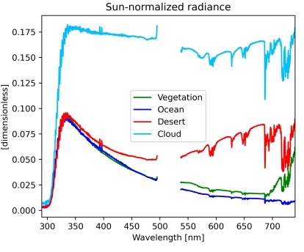
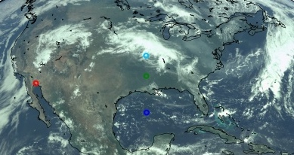
TEMPO Spectra
Credit: Ball
Notes:
Explain grating spectrometer, backscatter observations

Slide 11
Data Products

Slide 12
TEMPO Level 1 products
Product | Level | Description | Nominal sampling frequency | Maturity level
DRK | 1a | Dark exposure | Variable (typically sampled before the beginning of the other types of exposure) | Beta
RAD | 1b | Geolocated Earth radiances | Once per hour or more frequent (during daylight hours) | Beta
RADT | 1b | Geolocated Earth radiances (twilight) | Variable | Beta
IRR | 1b | Solar irradiance (working diffuser) | Once per week | Beta
IRRR | 1b | Solar irradiance (reference diffuser) | Once per 3 months | Beta
Beta: “The product is minimally validated but may still contain significant errors;... publication of research based on Beta maturity products is not recommended and highly discouraged”
Notes:
Explain what level 1, level 2 and level 3 product means and how the information contained in them is used. L1 are the raw spectral observations made by TEMPO (after radiometric calibration and geolocation), level 2 are geophysical products (clouds, trace gas concentrations…) provided at TEMPO’s native resolution, and level 3 the most important variables contained in the level 2 geophysical products on a regular grid.
Then describe what Beta maturity level means and the existence of a TEMPO validation plan document. Also refer that as more data becomes available for validation it is expected that the product will move to “provisional maturity level in the near future”.
Comment on the availability of v3 products and plans for reprocessing

Slide 13
TEMPO Level 2 & Level 3 products
Product | Level(s) | Description | Most relevant variables in level 2 and level 3 file | Maturity level
NO₂ | 2 & 3 | Nitrogen dioxide total, tropospheric, and stratospheric columns | vertical_column_troposphere, vertical_column_stratosphere | Beta
HCHO | 2 & 3 | Total formaldehyde columns | vertical_column | Beta
O3TOT | 2 & 3 | Total ozone columns | column_amount_o3 | Beta
CLDO4 | 2 & 3 | Cloud parameters | cloud_fraction, cloud_pressure | Beta
Level 2: Information provided at TEMPO’s native resolution (hourly sampling frequency or less; ~10 km²); usually one hour East-West scan is broken in 9 to 10 level 2 files.
Level 3: All level 2 data from a TEMPO East-West scan on a regular grid (0.02° x 0.02°)
Notes:
Remark that nominal sampling frequency is one per hour or more frequently (optimized scan or special observations) during daylight hours, which would be illustrated later with the HCHO and NO2 animations.
I should also explain that for all products the most relevant variables are contained in the “product” group. Should I mention here something about (file formats?)

Slide 14
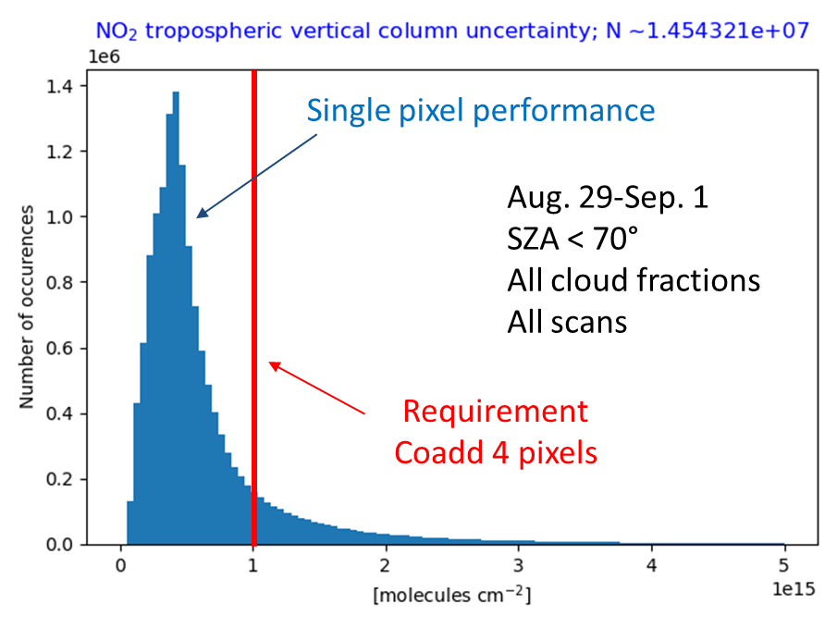
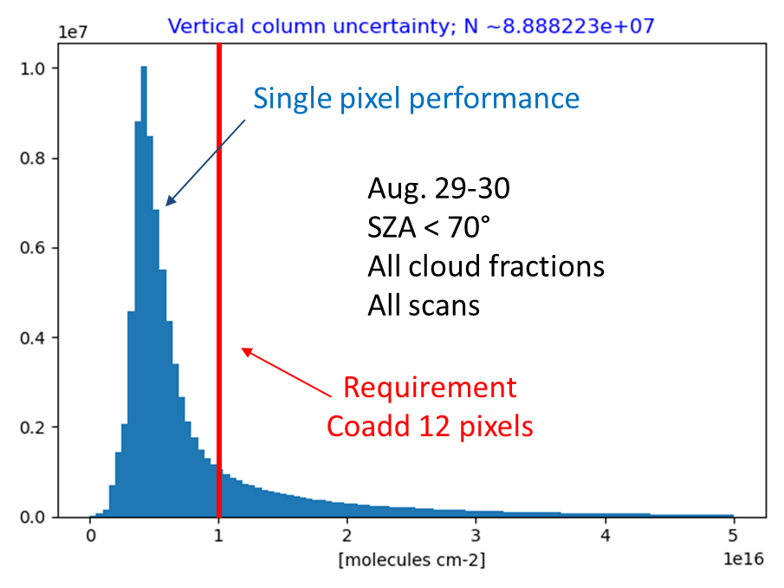
Level 2 product requirements
NO₂ tropospheric column uncertainty; N~2x10⁷
Product | Required precision | Temporal revisit*
0-2 km O₃ (selected scenes) | 10 ppbv | 2 hour
Tropospheric O₃ | 10 ppbv | 1 hour
Total O₃ | 3% | 1 hour
Tropospheric NO₂ | 1 x 10¹⁵ molecules cm⁻² | 1 hour
Tropospheric HCHO | 1 x 10¹⁶ molecules cm⁻² | 3 hour
Number of occurrences
HCHO column uncertainty; N~8x10⁷
Number of occurrences
* number of hourly measurements to be averaged to achieve required precision
There are ongoing efforts to expand the suite of TEMPO operational products with aerosol information (AOD, layer height, UVAI) and traces gases (SO₂, CHOCHO, BrO, H₂O and HONO) in the near future.
Notes:
Make it clear that TEMPO products fulfill in most cases >90% of the times the requirement for precision.

Slide 15
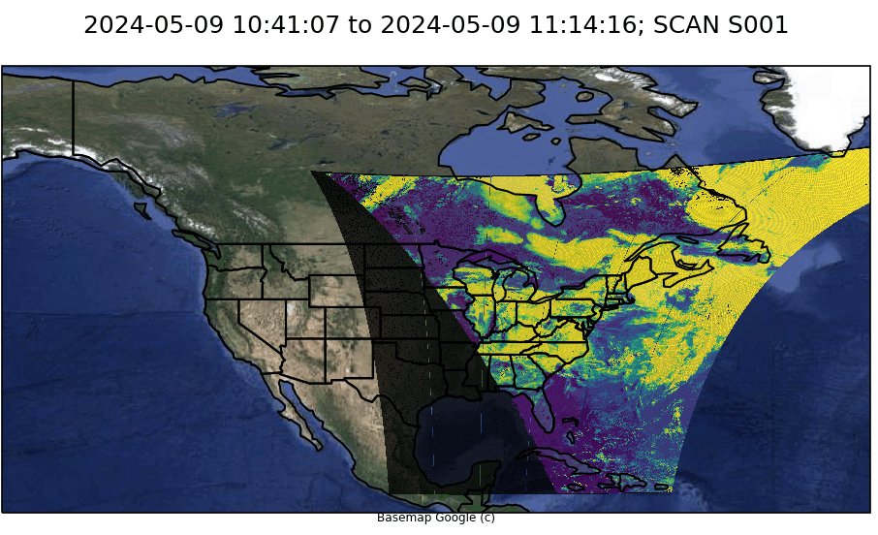
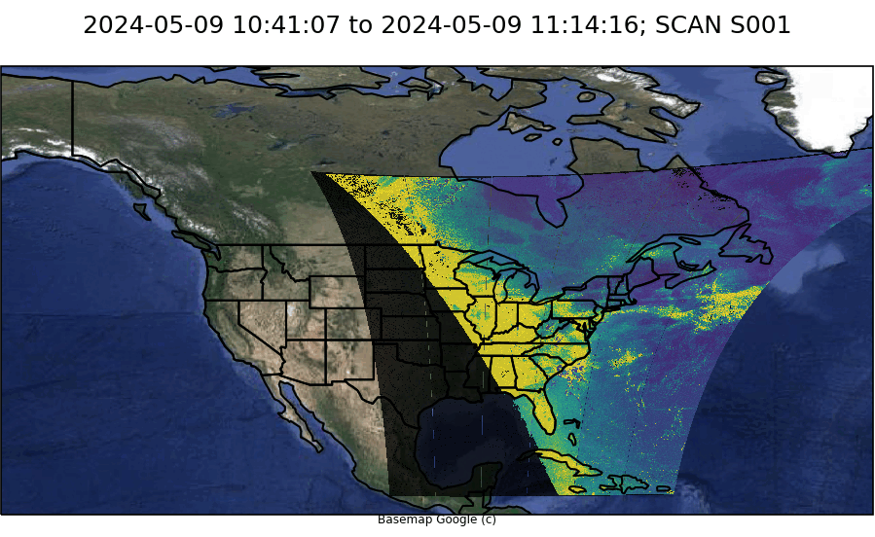
One day of HCHO retrievals: filtering data
To perform qualitative studies it is essential to perform quality control on the data; multiple variables in the level 2 and level 3 files (main_data_quality_flag, cloud_fraction, vertical_column_uncertainty, snow_ice_fraction…) provide suitable information to filter data depending on the user’s application.
Cloud fraction
Vertical column uncertainty
Notes:
Use this animation to talk about the need to filter out some retrievals using quality flags, reported uncertainties, cloud fractions and snow and ice information provided in the level 2 and level 3 files. It is also important to remark here that this release is at a beta level and that future versions of the products would still include significant changes and improvements. This will be also a good opportunity to talk about granule vs scan.
Should we include links to the UserGuide files (they should be ready by then)

Slide 16
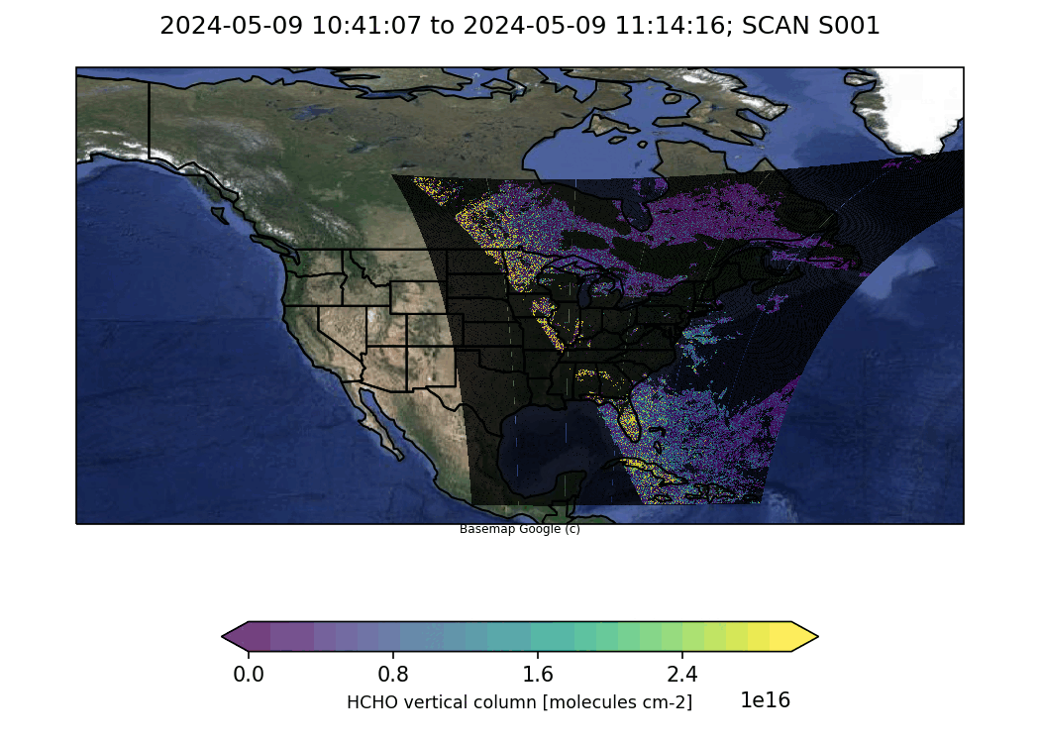
One day of HCHO retrievals showing data only with cloud fraction < 0.25
Notes:
Use this animation to talk about the need to filter out some retrievals using quality flags, reported uncertainties, cloud fractions and snow and ice information provided in the level 2 and level 3 files. It is also important to remark here that this release is at a beta level and that future versions of the products would still include significant changes and improvements. This will be also a good opportunity to talk about granule vs scan.
Should we include links to the UserGuide files (they should be ready by then)

Slide 17
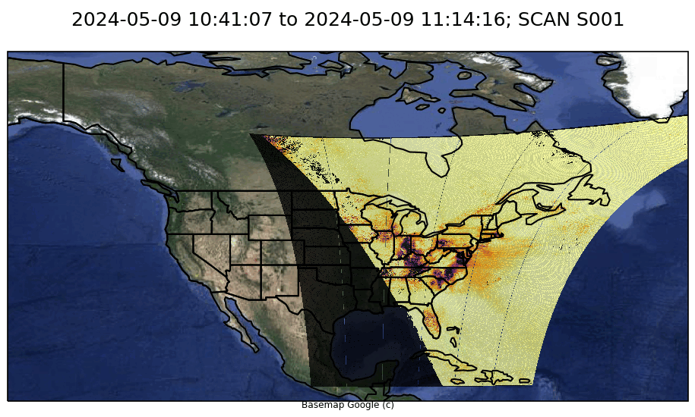
One day of NO₂ retrievals (unfiltered)
As mentioned previously it is important to filter data using the criteria described in the user guides
Notes:
Use this animation to talk about the need to filter out some retrievals using quality flags, reported uncertainties, cloud fractions and snow and ice information provided in the level 2 and level 3 files. It is also important to remark here that this release is at a beta level and that future versions of the products would still include significant changes and improvements. Should we include links to the UserGuide files (they should be ready by then)

Slide 18
How to find TEMPO data products
on Earthdata Search

Slide 19
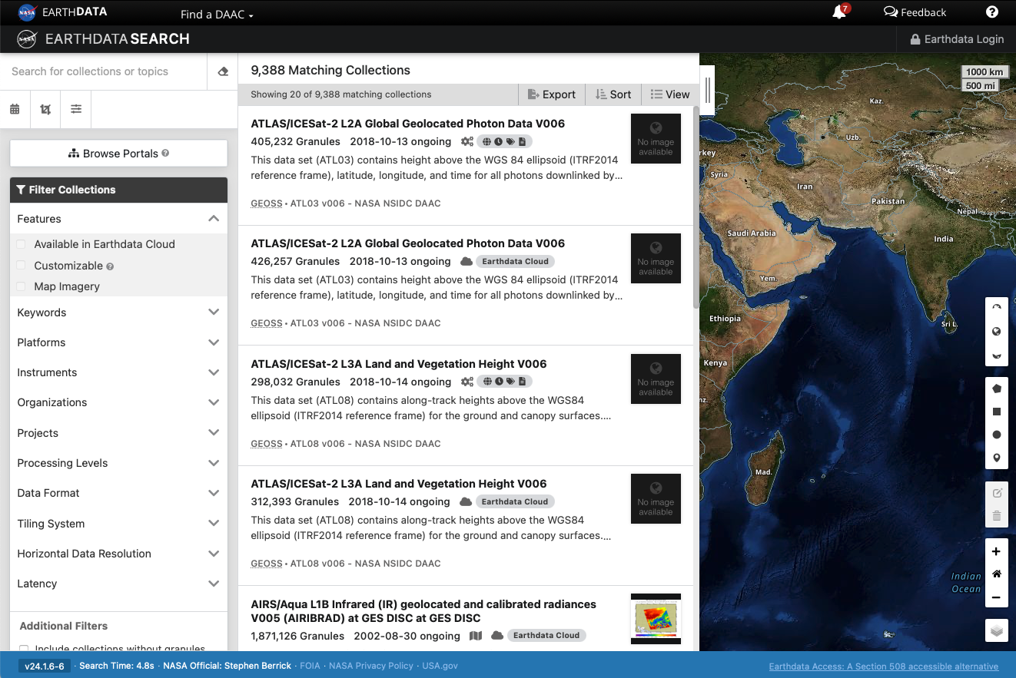
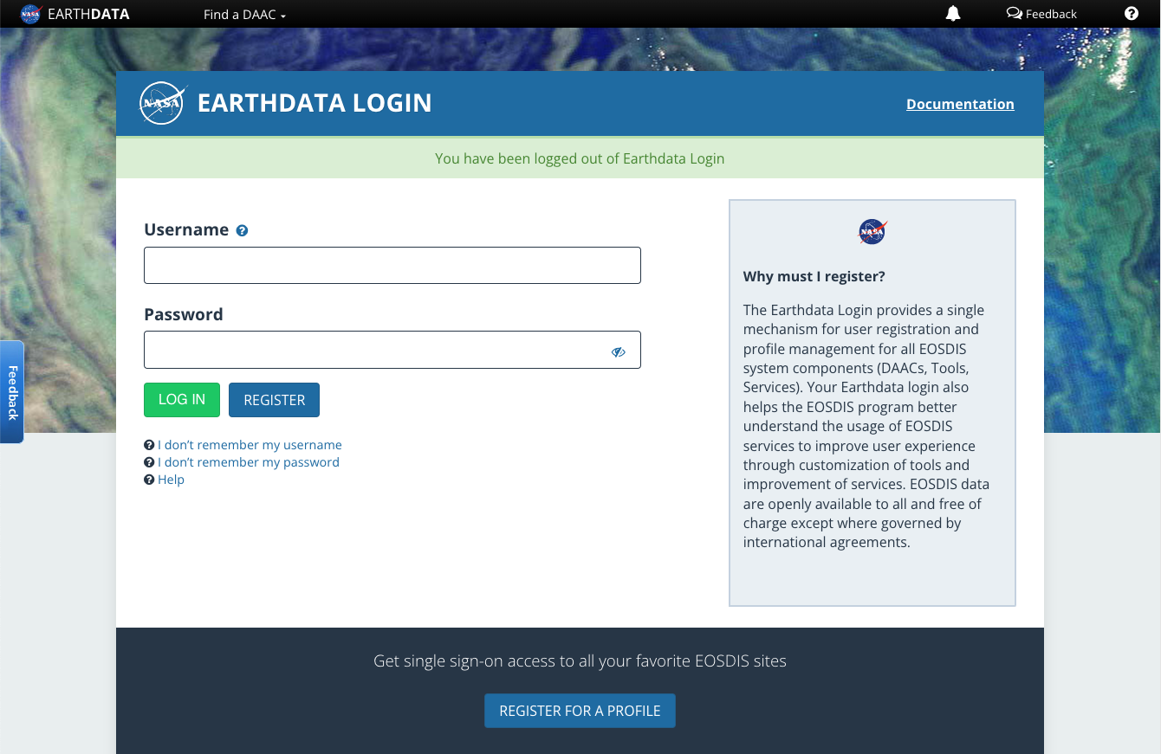
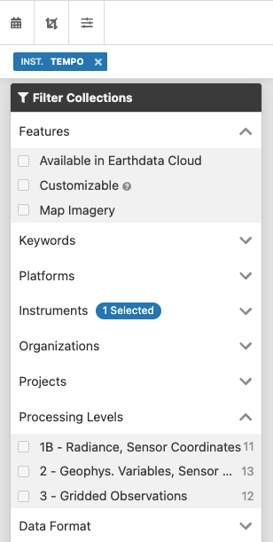
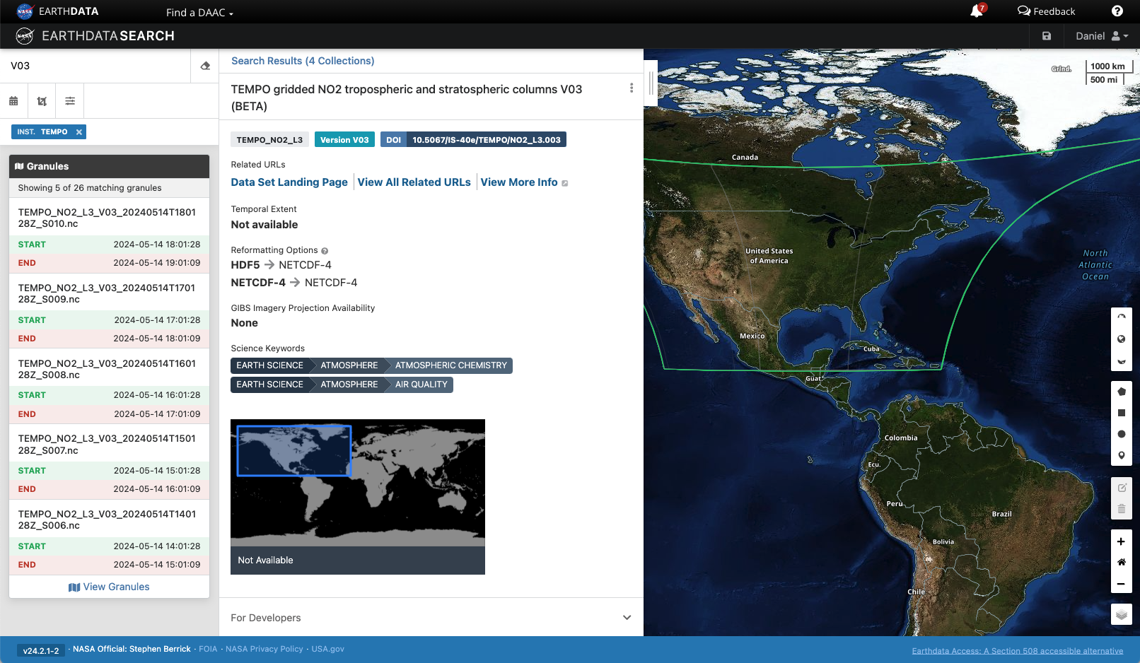
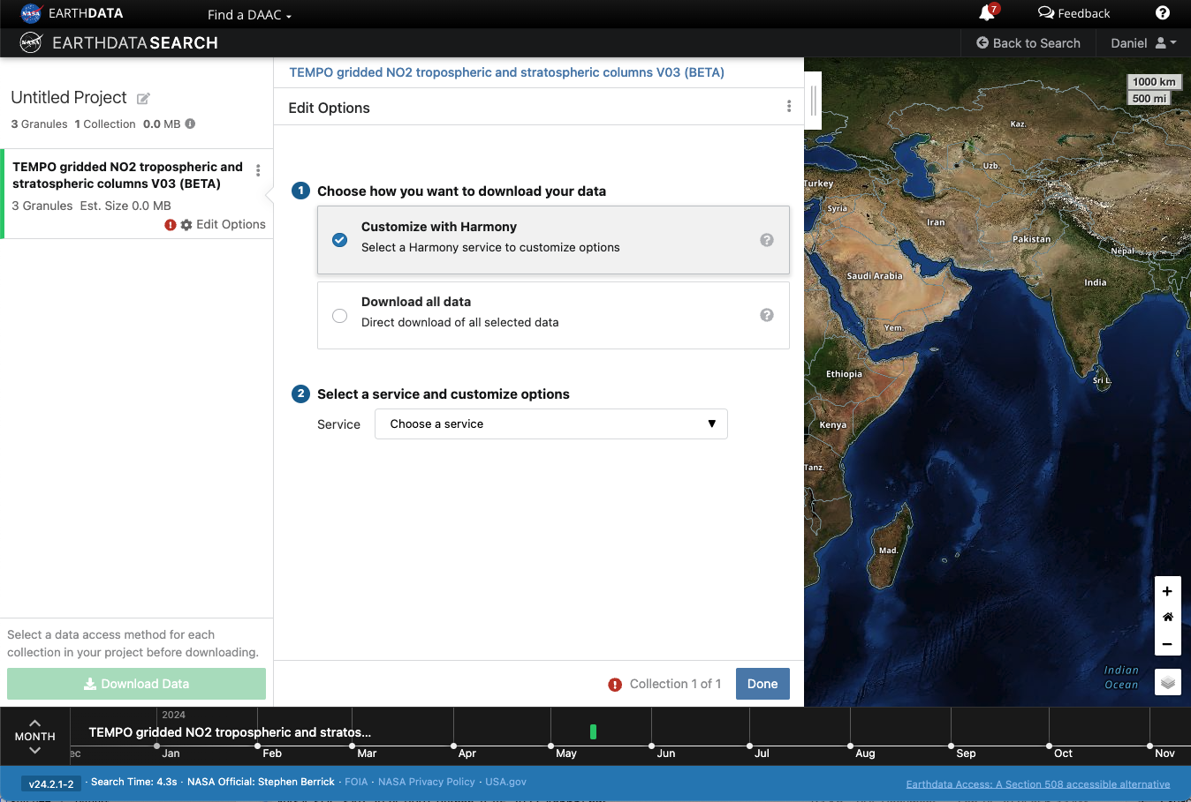
Summary
Navigate to Earthdata Search
Log in
Search and filter
search.earthdata.nasa.gov/
Dataset details
Customizing the download or access

Slide 20
Demonstration

Slide 21
Demonstration Links - for reference
Earthdata Search: https://search.earthdata.nasa.gov
TEMPO Project landing page: https://asdc.larc.nasa.gov/project/TEMPO
NASA Earthdata Cloud information: https://www.earthdata.nasa.gov/eosdis/cloud-evolution
NASA CMR STAC API tutorial: https://nasa-openscapes.github.io/2021-Cloud-Hackathon/tutorials/02_Data_Discovery_CMR-STAC_API.html
Panoply
https://www.giss.nasa.gov/tools/panoply/

Slide 22
TEMPO Resources at ASDC

Slide 23
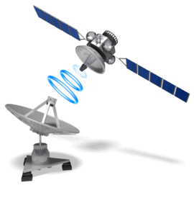


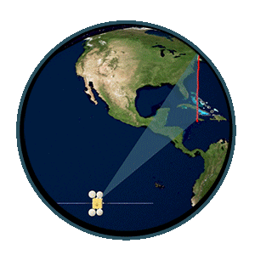




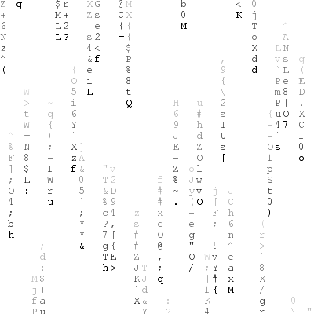







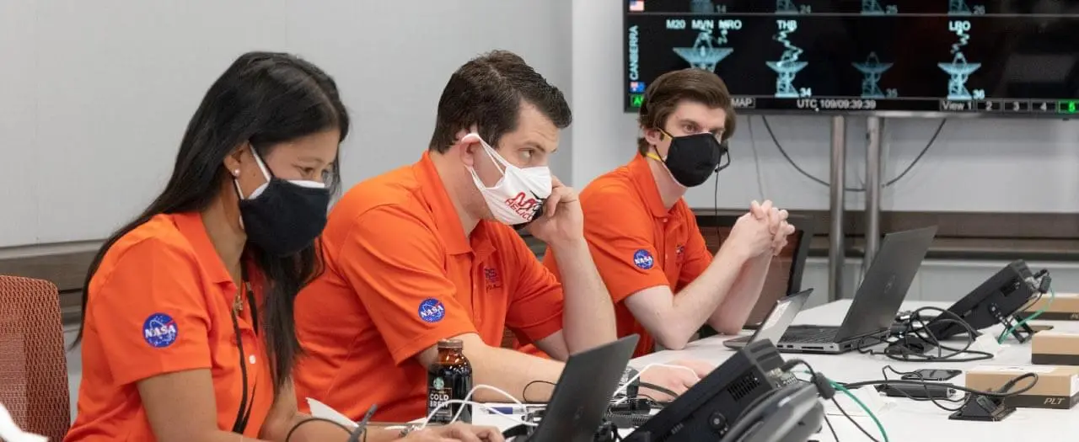

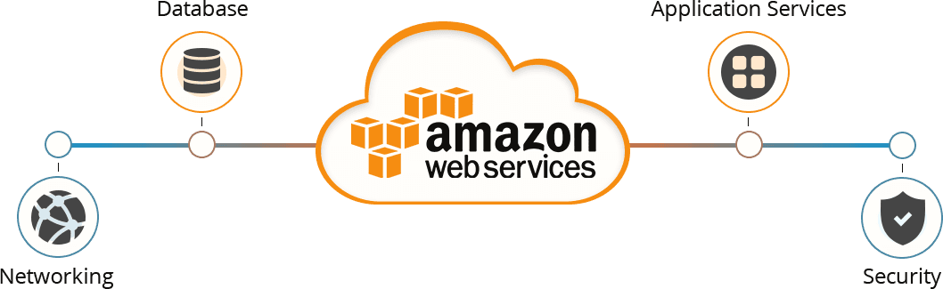
> 100 Gbps
+/- 30 Mbps
Notes:
Following each TEMPO scan of North America, Intelsat 40e transmits the data to the ground station using binary system. Subsequently, the Science Team at SAO initiates the decoding to generate L0 data and processing of the L0 data to higher processing levels L1, L2, and L3. This processed data is then pushed to ASDC’s Dropbox for ingestion by our Cumulus ingest system. The system archives the data permanently in Virginia and ingests a public copy to the Earth Data Cloud using AWS US-West 2, located in the state of Oregon.
Once the data is accessible, users can download it via Earth Data Search, as demonstrated earlier. Additionally, users can subset the data using OPeNDAP and Harmony. Furthermore, visualization of the data is possible using tools like Worldview and Earth Geographic Information System or EGIS for short.
TEMPO marks our first mission utilizing the AWS cloud, TEMPO's integration with the AWS cloud infrastructure opens up exciting possibilities for comprehensive data analysis. Users can leverage resources like Elastic Cloud Computing or EC2 for short and to perform advanced analytics and modeling.
As always, the Earthdata Forum stands ready to address any inquiries or concerns. We are committed to facilitating your research endeavors and maximizing the impact of TEMPO data in advancing our understanding of atmospheric composition and air quality dynamics.

Slide 24
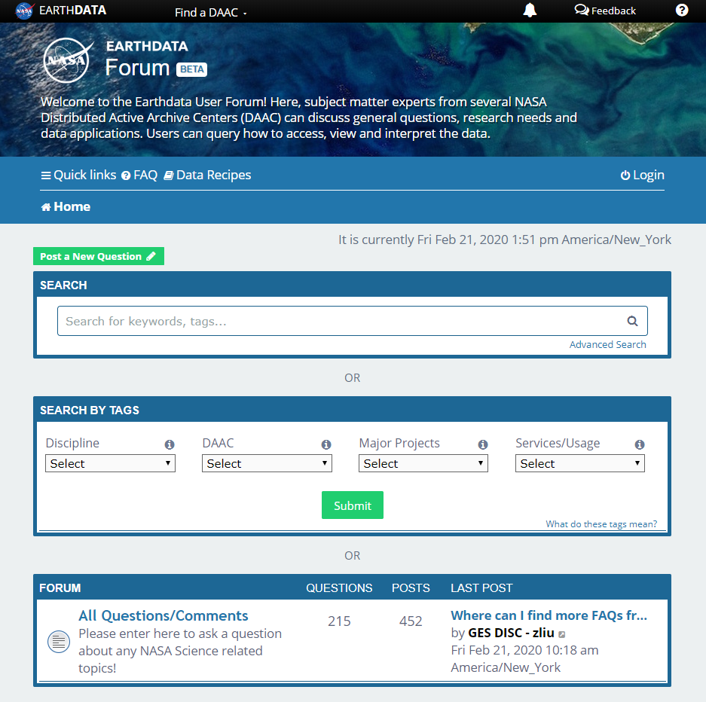
Earthdata Forum
Science Data Users can seamlessly search for information even if they do not know which DAAC the data belongs to.
Scientists & Data Providers can effectively assist their user community in more accurately using their products.
DAACs & Subject Matter Experts (SMEs) can quickly link users to existing resources.
DAAC User Services can swiftly provide inquirers with an authoritative source related to DAAC data products & services.
https://forum.earthdata.nasa.gov/
Notes:
The Earthdata Forum is an online platform where users can interact with NASA's DAAC experts to discuss data applications, research needs, and get help with accessing, visualizing, and manipulating NASA's Earth observation data. Users can check if their queries have been previously addressed or post new questions if needed. Subject Matter Experts are committed to responding promptly, often within hours.Earthdata Forum provides a central online location where data users can interact with subject-matter experts from NASA’s Distributed Active Archive Centers (DAACs) to discuss data applications and research needs and get answers to specific questions about accessing, visualizing, and manipulating NASA’s Earth observation data.
If you have any questions, we encourage you to visit the EarthData Forum. There, you can check if your query has been previously addressed. In the event your question hasn't been asked before, or if the existing answers are outdated, please feel free to create a new post. Our Subject Matter Experts (SMEs) are committed to promptly responding to your inquiries, often within a matter of hours.

Slide 25
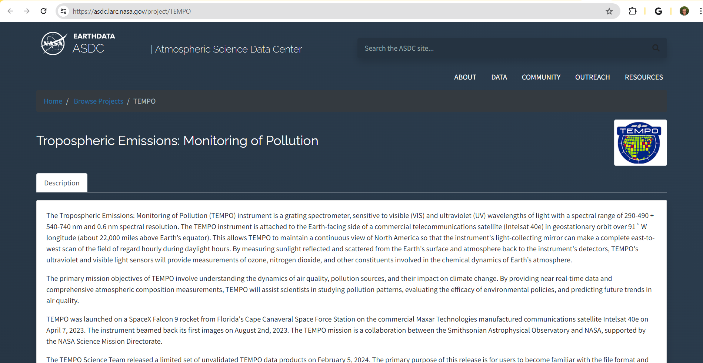
ASDC Webpage
Notes:
Another very important source of information is Navigating our website, you'll find a wealth of resources for exploring and analyzing TEMPO data. Through tools like Earth Data Search, users can easily locate and download TEMPO datasets. Advanced functionalities such as OPeNDAP and Harmony enable users to subset and manipulate data according to their specific research needs.
SAO is maintaining a comprehensive TEMPO (Daily log) during nominal operations. This log serves as a detailed record of instrument performance, data acquisition, and any important events encountered during the mission.
On the landing page, you will also discover Algorithm Theoretical Basis Documents (ATBD's), comprehensive TEMPO User Guides, and the latest Data Validation updates.

Slide 26
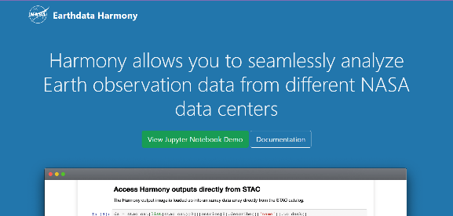
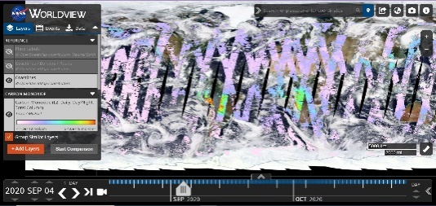
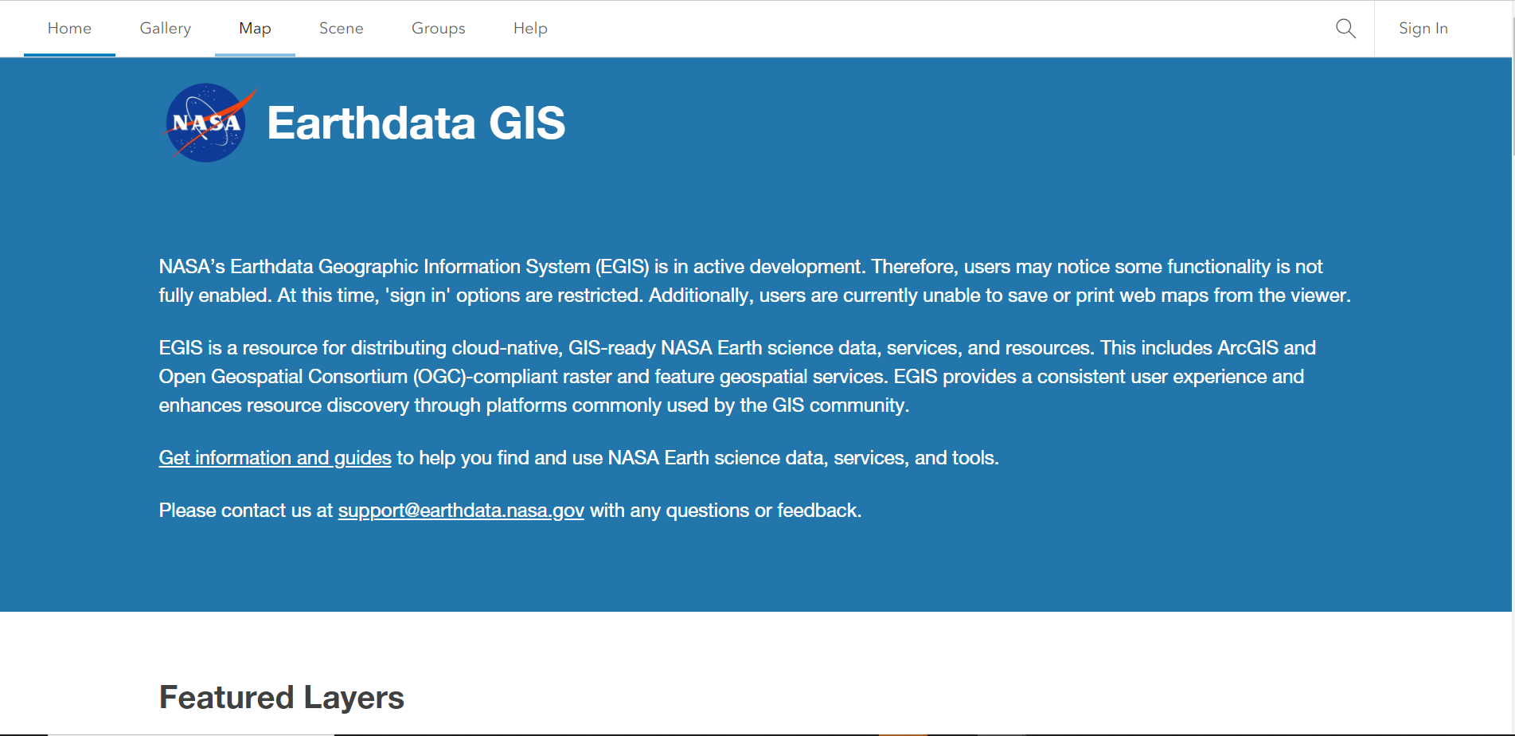
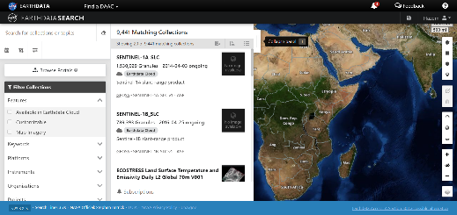
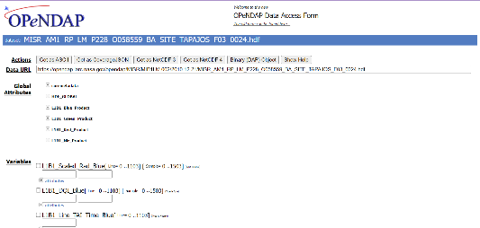
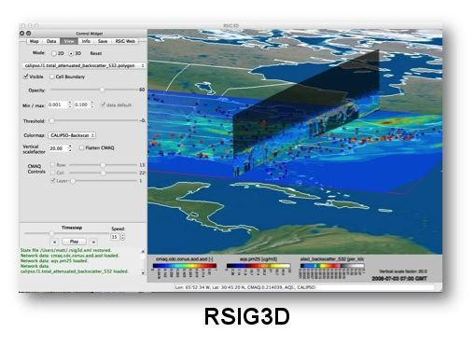
Additional Resources
Harmony Services
https://harmony.earthdata.nasa.gov/
Worldview
https://worldview.earthdata.nasa.gov/
Earthdata GIS EGIS
https://gis.earthdata.nasa.gov/portal/
Earthdata Search
https://search.earthdata.nasa.gov/search
OPeNDAP
https://opendap.earthdata.nasa.gov/
Remote Sensing Information Gateway
https://www.epa.gov/hesc/rsig3d-data-inventory
Notes:
In the top left corner, you'll find Harmony Services, offering convenient options for data subsetting and aggregation, alongside programmatic access facilitated by the Harmony-py Python library.
At the top center, Worldview takes the spotlight as a powerful solution for imagery and data visualization. Seamlessly integrating with various satellite datasets, Worldview hosts the key variables discussed today, including NO2, HCHO, UVAI, O3, and cloud cover.
On the top right, Earth GIS provides a powerful toolset, allowing users to pull mosaic datasets directly into their local ArcGIS Pro or QGIS environments for in-depth analysis.
Moving to the bottom left, Earthdata Search stands ready for seamless data filtering and web access downloads. It also offers additional services such as subsetting and aggregation.
In the bottom center, OPeNDAP on the cloud provides flexible spatial and temporal subsetting capabilities, enhancing accessibility and usability of the data.
Lastly, in the bottom right corner, RSIG. Not only does it offer executable software for data subsetting and visualization, but it also supports the integration with EPA ground sensors data and supports programmatic access through its Application Programming Interface (API).

Slide 27
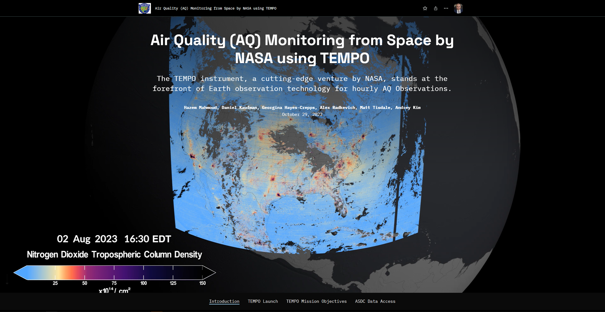

TEMPO Storymap
Notes:
All of these resources, services for Tempo data access with step by step videos showing how to use these tools are listed in this story map titled (Air Quality Monitoring from space by NASA using TEMPO). You can scan this QR code to take you to the story map and I will add this link in chat too.

Slide 28
Atmospheric Science Data Center
NASA Langley Research Center
Hampton, Virginia (USA)
https://asdc.larc.nasa.gov/
support-asdc@earthdata.nasa.gov

