Slide 1
The two-cavity method for characterizing acoustical materials—an interlaboratory study
Martha C. Brown NASA Langley Research Center, Hampton, VA | Anthony Ciletti Wichita State University, Wichita, KS | Janith Godakawela and Bhisham Sharma Michigan Technological University, Houghton, MI

Slide 2
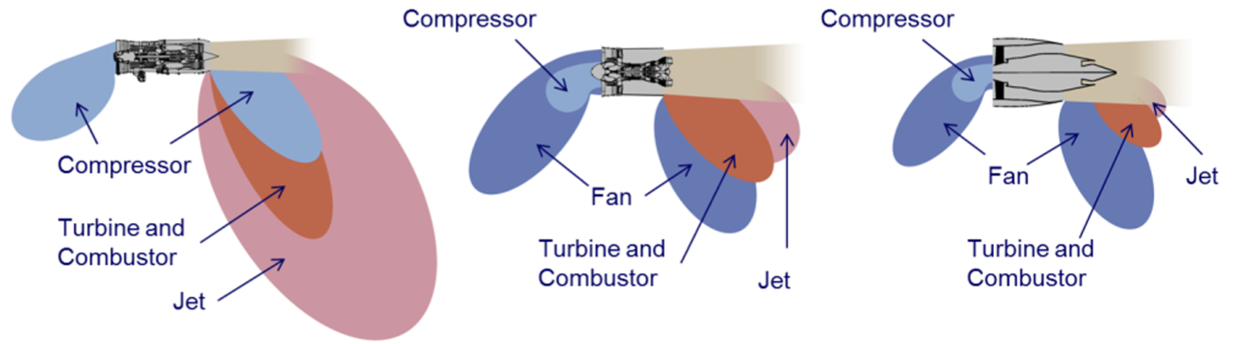
Evolution of Aircraft Engine Noise
1960s
1:1 BPR Engine
1990s
6-8:1 BPR Engine
2000s
12:1 BPR Engine
The evolution of the relative dominance of various acoustic sources
as the engine bypass ratio (BPR) has increased.
Source: Epstein, Alan, “The Lessons of P&W’s Geared Turbofan Engine and the Implications for the Future,” Keynote Address, International Symposium on Air Breathing Engines (ISABE), Phoenix, AZ, October 2015.
Introduction | TPMS Structure | Experimental Method | Results | Conclusion | Future Work

Slide 3
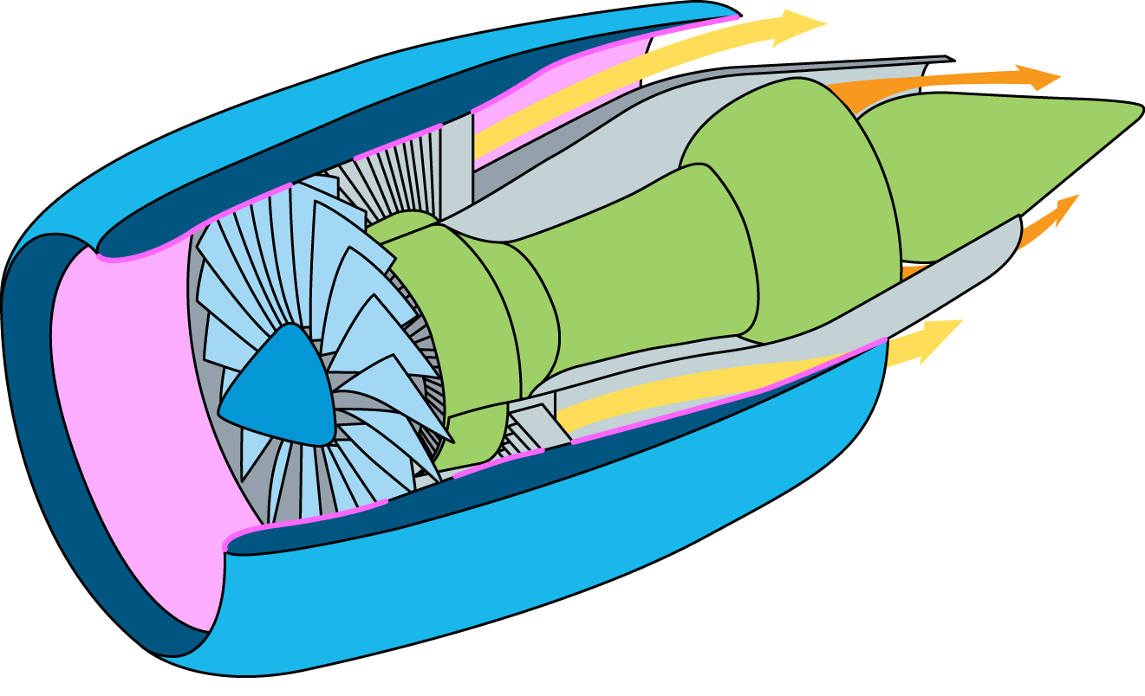
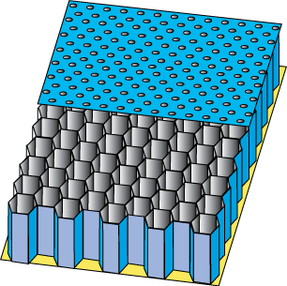
Conventional Liner Locations
Aircraft Engine Nacelle
Acoustic Liners
Bypass Flow
Perforate
Facesheet
Core Flow
Honeycomb
Core
Backplate
Single-Layer Liner
Introduction | TPMS Structure | Experimental Method | Results | Conclusion | Future Work

Slide 4
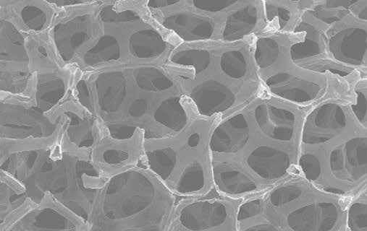
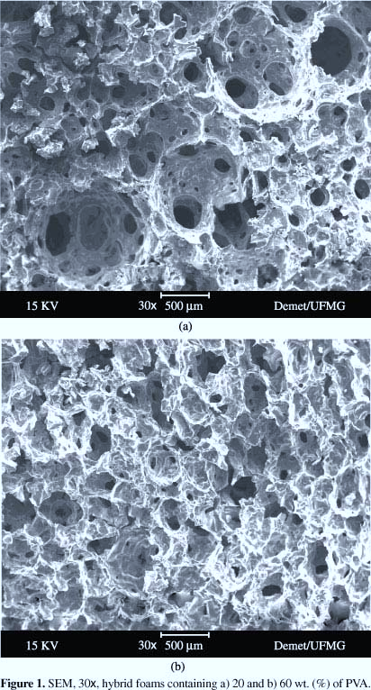
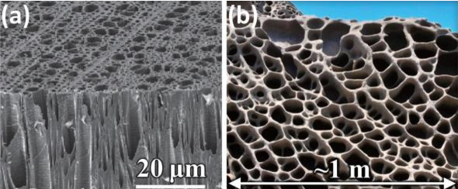
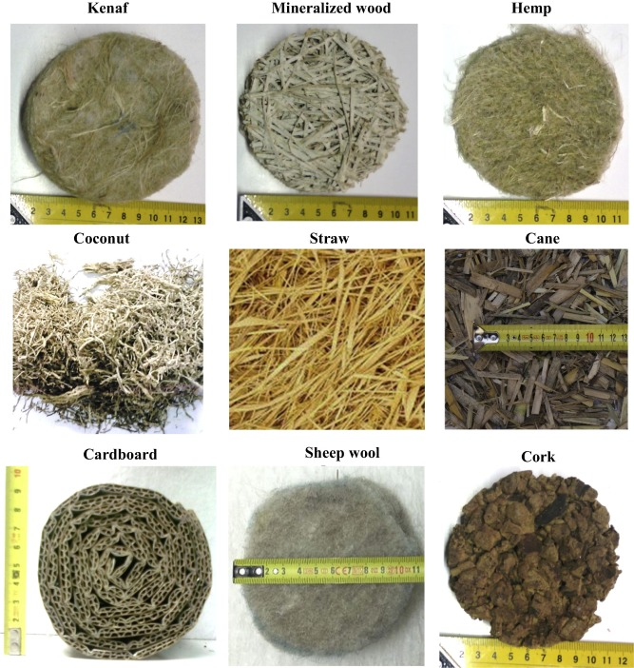
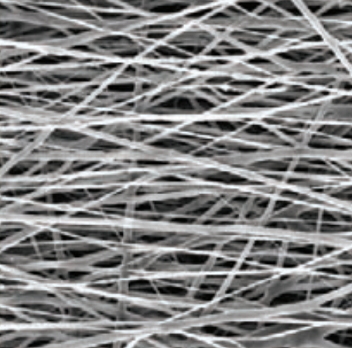
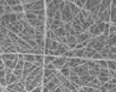
Current Broadband Acoustical Materials
Conventional bulk absorbers
Underlying porous architecture is incidental to the fabrication process.
Fabrication methods limit:
    Microstructural optimization
    Material optimization
    Functionality optimization
Organic Foams
Hybrid Foams
Inorganic Foams
Organic Fibers
Hybrid Fibers
Inorganic Fibers
Various types of commonly used porous acoustical materials.
Introduction | TPMS Structure | Experimental Method | Results | Conclusion | Future Work

Slide 5
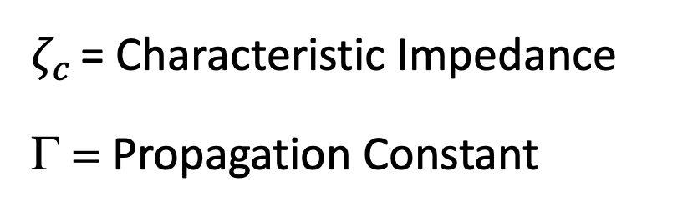
Characterizing Porous Materials
Intrinsic Parameters
Characterization Methods
$ζ_{c}$ = Characteristic Impedance
Γ = Propagation Constant
Two-Thickness Method
  TWO samples
Two-Cavity Method
  ONE sample + 2 cavity depths
Porous media needs to be uniform for analysis purposes.
When the intrinsic parameters are known, then the surface impedance can be predicted for any thickness.
Introduction | TPMS Structure | Experimental Method | Results | Conclusion | Future Work

Slide 6
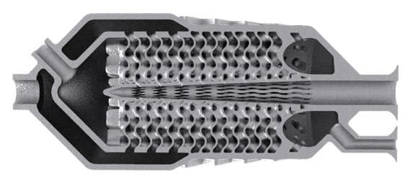
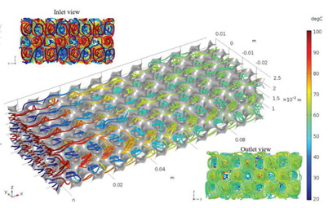
Triply Periodic Minimal Surfaces
Potential multifunctionality
Load bearing + Thermal management + Energy absorption + Acoustic absorption?
Inlet View
TPMS heat exchangers*
Outlet View
*Reference: nTopology.com
Introduction | TPMS Structure | Experimental Method | Results | Conclusion | Future Work

Slide 7
Triply Periodic Minimal Surfaces
Design and build tunable bulk materials for aerospace applications.
  Focus on Triply Periodic Minimal Structures (TPMS).
  Tunable to desired frequency range of interest.
  Focus on acoustic benefits where traditional designs are not feasible. (i.e., multifunctionality, installation on other locations in an engine)
Benefits
  Additive manufacturing facilitates the ability to control the TPMS characteristics.
  TPMS structures can be modeled.
Introduction | TPMS Structure | Experimental Method | Results | Conclusion | Future Work

Slide 8
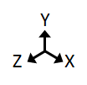
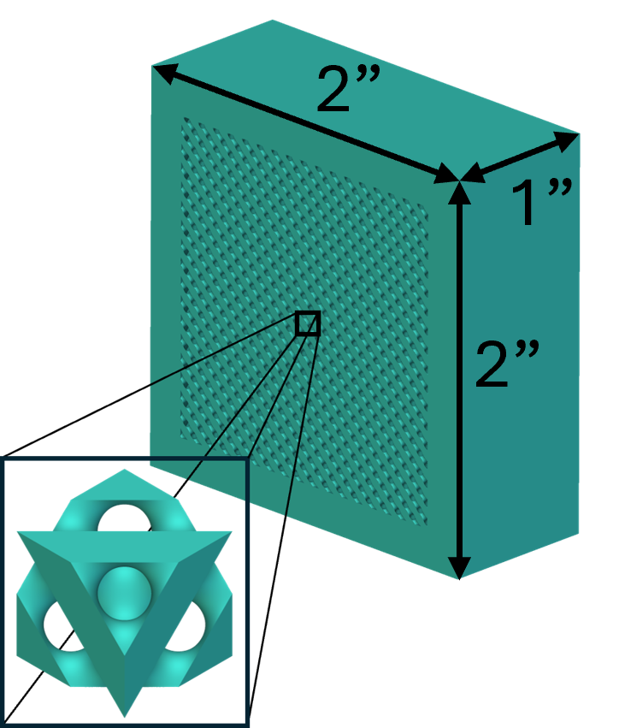


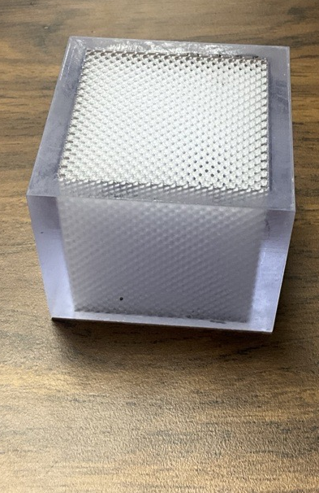
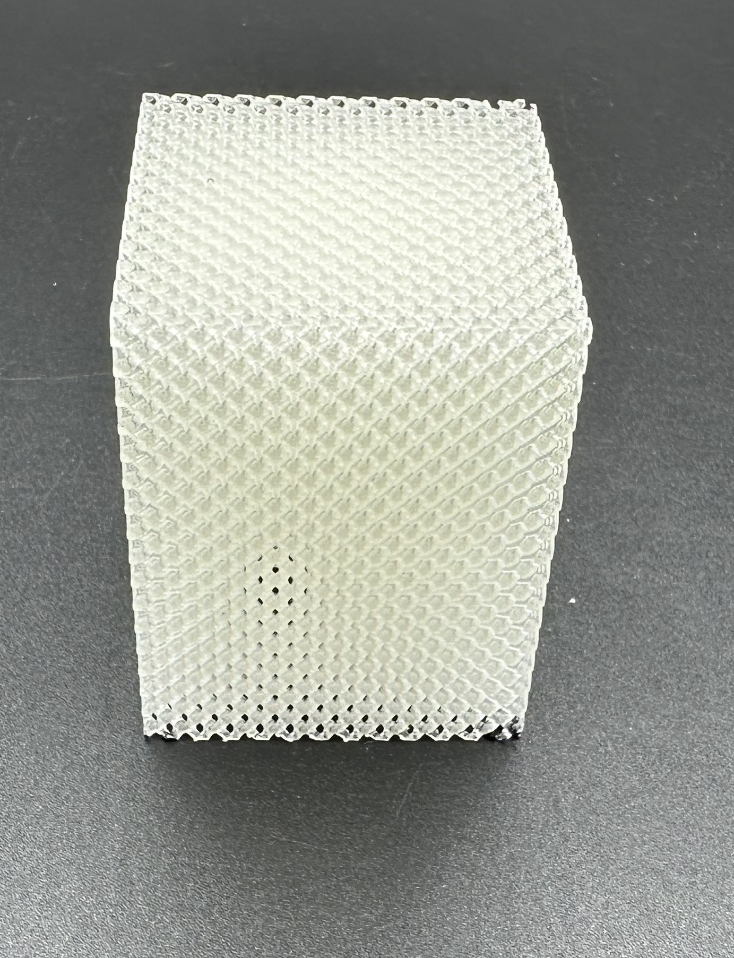
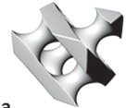
Sample Selection and Fabrication
All samples were fabricated using stereolithography.
Samples were printed with porosities of 40% and 60%.
2.0 in active square sample
1.5 in square sample
Top View
Iso View
Diamond
Sample thickness: 2 in, 60% porosity
Introduction | TPMS Structure | Experimental Method | Results | Conclusion | Future Work

Slide 9
Overview of Interlaboratory Study
Same Design
Stereolithography (SLA)
+ Accura60 Resin
Stereolithography (SLA)
+ Formlabs Clear V4 Resin
Assume: Uniform Sample
Normal Impedance Tube
Normal Impedance Tube
Measured Results
Measured Results
Two-Cavity Method
Characterization Method
Introduction | TPMS Structure | Experimental Method | Results | Conclusion | Future Work

Slide 10
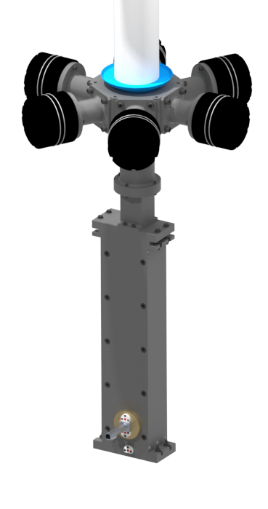
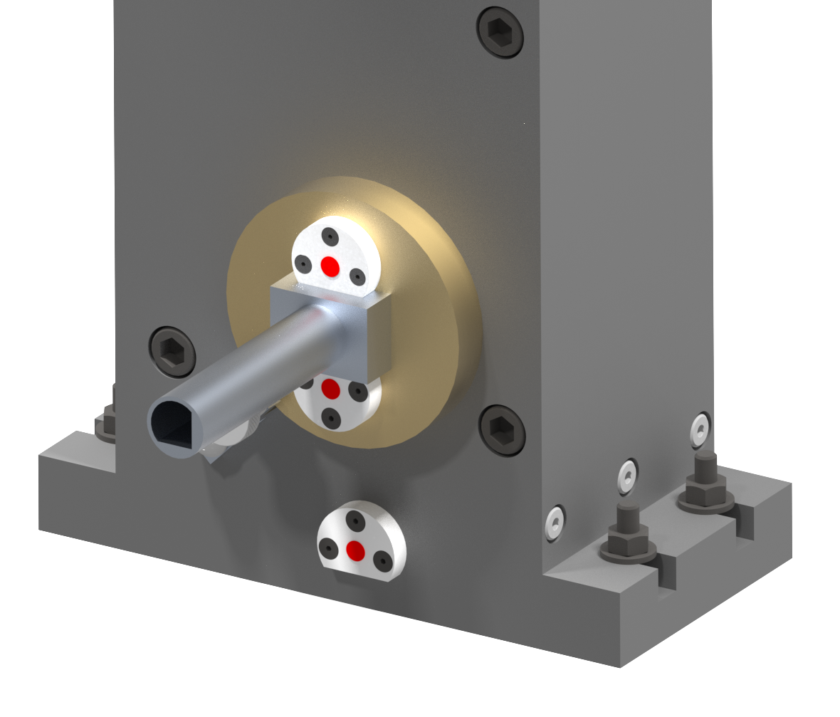
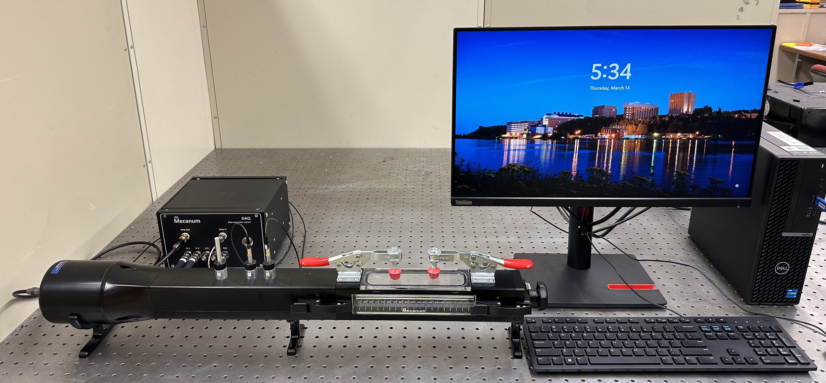
Test Rigs
Capabilities:
Sound pressure levels (SPL): 120 and 140 dB
Sound Source: tonal (stepped-sine, swept-sine, multi-tone) and broadband
Frequency range of 500 to 3000 Hz
Eduction Method: Two-Microphone Method
Capabilities:
Sound pressure levels (SPL): 100 dB
Sound Source: tonal (stepped-sine, swept-sine, multi-tone) and broadband
Frequency range of 500 to 3000 Hz
Eduction Method: Two-Microphone Method
Rotating Plug
Mecanum Normal Impedance Tube
1.5 in square samples
Source
Measurement
Sample Installation
LTF Normal Impedance Tube
2.0 in square samples
Introduction | TPMS Structure | Experimental Method | Results | Conclusion | Future Work

Slide 11
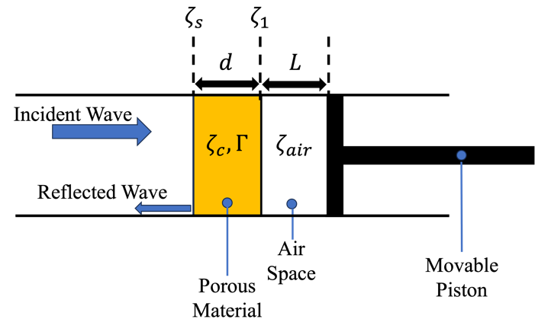


Overview of Two-Cavity Method
$$ζ_{C}=\sqrt{\frac{ζ_{S}ζ_{S}^{′}\left(ζ_{1}−ζ_{1}^{′}\right)−ζ_{1}ζ_{1}^{′}\left(ζ_{S}−ζ_{S}^{′}\right)}{\left(ζ_{1}−ζ_{1}^{′}\right)−\left(ζ_{s}−ζ_{S}^{′}\right)}}$$
Characteristic Impedance
Propagation Constant
$$Γ=\frac{1}{2jd}ln\left[\frac{(ζ_{S}+ζ_{C})(ζ_{1}−ζ_{C})}{{(ζ}_{S}−ζ_{C})(ζ_{1}+ζ_{C})}\right]$$
$$ζ_{1}=−jζ_{air}cot \left(kL\right)$$
Cavity of depth L
$$ζ_{1}′=−jζ_{air}cot \left(kL′\right)$$
Cavity of depth L’
Introduction | TPMS Structure | Experimental Method | Results | Conclusion | Future Work

Slide 12
Overview of Two-Cavity Method
$$ζ_{C}=\sqrt{\frac{ζ_{S}ζ_{S}^{′}\left(ζ_{1}−ζ_{1}^{′}\right)−ζ_{1}ζ_{1}^{′}\left(ζ_{S}−ζ_{S}^{′}\right)}{\left(ζ_{1}−ζ_{1}^{′}\right)−\left(ζ_{s}−ζ_{S}^{′}\right)}}$$
Characteristic Impedance
Propagation Constant
$$Γ=\frac{1}{2jd}ln\left[\frac{(ζ_{S}+ζ_{C})(ζ_{1}−ζ_{C})}{{(ζ}_{S}−ζ_{C})(ζ_{1}+ζ_{C})}\right]$$
$$ζ_{1}=−jζ_{air}cot \left(kL\right)$$
Cavity of depth L
$$ζ_{1}′=−jζ_{air}cot \left(kL′\right)$$
Cavity of depth L’
Cavity Depths Explored: 0.5, 1.0, 2.0 in
Introduction | TPMS Structure | Experimental Method | Results | Conclusion | Future Work

Slide 13
Overview of Two-Cavity Method
$$ζ_{C}=\sqrt{\frac{ζ_{S}ζ_{S}^{′}\left(ζ_{1}−ζ_{1}^{′}\right)−ζ_{1}ζ_{1}^{′}\left(ζ_{S}−ζ_{S}^{′}\right)}{\left(ζ_{1}−ζ_{1}^{′}\right)−\left(ζ_{s}−ζ_{S}^{′}\right)}}$$
Characteristic Impedance
Propagation Constant
$$Γ=\frac{1}{2jd}ln\left[\frac{(ζ_{S}+ζ_{C})(ζ_{1}−ζ_{C})}{{(ζ}_{S}−ζ_{C})(ζ_{1}+ζ_{C})}\right]$$
$$ζ_{1}=−jζ_{air}cot \left(kL\right)$$
Cavity of depth L
$$ζ_{1}′=−jζ_{air}cot \left(kL′\right)$$
Cavity of depth L’
SAME analysis code used on separate datasets.
Introduction | TPMS Structure | Experimental Method | Results | Conclusion | Future Work

Slide 14

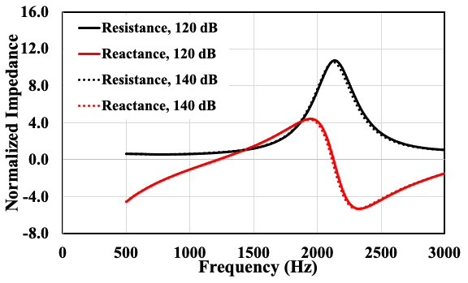
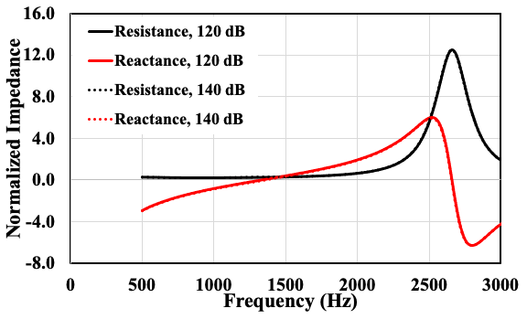
Demonstration of Sample Linearity
NASA Printed, Sample thickness = 2 in.
40% porosity
60% porosity
Introduction | TPMS Structure | Experimental Method | Results | Conclusion | Future Work

Slide 15
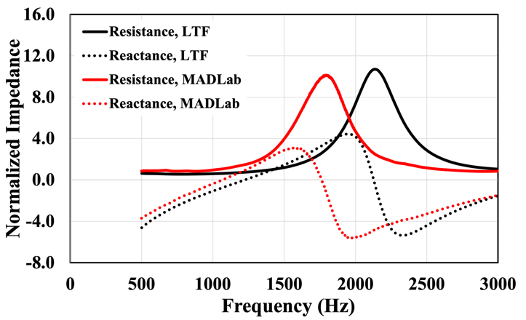
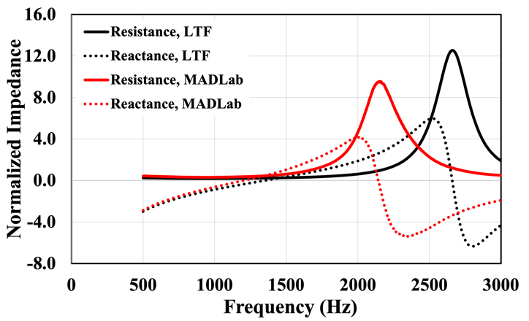
Comparison of Measured Results
Sample thickness = 2 in.
40% porosity
60% porosity
Introduction | TPMS Structure | Experimental Method | Results | Conclusion | Future Work

Slide 16
Comparison of Measured Results
Sample thickness = 2 in, 0.0 in cavity
40% porosity
60% porosity
Differences indicate further investigation is required.
Introduction | TPMS Structure | Experimental Method | Results | Conclusion | Future Work

Slide 17
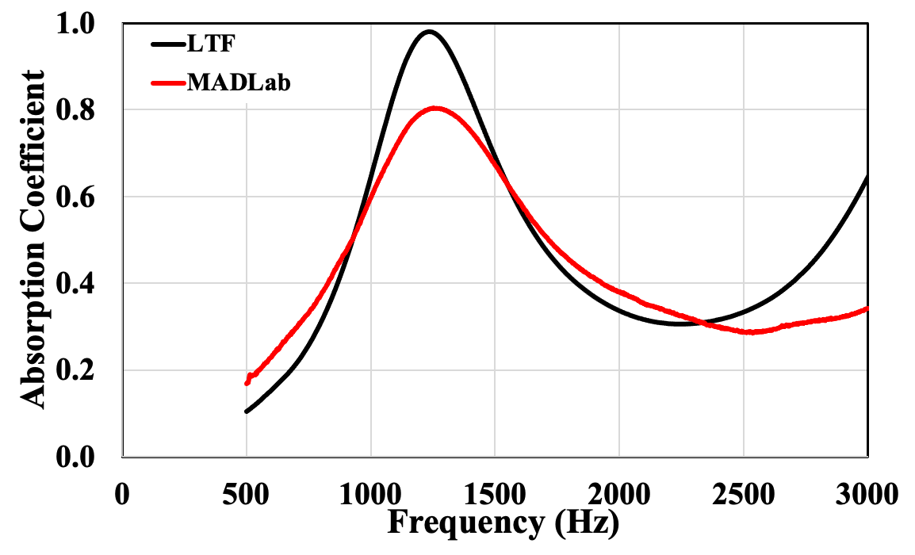
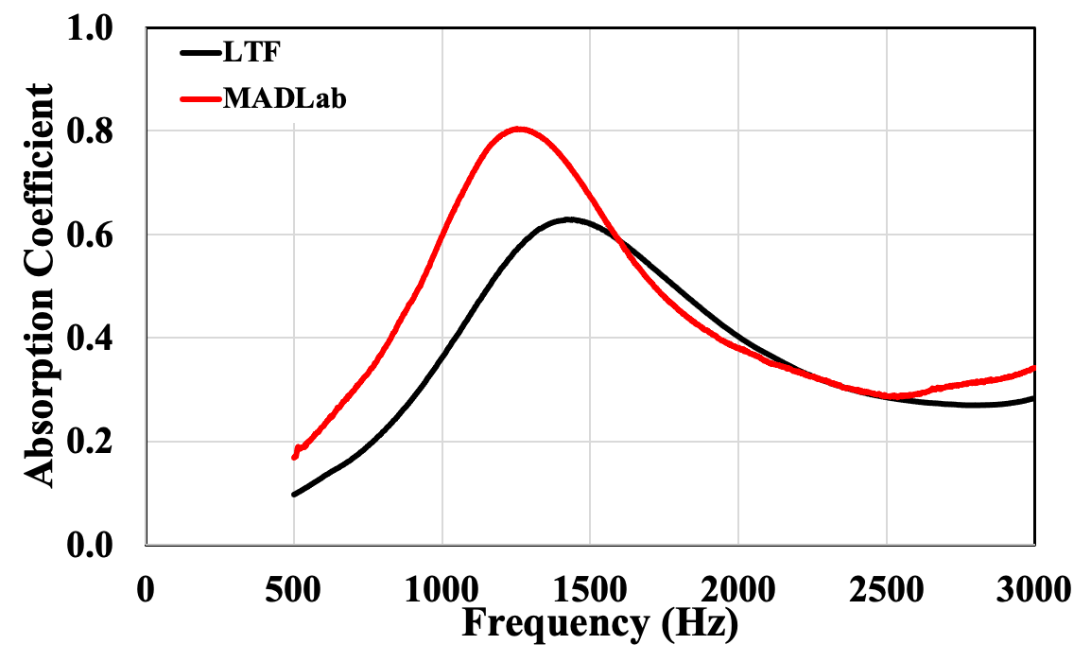
Comparison of Measured Results
Sample thickness = 2 in, 0.0 in cavity
40% porosity
60% porosity
Introduction | TPMS Structure | Experimental Method | Results | Conclusion | Future Work

Slide 18
Comparison of Measured Results
Sample thickness = 2 in, 0.0 in cavity
40% porosity
60% porosity
Frequency range of interest can be targeted by tuning porosity.
Differences indicate further investigation is required.
Introduction | TPMS Structure | Experimental Method | Results | Conclusion | Future Work

Slide 19
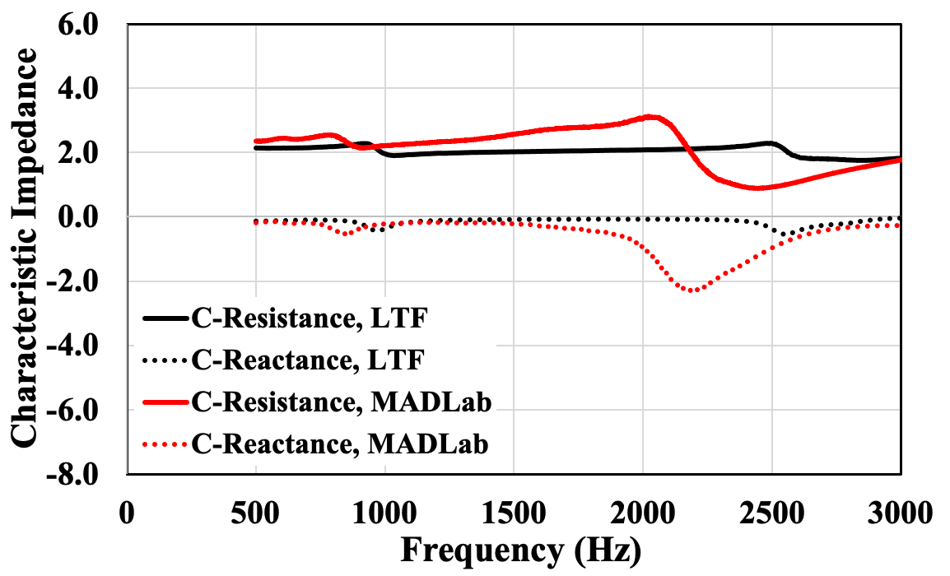
Explore intrinsic properties of samples
Sample thickness = 2 in, 60% porosity, Cavity depth combinations: 1 in and 2 in
Introduction | TPMS Structure | Experimental Method | Results | Conclusion | Future Work

Slide 20
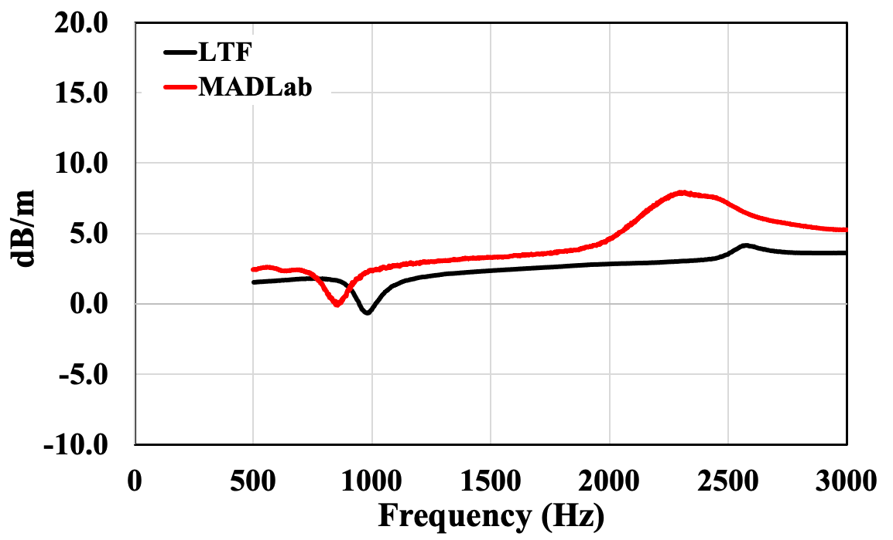
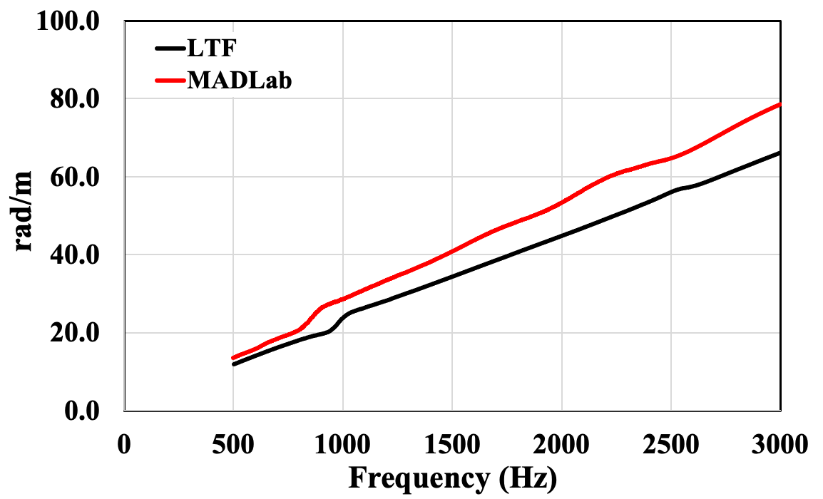
Explore intrinsic properties of samples
Sample thickness = 2 in, 60% porosity, Cavity depth combinations: 1 in and 2 in
Introduction | TPMS Structure | Experimental Method | Results | Conclusion | Future Work
Notes:
Remove the real and imaginary component.
Keep the units.

Slide 21
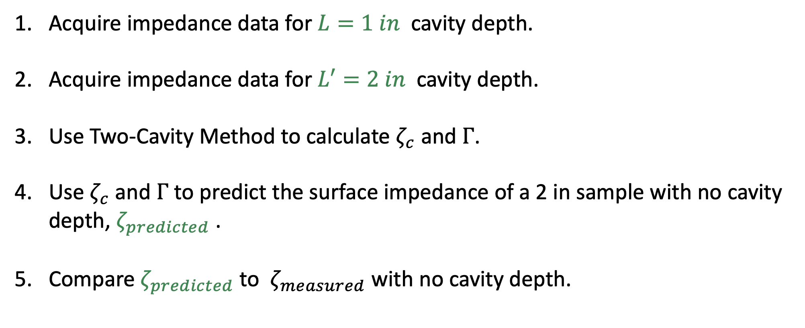
Comparison of Measured vs Prediction
Sample thickness = 2 in., 60% porosity, Cavity depth combinations: 1 in. and 2 in.
Acquire impedance data for $L=1 in$ cavity depth.
Acquire impedance data for $L′=2 in$ cavity depth.
Use Two-Cavity Method to calculate $ζ_{c}$ and $Γ$.
Use $ζ_{c}$ and $Γ$ to predict the surface impedance of a 2 in sample with no cavity depth, $ζ_{predicted}$ .
Compare $ζ_{predicted}$ to $ζ_{measured}$ with no cavity depth.
Introduction | TPMS Structure | Experimental Method | Results | Conclusion | Future Work

Slide 22
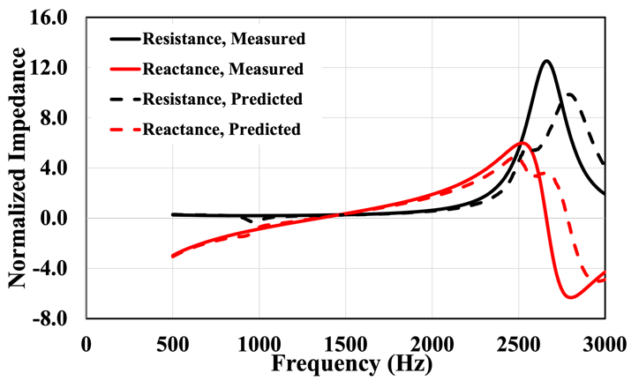
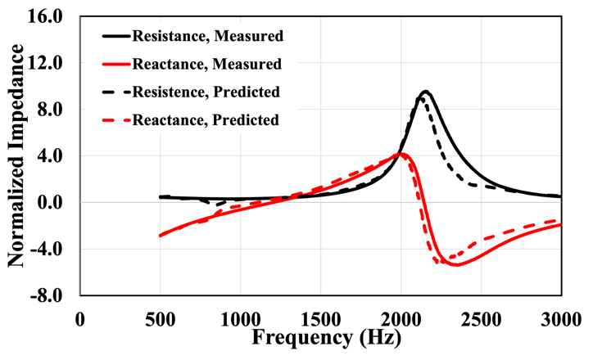
Overview of Interlaboratory Study
Sample thickness = 2 in., 60% porosity, 0.0 in cavity
Introduction | TPMS Structure | Experimental Method | Results | Conclusion | Future Work
Notes:
NASA=> issue with the application of the two-cavity method (need further investigation)

Slide 23
Concluding Remarks
The interlaboratory study demonstrated the importance of collaboration for the purpose of improving modeling techniques.
Differences in measured results between the Liner Technology Facility and MADLab demonstrate the need to better understand as-designed and as-built samples.
More analysis is needed to properly use the Two-Cavity Method on TPMS structures.
Introduction | TPMS Structure | Experimental Method | Results | Conclusion | Future Work

Slide 24
Future Work
Reduce additive manufacturing error by using the same parent material and source printer.
Conduct a deep-dive into the phase unwrapping process.
Explore optimal two-cavity combinations for the Two-Cavity Method.
Integrate the Two-Thickness Method into the investigation to better refine the Two-Cavity Method process.
Testing: Consistent SPLs and type of sound source.
Introduction | TPMS Structure | Experimental Method | Results | Conclusion | Future Work

Slide 25

Acknowledgments
Advanced Air Transport Technology Project (AATT)
of the NASA Advanced Air Vehicles Program for funding this work

Slide 26

Notes:
NASA Presentation Sign-Off Page

