Slide 1
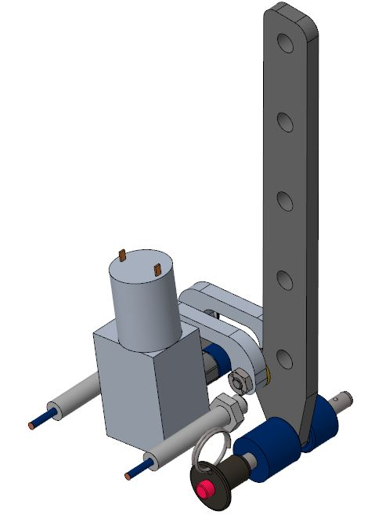
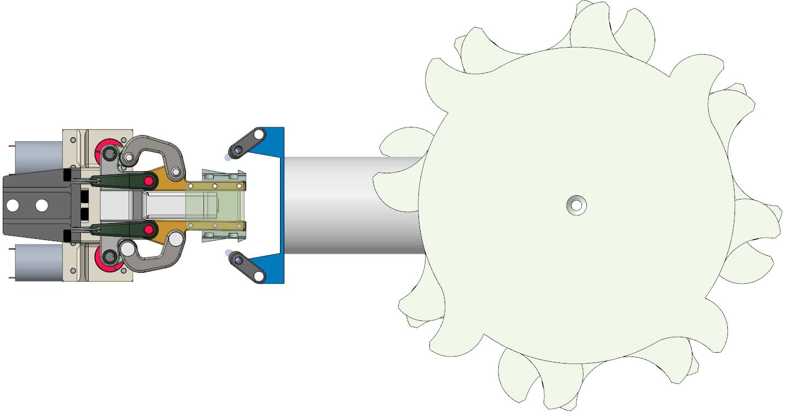
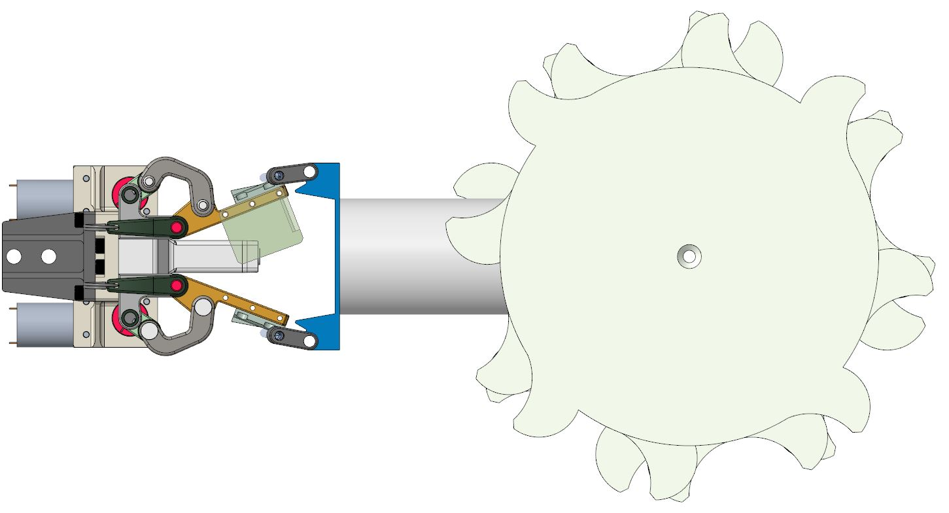
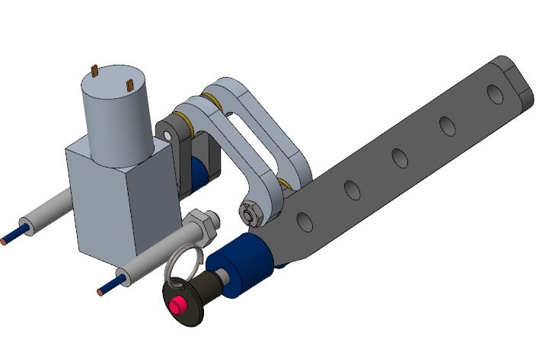
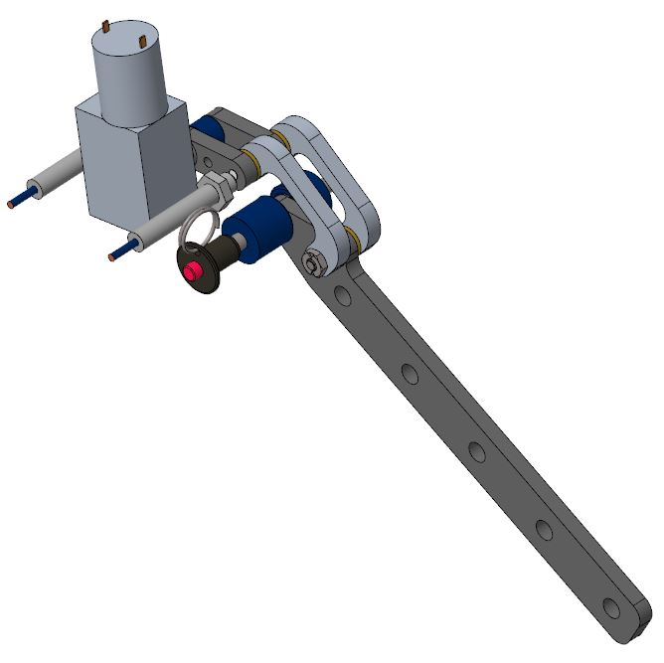
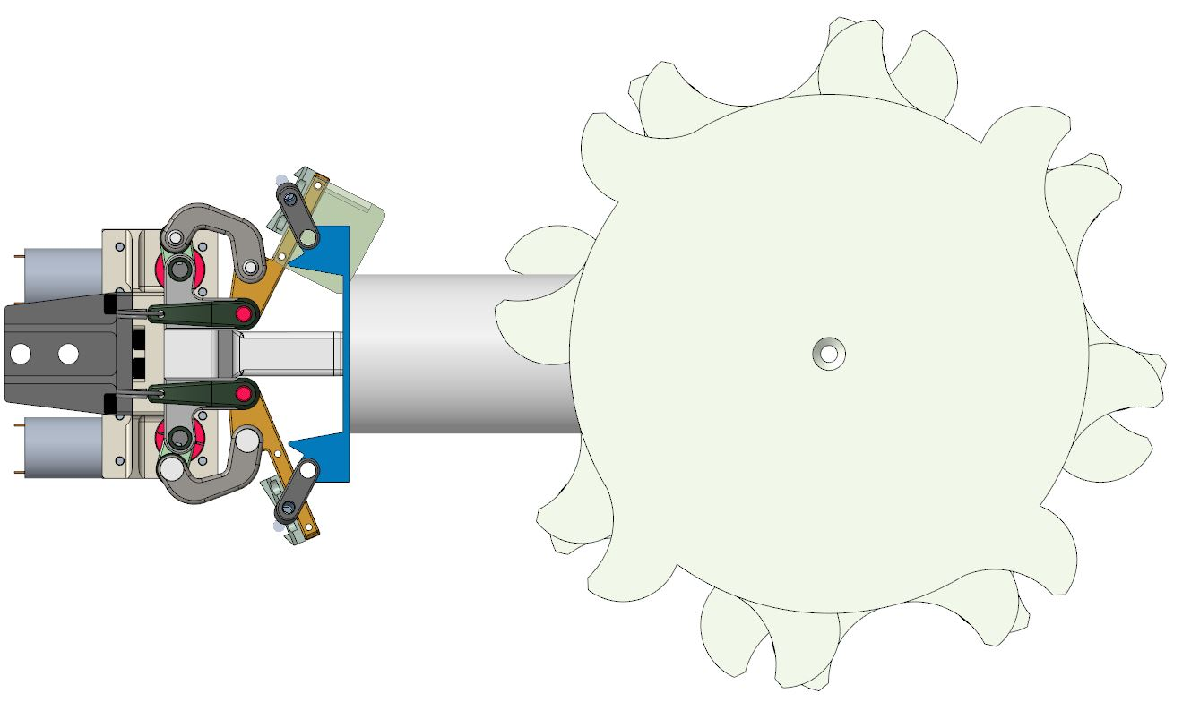
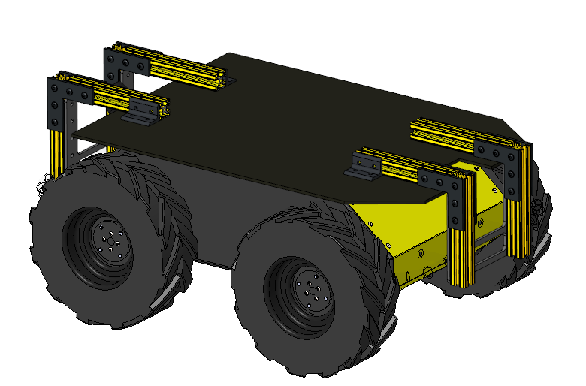
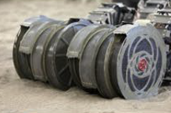
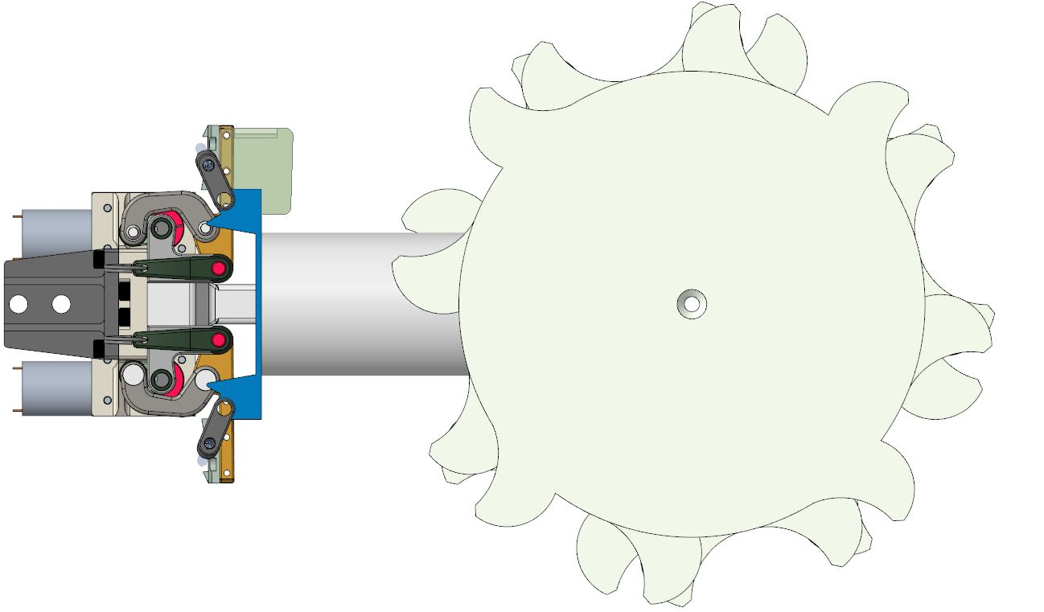
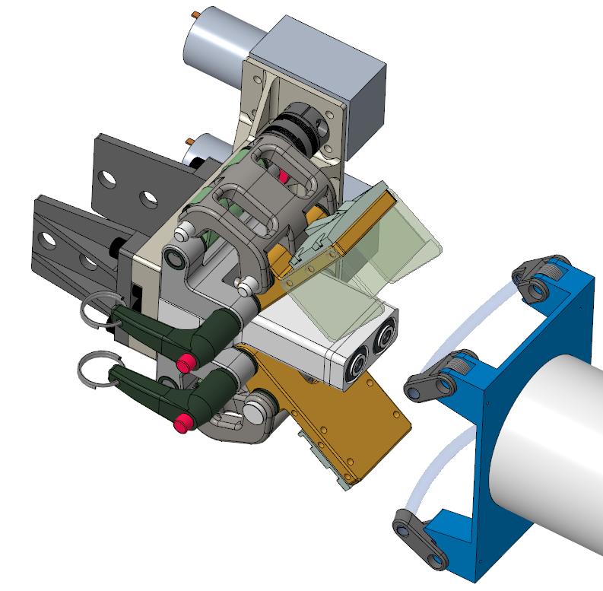
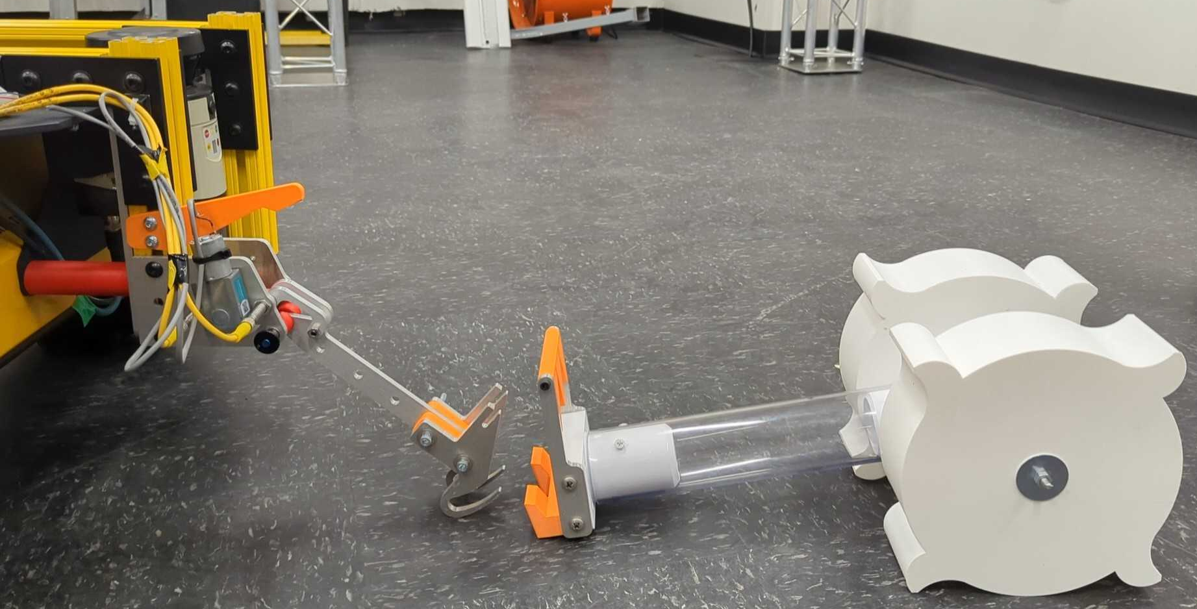
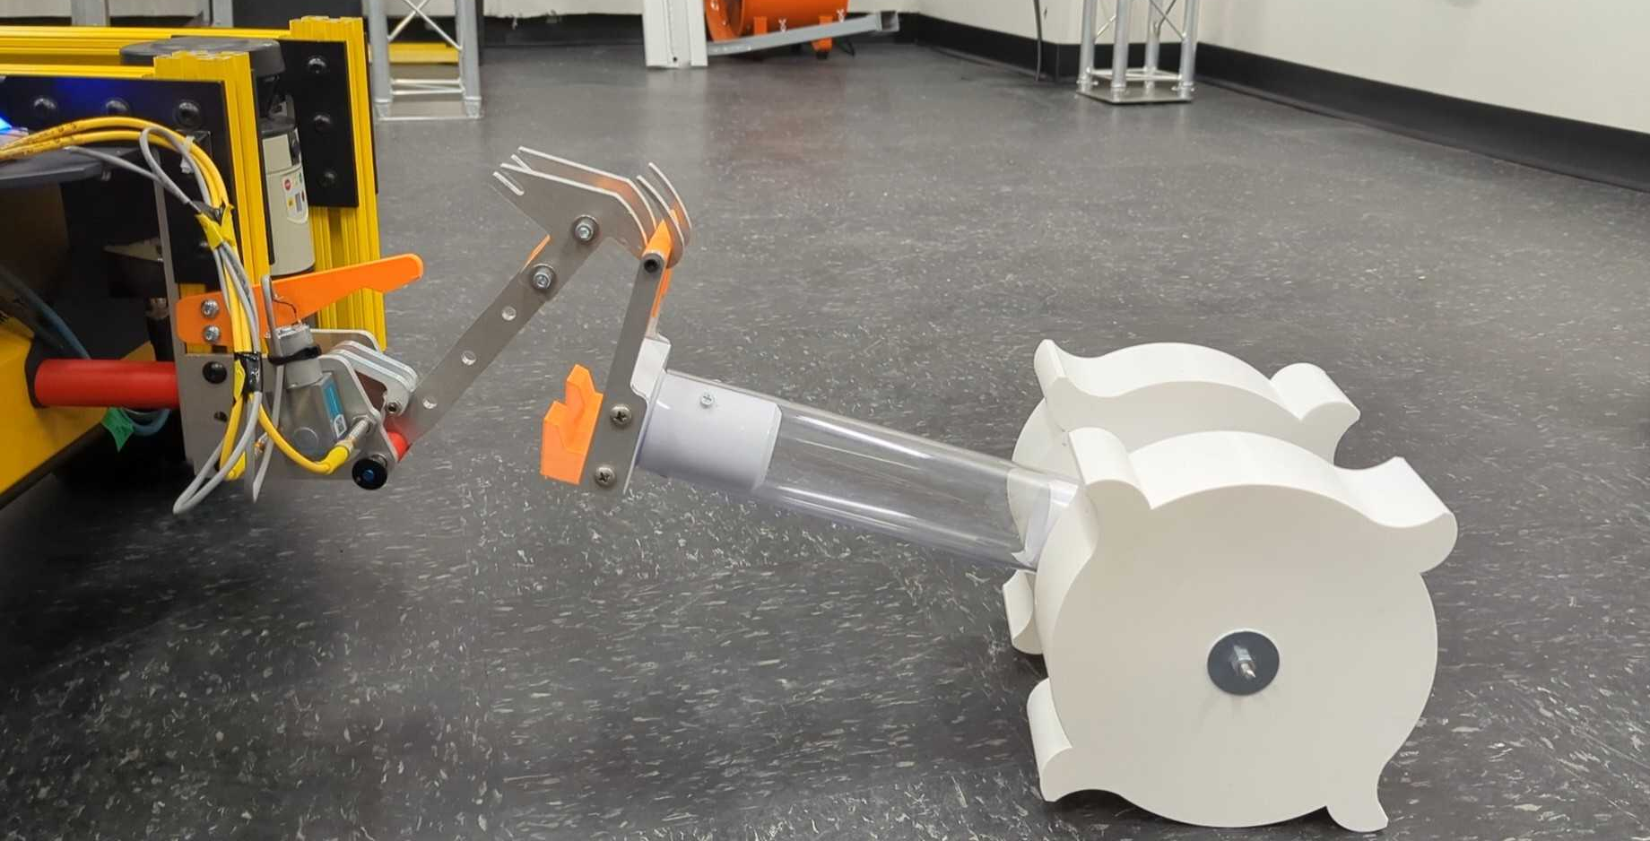
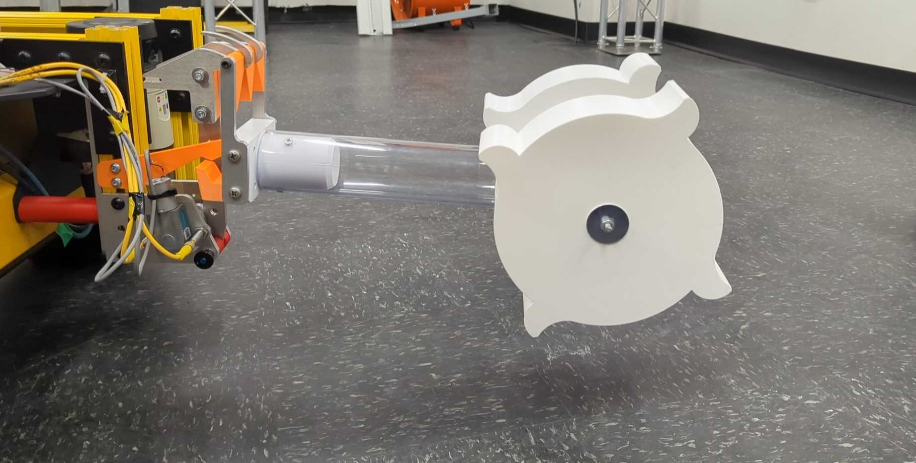
Modular Interface for Commercial Lunar Payload Services (CLPS) Excavators (MICE)
Early development of a solution to robotic removal and replacement of excavation and site preparation implements on a lunar mobility platform.
E. A. Bell, N. J. Gelino, M. A. Gudino, B. H. Burdess
The Need for Modularity and Repairability
The MICE project’s goal is to perform early development work on various Modular Disconnect System (MDS) concepts. These MDS concepts would allow a lunar mobility platform to perform implement swap out or replace damaged implements in-situ.
The Artemis program seeks to create a sustained lunar presence and robust economy driven by the resources available on the moon and enabled by supporting infrastructure. This vision will require robotic manipulation of tens to hundreds of thousands of cubic meters of regolith in one of the harshest environments known to man. Regolith handling system failures are expected.
The capability to robotically maintain and repair excavation and site preparation systems must be developed to avoid abandonment of systems when failures occur.
Ground Pickup MDS
Hub MDS
While implements could be placed on a tool rack for storage and potentially charging, it would be beneficial to have an MDS capable of retrieving implements that are placed on the lunar surface. Doing so would reduce the total traverse time required (as the system would no longer need to drive to a tool rack), potentially reduce flight mass, and increase flexibility in a construction con-ops.
The hub MDS concept provides a lower mass/volume solution than the ground pickup MDS by utilizing the shoulder joint on a rover such as IPEx to perform vertical alignment.
The hub MDS concept shown in figure 4 and 5 uses a pair of over-center latching arms to connect to the implement and provide a pre-loaded mechanical connection. An arbitrary electrical connection is placed between the two latching arms and is protected from dust via a dust cover (shown in figure 5 in transparent green)
This concept is currently in development and will be tested in summer 2024.
Placing the implement on the lunar surface requires a vertical-axis system to perform attach/detach operations. Placement on the lunar surface also increases the chance of misalignment between the two halves of the MDS connection point due to terrain.
Mobility Platform
Excavator
Modular
Disconnect
System
The ground pickup MDS concept is a further development of the Quick Attach concept developed for the Chariot rover. With this new design, a hook and bar connection mechanism (like Quick Attach) is placed on the end of a rotating arm. The arm allows for significant vertical misalignment between the implement and the final rover connection point. The arm uses an over-center mechanism to provide rigidity when fully retracted.
Compactor
Figure 1. MICE Modular Disconnect System (MDS) connects an arbitrary mobility platform to a set of excavation and site preparation implements. Current MICE testing is performed using a Clearpath Robotics Husky robotic platform as a simulated lunar rover.
Grader
Figure 2. Ground pickup arm actuation.
Additionally, the ability to utilize a common set of tools on an arbitrary and diverse set of mobility platforms would reduce payload mass and single point failures on construction work sites.
Figure 4. Hub MDS connection to the IPEx bucket drum implement.
Motor
Test Fixture Framing Bracket
Latch
Dust Cover
Building On Previous Work
The MICE project is not the first to tackle tool changers and MDS concepts. The team has performed a vast literature review and identified lessons learned and key benefits from other MDS concepts.
Previous work was performed at Kennedy Space Center (KSC) on the Quick Attach Docking Interface for the Lunar Electric Rover project [2]. The team developed an MDS to be used on NASA’s Chariot rover. Testing was performed to attach and detach a grader blade from the rover. This work highlighted key requirements to any rover-based MDS concept. Specifically, a need for significant pre-load, a high degree of dust tolerance, and a desire for increase interface reach.
Manual Over-ride Pins
Spring Resetting Cable
Figure 5. Hub MDS connection isometric view.
Further Advancement
MICE is seeking funding to advance these MDS concepts by testing on a mobility platform in lunar simulant at ambient conditions as well as further testing in dusty vacuum conditions.
Additionally, MICE is adding electrostatic measurement equipment to the Atmospherically Sealed Simulator for In-situ System Testing (ASSIST) vacuum chamber. This will improve ASSIST’s ability to test equipment with lunar-like triboelectric effects.
[1]“Skid-steers with different attachements,” (Accessed 2024) https://en.wikipedia.org/wiki/Bobcat_Company
[2] Schuler, J. M., Nick, A. J., Immer, C., & Mueller, R. P. (2010). Quick Attach Docking Interface for Lunar Electric Rover. In Earth and Space 2010: Engineering, Science, Construction, and Operations in Challenging Environments (pp. 1382-1393).
Figure 3. Ground pickup MDS attaching simulated IPEx Drum.

