Slide 1


OMI Phase-F Data Preservation
James Johnson^{1,2}, Irina Gerasimov^{1,2}, Lena Iredell^{1,2}
(1) ADNET Systems Inc., (2) NASA Goddard Space Flight Center

Slide 2
Introduction
The NASA GES DISC is the primary archive for the Aura OMI products. After 20 years of operations, the OMI instrument is nearing its end and entering Phase-F (closeout). It is time to begin the process of preserving the data, documentation, software and associated information that were produced by the OMI project over its lifetime.
The NASA ESDIS project has defined the process for data preservation which is spell out in the document NASA Earth Science Data Preservation Content Specification (rev. C) or PCS (423-SPEC-001).
Why? To allow a future user to understand how the OMI products were created and used, thus enabling long-term scientific research of these data.

Slide 3
PCS Categories
Measuring Instrument/Platform Description
Instrument and Science Data Products an
Science Raw Data, Product and Algorithm
Instrument Calibration
  On-orbit, in-flight, in-the-field Calibration Methods
  Calibration Data
Science Algorithm Software
Science Data Product Algorithm Input
Science Data Product Validation
Science Data Access and Analysis Tools
PCS Checklist
h
Measuring Instrument/Platform Description
  Instrument and Platform Description
  Preflight/Pre-operational Instrument Calibration Data
Instrument and Science Data Products and Metadata
  Raw Data and Derived Products
  Data Product Metadata
Science Raw Data, Product and Algorithm Documentation
  Instrument and Science Team
  Data Product Requirements and Designs
  Processing and Algorithm Version History
  Data Product Generation Algorithms
  Data Product Quality
  Data Product Application

Slide 4
Preservation Status at GES DISC
Science team locates items specified under the PCS deemed relevant for preservation.
  include info for all products and versions since mission start
  GES DISC has current versions of data (v4 and v3)
  what about v1 and v2, and replaced/retired v3 products?
PCS checklist (spreadsheet) will track the status of all items
Items are transferred to the GES DISC. This can be done in stages.
Items (including PCS checklist) are placed in the GES DISC docserver
Items are made accessible through the GES DISC home page

Slide 5
Preservation Status at GES DISC
Completed missions: Aura HIRDLS and SORCE
In progress: Aura OMI*, Aura MLS, Aqua AIRS, TRMM and Terra/Aqua/Aura DPREP
UARS and TOMS were done prior to adoption of PCS
Note: Any ITAR documents are not public, they are listed in the PCS checklist but kept offline and handled via NASA ITAR requirements

Slide 6
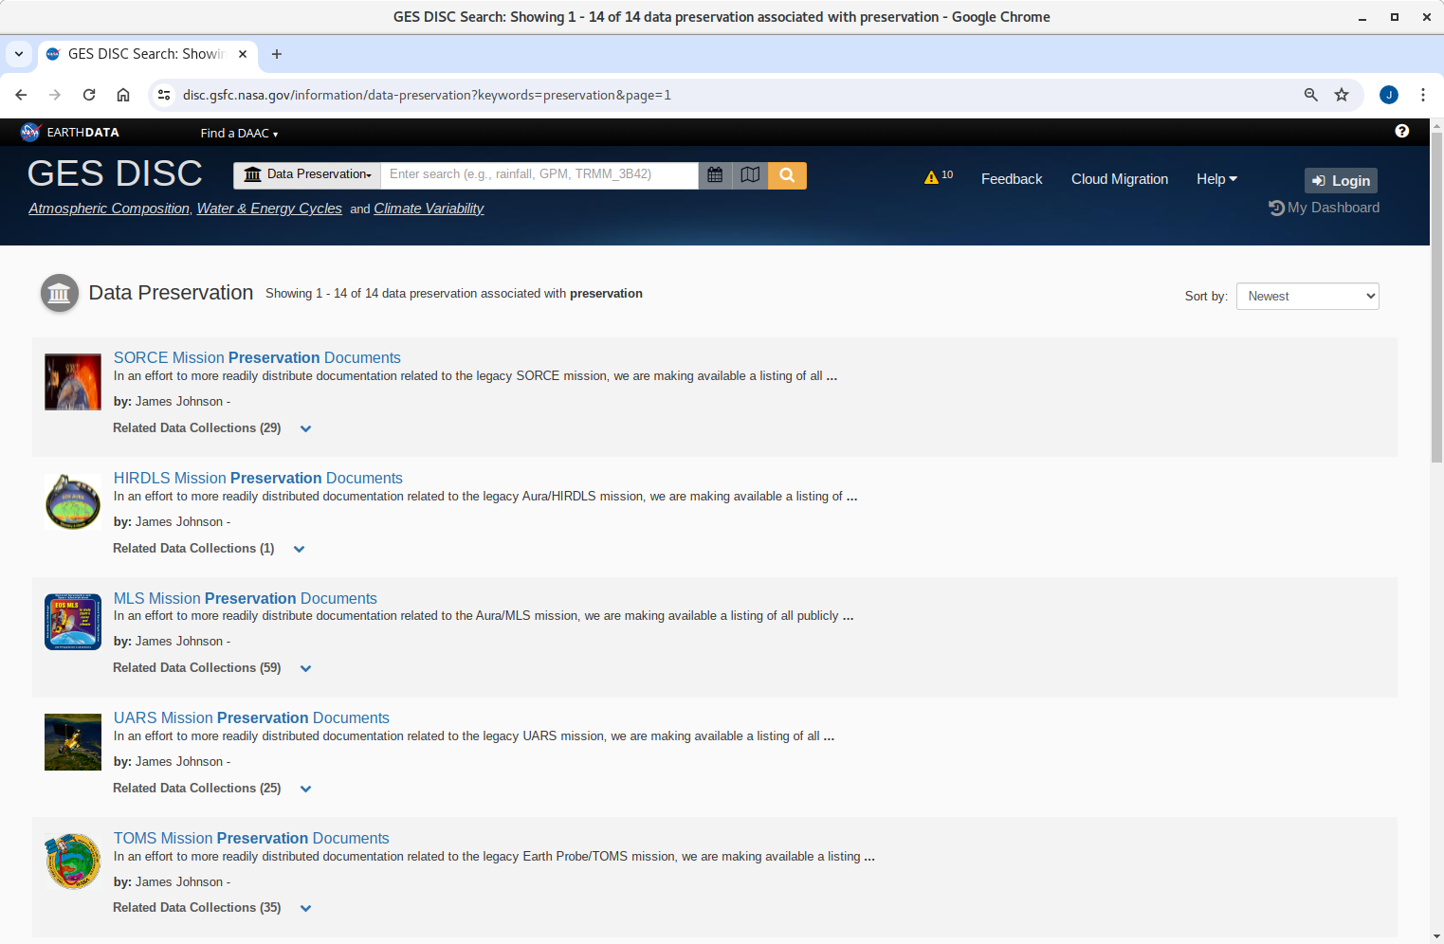
GES DISC Preservation Website

Slide 7
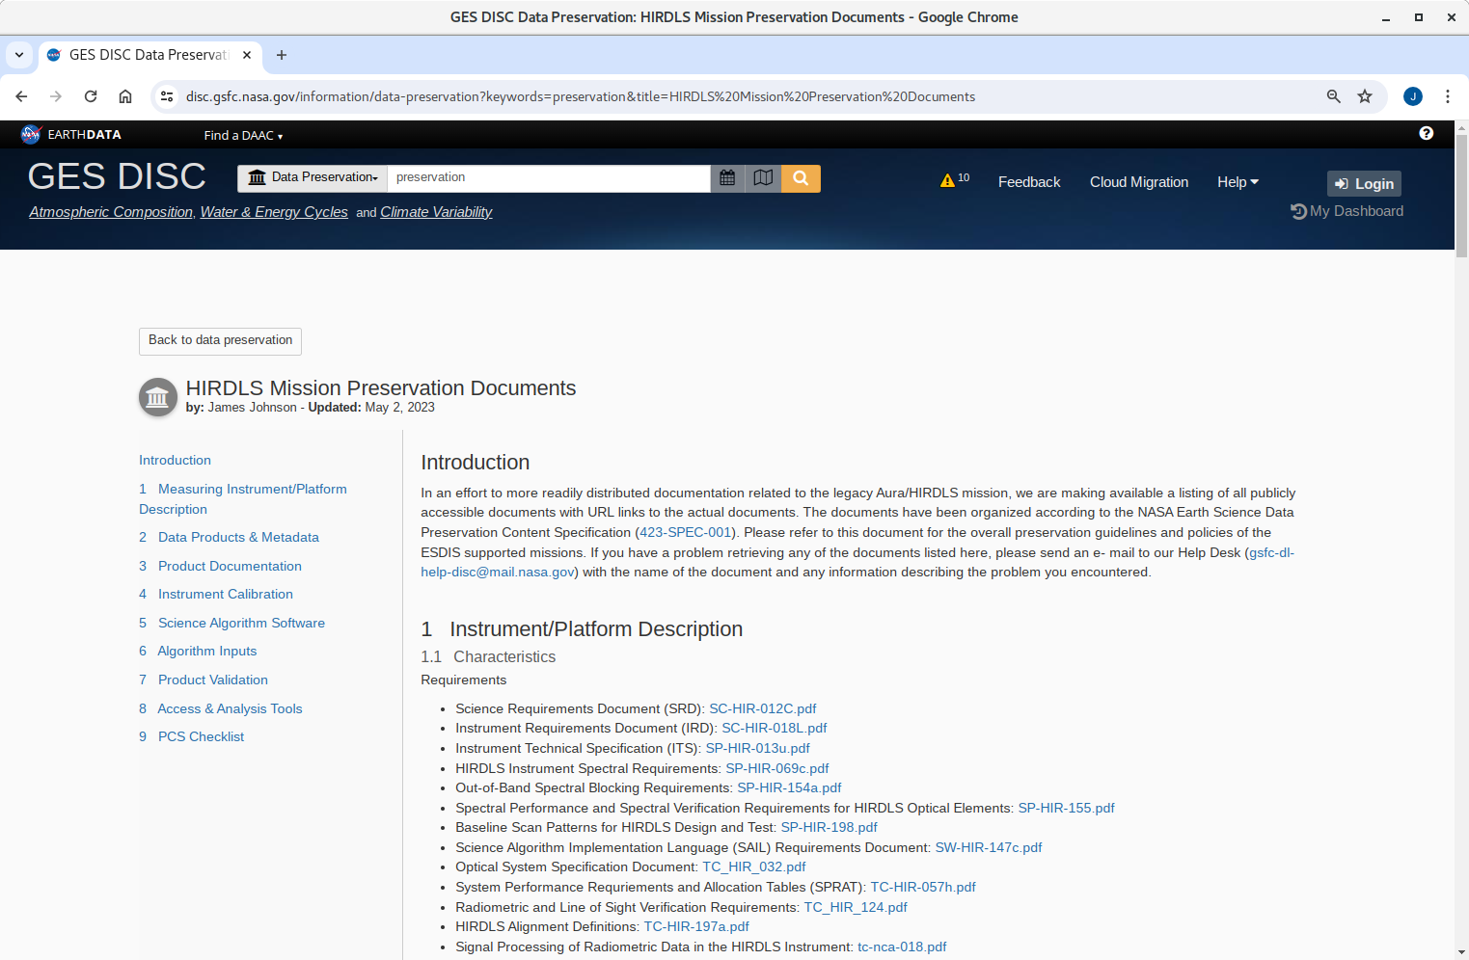
HIRDLS Preservation Page

Slide 8
Sources
PCS: https://www.earthdata.nasa.gov/esdis/esco/standards-and-practices/preservation-content-spec
GES DISC Homepage: https://disc.gsfc.nasa.gov
GES DISC Preservation Site: https://disc.gsfc.nasa.gov/information/data-preservation

