Slide 1


NASA Aeronautics Research
National Aeronautics and Space Administration
Name
Title
Date
www.nasa.gov

Slide 2



Why is “Aeronautics” the First “A” in NASA?
The nation's early aeronautics research led to creation of NASA.
7,500 NACA employees
$300 million in NACA research facilities
(Langley, Lewis Field, Ames)
NACA research process
National Advisory Committee for Aeronautics
March 3, 1915
National Aeronautics and Space Administration
October 1, 1958
Notes:
In 2015 NASA celebrated 100 years since the founding of the National Advisory Committee for Aeronautics, or the N-A-C-A.
During the time of the NACA, many of the facilities and ways of doing research that are part of NASA today came to being. The NACA became NASA on October 1, 1958, with a new focus on flight into space, which began during the NACA years mainly through the X-15 research aircraft program.
Aeronautics research made the space program possible, as spacecraft have to go through Earth’s atmosphere twice. So the sciences of aerodynamics, thermodynamics, materials and structures all played a role in the new space-focused organization.
NASA dedicated an “A” to aeronautics to recognize the contributions we continue to make in advancing research and development for civil aviation.

Slide 3
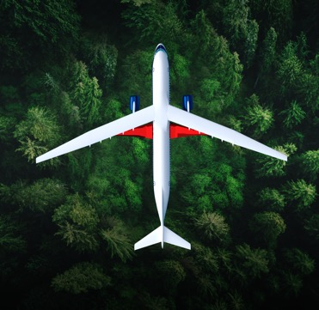
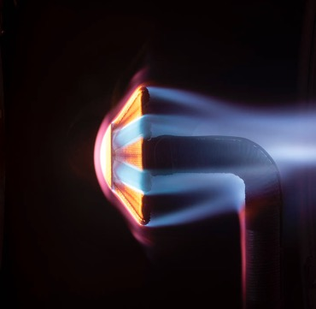

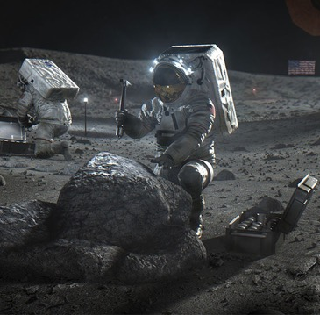
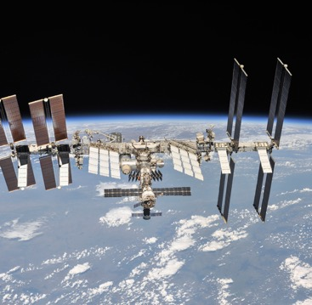
NASA Aeronautics is One of Five Mission Directorates
Exploration Systems Development
Aeronautics
Space Technology
Science
Space Operations
NASA explores technologies that reduce aircraft noise and fuel use, get you gate-to-gate safely and on time, and transform aviation into
an economic engine at
all altitudes.
NASA technologies developed for spaceflight benefit our everyday life. The Artemis program proves and matures what those technologies can do and reduces risk for exploration of Mars
and beyond.
NASA and the nation’s science community use space observatories conduct scientific studies of the Earth from space
to visit and return samples from other bodies in the solar system, and to
peer out into our galaxy and beyond.
NASA's Artemis program
is defining and creating the steps path from Earth back to the Moon and on to Mars, including the Orion capsule, the Space Launch System, Exploration Ground Systems, the Gateway, and Human Landing System.
NASA's work in beyond low-Earth orbit includes commercial launch services to the International Space Station, exploration systems, space transportation systems, and broad scientific research on orbit.
Notes:
Aeronautics research is one of NASA’s five missions.

Slide 4

Aviation is Vital to our Nation’s Economy
$1.37 trillion economic impact from commercial aviation in 2023*
$77.3 billion positive manufacturing trade balance in 2022**
8.97 million flights by U.S. carriers worldwide in 2022***
24 million tons of freight transported by U.S. airlines in 2022***
2.2 million aerospace/defense jobs; 603,000 in aeronautics/aircraft in 2022**
* From Airlines for America
** From Aerospace Industries Association
*** From Bureau of Transportation Statistics
Notes:
Updated 3/7/24​
​
How important is aviation to the U.S. economy? ​
​
​
$1.25 trillion of economic impact from commercial aviation in 2022.​
(From Airlines for America. https://www.airlines.org/impact/#:~:text=Commercial%20Aviation%20is%20a%20Critical,of%20%241.25%20trillion%20in%202022.)​
​
$77.3 billion positive manufacturing trade balance in 2022.​
2.2 million aerospace/defense jobs; 602,000 in aeronautics/aircraft in 2022.​
(From Aerospace Industries Association. https://www.aia-aerospace.org/news/aia-releases-2023-facts-figures-data-highlighting-ad-industrys-return-to-pre-pandemic-levels/)​
​
8.97 million flights by U.S. carriers worldwide in 2022.​
24 million tons of freight transported by U.S. airlines in 2022.​
(Statistics from Bureau of Transportation Statistics ​
​
​
​

Slide 5
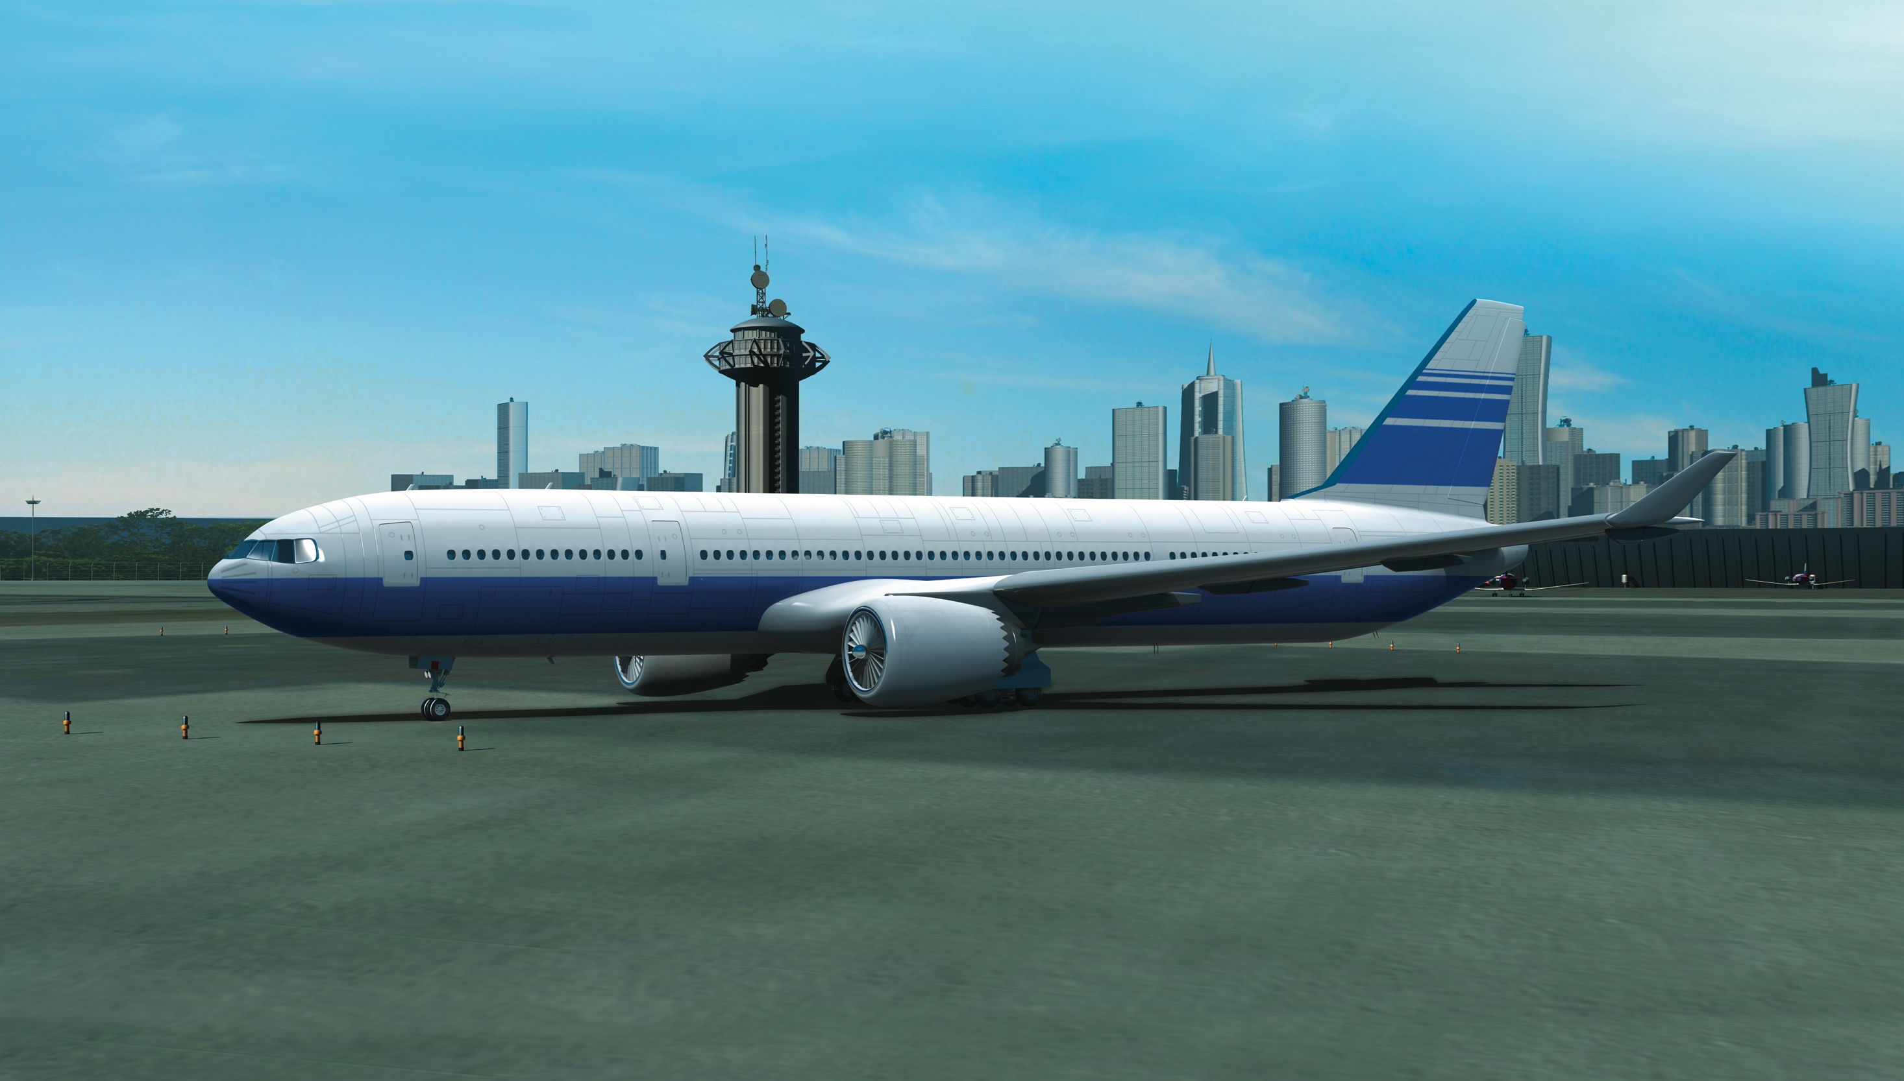

NASA has Made Decades of Contributions to Aviation
NASA-developed technology is on board every U.S. commercial aircraft and control tower.
+ AIR TRAFFIC MANAGEMENT
• Center TRACON Automation System (CTAS) – 1990s
• Traffic Management Advisor (TMA) – 1990s
• Surface Management System (SMS) – 2000s
• Future Air Traffic Management Concepts Evaluation Tool (FACET) – 2000s
+ COMPUTATIONAL FLUID DYNAMICS (CFD)
+ NASA STRUCTURAL ANALYSIS (NASTRAN)
+ COMPOSITE STRUCTURES
+ AIRBORNE WIND SHEAR DETECTION
+ TURBO AE
+ LIGHTNING PROTECTION STANDARDS
+ DIGITAL FLY-BY-WIRE
+ WINGLETS
+ SUPERCRITICAL AIRFOIL
+ AREA RULE
+ GLASS COCKPIT
+ ICING DETECTION
+ JET ENGINE
COMBUSTORS
+ ENGINE NOZZLE CHEVRONS
+ DAMAGE-TOLERANT FAN CASING
+ RUNWAY GROOVES
+ WIND TUNNELS
Notes:
NASA Aeronautics has made decades of contributions to aviation. Our research heritage goes back more than 100 years to the days of the National Advisory Committee for Aeronautics, the organization from which NASA was created in 1958.
Every U.S. commercial aircraft and U.S. air traffic control tower has NASA-developed technology on board.
That’s why we say, “NASA’s with you when you fly.”
The technologies and knowledge shown here are woven into the DNA of aviation as we know it today.
(For details of tech items, visit: https://www.nasa.gov/sites/default/files/files/c_litho_12_07_09_v2_high.pdf. Similar charts for general aviation, military aircraft, civil rotorcraft and tilt rotor are available at https://www.nasa.gov/aero/nasa-aero-lithographs.html)

Slide 6
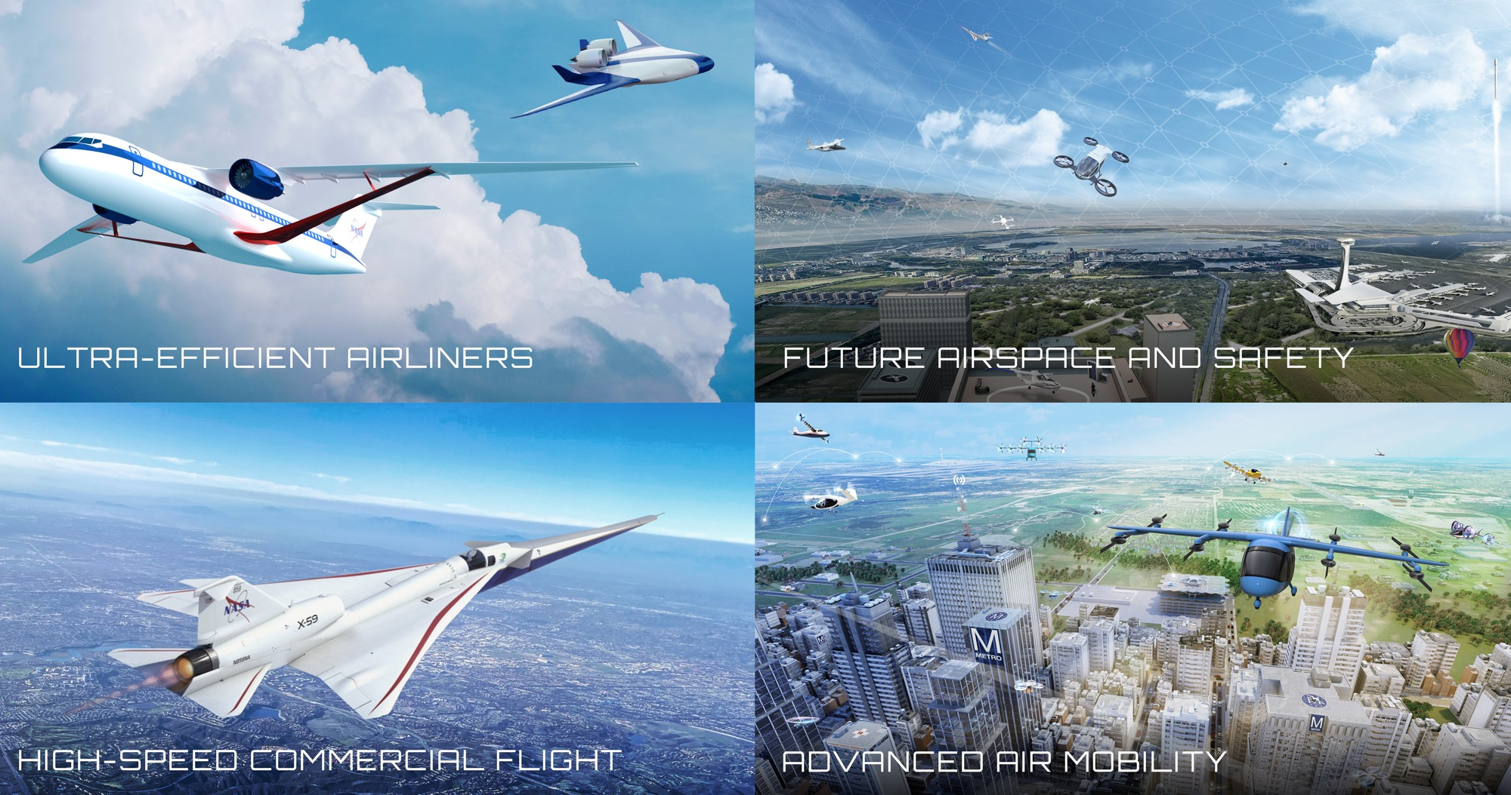
Four Transformations for Sustainability, Greater Mobility, and Economic Growth
Four Transformations for Sustainability, Greater Mobility, and Economic Growth
Notes:
Updated 5/30/23
NASA is leading transformation of aviation in four technical areas.
Each of these transformation areas is enhanced and advanced by a fifth transformational area, our Innovation Ecosystem, which produces new knowledge/ideas to lead to new transformation areas.
Ultra-Efficient Airliners: We are accelerating the ability of the next generation of large commercial aircraft to use less energy and use cleaner energy. Our work is a major contribution to the U.S. goal for net-zero greenhouse gas emissions by 2050.
Future Airspace and Safety: We are working with partner FAA to continue evolution of our national airspace system to safely integrate all types of air vehicles in an increasingly complex environment, and to do so more sustainably – using digital technologies on the ground and on board vehicles to enable more efficient trajectories that use less energy.
Advanced Air Mobility: With nearly 100 industry partners, we are working to enable an economically viable and safe system in which aircraft from drones to air taxis can fly new missions over the most rural countryside to the dense urban landscape – missions such as passenger transport, medical deliveries, utility inspections, disaster response. Our Advanced Air Mobility mission is working with the aviation community to solve challenges in vehicle development and operations, airspace design and operations, and community integration.
High-Speed Commercial Flight: We are potentially removing a key barrier to commercial supersonic flight over land by proving that we can get rid of the sonic boom, while also exploring solutions to local noise and emissions associated with supersonic flight. With our federal partners we are also investigating the potential of even higher speed flight such as high-supersonic and hypersonic speeds.

Slide 7



U.S. Aviation Climate Action Plan
U.S. Aviation Climate Goal:
Net-Zero Greenhouse Gas Emissions from the U.S. Aviation Sector by 2050
“The United States believes that addressing the climate crisis through enhanced ambition is a defining priority of our time. This Aviation Climate Action Plan provides a whole-of-government approach and policy framework for the aviation sector to contribute to broader, economy-wide objectives.”
- U.S. Aviation Climate Action Plan
Notes:
Aviation GHG emissions include life cycle carbon dioxide (CO2), nitrous oxide (N2O), and methane (CH4) emissions. Aircraft engines produce negligible amounts of nitrous oxides and methane, so this plane has a focus on aviation combustion CO2 emissions and well-to-tank life cycle GHG emissions (CO2, N2O, and CH4). The U.S. Aviation 2050 Goal is based on emissions that are measurable and currently monitored. Research is ongoing into the climate impacts of aviation-induced cloudiness and the indirect climate impacts of aviation combustion emissions (see section 7 for details on the climate impacts of aviation non CO2 combustion emissions).​
This U.S. aviation goal encompasses CO2 emissions from (1) domestic aviation (i.e., flights departing and arriving within the United States and its territories) from U.S. and foreign operators, (2) international aviation (i.e., flights between two different ICAO Member States) from U.S. operators, and (3) airports located in the United States.​
​
NOTE: The U.S. goal states "greenhouse gas emissions," while the international community states "carbon emissions." We make the distinction.​
Link to US Aviation Climate Action Plan: https://www.faa.gov/sites/faa.gov/files/2021-11/Aviation_Climate_Action_Plan.pdf​

Slide 8



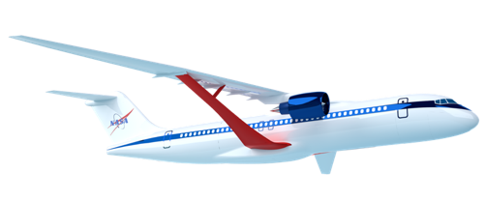

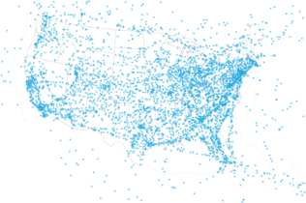
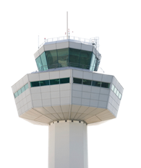
Aviation Pillars for a Sustainable Future
Global Aviation GOAL: net-zero carbon emissions by 2050
NASA = Primary Role
NASA = Supporting Role
NASA = Primary Role
www.nasa.gov |
8
Notes:
Transformation Areas: Ultra-efficient Airliners, Future Airspace and Safety
The global aviation community in 2021 established the aggressive goal of net-zero carbon emissions by 2050 through four means – what we fly, how we fly, the fuels we use to fly, and the use of high-quality carbon offsets in the near-term with carbon removal opportunities to address residual CO2 emissions in the longer term. The challenge to meet the goal is magnified as fleet growth has outpaced improved fleet efficiency, leading to increased overall carbon emissions; even though the operational fleet has become 2% more efficient each year, the total amount of carbon emitted annually in 2019 (905 Mt) is 39% higher than it was in 2005 due to overall traffic growth.
This aggressive goal for overall carbon emissions is focused today on commercial aviation, as that is the predominant form of aviation today. As new aviation sectors develop and flourish, they must do their part to contribute to the sustainability of aviation – they have to be green from the outset.
NASA’s primary contribution and largest investment is in R&D of technologies for low emissions and low noise aircraft.
NASA plays a primary role with significant investment in R&D of operational concepts and technologies deployed by the FAA and on aircraft flight decks. NASA does not have research related to airport infrastructure.
NASA plays a supporting role in characterizing the environmental impact of sustainable aviation fuels, and possibly via use in NASA flight research operations.
The aviation community also has stated a role for market based measures such as carbon offsets, where NASA has no role to play other than to reduce/eliminate the need for MBM/offsets.
Reference Info
https://aviationbenefits.org/media/167501/atag-net-zero-2050-declaration.pdf (provides the ATAG Goal declaration – Oct 5, 2021)
https://aviationbenefits.org/media/167475/fact-sheet_3_tracking-aviation-efficiency-v2.pdf (provides fuel efficiency and carbon emissions numbers by year. Updated in 2021, downloaded Nov 2, 2021)
(Backup information: This was the previous goal:
The global aviation community has established the aggressive goal of a 50% reduction in carbon emissions by 2050, and possible net zero emissions by 2060 through these three means - what we fly, how we fly, and the fuels we use to fly. This 50% reduction from 2005 levels is a very aggressive goal, because fleet growth outpaced fleet efficiency improvements since 2005. Even though the operational fleet has become 2% more efficient each year, the total amount of carbon emitted annually in 2019 (905 Mt) is 39% higher than it was in 2005 due to overall traffic growth.)

Slide 9


Sustainable Flight National Partnership Benefits
Small Core Gas Turbine for 5%-10% fuel burn benefit
Transonic Truss-Braced Wing for 5%-10% fuel burn benefit
Electrified Aircraft Propulsion
for ~5% fuel burn and maintenance benefit
High-Rate Composites for
4-6x manufacturing
rate increase
Sustainable Aviation Fuels for reduced lifecycle carbon emissions
Integrated Trajectory Optimization for 1%-2% reduction in fuel required and minimization of contrail formation
Next-generation transports using up to 30% less fuel, current and future fleets flying optimal trajectories,
engines burning sustainable aviation fuels for net-zero lifecycle greenhouse gas emissions
Notes:
NASA’s Sustainable Flight National Partnership (SFNP) will mature new green technology by late 2020s to maintain U.S. leadership as builders of next-generation commercial transports – the heart of the aviation system. Sustainable aviation system growth, increased airline travel, excellent engineering and manufacturing jobs, and economic growth will all result from achieving SFNP objectives and benefits. ​

Slide 10
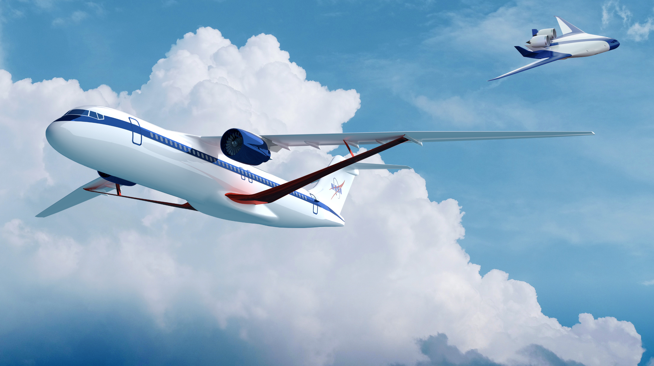
Ultra-Efficient Airliners
Real Progress. Real Value.
www.nasa.gov |
10
Notes:
​

Slide 11

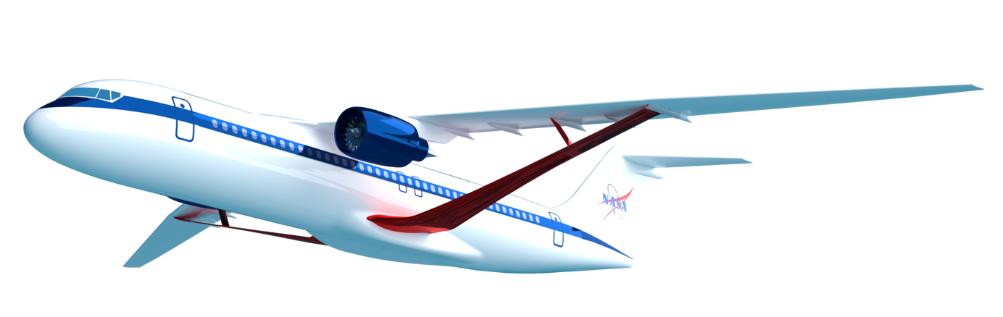
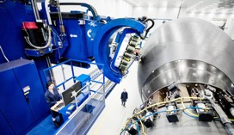
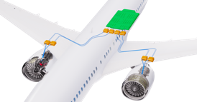
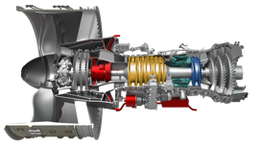
Subsonic Airliner Technologies
Ensure U.S. industry is the first to establish the new “S Curve” for the next 50 years of airliners
Integrated Aircraft System Efficiency
Propulsion Airframe Integration Opportunity
Aerodynamic Efficiency
Transonic Truss-Braced Wing
(5-10% fuel burn benefit)
Weight
High-Rate Composites
(4-6x manufacturing increase)
Electrified Aircraft Propulsion
~5% fuel burn and
maintenance benefit
Engine Efficiency
Small Core Gas Turbine
(5-10% fuel burn benefit)
Notes:
Transformation Area: Ultra-Efficient Airliners
NASA has identified four priority subsonic transport technologies that can have the greatest impact on the future sustainability of commercial aircraft fleet.
These priority technology areas were identified through research over the last twelve years, starting with Advanced Concept Studies in 2008 targeting aircraft with a 2030-35 entry into service.
NASA established aggressive goals targeting noise, emissions, and fuel burn, and worked with industry and academia to identify and drive innovation that can meet those goals. Over the years we’ve winnowed down to the most promising areas for NASA research to these four areas:
New vehicle level technologies such as the Transonic Truss Braced Wing can bring a 5-10% fuel burn benefit.
Small core gas turbine engines can also yield add 5-10% fuel burn benefit, and also serve as a critical enabling technology for future hybrid electric systems.
Electrified Aircraft Propulsion can yield another 5% fuel burn benefit and provide other efficiencies such as maintenance
High rate composite manufacturing – 4 to 6 times faster than current production rates – can reduce the weight of new aircraft, reducing fuel consumption, and opens up the design space to new types of structures and vehicles.
NASA has continued to mature these technologies from fundamental concepts and technologies through ground and flight tests, complemented by the Federal Aviation Administration's CLEEN research programs and continued industry innovation.
We are now at the beginning of the next new “S” curve for the next 50 years of commercial airliners. The promise of these priority technologies needs to be validated by the mid- to late-2020s so that they can form the foundation of the next generation of vehicles to enter service in the early 2030s.

Slide 12
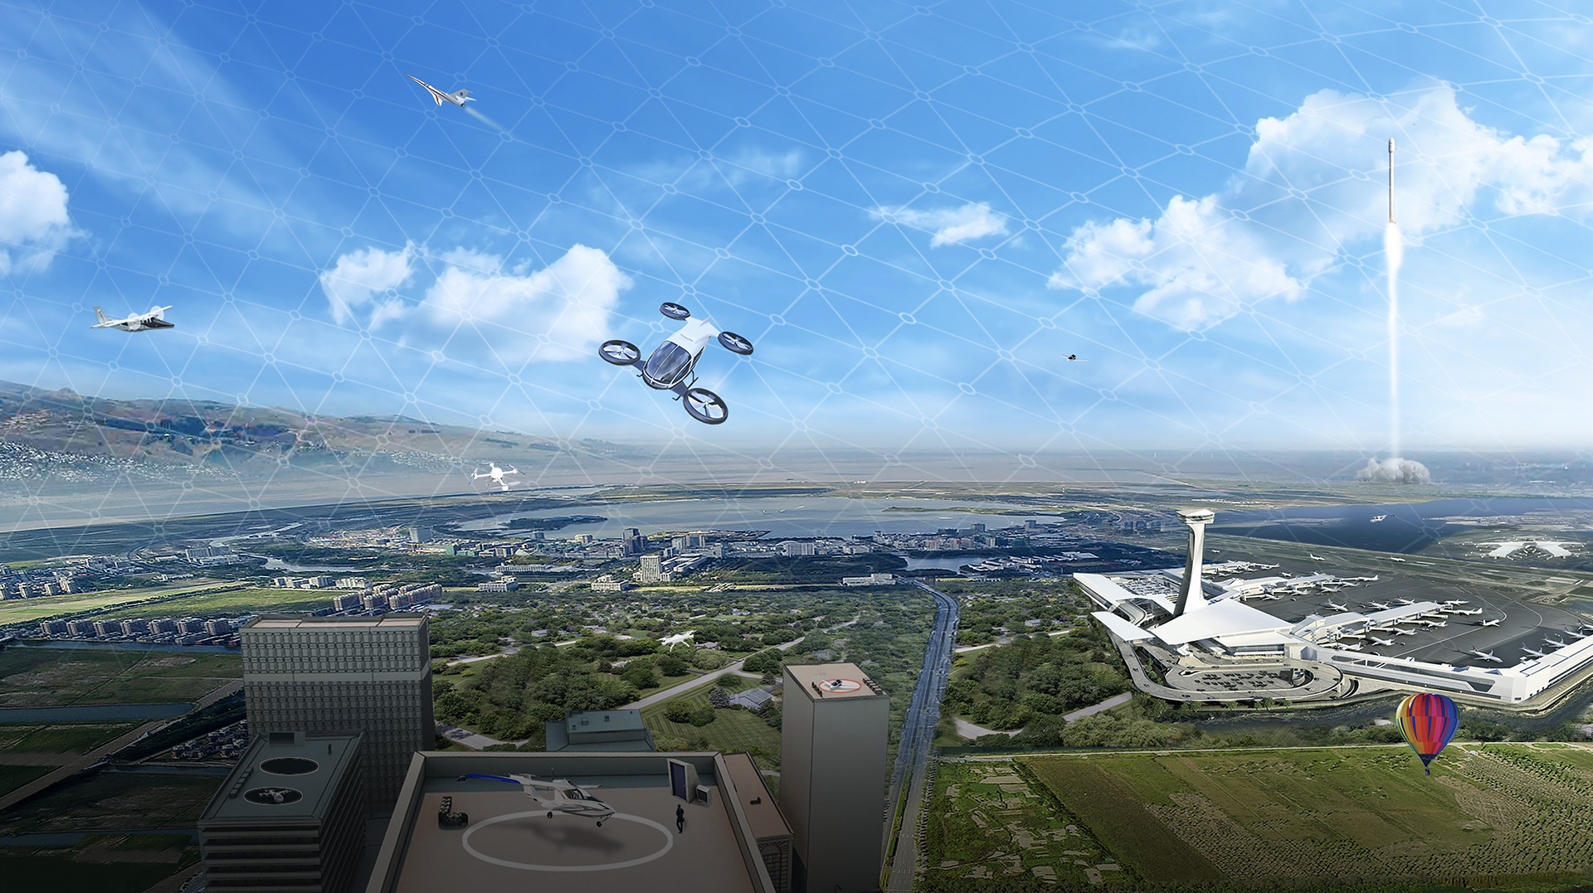
Future Airspace and Safety
Real Progress. Real Value.
www.nasa.gov |
12
Notes:
​

Slide 13
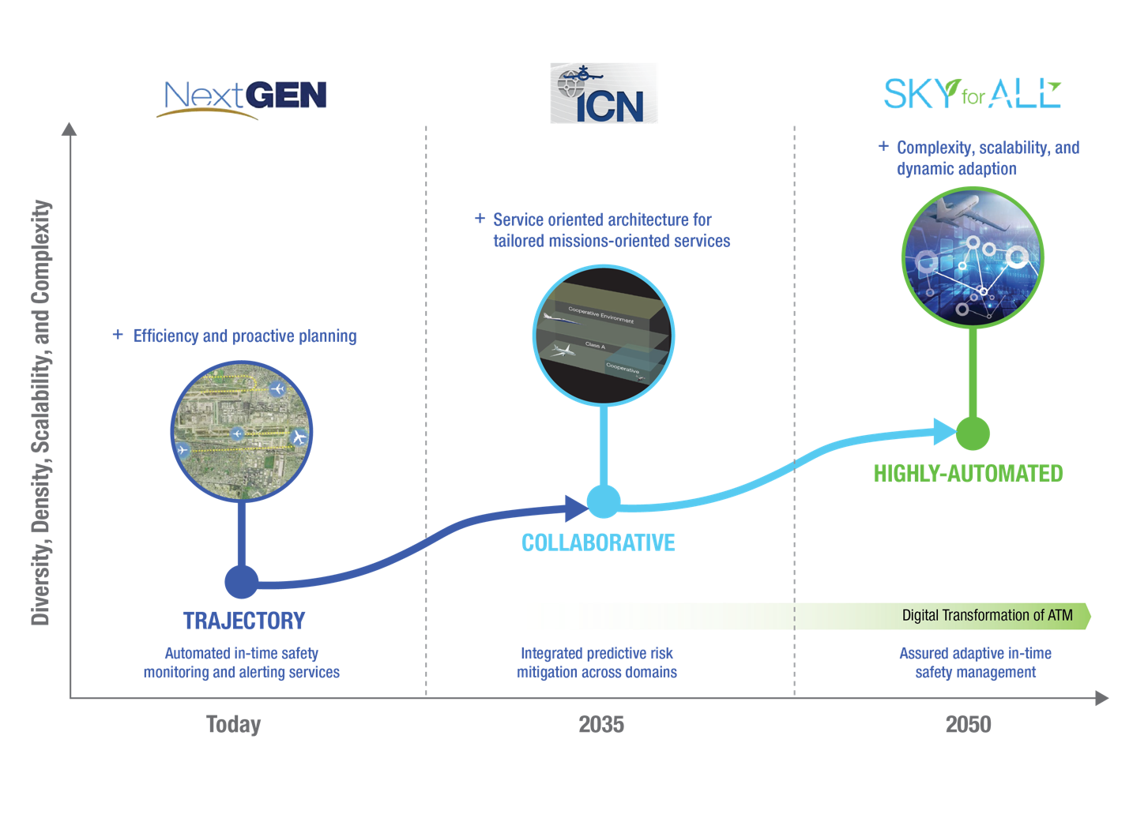

Future Airspace and Safety
NAS 2040
NAS 2040 provides data to power the Sky for All transformation.
www.nasa.gov |
Notes:
KEY MESSAGE: NASA Aeronautics’ ongoing work to advance airspace and safety are foundational elements to the future of aviation, from sustainability to traditional airline operations and advanced air mobility to high-speed flight. Our research enables the FAA and industry to keep pace with required change and enable aviation to safely grow at the expected pace. ​
NOTE: NextGEN and NAS 2040 are FAA-developed concepts.
We are leaving one era of evolution for our national airspace system – NextGen; entering another – NAS 2040; and planning for the next – Sky for All.
With years of NextGen tech transfer from NASA to the FAA now behind us, we are transitioning to developing tools that increase options for safe, sustainable decision-making in an an even more collaborative environment.
Our decades-long partnership with the FAA continues as we build on the efficiency gains, leveraging digital capabilities on the road to an airspace that is safe, adaptable, scalable, and now as a primary goal for NASA – that measurably contributes to more sustainable aviation.
In the 2040 timeframe, the FAA plans to make changes to the NAS to modernize aging infrastructure and transform to a more digital, information-based environment
This information-based environment will enable a digital transformation of the way air traffic management is done, creating airspace that is more dynamic and adaptive, allowing for increased diversity, density and complexity of operations and more proactive safety management
NASA is testing technologies and developing requirements to enable this future system. Our mid-century vision for the future of airspace and safety is called Sky for All

Slide 14
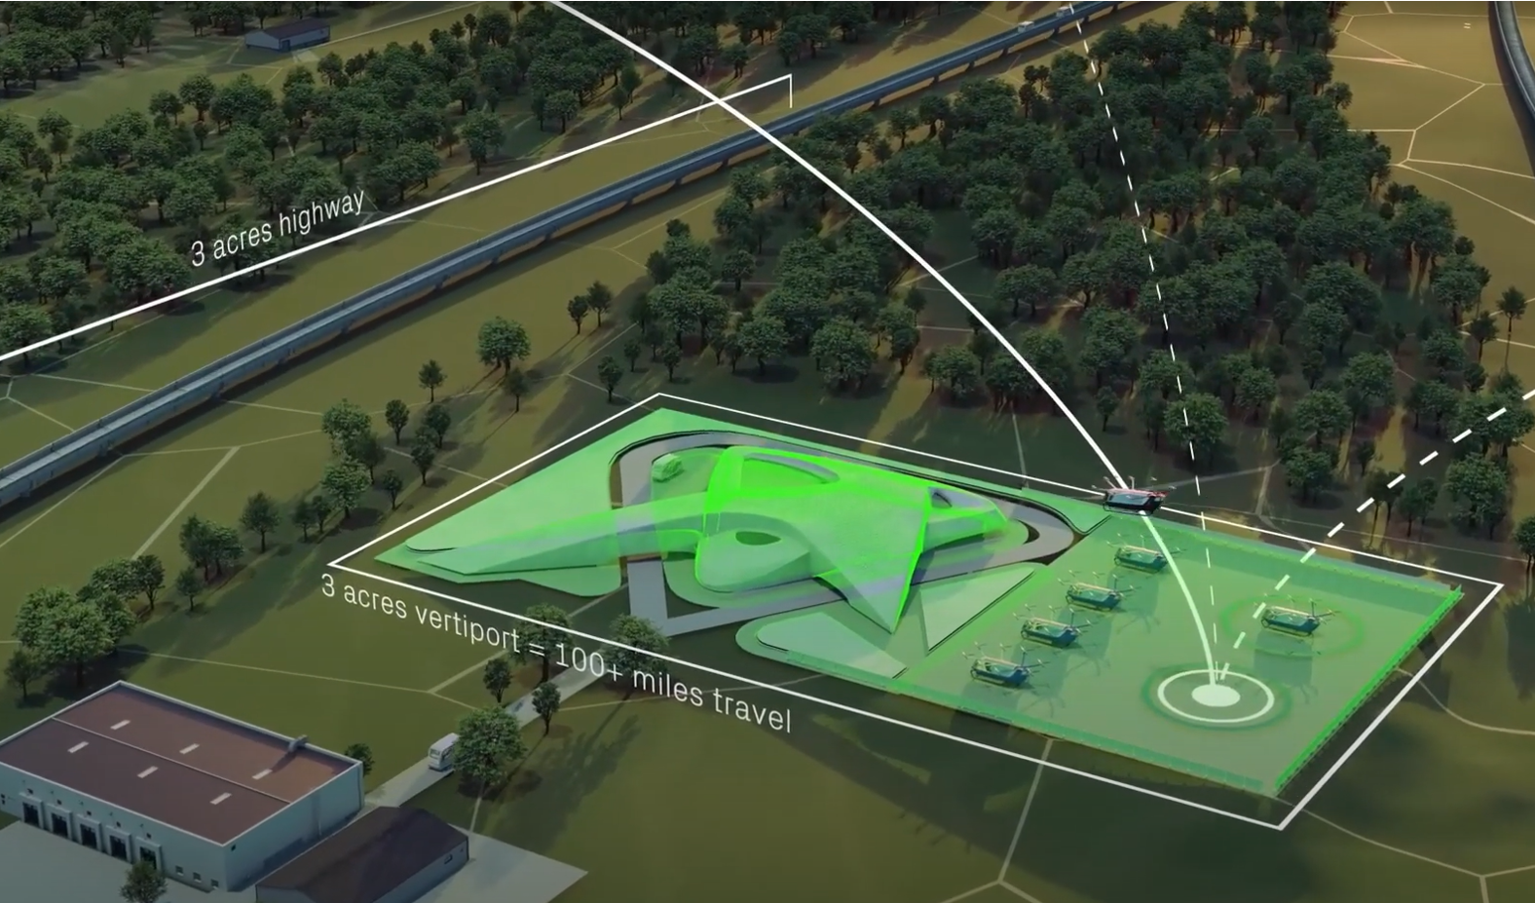
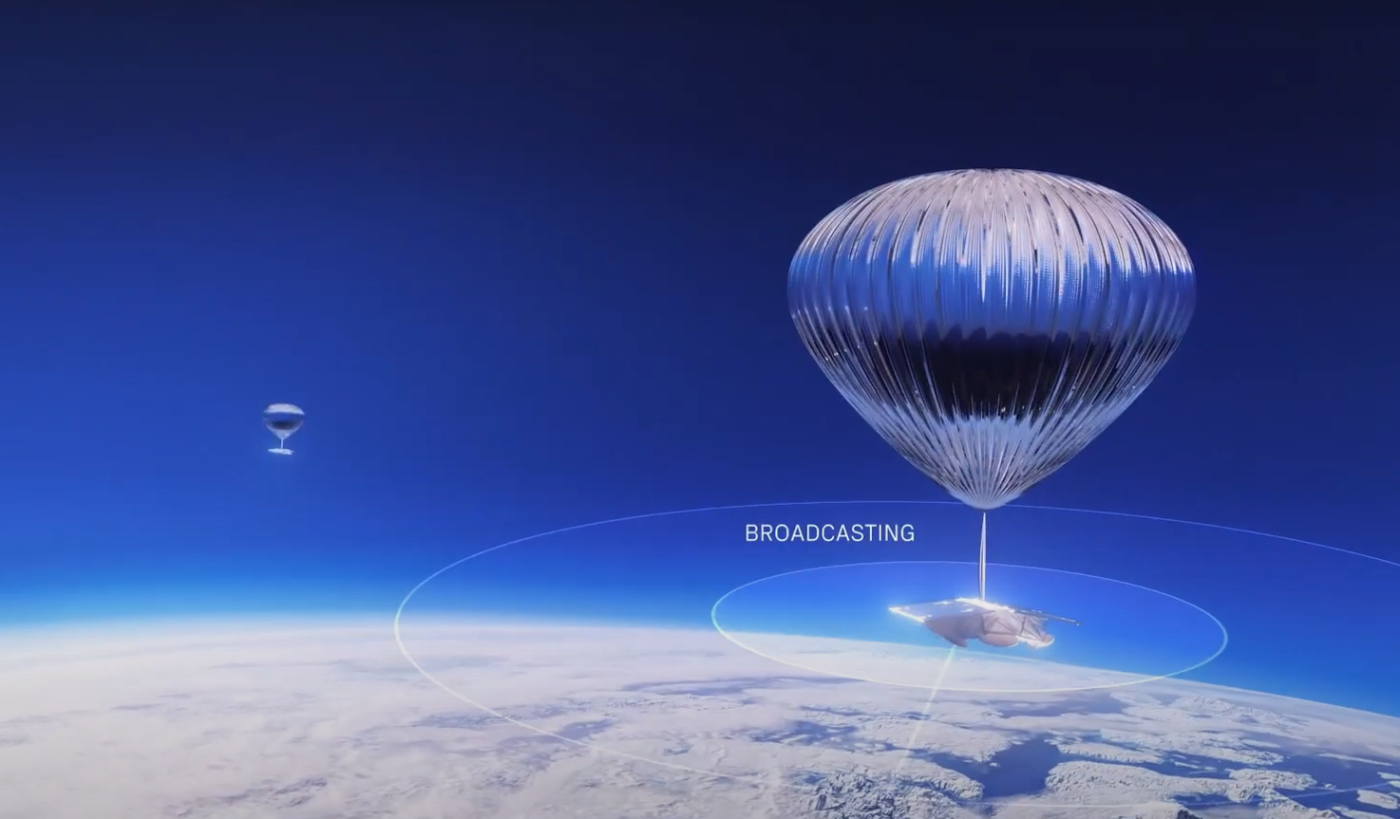

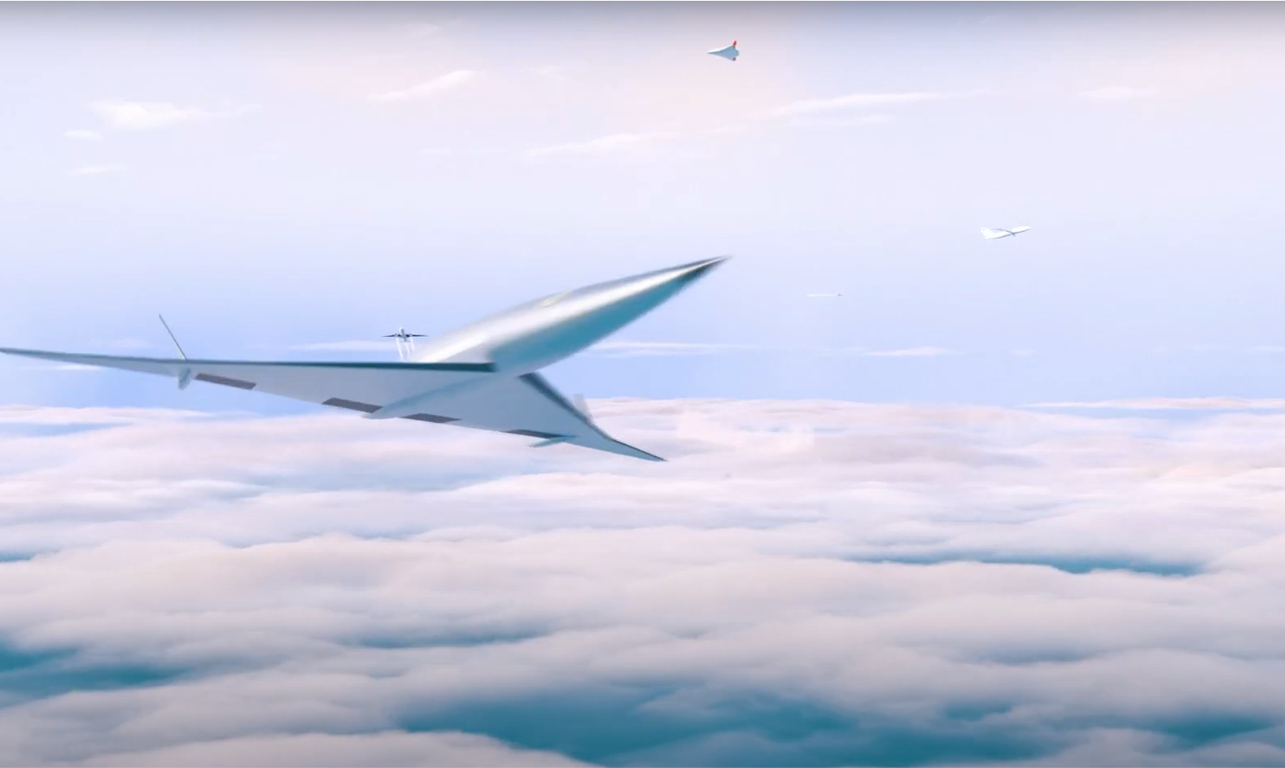
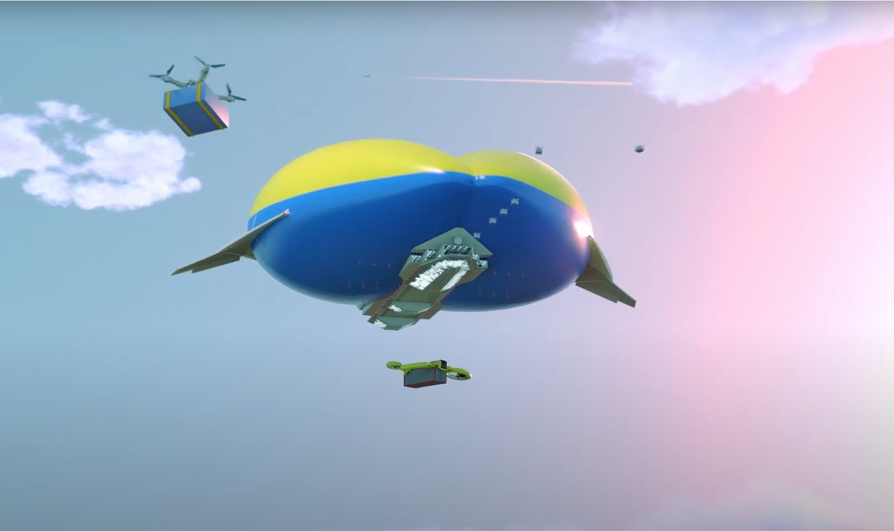
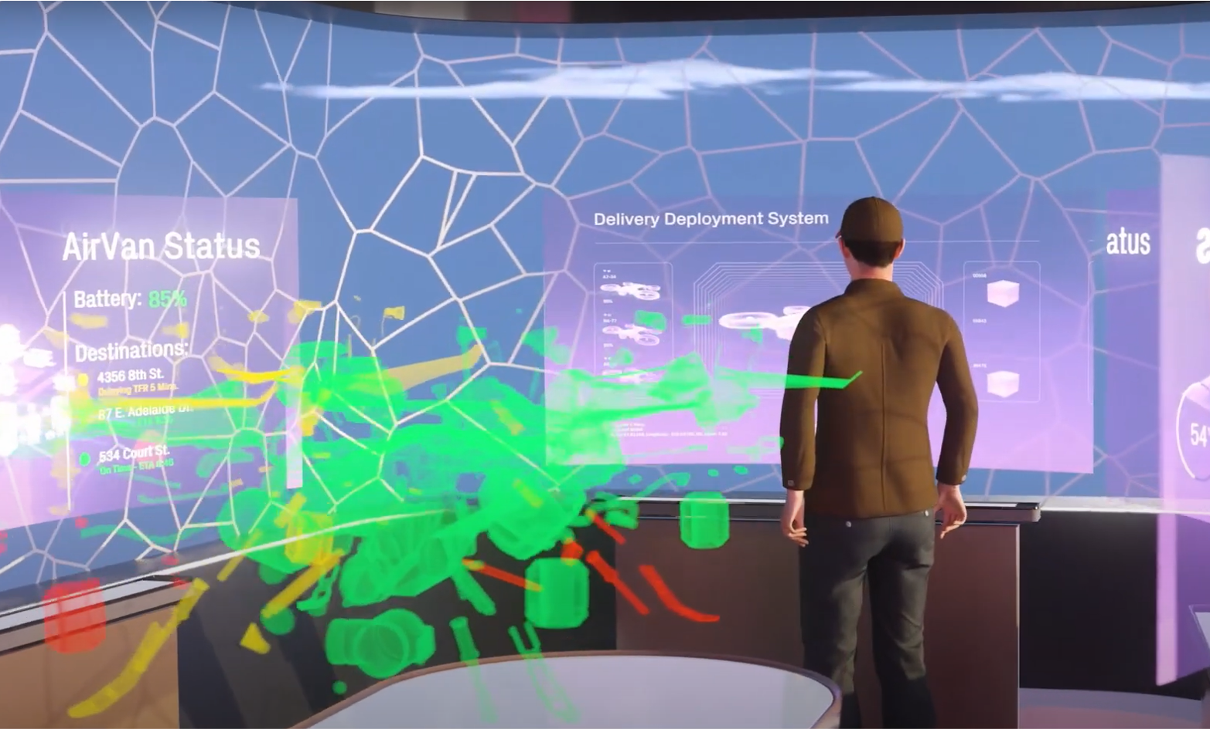
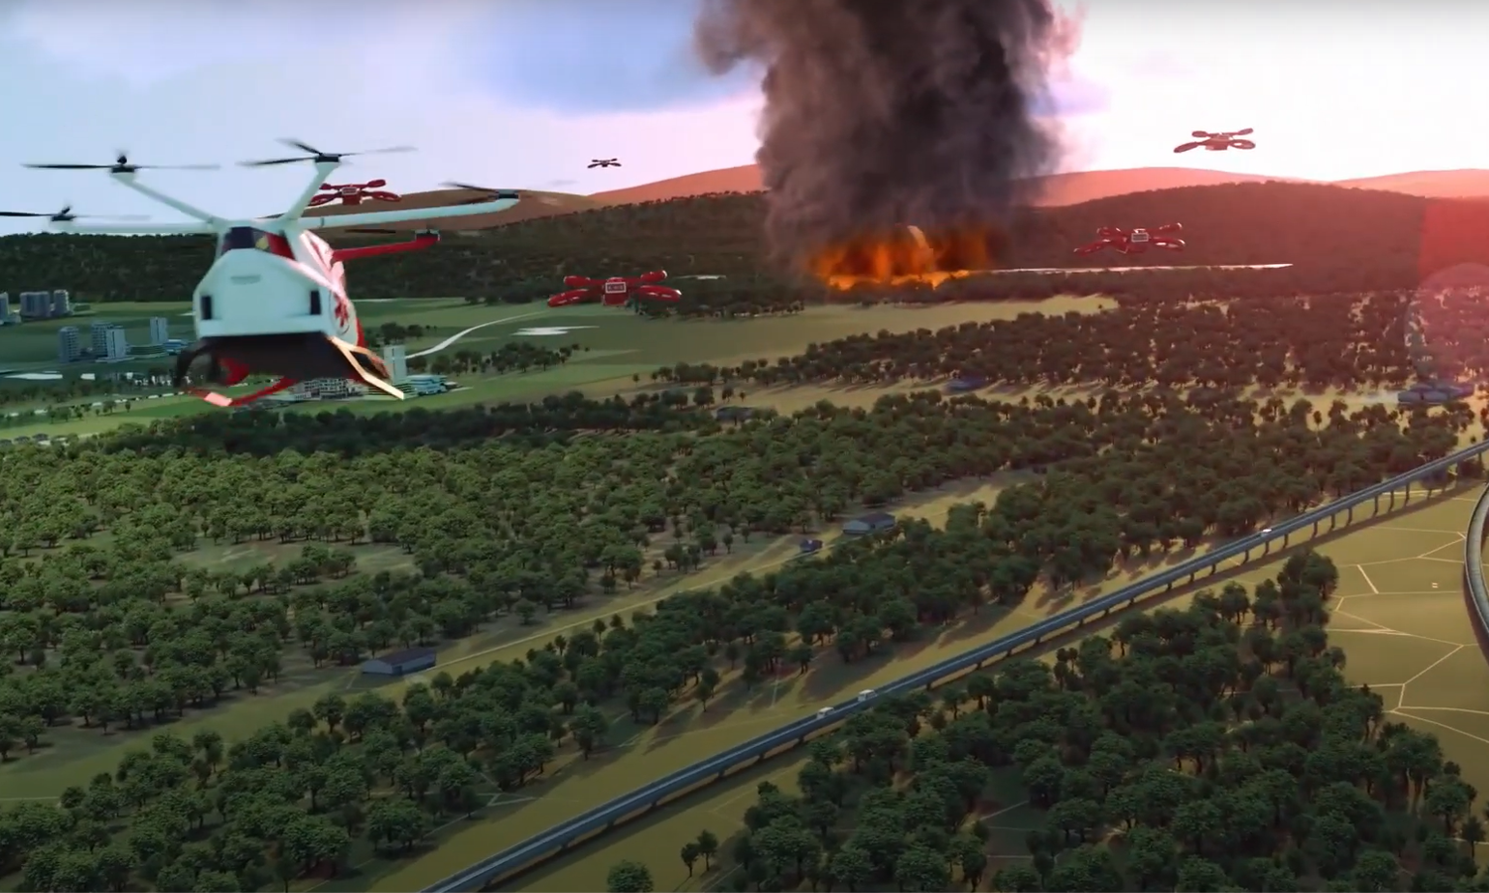
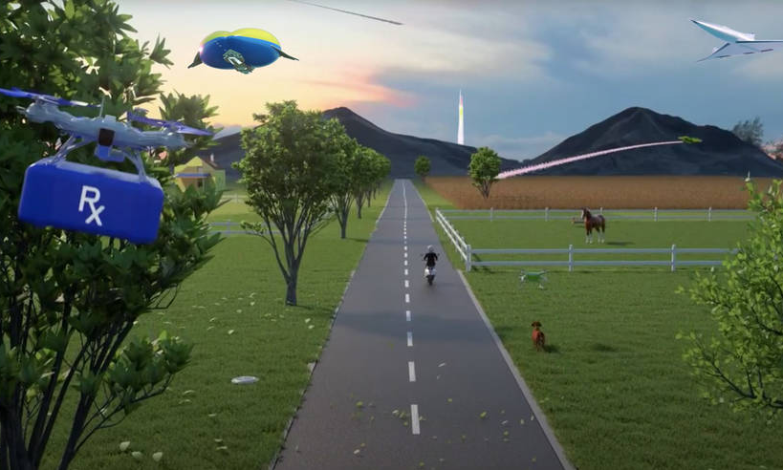

~ 2050: Planning to Achieve a Sky for All
Imagining tomorrow's aviation system today
NASA-led effort to gather inputs from the aerospace community and FAA
Co-developed vision of a mid-21st century shared airspace that is agile, scalable, optimizable, increasingly diverse, and equitable
Evolution from trajectory-based operations to collaborative and highly automated operations
Sky for All results will inform ARMD research and development portfolio and collaboration with FAA
Sustainable Solutions
Seamless Skies
Ubiquitous and Resilient Operations
Operator Optimization
Learning-Based Systems and Communities
A thriving airspace must be scalable, accessible, safe, sustainable, and resilient.
Notes:
Updated 3/23/23
Transformation Area: Future Airspace and Safety
While we work on technologies to realize the Info-centric National Airspace System, we are simultaneously setting the stage for what comes next … in 2040 and beyond … a Sky for All.
Sky for All is coordinating and collecting inputs from the aviation community to define the missions and challenges of an airspace that safely accommodates all.
Influences driving the Sky for All work:
Diversity of vehicles, operations, performance, missions and aviation systems
Complexity of diverse operations, performance, and off-nominal contingency
Density of operations
Volume increase on several orders of magnitude given the emergent vehicles
Highly integrated heterogenous airspace
Sky for All portal: https://www.nari.arc.nasa.gov/skyforall/

Slide 15
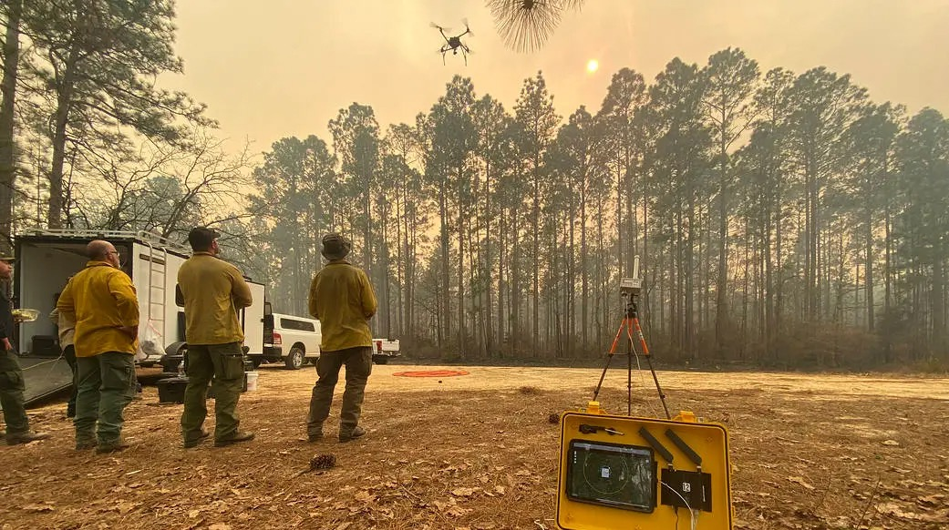

Wildland Fire Management
Wildland Fire Management
Real Progress. Real Value.
www.nasa.gov |
15
Notes:
​

Slide 16






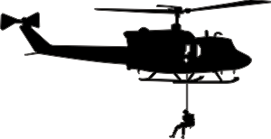






ACERO Use Cases
Communication, Position, Navigation, and Timing
Mission Planning, Data Standardization, and Data Dissemination for Monitoring Wildland Fire
Aerial Connectivity
Surveillance
Recovery
Communication Architecture
Airspace Management
Optionally Piloted Aircraft for Suppression
Response
Common Operating Picture
Logistics UAS
Persistent Communication and Logistics
Multi-Mission Integrated Operations
Aerial Ignition
Persistent Monitoring
Suppression
ACERO is developing airspace management and aircraft capabilities
to safely integrate remotely and optionally piloted aircraft into wildland fire operations.
Notes:
Updated 3/23/23
Transformation Areas: Advanced Air Mobility, Innovation, Future Airspace and Safety

Slide 17
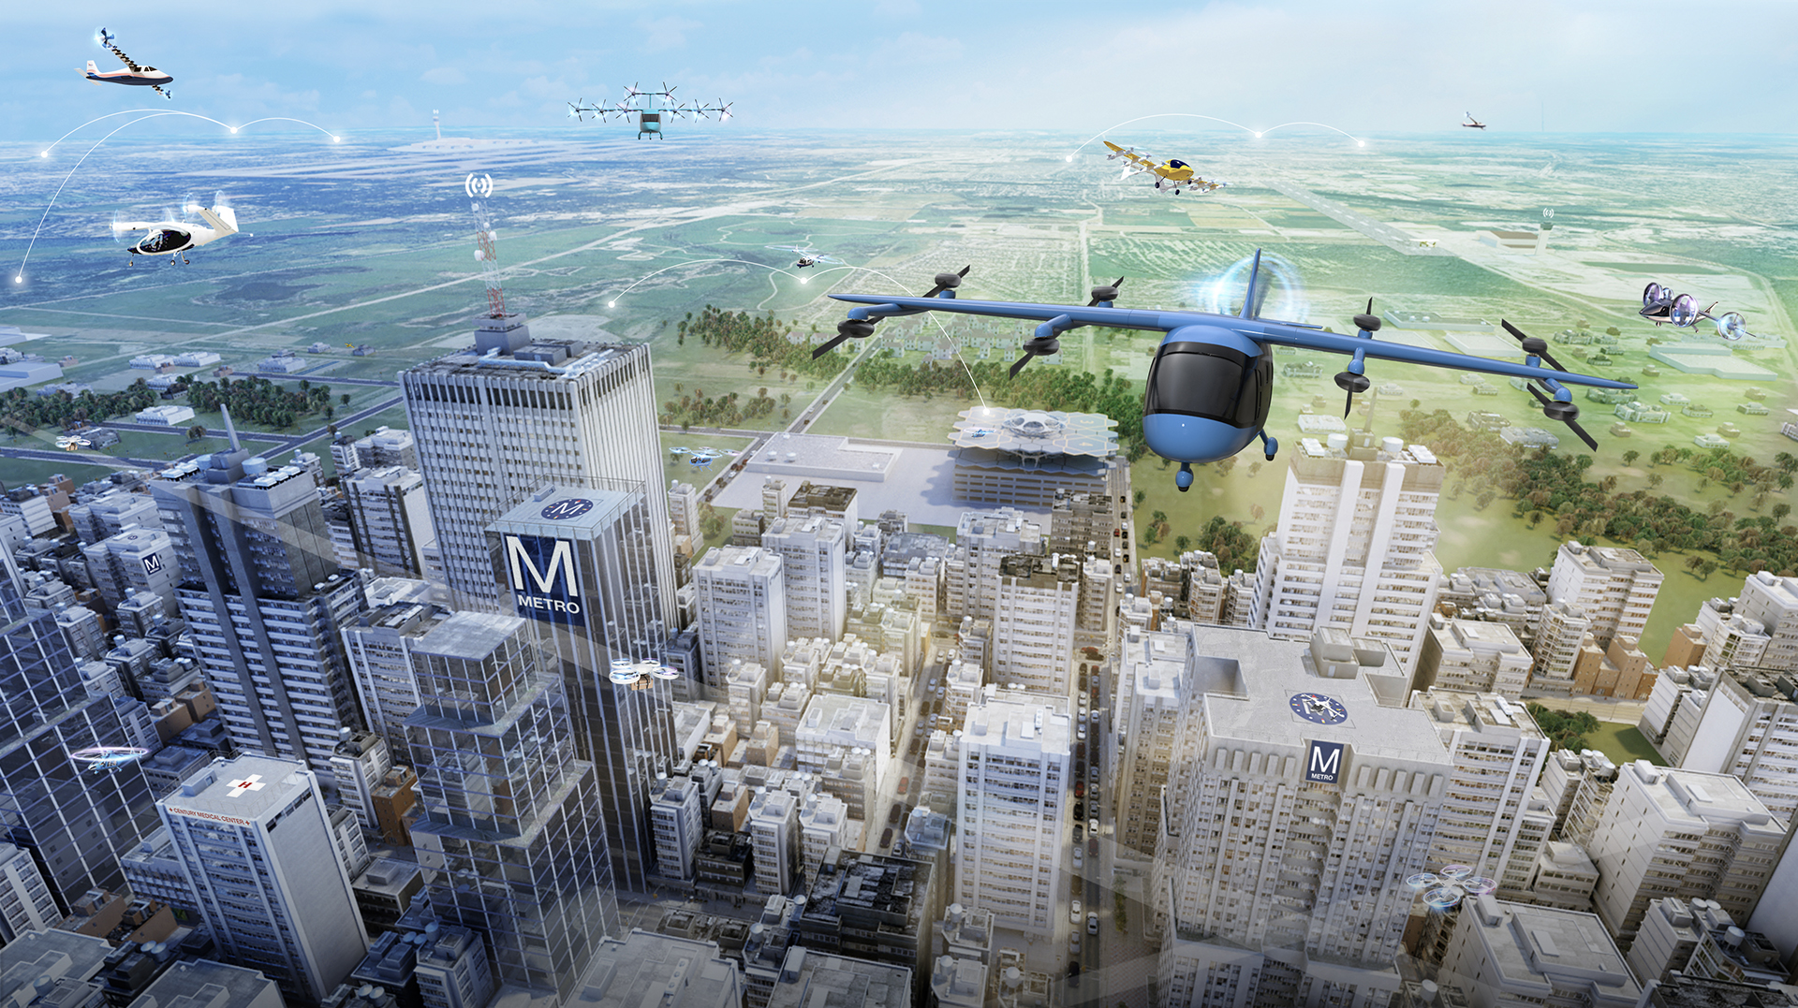

Advanced Air Mobility
Real Progress. Real Value.
www.nasa.gov |
17
Notes:
​

Slide 18
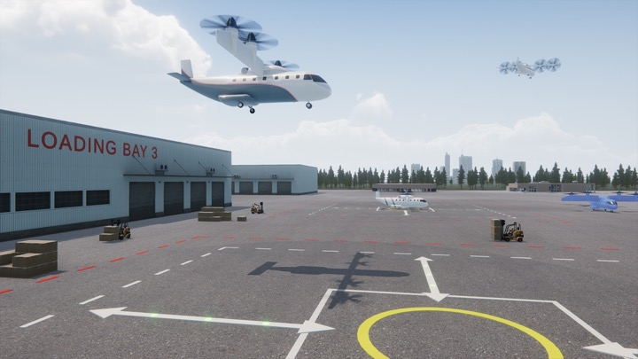
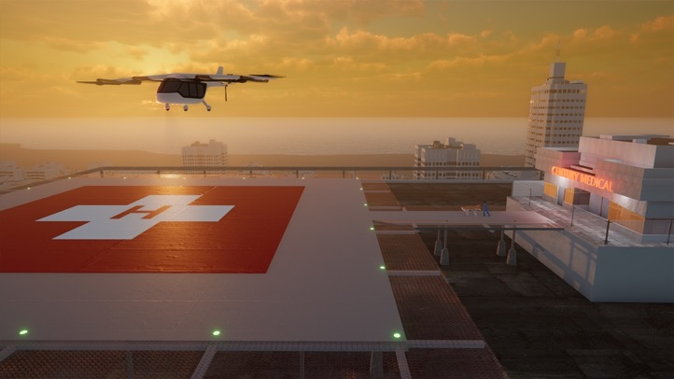
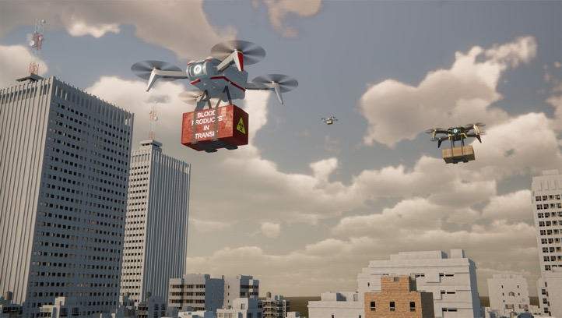
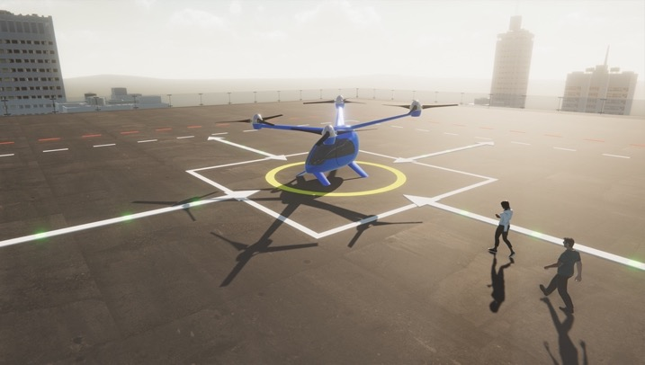
Advanced Air Mobility Missions are Emerging
CARGO
TRANSPORT
PUBLIC GOOD
CONSUMER/ ENTERPRISE GOODS AND SERVICES
PASSENGER TRANSPORT
AIA/Deloitte study shows annual estimated advanced air mobility market of $115B by 2035.
Notes:
Transformation Area: Advanced Air Mobility
[citation for $115B stat in black box: "AIA/Deloitte Joint Study, 2021: Source: https://www.aia-aerospace.org/wp-content/uploads/2021/09/2021-Facts-and-Figures-U.S.-Aerospace-and-Defense.pdf (page 17).]
NASA researches and demonstrates with more than 80 industry partners new vehicles and vehicle operations, airspace design and operations, and community integration solutions to enable a sustainable advanced air mobility system that supports U.S. economic growth, and benefits the public through missions including cargo/medical deliveries, disaster response, and on-demand passenger service.
NASA research is focusing on:
Vehicle development and operations – focus on capabilities that are critical enablers for UAM such as electric aircraft propulsion, materials and structures, autonomy. We are researching the noise impacts of UAM vehicles, and developing design tools manufacturers can use to create quiet UAM vehicles.
Airspace design and operations – develop and validate an operational concept for how to manage UAM traffic safely and efficiently. This is the next generation of the UAS Traffic Management (UTM) concept developed by NASA over the last five years, extending it to larger vehicles and flights above 400 feet altitude.
Community integration – understanding and addressing the most critical barriers to community integration, such as public acceptance (noise, security, privacy, etc), supporting infrastructure, and local regulations. We intend to identify ecosystem level challenges, and serve as a catalyst for the community to address these issues.

Slide 19
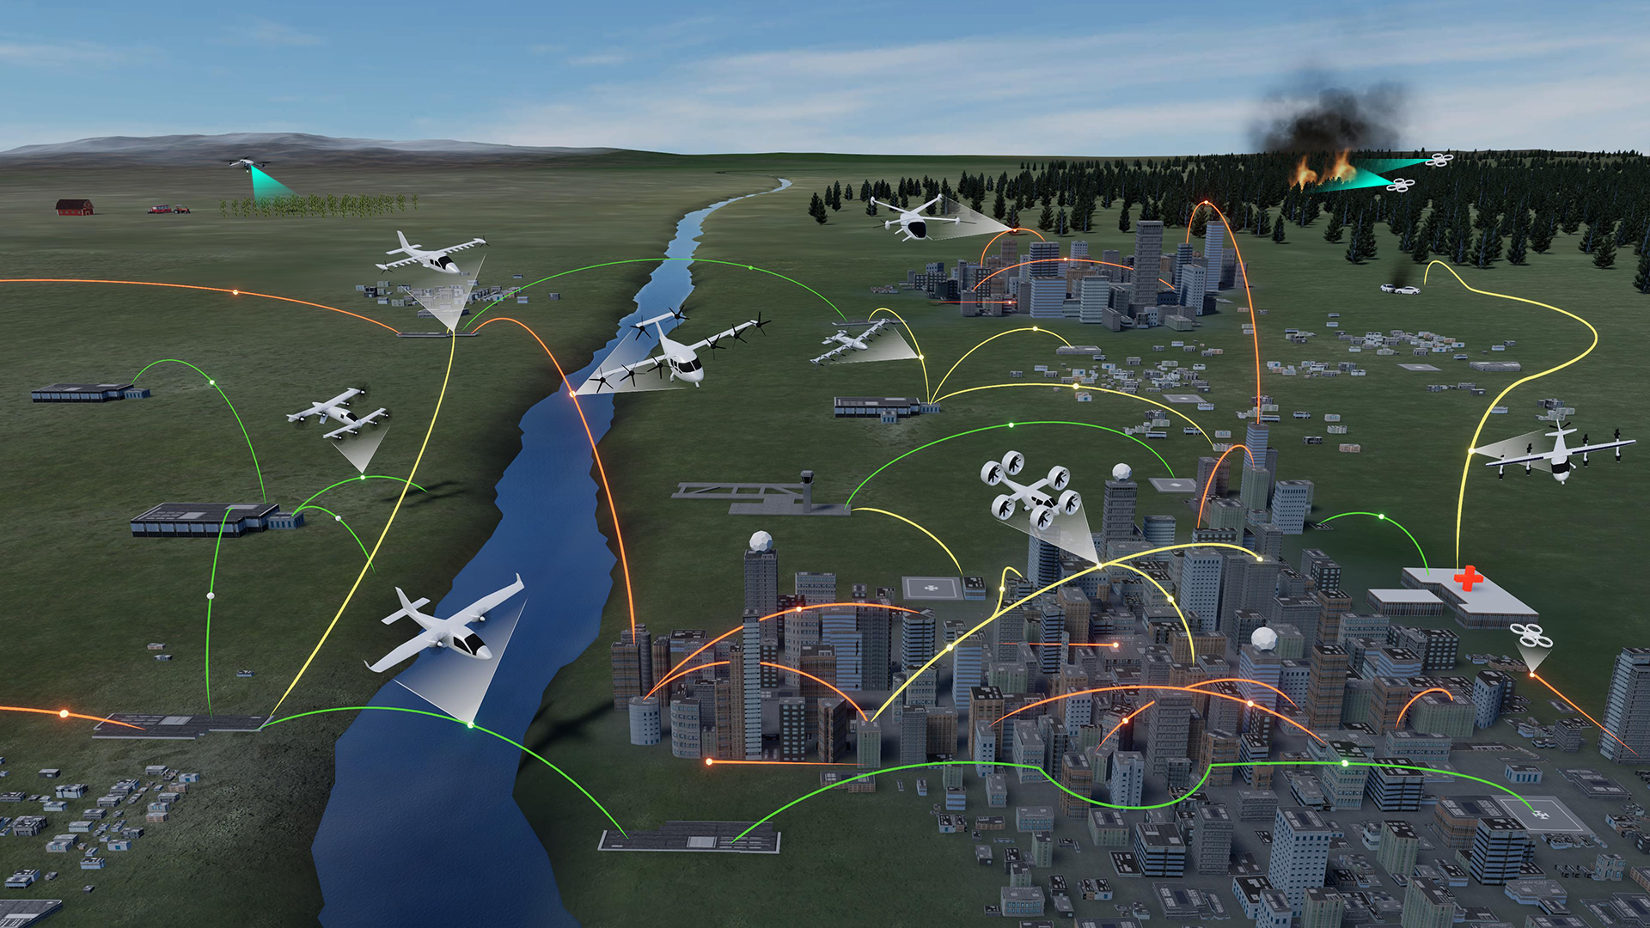
Advanced Air Mobility Mission
Wildland Firefighting
Operations
Rural Operations
On Demand
Air-Taxi
Urban Operations
Regional
Network
Cargo
Delivery
Inter-City
eC/STOL
Inter-City
eVTOL
Cargo
Delivery
Airport
Transfer
Air
Ambulance
Distribution
Center/Warehouse
Medical
Supply Delivery
Fleet
Operations
Inter-city
eCTOL
Small
Package Delivery
Cross-metro
Transfer
Safe, sustainable, affordable, and accessible aviation
for transformational local and intraregional missions
19
Notes:
Transformation Area: Advanced Air Mobility
AAM:​
Includes “rural” and “urban” applications​
Cargo transport, passenger-carrying, aerial work, etc. ​
eVTOL, sUAS, eCTOL, hybrid-electric, etc.​
Enabled by electrification and automation​
Does not include:​
Supersonic or hypersonic transport​
Existing hub-and-spoke air service with large transport aircraft ​
We are developing technologies to safely enable AAM operations without overloading the current air traffic management system. ​
Research is underway to develop new safety methods and collect data to assure safety of these operations. ​
We are gaining industry insight and sharing NASA plans through AAM ecosystem working groups to ensure we are focused on the highest priority challenges. ​
Through collaborations, we are leveraging expertise of AAM partners to jointly research and validate concepts of operation and core technologies such as on-board hazard avoidance, safety analysis, airspace integration needs, and aircraft flight deck design.

Slide 20
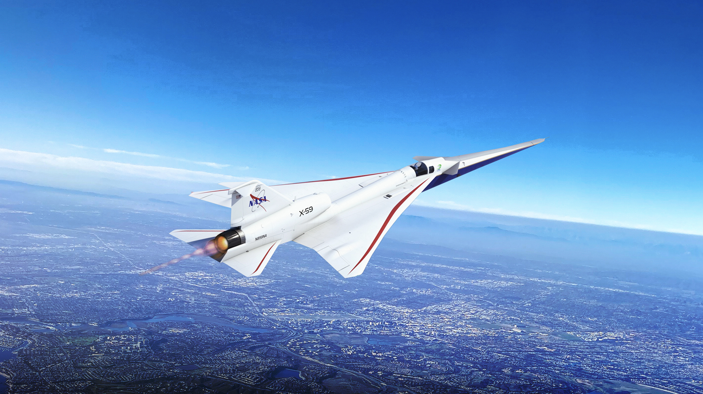

Real Progress. Real Value.
www.nasa.gov |
20
Notes:
​
​

Slide 21
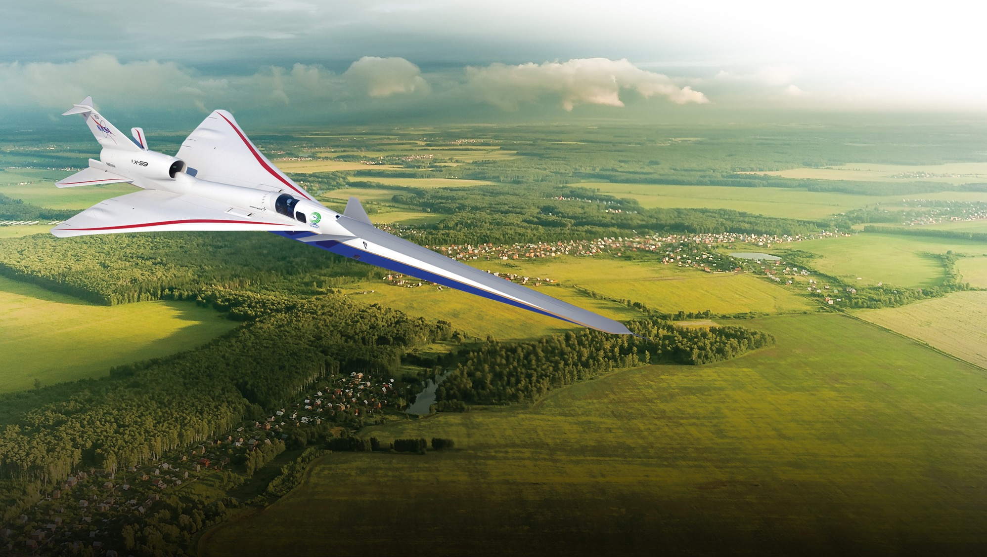

High-Speed Commercial Flight
Sustainable transformation of the speed of air travel
This mission will fly the
X-59 with its quiet supersonic technologies over U.S. communities, yielding data that could lead to new en route certification standards based on acceptable
sound levels.
Addressing the unique barriers to sustainable, environmentally responsible high-speed flight
Notes:
Updated 3/23/23
Transformation Area: High-Speed Commercial Flight
NASA is addressing the unique barriers to sustainable high-speed flight to enable global access and connection.
The first barrier is the sonic boom. Commercial aircraft are prohibited from flying at supersonic speeds over land due to international regulation, and that due to the disruptions of the loud sonic boom.
• NASA’s near-term focus:
⁃ Quiet overland flight is the principal barrier to opening a civil supersonic market
⁃ New international standards, based on response data from a large diverse population, are required
Action: We created the Quesst mission, which leverages years of fundamental research into what creates the sonic boom and ways to mitigate it. Under Quesst, we're building the X-59 -- an experimental aircraft with quiet supersonic technologies -- that can be flown over selected U.S. communities where volunteers provide their responses to what they hear, or don't hear.
• NASA is ramping up efforts to address broader sustainability challenges
⁃ New effort launched to address airport community noise
⁃ Longer-term research portfolio addresses high-altitude emissions
⁃ Synergistic with sustainable flight technology for subsonic aircraft, fuels and airspace operations
• NASA is investigating the potential of even higher speed flight.
⁃ Undertaking studies with industry of the commercial viability of higher than Mach 2 flight

Slide 22
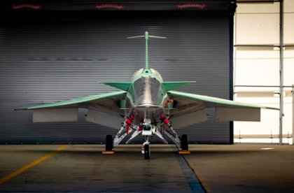
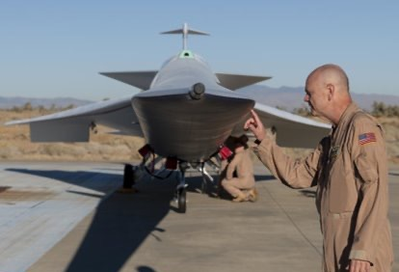
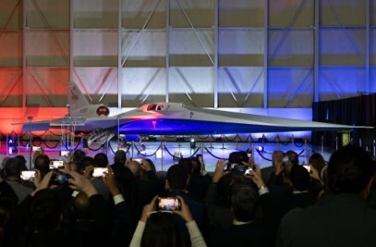
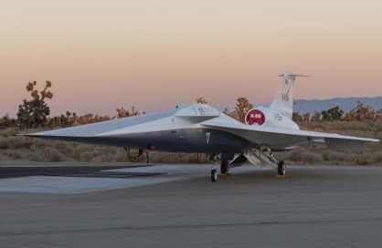
X-59 is Complete and Getting Ready to Fly​
Photo credit: NASA
Photo credit: NASA
Photo credit: Lockheed
Photo credit: NASA

Slide 23



Innovation Ecosystem
Real Progress. Real Value.
www.nasa.gov |
23

Slide 24
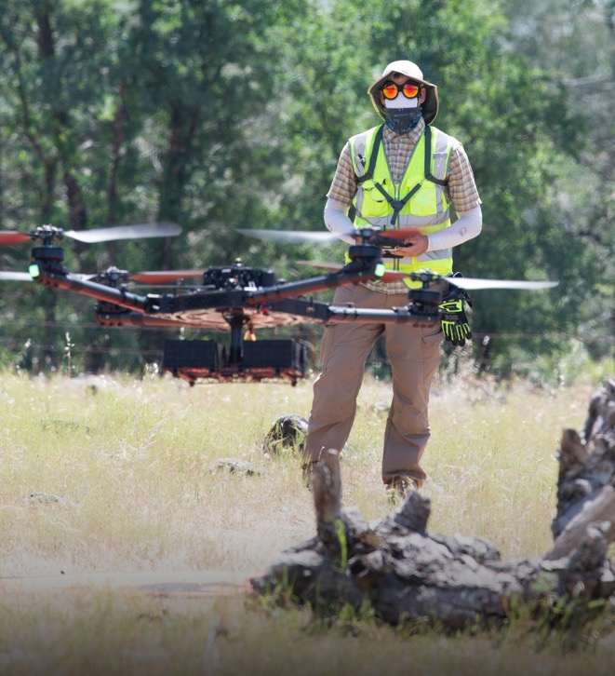
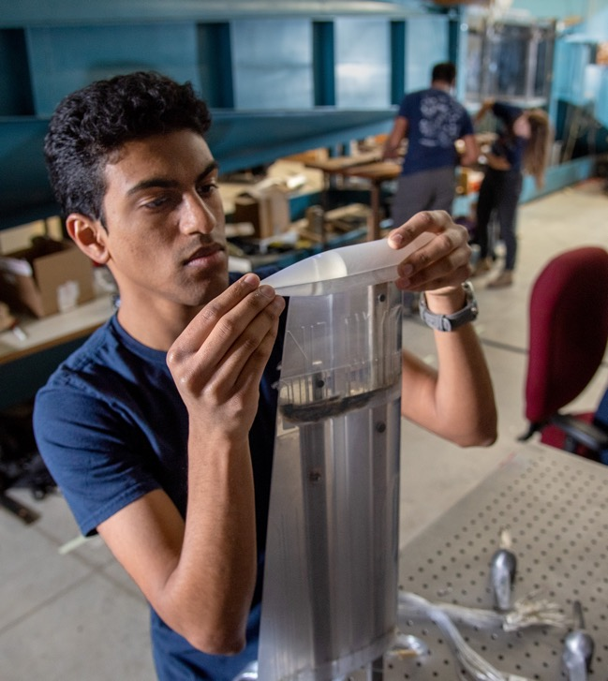
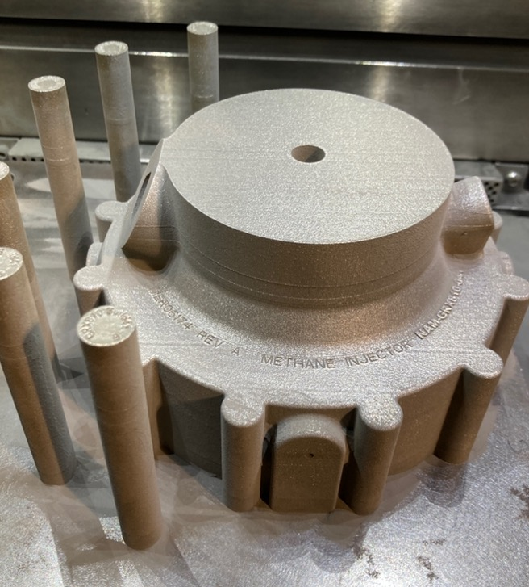
Innovation Ecosystem: NASA Leadership for the Aviation Community
Convergent Aeronautics Solutions
University Innovation
Transformational Tools and Technologies
Fosters a culture of innovation within ARMD by advancing disruptive system-level concepts and early-stage technologies for transformational impact
University-led innovation addresses aviation challenges Inspires and supports the next generation of researchers and entrepreneurs
Discovers, develops, and transitions innovative solutions through foundational research and cross-cutting tools and technologies for the aviation community
Notes:
KEY MESSAGE: NASA Aeronautics fosters innovation in physics-based tools, novel technologies, and advanced system concepts that supports the future of the entire aerospace industry. This innovation ecosystem attracts and cultivates the energy and ideas of people inside and outside NASA who ask “what if” and “what’s next.”
​
​
The job of our Innovation Ecosystem is to produce new knowledge/ideas to lead to new transformation areas.​
​
Innovation is a throughline for all of our work at NASA Aeronautics.​
​
We have three specific projects within our Transformative Aeronautics Concepts program that are dedicated to fostering innovation from within NASA and from without. ​
​
Convergent Aeronautics Solutions project: Invests in seemingly improbable ideas that might lead to solutions to the problems that plague aviation and impact safety, environmental and community impact, and the global growth in air traffic.​
University Innovation project: Supports educating the next generation of aeronautical innovators by providing opportunities for university-led teams to conduct research into transformative technology that supports NASA Aeronautics’ major research goals. These opportunities include the University Leadership Initiative and the University Student Research Challenge. ​
Transformational Tools and Technologies project: Develops state-of-the-art computational and experimental tools and technologies that are vital to ARMD's ability to advance the prediction of future aircraft performance in flight, such as first-of-a-kind tools that isolate the complex turbulent airflow around vehicles and within propulsion systems. ​
​
IMAGES:​
Left: The Scalable Traffic Management for Emergency Response Operations, or STEReO, project combines NASA technologies, particularly UTM, and govt/industry partnerships to offer a solution for safe integration of drones into natural disaster airspace management procedures. STEReO is under the Convergent Aeronautics Solutions project.​
​
Middle: A member of the University of Illinois team researching disruptive technologies for electric commercial aviation works alongside teammates – made possible with the support of NASA’s University Leadership Initiative.​
​
Right: An image of an additively-manufactured – meaning technologies used to grow three-dimensional objects one superfine layer at a time -- GRX-810 methane injector (https://www.nasa.gov/feature/glenn/2022/nasa-s-new-material-built-to-withstand-extreme-conditions)​

Slide 25










































































































University Innovation Project Expands Innovation Ecosystem
Over $200M in awards across a diverse portfolio of investments
Seeking and awarding proposals addressing all topics in ARMD's research portfolio
More than 80 awards to more than 100 universities
Nearly 40 Historically Black Colleges/Universities or Minority Serving Institutions
More than 500 students
Women faculty represented in fractions greater than the academic population
University Innovation Project includes University Leadership Initiative, University Student Research Challenge, Gateway to Blue Skies competition award winners, and Future Aircraft Maintenance Technician awards
www.nasa.gov |
25
As of May 2024
Notes:
As of March 2024
Map shows all universities across UI project (ULI, USRC), plus Gateway to Blue Skies competition award winners, and Future Aircraft Maintenance Technician study award recipients
102 universities​
41 states, includes DC​
34 MSI’s: ​
11 HBCU​
1 PBI​
11 HSI​
3 AANAPISI​
7 AANAPISI & HSI​
1 NASNTI​
​

Slide 26




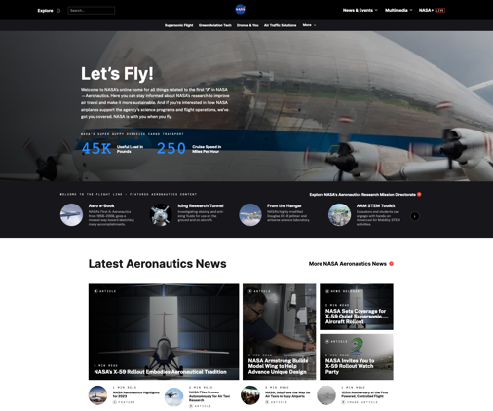
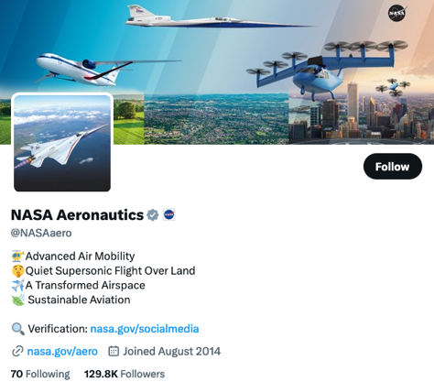
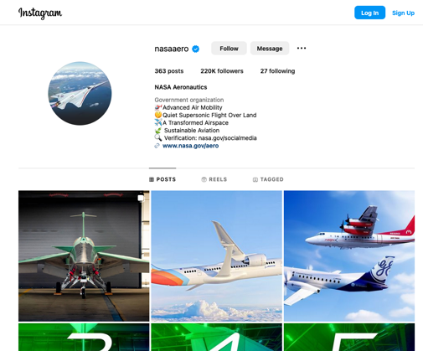
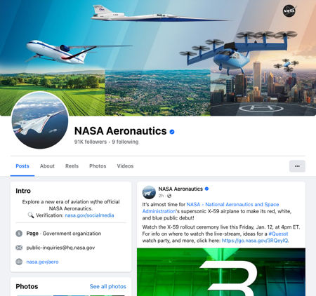
Follow Us
www.nasa.gov/aero
@NASAAero
@NASAAero
@NASAAero
Notes:
Follow NASA Aero on the web and social media for latest stories, news, program/project information, events, conference participation.
NASA's with you when you fly.

Slide 27
BACKUP

Slide 28

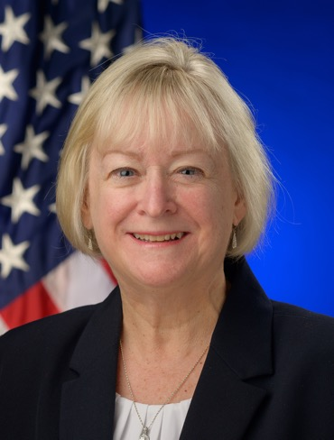



Aeronautics Research Mission Directorate (ARMD) Leadership
Robert Pearce
Associate Administrator*
ARMD
Carol Carroll
Deputy AA
ARMD
Jon Montgomery
Deputy AA for
Policy ARMD
TBD
Deputy AA for Programs ARMD
Barbara Esker
Assistant Deputy AA for Missions / Deputy AA for Programs (Acting)
*(AA)
Notes:
Members of ARMD's Office of the Associate Administrator, NASA Headquarters.

Slide 29
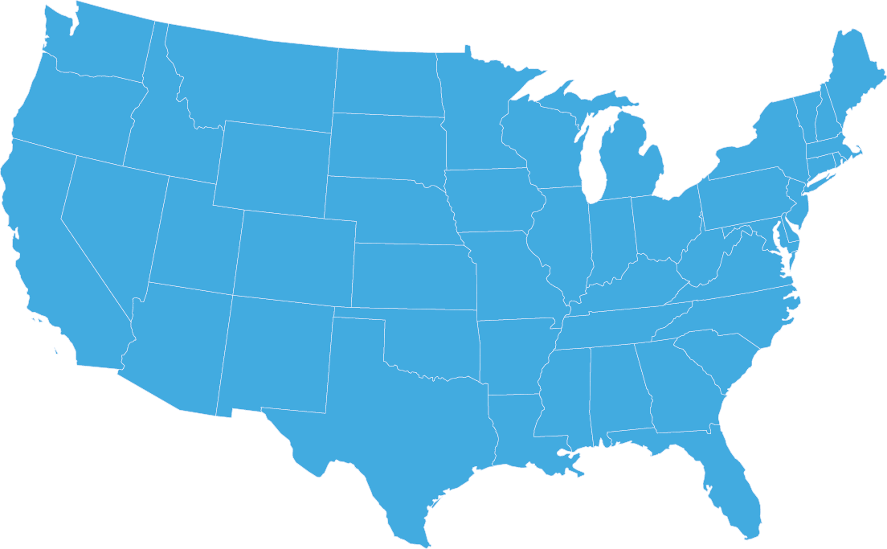
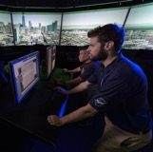
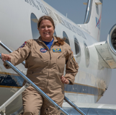
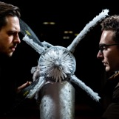
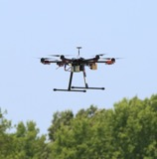
Where Does NASA Aeronautics Research Happen?
Aeronautics research takes place at four of NASA’s centers.
AMES
Airspace Management, Simulations,
Tech Integration
GLENN
ARMSTRONG
Flight Research and Support, Aerodynamics
GODDARD
AMES
HQ
LANGLEY
GLENN
ARMSTRONG
JPL
Propulsion Research, Flight Communications
Major Areas of
Inter-Center Collaboration
Langley/Glenn: Propulsion-Airframe Integration
Ames/Langley: Flight Deck and Ground-Based Automation Integration; Flight Mechanics; Aerodynamics
Armstrong/Other Research Centers: Flight Experiment Integration
MARSHALL
STENNIS
JOHNSON
LANGLEY
KENNEDY
Airspace Ops, Vehicle Aerodynamics and Integration, Mobile Testing, Autonomous Flight Research
Notes:
Updated center thumbnails 6/8/23

Slide 30

Thank You!

