Slide 1
Metadata Management Tool (MMT) Updates
EOSDIS Metadata Workshop Summer ESIP Meeting 2024
Tyler Stevens
EED-3 Metadata Team Product Owner
Tyler.B.Stevens@nasa.gov

Slide 2
Agenda
What is the MMT
Progress on MMT React Development
Metadata Roadmap
Demo

Slide 3
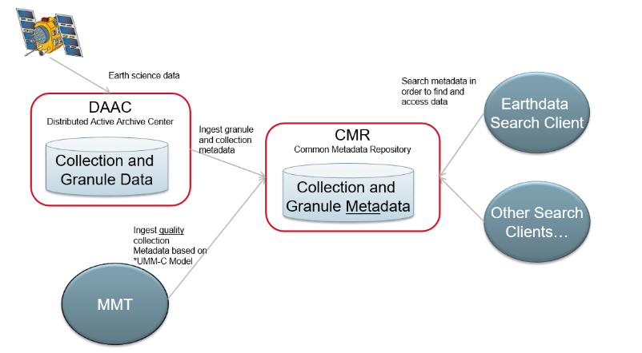
I. What is the MMT
The Metadata Management Tool (MMT) is a web-based user interface which allows metadata authors to create and manage their metadata records using the CMR’s Unified Metadata Model (UMM).
Metadata authors may also publish, view, delete, and manage CMR metadata records and access them using the MMT.
https://mmt.earthdata.nasa.gov/

Slide 4
II. Progress on MMT React Development
CRUD Metadata (Collections, Services, Tools, Variables)
CRUD Templates
CRUD Groups
CRUD Order Options
Support Drafts
Search Metadata
Support Associations
CRUD System and Provider Object Permissions
Manage Permissions
UI Changes To Support Navigation and Provider Context

Slide 5
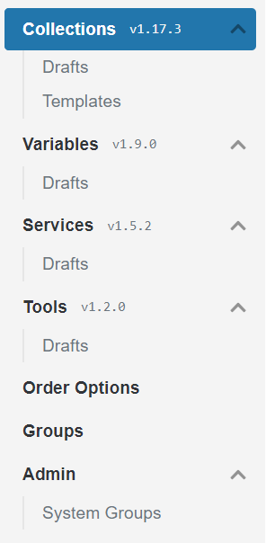
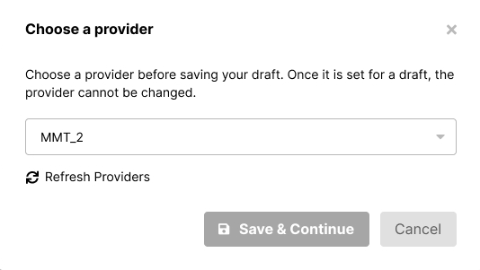
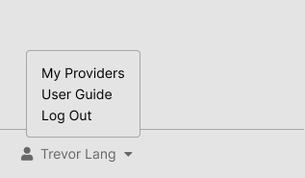
II. UI/UX Improvements
New Left-Hand Navigation and Provider Context
Provider Context
Navigation
Provider Login

Slide 6
II. User Testing
Providers can test in UAT at mmt.uat.earthdatacloud.nasa.gov
Please send feedback directly to Tyler Stevens (Slack or Tyler.B.Stevens@nasa.gov) or support@earthdata.nasa.gov

Slide 7
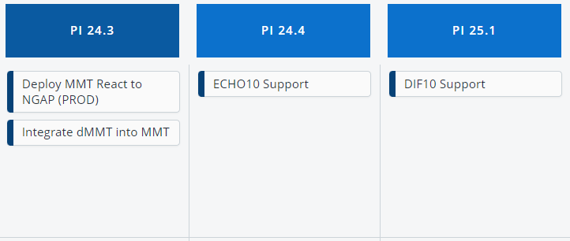
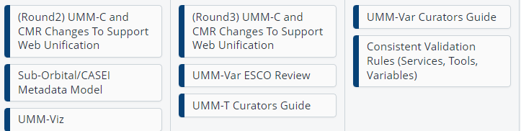
III. Metadata Roadmap
MMT
UMM

Slide 8
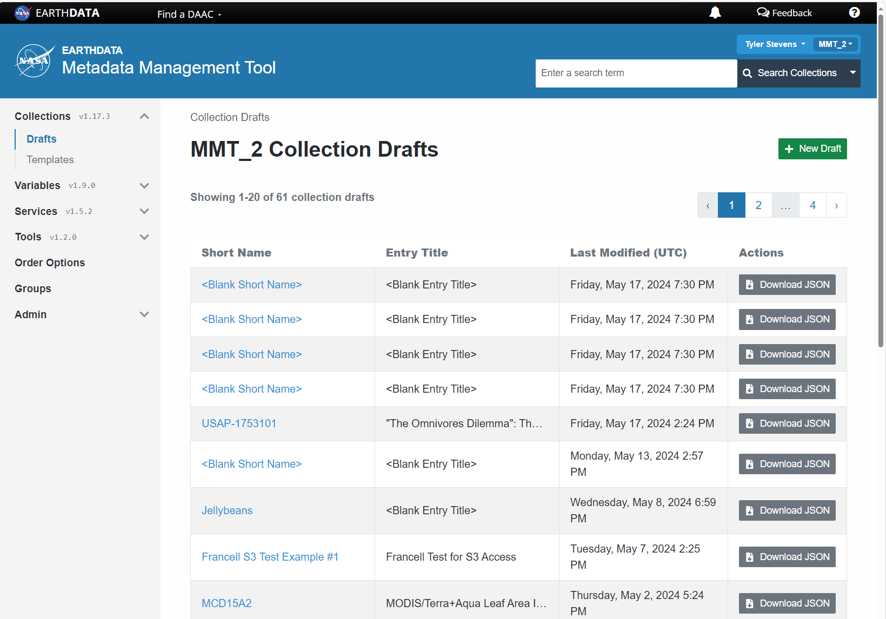
IV. MMT Demo

Slide 9
This work was supported by NASA/GSFC under Raytheon Company contract number 80GSFC21CA001

