Slide 1
Collaborating with xarray to enable reading hierarchical data files
Owen Littlejohns
NASA EED-3 / INNOVIM
owen.m.littlejohns@nasa.gov
2024 July ESIP Meeting
22nd – 26th July 2024

Slide 2
Processing Earth science data
NASA has a lot of expertise, but doesn’t need to write every single piece of code
Pangeo is a fantastic open-source community of tools for geoscience research
xarray, a Python package, is a widely used part of this ecosystem for accessing and analyzing geoscience data

Slide 3
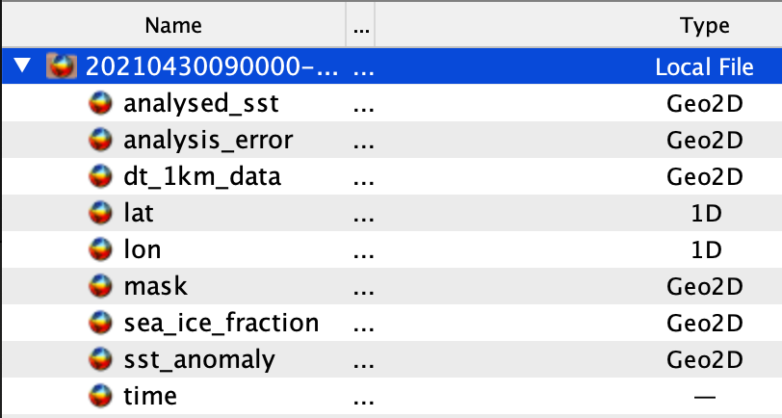
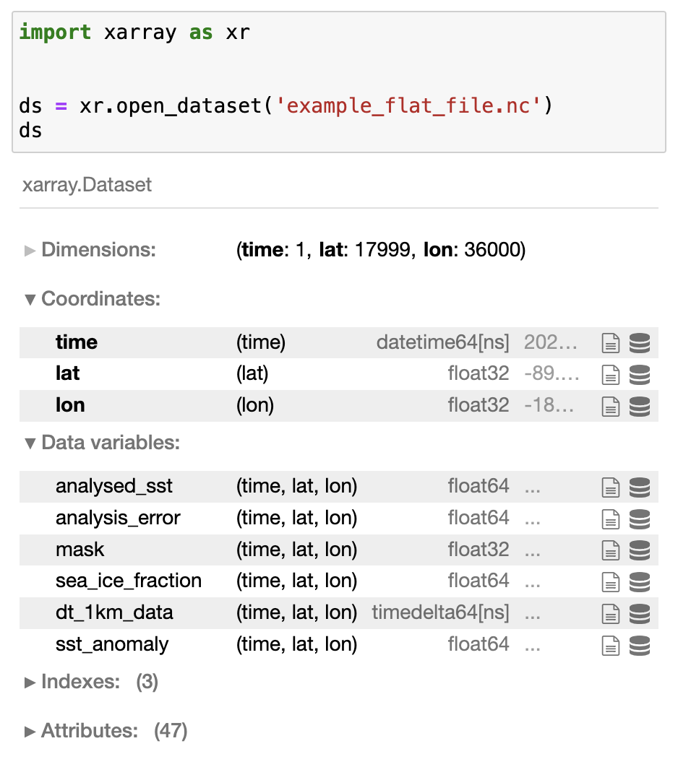
xarray is great with flat files
Top Left: Panoply view of a Daily Multi-Scale Ultra-High Resolution (MUR) Sea Surface Temperature (SST) file. Source data retrieved from the Physical Oceanography Distributed Active Archive Center (PO.DAAC).
Right: Jupyter notebook demonstrating xarray loading the same data into a Dataset.

Slide 4
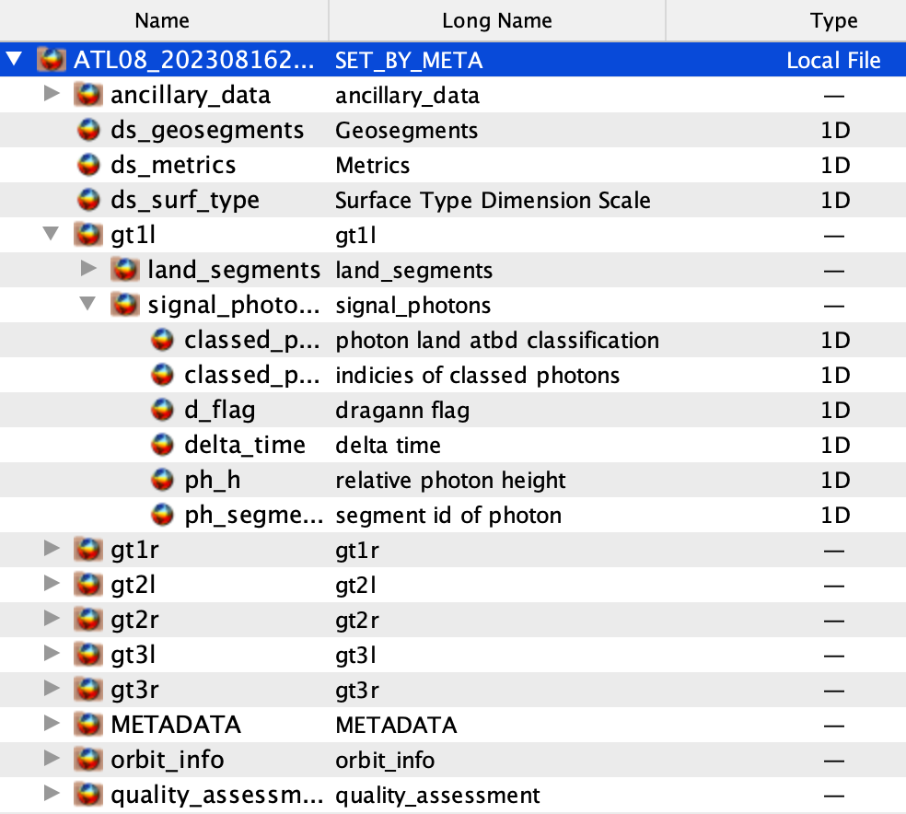
…but not all files are flat!
Panoply view of an Ice Cloud and land Elevation Satellite-2 (ICESat-2) Advanced Topographic Laser Altimeter System (ATLAS) Land and Vegetation Height (ATL08) file. Source data retrieved from the National Snow and Ice Data Center (NSIDC).

Slide 5
Enter… DataTree
xarray-datatree first released March 2022
Tree-like representation of hierarchical data
Each node (group) contains the same data an xarray Dataset would.
Each node is also aware of its parent and children
Operations can also be performed over the whole tree

Slide 6
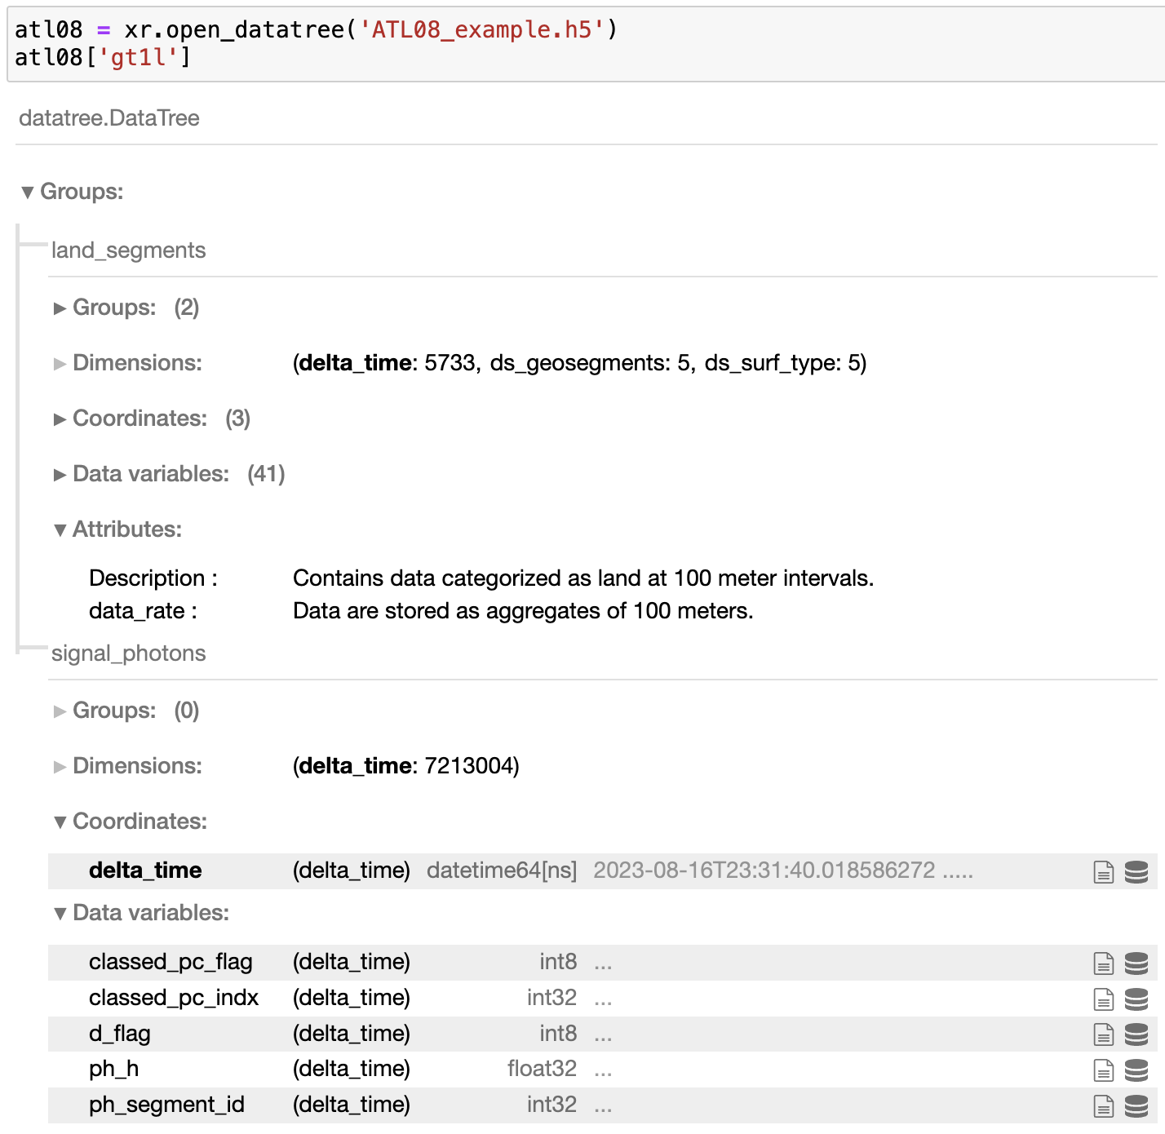
DataTree in action
Jupyter notebook demonstrating xarray loading a hierarchical ATL08 granule into a single DataTree object. Source data retrieved from the National Snow and Ice Data Center (NSIDC).

Slide 7
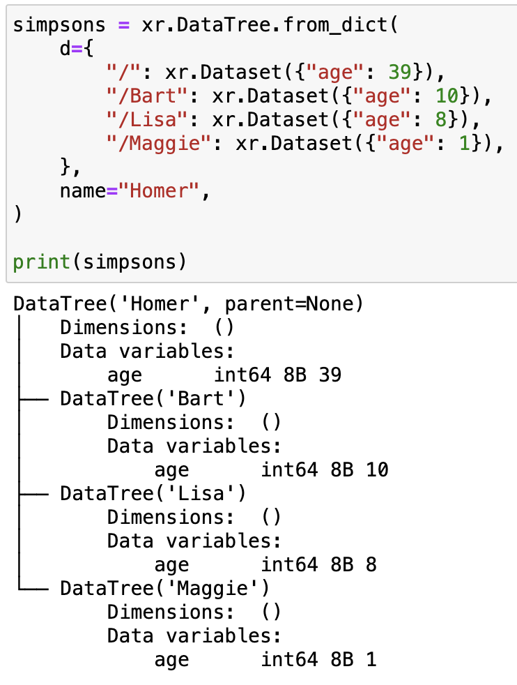
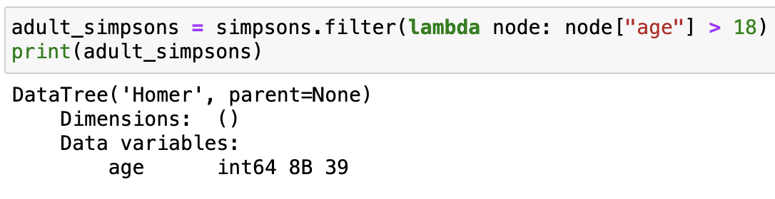
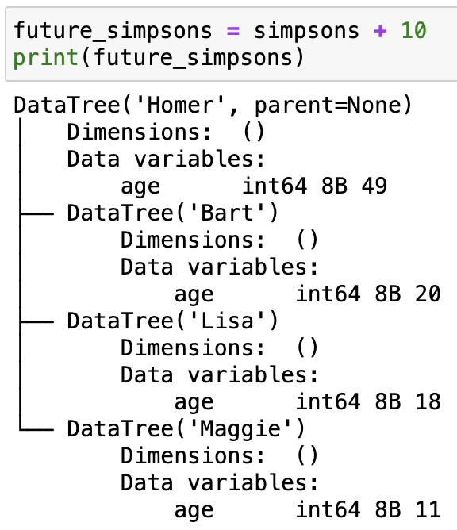
Manipulating DataTrees
Jupyter notebook demonstrating xarray manipulating DataTree objects. Examples derived from xarray-datatree documentation.
Left: Instantiating a DataTree representing the Simpsons family.
Top right: Filtering to find only adult members of the DataTree.
Bottom right: Applying an operation to all nodes to add 10 years to the ages of all nodes.

Slide 8
Bringing DataTree to xarray
Collaboration between xarray, NASA EOSDIS Evolution and Development-3 (EED-3), NSIDC, and Goddard Earth Sciences Data and Information Services Center (GES DISC)
Goals
  To migrate DataTree code into xarray
  To reduce bus/lottery factor of DataTree
  Improve DataTree during and after merging

Slide 9
Lessons learnt: Communication
Start with clear scope and expectations from all parties.
Continue to communicate throughout
  Regular tag-ups
  Clear process for resolving outstanding items
  Negotiation of scope

Slide 10
More lessons learnt
Contributions to open-source aren’t a one-and-done
Work will likely take longer than anticipated
Great opportunity to learn different coding and project best practices
Hopefully, an example for future similar engagements with open-source tools

Slide 11
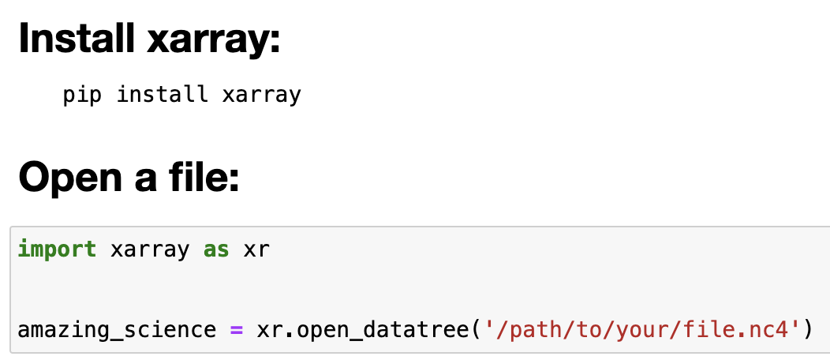
Want to try DataTree out?
Jupyter notebook demonstrating how xarray is invoked to open an arbitrary hierarchical NetCDF-4 file.

Slide 12
Questions?

Slide 13
This work was supported by NASA/GSFC under Raytheon Company contract number 80GSFC21CA001

