Slide 1
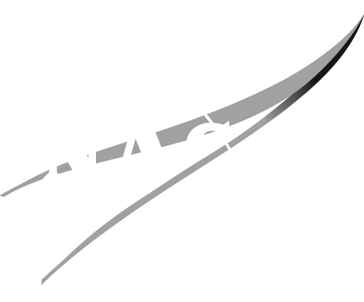
Monodisperse Single-Material Granular Tribocharging Modeling and Experimental Validation
James Phillips¹
Jessica Schwend¹, David Lund¹, Robert Frady¹, Krystal Acosta¹, Joseph Toth¹, Aaron Olson¹,
Jerry Wang¹, Charles Buhler¹, Sid Clements², Tarek Elgohary³, Adrienne Dove³
¹NASA Kennedy Space Center
²Appalachian State University
³University of Central Florida
2024 ESA Annual Meeting
Ottawa, Canada June 10-12, 2024
Electrostatics and Surface Physics Laboratory
NASA Kennedy Space Center, Florida

Slide 2
Background
Understanding grain tribocharging under vacuum is of interest for space applications
Developing models to determine how lunar dust will charge and be deposited
Experiments are required to bound results from these simulations
Asymmetry in granular systems lead to charge transfer:
  Size asymmetry is known well [Lacks, 2011; Bilici, 2014]:
    smaller particles tend to charge negatively
    larger particles tend to charge positively
  Contact asymmetry will be further examined here:
    more dynamic particles tend to charge positively
    more static particles tend to charge negatively
    previously discussed at 2013 ESA Annual Meeting [Buhler, 2013]
2024 ESA Annual Meeting
Ottawa, Canada June 10-12, 2024
Electrostatics and Surface Physics Laboratory
NASA Kennedy Space Center, Florida

Slide 3
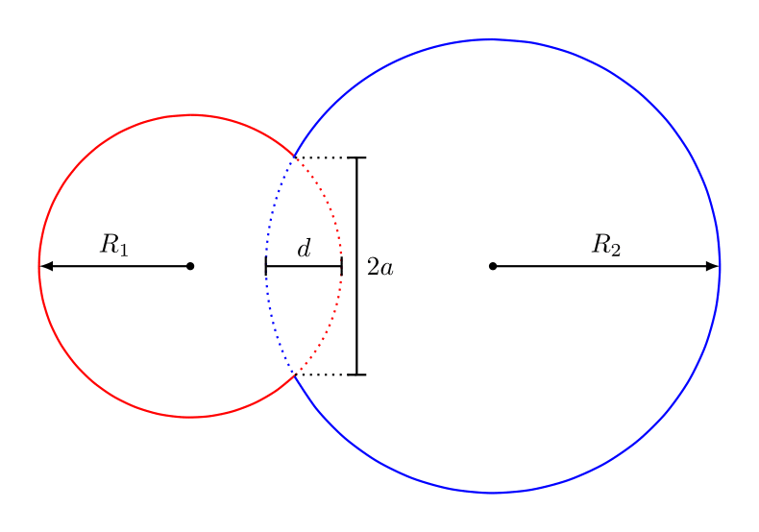
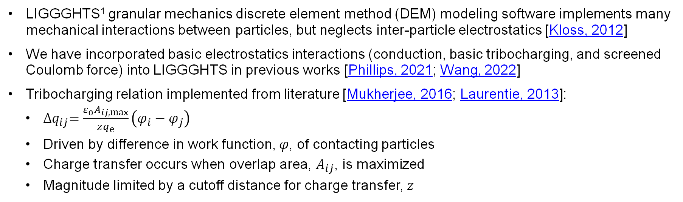
Applications to Modeling/Simulations
LIGGGHTS¹ granular mechanics discrete element method (DEM) modeling software implements many mechanical interactions between particles, but neglects inter-particle electrostatics [Kloss, 2012]
We have incorporated basic electrostatics interactions (conduction, basic tribocharging, and screened Coulomb force) into LIGGGHTS in previous works [Phillips, 2021; Wang, 2022]
Tribocharging relation implemented from literature [Mukherjee, 2016; Laurentie, 2013]:
  ${∆q}_{ij}=\frac{ε_{0}A_{ij,max}}{zq_{e}}\left(φ_{i}−φ_{j}\right)$
  Driven by difference in work function, $φ$, of contacting particles
  Charge transfer occurs when overlap area, $A_{ij}$, is maximized
  Magnitude limited by a cutoff distance for charge transfer, $z$
This behavior is incomplete and results in particles with identical work functions remaining neutral (unlike reality)
Contact detection will be implemented and linked to charging
¹ Large-scale Atomic/Molecular Massively Parallel Simulator (LAMMPS) Improved for General Granular and Granular Heat Transfer Simulations (LIGGGHTS®) is a registered trademark;
DCS Computing GmbH is the official producer of the LIGGGHTS® software; LIGGGHTS®-PUBLIC is provided under the GNU General Public License v2.0
2024 ESA Annual Meeting
Ottawa, Canada June 10-12, 2024
Electrostatics and Surface Physics Laboratory
NASA Kennedy Space Center, Florida

Slide 4
Experimental Overview
Tray filled with insulating spherical glass beads is slowly inclined
Beads rub against one another as they pour out of tray opening
Beads leaving tray fall and are captured inside Faraday cup
Net charge of all beads within cup is monitored with electrometer
Polarity of beads remaining in tray is confirmed with field meter
After system equilibrates, mass of beads in cup is measured
Overall charge-to-mass ratio is computed
Vacuum Chamber
Faraday
Cup
Motor
2024 ESA Annual Meeting
Ottawa, Canada June 10-12, 2024
Electrostatics and Surface Physics Laboratory
NASA Kennedy Space Center, Florida

Slide 5
Experimental Challenges
Beads bouncing out of Faraday cup
  Anti-static foam was added to bottom of cup to stop beads from escaping
Isolating beads from wall interactions
  Double-sided tape was used to coat inside of tray with identical beads
Assuring neutrality of all beads before beginning the experiment
  First Experiments: beads added to tray in layers and neutralized with ionizer fan after each layer
  Later Experiments: beads neutralized with ionizer fan directly as they were poured into tray
  Field meter was used to verify neutrality of particle bed before starting experiment
Larger particles tend to avalanche all at once compared to smaller particles
  Attempted to run experiments multiple times until clean capture, but data for larger particles is sparse
2024 ESA Annual Meeting
Ottawa, Canada June 10-12, 2024
Electrostatics and Surface Physics Laboratory
NASA Kennedy Space Center, Florida

Slide 6
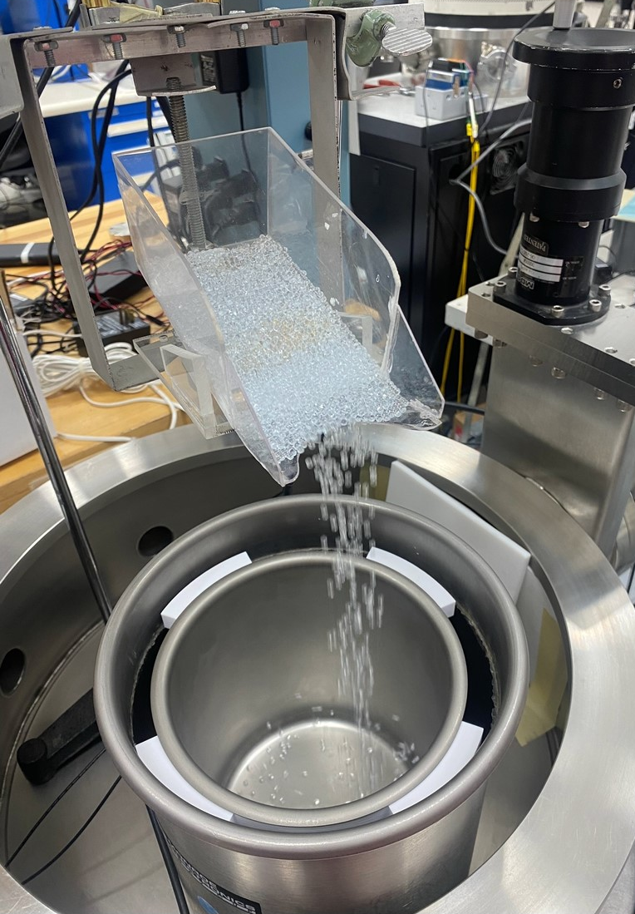
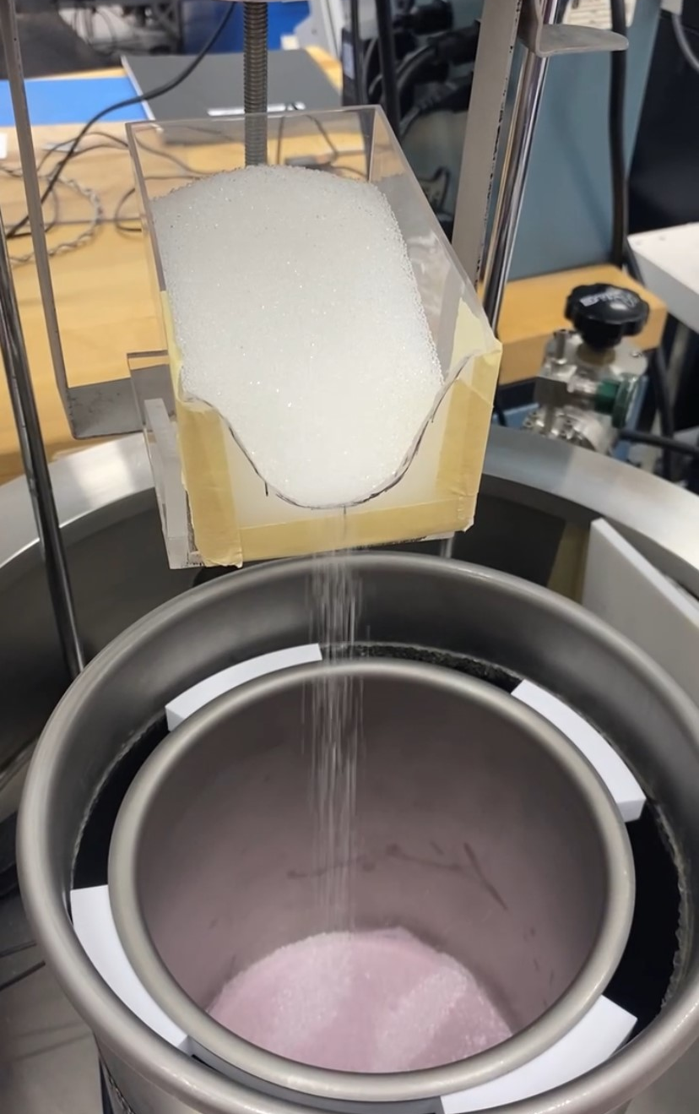
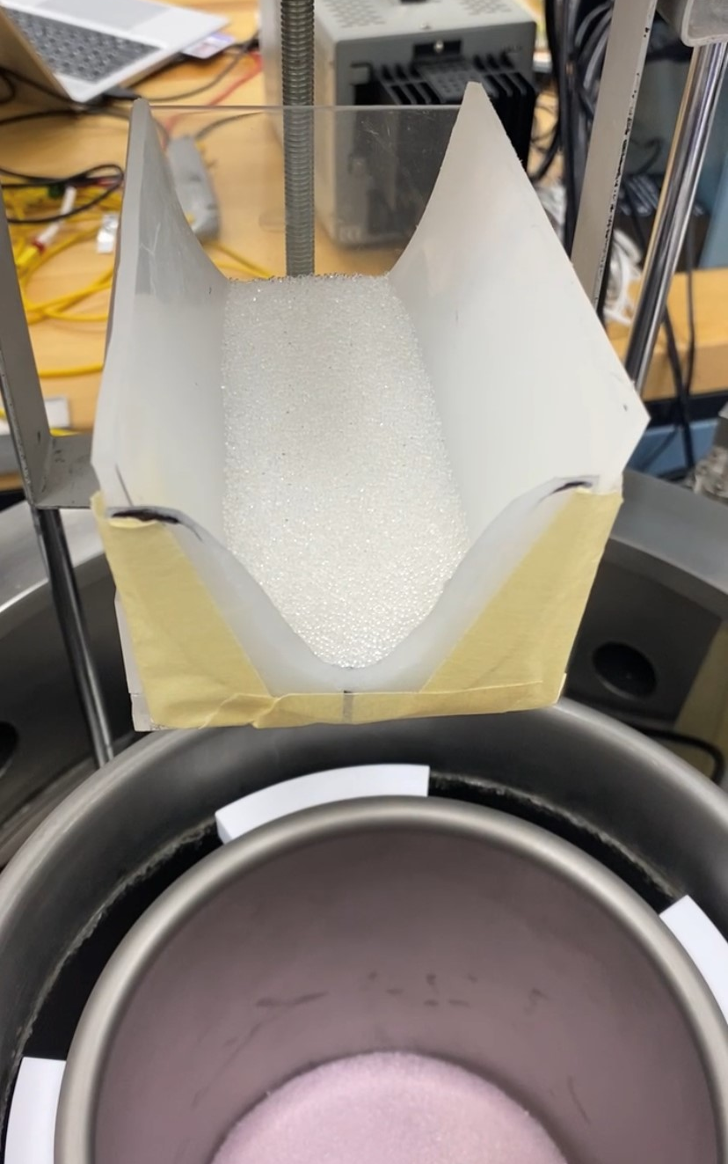
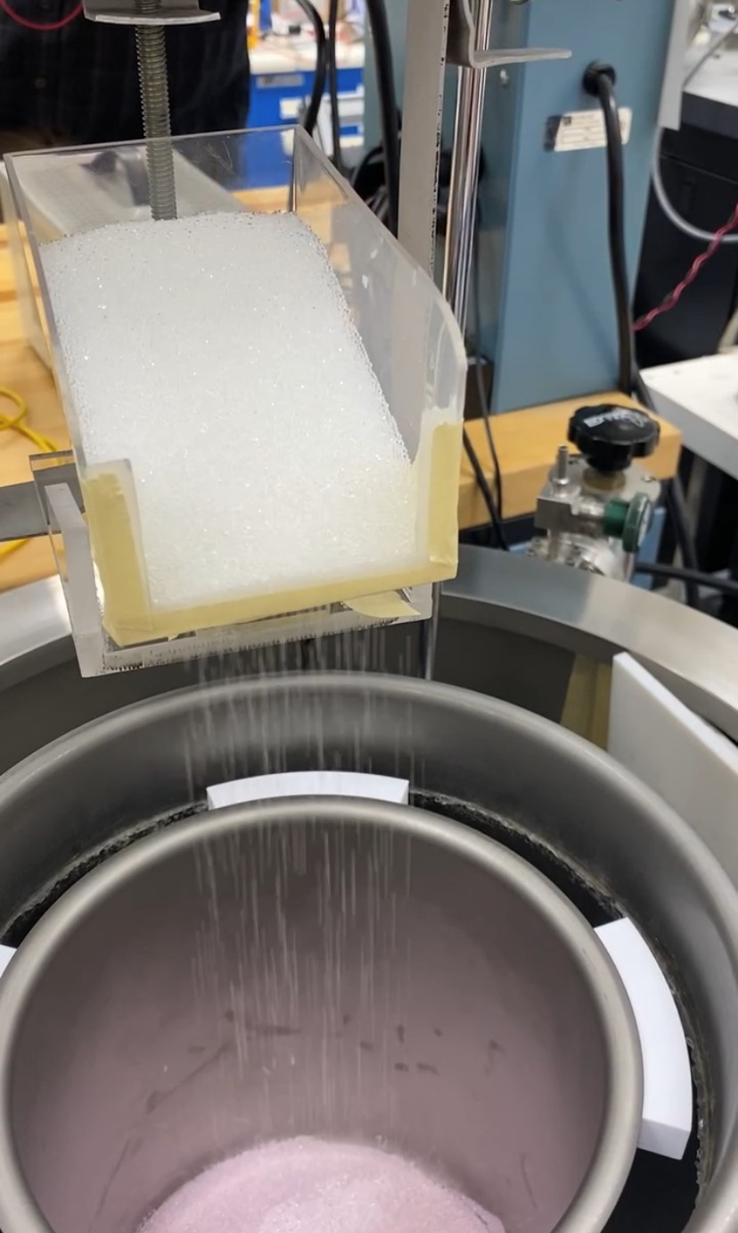
Experimental Setup: Tray Design
Several profiles were examined to limit avalanching and minimize wall interactions
Worked well to vary flow rate of particles, but significant particle-wall charging was still measured
2024 ESA Annual Meeting
Ottawa, Canada June 10-12, 2024
Electrostatics and Surface Physics Laboratory
NASA Kennedy Space Center, Florida

Slide 7
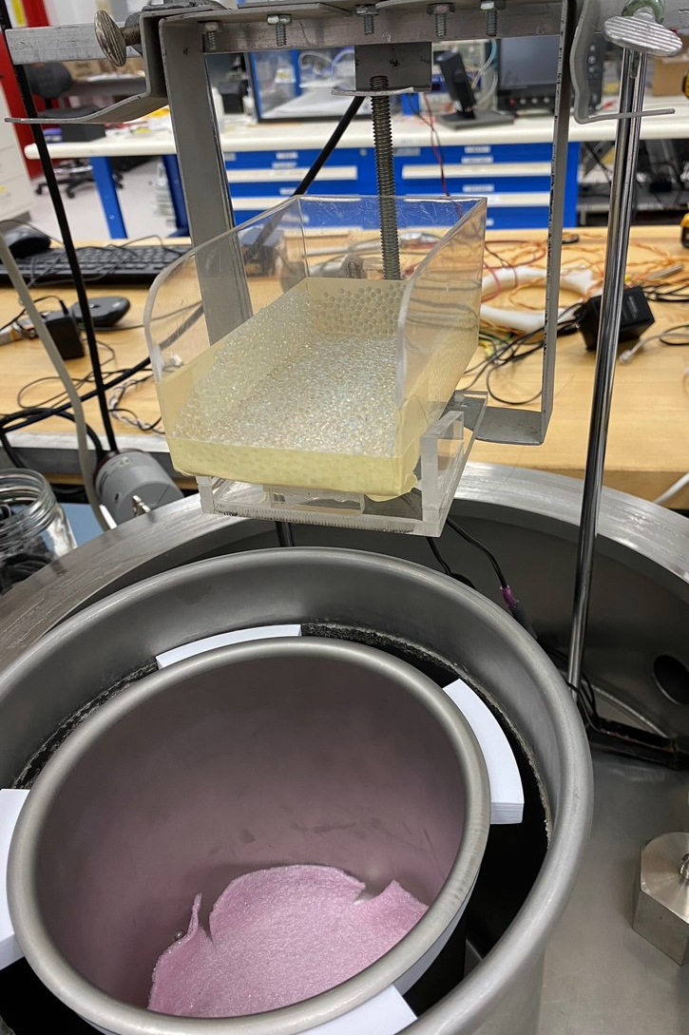
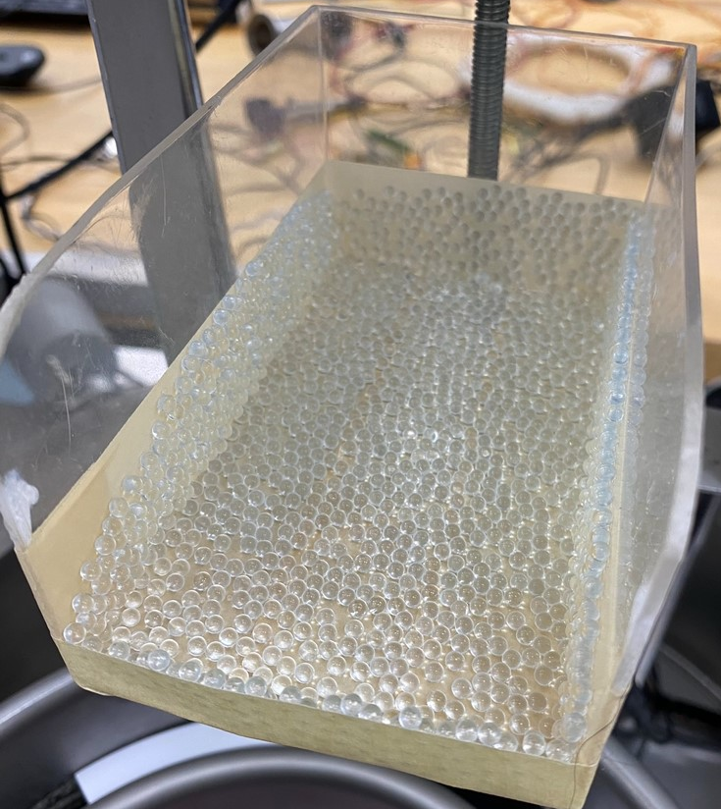
Experimental Setup: Wall Isolation
Double-sided tape was used to adhere layer of particles to wall of tray
Ensures particles only interact with other particles and not tray walls
Open front profile prone to avalanching of large particles, but necessary
Vacuum Chamber
Double Sided Tape
Faraday
Cup
Motor
2024 ESA Annual Meeting
Ottawa, Canada June 10-12, 2024
Electrostatics and Surface Physics Laboratory
NASA Kennedy Space Center, Florida

Slide 8
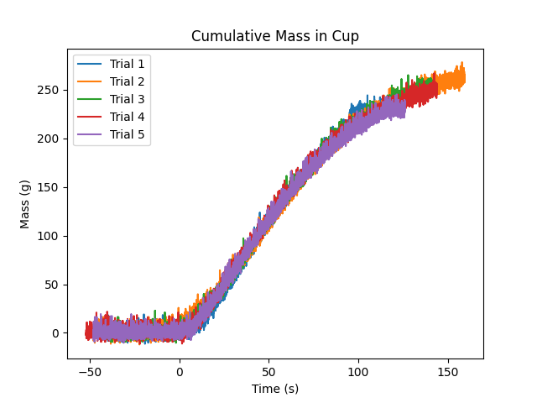
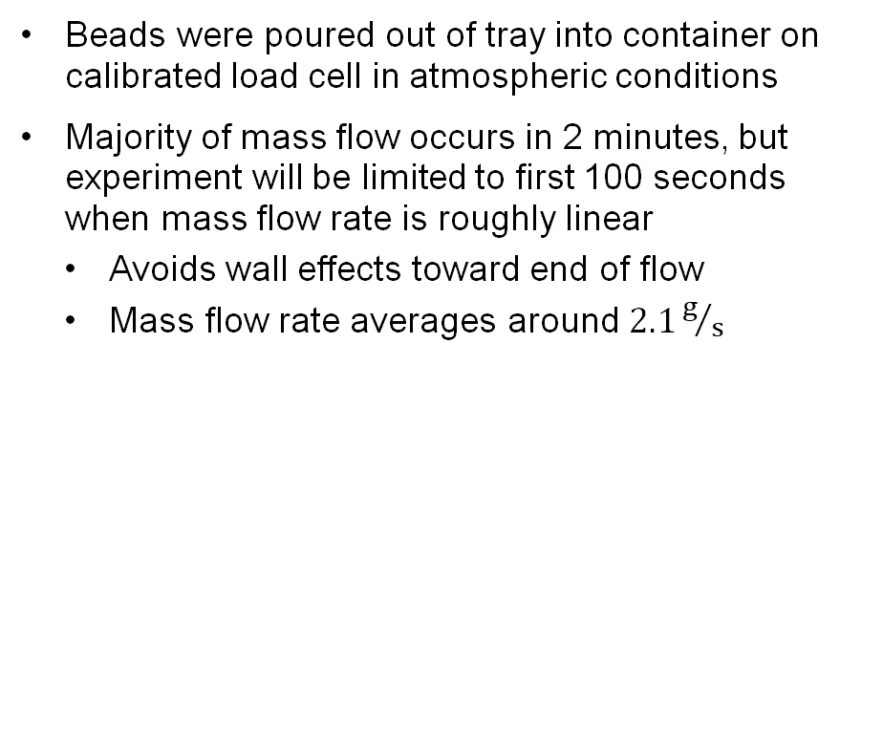
Experimental Results: Mass Flow Rate
Beads were poured out of tray into container on calibrated load cell in atmospheric conditions
Majority of mass flow occurs in 2 minutes, but experiment will be limited to first 100 seconds when mass flow rate is roughly linear
  Avoids wall effects toward end of flow
  Mass flow rate averages around $2.1g/s$
2024 ESA Annual Meeting
Ottawa, Canada June 10-12, 2024
Electrostatics and Surface Physics Laboratory
NASA Kennedy Space Center, Florida
Notes:
6-21-23\MassFlowRate

Slide 9
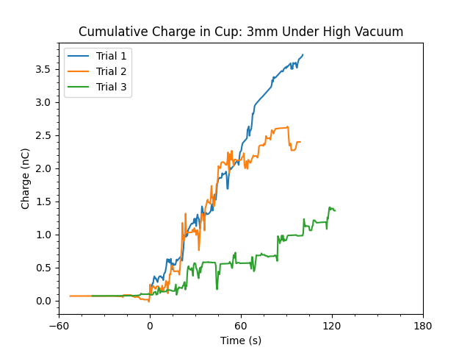
Experimental Results: Larger Particles
3mm diameter glass beads under high vacuum:
  Larger particles have fewer interactions and do not charge to the same degree as smaller ones
  Avalanching occurred in green run, so not as many contacts were made and charge was low
Net charge in cup is positive in all cases
  Ranges between 1 and 4 nC for similar mass
 | Charge (nC) | Mass (g) | Q/m (pC/g)
Trial 1: | +3.7 | 280 | 13
Trial 2: | +2.6 | 295 | 8.8
Trial 3: | +1.4 | 295 | 4.7
Mean: | +2.6 | 290 | 9.0
2024 ESA Annual Meeting
Ottawa, Canada June 10-12, 2024
Electrostatics and Surface Physics Laboratory
NASA Kennedy Space Center, Florida
Notes:
7-17-23: larger particles, avalanching, differently shaped tray opening

Slide 10
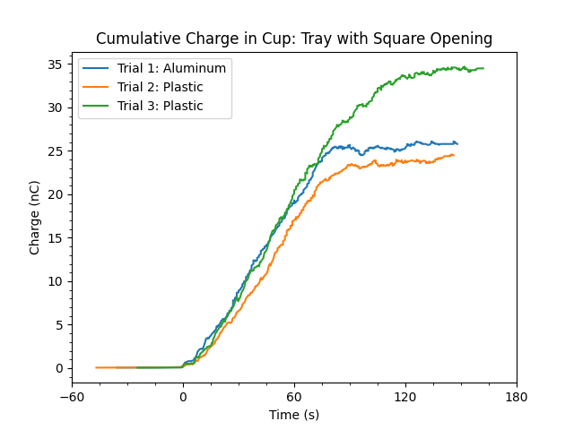
Experimental Results: Refined Opening
1mm beads were poured out of aluminum and plastic trays in high vacuum conditions
Net charge in cup is positive in all cases
  Ranges between 23 and 35 nC for similar mass
Aluminum vs plastic tray did not differ significantly
Determined square opening is best config
 | Charge (nC) | Mass (g) | Q/m (pC/g)
Trial 1: | +25.8 | 320* | 81*
Trial 2: | +23.9 | 320* | 75*
Trial 3: | +34.5 | 320* | 108*
Mean: | +28.1 | 320* | 88*
*assumed mass
2024 ESA Annual Meeting
Ottawa, Canada June 10-12, 2024
Electrostatics and Surface Physics Laboratory
NASA Kennedy Space Center, Florida
Notes:
6-16-23\electrometer\square_edge: switched to smaller beads and square front opening

Slide 11
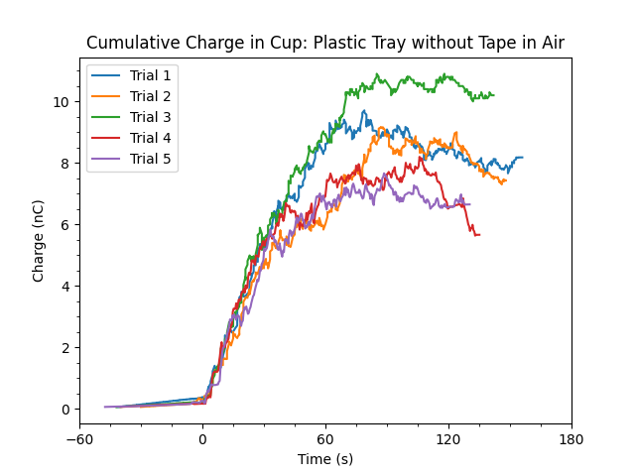
Experimental Results: Before Tape
1mm beads were poured out of plastic tray in atmospheric conditions
Net charge in cup is positive in all cases
  Ranges between 7 to 11 nC for similar mass
  Interactions with walls dampen charging
Tape added to plastic tray to minimize wall effects
 | Charge (nC) | Mass (g) | Q/m (pC/g)
Trial 1: | +8.7 | 320 | 27
Trial 2: | +8.6 | 320 | 27
Trial 3: | +10.5 | 320 | 33
Trial 4: | +7.6 | 320 | 24
Trial 5: | +7.0 | 320 | 22
Mean: | +8.5 | 320 | 27
2024 ESA Annual Meeting
Ottawa, Canada June 10-12, 2024
Electrostatics and Surface Physics Laboratory
NASA Kennedy Space Center, Florida
Notes:
6-21-23\Plastic_Air

Slide 12
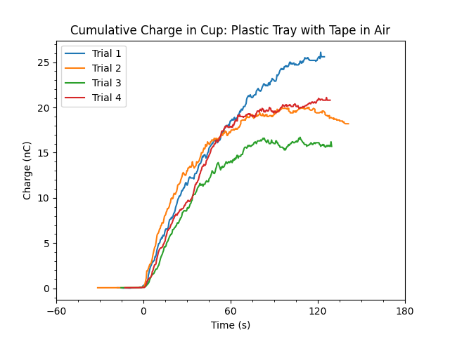
Experimental Results: After Tape
1mm beads were poured out of taped tray in atmospheric conditions
Net charge in cup is positive in all cases
  Ranges between 16 to 26 nC for similar mass
More interactions because tape limits sliding
 | Charge (nC) | Mass (g) | Q/m (pC/g)
Trial 1: | +25.4 | 320 | 79
Trial 2: | +19.7 | 320 | 61
Trial 3: | +16.0 | 320 | 50
Trial 4: | +20.3 | 320 | 63
Mean: | +20.4 | 320 | 64
2024 ESA Annual Meeting
Ottawa, Canada June 10-12, 2024
Electrostatics and Surface Physics Laboratory
NASA Kennedy Space Center, Florida
Notes:
6-22-23\tape

Slide 13
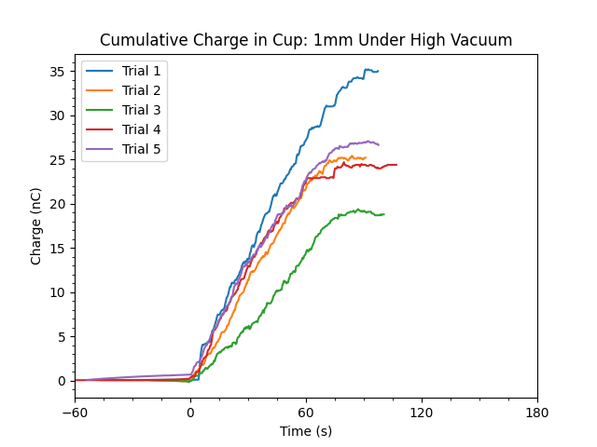
Experimental Results
1mm diameter glass beads under high vacuum:
  Higher net charge for 1mm vs 3mm particles
Net charge in cup is positive in all cases
  Ranges between 19 and 36 nC for similar mass
 | Charge (nC) | Mass (g) | Q/m (pC/g)
Trial 1: | +35.2 | 194 | 181
Trial 2: | +25.4 | 199 | 128
Trial 3: | +19.4 | 186 | 104
Trial 4: | +24.7 | 202 | 122
Trial 5: | +27.1 | 209 | 130
Mean: | +26.4 | 198 | 133
2024 ESA Annual Meeting
Ottawa, Canada June 10-12, 2024
Electrostatics and Surface Physics Laboratory
NASA Kennedy Space Center, Florida

Slide 14
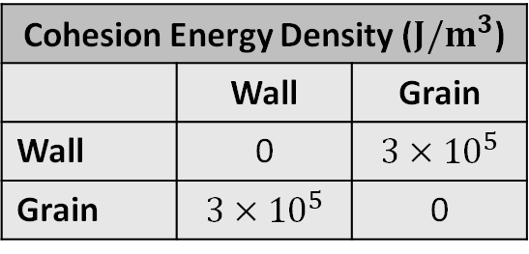
Simulation Setup
Reconciling experimental results with models by implementing contact detection and counting
Cohesion between grains and tray walls was set to large value
  Enforces grains to be tangent to tray surface
  Does not limit sliding/rolling motions
Coefficients of friction between grains and tray walls were set to large value
  Prohibits grains from sliding/rolling along tray surface
Cohesion Energy Density ($J/m^{3}$)
 | Wall | Grain
Wall | 0 | $$3×{10}^{5}$$
Grain | $$3×{10}^{5}$$ | 0
Coefficient of Rolling Friction
 | Wall | Grain
Wall | 0 | 1
Grain | 1 | 0
Coefficient of Sliding Friction
 | Wall | Grain
Wall | 0 | 1
Grain | 1 | 0
2024 ESA Annual Meeting
Ottawa, Canada June 10-12, 2024
Electrostatics and Surface Physics Laboratory
NASA Kennedy Space Center, Florida

Slide 15
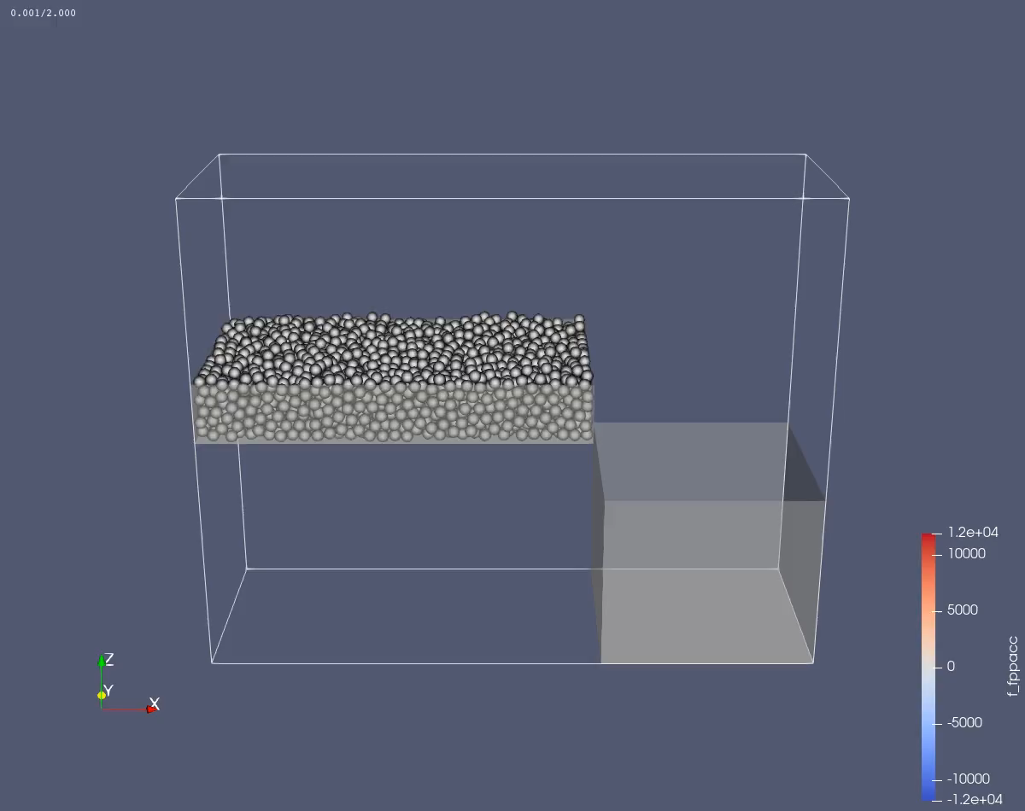
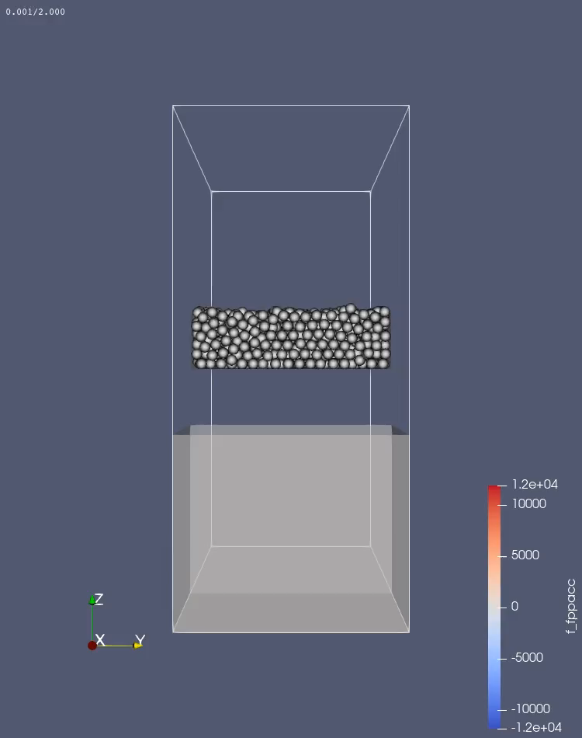
Simulation Example
2024 ESA Annual Meeting
Ottawa, Canada June 10-12, 2024
Electrostatics and Surface Physics Laboratory
NASA Kennedy Space Center, Florida

Slide 16
Simulation Challenges
Mesh objects in LIGGGHTS must all have identical physics applied
  Tray behaves as if covered with double-sided tape [intended]
  Faraday cup also covered in double-sided tape [unfortunate]
Contacts inside Faraday cup are still counted and cause artificial inflation of numbers
Mitigations:
  Trajectories of particles in XZ plane are plotted as function of time
  Intersections with YZ plane indicating free fall of particle recorded
  Time step at which this occurs is used to look up number of contacts per particle
2024 ESA Annual Meeting
Ottawa, Canada June 10-12, 2024
Electrostatics and Surface Physics Laboratory
NASA Kennedy Space Center, Florida

Slide 17
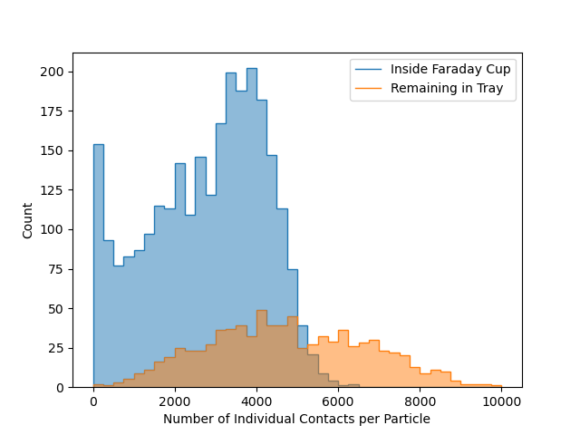
Simulation Preliminary Results
Bimodal distribution of per-particle contacts seen when comparing beads inside Faraday cup to those remaining behind in tray
Though preliminary, can be related to bipolar nature of charge segregation in monodisperse systems
Average number of contacts for beads on walls of tray was higher than for those collected in cup
 | Total Contacts | Total Beads | Average Contacts | Full Width Half Max
Remaining in Tray | 3958740 | 833 | 4752 | ~2000
Inside Faraday Cup | 7441878 | 2687 | 2769 | ~6000
2024 ESA Annual Meeting
Ottawa, Canada June 10-12, 2024
Electrostatics and Surface Physics Laboratory
NASA Kennedy Space Center, Florida

Slide 18
Summary
All experiments indicated positive charge on beads in Faraday cup and negative charge in tray
Particles that are more dynamic charge positively (i.e. those that slide/roll out of tray)
Particles that are more static charge negatively (i.e. those left behind in tray)
Improvements still needed to align simulations with experimental results
-
-
+
-
-
-
-
-
-
+
+
+
+
+
+
2024 ESA Annual Meeting
Ottawa, Canada June 10-12, 2024
Electrostatics and Surface Physics Laboratory
NASA Kennedy Space Center, Florida

Slide 19
Future Work
Perform additional tests with different materials than only glass beads
Improve contact counting in simulations to align with experimental data
  Better discriminate between static and dynamic particles in simulations
    Track static-dynamic and dynamic-dynamic bead contacts separately
  Place limits on number of interactions per grain to simulate saturation of charge
Decrease sizes of and increase number of particles in simulation to align with experiments
Investigate scenarios other than only pouring grains
  Fluidized beds, vacuuming up/blowing off surface grains, etc.
2024 ESA Annual Meeting
Ottawa, Canada June 10-12, 2024
Electrostatics and Surface Physics Laboratory
NASA Kennedy Space Center, Florida

Slide 20
References
Bilici, M.A., Toth III, J.R., Sankaran, R.M., Lacks, D.J. 2014. “Particle size effects in particle-particle triboelectric charging studied with an integrated fluidized bed and electrostatic separator system.” Review Scientific Instruments, 85(10):103903.
Buhler, C.R., Clements, J.S., Deckman, H., Dougal, S., Lamberti, W., Moebus, J., Reynolds, R. 2013. “New Observations on the Bipolar Nature of Charge Segregation in Triboelectrically Charged Granular Materials.” Electrostatics Society of America 2013 Annual Meeting.
Kloss, C., Goniva, C., Hager, A., Amberger, S., Pirker, S. 2012. “Models, algorithms and validation for open-source DEM and CFD–DEM.” Progress in Computational Fluid Dynamics, 12(2–3):140–152.
Lacks, D.J., Sankaran, R.M. 2011. “Contact electrification of insulating materials.” Journal of Physics D: Applied Physics, 44(45):453001.
Laurentie, J., Traore, P., Dascalescu, L. 2013. “Discrete Element Modeling of Triboelectric Charging of Insulating Materials in Vibrated Granular Beds.” Journal of Electrostatics, 71(6):951–957.
Mukherjee, R., Gupta, V., Naik, S., Sarkar, S., Sharma, V., Peri, P., Chaudhuri, B. 2016. “Effects of Particle Size on the Triboelectrification Phenomenon in Pharmaceutical Excipients: Experiments and Multi-Scale Modeling.” Asian Journal of Pharmaceutical Sciences, 11(5):603–617.
Phillips III, J.R., Wang, H., Hillegass, A., Esparza, A., Dove, A.R., Elgohary, T.A. 2021. “Implementation of Charged Particle Behavior in Discrete Element Method (DEM) Simulations.” ASCE Earth and Space 2021 Conference.
Wang, H., Phillips III, J.R., Dove, A.R., Elgohary, T.A. 2022. “Investigating Particle-Particle Electrostatic Effects on Charged Lunar Dust Transport via Discrete Element Modeling.” Advances in Space Research, 70(10):3231-3248.
2024 ESA Annual Meeting
Ottawa, Canada June 10-12, 2024
Electrostatics and Surface Physics Laboratory
NASA Kennedy Space Center, Florida

Slide 21
Backup Slides
2024 ESA Annual Meeting
Ottawa, Canada June 10-12, 2024
Electrostatics and Surface Physics Laboratory
NASA Kennedy Space Center, Florida

Slide 22
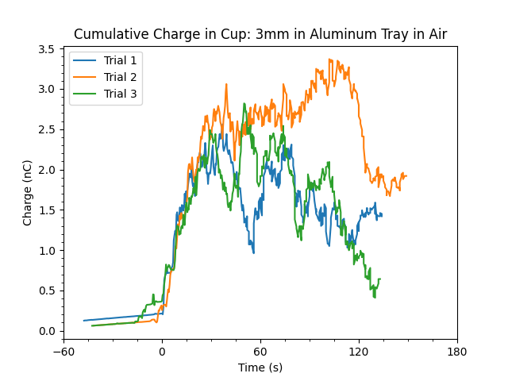
Experimental Results: Wall Interactions
3mm beads were poured out of aluminum tray in atmospheric conditions
Net charge in cup is positive in all cases until beads contacting walls fell into cup as well
  Indicates need for double-sided tape
2024 ESA Annual Meeting
Ottawa, Canada June 10-12, 2024
Electrostatics and Surface Physics Laboratory
NASA Kennedy Space Center, Florida
Notes:
6-21-23\Alum_Air

Slide 23
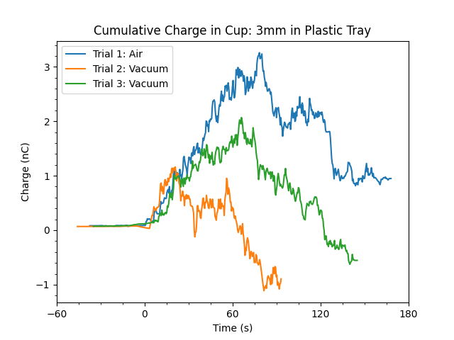
Experimental Results: Wall Interactions
3mm beads were poured out of plastic tray in atmospheric and high vacuum conditions
Net charge in cup is positive in all cases until beads contacting walls fell into cup as well
  Indicates need for double-sided tape
2024 ESA Annual Meeting
Ottawa, Canada June 10-12, 2024
Electrostatics and Surface Physics Laboratory
NASA Kennedy Space Center, Florida
Notes:
6-22-23\plastic

