Slide 1


VIPER Lunar Rover Data Systems
An Architecture for Exploration
Jay Trimble
June 13, 2024
Notes:
STILL

Slide 2
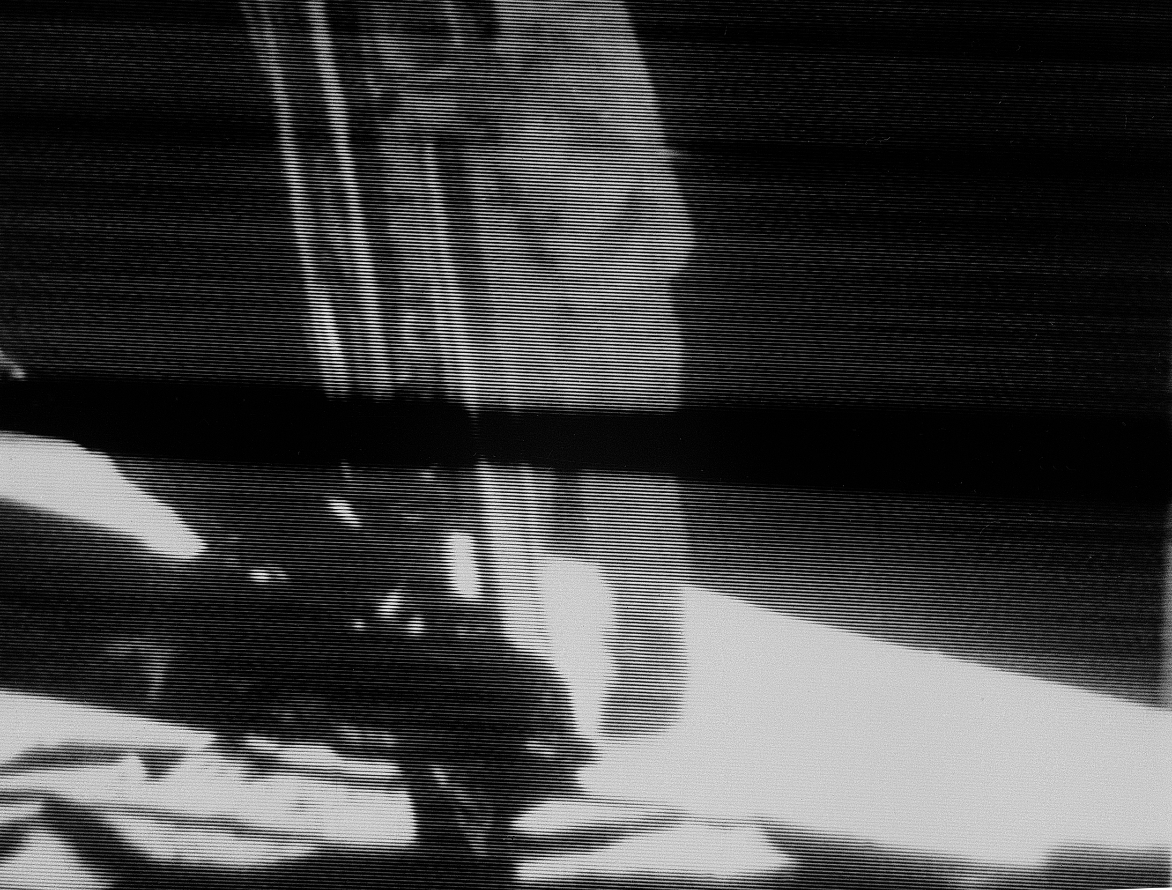
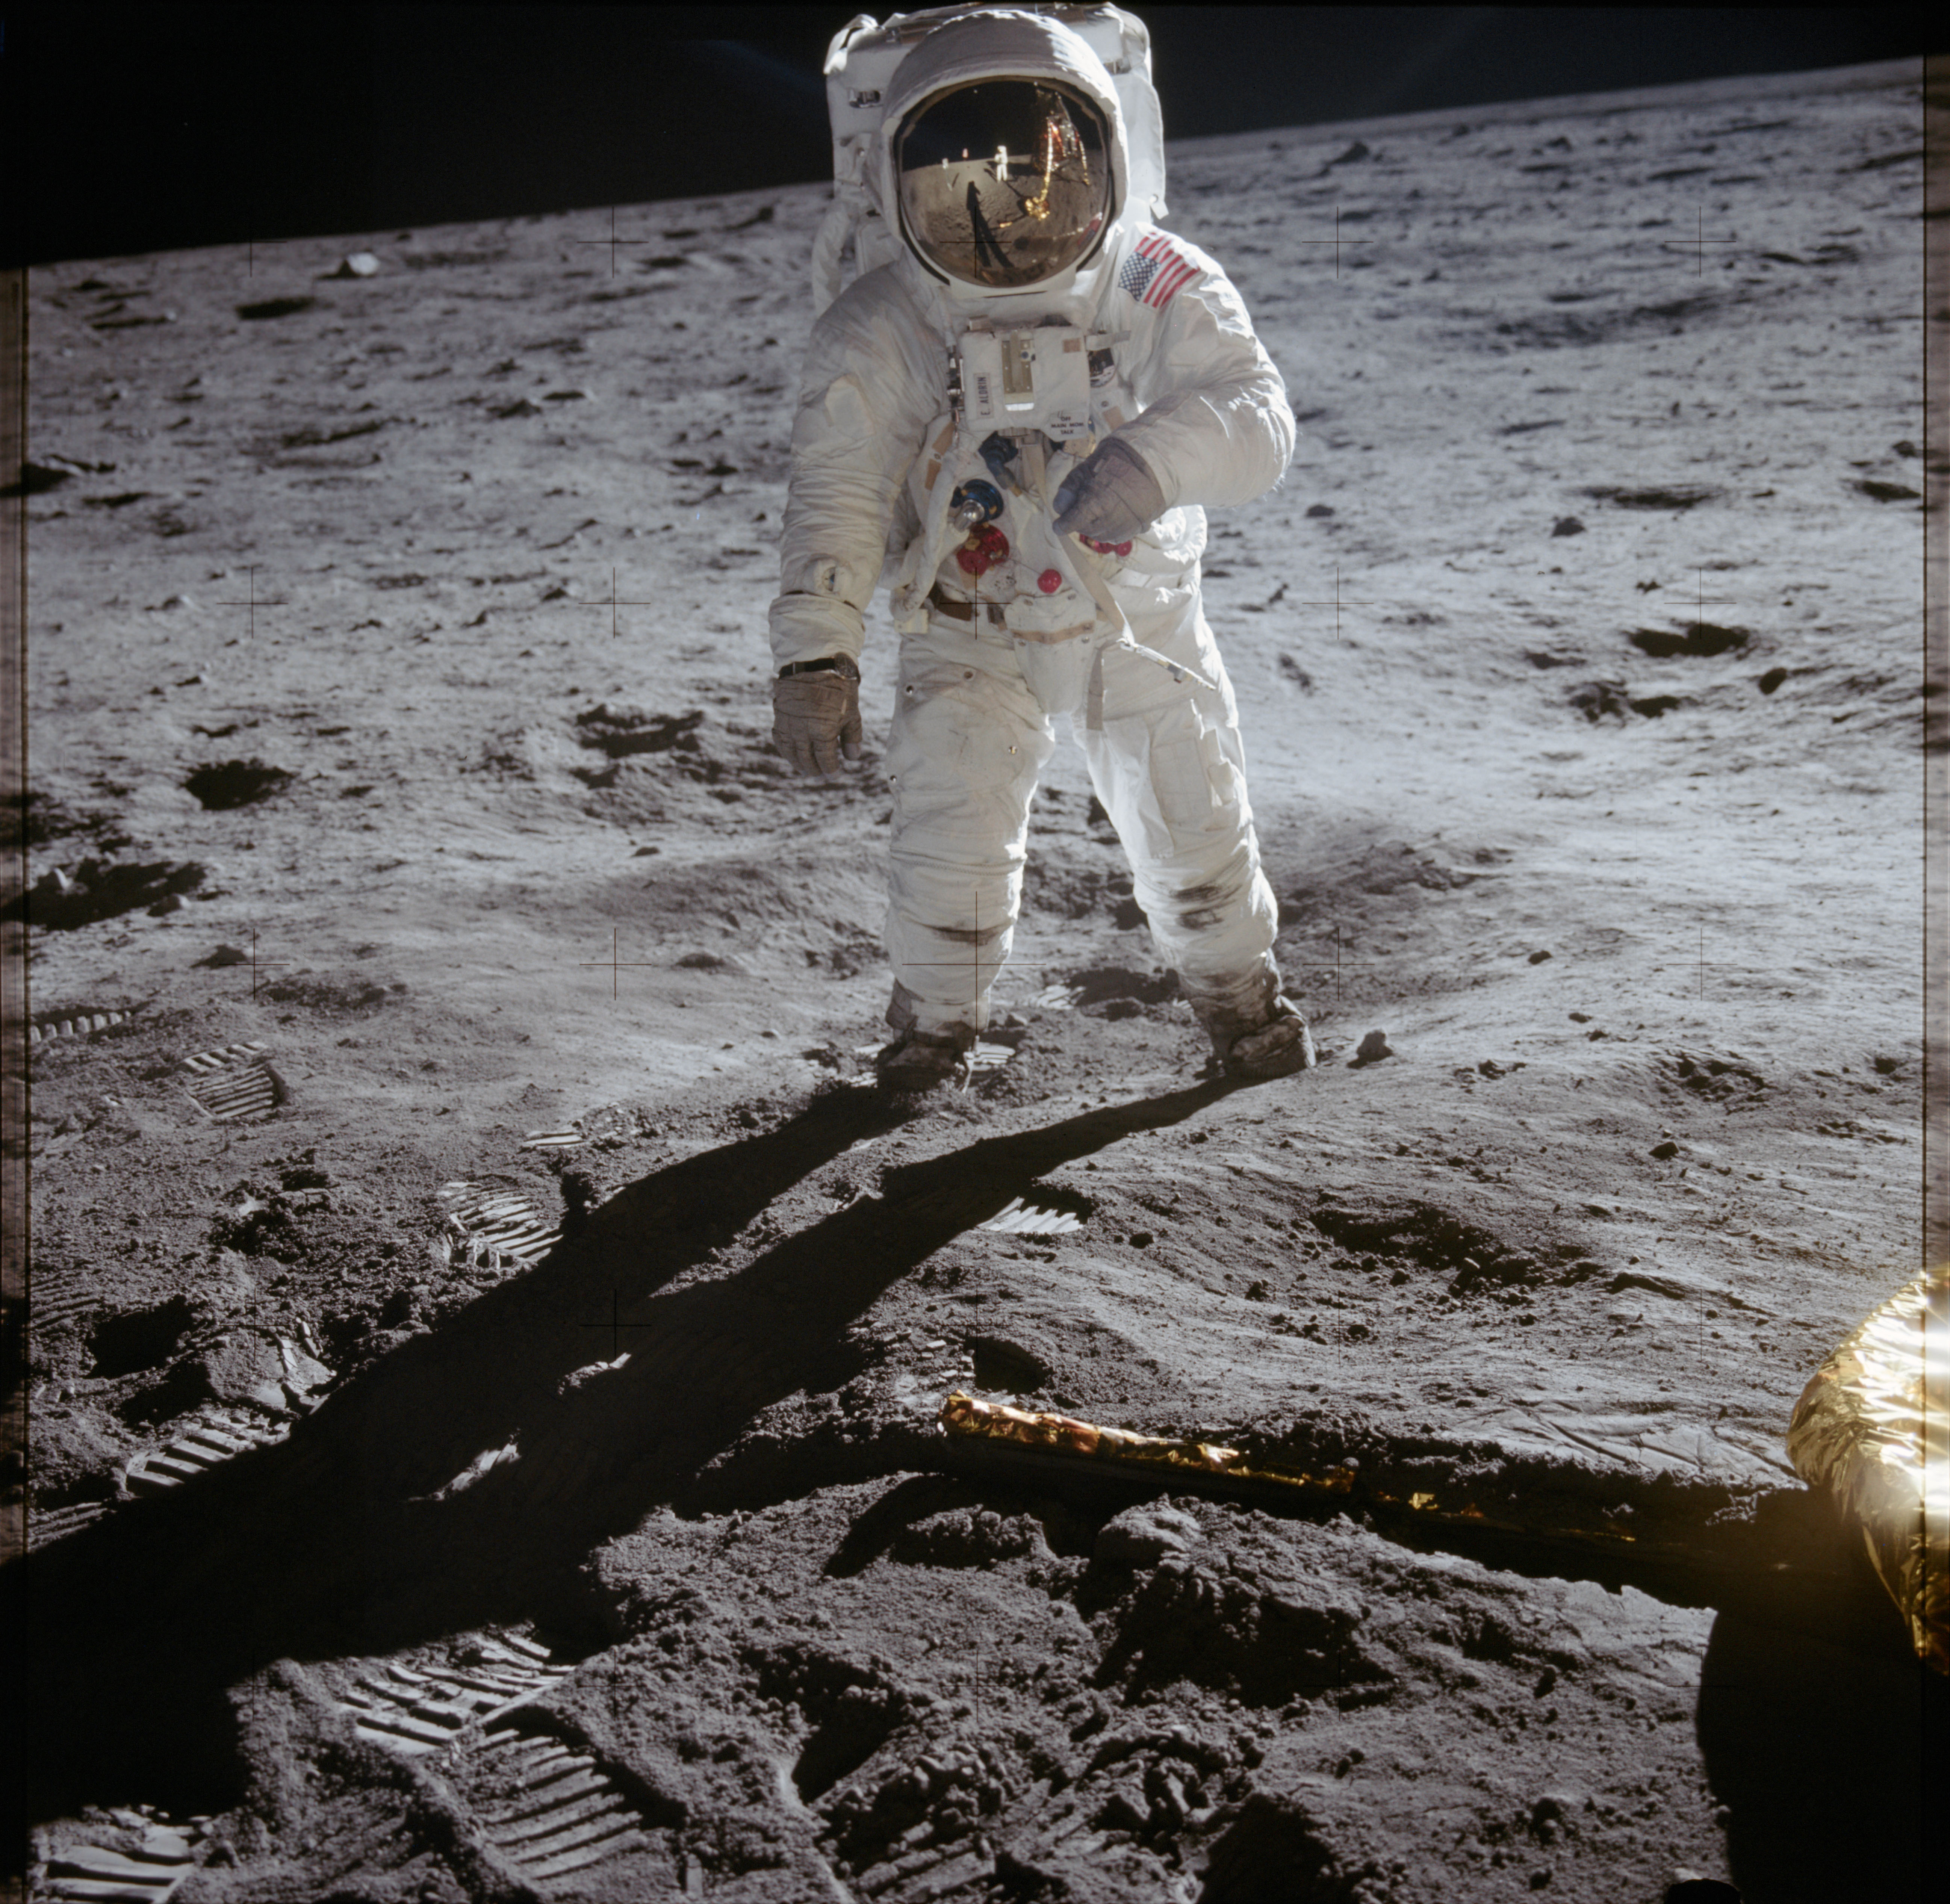
50+ Years Ago
50+ Years ago today
Neil Armstrong and Buzz Aldrin took the first human steps on another world, while Mike Collins orbited above
  Do you remember the moment?

Slide 3
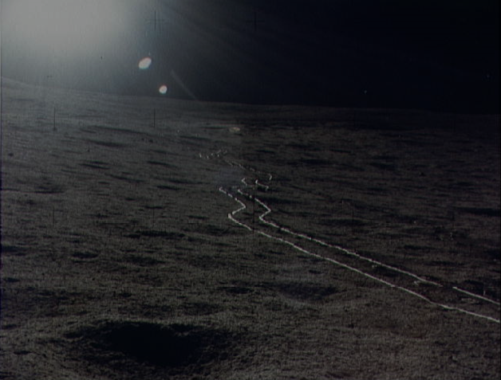
No crewed mission has left Earth orbit since the last Apollo mission, in 1972

Slide 4

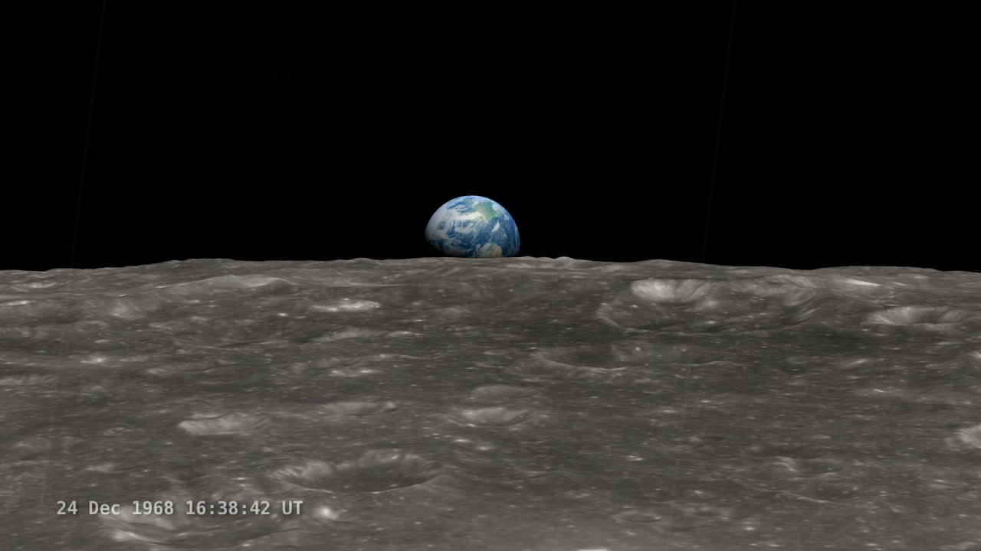
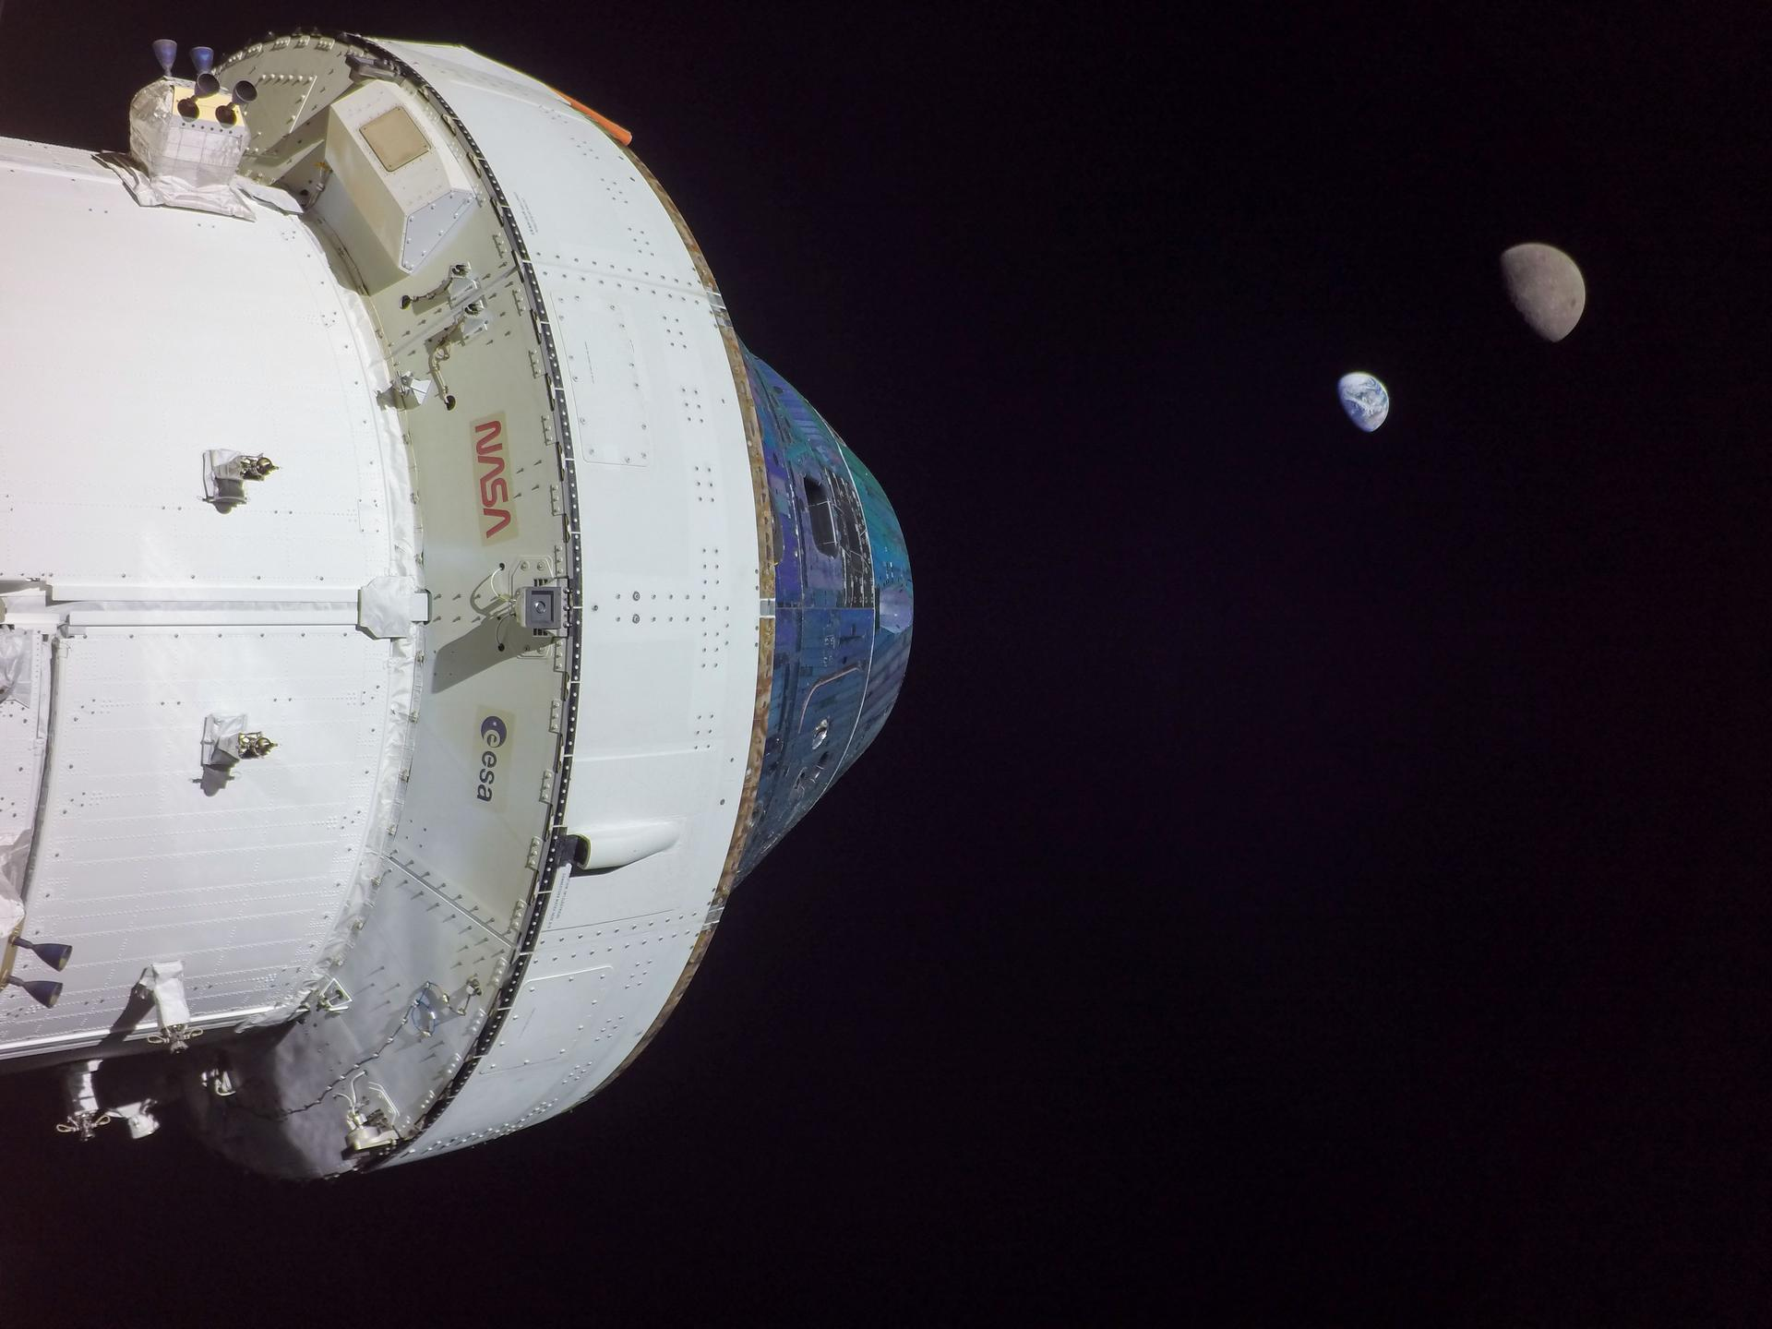
We are going back to the Moon

Slide 5
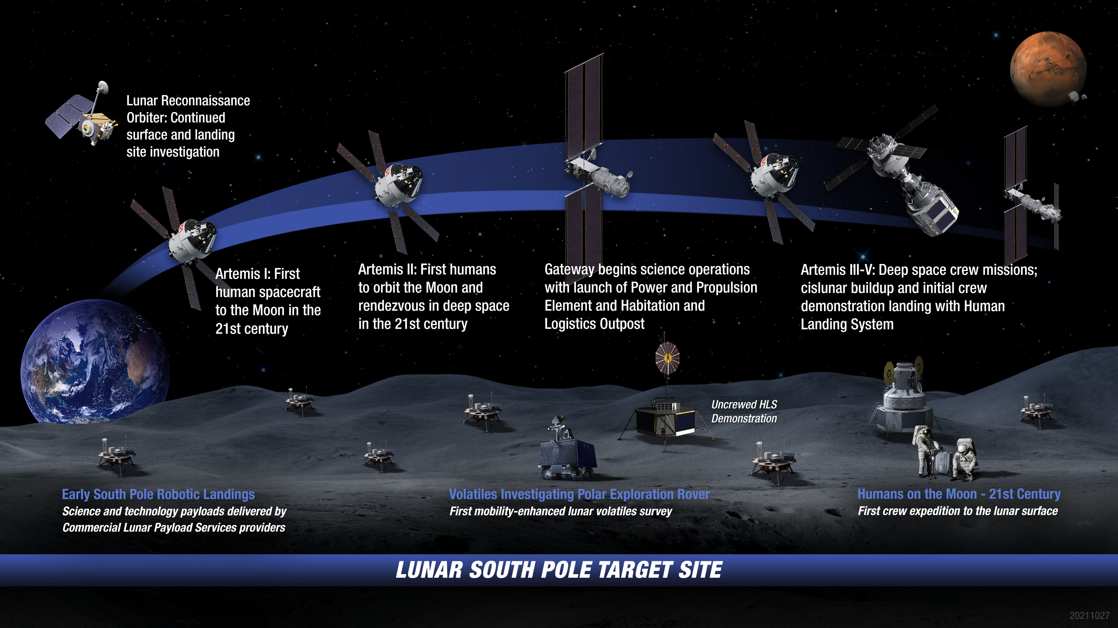
Enter Artemis: Landing Robots & Humans On the Moon

Slide 6
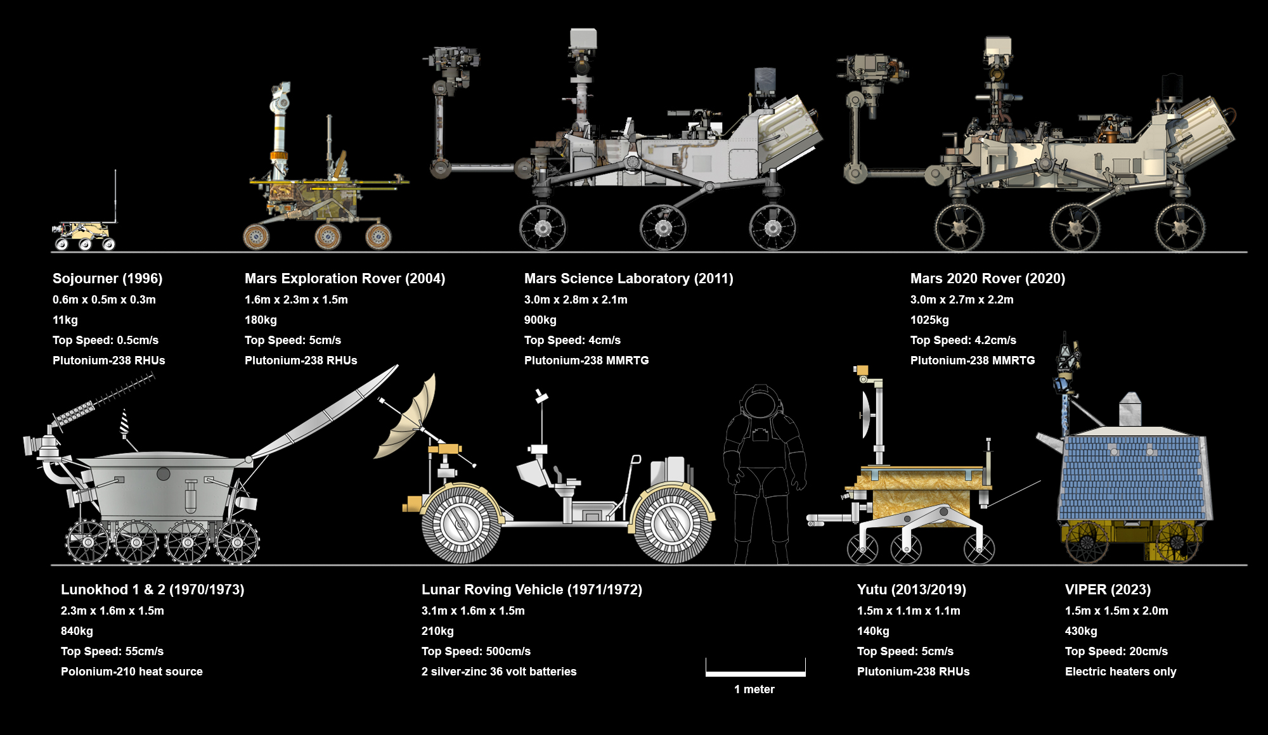
VIPER and its roving peers
(2024)

Slide 7
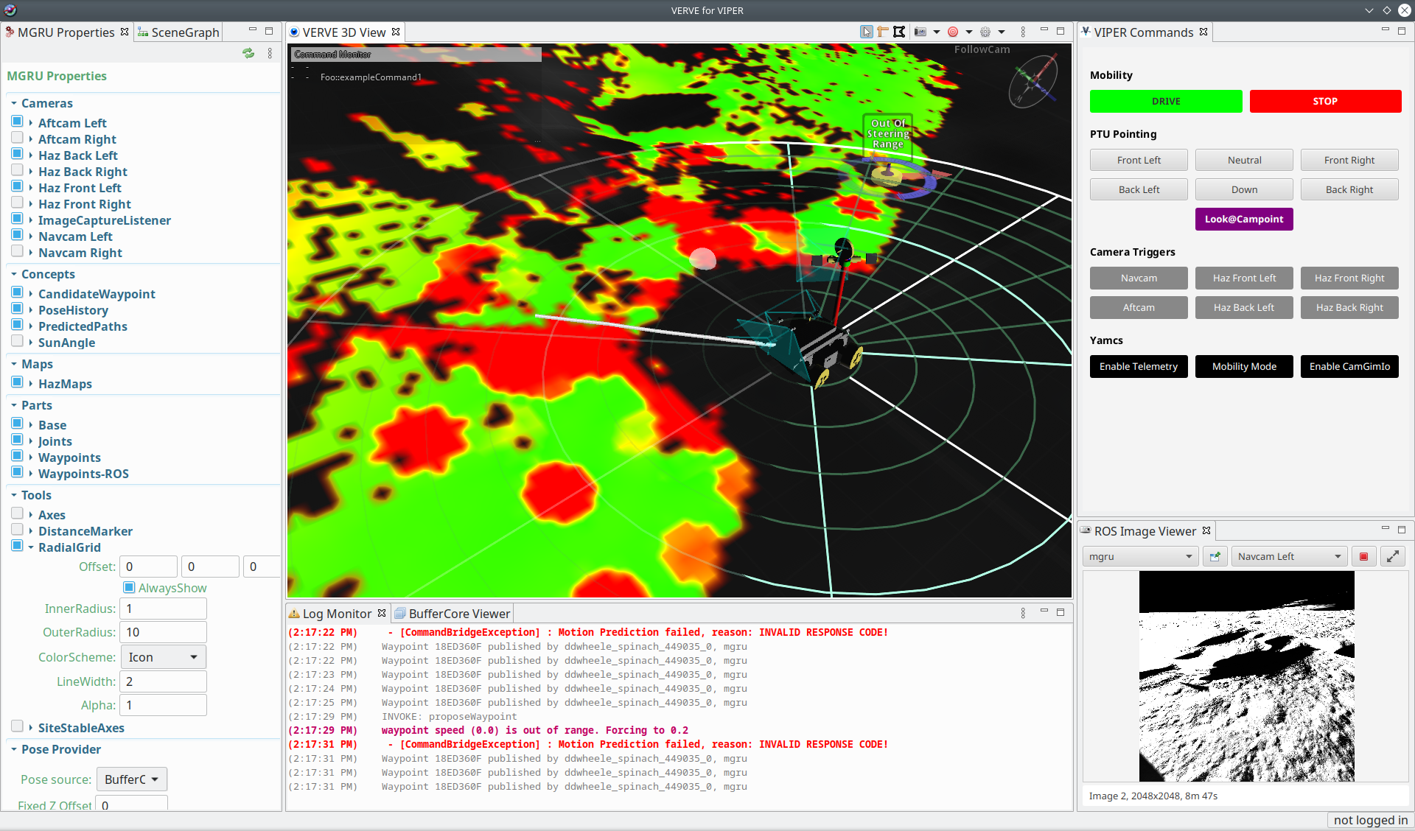
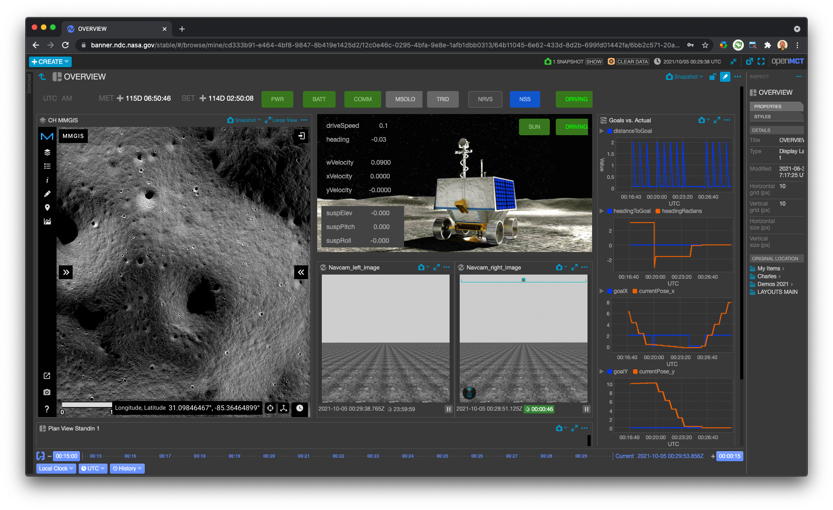
KSC
MSOLO
JSC
Rover Systems & Thermal
Rover Driving
Mission Monitoring
ARC
Systems & Execution
Comms round trip ~6 - 10 sec
Science Station
Waypoints ~ 5 m
Astrobotic Lander
Traverse Points ~ 50 m
Drill A
Science Station
Drill B
Area of Drill Opportunity
Drill C
Nobile Crater Area, Moon South Pole
Low light angle at poles

Slide 8
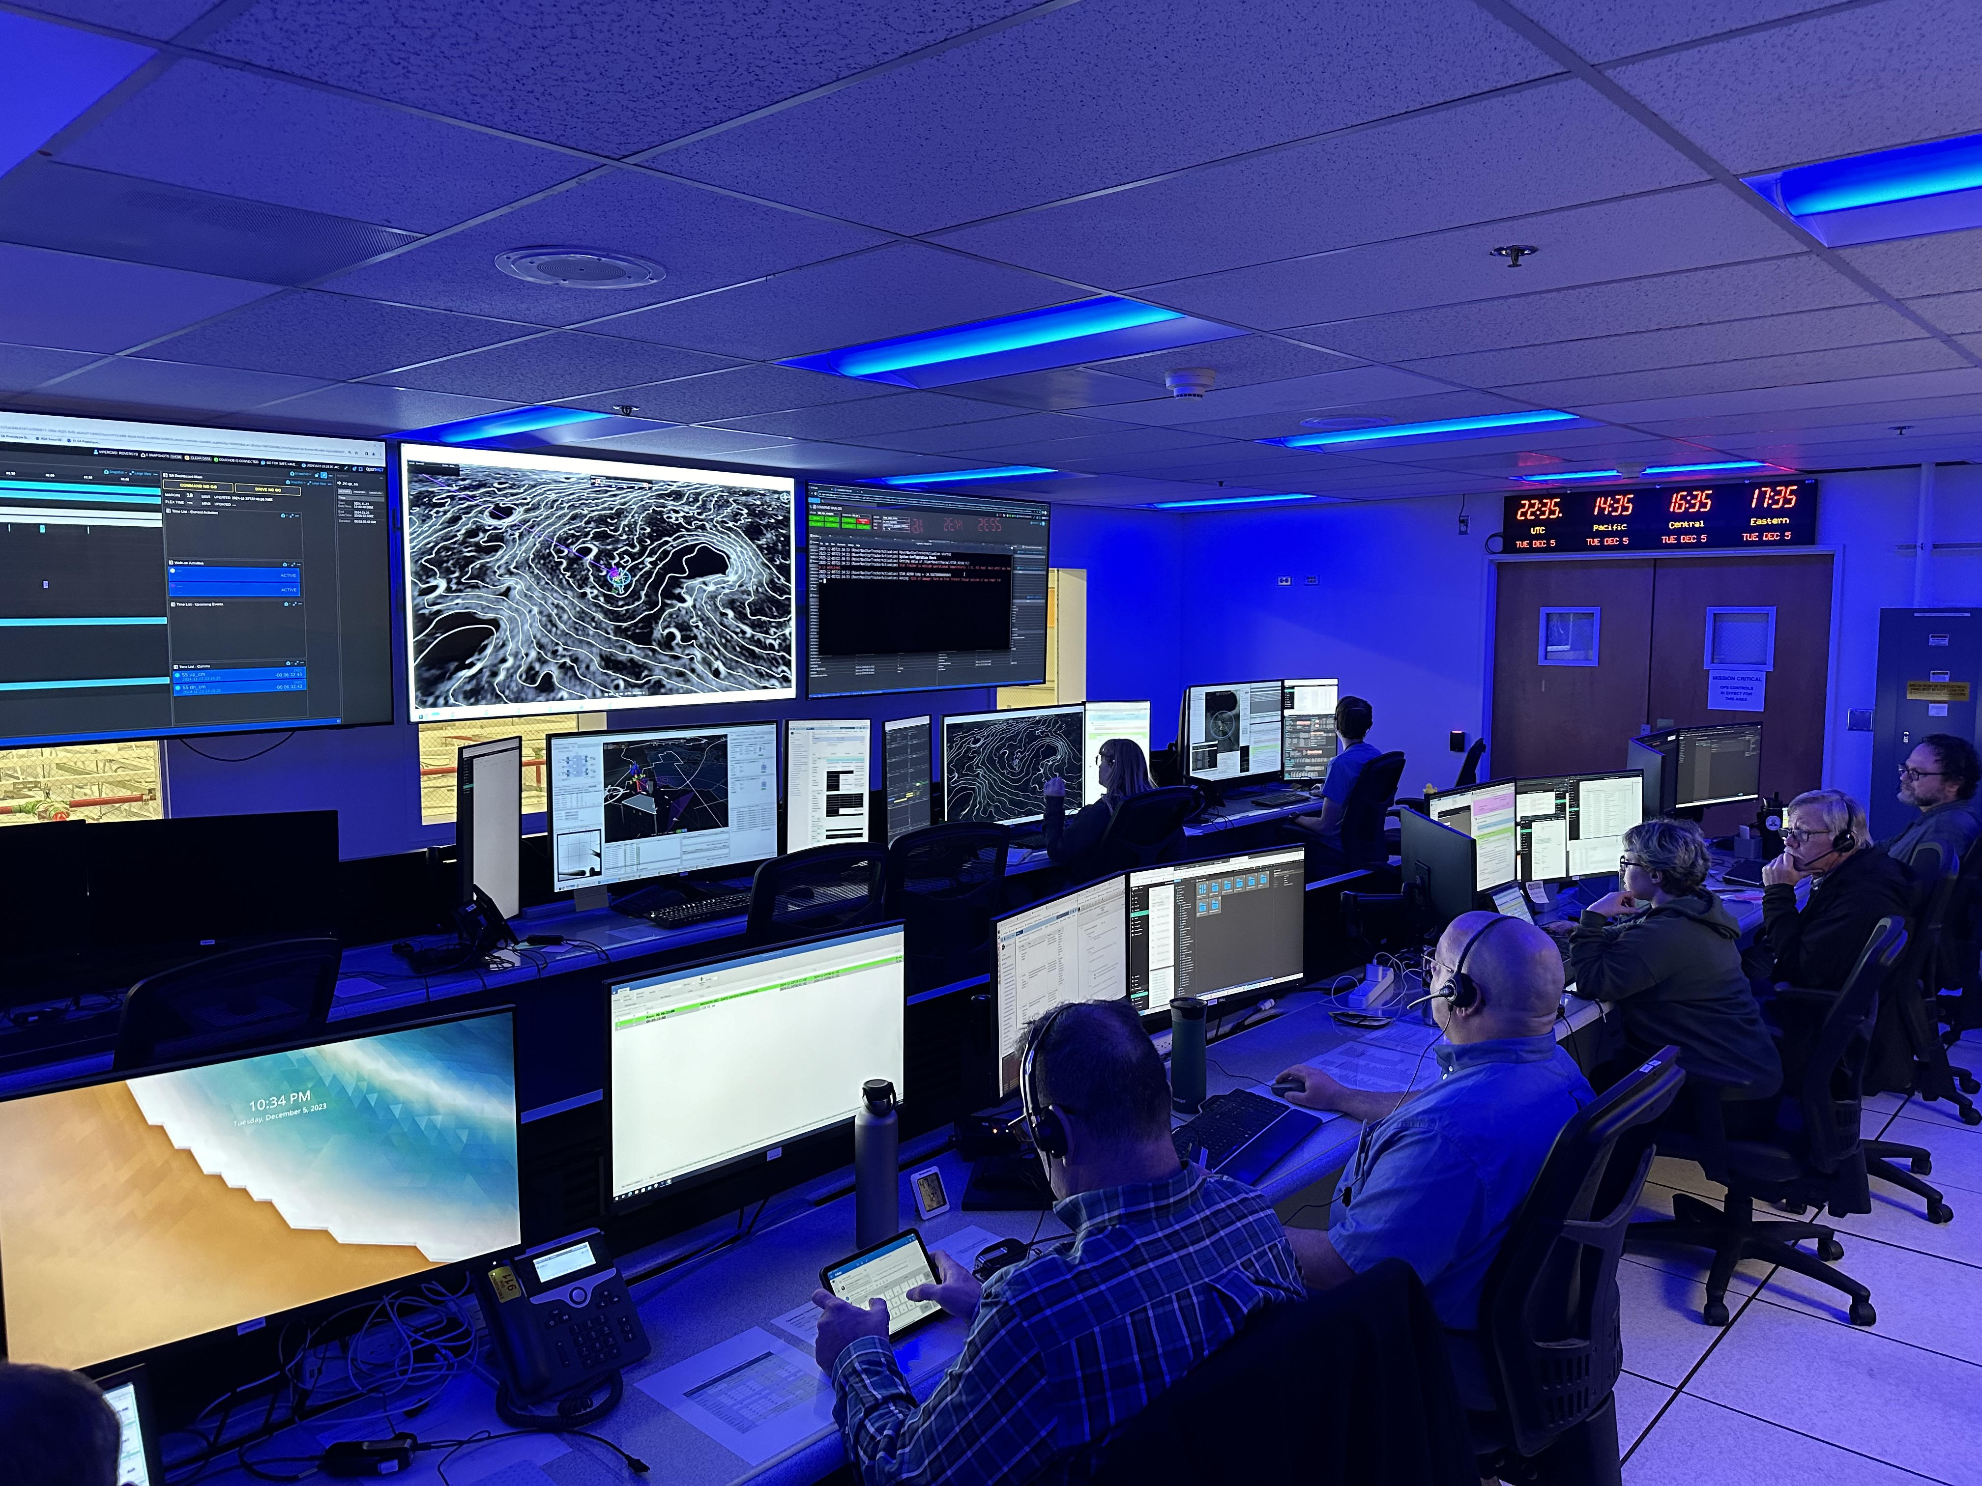
VIPER Mission Control

Slide 9
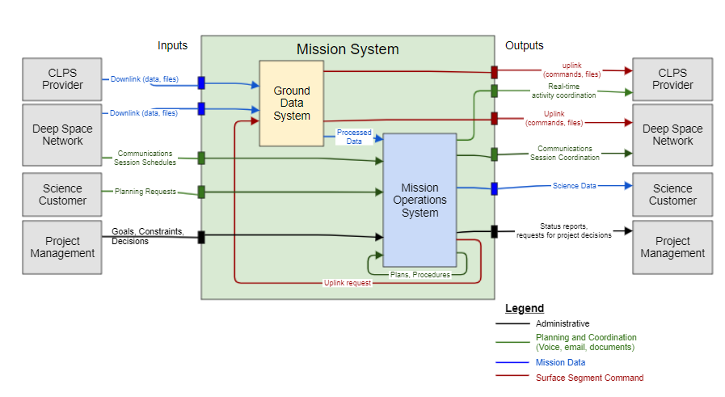
MS Architecture

Slide 10
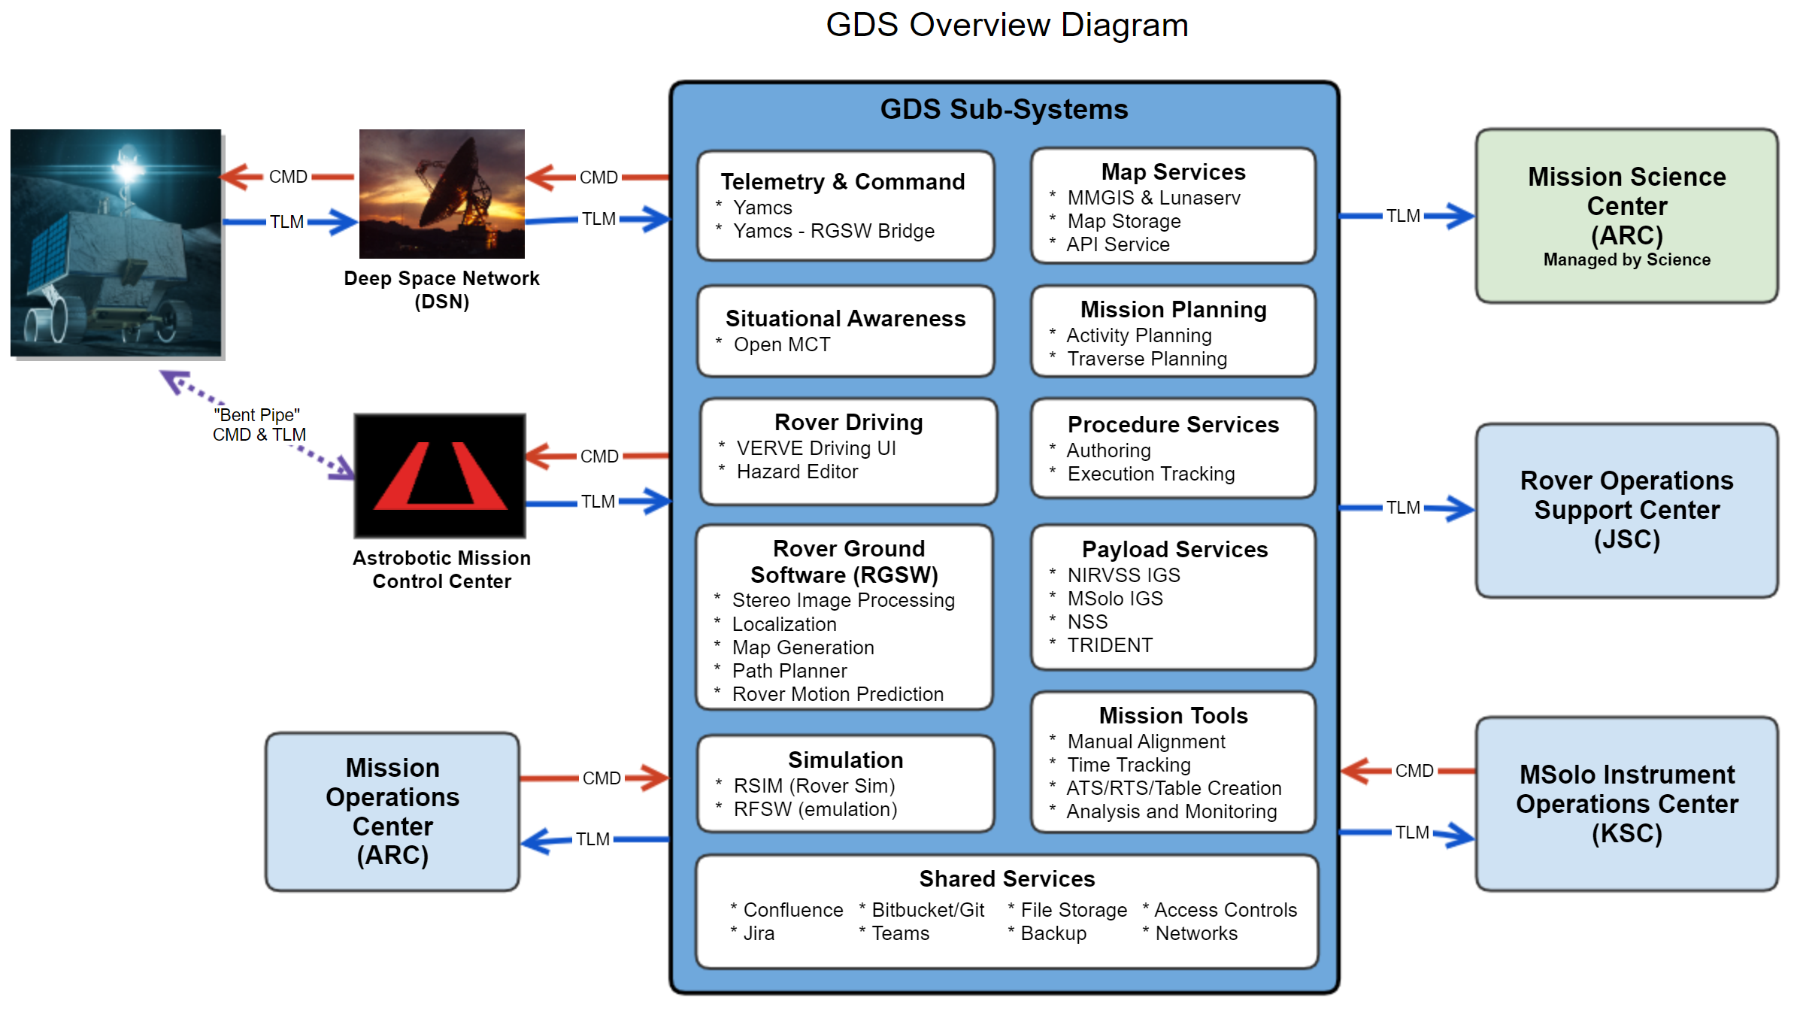

Slide 11
A New Software Landscape
Telemetry Processing & Command
YAMCS
Commercial/Open Source
Map Services
AMMOS/JPL Integrated with Open MCT
Multi-Domain Situational Awareness/Data Display
Open MCT
Internal/Open Source
Mission Planning
Internal
Rover Ground Software
Internal
Procedures
PRIDE
Commercial/Proprietary
Simulation
Internal
Mission Tools
Manual Alignment
Time Tracking
Engineering Supt Tools
Internal
Shared Services
Confluence Bitbucket/Git Teams Jira File Storage Backup
Commercial Proprietary

Slide 12
Internally Developed Software Example

Slide 13
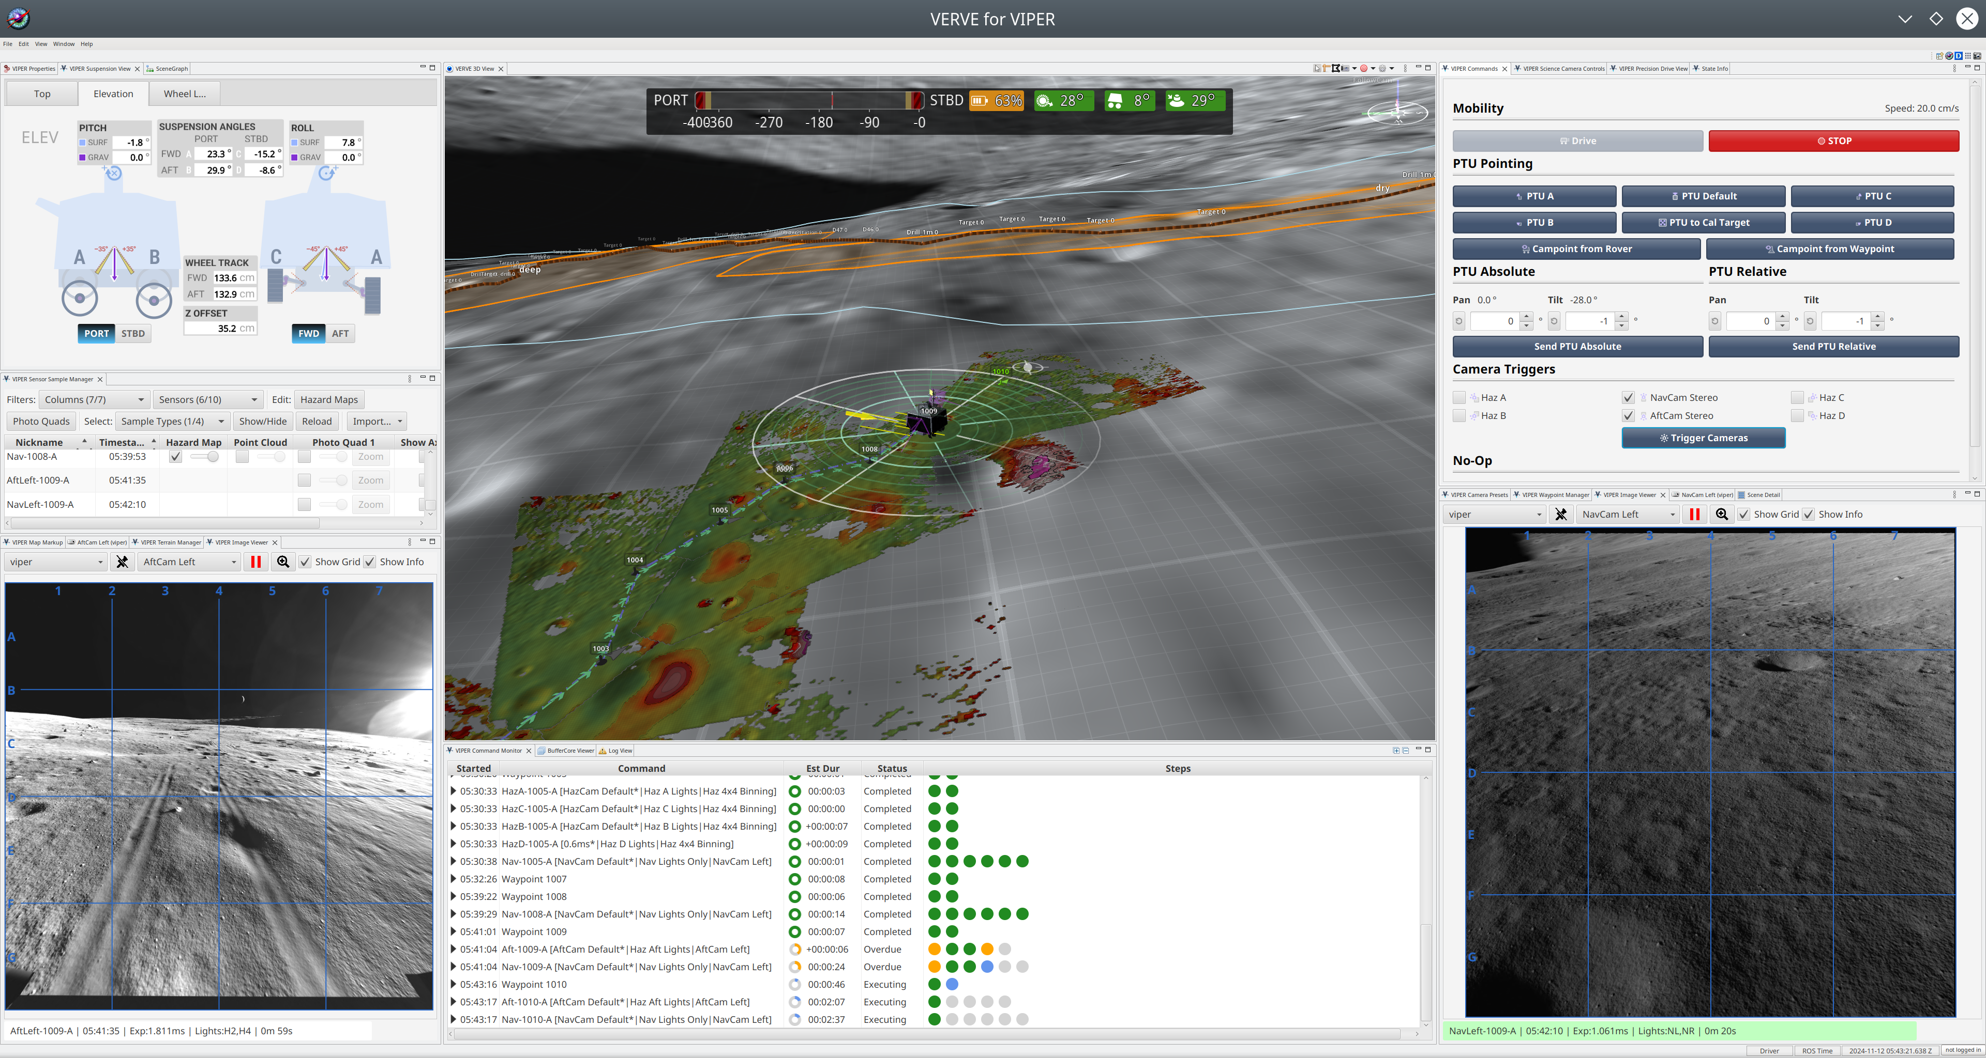
Rover Driving Tool
Orient Pan Tilt Unit
Nav/Aft/Haz image commands
3D environment visualization
Hazards (w/manual editor)
Open MCT (embedded)
View desired traverse
Set waypoints
View predicted path
Command rover motion
Visual Environment for Remote Virtual Exploration

Slide 14
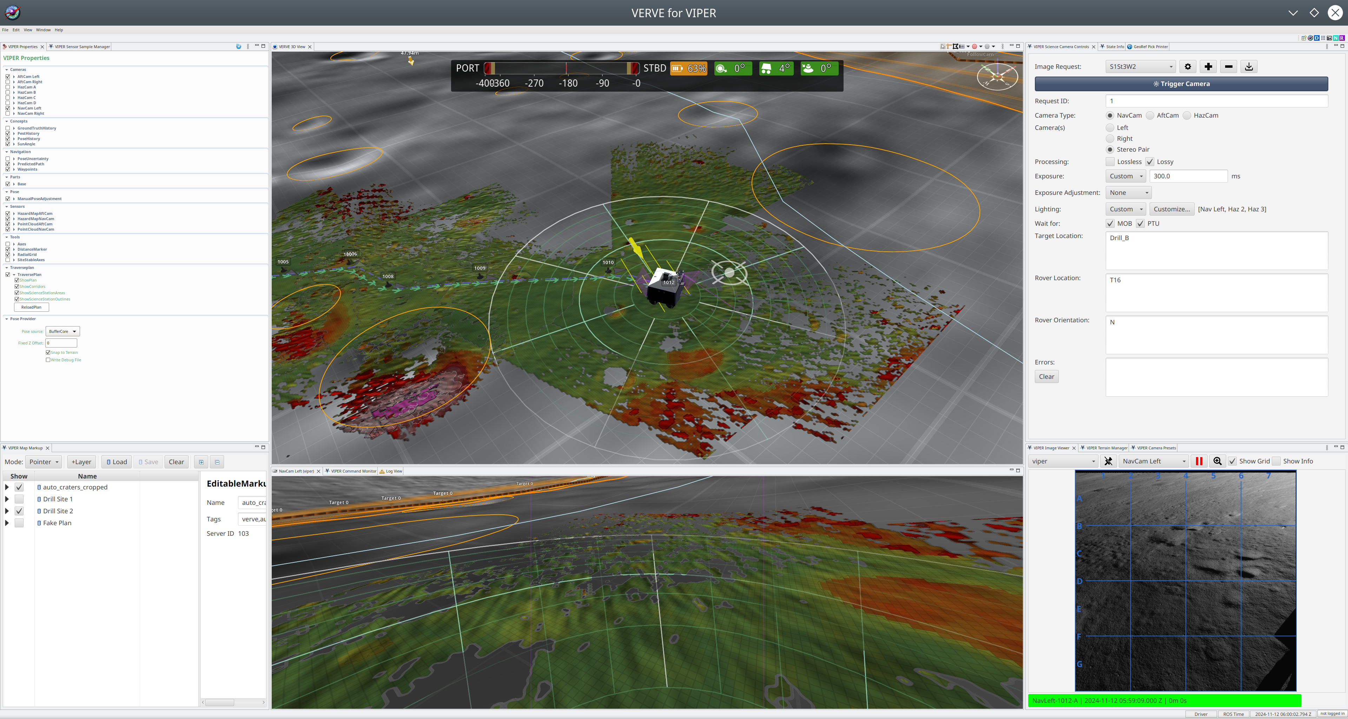

Slide 15
Open Source Software

Slide 16
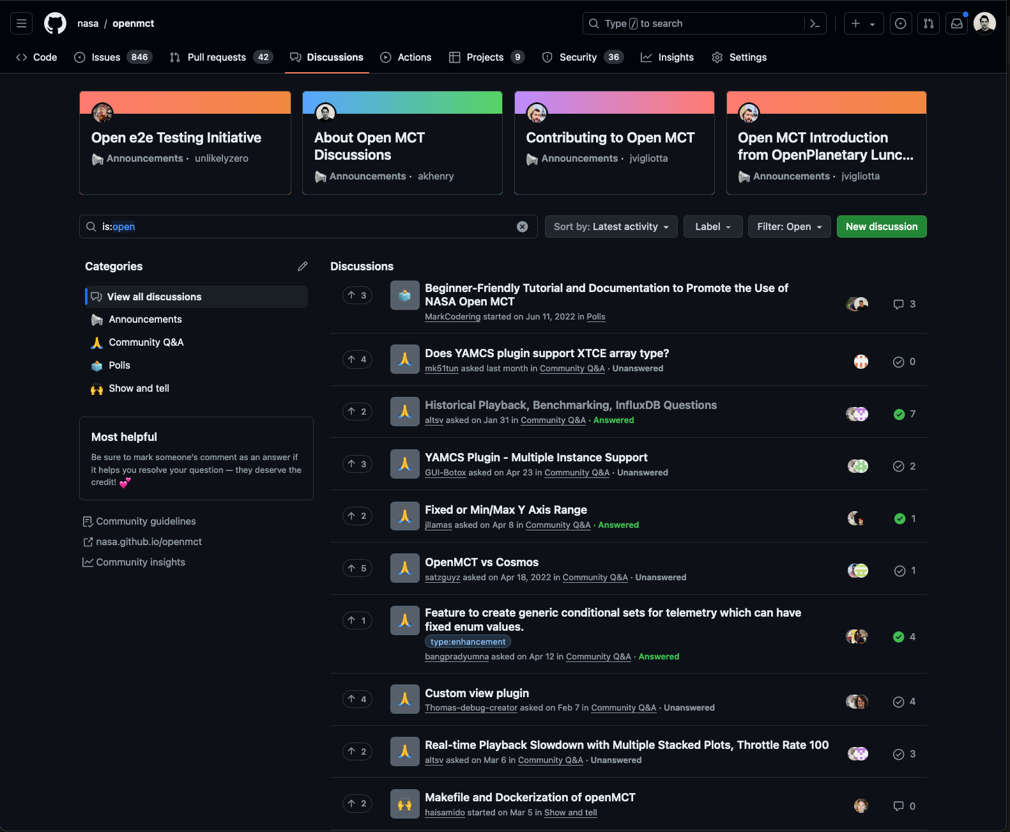
Open Source Applications: Open MCT
Open Mission Control Technologies - Open MCT
Info
  https://nasa.github.io/openmct/
Code
  https://nasa.github.io/openmct/
  To succeed open source requires support, info, community engagement, activity
  Users want to see an active supported community
  What is success?
  Number and type of use?
  Contributions?

Slide 17
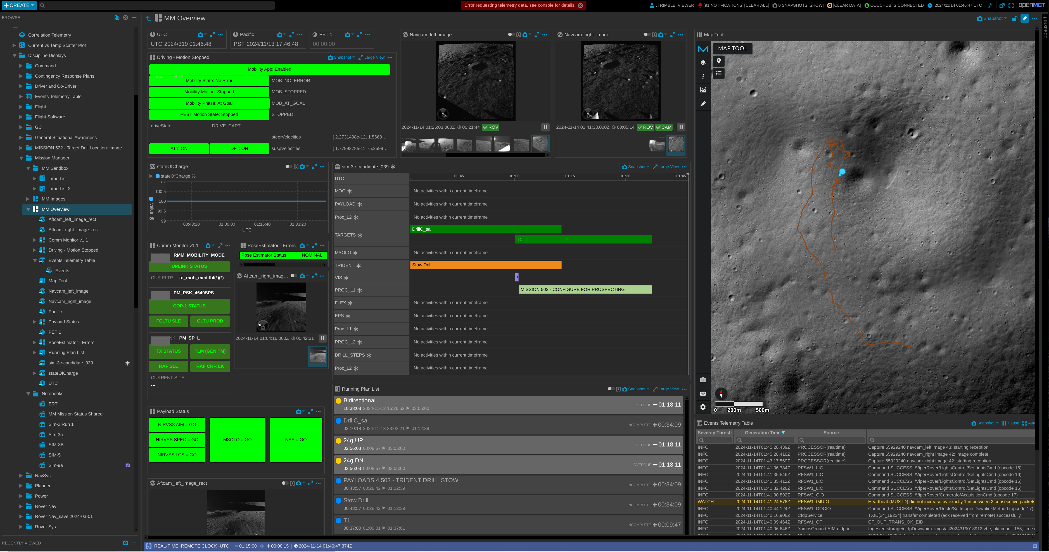
Open MCT Integrated Visualization
Realtime and Historical Plots/Tables
Rover Image Display
2D and 3D Map Layer Display
Instrument Data Heatmaps
Rover Traverse Plans
Activity Timelines
Events and Limit Violations
Fault Manager
Procedure Library
Shared Procedure View
User Annotations
Console and User Notebooks
Customized Layouts

Slide 18
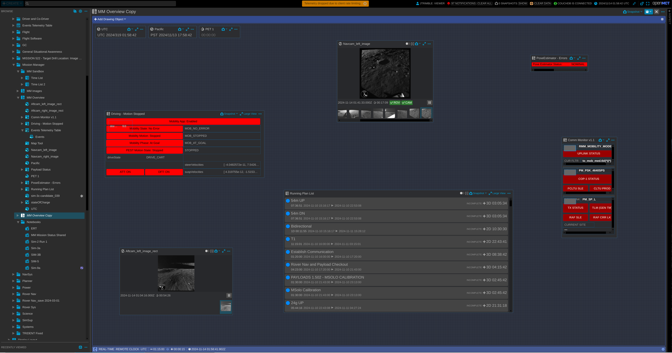
Compose

Slide 19
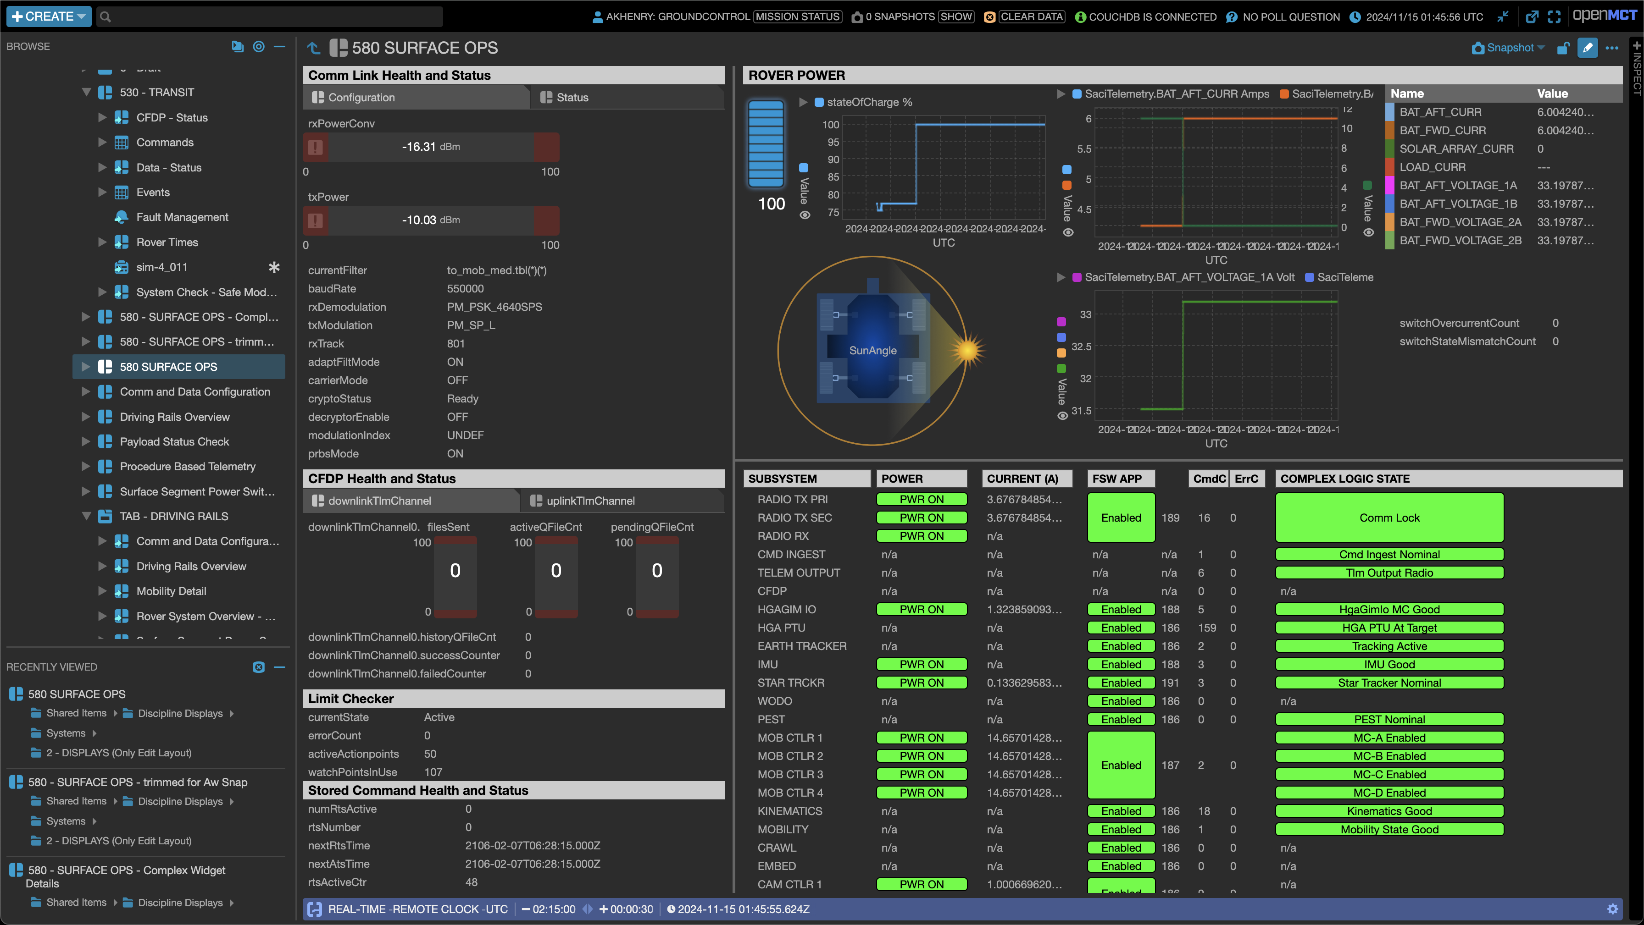

Slide 20
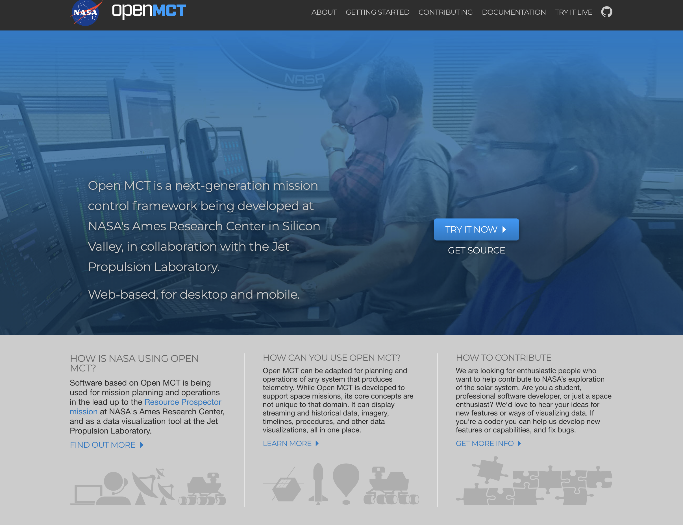
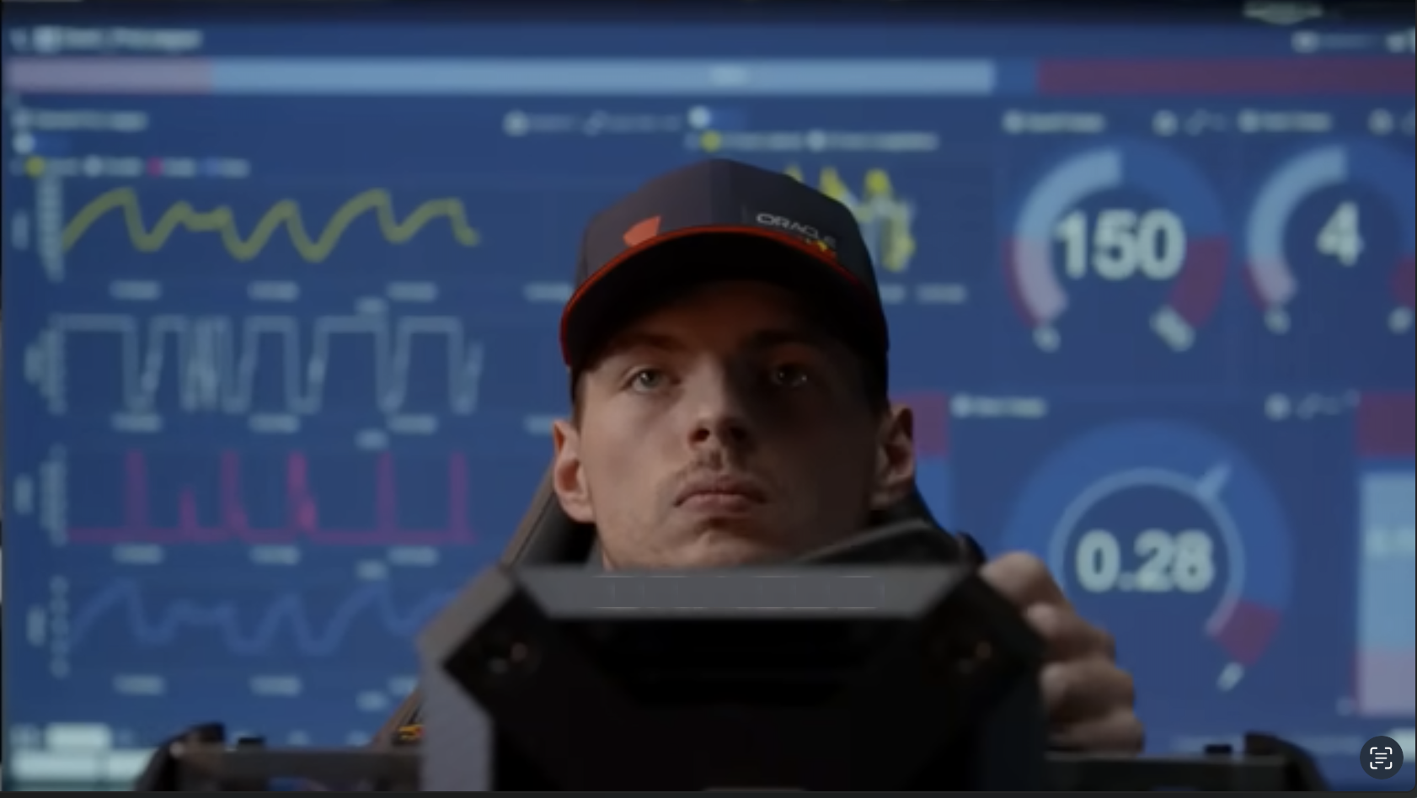
Open Source Applications Benefits
Collaboration that works
Use, adopt, make it your own, contribute
No ownership issues
Instant access
Enables broad use in and out of the space community
https://github.com/nasa/openmct
Formula 1 Simulation, Credit: Oracle Red Bull Racing

Slide 21
Multi-Center Open Source Mission Control
MCOSMC
Led by NASA AMMOS/JPL
Open Source enables external and internal collaboration
NASA investigating a Multi Center Open Source Mission Control Software Stack
Enables intra-agency and external collaboration
Hosting Environment (OS, Dependencies, etc.)
Open Source T&C
Open MCT
(NASA Open Source)
Mission- Specific Plugins
Agency-Specific Plugins

