Slide 1
A Compendium for Artificial Intelligence and Machine Learning for Satellite Collision Avoidance at NASA Conjunction Assessment Risk Analysis (CARA)
Cognitive Space Operations (COGSPO)
Reverse Industry Day
June 25-26th, 2024 Cary, NC
Presented by Dr. Alinda K. Mashiku
NASA CARA Manager
NASA Goddard Space Flight Center

Slide 2
AGENDA
Background and Motivation for AI/ML for CA
CARA Overview
Conjunction Data
AI and ML for Risk Assessment
  Unsupervised Machine Learning
  Fuzzy Inference Systems
  Deep Neural Networks
AI and ML for Decision Support
  Shallow Binary Classifier
  Long-Short Term Memory Neural Networks
Summary
2

Slide 3
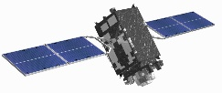
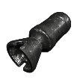
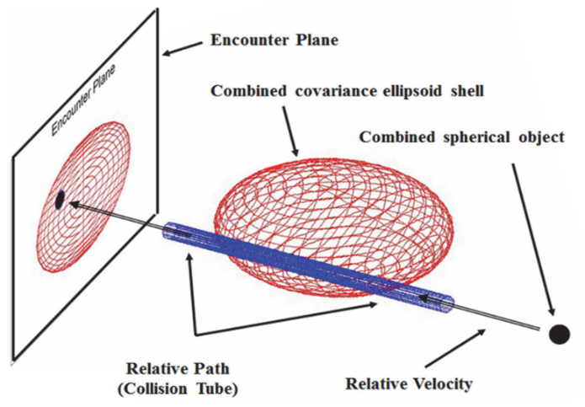
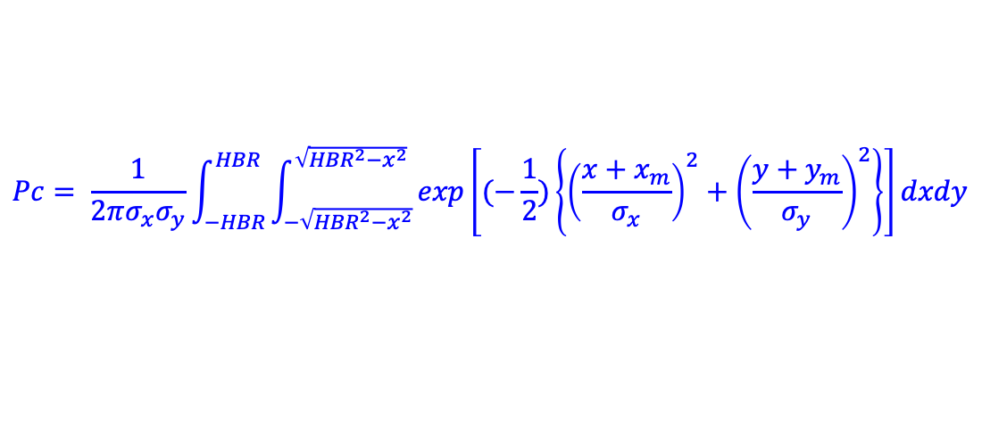
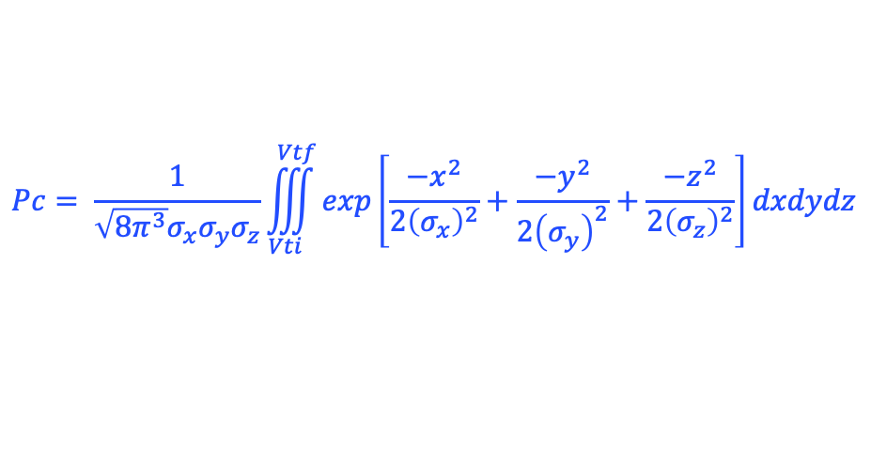
Background and Motivation
Primary and Secondary objects in a close encounter (conjunction) are described by:
-Position (Relative Position)
-Velocity
-Covariance matrix (region of uncertainty)
-Hard-body radius (HBR) (circumscribing radii)
HBR
HBR
Primary Object
Secondary Object
$$Pc= \frac{1}{\sqrt{8π^{3}}σ_{x}σ_{y}σ_{z}}\iiint_{Vti}^{Vtf}{exp\left[\frac{−x^{2}}{2{\left(σ_{x}\right)}^{2}}+\frac{−y^{2}}{2{\left(σ_{y}\right)}^{2}}+\frac{−z^{2}}{2{\left(σ_{z}\right)}^{2}}\right]}dxdydz$$
Probability of Collision (Pc) computed from integrating the combined covariance matrix over the total HBR volume swept.
If relative motion in the encounter region is linear, the problem can be reduced to a two-dimensional integral by integration and projection.
This “2D” Pc is the primary method currently used in the field of space situational awareness for Risk Assessment.
$$Pc= \frac{1}{2πσ_{x}σ_{y}}\int_{−HBR}^{HBR}{\int_{−\sqrt{{HBR}^{2}−x^{2}}}^{\sqrt{{HBR}^{2}−x^{2}}}{exp\left[(−\frac{1}{2})\left\{{\left(\frac{x+x_{m}}{σ_{x}}\right)}^{2}+{\left(\frac{y+y_{m}}{σ_{y}}\right)}^{2}\right\}\right]}}dxdy$$
Notes:
,

Slide 4
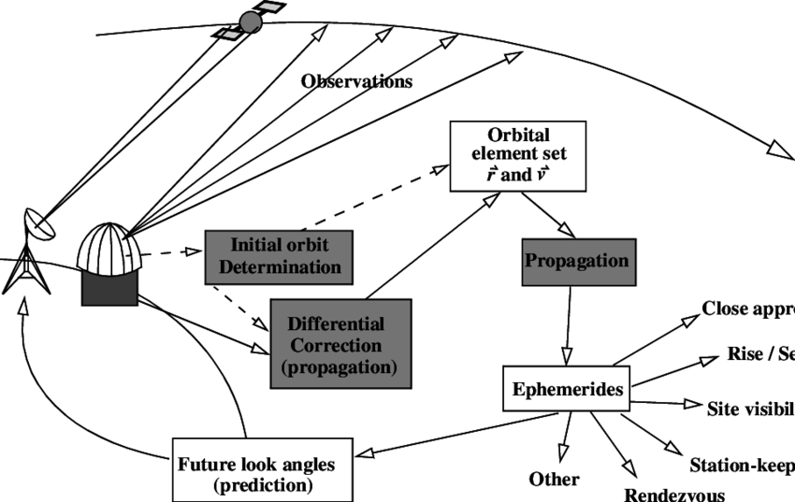
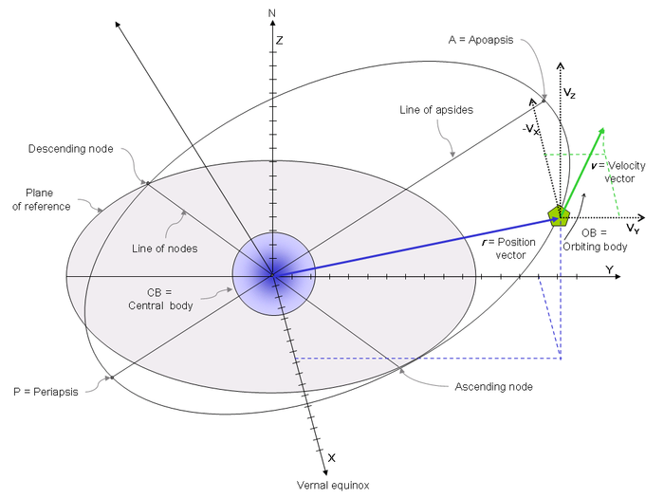

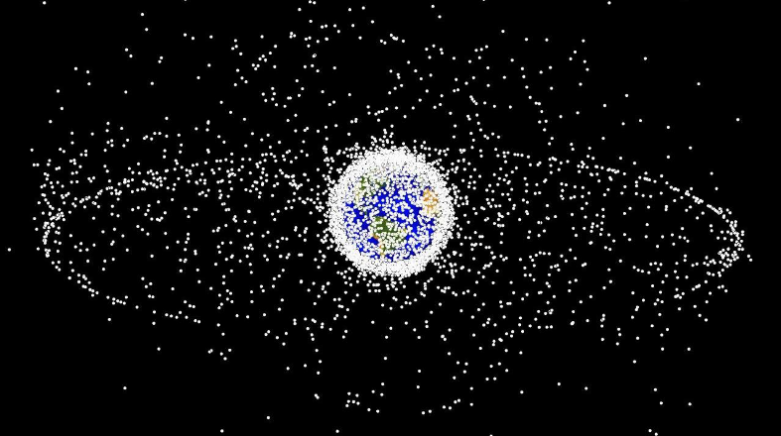
Background and Motivation
Newton’s laws of universal gravitation
and laws of motion
Orbital Mechanics
Sensor tasking
Navigation OR
Orbit Determination
We’ve done a very good job tracking space objects within measureable and quantifiable uncertainties; performing conjunction assessment and risk analysis successfully.
What are the challenges of tomorrow?
Resident Space Objects
Notes:
6 orbital elements that can give you the position and velocity in 3D.
The basics of orbital motion: Foundation needed for trajectory design and Navigation

Slide 5
BLUF
Investigate and construct an architecture with physics-based statistical parameters using AI/ML for:
  Use statistical representation of the random vector (state) and the uncertainties (covariance) to construct the parameters
  CA (collision avoidance) decision making involves mostly Pc, however in operations additional constructs are considered ex. Miss-distance, OD quality etc.
  Sensor tasking is also a key component/contributor to the CA decision support. How can we incorporate this qualitatively and quantitatively?
  Intelligent and augmented risk assessment.
Reliable and rapid/early decision-support.
2 MAIN QUESTIONS
Can we perform risk assessment with increased certainty using conjunction data available?
Can we perform rapid/early decision support (for collision avoidance) using conjunction data available?

Slide 6
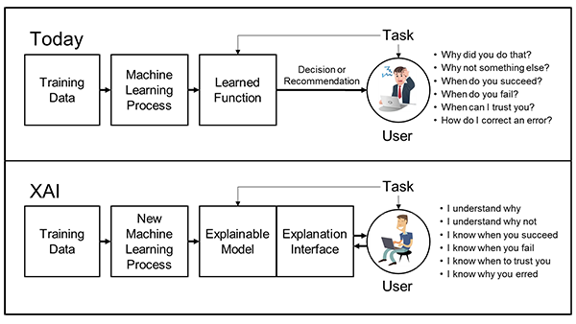
Key Points to Consider
Explainable AI (XAI) Concept
In Machine Learning, quality data is imperative.
Must have a clear goal for the outcome.
Can we explain the outcome?
  Explainable AI
Training AI/ML to do CARA requires access to “truth” data
  No Truth data exists (no collisions)
  Existing conjunction data poses analysis challenges
    Multiple non-deterministic factors involved
    Each conjunction is unique
Ref: https://www.darpa.mil/program/explainable-artificial-intelligence
Simulated Collisions!

Slide 7
CARA Overview

Slide 8
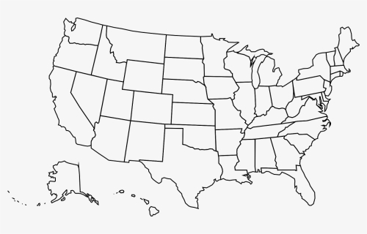

Satellite Conjunction Assessment Operations for Collision Avoidance at NASA
Human Space Flight (HSF) CA performed by Flight Operations Directorate (FOD) at JSC
  ISS/visiting vehicles (VV), commercial crew and exploration missions
  Support includes risk assessment and execution of collision avoidance maneuvers if required
The NASA Conjunction Assessment Risk Analysis (CARA) program is responsible for risk analysis and mitigation support for ~100 non-HSF spacecraft
  Started in 2005 at GSFC based on HSF process
  Agency-central service for CA and international partnerships (i.e., JAXA, CNES)
  Work very closely with the DoD Space Force DEL 2 (18th SDS and 19th SDS)
CA at other central bodies (Moon, Mars, etc.) supported by the MADCAP (Multi-mission Automated Deep space Conjunction Assessment Process) program at JPL
  Cis-lunar, Planetary and beyond
8

Slide 9
Satellite Conjunction Assessment:
NASA Process Details
 | Pc < 1e-7 | No concern
 | 1e-7 < Pc < 1e-4 | Monitor; Maneuver Planning
 | Pc > 1e-4 | High Risk
Catalog Object i+1
Secondary Object
Secondary Object
Catalog Object i+2
Maneuver
∆V
Primary S/C
Catalog Object i
Primary S/C
Primary S/C
Primary S/C
Conjunction Assessment (CA) is the process of identifying close approaches between two orbiting objects; sometimes called conjunction screening.
The 18th Space Defense Squadron (18 SDS) at Vandenberg Space Force Base (VSFB) maintains the high accuracy catalog of space objects. Orbital Safety Analysts (OSAs) at VSFB screen protected assets against the catalog, perform tasking requests, and generate close approach data.
CA Risk Analysis (CARA) is the process of assessing collision risk and assisting satellites in planning maneuvers to mitigate that risk, if warranted.
The NASA CARA program performs risk assessment for all NASA operational non-HSF satellites, and some partner missions.
Collision Avoidance is the process of executing mitigative action, typically in the form of an orbital maneuver, to reduce collision risk.
Each satellite Owner/Operator (O/O) – mission management, flight dynamics, and flight operations – is responsible for making maneuver decisions and executing the maneuvers.
NOTE: The Screening process and catalog is owned by DOD; AI/ML solutions may exist for this step but are not within CARA purview.
9

Slide 10


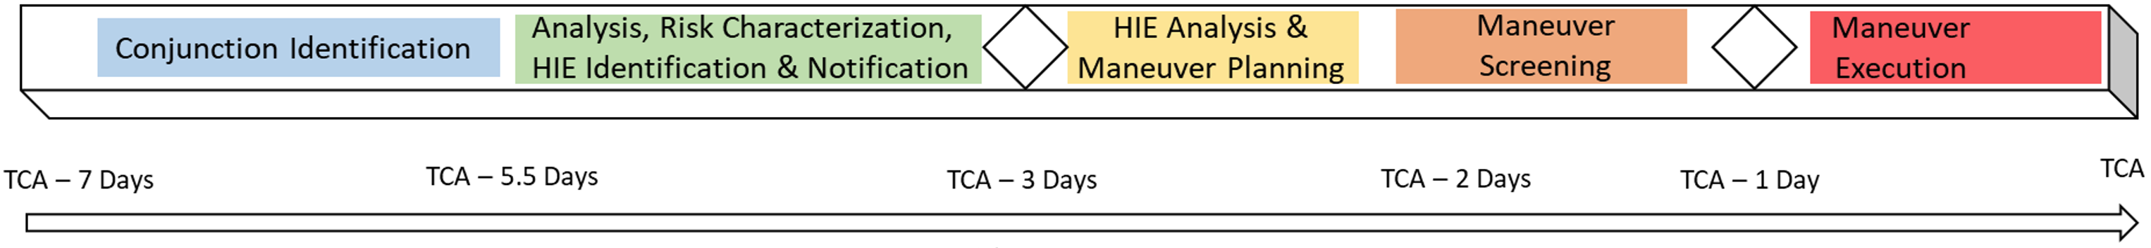
CARA Real Time Process (3x a Day, TCA-7days)
SSN
COSA
Management
LEGEND:
CARA
External
Mission Ground Station
Mission
Operations
Software & Ground System
TCA: Time of Closest Approach
HIE: High Interest Event
CA PROCESS IS COMPLEX!
For each Conjunction Event:
7 – 41 Active Interfaces and
7 – 25 Total Data Sets Transferred
Analysis
Decision Point: Begin Maneuver Planning
Decision Point: Maneuver Go / No-Go
10
Notes:
Main talking points:
CARA real-time ops processes: Run screenings 3x a day with notifications as early as 7 days from TCA: Generic five steps outlined in the progress bar below
Involves the 5 CARA groups to analyze the information to notify and engage with the missions
Overall: 7-41 active interfaces and 7-25 total data sets transfered

Slide 11
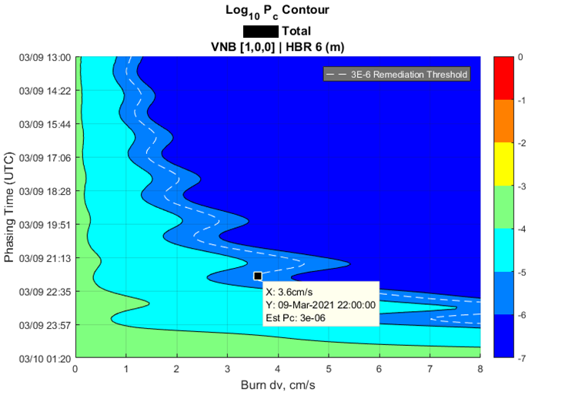
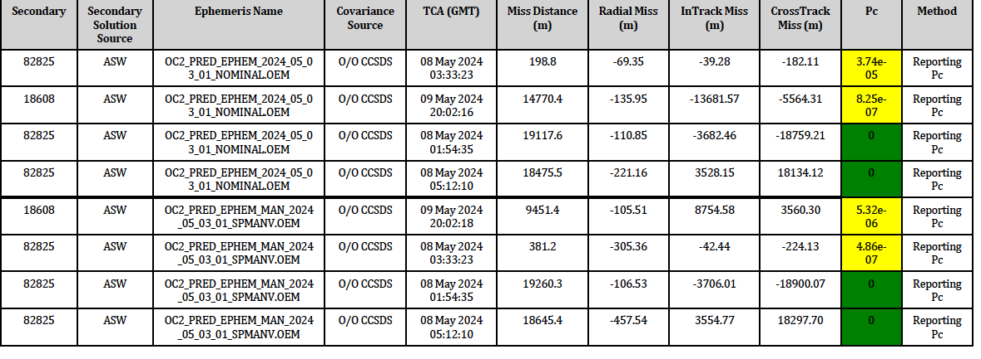





Maneuver Planning
1. Maneuver Trade Space
2. Generate Burn Ephemeris
3. Maneuver Screening
4. Results Analysis
Screening Volume
Burn dV = 3.6 cm/s
Time of Closest Approach
Pc > 1e-4
11
Notes:
Maneuver planning is an iterative process
Cycle: Maneuver Trade Space → Generate burn ephems → Maneuver screening → Results analysis
Multiple cycles can be required to decide on a final maneuver
Requires iteration between CARA and mission
Mission input used to generate CARA maneuver planning products
Mission and spacecraft considerations and/or limitations factor into CARA recommendations
With experience and refinements, iterative process can be reduced and/or eliminated in most cases

Slide 12
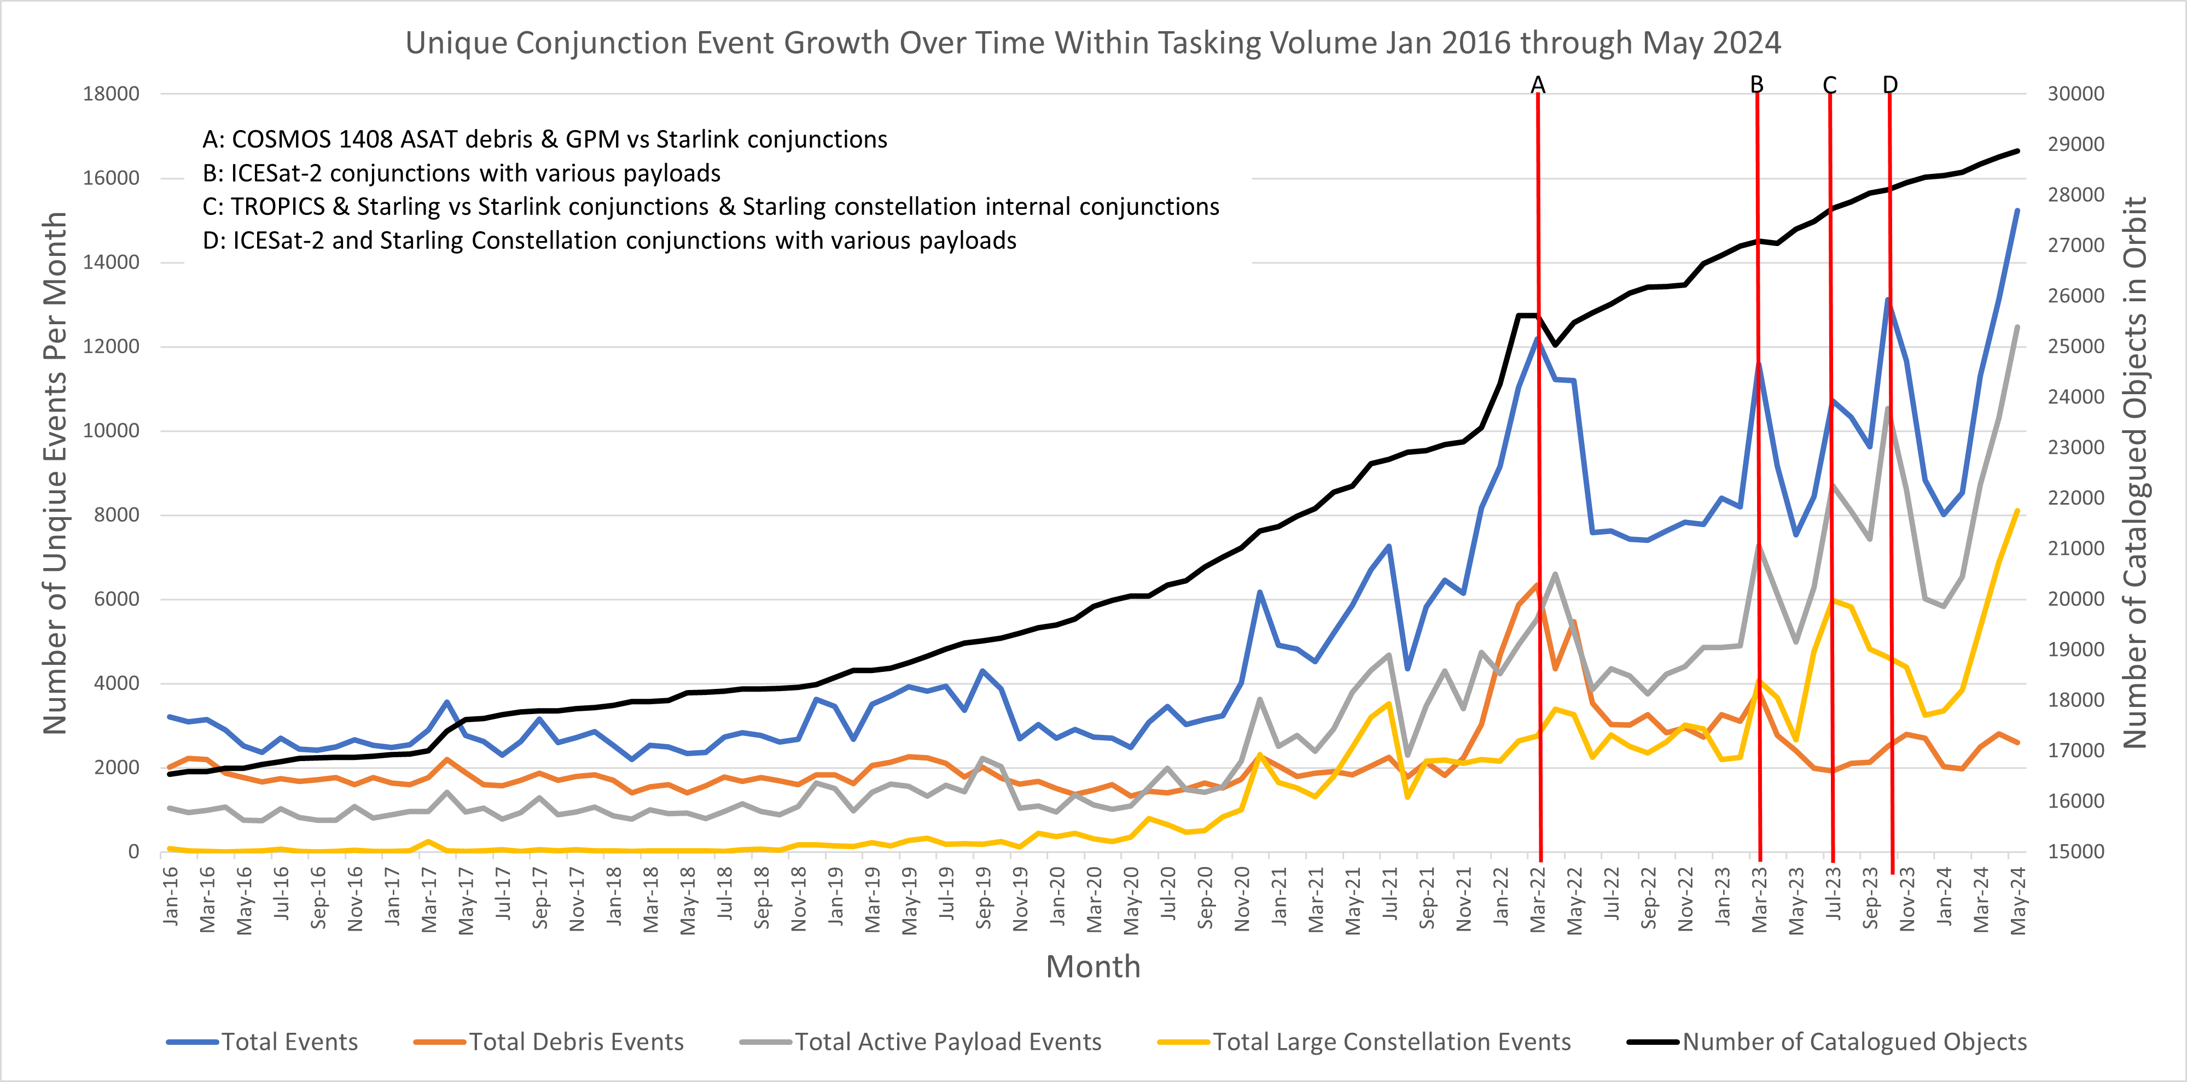
Conjunction Statistics (January 2016-May 2024)
6 Reportable Break-up events in 2023:
Introduced between 6 – 500 debris objects per event
6 Break-up events in 2022:
Introduced between 6 – 500 debris objects per event
3 Break-up events in 2021:
Introduced between 12 – 1000 debris objects per event
+28,000 Catalogued Objects in orbit
Increase in total conjunction events as of Dec 2023:
• 40% since 12/2022 (~1 year)
• 133% since 12/2021 (~2 years)
• 250% since 12/2020 (~3 years)
Operational Workload is increasing!
12

Slide 13
Operational Challenges with Large Constellations
Large effort to coordinate with numerous large constellation operators and secondary O/Os in general
Each O/O has their own CONOPS and have various levels of CA CONOPS sophistication (i.e., autonomous on-board maneuvers)
O/O ephemeris quality evaluation is important in order to determine the efficacy of the O/O solution for decision-making
Need to continue nominal operations while incorporating new large constellation and other secondary payload evaluation and conops
13

Slide 14
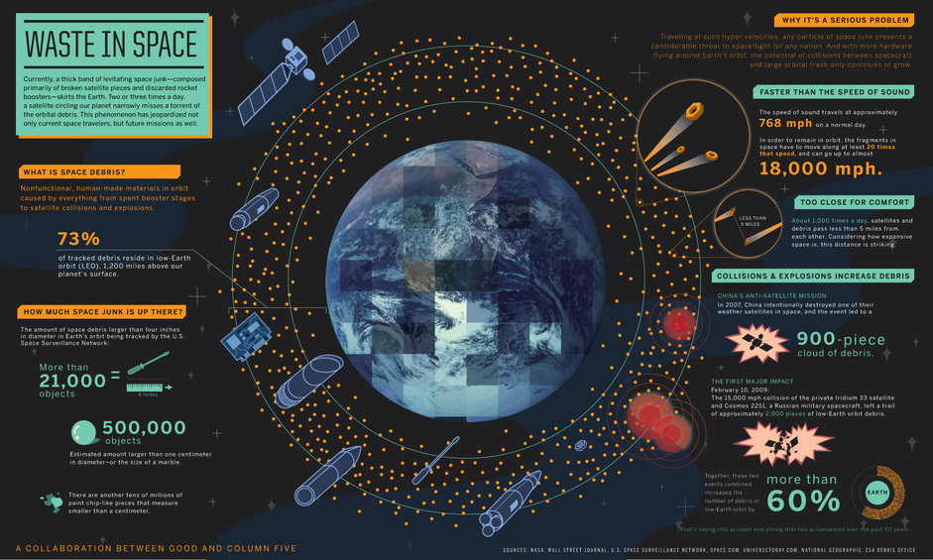

Artificial Intelligence for Space Situational Awareness and Space Traffic Coordination
Intelligent data analytics can help us understand and augment problem-solving techniques beyond our current capabilities.
(1) https://media.defense.gov/2017/Oct/04/2001822339/-1/-1/0/171004-F-O3755-1003.JPG
(2) https://www.isdi.education/es/isdigital-now/blog/actualidad-digital/dealing-big-data-and-analytics

Slide 15
Conjunction Data

Slide 16
Conjunction Data Messages (CDM)
The Consultative Committee for Space Data Systems (CCSDS) carries the Recommended Standard Blue Book for Conjunction Data Messages (CDMs) https://public.ccsds.org/Pubs/508x0b1e2s.pdf
3.1.1 The CDM in KVN (Key/Value Notation) shall consist of digital data represented as ASCII text lines. The lines constituting a CDM shall be represented as a combination of the following:
  a) a header;
  b) relative metadata/data (metadata/data describing relative relationships between Object1 and Object2);
  c) metadata (data about how Object1 and Object2 data were created);
  d) data (for both Object1 and Object2); and
  e) optional comments (explanatory information).
Since 2005 and as of June 5th, 2024, CARA has screened 11,055,752 OCMs/CDMs!
16

Slide 17
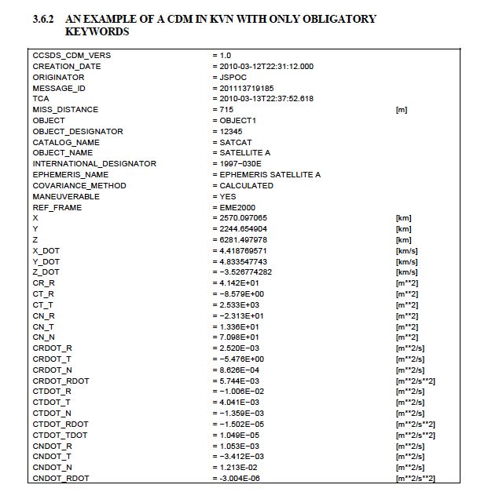
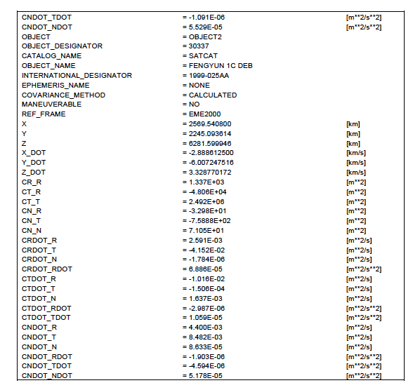
Example of CDM Data
CDM data can have additional optional Keywords as COMMENTS or specific identified labels with their respective values. (ex. COLLISION_PROBABILITY)
17

Slide 18



Conjunction Data for AI/ML Data Curation
Day 3
Day 4
Day 2
Day 5
TCA
Day 6
Day 1
Day 7
Sat A
Maneuver
Sat B
Sensor Tracking
Sat C
Sensor Tracking
Solar Activity
Varying quantities of CDMs per event (ranging from 1 to 21)
Varying prediction durations to TCA; impacting accuracies
Space weather atmospheric perturbations
Varied observation solutions; depend on geometry and state accuracy
Complex and Nuanced Data Archive!
Can’t predict future maneuvers from CDM data

Slide 19
AI and ML for Risk Assessment

Slide 20
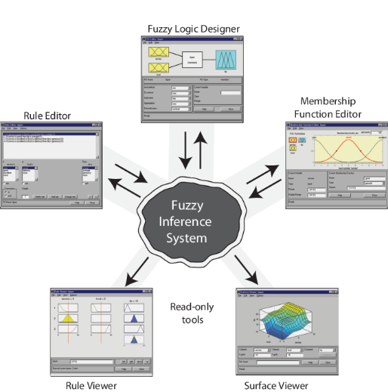
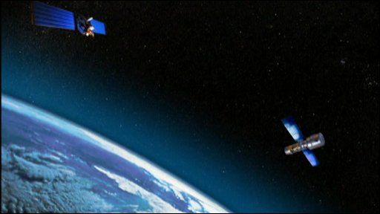
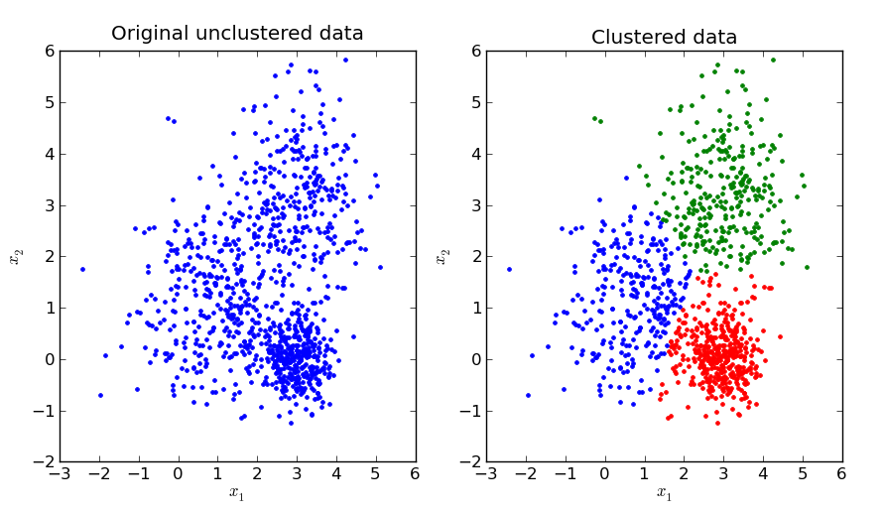
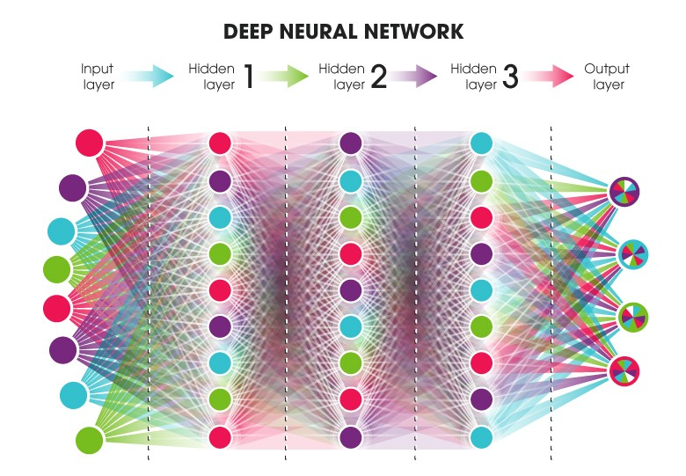
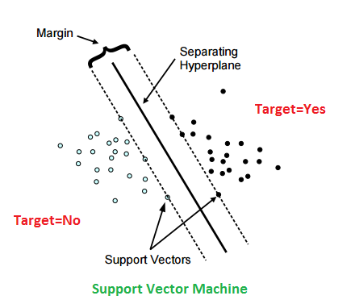
Approach
(1) Obtain Data
(2) Data Wrangling
(3)Train Model
Unsupervised Machine Learning Methods: Clustering and Classification
Fuzzy Inference System (FIS)
K-means
Partition N observations into K clusters.
Two spacecraft at Time of close approach (TCA)
SVM-Support Vector Machines
Statistical Parameters
Probability of Collision
Miss Distance
Mahalanobis Distance
Bhattacharyya Distance
Kullback-Leibler Distance etc.
Separation into K groups with the widest gap possible
Deep Neural Network (DNN)
Notes:
GOAL: Classification of information parameters (substitute and/or supplement Pc)
GOAL: Provide a binary decision output based on
aggregated weighted parameters
GOAL: Training a Deep
Neural Network model for
decision making based on
known inputs and known
outputs.
10 hidden layers
Scaled conjugate gradient training algorithm
Training 70
Testing 15
Validation 15

Slide 21
Parameter set considerations
Investigate statistical parameters using the available information that could provide augmented insight into conjunction events.
Developed a set of “statistical information parameters” (and their variations) derived from some of the same information used to compute Pc.
    Probability of Collision (Pc)
    Mahalanobis Distance (MHD)
    Miss Distance (MD)
    Bhattacharyya Distance (BD)
    Angle between two orbit planes(OA)
    Kullback-Leibler Distance (KLD)
    Other?
(Both Primary and Secondary)
-Position and Velocity
-Covariance matrix
-Other?

Slide 22
Data Wrangling: Unsupervised Machine Learning
Unsupervised learning methods classify data into groups based on features within the dataset that may not be immediately obvious to a human operator.
Clustering algorithms fall into two broad groups:
  -Hard Clustering: each data point belongs to only one cluster ex. K-means and Support Vector Machines
  -Soft Clustering: each data point belongs to more than one cluster ex. Fuzzy C-means and Gaussian Mixture Models
Two clusters/classifications were defined:
  “safe” or “not safe”
The performance metric was compared to a
Monte Carlo computation for the ground truth
based on Pc
  1 – ensemble’s correct assignment
  0 – ensemble’s incorrect assignment
Clustering Performance Methods for K-means and SVM using the Performance Metric
Parameter | K-means | SVM
Probability of Collision (Pc) | 0.7742 | 0.9995
Miss Distance (MD) | 0.6389 | 0.8314
Mahalanobis Distance (MHD) | 0.6983 | 0.8810
Bhattacharyya Distance (BD) | 0.7611 | 0.8864
Kullback-Leibler Distance (KLD) | 0.7736 | 0.8459
Orbit Angle (OA) | 0.5387 | 0.8711
These performance values were used as input
weights for the risk assessment tools
Notes:
The data fed into unsupervised learning algorithms are not initially labeled with their classifications, but rather, the algorithms infers its own functionality onto the data to generate those classifications.
The intention of this initial approach of using unsupervised machine learning on the information parameter set, was to explore the data and determine if an internal representation existed that would cluster the parameter sets into two categories: safe or close-encounter (not safe).

Slide 23
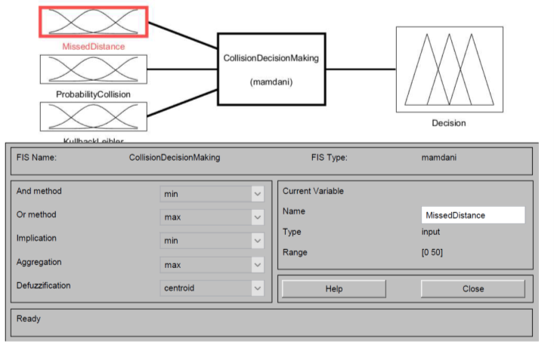
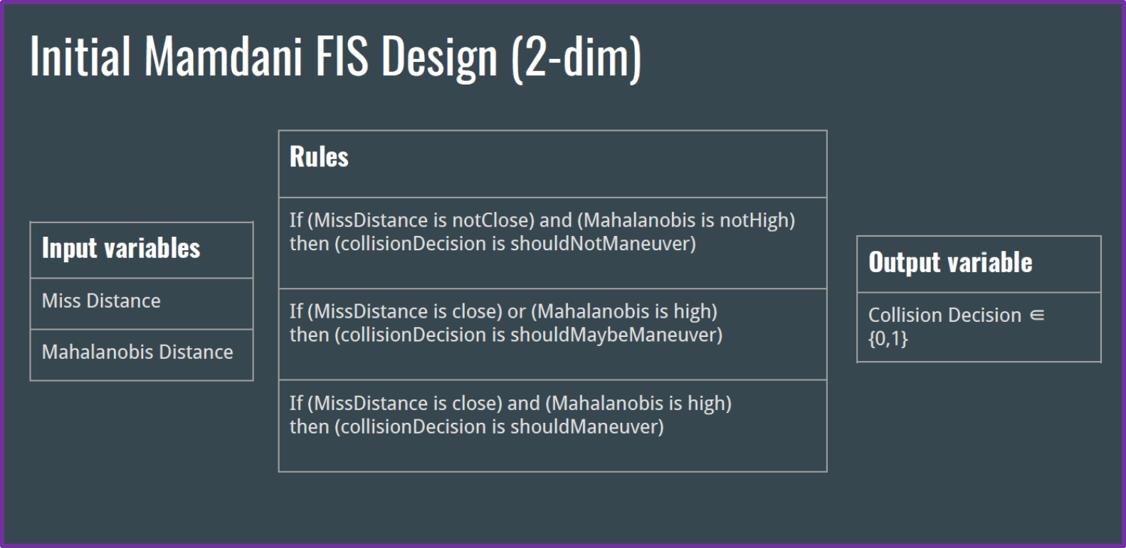
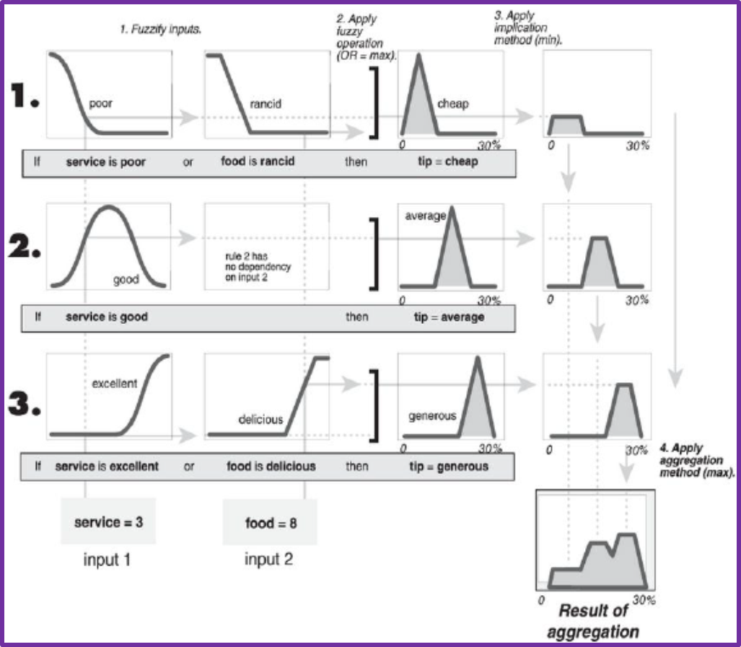
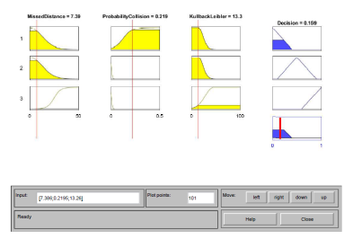
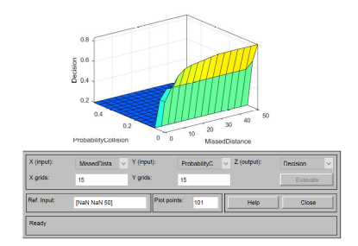
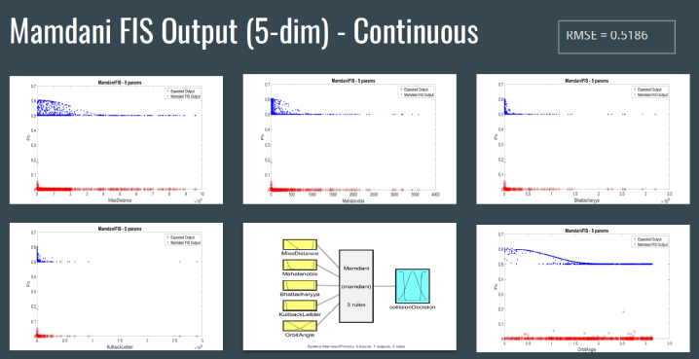
Machine Learning for Space Situational Awareness
Using Fuzzy Inference System (FIS)
FIS
Evaluation
Fuzzy-Inference System (FIS) Logic Design
Two spacecraft at Time of close approach (TCA)
(500 simulated cases)
K-means
FIS Input-Output Determination
Partition N observations into K clusters.
Statistical Parameters
Probability of Collision
Miss Distance
Mahalanobis Distance
Bhattacharyya Distance
Kullback-Leibler Distance etc.
SVM-Support Vector Machines
Separation into K groups with the widest gap possible
Summer Internship work (Partial) by
Evana Gizzi (Tufts University)
Mitch Zielinski (Purdue University)
Non-definitive output
Notes:
10 hidden layers
Scaled conjugate gradient training algorithm
Training 70
Testing 15
Validation 15

Slide 24
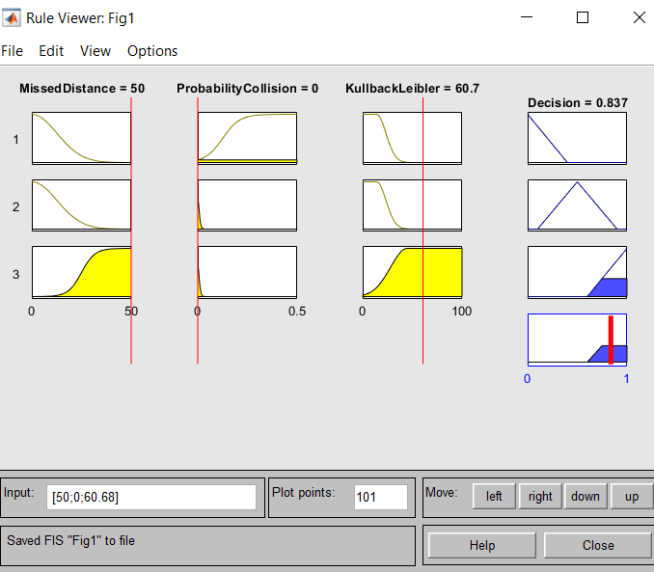

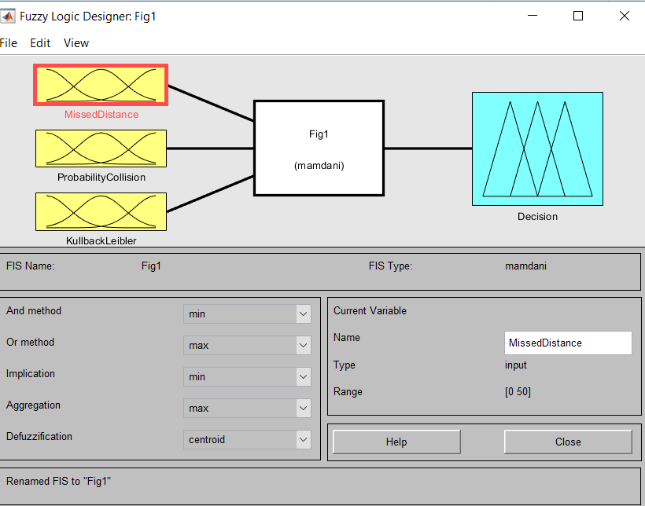
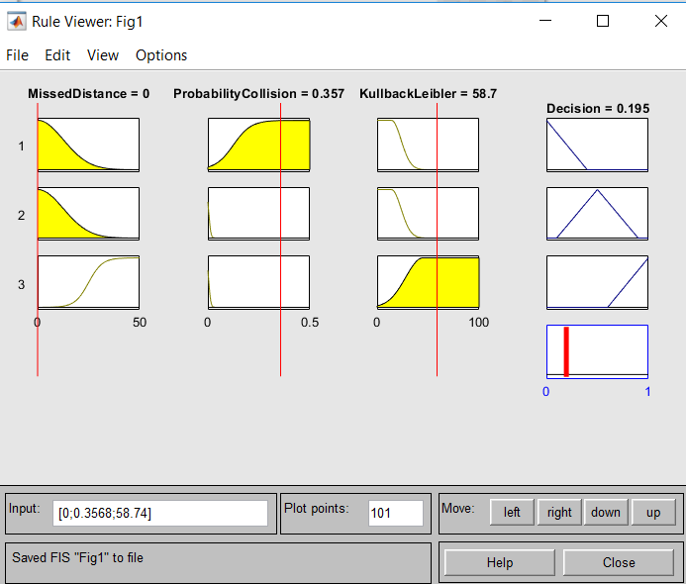
Fuzzy Inference Systems
Fuzzy Inference Systems (FIS) map input to output using fuzzy logic, which is able to express partial membership of variables or parameters to certain sets using Fuzzy Membership functions (FMF).
Using the Mamdani FIS, we investigated the decision-making tool’s output using three informational parameters: Miss-Distance, Probability of Collision and the Kullback-Leiebler Divergence
High – MD
Low – Pc
Mid – KLD
Output : 0.837
{Safe}
Low – MD
High – Pc
Mid – KLD
Output : 0.195
{Unsafe}
Fuzzy Logic Designer GUI using MATLAB® defining the FMFs MD, Pc and KLD.
Define FMF in the Membership Editor and the decisions rules in the Rule Editor ex. {0,1} = (unsafe, safe}
Notes:
FIS’s are used mostly in decision making problems, where there is not a concise certainty on whether an input belongs to a discretized set.

Slide 25
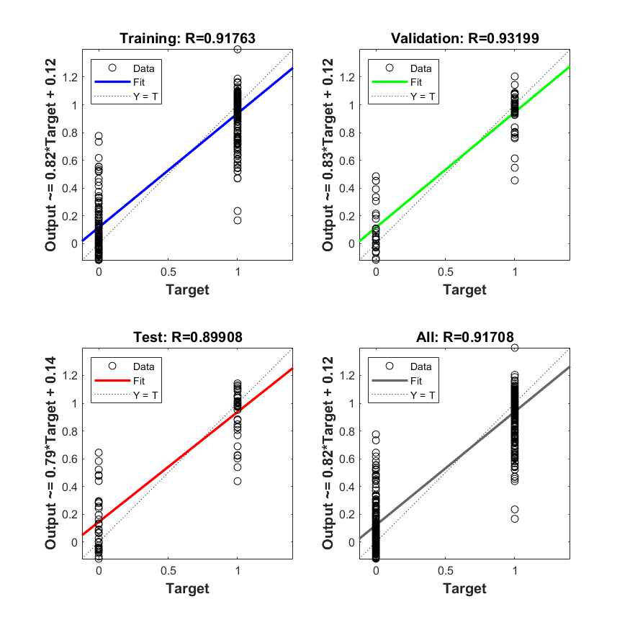
Machine Learning for Space Situational Awareness
Using Deep Neural Networks
Preliminary overall performance was ~92% accurate
Two spacecraft at Time of close approach (TCA)
(500 simulated cases)
Statistical Parameters
Probability of Collision
Miss Distance
Mahalanobis Distance
Bhattacharyya Distance
Kullback-Leibler Distance etc.
A Deep Neural network has:
Nodes and weights operated by nonlinear functions
Target and Output
0 - Safe
1 - Close approach
Notes:
10 hidden layers
Scaled conjugate gradient training algorithm
Training 70
Testing 15
Validation 15

Slide 26
AI and ML for Decision Support

Slide 27
Background on AI/ML for Decision Support
Continual exponential growth in launched spacecraft and tracked debris.
Risk Assessment is necessary to prevent collisions in a timely manner.
KEY QUESTIONS:
When we have a list of high interest events, how do we prioritize the risks for mitigation?
What parameters are associated with higher Pc events OR high-risk events?
How many observations leading to TCA are needed before a collision avoidance decision can be implemented?
Can we move the Decision Points Earlier?
Decision Point: Begin Maneuver Planning
Decision Point: Maneuver Go / No-Go
27

Slide 28
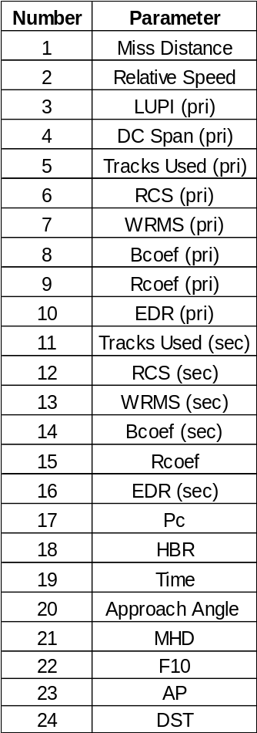
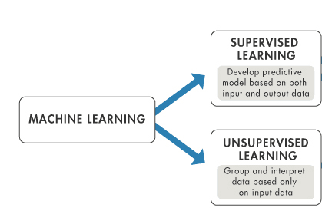
Approach
Spacecraft data from 2015-2018 from 365,000+ Conjunction Data Messages
Supervised Learning (SL)
  Binary Classification
  Using those trends to try and predict miss distance with uncertainty
Unsupervised Learning (USL)
  Determine trends in data at close TCA
28

Slide 29
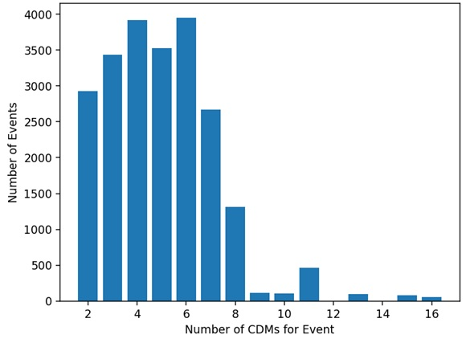
SL: Long-Short Term Memory Neural Networks
Sequenced-based prediction with masked time-steps
Type of Recurrent Neural Network that retains information from each input
Mean squared log error loss function with an 80/20 data split with min-length of two CDMs
Simulate a “High-Risk” Pc = 10⁻⁸ vs “Operational High-Risk” Pc = 10⁻⁴
Layer | Output Dimensions
Masking | (MaxLen, Features)
LSTM + ReLU | (5*MaxLen)
Repeat Vector | (1, 5*MaxLen)
LSTM +ReLU | (5*MaxLen)
Time Dis. Dense + Linear | (Pred. Miss Distance)
29

Slide 30
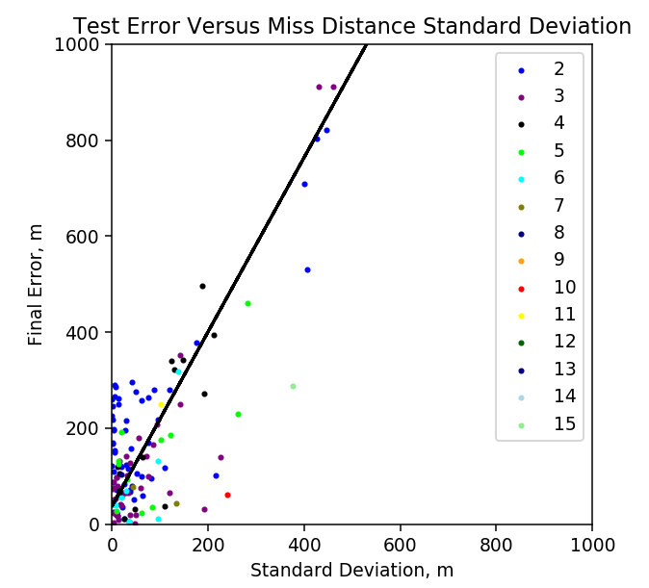
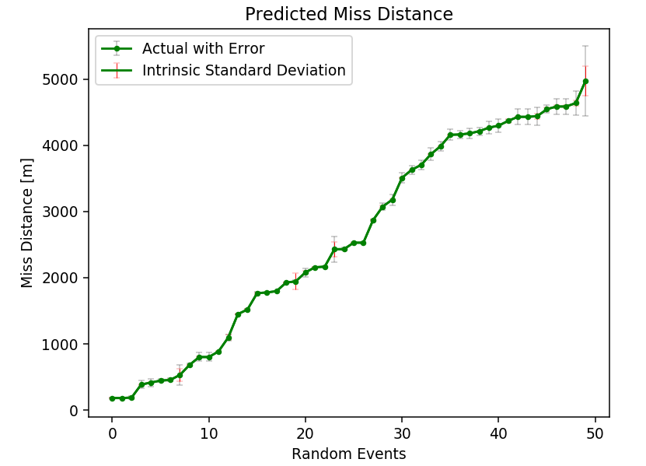
SL: LSTM (Long Short-Term Memory) Model Results
We chose an LSTM model because of its potential to predict values using data in a time-series approach
Most events contain < 4 CDMs
Large Stand. Dev. yields large error
Average prediction at one day until TCA
Larger error as miss distance increases
Predicts miss distance with an average error of < 0.2 km, but affected by intrinsic error in prediction
Increased decision uncertainty with increased miss-distance.
30

Slide 31
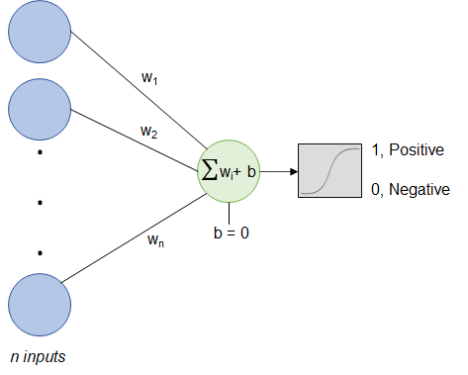
USL: Shallow Binary Classifier
Weights analysis for clustered parameter-set importance
Standardized parameters to have a zero mean with standard deviation of 1
Full events are combined into a single event to monitor deviations across the set
31

Slide 32
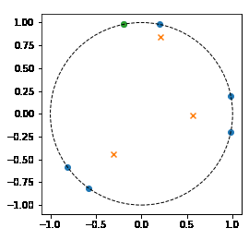
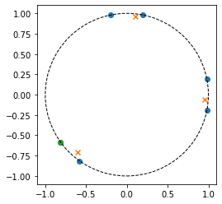
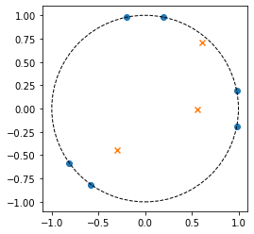
USL: Competitive Networks for Binary Classification
Learns the feature space through migrating weights towards clustered regions
Identifies regions where similar inputs exists
Standardized inputs to have same range of activation space
Time-varying convergence to a solution (clustered region); with some uncertainty.
32

Slide 33
Summary and Conclusions

Slide 34
Summary
Fuzzy Inference Systems: Risk Assessment
  Generated a decision space that may not be able to successfully capture the bi-modal classifications made by unsupervised or supervised techniques for this application.
  It provided an aggregated output based on the weights of the Fuzzy-membership functions.
Deep Neural Networks: Risk Assessment
  Presented more promising results compared to the Fuzzy Inference System for a collision avoidance decision-making tool.
  An augmented or exclusive satellite collision avoidance decision-making construct suggests a favorable architecture with modeled binary or tertiary decisional outputs.
Shallow Binary Classifier: Decision Support
  Parameters, such as EDR, RCS, Rcoef, and MHD are consistently grouped together with Pc and Miss Distance.
  Time-varying convergence to a solution (clustered region); with some uncertainty.
Long- Short Term Models (LSTM): Decision Support
  LSTM Models can predict miss distance with an average error of < 0.2 km but affected by intrinsic error in prediction. Is this good enough for operational decision making?
NOW WHAT?
34
Notes:
Parameters, such as EDR, RCS, Rcoef, and MHD are consistently grouped together with Pc and Miss Distance
Higher than average EDR yield higher Pc values
LSTM Models can predict miss distance with an average error of < 0.2 km, but dependent on intrinsic error in prediction
Future research includes:
LSTM uncertainty model
Introducing weighted loss functions

Slide 35
Logical Questions for Big Data in CA
Assumptions were made for collision data; Are the results explainable?
Predictions of future measurement updates (sensor input) are nearly impossible to model since they are not entirely physics based. How do you predict the next track?
Predicting mission-based maneuvers as part of the CONOPS is difficult or impossible to model. How do you predict intent of the Owner/Operator?
All the above impact the operational use of AI for CARA…
THEREFORE, we must ask the right questions, to get a useful result.
35

Slide 36
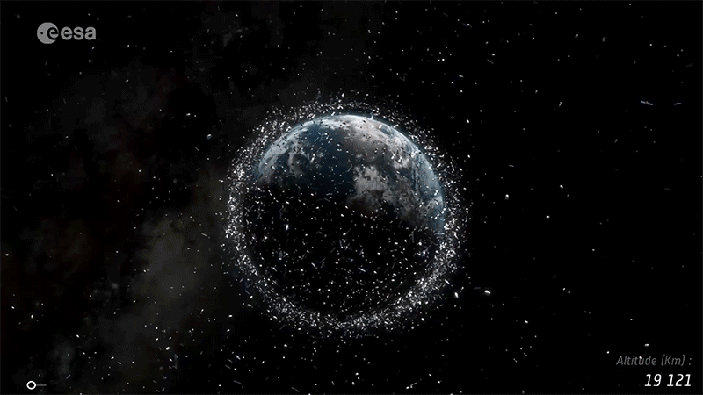
Conclusion: Where can AI/ML fit for CA?
Orbit environment is rapidly growing, especially with the growth of Large constellations
Ongoing research is being implemented to determine an optimal and representative physics-derived adaptive set of parameters for each conjunction case using real data.
  Potential algorithm improvements for the screening process (i.e., an adaptive screening volume, etc.)
  Investigate incorporating adaptive Recurrent Neural Network (RNNs) model to ingest time-series based information sequentially incorporated to provide predictions at TCA.
  An LSTM uncertainty model may incorporate ways to quantify and improve on predictions that include bounded uncertainties
A lot of important factors to consider in predicting the future use of AI and ML for collision avoidance in the space environment.
CREDIT: ESA (2017): 18,000 Catalogued Space Objects
36

Slide 37
Acknowledgements
This work was performed over several years with various funding sources and multiple collaborators:
  Dr. Carolin Frueh; Purdue University, Aeronautical and Astronautical Engineering, 2018
  Dr. Nargess Memarsadeghi, NASA Goddard Space Flight Center, Software Division, 2018,
  Dr. Evana Gizzi, NASA Goddard Space Flight Center, Software Division, 2019
  Mitch Zielinski, Purdue University, Graduate Student, 2019
  Briana Robertson, Louisiana State University, Undergraduate Student, 2020
Reference Papers: https://www.nasa.gov/cara/cara-publications/#pub-i
  Predicting Satellite Close Approaches Using Statistical Parameters in the Context of Artificial Intelligence – Mashiku et al (2019)
  Early Information Parameter-Set Analysis for Satellite Close Approaches using Machine Learning – Robertson and Mashiku (2021)
37

Slide 38


Slide 39
ACRONYMS REFERENCE
ASAT | Anti-Satellite Test | NOAA | National Oceanic and Atmospheric Administration
CA | Conjunction Assessment | NPR | NASA Procedural Requirements
CAOIA | Conjunction Assessment Operations Interface Agreement | NSDC | National Space Defense Center
CAPO | Conjunction Assessment Program Office | OADR | Open Architecture Data Repository
CARA | Conjunction Assessment Risk Analysis | OCAP | Orbital Collision Avoidance Plan
CCSDS | Consultative Committee for Space Data Systems | OD | Orbit Determination
CIC | Commercial I Cell | OEM | Orbit Ephemeris Message
COSA | CARA Orbital Safety Analysts | O/O | Owner/Operator
COSMOS | Kosmos (Russian satellites operated by the former Soviet Union and subsequently Russia) | OSA | Orbital Safety Analysts
DOC | Department of Commerce | PC | Probability of Collision
DOD | Department of Defense | PPBE | Planning, Programming, Budgeting, and Execution
EGA | Earth Gravity Assist | SAA | Space Act Agreement
ESMO | Earth Science Missions Office | SAC-T | Sprint Advanced Concept Training
FAA | Federal Aviation Authority | SC | Spacecraft
FCC | Federal Communications Commission | SDS | Space Defense Squadron
HBR | Hard Body Radius | SMD | Science Mission Directorate
HIE | High Interest Event | SME | Subject Matter Expert
HSF | Human Space Flight | SSA | Space Situational Awareness
MADCAP | Multimission Automated Deepspace Conjunction Assessment Process | SSN | Space Surveillance Network
MRPP EMI | Mission Resilience and Protection Program Electro Magnetic Interference | SW | Software
MSA | Maneuver Screening Analysis | TCA | Time of Closest Approach
NID | NASA Interim Directive

Slide 40
Deep Neural Networks
For comparison we designed and implemented a Deep Neural Network (DNN) model for decision making augmentation with Pc.
In this context of using DNN for decision making, we considered a few informational parameters: Pc, KLD, MHD, BD, MD and the OA. We grouped the informational parameter into arbitrary assignments of 4 groups:
-Group 1 = {KLD, MD, BD, Pc, MHD}
-Group 2 = {KL, MD, MHD, Pc}
-Group 3 = {Pc, MHD, OA}
-Group 4 = {Pc}
DNN model design considerations:
  Three sets of numbers for hidden layers: {10, 20 and 40}
  Backpropagation training functions: Scaled-conjugate gradient (SCG) and Levenberg-Marquardt (LM)
  Training, Validation and Testing ratios: 0.7, 0.15 and 0.15 respectively
Used a sample data set of 1000 samples of simulated data containing both safe and unsafe encounter classifications.
Group 3 and Group 4 will be presented.
(Note the binary outputs assignments for the DNN are not the same assignments as for the FIS, but bear similar theoretical meaning and representation).
Notes:
In our application, we chose the scaled conjugate gradient algorithm due to its enhanced performance compared to other gradient derivatives methods²⁴. During training, several stopping conditions need to be pre-defined such as the number of epochs (iterations), maximum duration, performance goal, minimum performance gradient and a validation performance²⁵.
In our application, we chose the LM backpropagation training function because of its promising performance and speed and it has an efficient implementation in MATLAB. The LM algorithm was designed to reach second-order training speed without having the need to compute the Hessian, which is a second order derivative matrix or the derivative of the Jacobian²¹.

Slide 41
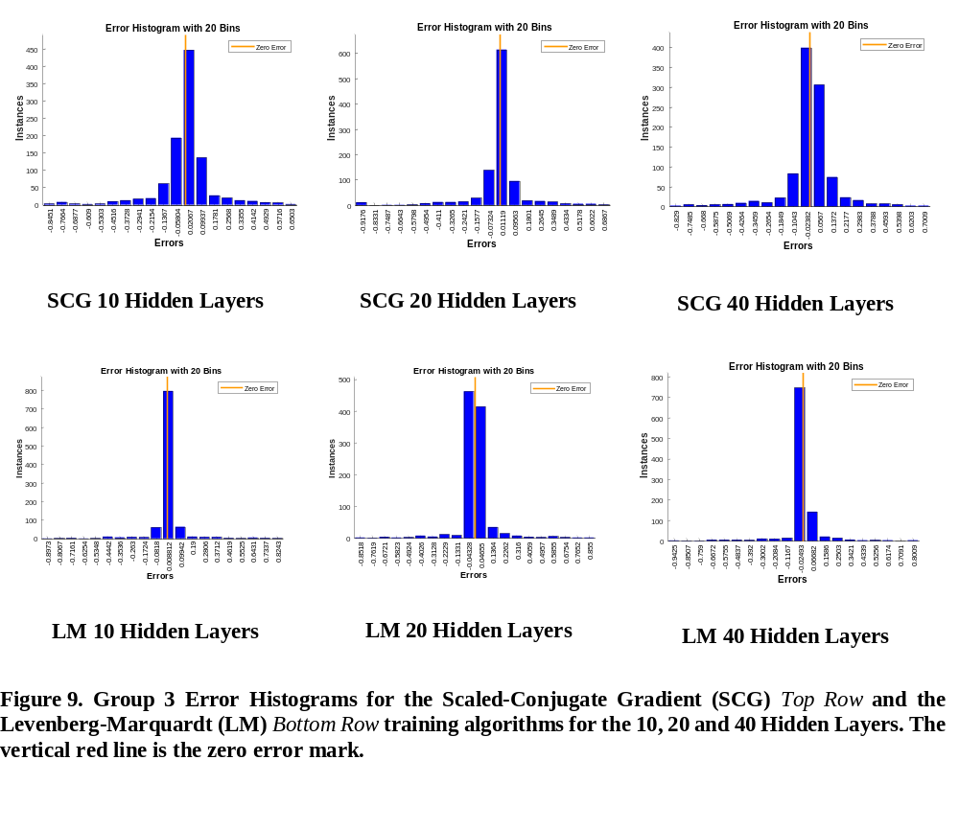
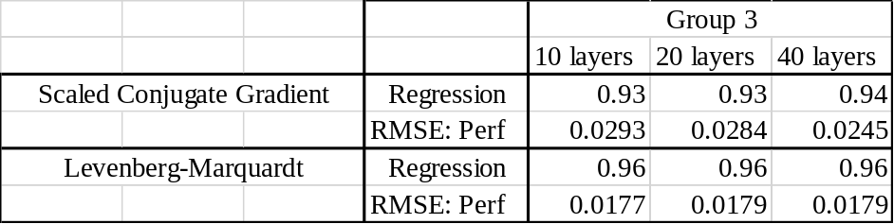
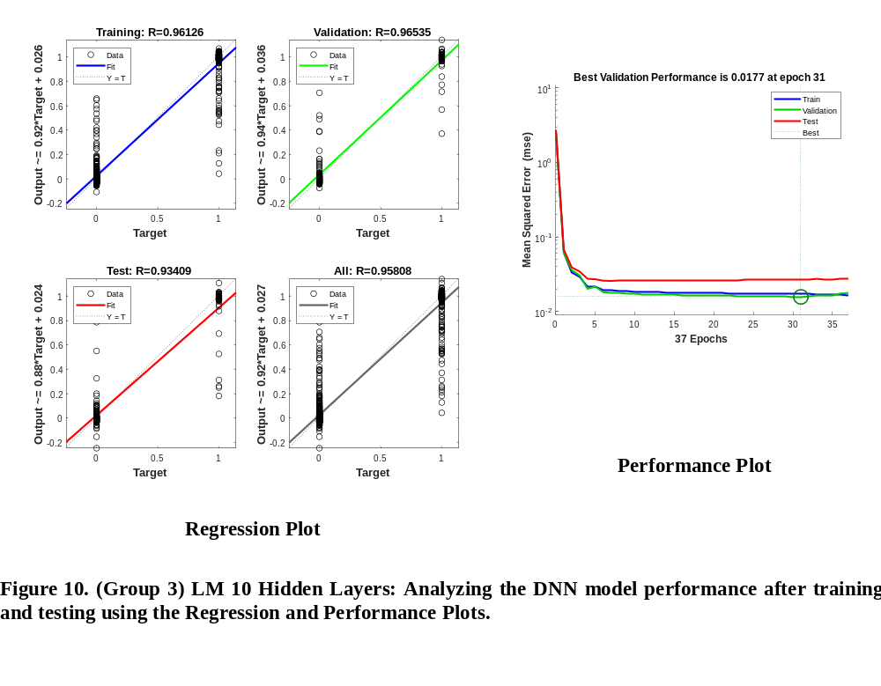
Deep Neural Networks: Group 3
This was the best performing Group of all 4 considered here.
The best performing DNN model used the LM algorithm with 10 hidden layers
Performance Metrics for Group 3.
DNN Performance analysis after training and testing.
Error histograms for SCG (top) and LM (below). The vertical red line is the zero error mark.
Notes:
The performance will be measured using the regression R value which is an indication of the relationship between the outputs and the targets.
If Regression is equal to 1, then this indicates that there is an exact linear relationship between the outputs and targets, and if Regression is equal to 0, then there is no linear relationship between outputs and targets.
This is what we will be using for this preliminary exploration, however there are other non-linear Regression constructs²⁶, that could be explored and may perhaps provide an improved result when the results are not constrained to a binary output {0,1} = {unsafe, safe}

Slide 42
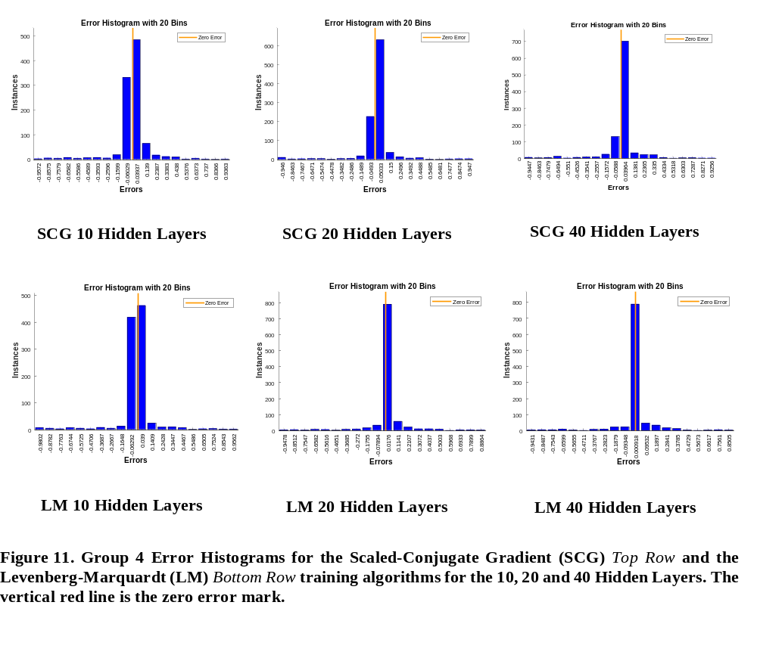
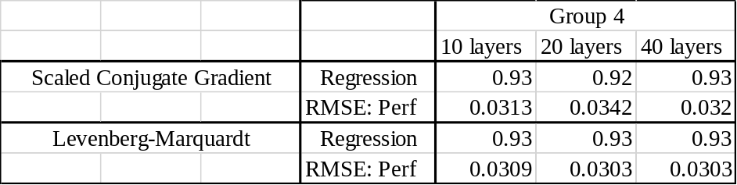
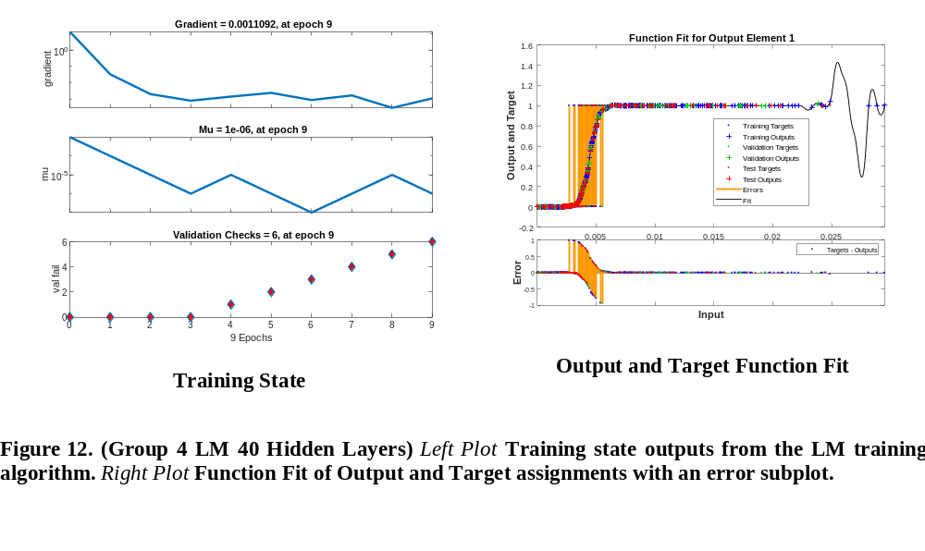
Deep Neural Networks: Group 4
This was the least performing Group of all 4 considered here.
The best performing DNN model used the LM algorithm with 10 hidden layers
Performance Metrics for Group 4.
Training state output and function fit (target vs output) with an error subplot
Error histograms for SCG (top) and LM (below). The vertical red line is the zero error mark.
Notes:
The performance will be measured using the regression R value which is an indication of the relationship between the outputs and the targets.
If Regression is equal to 1, then this indicates that there is an exact linear relationship between the outputs and targets, and if Regression is equal to 0, then there is no linear relationship between outputs and targets.
This is what we will be using for this preliminary exploration, however there are other non-linear Regression constructs²⁶, that could be explored and may perhaps provide an improved result when the results are not constrained to a binary output {0,1} = {unsafe, safe}

Slide 43
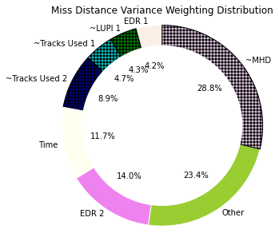
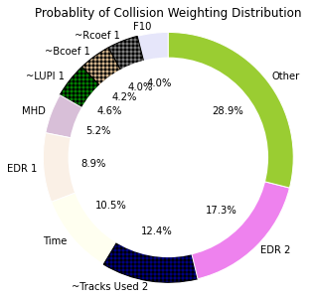

Binary Classification Results
High EDR and low Tracks Used correlate to larger PC Values
82% accuracy for high Pc
92% accuracy for low Pc
43
Notes:
These parameters are highlighted as having the most relationship to high 0.2 importance
Input is standardized event parameters across a sequence

Slide 44
Best Practices: NASA Handbook
NASA Spacecraft Conjunction Assessment and Collision Avoidance Best Practices Handbook https://nodis3.gsfc.nasa.gov/OCE_docs/OCE_51.pdf
Helps space system operators understand existing capabilities and processes
  Includes related US Space Command (USSPACECOM) and the US Space Force 18th Space Defense Squadron (SDS) best practices
Provides technical background on NASA CA processes, including why requirements were levied and how to implement them
Offers best practices for use by any spacecraft Owner/Operator to help protect the space environment
Companion software repository contains many of the tools used by NASA: https://github.com/nasa/CARA_Analysis_Tools
44

Slide 45
Best Practices: NASA Handbook
Preface
Acknowledgements
Introduction
Roles and Responsibilities
History
Space Vehicle and Constellation Design
Pre-Launch Preparation and Early Launch Activities
On-Orbit Collision Avoidance
Contact Information
Appendix A: Acronyms
Appendix B: Glossary
Appendix C: Best Practices List
Appendix D: Best Practices for NASA Missions
Appendix E: Use of Analytic Theory Orbital Data in Conjunction Assessment
Appendix F: Expected CA Event Rates
Appendix G: Orbital Debris Density
Appendix H: Satellite Colocation Analysis
Appendix I: Satellite Covariance Realism Assessment Procedures
Appendix J: CARA Risk Assessment Tools Validation
Appendix K: R-15 Message
Appendix L: Commercial Data in NASA Conjunction Assessment
Appendix M: Use of the Probability of Collision (Pc) as the Risk Assessment Metric for Conjunction Assessment
Appendix N: Pc Calculation Approaches
Appendix O: Collision Consequence
Appendix P: Event Actionability
Appendix Q: List of Works Cited
Content developed from a US-based inter-agency working group
AVAILABLE HERE: https://www.nasa.gov/press-release/nasa-releases-best-practices-handbook-to-help-improve-space-safety
45

