Slide 1
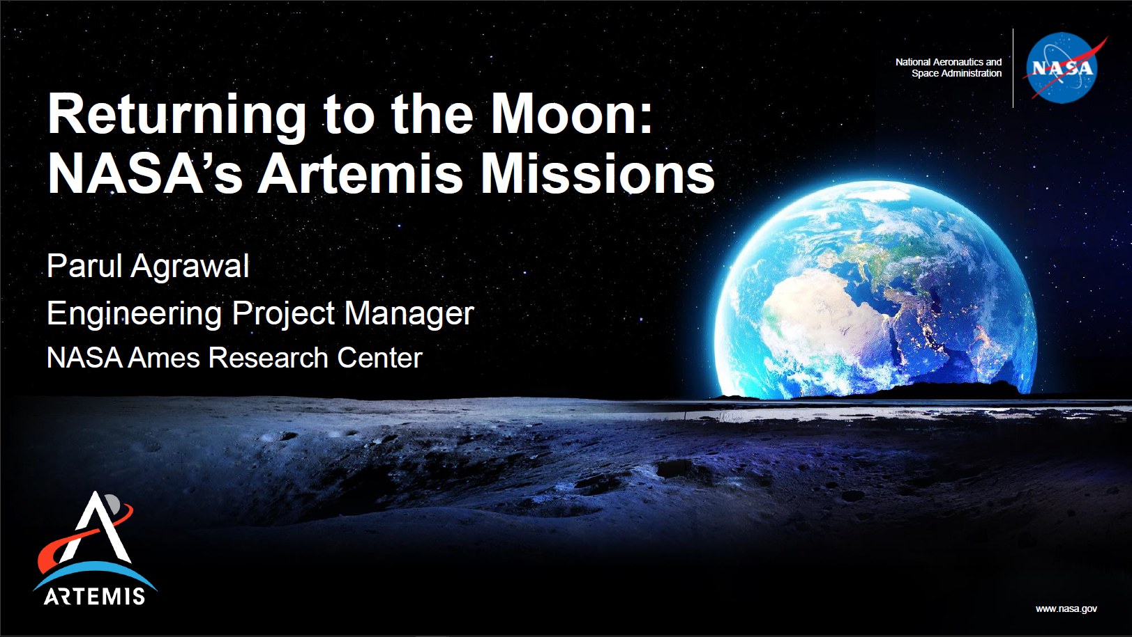
Artemis radiation environment
Anthony DeStefano, PhD
Space Environments Engineer
NASA Marshall Space Flight Center

Slide 2
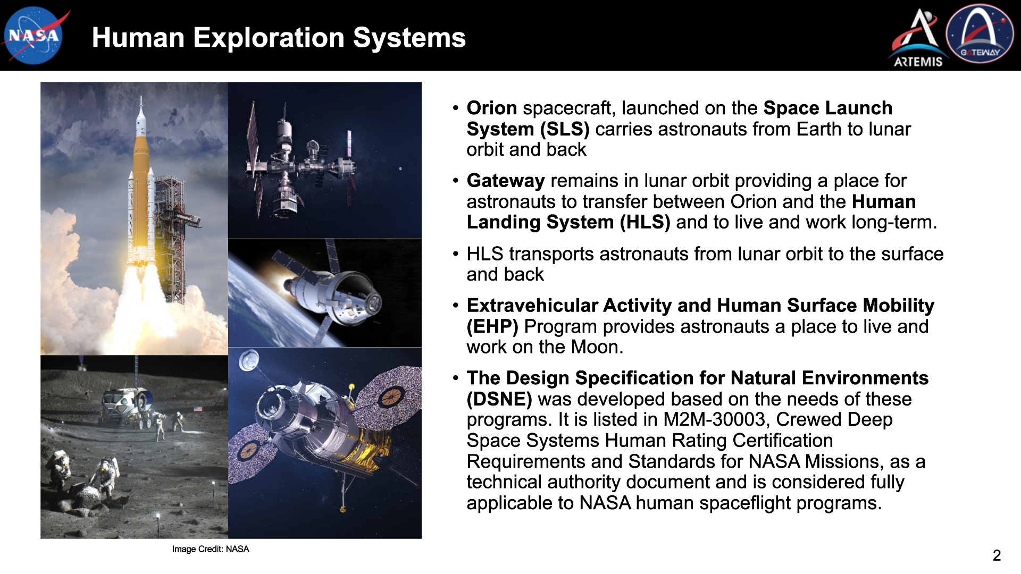

Slide 3
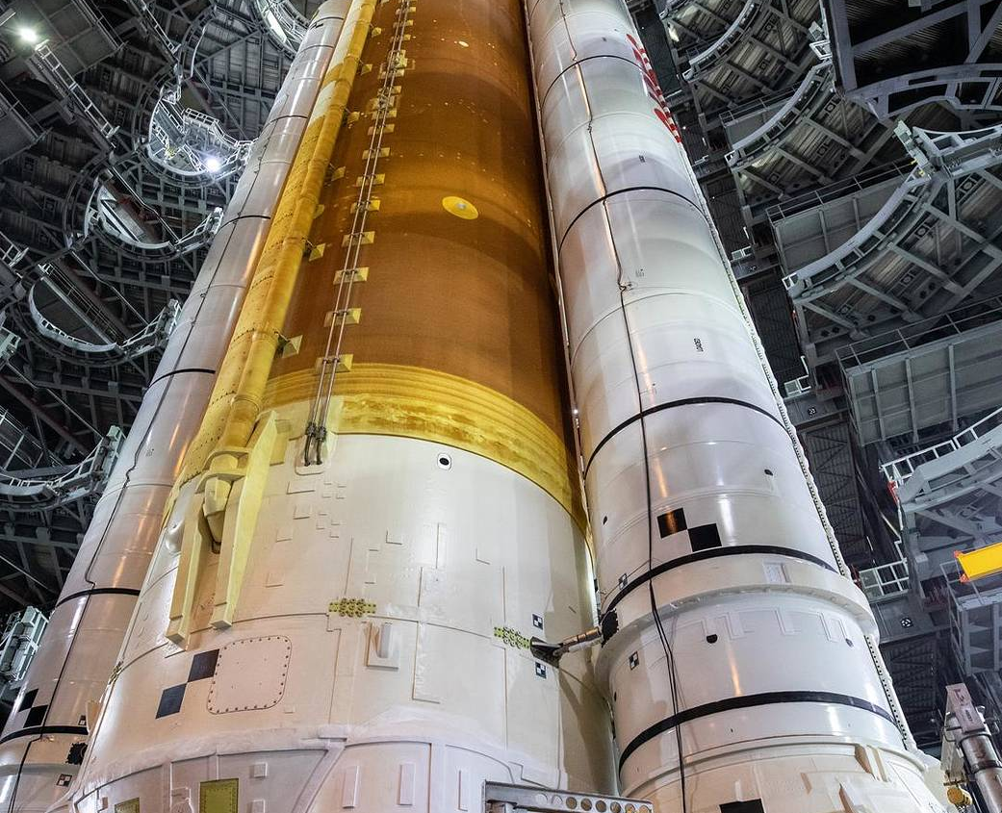
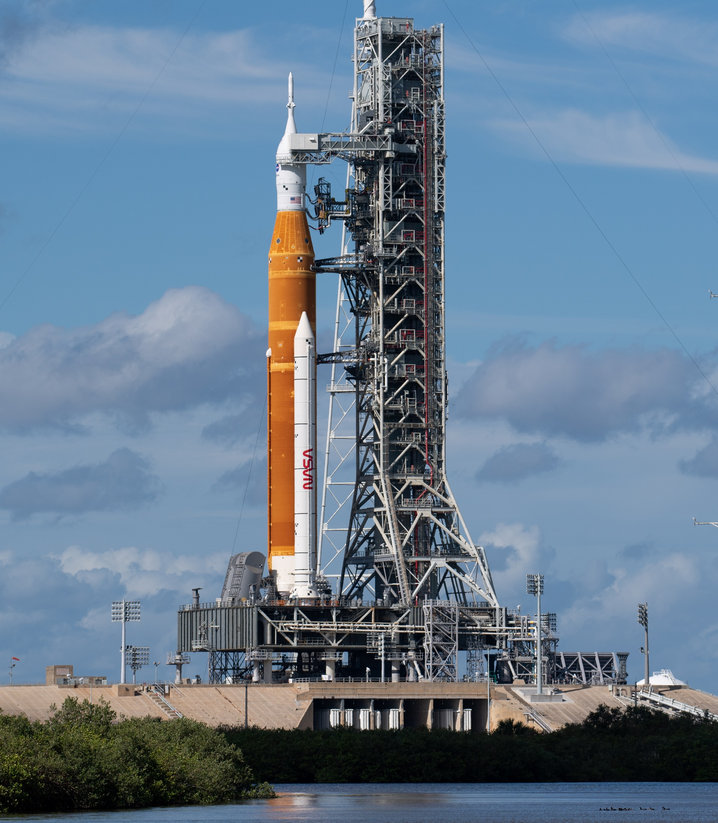
Artemis and the
Space Launch System
Artemis 1
98 meters tall
2.6 million kilograms when fully fueled
4400 tons of thrust
Payload to TLI/Moon > 27 tons
Payload volume 14.6 m³
FS-2023-05-119-MSFC

Slide 4
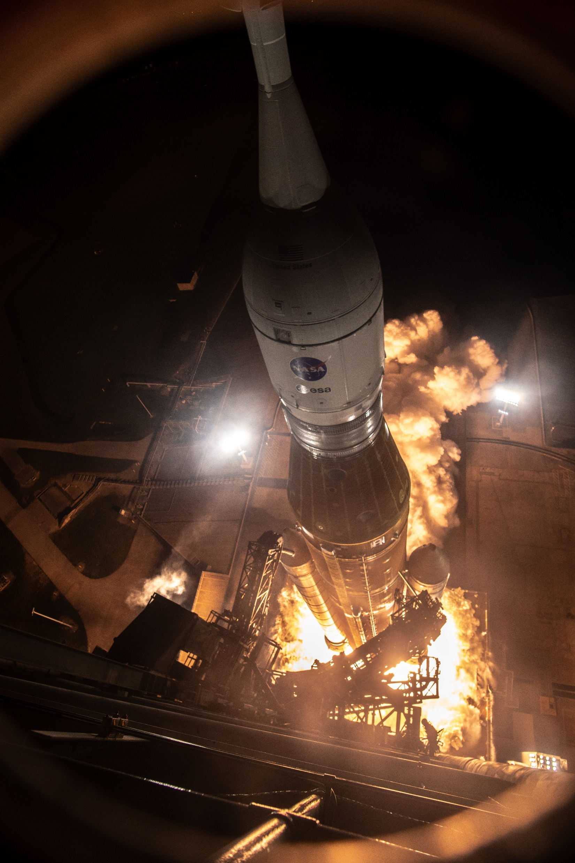
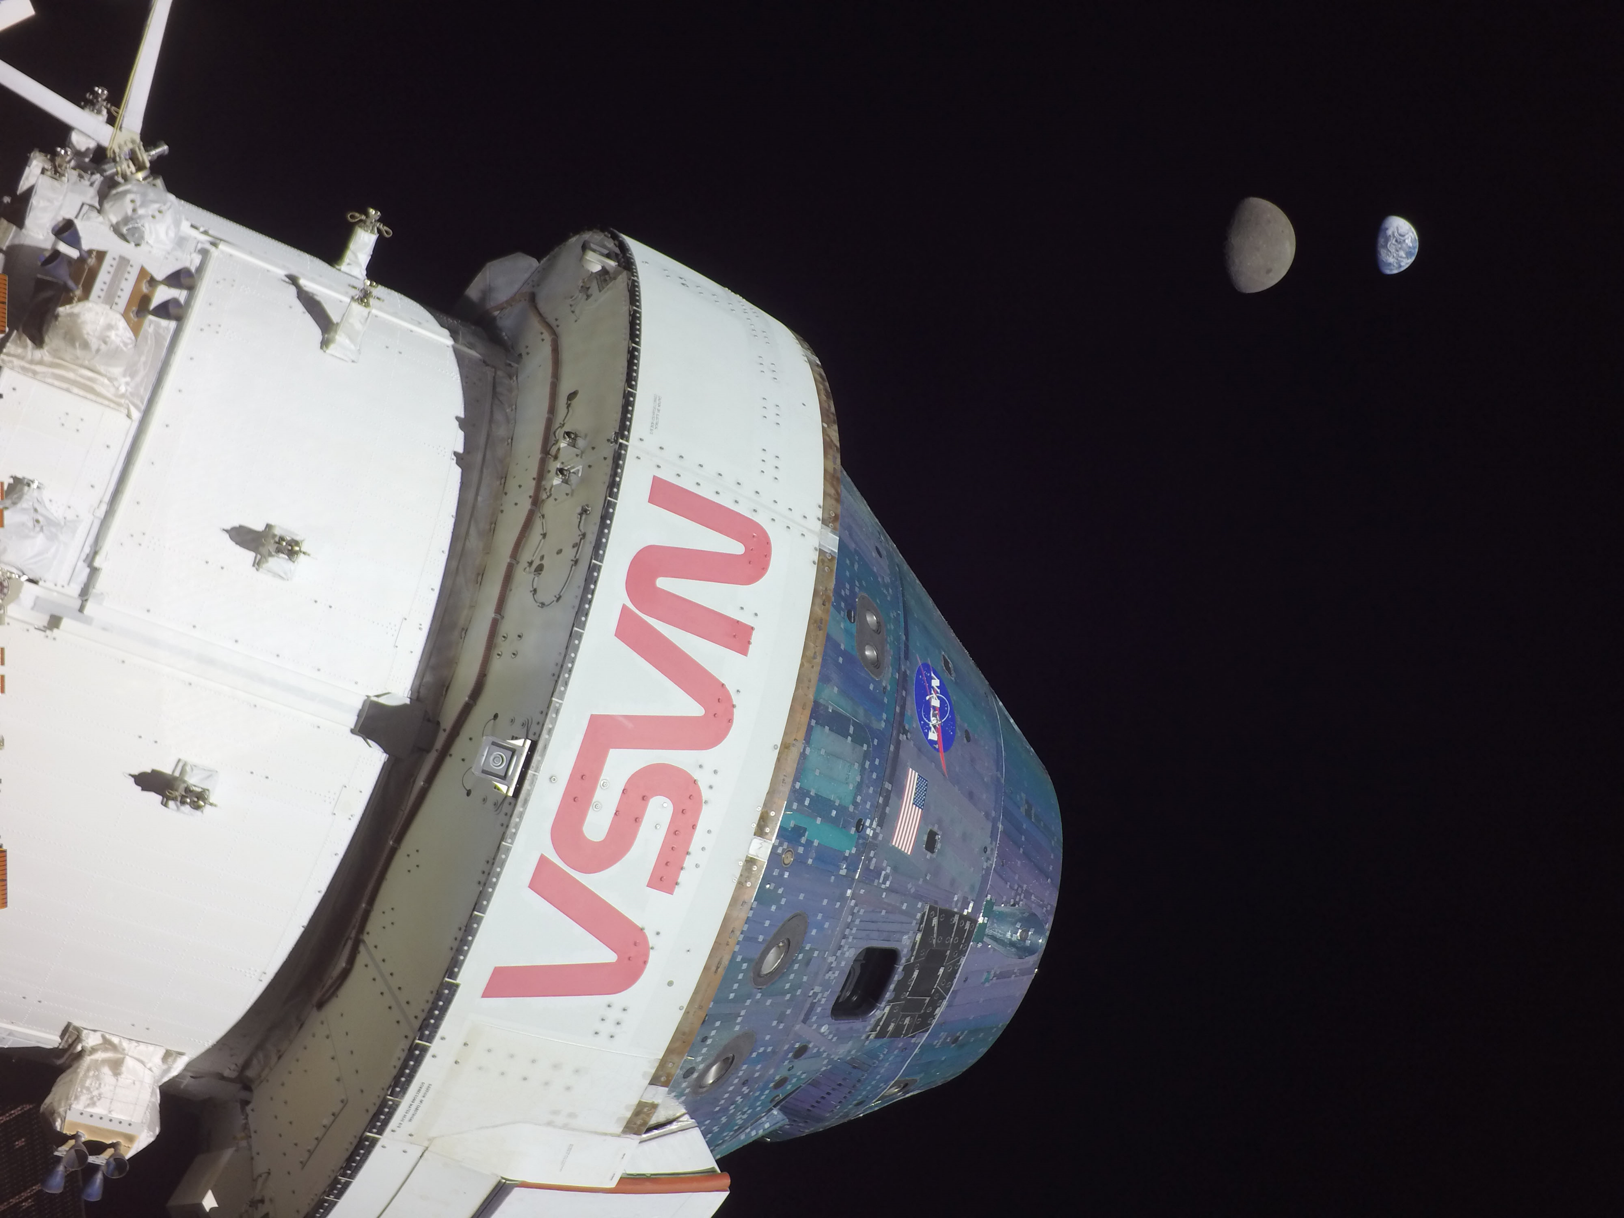
Artemis 1 lifted off from Launch Complex 39B at Kennedy Space Center at 1:47 a.m. EST on
Nov. 16, 2022
Orion reached 432,210 kilometers away from our home planet, surpassing the record for distance traveled by a spacecraft designed to carry humans, previously set during Apollo 13

Slide 5
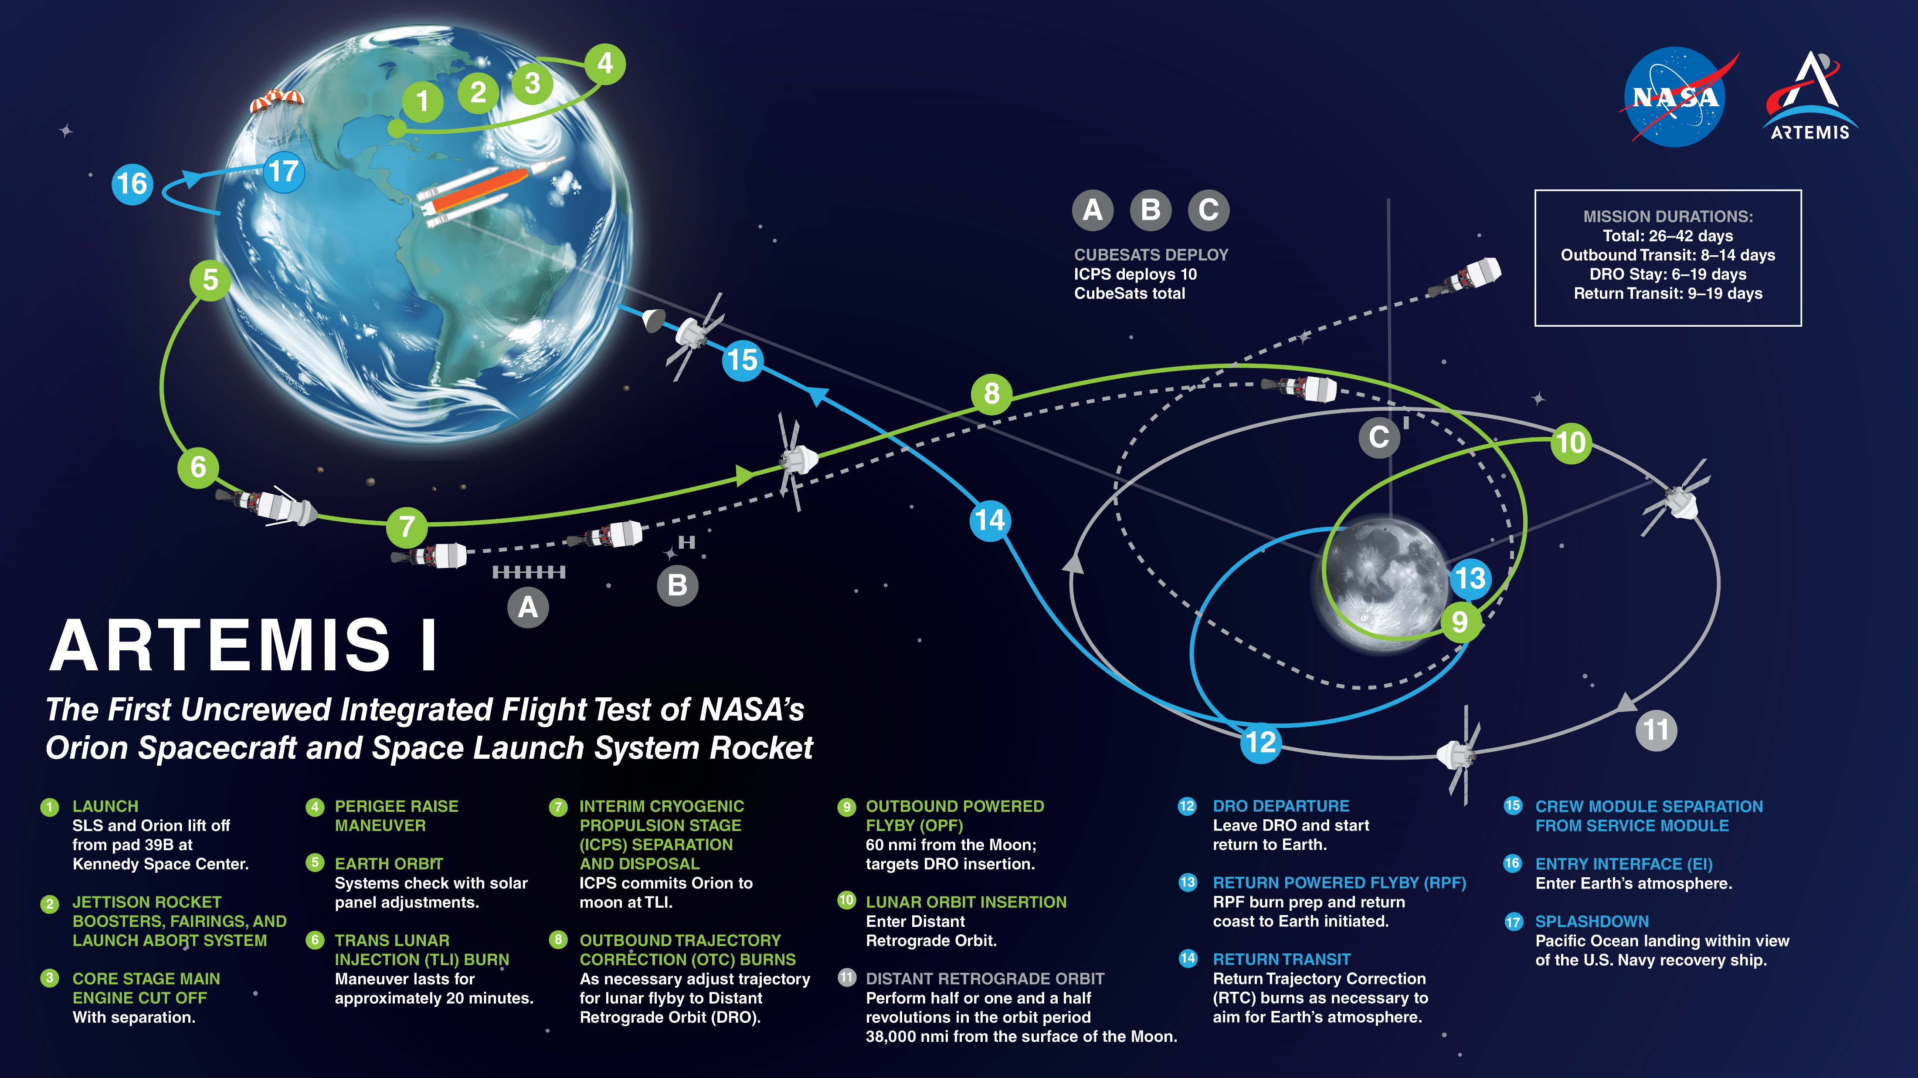

Slide 6
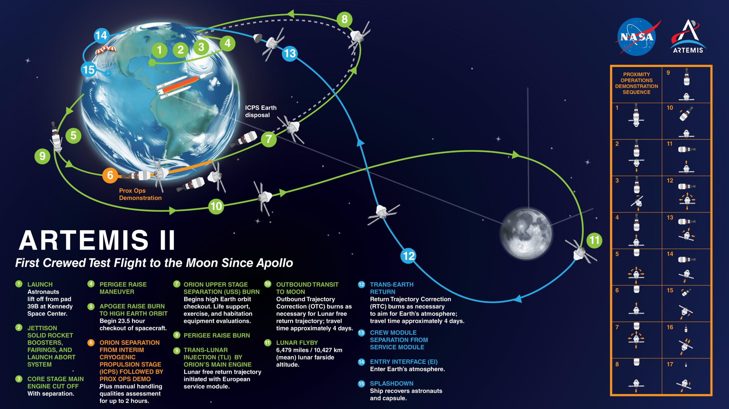
6

Slide 7
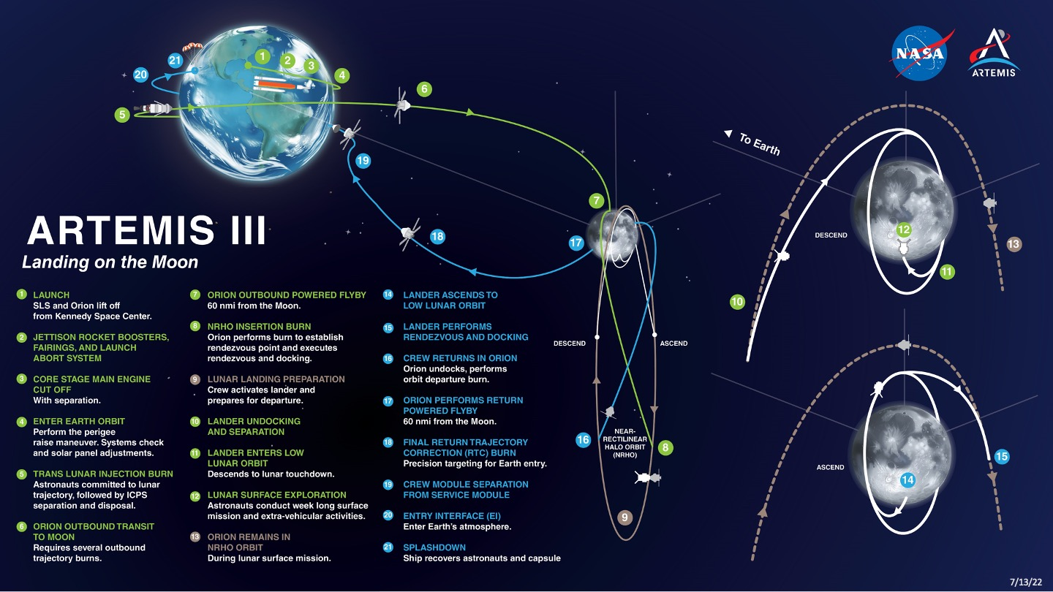
7

Slide 8

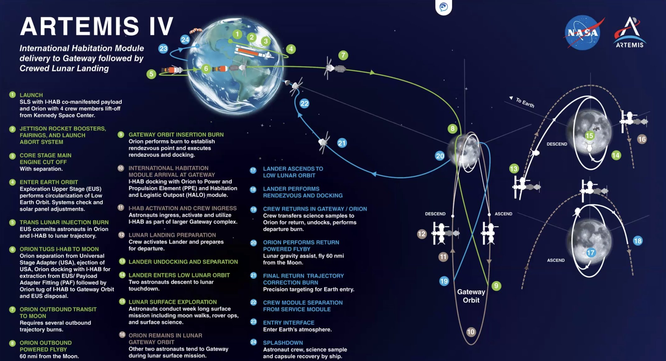

Slide 9
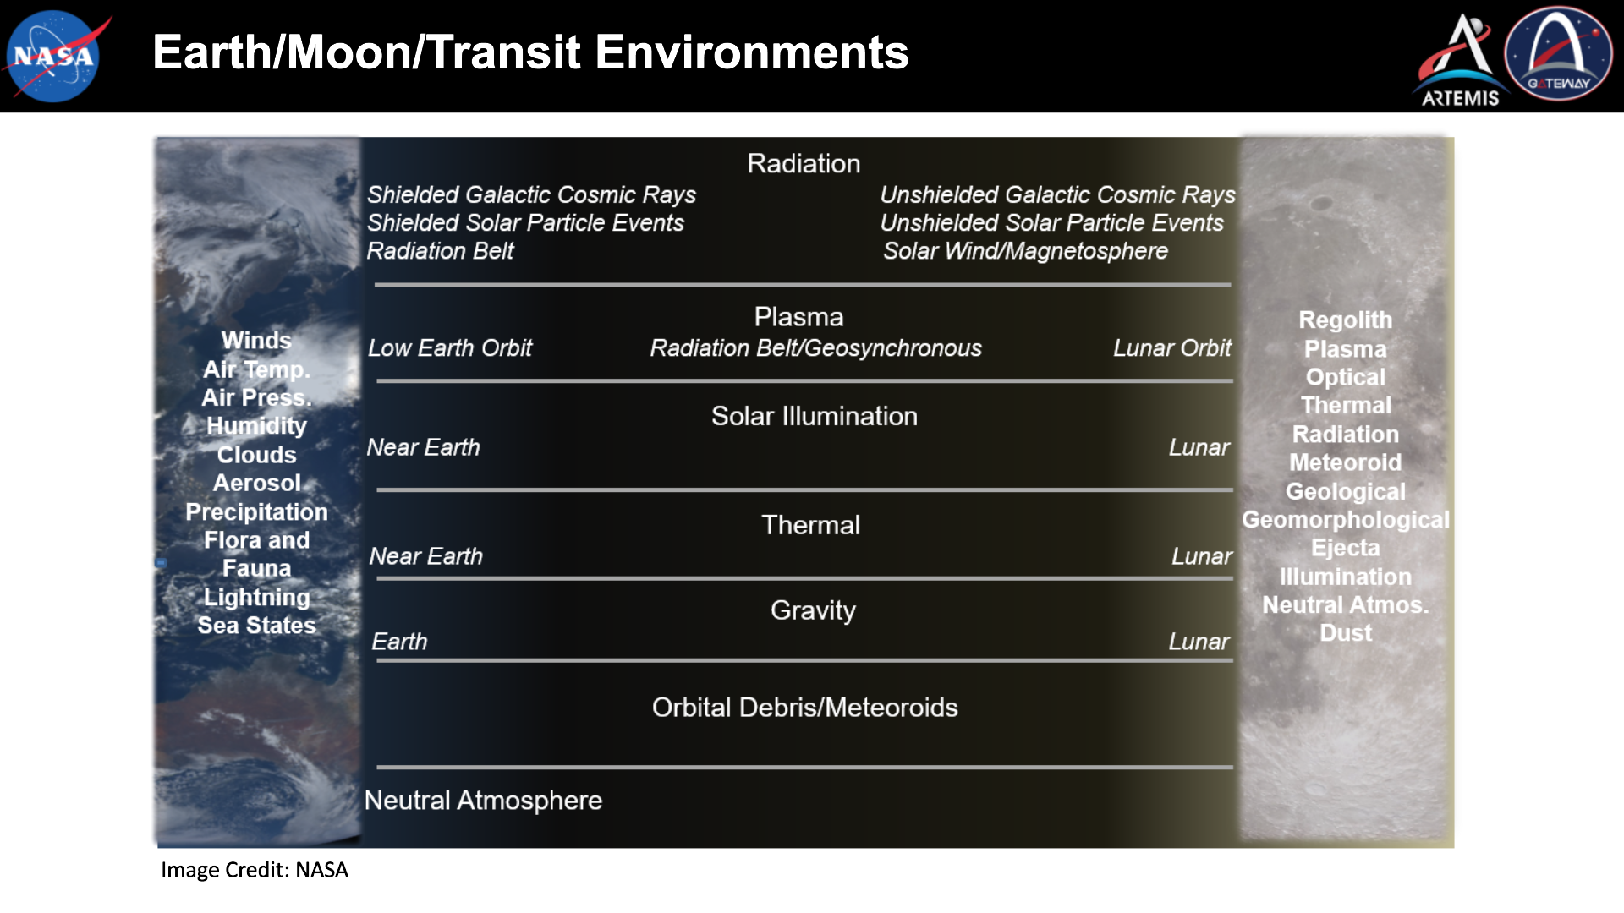

Slide 10
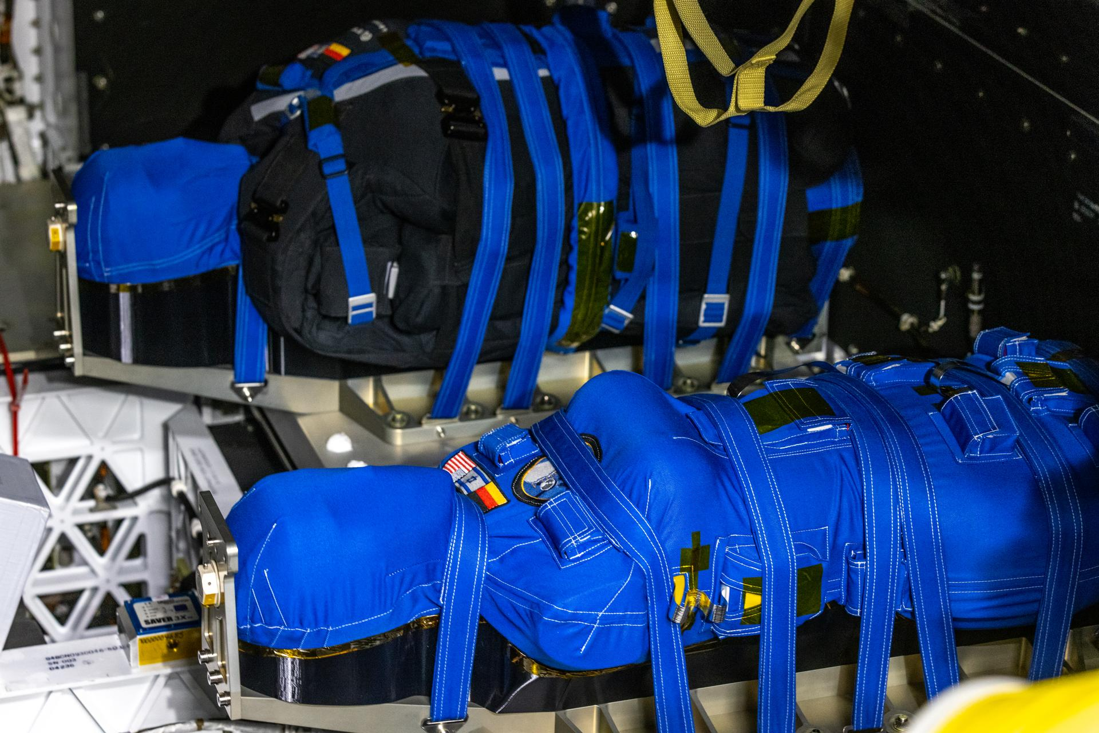
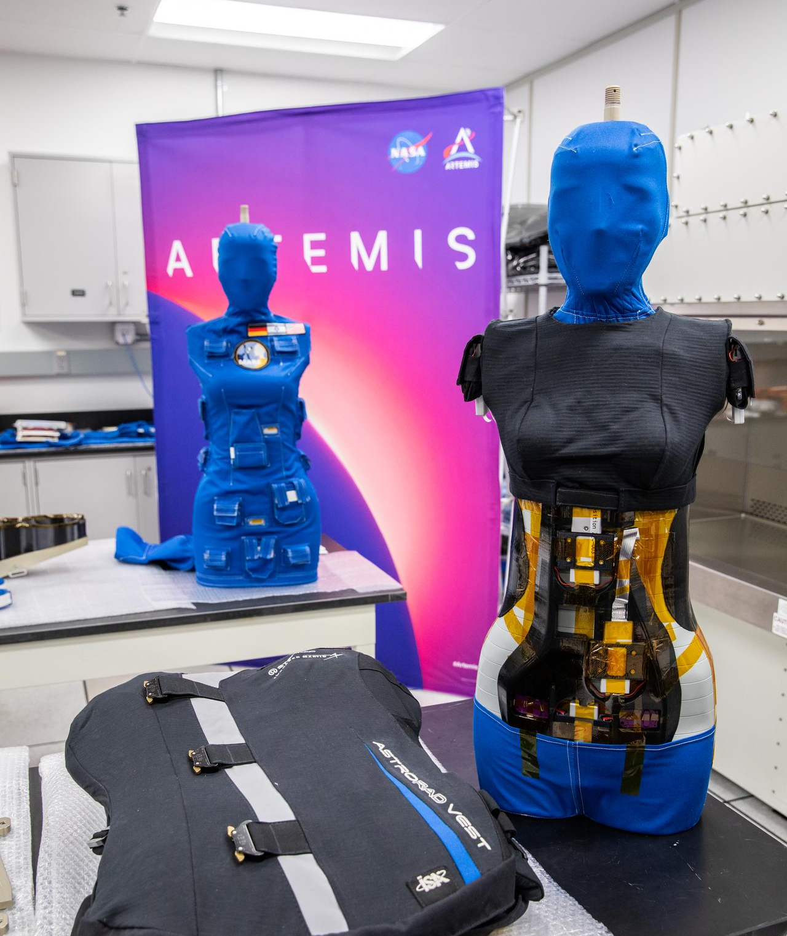
Zohar & Helga, phantoms equipped with radiation detectors on Artemis 1 to collect radiation data
Credit: NASA (https://www.nasa.gov/reference/artemis-i/)

Slide 11
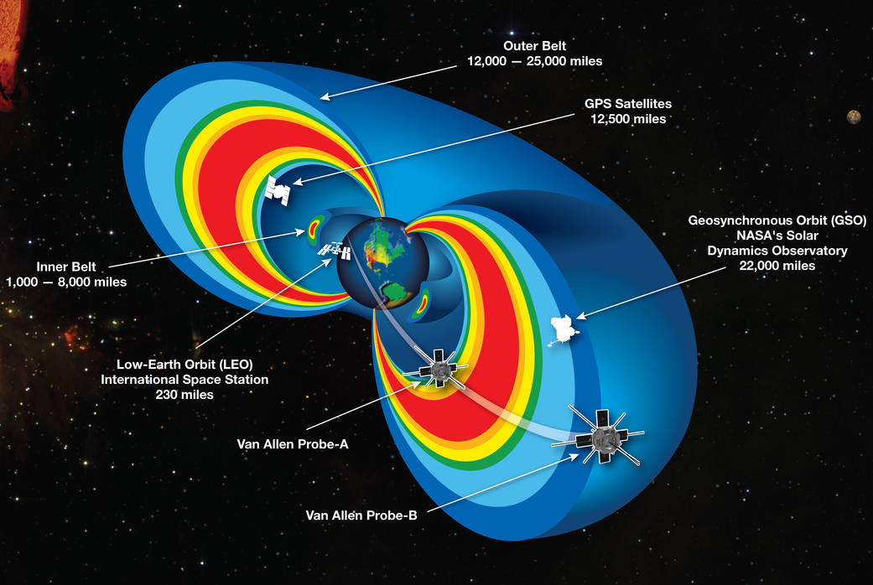
Inner & outer radiation belts around Earth are trapped, high energy charged-particles
Credit: NASA

Slide 12
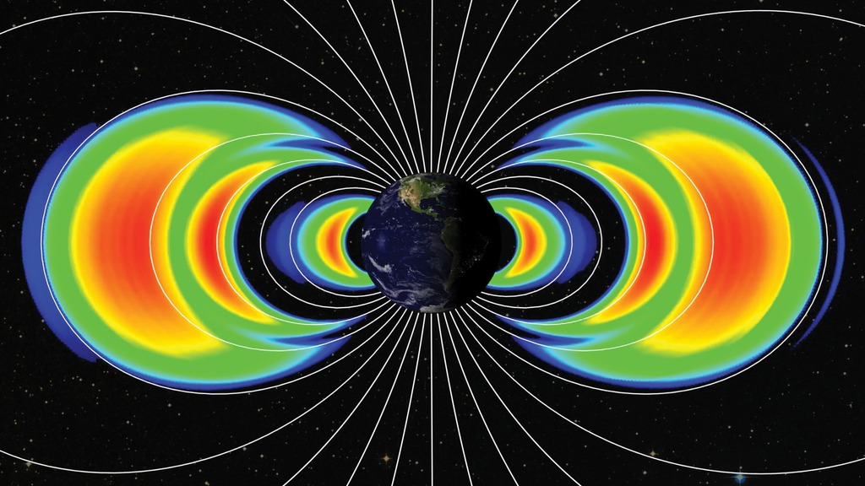
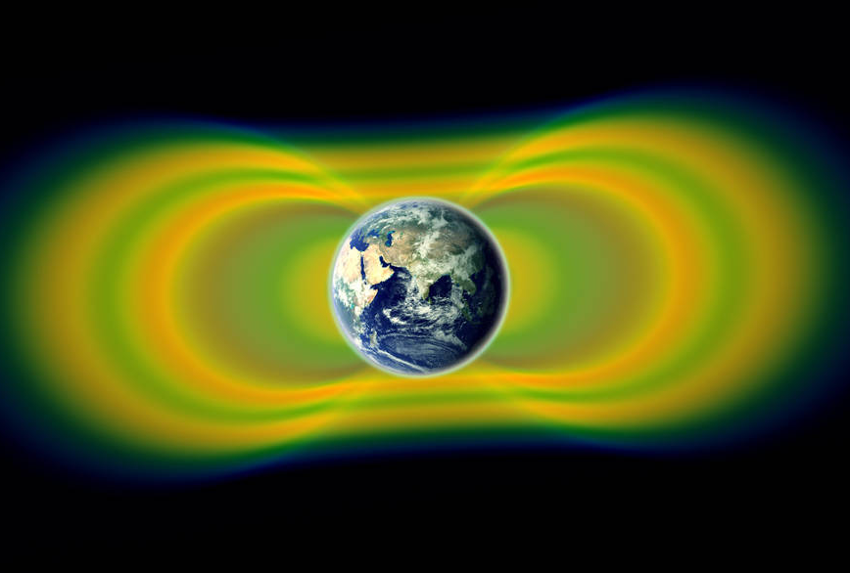
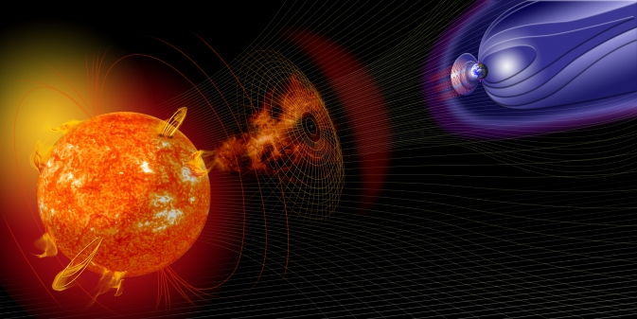
Radiation Environments: Radiation Belts
Protons and electrons trapped in the Earth’s magnetic field.
Long term fluctuations with solar cycle
  Increased electrons at solar maximum, increased protons at solar minimum.
Episodic electron enhancements caused by geomagnetic storms.
  Animation: https://svs.gsfc.nasa.gov/20057
Spacecraft Concerns:
  Protons -> Single Event Effects
  Protons and Electrons -> Ionizing Dose and Displacement Damage Dose
Image Credit: NASA (https://www.nasa.gov/feature/goddard/2019/ten-highlights-from-nasa-s-van-allen-probes-mission)
Image Credit: NASA (https://www.nasa.gov/mission_pages/sunearth/news/storms-on-sun.html)

Slide 13
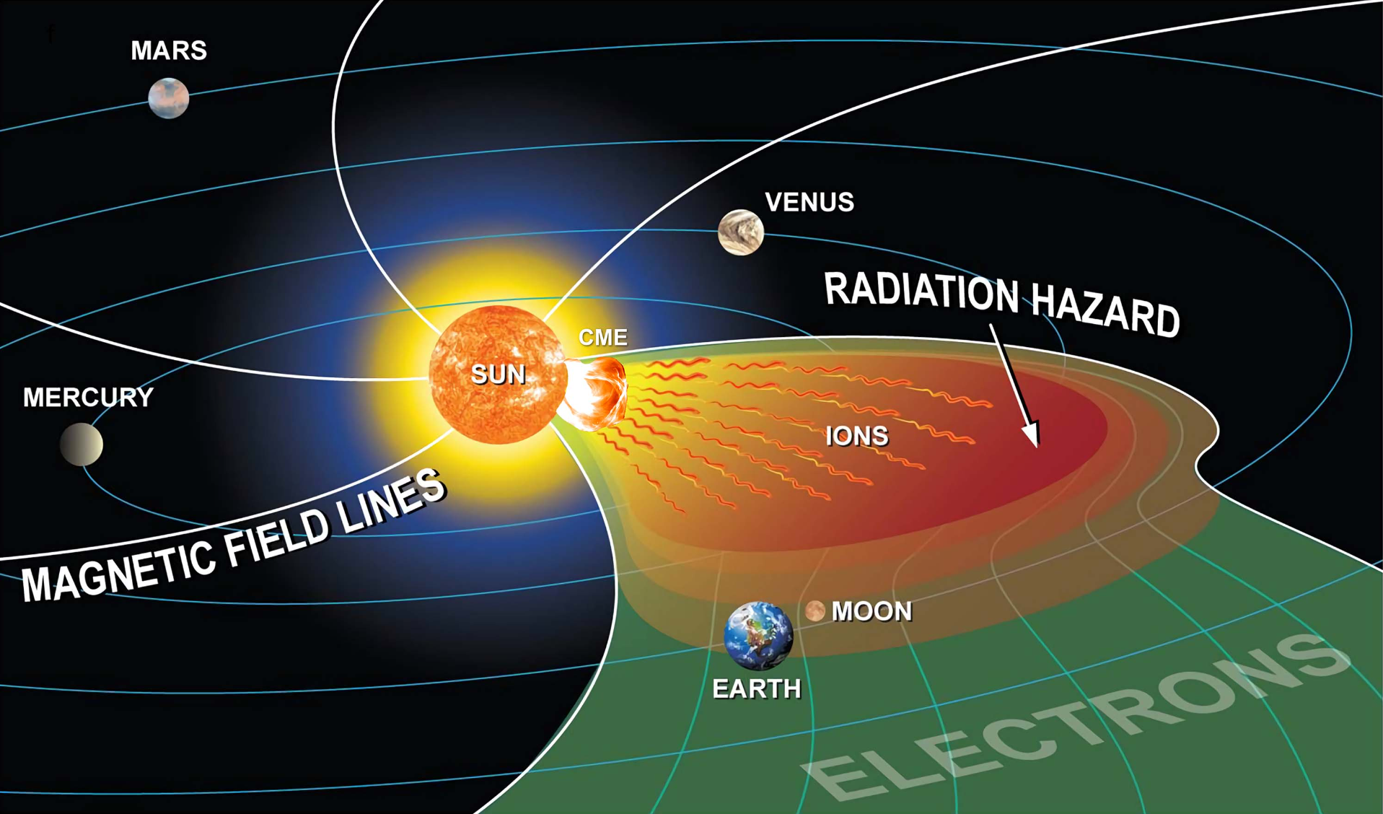
Solar Particle Events
are eruptions from the Sun
Credit: NASA HQ
13

Slide 14
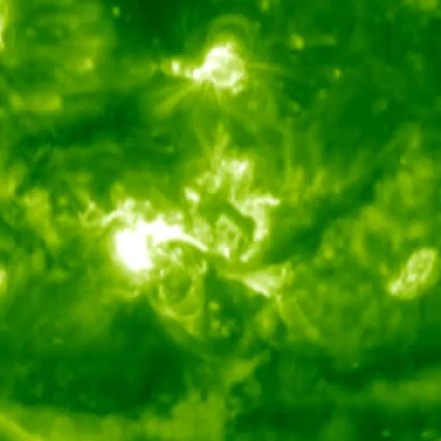
X17 Flare and 2125 km/s Coronal Mass Ejecta from the Halloween Storm of 2003
Credit: NASA STEREO

Slide 15
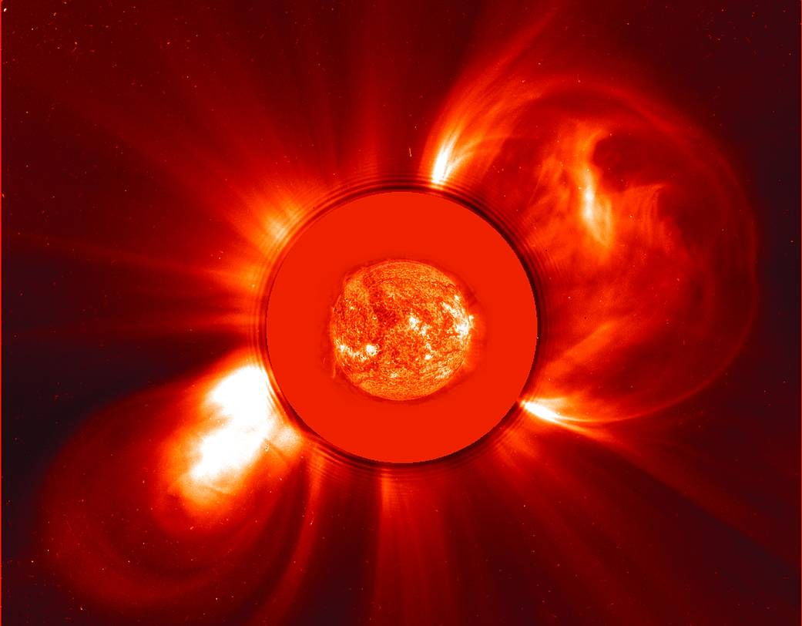
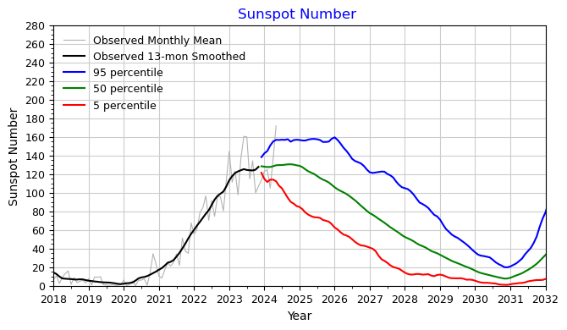
Radiation Environments: Solar Particle Events (SPEs)
Accelerated ions (mostly protons) originating from the Sun.
  Accelerated by magnetic eruptions on the Sun also associated with solar events such as coronal mass ejections and solar flares.
  Particles cause Single Event Effects and Ionizing and Displacement Damage Dose
Episodic with large range of intensity and not every event is directed toward Earth.
  Animation: https://svs.gsfc.nasa.gov/4056
Frequency varies with solar cycle, but intense events can happen any time.
Earth’s magnetic field provides some protection for low Earth orbit satellites.
Image Credit: NASA (https://soho.nascom.nasa.gov/gallery/images/c2eitnov800.html)
https://www.nasa.gov/solar-cycle-progression-and-forecast/

Slide 16
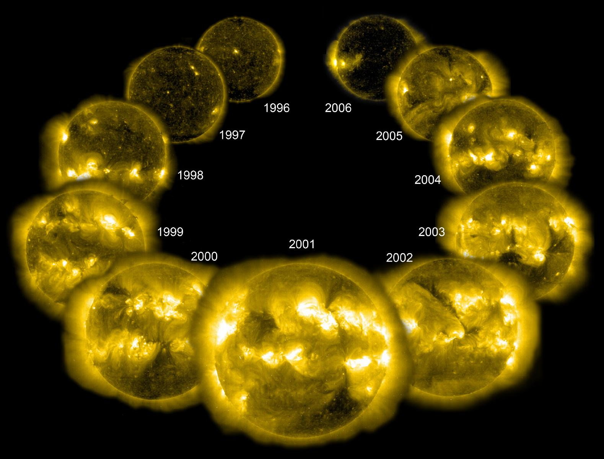
Solar activity cycles about every 11 years

Slide 17
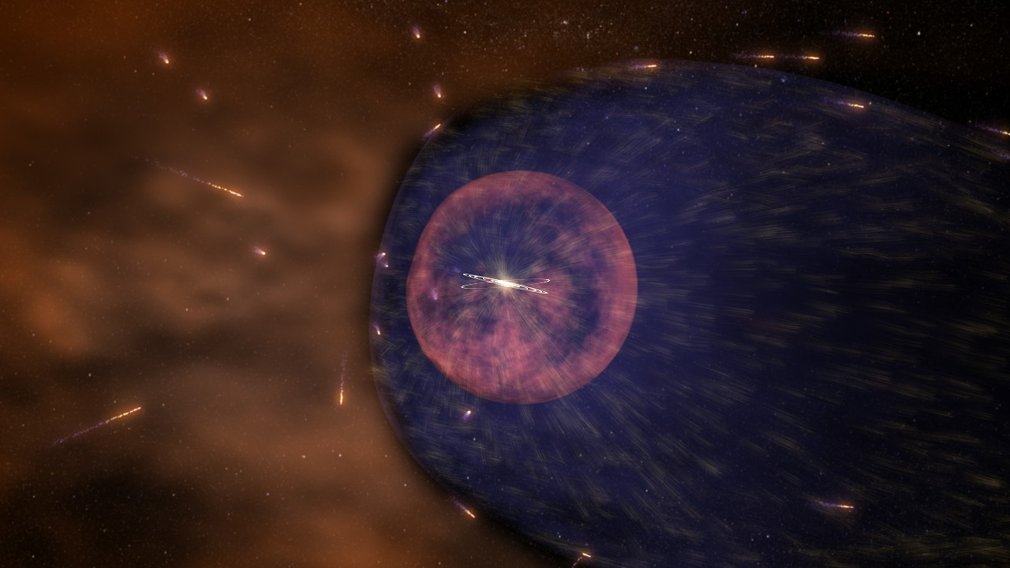
Galactic Cosmic Rays (GCRs) come from outside our Solar System at extreme energies
Credit: NASA

Slide 18
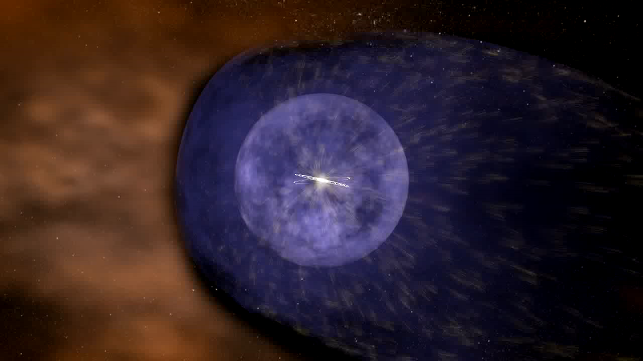
GCRs reach Earth easier during solar minimum, and are shielded better during solar maximum
Credit: NASA

Slide 19
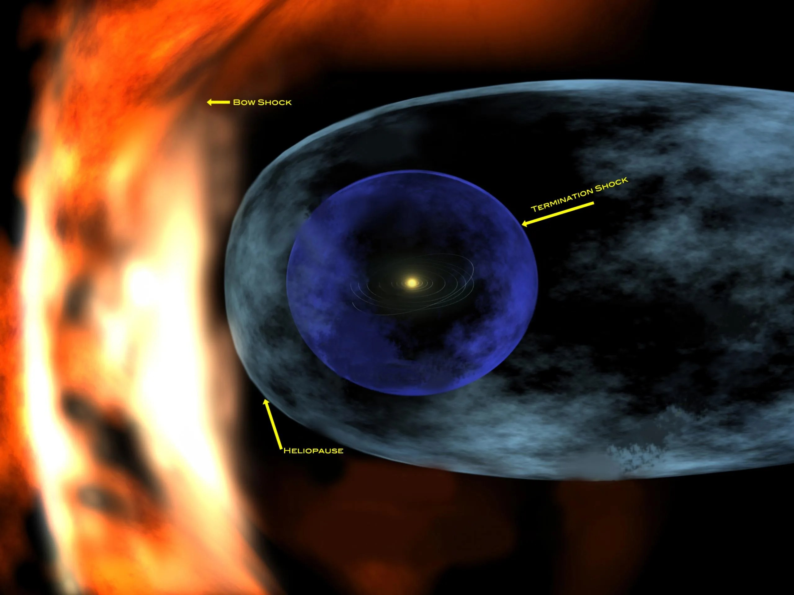
Radiation Environments: Galactic Cosmic Rays (GCRs)
Ions originating from outside the solar system, Hydrogen -> Uranium.
  Single Event Effects
  Ionizing Dose - small compared to SPE dose.
Intensity varies slowly with solar cycle.
  Minimized during Solar Max
  Maximum during Solar Min
Earth’s magnetic field provides some protection for low Earth orbit satellites, but not at the polar regions.
Image Credit: NASA

Slide 20
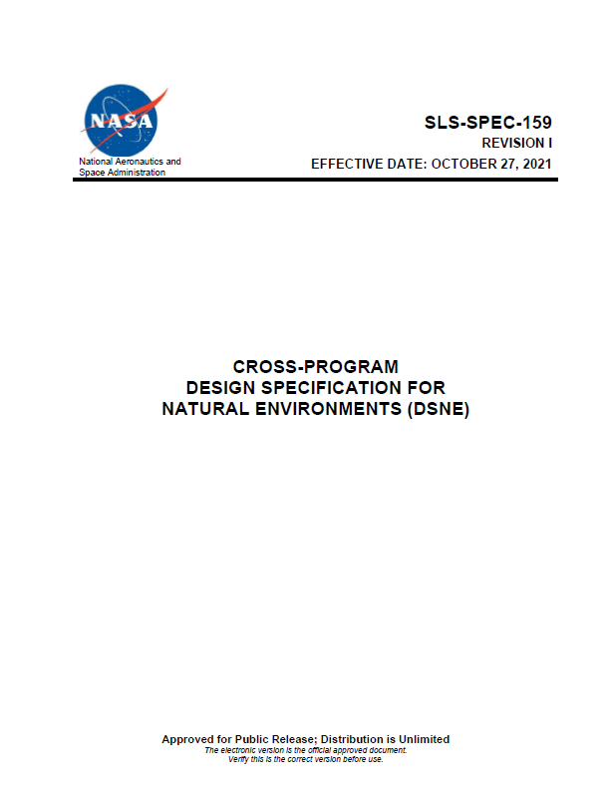

Requirements and Verification
The Design Specification for Natural Environments is not a requirements document.
Programs must have a requirement pointing to the specification:
  Example: The spacecraft shall meet all safety, performance, utilization, and mission objectives during and after exposure to the natural space environments as defined in SLS-SPEC-159, Cross-Program Design Specification for Natural Environments (DSNE).
  Allows each program flexibility in applying environments to meet program specific objectives while still maintaining a consistent set of environments across all programs.
Environments flow to each design partner/developer, reviews must be performed to ensure component level definitions are consistent with DSNE.
Verification is performed by reviewing subsystem verifications
  Example: Audit of the natural environment requirements shall consist of a review of subsystem/component verification and must include each of the natural environments sub-disciplines to ensure that they were correctly defined and applied for the respective hardware and software verification tests and analyses.
https://ntrs.nasa.gov/citations/20210024522

Slide 21
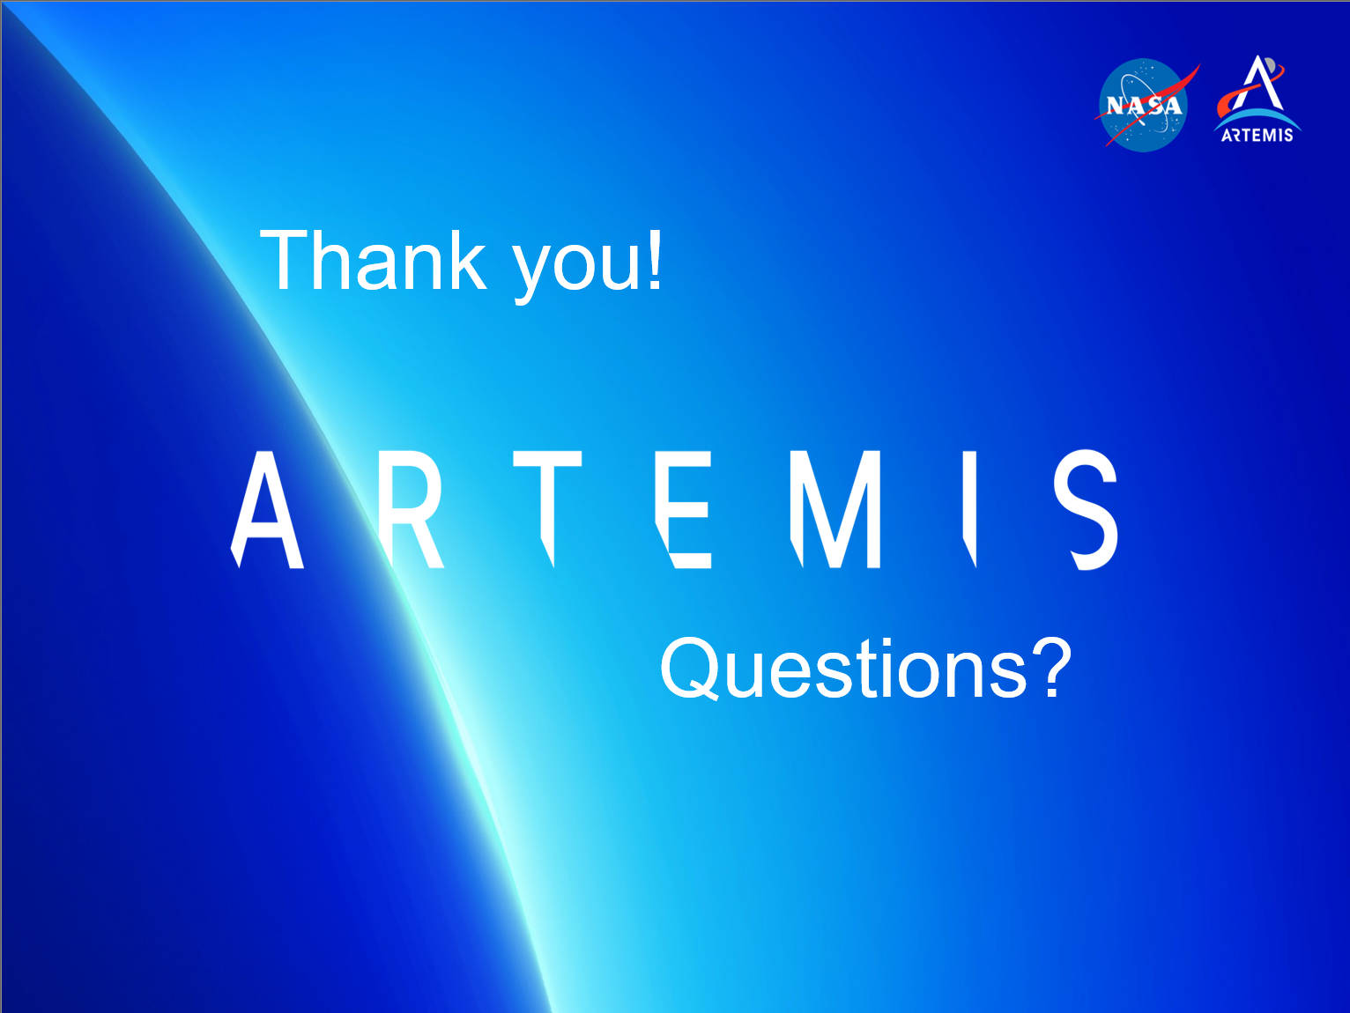

Slide 22
