Slide 1

Speckle Pattern Application to Woven Softgoods
Rylee Cardon
National Aeronautics and Space Administration
Marshall Spaceflight Center
EM41 Nonmetallic Materials

Slide 2
Table of Content
Background
Current methods
Problems with current methods
Clear coat and additive method
Paint gun method
Results
Conclusion

Slide 3
Background
Photogrammetry is a test method used for detecting strain in an object put under tension
In order to detect the strain a random black and white pattern is applied to the item
The pattern must meet certain requirements
  Roughly 50% white 50% black
  Random and isotropic pattern
  Similarly sized spots
  Pattern must be distinct
  Preferably matte

Slide 4
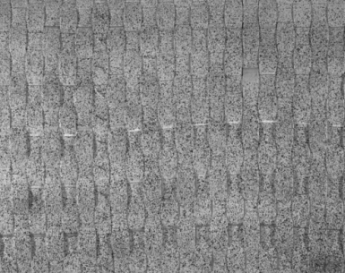
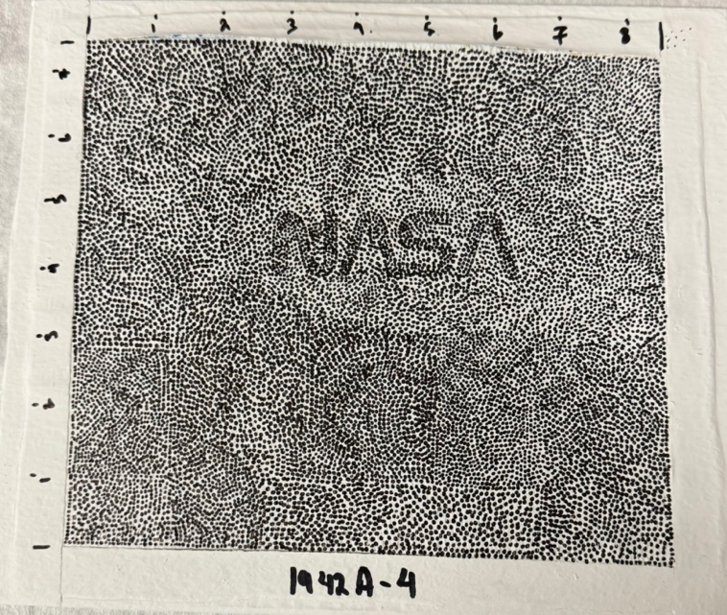
Current Methods for Speckling
Spray paint
Hand painting
Stencils
Roller stencil
Temporary Tattoo sheets
Stamp pad

Slide 5
Why Develop a New Method
Time constraints
  Large articles take lots of time to apply current methods.
Area coverage
  Current methods take a long time when trying to cover large areas even when they are quick to apply to smaller surfaces.
Scalability
Increase in testing cadence
  There will be more testing done as more companies begin to build their own inflatable habitats.
  There has been an increase in capability at MFSC by building a reconfigurable test pad exclusively for burst tests.
Even coating of articles
  The surface inconsistencies that come with a woven application makes even and consistent application difficult for current methods.

Slide 6
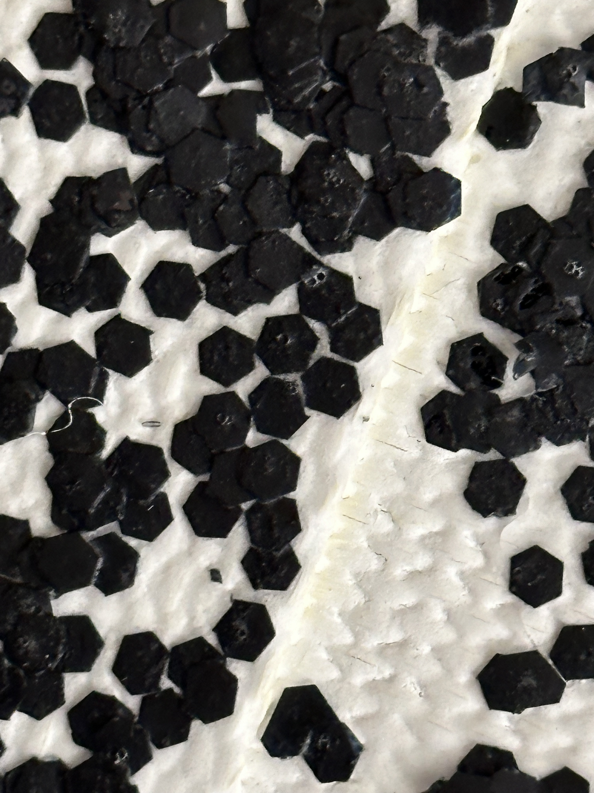
Clear Coat and Additive Method
Hexagonal plastic additive added to a matte clear coat
Several application methods were tested
  Paint brush
  Roller
  Sponge
Different ratios of clear coat to additive were also tested
  1 to 1
  2 to 1
  4 to 3

Slide 7
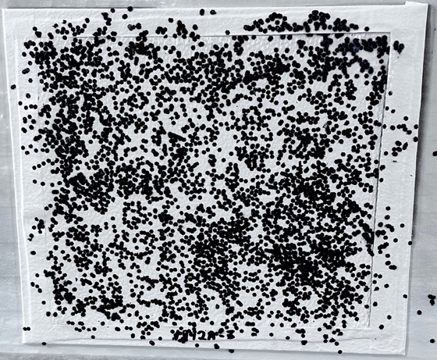
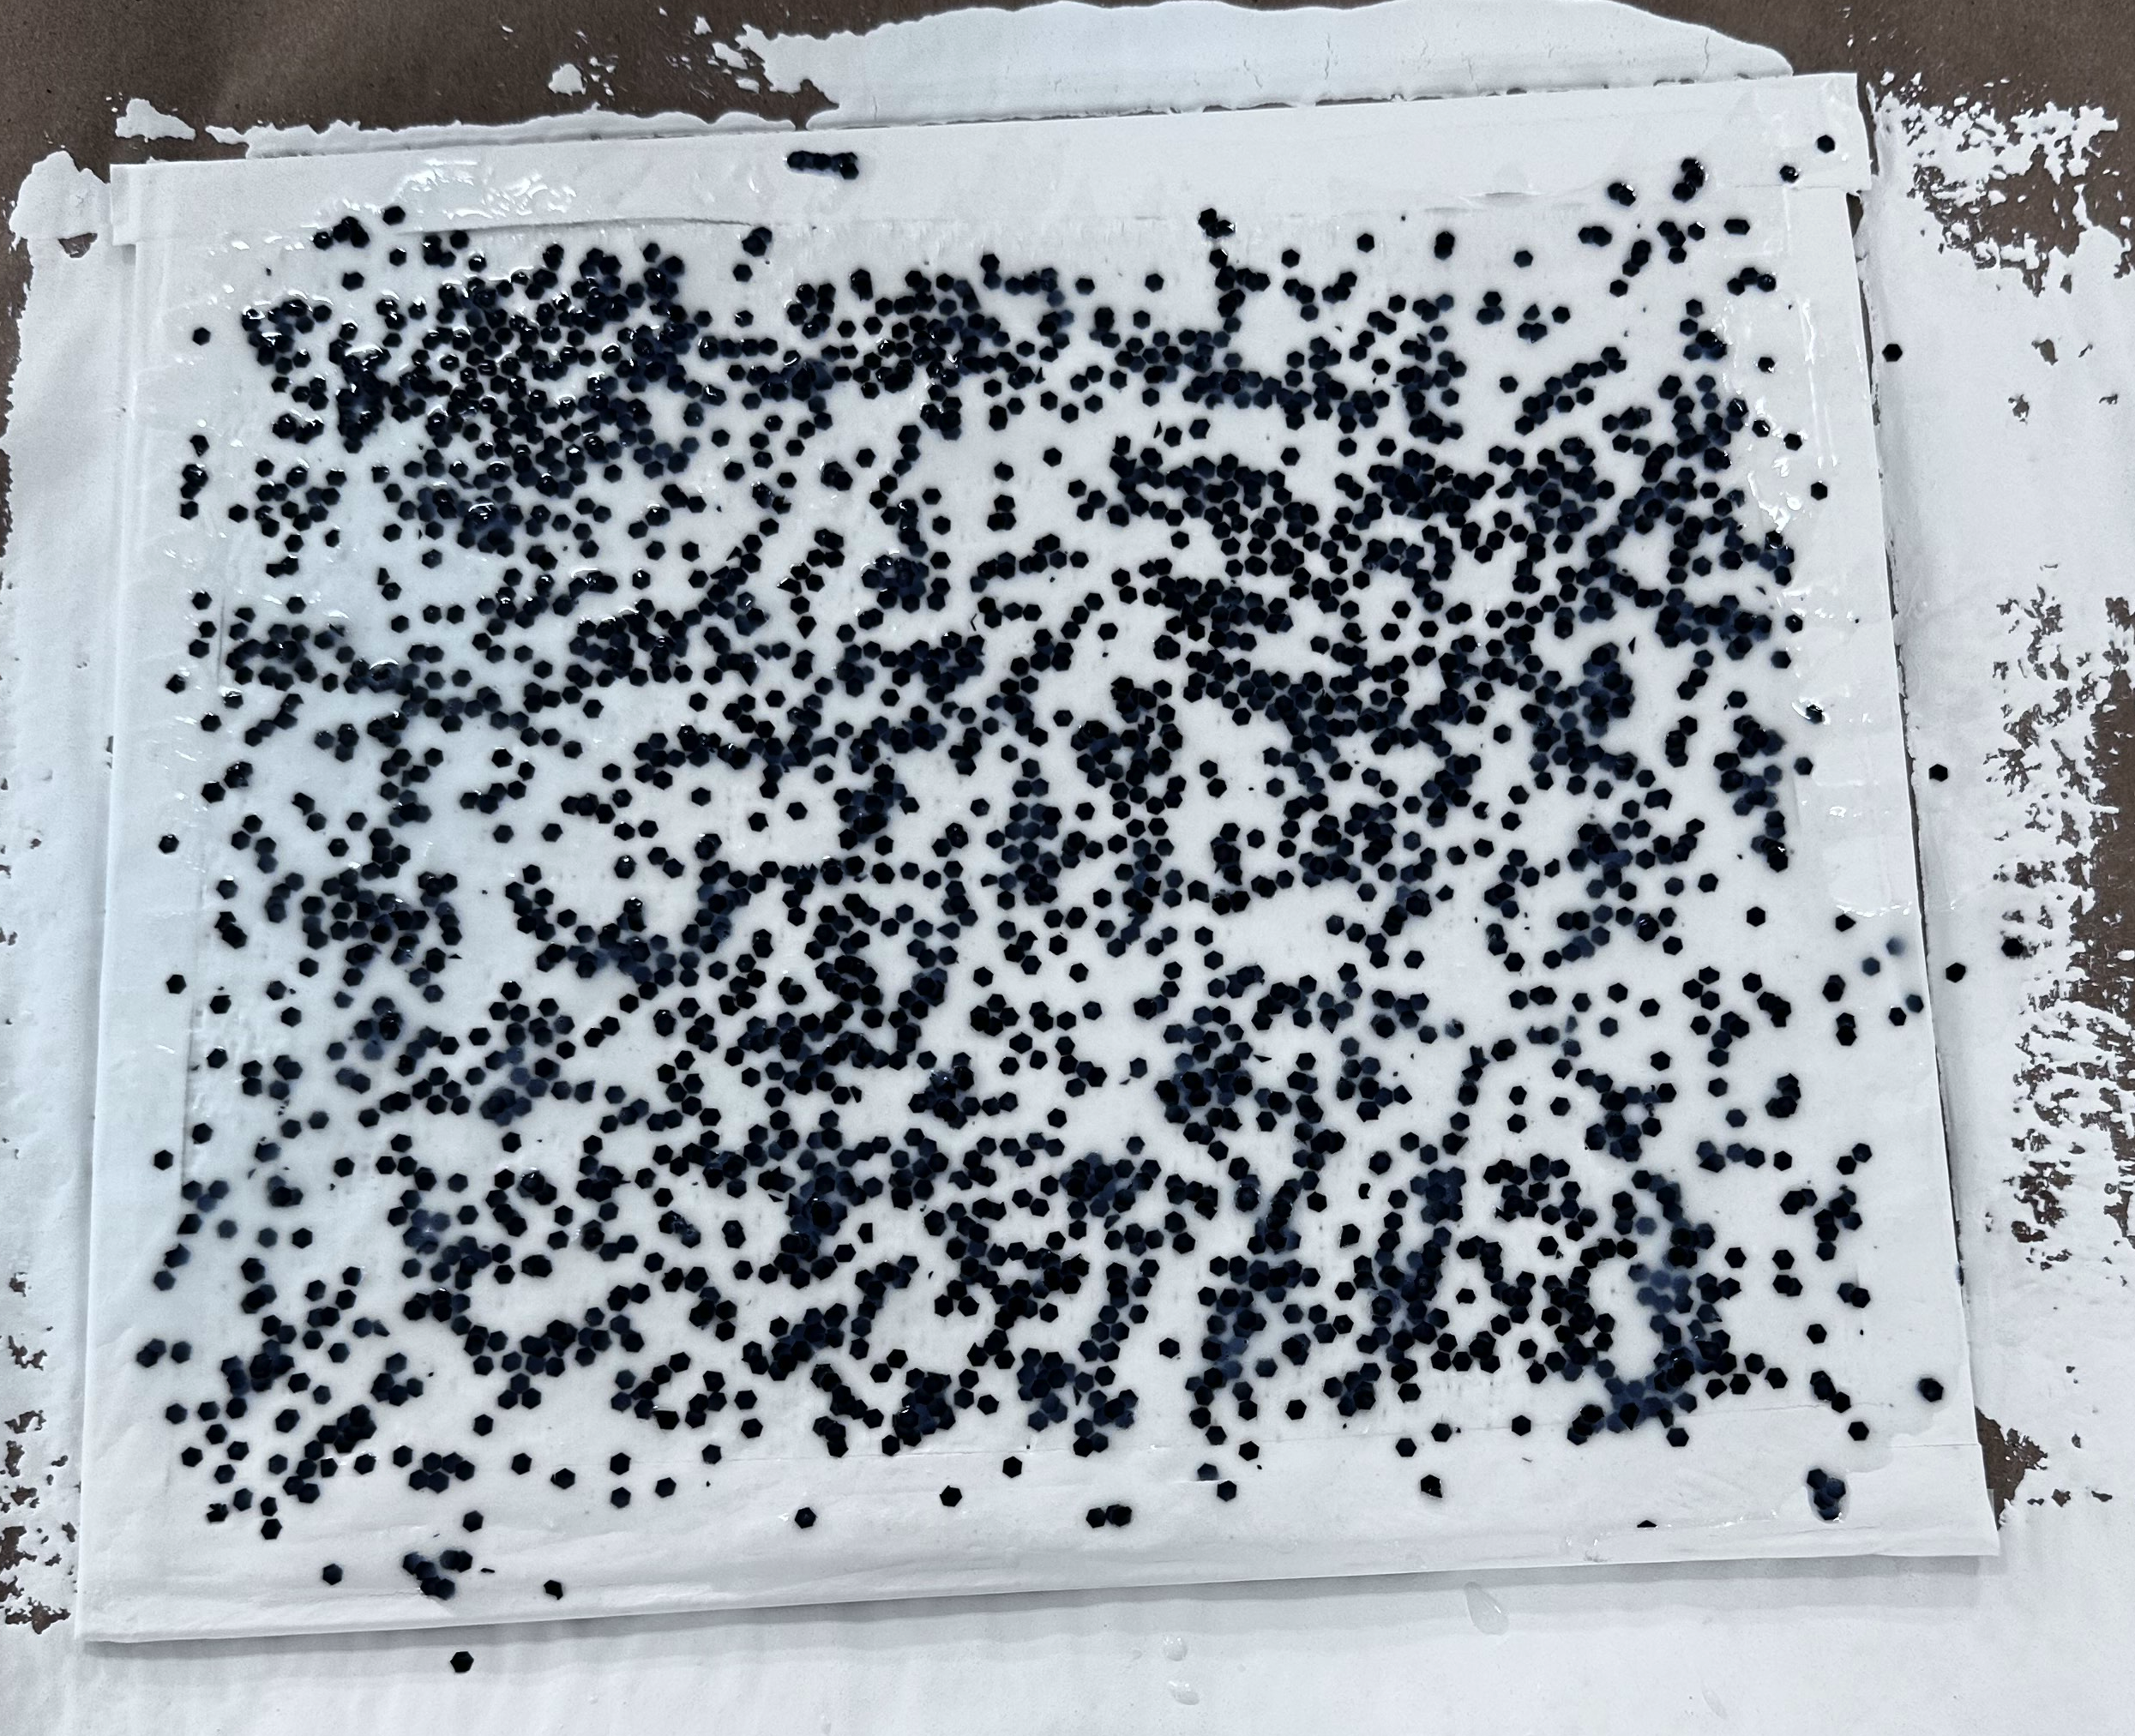
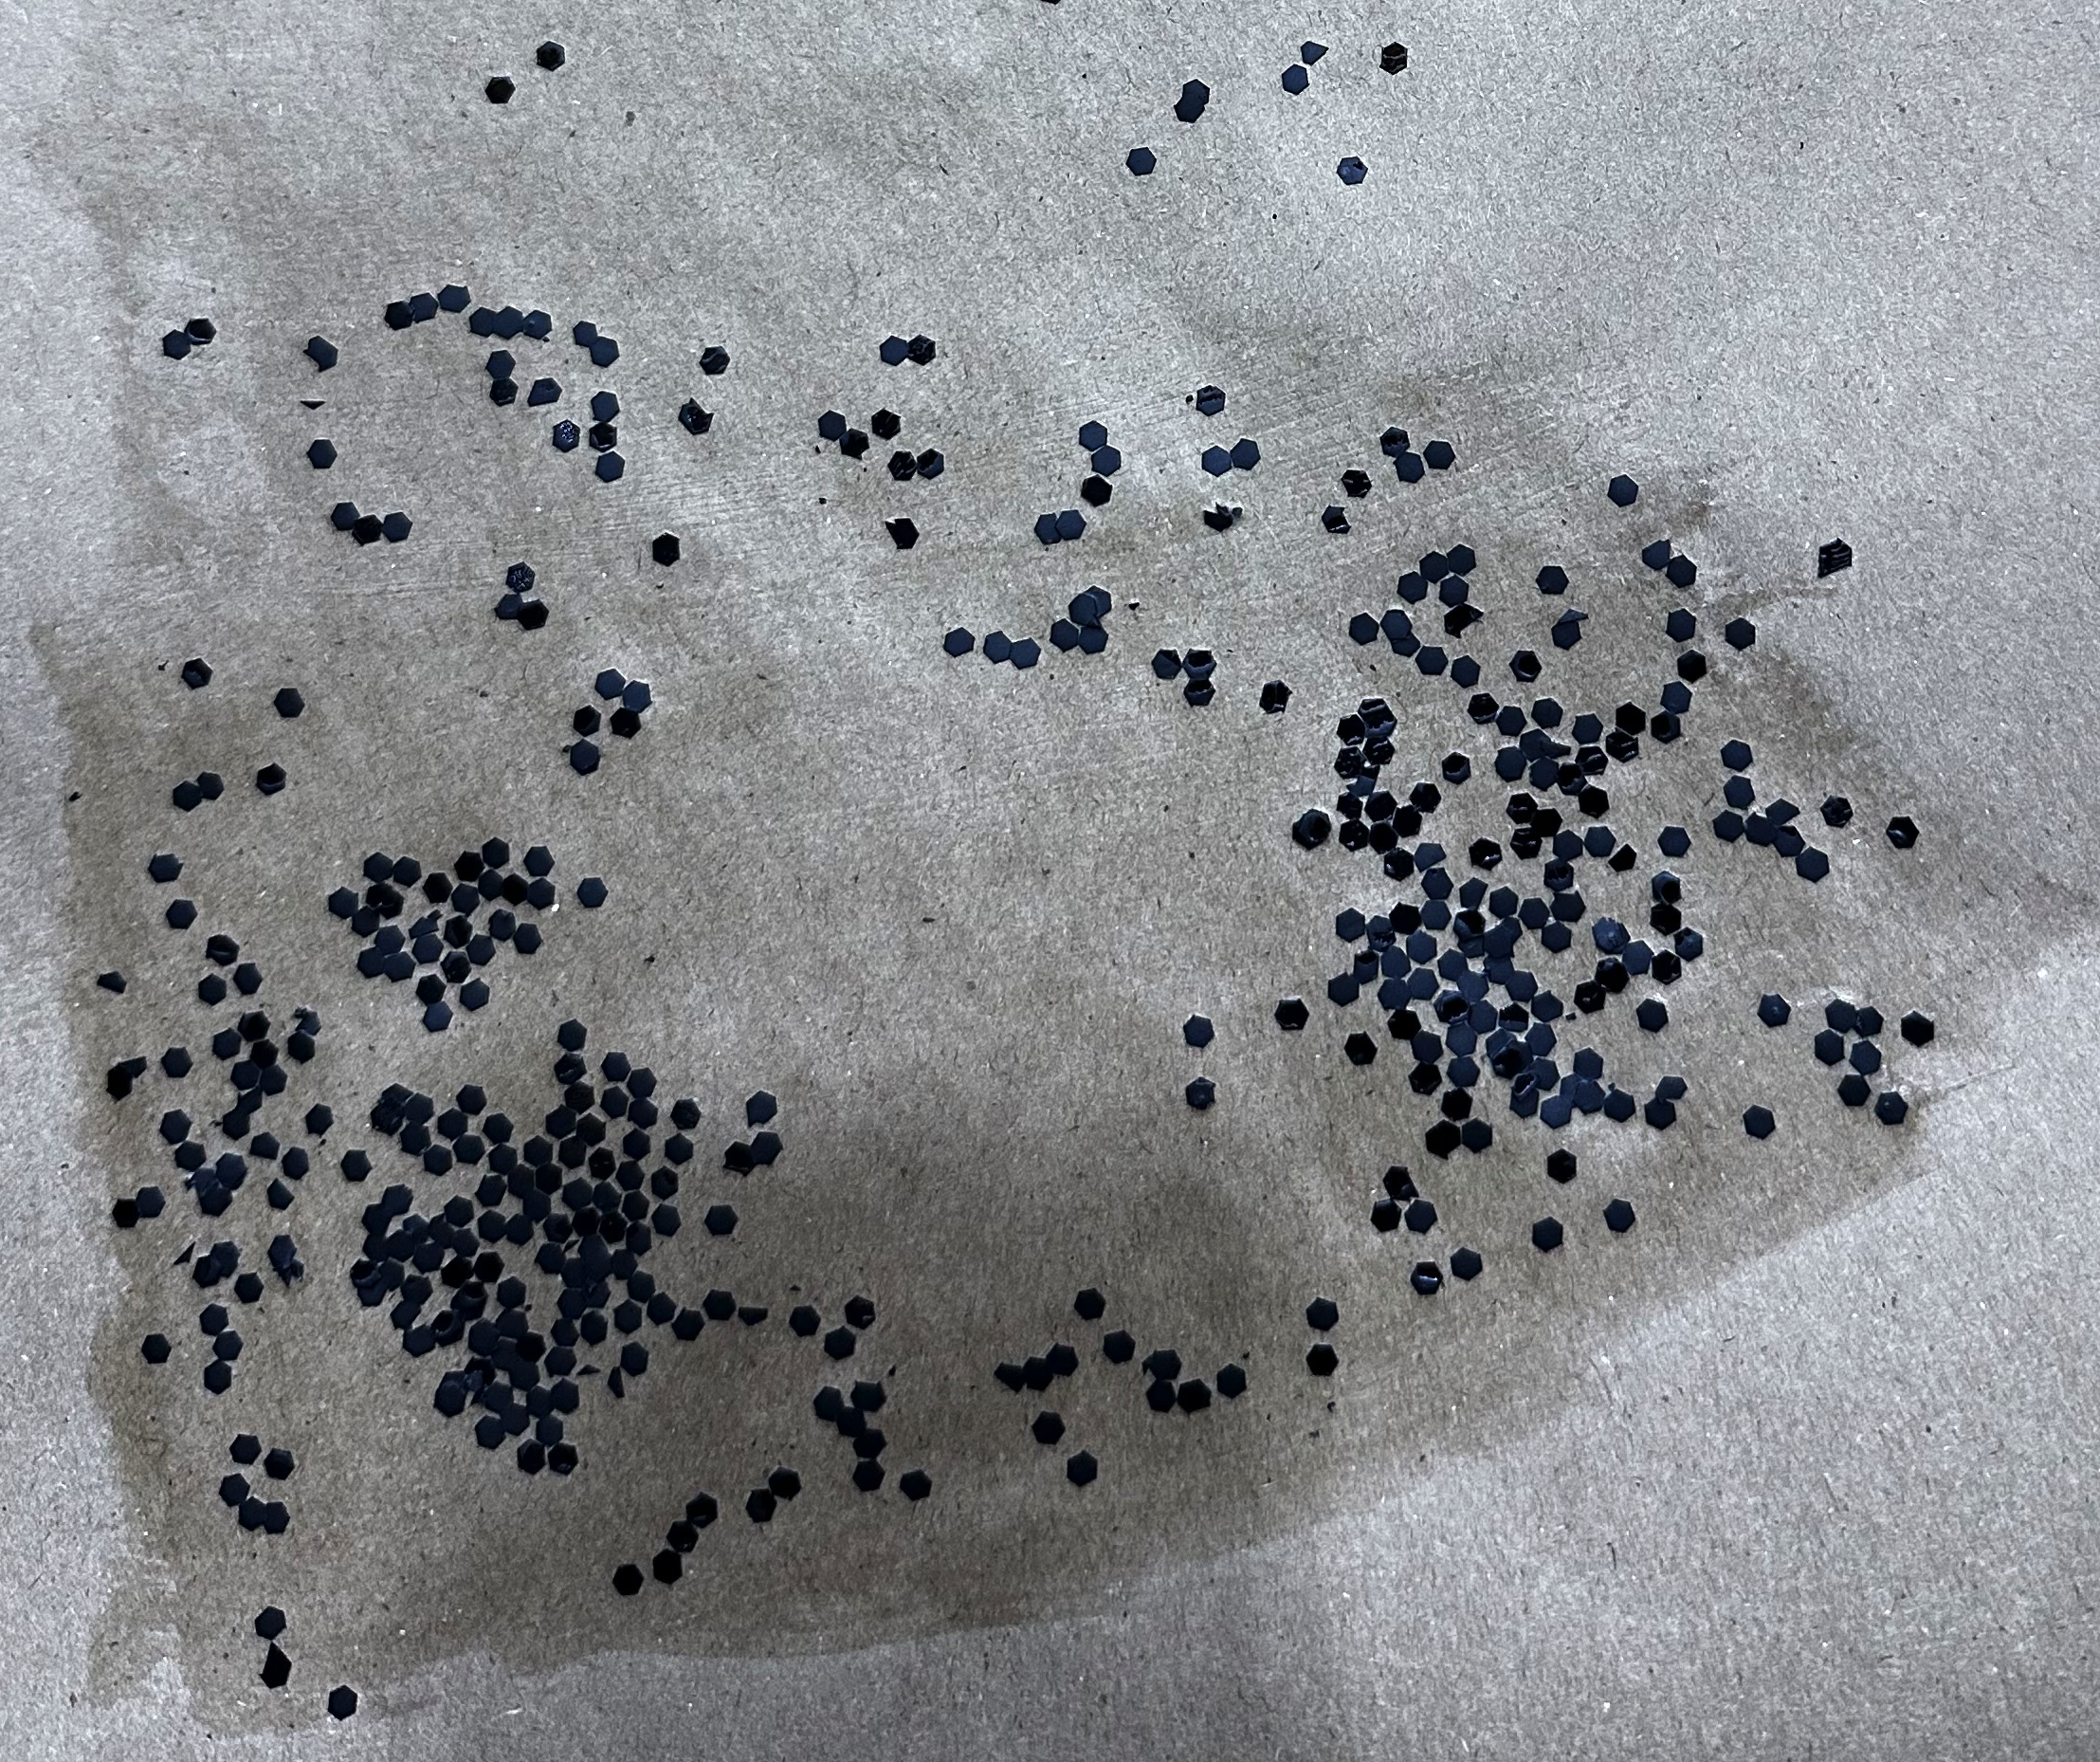
Clear coat and additive results
Ratios
  2 to 1 was too runny and as seen in the picture to the left there were puddles left on the test sample
  1 to 1 had so much additive it was too thick to paint
  4 to 3 was an ideal ratio
Application methods
  Paintbrush
    Moved the additive off the sides of the paper as seen in the bottom right image
  Paint roller
    Didn't pick up much additive and mostly absorbed clear coat
  Sponge
    Spread the additive well when dabbed
    Best method found
4 to 3 ratio applied on white painted Kevlar
2 to 1 ratio sample on white painted Kevlar
2 to 1 ratio applied with a paint brush to paper

Slide 8
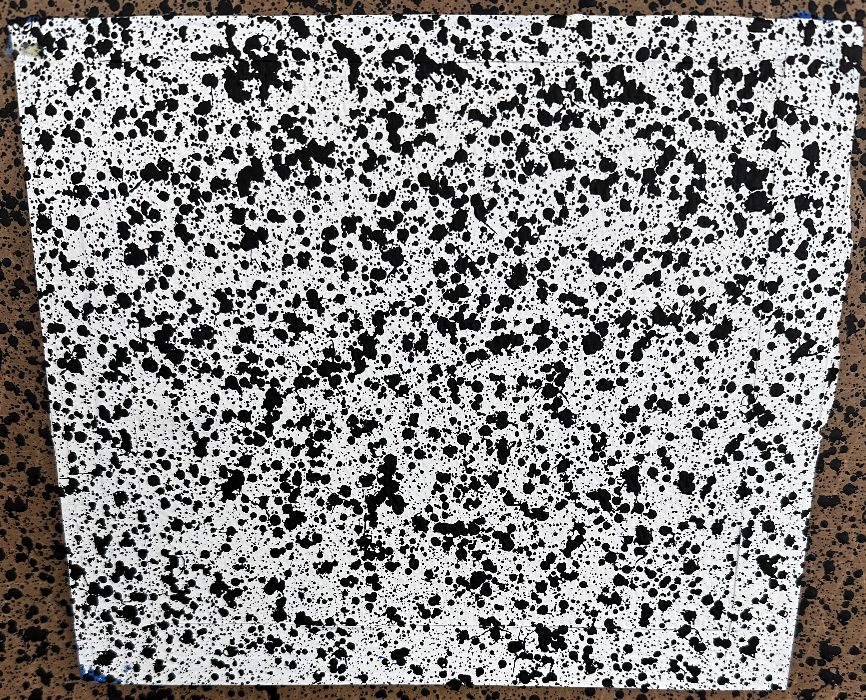
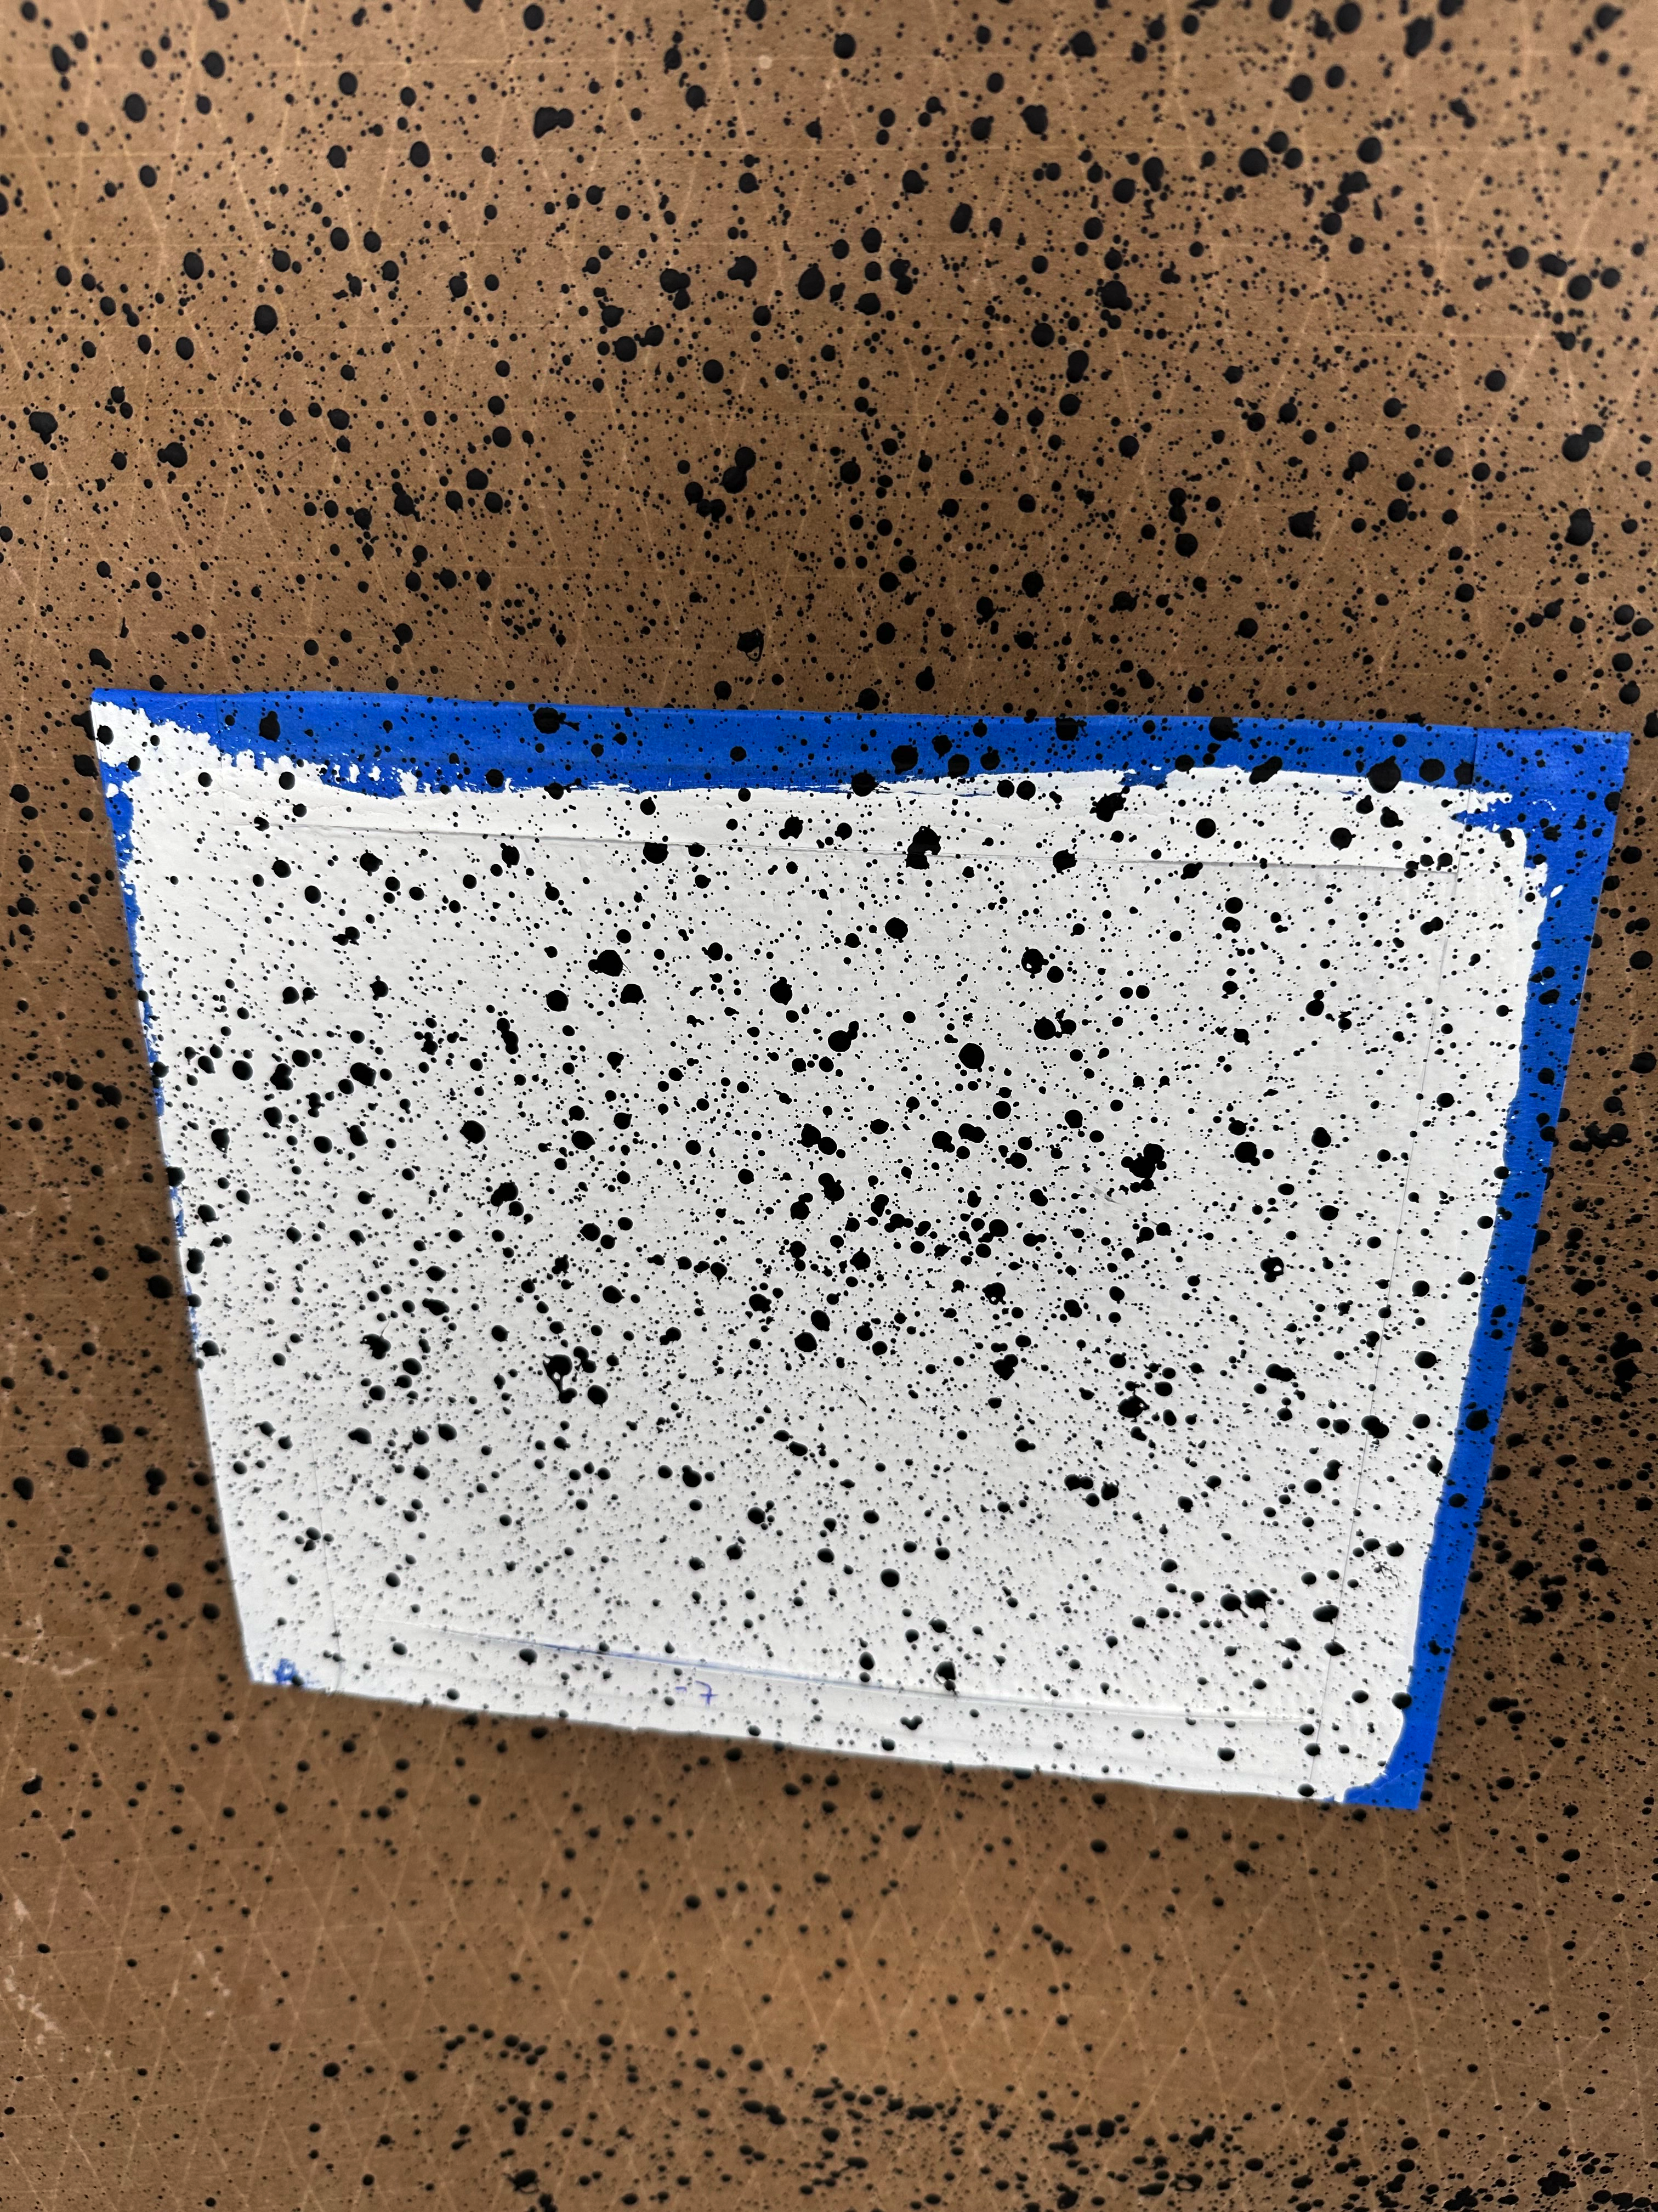
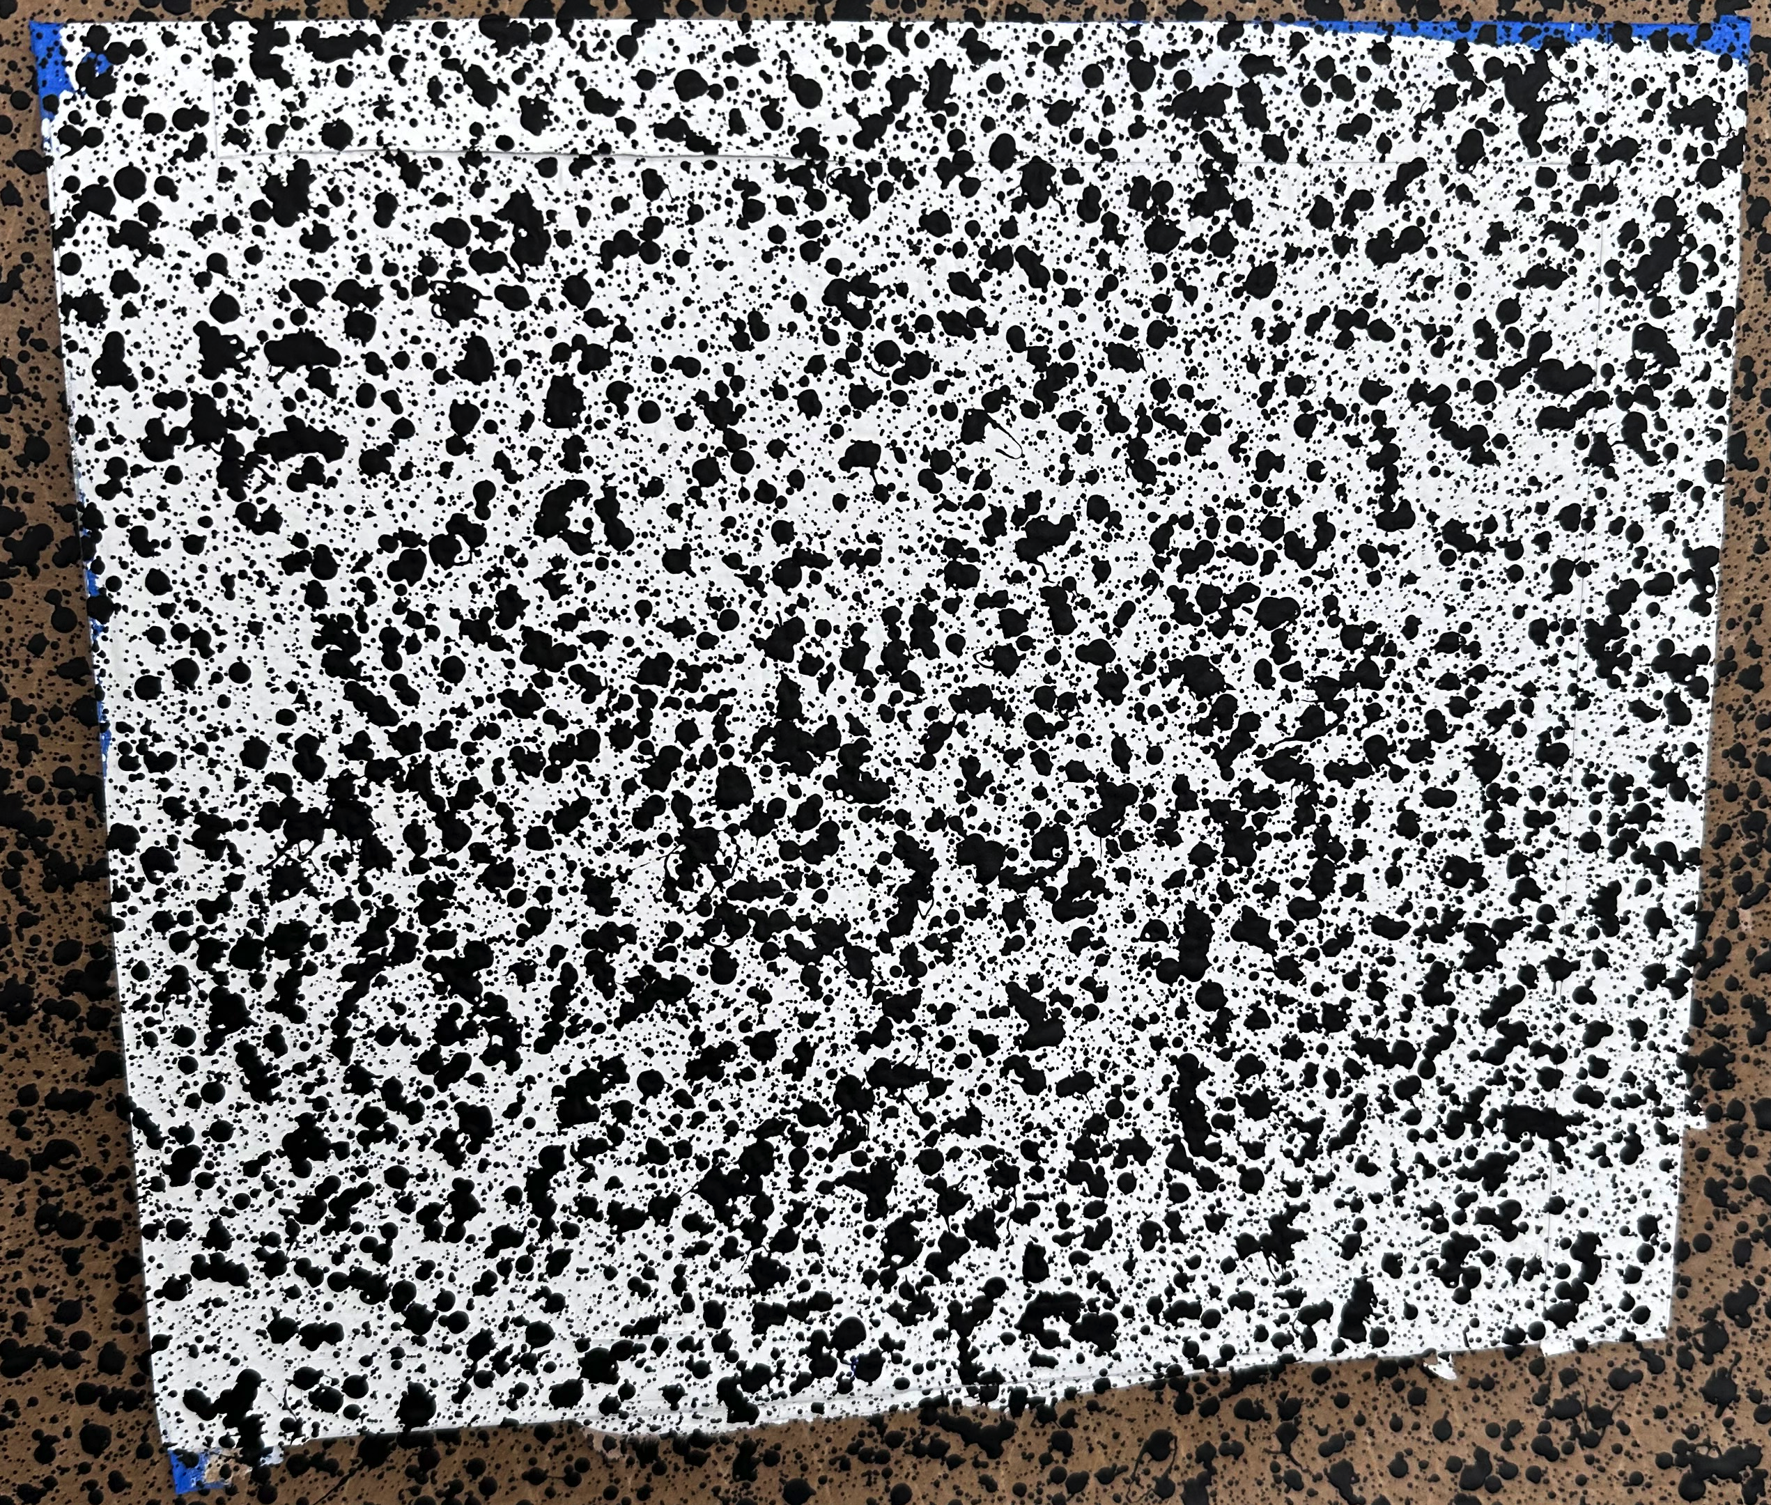
Paint Gun Application Method
Paint is atomized in different sized particles
The spread of the dots
  Stand off distance
Dot size
  Gun input pressure
  Pot regulator pressure
The ideal settings for woven articles
  Main Psi in 20 Psi
  Pot pressure 8.5 Psi
Different settings were tested until a continuous pattern was achieved using trial and error
  Initially tested on paper then tested on the test articles
A Graco splatter gun was used for this method
High atomization with a close gun distance
Medium atomization with a farther gun distance
High atomization with multiple spray passes

Slide 9
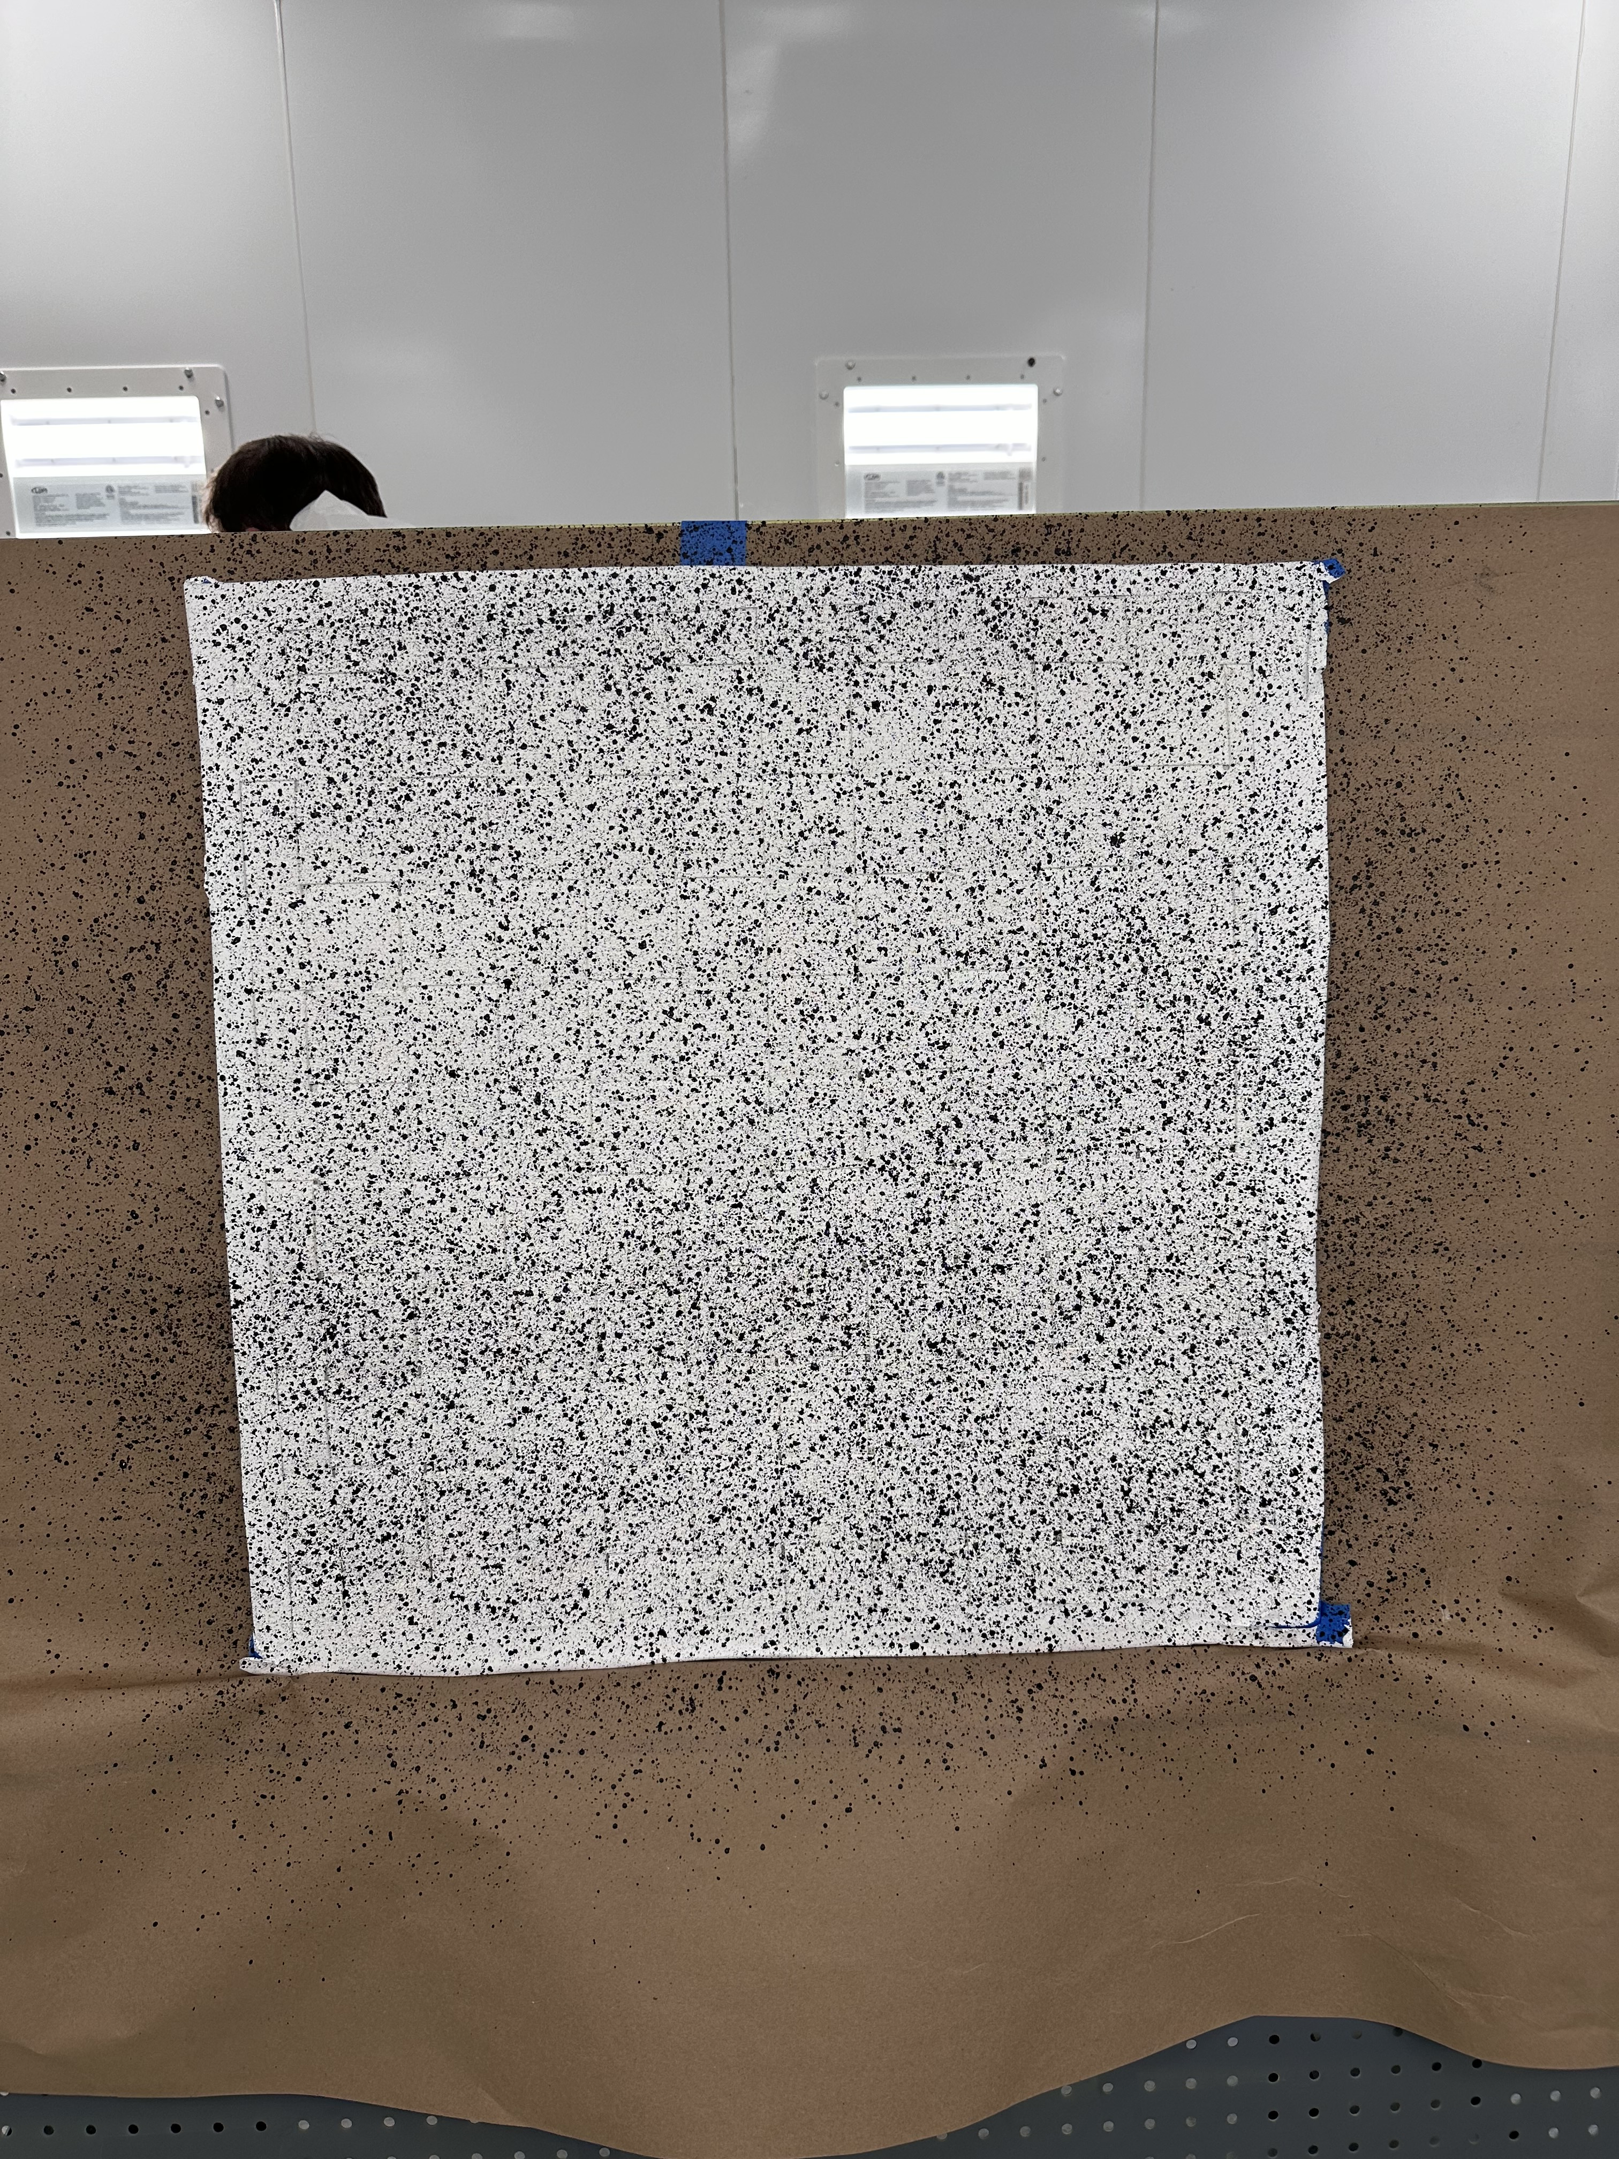
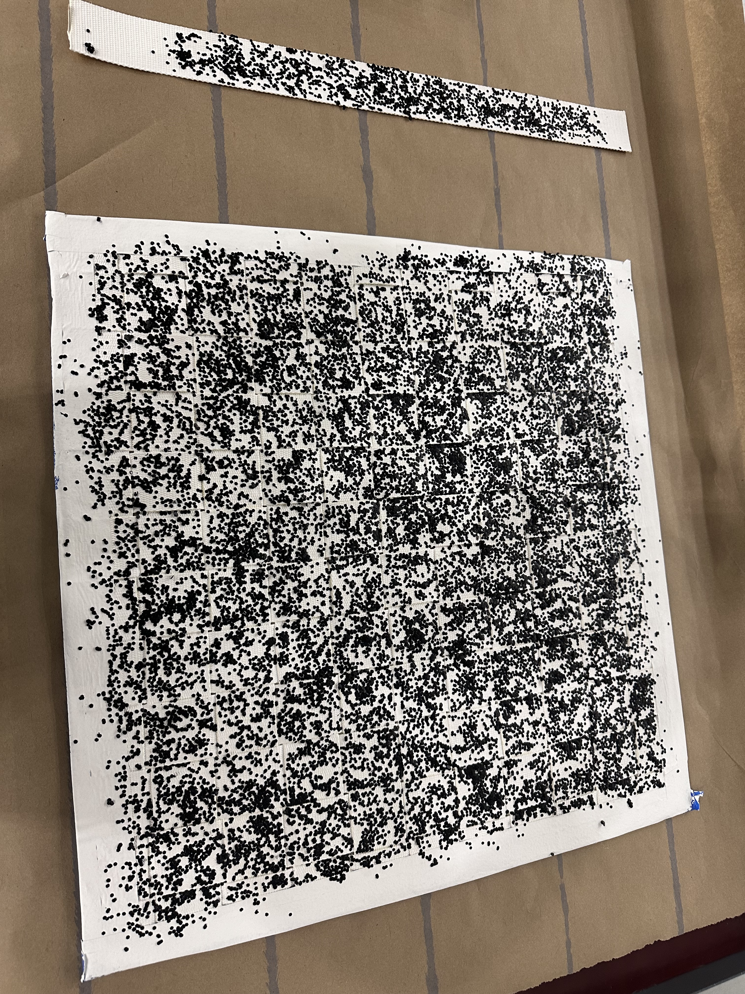
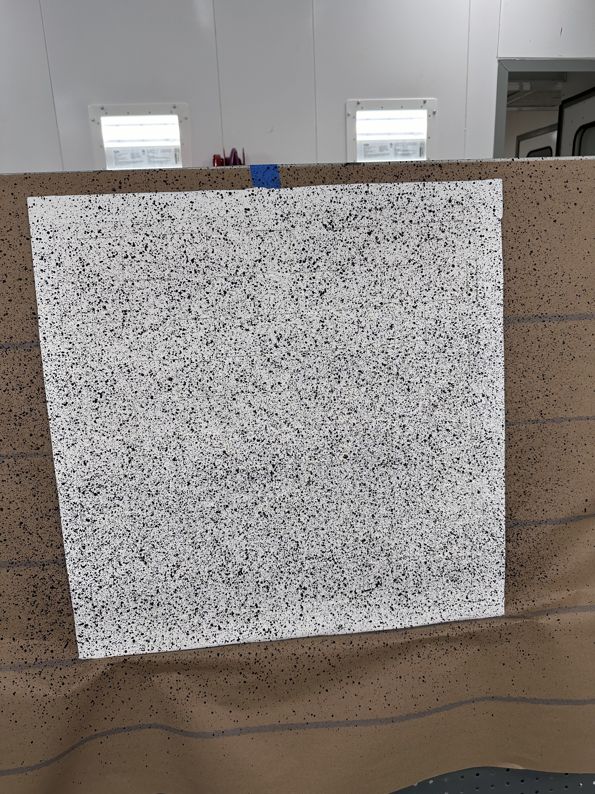
Woven Test Articles
No problems with unusual architectures / surfaces
Each test article is 2’x2’ woven polypropylene painted white
Good adherence
  as the articles were removed from the metal plates they are gently flexed to determine how they will react to an expanding habitat

Slide 10
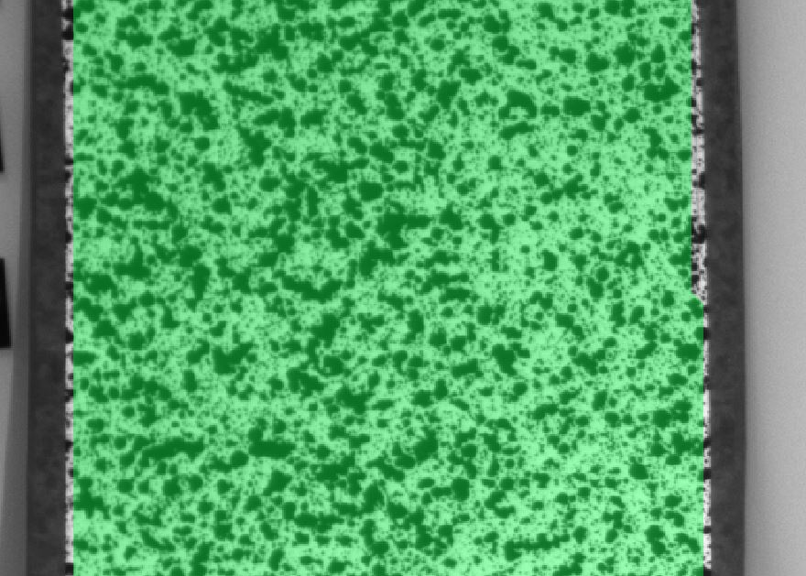
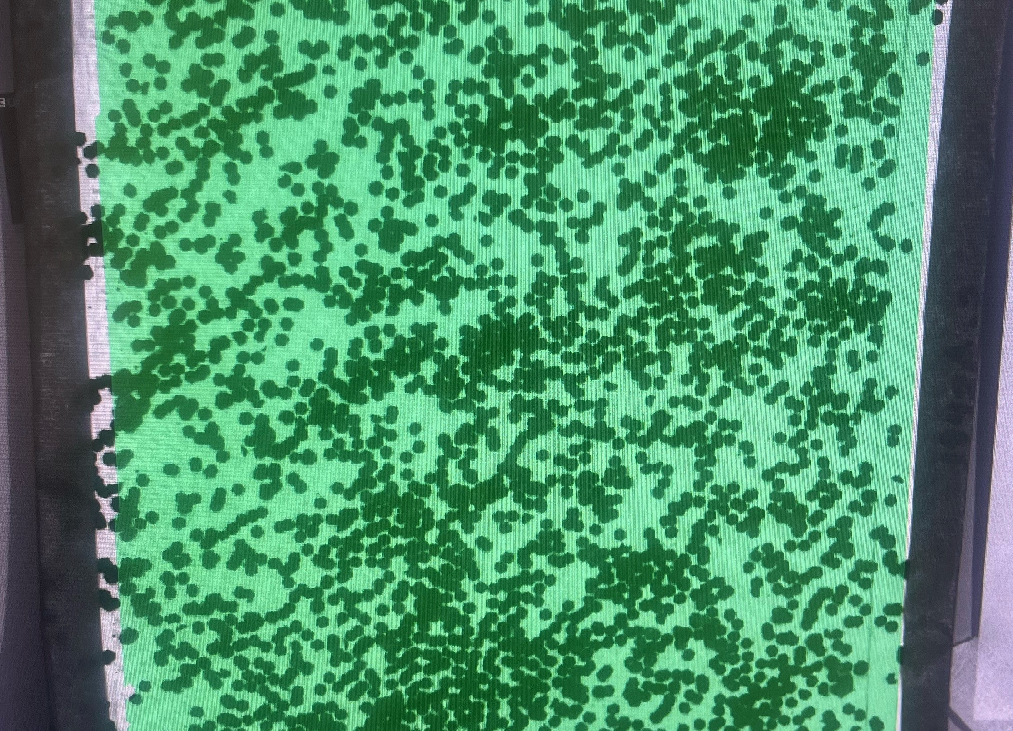
Results on VIC system
Spray Gun Pattern
Additive Pattern

Slide 11
Conclusion
The additive method
  Pros
    More accurate
    Costs less
    Useful in small spaces
    Can be adjusted to different layouts.
  Cons
    Takes longer than spray gun method
Spray gun method
  Pros
    Can cover large uninterrupted areas
    Fastest method
  Cons
    More expensive
    Space dependent
    Not as accurate

Slide 12
References
Adkins, I., “Vic-3D 9 manual and testing guide,” Correlated Solutions, Inc. Available: https://correlated.kayako.com/article/60-vic-3d-9-manual-and-testing-guide.
Selig, M.M. et al. (2015) ‘Creep burst testing of a woven inflatable module’, 2nd AIAA Spacecraft Structures Conference [Preprint]. doi:10.2514/6.2015-1625.

