Slide 1


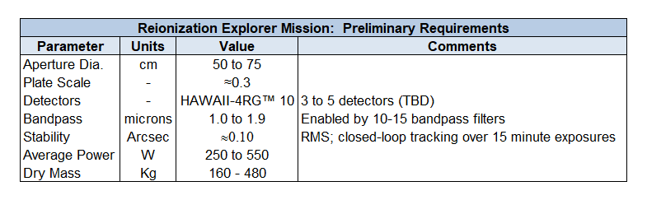
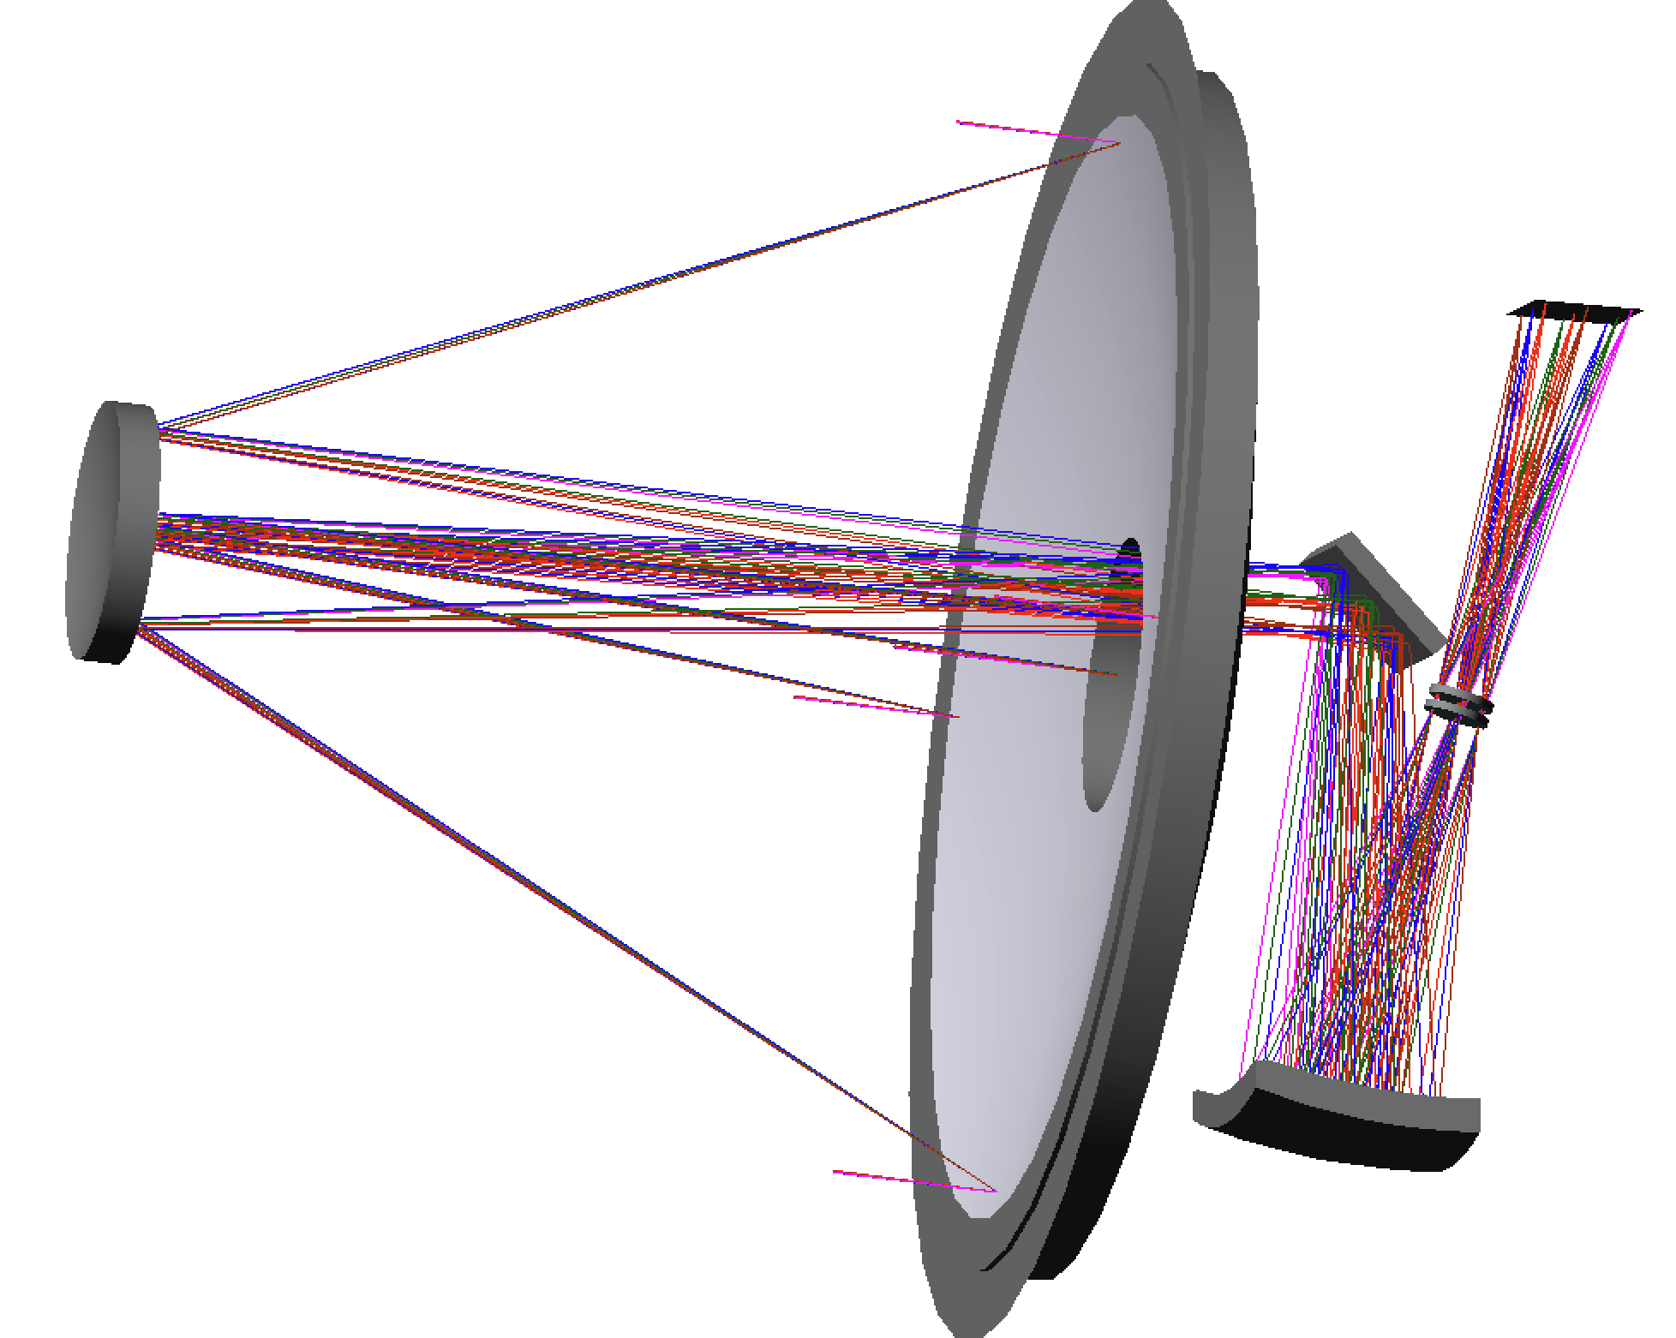
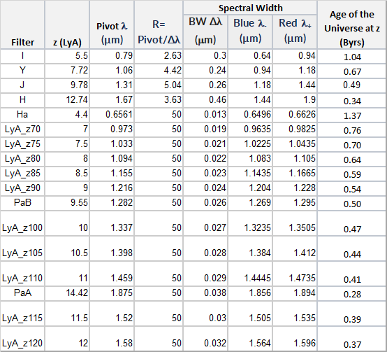
A Low-cost Innovative Observatory for the Reionization Explorer Mission (REX)
T. Casey (Aerodyne), B. Pasquale (NASA GSFC), J. Rhoads (NASA GSFC) S. Malhotra (NASA GSFC)
INTRODUCTION
METHODS
RESULTS
The early universe, from 400 to 800 million years after the Big Bang, or “Cosmic Dawn,” is characterized by large scale distributions of neutral and ionized intergalactic gas undergoing reionization on a cosmic scale at redshifts effectively unobservable through Earth’s atmosphere. Characterizing this active period of cosmological history requires wide-field, narrow passband surveys of galactic Lyman-alpha light red-shifted to the near infrared.
We are the requirements development phase for a large FOV (0.5-to-1.0 degree²) instrument with plate scale on the order of 0.3”/pixel to obtain a comprehensive view of the Cosmic Dawn reionization process over a representative volume of the early universe.
Fig. 3 Summary of Results to-date
Fig. 2 A 50cm to 75cm aperture telescope provides the required resolution and data volume for REX
In-process assessments of existing telescopes, focal planes and spacecraft are showing that the REX spacecraft can be built within the constraints of a NASA SMEX budget. Discussions with various industry potential partners are underway revealing multiple approaches to achieving REX science goals. Remaining work includes orbit trades, internal focal plane design, and focal plane cooling approach.
REX combines low noise Near Infrared detectors and wide field optics to rapidly map large areas of space during the crucial Cosmic Dawn epoch of 400-800 million years after the Big Bang (Red Shift z=7 to z=10+).
The REX filter complement will (a) provide narrow passbands whose central wavelengths sample Lyman-alpha emission across the reionization epoch; (b) incorporate complementary broad-band capabilities that ensure the power of REX as a stand-alone reionization observatory; and (c) enable a wide range of additional science. Filters will be individually selectable in wheels, enabling a flexible operations concept where fields and exposure times can be varied to maximize science return.
REX will establish new cost paradigms for attaining high value astrophysics results using low-cost mission components and approaches to reliability.
The REX team is now well positioned to engage in the next level of trades to be closed ahead of the expected NASA call for Small Explorer proposals sometime in the late Spring of 2025. These trades will establish the exact orbit to optimize observatory performance and science data volume. Additionally various cooling strategies for the REX Focal Plane will be investigated and traded in this same time frame.
Our requirements development methodology focuses on finding existing telescope and spacecraft designs that are suitable for re-use on REX avoiding a large fraction of traditional non-recurring design and development costs..
Fig. 1 REX will carry an extensive filter complement selected from the list shown here to enable unprecedented views of the Reionization period of “Cosmic Dawn”
CONCLUSIONS
Through disciplined application of design-for-cost principles and a thorough searching for existing designs that can achieve our science objectives, we have developed a game changing approach at advancing our understanding of the formation of the universe with a low-cost Small Explorer (SMEX) mission. REX is a mission that will deliver remarkable science results by leveraging state-of-the-art, yet affordable, telescope, detector and spacecraft components and approaches to reliability.
REX will be capable of extending our understanding of the Cosmic Dawn reionization event by collecting data unavailable to a ground-based telescope
Through careful assessment of existing designs and commercial products, REX science goals are achievable in the context of a NASA Small Explorer project
The NASA GSFC REX team is ready to proceed with early mission analyses and trades to establish REX Orbit, Operations Concept, cooling strategies, and filter wheel configuration
Design-to-Cost principles are rigorously applied in developing the REX “Reference Architecture” enabling rapid assessment of available mission components for minimal non-recurring cost.
REFERENCES
Fig. 2 Reference spacecraft architectures developed internally are used to assess suitability of existing high TRL spacecraft to enable REX to “fit” traditional NASA SMEX cost models
1. “The Reionization Explorer, REX: Science Overview”. Malhotra, S., Rhoads, J. E., Casey, T. M. Pasquale, B. A., Kruk, J. W., Mosby, G., Rauscher, B. J. 2024, these SPIE proceedings, paper 13092-31
Footer or Copyright Information

