Slide 1
CONSTITUTIVE LAW SELECTION FOR FINITE ELEMENT MODELING OF INCREMENTAL ROTARY FORMING
Elizabeth Urig
Analytical Mechanics Associates, Inc &
University of Virginia
Notes:
Enter speaker notes here.

Slide 2


About the Presenter
Elizabeth Urig, Senior Materials Engineer
  MS in Materials and Science Engineering, University of Virginia
Interests: Computational Materials, Advanced Manufacturing, Metallurgy
Co-authors: David Stegall, NASA Langley Research Center
Leonid Zhigilei, University of Virginia
Collaborators: Cecilia Mulvaney (Tues 9:20am, Center St Room B&C)
Andrew Boddorff (Wed 5pm, Center St Room B&C)
Work conducted under the Advanced Air Transport Technology (AATT) project (RSES Contract: 80LARC23DA003)
elizabeth.d.urig@nasa.gov
Notes:
Enter speaker notes here.

Slide 3
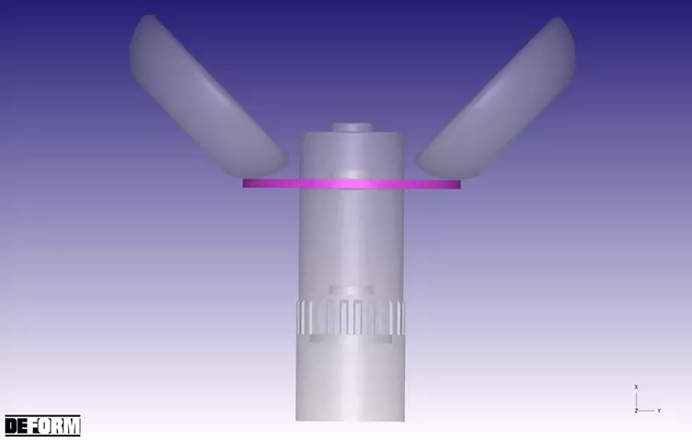
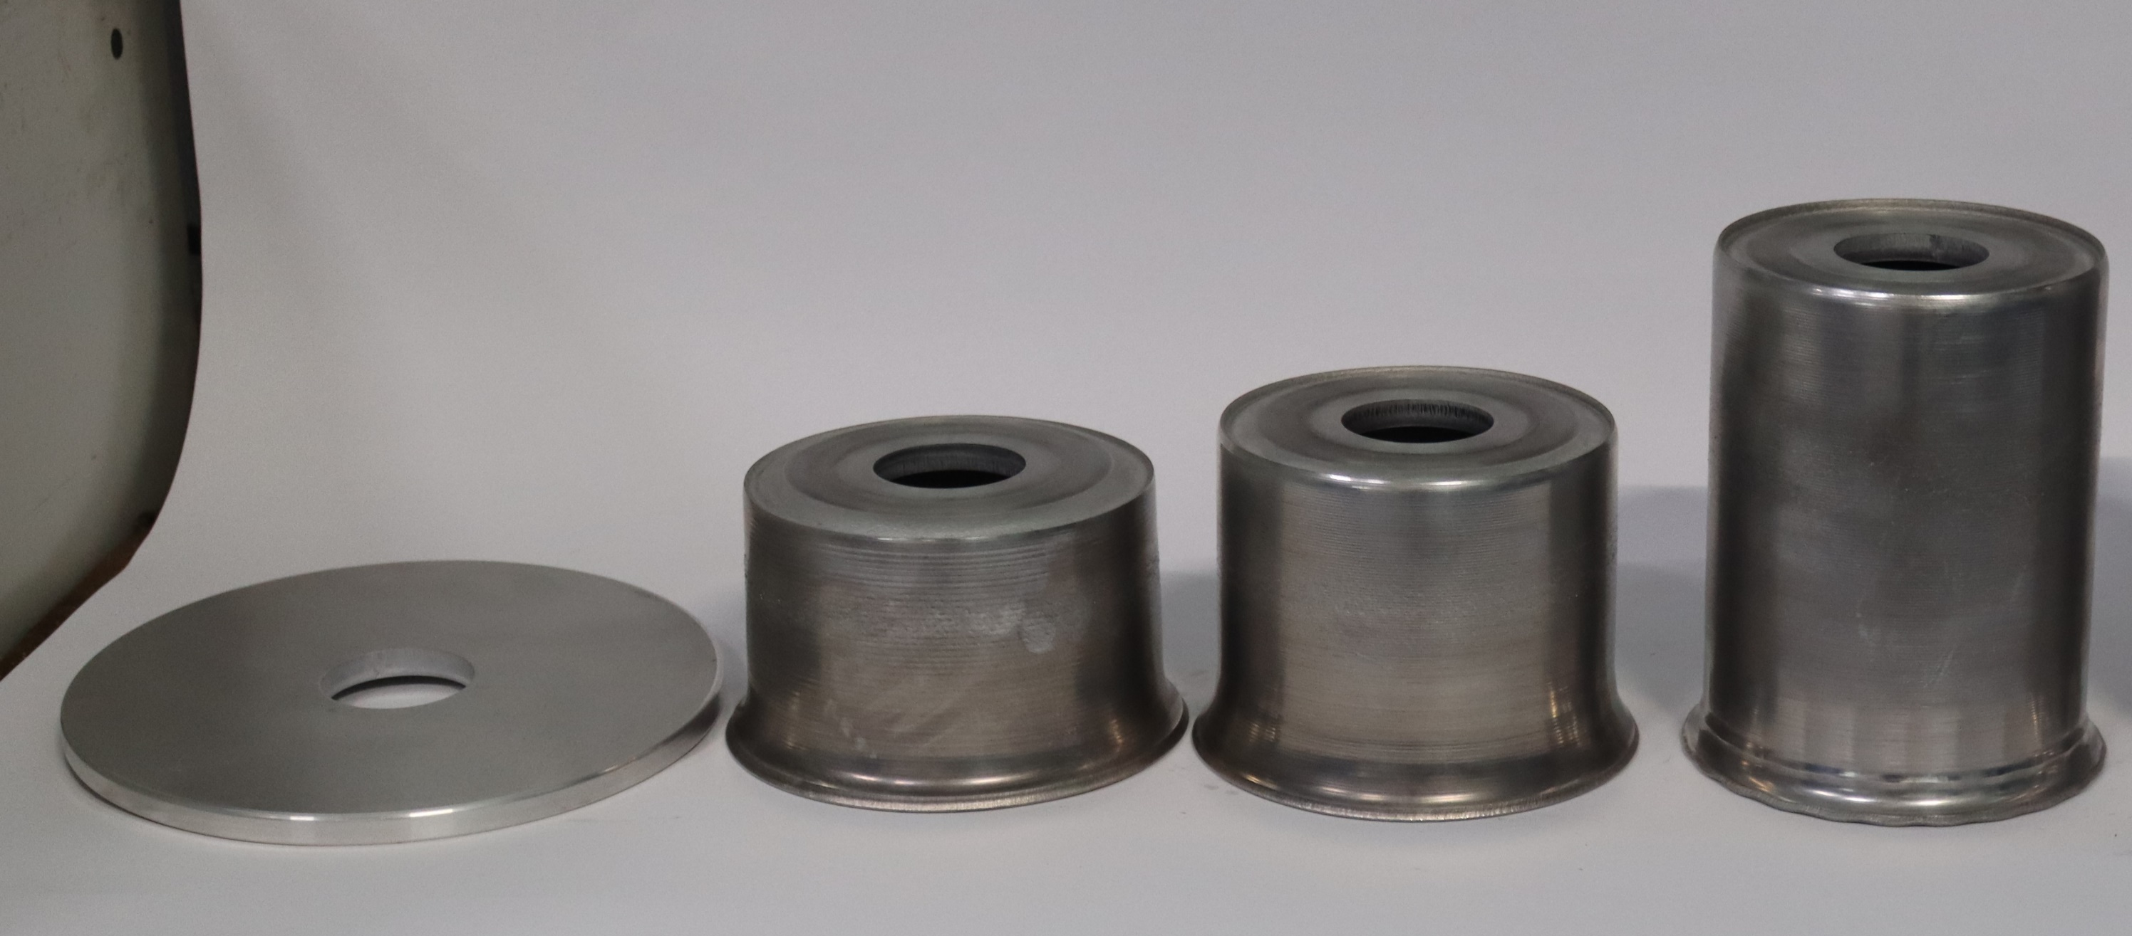
Motivation
Leverage spin and flow forming to manufacture near-net shape aerospace components
Aim: Accurately predict the forming loads, residual stress, final geometry, and strain accumulation
Challenge: Determine a constitutive model that will account for the thermal profile, deformation history, and work hardening behavior of rotary forming processes
Urig, Elizabeth, Karen Taminger, and Leonid Zhigilei. “Modeling Al-6061 Microstructural Evolution during Integrally Stiffened Cylinder Formation.” Presented at the 10th International Conference on Multiscale Materials Modeling, Baltimore, October 20, 2022.

Slide 4
Rotary Forming Overview

Slide 5
Spin Forming Material Response
X
.P1
.P4
.P7
.P10
.P2
.P5
.P8
.P11
**All results shown from 3D FEA simulated with Hollomon constitutive model
.P3
.P6
.P9
.P12
Y

Slide 6
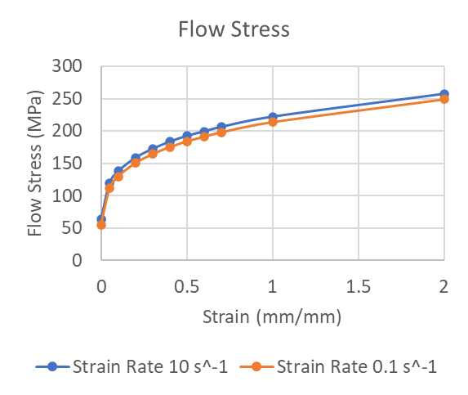


Constitutive Models
Constitutive models describe the material responses to different mechanical and/or thermal loading conditions
Analytic solutions to describe the underlying physics of material behavior
Mechanical Conditions: Strain, strain rate, dislocation density
Thermal: Temperature, temperature gradient, time
$$σ=f(ε,\dot{ε},T)$$
$σ=f(\hat{σ},\dot{ε},T)$
“Experimental Flow Stress Data.” Battelle Technical Report 16, pp B-11, November 1982.
Notes:
Enter speaker notes here.

Slide 7


Path-Dependence Example
$$σ=f(ε,\dot{ε},T)$$
$σ=f(\hat{σ},\dot{ε},T)$
Modified Hollomon (Power Law)
Johnson Cook
Mechanical Threshold Stress
Follansbee, Paul S. “On the Definition of State Variables for an Internal State Variable Constitutive Model Describing Metal Deformation.” Materials Sciences and Applications 2014 (June 20, 2014). https://doi.org/10.4236/msa.2014.58062.

Slide 8
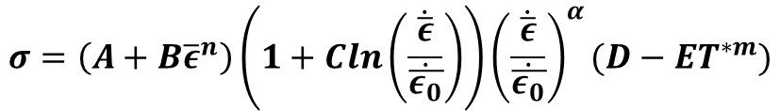



Path-Independent Constitutive Models
Modified Hollomon
  The Hollomon constitutive law considers the strain hardening exponent, and how the hardening behavior will affect the stress response
Johnson-Cook
  Johnson-Cook is a robust constitutive law that considers the strain hardening, strain rate hardening, and thermal softening effects
$$σ=Kε^{n}+C$$
$$σ=\left(A+B{\overline{ε}}^{n}\right)\left(1+Cln\left(\frac{\dot{\overline{ε}}}{\dot{\overline{ε_{0}}}}\right)\right){\left(\frac{\dot{\overline{ε}}}{\dot{\overline{ε_{0}}}}\right)}^{α}(D−ET^{∗m})$$
$$T∗=\frac{T−T_{room}}{T_{melt}−T_{room}}$$
$$D=D_{0}exp(k{\left(T−T_{b}\right)}^{β})$$
Kuykendall, Katherine Lynn. “An Evaluation of Constitutive Laws and Their Ability to Predict Flow Stress over Large Variations in Temperature, Strain, and Strain Rate Characteristic of Friction Stir Welding,” n.d.
Notes:
Enter speaker notes here.

Slide 9
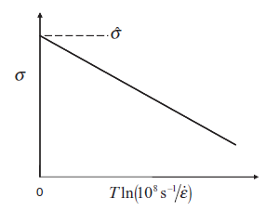
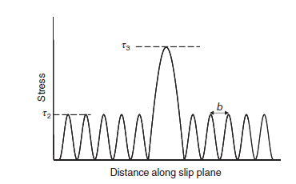
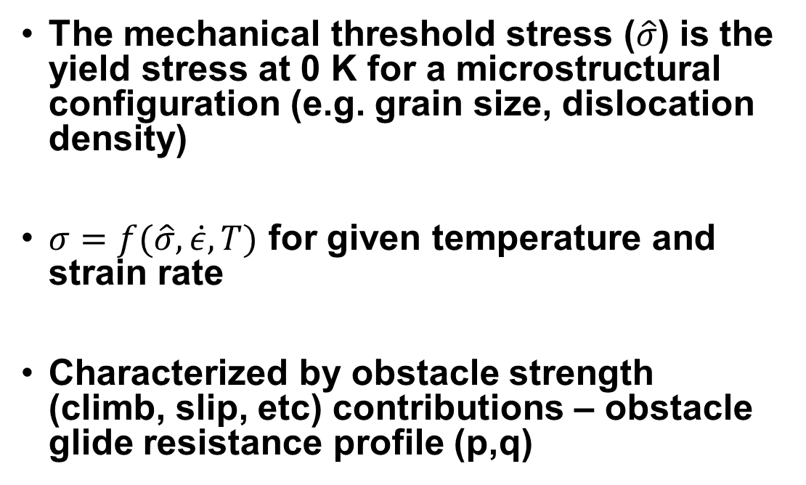
Mechanical Threshold Stress (MTS)
The mechanical threshold stress ($\hat{σ}$) is the yield stress at 0 K for a microstructural configuration (e.g. grain size, dislocation density)
$σ=f(\hat{σ},\dot{ε},T)$ for given temperature and strain rate
Characterized by obstacle strength (climb, slip, etc) contributions – obstacle glide resistance profile (p,q)
Follansbee, Paul S. Fundamentals of Strength: Principles, Experiment, and Applications of an Internal State Variable Constitutive Formulation. Hoboken: Wiley [u.a.], 2014.

Slide 10

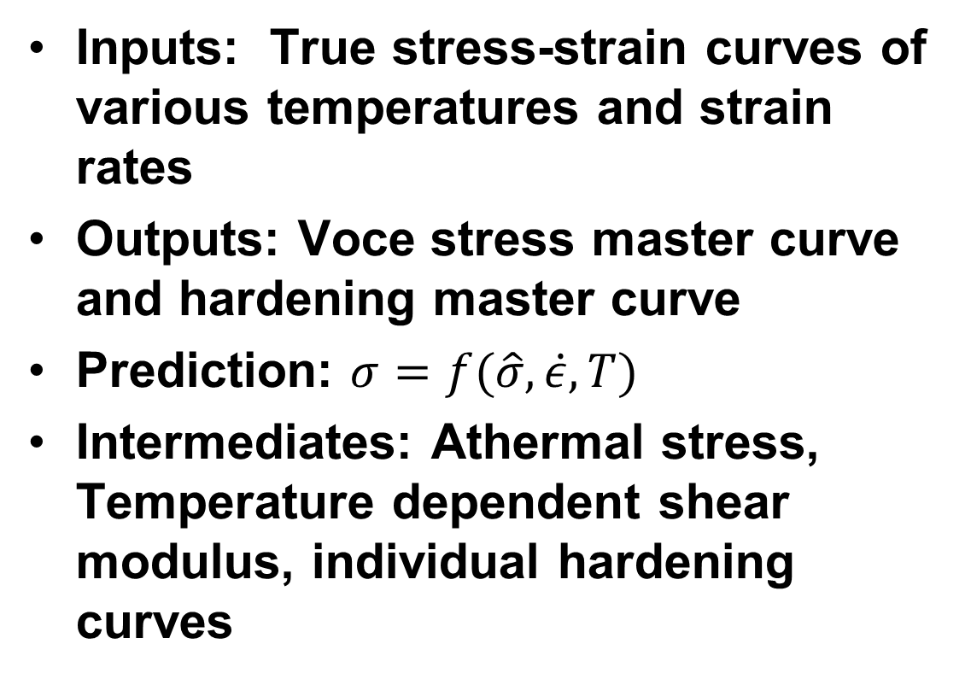

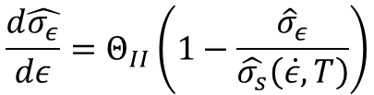
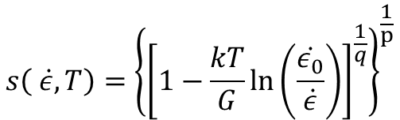
MTS Inputs and Outputs
Inputs: True stress-strain curves of various temperatures and strain rates
Outputs: Voce stress master curve and hardening master curve
Prediction: $σ=f(\hat{σ},\dot{ε},T)$
Intermediates: Athermal stress, Temperature dependent shear modulus, individual hardening curves
$$σ=σ_{a}+ s(\dot{ε},T)\hat{σ}$$
$$\frac{σ}{μ}=\frac{σ_{a}}{μ}+ s_{ε}\left(\dot{ε},T\right)\frac{{\hat{σ}}_{ε}(ε,\dot{ε},T)}{μ_{0}}$$
$$\frac{d\hat{σ_{ε}}}{dε}=Θ_{II}\left(1−\frac{{\hat{σ}}_{ε}}{\hat{σ_{s}}\left(\dot{ε},T\right)}\right)$$
$$s\left( \dot{ε},T\right)={\left\{{\left[1−\frac{kT}{G}\ln\left(\frac{\dot{ε_{0}}}{\dot{ε}}\right)\right]}^{\frac{1}{q}}\right\}}^{\frac{1}{p}}$$
Short-range obstacles: Glide resistance and free energy required to overcome and obstacle
Follansbee, Paul S. Fundamentals of Strength: Principles, Experiment, and Applications of an Internal State Variable Constitutive Formulation. Hoboken: Wiley [u.a.], 2014.

Slide 11
Monotonic Stress Strain Curve Comparison
Hollomon most closely follows the red experimental line
Though MTS is slightly underpredicting the flow stress at room temperature, good agreement with saturation stress globally (R²= 0.9607)
Notes:
Enter speaker notes here.

Slide 12

Implementation of MTS in FEA (DEFORM)
Notes:
Enter speaker notes here.

Slide 13
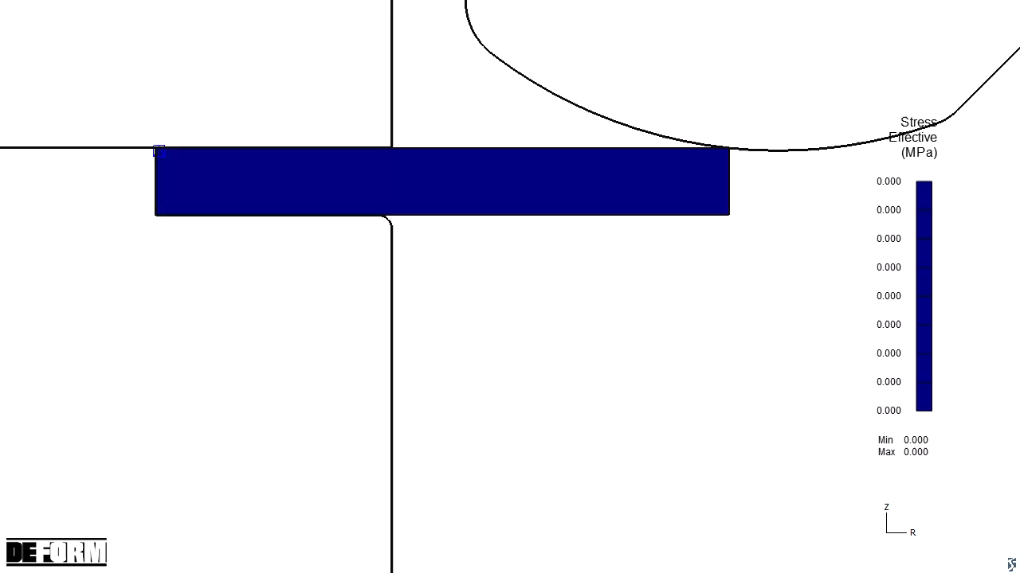
Implementation of MTS in FEA (DEFORM)
Notes:
Enter speaker notes here.

Slide 14
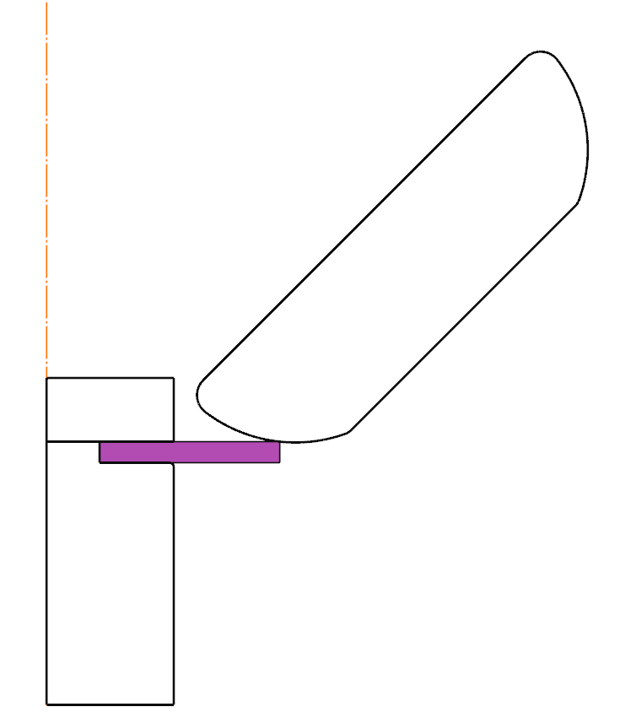
Predicted Vertical Forces in 2D FEA Simulations
Notes:
Enter speaker notes here.

Slide 15
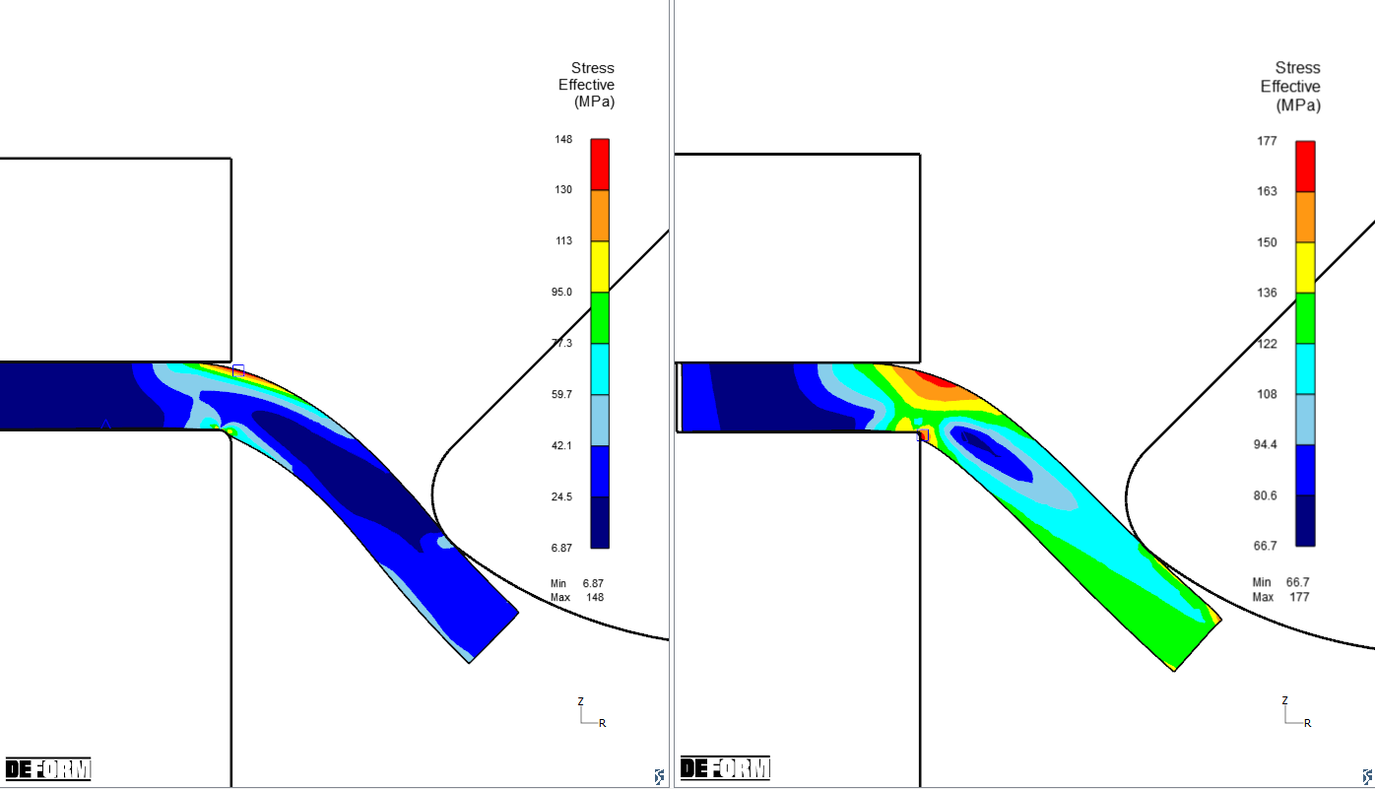
Constitutive Model Comparison
  Hollomon: 327% error (38.9 kN to 9.12 kN)
  MTS: 15% error (10.5 kN to 9.12 kN)

Slide 16
Conclusions
Oscillating loading conditions yield complex stress states of alternating tension and compression, mimicking low cycle fatigue
Leveraging a path-dependent constitutive model offers the ability to implement strain hardening and more accurate material behavior
Implementation of the MTS constitutive model in a spin forming finite element model showed an improved accuracy of 312%

Slide 17
References
Urig, Elizabeth, Karen Taminger, and Leonid Zhigilei. “Modeling Al-6061 Microstructural Evolution during Integrally Stiffened Cylinder Formation.” Presented at the 10th International Conference on Multiscale Materials Modeling, Baltimore, October 20, 2022
“Experimental Flow Stress Data.” Battelle Technical Report 16, pp B-11, November 1982.
Follansbee, Paul S. “On the Definition of State Variables for an Internal State Variable Constitutive Model Describing Metal Deformation.” Materials Sciences and Applications 2014 (June 20, 2014). https://doi.org/10.4236/msa.2014.58062.
Kuykendall, Katherine Lynn. “An Evaluation of Constitutive Laws and Their Ability to Predict Flow Stress over Large Variations in Temperature, Strain, and Strain Rate Characteristic of Friction Stir Welding,” n.d.
Follansbee, Paul S. Fundamentals of Strength: Principles, Experiment, and Applications of an Internal State Variable Constitutive Formulation. Hoboken: Wiley [u.a.], 2014.

Slide 18
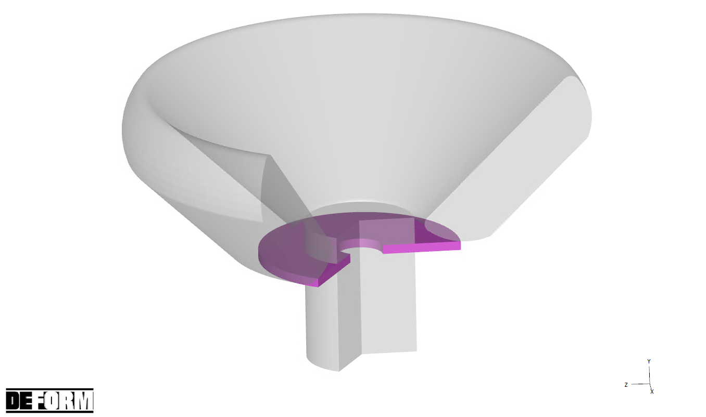
2D to 3D Vertical Load Conversion

Slide 19
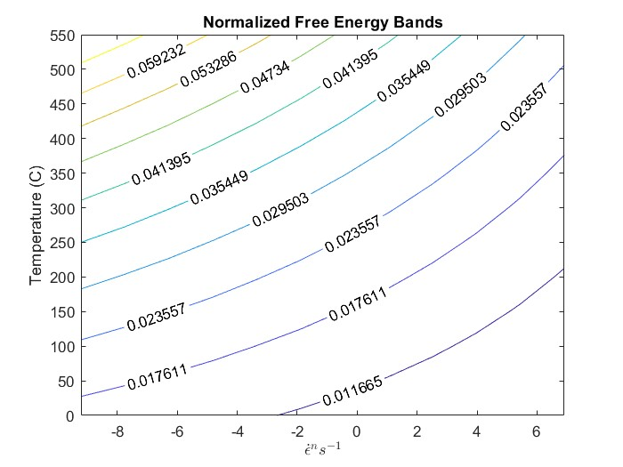
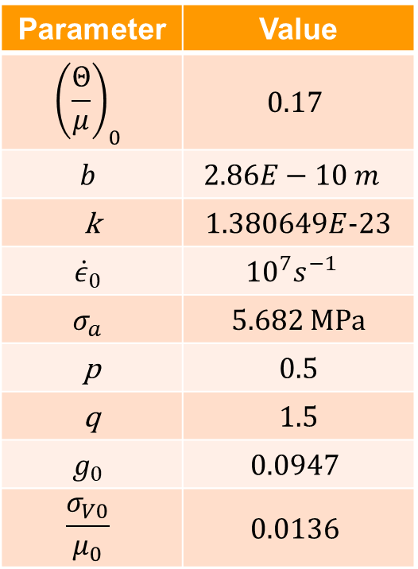
MTS Constants for Al 6061-O
Parameter | Value
$${\left(\frac{Θ}{μ}\right)}_{0}$$ | $$0.17$$
$$b$$ | $$2.86E−10 m$$
k | 1.380649$E$-23
$${\dot{ε}}_{0}$$ | $${10}^{7}s^{−1}$$
$$σ_{a}$$ | 5.682 MPa
p | 0.5
q | 1.5
$$g_{0}$$ | $$0.0947$$
$$\frac{σ_{V0}}{μ_{0}}$$ | $$0.0136$$

Slide 20
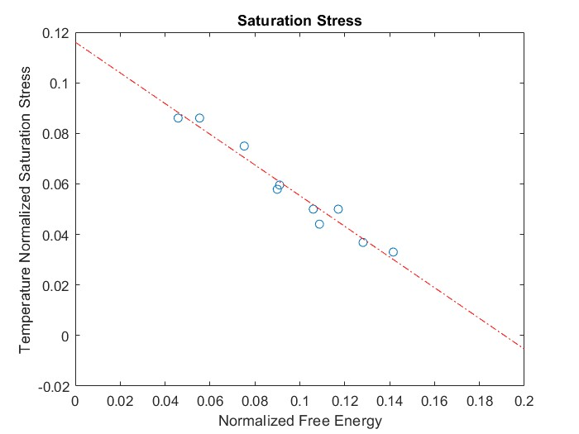
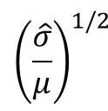
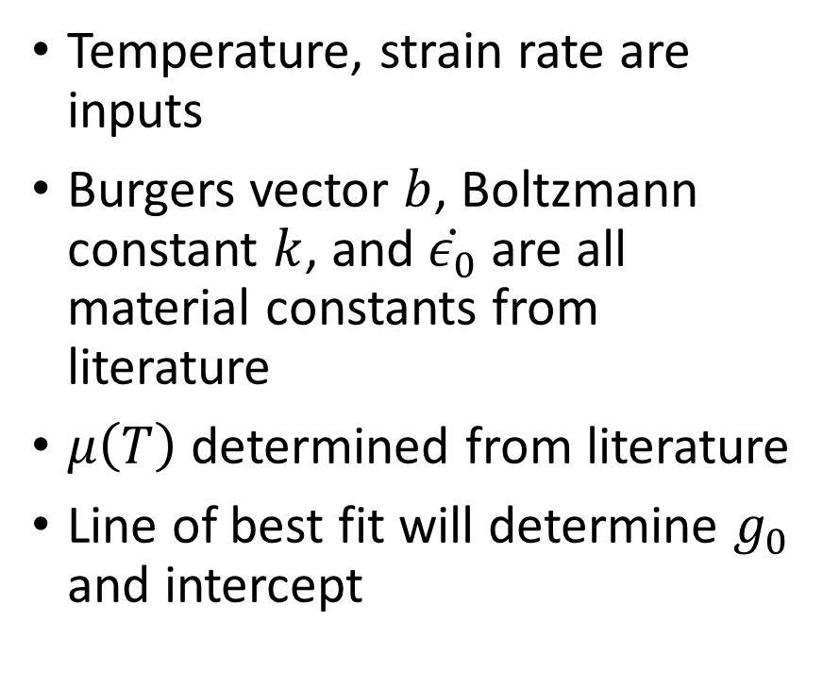
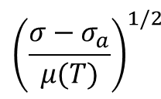
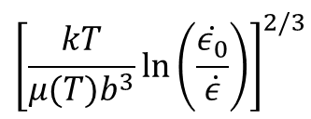
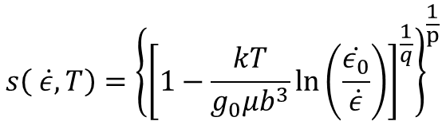

State Equation
$$σ=σ_{a}+ s(\dot{ε},T)\hat{σ}$$
$$s\left( \dot{ε},T\right)={\left\{{\left[1−\frac{kT}{g_{0}μb^{3}}\ln\left(\frac{\dot{ε_{0}}}{\dot{ε}}\right)\right]}^{\frac{1}{q}}\right\}}^{\frac{1}{p}}$$
Temperature, strain rate are inputs
Burgers vector $b$, Boltzmann constant $k$, and $\dot{ε_{0}}$ are all material constants from literature
$μ\left(T\right)$ determined from literature
Line of best fit will determine $g_{0}$ and intercept
$${\left(\frac{\hat{σ}}{μ}\right)}^{1/2}$$
R²= 0.9607
$${\left(\frac{σ−σ_{a}}{μ(T)}\right)}^{1/2}$$
$${\left[\frac{kT}{μ(T)b^{3}}\ln\left(\frac{\dot{ε_{0}}}{\dot{ε}}\right)\right]}^{2/3}$$

