Slide 1
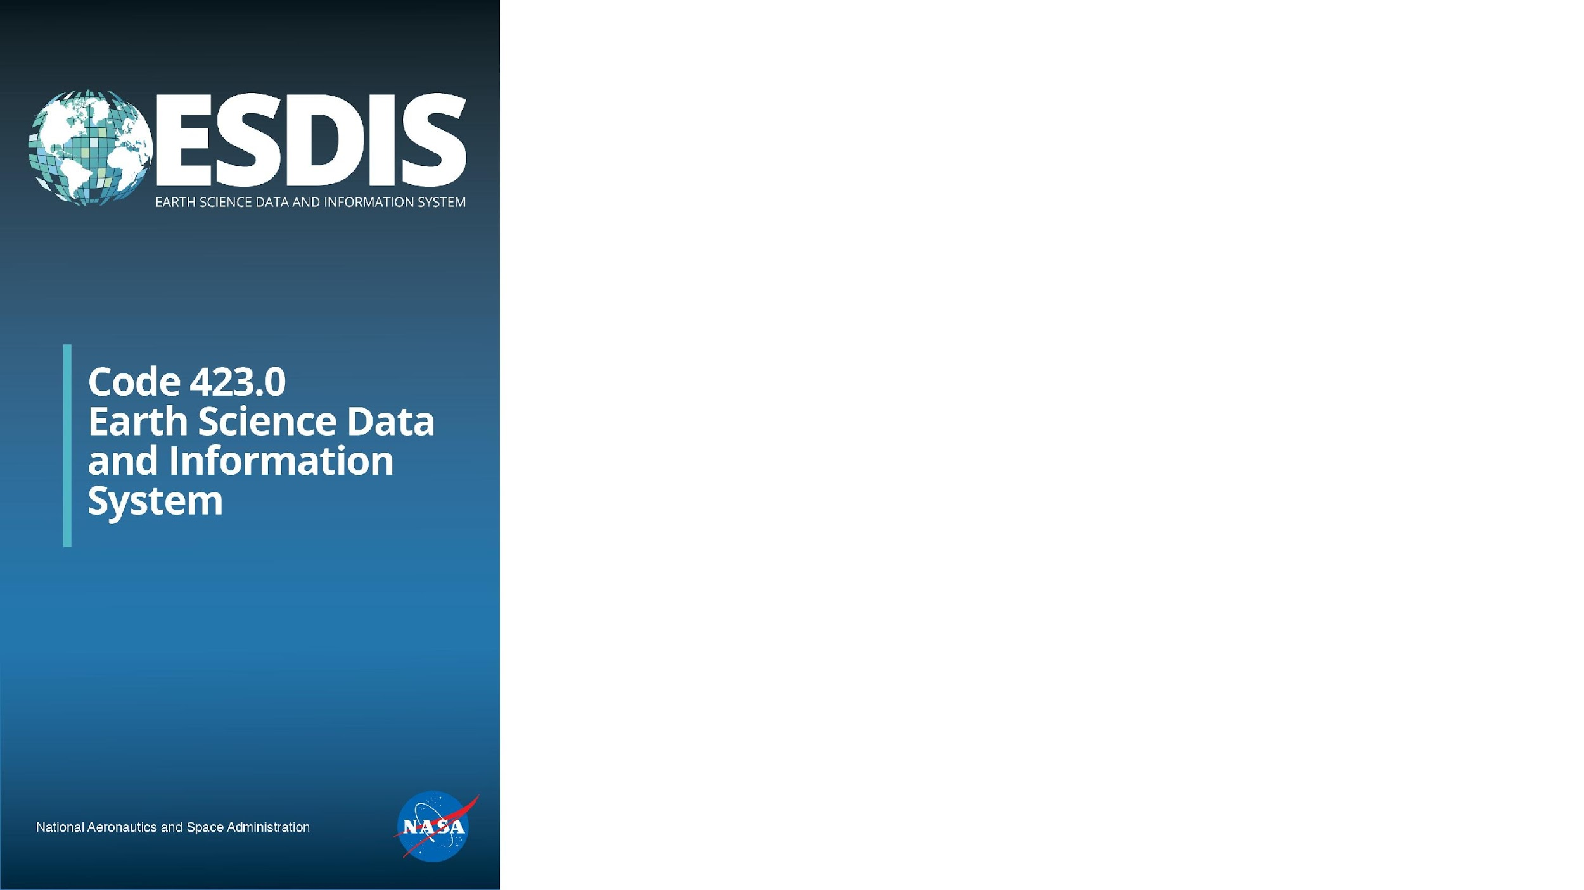
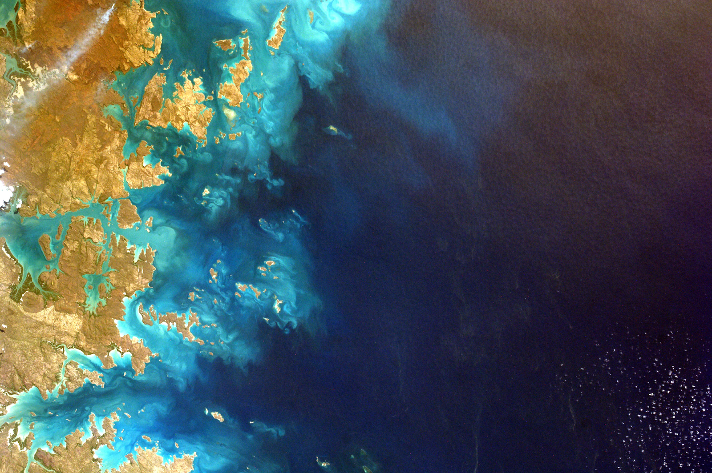
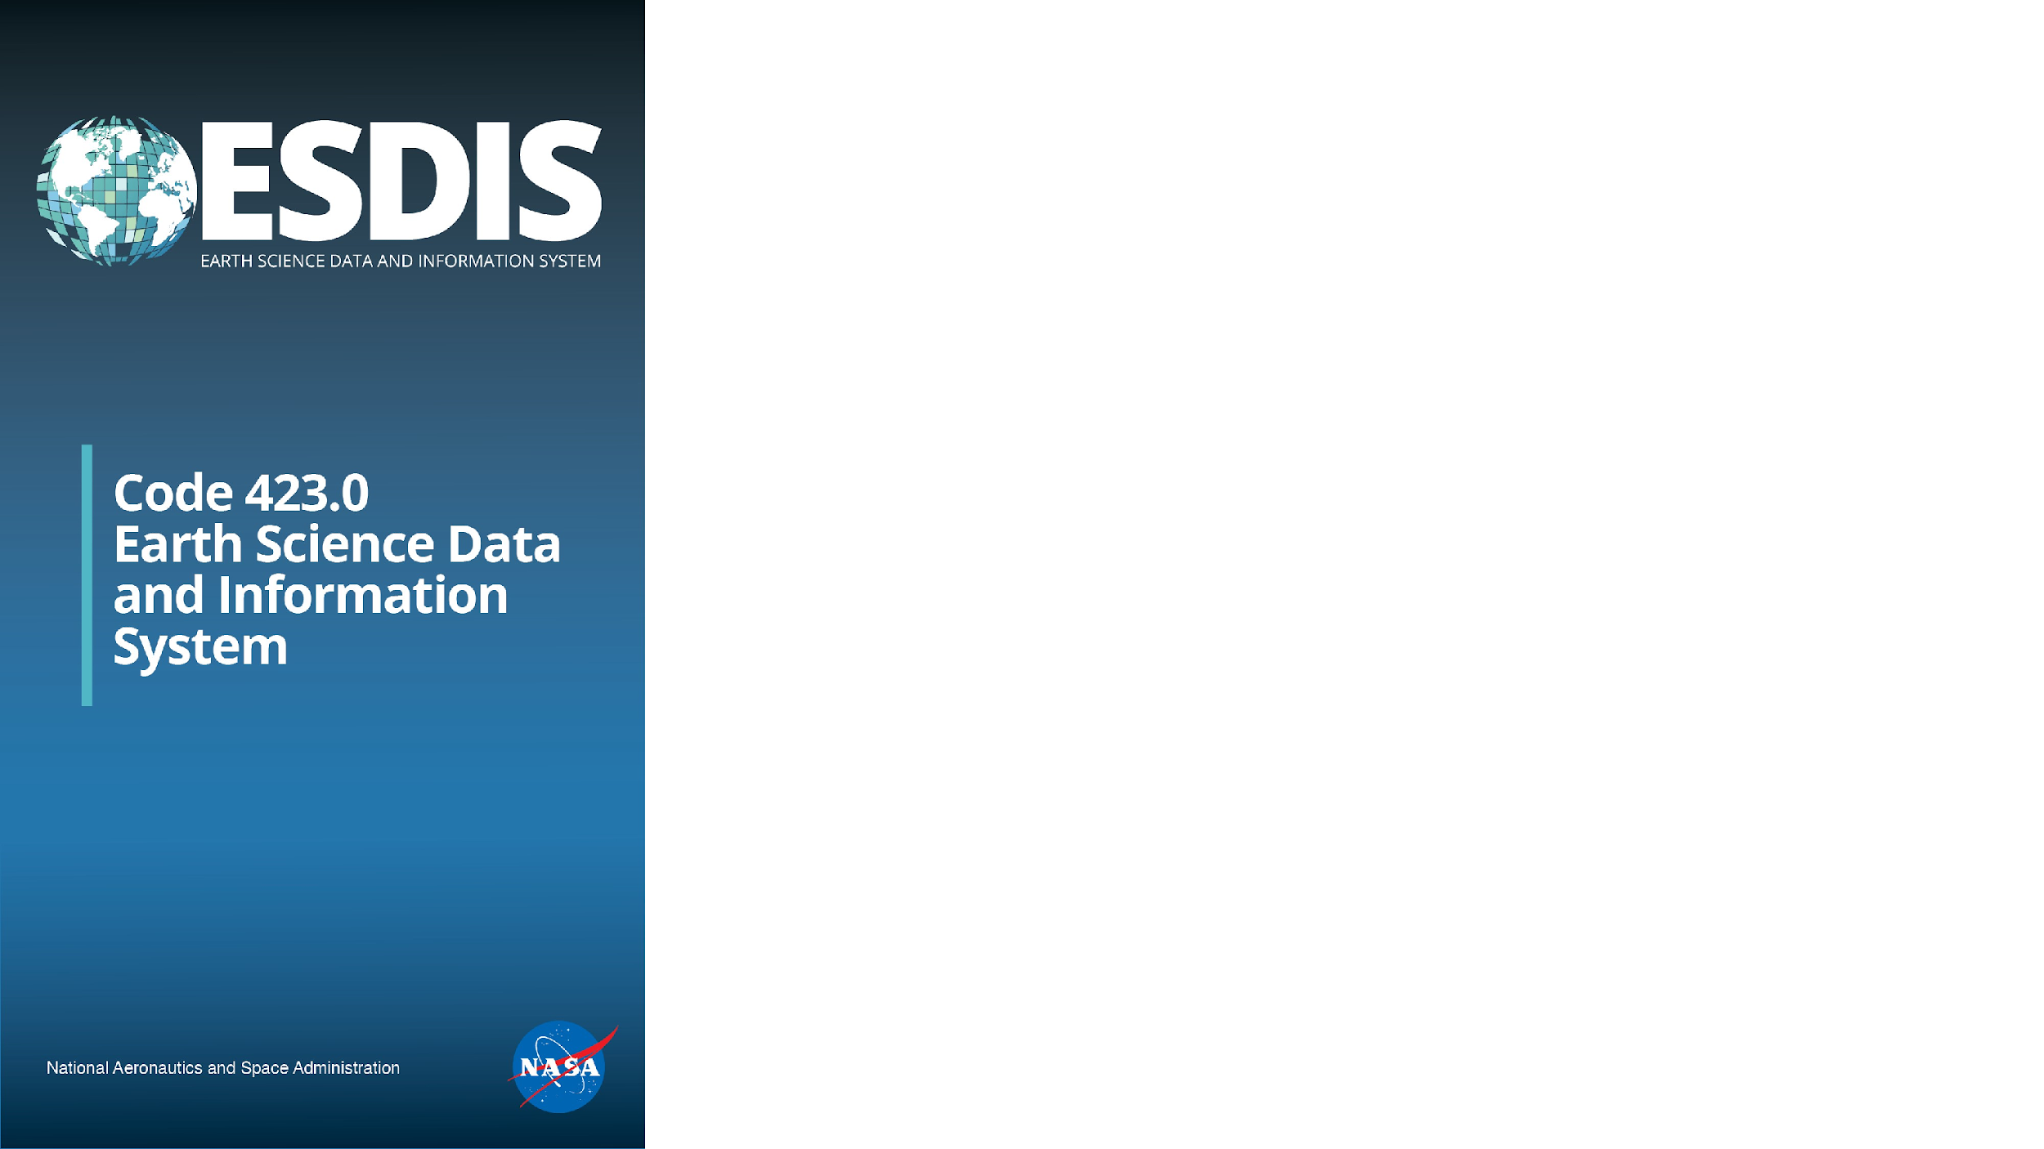


Why NASA earthdata went to the cloud
Doug Newman
NASA ESDIS Project
Goddard Space Flight Center
Summer ESIP
July 23rd 2024

Slide 2

If you take one thing away from this talk…
NASA earth science data will be easily accessible to all in an environment that allows the leverage of compute capabilities required for earth science visualization and analysis today and for the foreseeable future.
That environment is the Amazon Web Services (AWS) cloud today. In the future, we aspire to be ‘multi-cloud’.
Notes:
‘Easily’ - we continue to work on that.

Slide 3
Welcome to our data fortress
You have likely heard about the perils of the data fortress. Where an organization, business or institution sets up storage and compute and downloads a lot of data from a provider (like us). Those lucky enough to have access enjoy the ability to perform analysis and visualization adjacent to the data using powerful compute resources.
The Earthdata Cloud is our data fortress and ALL are welcome. But, in general, you pay for your compute.
Notes:
You have likely heard about the perils of the data fortress. Where an organization, business or institution sets up storage and compute and downloads a lot of data from a provider (like us). Those lucky enough to have access enjoy the ability to perform analysis and visualization adjacent to the data using powerful compute resources.
But if you are not part of that organization, business or institution? You are stuck with your laptop and a hard drive.
The cloud allows us to create equitable access to the power of a HPC environment.
This paradigm _shifts_ compute cost. Instead of buying physical compute and storage (laptop, hard drives) you are renting compute and storage.

Slide 4
The reasons
Easy access to data
Rapid deployment
Scalability
Flexibility
Reduced redundancy
Cost effectiveness
This is a somewhat ordered list!
https://www.earthdata.nasa.gov/eosdis/cloud-evolution

Slide 5
What’s in it for ESDIS?
Notes:
ESDIS - Earth Science Data Information System

Slide 6
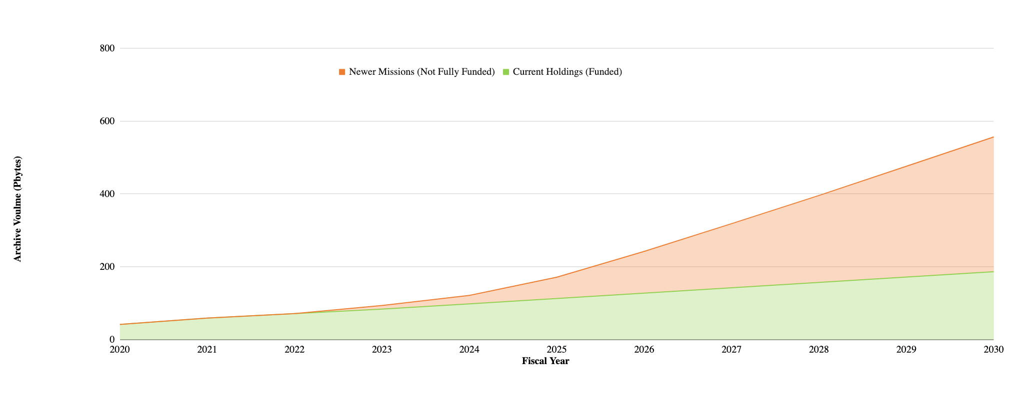
Scalability - the data explosion
‘The size and use of the archive can expand easily and rapidly as needed.’
DON’T PANIC!
Notes:
Current archive size (06/11/2024): 125 PB
https://www.earthdata.nasa.gov/eosdis/system-performance-and-metrics/esdis-metrics/eosdis-monthly-metrics

Slide 7
Flexibility
‘Mission needs can dictate options … to enable the best use of mission data.’
Common Metadata Repository Clojure, AWS ECS, Oracle
Harmony Typescript, Express JS, Kubernetes, Docker
Giovanni in the cloud Python, Node, Lambda, API Gateway, DynamoDB
Notes:
ECS - Elastic Container Service
API - application programming interface

Slide 8
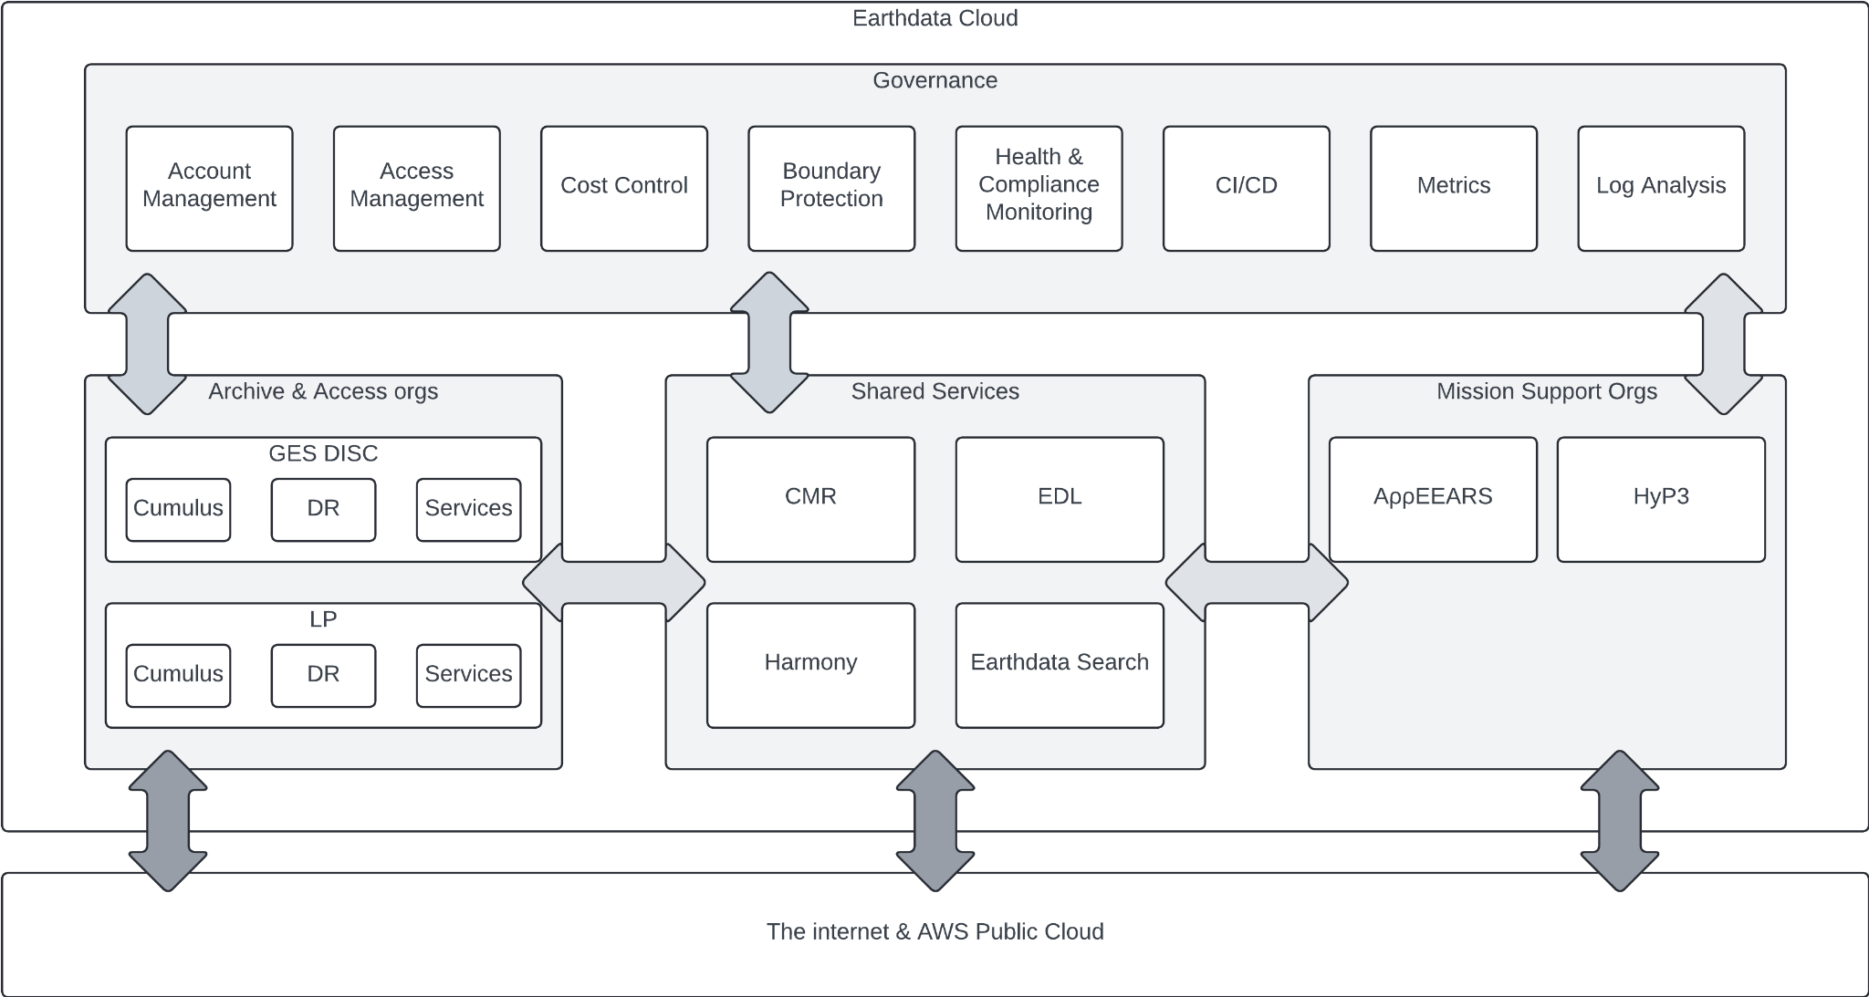
Reduced redundancy
‘The use of a common infrastructure with cloud native services will reduce redundant tools and services…’
Notes:
CI/CD - Continuous Integration & development
DR - Disaster Recovery
GES DISC - Goddard Earth Sciences Data and Information Services Center
LP - Land processes
CMR - Common Metadata Repository
EDL - Earthdata Login
HyP3 - Alaska Satellite Facility's Hybrid Pluggable Processing Pipeline
AppEEARS - Application for Extracting and Exploring Analysis Ready Samples

Slide 9
What’s in it for the user?

Slide 10
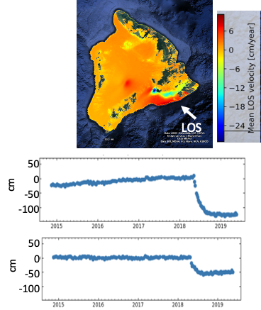
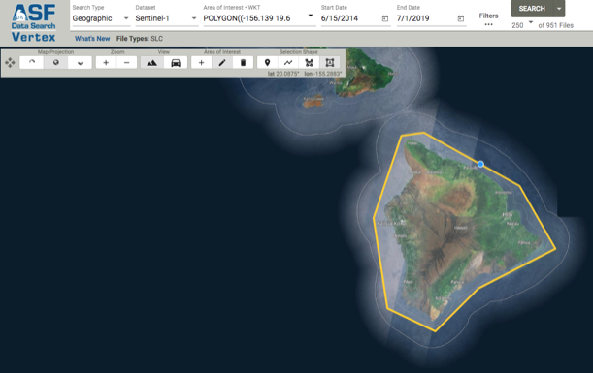
Easy access to data
‘Before’ using Vertex in 2021
‘Enabling cloud-based InSAR science for an
exploding NASA InSAR data archive’
4TB of data, 107 days of processing.
Notes:
InSAR - Interferometric Synthetic Aperture Radar
Vertex - Alaskan SAR facility data search application
https://wiki.earthdata.nasa.gov/download/attachments/197003646/ACCESS_ESDSWG_Bekaert.pptx?api=v2

Slide 11
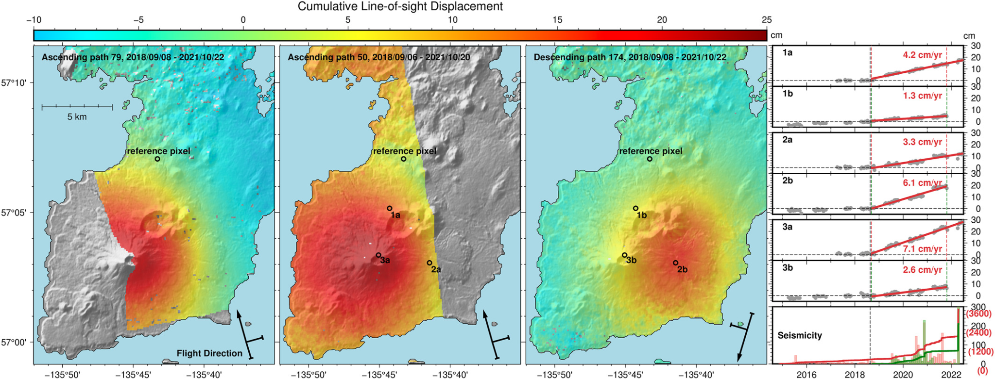
Easy access to data
‘Data users will be able to access data directly in the cloud, making the need to download volumes of data unnecessary.’
‘After’ using HyP3 in 2022
’Mt. Edgecumbe seismic storm’
observed April 2022, paper published October 2022.
Notes:
https://agupubs.onlinelibrary.wiley.com/doi/10.1029/2022GL099464

Slide 12
Rapid deployment: Managed Services
‘Users can bring their algorithms and processing software to the cloud and work directly with the data in the cloud’
Scale and orchestrate analysis with ECS, EKS and Fargate
Stand up analysis pipelines with CloudFormation and Code*
Maintain databases without DBAs
Develop and deploy machine learning processes with Sagemaker
Reproduce your science with Jupyter Notebooks
Notes:
EKS - Elastic kubernetes service
DBA - Database administrator

Slide 13
Cost effectiveness
‘EOSDIS and NASA pay only for the storage and services used.’
Our users can also benefit from this.
Rent large amounts of compute for short periods of time
Economy of scale: Oracle RDS is generally cheaper than bringing your own oracle license to your compute*
*https://houseofbrick.com/blog/oracle-database-workloads/
Notes:
RDS - Relational Database Service

Slide 14
Bonus: Community reach
Underserved communities can benefit from the cloud
Reduced ISP risk
Cloud vendor outreach*
*https://aws.amazon.com/about-aws/global-infrastructure/aws-incommunities/
Notes:
ISP - Internet Service Provider

Slide 15
The paradigm shift

Slide 16
Rent instead of own
Ephemeral resources that get the job done and then go back in someone else’s box.
Like music!

Slide 17



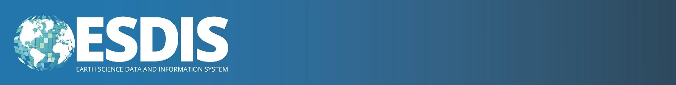
May the force be with you
Always
Email:
douglas.j.newman@nasa.gov
Website:
earthdata.nasa.gov
Social Media:
@earthdata

