Slide 1
Integrated Modeling for Payload Test of the Roman Space Telescope
James Govern (NASA/Aerodyne)
Kuo-Chia (Alice) Liu (NASA)
Cory Smiley (NASA/Aerodyne)
KJ Dziak (NASA/Aerodyne)
Joe Howard (NASA)

Slide 2
Roman System Level Thermal Vacuum Test Overview
The spacecraft and payload assembly (SCIPA) thermal-vacuum (TVAC) test is a key end-to-end verification test for both optical and thermal systems.
This test will be performed in a flight-like environment in the Space Environment Simulator (SES) at NASA Goddard Space Flight Center.
The scope of this test will be to capture data for the verification, trending, and system behavior of the SCIPA.
Optical Telescope Assembly
O1 | Verify workmanship by thermal cycling
O2 | Demonstrate performance over temperature extremes
O3 | Power up after exposure to cold survival temperature
O4 | Verify thermal design and validate thermal model through thermal balance testing
O5 | Verify non-optical requirements (select MRDs and deferred level 3s)
O6 | Verify alignment requirements and unvignetted IPA optical path
O7 | Complete cross checks of end-to-end Wavefront Error (WFE) performance
O8 | Characterize SCIPA system behavior in flight-like thermal environment
O9 | Demonstrate functionality
O10 | Characterize WFI WFE and CGI alignment sensitivity due to SC temperature variations
Instrument
Carrier
Wide Field Instrument (WFI)
Coronagraph
Instrument (CGI)
Spacecraft Bus
Flight Spacecraft + Integrated Payload Assembly
(SCIPA)

Slide 3
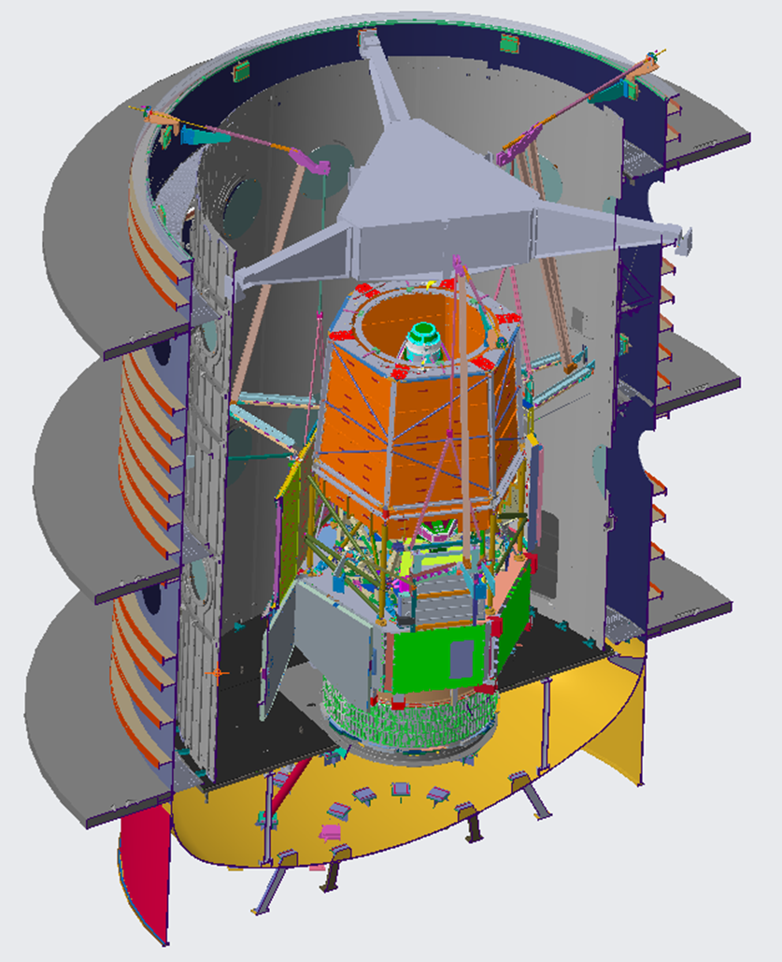
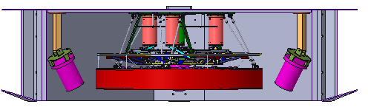
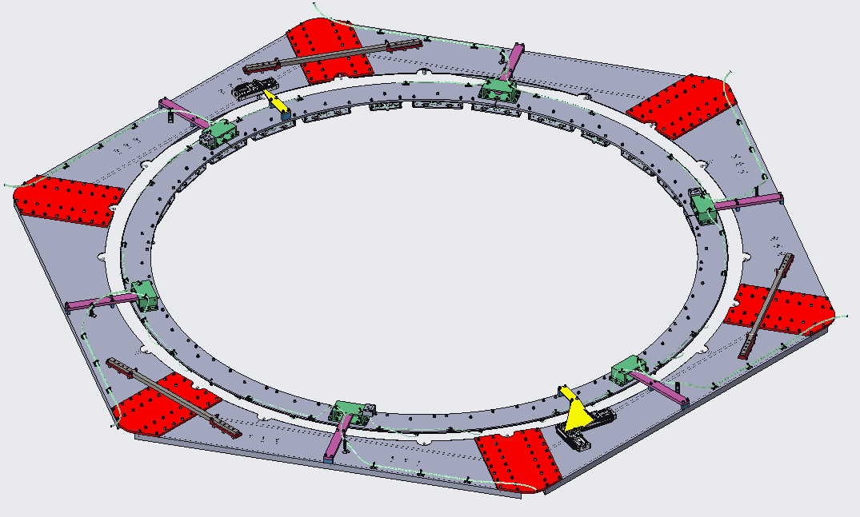
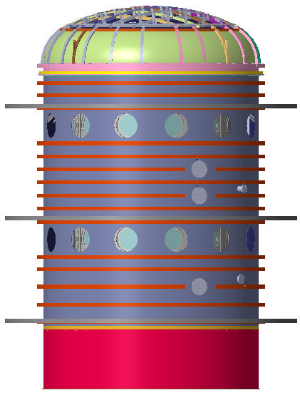
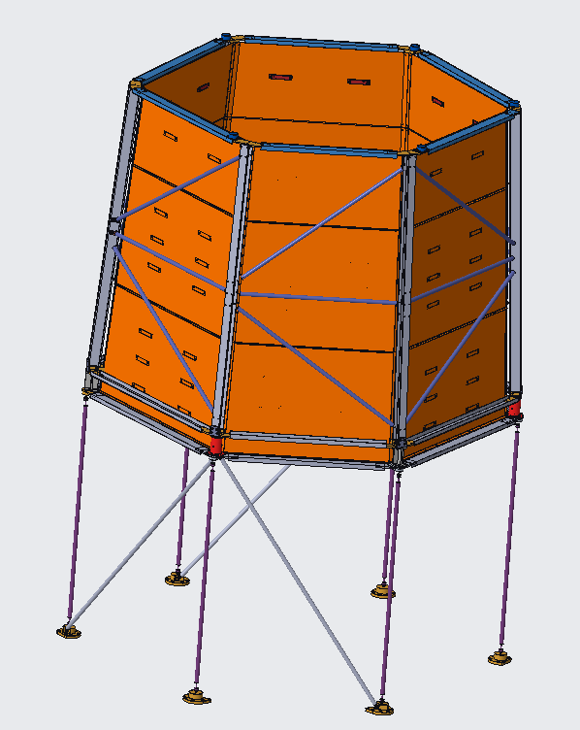

SCIPA TVAC Test Configuration
Optical Large Aperture Flat System (OLAFS)
(mirror with tip/tilt/focus actuators for WFE crosscheck test)
Space Environment Simulator (SES)
(thermal vacuum chamber)
Top Deck Assembly
(LED System for alignment verification test)
Flight SCIPA
Outer Barrel Assembly (OBA) Simulator
(flight OBA controls the telescope thermal environment)

Slide 4
Integrated Modeling (IM)
IM is responsible for verifying by analysis performance requirements that cannot be practically verified by test or can only be partially verified by test.
  On-orbit, end of life optical quasi-static wavefront error (WFE), alignment, and stability are key performance requirements verified by IM.
IM supports the Integration and Test team (I&T) with system level analysis of the SCIPA TVAC configuration with key metrics including:
  Test design and test Ground Support Equipment (GSE) development
  Pre-test predictions and analysis backouts
IM analyses for SCIPA TVAC includes:
  Structural-Thermal-Optical (STOP)
  Composite dryout
  Gravity sag
  Jitter (chamber vibrations)

Slide 5
IM Model Integration
Optical Telescope Assembly
Flight
Payload
Flight
SCIPA
SCIPA TVAC Test
L3Harris
GSFC, IM
GSFC, IM
GSFC, IM
IM implements a vertical model integration process to generate thermal and structural models for the SCIPA TVAC configuration.
Instrument
Carrier
Spacecraft
Bus
SCIPA TVAC GSE
GSFC, IC
GSFC, SC
GSFC, I&T
Wide Field Instrument
OLAFS
L3Harris
BAE Systems
Flight Model/s
SES
Coronagraph Instrument
GSFC, I&T
GSE Model/s
Thermal Model Only
JPL
The final integrated structural model goes through series of modifications to generate configurations that support variety of analyses and cases.
Jitter Configuration
SCIPA TVAC Structural
Finite Element Model
STOP Configuration
Composite Dryout Configuration

Slide 6
IM STOP Analysis: Test to Flight difference
Thermal
Model
Thermal
Analysis
Temperature Profiles
Map Temps to NASTRAN Grid Points
Thermal Desktop
Thermal Desktop
Thermal Desktop + NASTRAN
Discipline Model
NASTRAN
Structural
Model
Thermo-elastic Analysis relative to 293K
NASTRAN Thermal Load Cases
Analysis / Process
NASTRAN
Intermediary
Result
Motions of Optical Element Surface Grid Points
Optical Element Rigid Body Motions
Final Result
Calculate SurfaceSZernikes 4-11
Convolute alignment/Zernikes with LOM
Perturbed System Ray Trace
ΔWFE, ΔLOS
MATLAB w/ DOCS
SigFit
Linear Optical Model
Optical Model
Distortions can be fed along two parallel paths to compute optical response:
First path uses a CODE V optical model with SigFit software to compute ray traces
Second path uses a Linear Optical Model (LOM) with sensitivities derived from the Code V optical model

Slide 7
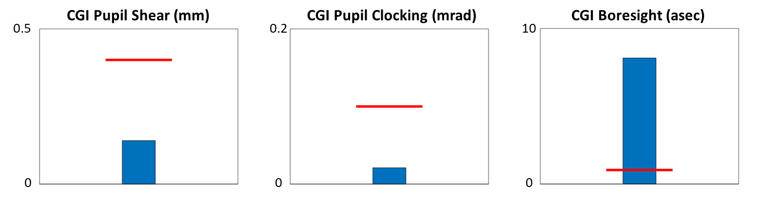
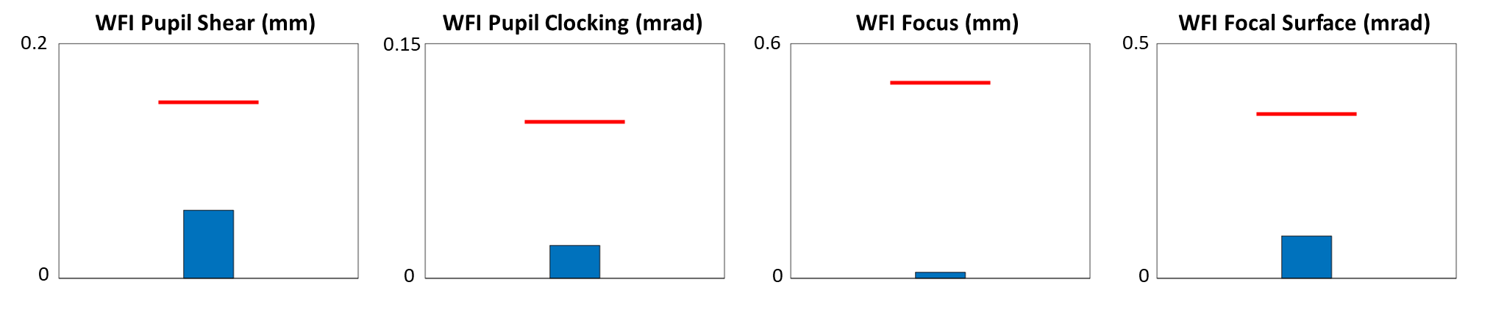
IM STOP Analysis, Test to Flight difference (continued)
While flight-like, the SCIPA TVAC test environment does not perfectly mimic the Roman on-orbit environment.
Alignment budgets for Wide Field and Coronagraph channels include allocations for Ground-to-Orbit effects, including a sub-allocation for Payload Test to Flight delta to account for different thermal and thermo-elastic conditions.
Wide Field channel WFE test-to-flight delta is also assessed to ensure compensation mechanisms have sufficient range subject to the test environment.
* CGI boresight anticipated to fall within allocation based on pending updates to thermal profile
CBE
Allocation

Slide 8
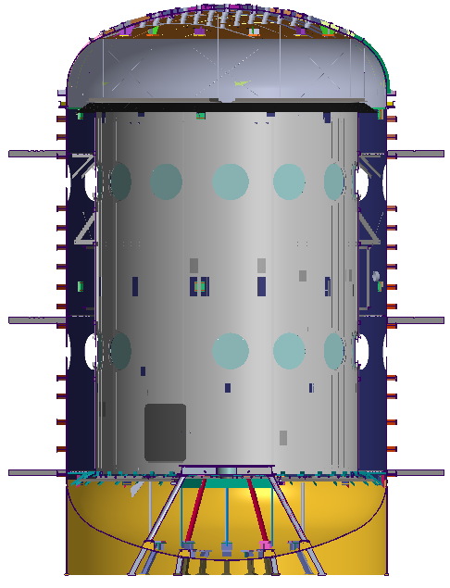
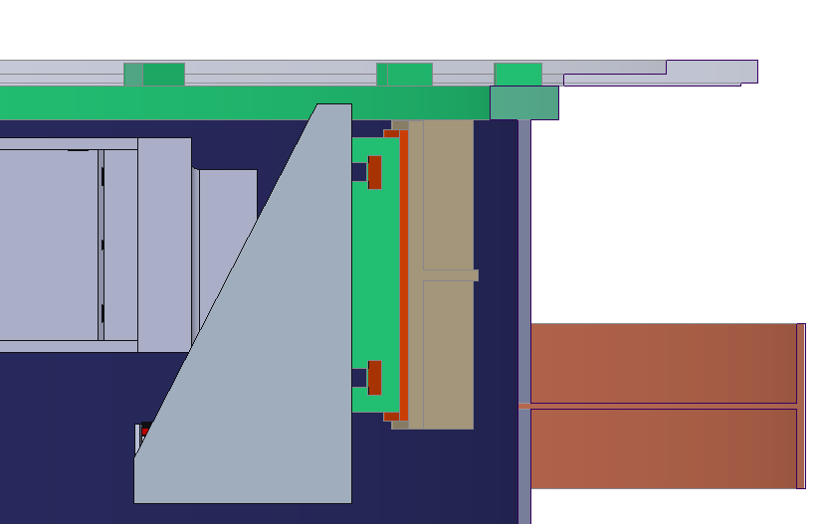
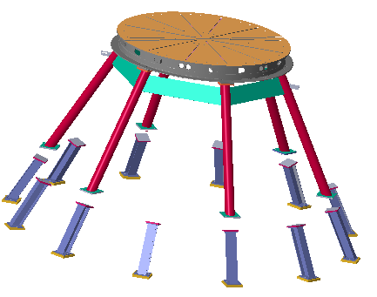
IM Jitter Analysis, Chamber Dynamic Disturbances
Modal Structural Model
Normal Modes Analysis
Eigenvectors and Eigenvalues
Disturbance sources include:
  Fluid flow through shrouds (dominated by floor shroud)
  Variety of pumps used to maintain vacuum and move fluid through shrouds
  Background facility noise
Structural
Optical Model
Linear Optical Model
Optical
Upper Hard Points
(disturbance path)
Integrated
Modeling
Mechanical Disturbances
Integrated Dynamics Model
Time and/or Frequency Domain Analysis
OLAFS
with mechanical Interface to the chamber upper hard points
ΔWFE, ΔLOS
Analysis includes 101 instantiations based on sweeping disturbance frequency ± 20% to account for modeling uncertainty
Disturbance input profiles generated from chamber operation tests with accelerometers implemented to capture data at key locations
Process proven to be sufficiently conservative based on recent Wide Field Instrument TVAC tests at GSFC and BAE Systems
Discipline Model
chamber hard point mount
Analysis / Process
Flight SCIPA
with mechanical Interface to the Payload Table System
Intermediary
Result
Final Result
Payload Table System
(disturbance path)

Slide 9
IM Jitter Analysis, Chamber Dynamic Disturbances (continued)
Predictions from initial jitter analyses show violation of Wavefront Error and Line of Sight allocations
  For both “image-to-image” and “within image” metrics
Vibration isolation systems, implemented for both OLAFS and the Flight SCIPA, attenuate jitter and bring predictions within allocations
Further modeling work showed isolation system for the Flight SCIPA has minimal contribution to isolation given payload table system compliance
OLAFS
Flight SCIPA
Wavefront Error
Wavefront Error
Frequency (Hz)
Frequency (Hz)
Line of Sight Error
Line of Sight Error
Frequency (Hz)
Frequency (Hz)
No isolation
Isolation

Slide 10
SCIPA TVAC Model Validation Plans
Our general approach is to correlate models at lower levels and then use higher-level tests for model validation and interface model correlation.
The SCIPA TVAC test data will be used to validate thermal and thermo-elastic structural models:
Thermal Model Correlation
Thermo-elastic Model Validation
All flight Payload Element thermal models correlated based on thermal balance (WFI, CGI, Telescope, Instrument Carrier)
Thermal balance tests at steady state cold, nominal, hot operational and cold survival temperature plateaus provide correlation data to sensed temperatures and key heat loads.
Transient correlation data is based on:
  Modelled mass correlation to as-measured or calculated masses
  Correlation of model heat control circuits and tuning model parameters to test data
  Demonstration that thermal model prediction is conservative, i.e. model predicts a larger rate of change than as measured during test
No direct distortions are measured during the SCIPA TVAC test; instead, we rely on optical test measurements for model validation:
  Wide Field channel WFE and alignment at temperature plateaus for steady state validation
  Wide Field channel WFE and Coronagraph channel pupil position during temperature transitions for validation of transient behavior
  Wide Field channel WFE following changes to environment and/or selected heater inputs to force flight-like temperature gradients
Validation criteria, based on optical test measurements:
Model
Prediction
Model Uncertainty Factor
Test
Measurements
Test
Uncertainty
x
>
+

Slide 11
Summary
All flight elements have made great progress in I&T, with many model validation tests and model correlation activities complete.
  CGI and WFI have completed all planned model validation tests.
  The telescope has completed all planned model validations tests, except the system level thermal vacuum test for optical performance verification.
  The spacecraft has completed most planned model validation tests, but several thermal and dynamics related tests are pending.
The SCIPA TVAC test is scheduled for mid-2025, with a Pathfinder test in late 2024 to demonstrate key Ground Support Equipment (GSE) before its integration with the flight hardware.
IM has played an integral part in the test development, and is continuing to work in lockstep with the I&T and optical teams to mature GSE designs and test plans.
  IM analyses to-date demonstrate test budget closure.
  Final test predictions anticipated early 2025.

