Slide 1
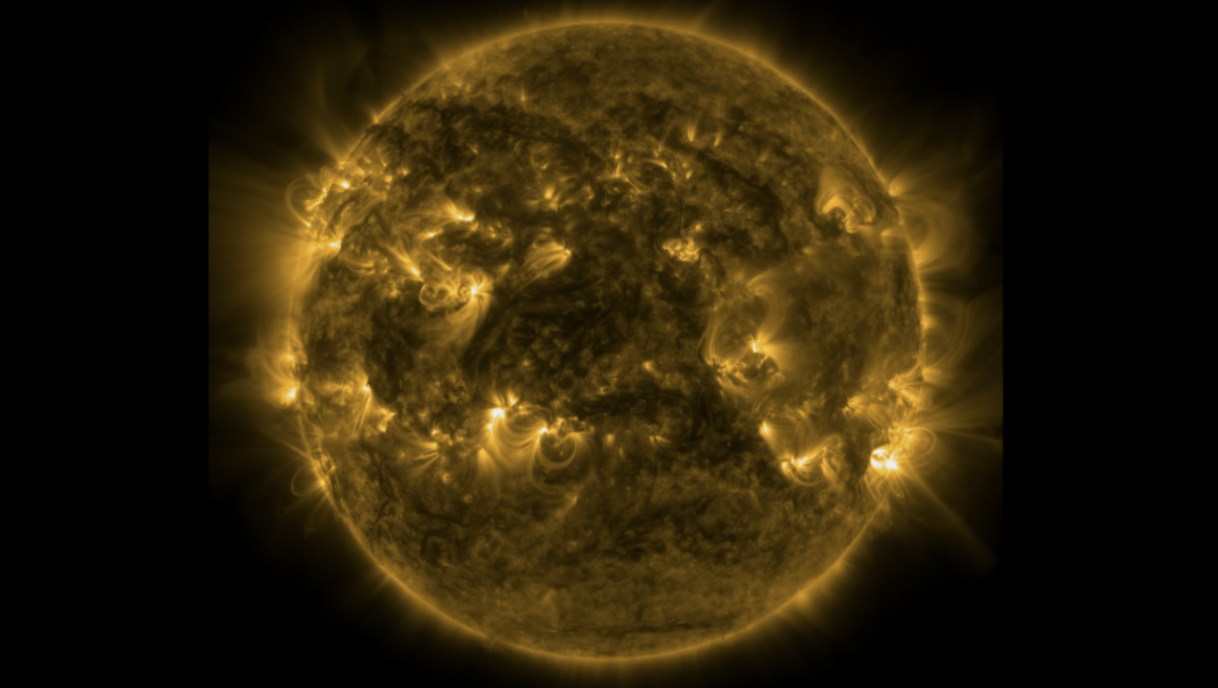

Constraining nanoflare frequency through observations and models
Biswajit Mondal
biswajit.mondal@nasa.gov
NASA Postdoctoral Program
NASA Marshall Space Flight Center
Huntsville, AL, USA
June-20-2024

Slide 2
Group and collaborators
MSFC heliophysics team:
Dr. Amy R. Wineberger,
Dr. P.S. Athiray,
Dr. Sabrina L. Savage
and MaGIXS team.
Collaborators:
Dr. J.A. Klimchuk (NASA GSFC)
Dr. Helen E. Mason (Univ. Cambridge)
Dr. Giulio Del Zanna (Univ. Cambridge)
Dr. Aveek Sarker (PRL)
Dr. Santosh Vadawale (PRL) and others!

Slide 3
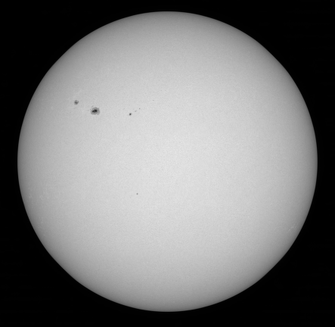
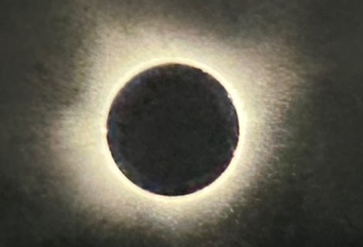
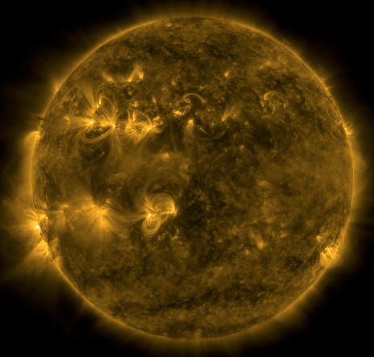
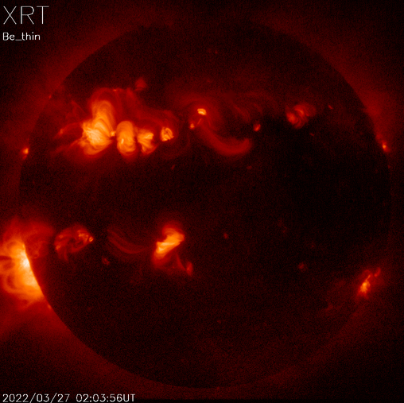
Sun in different wavelengths
Visible
Visible wavelength, during solar eclipse
Habbal et. al. ApJL(2021)
X-rays
EUV
Druckmüller et al., (2009)

Slide 4
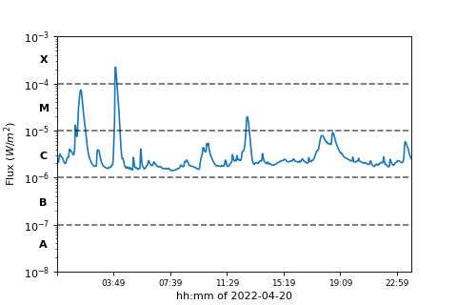
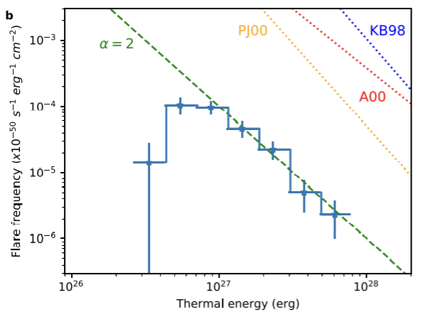
Nanoflare concepts from larger flares
The large solar flares, can not account for the overall coronal energy requirement (Sakurai 2017).
smaller flares occur more frequently.
Parker (1988) hypothesized the small-scale flares, termed as nanoflares having total energy around ∼10²⁴ erg, occurring all over the Sun.

Slide 5
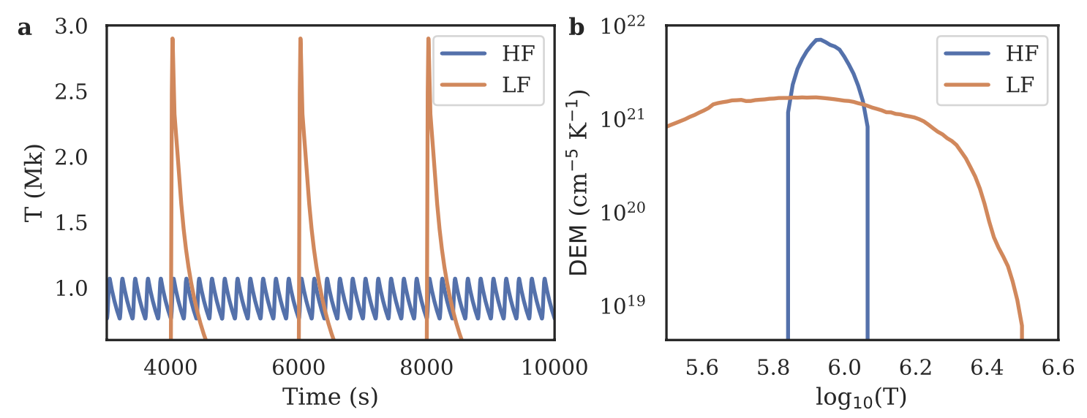
Observable properties
Direct detection of individual nanoflares are difficult.
Used indirect methods, e.g., Differential Emission Measure (DEM) or existence of hot plasma etc.

Slide 6
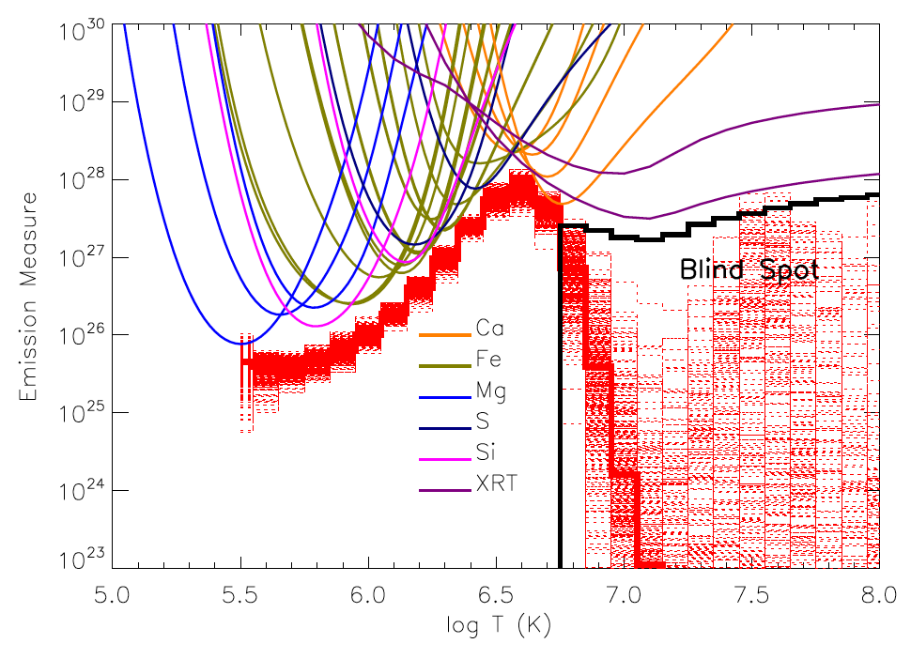
Challenges in determining DEM!
EIS + XRT
Winebarger et al. (ApJL 746:L17, 2012)

Slide 7
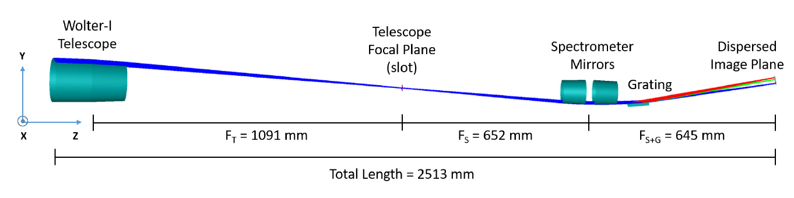
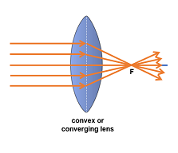
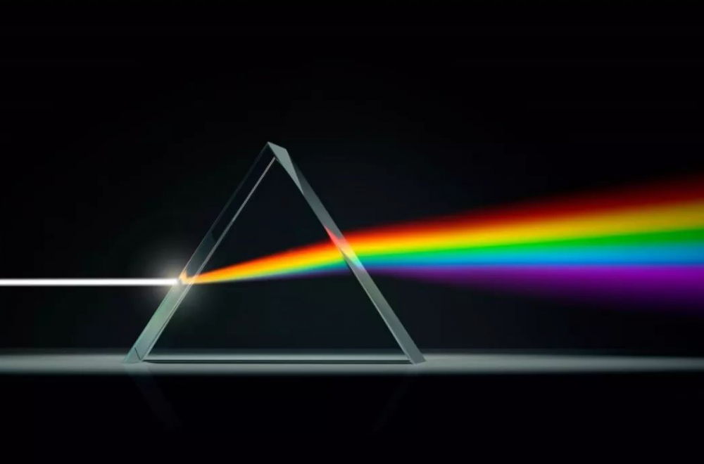
Marshall Grazing Incident X-ray Spectrometer (MaGIXS)
Champey et al. 2022

Slide 8
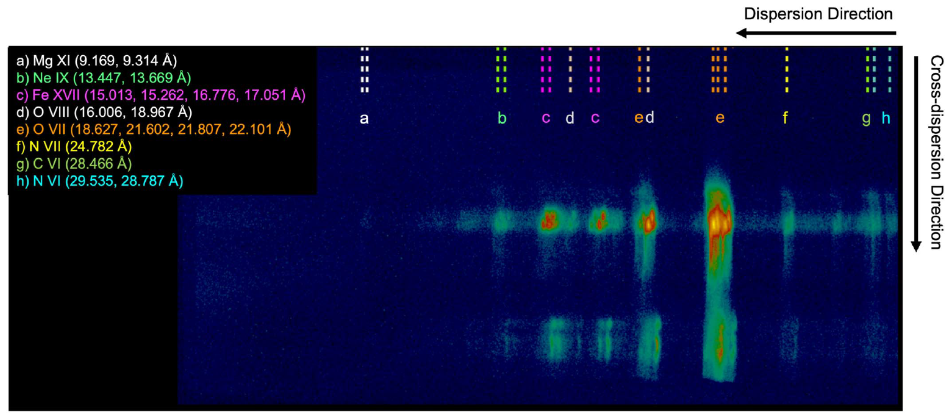
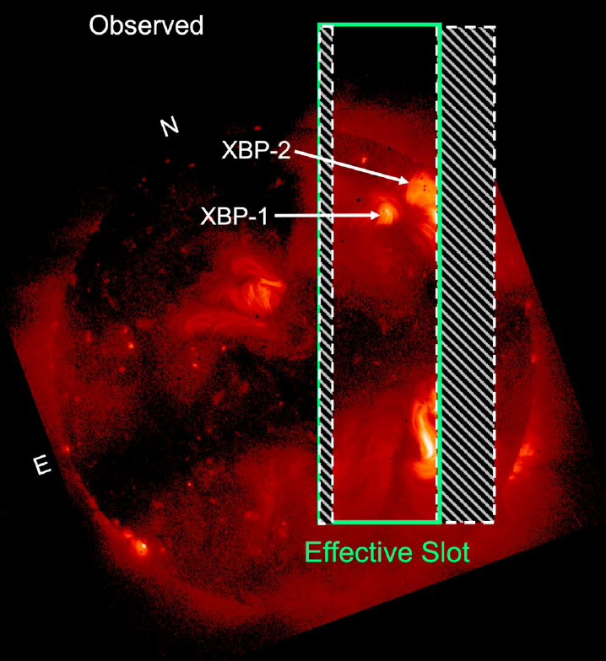
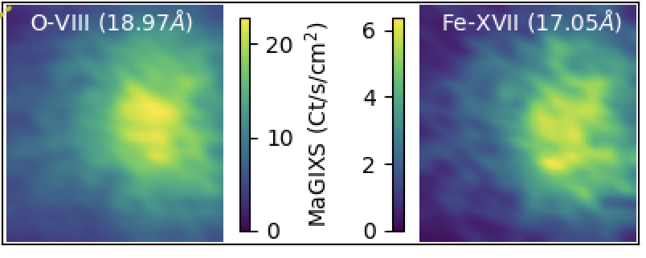
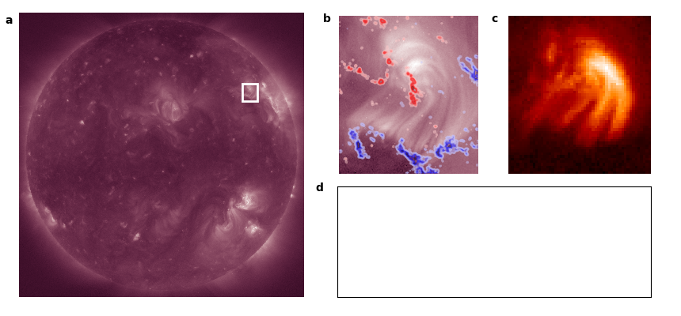
Overlapping spectral images observed by MaGIXS
AIA 193 + HMI
XRT
XBP-1
XBP-1
Savage et al (ApJ 945:105, 2023)

Slide 9
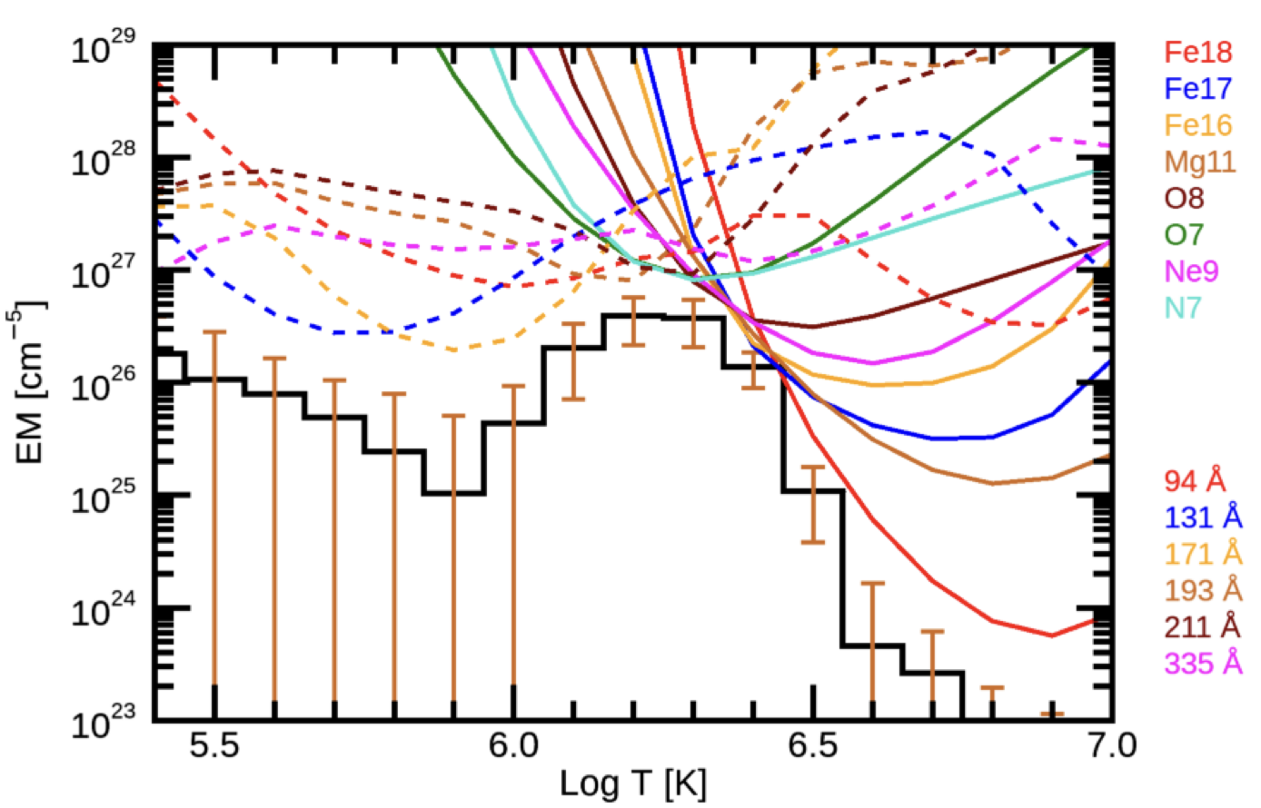
Better constraint of DEM at higher temperature
AIA + MaGIXS
Athiray & Winebarger (ApJ 961:181 2024)
What is the heating frequency?

Slide 10
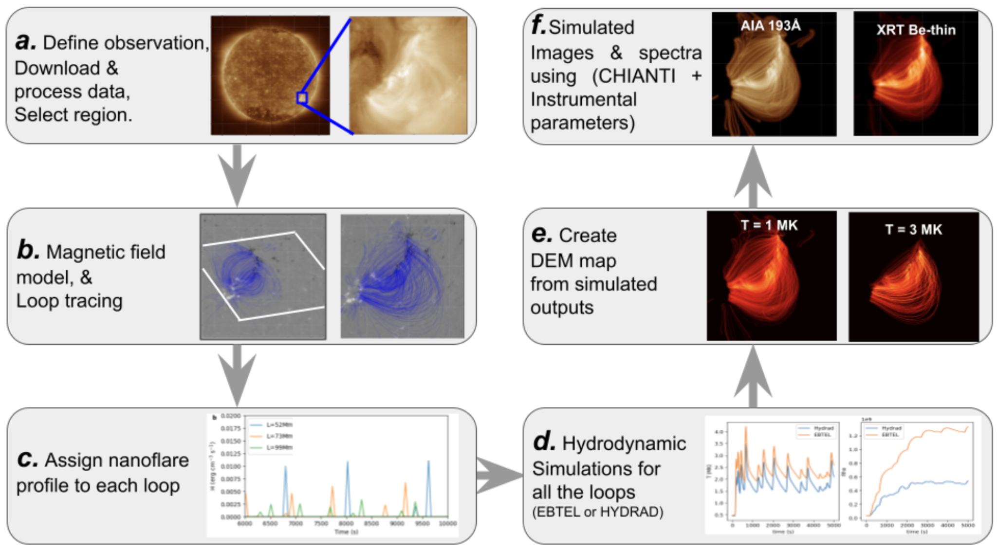
Combined observations with model

Slide 11
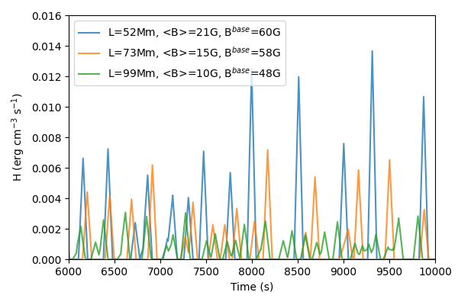
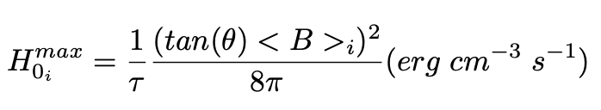
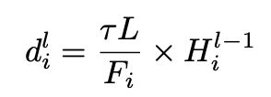
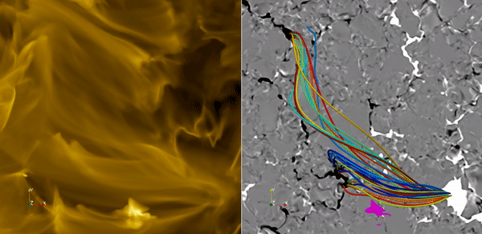
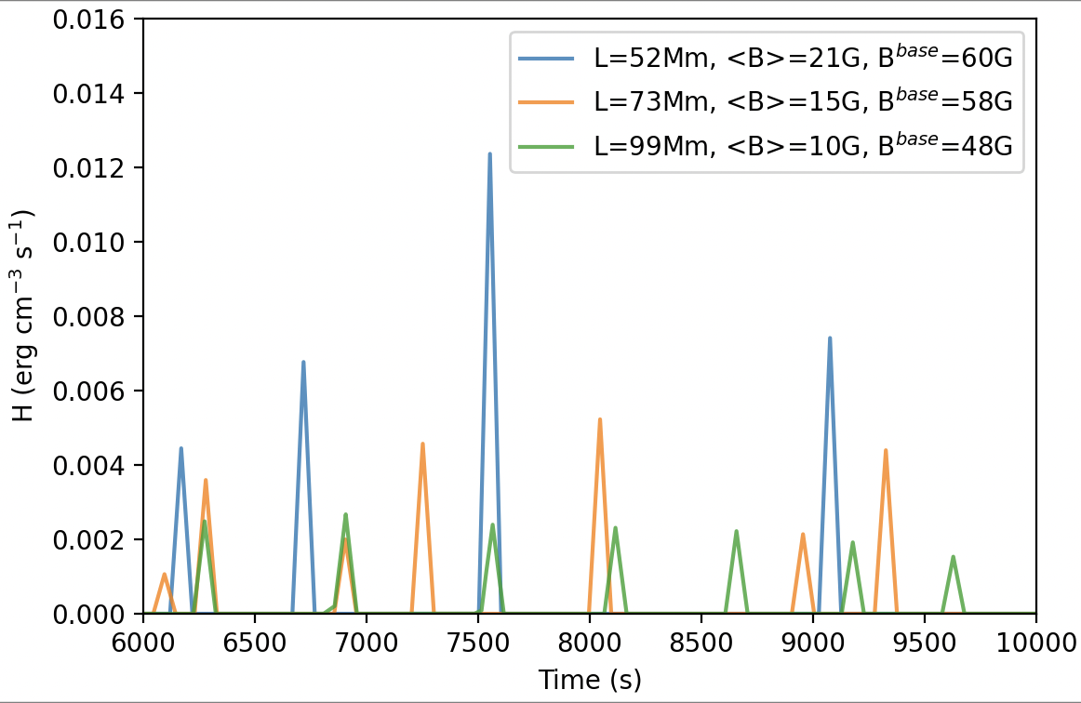
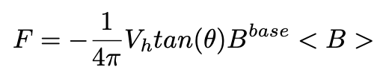
Create nanoflare profile
Consider triangular heating profiles having a duration, 𝜏 = 100 s.
The peak heating rate during an event is randomly chosen between minimum (H₀^{min} ) and maximum (H₀^{max}) values that are loop dependent.
tan(θ) = 0.2
V_{h} = 1.5 km/s
tan(θ)= 0.2
V_{h} = 0.5 km/s
Mondal, Klimchuk et al (2023 ApJ 945:37 2023)

Slide 12
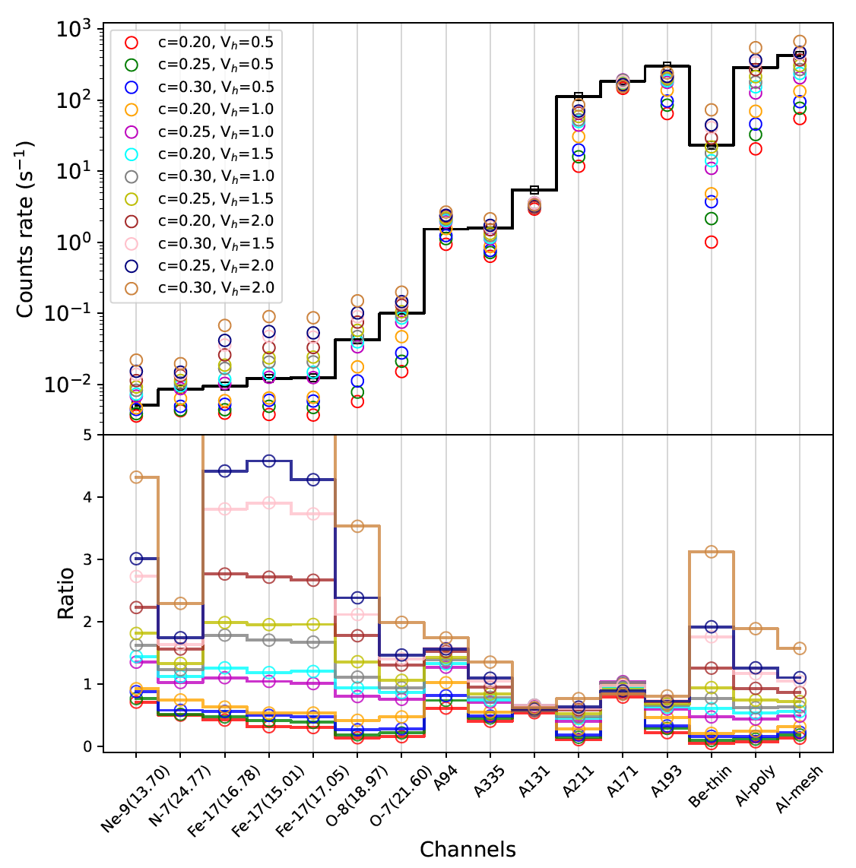
Comparison between simulations and observations
AIA
XRT
MaGIXS

Slide 13
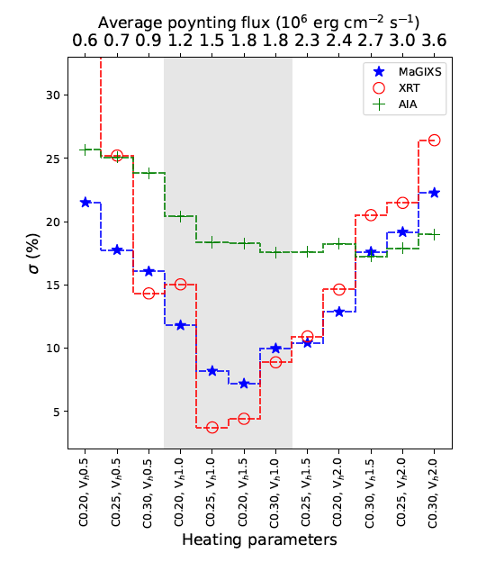
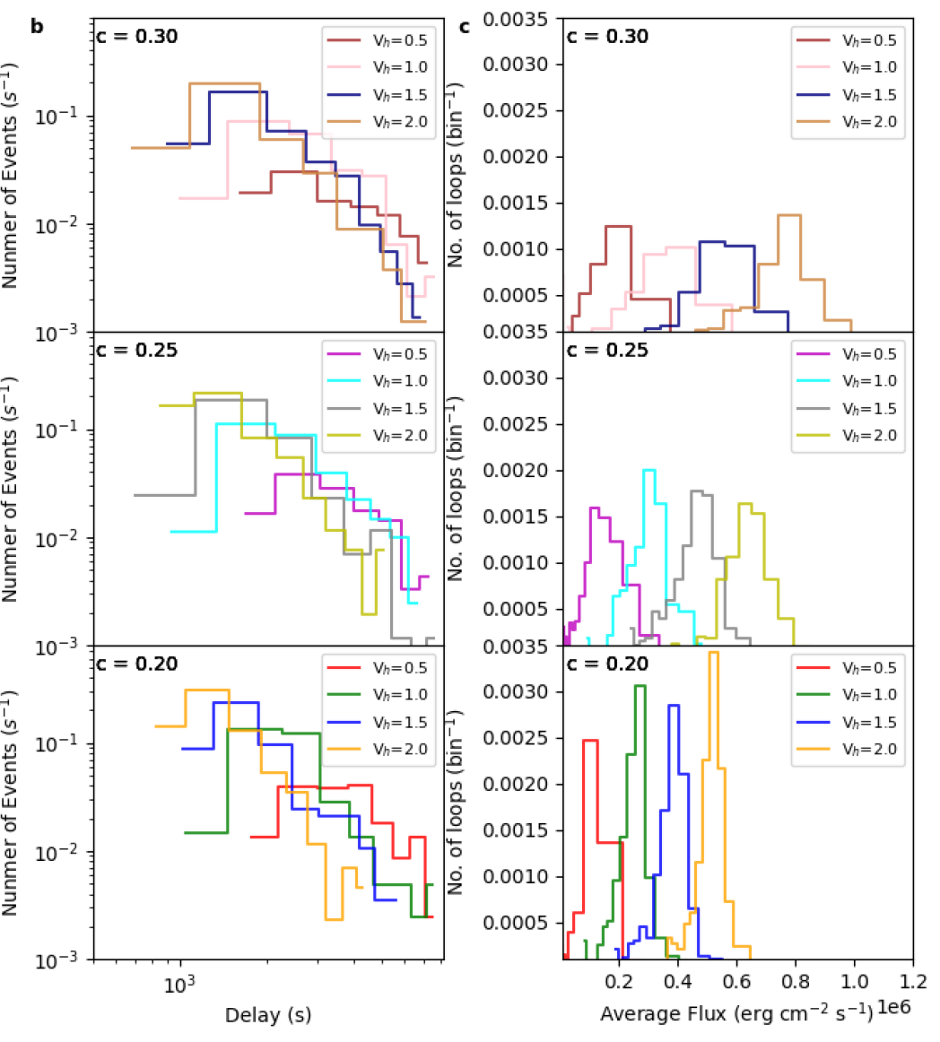
Results & Discussions
Avg. flux =
~3 ✕ 10⁵ erg cm⁻² s⁻¹.
Avg. delay = 1500-3000 s.

Slide 14
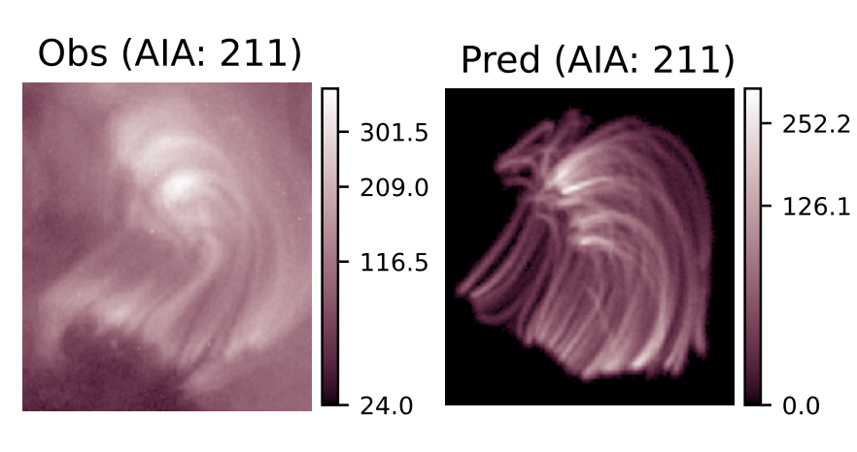
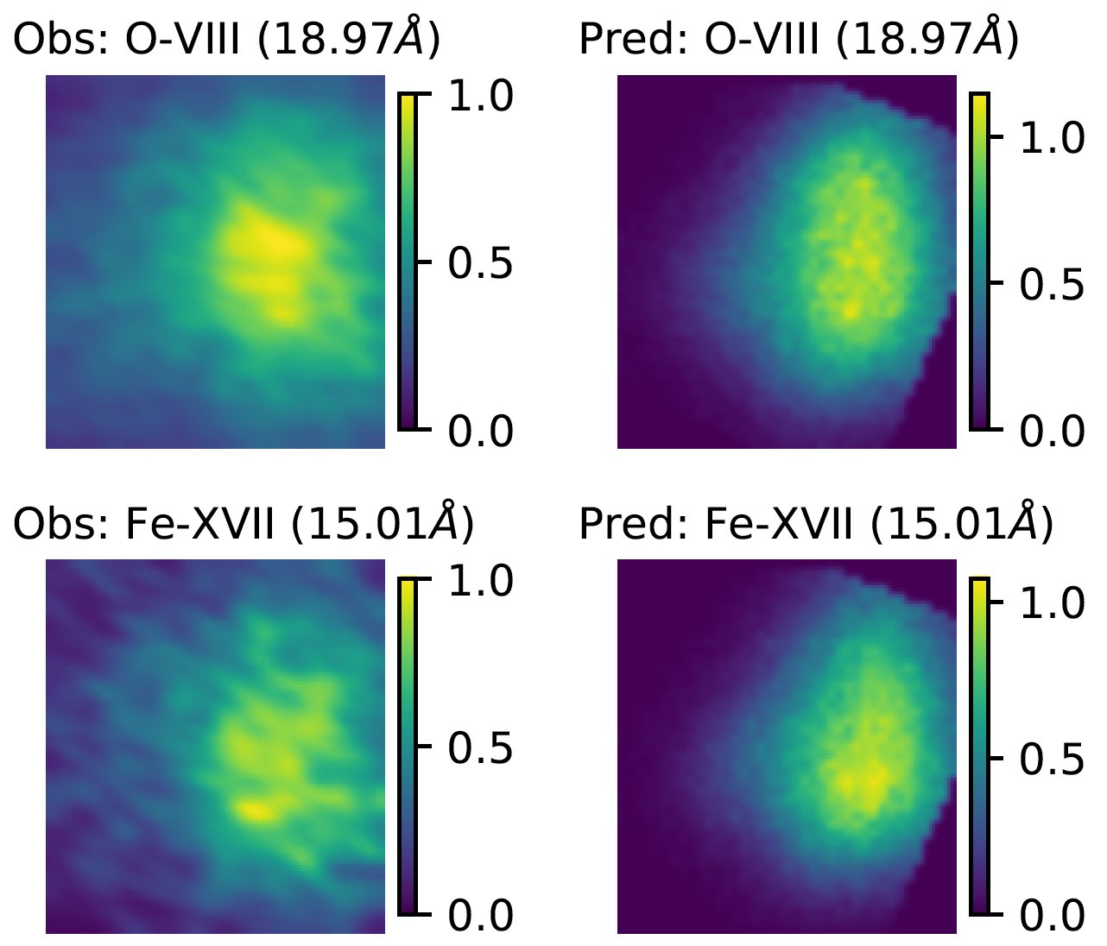
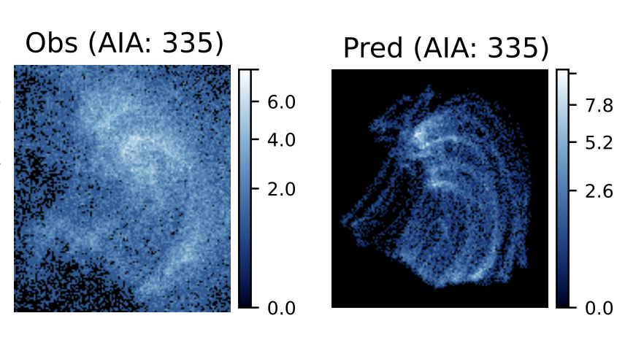
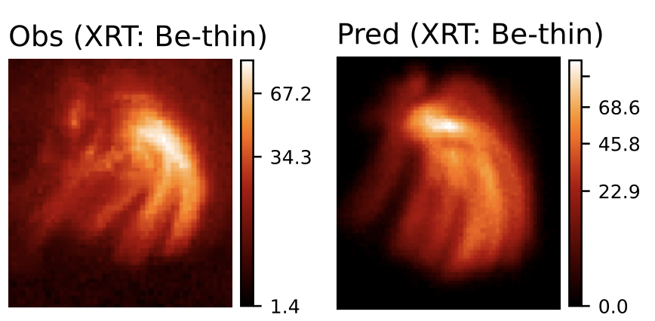
Observed and Predicted images of XBP-1
DN/s
DN/s
Derived from MaGIXS
Simulated
Observed by AIA & XRT
Simulated
Mondal et al, (ApJ 967, 23, 2024)
HF nanoflare -> average delay = 1500 - 3000 s -> smaller than the cooling time.
Average Poynting flux = ~5e5 erg/cm2/s
MaGIXS and XRT are more sensitive.

Slide 15
Can we use a similar approach to understand the heating during the evolution of the ARs?

Slide 16
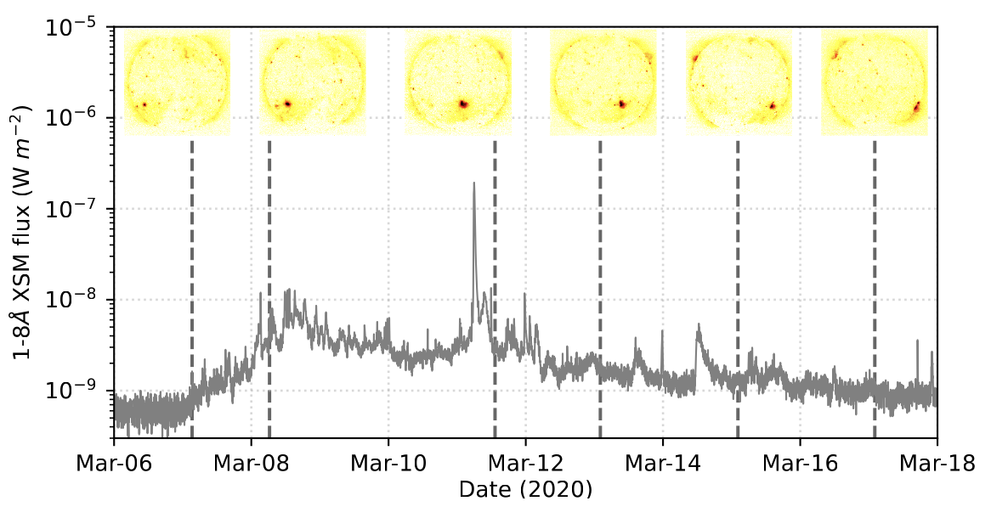
AR 12758

Slide 17
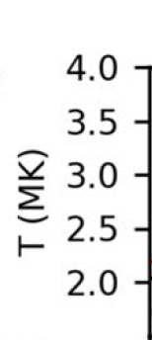
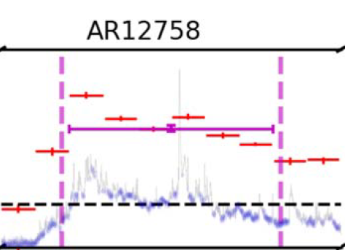

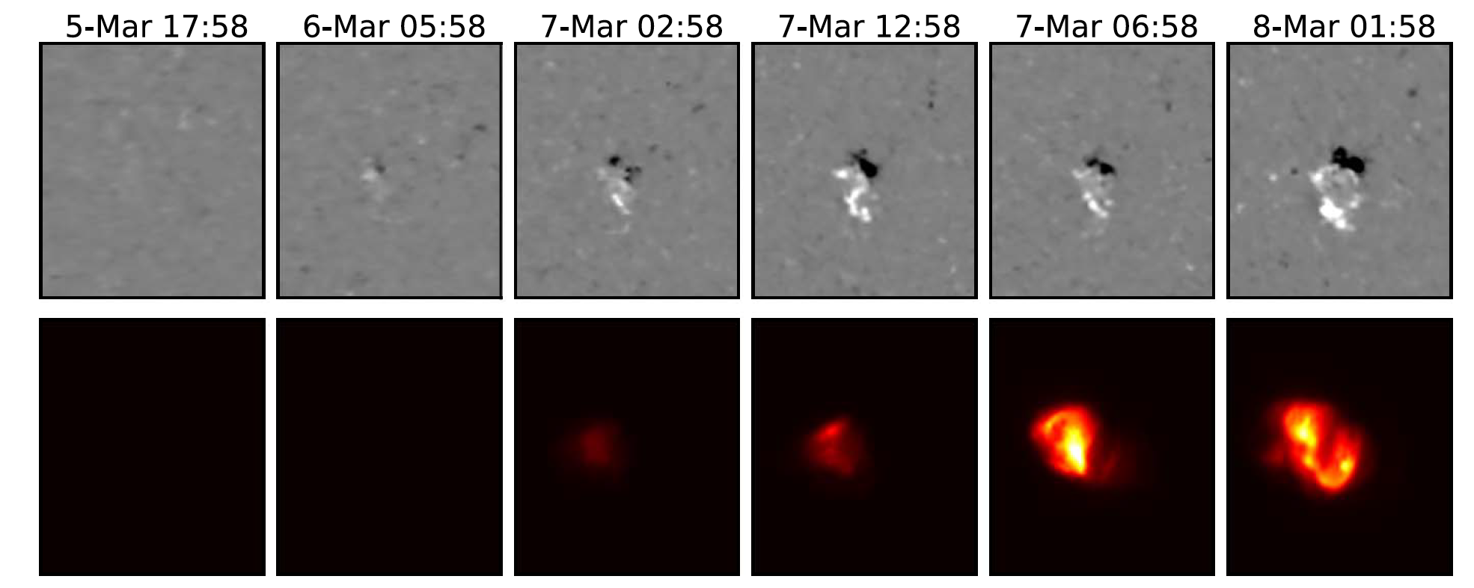
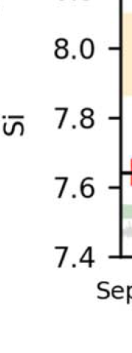
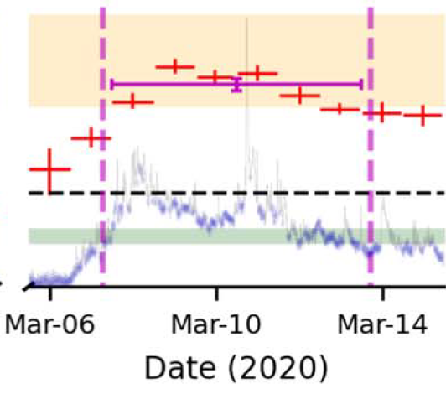

Formation of AR12758
Evolution of plasma parameters!
FIP bias
Evolution of this AR was studied from soft X-ray disk-integrated spectroscopy by Chandrayaan-2/XSM.
Step-1: Simulate the evolution of this AR and compared with disk-integrated quantities.
Mondal et al (ApJ 955:146, 2023b)

Slide 18
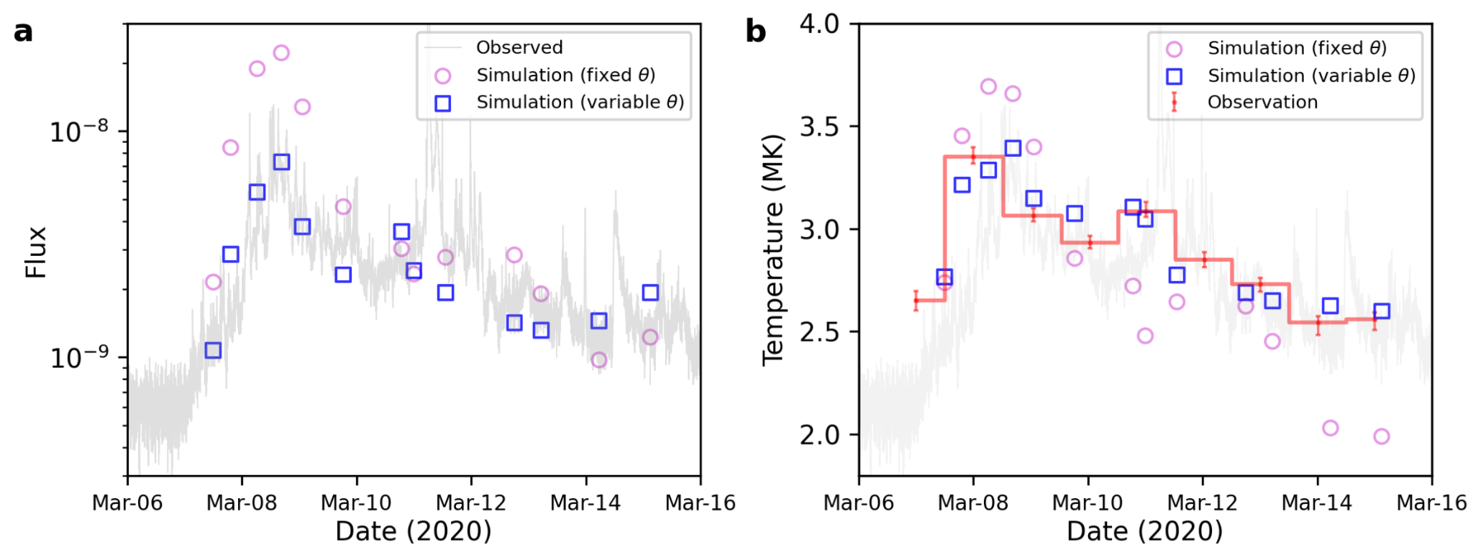
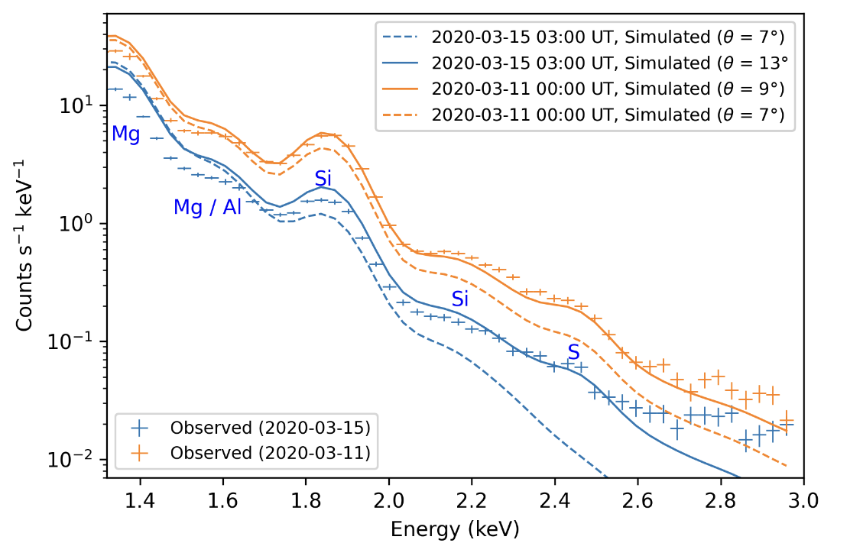
Observed and predicted X-ray flux and spectra

Slide 19
Variation of integrated temperature derived from X-ray spectra

Slide 20
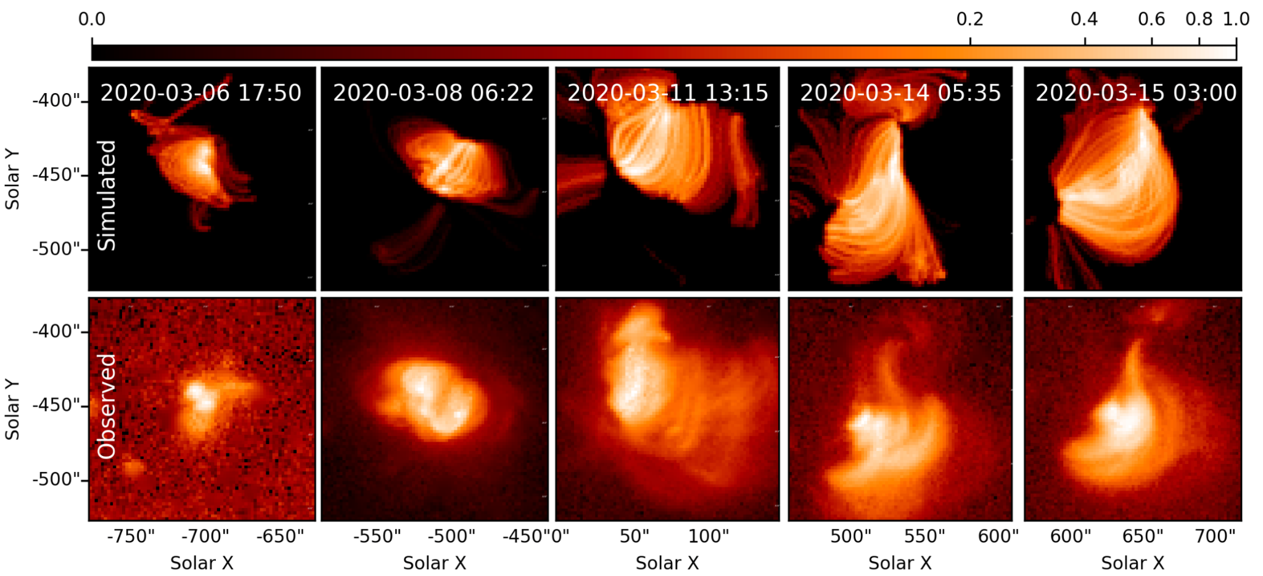
Spatial variation of X-ray emissions

Slide 21
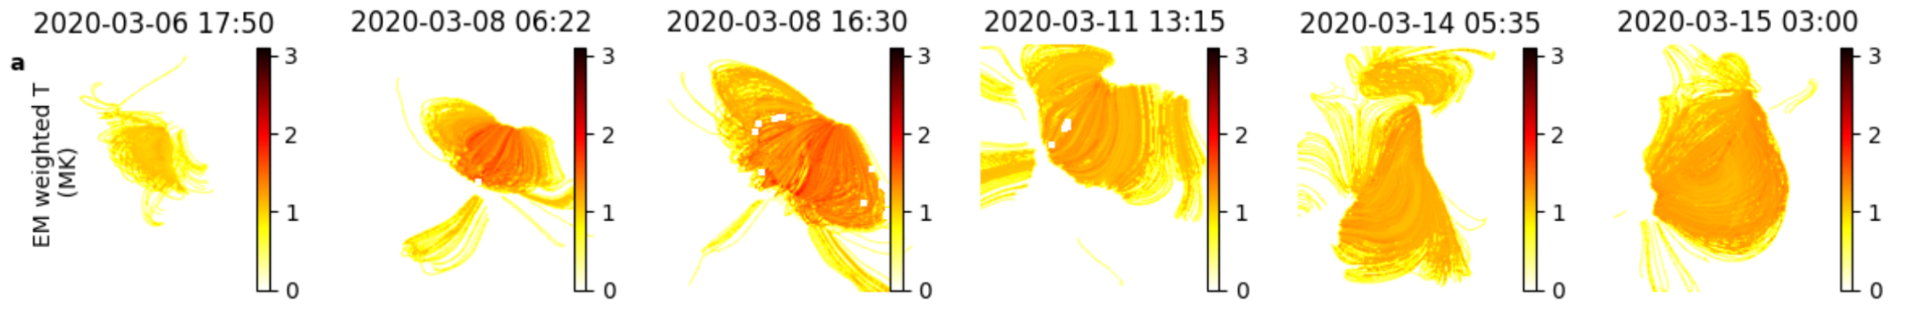
Spatial variation of temperatures
EM weighted T varies (1 to 3 MK) with spatial location of the AR.
Indicating different heating frequency.

Slide 22
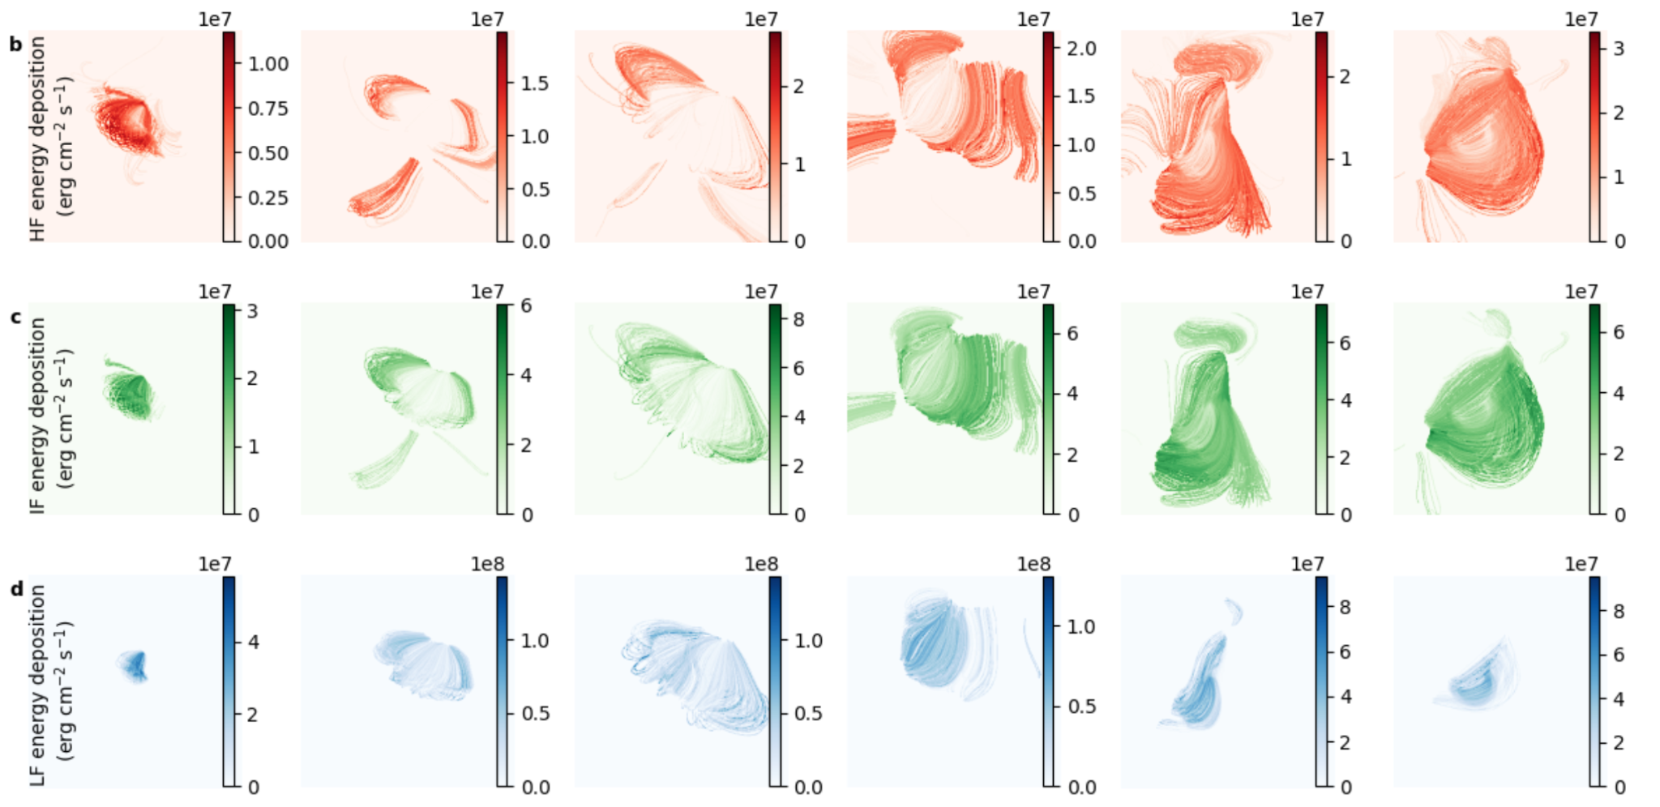
Contributions of different heating events
Mondal et al, 2024 (under preparation)

Slide 23
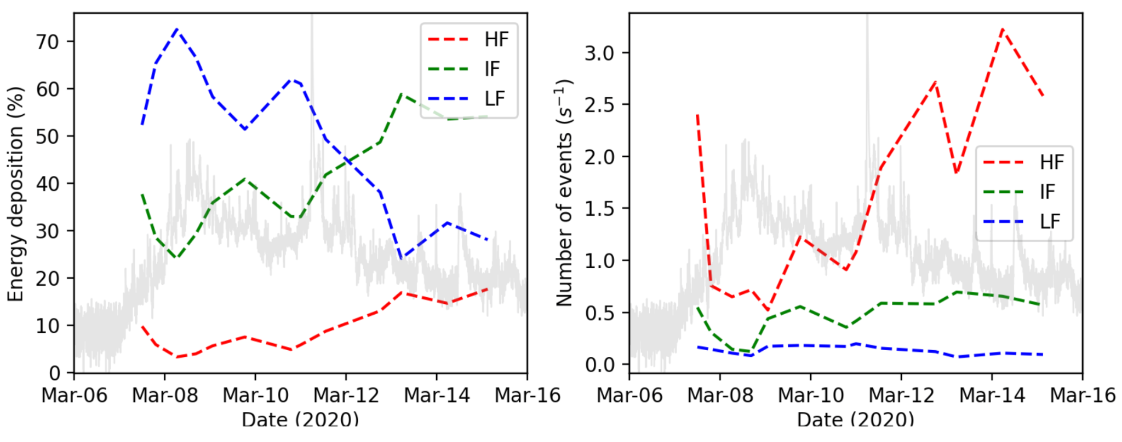
Evolution of heating frequency and their contributions
Mondal et al, 2024 (under preparation)

Slide 24
Summary
Investigated the nanoflare heating of an XBP observed by MaGIXS, AIA and XRT
Nanoflare heating can reproduce the observed intensity of the XBP with an average nanoflare delay time in the order of 1500-3000 s, which is likely to be high-frequency.
The average poynting flux is found to be in the range of ~3 ✕ 10⁵ erg cm⁻² s⁻¹, which agrees with the earlier report.
X-ray observations, e.g., MaGIXS and XRT are more sensitive to diagnose the heating frequency, whereas only AIA channels are less sensitive.
Studied the evolution of heating frequency throughout the evolution of an AR.
Emerging phase shoes more LF energy depositions, while in the decay phase, energy depositions by IF nanoflares are dominating.

Slide 25
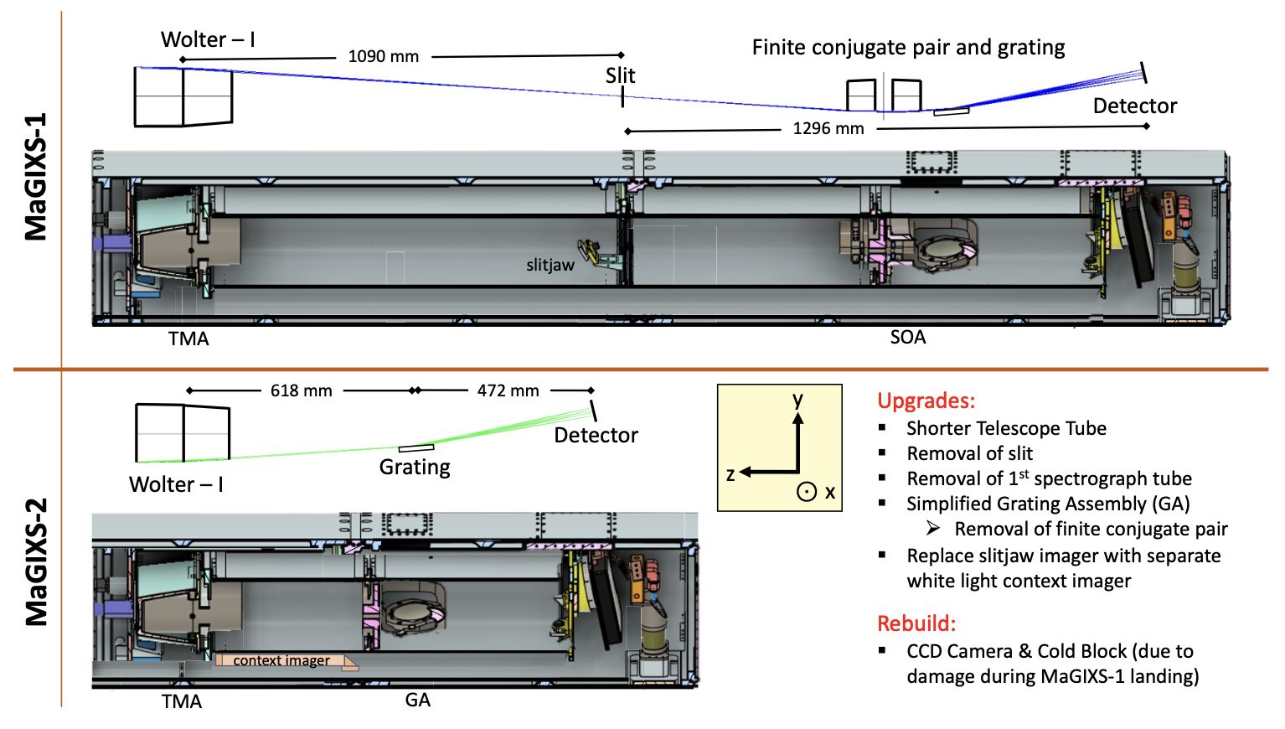
MaGIXS-2 (Next month)
Thank You for your attention!
Credit: MaGIXS team

