Slide 1
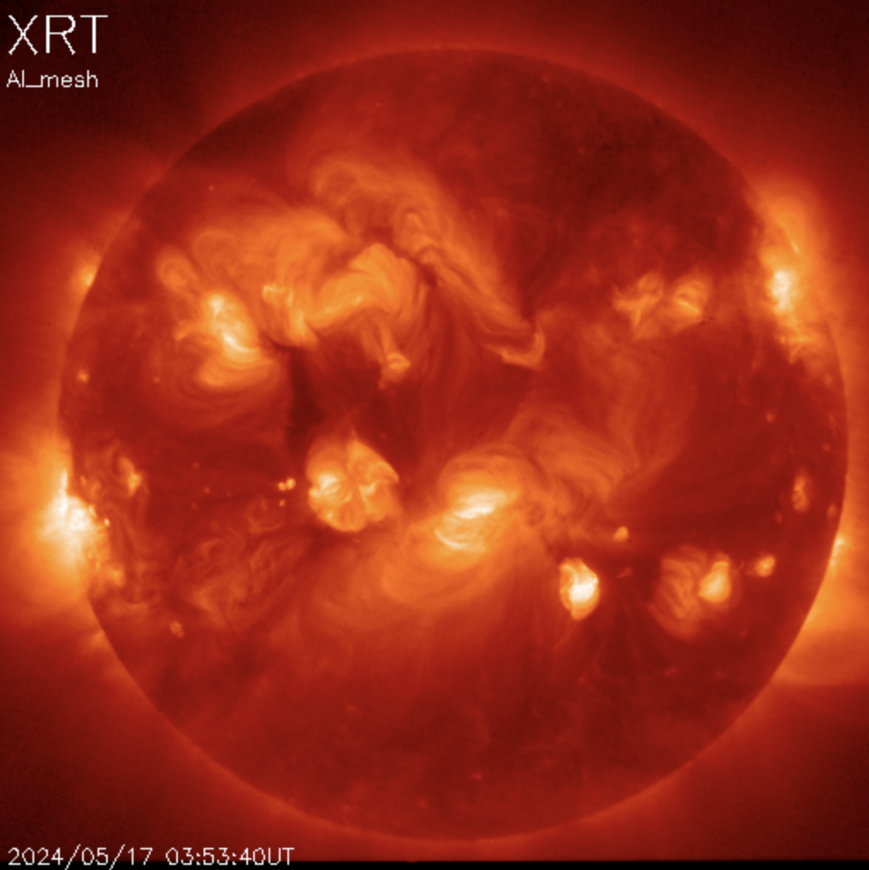

Temporal and spatial evolution of nanoflare heating in solar AR
Biswajit Mondal (NPP, NASA MSFC)
J.A. Klimchuk (NASA GSFC)
Jiayi Liu (University of Hawaii)
Amy R. Wineberger (NASA MSFC)
P.S. Athiray (UAH, NASA MSFC)
Email: biswajit.mondal@nasa.gov
11th Coronal Loops Workshop, Spain, June-26-2024

Slide 2
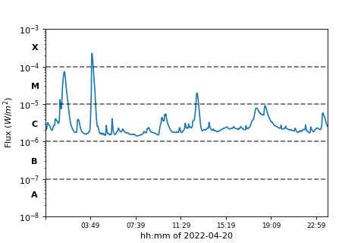
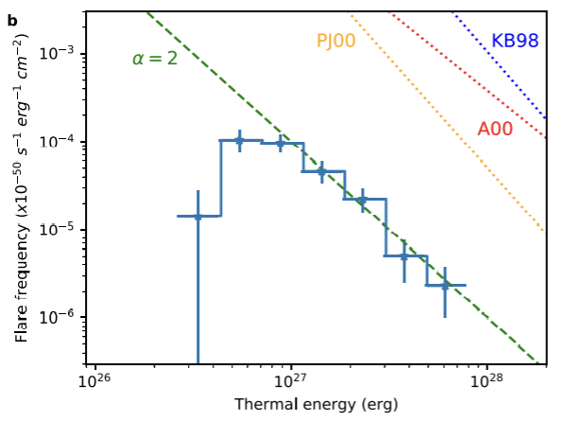
Nanoflare concepts from larger flares
The large solar flares, can not account for the overall coronal energy requirement (Sakurai 2017).
smaller flares occur more frequently.
Parker (1988) hypothesized the small-scale flares, termed as nanoflares having total energy around ∼10²⁴ erg, occurring all over the Sun.

Slide 3
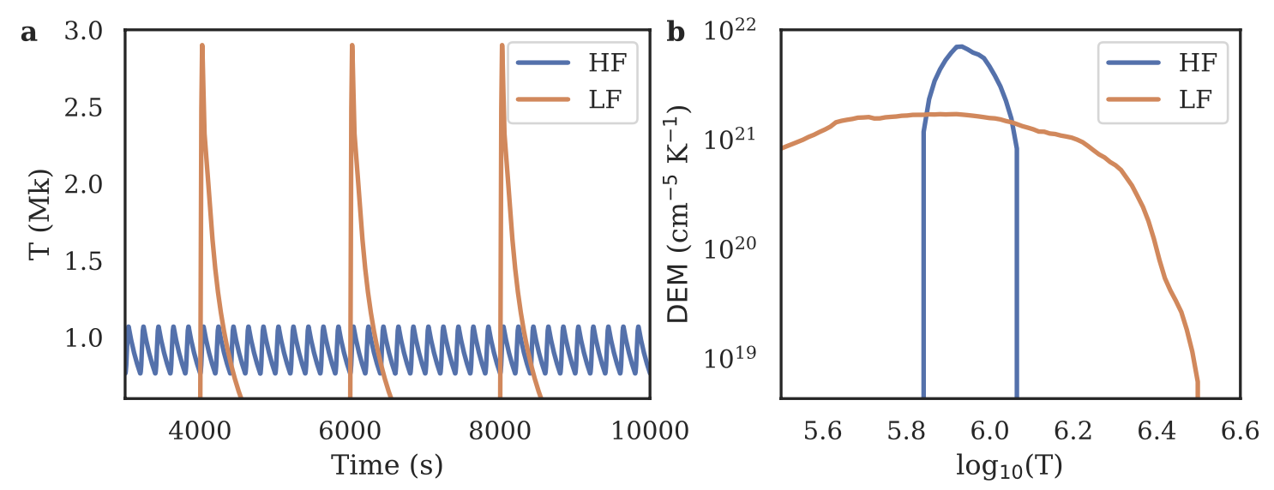
Observable properties
Direct detection of individual nanoflares are difficult.
Used indirect methods, e.g., Differential Emission Measure (DEM) or existence of hot plasma etc.

Slide 4
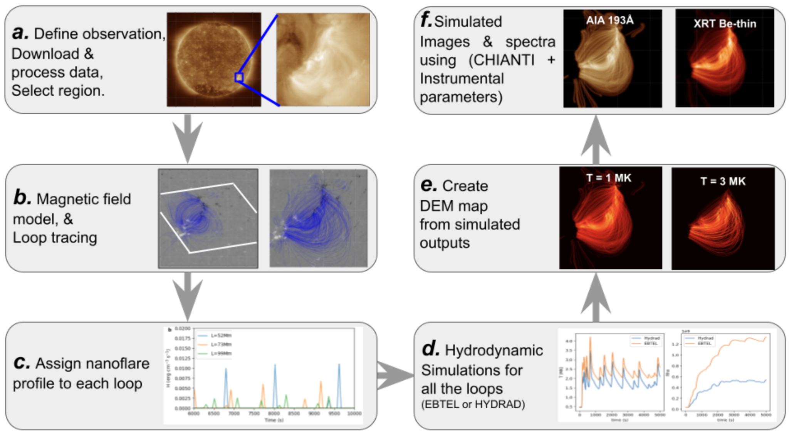
Combined observations with model

Slide 5
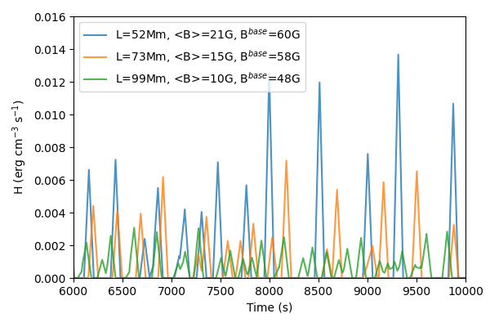
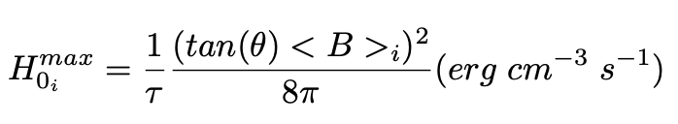
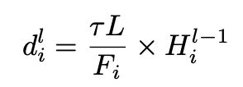
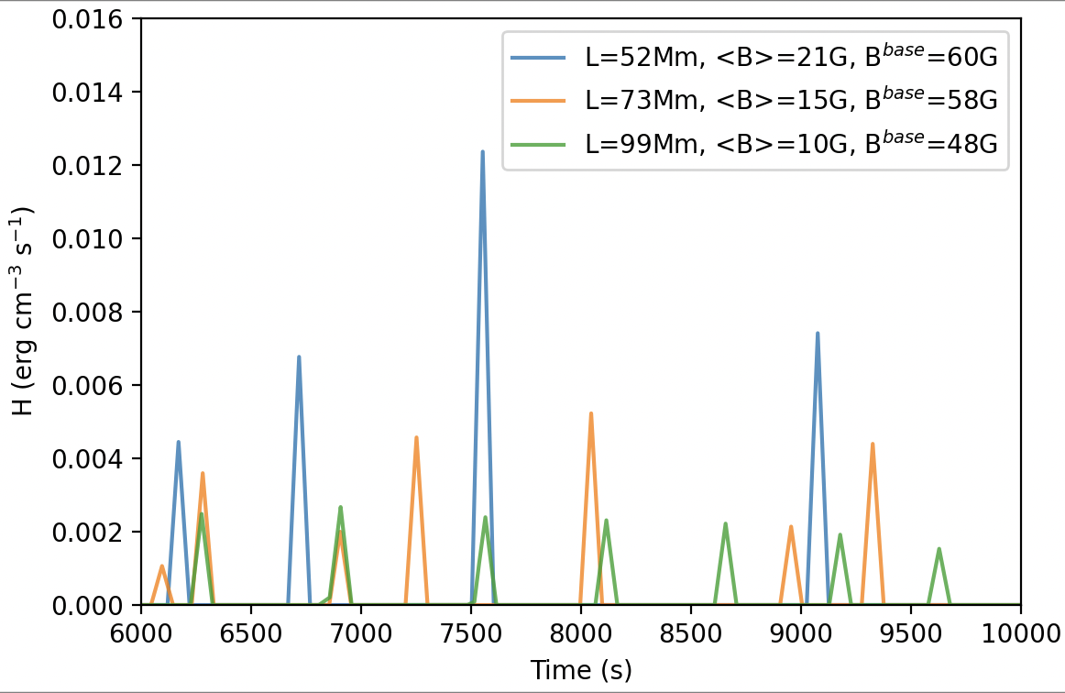
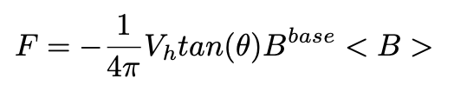
Create nanoflare profile
Consider triangular heating profiles having a duration, 𝜏 = 100 s.
The peak heating rate during an event is randomly chosen between minimum (H₀^{min} ) and maximum (H₀^{max}) values that are loop dependent.
tan(θ) = 0.2
V_{h} = 1.5 km/s
tan(θ)= 0.2
V_{h} = 0.5 km/s
Mondal, Klimchuk et al (2023 ApJ 945:37 2023)

Slide 6
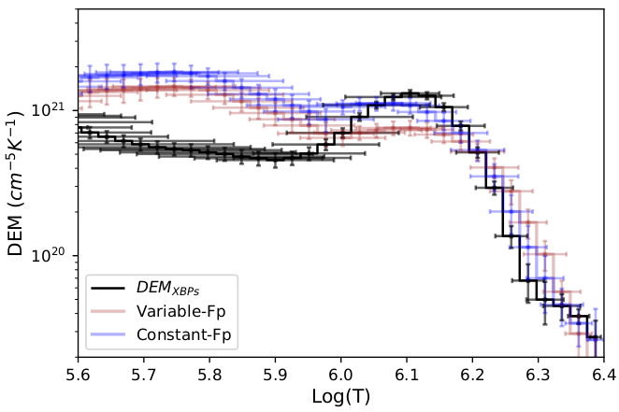
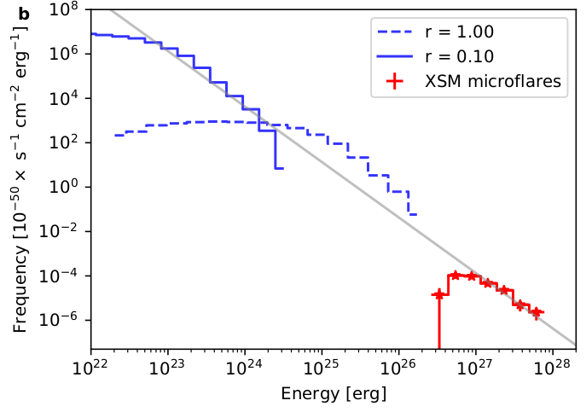
Earlier study-I: Nanoflare heating of quiet-sun XBPs
Simulated DEMs
∝ E ^{-𝛼}
Observed DEM
Mondal et al, (ApJ, 945:37, 2023)

Slide 7
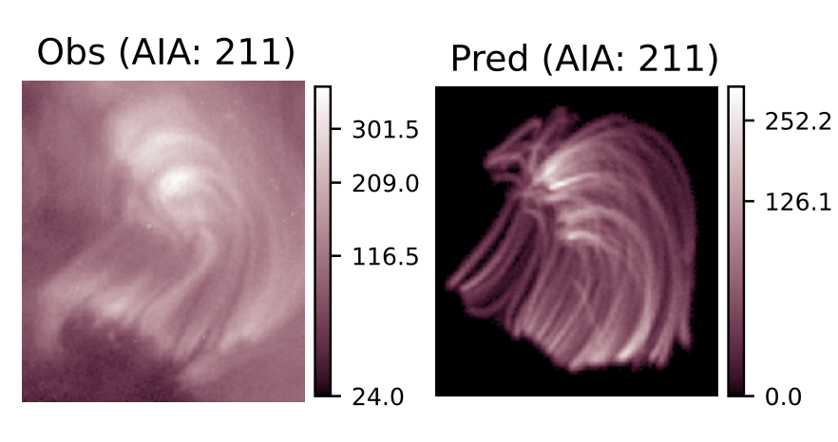
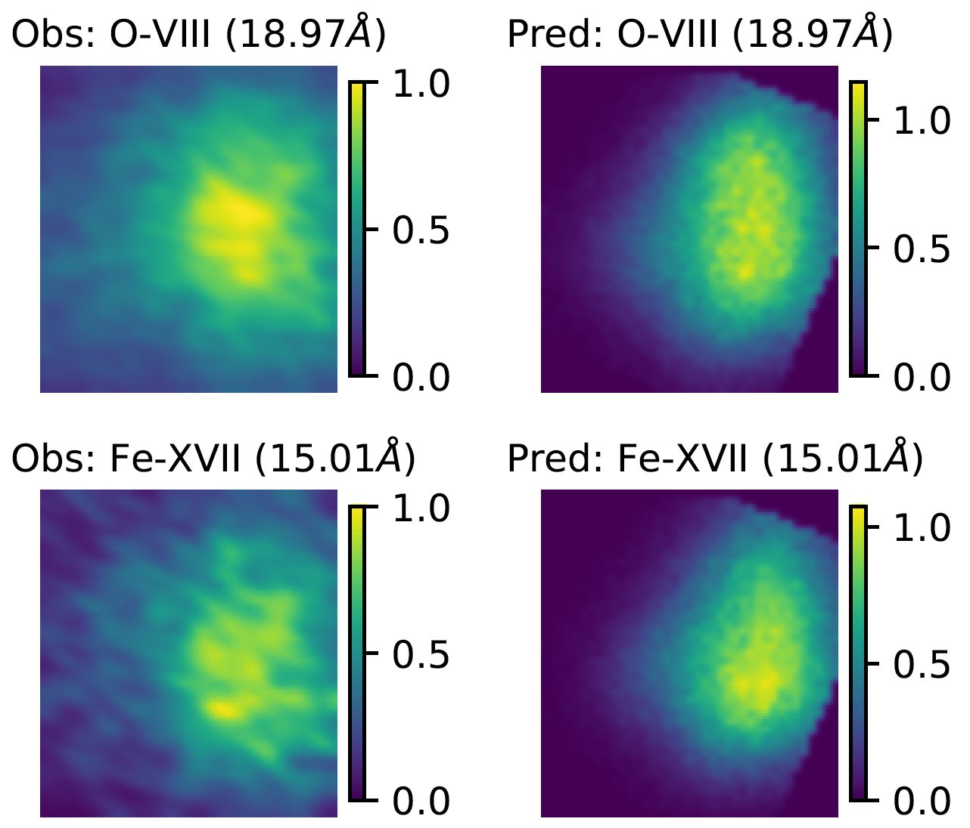
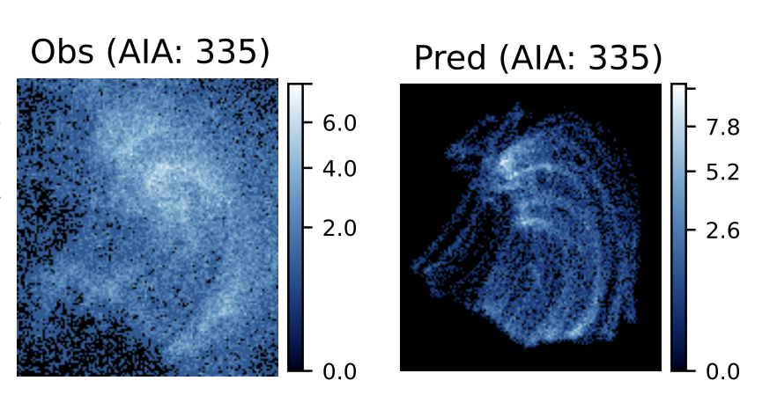
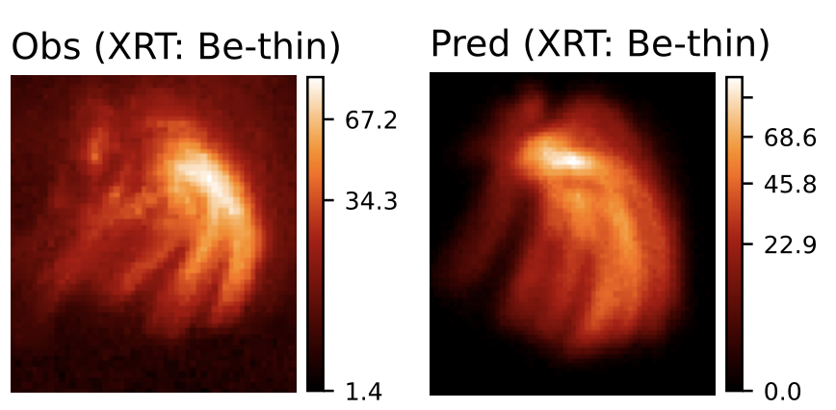
Earlier study-II: Nanoflare heating of an XBP observed by MaGIXS
DN/s
DN/s
Derived from MaGIXS
Simulated
Observed by AIA & XRT
Simulated
Mondal et al, (ApJ 967, 23, 2024)
HF nanoflare -> average delay = 1500 - 3000 s -> smaller than the cooling time.
Average Poynting flux = ~5e5 erg/cm2/s
MaGIXS and XRT are more sensitive.

Slide 8
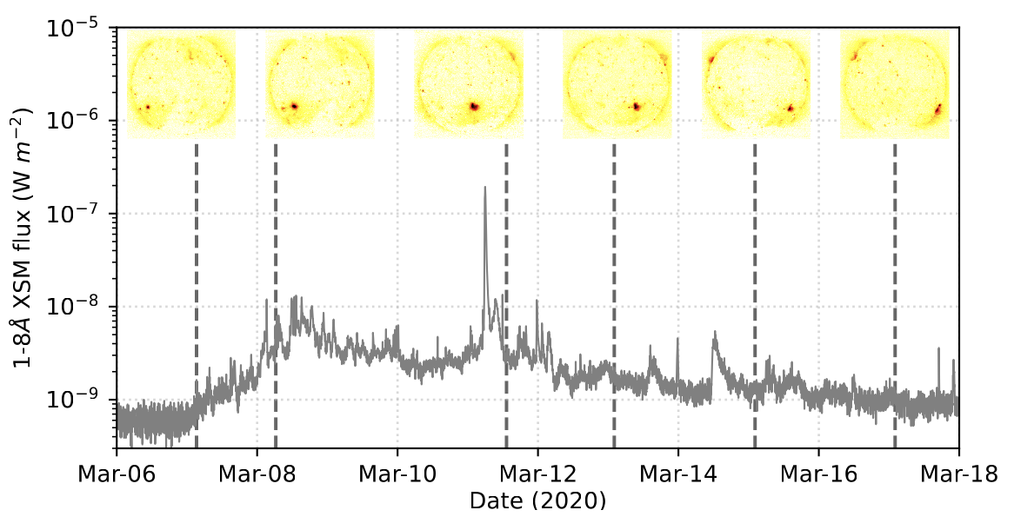
AR 12758

Slide 9
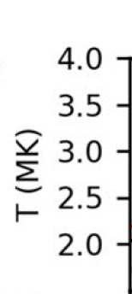
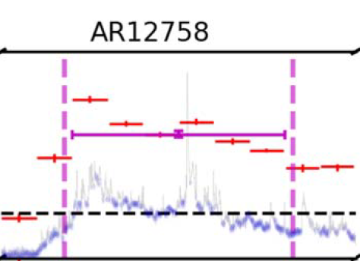

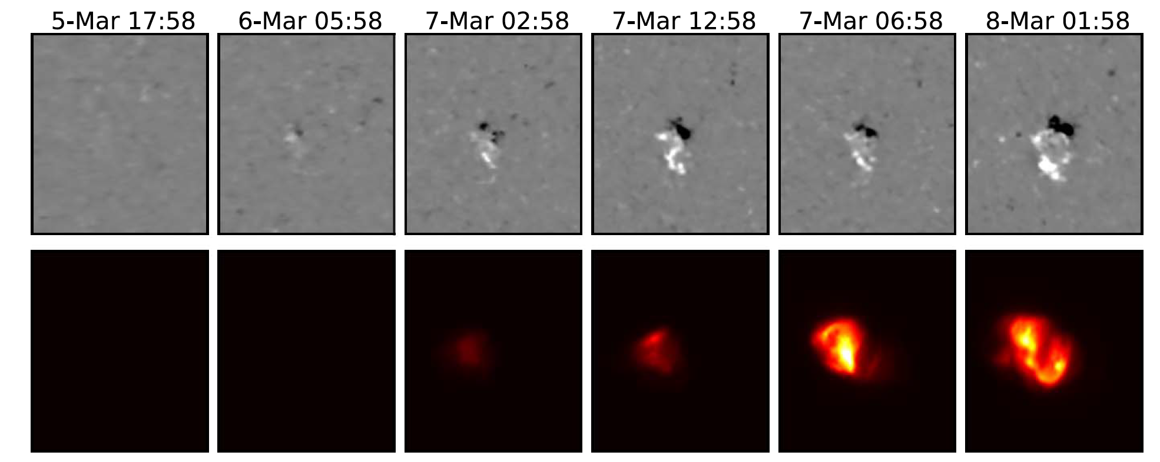
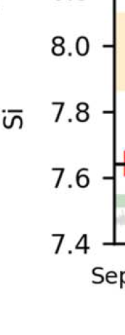
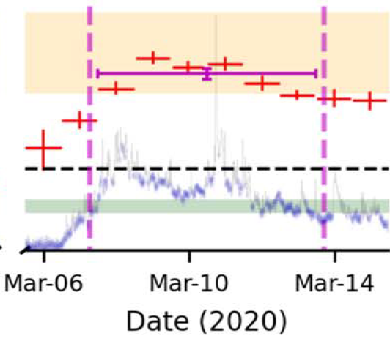

Formation of AR12758
Evolution of plasma parameters!
FIP bias
Evolution of this AR was studied from soft X-ray disk-integrated spectroscopy by Chandrayaan-2/XSM.
Step-1: Simulate the evolution of this AR and compared with disk-integrated quantities.
Mondal et al (ApJ 955:146, 2023b)

Slide 10
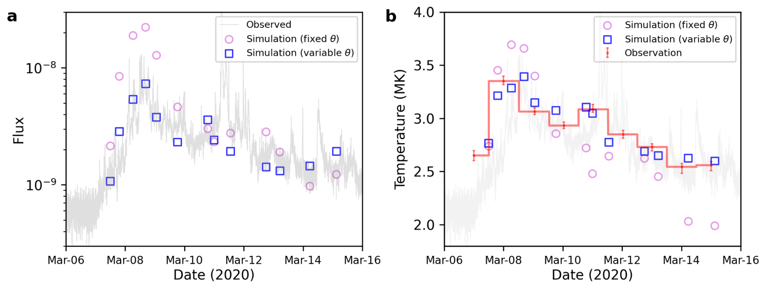
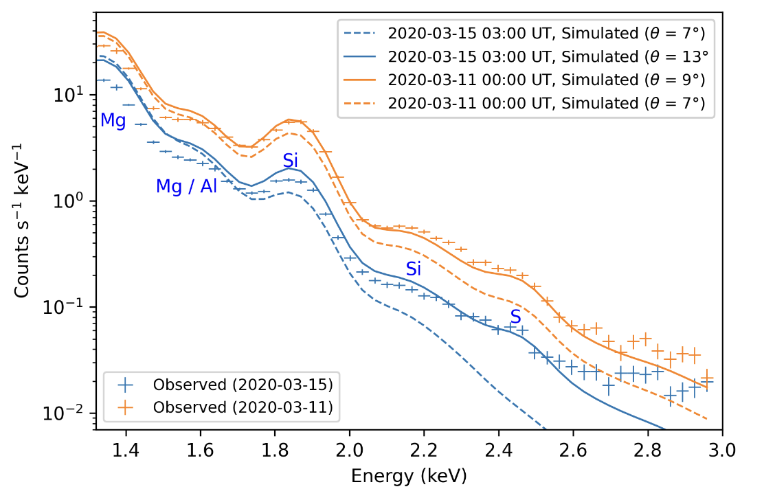
Observed and predicted X-ray flux and spectra

Slide 11
Variation of integrated temperature derived from X-ray spectra

Slide 12
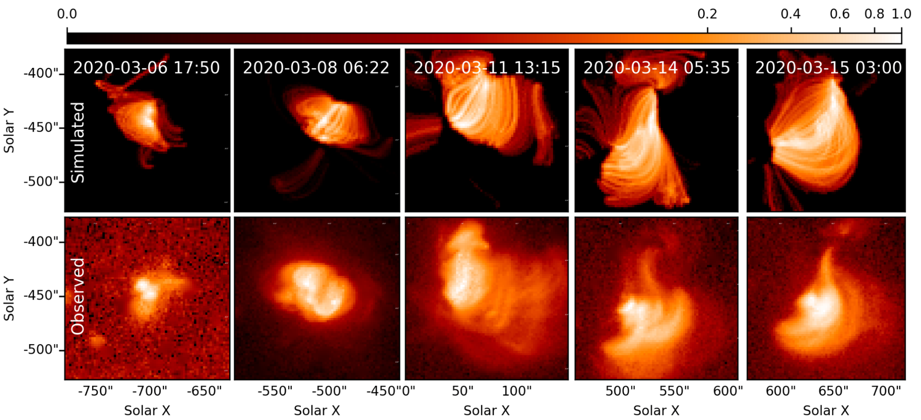
Spatial variation of X-ray emissions

Slide 13
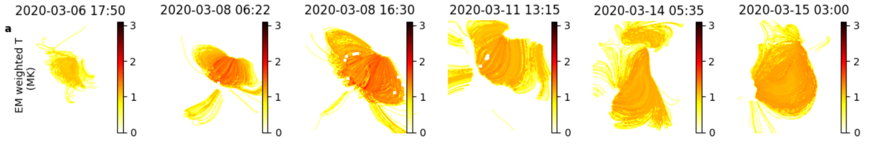
Spatial variation of temperatures
EM weighted T varies (1 to 3 MK) with spatial location of the AR.
Indicating different heating frequency.

Slide 14
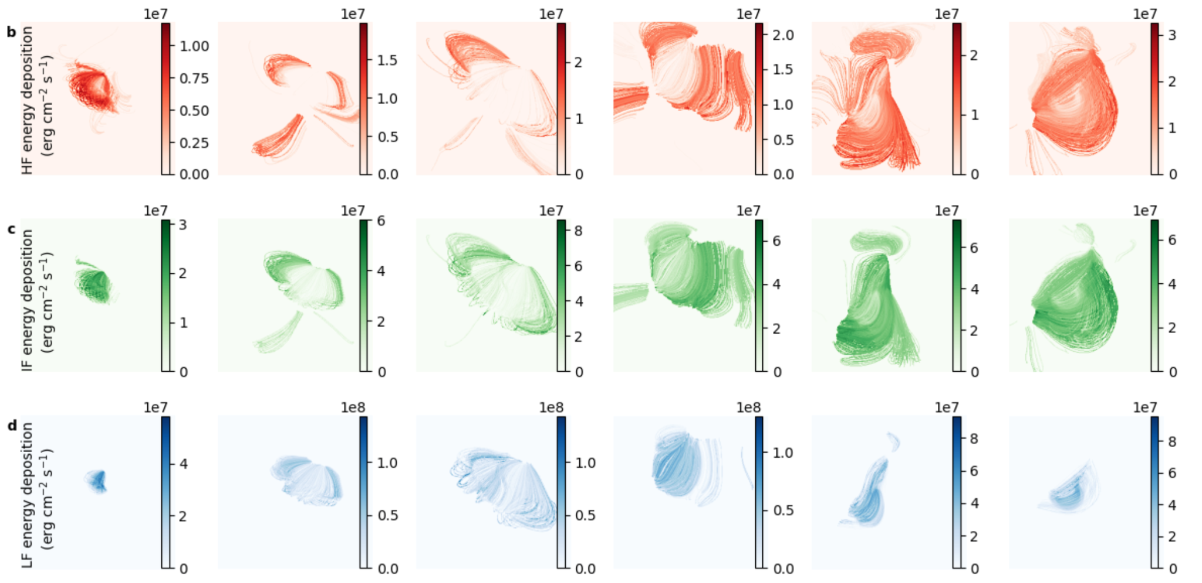
Contributions of different heating events
Mondal et al, 2024 (under preparation)

Slide 15
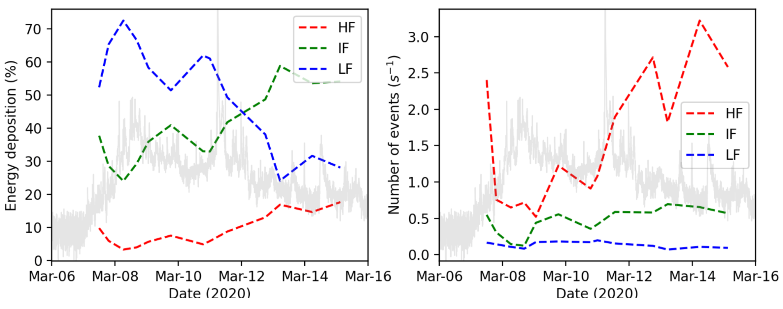
Evolution of heating frequency and their contributions
Mondal et al, 2024 (under preparation)

Slide 16
Summary
Investigated the nanoflare heating during the evolution of an AR
Observed X-ray flux could appropriately model from the observed photospheric magnetogram.
HF nanoflares are always higher in number, but their energy deposition is less.
Emerging phase of the AR shoes more LF energy depositions, while in the decay phase, energy depositions by IF nanoflares are dominating.

Slide 17
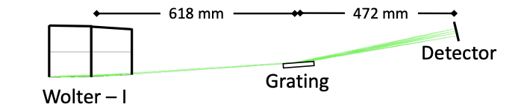
MaGIXS-2 (Next month)
BM, acknowledge the NSF travel support (AGS 2417806) to present this work
Thank You for your attention!

