Slide 1

NASA Advanced Air Vehicles Program (AAVP)
Status Update
National Aeronautics and Space Administration
United Kingdom Visit
June 19-21, 2024
www.nasa.gov

Slide 2
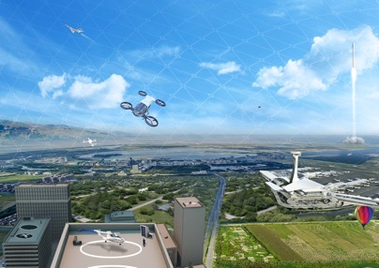
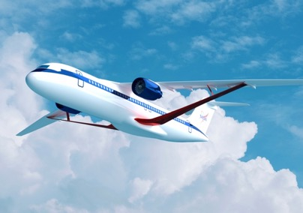
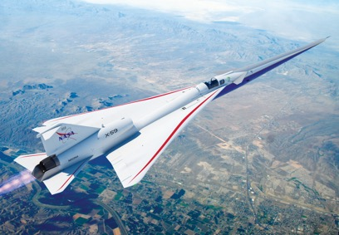

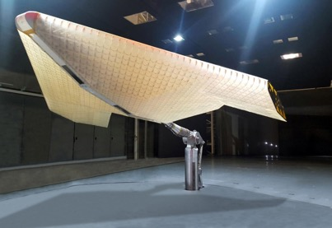
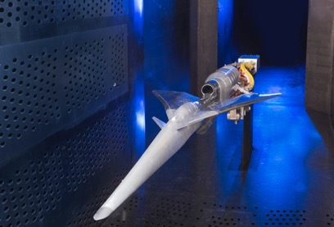
NASA Aeronautics Programs
Airspace Operations and Safety Program
Advanced Air Vehicles Program
Integrated Aviation Systems Program
Transformative Aeronautics Concepts Program
Aerosciences Evaluation and Test Capabilities Portfolio
2

Slide 3
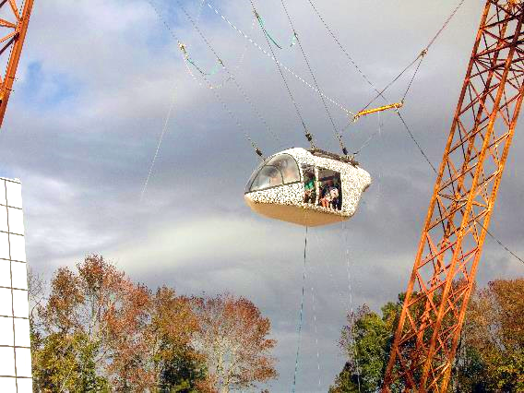

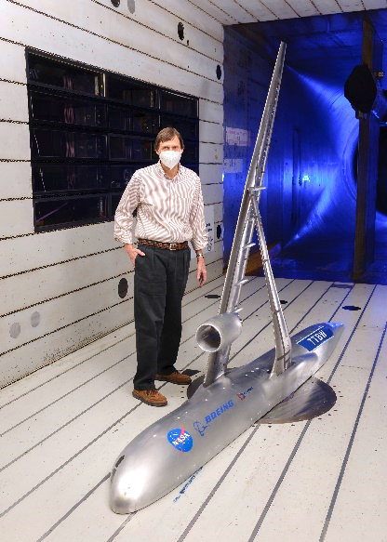
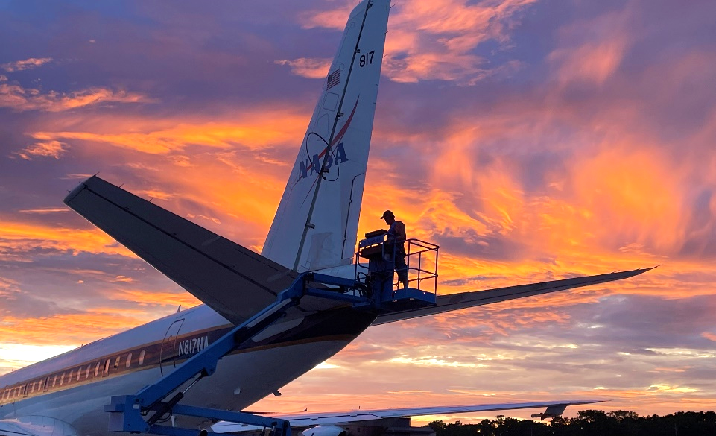
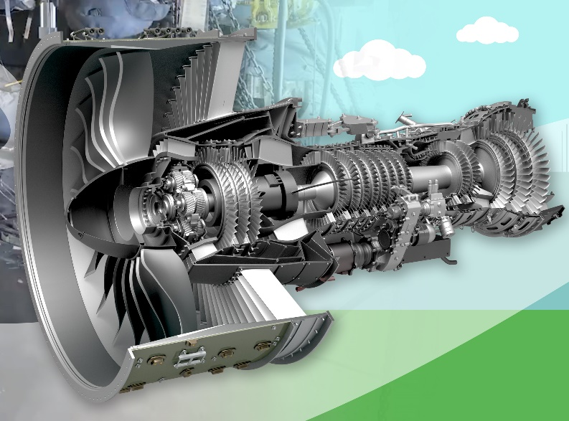
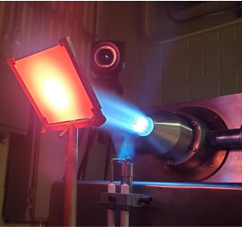
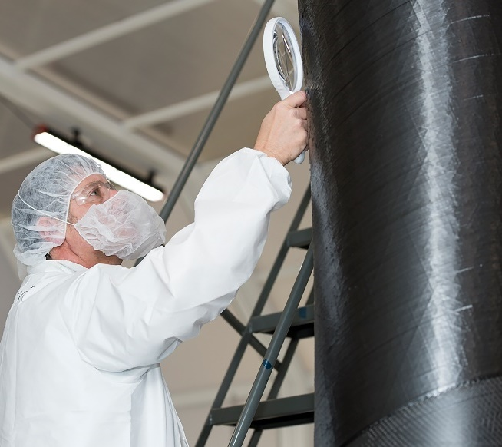
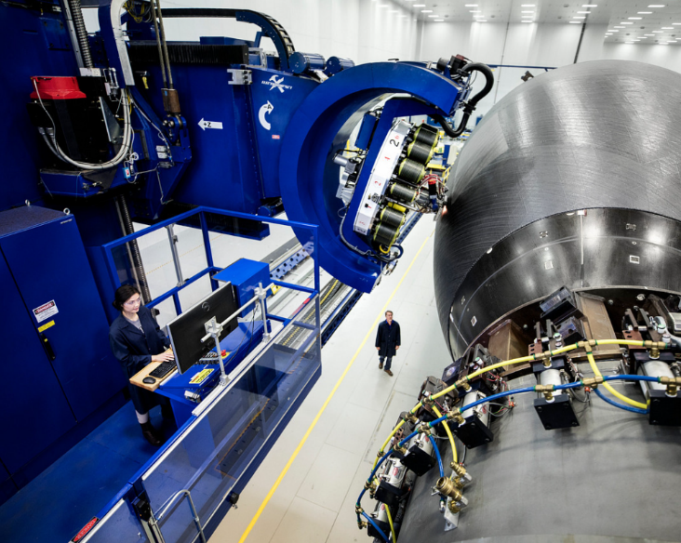
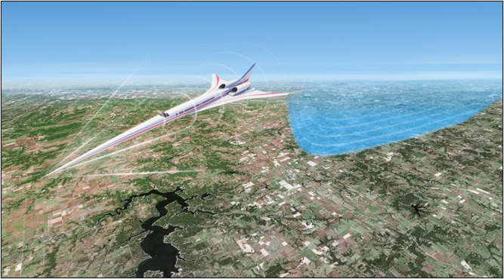
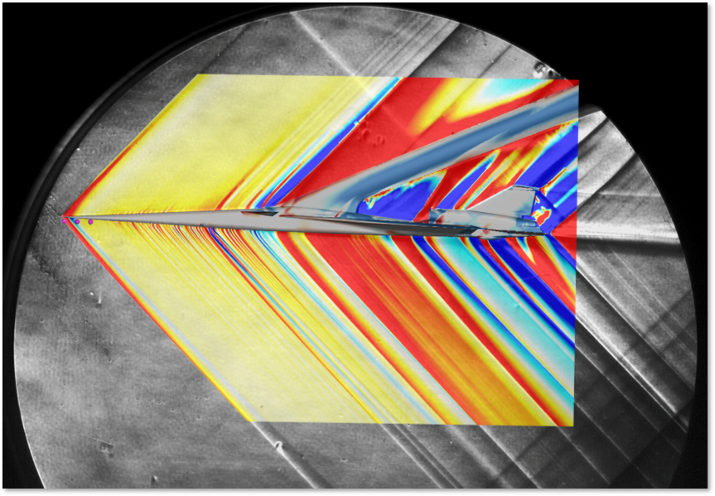
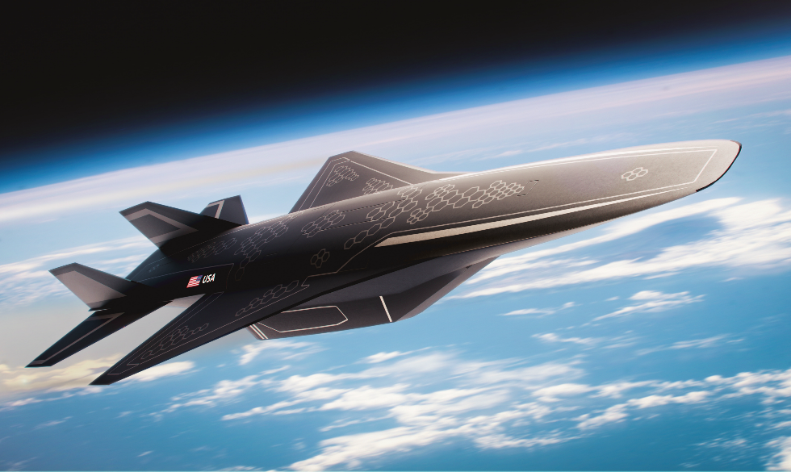
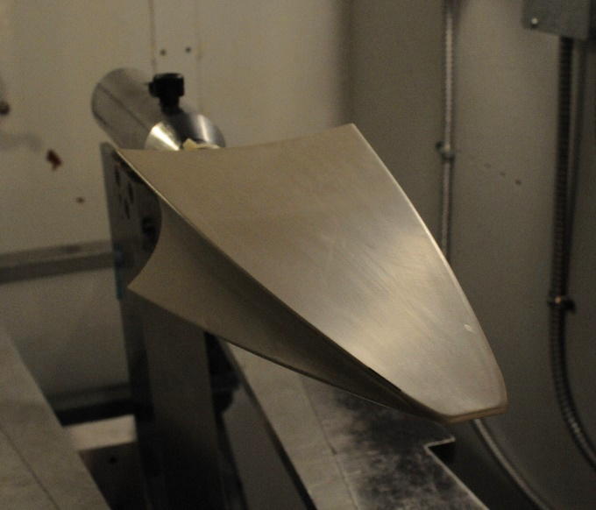
Advanced Air Vehicles Program
RVLT | RVLT | RVLT | RVLT | RVLT | RVLT | RVLT | RVLT | RVLT | RVLT | AATT | AATT | AATT | AATT | AATT | AATT | AATT | AATT | AATT | HyTEC | HyTEC | HyTEC | HyTEC | HyTEC | HyTEC | HyTEC
Revolutionary Vertical Lift Technology Advanced Air Transport Technologies Hybrid Thermally Efficient Core
At the forefront of cutting-edge research and technology…
Generating innovative concepts, capabilities, and knowledge…
Enabling revolutionary advances for a wide range of air vehicles…
Hi-Rate Composite Aircraft Manufacturing Commercial Supersonic Technology Hypersonic Technology
3
HiCAM | HiCAM | HiCAM | HiCAM | HiCAM | CST | CST | CST | CST | CST | CST | CST | CST | CST | CST | HTP | CST | HTP | HTP | HTP | HTP | HTP | HTP | HTP | HTP | HTP | HTP | HTP .

Slide 4
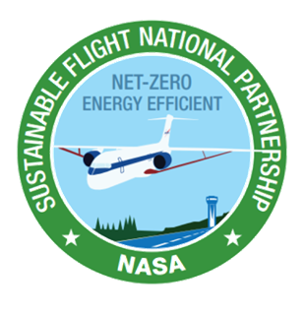
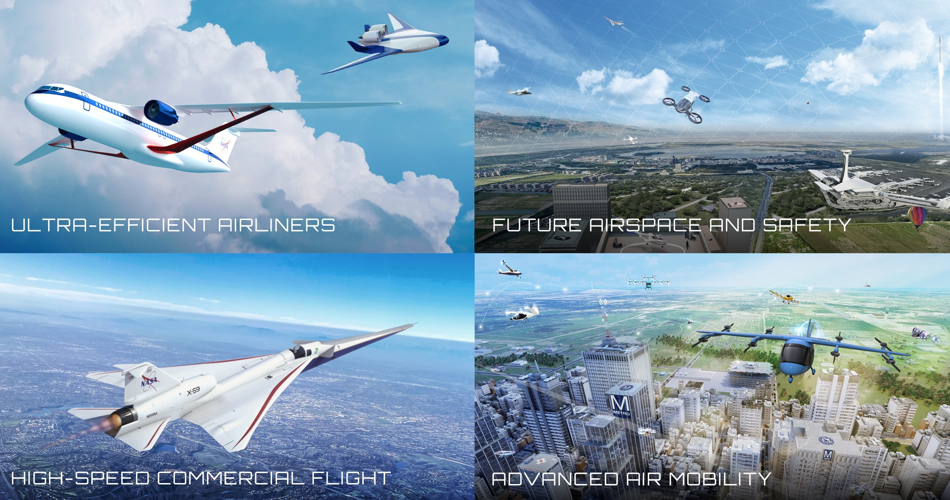
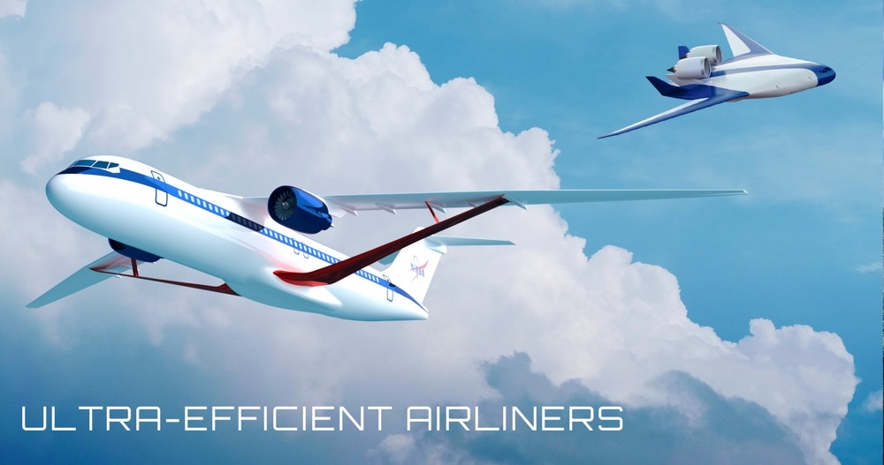

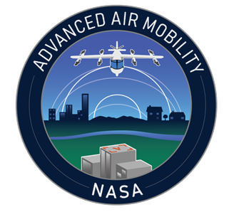
Enabling Aeronautics Transformations
4

Slide 5

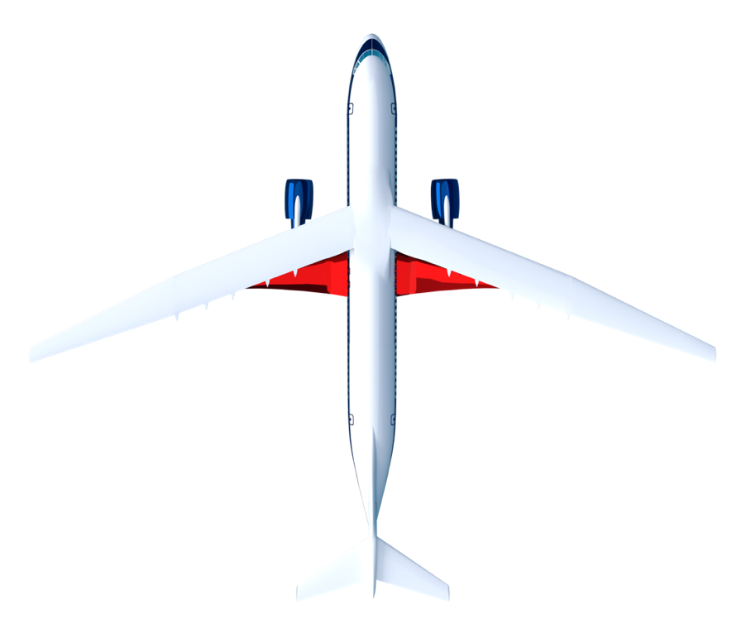
Sustainable Flight National Partnership Benefits
Small Core Gas Turbine for 5%-10% fuel burn benefit
Transonic Truss-Braced Wing for 5%-10% fuel burn benefit
Electrified Aircraft Propulsion
for ~5% fuel burn and maintenance benefit
High-Rate Composites for
4-6x manufacturing
rate increase
Sustainable Aviation Fuels for reduced lifecycle carbon emissions
Integrated Trajectory Optimization for 1%-2% reduction in fuel required and minimization of contrail formation
Next-generation transports using up to 30% less fuel, current and future fleets flying optimal trajectories,
engines burning sustainable aviation fuels for net-zero lifecycle greenhouse gas emissions
5
Notes:
NASA’s Sustainable Flight National Partnership (SFNP) will mature new green technology by late 2020s to maintain U.S. leadership as builders of next-generation commercial transports – the heart of the aviation system. Sustainable aviation system growth, increased airline travel, excellent engineering and manufacturing jobs, and economic growth will all result from achieving SFNP objectives and benefits. ​

Slide 6
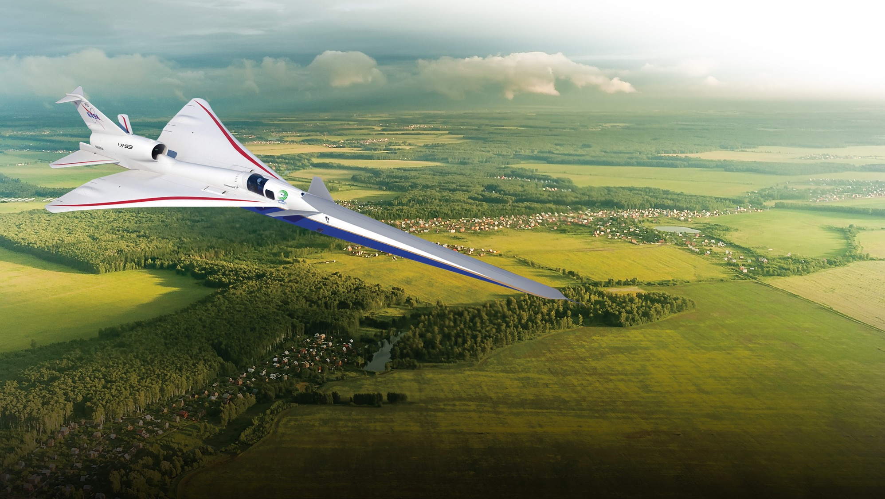

Quesst Mission
This mission will fly the
X-59 with its quiet supersonic technologies over U.S. communities, yielding data that could lead to new en route certification standards based on acceptable
sound levels.
Addressing the unique barriers to high-speed flight
6

Slide 7
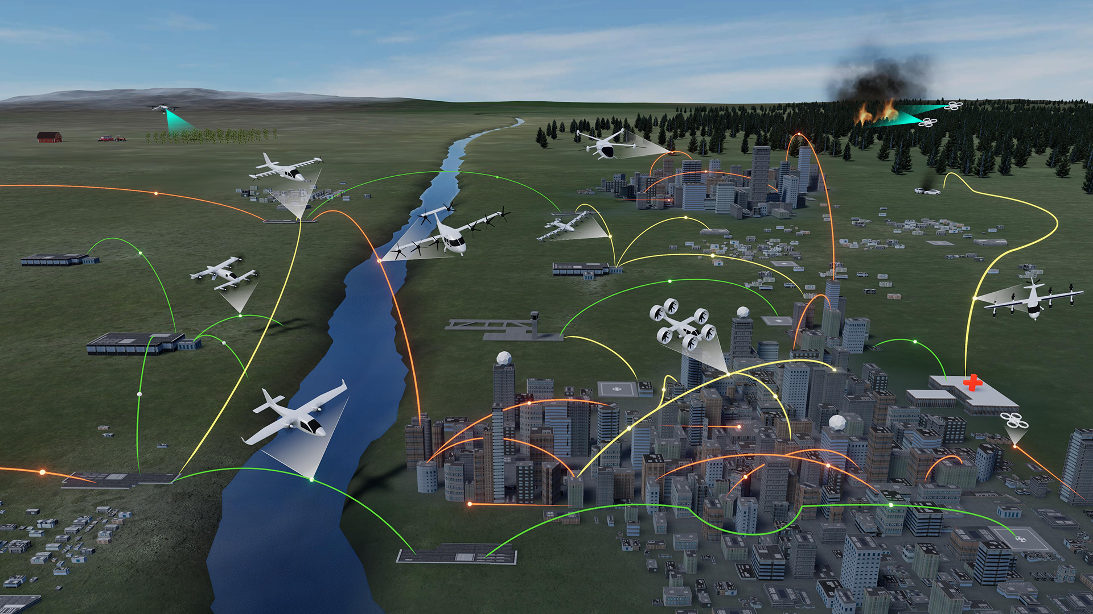
Advanced Air Mobility Mission
Wildfire Fighting
Operations
Rural Operations
On Demand
Air-Taxi
Urban Operations
Regional
Network
Cargo
Delivery
Inter-City
eC/STOL
Inter-City
eVTOL
Cargo
Delivery
Airport
Transfer
Air
Ambulance
Distribution
Center/Warehouse
Medical
Supply Delivery
Fleet
Operations
Inter-city
eCTOL
Small
Package Delivery
Cross-metro
Transfer
Safe, sustainable, affordable, and accessible aviation
for transformational local and intraregional missions
7

Slide 8
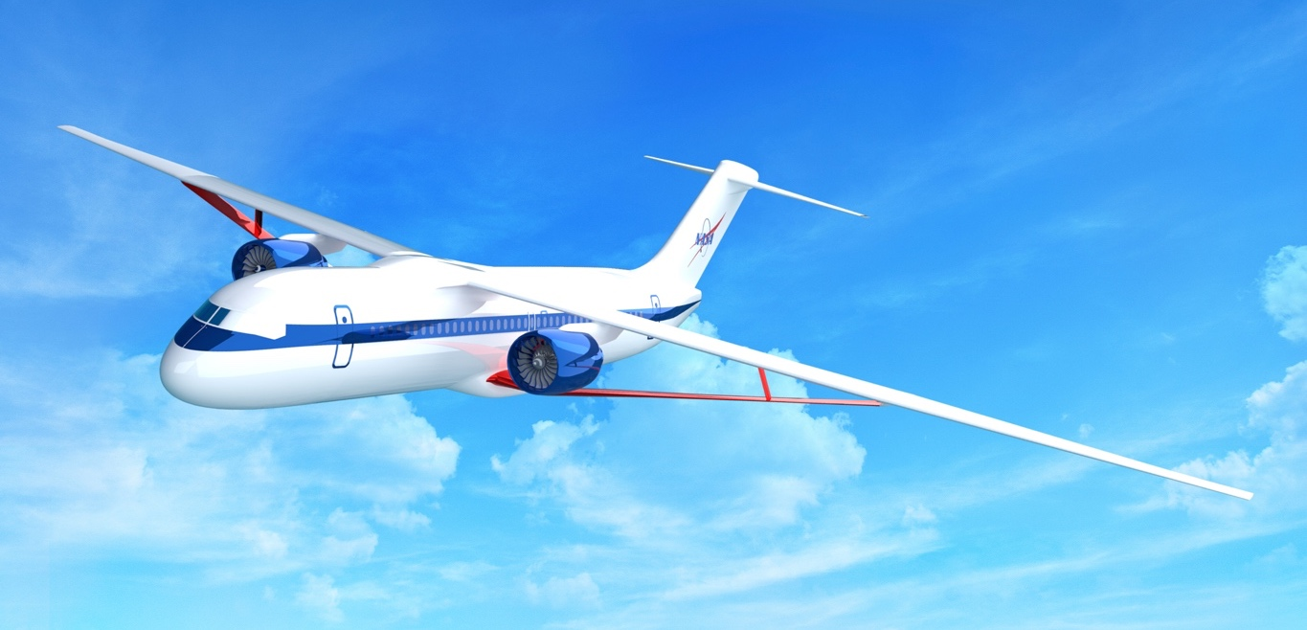
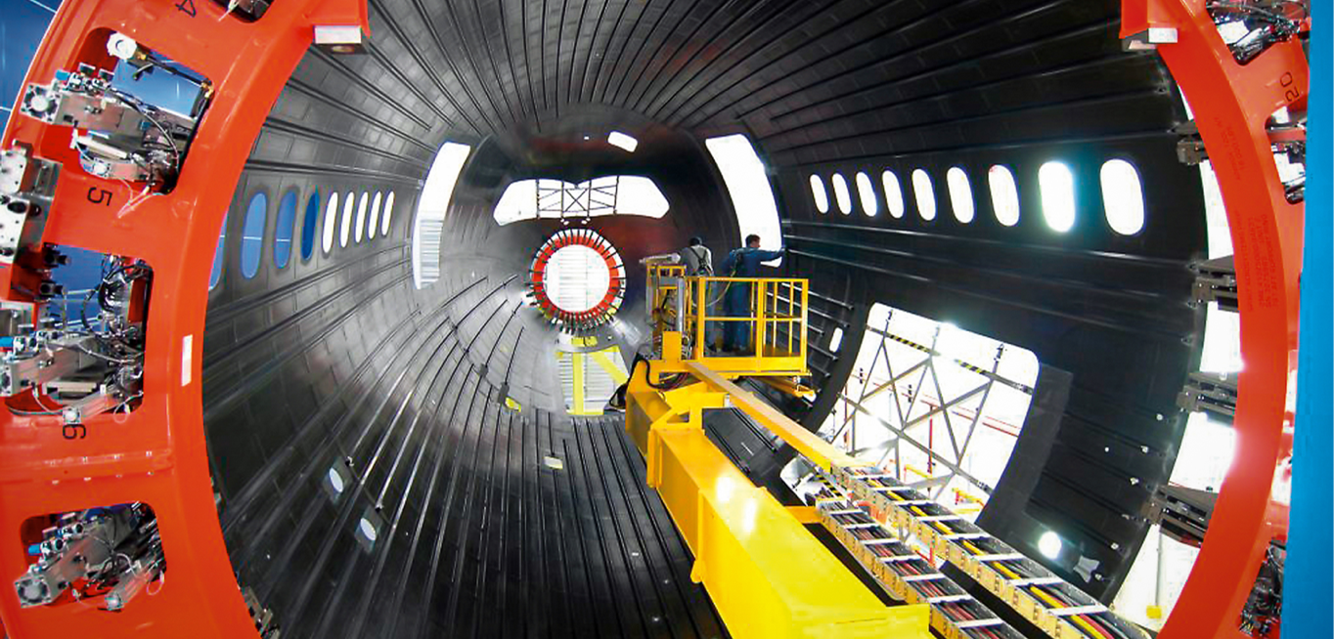

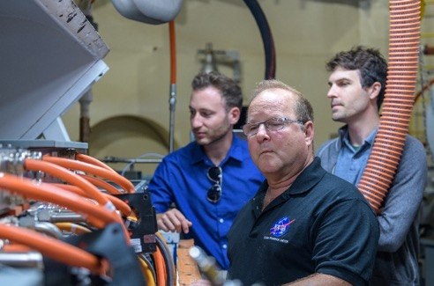
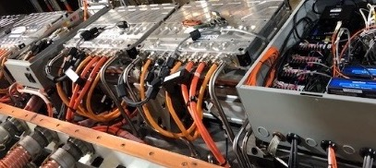
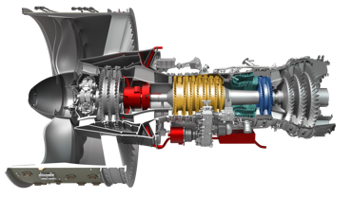
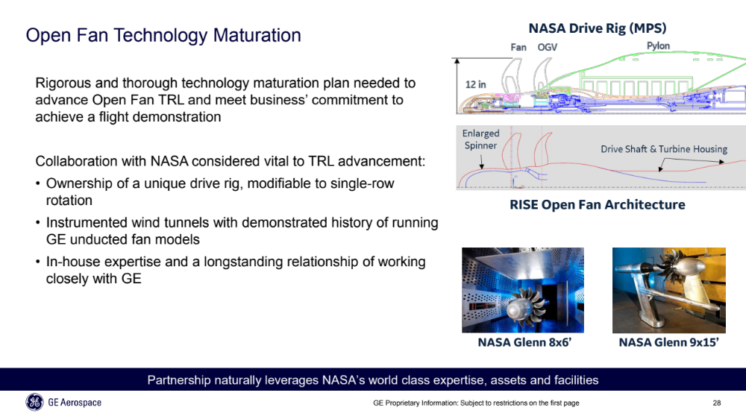
Ultra-Efficient Airliners Transformation: AAVP Highlights
Boeing ecoDemo SAF emissions flights with Boeing, GE, FAA, and partners
TTBW tech maturation (low speed, deep stall, icing)
High-rate, composite manufacturing approach maturation
Engine Hybridization Testing
NASA/FAA/GE partnership on next-generation ducted and open fan technologies
TRL 6 core ground demonstration
Electrical Powertrain Components in NASA’s Electrified Aircraft Testbed
Maturing key integrated vehicle and propulsion technologies on the path to aviation sustainability.
8

Slide 9
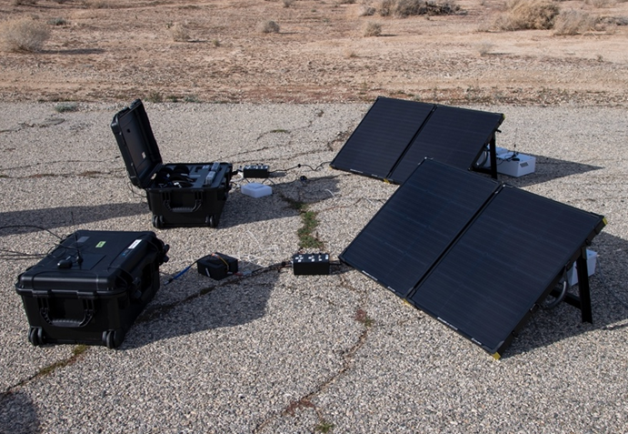
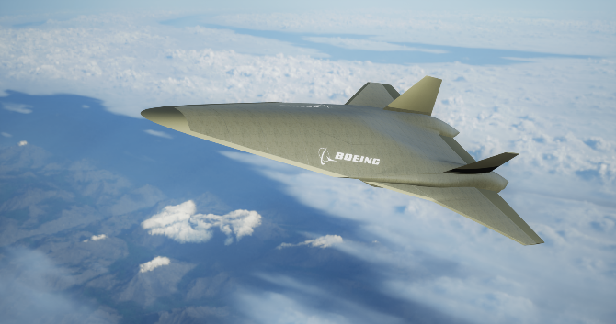
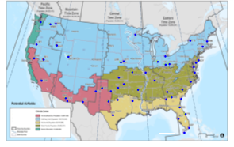
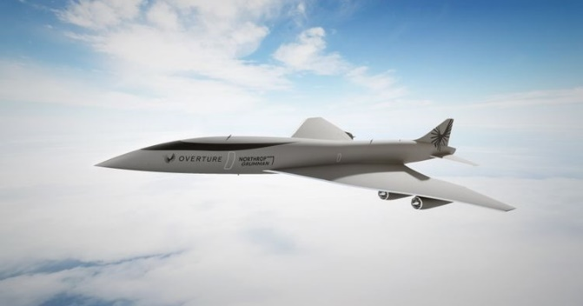
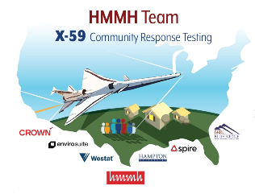
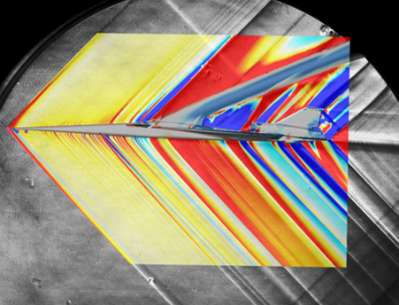
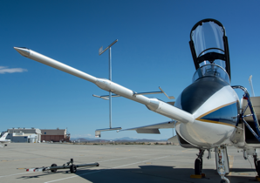
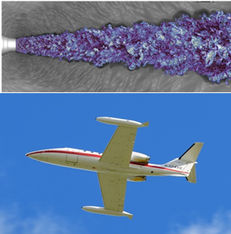
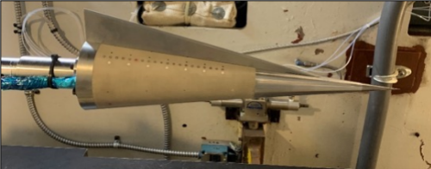
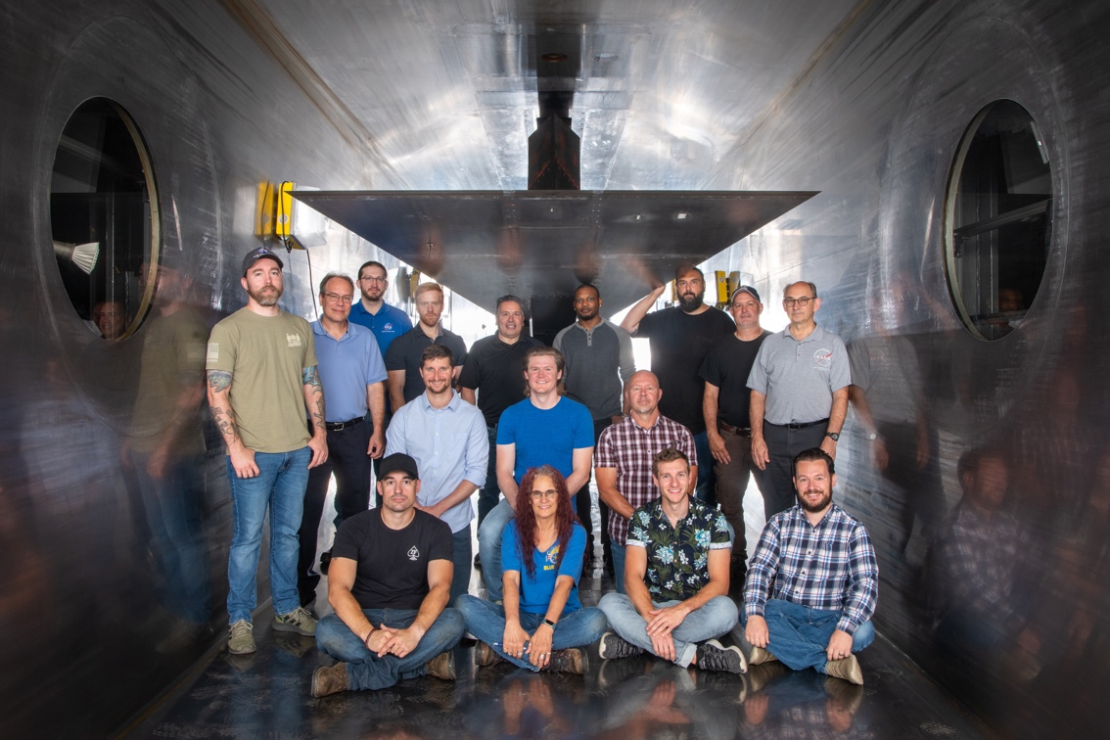
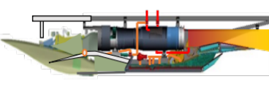
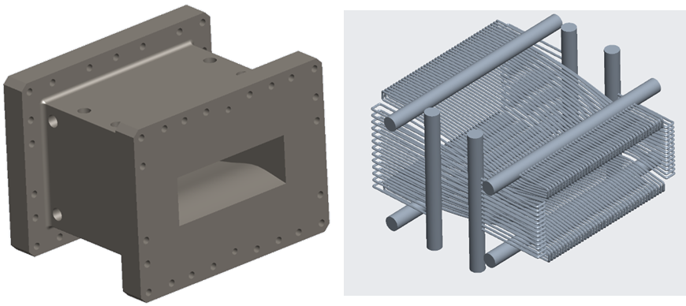
High-Speed Flight Transformation: AAVP Highlights
Quesst
Phase 2 and 3 readiness
Design studies for
Mach 2-5 commercial market
Boundary layer transition and heating
High-temp durable materials and coatings for seals, high-temp strain and optical temp measurement systems
Landing and takeoff
noise predictions
Combined Cycle Engine
‘Phase 4Sim’ test in 10x10 SWT
Tackling technical and regulatory boundaries facing overland supersonic and high-speed commercial flight.
9

Slide 10
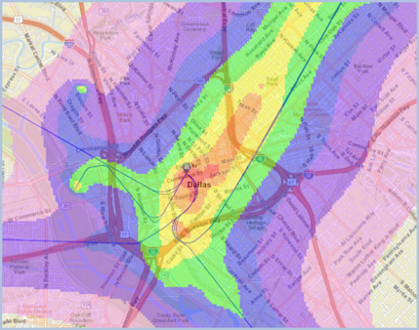
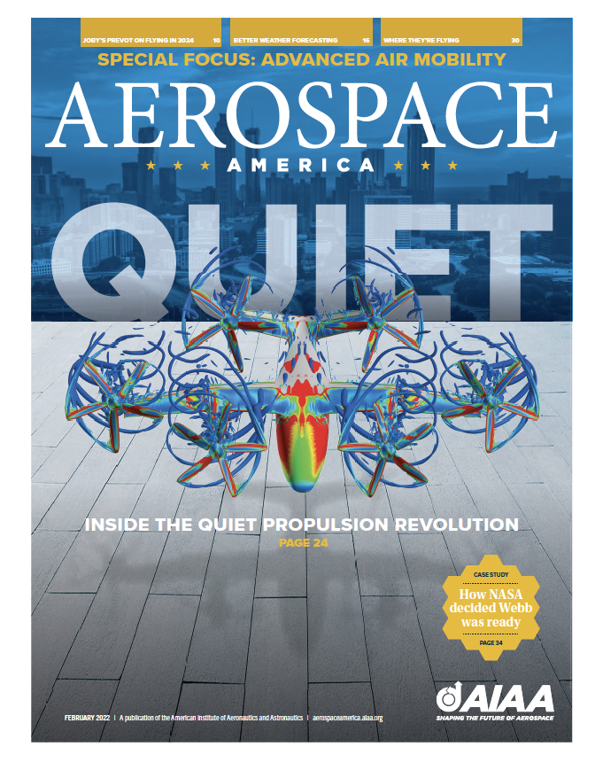
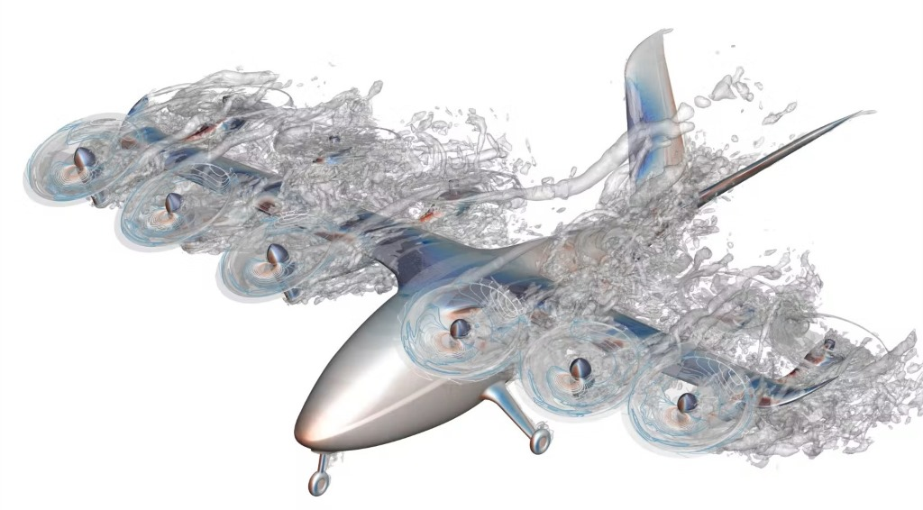
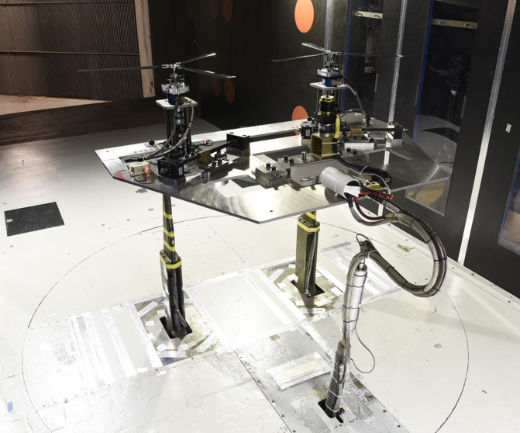
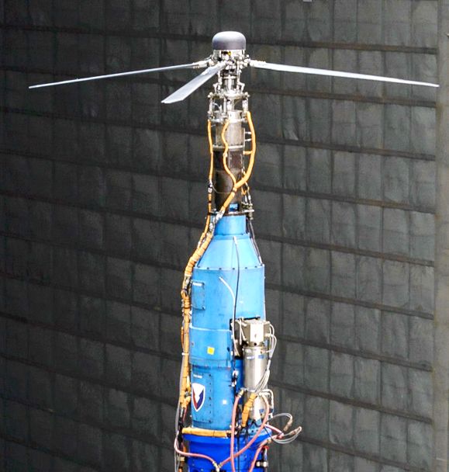
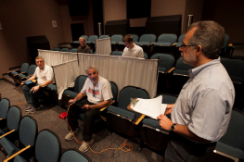
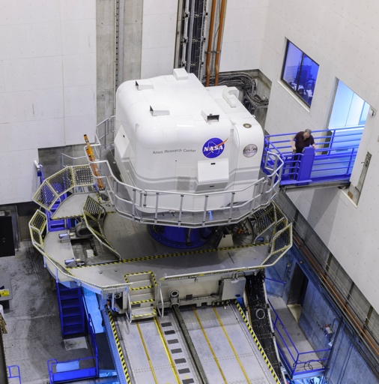
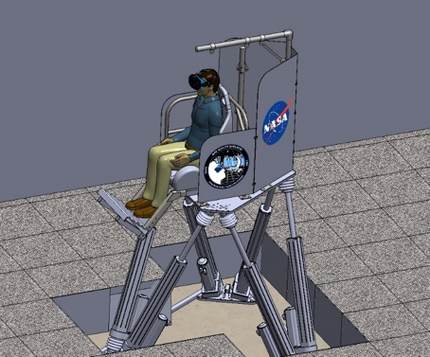
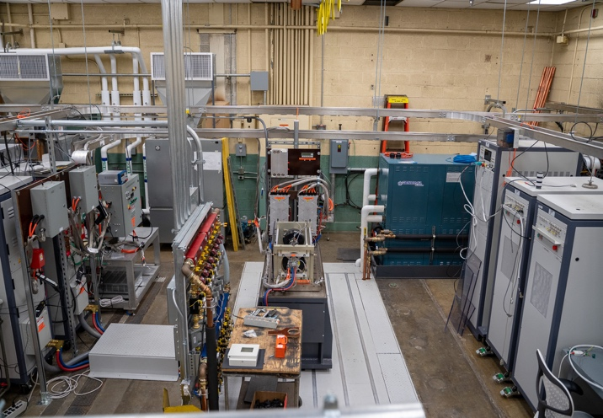



Advanced Air Mobility Transformation: AAVP Highlights
Image from Archer website
OEMs using NASA noise and
performance prediction tools
AAM fleet noise in FAA AEDT tool
Validation testing of
computational tools
    Handling and ride quality for AAM
    AAM fuselage drop test
Assessing electric powertrain reliability and power quality
Delivering critical noise, performance, and vehicle safety tools, insights, and standards guidelines.
10

Slide 11



AAVP at the Forefront of the Emerging New Era of Flight
  Breaking down barriers to open new markets, advancing U.S. competitiveness, and making air travel more sustainable for the Nation and the world
Next Generation Subsonic Transports
Making air travel cleaner, quieter, and more affordable
Commercial Supersonic Flight
Connecting people faster
Advanced Air Mobility
Allowing people to move about more easily
Hypersonic Flight
Enabling a future vision for hypersonic transport
Creating new “S” curves for the next 50 years of aviation
11

Slide 12




