Slide 1
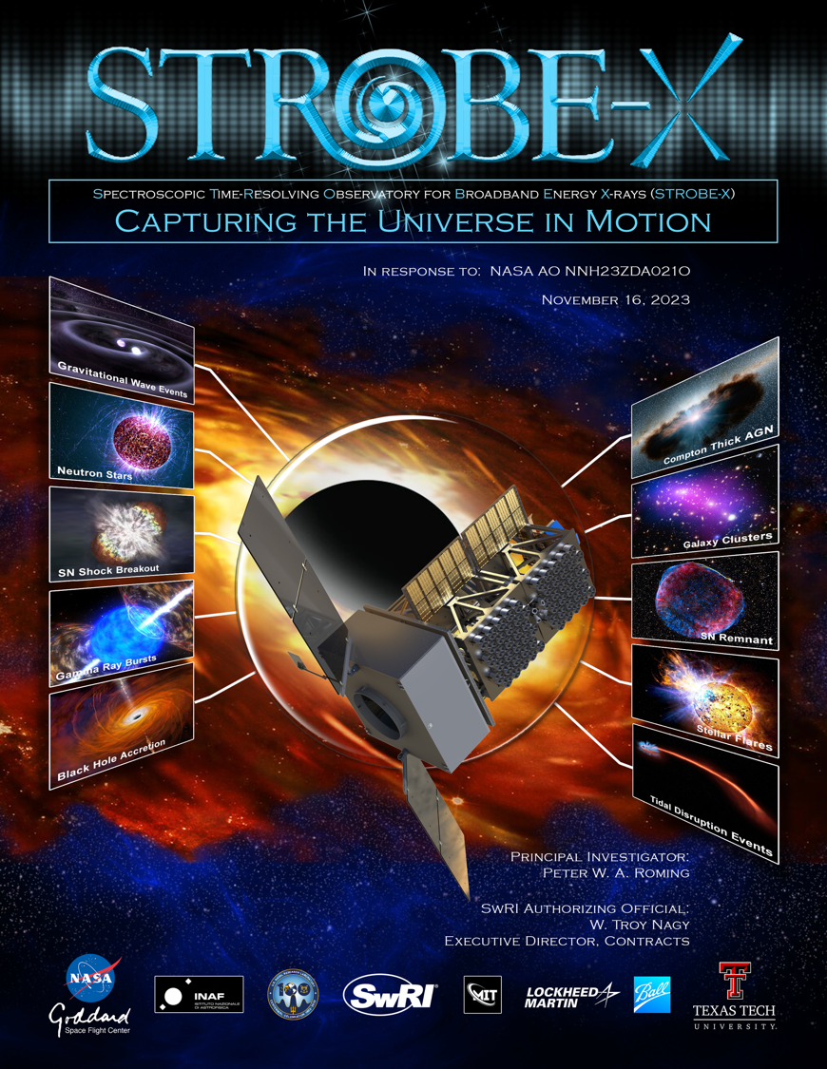
STROBE-X Probe Overview
Colleen A. Wilson-Hodge (NASA/MSFC) for
The STROBE-X Team

Slide 2
Mission Overview
STROBE-X is the game-changing, next-generation mission for high throughput X-ray spectroscopy and TDAMM
  Unparalleled laboratory for probing objects with dense sampling on timescales from microseconds to years
It directly addresses all three of NASA Astrophysics Science Objectives
  Combines Astro2020 highest priority sustaining activities (TDAMM and an X-ray or FIR probe) into one powerful facility
Probes real-time evolution of physical conditions at the heart of the most extreme astrophysical environments
STROBE-X is a facility for the entire community:
  Provides alerts from its onboard monitor
  Responds to ground-based alerts in minutes
  Delivers >10,000 pointed observations per year (with 70% GO time)

Slide 3
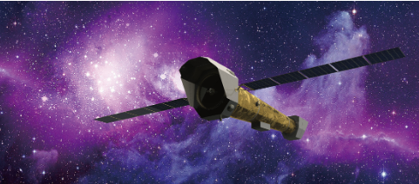
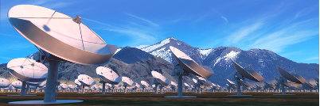
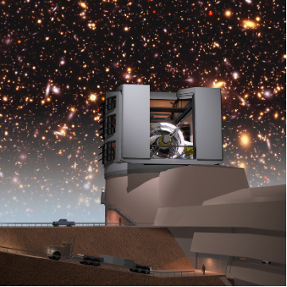
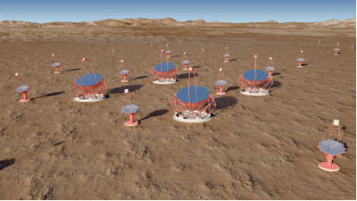
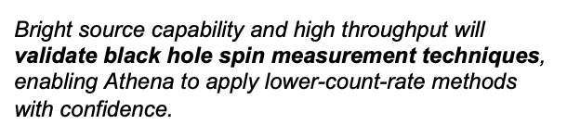
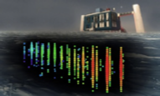
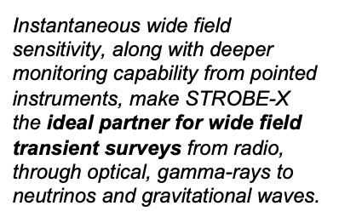
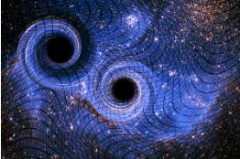
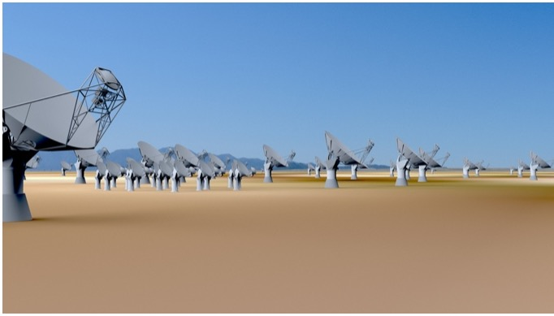
Powerful Synergies with Upcoming Facilities

Slide 4
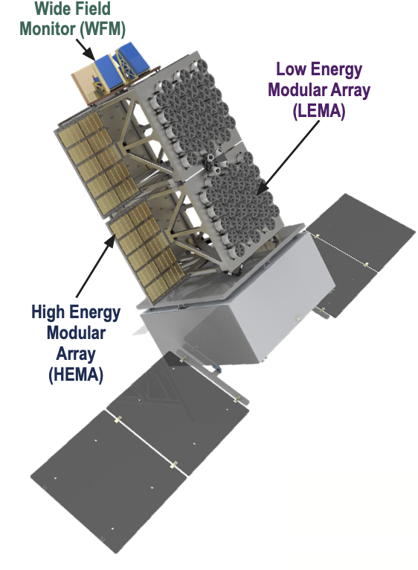
STROBE-X Mission Overview
Two pointed instruments (LEMA & HEMA) together covering 0.2–30 keV X-ray band
Wide Field Monitor provides transient alerts and full sky source monitoring (2–50 keV)
Highly modular design improves reliability at reduced cost and allows easy scaling, and integration schedule flexibility
LEO orbit (<15° incl.) reduces background and radiation damage
Rapid slewing agile spacecraft from Lockheed Martin:
  Pointed instruments can observe >3 sources per orbit (avoiding Earth occultations)
  Autonomously respond to onboard or ground transient alerts and begin observing in <9–14 min (depends on angle from boresight)
Broad field of regard (entire sky outside 45° Sun exclusion zone)
High rate downlinks (Ka band) to ground stations
Low-latency alerts and TOO commanding via space-to-space link
2-50 keV
0.2-12 keV
2-30 keV

Slide 5
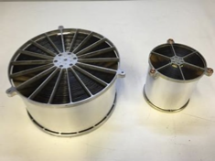
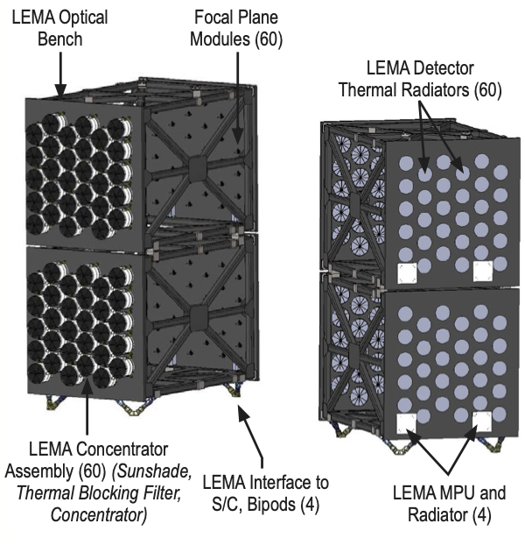
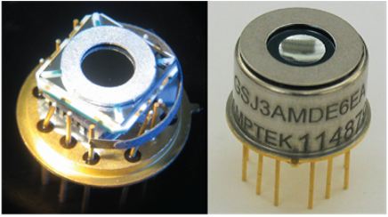



STROBE-X Low Energy Modular Array (LEMA)
Concentrator optics scaled up from NICER (diameter and focal length)
  4’ FoV (non-imaging)
SDDs and electronics inherited from NICER
  ΔE = 85 eV @ 1keV
Composite optical bench designed by BAE Inc.
2x30 concentrators,1.6 m²

Slide 6
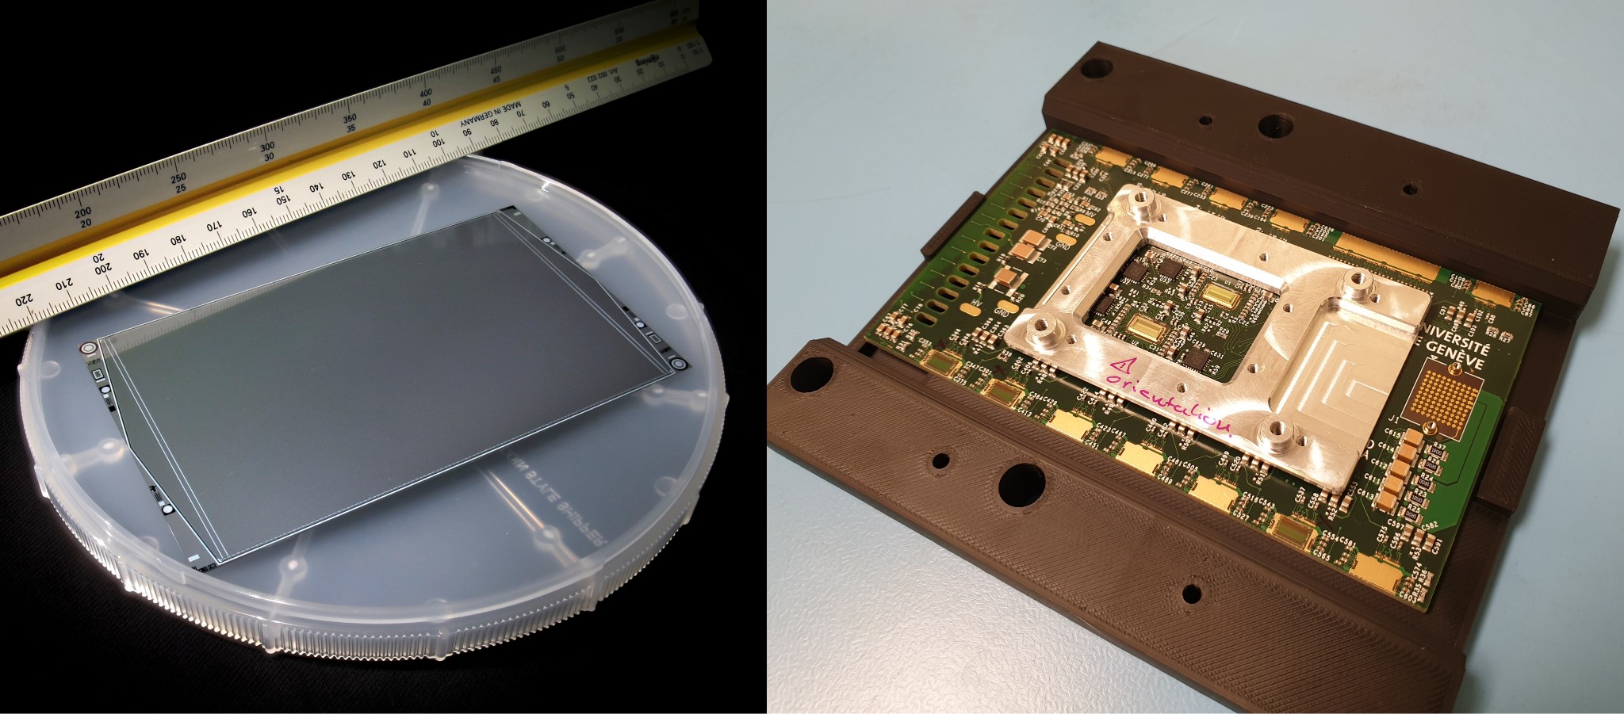
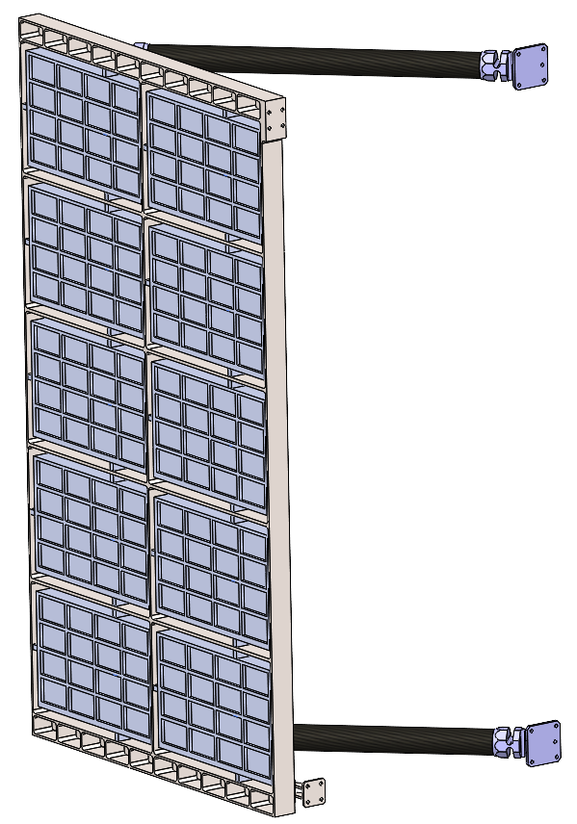
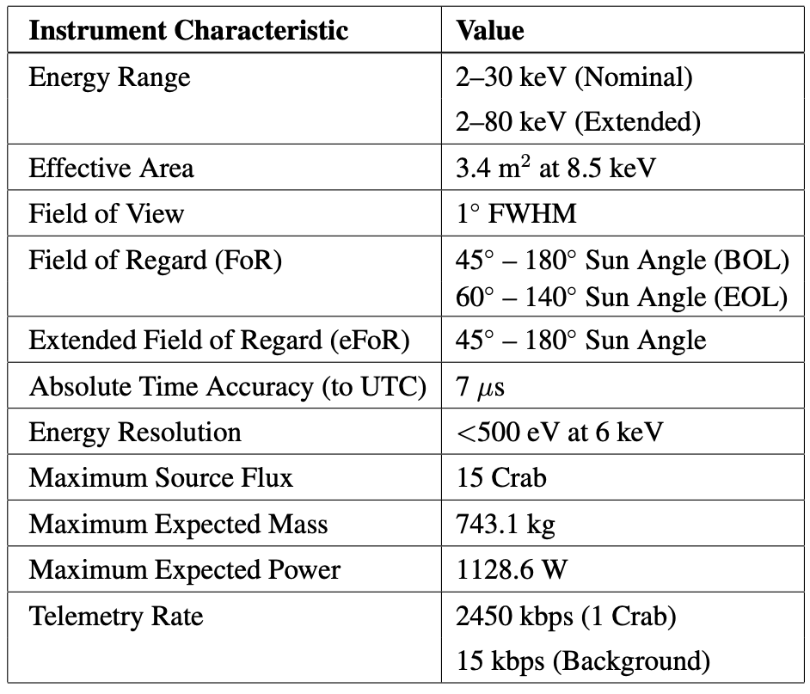


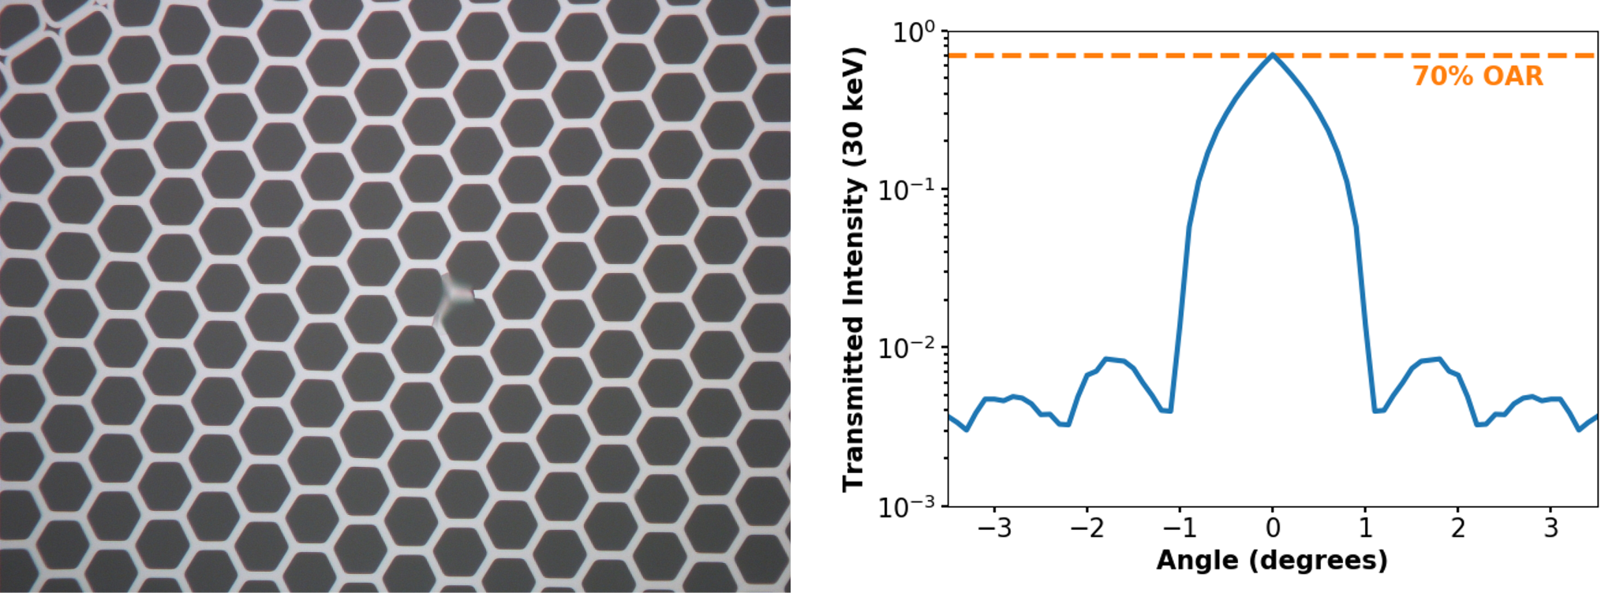
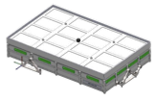




STROBE-X High Energy Modular Array (HEMA)
SDD
FEE
Panel (1 of 4)
Large area SDDs paired with lead-glass MCP collimators in 16-detector “modules”
Configuration
  4x10 modules = 3.4 m²
  Fixed panels
Collimator
Module

Slide 7
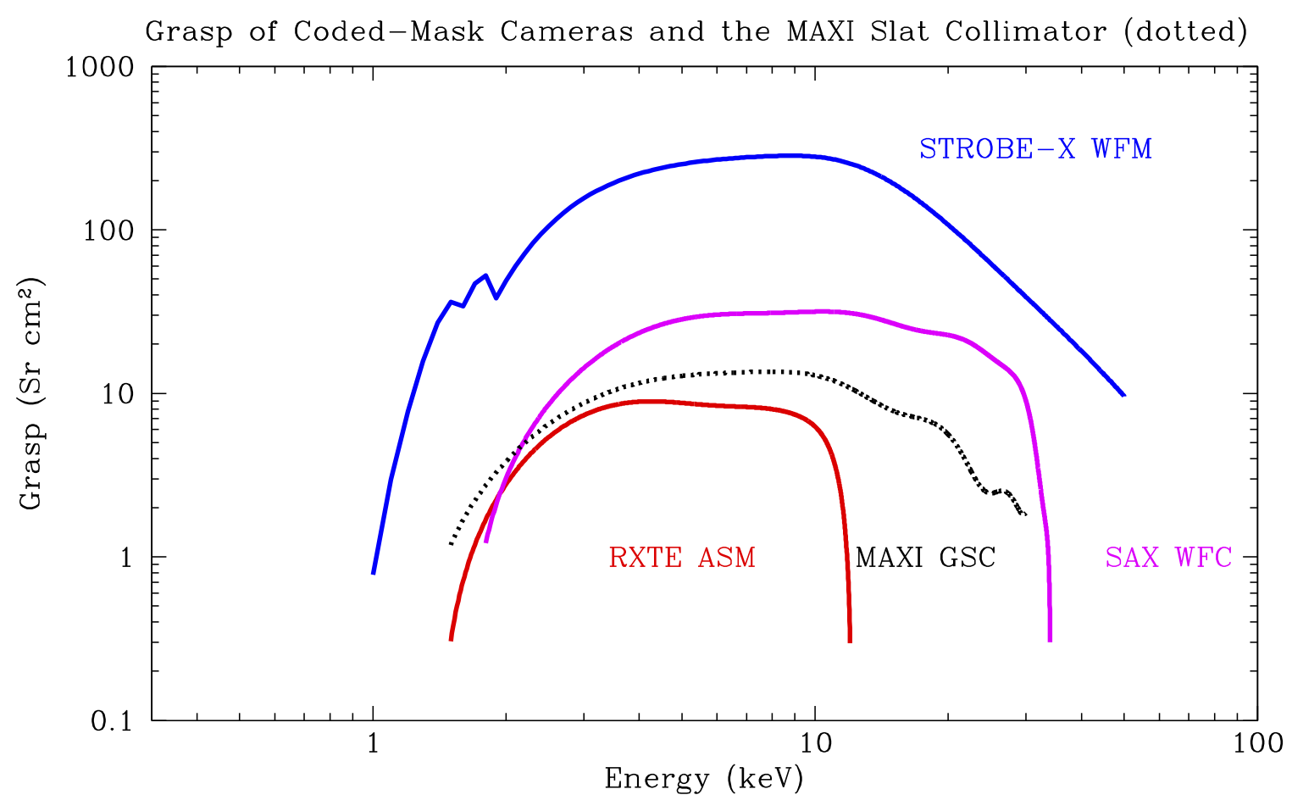
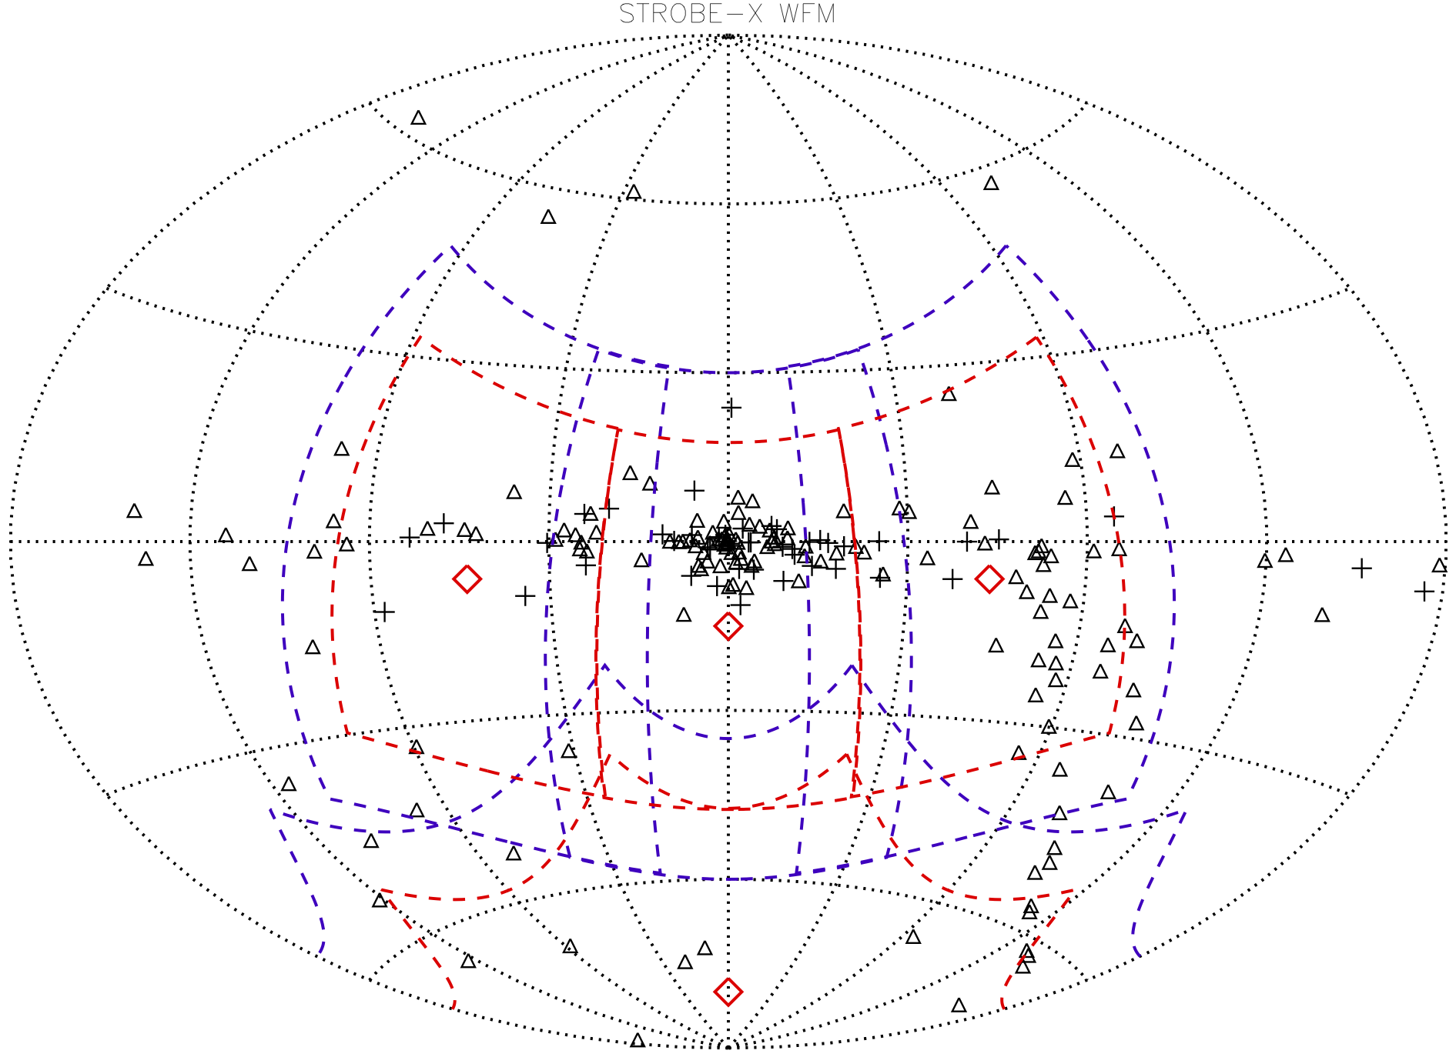
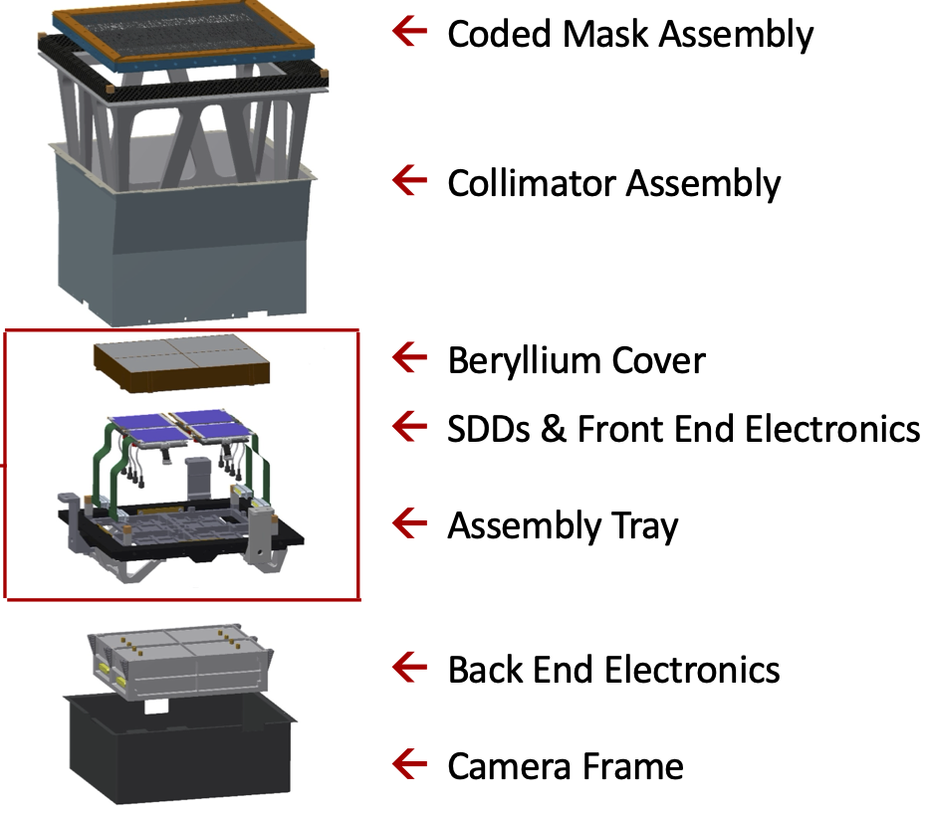


STROBE-X Wide Field Monitor (WFM)
1.5D coded mask camera with similar SDDs to HEMA
  2–50 keV, ΔE = 300 eV
4 camera pairs combine to view ⅓ of the sky at a time
All data come down in event mode
Onboard processing can produce alerts

Slide 8
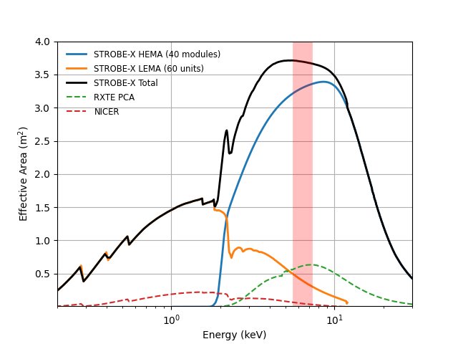
STROBE-X Key Capabilities
Serves the broad TDAMM and X-ray astrophysics community with rapid alerts (arcmin localizations), and rapid response to TOOs on a range of timescales
Pointed instruments provide unprecedented sensitivity to probe flux and spectral variability on short timescales to reveal fundamental physics and astrophysics
High throughput instruments allow measurements over a huge dynamic range in source brightness
Simultaneous broadband coverage provides measurements that constrain absorption, thermal emission, comptonization and reflection spectra and their temporal relationships
Enormous collecting area, with similar count rates from LEMA and HEMA for typical spectra

Slide 9
STROBE-X: Novel TDAMM Operations
Enabling TDAMM Science requires a novel concept of operation.
10s of targets per day, daily updates to observing plan
With the next generation of GW detectors, we will know about NS-NS mergers 10-15 minutes before they happen, and have localizations that easily fit inside the WFM field of view.
  Therefore, if we can respond in real-time, we could repoint STROBE-X to catch the NS-NS merger as it happens.
In order to enable this kind of capability, this will require STROBE-X to have the following capabilities:
  Automated repointing to external triggers.
  Low latency communications to allow for rapid TOO uplink.
  The ability to uplink TOOs with no-human-in-the-loop.
STROBE-X plans to do the above and more, enabling true rapid response TDAMM science!

Slide 10
STROBE-X: A True Swift-like TDAMM mission
Lots of proposed missions talk about having "Swift like" response.
  Typically this means TOO response in the 4-8 hour range. This is what Swift could do 20 years ago, but not today.
  Currently Swift’s highest urgency TOO response time (from receipt of request to execution of command) is ten seconds.
STROBE-X a true Swift-like TDAMM mission. This is achieved by:
  Designing a spacecraft capable of true autonomous response to triggers.
  Using a continuous communications solution to allow near-zero latency commanding of the spacecraft.
  By leveraging the heritage and expertise of the Swift Science Operations team at Penn State to design a next generation operations for STROBE-X, that builds upon and improves what Swift does today.

Slide 11
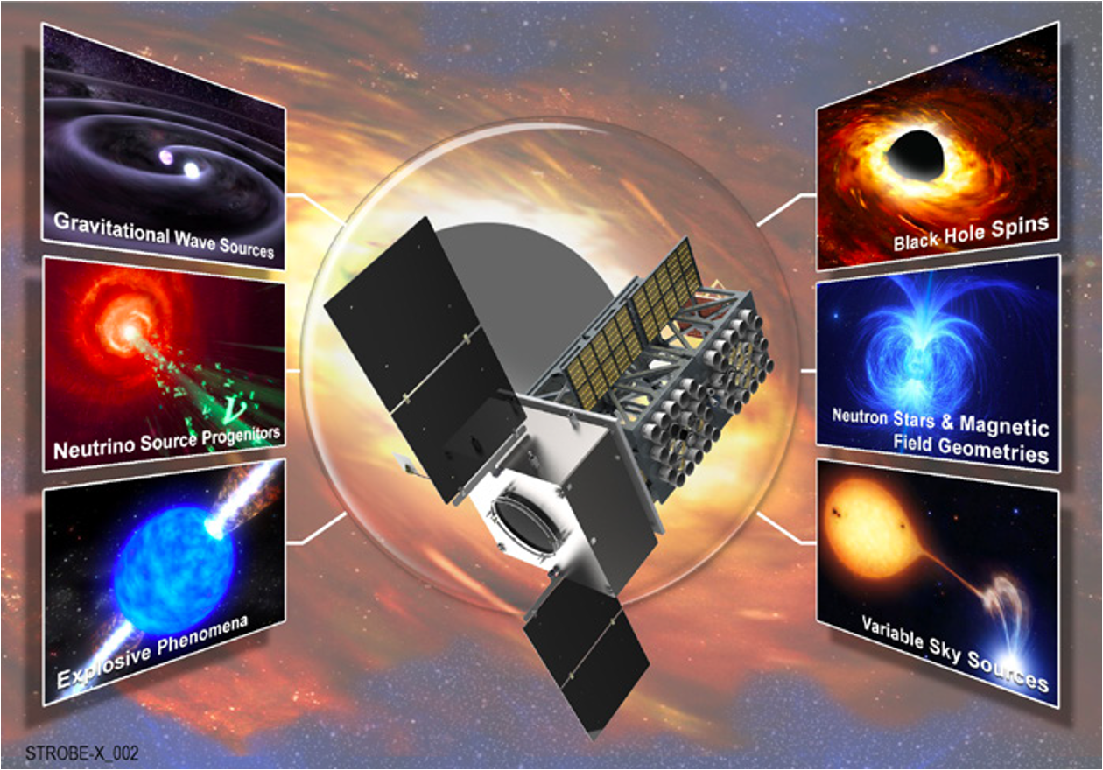
STROBE-X Science Goals
Multimessenger: GW and neutrino progenitors and counterparts
Time Domain Astronomy of Explosive Transients
Gravity and Extreme Physics: Black hole spins, NS EOS, magnetic fields
The Dynamic Universe
Notes:
Focus on 3 of 4 science goals and GO science most relevant to gamma-ray astrophysics.

Slide 12
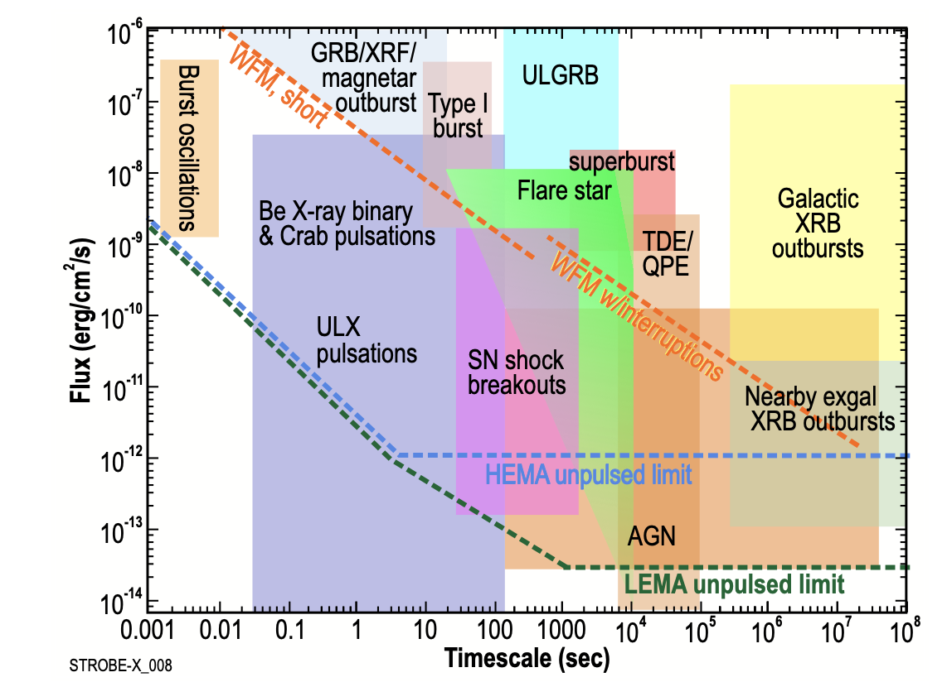
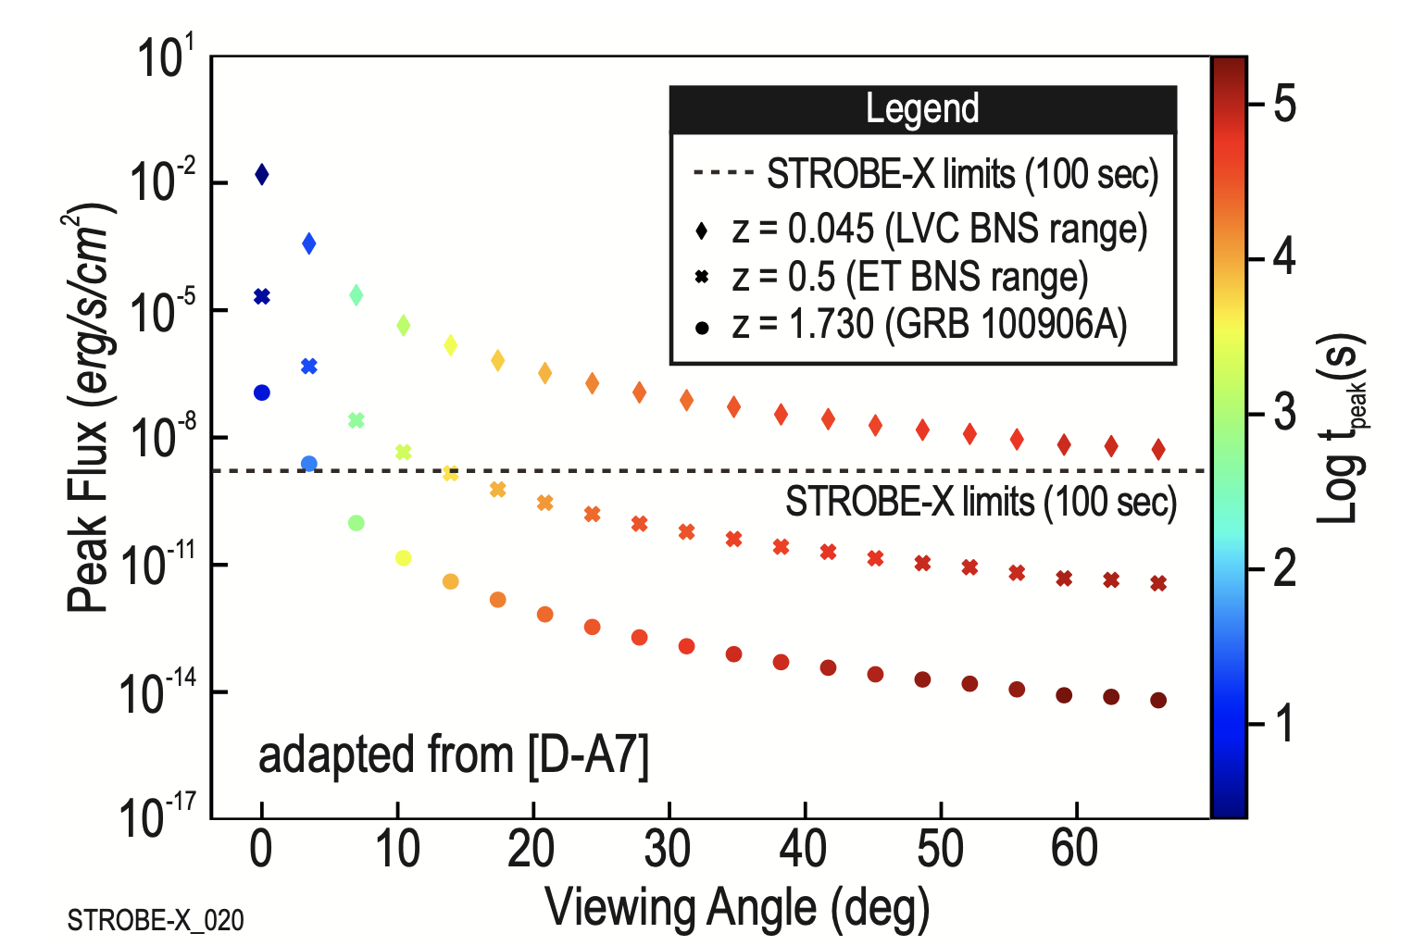
STROBE-X Multimessenger
Neutron Star Mergers, GW sources
Detect and localize > 5 NSM/yr
  Timing, position to ground < 5 mins after trigger (positions of ~1ʹ on the sky)
  Up to ~20 joint GW/NSM per year
with ET +.
X-ray Plateaus in sGRB light curves
  Remnant constraints: NS vs. BH, potentially out to z=2
  Redshifts from absorption edge → constrain NSM delay time distributions
Notes:
Multimessenger goal - detect and localize sGRBs, use X-ray plateau emission to characterize redshift distributions and binary formation mechanisms

Slide 13
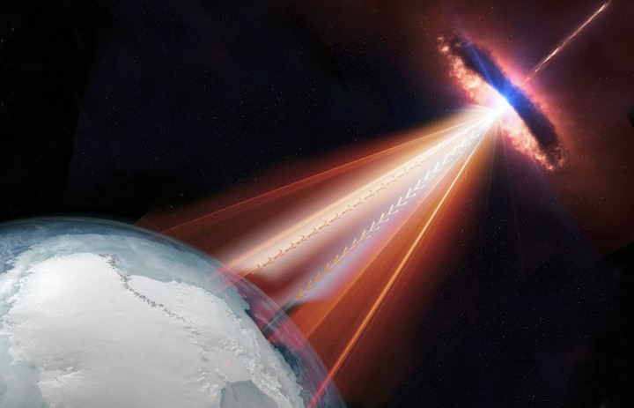
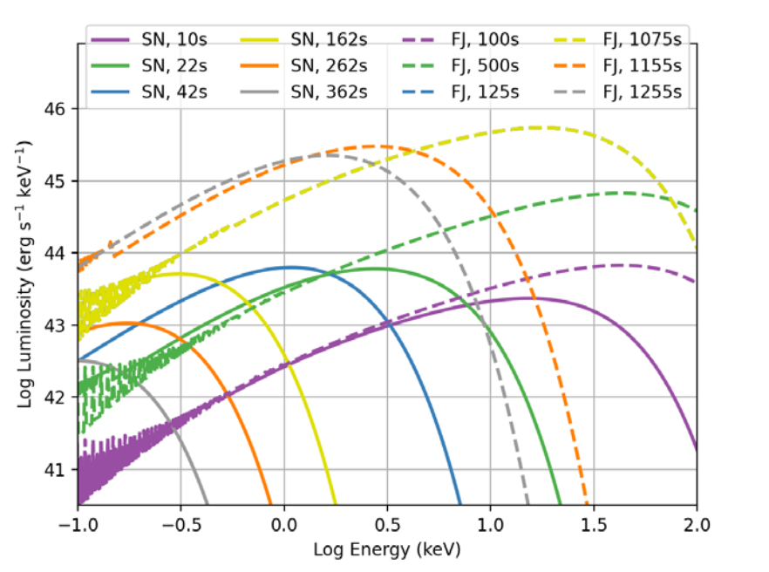
STROBE-X Multimessenger & Explosive Transients
Neutrino Sources, Coincident with Blazar Flares:
Constraining models of cosmic ray and neutrino production in blazar jets.
WFM allows monitoring of ~100 bright AGN
High cadence follow-up for flares of fainter AGN
Expect > 5 over the mission
ICE CUBE/NASA
SN Shock Breakout + Early Emission:
Constraining jet vs convection driven SNe
Out to 200 Mpc
Notes:
Multimessenger -

Slide 14
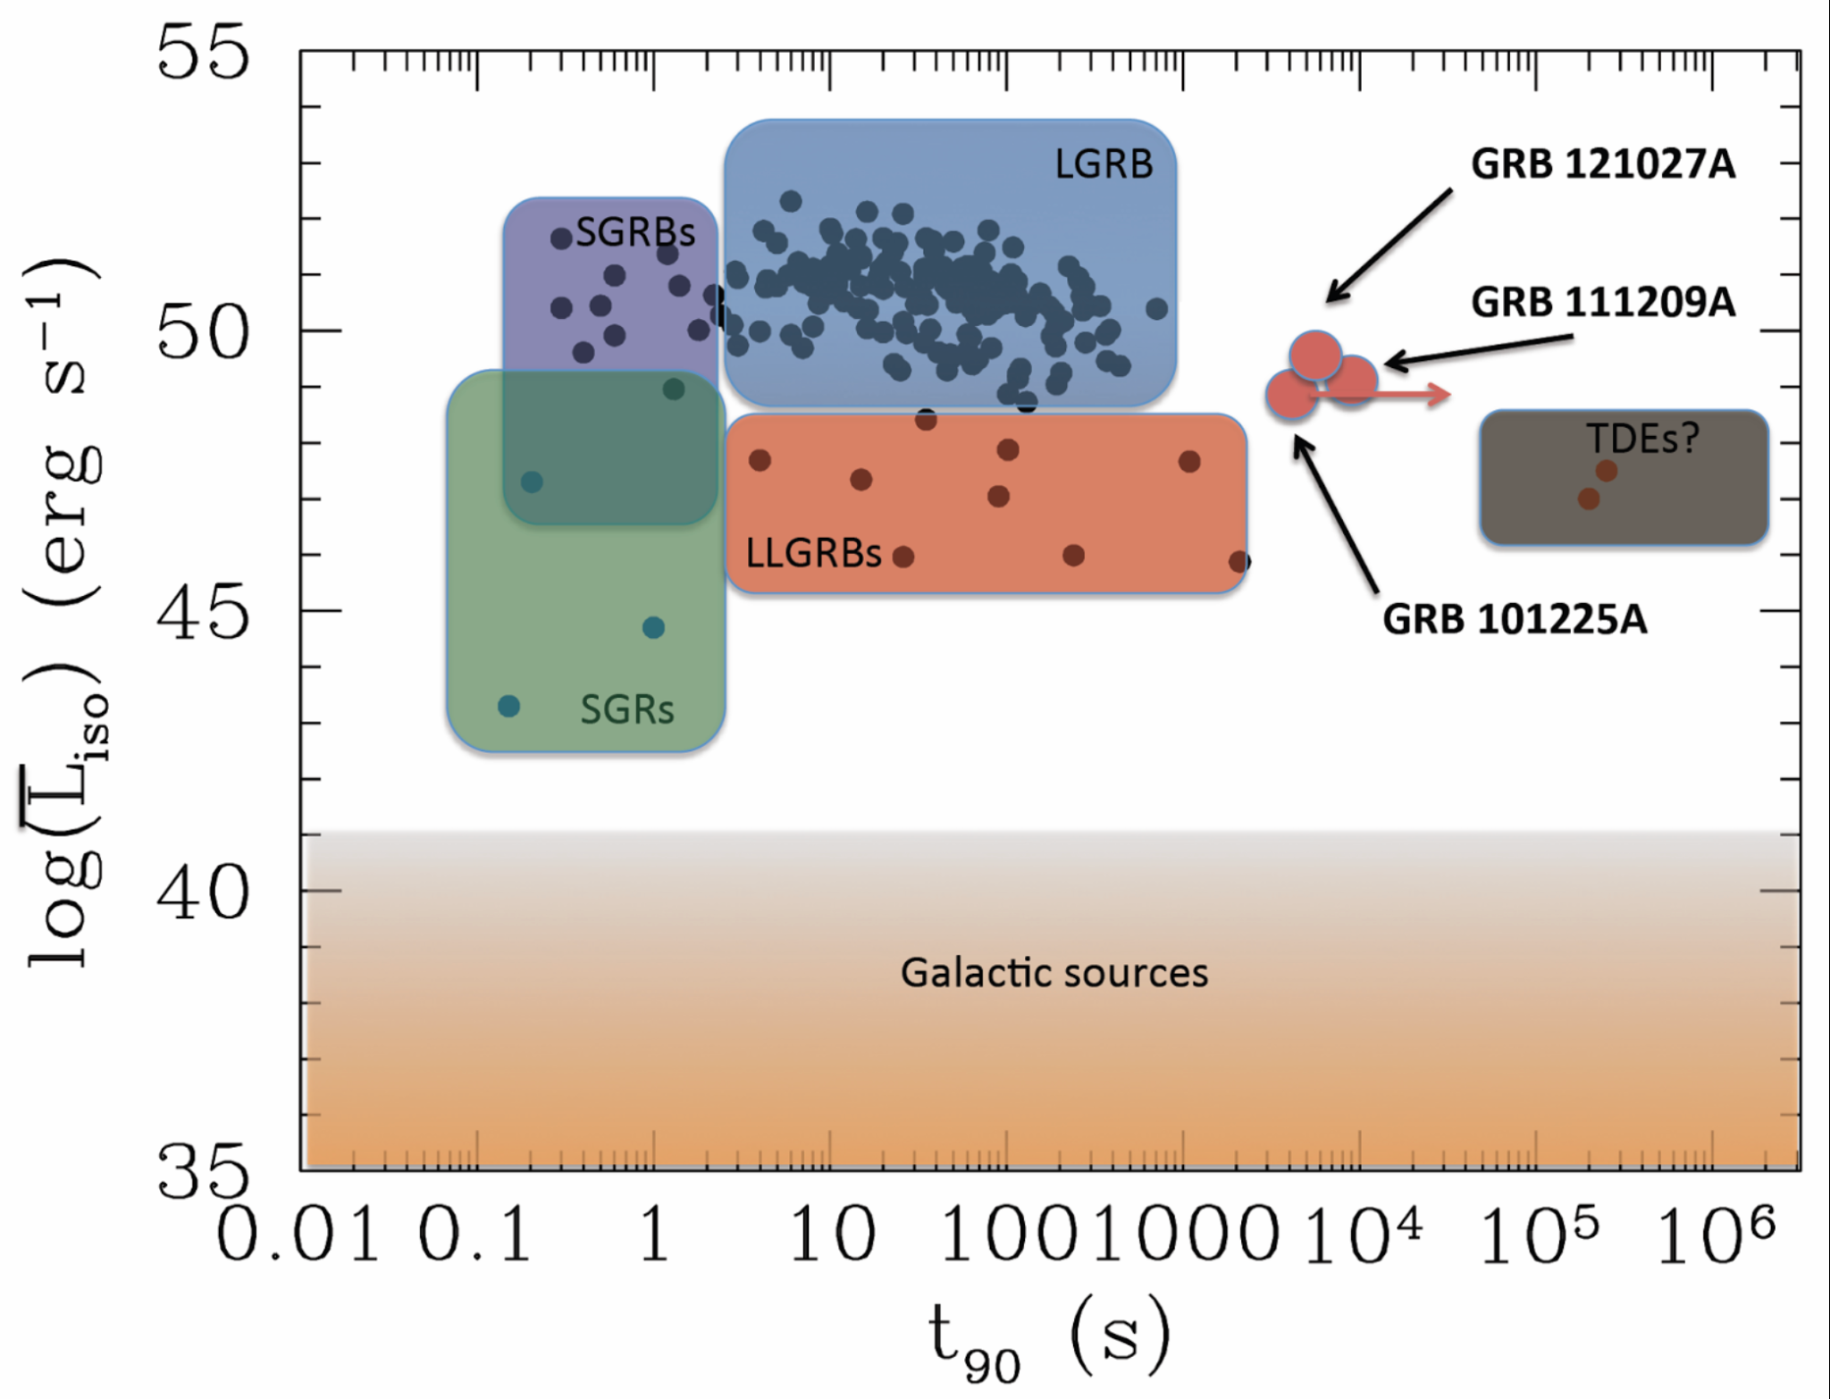
STROBE-X Explosive Transients
Long GRBs
X-ray Flashes: A significant subset of GRBs have a peak energy in the X-rays < 50 keV. Open question whether they are the “tail end” of a standard long GRB progenitor or are the result of a unique progenitor/central engine. > 10 XRFs/yr with STROBE-X.
Ultra Long GRBs: GRBs with prompt emission > 1000s. Still unknown progenitor/physics. We expect > 4/yr with STROBE-X.
Levan, 2015

Slide 15
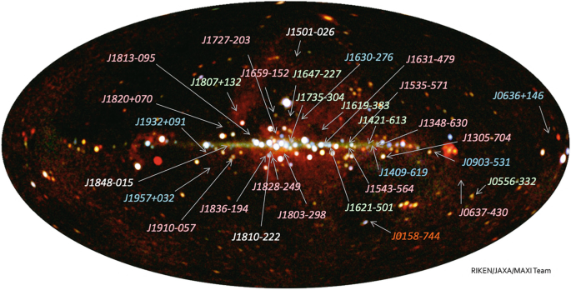
STROBE-X The dynamic Universe
Daily WFM Sky maps with ~5 mCrab sensitivity
5’ resolution, avoiding the confusion near the Galactic Center that plagues many wide-field instruments
Swift-like flexibility in follow-up, but with ability to make spectra and power spectra for discovered sources from WFM
Over years, will stack up to be the best medium-energy X-ray survey ever made

Slide 16
More STROBE-X Gamma-Ray Synergies
GRB Prompt Emission
Magnetars
Blazar Physics
Gamma-ray binaries
Classical Novae

Slide 17
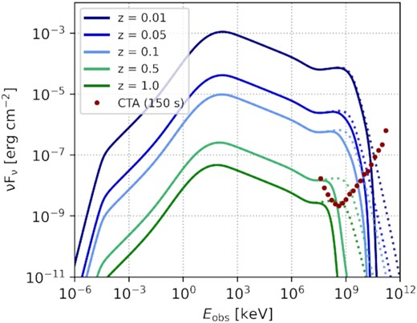
Prompt GRB emission in X-rays
Immediate arcmin localization
May be more sensitive to lower luminosity GRBs that (1) may dominate intrinsic rates and cosmic ray production
(2) are nearby enough for TeV to reach us without ɣɣ absorption
Rudolph et al. 2022

Slide 18
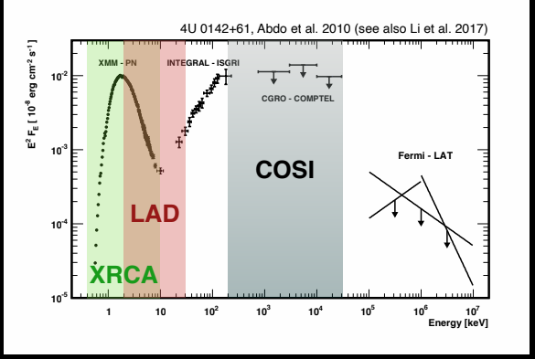
Magnetars
Expected to emit in MeV+ range
May need good timing solutions to improve sensitivity, gain insights into emission
Monitoring from WFM to know when they are active

Slide 19
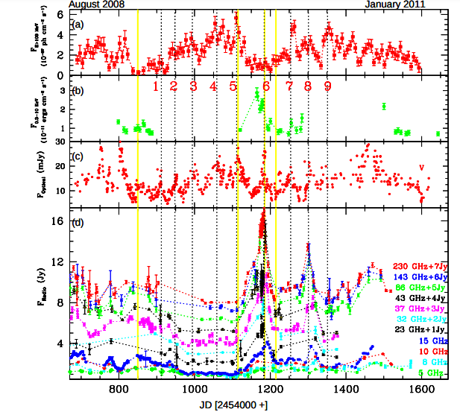
Blazar physics
Figure from Rani et al. 2013
X-rays currently hardest to monitor, even with Swift
WFM gets bright blazars for free
XRCA gets spectra on timescales similar to fluxes from Swift XRT

Slide 20
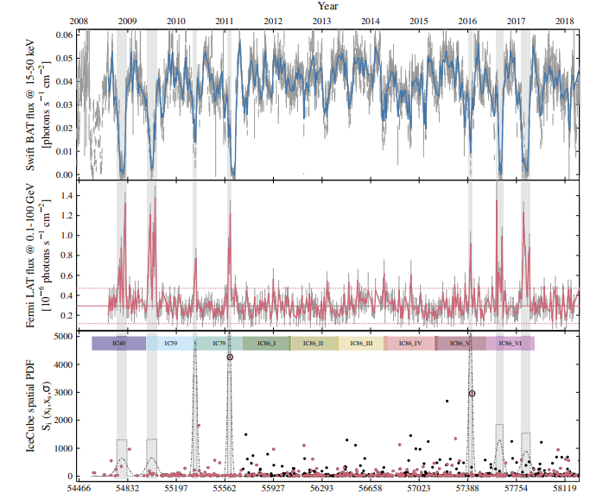
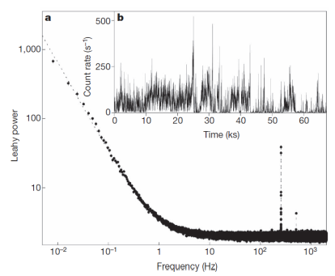
Gamma-ray binaries
Left: power spectrum of transitional millisecond pulsar; these are also strong Fermi sources, and need X-ray pulsation measurements to confirm them when in gamma-ray bright states, from Papitto & De Martino 2010, shows need for large collecting area and high time resolution!
Right: Koljonen et al. 2023 - Cyg X-3, possible neutrino source. Needs further X-ray and gamma-ray monitoring to confirm and understand

Slide 21
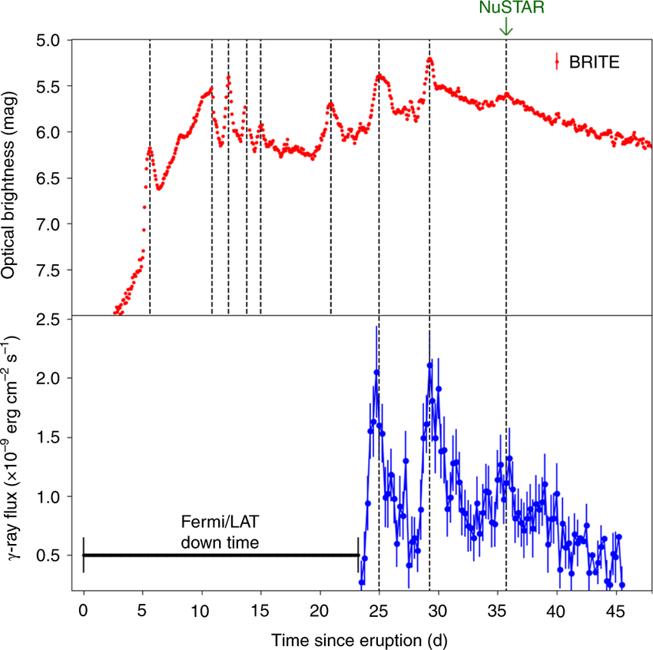
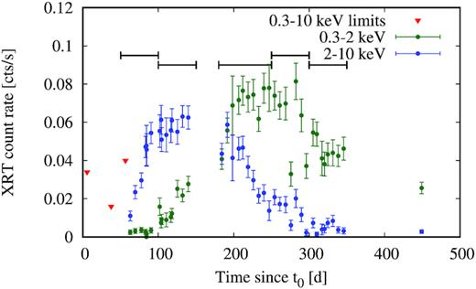
Classical Novae
Left: Aydi et al. 2020 Right: Sokolovsky et al. 2020
STROBE-X can get better sensitivity, coverage and help understand how shocks produce hard X-rays and gamma-ray, and maybe even drive the optical emission in classical novae

Slide 22


Summary
STROBE-X has true “Swift-like” operations with rapid (seconds-minutes) autonomous repointing from on-board and on-ground
STROBE-X provides key complementary X-ray observations for gamma-ray missions, e.g., GRBs - prompt emission and afterglow plateaus, AGN monitoring, blazar flares, magnetars, supernova shock breakouts, classical novae STROBE-X alerts the community to transient events detected onboard with arcmin localizations within seconds
STROBE-X enables more than 10,000 GO observations per year in addition to its primary science.
Mission and instrument papers will appear soon in JATIS (and arXiv)

