Slide 1
Additive Manufacturing: More Than Just 3D Printing
Ilana Lu
Marshall Space Flight Center, EM42 Additive Manufacturing Team
June 24, 2024

Slide 2
What is “Additive Manufacturing”?
Construction of a three-dimensional object, usually with material joined layer by layer
Also, may be referred to as: 3D printing, additive fabrication, direct digital manufacturing, freeform fabrication, solid freeform fabrication, rapid manufacturing, and rapid prototyping

Slide 3
Capabilities & History of MSFC AM Lab
Our lab has experience with about 30 different systems over the last 30 years
Highlights of current technologies
  Metallics
    Laser Powder Bed Fusion
    Blown Powder Directed Energy Deposition
    Wire Arc Directed Energy Deposition (Cold Metal Transfer)
    Liquid Metal Droplet
  Polymers
    Fused Deposition Modeling
    Stereolithography
  Ceramics (Coming soon)
    Stereolithography
NASA Additive Manufacturing Objectives & Priorities
  Develop, Maintain, and Lead Implementation of Flight Certification Standards (NASA-STD-6030)
  Material & Process Development and Characterization
  Share knowledge and data in pursuit of a well-informed AM user community across NASA, other government agencies, and the space industry collectively to enable a smart buyer approach and continued advancement of additive technologies
  Lead research institute furthering computational tools for additive manufacturing

Slide 4
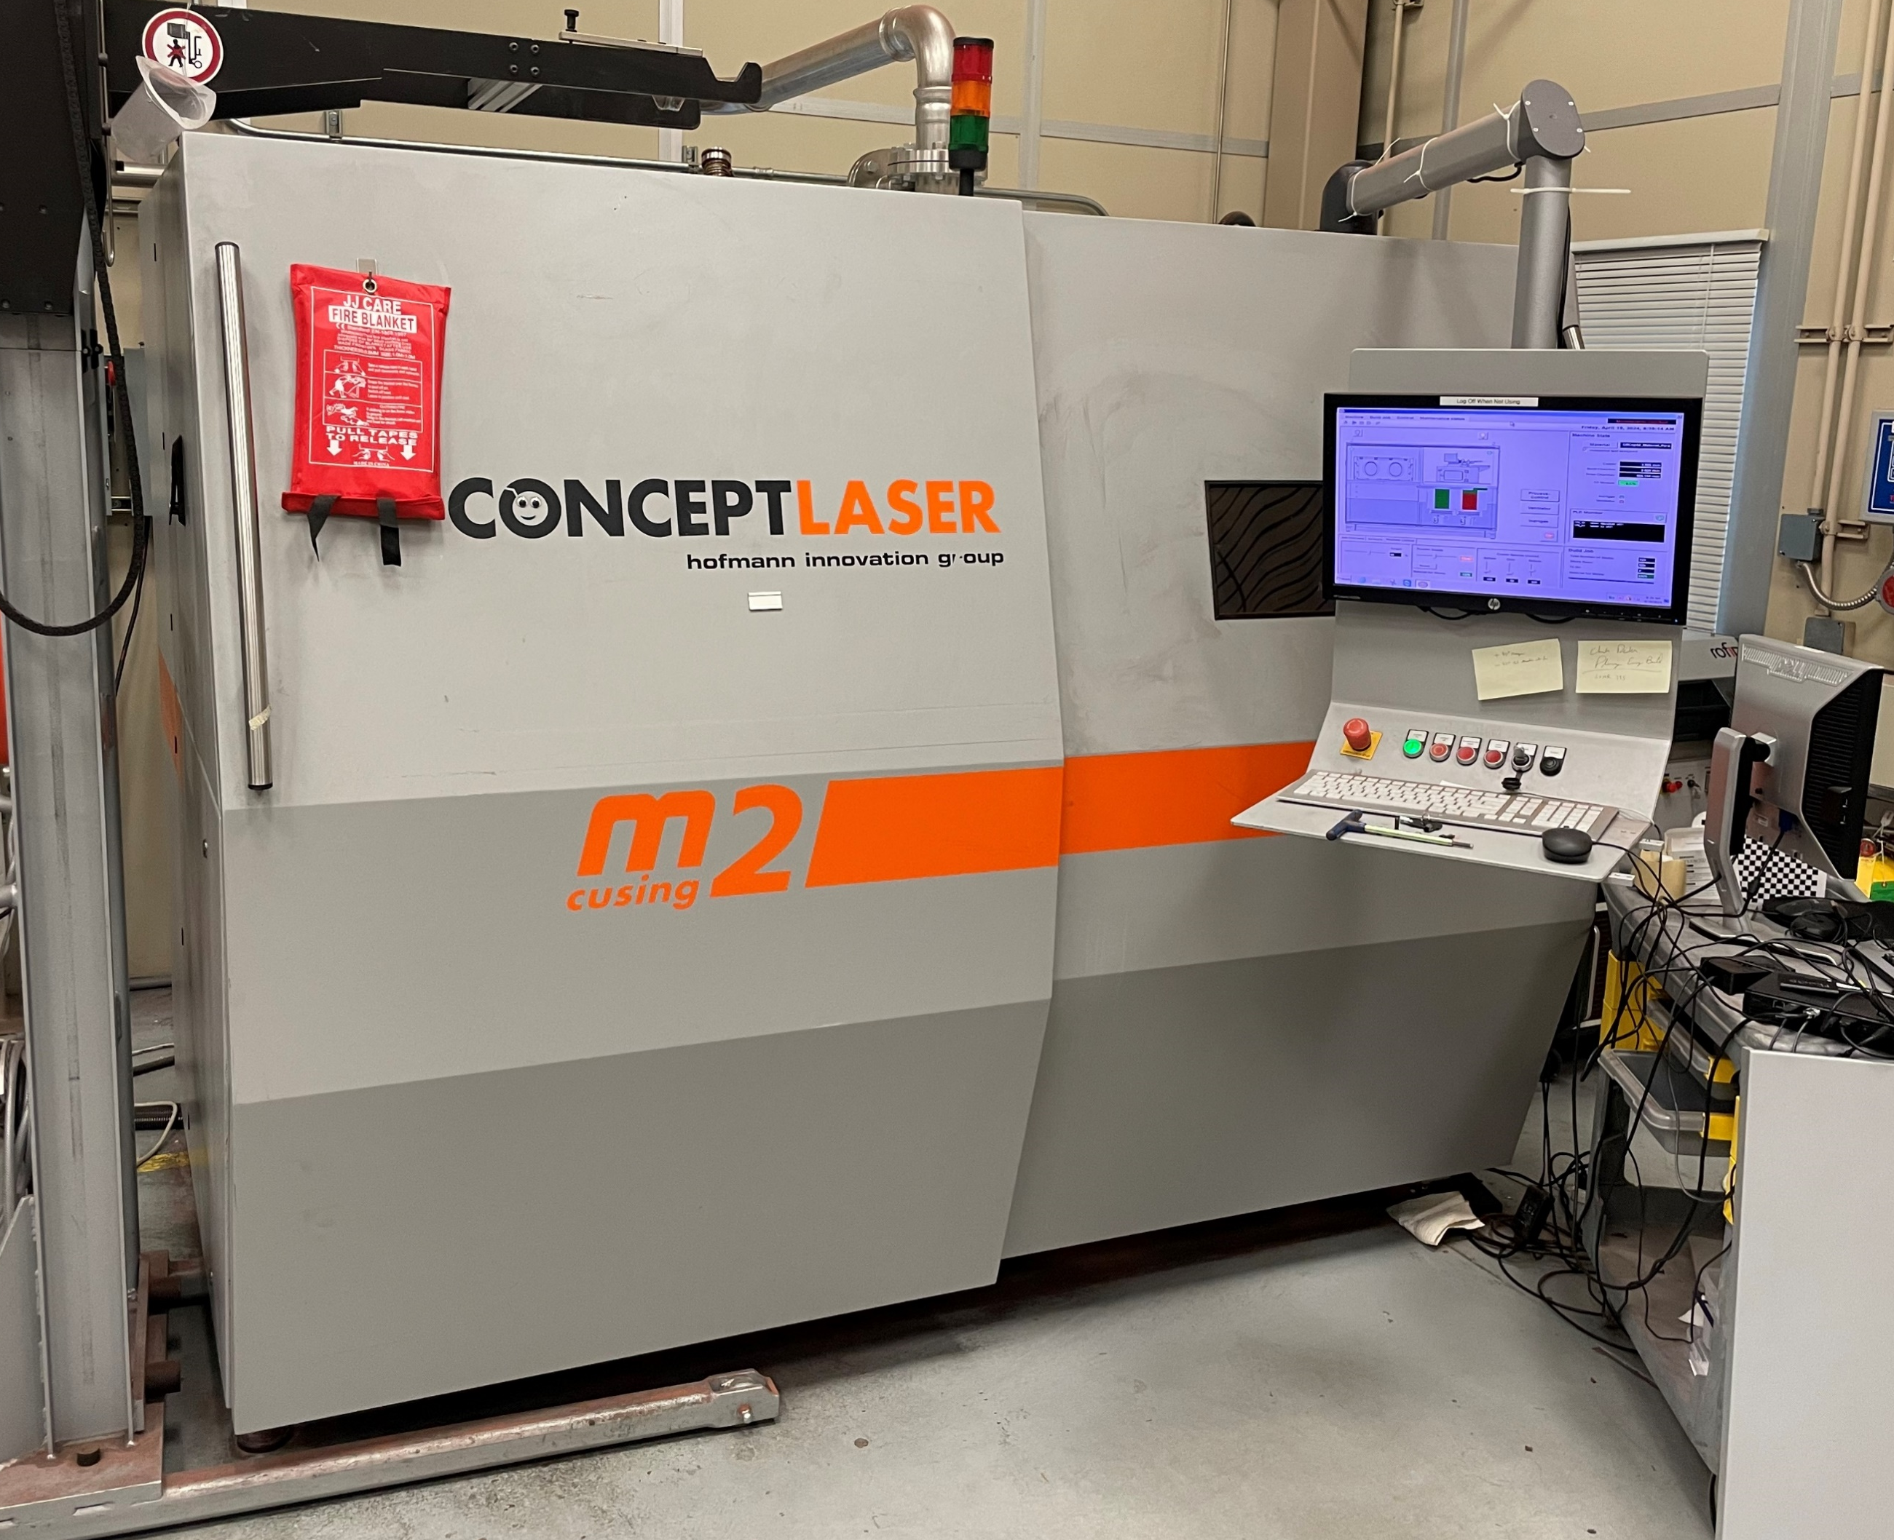
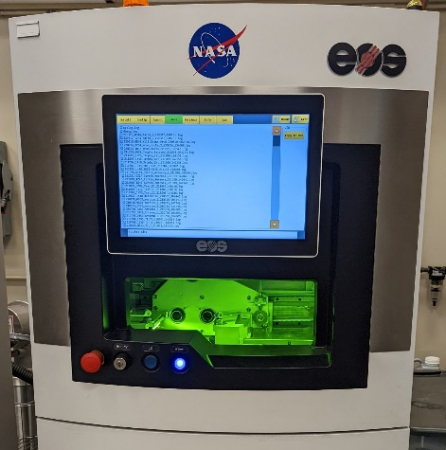
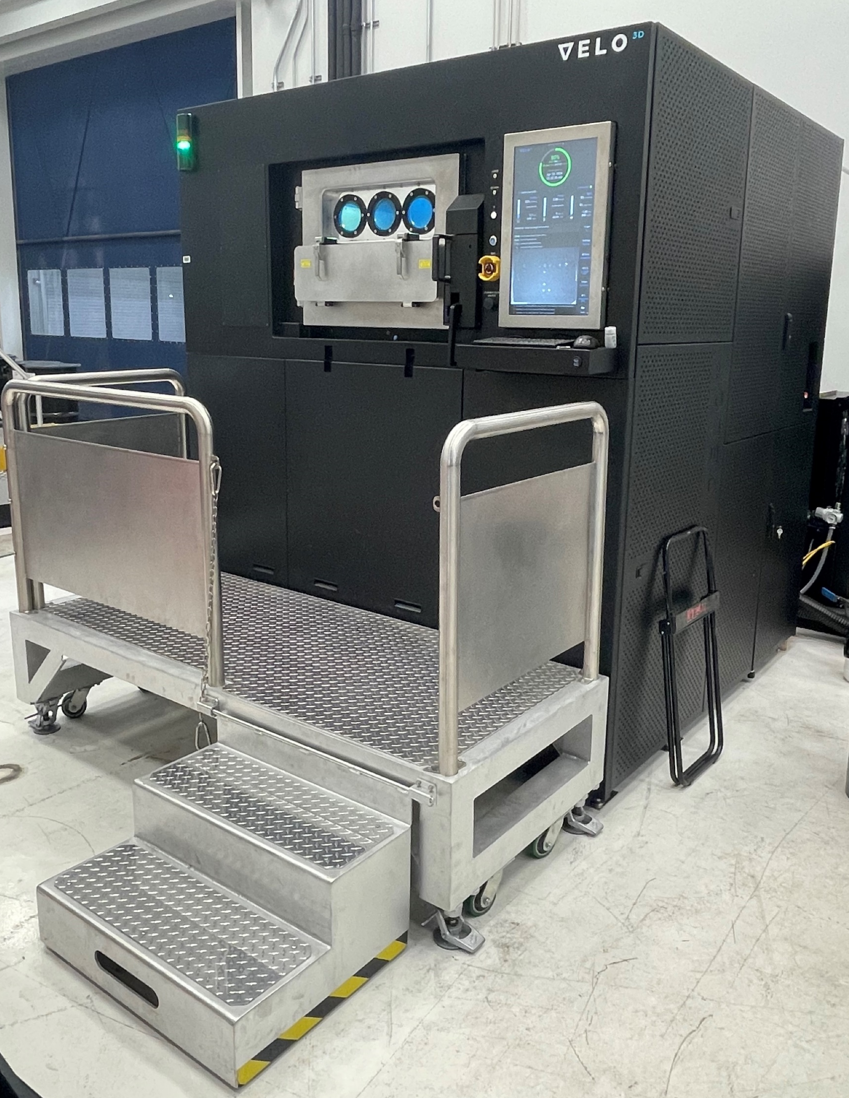
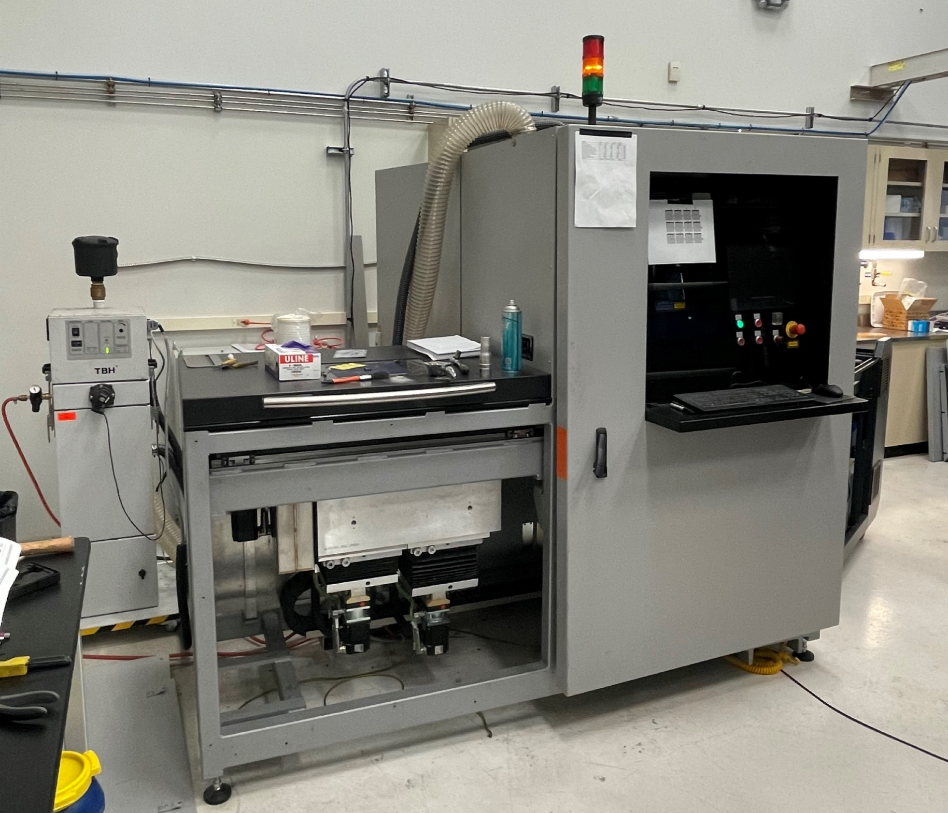
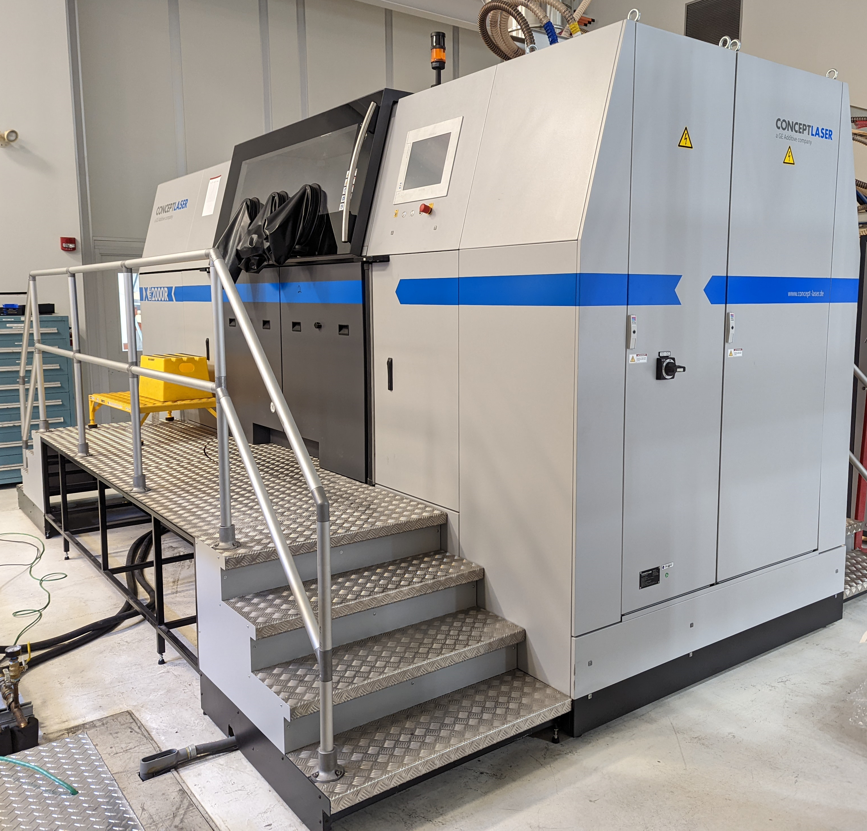
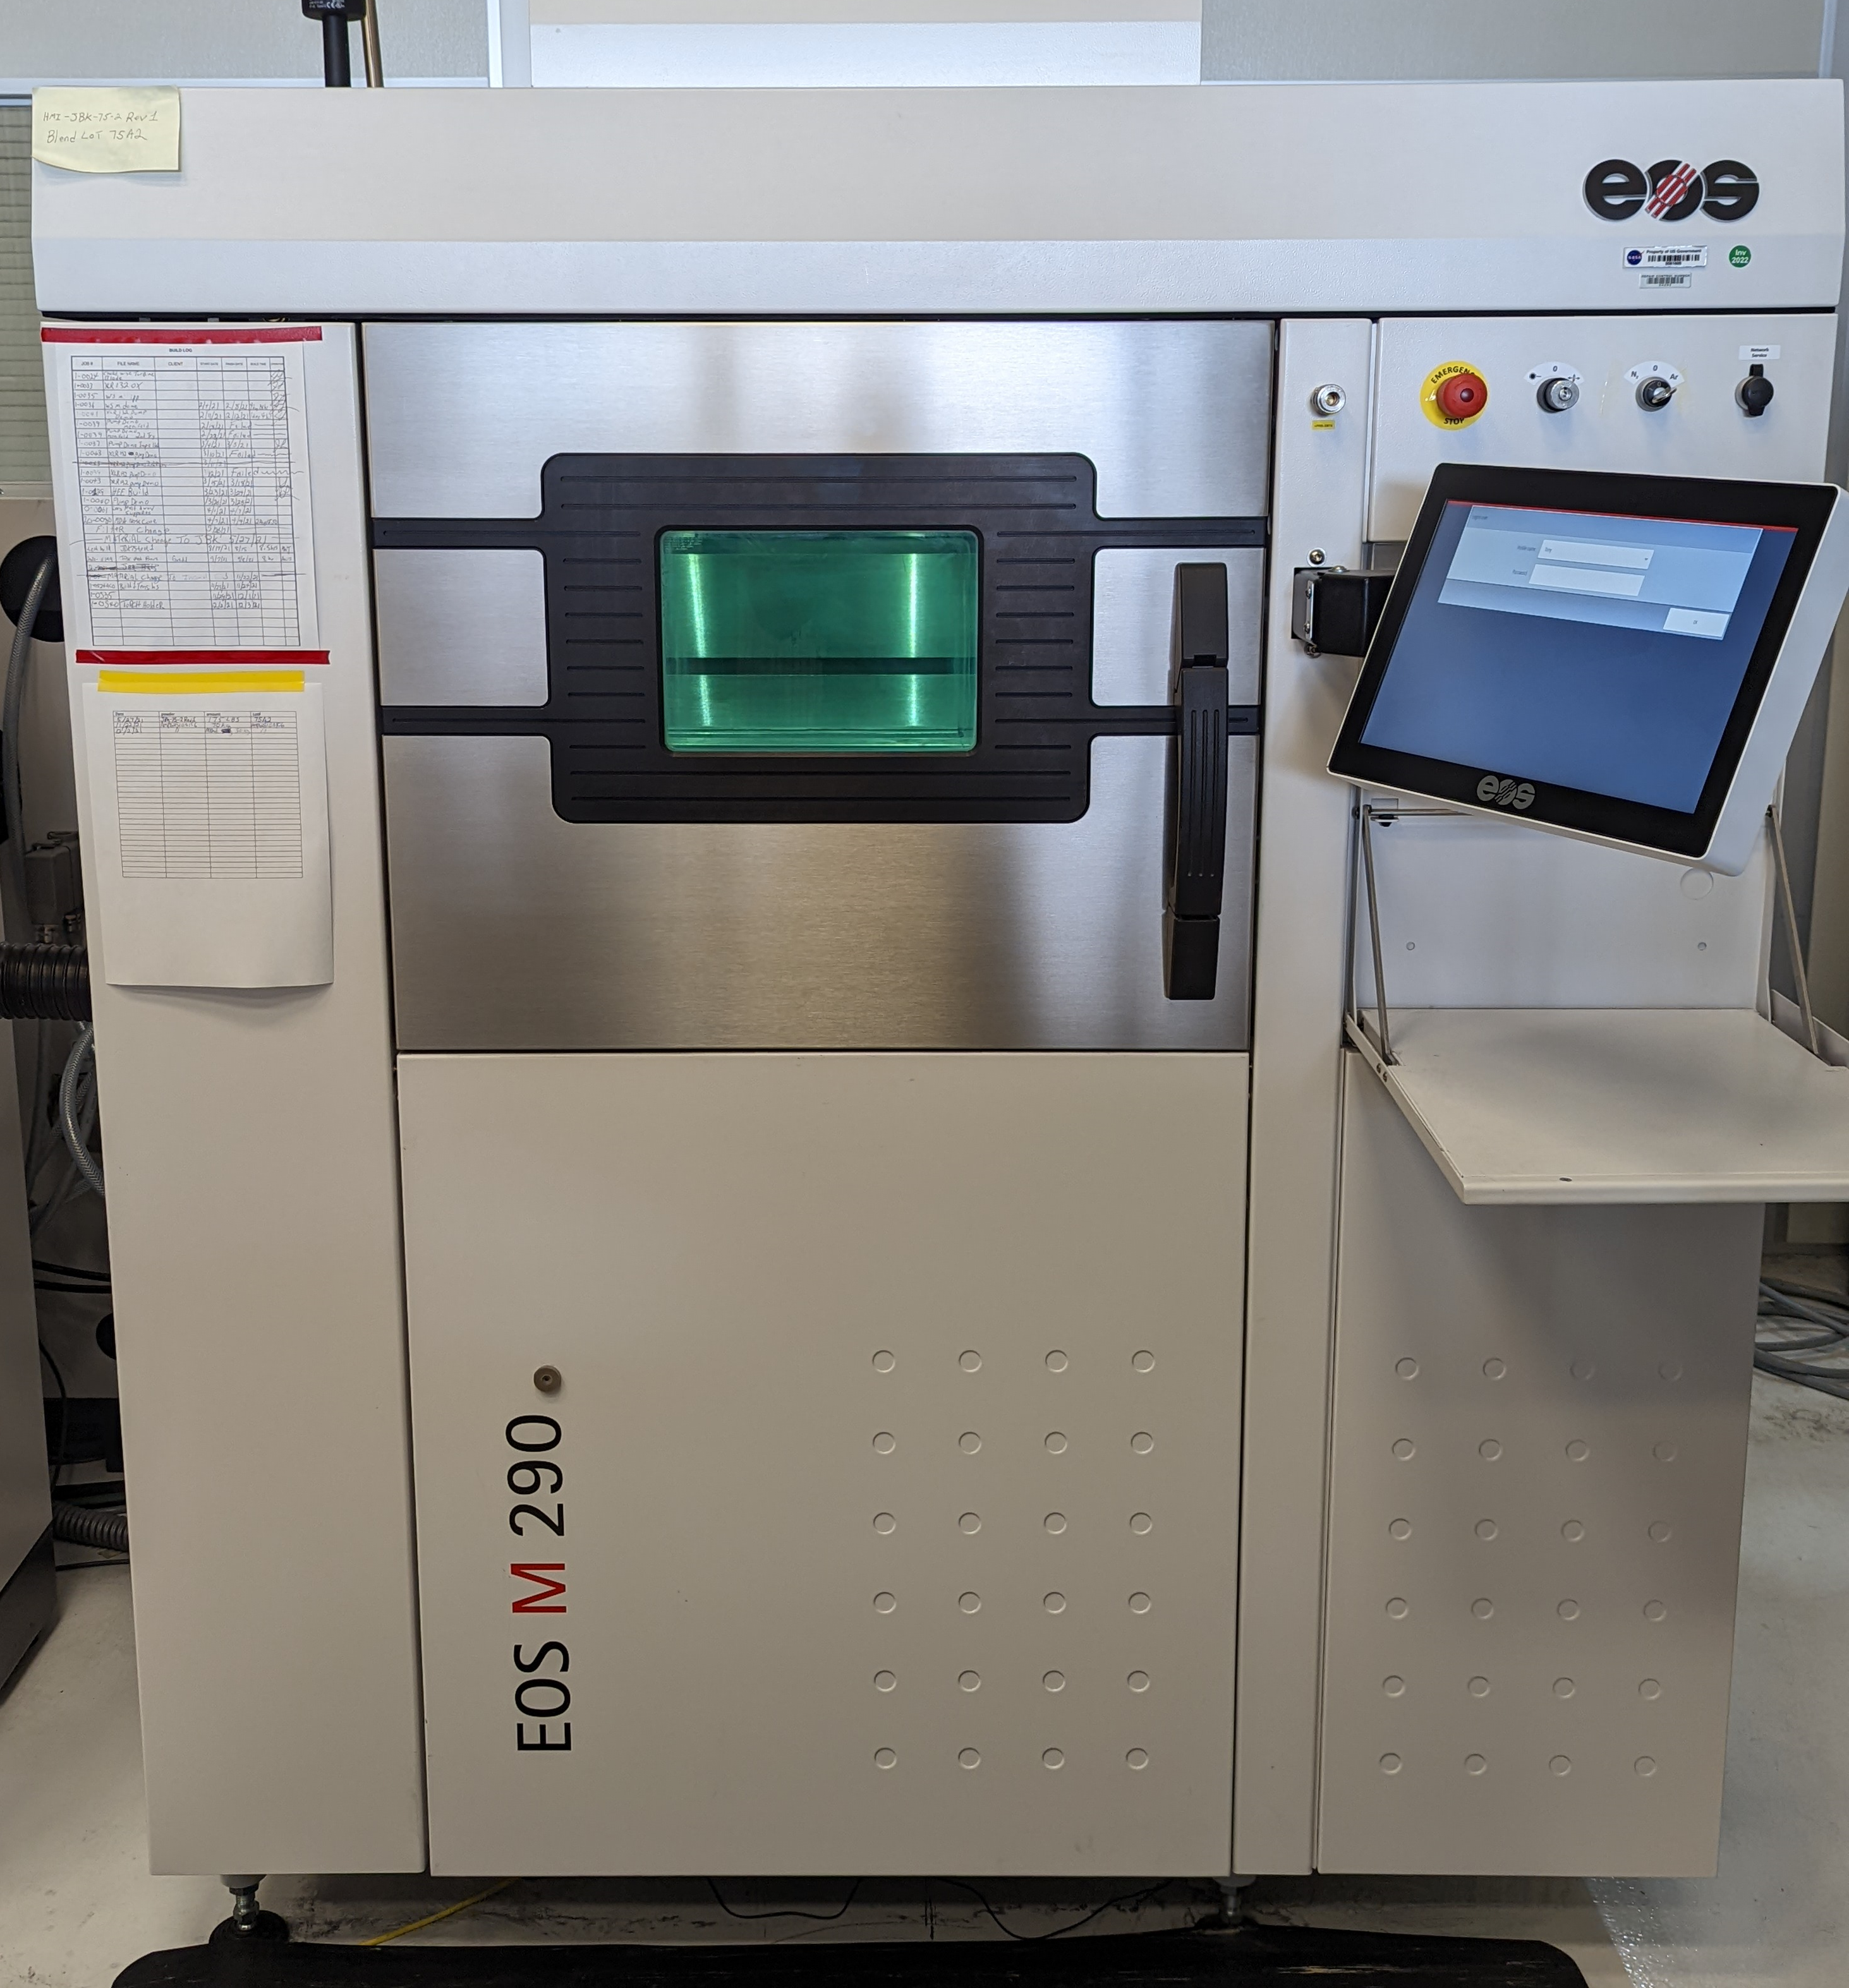
Laser Powder Bed Fusion
Metal Powders
Concept Laser M2
GRCop-42
Build Volume: 245 x 245 x 350 mm
EOS M100
Various Materials
Build Volume: 100 Ø x 95 mm z
Laser Fusion Solutions upgraded M1
Various Materials including Lunar Regolith Simulant
Build Volume: 250 mm³
Velo Sapphire
In718
Build Volume: 315 Ø x 400 mm z
Concept Laser Xline 2000R
In718
Build Volume: 400 x 800 x 500 mm
EOS M290 (Two Machines)
HR1, JBK75
Build Volume: 250 x 250 x 325 mm

Slide 5
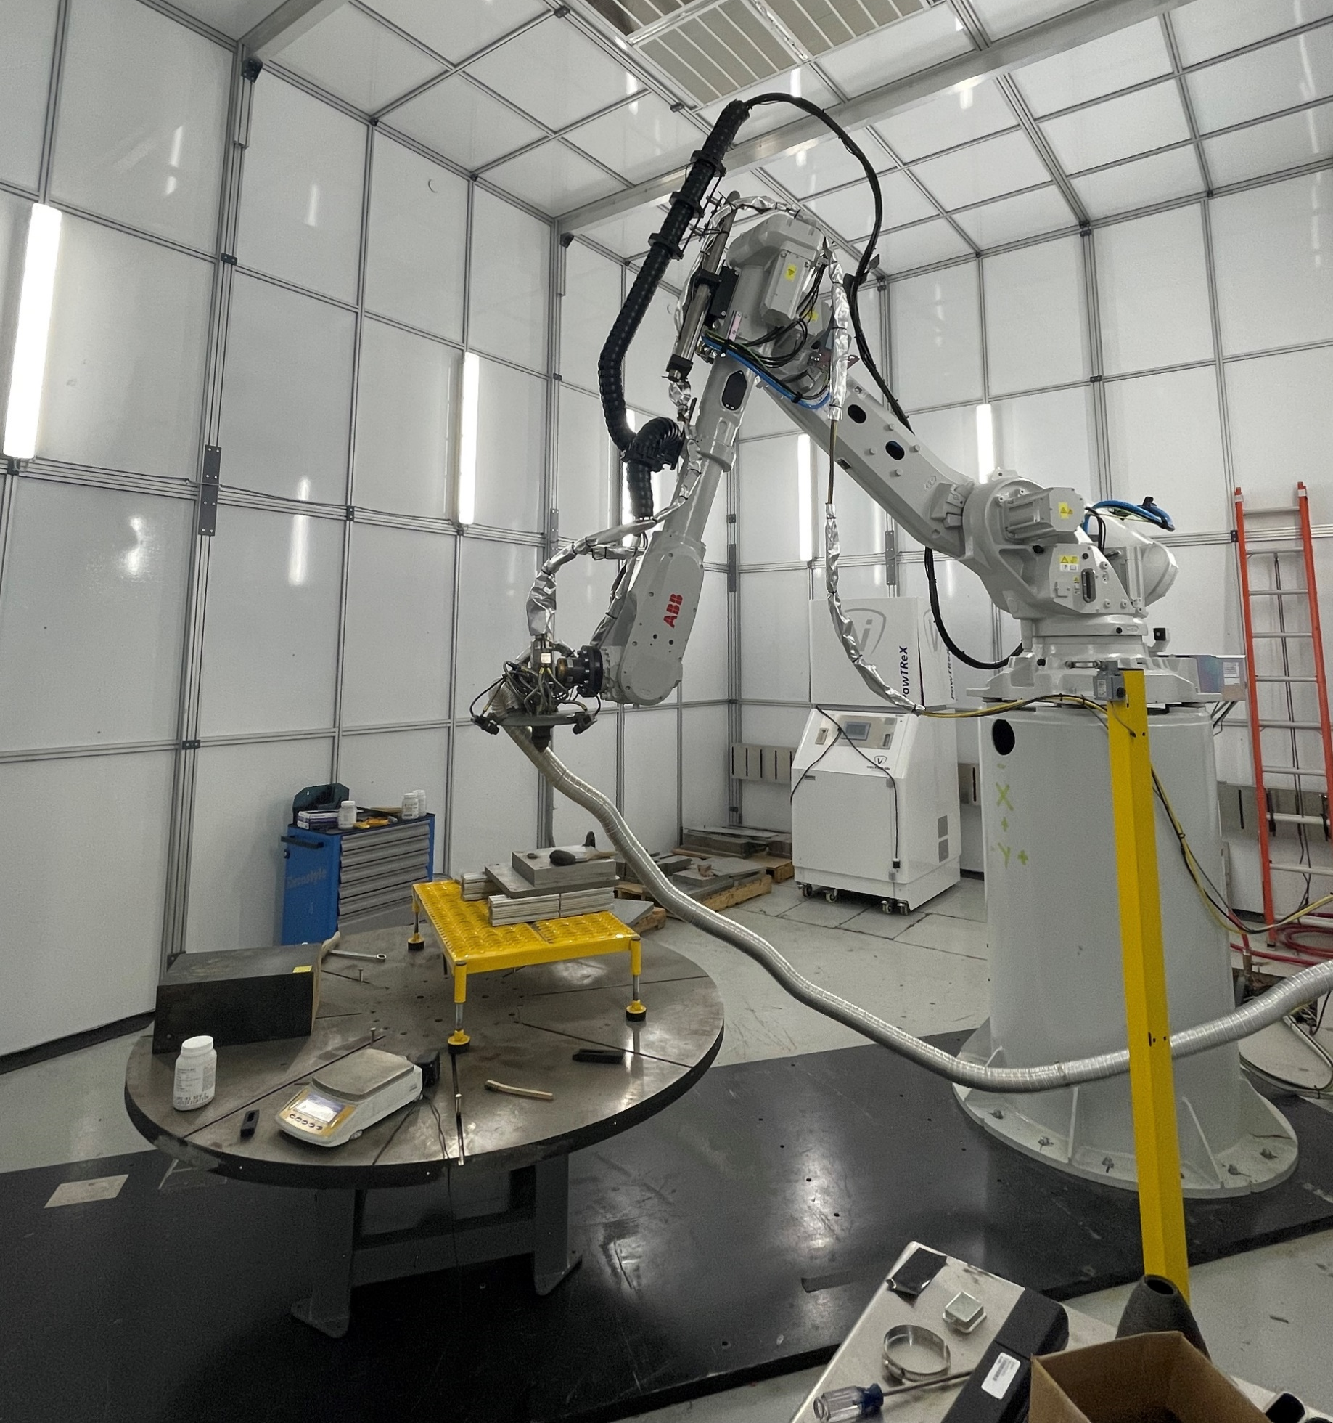
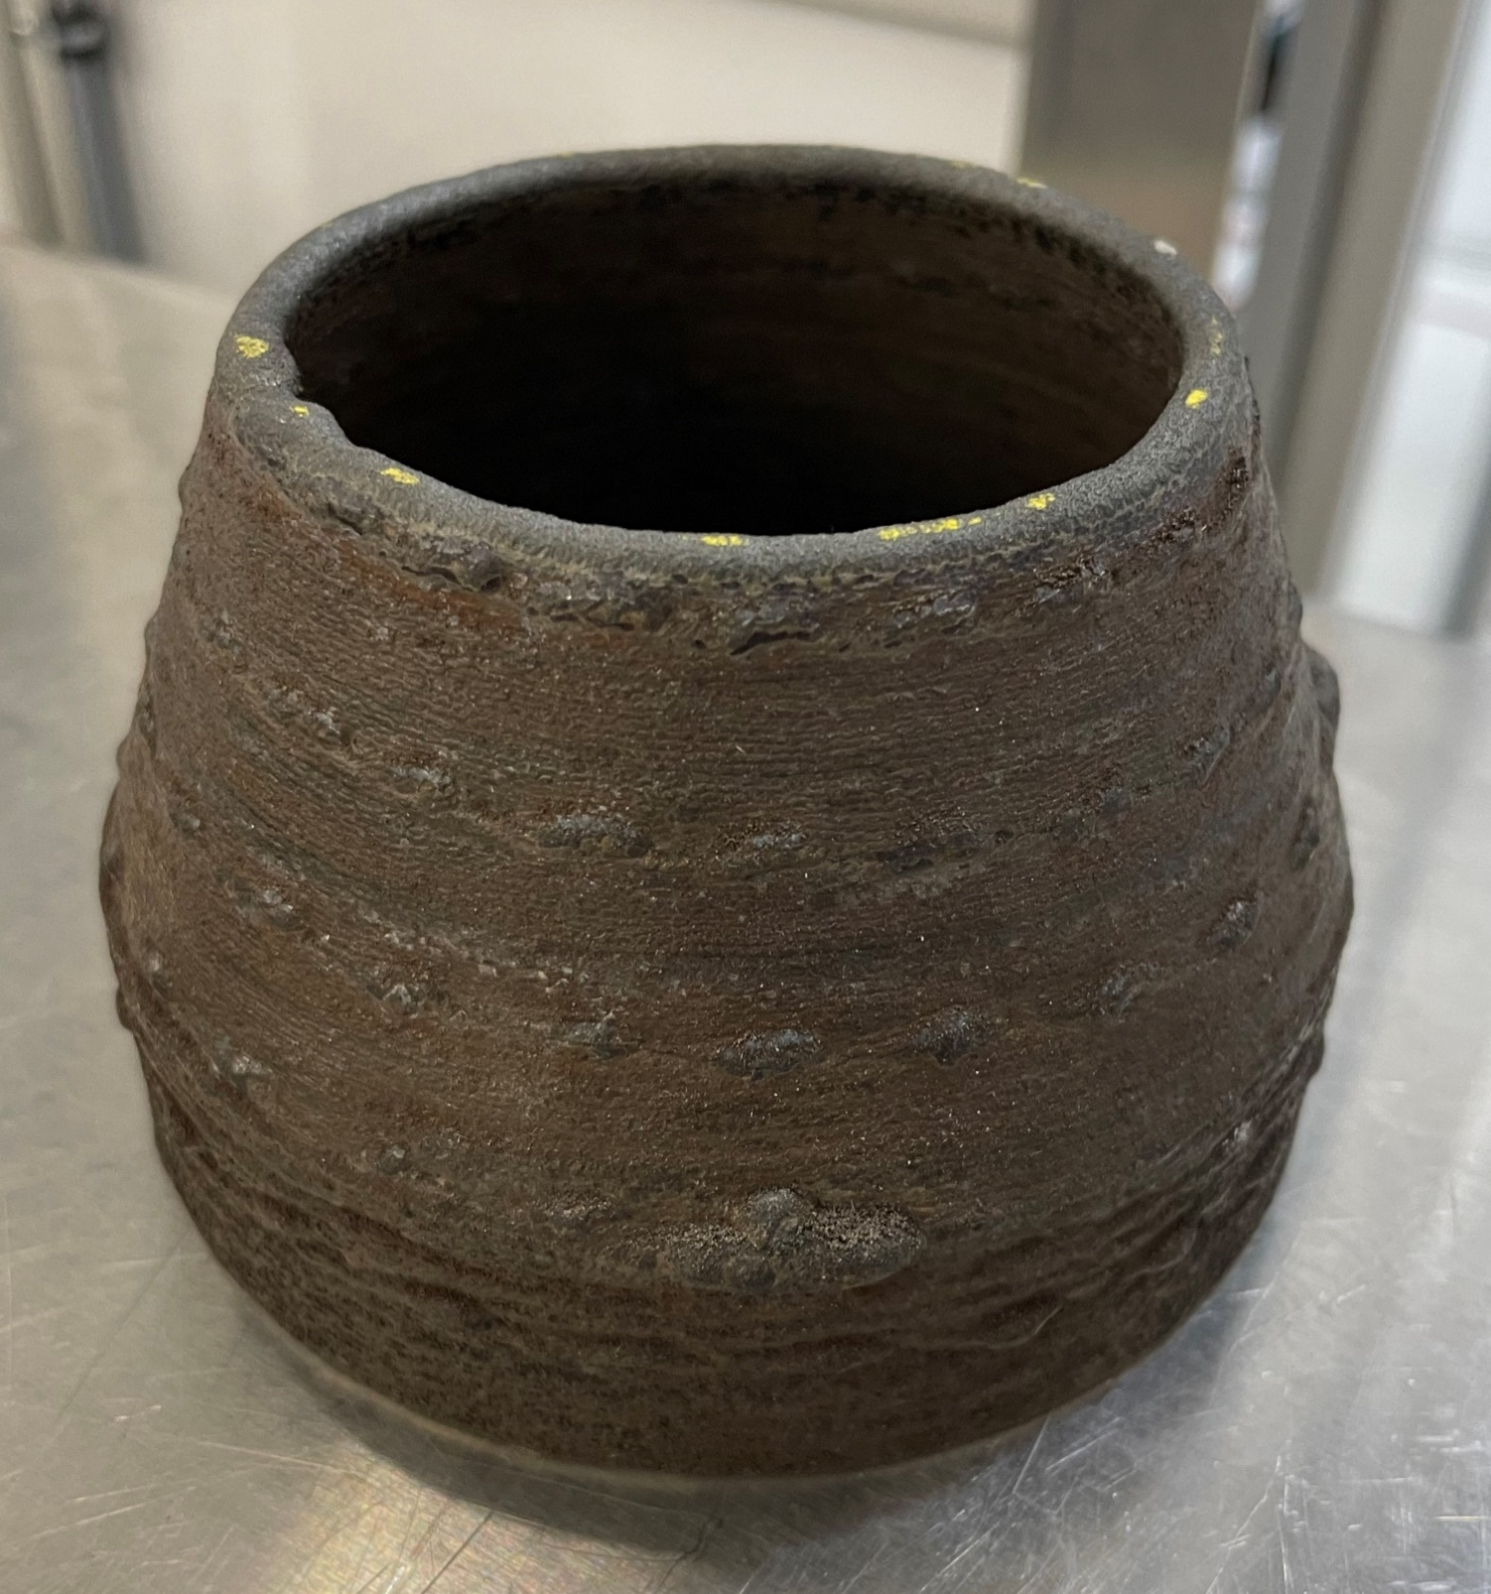
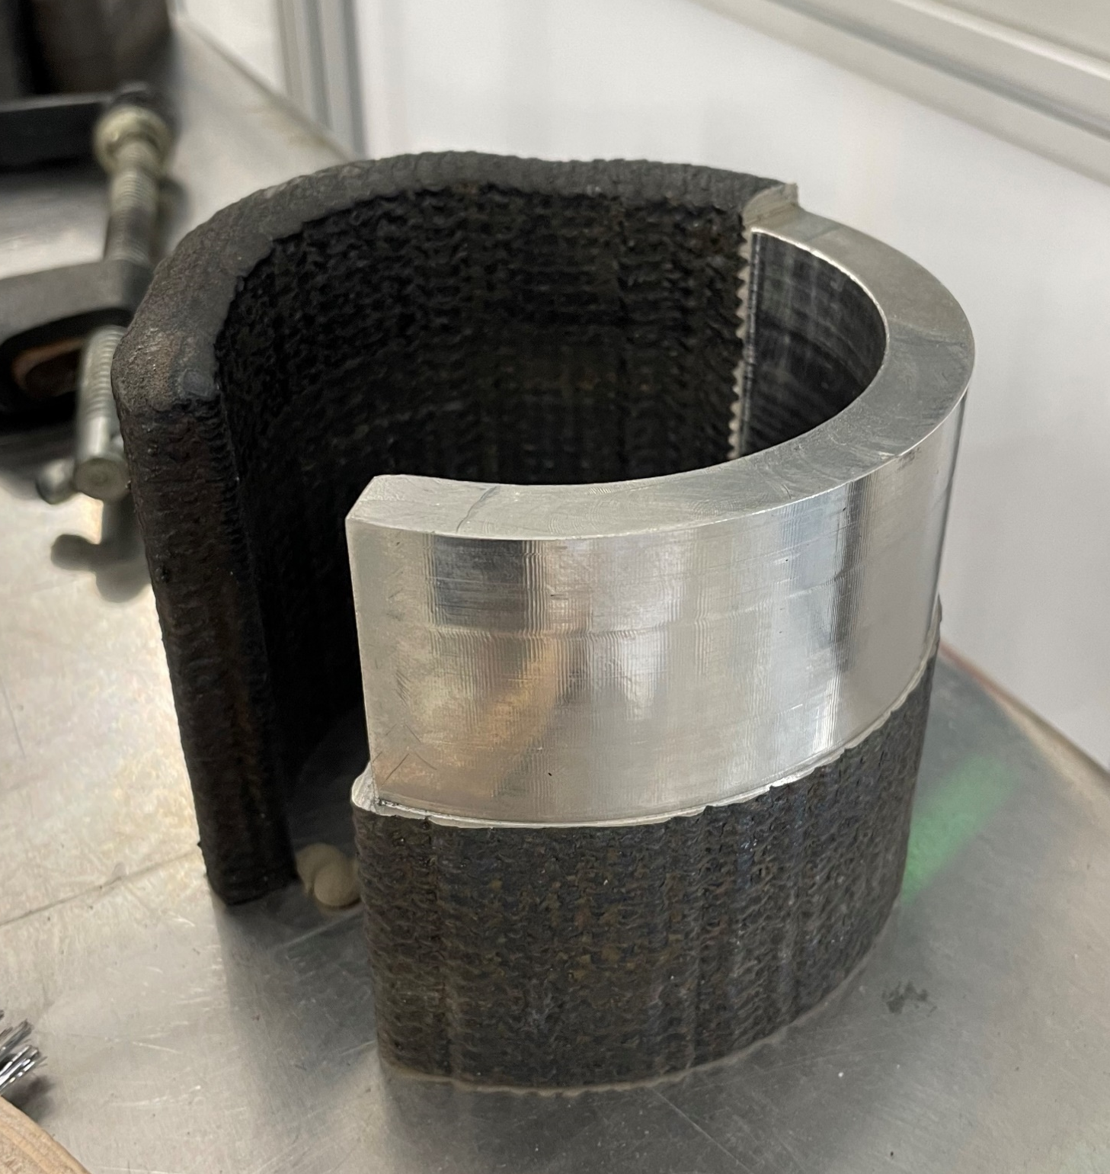
Directed Energy Deposition
Blown Metal Powder
DM3D Blown Powder DED System
Alloys: In718, HR-1, Copper
Cell was sized with RS-25 nozzle in mind.

Slide 6
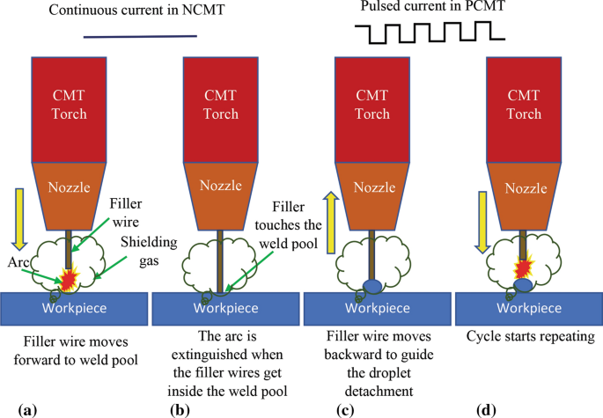
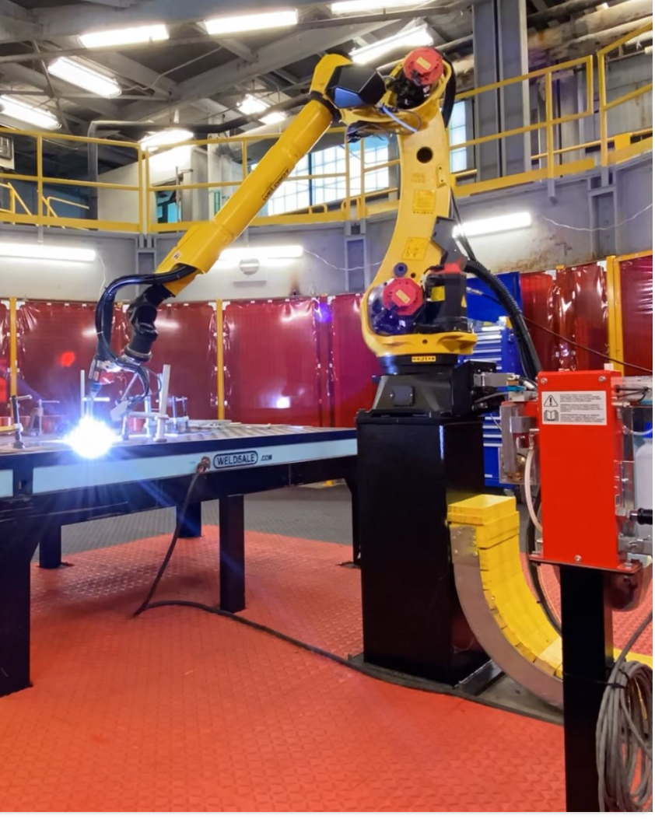
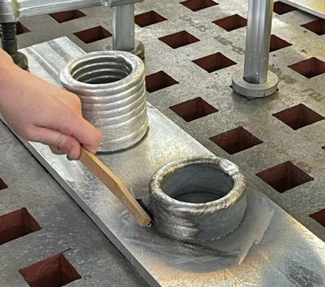
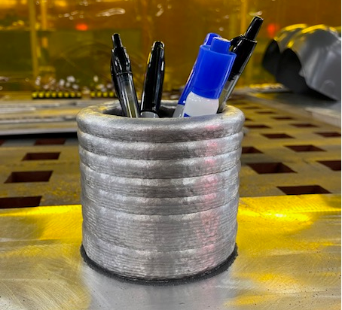
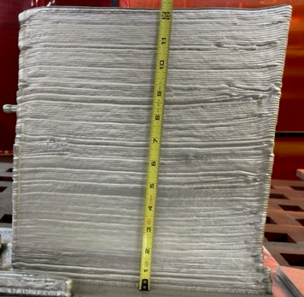
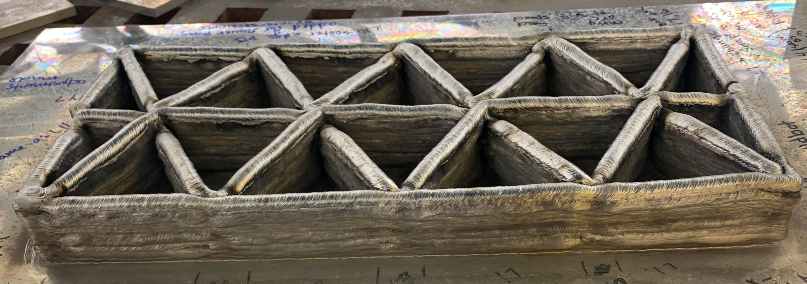
Cold Metal Transfer
Commercial Fronius power supply mounted on a Fanuc 6-axis robot
Est. Deposition Rate
4.32 (Wire diameter²)
x
Wire feed speed (varies by alloy)
x
0.91 efficiency
Materials
Various Aluminum alloys: 2319, 5183, 2050

Slide 7
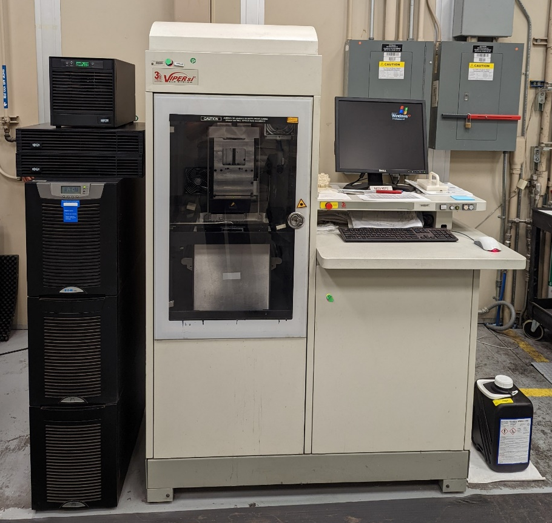
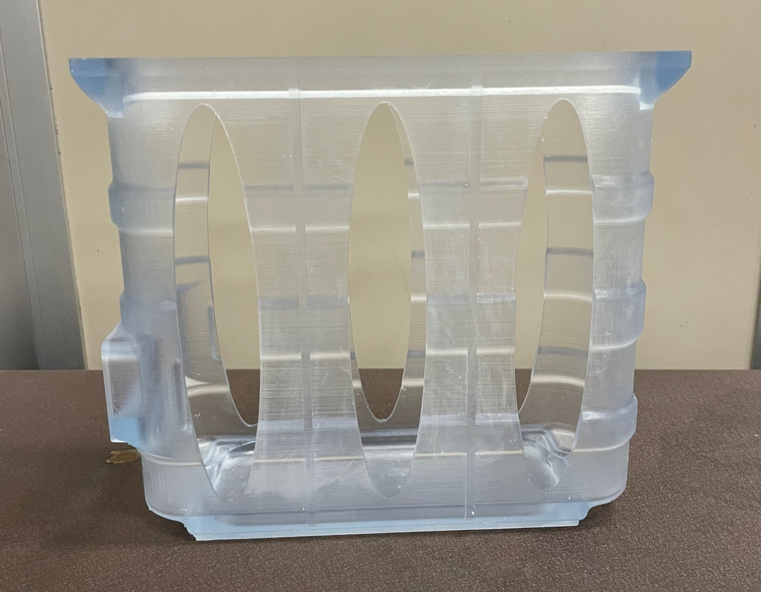
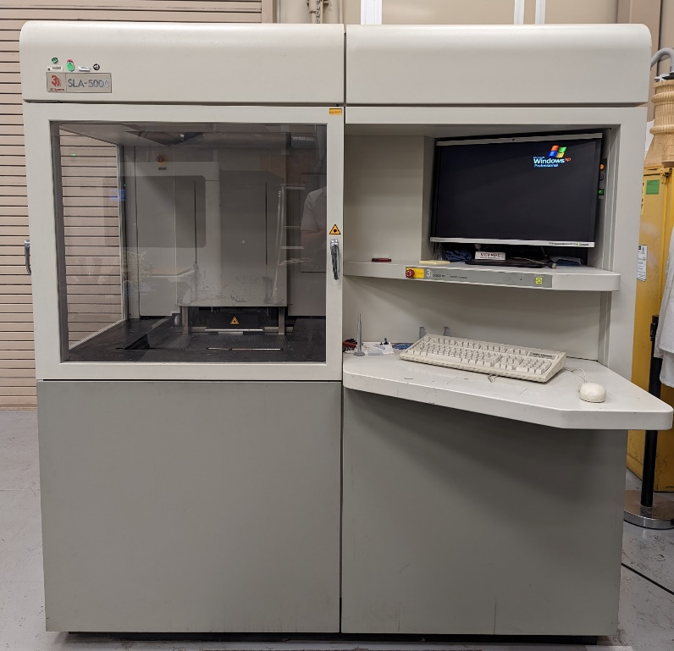
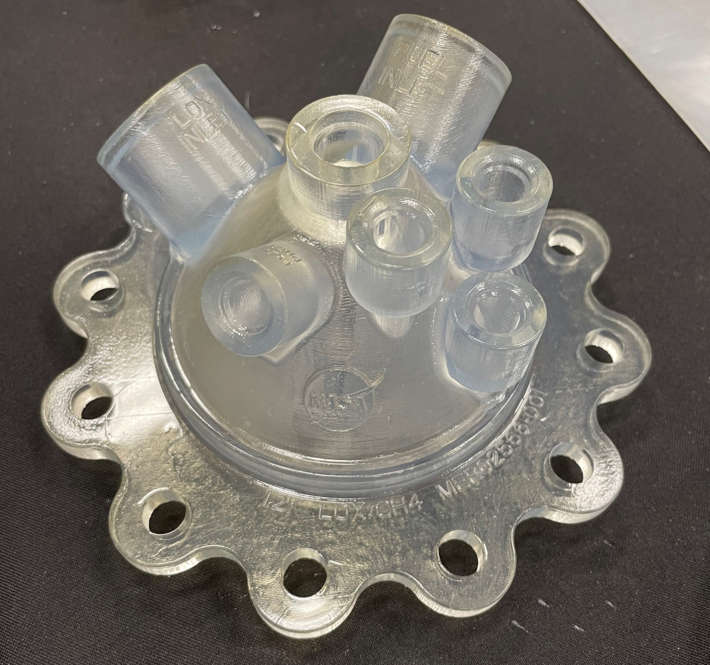
Stereolithography (SLA)
Viper SLA
DMX Somos
Build Volume: 10 in³
5000 SLA
Somos Watershed 11122 XC
Build Volume: 20 in³

Slide 8
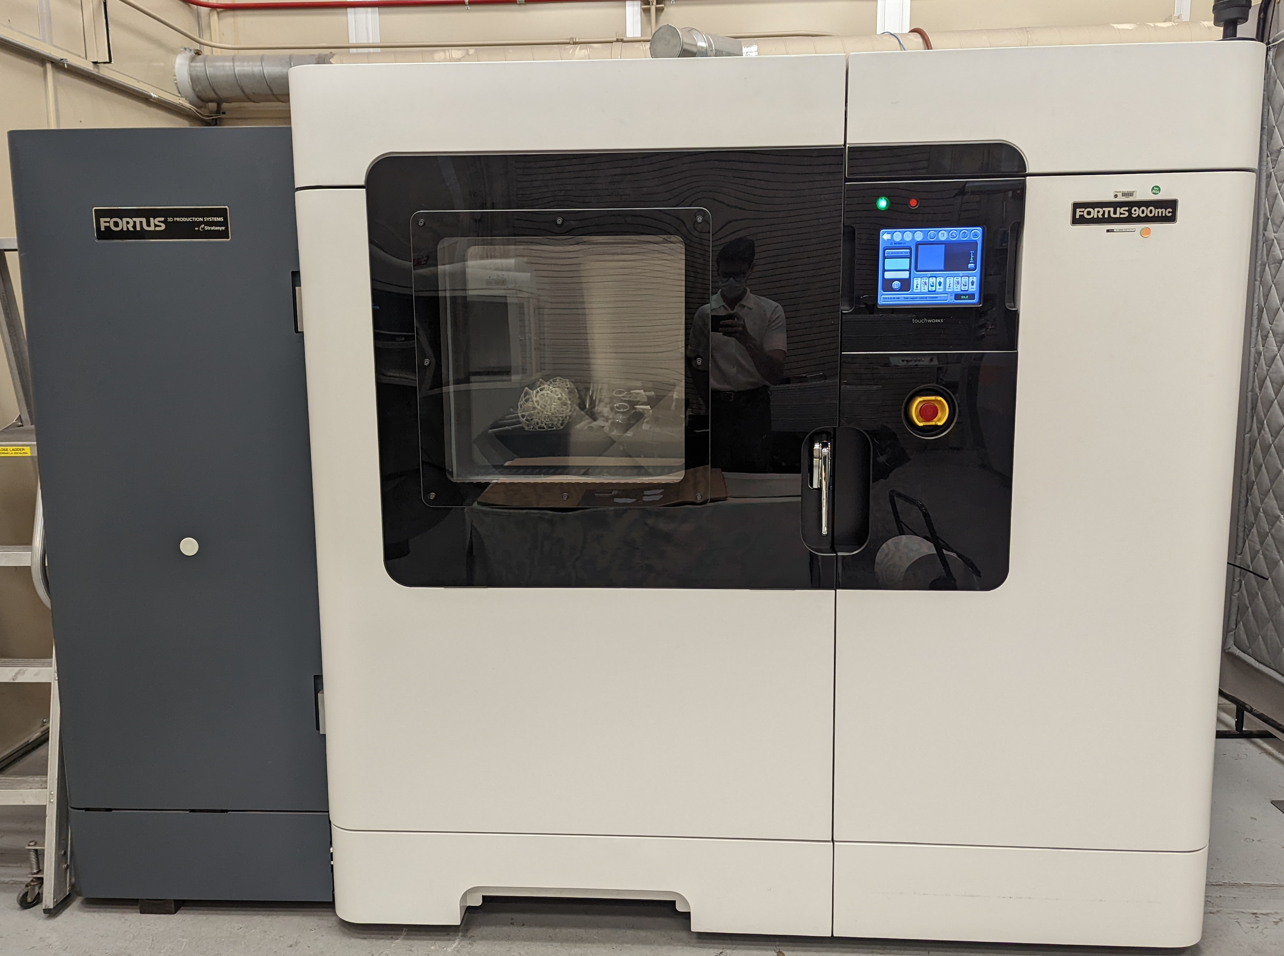
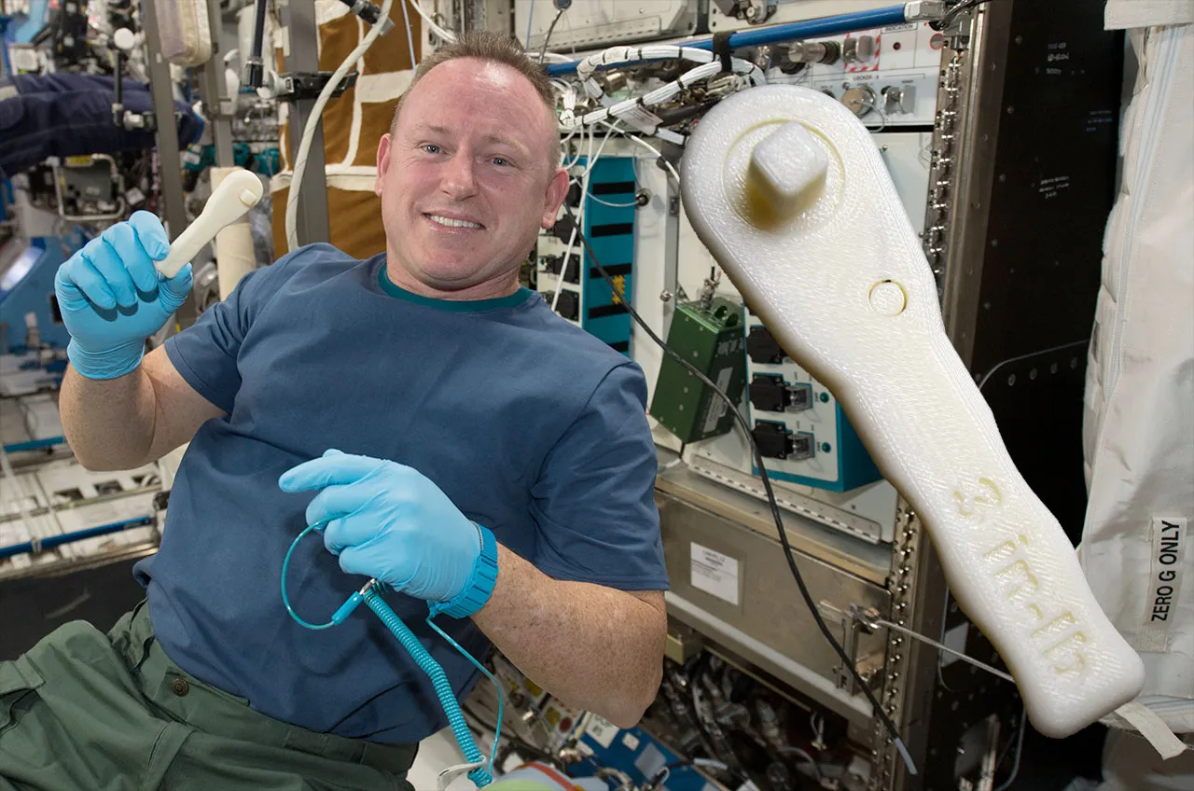
Fused Deposition Modeling
Stratasys Fortus 900
ABS, Polycarbonate, Ultem 9085
Build Volume: 914 x 609 x 914 mm

Slide 9
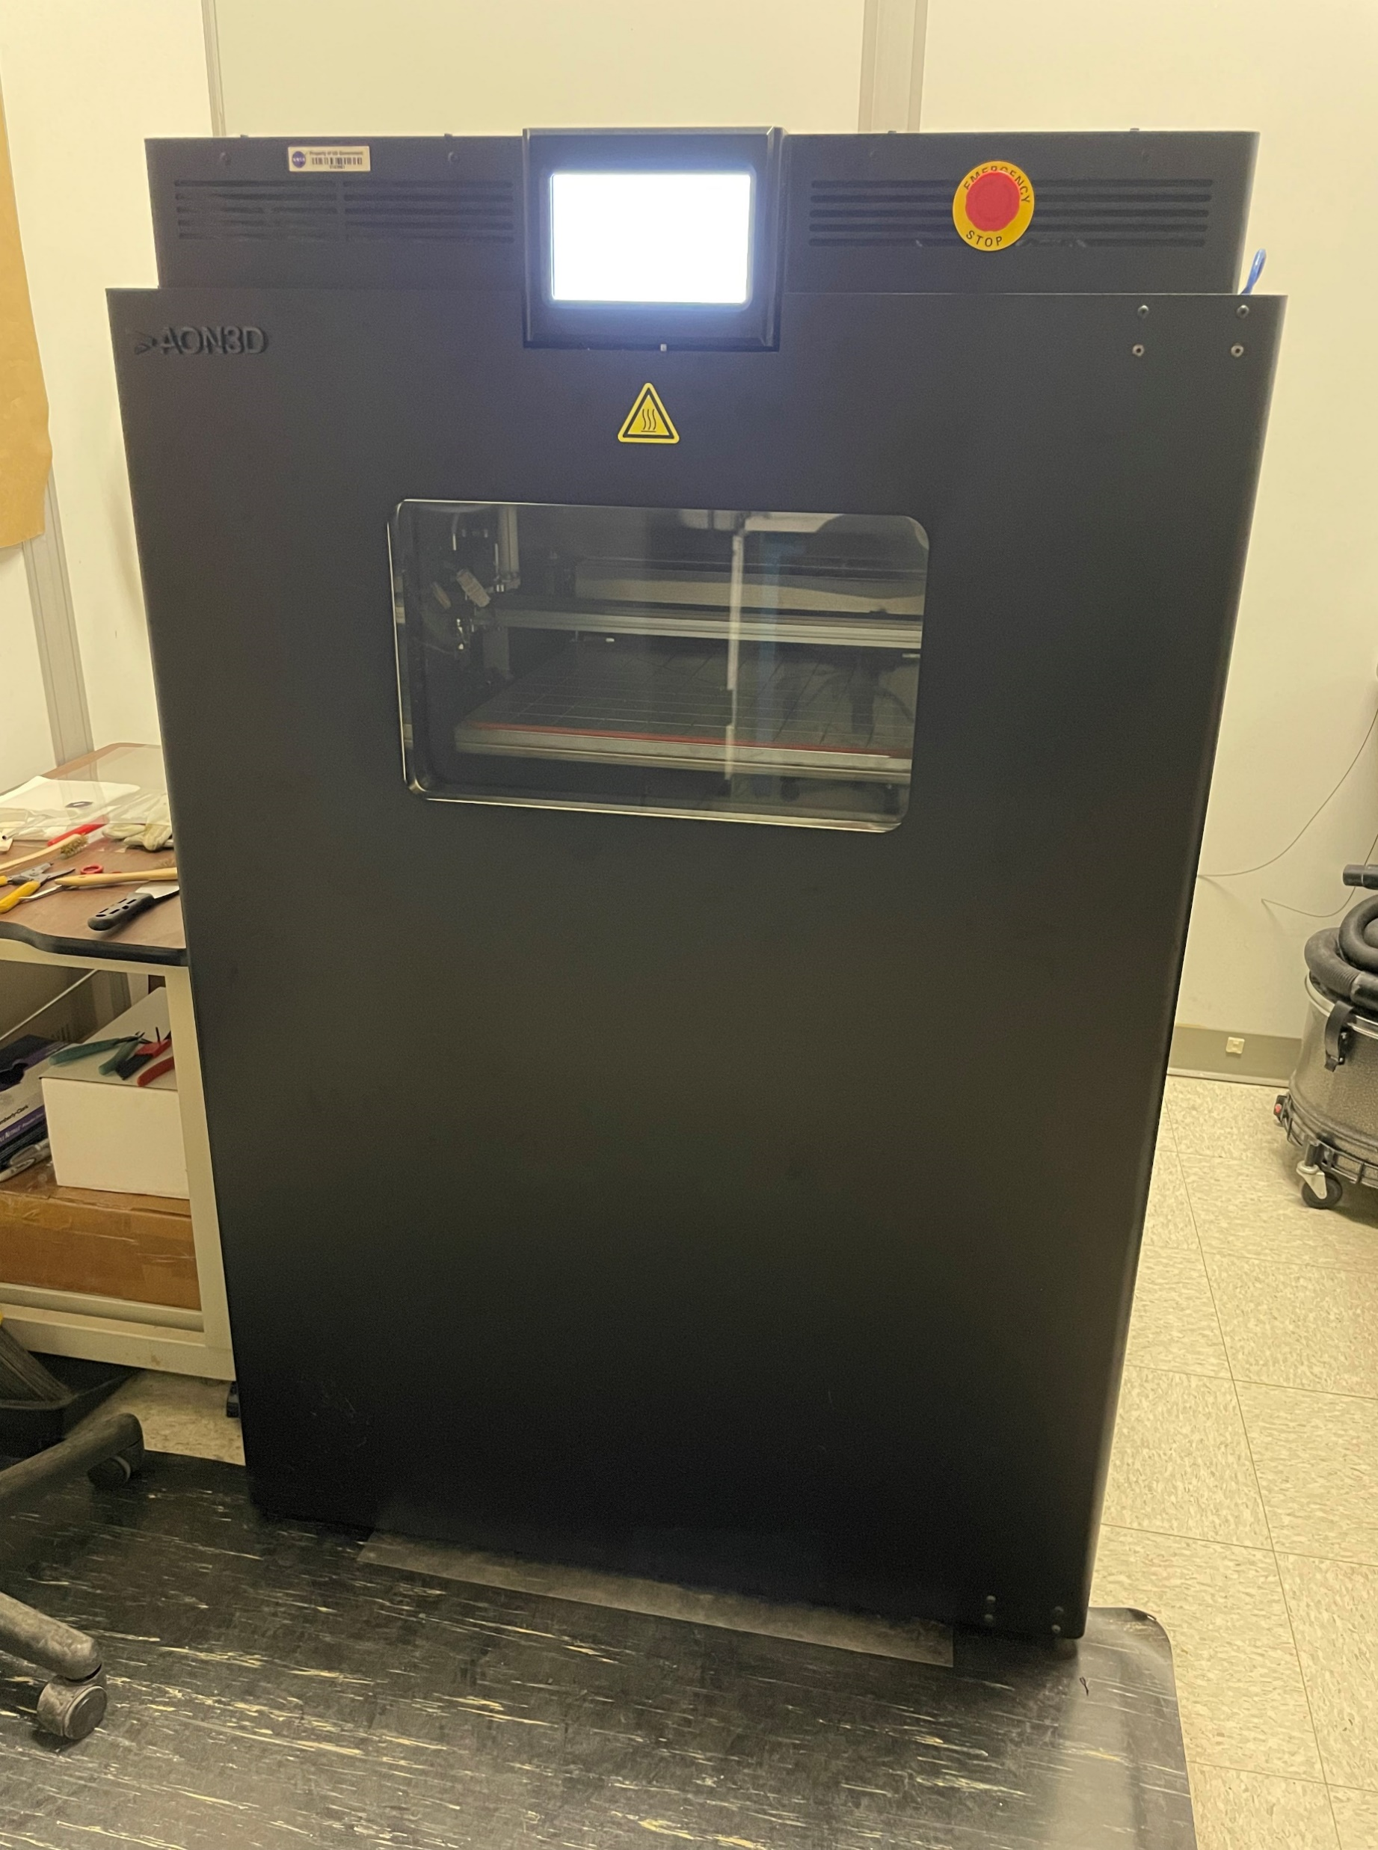
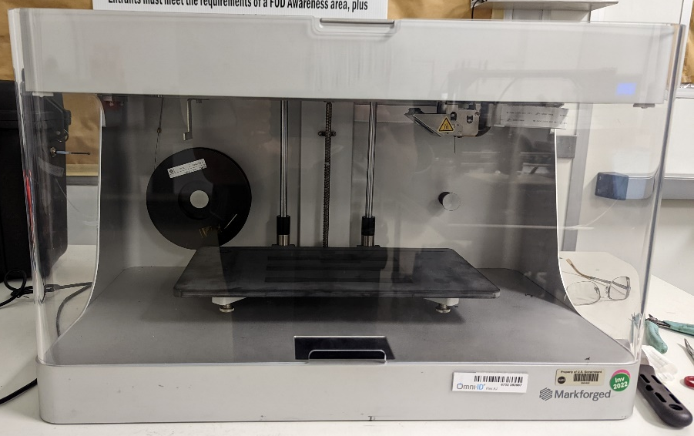
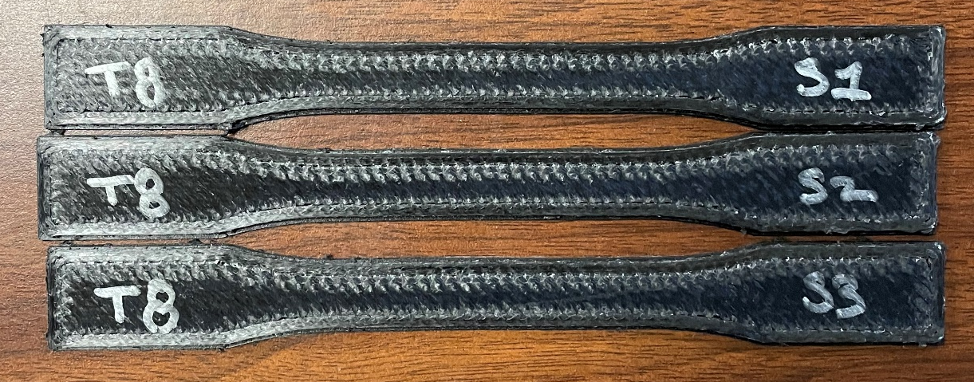
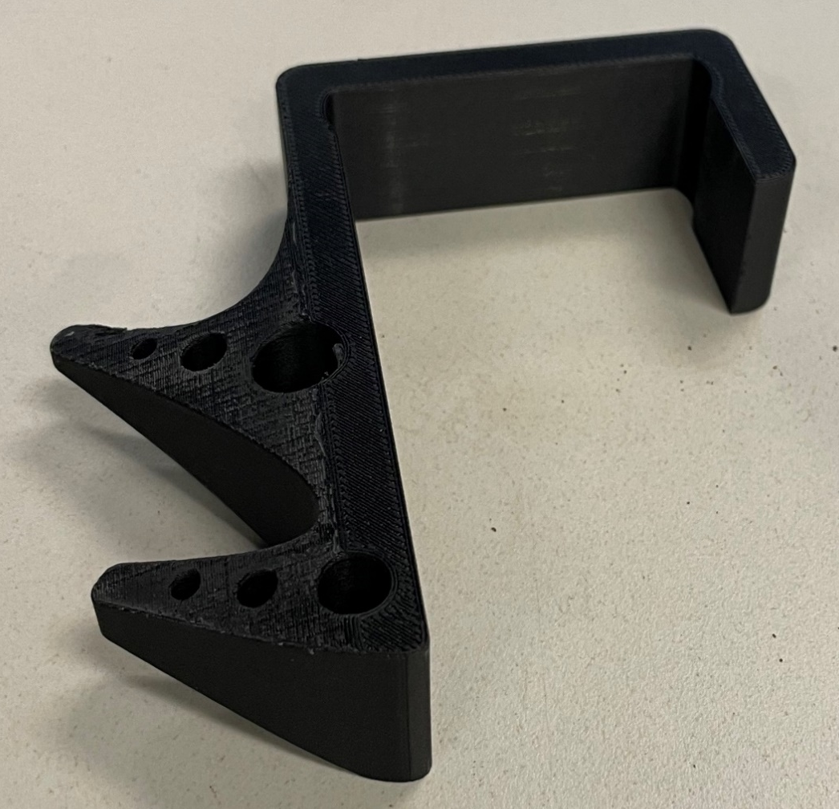
Fused Deposition Modeling
Markforged Mark Two
Carbon Fiber, Glass Fiber, Kevlar
Build Volume:
320 x 132 x 154 mm
AON M2+
PEEK, PEKK
Build Volume: 450 × 450 × 565 mm

Slide 10
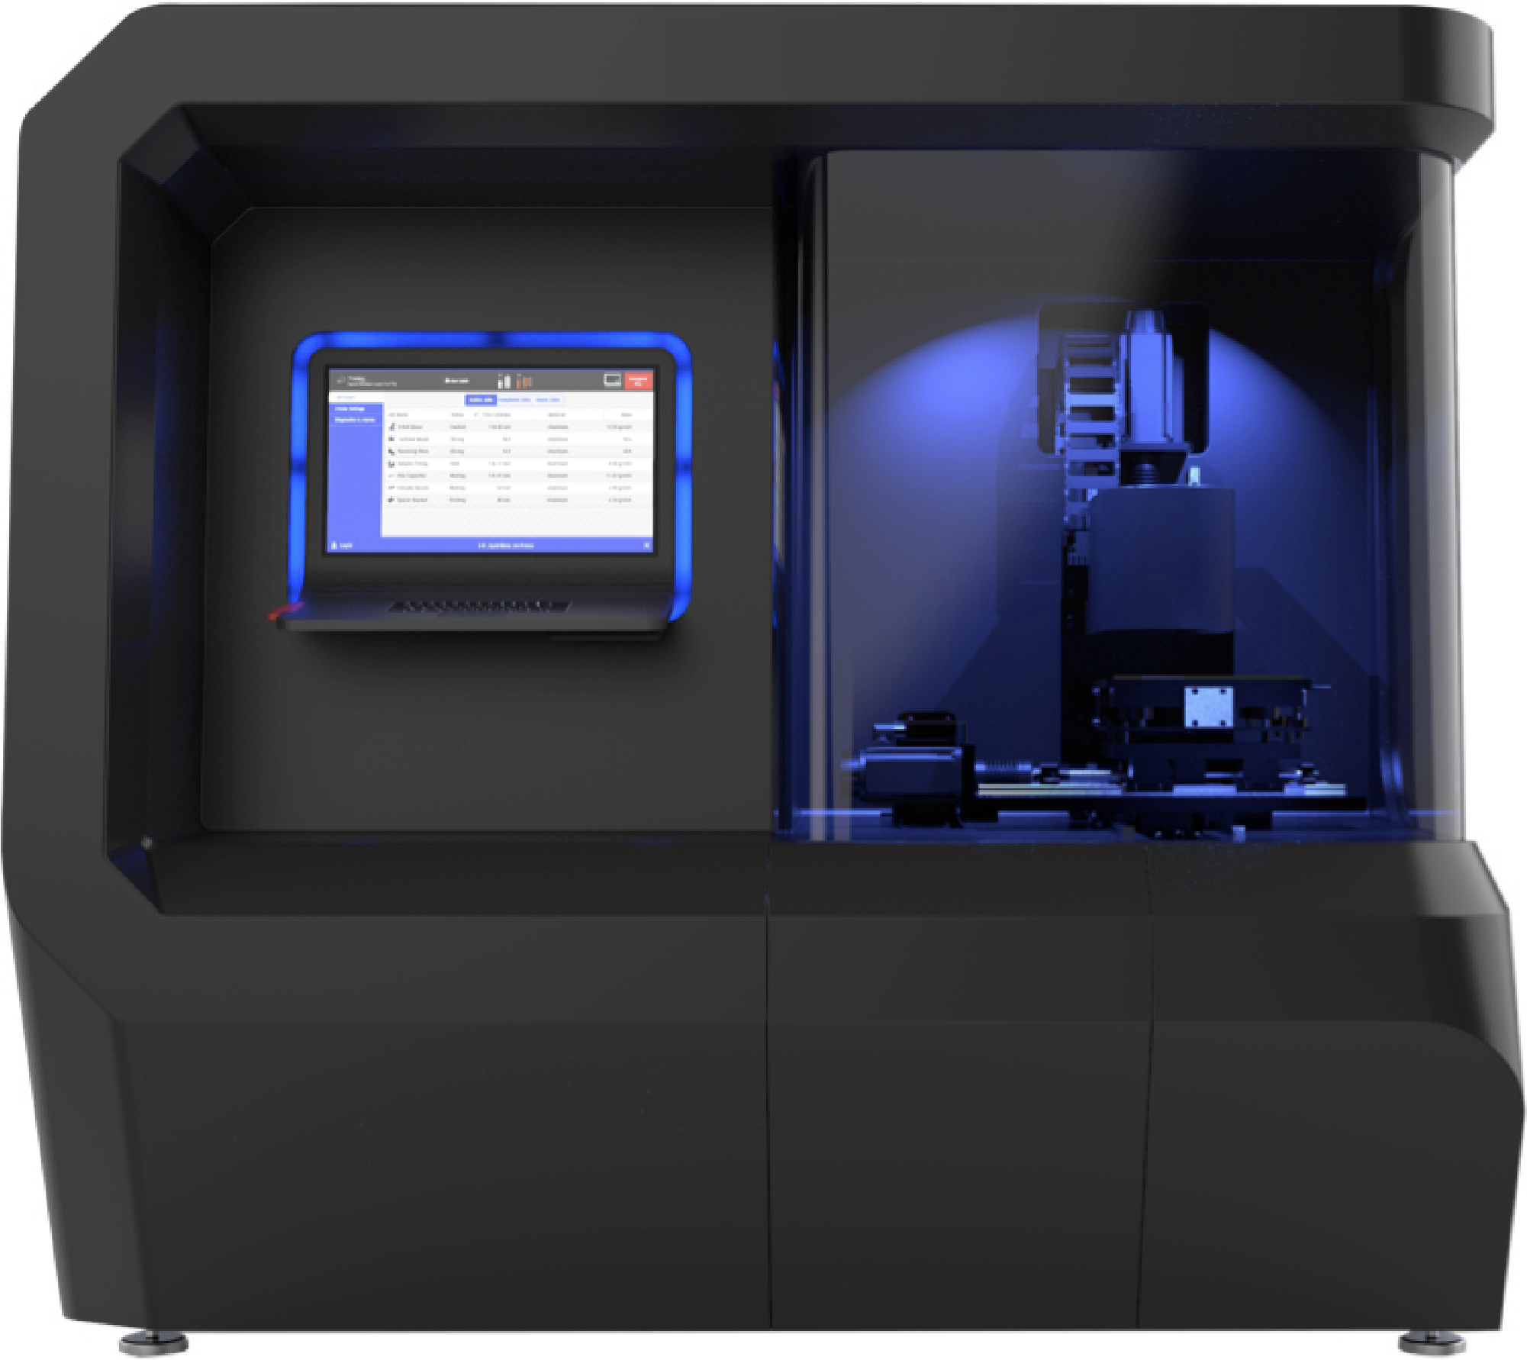
Coming Soon:
Liquid Metal Droplet Printing
Additec ElemX
Build Volume
12in x 12in x 4.7 in
300mm x 300mm x 120mm
Maximum Build Rate
0.5 pounds/hour
Minimum Layer Thickness
0.24 mm
Feedstocks
1.6mm wire diameter
Wire feedstock fed into ceramic crucible and melted
Build plate rapidly moved along toolpath for the layer
Metal droplets ejected by pulsed Lorentz force using external coil
Liquid metal coalesces one drop at a time on heated build plate
Layer is scanned once completed and process progresses to next layer
Simple water quench to remove from build plate

Slide 11
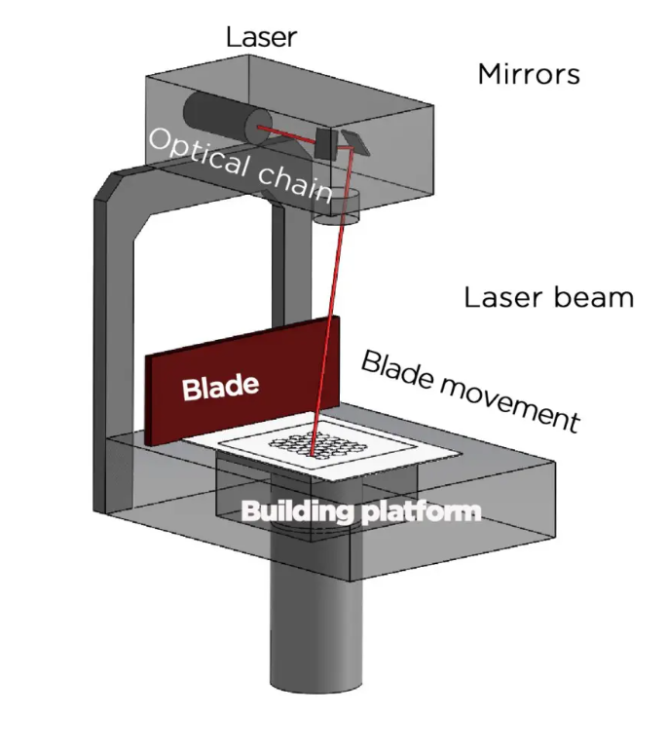
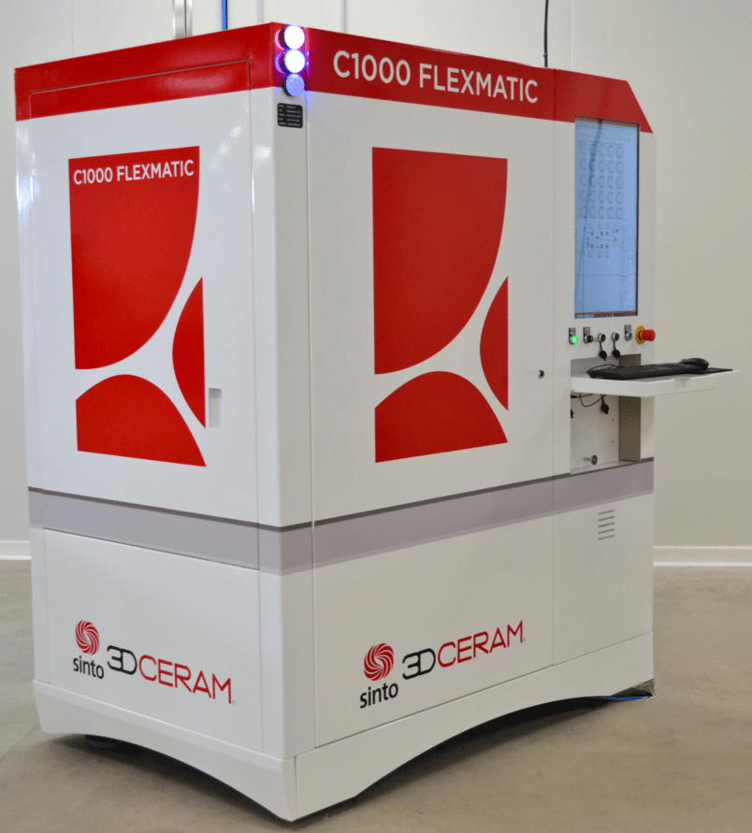
Coming Soon:
Ceramic Printing
Material Catalog
Silicore DS/DX
Aluminum Nitride
Silicon Nitride
Silicore
Alumina Toughened Zirconia
Cordierite
Zirconia 8Y
Tricalcium Phosphate
Fused Silica
Zirconia 3Y
Hydroxyapatite
Alumina
Build Volume
320mm x 320mm x 200mm
Layer Thickness
0.025 – 0.125 mm

Slide 12
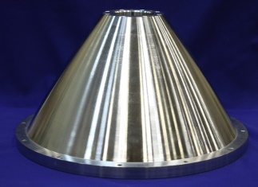
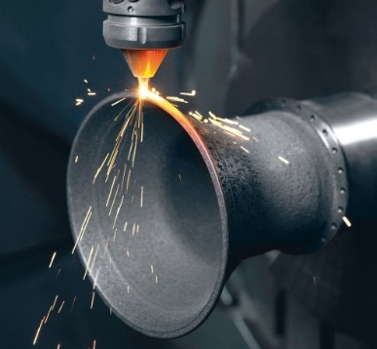
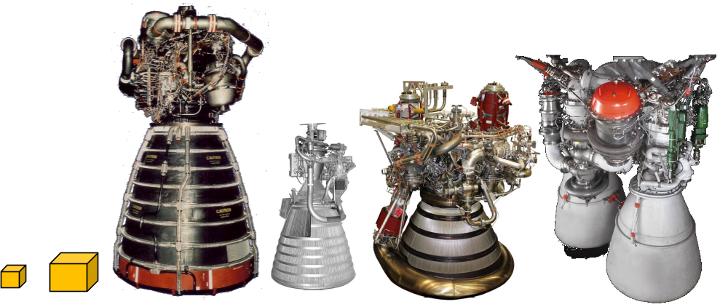
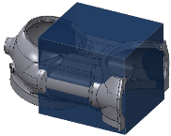
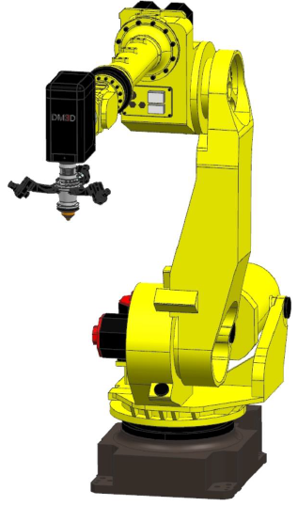
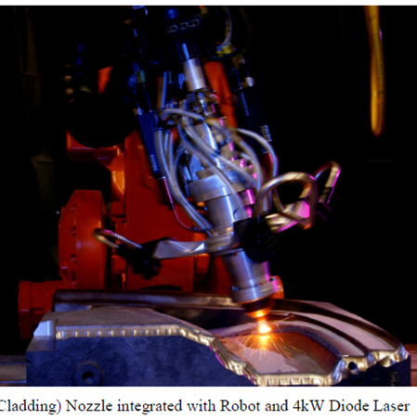
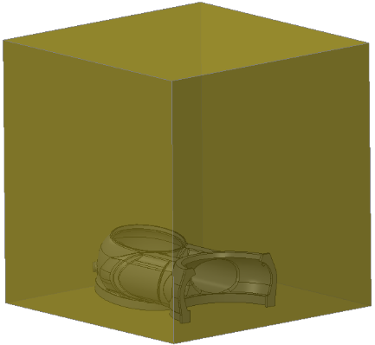
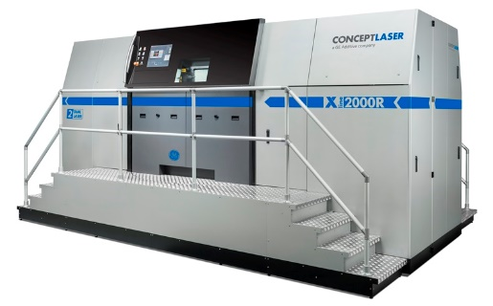
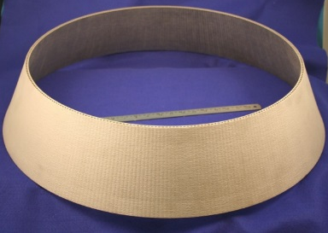
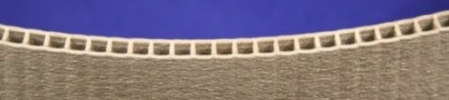
Additive Manufacturing Applications: Large Scale AM
In House capability
Current AM Build Boxes
10x10x10
16x24x19
Manifold in Build Box
To a Needed Future State
DED Build Box
12 ft X 8 ft X 10 ft
90” Diameter
Manifold Large Platform Build Box
LPBF Build Box
800 x 400 x 500 mm3

Slide 13
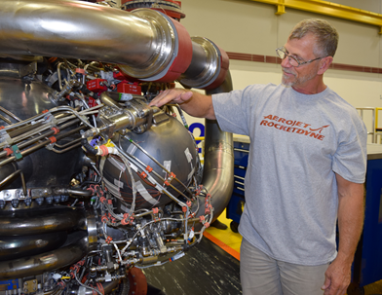
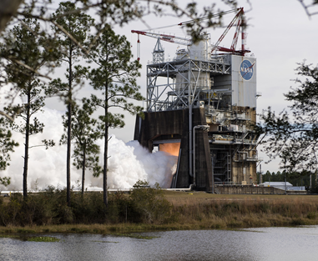
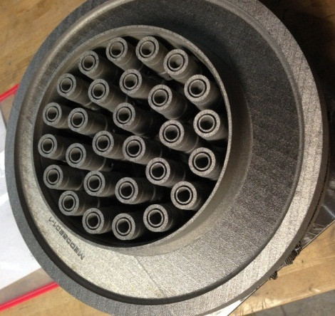
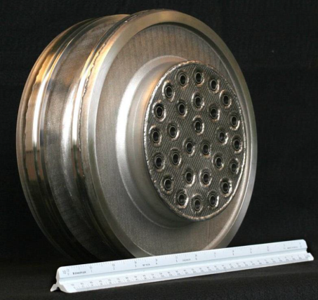
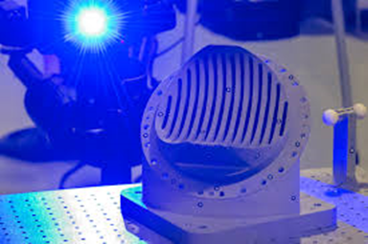
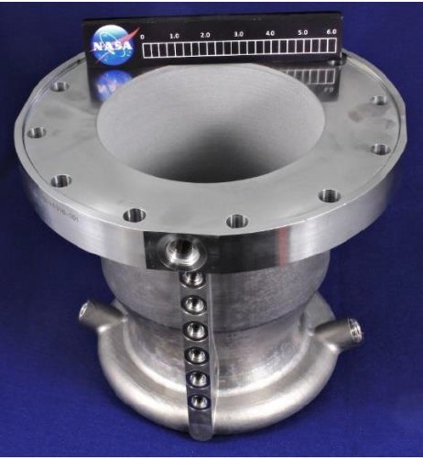
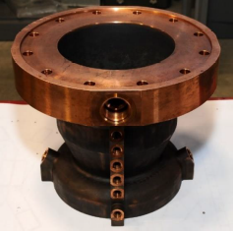
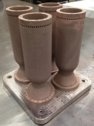
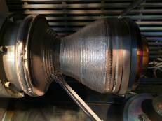
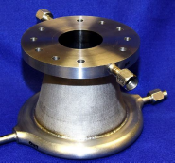
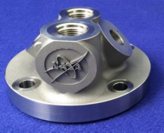
Propulsion Applications
NASA MSFC has also built channel-cooled combustion chambers using L-PBF, but that use bi-metallic additive and hybrid techniques.
Multiple Copper, Nickle and Stainless Materials
Designs tested ranged from 200 to 1,400 psia in multiple propellants, producing 1,000 to 35,000 lbf thrust.
NASA MSFC rocket injectors made by AM resulting in a 70% reduction in cost.
Using traditional manufacturing methods: 1 Year, 163 parts
With AM, 4 months. only 2 parts
RS25 Prime Contractor, Aerojet Rocketdyne, technician exhibits the RS-25 pogo accumulator (top and middle), which was subsequently hot-fire tested (bottom)
Over 100 Weld Eliminated
Nearly 35% Cost Reduction
28-element Inconel® 625 fuel injector built using
an laser powder bed fusion (L-PBF) process
https://www.nasa.gov/press/2014/august/sparks-fly-as-nasa-pushes-the-limits-of-3-d-printing-technology/
https://arc.aiaa.org/doi/abs/10.2514/6.2018-4625
https://arc.aiaa.org/doi/abs/10.2514/6.2018-4625
https://www.nasa.gov/exploration/systems/sls/nasa-tests-3-d-printed-rocket-part-to-reduce-future-sls-engine-costs

Slide 14
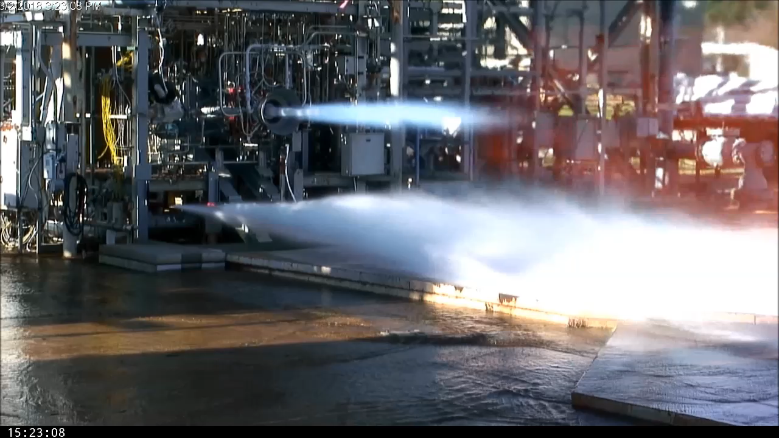
Examples of Additively Manufactured Rocket Components on Test

Slide 15





How did I get here?
My personal path to NASA MSFC

Slide 16





My Personal Path To Additive Manufacturing
2008-2010
2011-2014
2015
2017
2019
2022
2024
2019
2021
Started at Blue Origin as a friction stir welding engineer to develop and qualify weld joints
Welding trade school and then job shop welder/fabricator
Started community college for engineering
Started full time at University of South Carolina
Welding class in high school
Graduated with BS in ME from University of South Carolina
Undergraduate research with friction stir welding
Started as a contractor at MSFC for welding team
Converted to Civil Servant for EM32 Welding Team—working on AM processes
Joined EM42 AM Team
Graduated with MS in ME from University of South Carolina
Thesis completed on friction stir welding as an AM process

Slide 17


What are some things I do at NASA?
Process development: Creating stable, repeatable welding or AM processes, usually trial and error to figure out which key process variables (KPV) or combinations of these will produce the best results
Project Management: Responsible for schedules, coordination, external support, procurement needs, milestones, and ensuring quality deliverables for a subset of projects usually with respect to process development
Production support: Occasionally called to support welding or AM issues for production hardware for Boeing SLS or other launch providers
Consulting: Occasionally asked to provide welding or AM support internal to MSFC (design, in-space manufacturing, etc), other NASA Centers, and industry partners

Slide 18





AM-Related Industries: More than just 3D printing

Slide 19



Robotics
Robots and AM go hand in hand
  Robot platforms, positioners, gantry systems are all convenient ways to create toolpaths and motion for AM processes
Related technologies for robots include machine learning (ML), artificial intelligence (AI), nondestructive evaluation (NDE) for detection of defects, and material handling
Local resource to learn robotics and controls for FREE: Home - AlabamaRTP

Slide 20




Generative Design and Topology Optimization
Design of components and structures can be optimized using machine learning, artificial intelligence, or other complicated methods not conventionally used
The goal is to maximize part performance by mathematically modelling and optimizing for factors such as external forces, load conditions, boundary conditions, constraints, and material properties within the design envelope
These organic, freeform shapes generated by the computer program are hard to machine from billets with traditional and subtractive manufacturing techniques
  AM is a great option to build the extremely complex geometries

Slide 21



Material Engineering
Alloy chemistry and composition of many materials can/must be altered for the AM process to optimize the properties and microstructure
  Integrated computational materials engineering (ICME) and other physics-based modeling technologies provide ways to calculate and iterate potential new alloys before they’re made in a lab
Modeling of the process itself using thermal boundary conditions and material properties is also an increasingly popular field of study
  Models of residual stress, thermal gradients and cooling rates, etc

