Slide 1
Spectroscopic measurement techniques at NASA
NASA/ONERA/DRL Workshop on surface and flowfield optical measurement techniques for aerospace flows
19 July, 2024, ONERA's Fauga Mauzac site, Toulouse, France
Speakers: Paul M. Danehy*, Neil Rodrigues**, Amanda Braun***
Advanced Measurements and Data Systems Branch, NASA Langley Research Center
*ST for Advanced Measurement Systems
** Optical Physicist, Research Aerospace Technology
*** NASA Postdoctoral Fellow

Slide 2
Today’s Presentations from NASA
Spectroscopic measurement techniques at NASA
Surface measurements techniques at NASA
Flow measurements techniques at NASA
~8 minutes overview by Paul Danehy, ST for Advanced Measurement Systems
~7 minutes of highlights from in-person workshop attendees

Slide 3
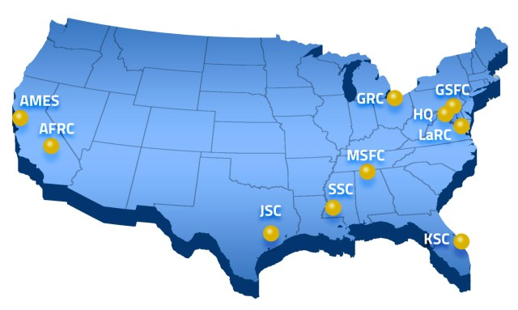
Measurement techniques for aerospace flows @ NASA
Excluding Conventional ‘standard’ measurement techniques herein: lift, drag, surface pressure…
  Most tunnel data acquired is conventional (lift, drag); AMS can explain why
Concerned today with Advanced Measurement Systems (AMS)
  AMS = non-intrusive flow and non-conventional surface measurement techniques for wind tunnels, flight
NASA AMS Efforts:
  Civil Servants and Onsite Contractors at many NASA Centers
    Primarily Aero Research Centers: Ames, Glenn, Langley, Armstrong but Marshall too
  We leverage broader national and international instrument development community
    Universities and industry through Small Business Innovative Research (SBIR)
    Purchase available technologies where possible (e.g. software for PIV, BOS, etc.)
Recent Trends in Ground Testing at NASA
  Computational methods are transitioning from RANS to time-resolved methods
    Drives need for high-speed, time-resolved measurements, spectra
    100 Hz, 10 kHz, 1 MHz, or faster
  Fewer facilities → need to get more information out of wind tunnel testing
  Modelling of facility itself to improve comparison with computations → need to characterize facilities
Major NASA Centers

Slide 4
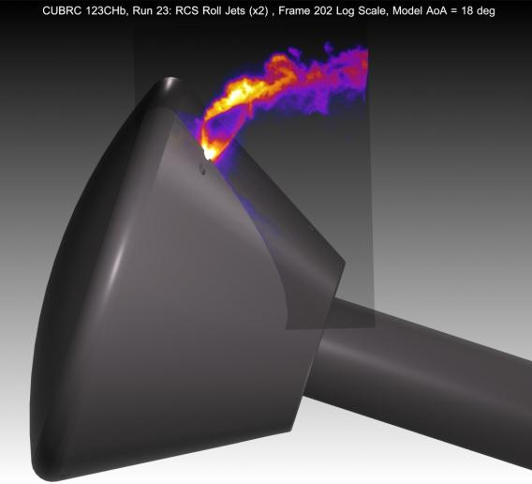
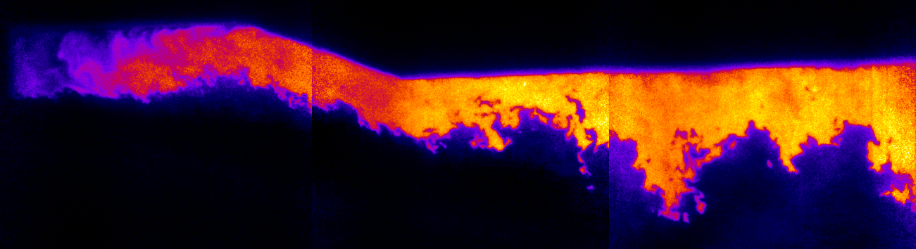
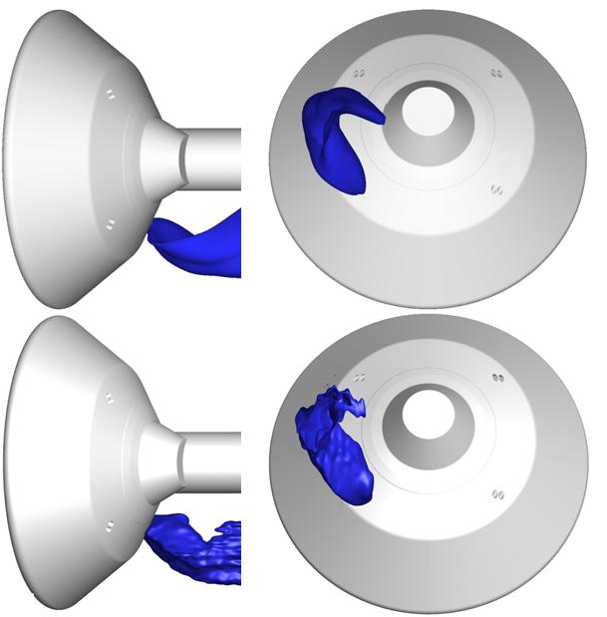
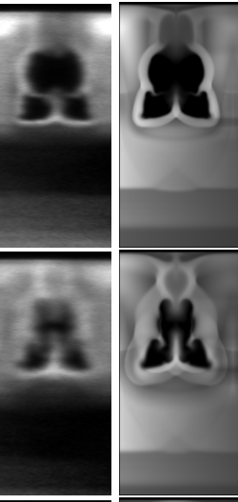
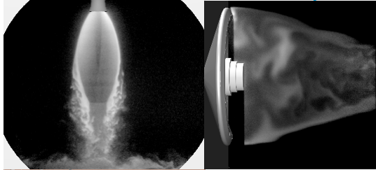
Spectroscopic Techniques
Spectroscopic Flow Visualization
Planar laser-induced fluorescence (PLIF)
  OH for reacting, NO seeded for non-reacting, O-atom
  2D, 3D flow visualization, velocity, temperature
  10 Hz continuous operation
  >200 kHz pulse burst laser system
  Flow visualization applications:
    Supersonic Combustion [Danehy LaRC & university collaborators]
    Reaction Control Systems (RCS) [Bathel, Inman, Danehy LaRC]
    Fuel air mixing [Ground, Drozda, Danehy LaRC]
    Plume Surface Interactions (PSI) [Rodrigues, Tyrrell, Danehy LaRC]
    Wake flows [Rodrigues, Tyrrell, Danehy LaRC]
    Boundary layer transition [Bathel, Inman, Danehy LaRC]
    Hypersonic Materials Test [Bathel, Inman, Johansen, Danehy LaRC]
Laser Induced Fluorescence of O and N atoms
  NASA Ames Arcjets (dormant)
Rayleigh Scattering
  Density measurement and flow vis for PSI [Rodrigues, Braun LaRC]
Orion RCS Jet PLIF
OH PLIF in supersonic
combustion of C2H4 with GWU @ UVA
Highlight
Highlight
Mars Science Lab (MSL) PLIF (bottom) vs CFD (top)
Supersonic fuel/air mixing
PLIF CFD
PLIF visualization of PSI and entry vehicle wake

Slide 5
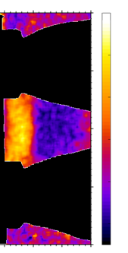
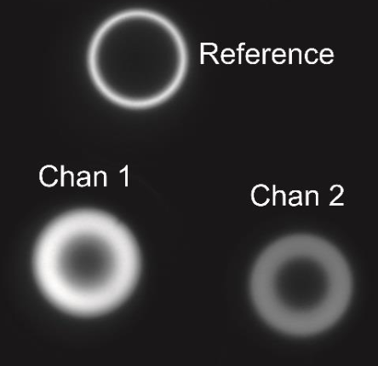
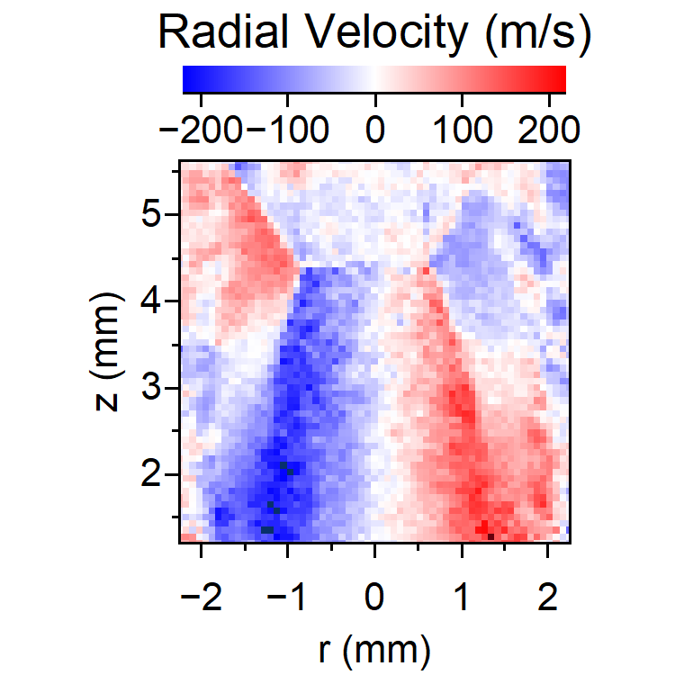
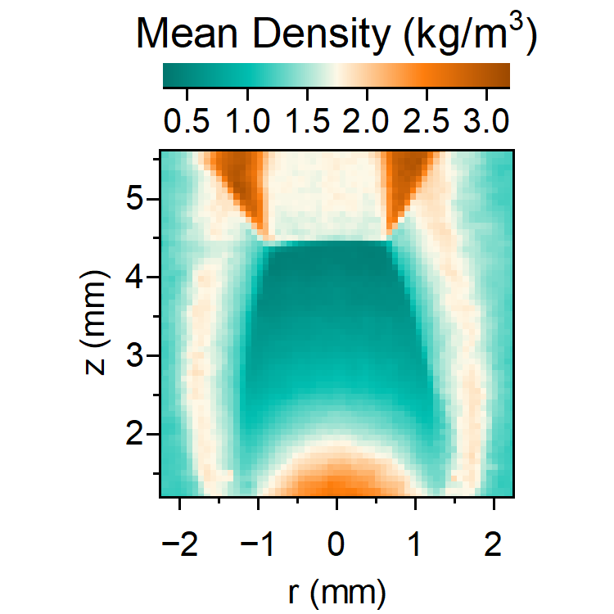
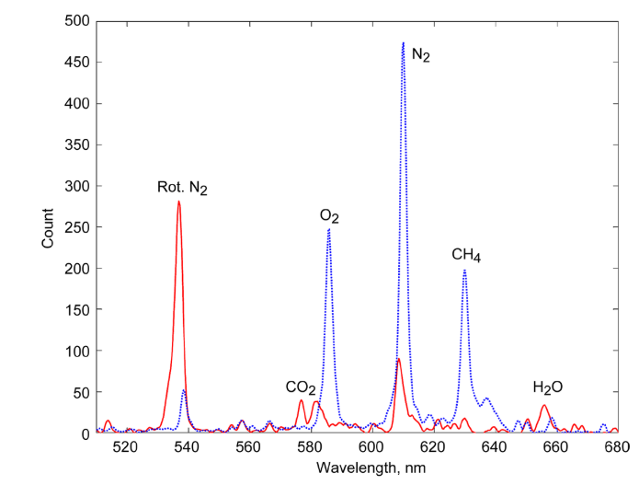
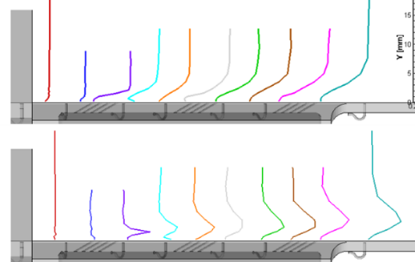
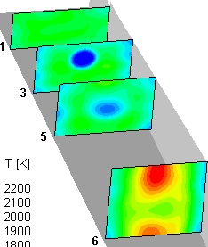
Spectroscopic Techniques
Spectroscopic Quantitative Measurements
Planar laser-induced fluorescence (PLIF)
  OH and NO thermometry
  10 Hz or >200 kHz [Rodrigues, Danehy LaRC]
Interferometric Rayleigh Scattering (IRS)
  Temperature, density, velocity at multi points [Fagan GRC]
  Temperature, density, velocity at single point [Panda ARC]
  Temperature, density, velocity at multi points [Danehy LaRC, Cutler GWU]
Filtered Rayleigh Scattering (FRS)
  Temperature, density/pressure, velocity [Braun, Rodrigues, Danehy LaRC]
Raman
  Temperature, density, species concentration in flames [Kojima GRC]
  Temperature and velocity (PIV) in film cooling flows [Wernet, Locke GRC]
CARS
  Collaborations with University partners (GWU, UVa) [Danehy LaRC]
    Less emphasis on CARS in recent years
High
Low
Multi-point IRS at NASA GRC
OH PLIF
Temperature
PLIF Thermometry for SLS Base Heating Study
Raman in Ch4-air flame at NASA GRC
Highlight
FRS in a jet flow at NASA LaRC
CARS thermometry in supersonic combustor at NASA LaRC
Mean Temperature
RMS Temperature
Raman temperature profiles on film cooling plate at NASA GRC

Slide 6
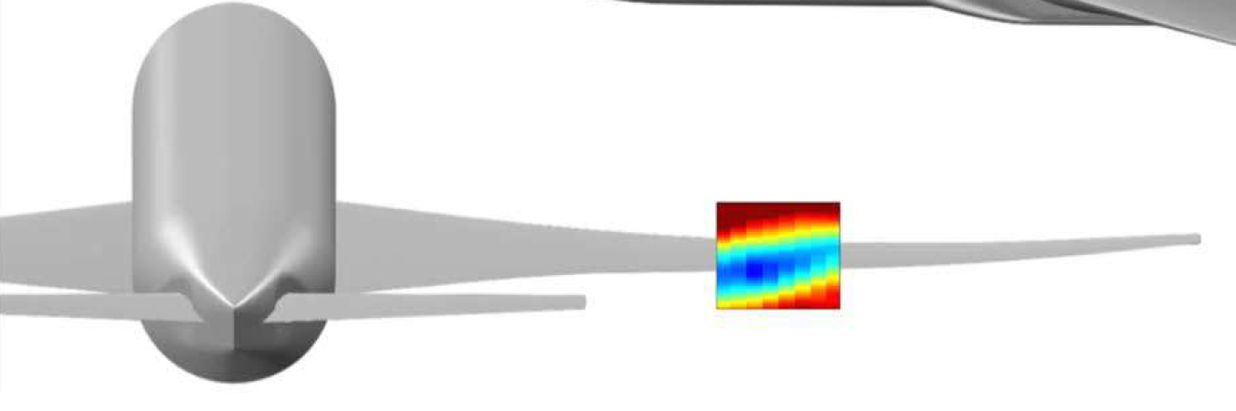
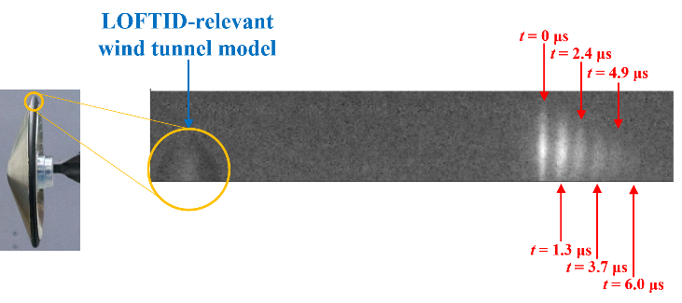
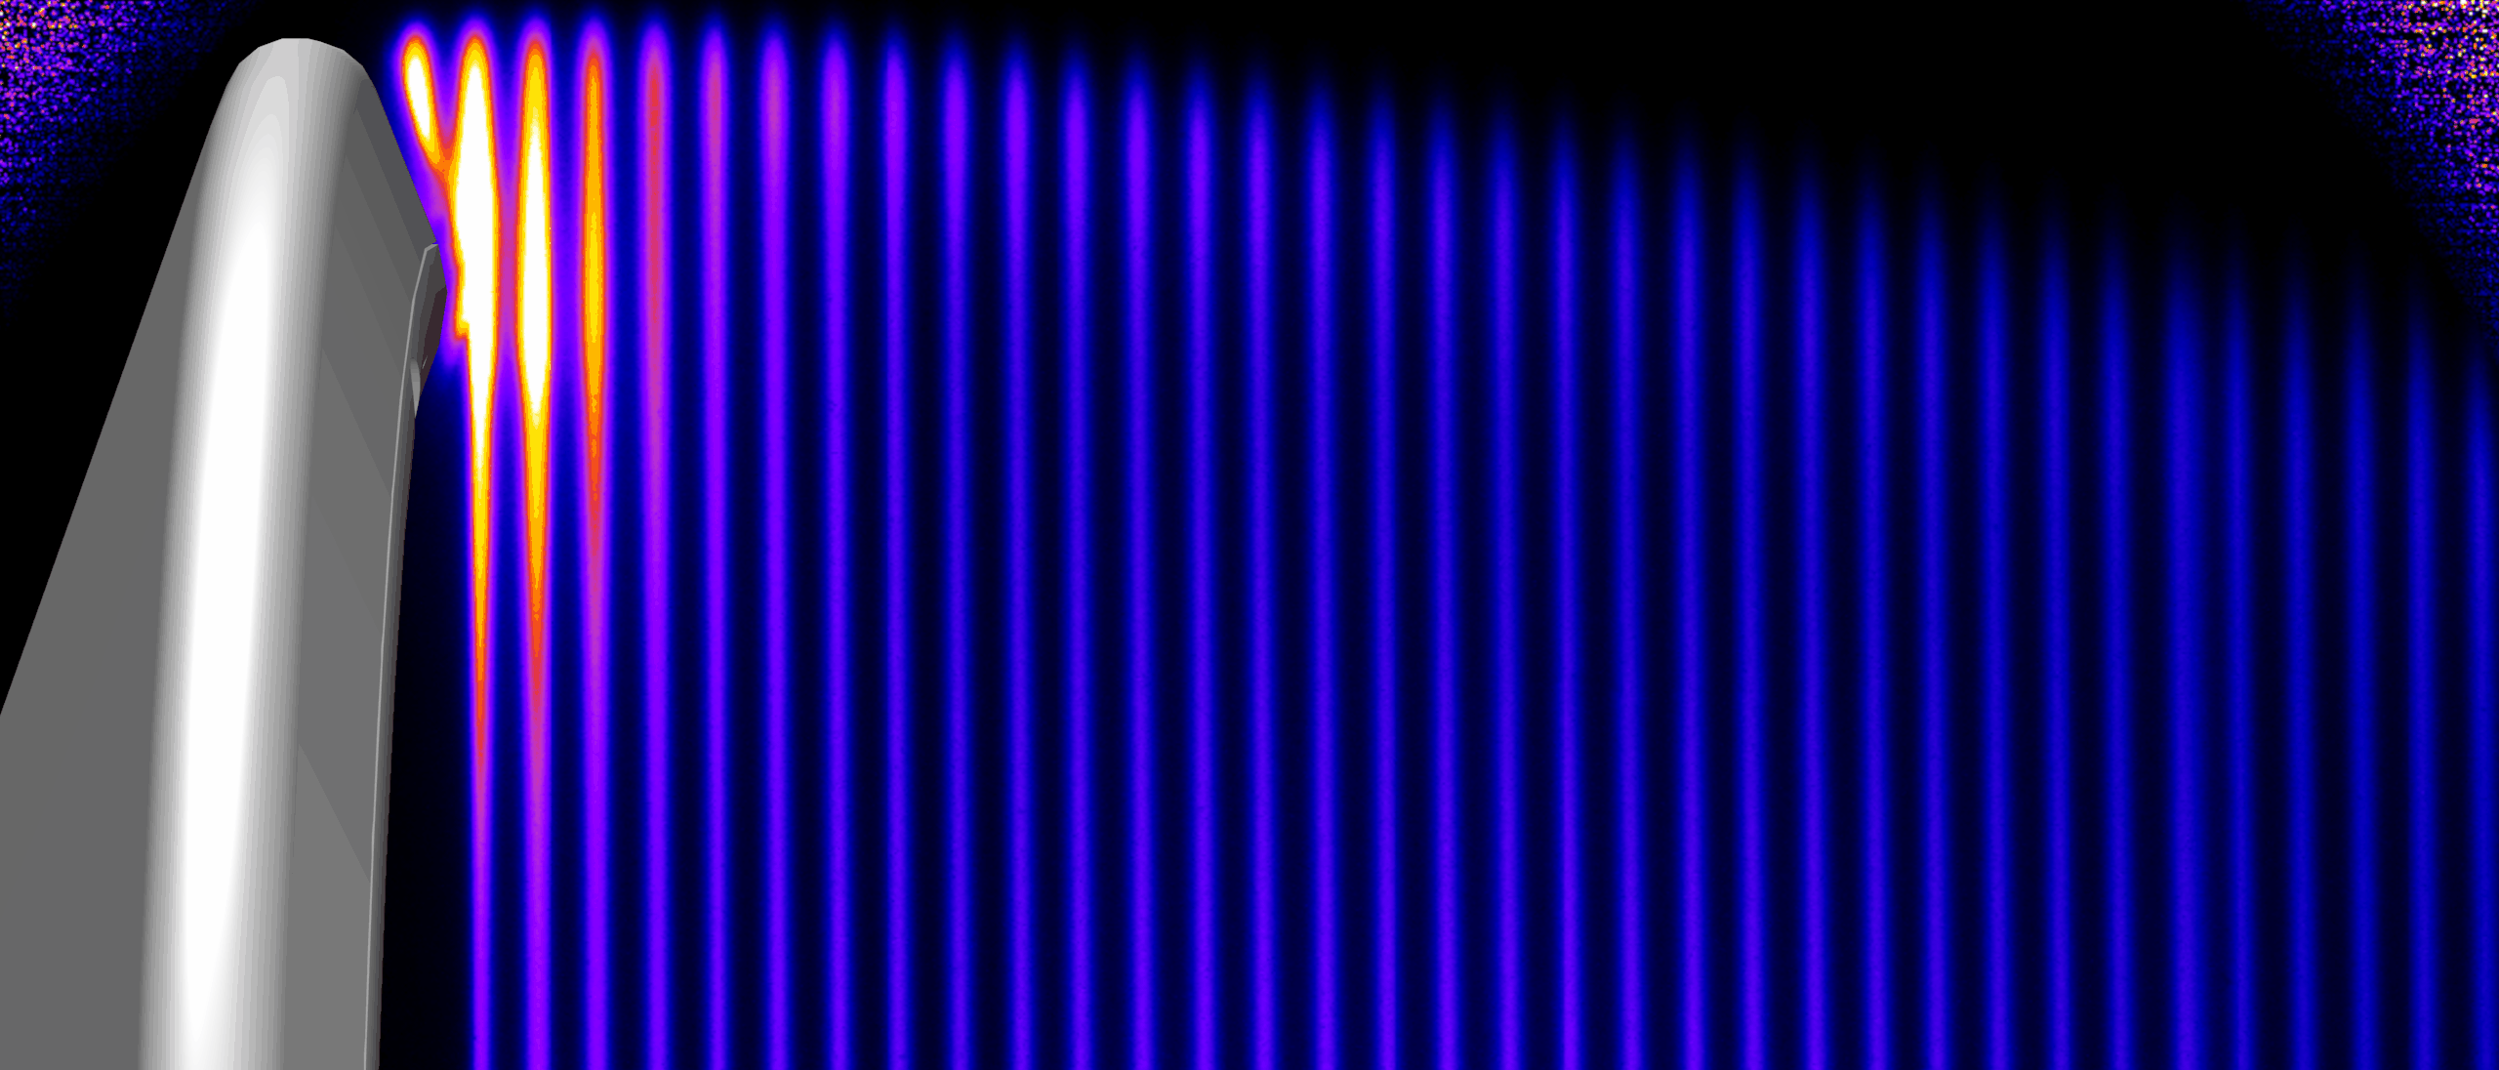
Molecular Based Velocimetry Systems
Spectroscopic Velocimetry Measurements
No particle seeding
Femtosecond Laser Electronic Excitation Velocimetry (FLEET)
  1 kHz, unseeded Molecular Tagging Velocimetry in air or N₂
  Applications:
    Transonic vehicle wakes (NTF) [Reese, Burns, Danehy LaRC]
    Freestream / wake (Mach 10) [Rodrigues, Tyrrell, Danehy LaRC]
Nitric Oxide Molecular Tagging Velocimetry (NO MTV)
  10 Hz, 75 lines, axial velocity
  >100 kHz, ~10 lines in near future
  Applications
    Hypersonic Boundary Layers (Mach 10) [Bathel, Danehy LaRC]
    Hypersonic wake flows (Mach 10) [Rodrigues, Danehy LaRC]
Krypton Tagging Velocimetry (coming soon)
  >100 kHz system being delivered by SBIR partner.
FLEET Velocimetry in the common research model wing wake in the NTF
FLEET
FLEET Velocimetry in the Mach 10 tunnel at NASA Langley
Highlight
Nitric Oxide MTV in a capsule wake flow at Langley Mach 10 Wind Tunnel

Slide 7
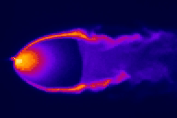
Planar Laser-Induced Fluorescence (PLIF)
Highlight
Laser sheet excites molecules
2D, temporally and spatially-resolved technique
  Spatial resolution < 1 mm
  Temporal resolution < 1 μs
    Repetition-rate of 10 Hz typical
PLIF of seeded nitric oxide (NO) and hydroxyl (OH) used at NASA Langley
  Ideal for low-pressure, supersonic/hypersonic environments
  Spectroscopic and chemical properties of NO/OH are well known
  UV excitation: commercial tunable lasers
  UV fluorescence: commercial intensified cameras
PLIF signal generally scales with gas density
  Location of flow structures (e.g., shocks)
  Molecular tagging methods used for velocity
  Spectroscopy exploited for thermodynamic properties
0.1 Pa Vacuum Chamber, Mach 10 Hypersonic Tunnel, Lab Development
Tunable Laser
Excited molecules fluoresce
Excited state
Gas flow
Ground state
Camera detects

Slide 8
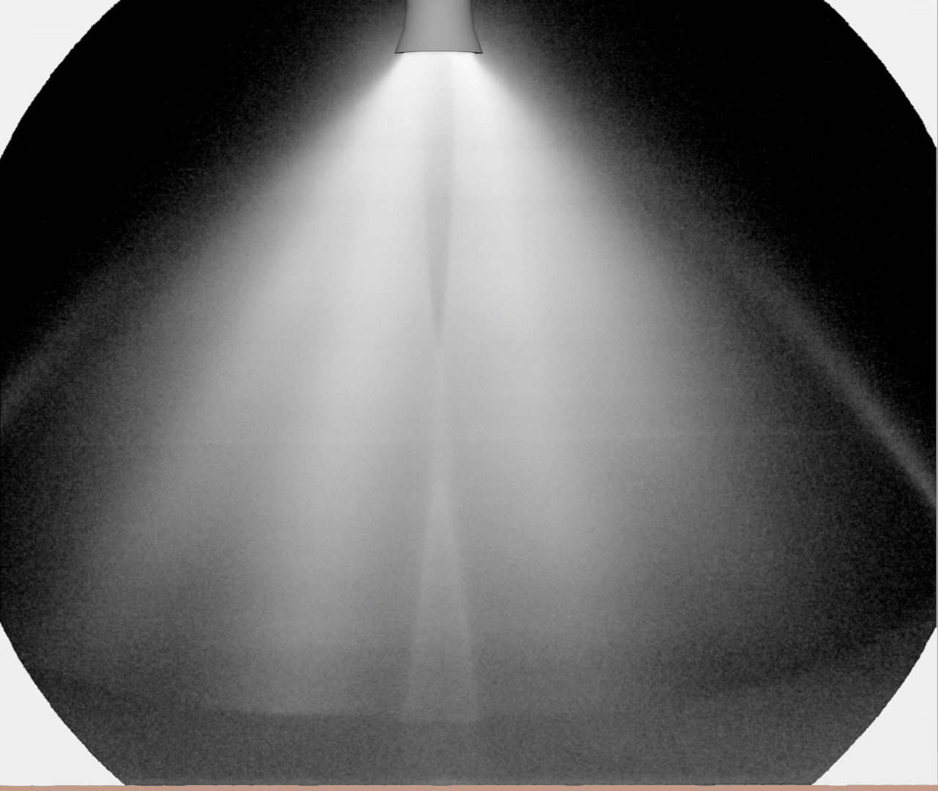
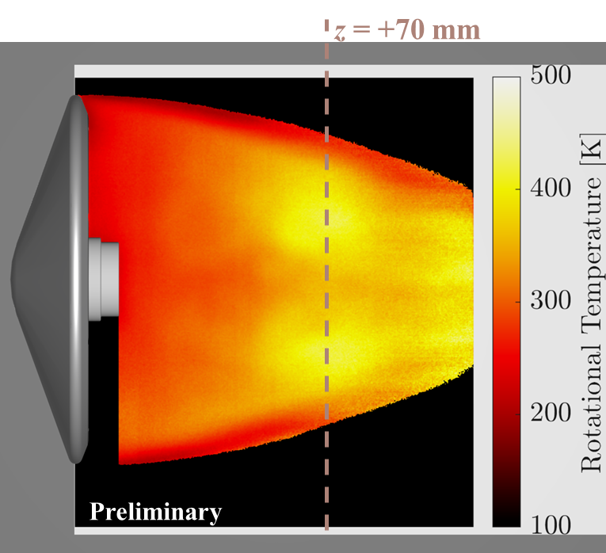
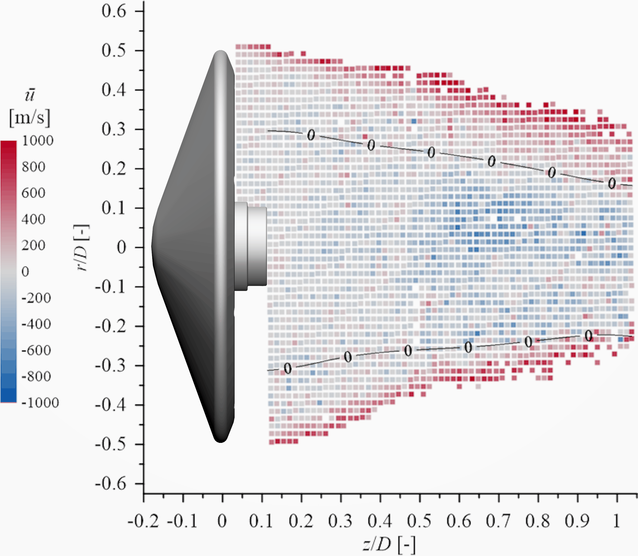
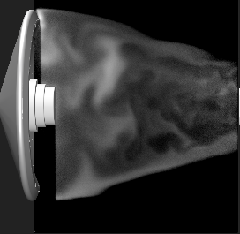
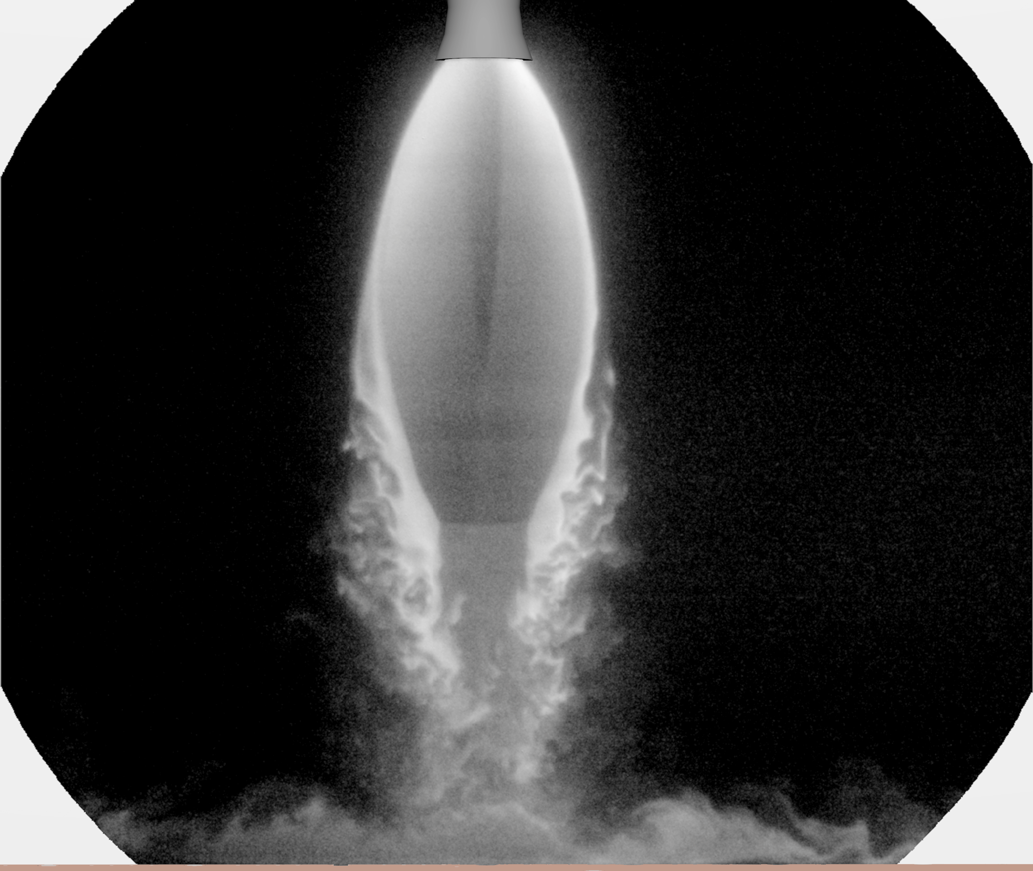
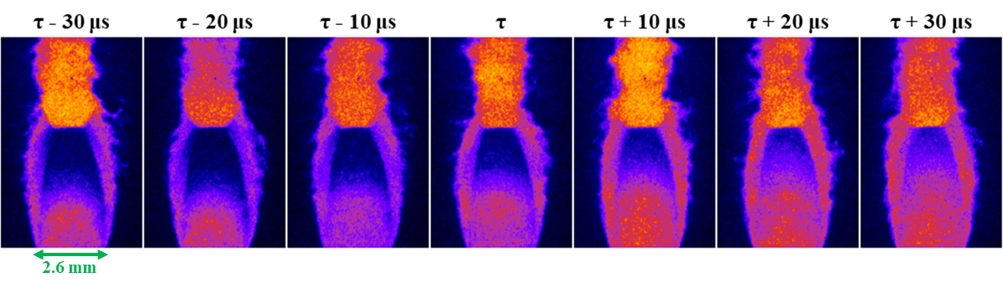
Recent PLIF Examples for Space Technology
Highlight
Plume-Surface Interaction
Hypersonic Wakeflow
Visualization, Velocimetry, Thermometry
Lunar-relevant Conditions
High-Speed, Multi-Parameter Development
Laser frequency (wavelength) scan at 100 kHz
Martian-relevant Conditions

Slide 9
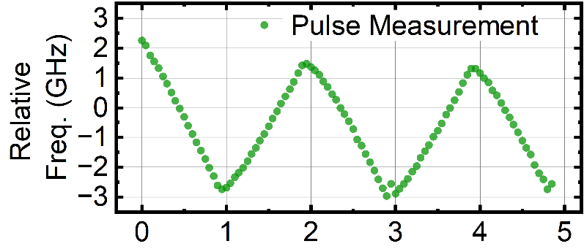
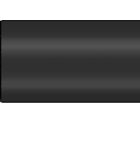
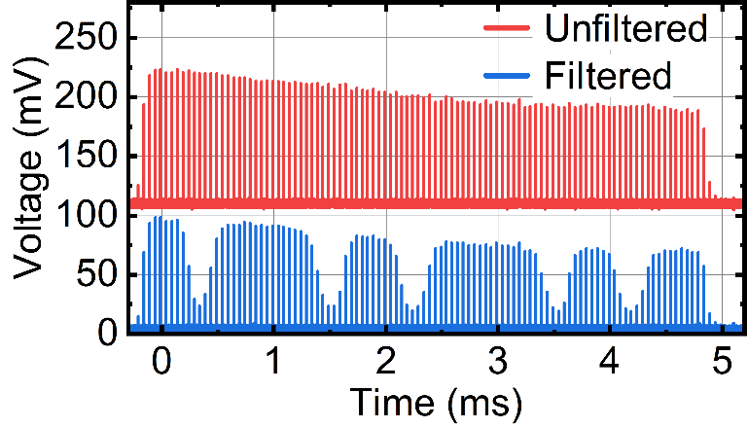
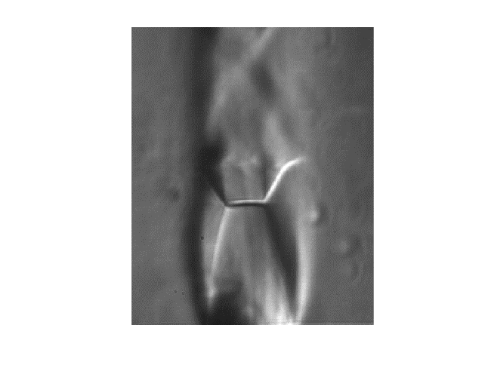
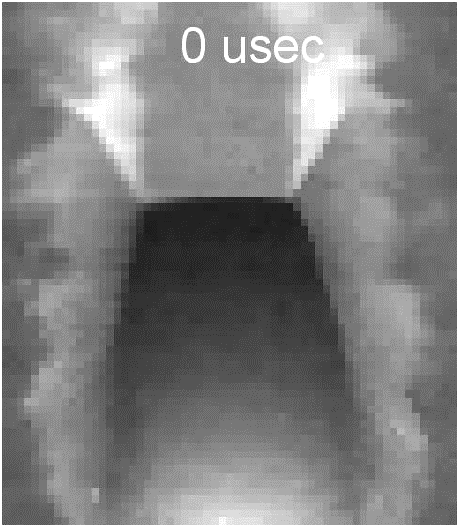
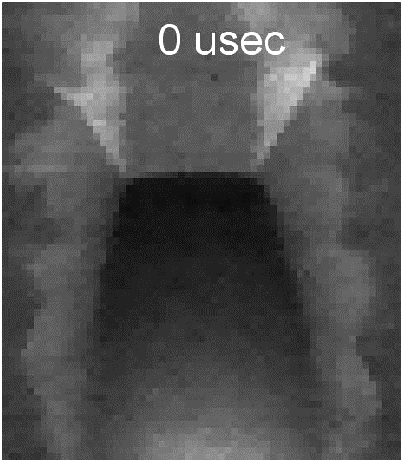
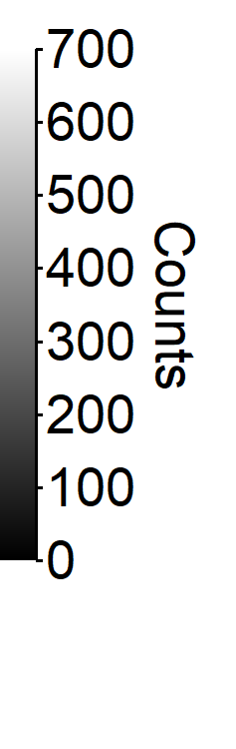
Burst-mode Filtered Rayleigh Scattering
Highlight
Frequency-scanning burst-mode laser technology allows for unseeded, multi-parameter measurements in 1-ms.
Wavemeter
S3
S5
1064 nm
S1
532 nm
SHG
Unfiltered
S2
S4
Iodine Cell
Iodine Cell
Filtered
Power Amplifier
Filtered Camera
Iodine Cell
Pulse Slicing
Unfiltered
Filtered
Schlieren
1200
Master Oscillator
cw Laser
Unfiltered Camera
Function Generator
Counts
0

Slide 10
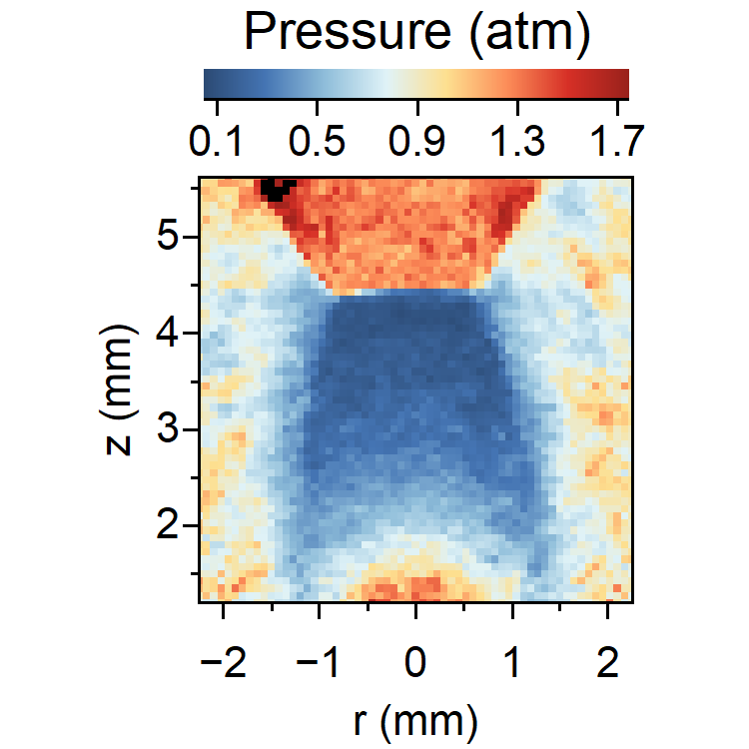
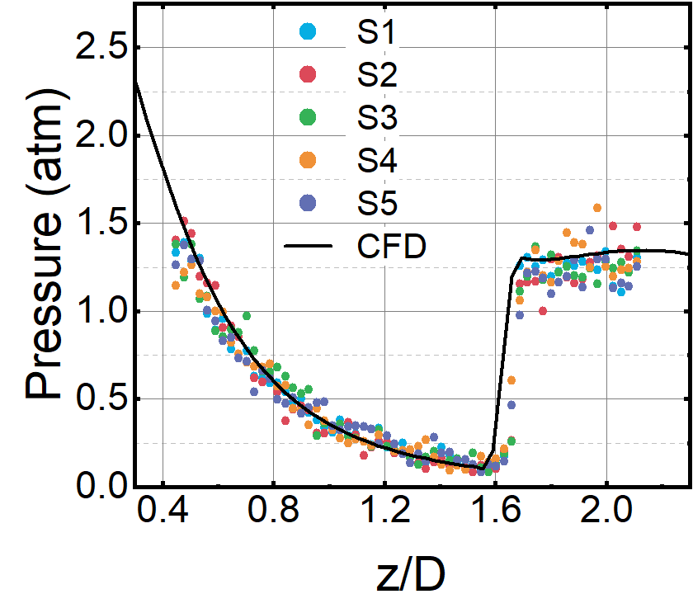
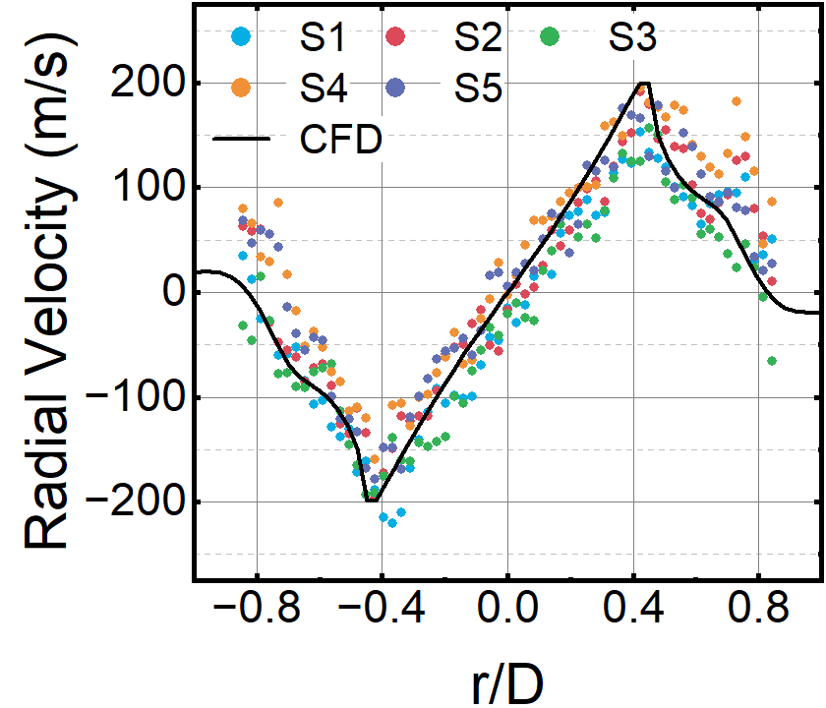
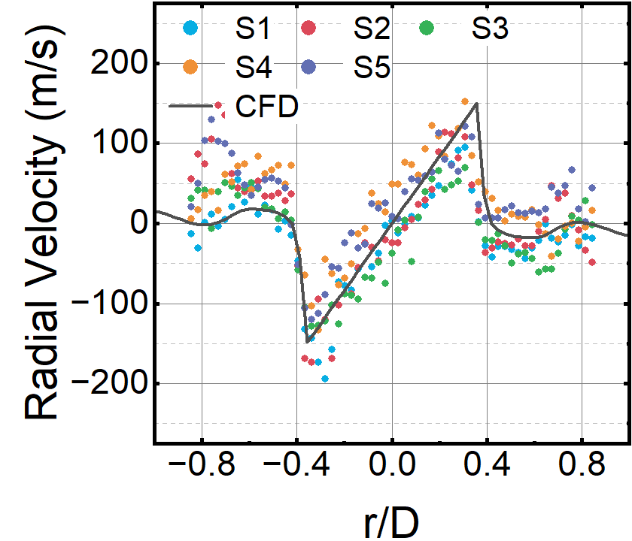
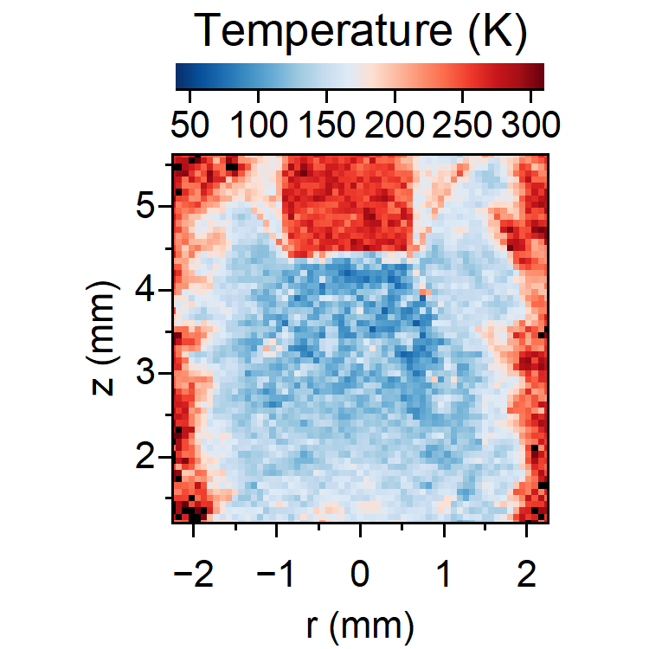
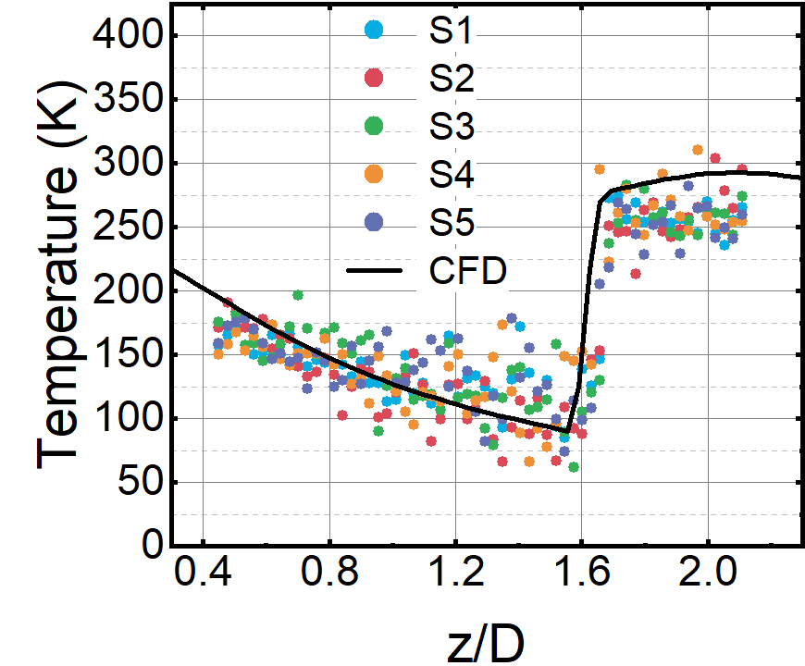
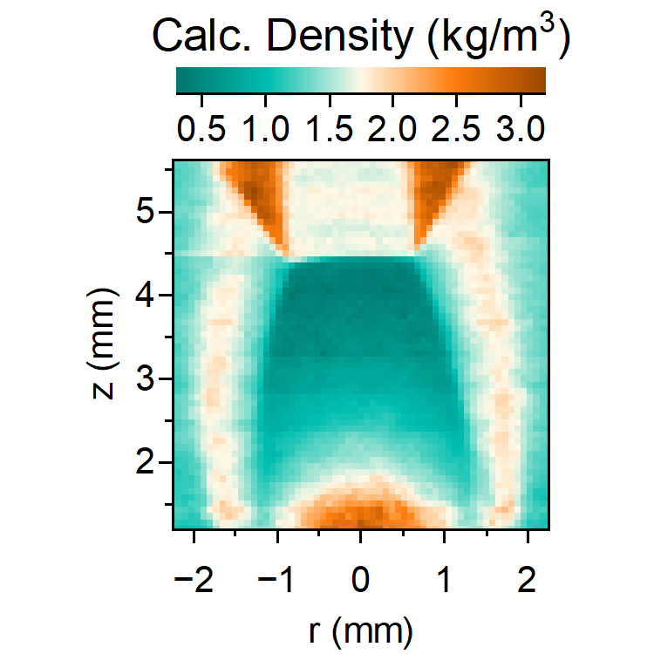
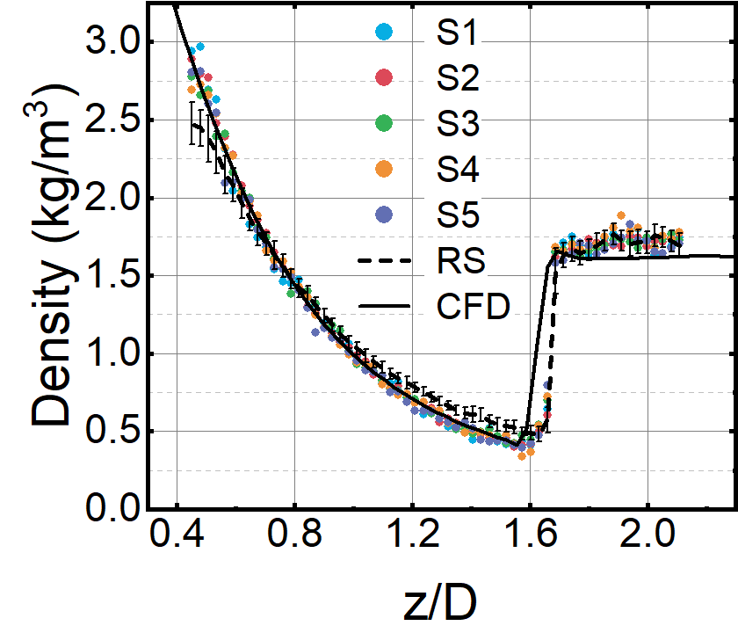


Planar Multi-parameter FRS Measurements
Highlight
Comparison with CFD along jet centerline.
S1
S1
$$z \sim 2 mm$$
$$z \sim 3.5 mm$$
S1
S1
S1
Extension to kHz or MHz measurement rates by increasing laser and scan repetition rate.

