Slide 1
Surface measurement techniques at NASA
NASA/ONERA/DRL Workshop on surface and flowfield optical measurement techniques for aerospace flows
19 July, 2024, ONERA's Fauga Mauzac site, Toulouse, France
Speakers: Paul M. Danehy*, JT Heineck**
*Advanced Measurements and Data Systems Branch, NASA Langley Research Center
**Experimental Aero-physics Branch at NASA Ames Research Center

Slide 2
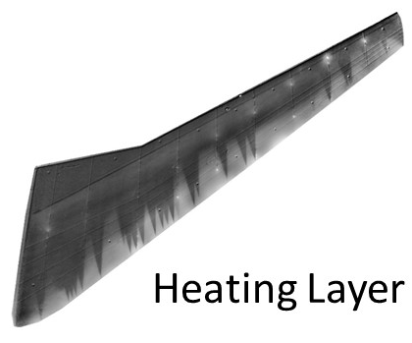
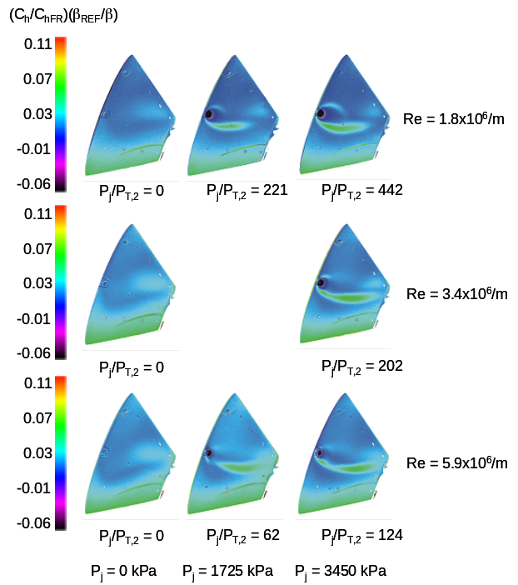
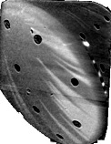
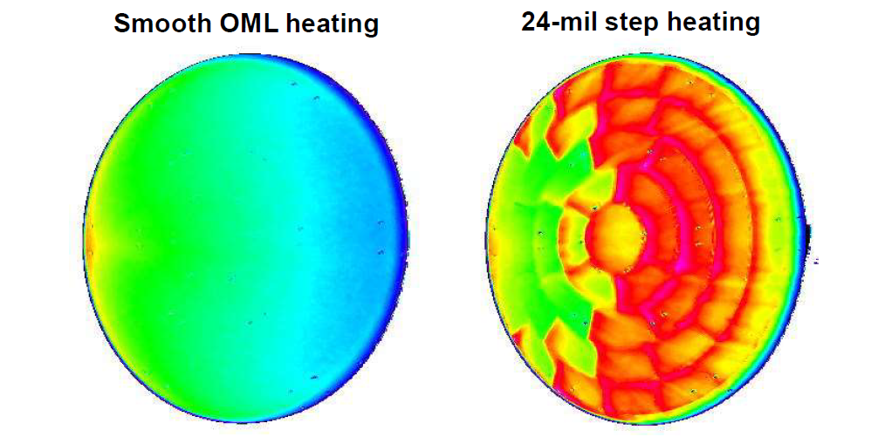
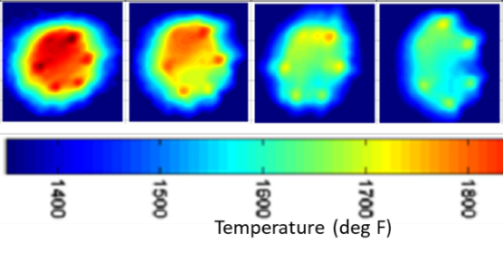
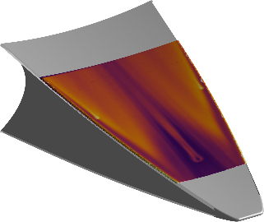
Surface Measurement Systems at NASA
Surface Temperature Based Measurements
Temperature Sensitive Paint
  Surface heating, transition detection at NTF, M10 [Watkins LaRC]
  Supersonic boundary-layer transition (SBLT) on an F-15.
Phosphor Thermography
  Hypersonic heat flux measurements in Langley Aerothermodynamics Labs (LAL) [Mason, Rufer LaRC]
Scientifically Calibrated In-Flight Imagery (SCIFLI)
  High-resolution imagery and quantitative heating data for space flight; images acquired from ground and air [Inman, Scott LaRC]
Infrared Thermography
  Temperature, heating, transition detection [Borg, Turbeville LaRC]
  Transition detection on rotating helicopter blades
  [Heineck, Garbeff, ARC]
Transition detection at National Transonic Facility (NTF) using TSP
Transition detection at Unitary Plan Wind Tunnel
Reaction control jet interaction at Mach 10
Blunt Body Block-TPS Roughness Phosphor heating data for Orion
  SCIFLI observation of Orion Capsule heat shield temperature on EFT-1
IR thermography from BOLT tripping study at 20" Mach 6
Highlight

Slide 3
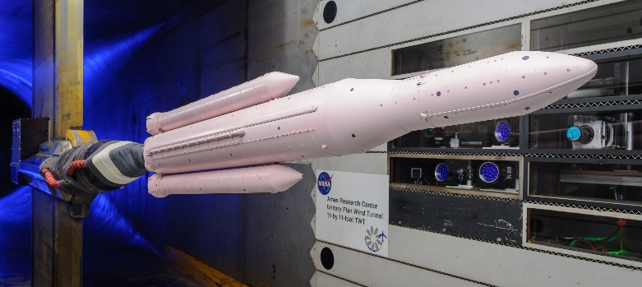
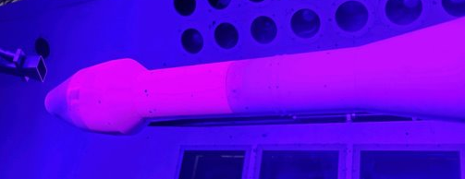
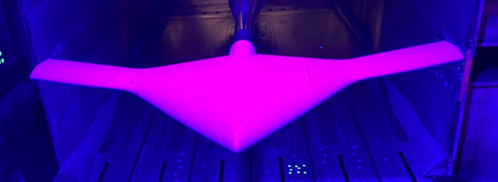
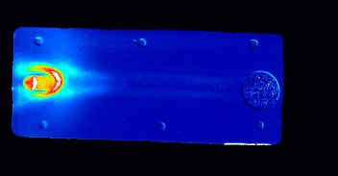
Surface Measurement Systems at NASA
Surface Pressure Measurements
Pressure Sensitive Paint
  Unsteady PSP software/hardware development led by Ames
  Unsteady PSP at kHz rates (11 foot TWT) [Lash, Roozeboom, ARC]
  Unsteady PSP at 10 kHz (TDT, Mach 6) [Watkins, Reese, LaRC]
  Mean pressure distribution (NTF). [Watkins, Reese, LaRC]
  PSP effort in turbine rig at NASA Glenn [Bencic GRC]
Highlight
Highlight
Unsteady PSP at the Ames 11 Foot TWT
Highlight
uPSP at TDT
Highlight
Unsteady PSP at the Langley Transonic Dynamics Tunnel (TDT)
PSP on the SWIFT model at the Langley NTF
Shock boundary layer interactions collected at 10 kHz in Mach 6

Slide 4
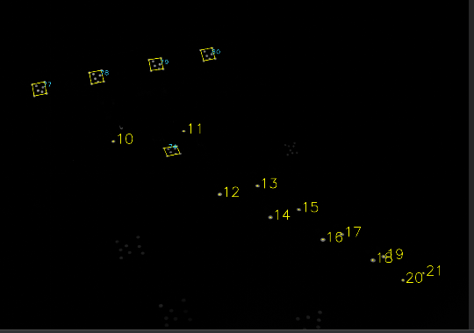
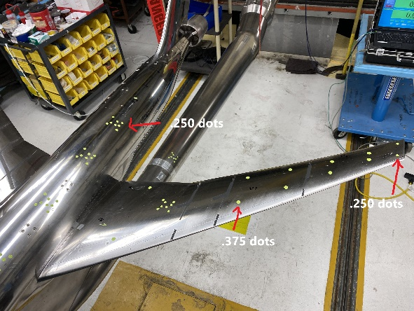
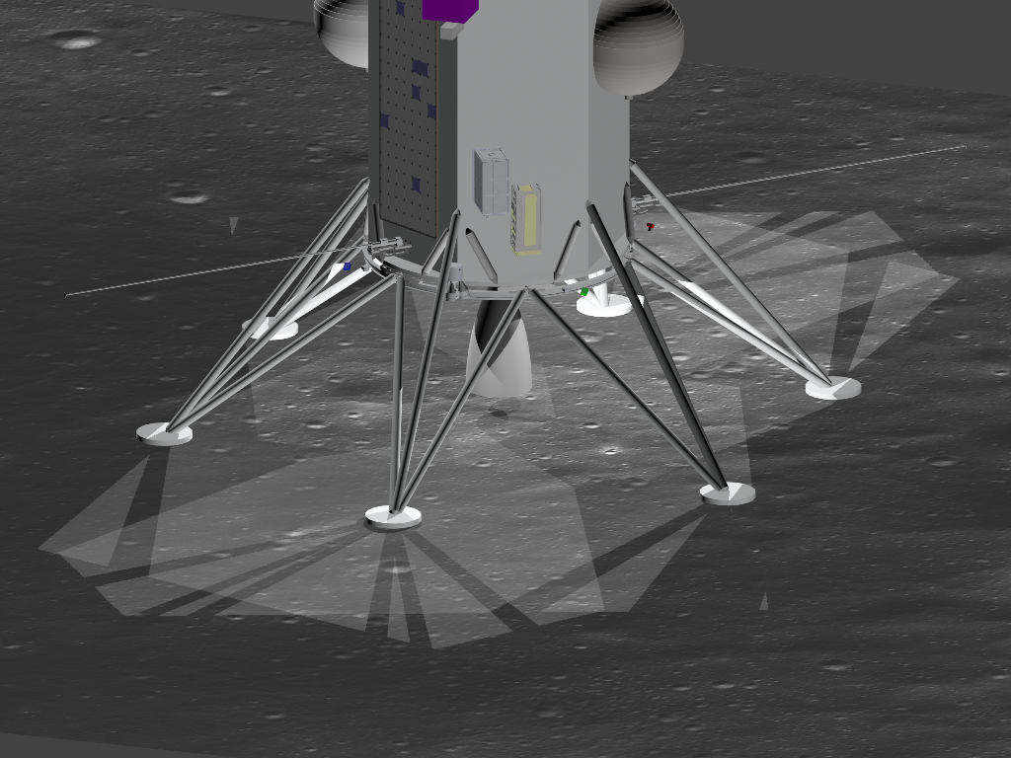
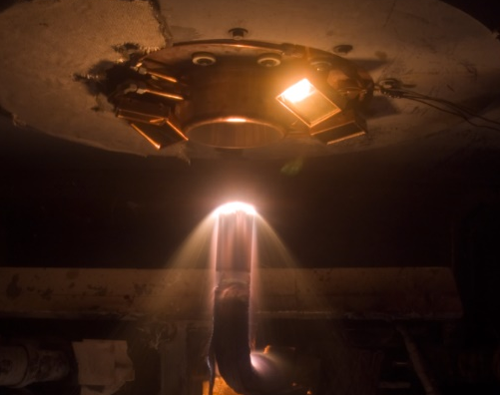
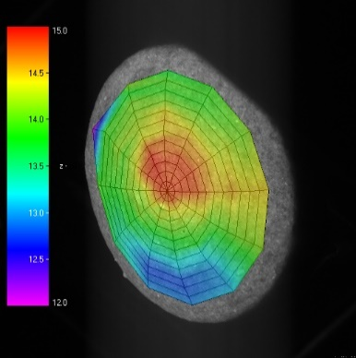
Surface Shape Measurement Systems at NASA
Surface Shape / Attitude Measurements
LaRC
Stereo Photogrammetry
  Dedicated system being developed for NTF
  4, 8 camera photogrammetry system for wing bend/twist
  4 Hz upgrading to 100 Hz [Tran, Fahringer, LaRC]
Stereo Cameras for Lunar Plume Surface Studies (SCALPSS)
  4 and 6 camera photogrammetry systems to measure depth and shape of crater generated by plume surface interaction when vehicles land on the moon, Mars. [Maddock, Tyrrell, Danehy LaRC]
Heatshield material recession measurement at Ames Arc Jets
  Orion heat shield qualification
  Orion gap filler behavior for full-trajectory run
  [Heineck, Schairer ARC]
Multi-camera photogrammetry system at the National Transonic Facility (NTF)
Photogrammetry
  SCALPSS cameras on Intuitive Machines 1 Nova-C CLPS lander
Max
Top
Δ z
Min
Bottom

Slide 5
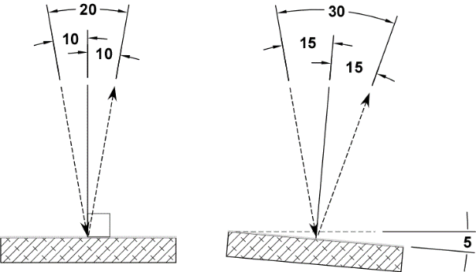
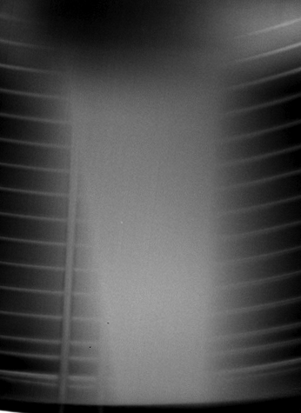
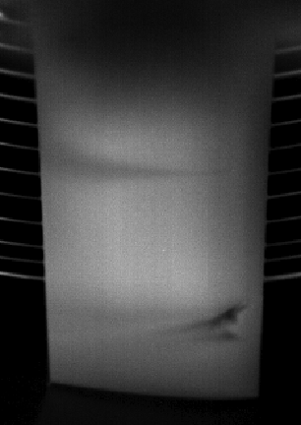
BL detection on rotorcraft blades
Highlight
In collaboration with DLR Göttingen (Markus Raffel, Christian Wolf),
a blade tracking method was developed, enabling thermal imaging of a moving rotor blade.
Image with fixed mirror
Image with spinning mirror

Slide 6
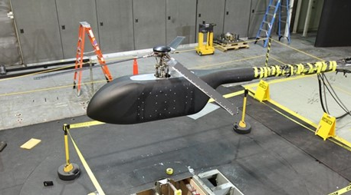
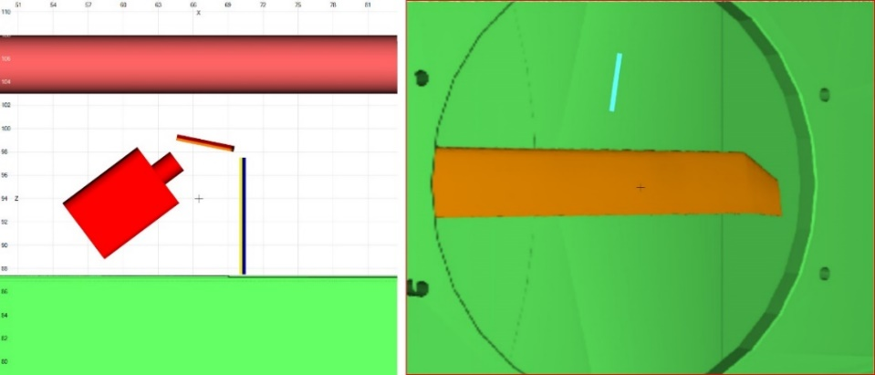
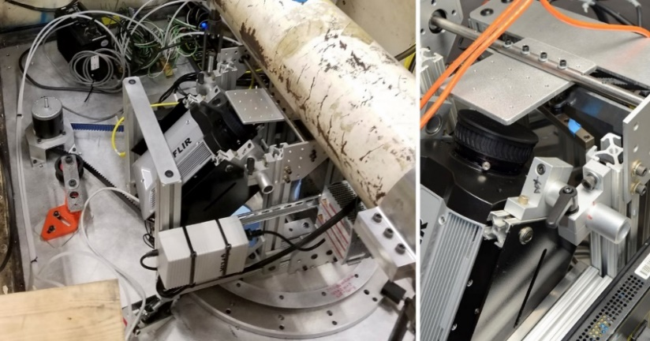
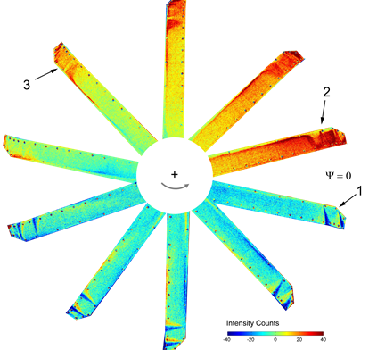
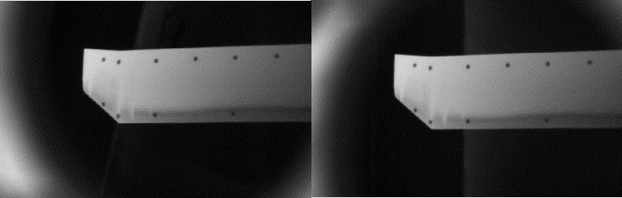
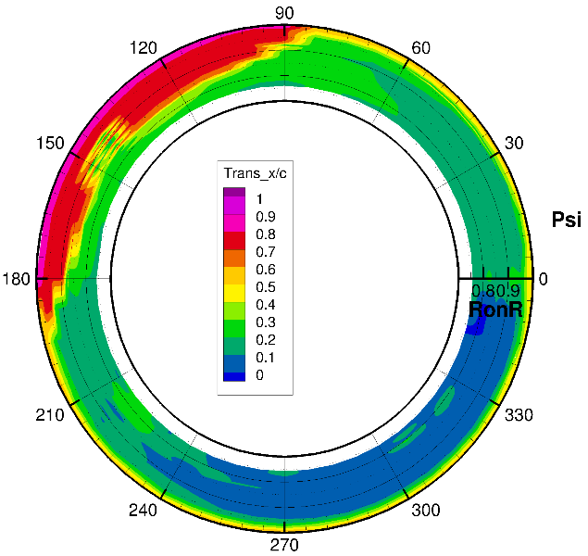
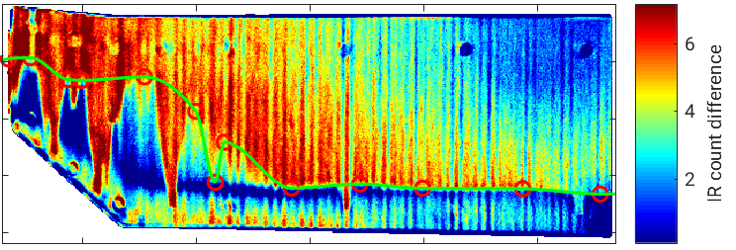
BL detection on rotorcraft blades
Highlight
Lower and upper surface mapping of transition in forward flight - LaRC 14- x 22- foot Subsonic WT
Folding mirror
Spinning mirror
Folding mirror
Spinning
mirror
U∞
U∞
Lower surface mapping
Upper surface DIT sample (DLR processed)
Upper surface mapping (DLR Processed)

Slide 7
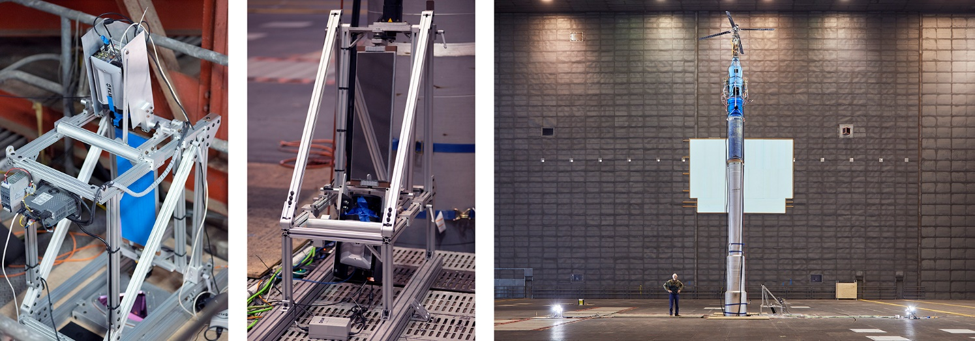
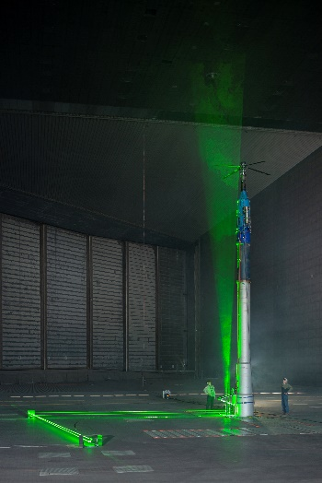
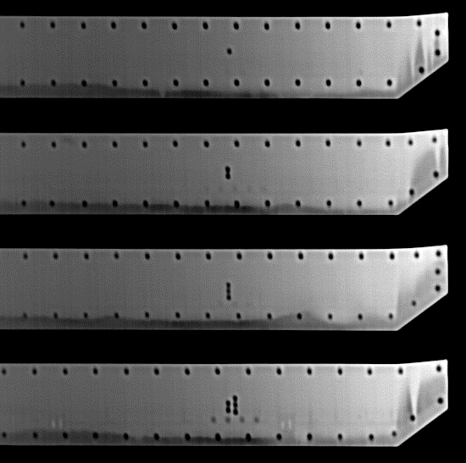
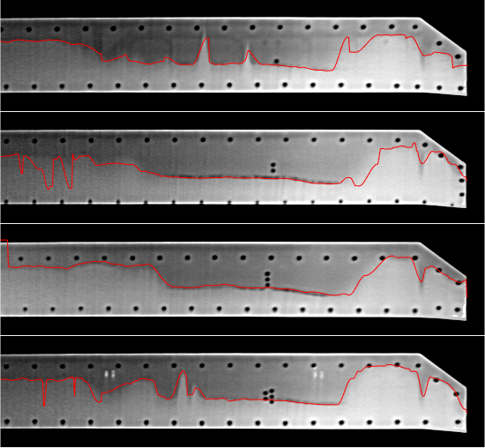
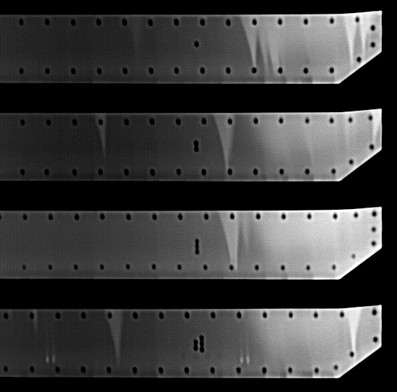
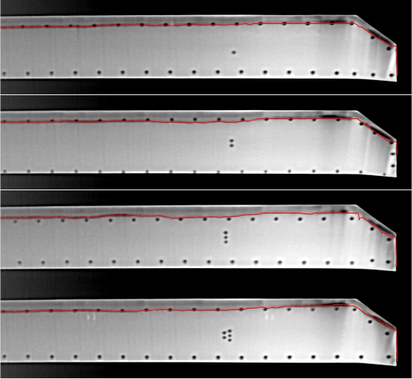
BL detection on rotorcraft blades
Highlight
Hover Validation and Acoustic Baseline (HVAB) – ARC NFAC 80- x 120- Foot Wind Tunnel
Four imaging-based measurements:
Photogrammetry: bend/twist to 0.1 deg accuracy
Shadowgraphy: RT monitor of wake and contraction
PIV: Vortex strength and wake contraction
BL Thermography: highest priority
Lower surface, 4 deg col
Upper surface, 4 deg col
Lower surface, 12 deg col
Upper surface, 12 deg col

Slide 8
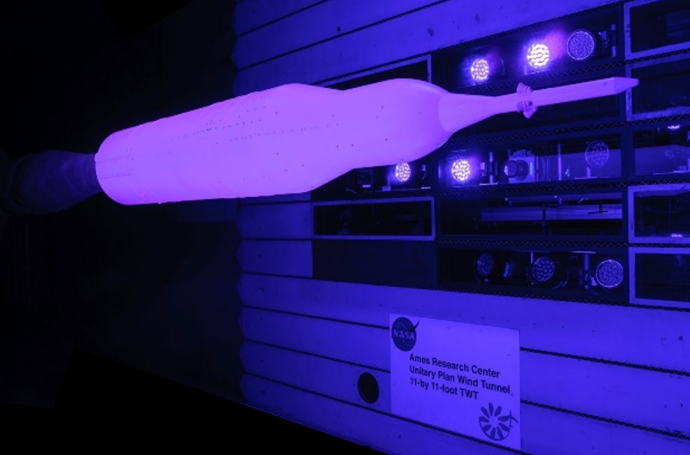
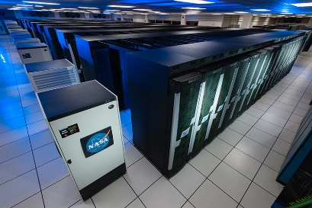
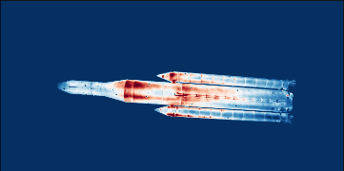
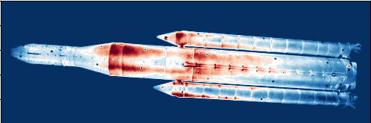
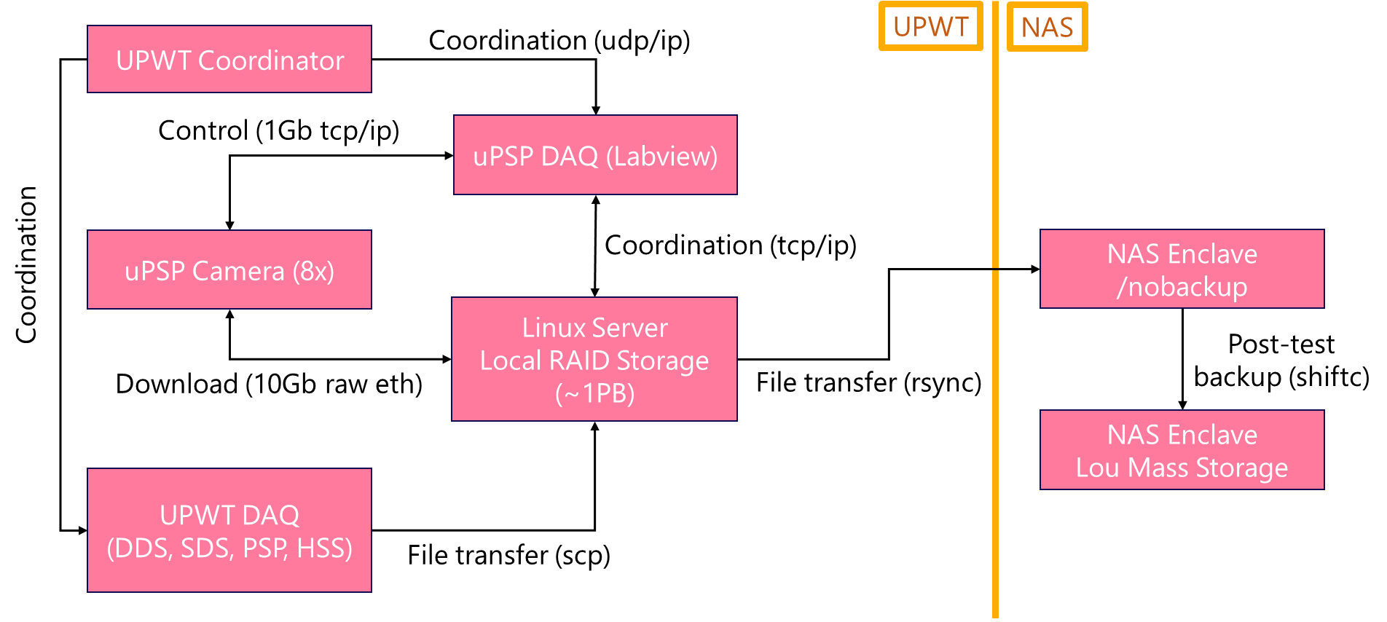
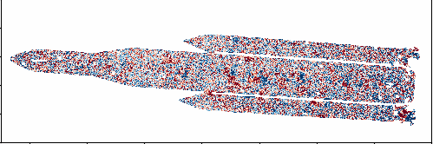
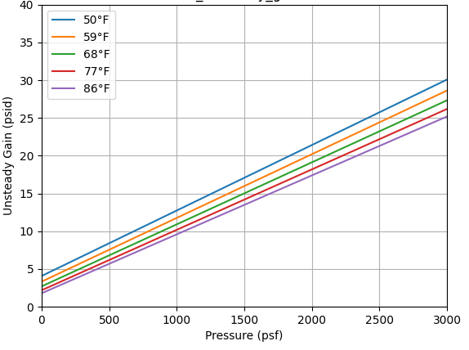
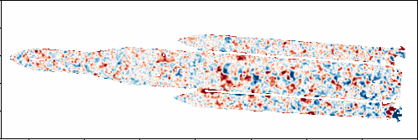
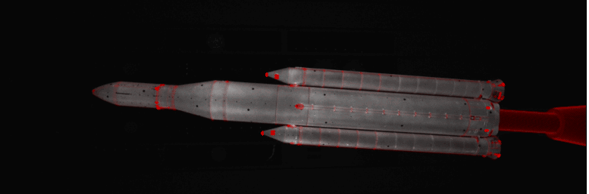
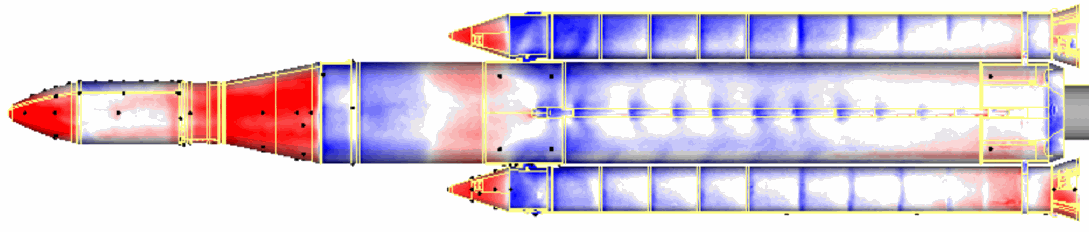
Unsteady Pressure-Sensitive Paint at NASA
Highlight
System Development Led by Ames, Deployed Across NASA
Data Acquisition → Data Transfer → Data Processing at the Ames Unitary 11-ft Transonic Wind Tunnel
  Connecting acquisition in wind tunnels to the NASA Advanced Supercomputer for processing and accessibility.
Raw video frames
100GigE
Registration
Mitigate frame-to-frame vibration
Intensity Ratio
R[k] = Counts_{mean} / Counts[k]
(R ∝ Surface Pressure)
Denoising
Image filtering
3D Projection
2D-3D correspondances
Requires knowledge of local
surface P_{s}, T. We use:
T = Thermocouple average
P_{s} = Lifetime PSP measurement
3D Surface Pressure
P[k] = Gain(P_{s} , T) x R[k]
POC: E. Lara Lash
elizabeth.l.lash@nasa.gov

Slide 9
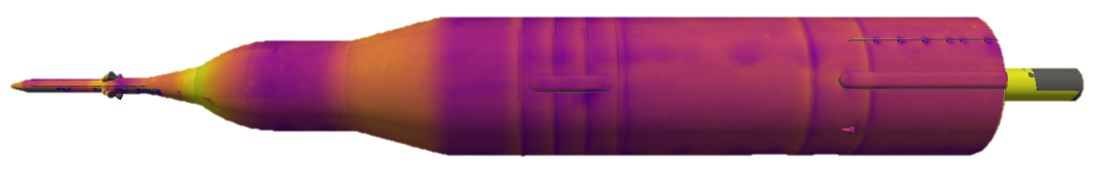
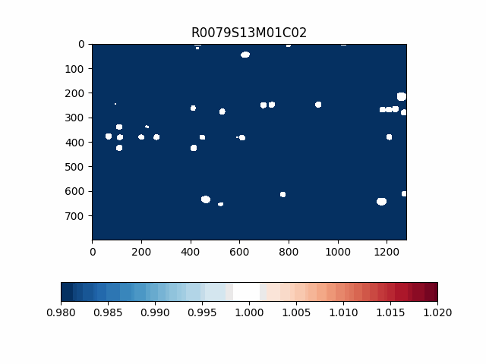

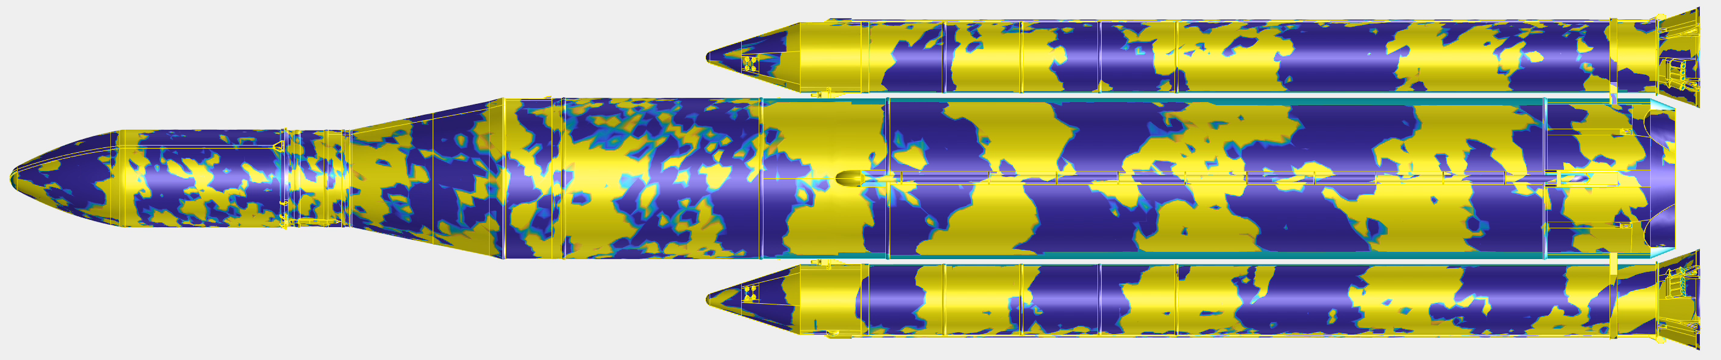
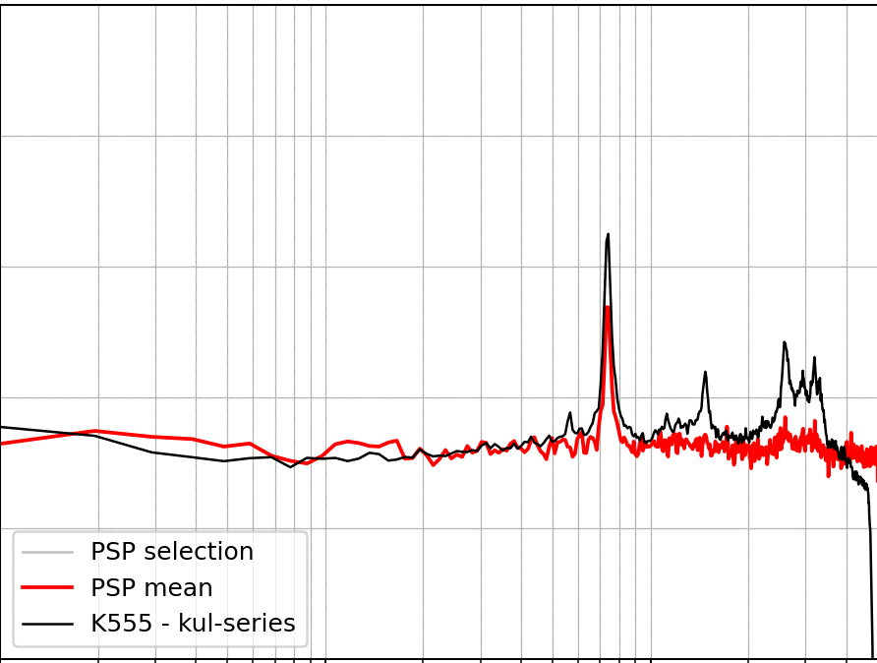
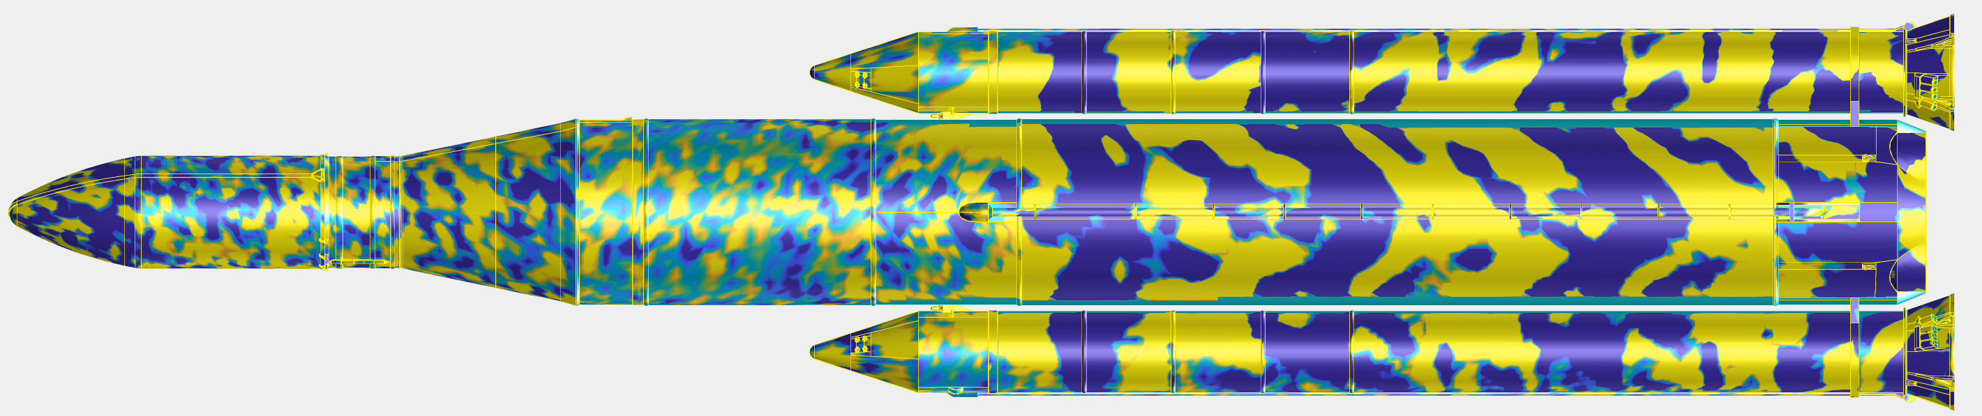
Unsteady Pressure-Sensitive Paint at NASA
Highlight
Flow
State of the art results from recent NASA tests.
Subsonic
Supersonic
Innovative high-speed lifetime technique. Acquires steady-state datapoint using high-speed cameras for a Kulite-free calibration to pressure.
Subsonic
Kulites
Multiple cameras allows for magnified focus in regions of interest of time-resolved fluctuating pressure.
Kulite to local PSP comparisons for increasing Mach number in the frequency domain.
Supersonic
POC: E. Lara Lash
elizabeth.l.lash@nasa.gov
-- PSP Mean
-- Kulite
DMD mode visualizations across entire model.

Slide 10
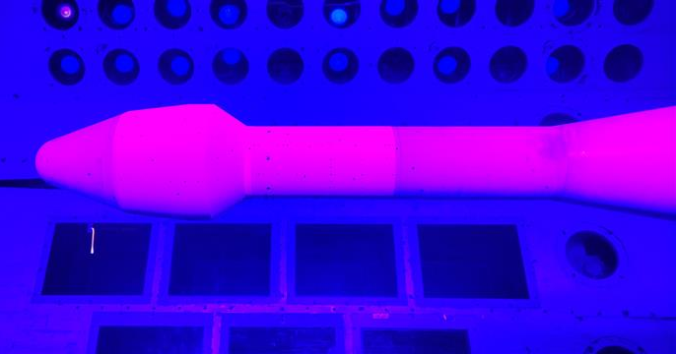

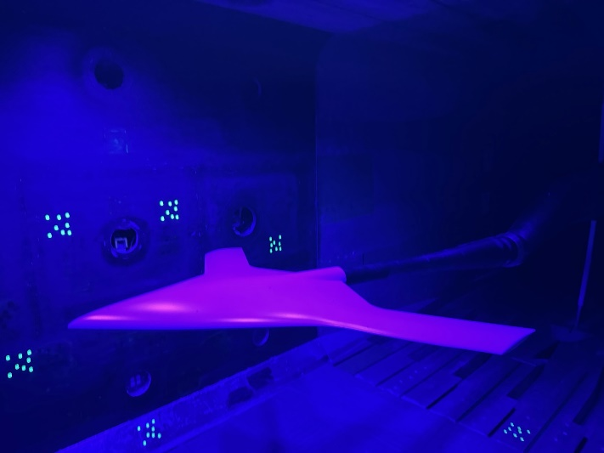
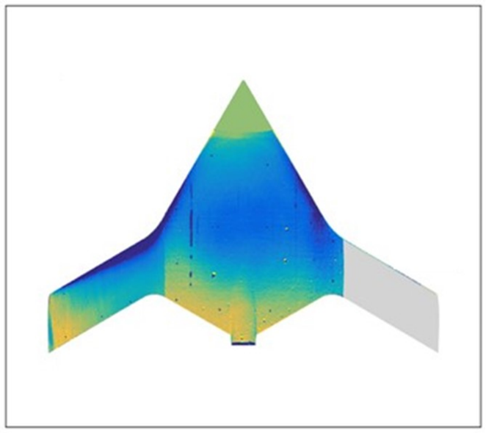
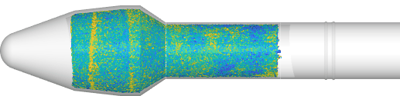
Unsteady Pressure-Sensitive Paint at NASA
Highlight
Novel PSP formulas at Langley Transonic Dynamic Tunnel (TDT) for heavy gas environments and the National Transonic Facility (NTF) for cryogenic environments (low oxygen)
  Leverages system developments and advancements in data processing for a myriad of NASA facilities.
Low-speed PSP Capability at Langley’s NTF on SWIFT model
uPSP on Coe model at TDT
POC: E. Lara Lash (Ames) and Neal Watkins (Langley)

