Slide 1
Flow characterization techniques at NASA
(non-spectroscopic)
NASA/ONERA/DRL Workshop on surface and flowfield optical measurement techniques for aerospace flows
19 July, 2024, ONERA's Fauga Mauzac site, Toulouse, France
Speakers: Paul M. Danehy*, Jenna Eppink**,
Chung-sheng Yao**, Brett Bathel*
*Advanced Measurements and Data Systems Branch, NASA Langley Research Center
** Flow Physics and Controls Branch, NASA Langley Research Center

Slide 2
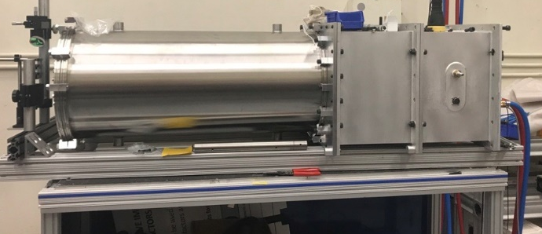
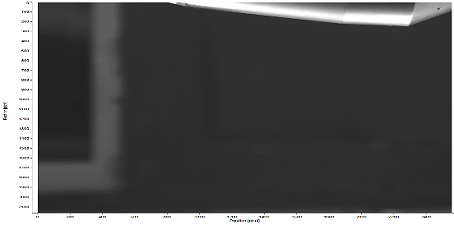
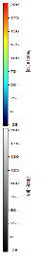
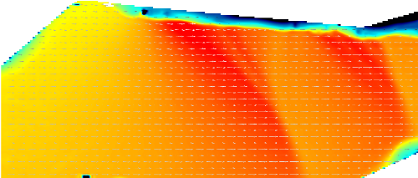
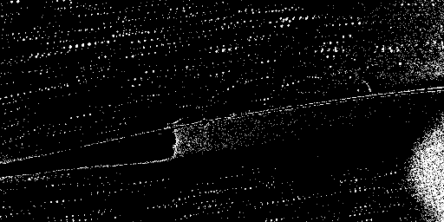
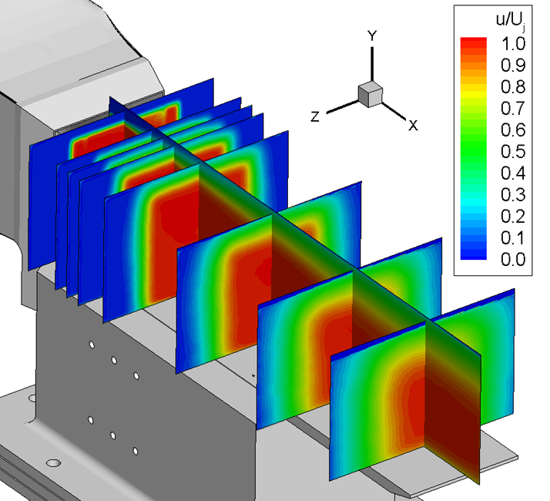
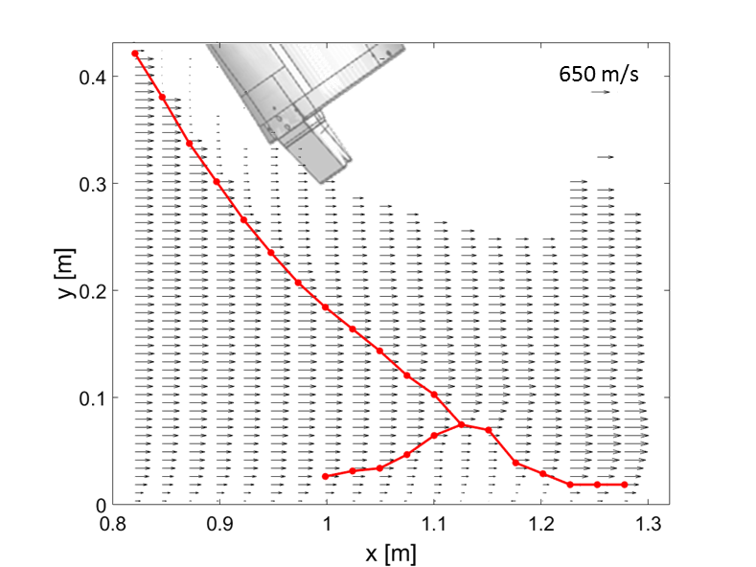
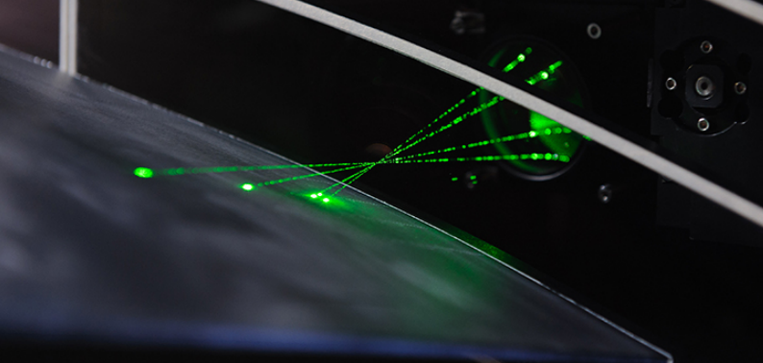
Particle/Fog Based Velocimetry/Visualization Systems
Velocity Measurements
Particle Image Velocimetry (PIV) /
Particle Tracking Velocimetry (PTV)
  10 Hz large field of view (14x22) [Jenkins, Bartram, LaRC]
  10 Hz, 10 kHz continuous PIV (TDT) [Gildersleeve, Bartram, LaRC]
  100+ kHz pulse-burst PIV (0.3 m TCT) [Burns, Danehy, LaRC]
  Lensless PIV (laboratory demo) [Eppink, Yao, LaRC]
  Fiber optic PIV [Jenkins, Yao, Bartram, LaRC]
  PIV at NASA Glenn [Wernet, Locke GRC]
Pulse burst laser High Speed Velocimetry Measurement
  Particle Image Velocimetry (PIV), Doppler Global Velocimetry (DGV)
  >100 kHz velocity in particle/fog seeded flows [Danehy, Burns LaRC]
Miniature laser Doppler velocimetry (LDV) system
  Pointwise 3C measurement
  Can be installed inside of a model [Kegerise, Neuhart LaRC]
Laser enclosure for 10 kHz PIV system in the Transonic Dynamics Tunnel (TDT)
PIV results from Coe model test in heavy gas in the Langley TDT
Highlight
M = 0.92, H₀ = 600 psf
Particle Tracking Velocimetry (PTV) on an airfoil in 0.3 m TCT at 100 kHz
Mach 0.25
Highlight
Highlight
DGV on COBRA model at 4’ UPWT
PIV velocity maps on film cooling plate at NASA GRC
Three component (3C) LDV system installed inside Juncture Flow Model in 14x22 wind tunnel

Slide 3
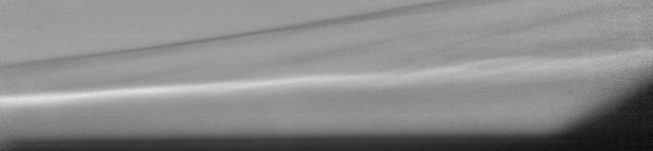
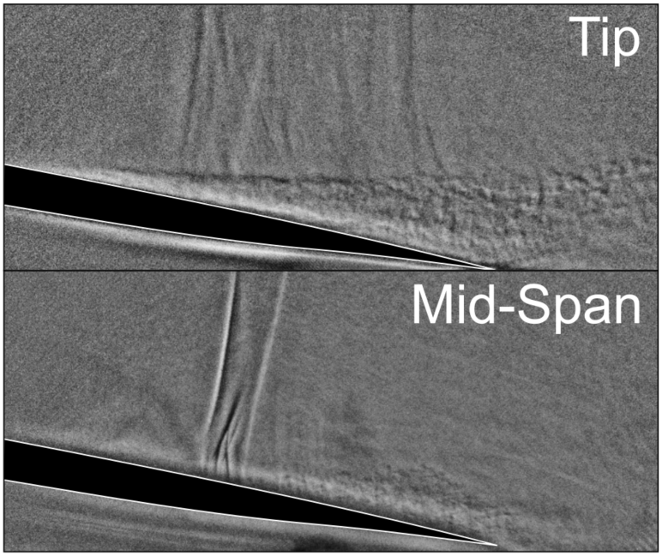
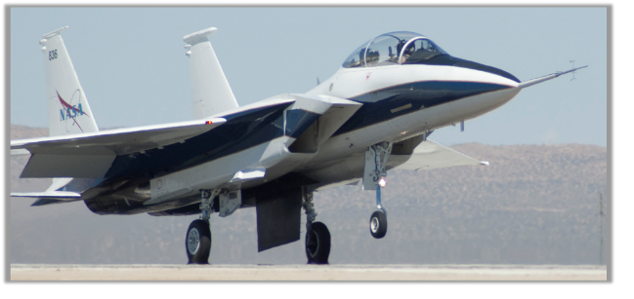
Density Based Visualization/Measurement Systems
Flow Visualization
Self Aligned Focused Schlieren (SAFS)
  Spatially resolved flow visualization [Bathel, Weisberger LaRC]
  Can scan region of sensitivity
  Potential for 100s of kHz
  Large field of view through small windows
  High quality windows not required
  System can be compact
  Transonic through Hypersonic demonstrated
  Langley & Armstrong researchers planning a flight test using SAFS to visualize shock structures that interact with article in flight. [Bathel, Weisberger LaRC]
Advanced Schlieren Efforts also at GRC and ARC
Highlight
SAFS on shock-interaction model at Langley 31-Inch Mach 10
SAFC demonstration on an airfoil in the 0.3 m TCT showing vortex and flow separation at the wing tip and shock pattern at mid span.
  SAFS to be installed on F-15 at NASA Armstrong.

Slide 4
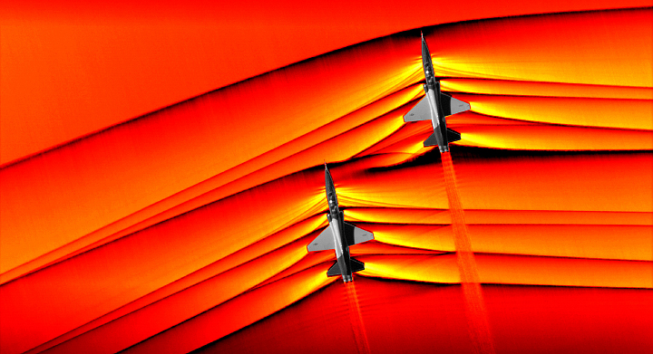
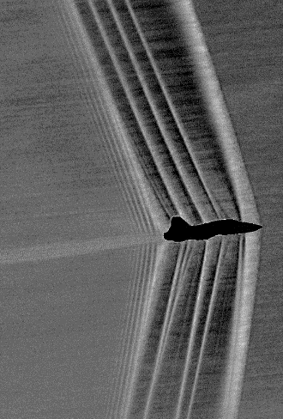
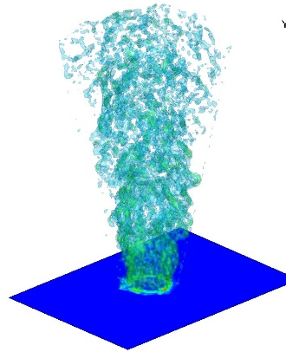
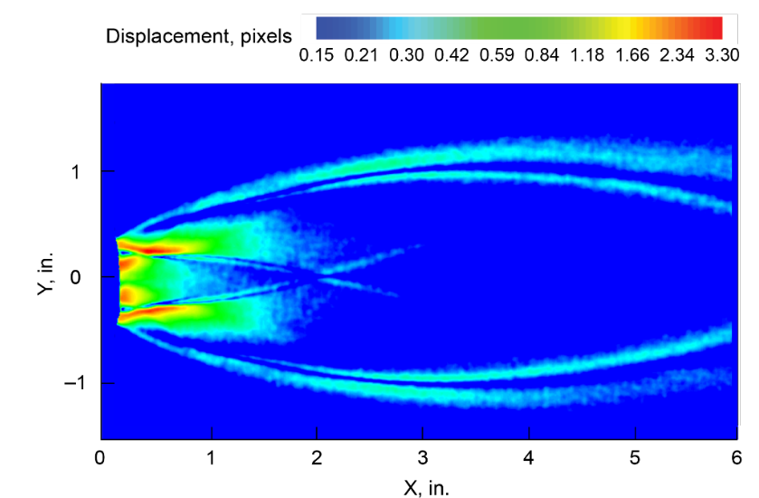
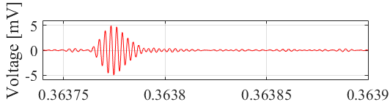
Density-Based Visualization/Measurement Systems
Density-based Flow Visualization and Measurements
Background Oriented Schlieren
  AirBOS [Heineck, Banks, ARC, AFRC]
  LimbBOS, GASPS [Haering AFRC]
  Real time BOS [Wernet, GRC]
  Tomographic BOS [Weisberger, Bathel LaRC]
    Quantitative density measurement
Focused Laser Differential Interferometry (FLDI)
  Density sensitive monitoring of instabilities at high speeds
  Sensitive point / line / multi-line measurements
  Laminar/Turbulent transition at >1 MHz [Weisberger, Bathel LaRC]
AirBOS, NASA ARC, AFRC
Tomographic BOS in a heated jet at NASA Langley
Real time BOS density sensitive measurement in the Glenn Altitude Combustion Stand
FLDI: 2nd mode
FLDI measurement of transition instability in Langley Mach 6 tunnel.

Slide 5
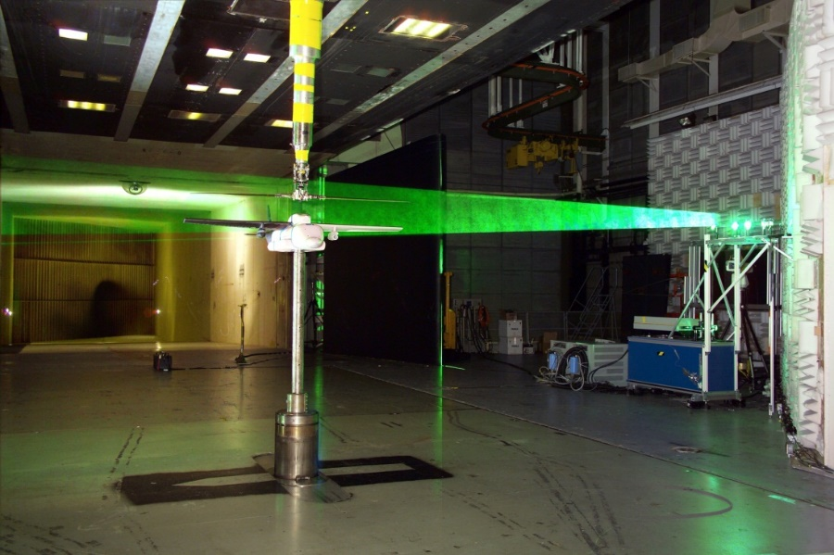
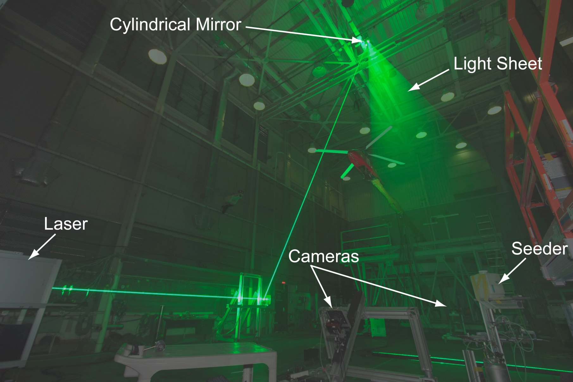
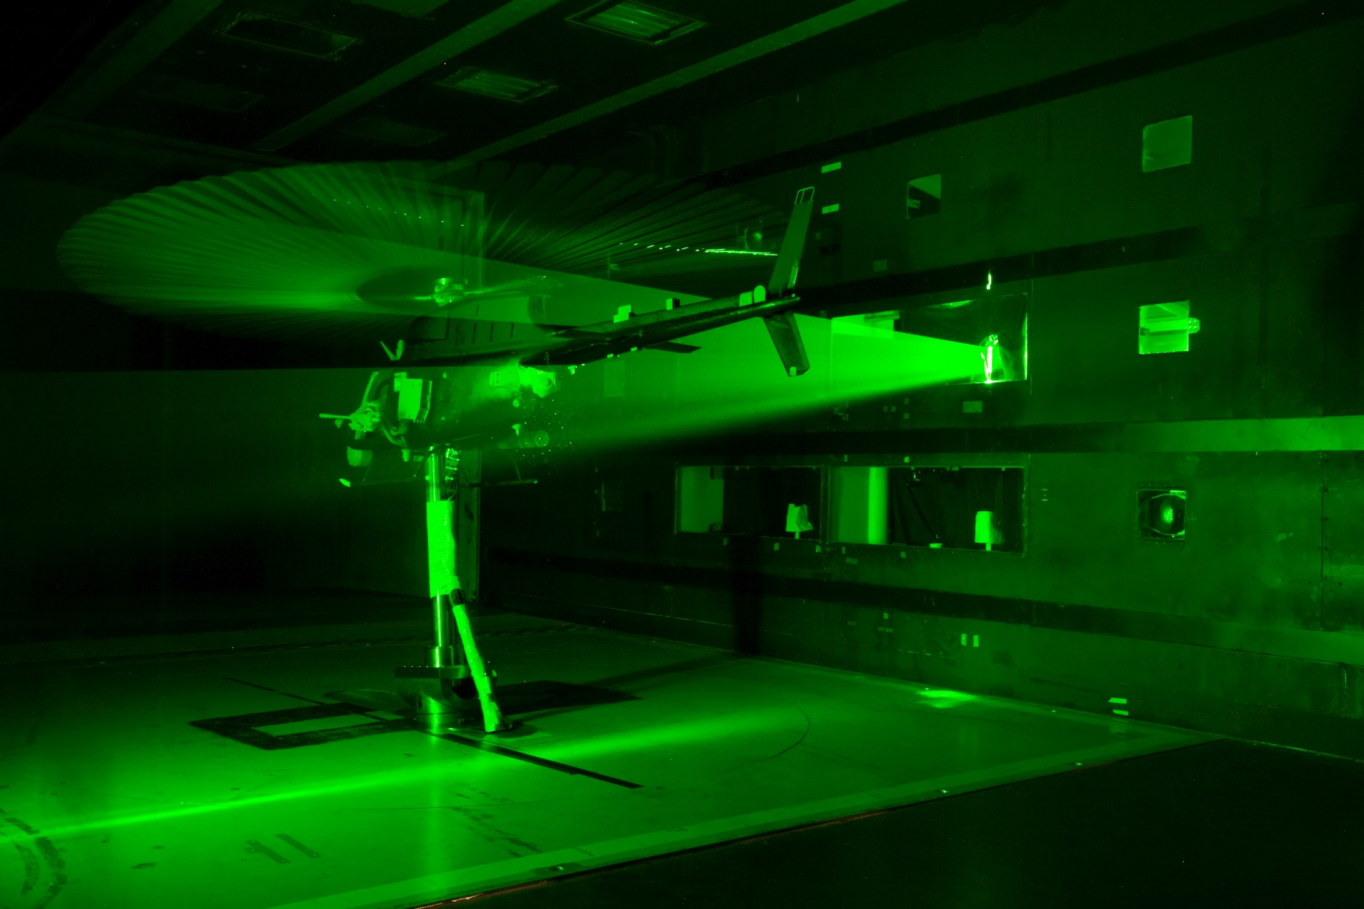
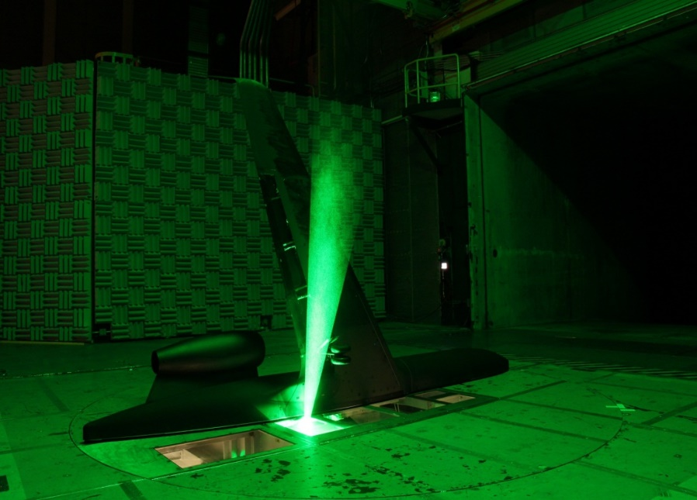
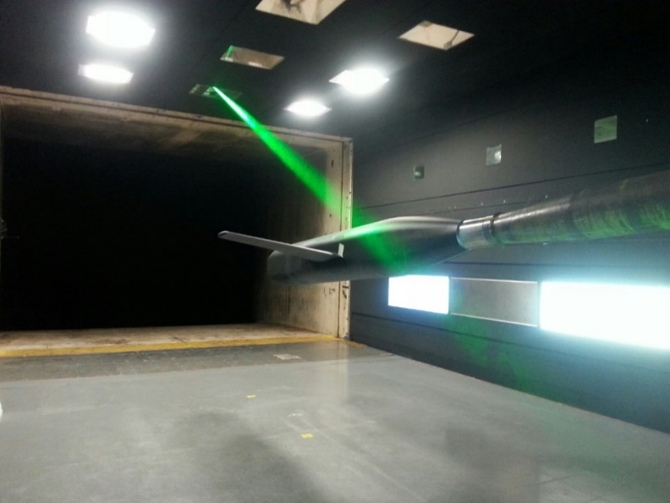
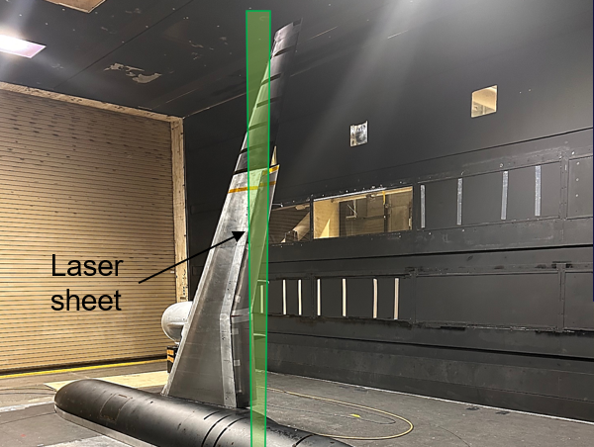
PIV With Large Field of View: 2D, stereo
Highlight
40x40x40
14x22
14x22
14x22
14x22
14x22

Slide 6
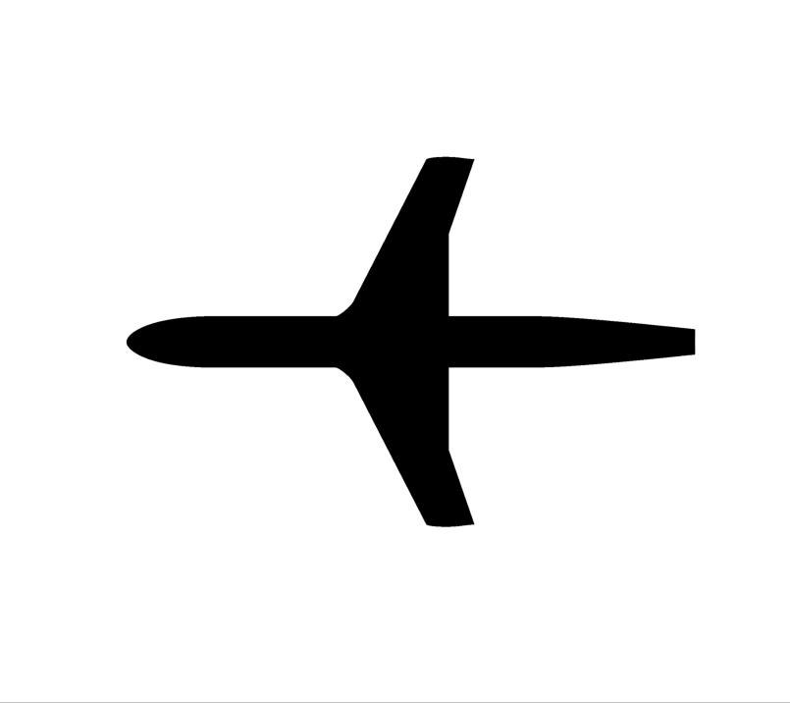
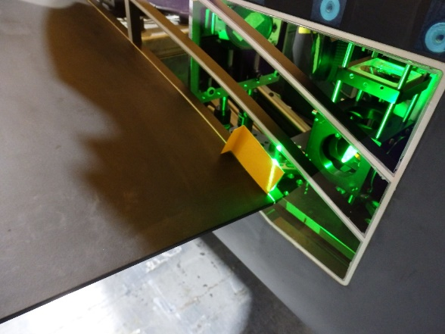
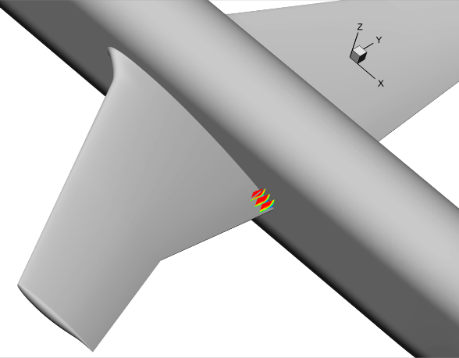
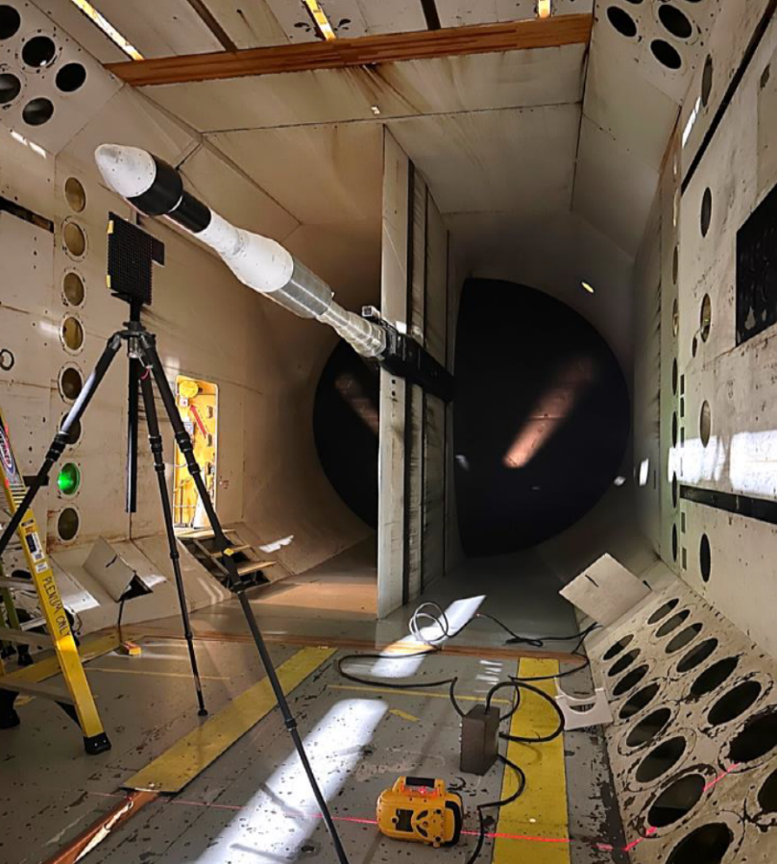
Stereo PIV cameras embedded in the test model with high-speed laser through optical fiber
Highlight
PIV in 16’x16’ Transonic Dynamic Tunnel tested in heavy gas
Airflow
Translation
Laser sheet
Cameras
PIV configuration depends on wind tunnel optical access and measurement requirements
Generally, use smoke-based seeding – MDG or Pea Soup smoke machines
Installation is most time-consuming step
Calibration and measurement uncertainty (issue)

Slide 7
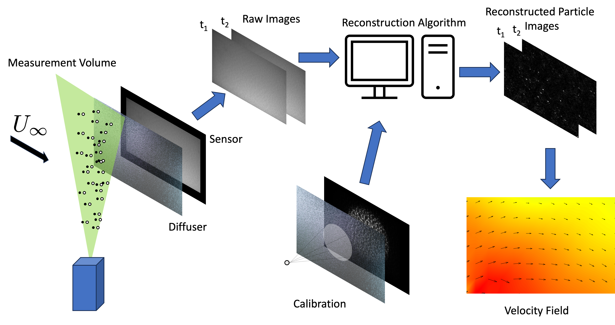
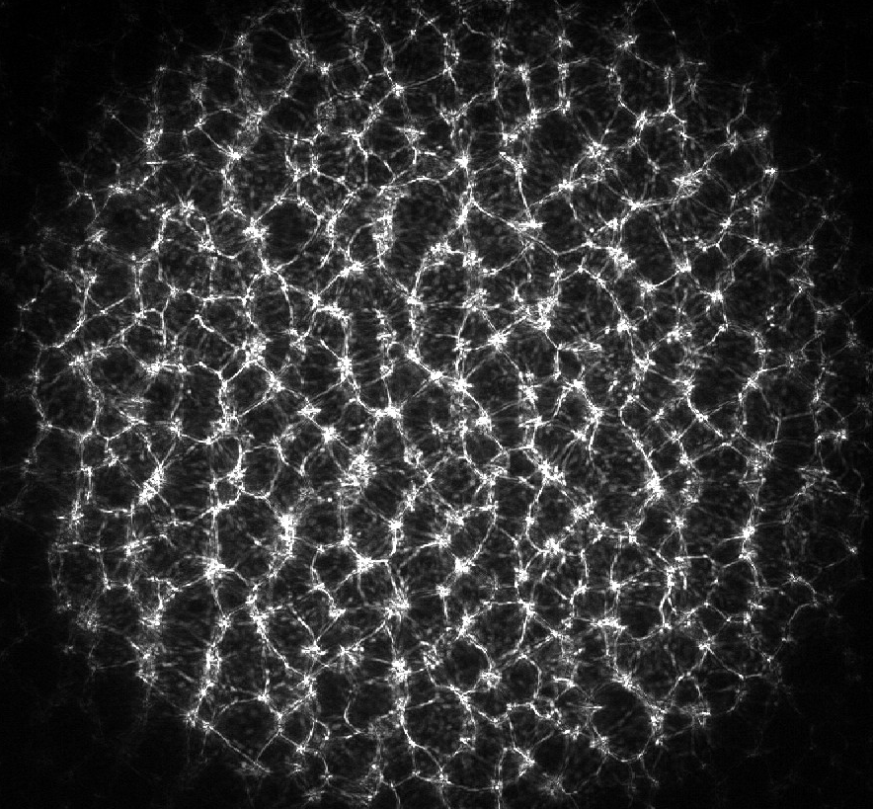
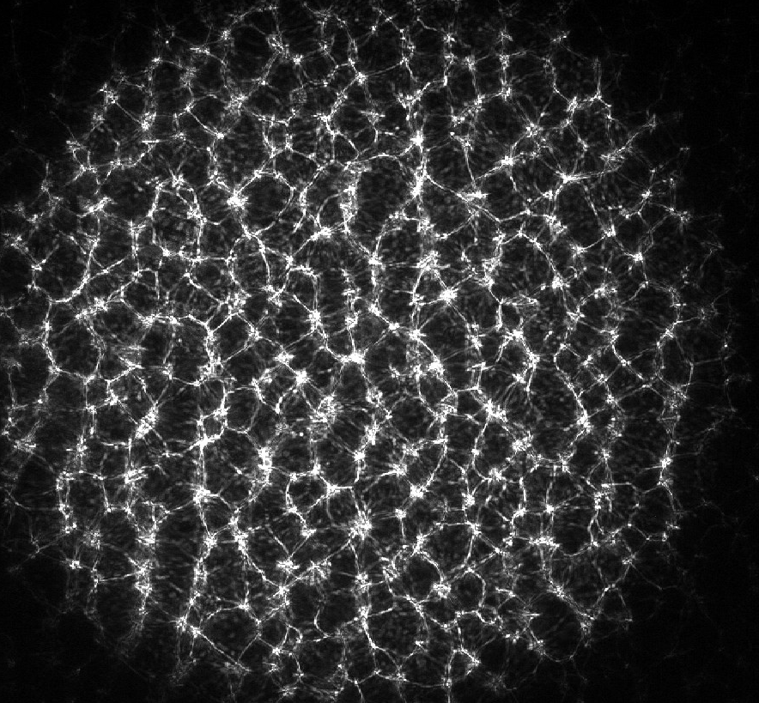
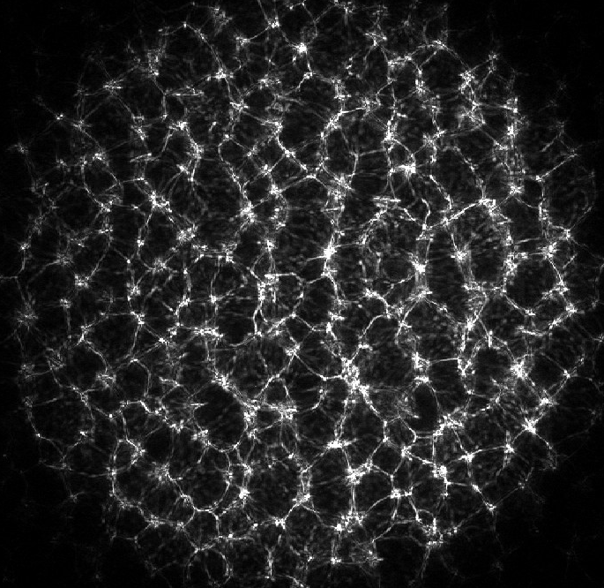
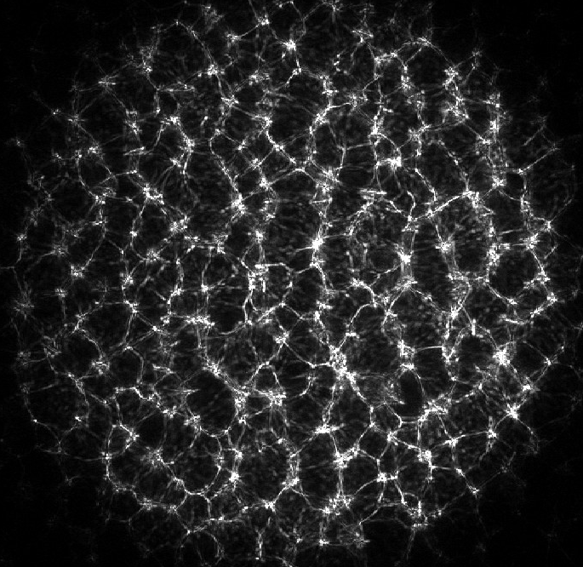
Lensless PIV - Introduction
Highlight
Motivation/Advantages:
  Compact size:
    Potential to embed sensors in models to perform near-wall flow-field measurements.
    Applications: Complex flow geometries, internal flows, limited/no optical access
  Versatility:
    3D measurement capabilities from a single sensor.
    Field of view is not tied to the magnification/working distance.
How it works:
  Instead of a lens, a thin mask (diffuser) is placed close to the sensor, and encodes the particle image onto the camera sensor, in a spatially-multiplexed manner.
  A computer algorithm (essentially, deconvolution) is used to reconstruct the particle images from the raw images.
  Meant for fairly small working distances (order of millimeters or less)
  Lensless imaging is already used in many different applications: microscopy, wearables, implantables, photography, and in vivo imaging
Example images from point source
In-plane Movement
Out-of-plane Movement

Slide 8
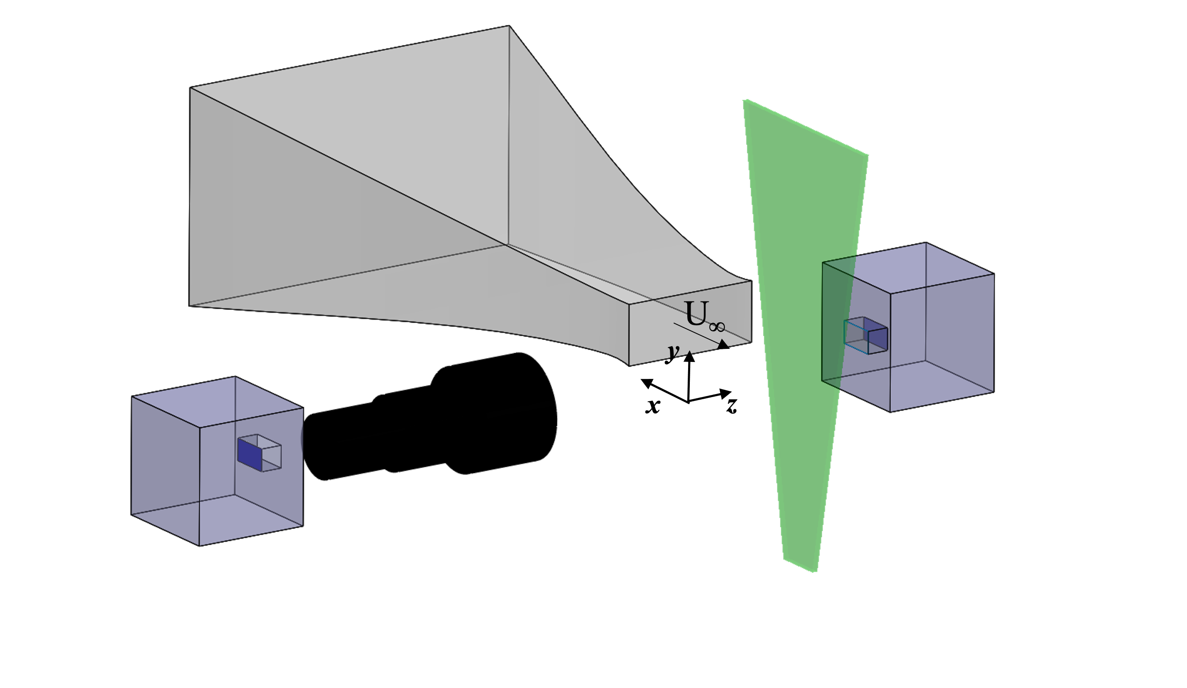
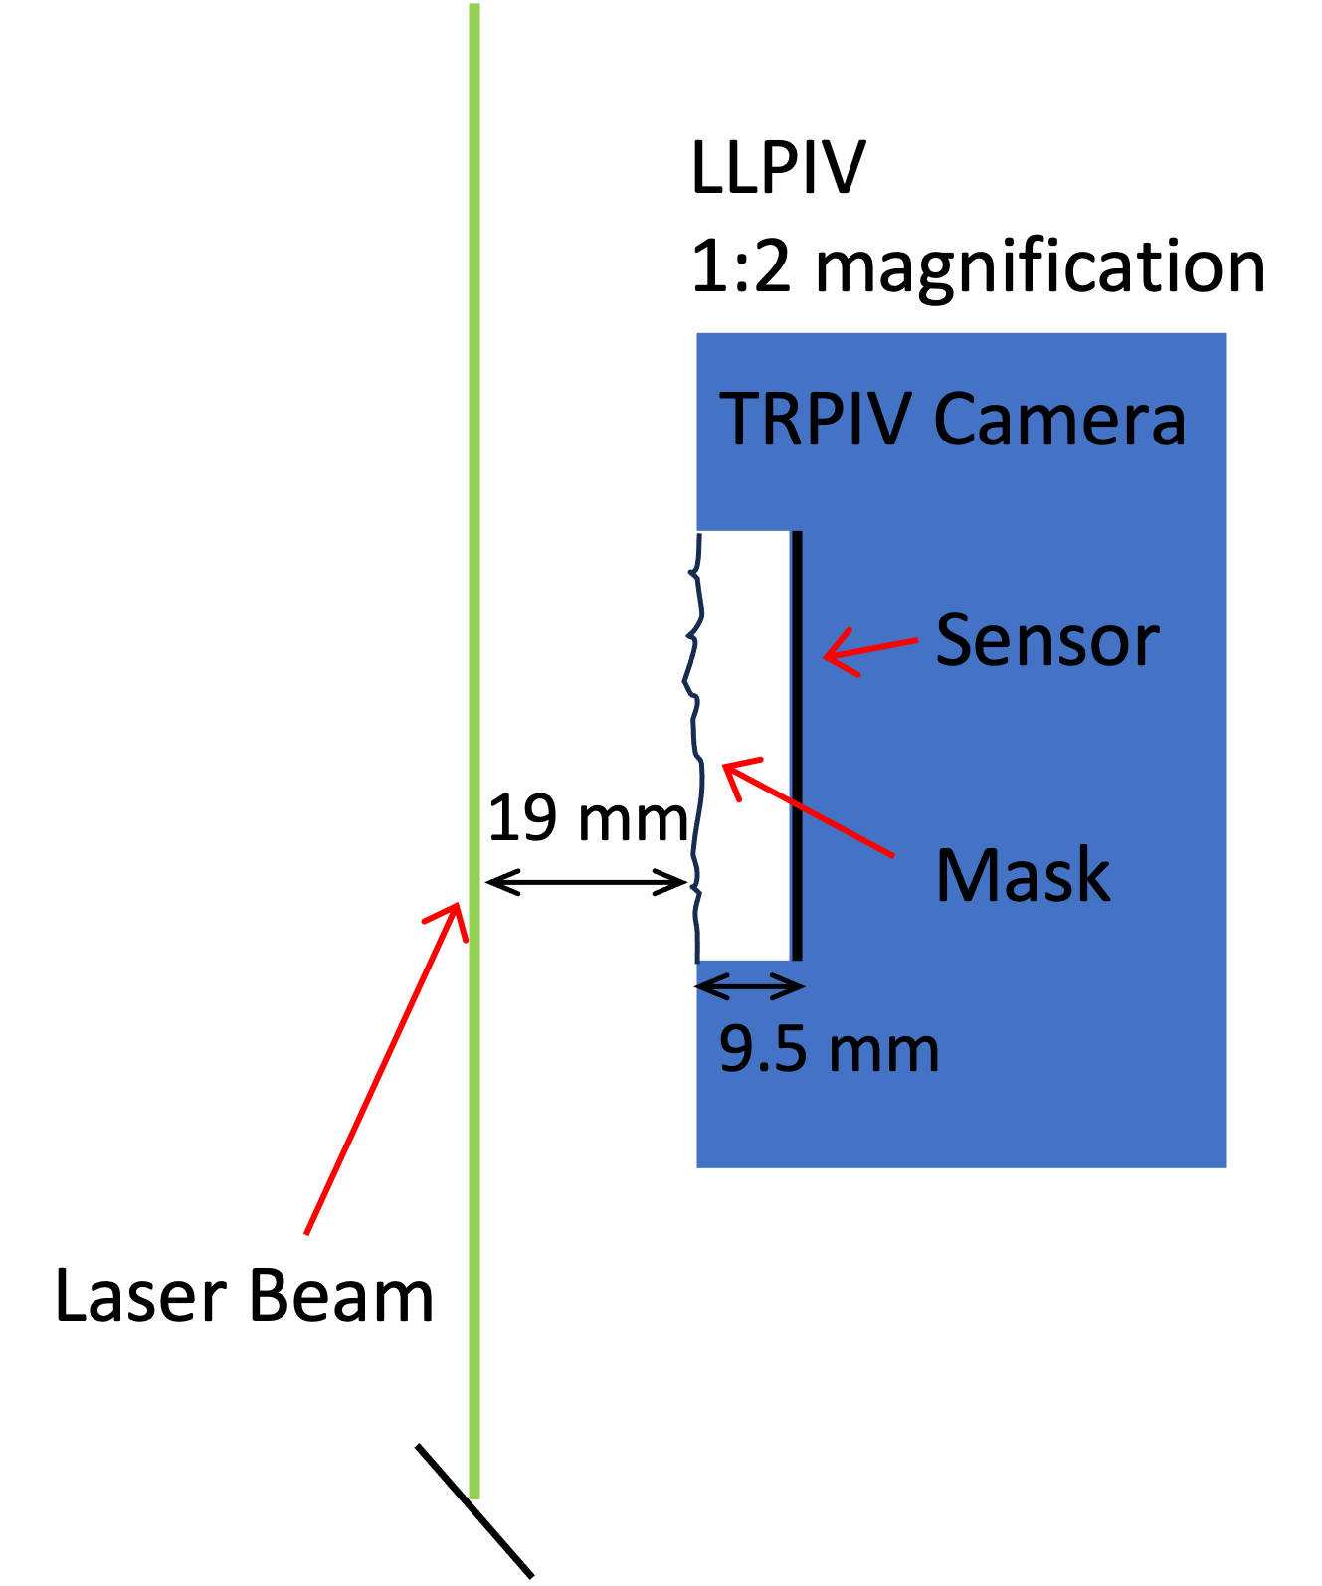
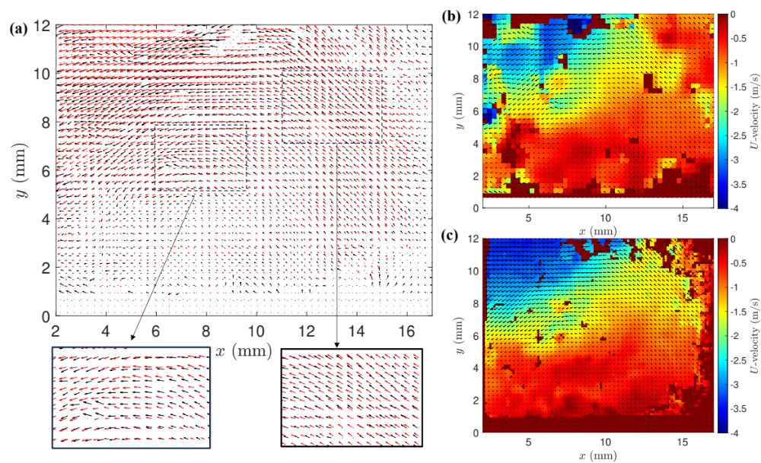
Lensless PIV - Results
Highlight
Particle image comparison:
Red: 2D Lensed PIV
Black: Lensless PIV
Benchtop Setup
Wind tunnel
Laser sheet
Lensless Camera
2D Lensed Camera
Instantaneous Flow Field Comparison
2D PIV
Lensless PIV
*Partical images are shifted slightly to allow for easier comparison

Slide 9
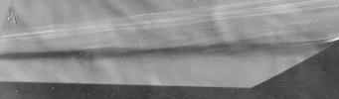
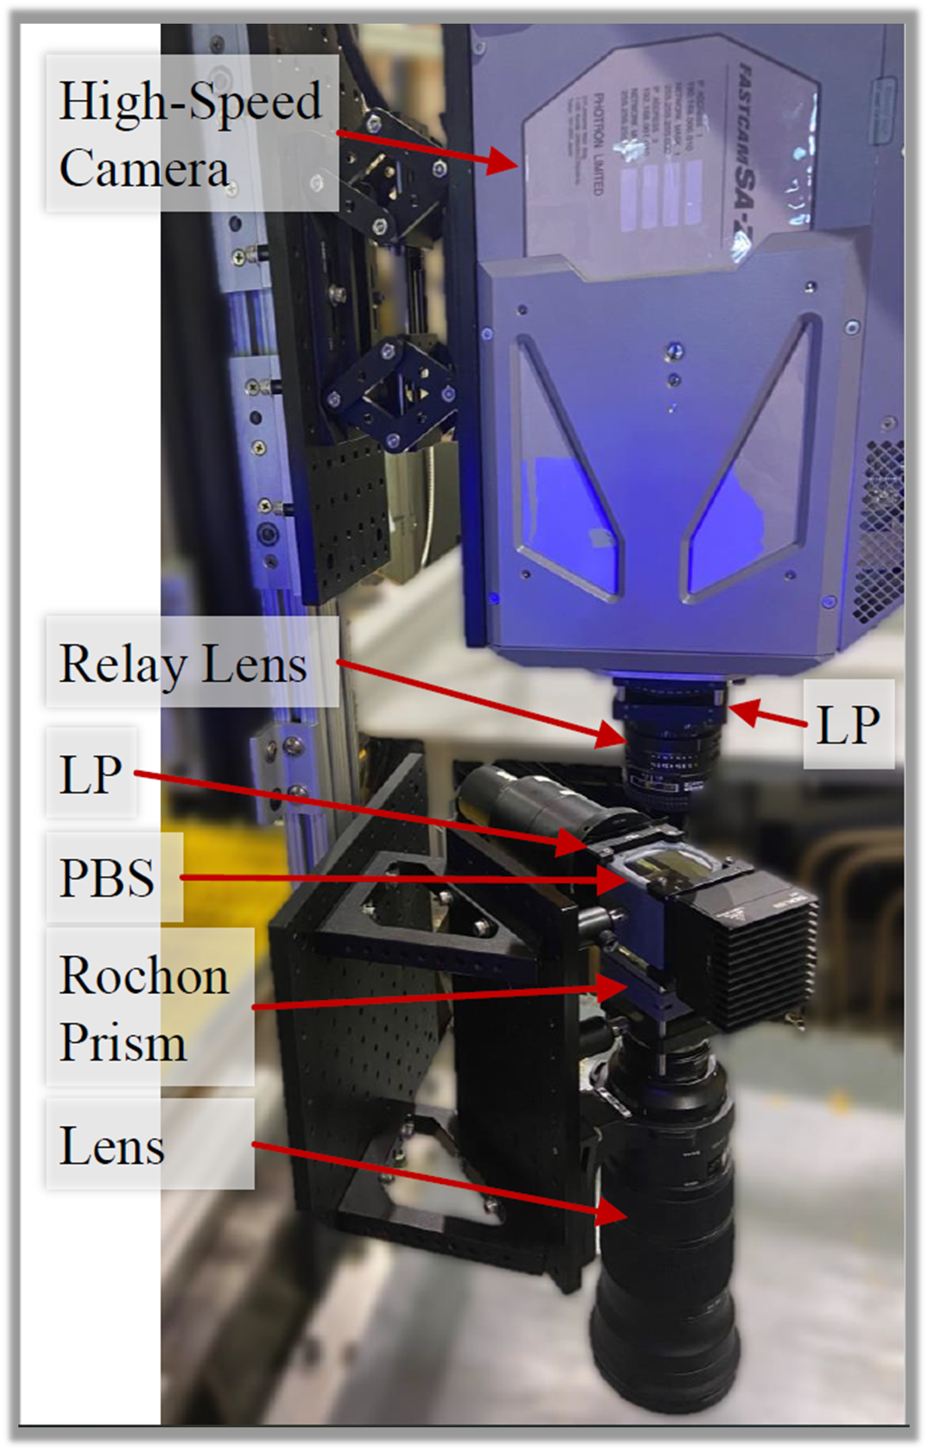
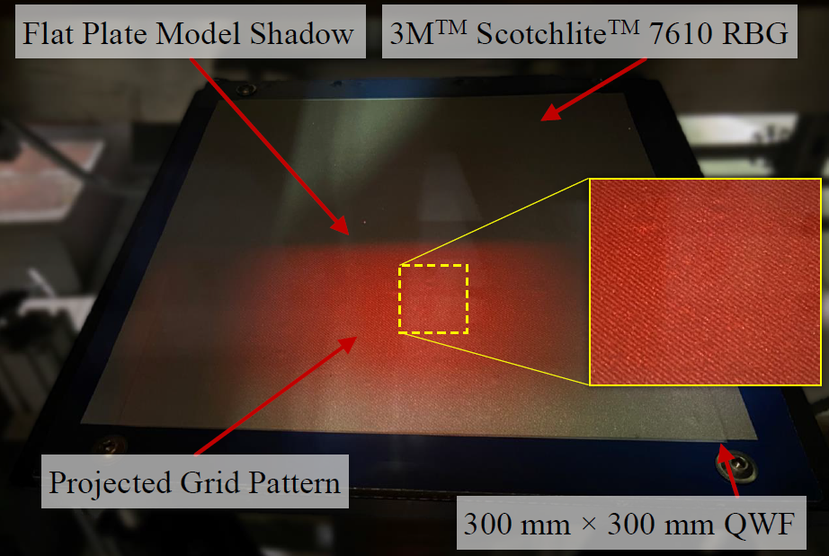
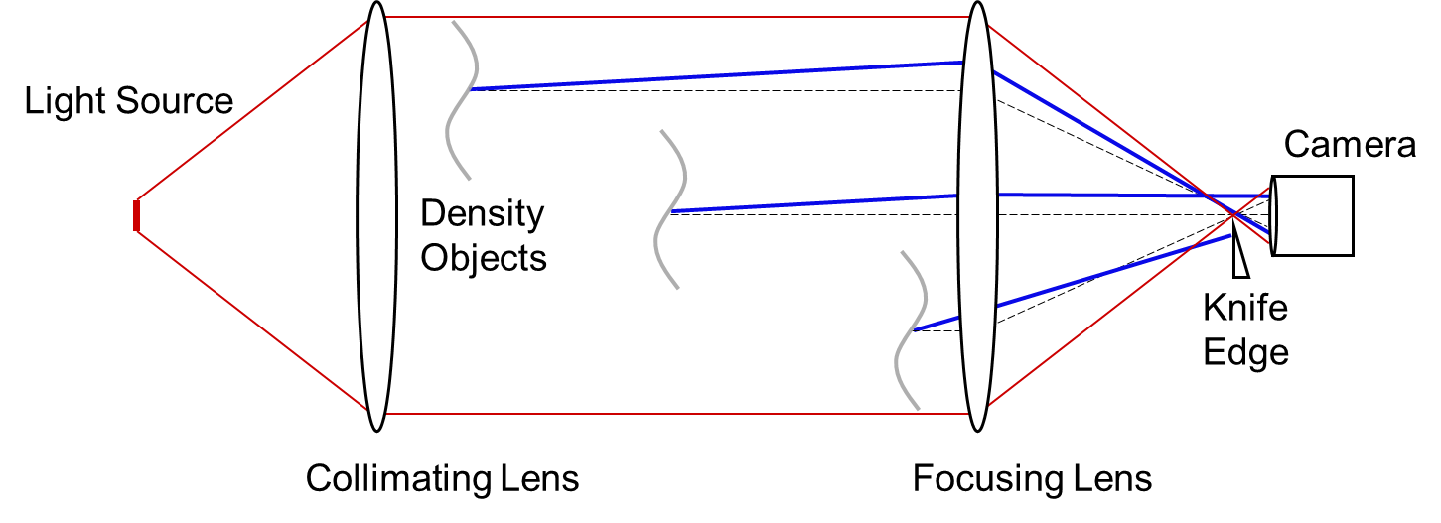
Self-Aligned Focusing Schlieren (SAFS)
Highlight
Conventional Schlieren in Mach 10 Flow
Schlieren Flow Visualization
  Path-integrated and focusing schlieren methods capture images of density gradients orthogonal to the imaging axis
  Focusing schlieren provides narrow depth-of-focus, filtering out artifacts otherwise present using path-integrated methods
    Window scratches, tunnel boundary layers, off-plane shockwaves, and HVAC thermals outside of tunnel
Issues
  Both methods require optical access on both sides of the wind tunnel
  Focusing schlieren requires precise alignment of opposing grid elements and set up is time-consuming
    Relatively large footprint, limited adjustability, sensitivity to vibration
Self-Aligned Focusing Schlieren
  Inherently self-aligned, requires only single-sided optical access, compact, use of polarization limits window glare, Scheimpflug adjustments allow imaging away from points of optical access
SAFS in Mach 10 Flow

Slide 10

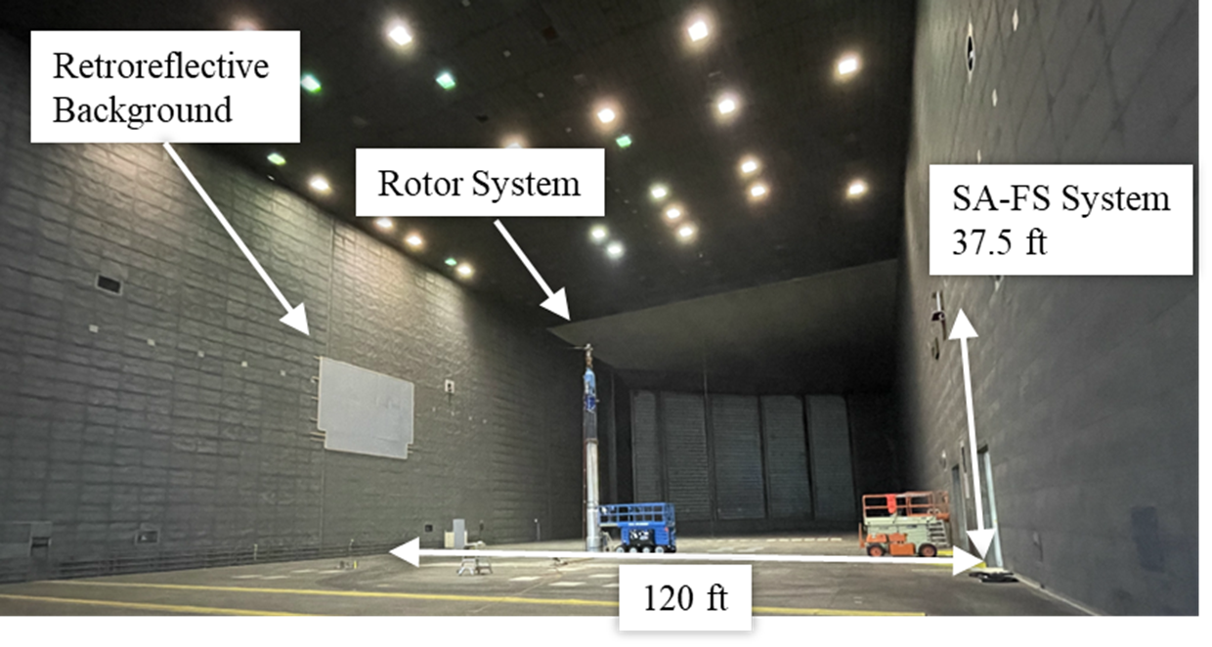
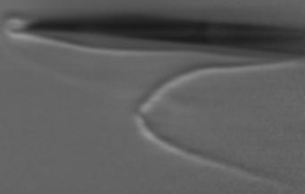
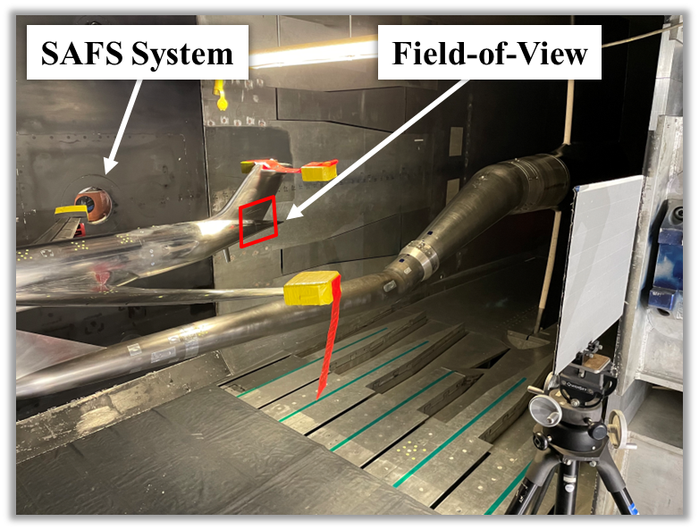
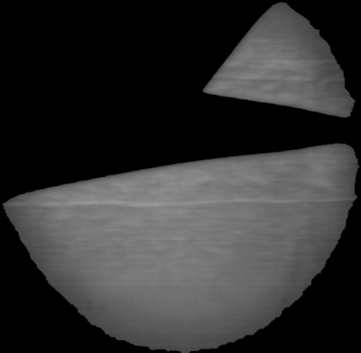
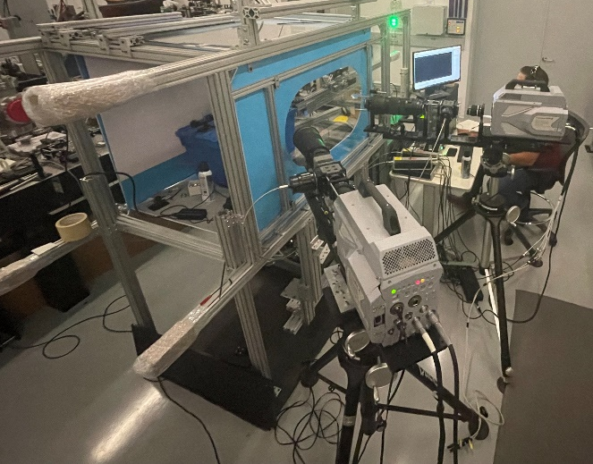
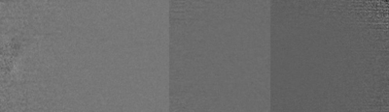
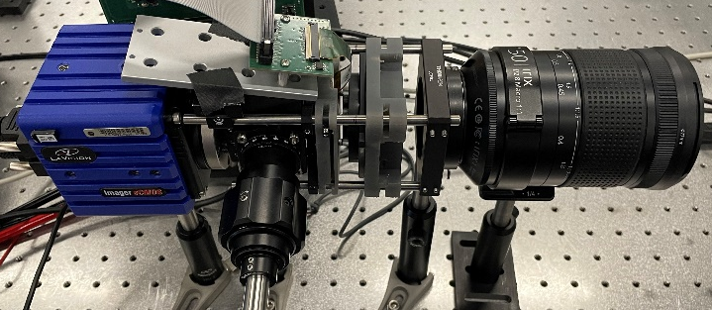
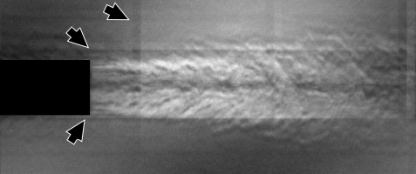
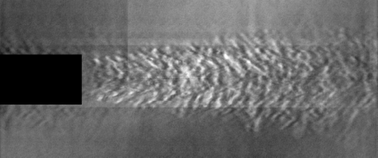
Self-Aligned Focusing Schlieren (SAFS)
Highlight
Ultra High-Speed: Blast Wave at 1 MHz
Large Scale Test Facilities: Rotorcraft Testing
Vortex Rollup
Secondary
Vortex
Cryogenic Test Facilities: Aircraft Model Testing
Scheimpflug Imaging for Optically Constrained Environments
Digital SAFS: Remote Sensitivity Adjustment

