Slide 1


Towards Ultra-Narrowband and Wavelength-Agile Burst-Mode Molecular Filtered Rayleigh Scattering
Laser Applications to Chemical, Environmental, and Security Analysis 2024
Amanda M. Braun, Mikhail N. Slipchenko, Terrence R. Meyer
Purdue University
Paul M. Danehy, Neil S. Rodrigues
NASA Langley Research Center
Jason Leicht, Sukesh Roy
Spectral Energies, LLC
The Meyer Research Group
| 1

Slide 2
Acknowledgements
NASA Space Technology Graduate Research Opportunity (NSTGRO20)
LaRC: William Holt Ripley, Dr. Ross Burns, Olivia Tyrell, Dr. Timothy Fahringer, Dr. Jian Gao, Steve Jones, Scott Bartram, Zachary Hunt
Dr. Jerome Braun
Dr. James Braun (no relation) and Alex Suppiah

Slide 3
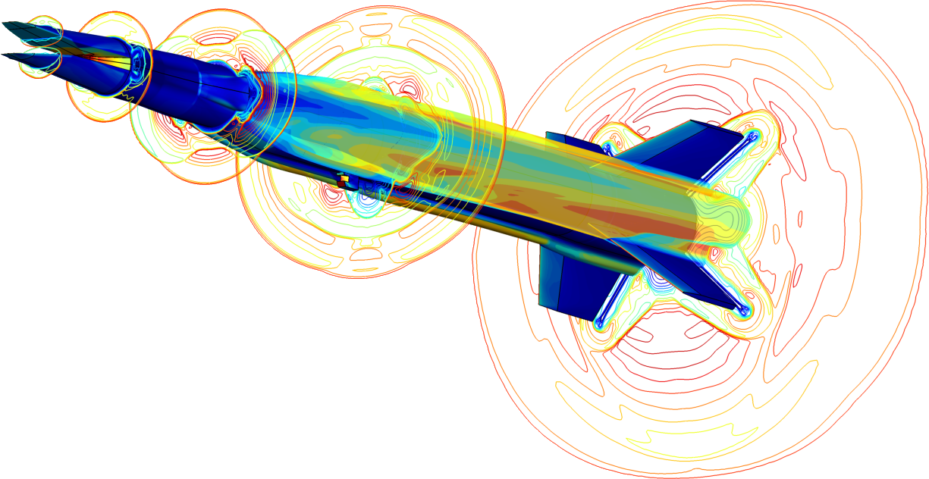
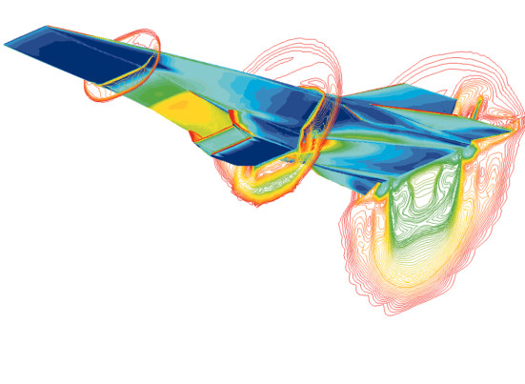
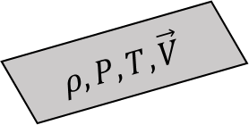
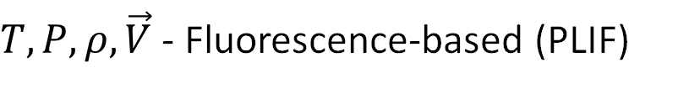
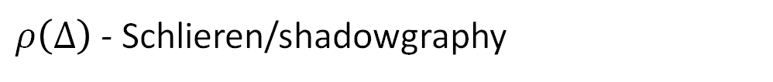
Why do we need optical diagnostics?
HIFiRE Flight 2 Vehicle ^{[1]}
Mach Number
$$ρ, P, T, \vec{V}$$
Surface Pressure
Mach Number
Surface Temperature
$ρ\left(Δ\right)$ - Schlieren/shadowgraphy
$T,P,ρ, \vec{V}$ - Fluorescence-based (PLIF)
$\vec{V}$ - Laser electronic excitation tagging (FLEET, PLEET)
$T,P,ρ, \vec{V}$ - Laser scattering (CARS, Raman, Rayleigh, DGV, PIV)
Hyper-X^{[2]}

Slide 4
Why do we need optical diagnostics?
HIFiRE Flight 2 Vehicle ^{[1]}
Mach Number
$$ρ, P, T, \vec{V}$$
Surface Pressure
Mach Number
Surface Temperature
$ρ\left(Δ\right)$ - Schlieren/shadowgraphy
$T,P,ρ, \vec{V}$ - Fluorescence-based (PLIF)
$\vec{V}$ - Laser electronic excitation tagging (FLEET, PLEET)
$T,P,ρ, \vec{V}$ - Laser scattering (CARS, Raman, Rayleigh, DGV, PIV)
Hyper-X^{[2]}

Slide 5
Why use Rayleigh scattering?
Technique
Velocity
Temperature
Pressure
Density
Unseeded
Particle Image Velocimetry
Doppler Global Velocimetry
Raman Scattering
Rayleigh Scattering
* Background interferences, weak signal levels, and difficulty making multi-parameter measurements
Notes:
Unseeded technique

Slide 6
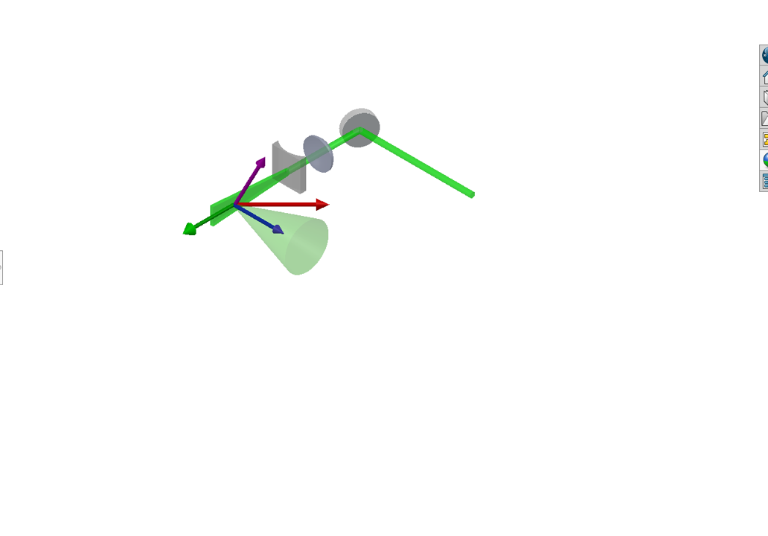
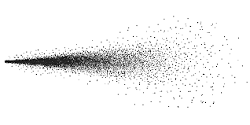
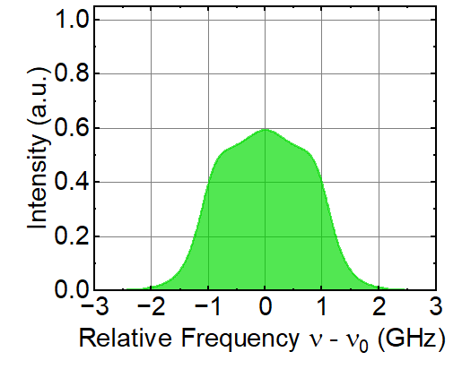







What is Rayleigh scattering?
$$\vec{V}$$
Flow Molecules
$$T, P, ρ, \vec{V}$$
Velocity Vector
$$T, P$$
Rayleigh Scattering
Incident Laser
$$ρ$$
Wave Vector
$$θ$$
$\vec{k}={\vec{k}}_{S}−{\vec{k}}_{L}$
Laser Vector
Scattering Vector
$$Δν_{D}=\frac{1}{λ} \vec{V} ∙\vec{\text{k}}$$
Doppler Shift
Notes:
Explanation

Slide 7
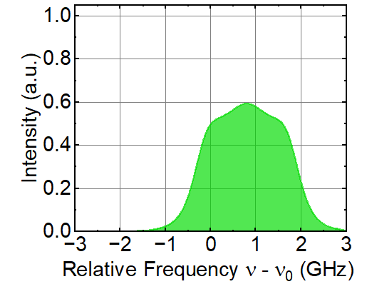

What is Rayleigh scattering?
$$\vec{V}$$
Flow Molecules
$$T, P, ρ, \vec{V}$$
Velocity Vector
$$T, P$$
Rayleigh Scattering
Incident Laser
$$ρ$$
Wave Vector
$$θ$$
$\vec{k}={\vec{k}}_{S}−{\vec{k}}_{L}$
$$Δν_{D}(\vec{V})$$
Laser Vector
Scattering Vector
$$Δν_{D}=\frac{1}{λ} \vec{V} ∙\vec{\text{k}}$$
Doppler Shift
Notes:
Explanation

Slide 8
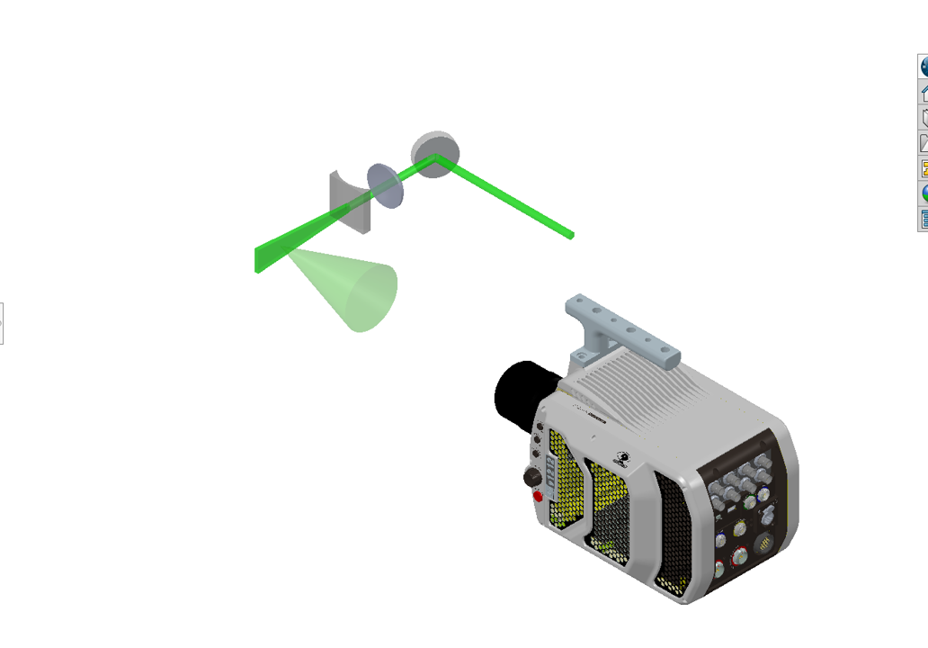
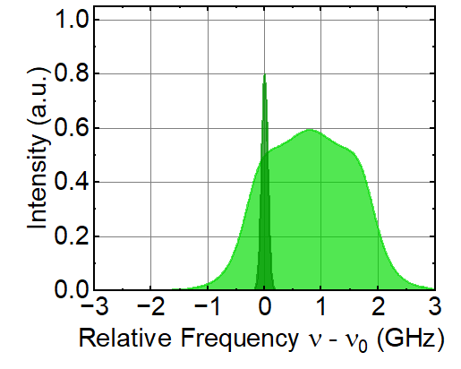
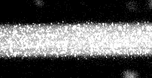



Why use filtered Rayleigh scattering?
Flow Molecules
$$T, P, ρ, \vec{V}$$
Rayleigh Scattering
$$T, P$$
Rayleigh Scattering
Incident Laser
$$ρ$$
$$Δν_{D}(\vec{V})$$
Mie/Stray Scattering
Notes:
Explanation

Slide 9
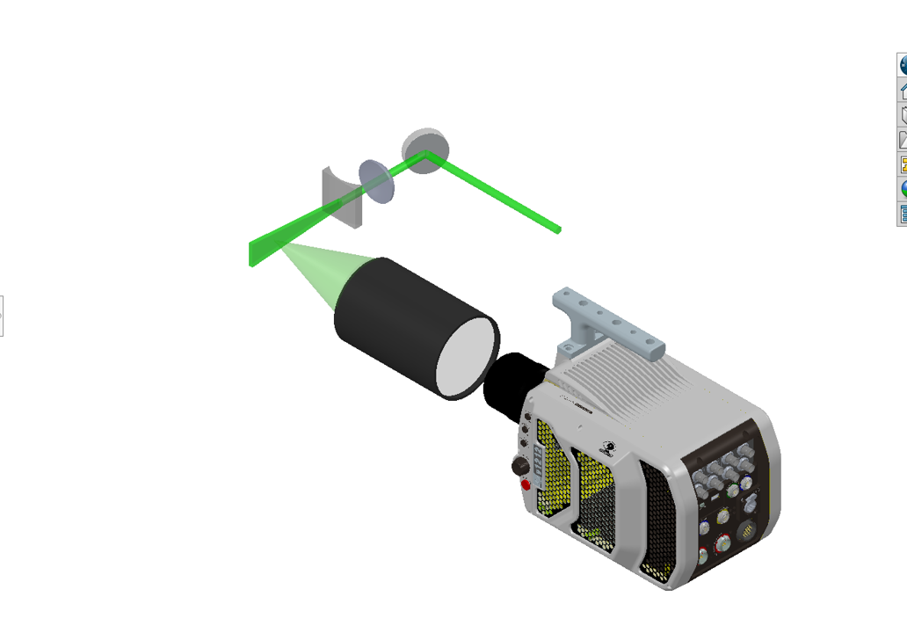
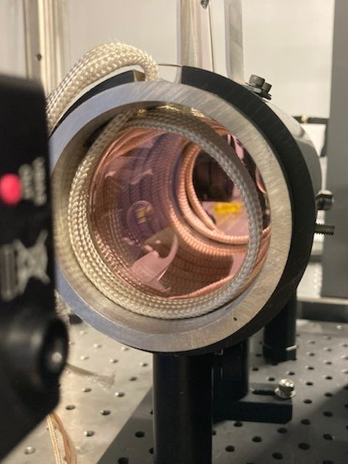
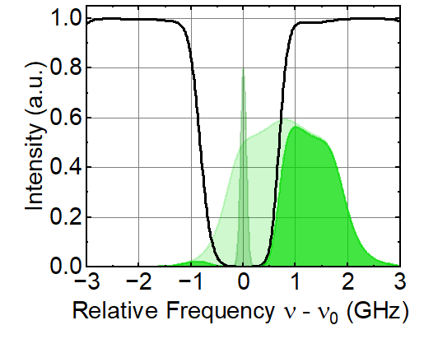
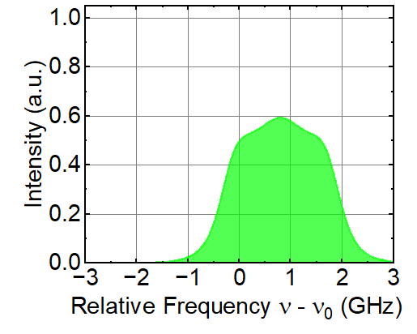




Why use filtered Rayleigh scattering?
Gaseous Iodine
Flow Molecules
$$T, P, ρ, \vec{V}$$
Rayleigh Scattering
Filter
Rayleigh Scattering
$$T, P$$
532 nm
$$T, P$$
$$ρ$$
$$ρ$$
$$Δν_{D}(\vec{V})$$
$$Δν_{D}(\vec{V})$$
Molecular
Filter
Mie/Stray Scattering
Notes:
Explanation

Slide 10
Why use filtered Rayleigh scattering?
Flow Molecules
$$T, P, ρ, \vec{V}$$
Rayleigh Scattering
Filter
Rayleigh Scattering
$$T, P$$
532 nm
$$T, P$$
$$ρ$$
$$ρ$$
Laser
$$Δν_{D}(\vec{V})$$
$$Δν_{D}(\vec{V})$$
Molecular
Filter
High speed
Mie/Stray Scattering
High intensity
Narrowband
Wavelength tunable
Notes:
Explanation

Slide 11
Why use burst-mode filtered Rayleigh scattering?
Laser | Duration | Rate | 532 nm Pulse Energy | Average Power
Flashlamp Pumped Q-switched | Continuous | 10s of Hz | 0.50-1.00 J^{[3]} | 10 W
Diode Pumped Q-switched | Continuous | kHz to MHz | 0.004 J (100 kHz)^{[4]} | 400 W
Flashlamp Pumped Burst-mode | 1-20 ms per 10 s | kHz to MHz | 0.50-1.00 J (100 kHz) ^{[5]} | 0.10 W
100 ms
Energy
Time
Energy
Time
10 s
Energy
Time
Condensate-Enhanced Applications
Molecular Applications
^{[6]}Wu et al., 2000: 500 kHz visualization of Mach 2.5 flow over a 14° Wedge.
^{[8]} Krishna et al., 2021: 10 kHz 1D temperature of propagating premixed flame
^{[7]} Koelling et al., 2022: 250 kHz visualization of tripped hypersonic flow.
^{[9]} Creel et al., 2023: 250 kHz visualization of laser-spark pressure wave
Notes:
Explanation

Slide 12
Burst-mode Laser Architecture
Master Oscillator
1064 nm
cw Laser Seed
Energy
What about the spectral characteristics?
Time
Repetition Rate
Pulse Slicing
Energy
Time
Power Amplifier
Duty Cycle
Amp 1
Amp 2
Amp 3
Amp 4
Amp 5
Energy
Amp 6
SHG
Time
Burst Duration
Notes:
Explanation

Slide 13
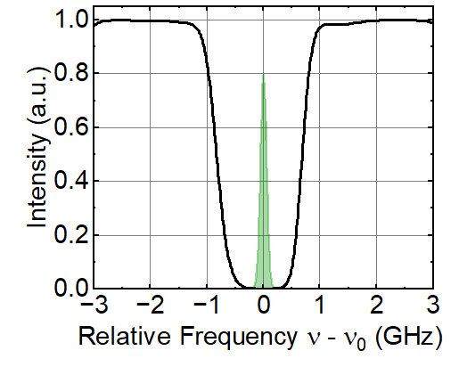
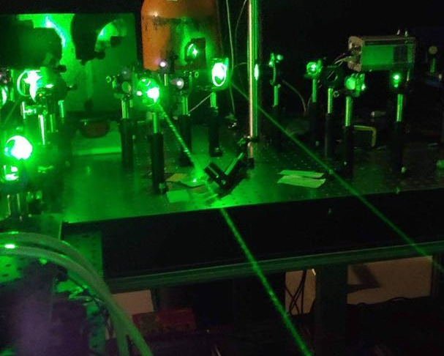
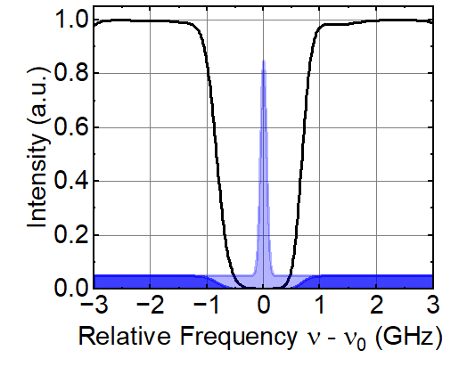
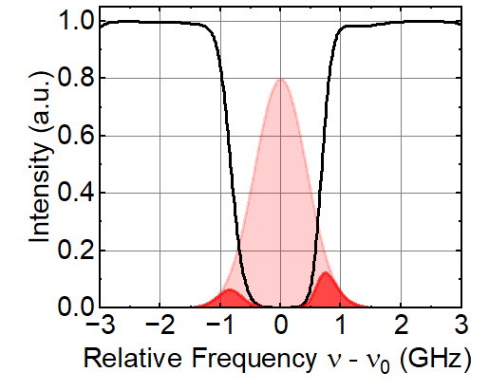
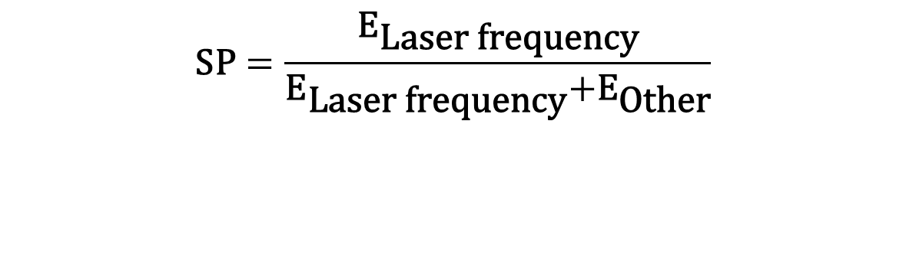
FRS requires a spectrally pure laser source
^{[10]} Barnes et al., 1993
High SP
Broadband Component
Broad Linewidth
$$\text{SP}=\frac{{\text{E}}_{\text{Laser} \text{frequency}}}{{\text{E}}_{\text{Laser} \text{frequency}}\text{+}{\text{E}}_{\text{Other}}}$$

Slide 14
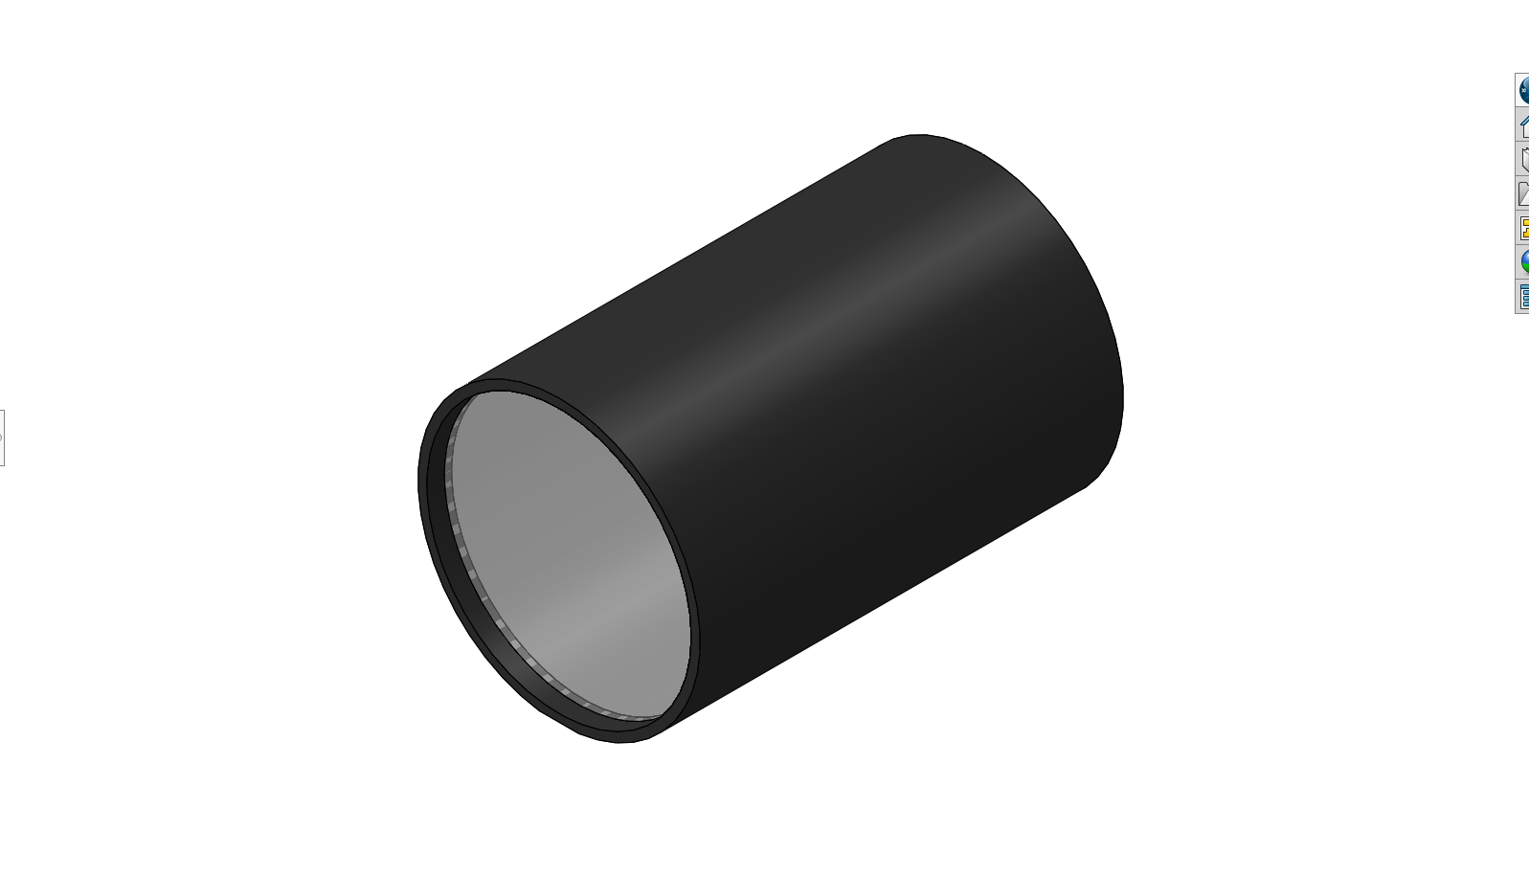
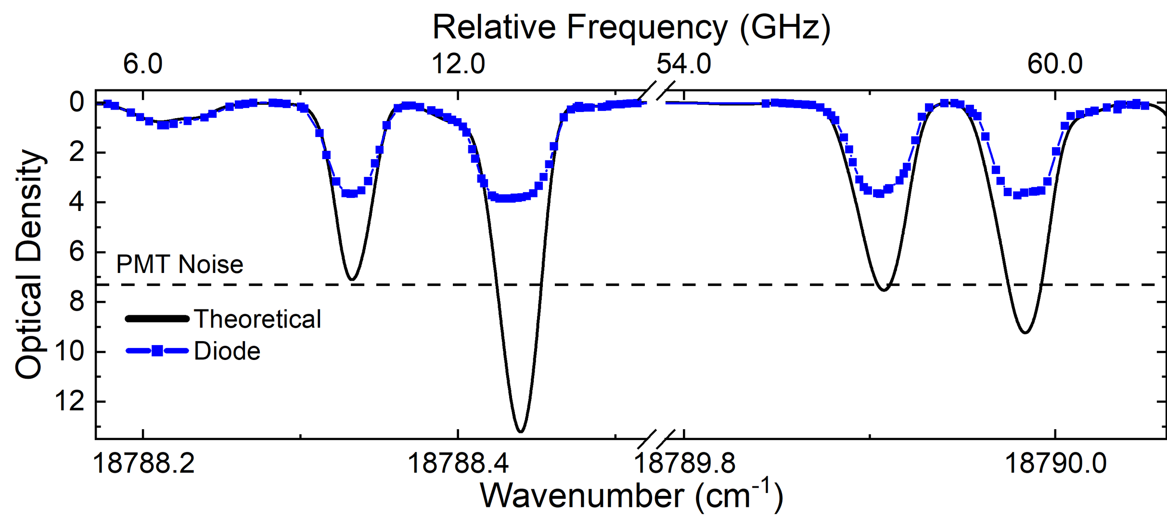

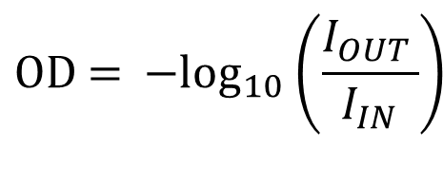


Methods to increase spectral purity
$$\text{OD}\text{ = }{\text{−}\text{log}}_{10}\left(\frac{I_{OUT }}{I_{IN}}\right)$$
$$I_{\text{OUT}}$$
Iodine Cell
$$\text{SP}\text{ = 1}−{10}^{−\text{OD}}$$
$$I_{\text{IN}}$$
< OD 4 SP = 0.99986
Theoretically > OD 6!

Slide 15
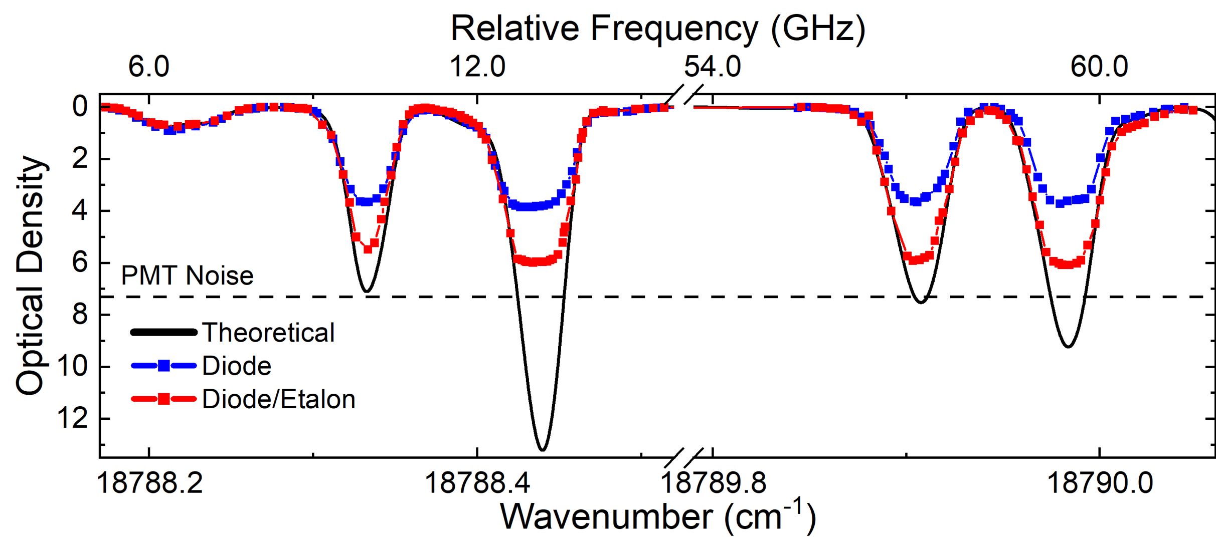
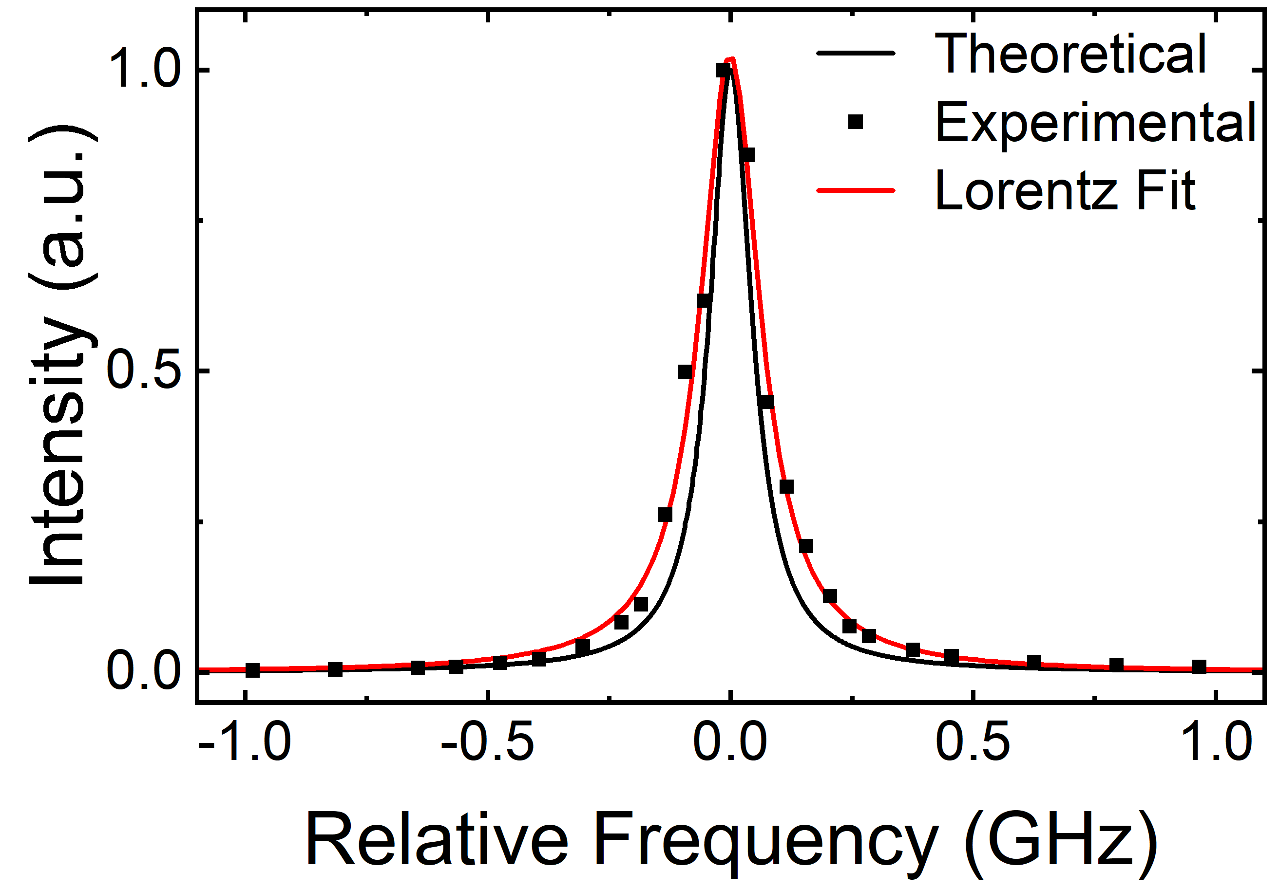
Methods to increase spectral purity
$$\text{OD}\text{ = }{\text{−}\text{log}}_{10}\left(\frac{I_{OUT }}{I_{IN}}\right)$$
Power Amplifier
$$I_{\text{OUT}}$$
Amp 1
Iodine Cell
Amp 2
Amp 3
$$\text{SP}\text{ = 1}−{10}^{−\text{OD}}$$
Amp 4
Amp 5
$$I_{\text{IN}}$$
Amp 6
Etalon
< OD 4 SP = 0.99986
Theoretically > OD 6!
~ OD 6 SP = 0.9999987

Slide 16
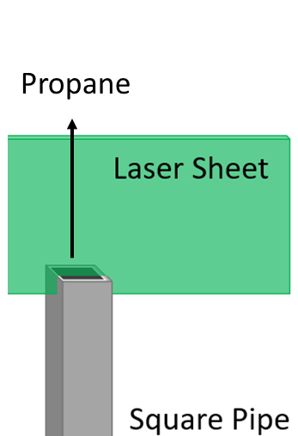
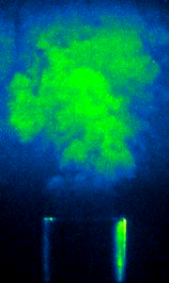
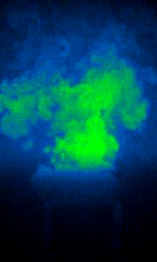

Demonstration of increased spectral purity
Filtered
No Etalon
Filtered Etalon
4096
4096
0
0
Potential for kHz-MHz single-parameter measurements
How can we achieve multi-parameter measurements?

Slide 17
Intensity of filtered Rayleigh scattering
Rayleigh Scattering
Background Scattering
$$I_{FRS}≈A ρ\int_{−∞}^{∞}{R\left(ν−ν_{0}−Δν_{D}(\vec{V}), P, T, θ\right) F\left(ν−ν_{0}\right)dν+B\int_{−∞}^{∞}{L\left(ν−ν_{0}\right) F\left(ν−ν_{0}\right)dν }}$$
Rayleigh
Filter
Laser
Filter

Slide 18
Intensity of filtered Rayleigh scattering
Rayleigh Scattering
Background Scattering
$$I_{FRS}≈A\frac{P}{T}\int_{−∞}^{∞}{R\left(ν−ν_{0}−Δν_{D}(\vec{V}), P, T, θ\right) F\left(ν−ν_{0}\right)dν+B\int_{−∞}^{∞}{L\left(ν−ν_{0}\right) F\left(ν−ν_{0}\right)dν }}$$
Rayleigh
Filter
Laser
Filter
1x Equation
2x Calibration Parameters
3x Unknowns

Slide 19
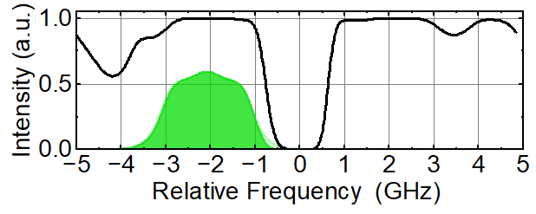
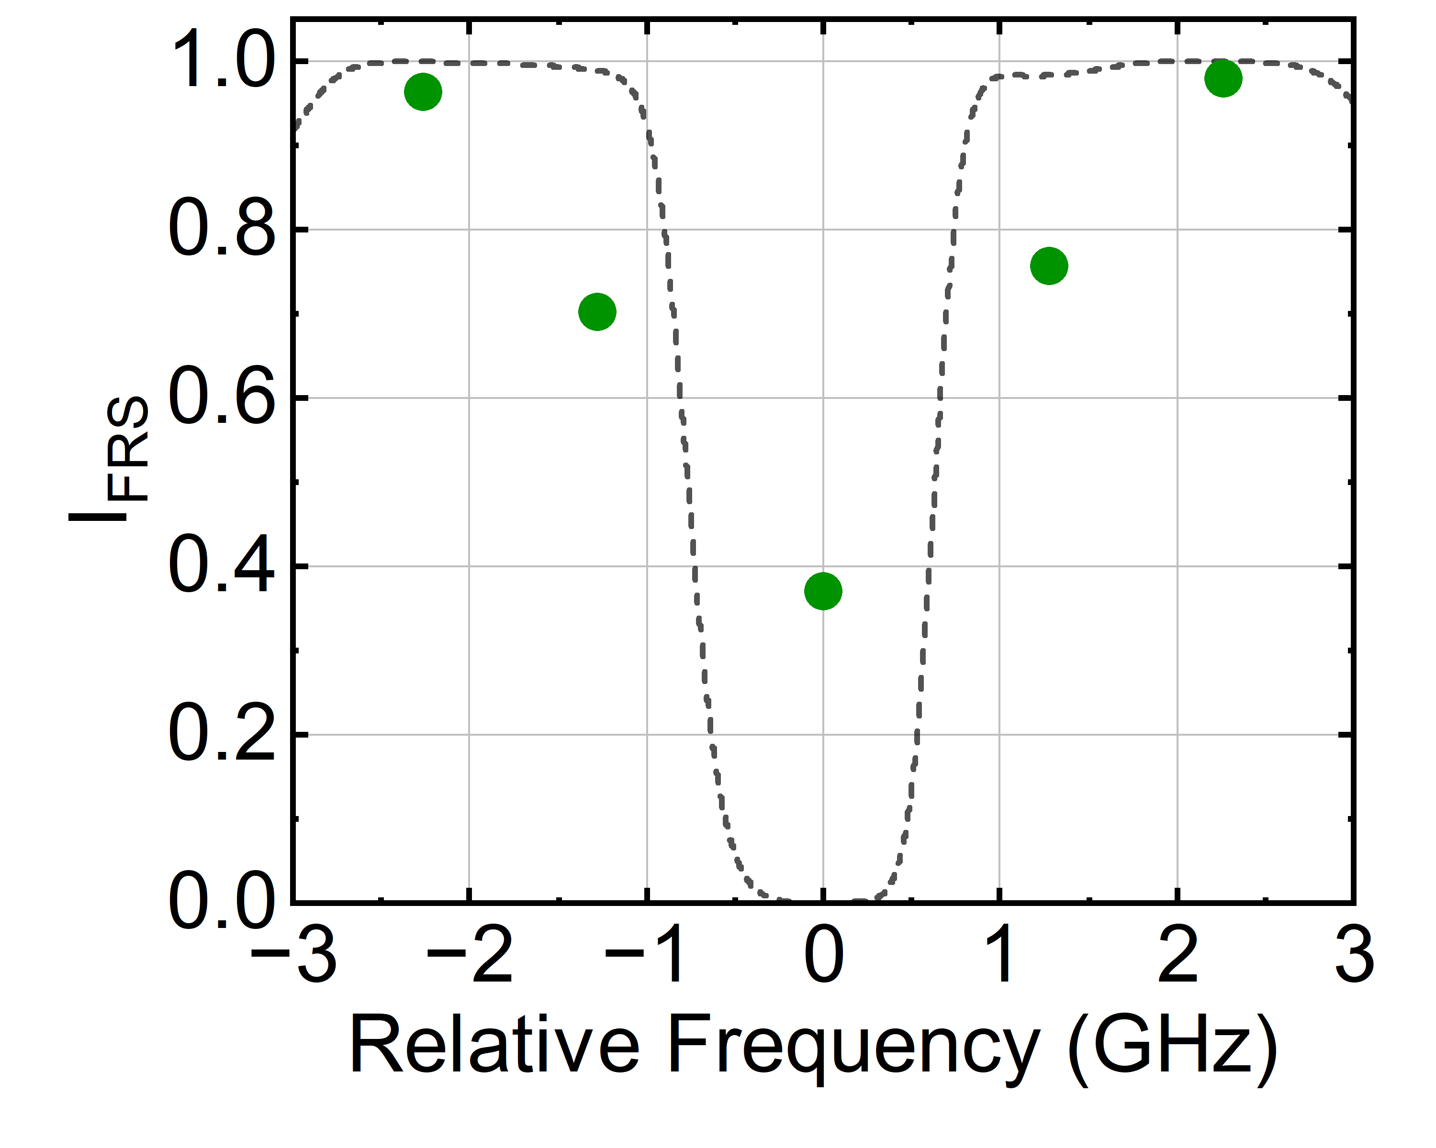
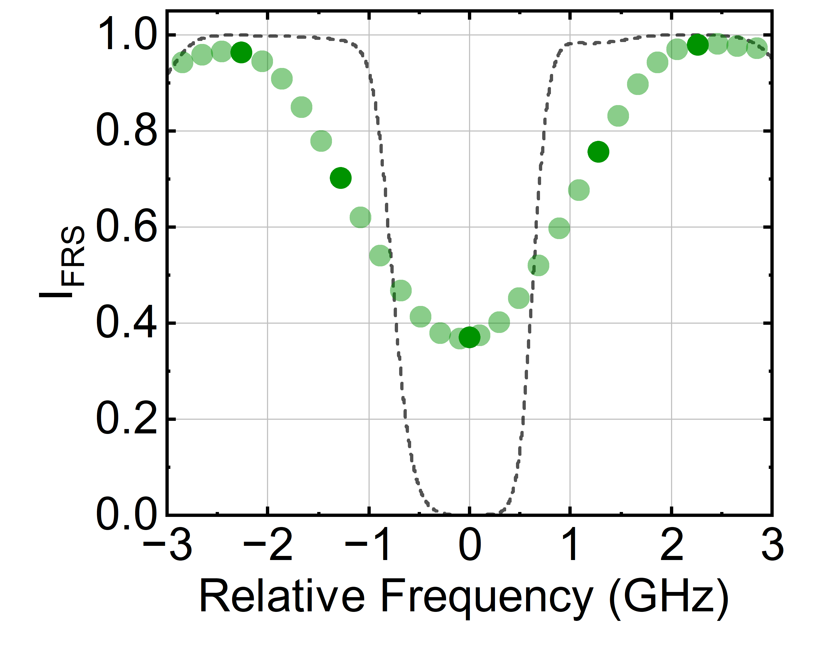
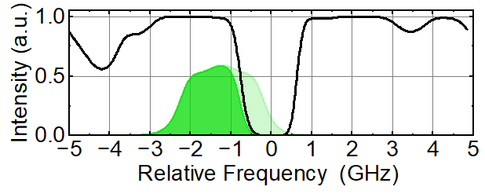
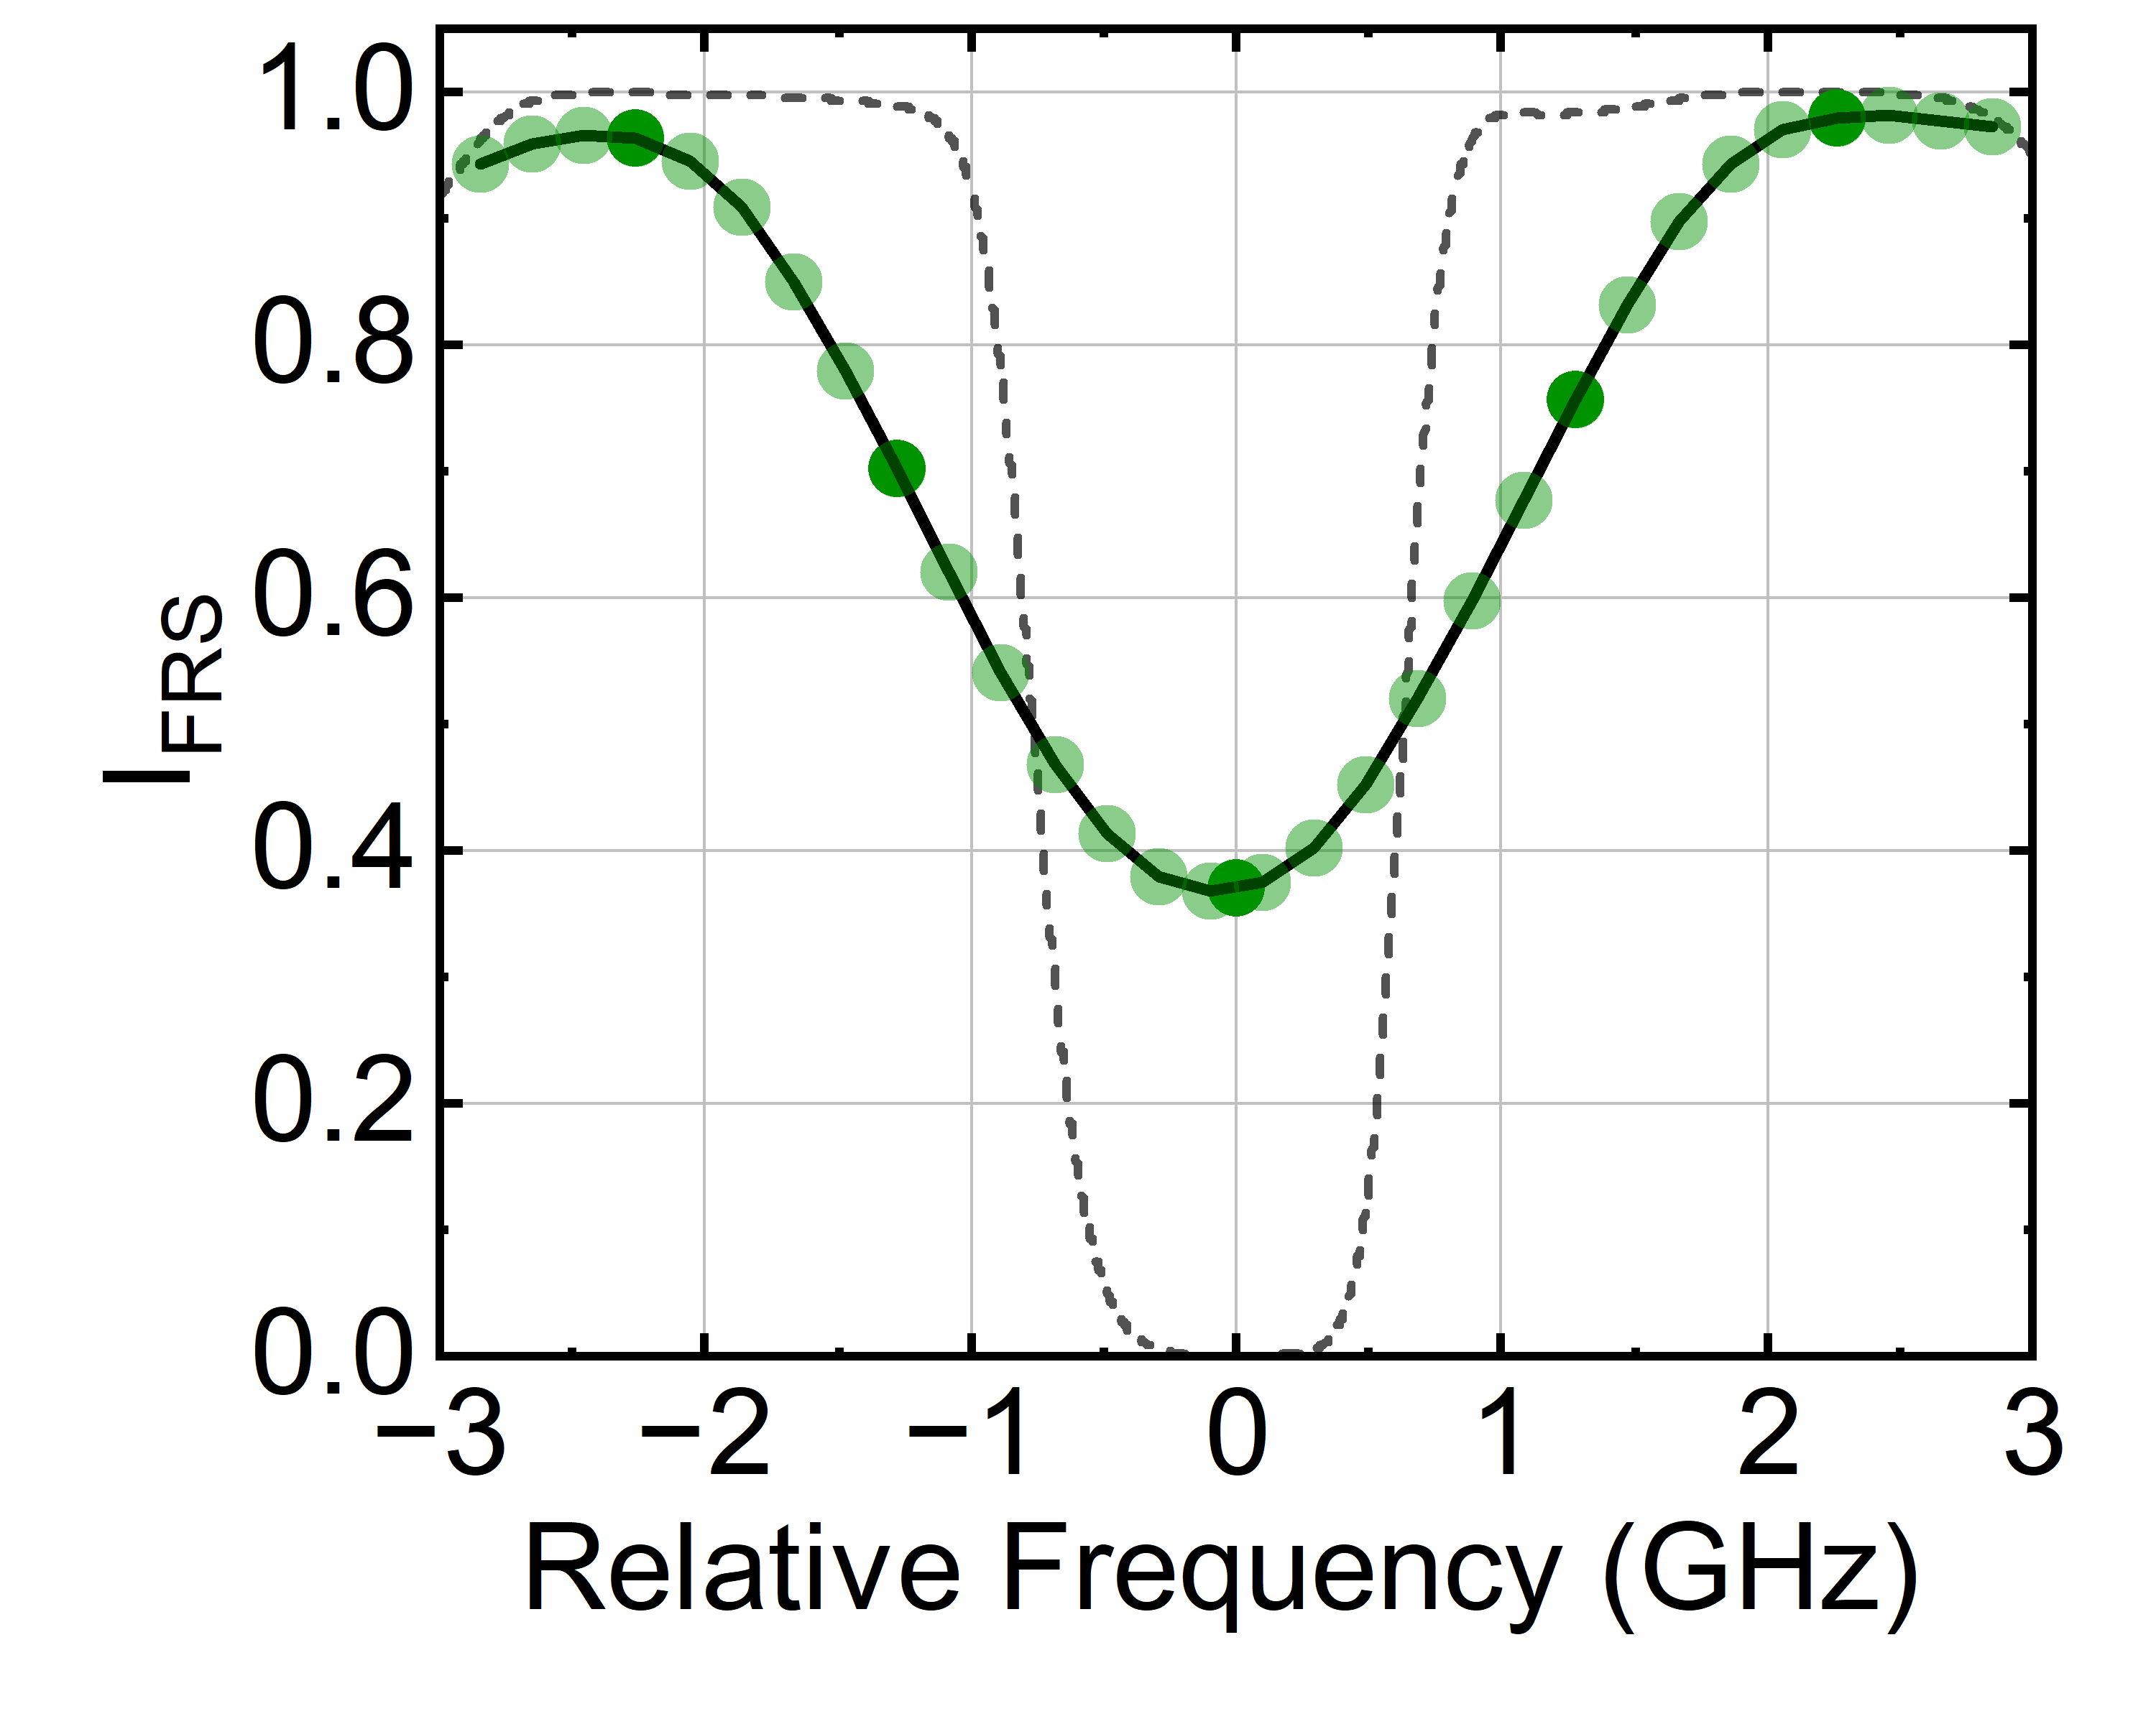
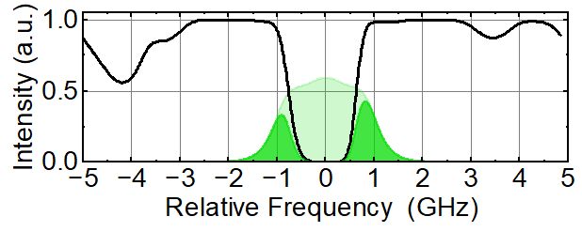
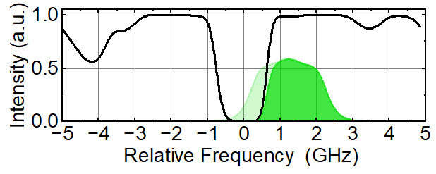
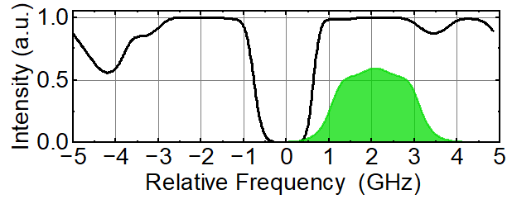
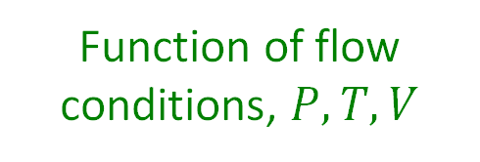
Frequency-scanning FRS for a single pixel
Function of flow conditions, $P, T, V$
Author | # Steps | # Avg. | Total time
^{[12]}Forkey et al. (1996) | 30 | 30 | 50 (3) min.
^{[11]}Boguszko et al. (2005) | 120 | 50 | 10 min.
^{[13]}Doll et al. (2014) | 13 | 60 s | 12 min.
Can we reduce this measurement time?

Slide 20
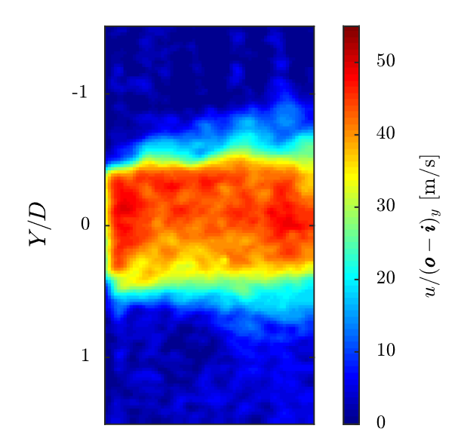
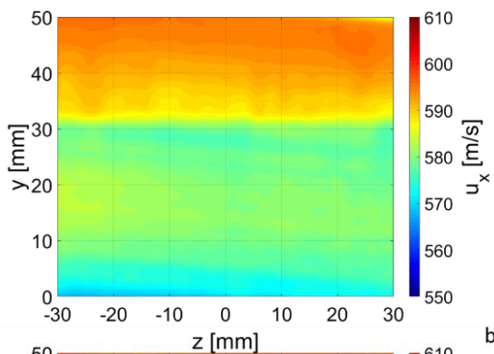
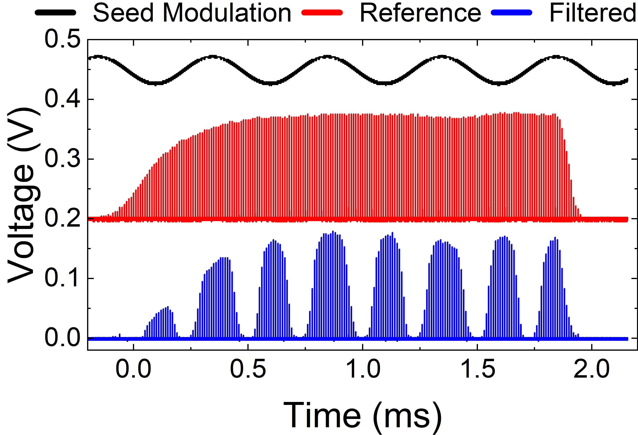
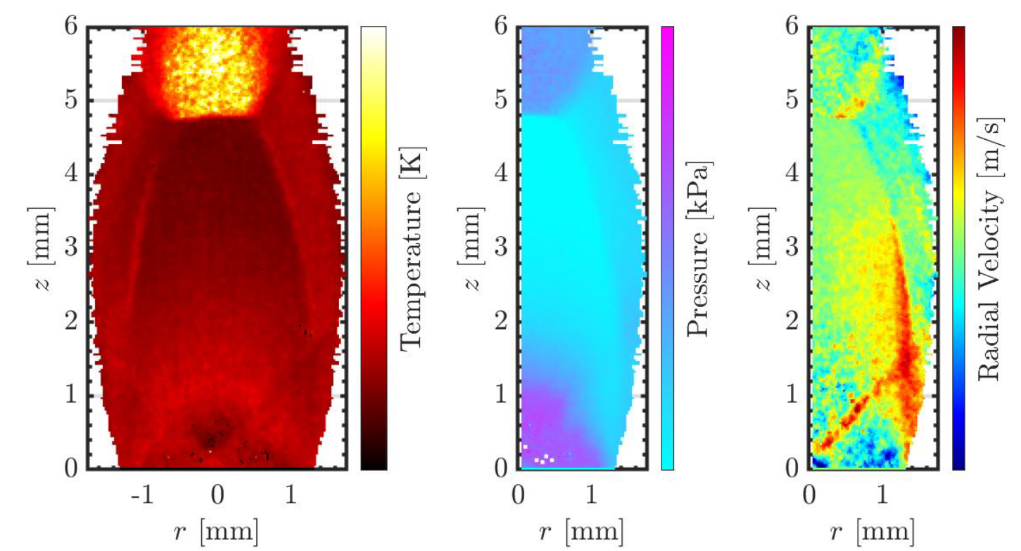
Method #1: Frequency-scanning burst-mode laser
Doppler global velocimetry
Potential to decrease measurement time to 10 ms or less
^{[14]} Fahringer et al. (2018)
^{[15]} Burns et al. (2020)
Planar laser induced fluorescence
^{[16]} Rodrigues et al. (2023)

Slide 21
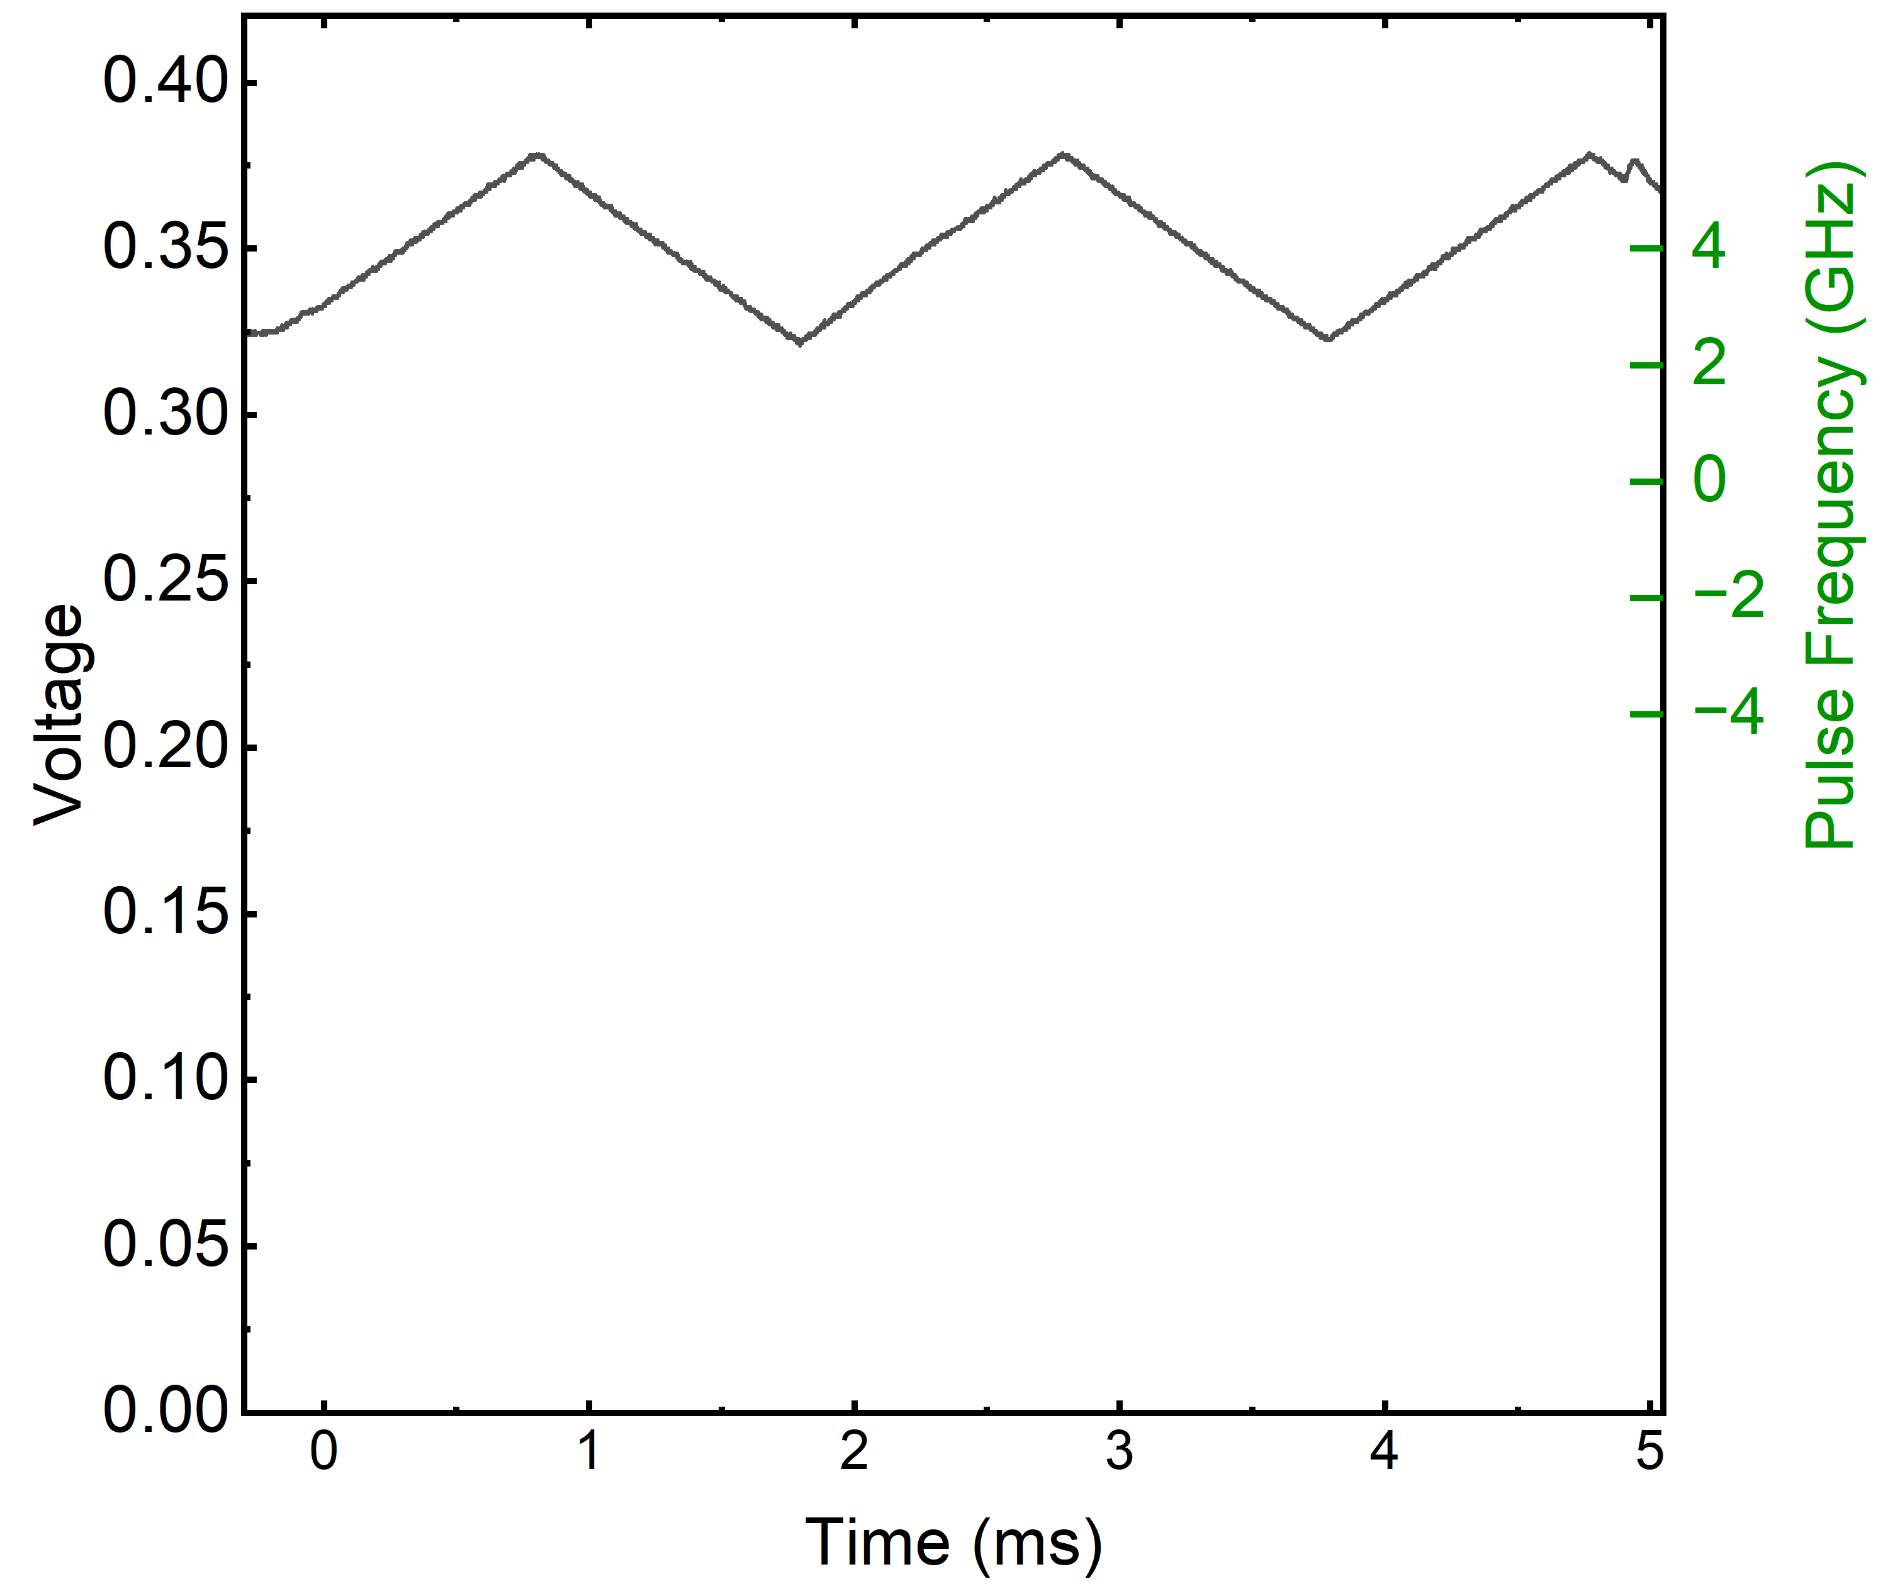
Frequency-scanning burst-mode laser
1064 nm
532 nm
SHG
Power Amplifier
Relative Frequency (GHz)
Function Generator Signal
Pulse Slicing
cw Laser
Master Oscillator
Function Generator

Slide 22
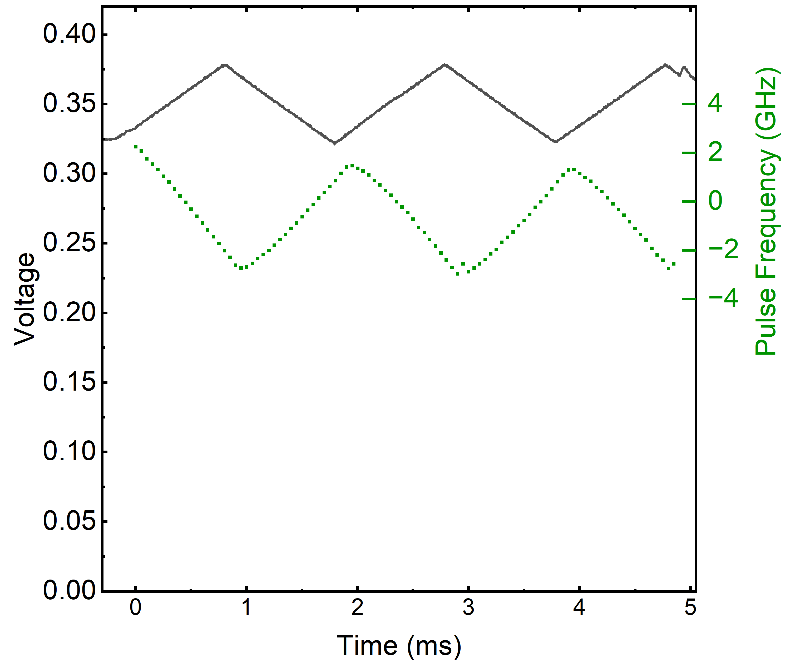
Frequency-scanning burst-mode laser
Wavemeter
1064 nm
532 nm
SHG
Power Amplifier
Relative Frequency (GHz)
Function Generator Signal
Pulse Slicing
Wavemeter Measurement
cw Laser
Master Oscillator
Function Generator

Slide 23
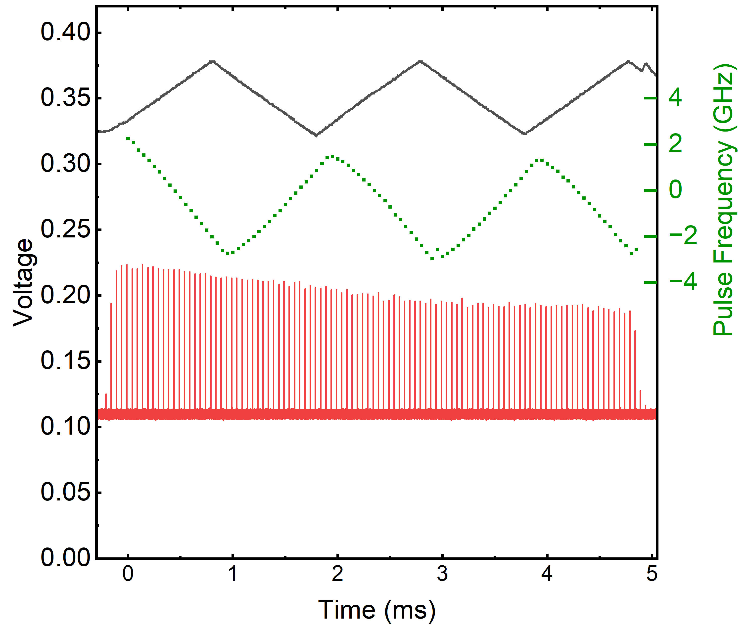
Frequency-scanning burst-mode laser
Wavemeter
1064 nm
532 nm
SHG
Unfiltered
Power Amplifier
Relative Frequency (GHz)
Function Generator Signal
Pulse Slicing
Wavemeter Measurement
Unfiltered Burst Profile
cw Laser
Master Oscillator
Function Generator

Slide 24
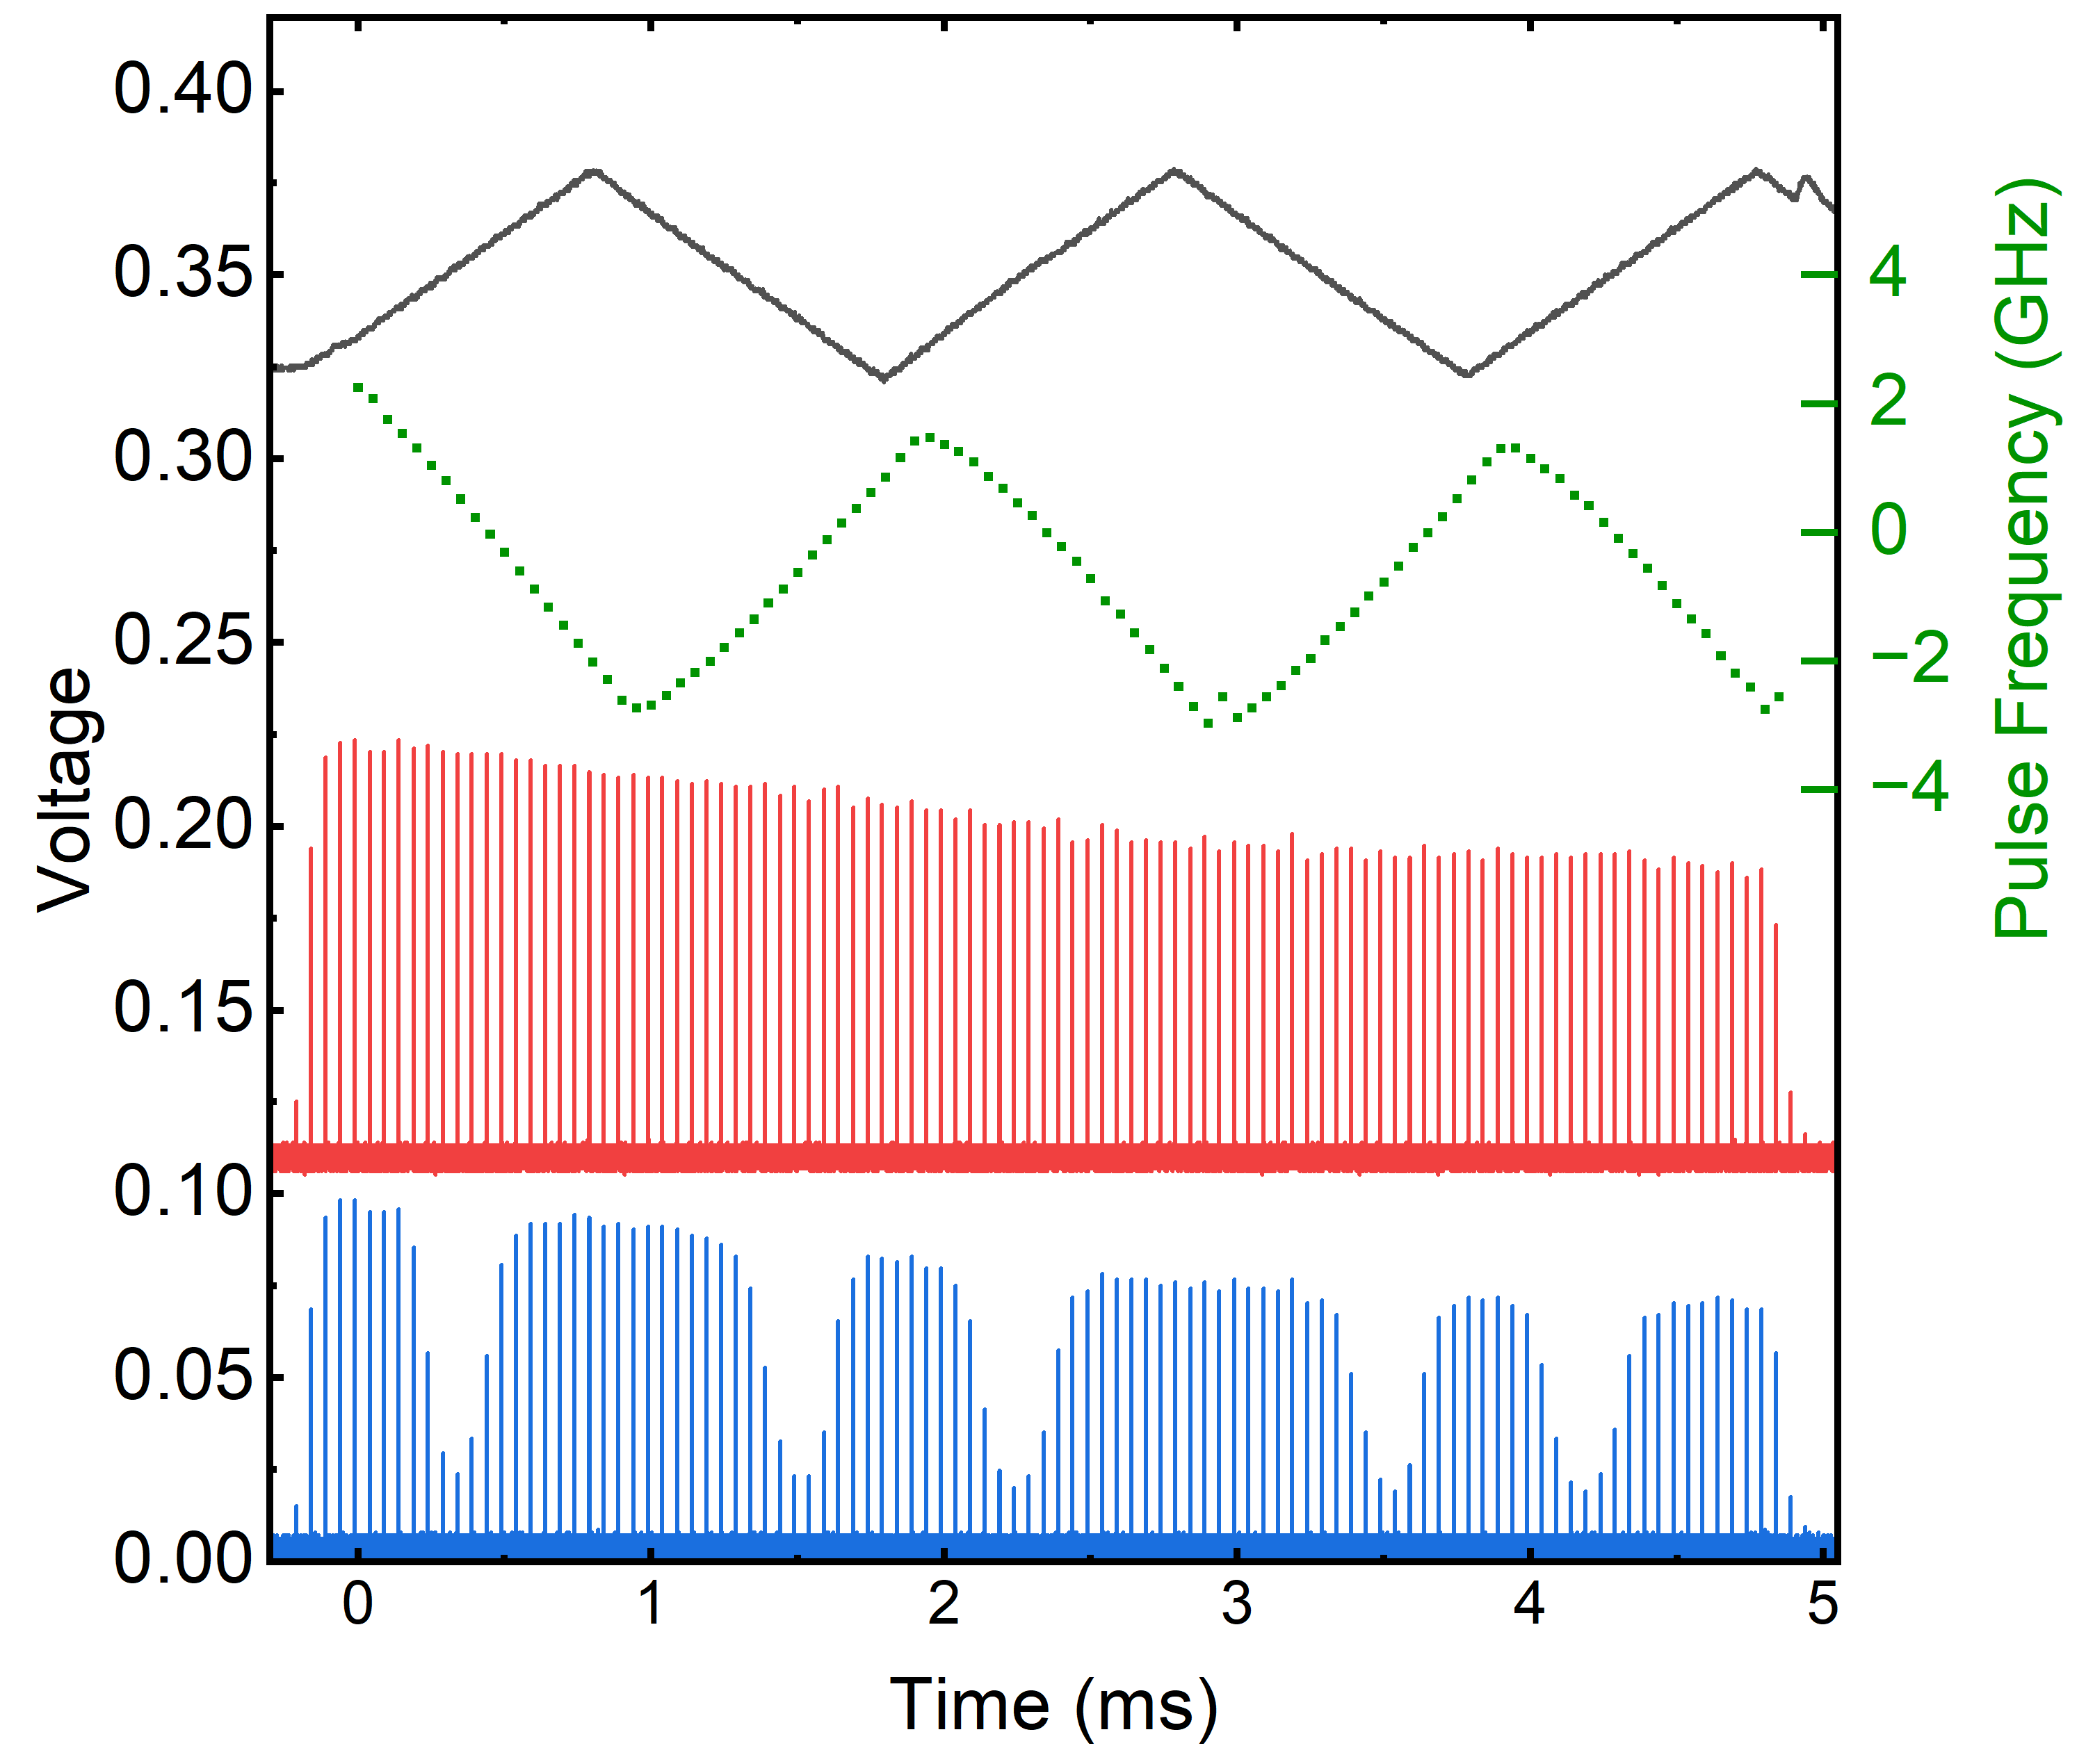
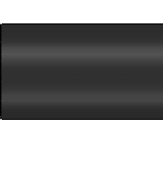
Frequency-scanning burst-mode laser
Wavemeter
1064 nm
532 nm
SHG
Unfiltered
Iodine Cell
Iodine Cell
Filtered
Power Amplifier
Relative Frequency (GHz)
Function Generator Signal
Pulse Slicing
Wavemeter Measurement
Unfiltered Burst Profile
Filtered Burst Profile
cw Laser
Master Oscillator
Function Generator

Slide 25

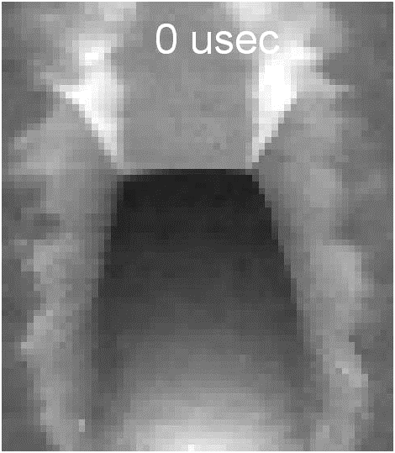
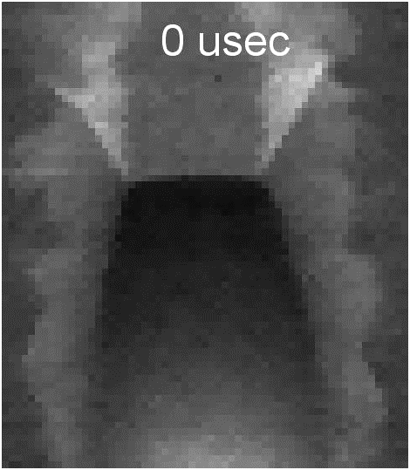


Sensitive to the radial velocity component
Wavemeter
Schlieren
1064 nm
Laser Sheet
532 nm
SHG
Unfiltered
+ Doppler Shift
Iodine Cell
Iodine Cell
Filtered
Power Amplifier
Filtered Camera
Flow
$$z$$
Iodine Cell
+ Velocity
Pulse Slicing
$$x$$
$$y$$
cw Laser
Master Oscillator
1200
Function Generator
Unfiltered Camera
Counts
$$y$$
$$z$$
$$x$$
0

Slide 26






Filtered Rayleigh scattering processing
$$I_{FRS}≈A\frac{P}{T}\int_{−∞}^{∞}{R\left(ν_{0}, P, T, V\right) F(ν_{0}) dν+B\int_{−∞}^{∞}{L(ν_{0}) F(ν_{0})dν }}$$
Reference
$$A=212, B=77$$
$$P=0.18 \text{atm}, T=106 K, \vec{V}=9.77 m/s$$
Experiment

Slide 27


Filtered Rayleigh scattering processing
$$I_{FRS}≈A\frac{P}{T}\int_{−∞}^{∞}{R\left(ν_{0}, P, T, V\right) F(ν_{0}) dν+B\int_{−∞}^{∞}{L(ν_{0}) F(ν_{0})dν }}$$
Reference
Experiment

Slide 28











Comparison with CFD results
CFD^{[17]}
Experimental
Pressure
Temperature
Radial Velocity

Slide 29




Comparison with CFD results
CFD ^{[17]}
Experimental
CFD
Mean (RS)
Calculated
Temperature
Pressure
Density
Temperature
Radial Velocity

Slide 30



Five simultaneous P, T, and V measurements in 5-ms
Potential for 100s of $kHz T, P, \vec{V}$Measurements
Can we further reduce the measurement time?

Slide 31




Method #2: Generate “discrete” pulse frequencies
Master Oscillator
$ν_{1,532}=+400$ MHz
Power Amplifier
$ν_{0,1064 }=0$MHz
cw laser seed
Energy
SHG
Time
Energy
EOM
Energy
FA
Time
Time
Pulse Slicing
+200 MHz AOM
Energy
Time
$ν_{1,1064}=+200$ MHz
Notes:
Acousto-optic effect: send oscillating electric signal to PZ tranducer. Induces sound wave (RF frequency). Create a change in the index of refraction. Doppler shifted by the amount of the sound wave

Slide 32




Method #2: Generate “discrete” pulse frequencies
Master Oscillator
$ν_{1,532}=+400$ MHz
Power Amplifier
$ν_{0,1064 }=0$MHz
cw laser seed
$ν_{2,532}=−400$ MHz
Energy
SHG
Time
Energy
EOM
Energy
FA
Time
Time
Pulse Slicing
+200 MHz AOM
-200 MHz AOM
Energy
Time
$ν_{1,1064}=+200$ MHz
$ν_{2,1064}=−200$ MHz

Slide 33

Generation of four frequency-shifted pulses
Master Oscillator
$ν_{0}+$0 MHz
Energy
1
CW
EOM
FA
Time
+200 MHz
Energy
99%
2
1%
Time
Wavemeter
-200 MHz
50%
1
3
50%
Energy
AOM1
AOM2
Time
2
3
Energy
4
+200 MHz
-200 MHz
Time
4
+300 MHz
-100 MHz
Energy
50%
50%
5
AOM3
AOM4
Time
+100 MHz
-300 MHz
5
6
6
Energy
+100 MHz
-100 MHz
Time
7
7
Energy
Time

Slide 34






Overexpanded jet facility
Shadowgraph
Laser Sheet
1064 nm
532 nm
SHG
+ Doppler Shift
Power Amplifier
Flow
$$z$$
Filtered Camera
$$x$$
$$y$$
AOM System
Iodine Cell
Master Oscillator
cw Laser
$$y$$
$$z$$
$$x$$
$$PR \sim 12$$
$$PR \sim 13.5$$
$$PR \sim 15$$

Slide 35







Visualization of the Doppler effect
$$z$$
$$x$$
$$y$$
+ Doppler Shift
1
4
3
2
1
4
Shadowgraphy
2
3
+ V
-V

Slide 36







Fitting with four measurements
$$I_{FRS}≈AC\frac{P}{T}\int_{−∞}^{∞}{R\left(ν_{0}, P, T, V\right) F(ν_{0}) dν+B\int_{−∞}^{∞}{L(ν_{0}) F(ν_{0})dν }}$$
Experiment
Reference
$$P=1.12 \text{atm}, T=169 K, \vec{V}=98 m/s$$
Average
$$P=1.15 \text{atm}, T=166 K, \vec{V}=−139 m/s$$
$$A=343, B=66$$

Slide 37













Simultaneous temperature, pressure, velocity
$2×2$ Binned
Pressure
Temperature
Rad. Velocity
Calc. Density
t ~ 0 µs
t ~ 40 µs
t ~ 80 µs

Slide 38



Centerline mean pressure and temperature
PR ~ 12
Theoretical Post-shock Conditions
Theoretical Exit Conditions

Slide 39


Centerline mean pressure and temperature
PR ~ 12
PR ~ 13.5

Slide 40



Centerline mean pressure and temperature
PR ~ 12
PR ~ 13.5
PR ~ 15

Slide 41





Pressure, temperature, and velocity at 25 kHz
Pressure
Temperature
Rad. K Velocity
Calc. Density
Potential for $\sim$MHz $T, P, \vec{V}$Measurements
How can we improve these results?

Slide 42










How to find the optimal configuration?
$$ν_{1}$$
Range
Pressure
Absolute Relative Error
$$ν_{1}$$
$$ν_{5}$$
$$ν_{2}$$
$$ν_{4}$$
$$ν_{2}$$
(GHz)
$$ν_{3}$$
$$ν_{3}$$
$$ν_{4}$$
$$ν_{5}$$
Number of Frequencies

Slide 43







How to find the optimal configuration?
Pressure
Temperature
Rad. K Velocity
1 atm, 300 K, 100 m/s
Can we keep the absolute relative error in $P, T, V$ below 2%?
0.5 atm, 100 K,
-100 m/s

Slide 44






Conclusions
Improved Spectral Purity
High-stray scattering applications
Increased Frequency-scanning FRS rate by ~600,000x
Potential for 100s of kHz $P, T, V$
Simultaneous $P, T,V$in 1 ms
Increased Frequency-scanning FRS rate by ~1,500,000x
Potential for MHz $P, T, V$
Simultaneous $P, T, V$in 40 µs

Slide 45
References
[1] Baurle, R. A. (n.d.). VULCAN-CFD applications. https://vulcan-cfd.larc.nasa.gov/WebPage/vulcan_apps.html
[2] “Hyper-X ED97-43968-1: Computational Fluid Dynamics (CFD) Image of Hyper-X Research Vehicle at Mach 7 with Engine Operating.” https://www.dfrc.nasa.gov/Gallery/Photo/X-43A/HTML/ED97-43968-1.html (accessed Oct. 02, 2022).
[3] “Spectra-Physics.” https://www.spectra-physics.jp/member/admin/document_upload/QuantaRay_PRO_LAB_INDI_datasheet.pdf
[4] “GX-series | EdgeWave.” https://www.edge-wave.de/web/en/produkte/short-pulse-systeme/hd-serie/ (accessed Oct. 02, 2022).
[5] J. Felver, M. N. Slipchenko, E. L. Braun, T. R. Meyer, and S. Roy, “High-energy laser pulses for extended duration megahertz-rate flow diagnostics,” Opt. Lett., vol. 45, no. 16, p. 4583, Aug. 2020, doi: 10.1364/OL.400831.
[6] P. Wu, W. L. Lempert, and R. B. Miles, “Megahertz Pulse-Burst Laser and Visualization of Shock-Wave/Boundary-Layer Interaction,” AIAA Journal, vol. 38, no. 4, pp. 672–679, Apr. 2000, doi: 10.2514/2.1009.
[7] F. R. Koelling, B. S. Leonov, and C. Limbach, “Filtered Rayleigh Scattering Visualization of Hypersonic Boundary Layer Trip Wake Flow at 250kHz,” presented at the AIAA AVIATION 2022 Forum, Chicago, IL & Virtual, Jun. 2022. doi: 10.2514/6.2022-3363.
[8] Y. Krishna, A. M. Mahuthannan, X. Luo, D. A. Lacoste, and G. Magnotti, “High-speed filtered Rayleigh scattering thermometry in premixed flames through narrow channels,” Combustion and Flame, vol. 225, pp. 329–339, Mar. 2021, doi: 10.1016/j.combustflame.2020.10.053.
[9] J. R. Creel, B. S. Leonov, and R. Miles, “Angle Optimized Filtered Rayleigh Scattering for the Imaging of Pressure Waves from Laser Generated Surface Sparks at 250,000 Frames per Second,” in AIAA SCITECH 2023 Forum, American Institute of Aeronautics and Astronautics. doi: 10.2514/6.2023-0350.
[10] N. P. Barnes and J. C. Barnes, “Injection seeding. i. theory,” IEEE J. Quantum Electron. 29, 2670–2683 (1993).
[11] M. Boguszko and G. S. Elliott, “On the use of filtered Rayleigh scattering for measurements in compressible flows and thermal fields,” Exp Fluids, vol. 38, no. 1, pp. 33–49, Jan. 2005, doi: 10.1007/s00348-004-0881-4.
[12] J. N. Forkey, N. D. Finkelstein, W. R. Lempert, and R. B. Miles, “Demonstration and characterization of filtered Rayleigh scattering for planar velocity measurements,” AIAA Journal, vol. 34, no. 3, pp. 442–448, Mar. 1996, doi: 10.2514/3.13087.
[13] U. Doll, G. Stockhausen, J. Heinze, and U. Meier, “Frequency scanning filtered Rayleigh scattering am HBK1,” presented at the Diagnostik i.d. Verbrennung, DIV10, Stuttgart, Oct. 2014. Accessed: Sep. 08, 2023. [Online]. Available: https://elib.dlr.de/91171/
[14] T. W. Fahringer, R. A. Burns, P. M. Danehy, P. M. Bardet, and J. Felver, “Pulse-Burst Cross-Correlation Doppler Global Velocimetry,” AIAA Journal, vol. 58, no. 6, pp. 2364–2369, Jun. 2020, doi: 10.2514/1.J059172.
[15] R. A. Burns, T. W. Fahringer, and P. M. Danehy, “Velocity measurements across an oblique shock using pulse-burst cross-correlation DGV,” in AIAA Scitech 2021 Forum, American Institute of Aeronautics and Astronautics. doi: 10.2514/6.2021-0120.
[16] N. S. Rodrigues, P. M. Danehy, N. Jiang, P. Hsu, J. Leicht, and S. Roy, “100 kHz High-Spectral-Resolution NO-PLIF Measurements for Compressible Flows,” in AIAA SCITECH 2023 Forum, National Harbor, MD & Online: American Institute of Aeronautics and Astronautics, Jan. 2023. doi: 10.2514/6.2023-0405.
[17] A. M. Braun et al., “Demonstration of Frequency-Scanning Burst-Mode Filtered Rayleigh Scattering for Multi-Parameter Gas-Phase Measurements,” in AIAA SCITECH 2024 Forum, in AIAA SciTech Forum. , American Institute of Aeronautics and Astronautics, 2024. doi: 10.2514/6.2024-1095.

Slide 46
Backup Slides

Slide 47





Burst profile using AOM-system
Iodine Cell
Filtered
1064 nm
532 nm
SHG
Power Amplifier
AOM System
Master Oscillator
Wavemeter
cw Laser

Slide 48
Uncertainty in background constant estimates

Slide 49



Model

Slide 50





What is Rayleigh scattering?
Incident Laser
Flow Molecules
$$T, P, ρ, \vec{V}$$
Incident Laser
Scattering
0.75 atm, 350 K, 0 m/s
1 atm, 300 K, 0 m/s
1.25 atm, 250 K, 0 m/s
Rayleigh Scattering
$$T, P$$
$$ρ$$
Notes:
Explanation

Slide 51






Same pixel with different fitted profiles
Pressure, $1.4 \text{atm}$
Temperature, $270 K$
Velocity, $−2 m/s$
+10%
-10%
-10%
+10%
-50 m/s
+50 m/s

Slide 52















Simultaneous P, T, and V in 1-ms
Scan 1
Scan 2
Scan 3
Scan 4
Scan 5
Can we further reduce the measurement time?

Slide 53


Frequency-switching FRS for a single pixel
$$ν_{1}$$
$$ν_{1}$$
$$ν_{5}$$
$$ν_{4}$$
$$ν_{2}$$
$$ν_{2}$$
$$ν_{3}$$
$$ν_{3}$$
$$ν_{4}$$
Fewer laser pulses with known laser frequency
$$ν_{5}$$

